Slide 1
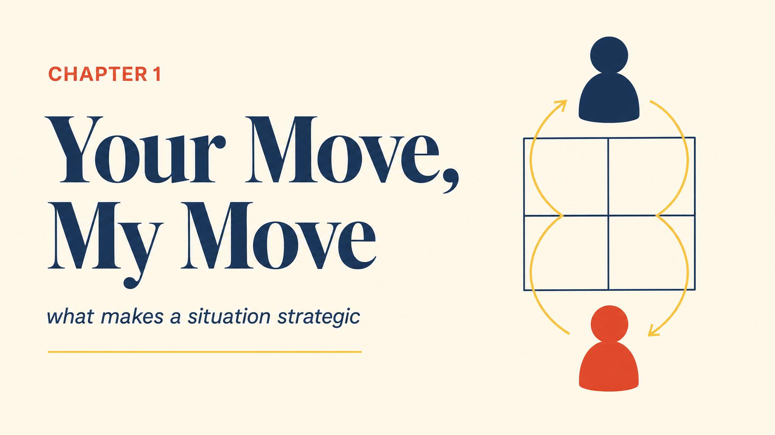
Notes:
Open with the interrogation room scene: 2am, the detective, the deal. The whole course pivots on this one distinction — decision versus strategic interaction. Hold the title up for a beat before moving on.

Slide 2
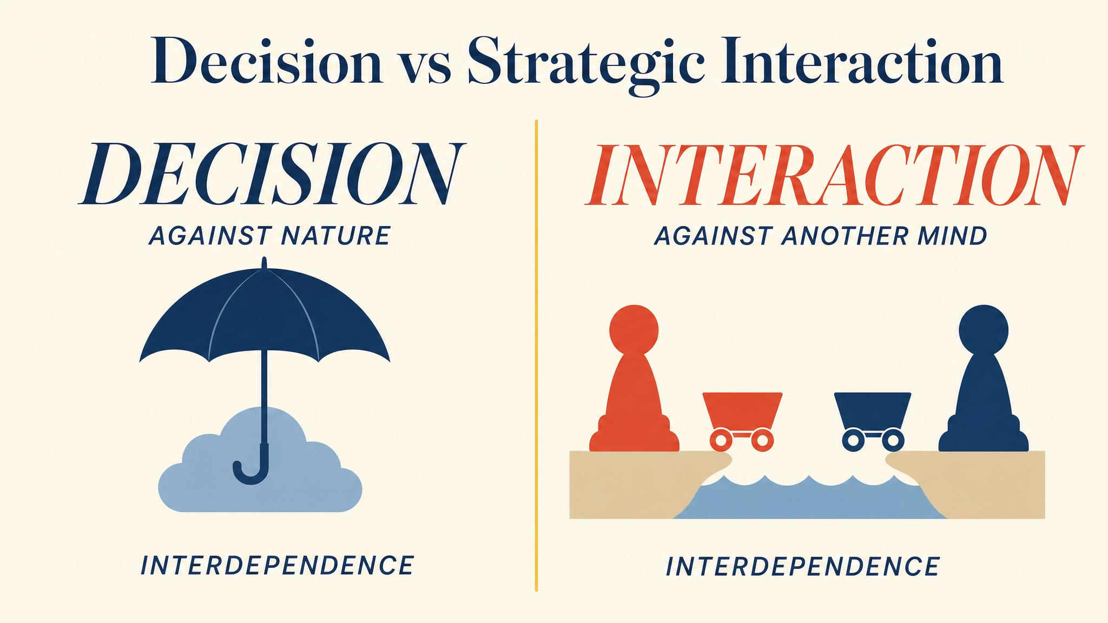
Notes:
The umbrella choice is a decision — nature doesn't push back. The coffee carts on the beach is a game — each owner reacts to the other. The key word, interdependence, defines the whole field.

Slide 3
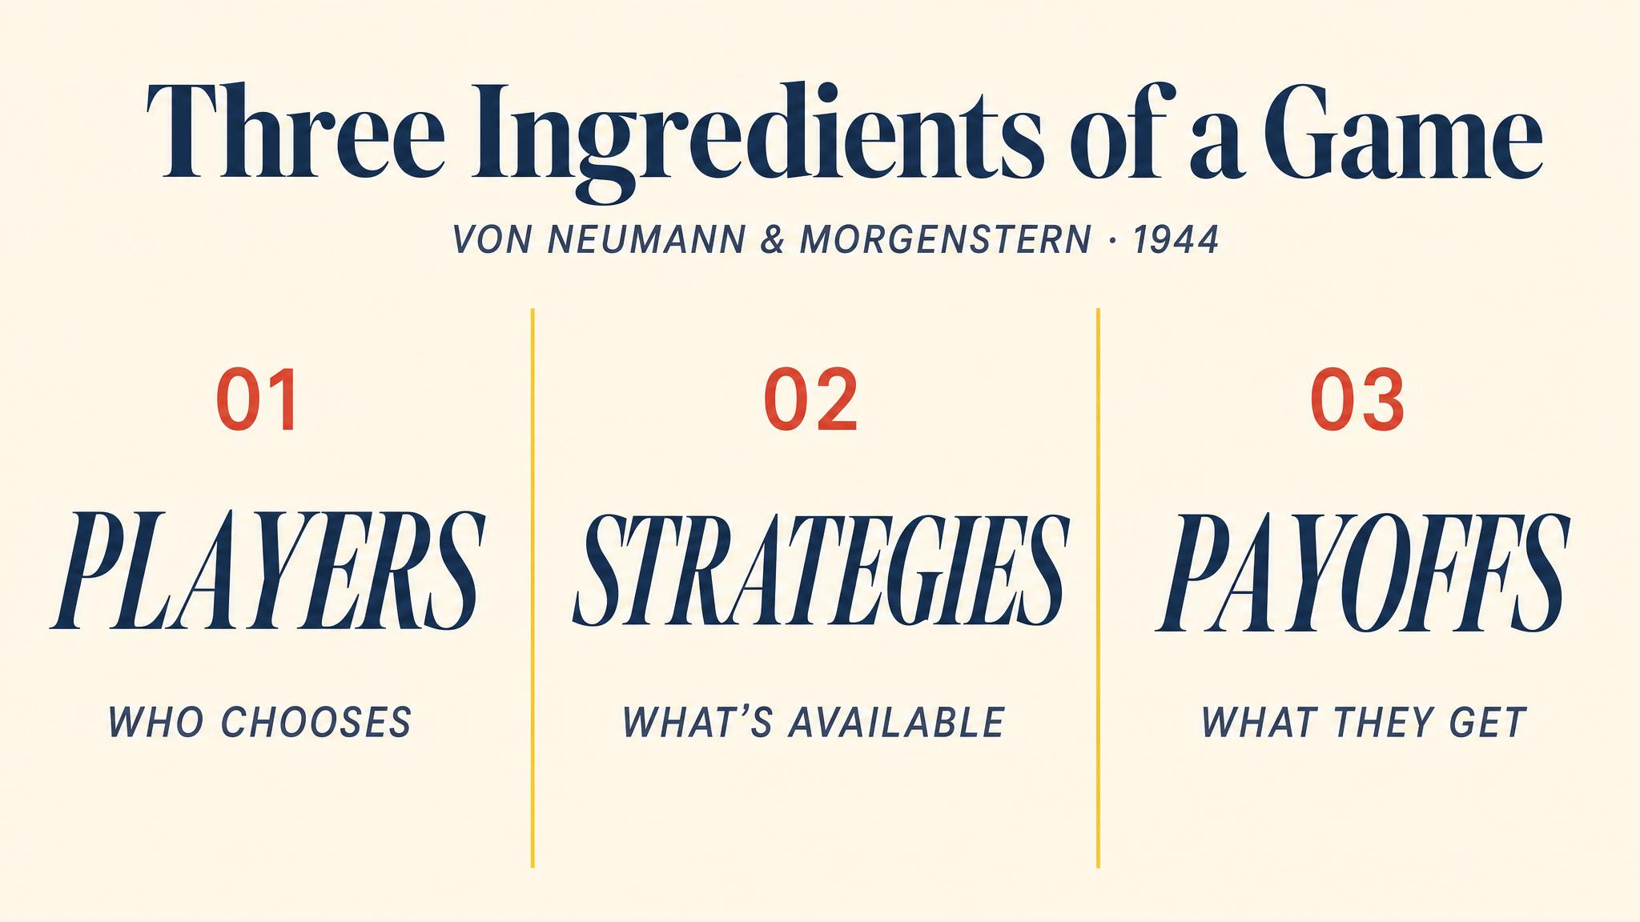
Notes:
Every game ever analysed — from poker to international trade — has these three ingredients. The vocabulary is mathematically dry but applies to almost every interesting situation in life.

Slide 4
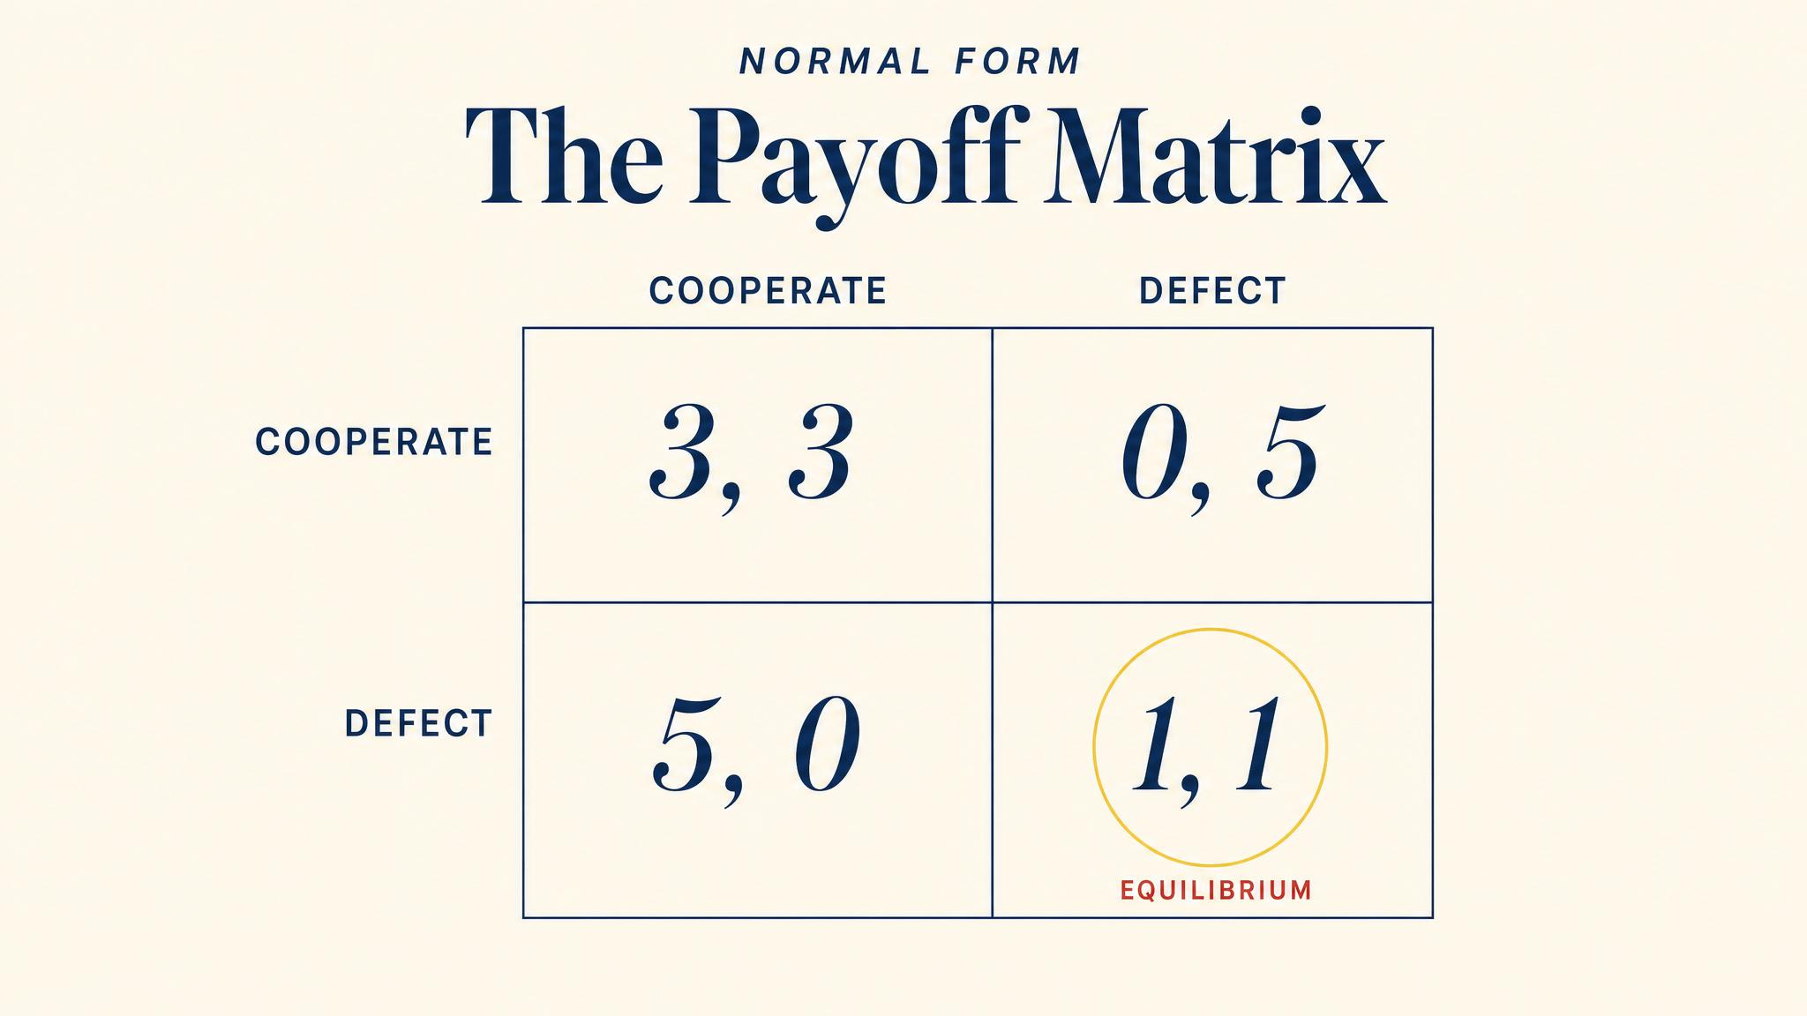
Notes:
Row player picks a row, column player picks a column, the cell tells you both payoffs. Walk through one cell to anchor the convention before unpacking the Prisoner's Dilemma.

Slide 5
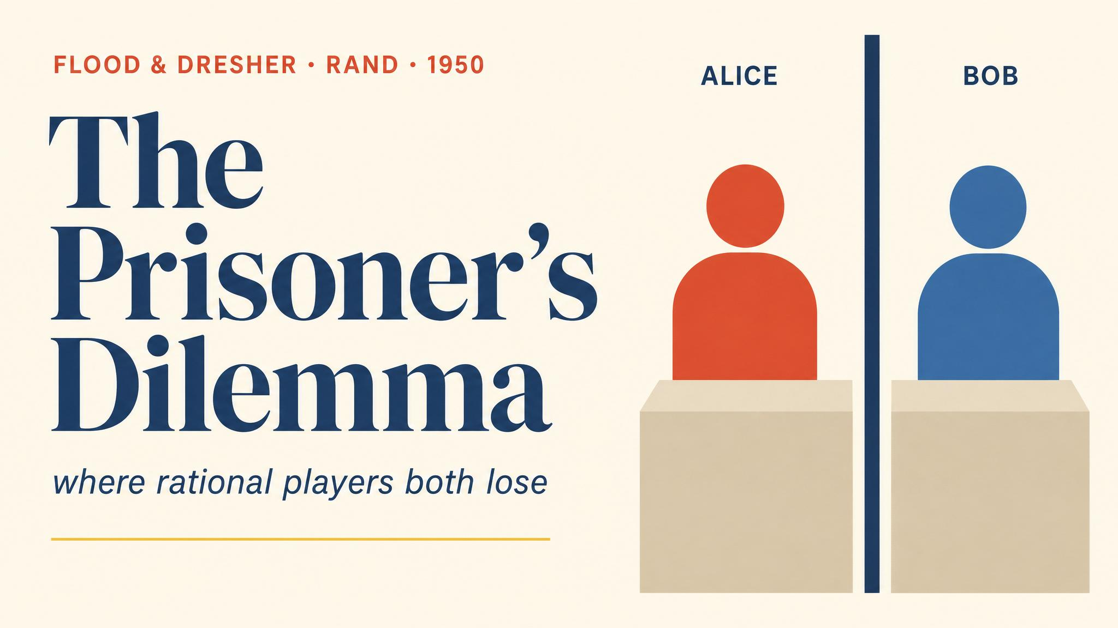
Notes:
Formalised by Merrill Flood and Melvin Dresher at the RAND Corporation in 1950, named by Albert Tucker. Walk through Alice's reasoning out loud — whatever Bob does, defection is better. So both defect, and both end up at 1, 1 when they could have had 3, 3.

Slide 6
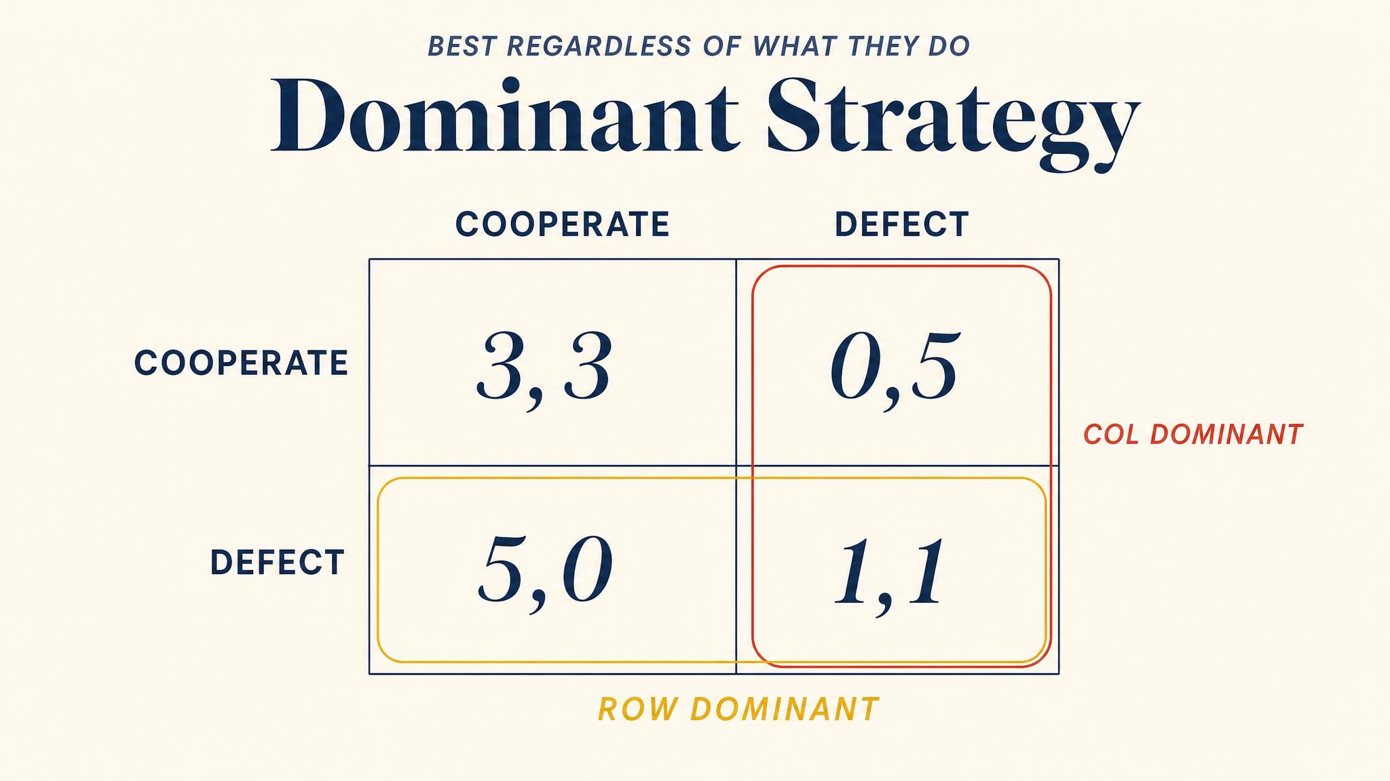
Notes:
A dominant strategy is the strategy that beats every alternative no matter what the other player does. When you have one, the analysis is over — you play it. The Prisoner's Dilemma is the cleanest example.

Slide 7
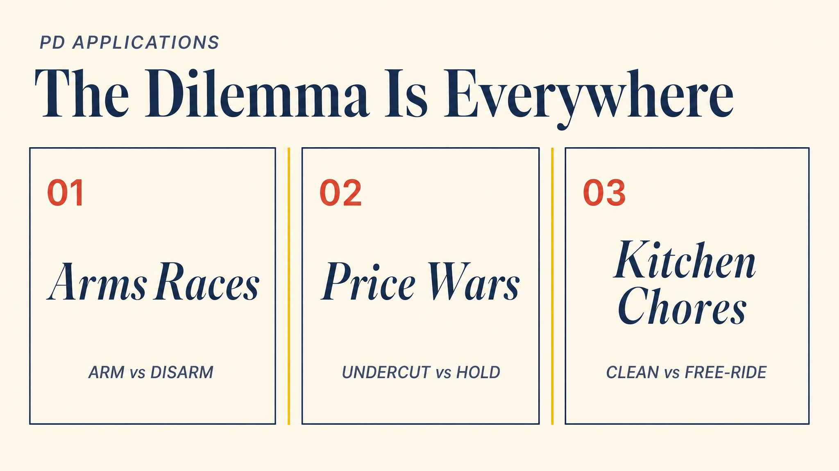
Notes:
Cold War arms race, OPEC cartels, the lysine price-fixing case from the nineties, even the kitchen-cleaning dynamic in a share house — all the same structure. That ubiquity is what makes the Prisoner's Dilemma so important.

Slide 8
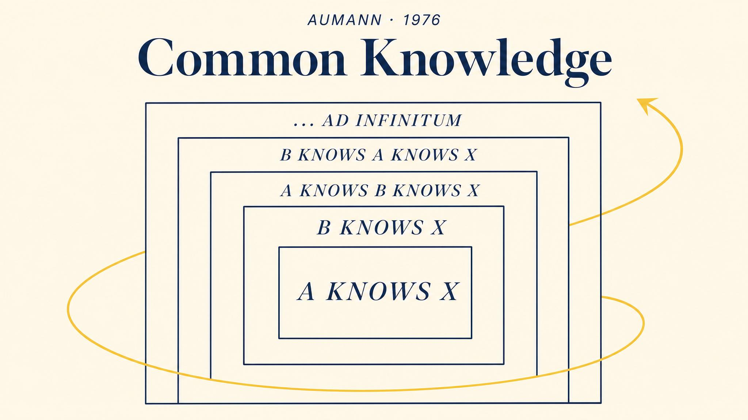
Notes:
Aumann formalised this in 1976. It is not enough for everyone to know the rules — everyone must know that everyone knows that everyone knows, infinitely. The two-generals problem is the cleanest demonstration of why this matters.

Slide 9
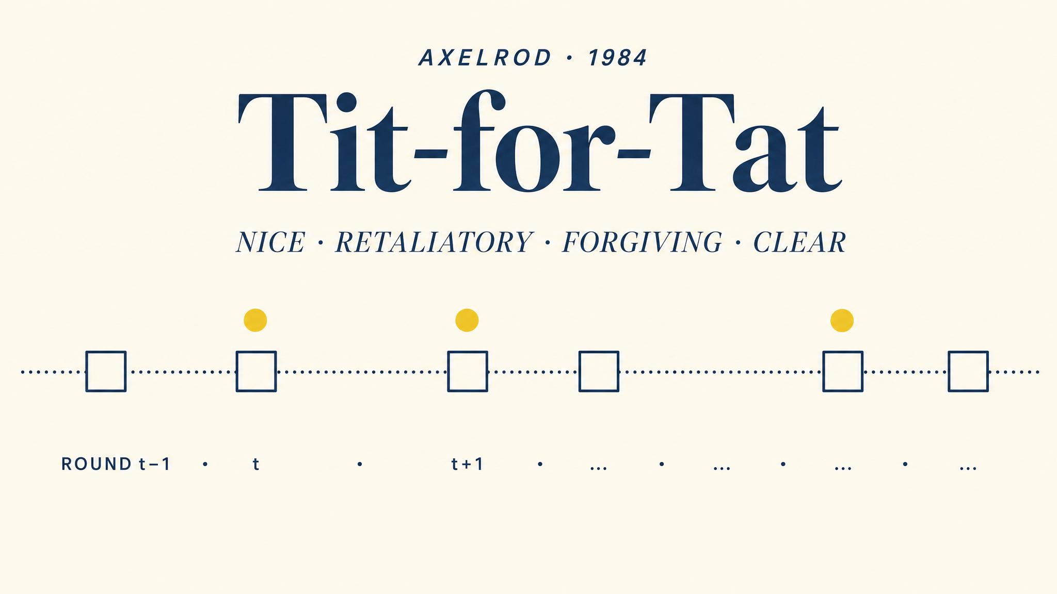
Notes:
In a one-shot game, defection dominates. But when the same pair meets again and again, cooperation becomes possible. Axelrod's 1984 tournament was won by Anatol Rapoport's four-line Tit-for-Tat: nice, retaliatory, forgiving, clear.

Slide 10
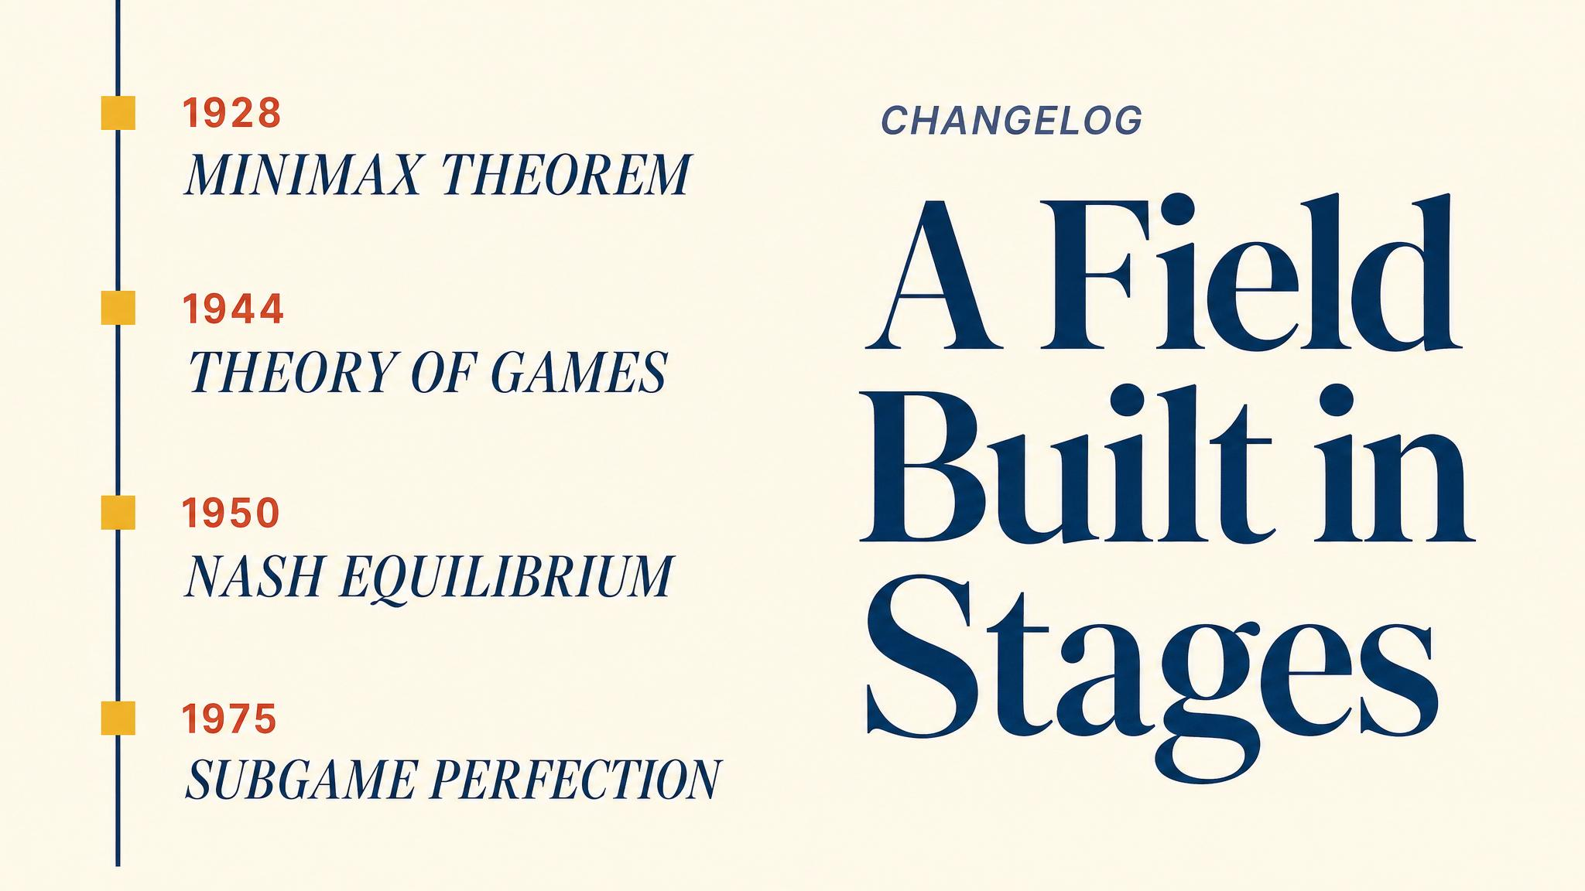
Notes:
Von Neumann's minimax theorem in 1928, then the 600-page book with Morgenstern in 1944, then Nash's one-page paper in 1950, then Selten's subgame perfection in 1975. Each step expanded what game theory could analyse.

Slide 11
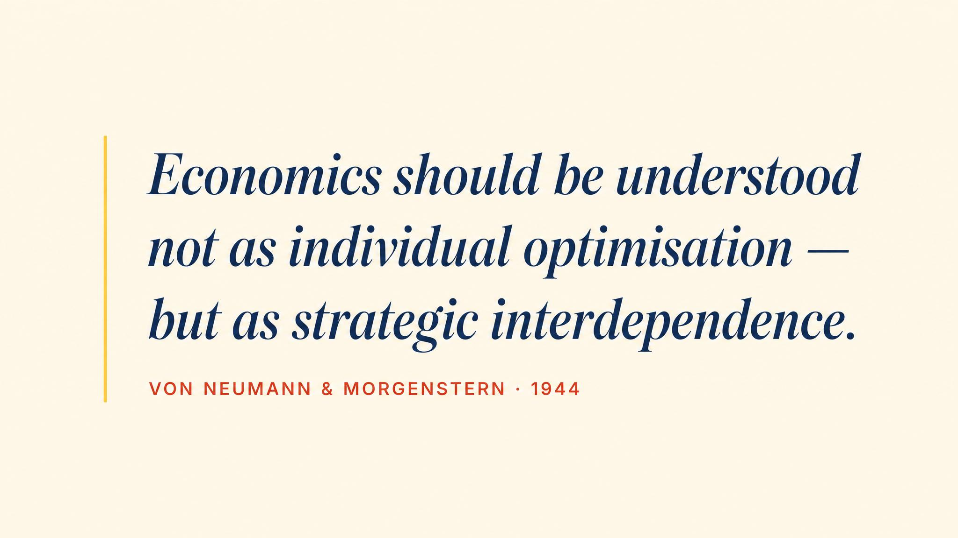
Notes:
Pause on this line — paraphrased from the 1944 book. The shift it announces is what made the field possible: economics moves from solo optimisation against nature to interdependent reasoning against other minds.

Slide 12
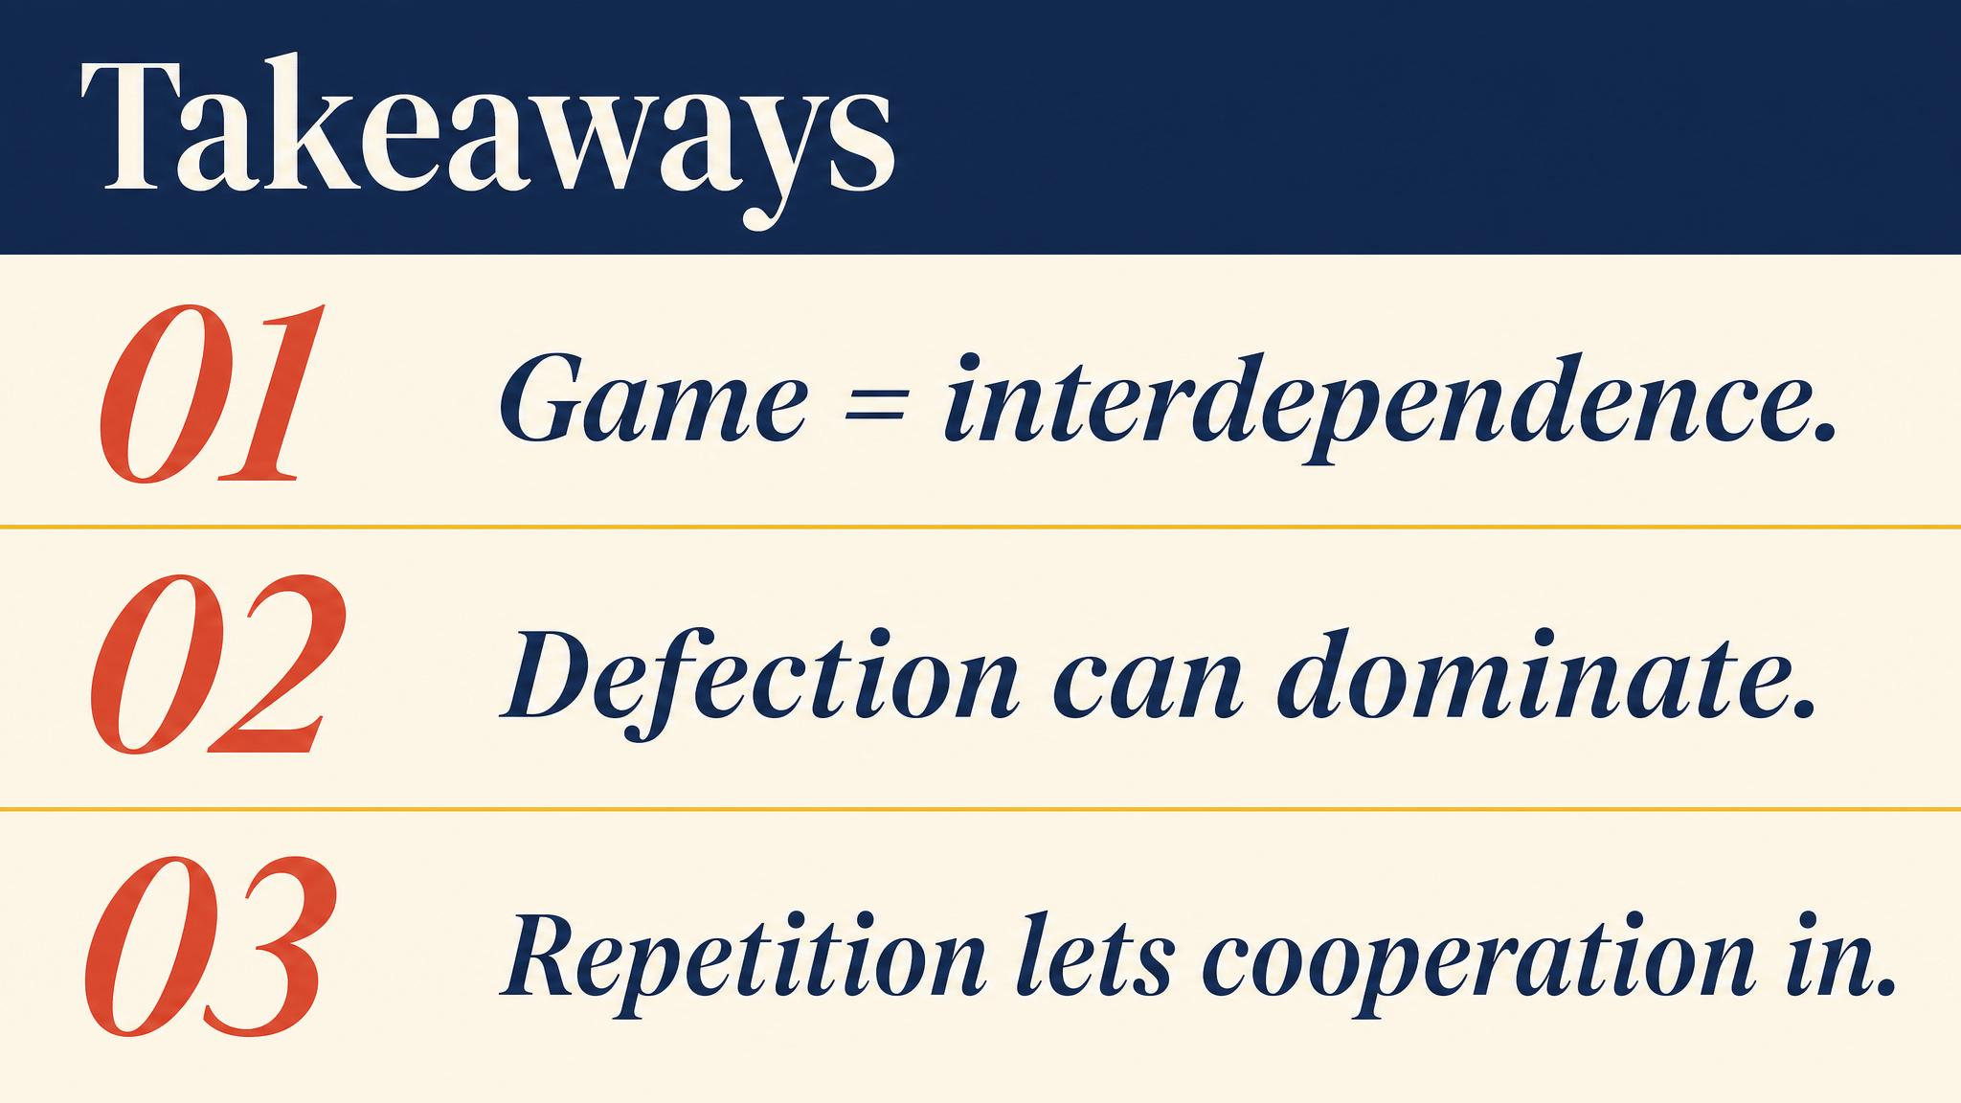
Notes:
Three things to carry forward. One: a game is mutual entanglement of choice. Two: rational individual choice can produce collectively bad outcomes. Three: the future, properly long, gives cooperation a chance.

Slide 13
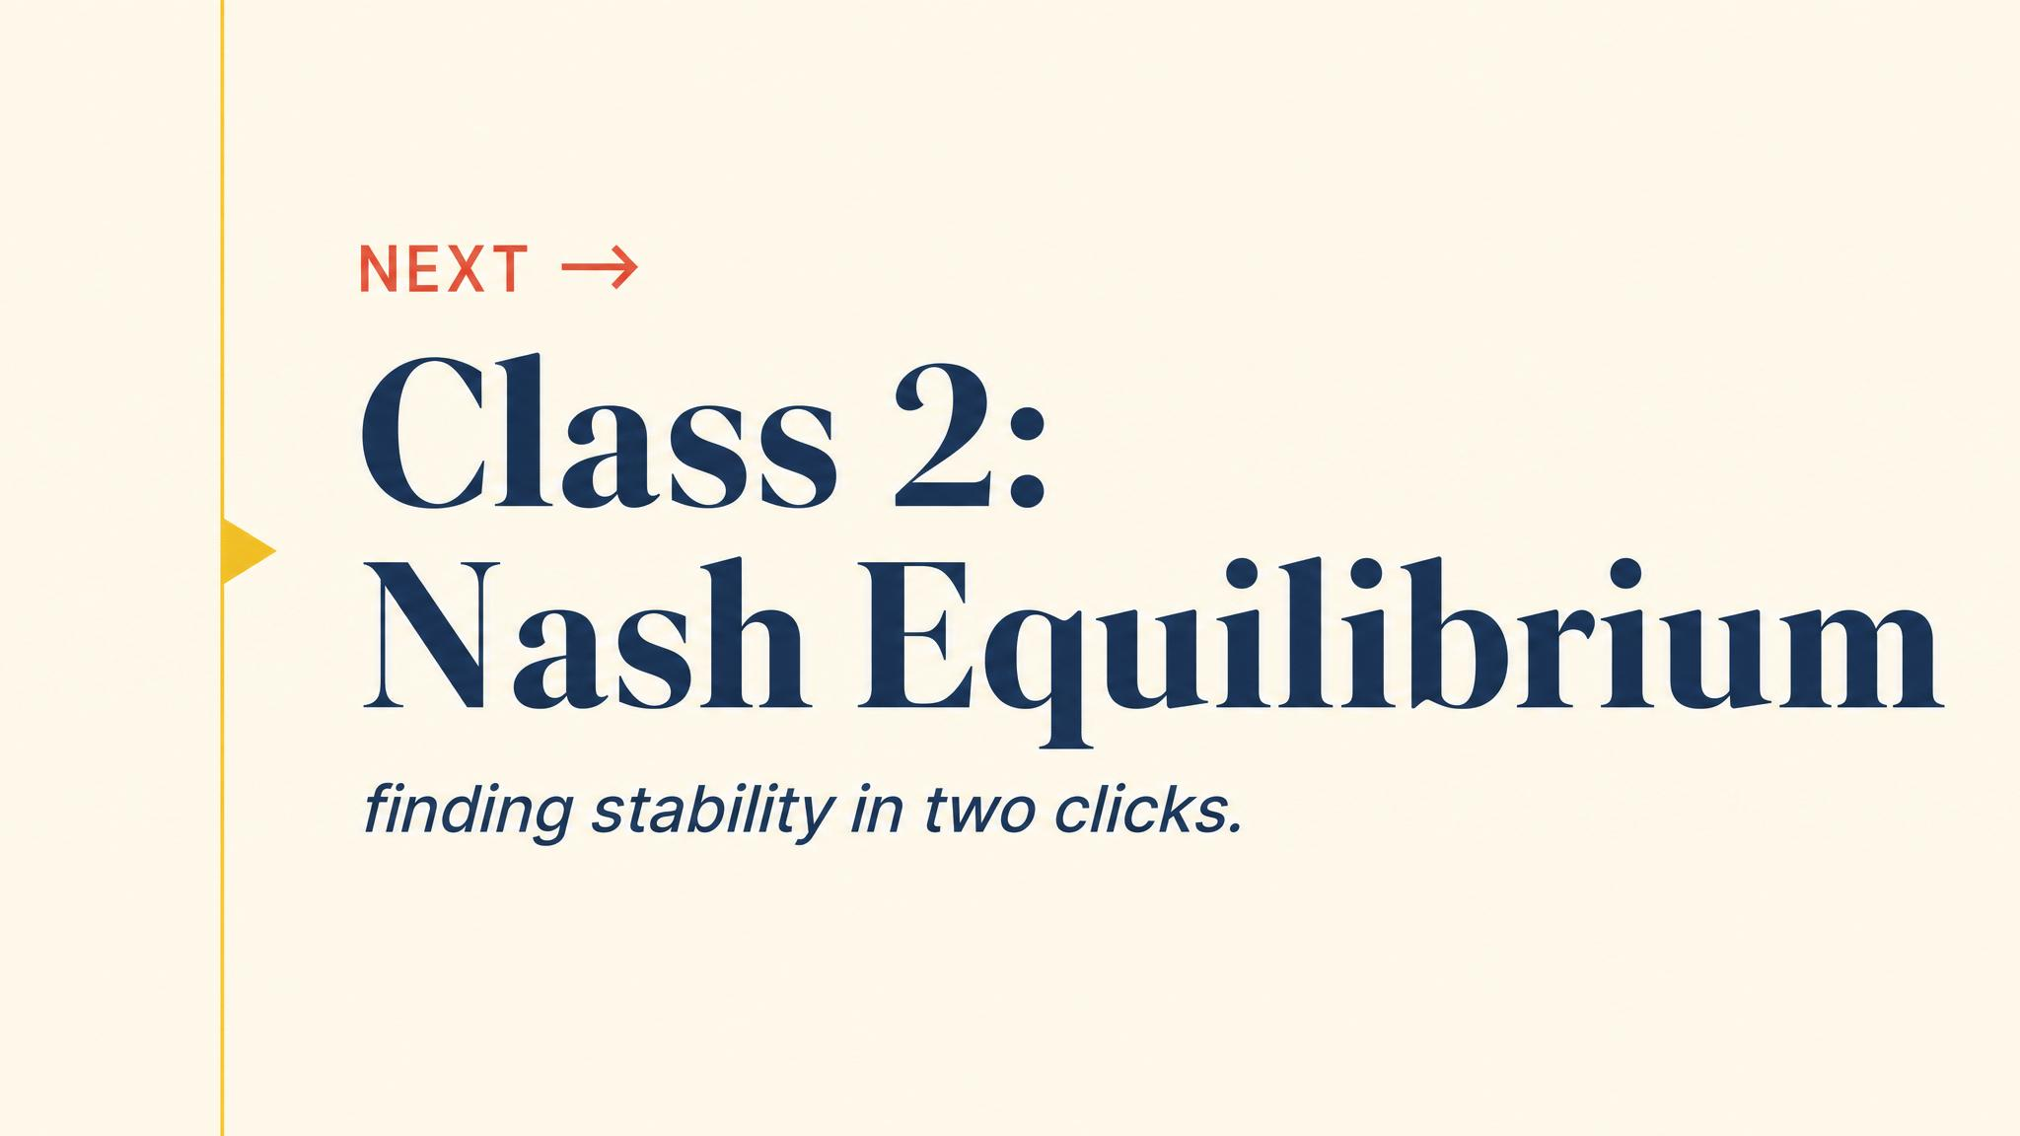
Notes:
Close with the bridge. Mutual defection was our first encounter with equilibrium. Next class we make the concept precise — and start finding equilibria systematically in any game we can write down.

