Slide 1
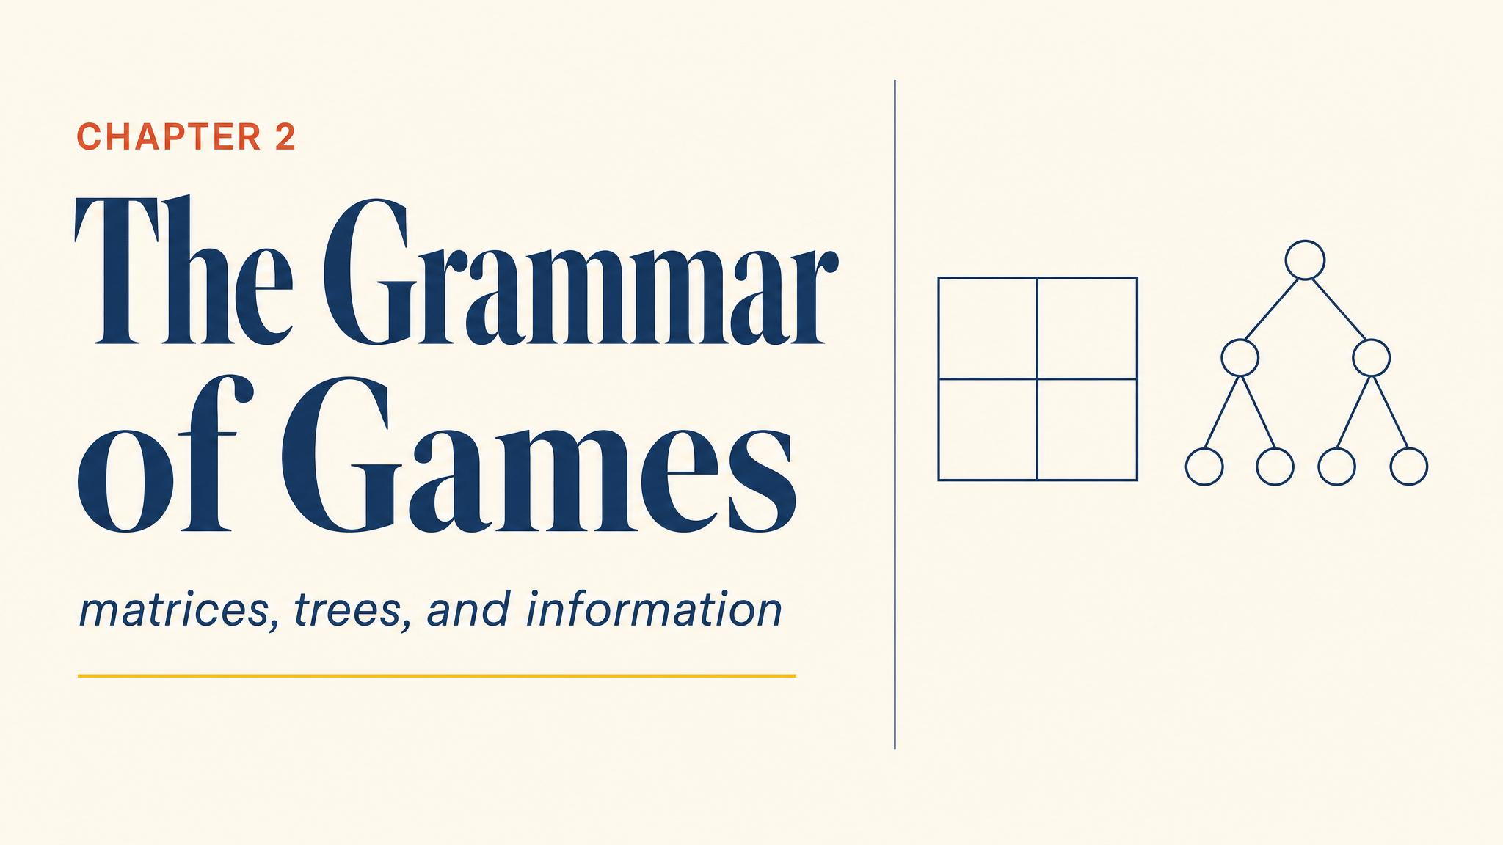
Notes:
Open with the poker tournament — the camera cutting between two stone-faced players. The whole chapter pivots on one question: how do we write a game down? Two languages, two ways of seeing.

Slide 2
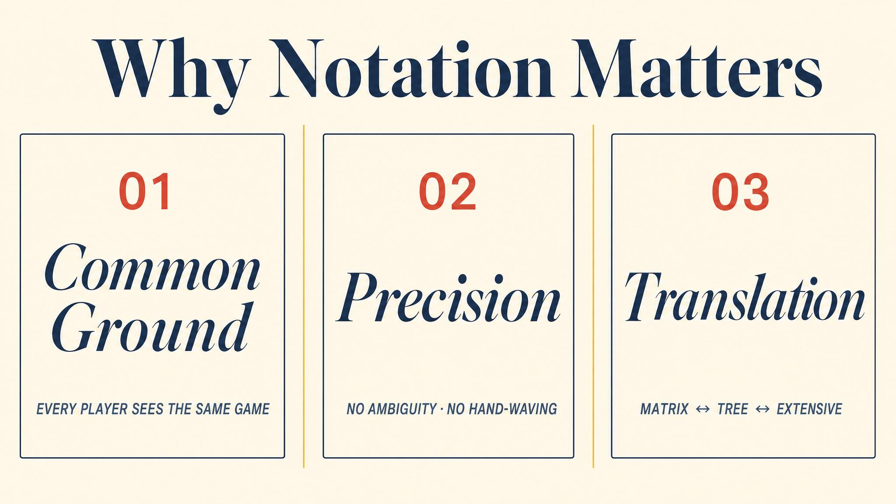
Notes:
Every discipline has a notation. Chemists, musicians, mathematicians — each notation makes certain relationships visible. Game theory needs the same kind of grammar.

Slide 3
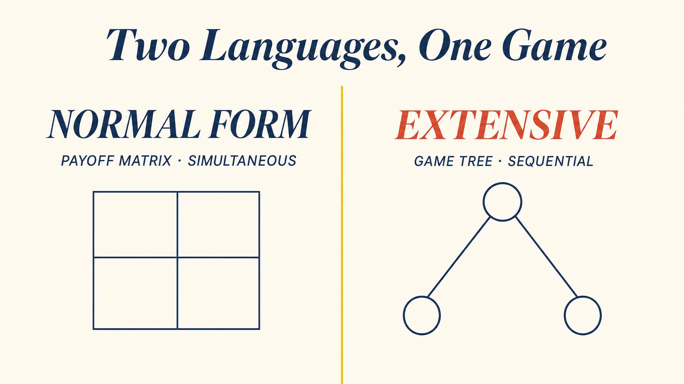
Notes:
Normal form compresses a game into a grid; extensive form unfolds it into a tree. These are not interchangeable — they are different ways of seeing the same situation, as Osborne and Rubinstein laid out in 1994.

Slide 4
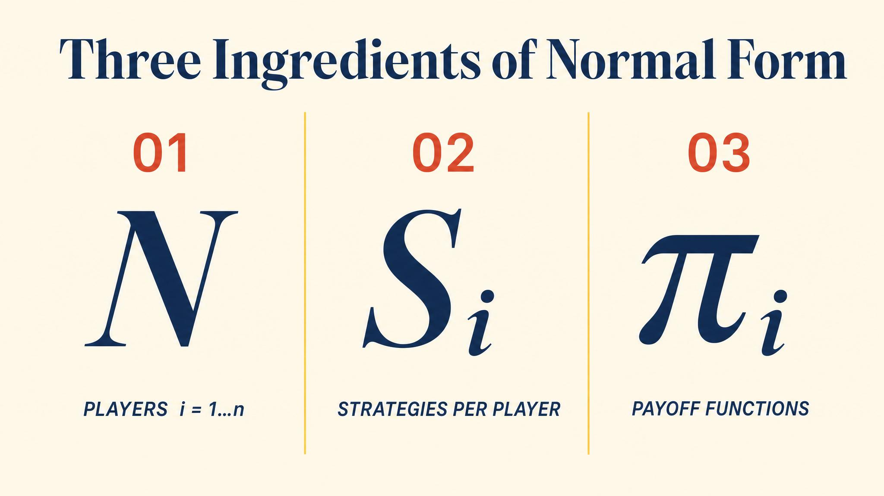
Notes:
A normal-form game has three elements. Players, strategies, payoffs — the same vocabulary Osborne and Rubinstein outlined in 1994 and we already met in Chapter 1.

Slide 5
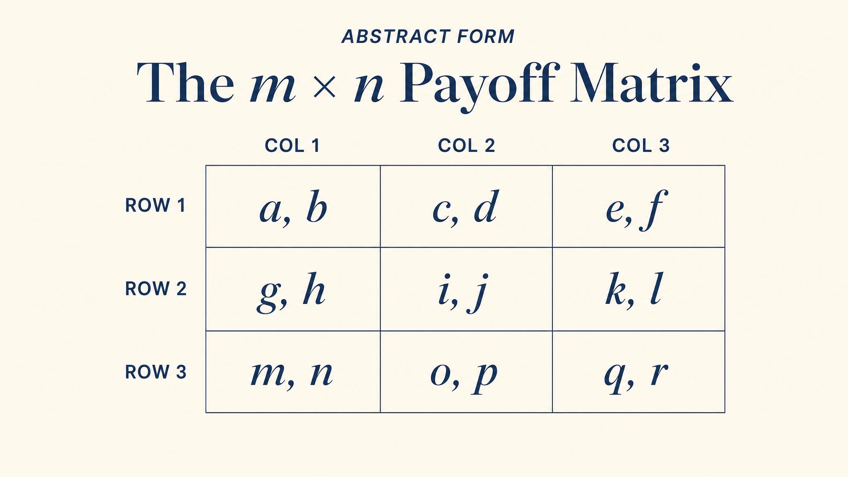
Notes:
Player 1's strategies label the rows, Player 2's the columns. Each cell holds two payoffs: row player first, column player second. The Battle of the Sexes is our anchor example.

Slide 6
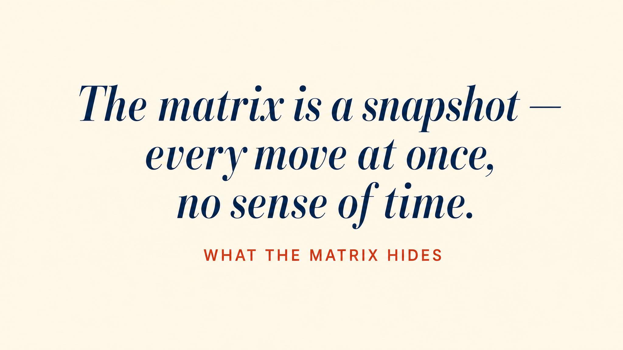
Notes:
For all its elegance, the normal form hides one thing: time. The matrix treats every game as if both players sealed their choices in envelopes — fine for simultaneous play, but awkward when someone moves first.

Slide 7
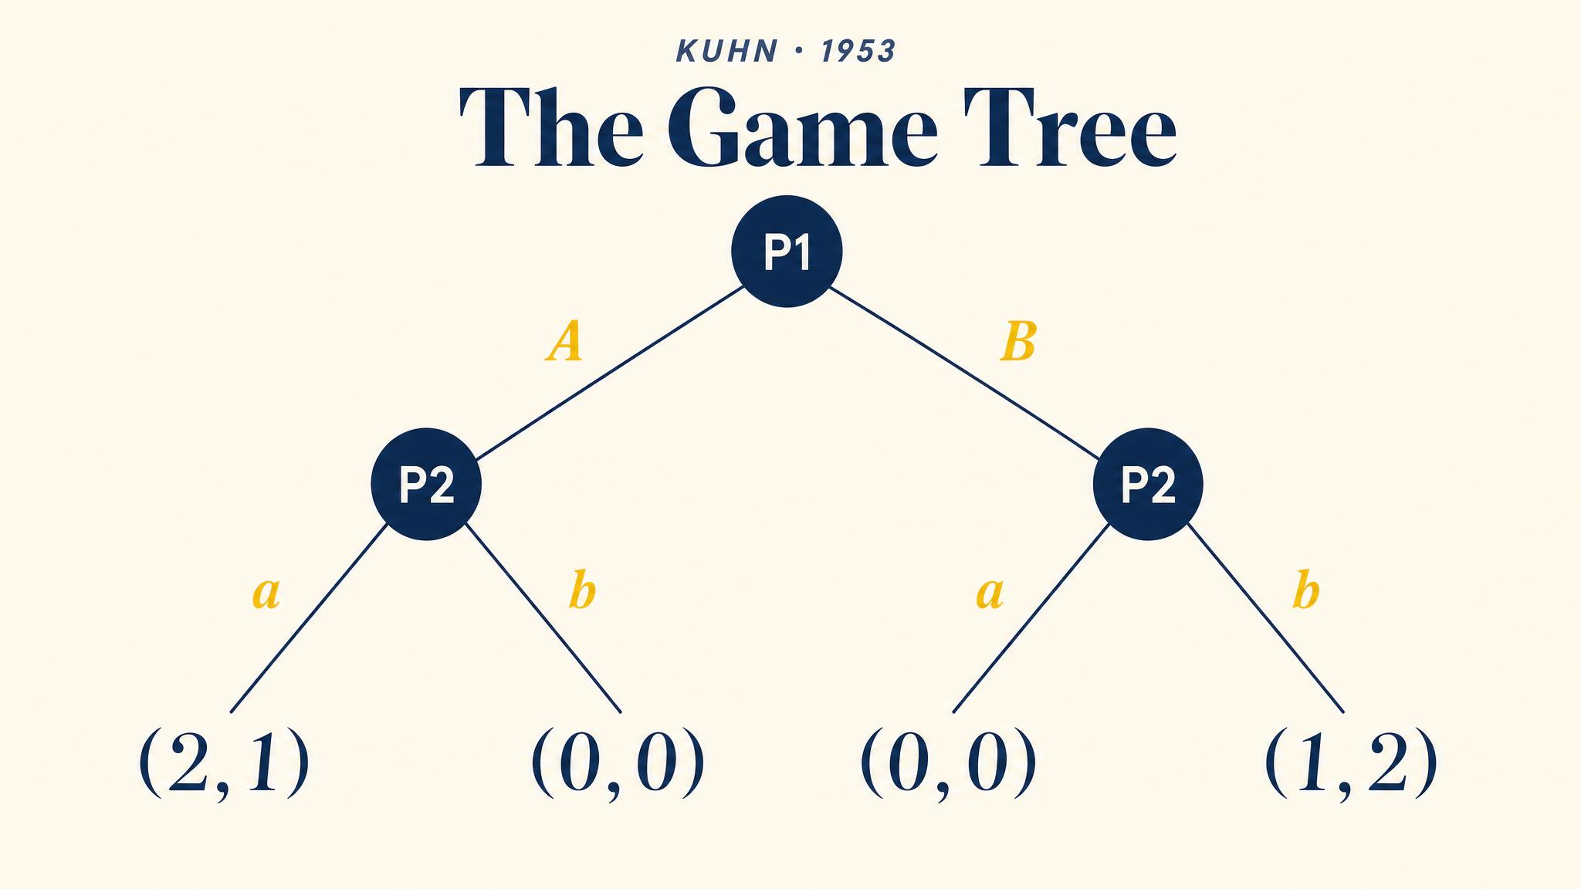
Notes:
Harold Kuhn formalised the game tree in 1953. Nodes, branches, player assignments, payoff vectors, and — crucially — information sets. This is the framework we still use today.

Slide 8
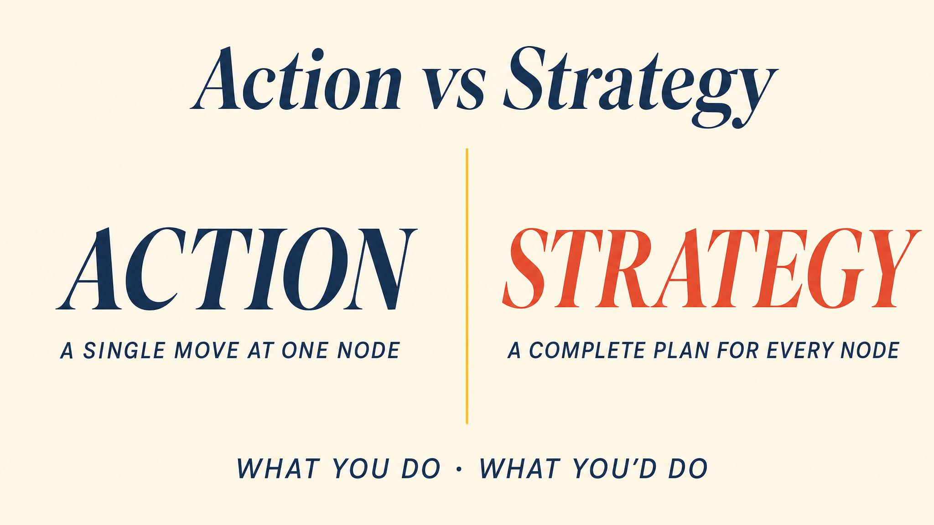
Notes:
An action is one move at one node. A strategy is a complete contingent plan — a recipe for every node where a player might be called upon to move, including nodes they never expect to reach.

Slide 9
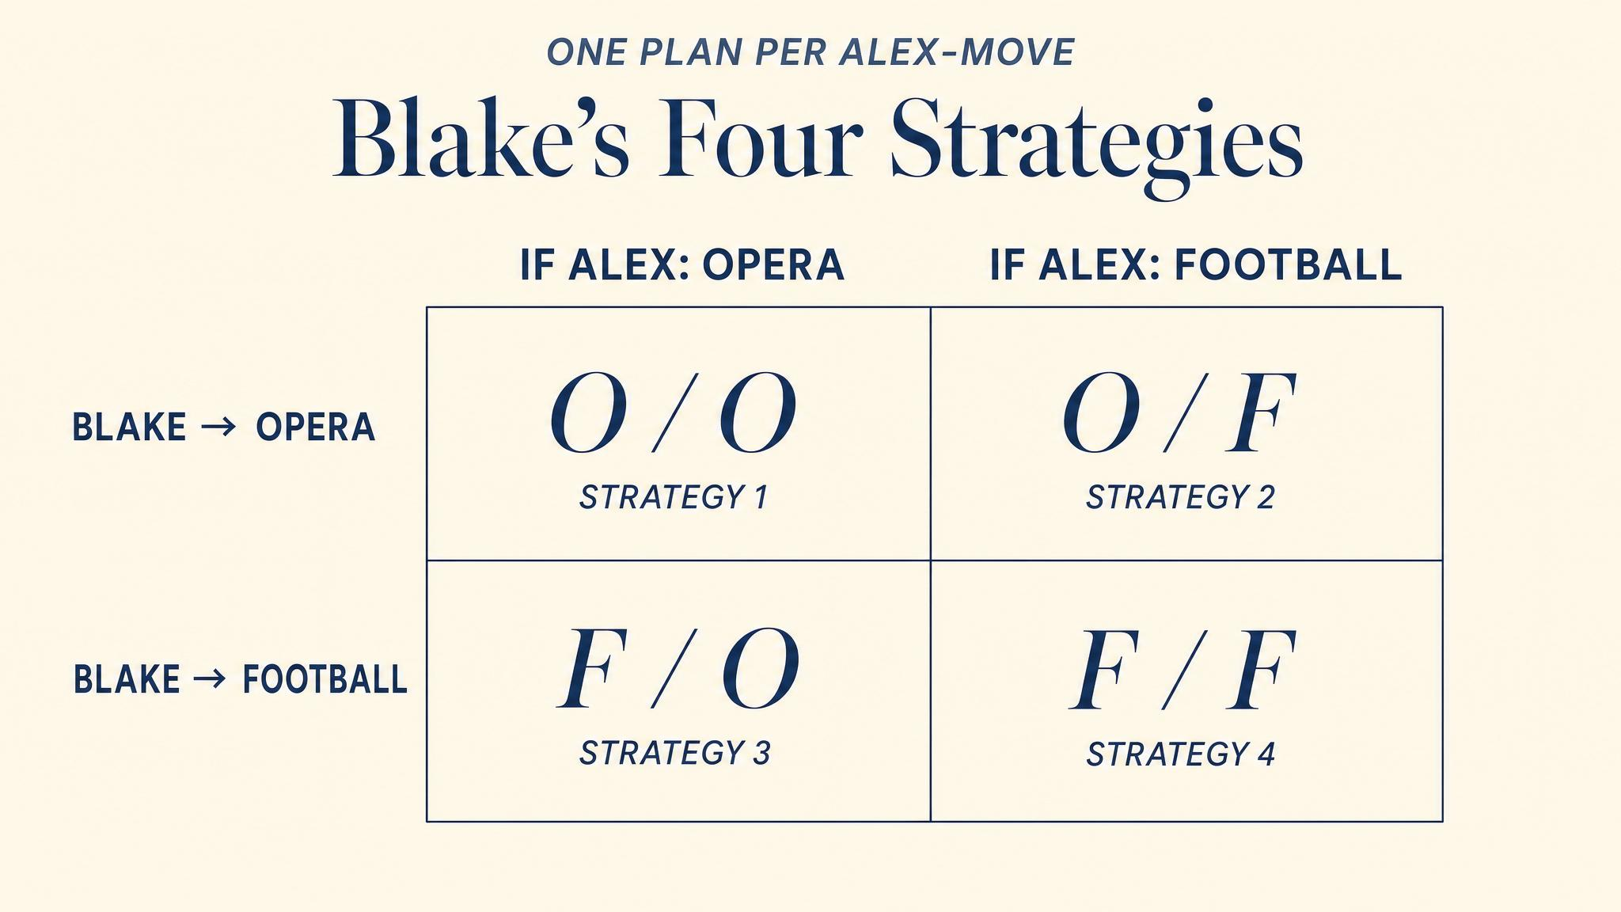
Notes:
Blake has two decision nodes, two actions at each — so four complete strategies, not two. The function-from-information-sets-to-actions framing is from Fudenberg and Tirole 1991. The number of strategies grows multiplicatively.

Slide 10
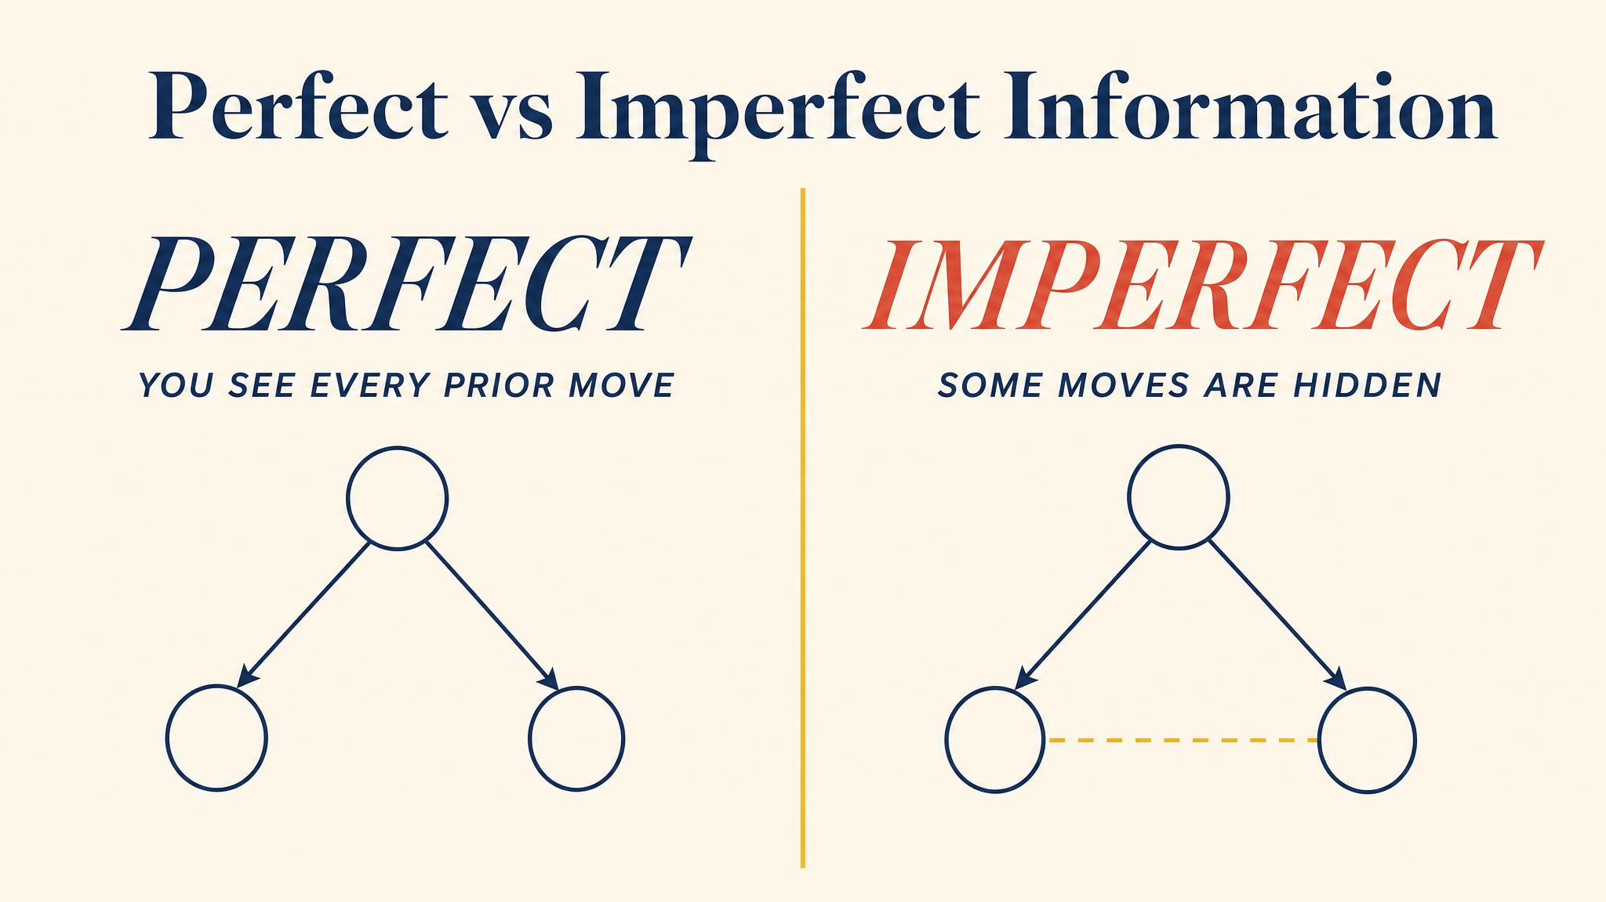
Notes:
Chess is perfect information. Poker is imperfect. Aumann and Hart in 2002 emphasise that perfect-information games can be solved by backward induction, while imperfect-information games may require mixing.

Slide 11
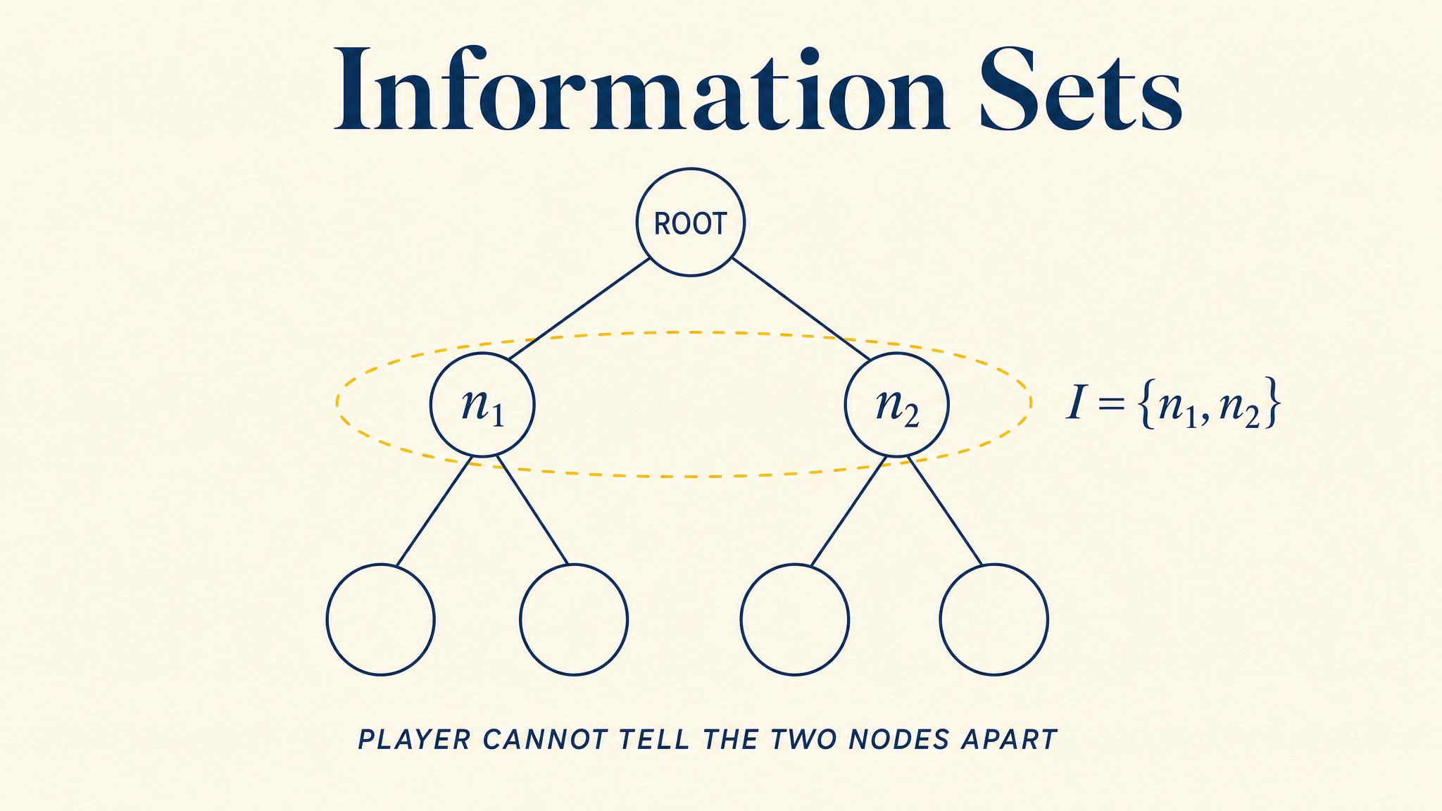
Notes:
An information set, introduced by Kuhn in 1953, groups decision nodes a player cannot tell apart. Simultaneous games are just sequential games where the second mover's nodes share one information set.

Slide 12
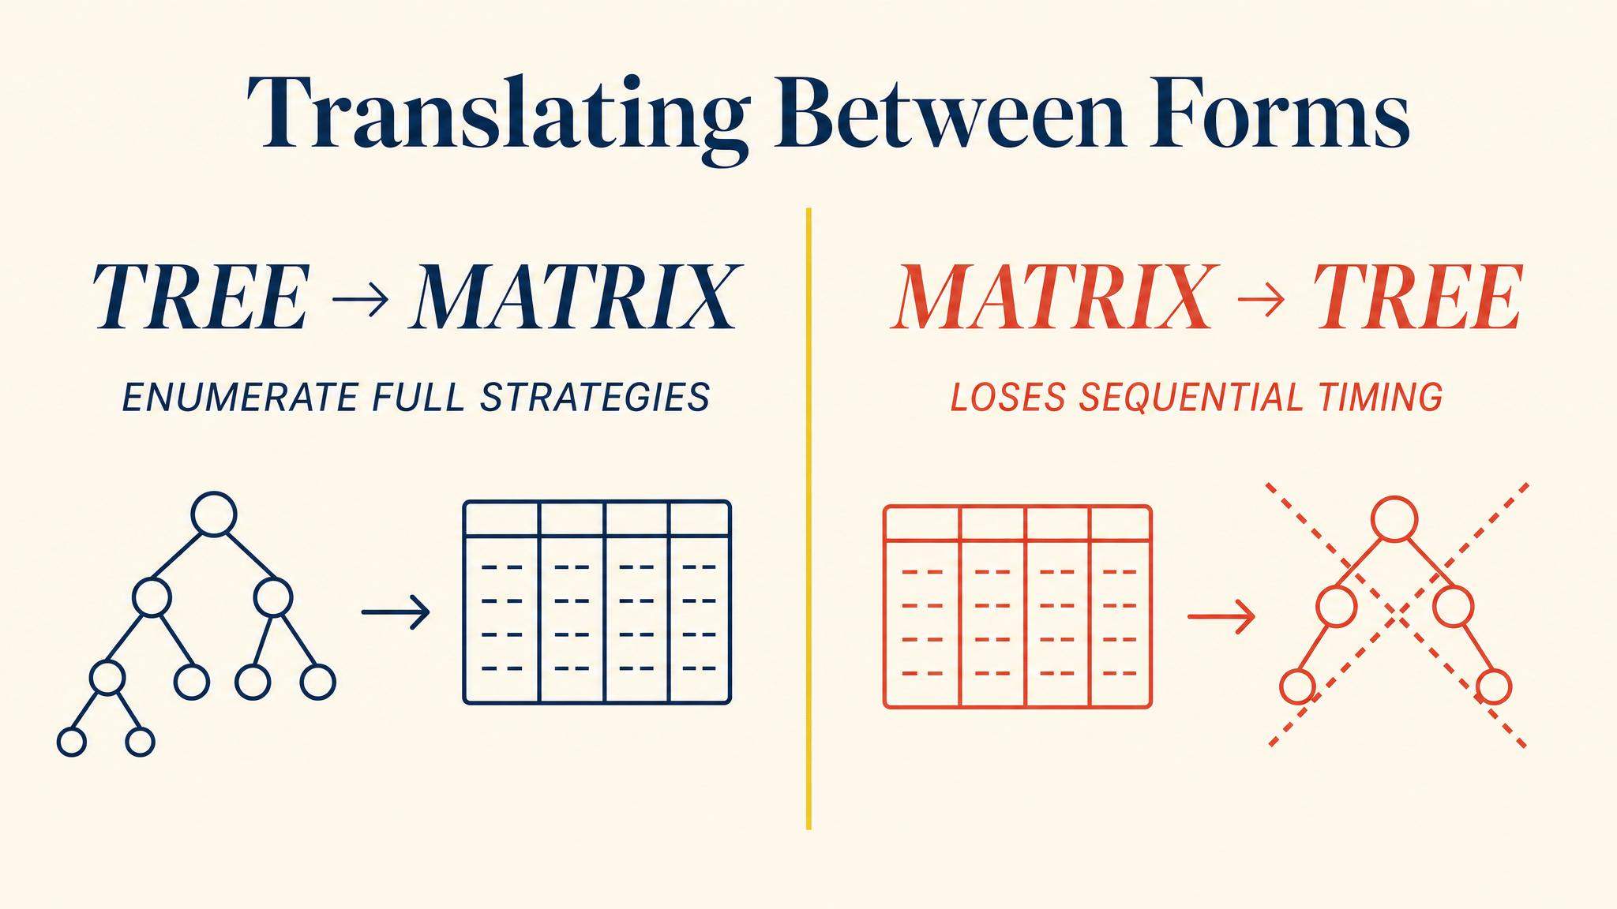
Notes:
Levin 2002 lays out the procedure: enumerate every contingent plan, trace through the tree, fill cells. Sequential Battle of the Sexes becomes a 2 by 4 matrix — bigger than the simultaneous 2 by 2 because observation creates strategic richness.

Slide 13
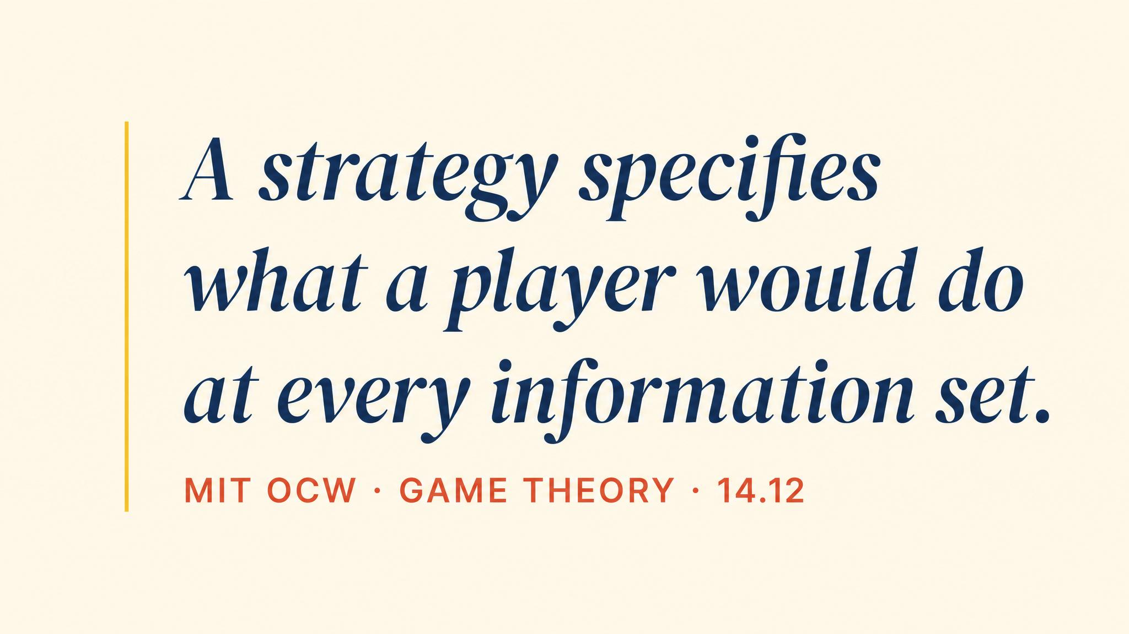
Notes:
Pause on this verbatim line from the MIT OpenCourseWare 2012 notes. The threat of what you would do at an unreachable node is exactly what shapes other players' choices — and what makes the reachable nodes reachable.

Slide 14
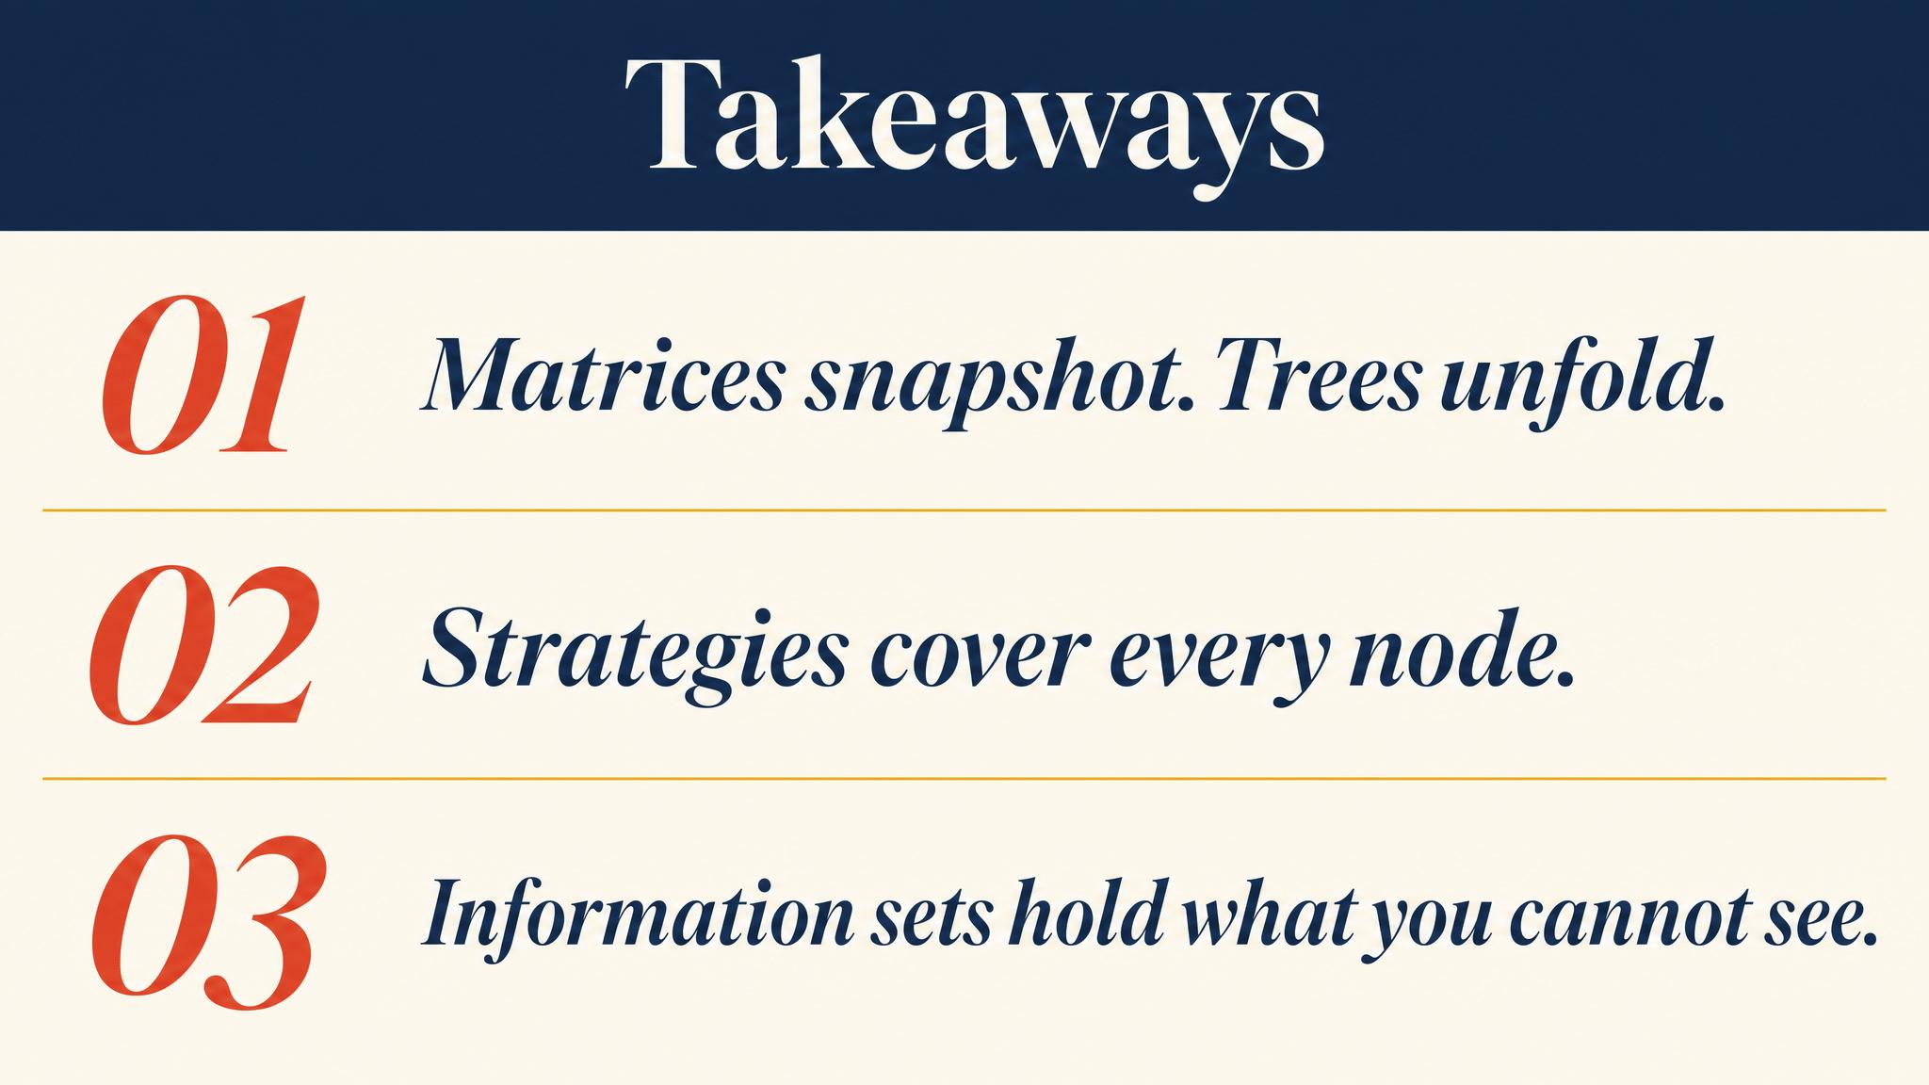
Notes:
Three things to carry forward. The matrix compresses; the tree unfolds. A strategy is a recipe for every node, including unreachable ones. Information sets, not nodes, are what strategies map from.

Slide 15
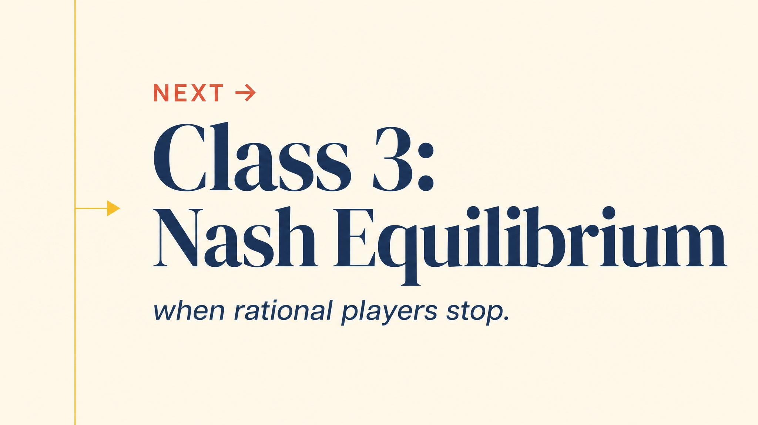
Notes:
Close with the bridge. Without the grammar of matrices and trees, we cannot even state Nash equilibrium precisely. Next chapter we make the central solution concept of game theory exact.

