Slide 1
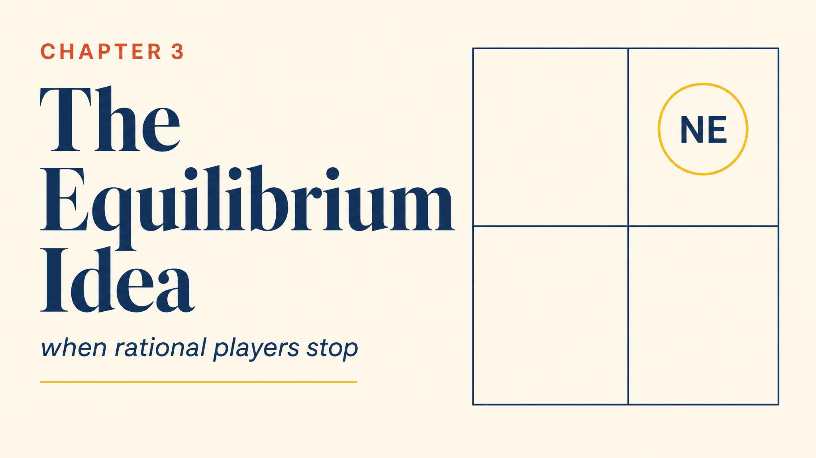
Notes:
Open with the 2018 US-China tariff escalation: both sides knew it hurt them, but neither could unilaterally back down. Welcome to Nash equilibrium — the most important concept in modern social science.

Slide 2
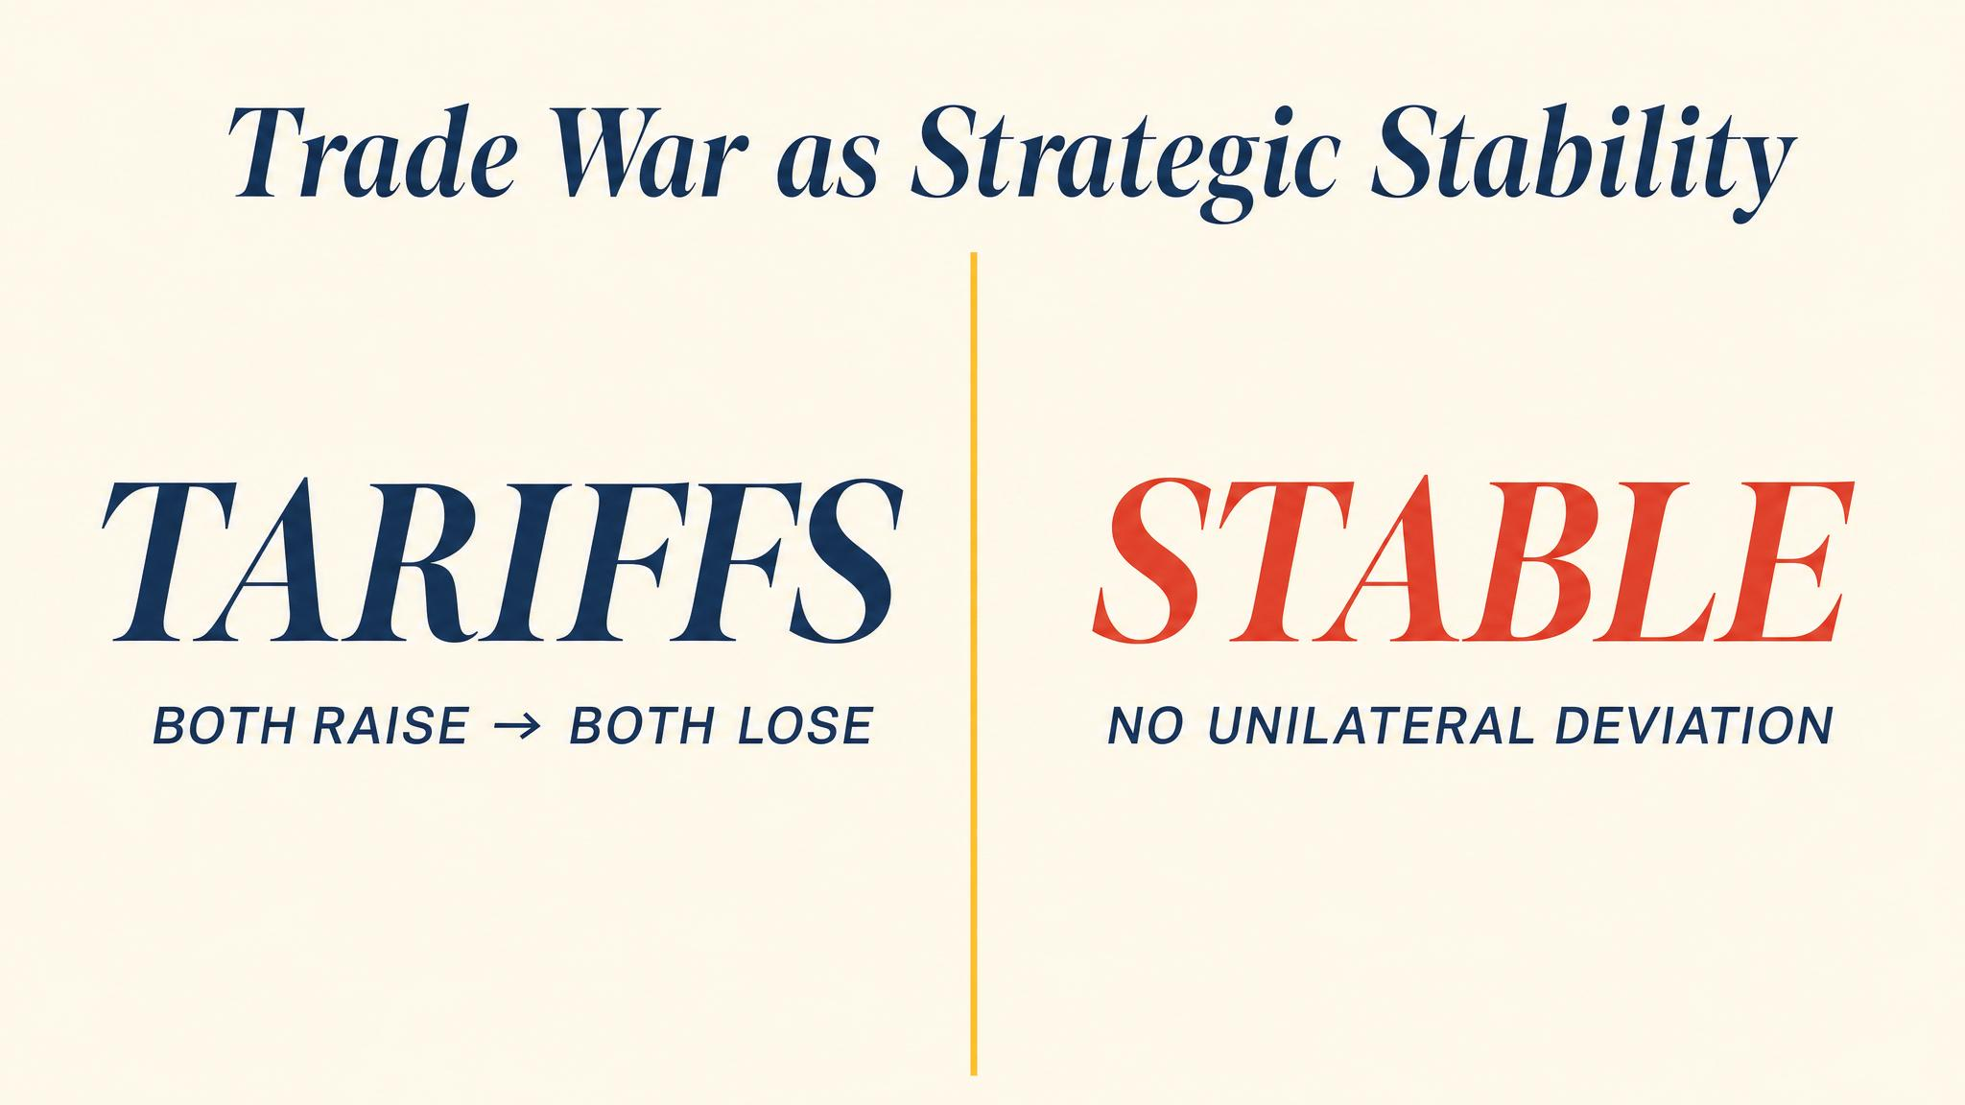
Notes:
Freedonia versus Sylvania: 4,4 for free trade, 1 or 5 for asymmetric outcomes, 2,2 for the tariff war. Both sides prefer 4,4 but neither can credibly hold there.

Slide 3
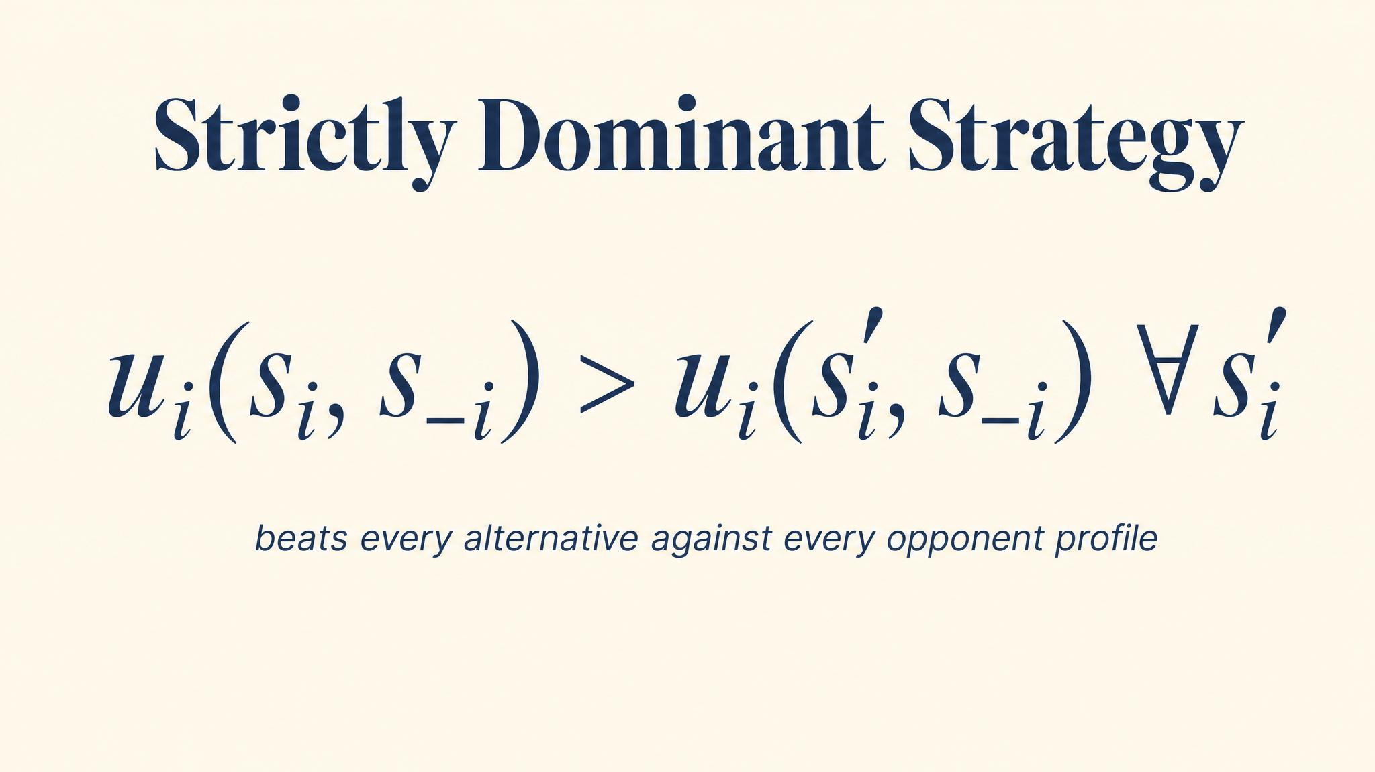
Notes:
Tariffs beats free trade for Freedonia whatever Sylvania does — 5 > 4 and 2 > 1. Same logic on the other side. When you have a strictly dominant strategy, the analysis is over.

Slide 4
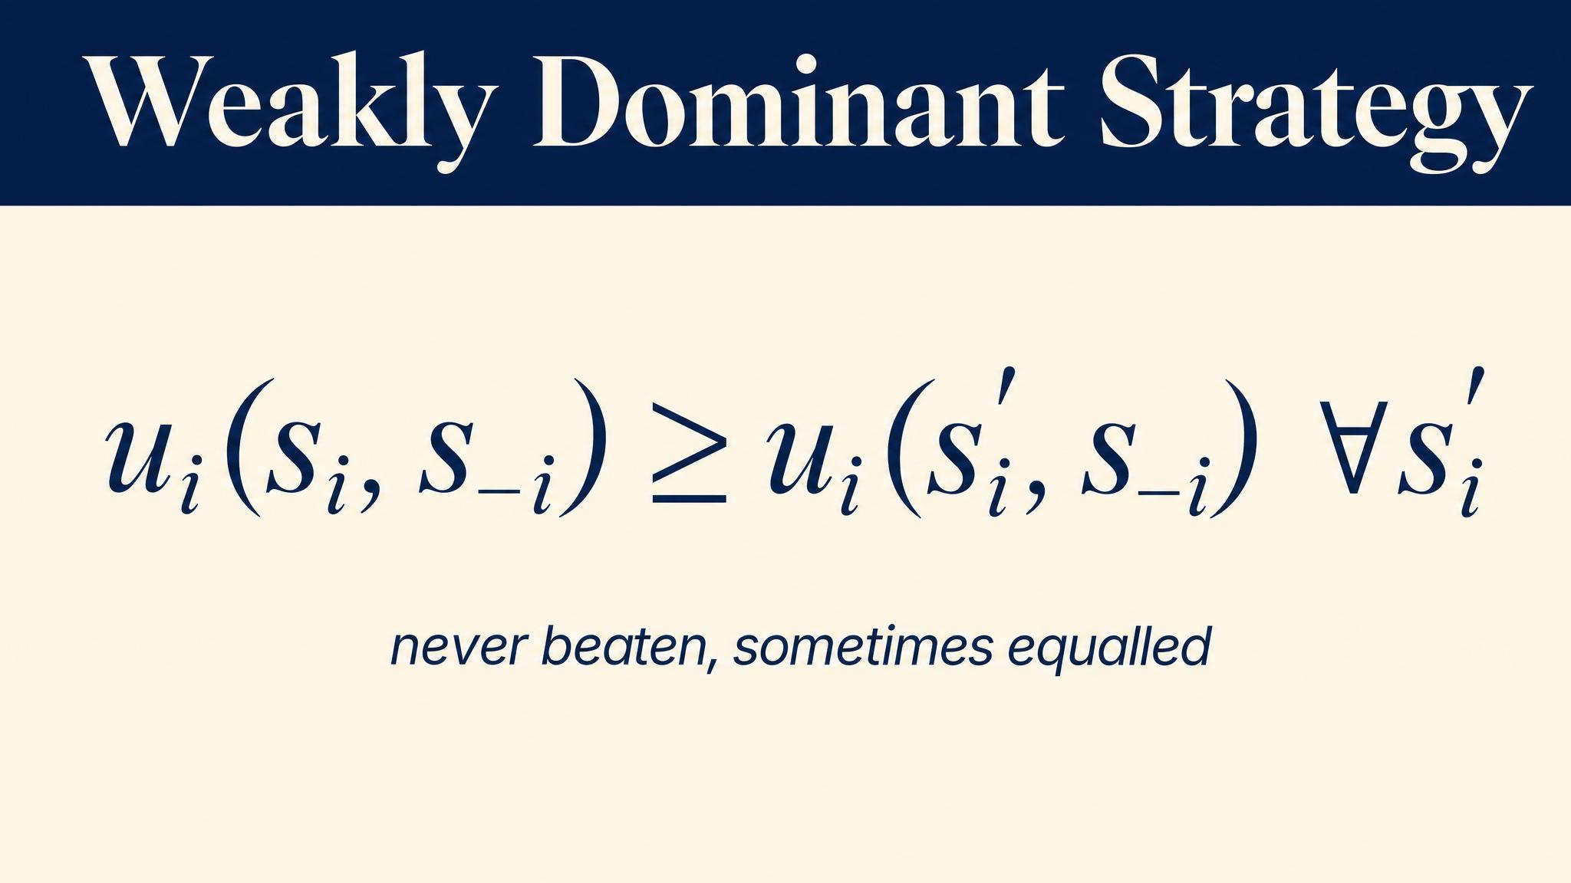
Notes:
A weakly dominant strategy ties some alternatives but beats at least one. Sealed-bid auctions: bidding your true value of $100 weakly dominates underbidding. We'll see this logic in Chapter 11.

Slide 5
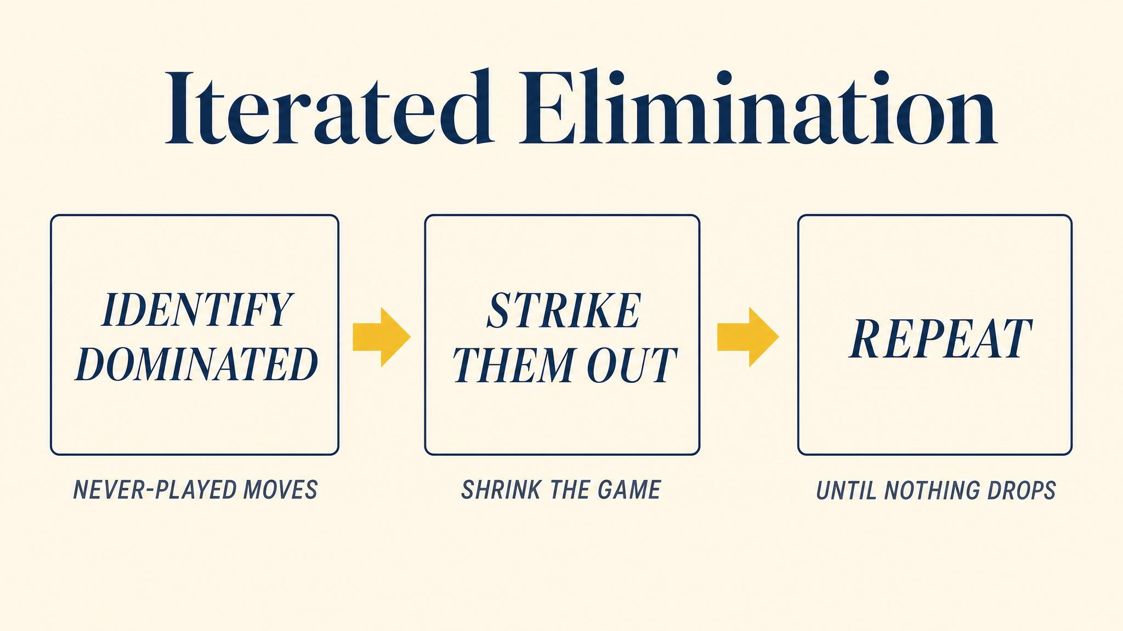
Notes:
Even when no strategy is outright dominant, we can peel layers. Remove dominated strategies; in the smaller game, more may become dominated. Each layer requires another level of common knowledge of rationality.

Slide 6
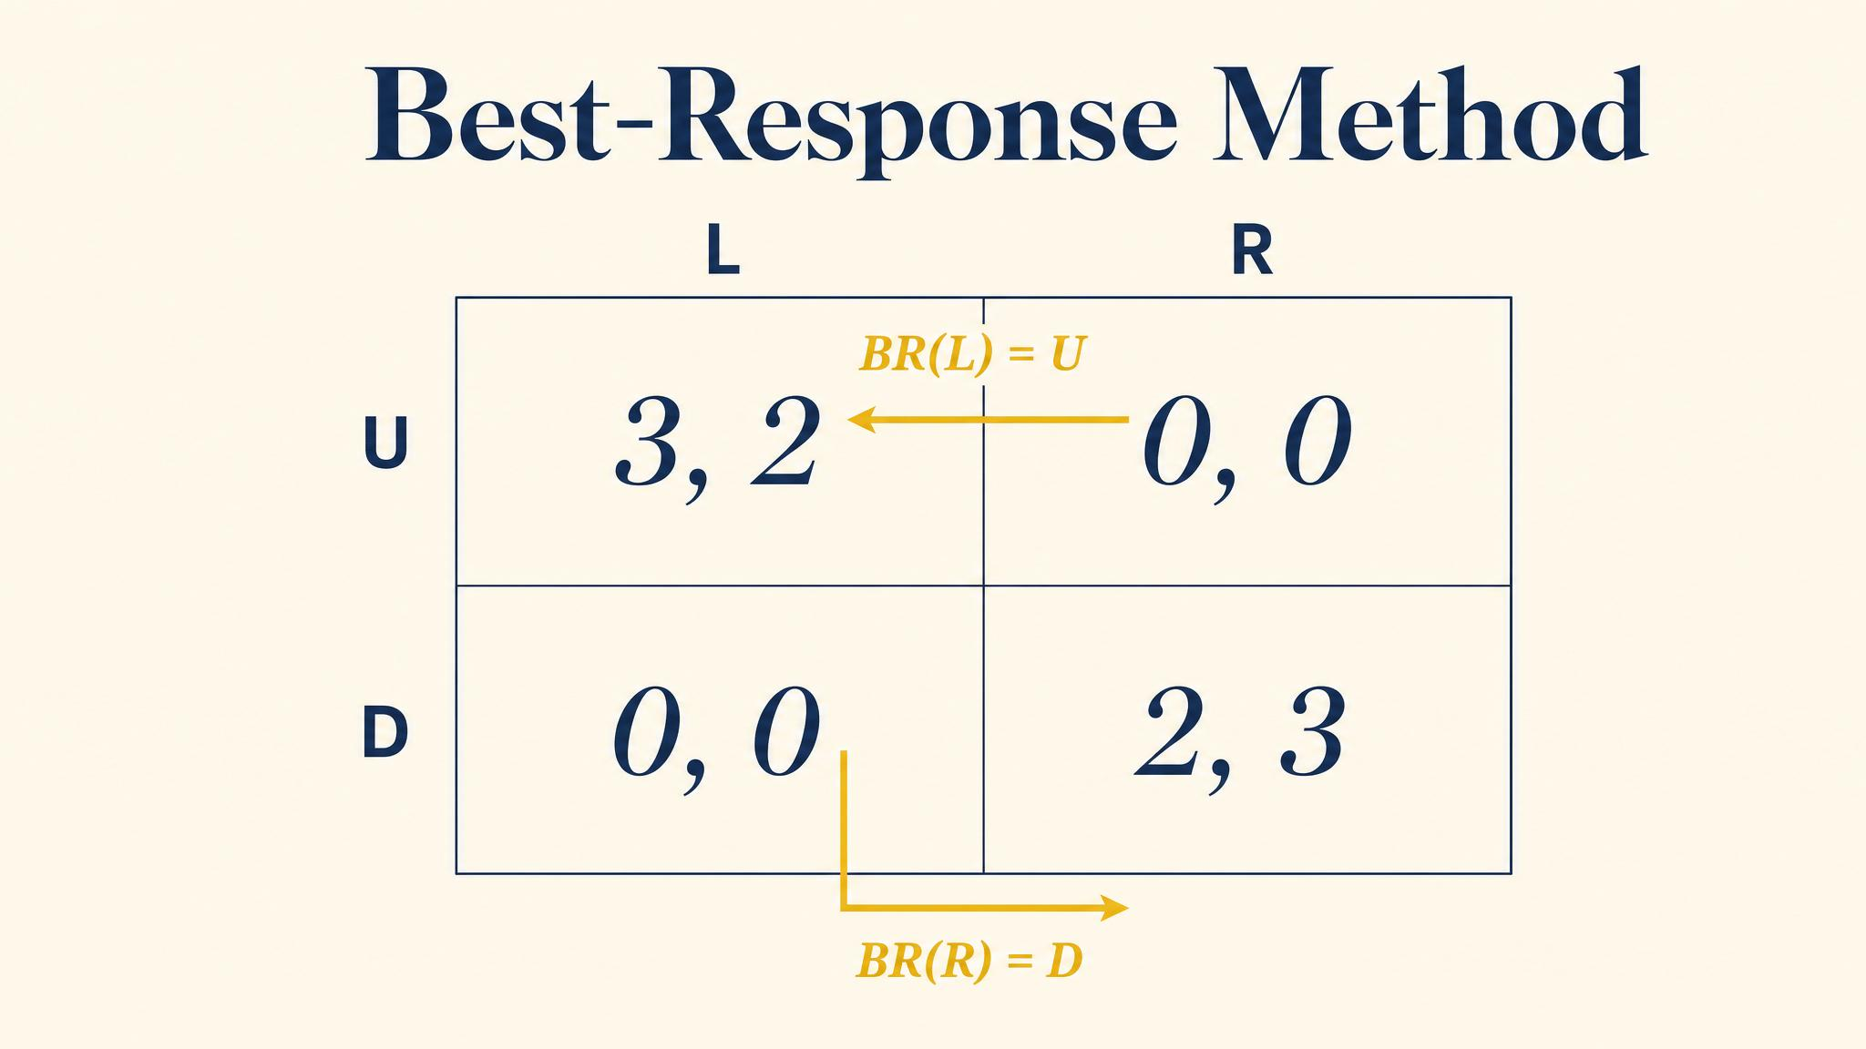
Notes:
Column by column for the row player; row by row for the column player. Where both dots land in the same cell, you have a Nash equilibrium.

Slide 7
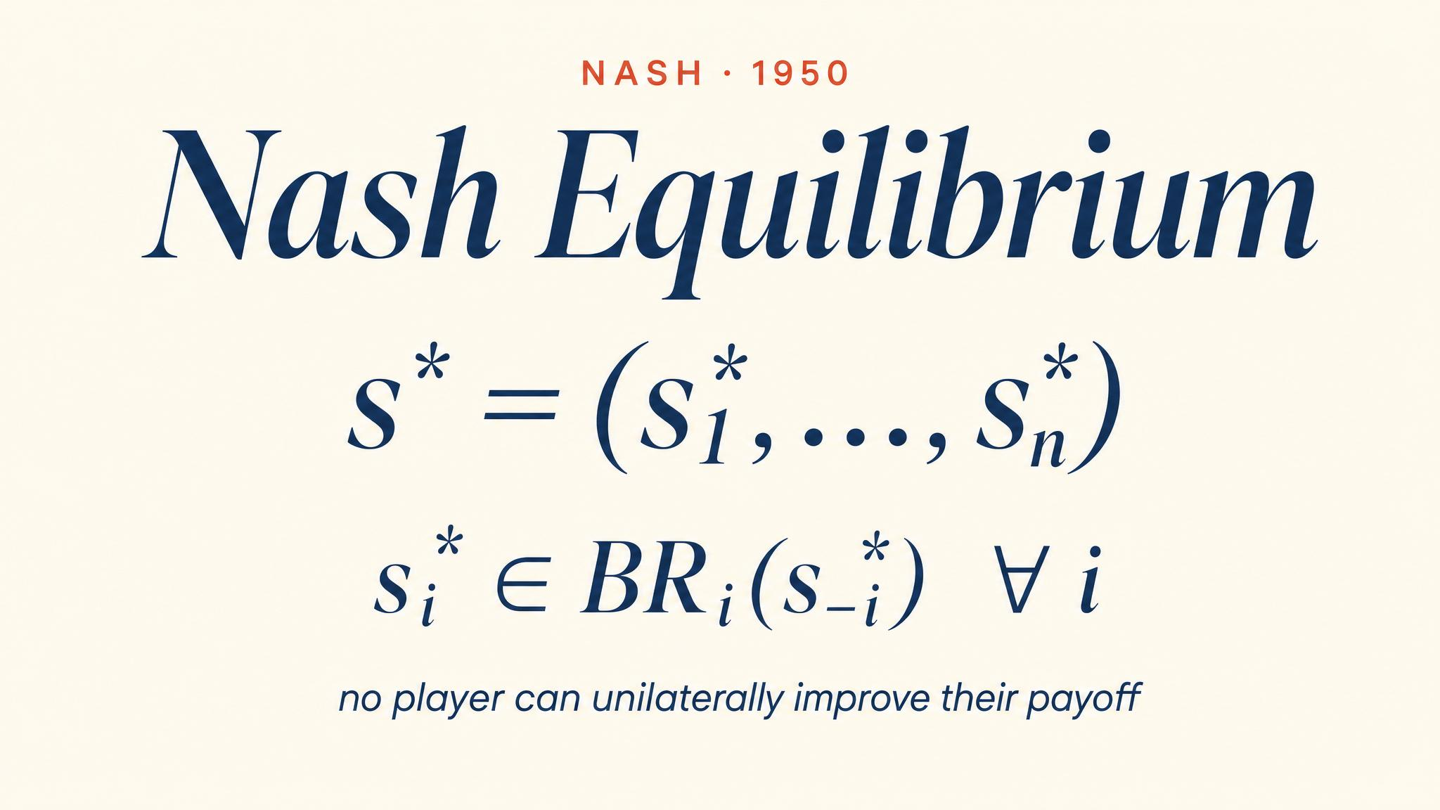
Notes:
Nash's one-page paper in 1950, when he was 21. Every player simultaneously playing a best response — no one regrets their choice after the dust settles. Self-enforcing stability.

Slide 8
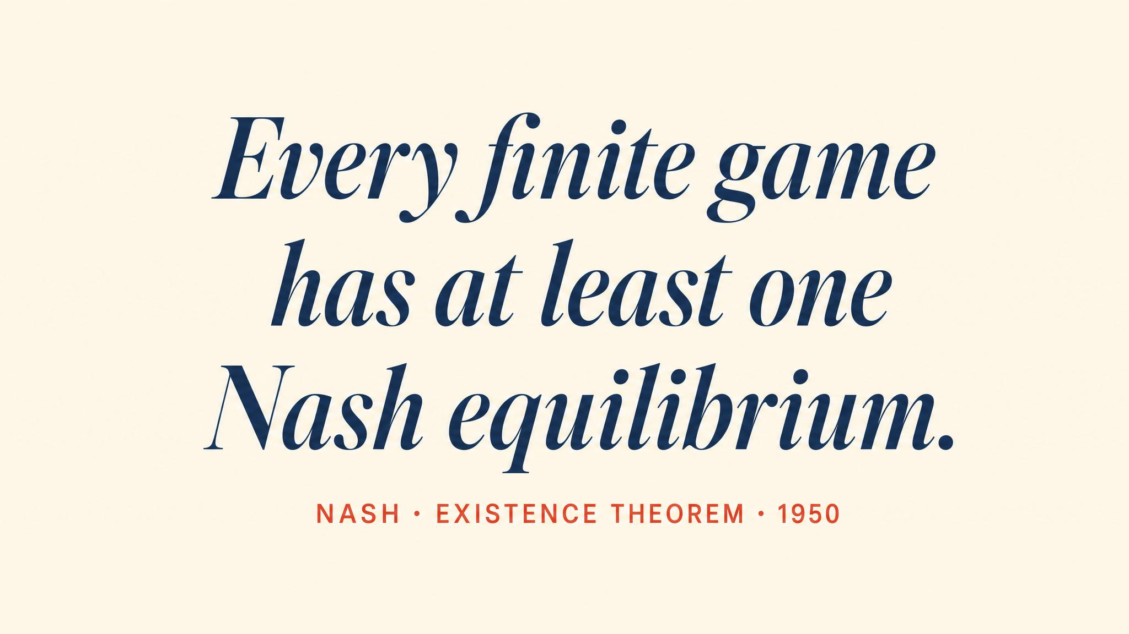
Notes:
Nash's 1950 paper, 1951 dissertation, and 1994 Nobel. His proof uses Brouwer's fixed-point theorem: every finite game has at least one Nash equilibrium, provided we allow mixed strategies — the topic of Chapter 4.

Slide 9
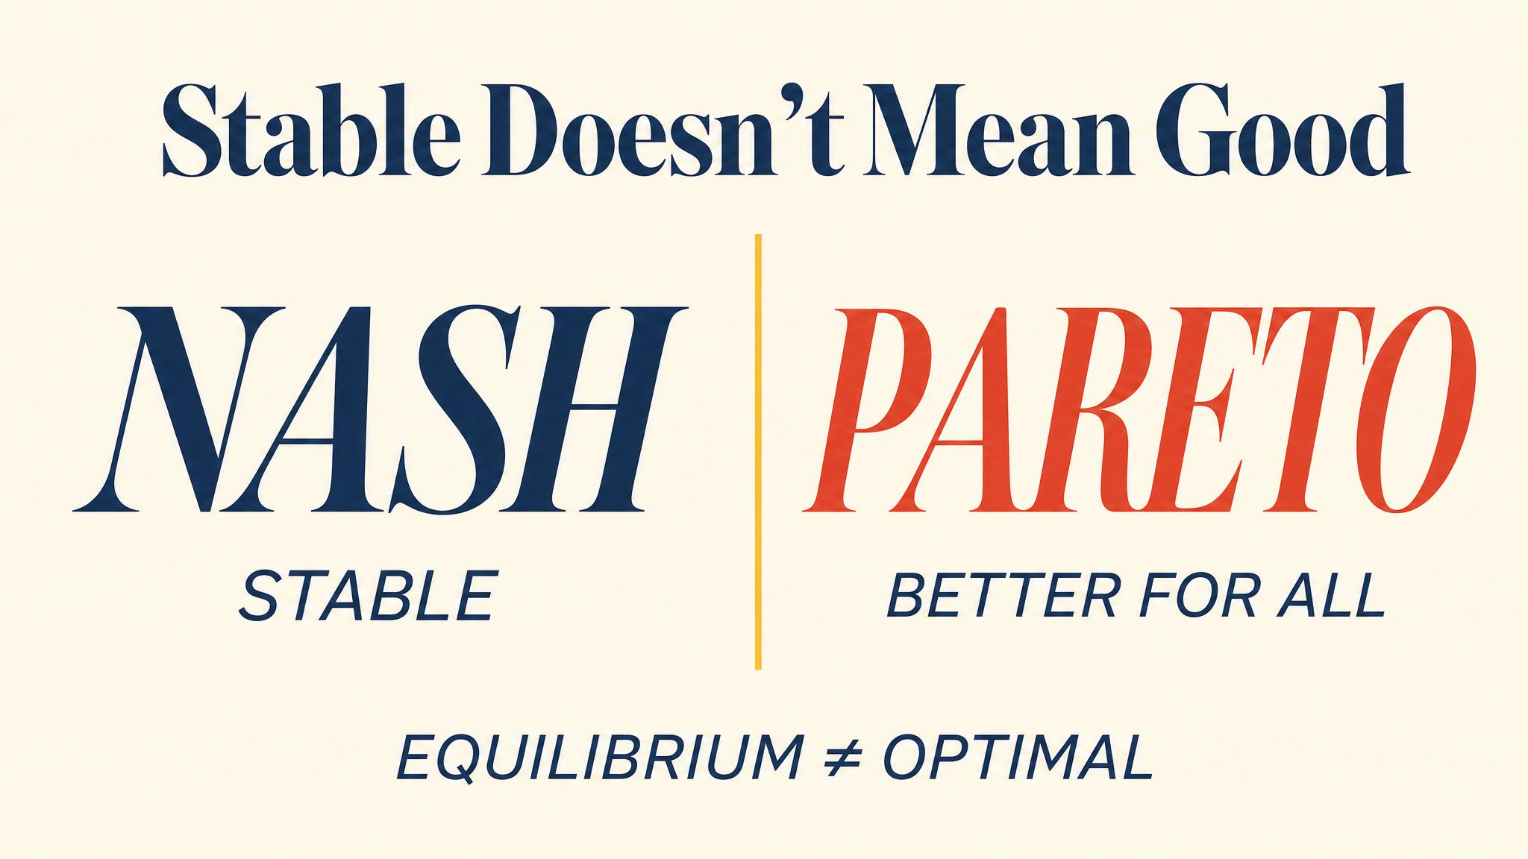
Notes:
Both sides prefer (4, 4) to (2, 2). Yet (2, 2) is the unique Nash equilibrium. The dilemma is the theory revealing a feature of strategic life: rational individual choice can produce collectively irrational outcomes.

Slide 10
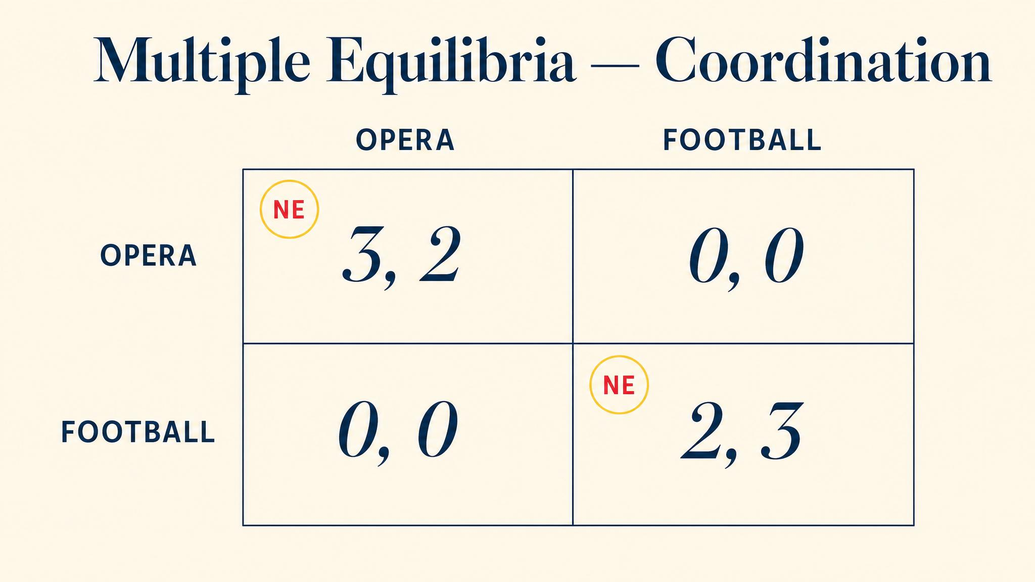
Notes:
Two drivers, narrow road. Both swerving left works. Both swerving right works. The theory cannot tell you which equilibrium will be played — the answer comes from outside the model.

Slide 11
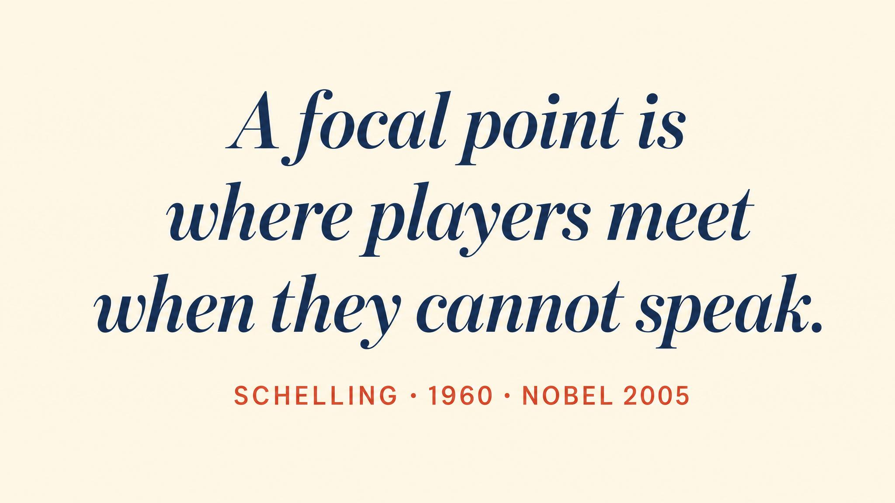
Notes:
Schelling's 1960 'Strategy of Conflict' asked: where would you meet a stranger in New York with no communication? Grand Central, noon. Salience and convention select among equilibria — Nobel 2005.

Slide 12
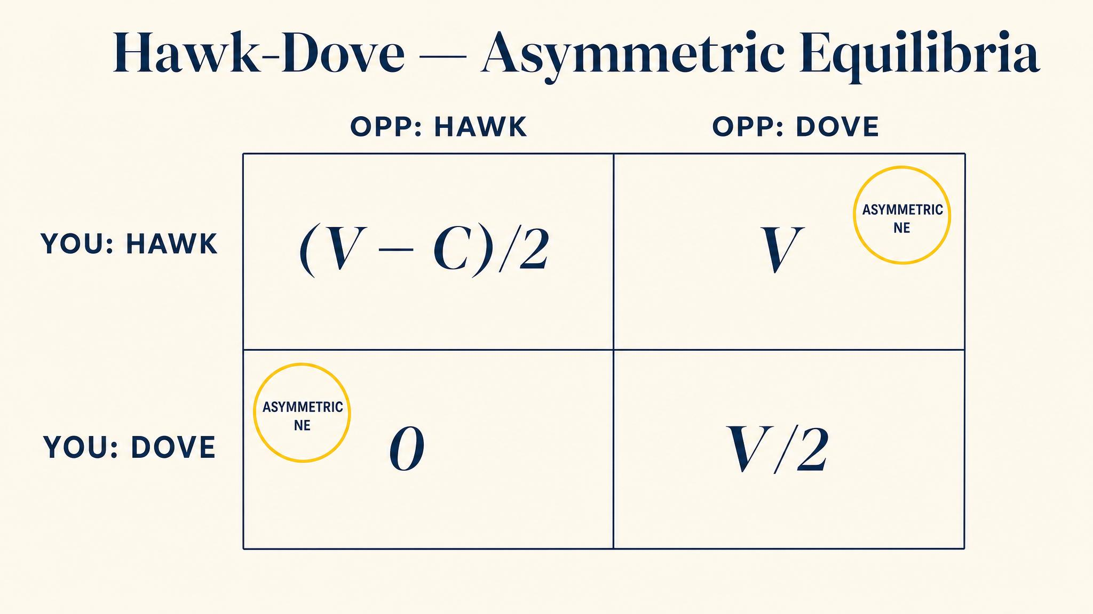
Notes:
Maynard Smith and Price's 1973 Hawk-Dove game. When fighting is costly, the equilibria are asymmetric (Hawk, Dove) and (Dove, Hawk) plus a mixed equilibrium. Central to evolutionary game theory in Chapter 9.

Slide 13
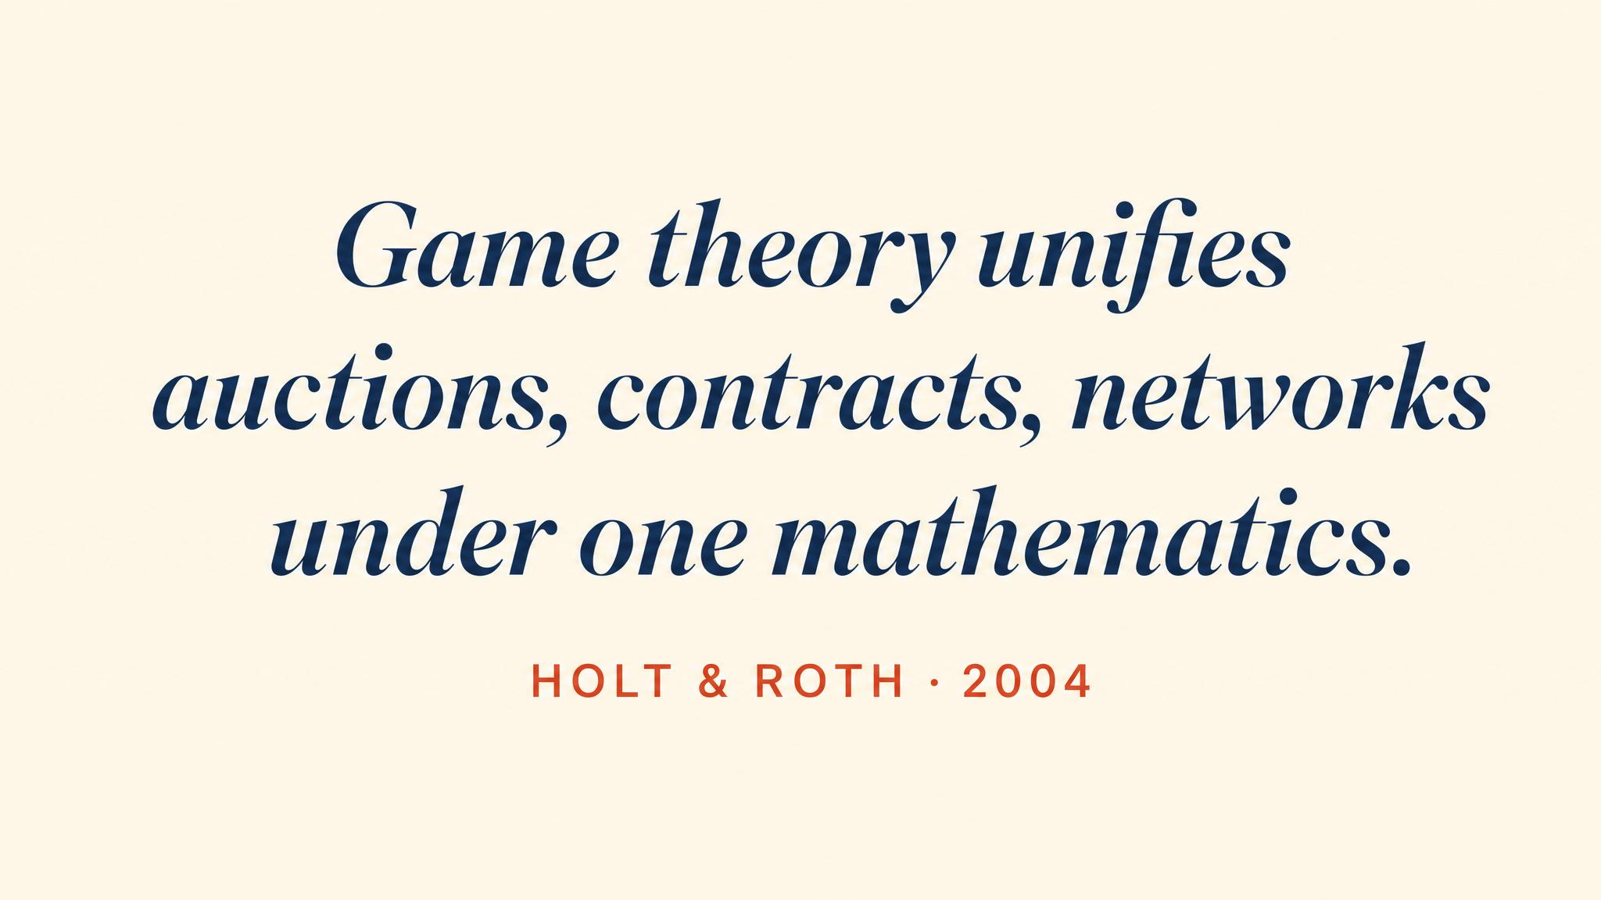
Notes:
Holt and Roth's 2004 retrospective on Nash's 50th anniversary: 'the most prominent unifying theory of social science'. The 1994 Nobel was shared with Harsanyi and Selten.

Slide 14
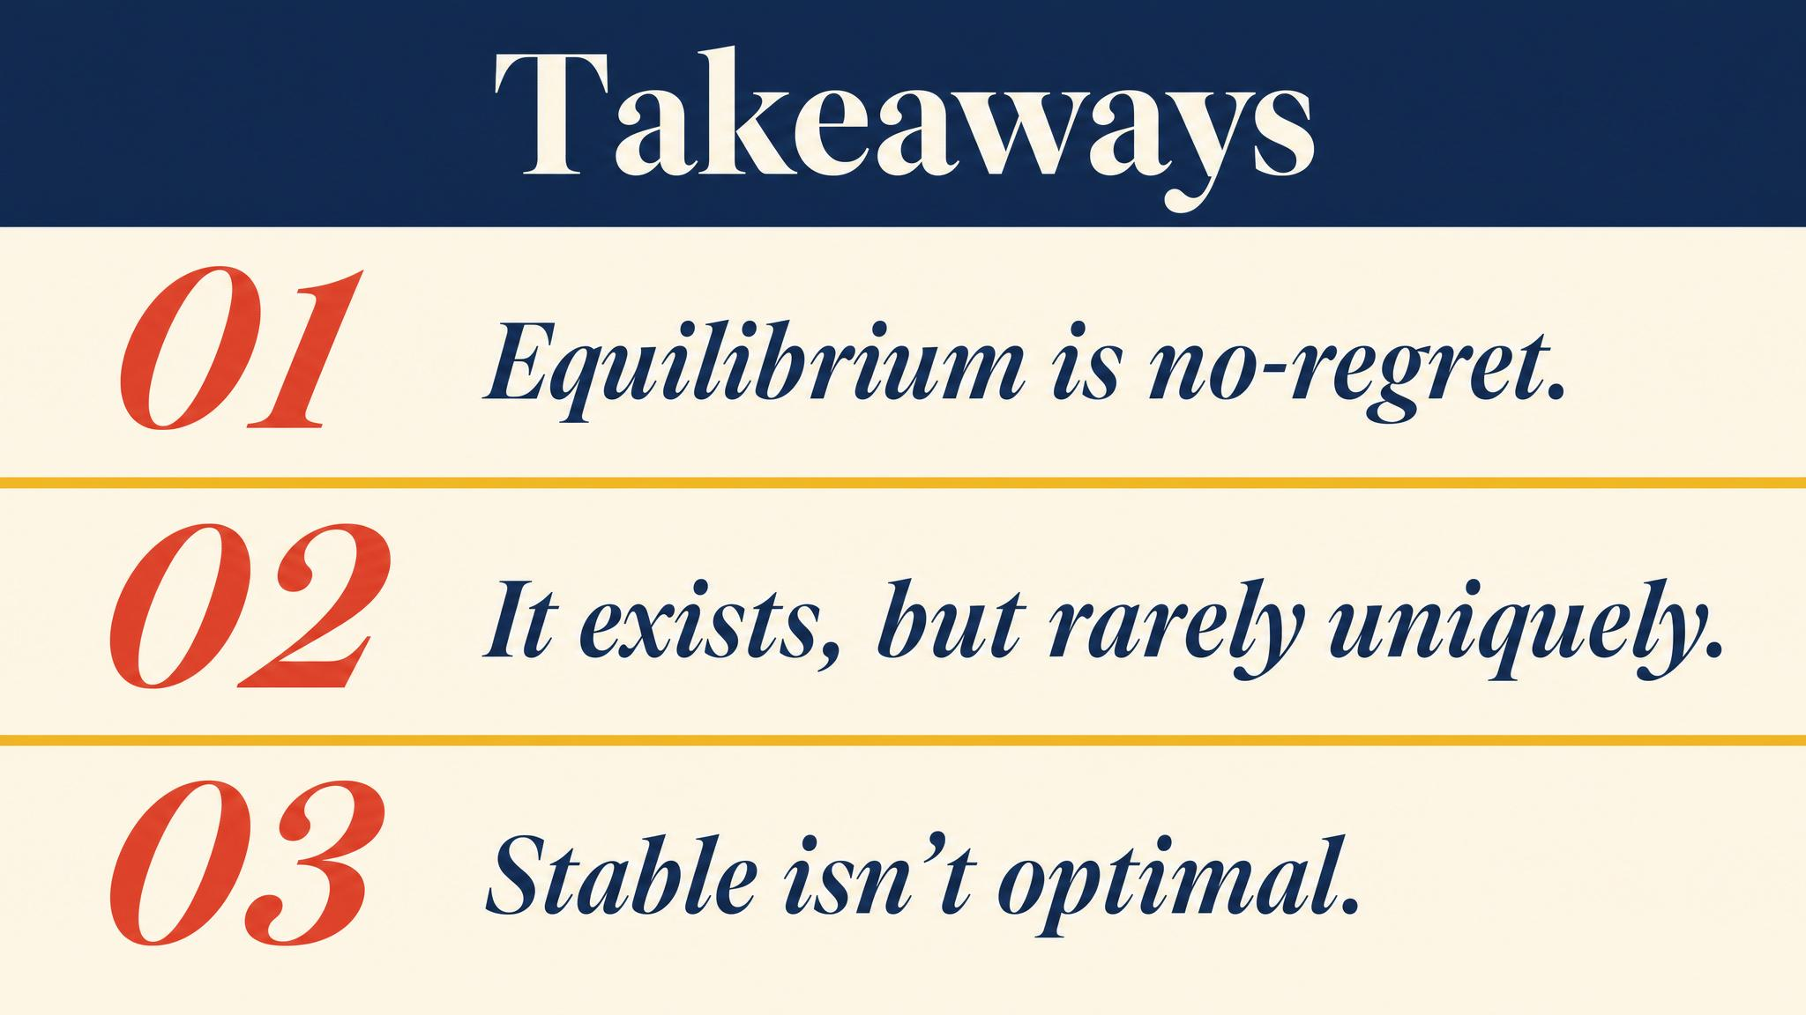
Notes:
Three things to carry forward. Equilibrium means stability, not optimality. Nash equilibria are mutual best responses. When there are multiple, theory alone cannot pick one — Schelling's focal points come from outside.

Slide 15
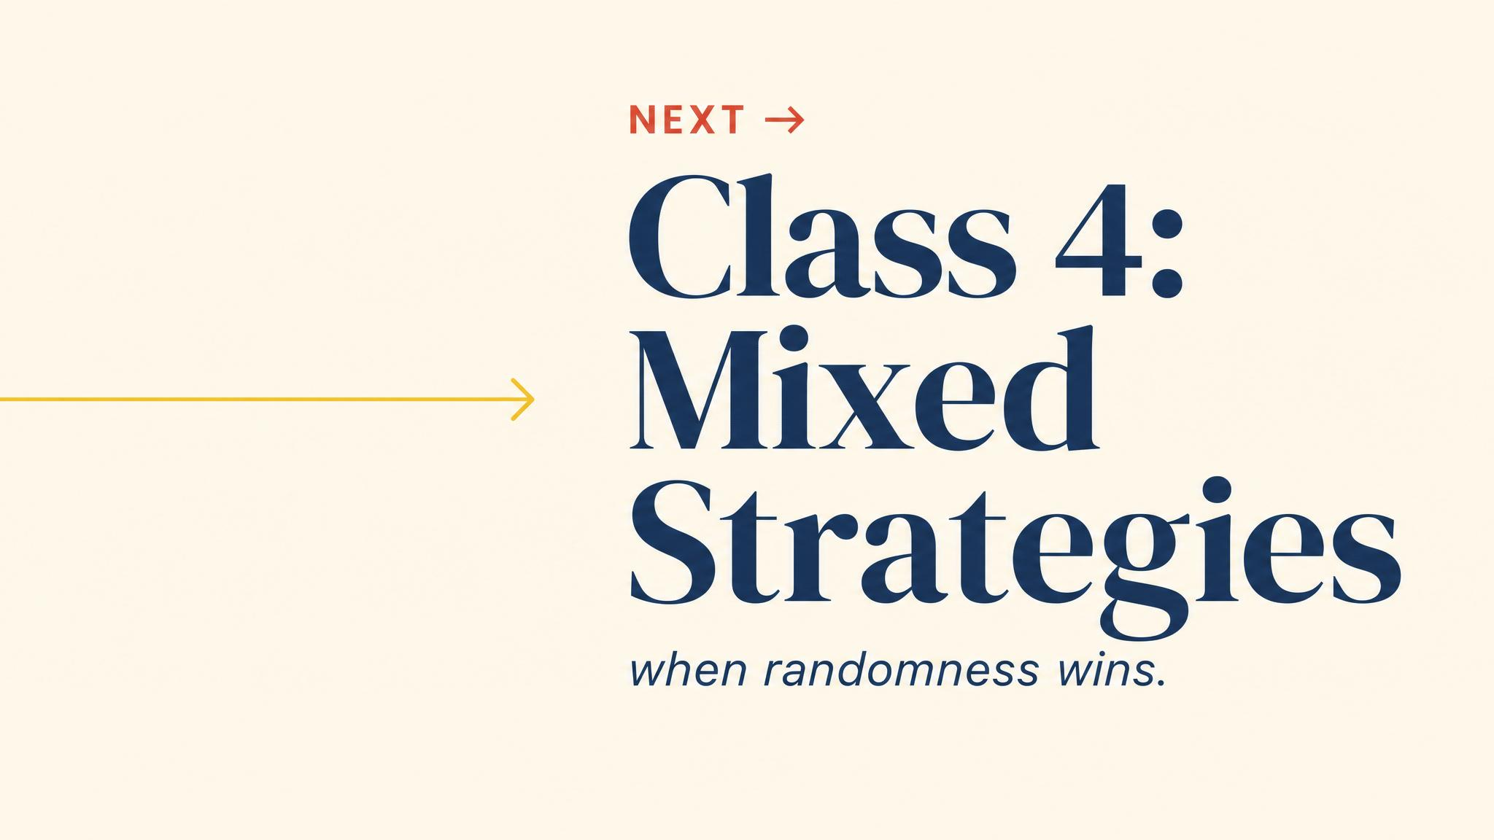
Notes:
Close with the bridge. Some games have no pure-strategy equilibrium. Mixed strategies will rescue Nash's existence theorem — get ready to flip some coins, strategically.

