Slide 1
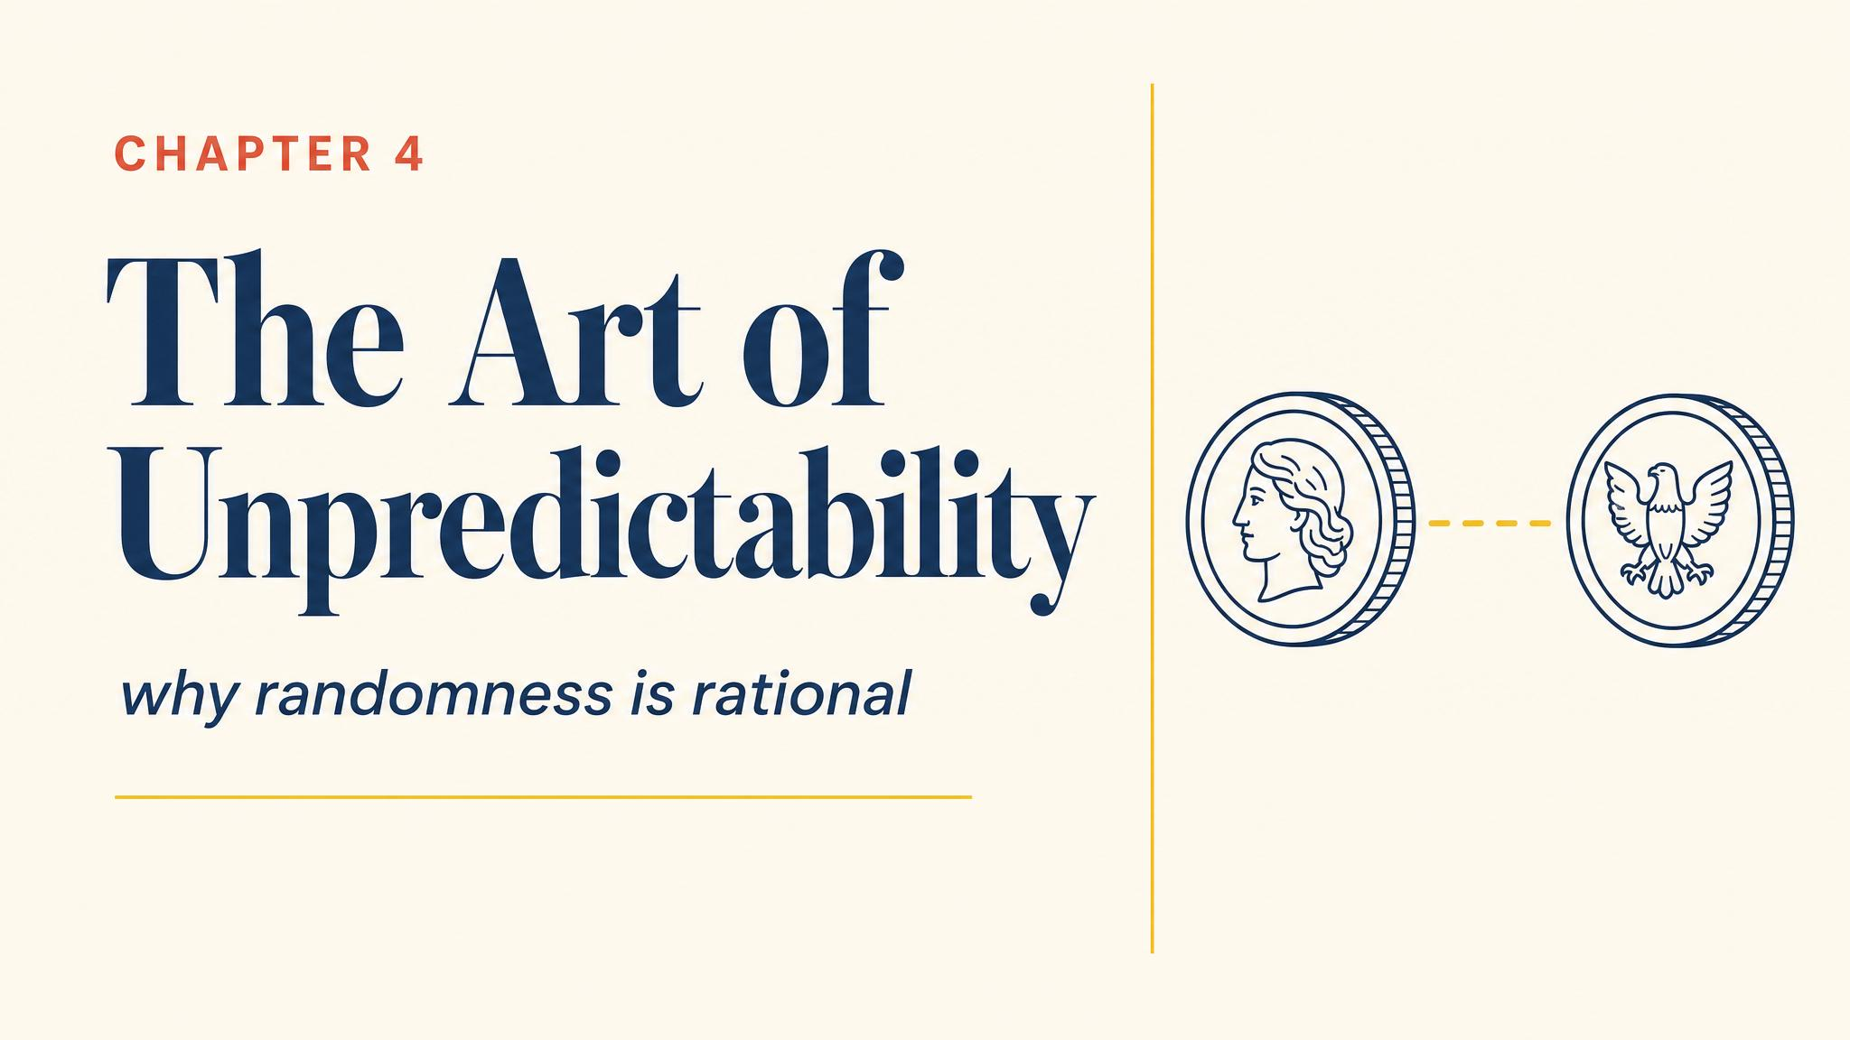
Notes:
Open with Zidane on the spot, Buffon settling into his crouch, ball arriving in 0.3 seconds. Pure simultaneous-move, zero-sum strategy. The only rational play here is genuine unpredictability.

Slide 2
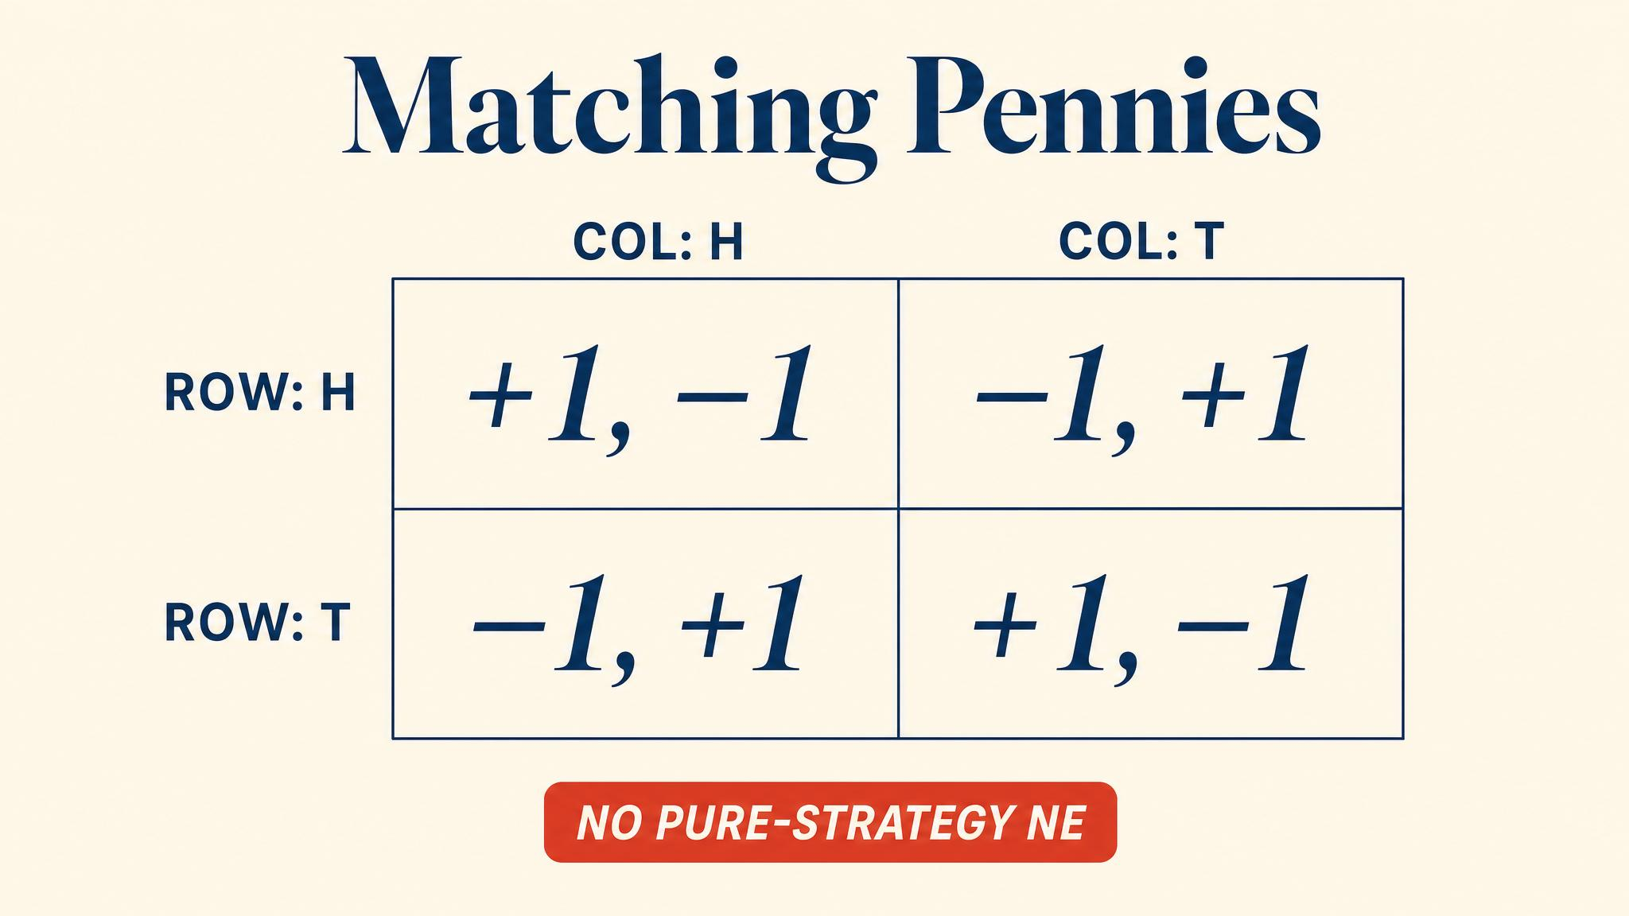
Notes:
Heads-heads gives Player 1 +1 and Player 2 -1; mismatches flip it. No cell is stable — every pure-strategy profile has someone wanting to deviate. The cycle never settles.

Slide 3
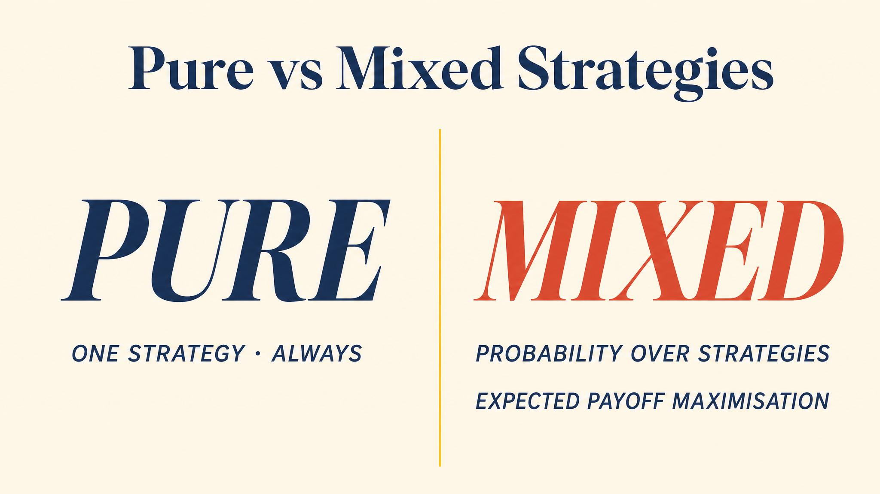
Notes:
A pure strategy is a definite choice. A mixed strategy is a probability distribution — Heads with probability p, Tails with probability 1-p. Not indecision; a calculated, deliberate plan.

Slide 4
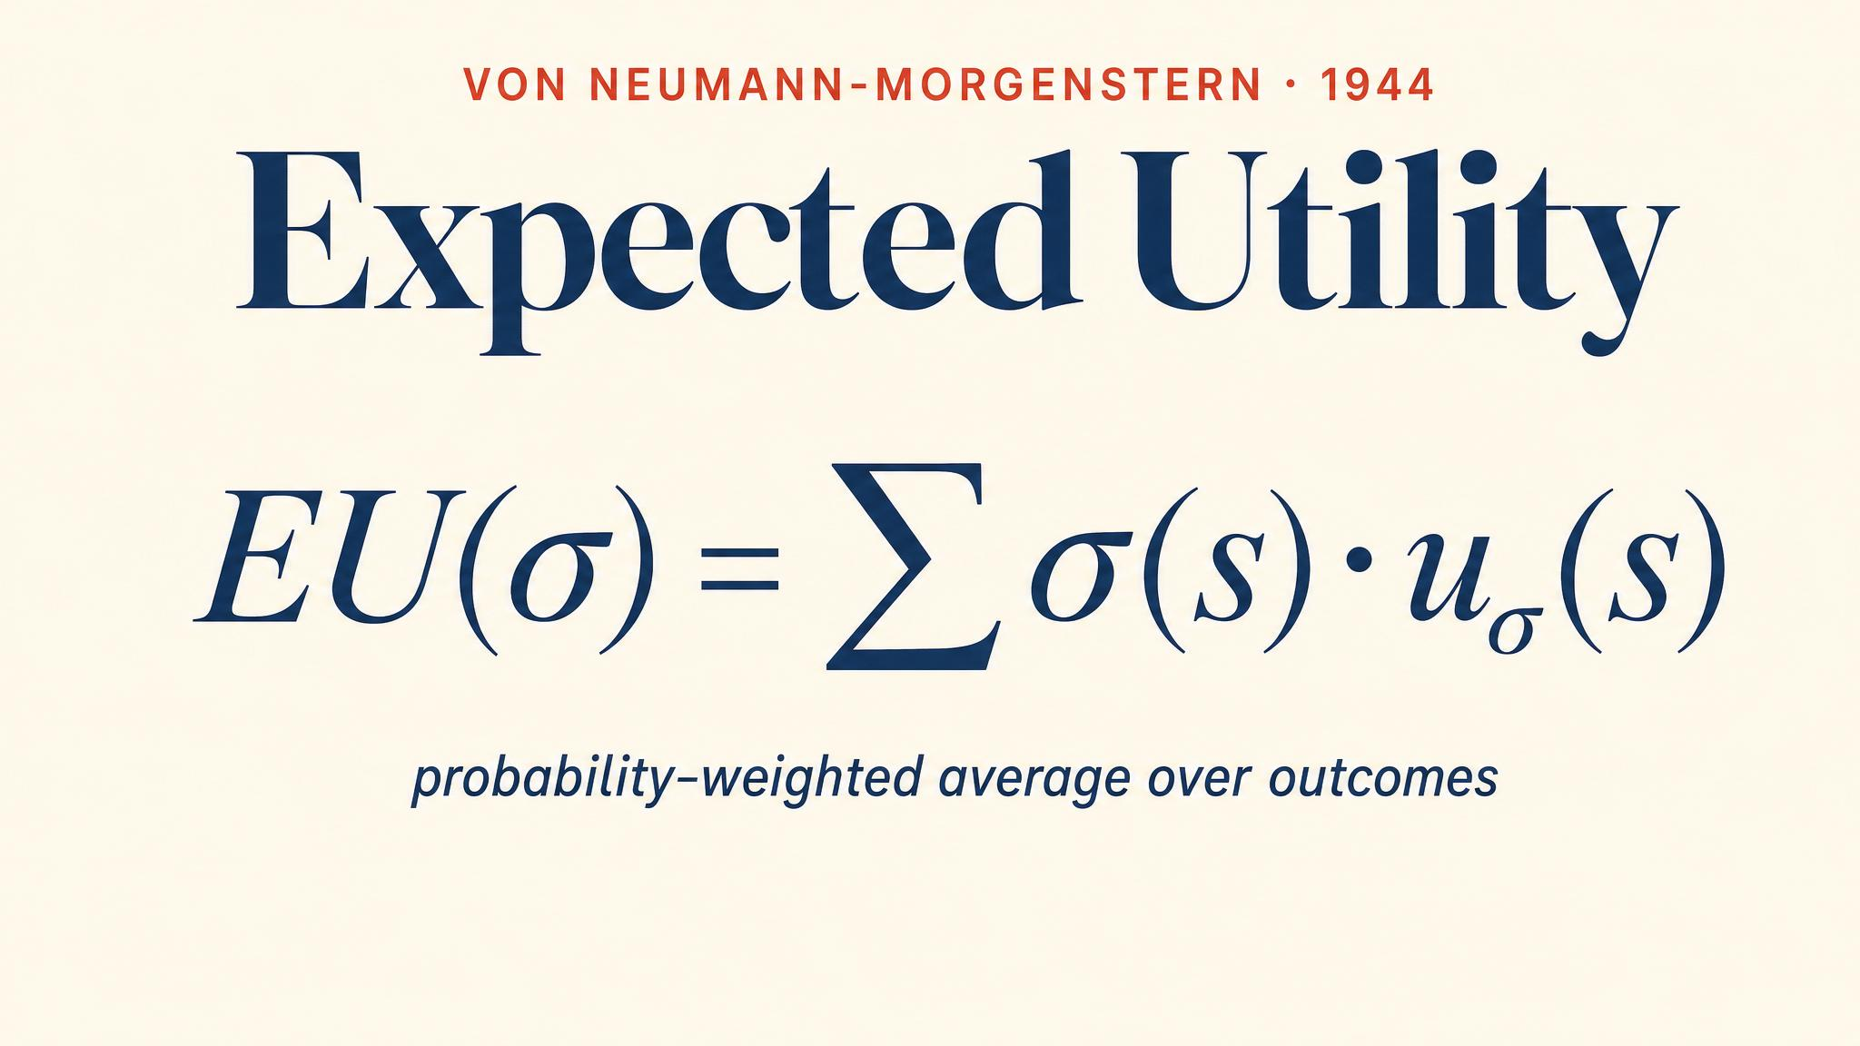
Notes:
Expected utility — the probability-weighted average — formalised by von Neumann and Morgenstern in 1944. This is how we compare random prospects on a single scale.

Slide 5
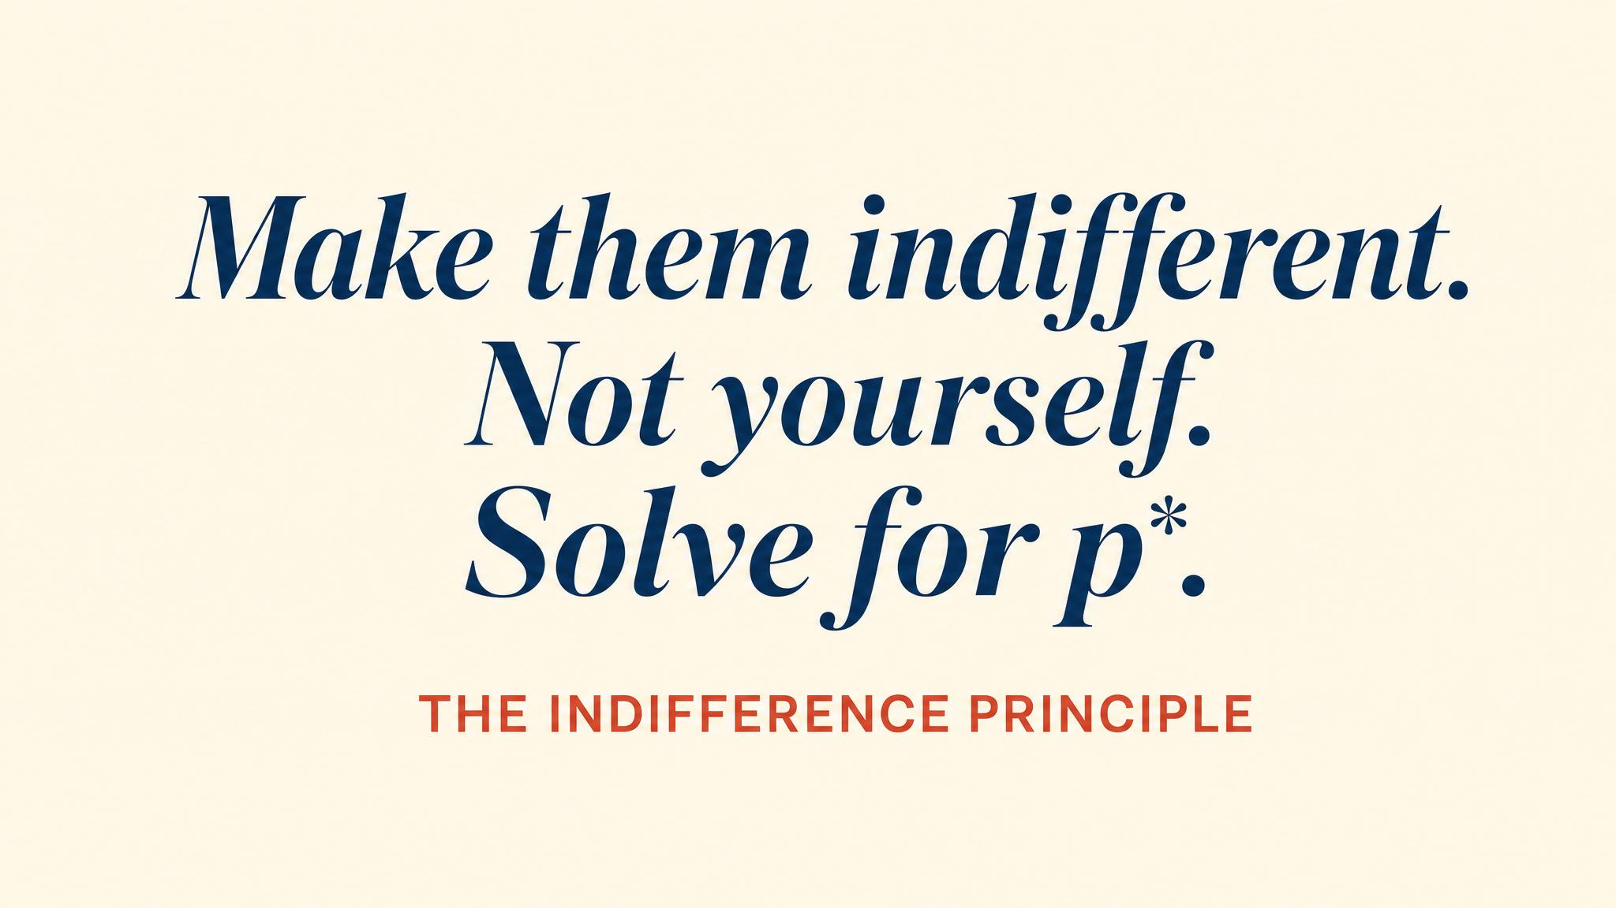
Notes:
The engine of every mixed-strategy calculation. Your equilibrium mixture solves your opponent's problem, not your own. If the opponent is willing to randomise, both options must give them the same expected payoff.

Slide 6
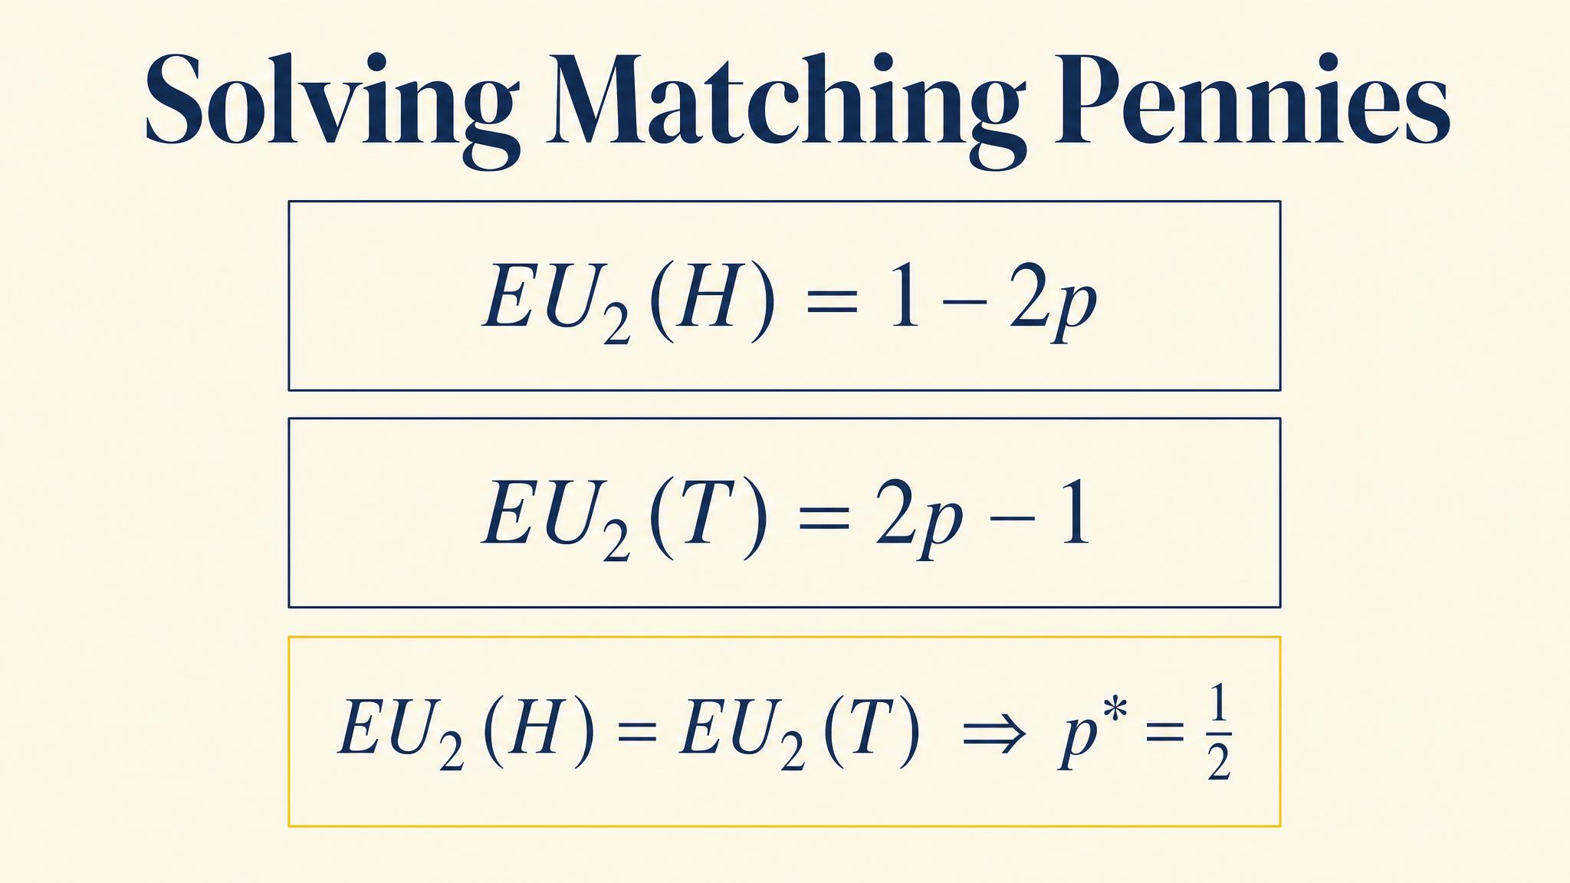
Notes:
Apply indifference: set Player 2's expected payoff from Heads equal to expected payoff from Tails. Solve: p = 1/2. By symmetry, q = 1/2. Each player's expected payoff at equilibrium is zero.

Slide 7
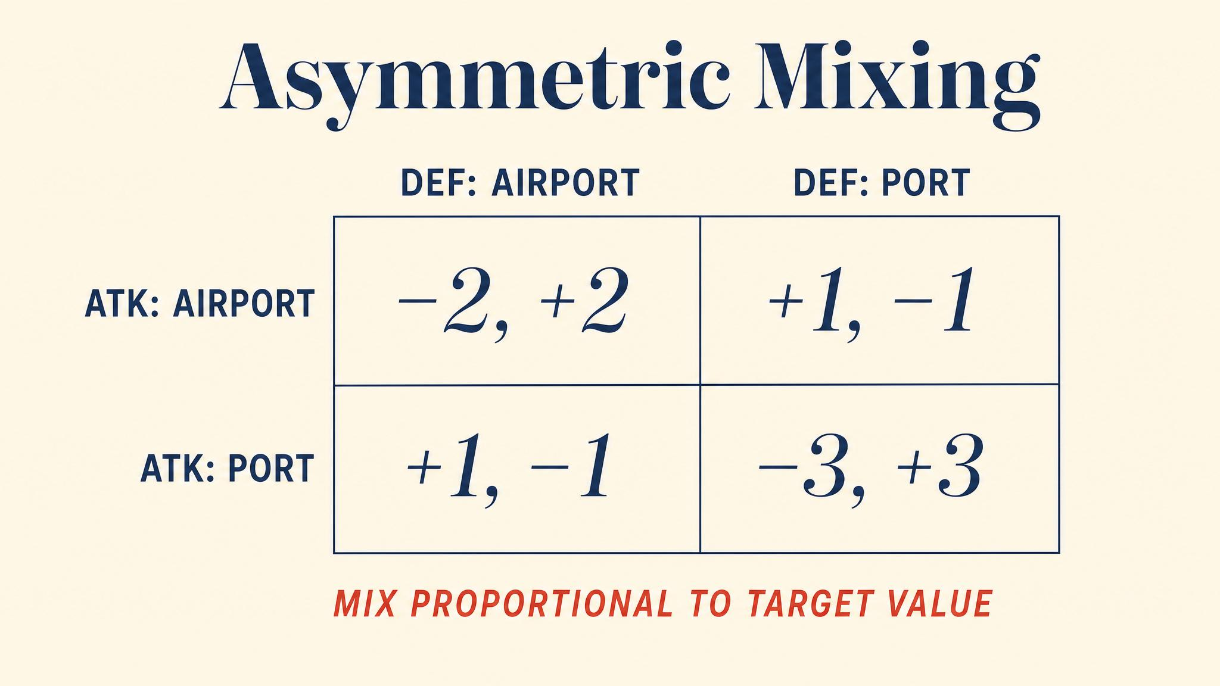
Notes:
Asymmetric payoffs (2,-2; -1,1; -1,1; 3,-3) give asymmetric mixing. Row plays A with probability 4/7 — even though Row's highest payoff is 3, achieved by B. Your mixture is your opponent's problem.

Slide 8
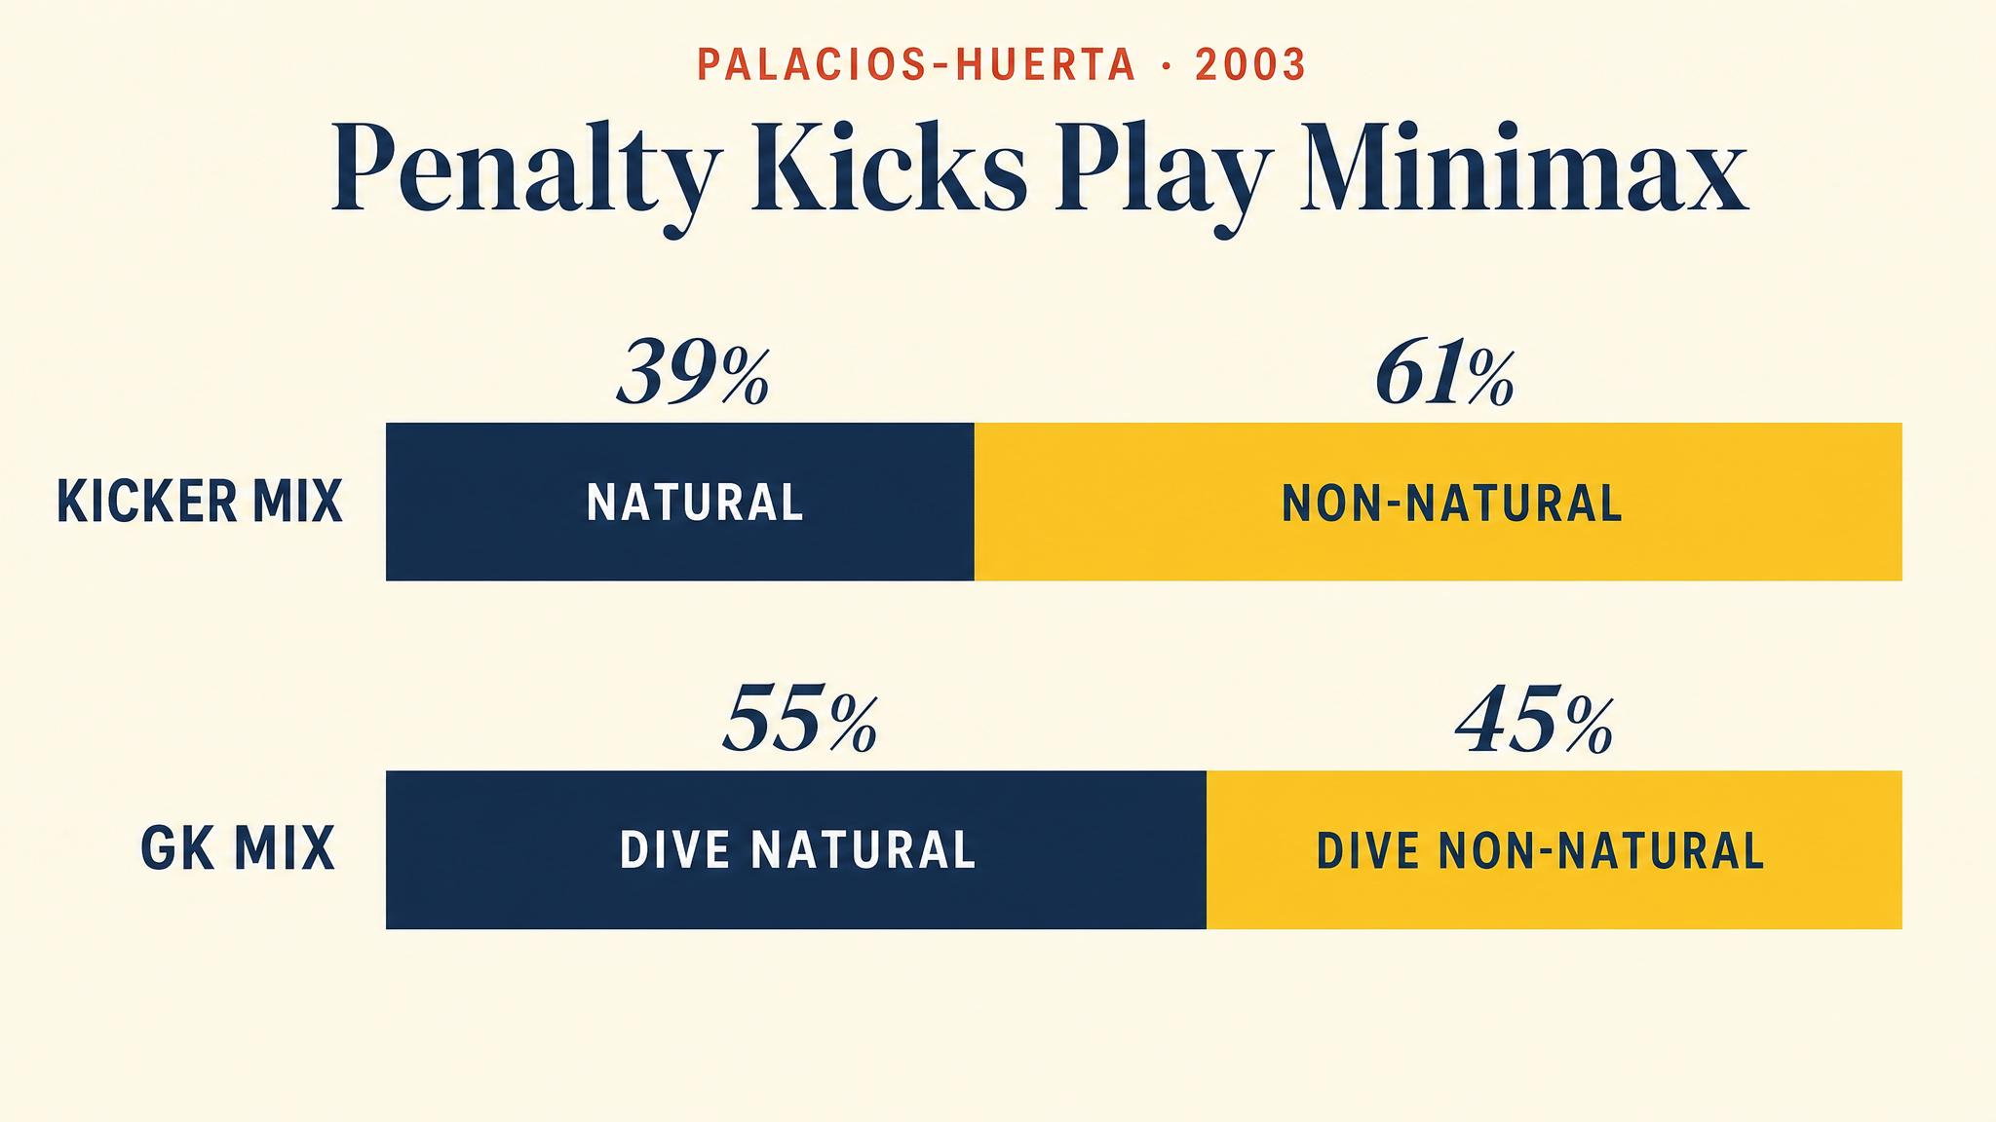
Notes:
Palacios-Huerta 2003: 1,417 professional penalty kicks from European leagues, 1995-2000. Scoring rates around 80% on both sides — statistically indistinguishable. No significant serial correlation. Theory verified at the highest level of play.

Slide 9
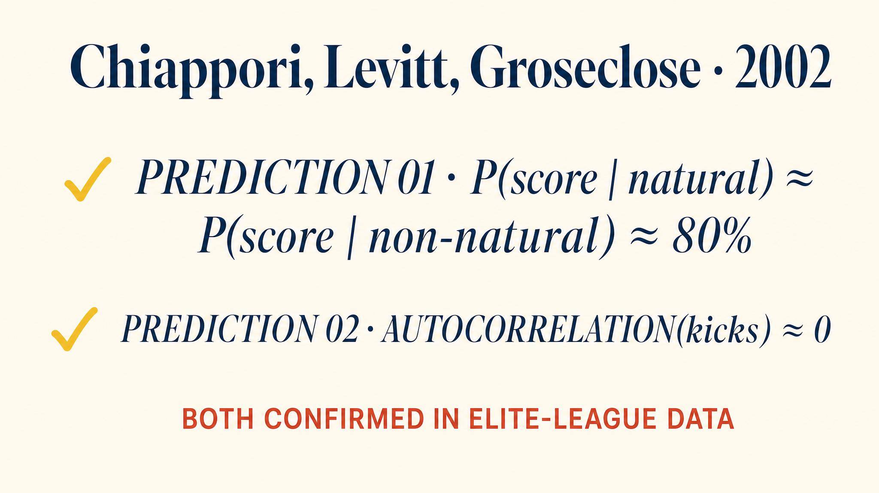
Notes:
Chiappori, Levitt and Groseclose (2002) analysed 459 kicks. Kickers chose their natural side around 45% of the time; goalkeepers dove there around 57%. Asymmetric mixing matching the asymmetric payoffs — exactly as Nash predicted.

Slide 10
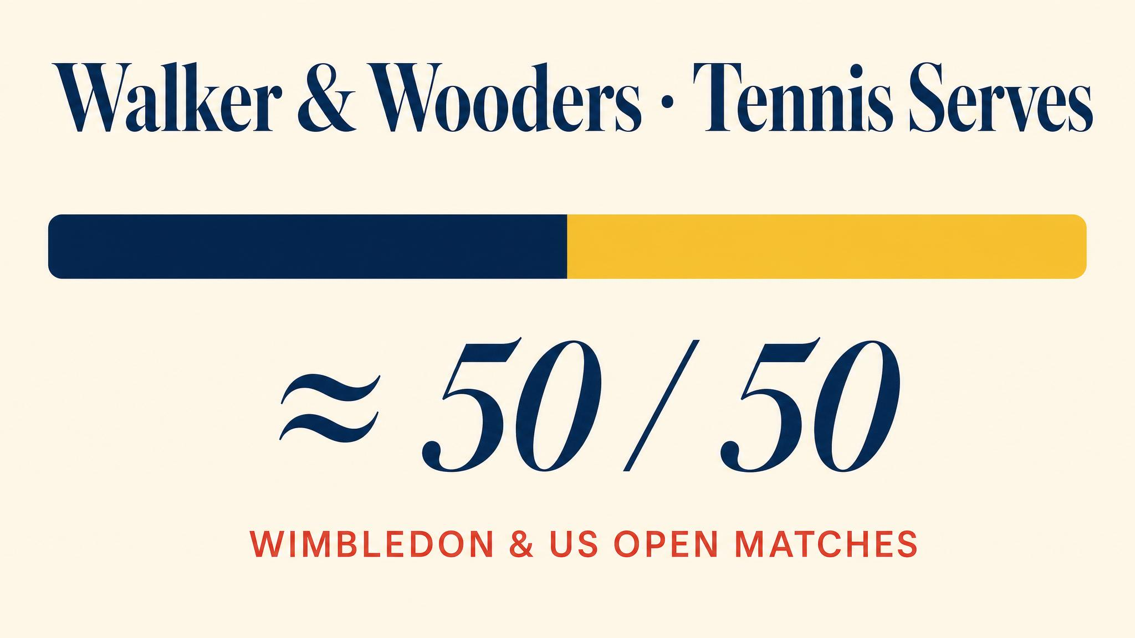
Notes:
Walker and Wooders (2001) at Wimbledon: servers varied direction to approximately equalise success rates across locations. Slight excess alternation, but overall consistent with minimax. Azar and Bar-Eli (2011) confirmed across more leagues.

Slide 11
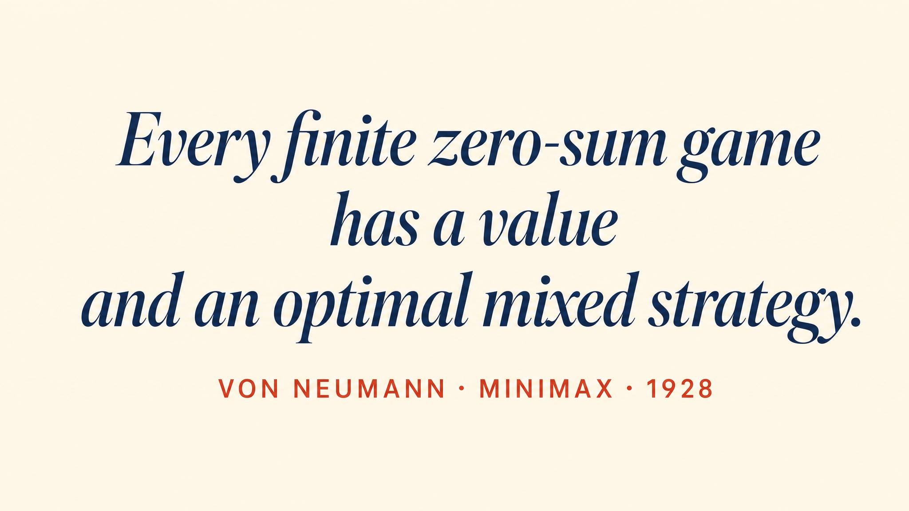
Notes:
Von Neumann 1928 — sixteen years before the field was even named. In any finite two-person zero-sum game, mixing closes the gap between maximin and minimax. The common value is the value of the game.

Slide 12
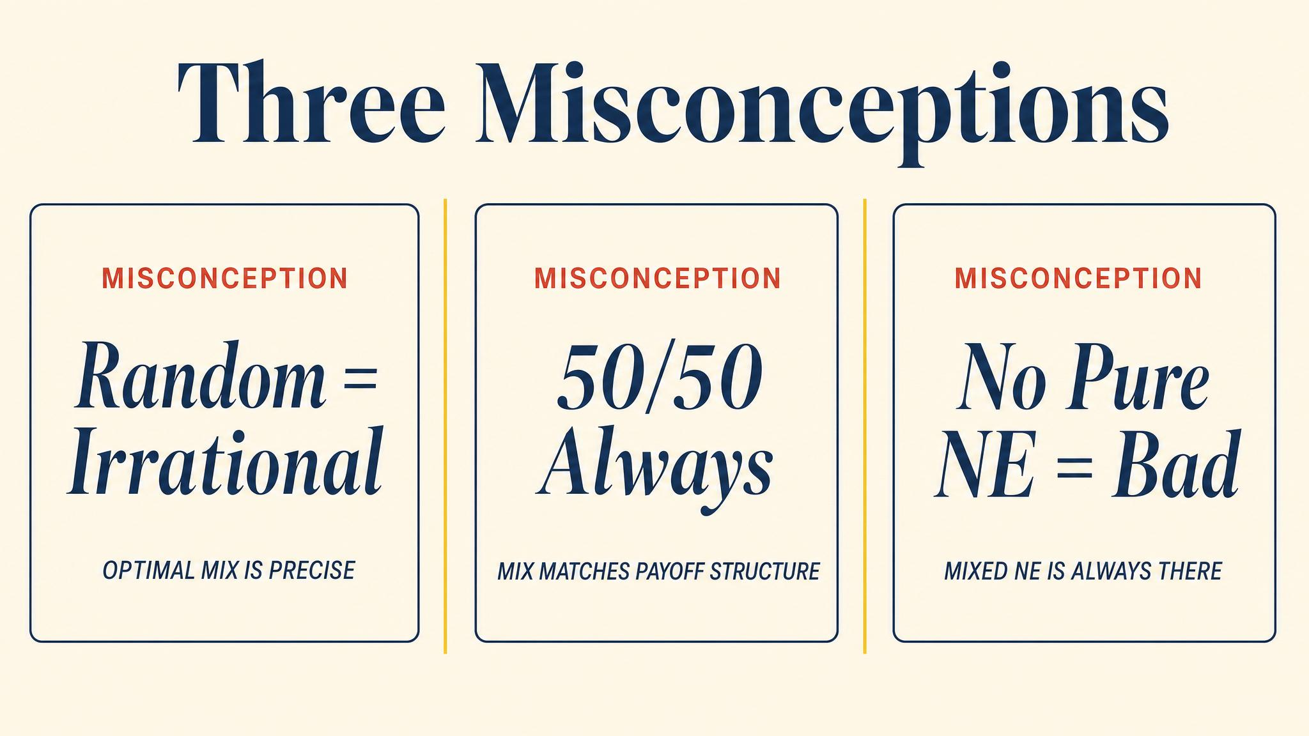
Notes:
Three errors students make: thinking your mixture maximises your payoff (no — it makes the opponent indifferent), thinking you mix toward your higher payoff (no — your mixture is determined by opponent payoffs), and thinking mixing is only for zero-sum games (no — every finite game has mixed equilibria).

Slide 13
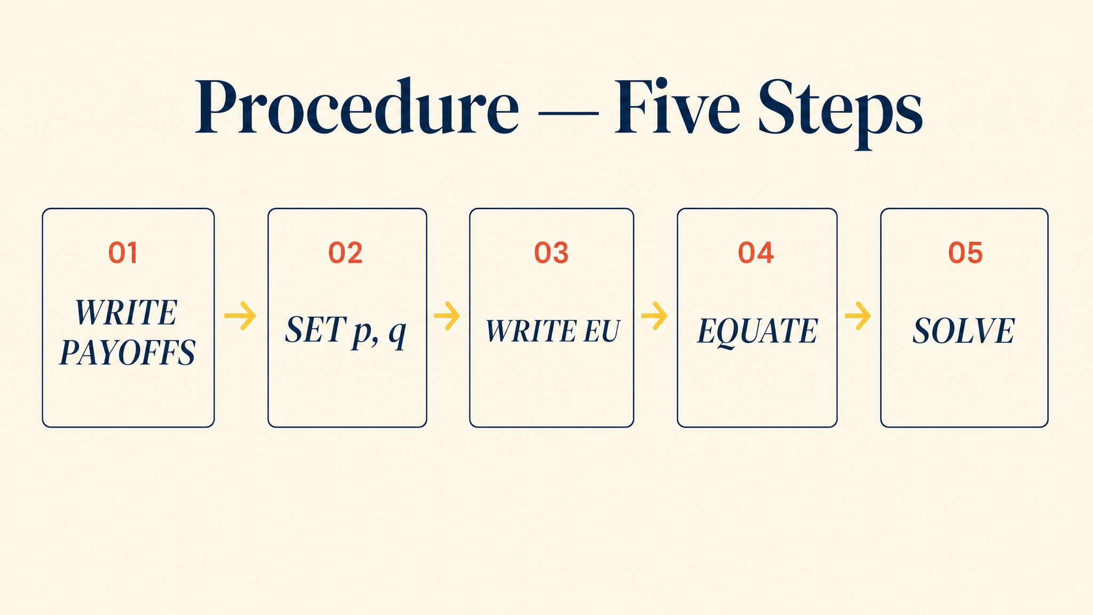
Notes:
Five steps. Check for pure equilibria. Assign p and q. Compute expected utilities for each player as a function of the other's mix. Set equal and solve. Verify both probabilities are in [0,1]. If outside, no fully mixed equilibrium exists.

Slide 14
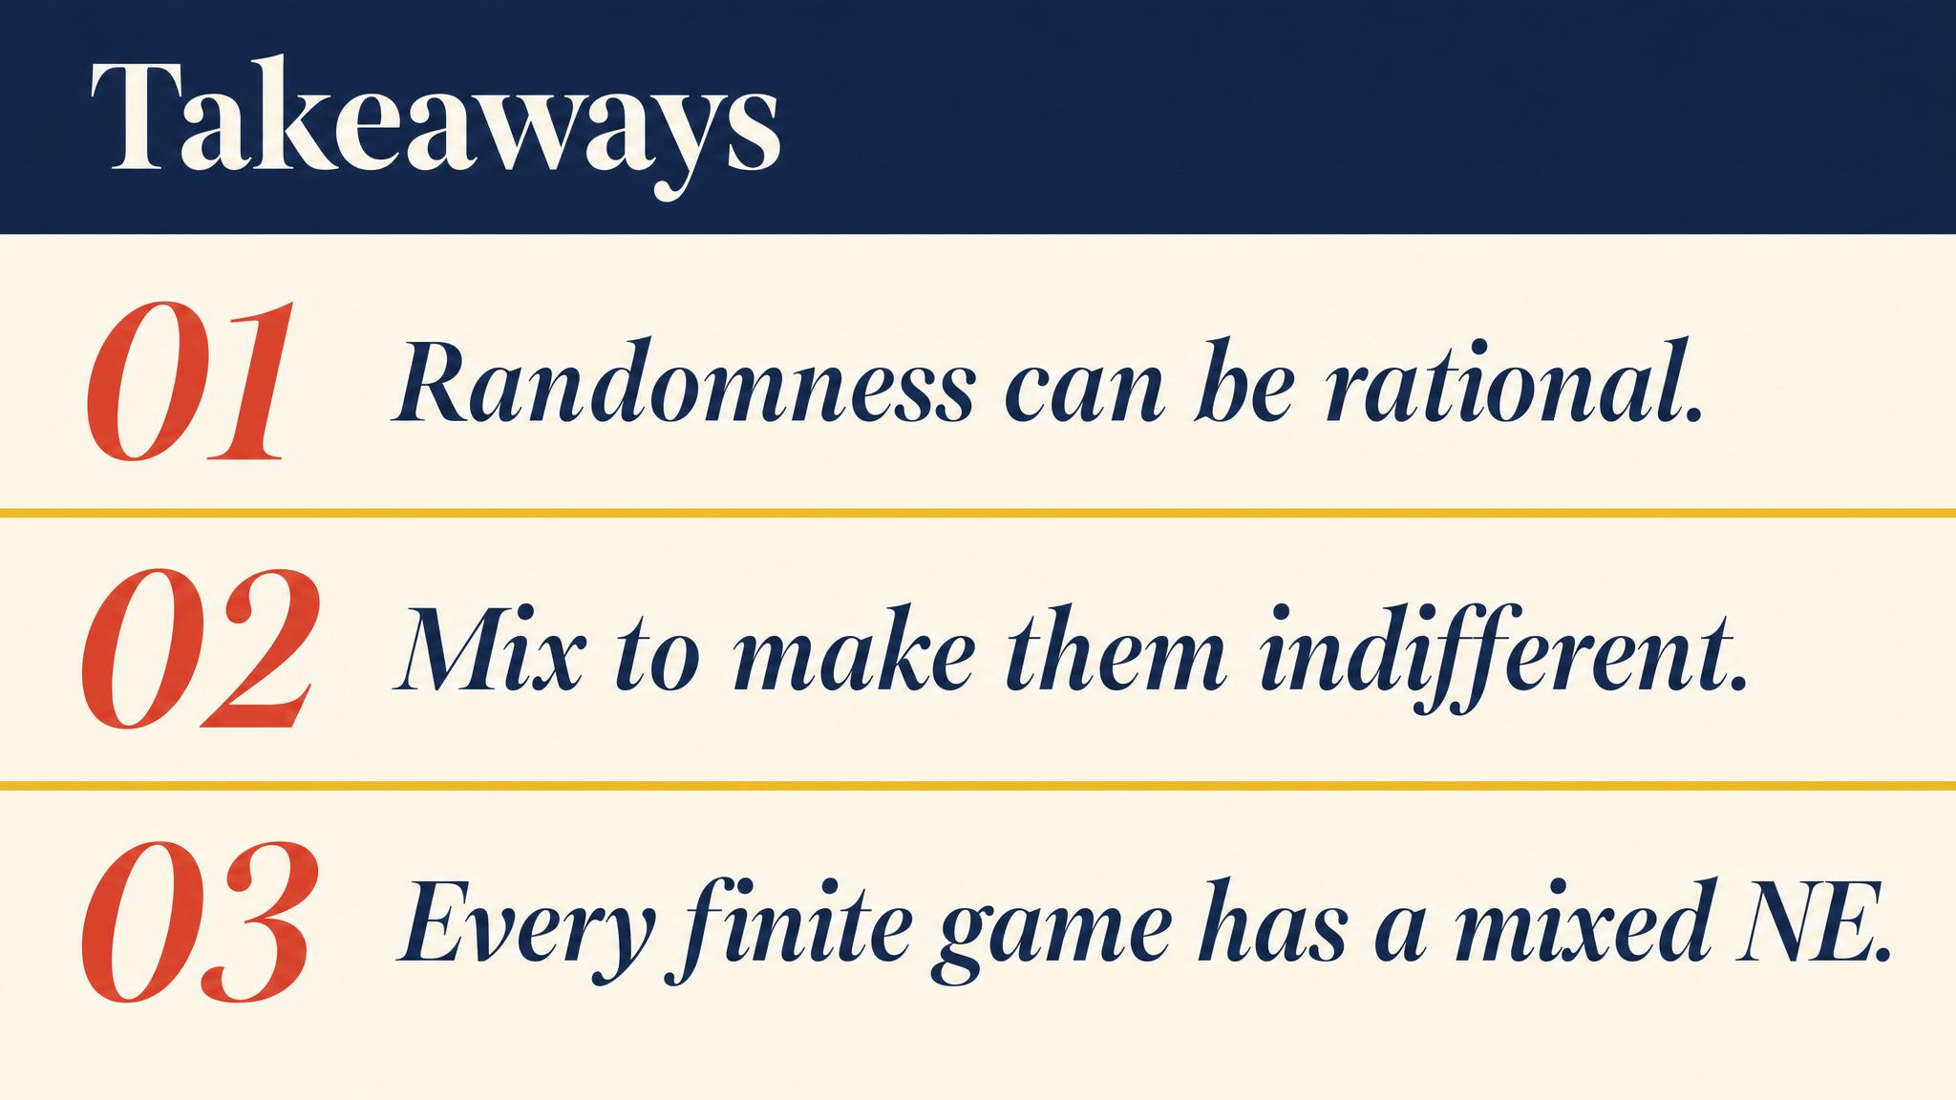
Notes:
Three things to carry forward. Mixing is rational unpredictability, not indecision. Your mixture solves the opponent's indifference problem, not your own. Penalty kickers and tennis servers actually do mix at Nash rates.

Slide 15
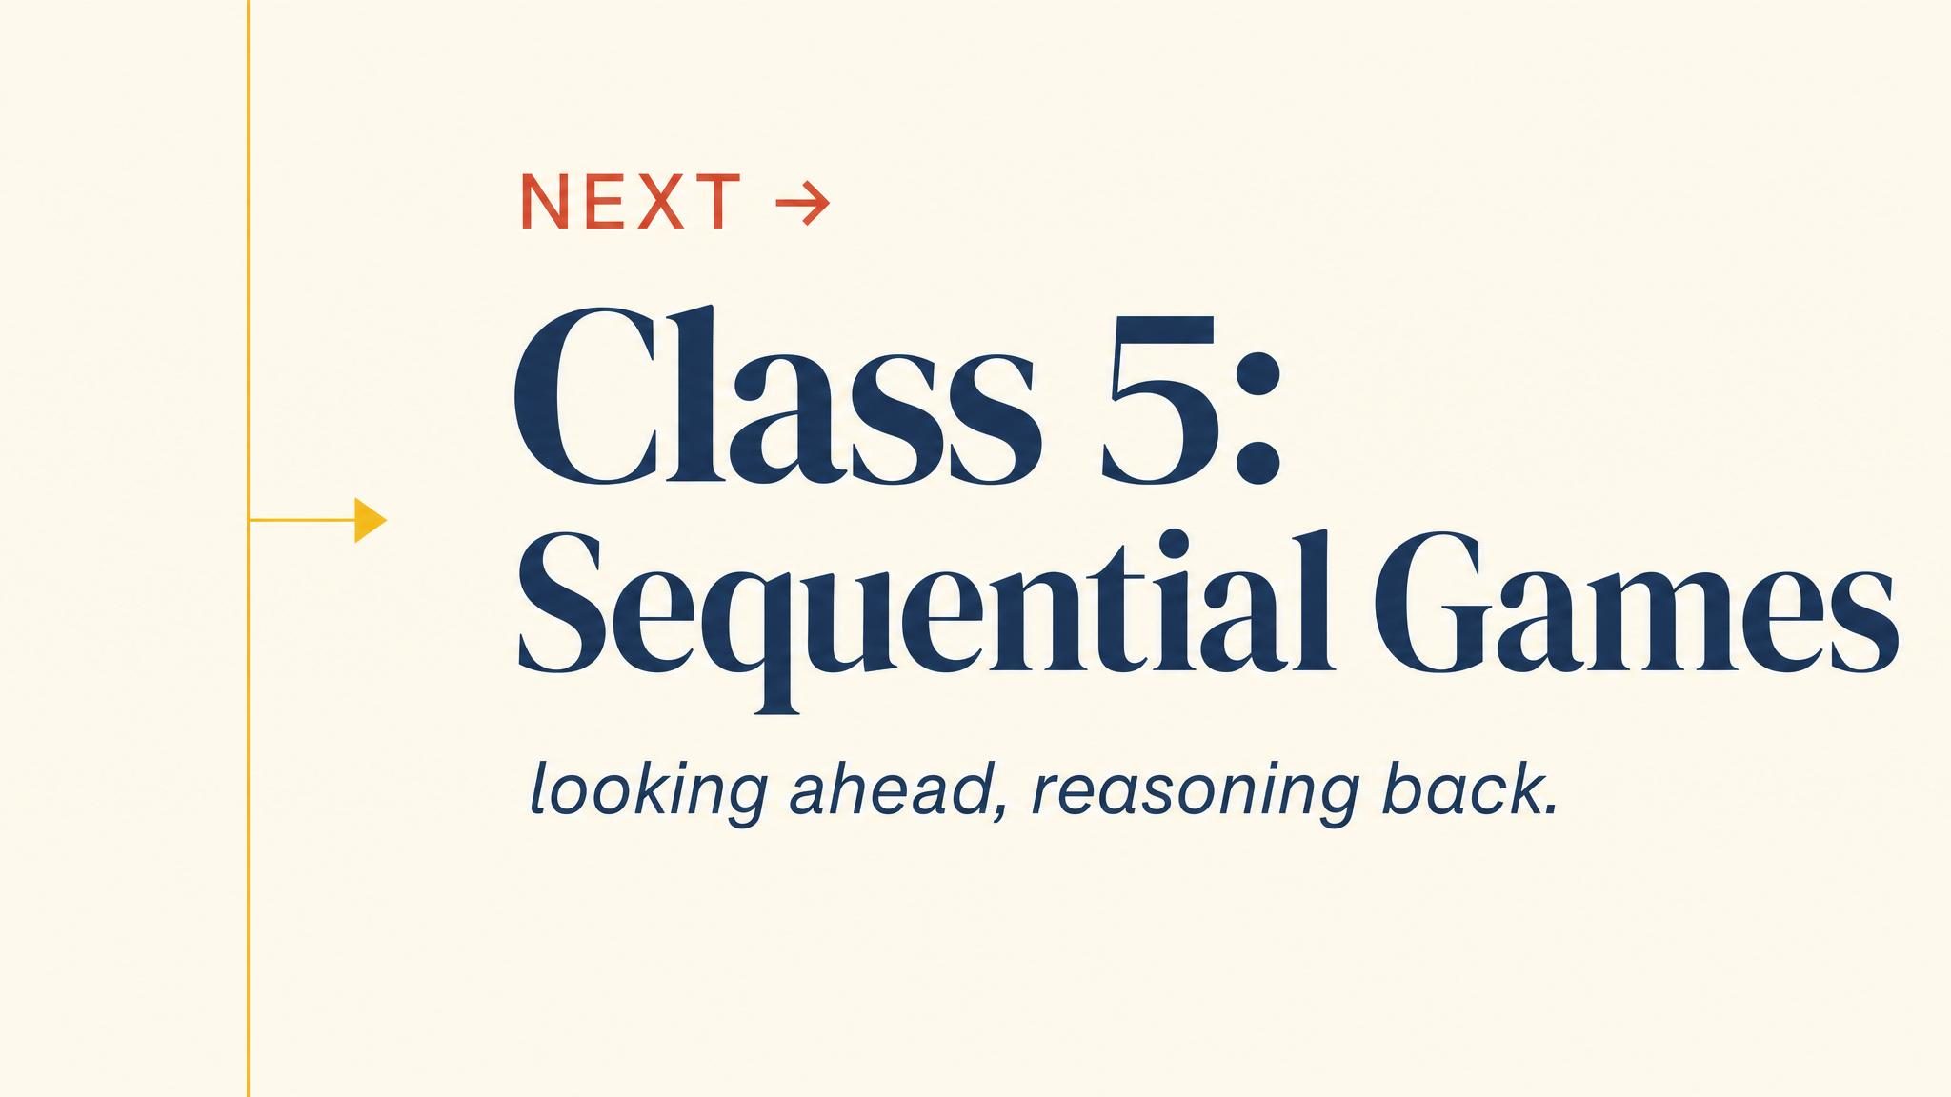
Notes:
Close with the bridge. We have solved 2x2 games using pure and mixed strategies. Next class: games that unfold over time. Backward induction, credible threats, and commitment all rest on the foundation we built today.

