Slide 1
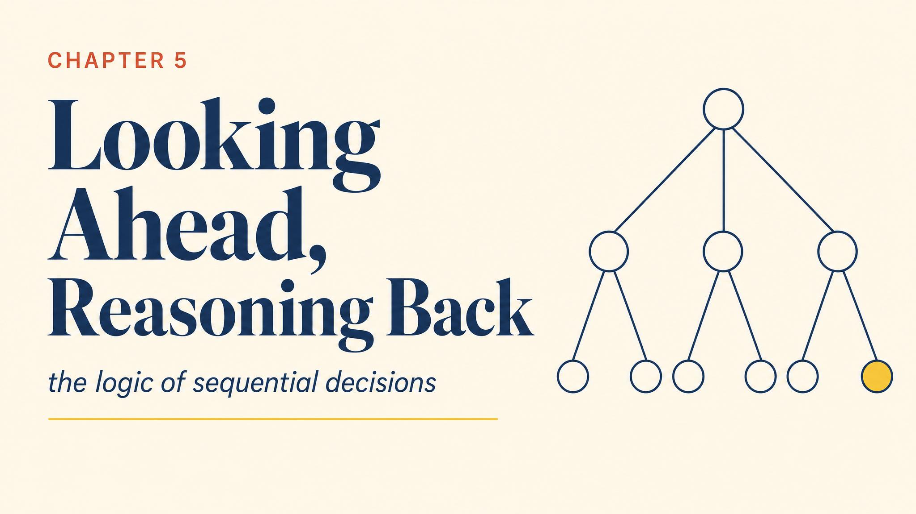
Notes:
Open with the 1999 Amazon-Barnes and Noble standoff. The threat was loud; the question was whether it was credible. Bezos reasoned backward from the end. So will we.

Slide 2
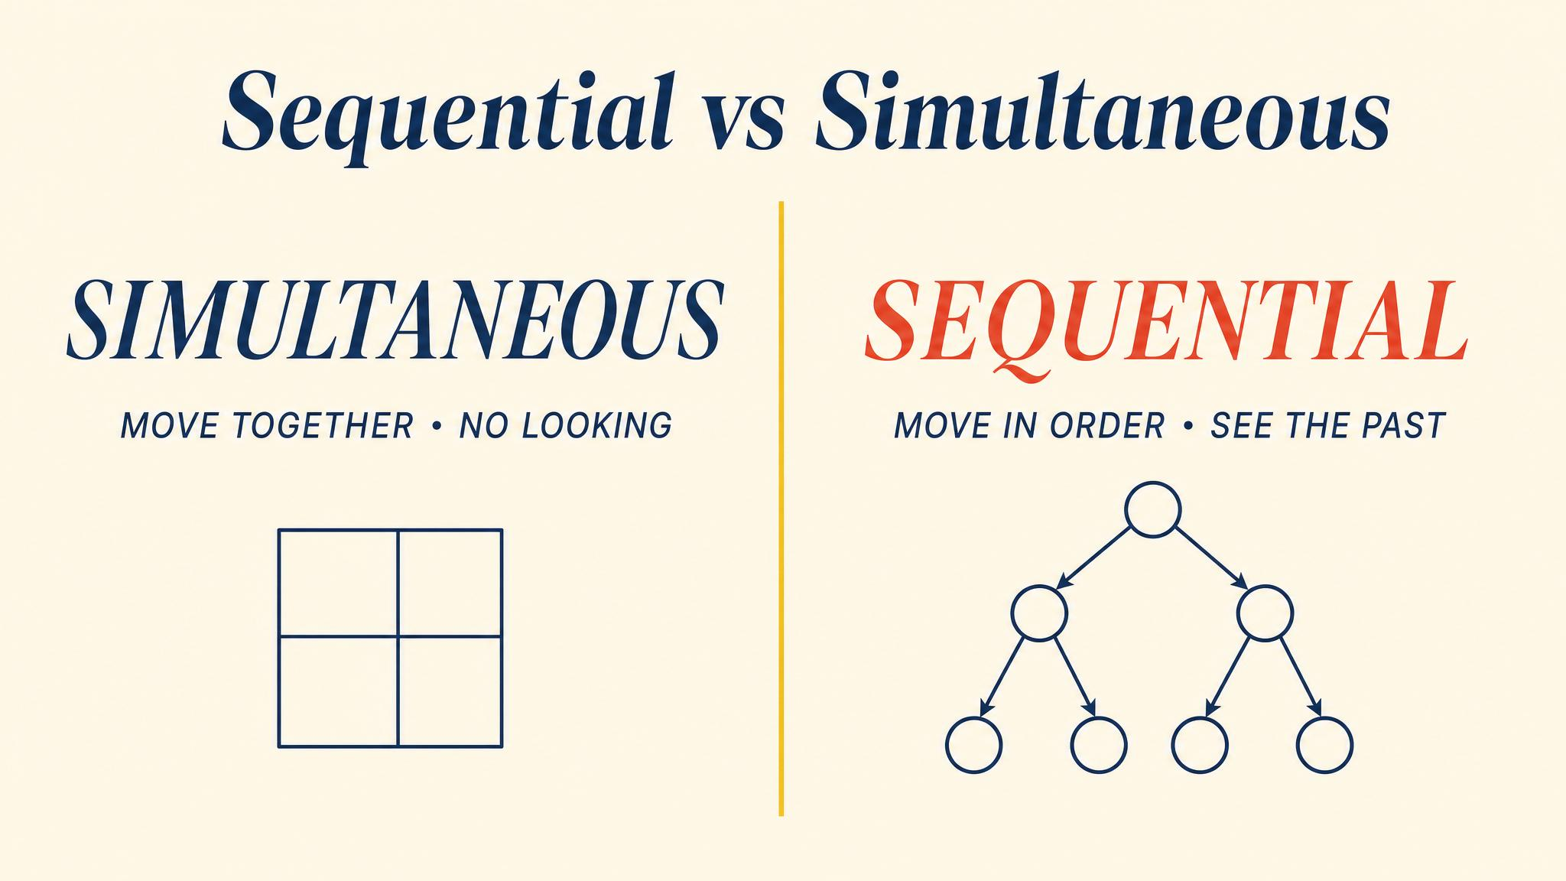
Notes:
In a simultaneous game you must anticipate. In a sequential game you can observe and react. The first mover, knowing the second will react rationally, can exploit that predictability.

Slide 3
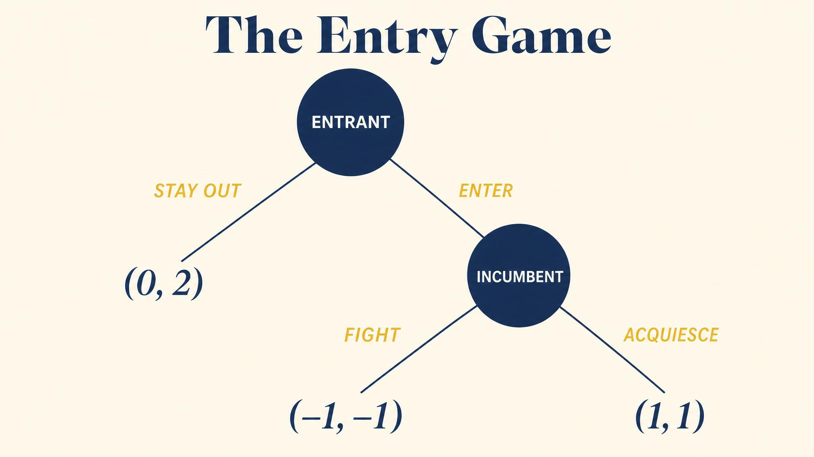
Notes:
Startup decides whether to enter. If yes, the incumbent decides whether to fight or accommodate. Stay out: 0, 5. Fight: -2, -1. Accommodate: 2, 2. The numbers do the strategic work.

Slide 4
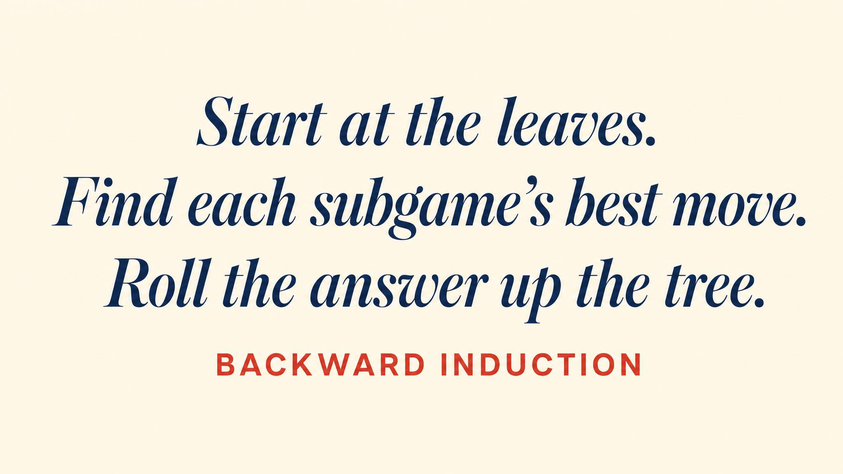
Notes:
Start at the end. Incumbent: accommodate (2) beats fight (-1). Replace that node with payoff (2, 2). Now the startup chooses: enter (2) beats stay out (0). Backward induction solves it cleanly.

Slide 5
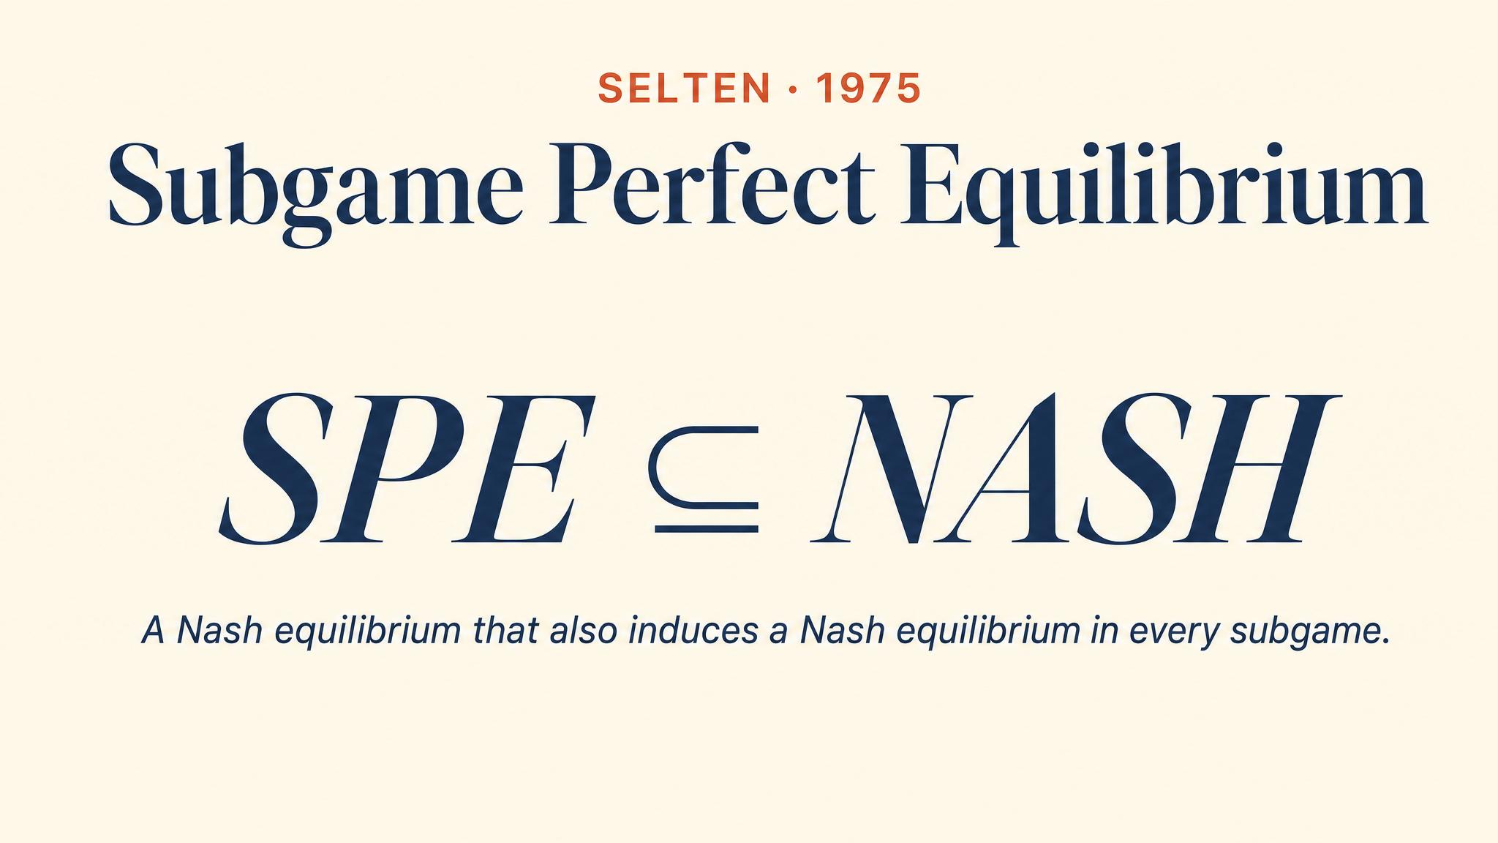
Notes:
Selten 1975 — subgame perfect equilibrium. A strategy profile must be a Nash equilibrium in every subgame, including those never reached. This eliminates the non-credible threats Nash alone admits.

Slide 6
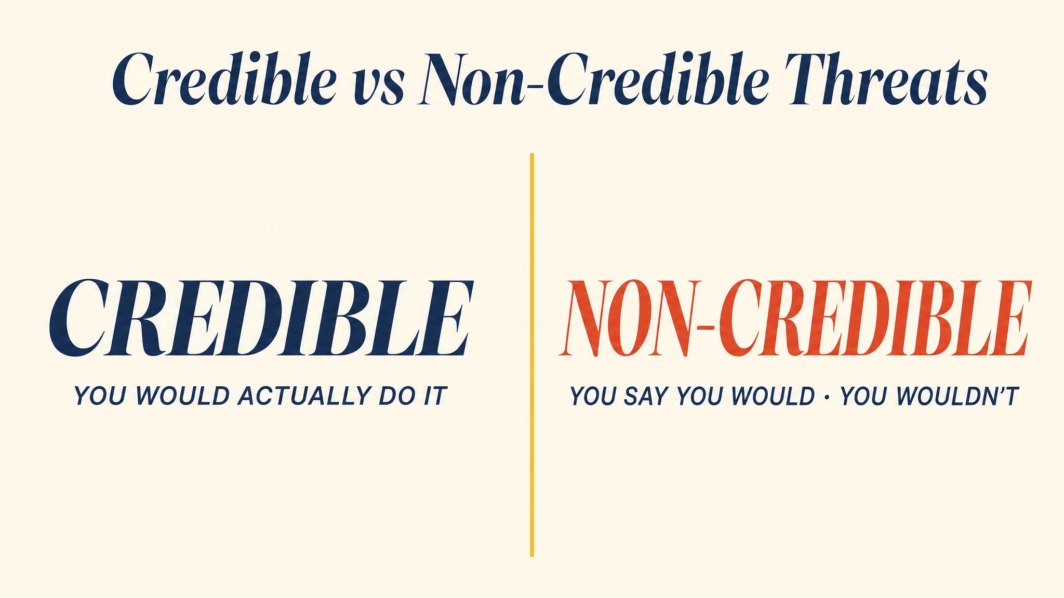
Notes:
A credible threat is one the threatener would actually carry out. A non-credible threat fails the backward-induction test — when the moment arrives, the threatener prefers to back down. Empty threats are everywhere in daily life.

Slide 7
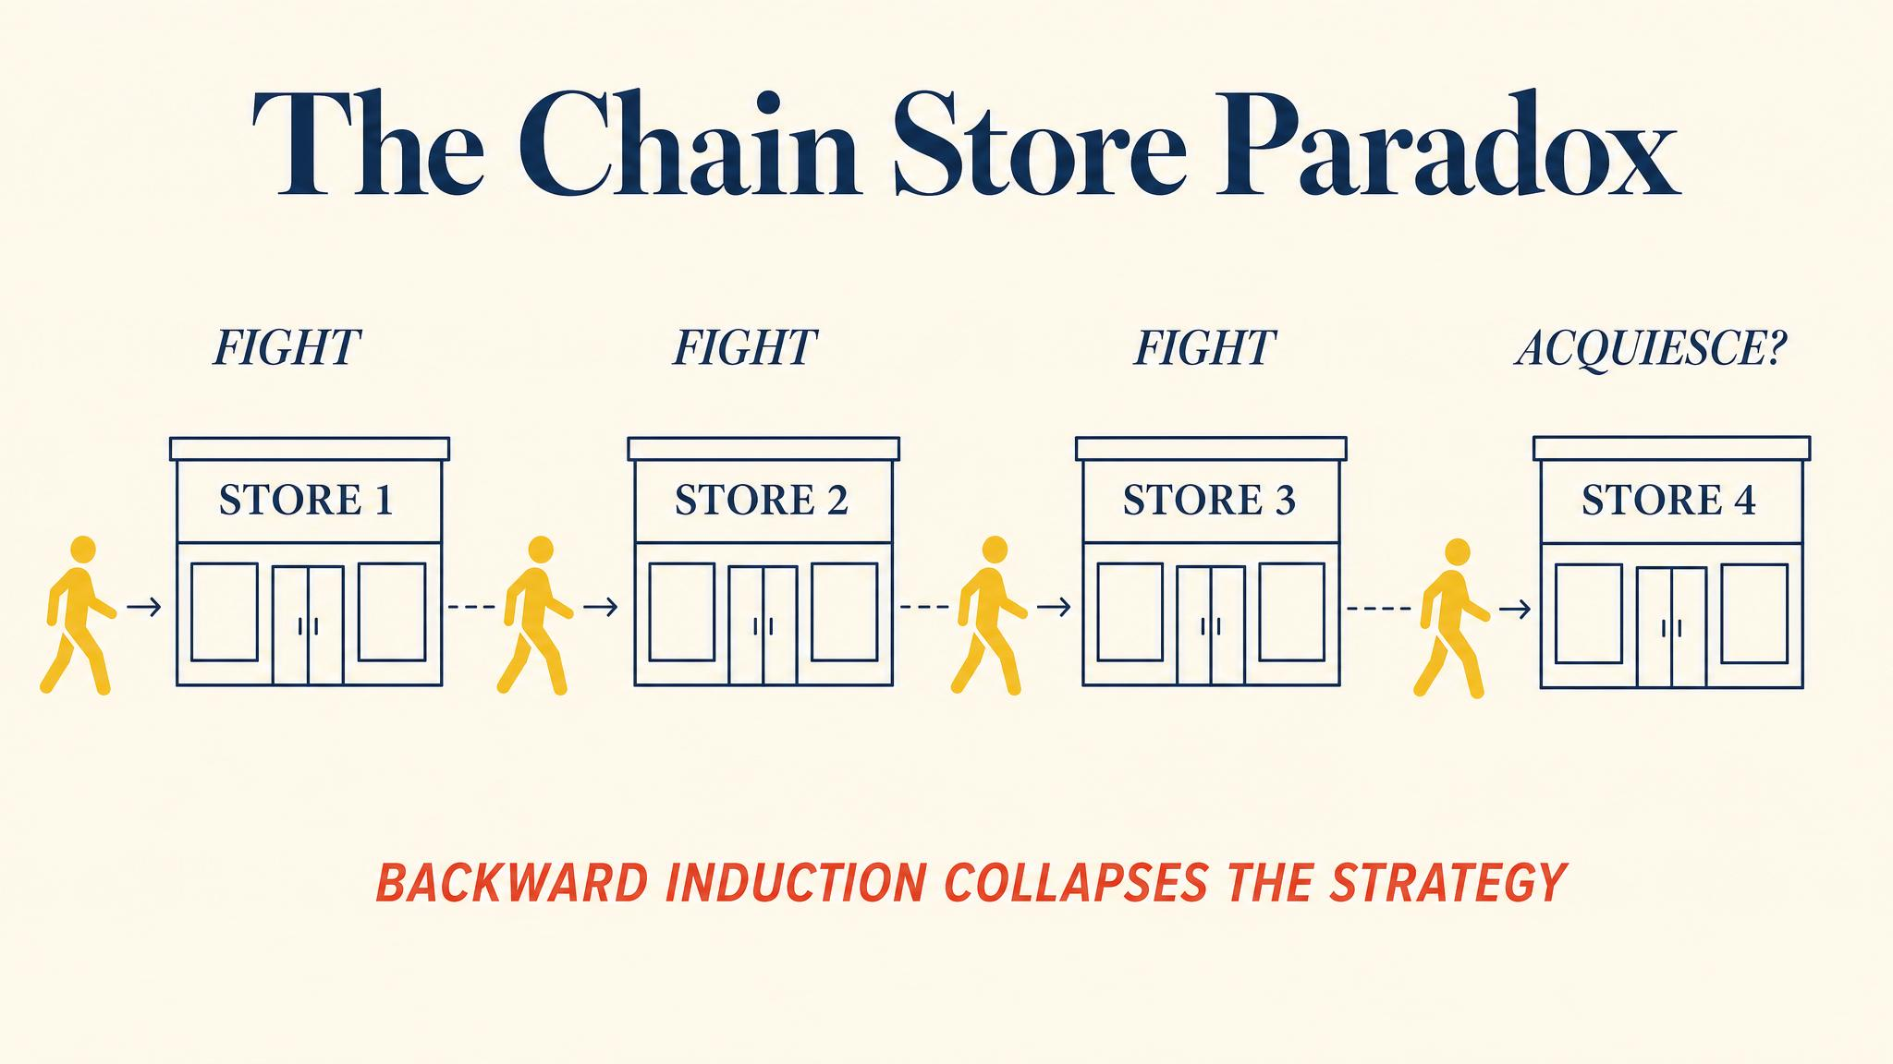
Notes:
Selten 1978: twenty markets, reputation should build up. But start from market 20 — no future to protect, so accommodate. Therefore market 19 too. The reputation logic unravels all the way to market 1. Selten himself found this troubling.

Slide 8
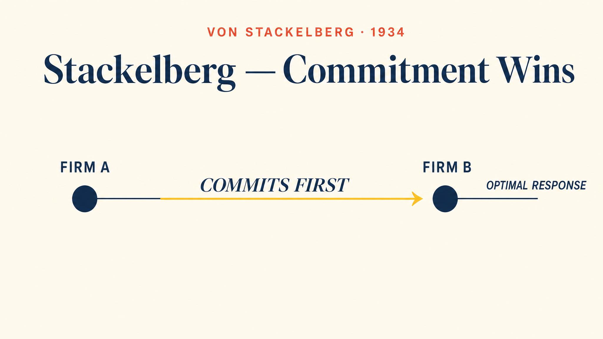
Notes:
Stackelberg 1934: the leader produces more than the Cournot quantity, the follower produces less, and the leader earns higher profits. Commitment, not threats. You gain power by reducing your own flexibility.

Slide 9
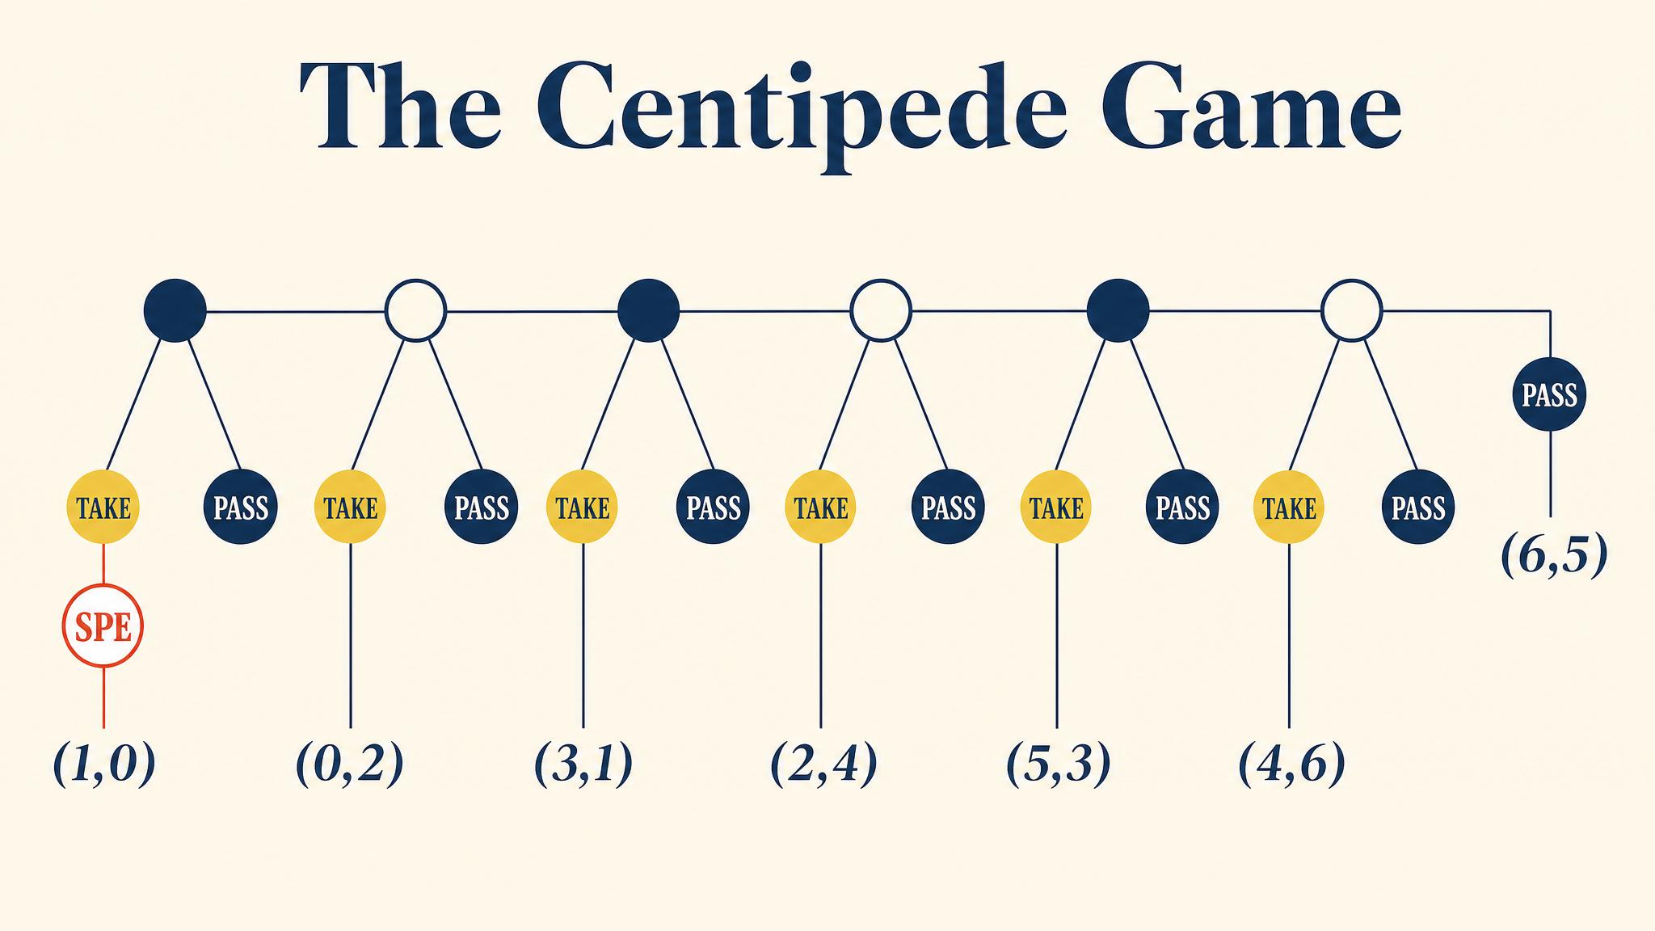
Notes:
Rosenthal 1981. The pot grows with each pass, but taking always slightly favours the taker. Backward induction predicts taking at round one. McKelvey and Palfrey 1992: real subjects almost never did. Cooperation survived several rounds.

Slide 10
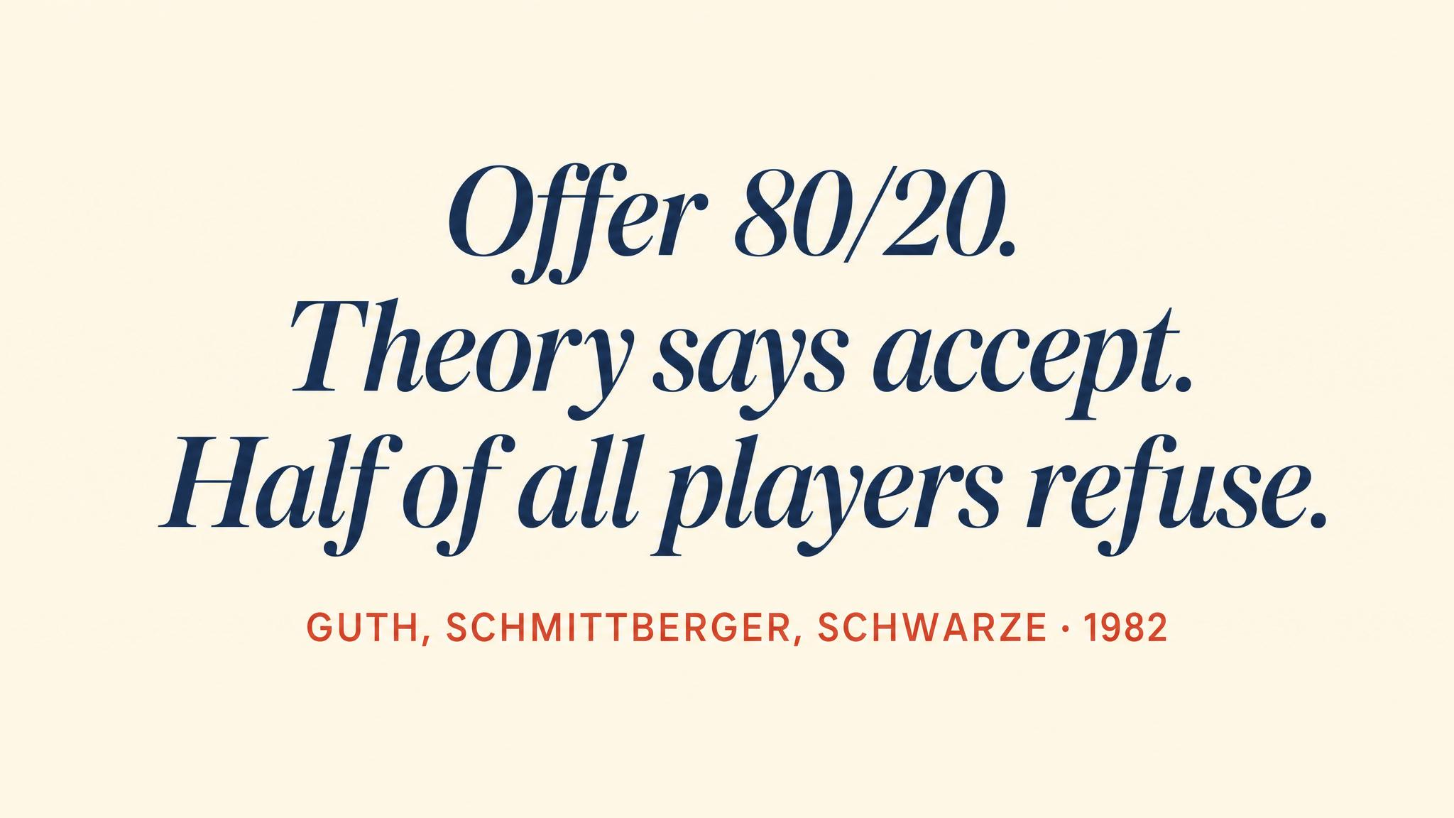
Notes:
Güth, Schmittberger and Schwarze 1982. Backward induction says: offer one cent, accept anything. Real responders reject low offers; real proposers offer 30-50%. Fairness preferences live in the payoffs the model assumed away.

Slide 11
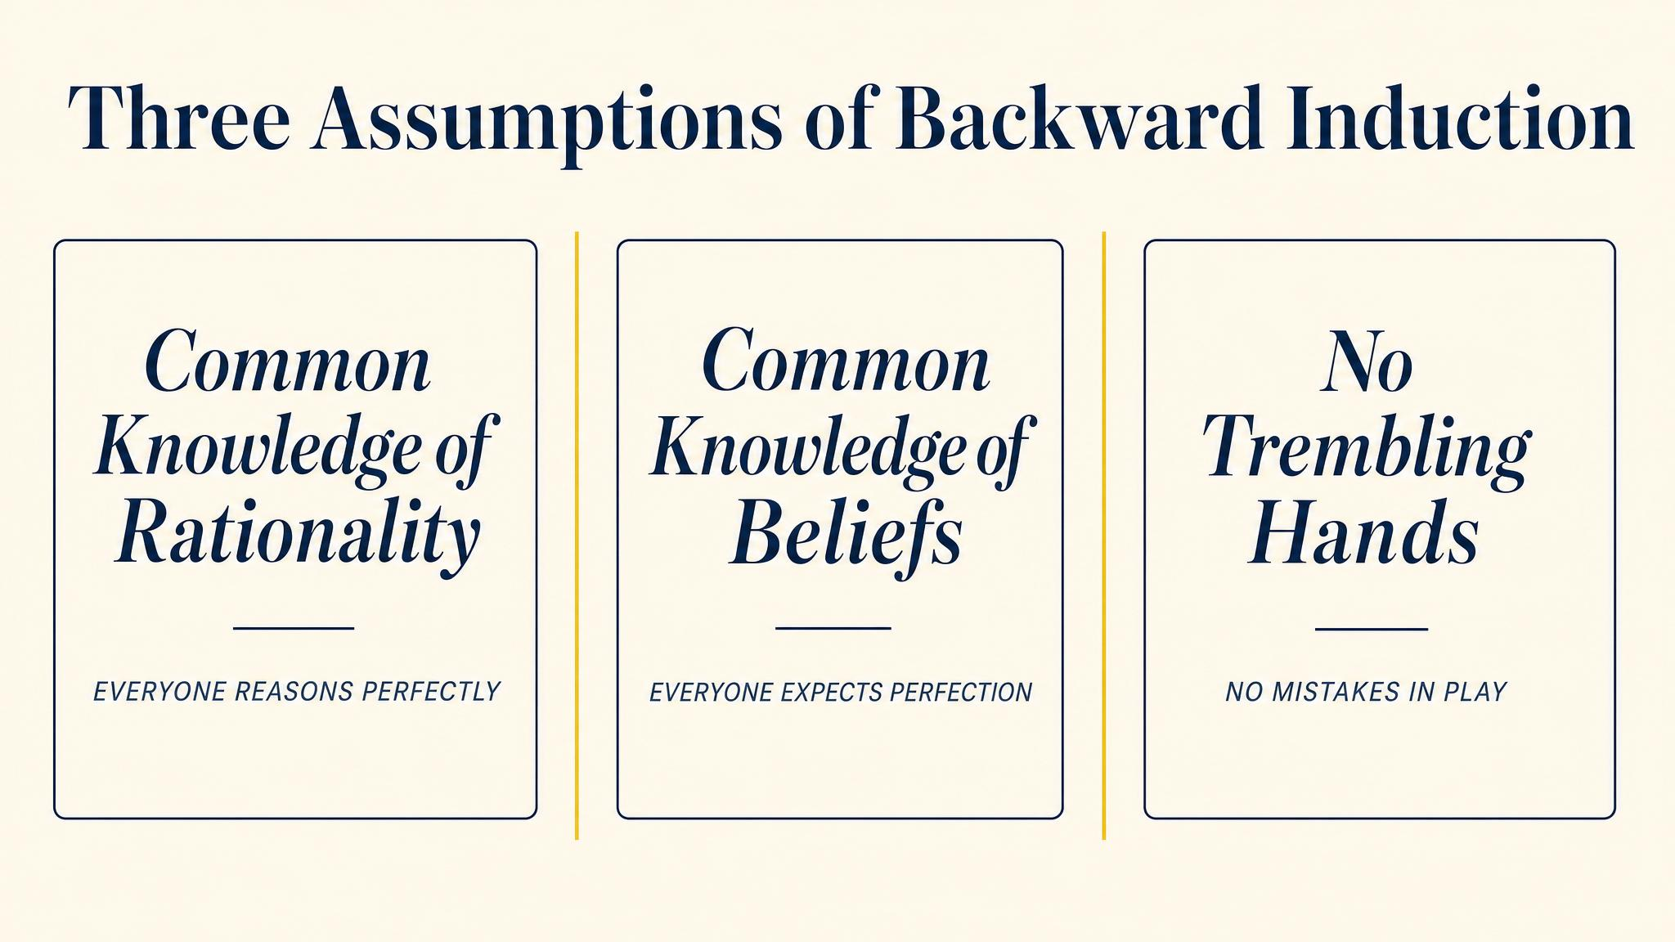
Notes:
Rubinstein 1994 lays out the assumptions. Rationality at every node. Common knowledge of rationality, infinitely iterated. And correct payoffs — the game tree must capture what players actually care about. Each failure point explains a different empirical gap.

Slide 12
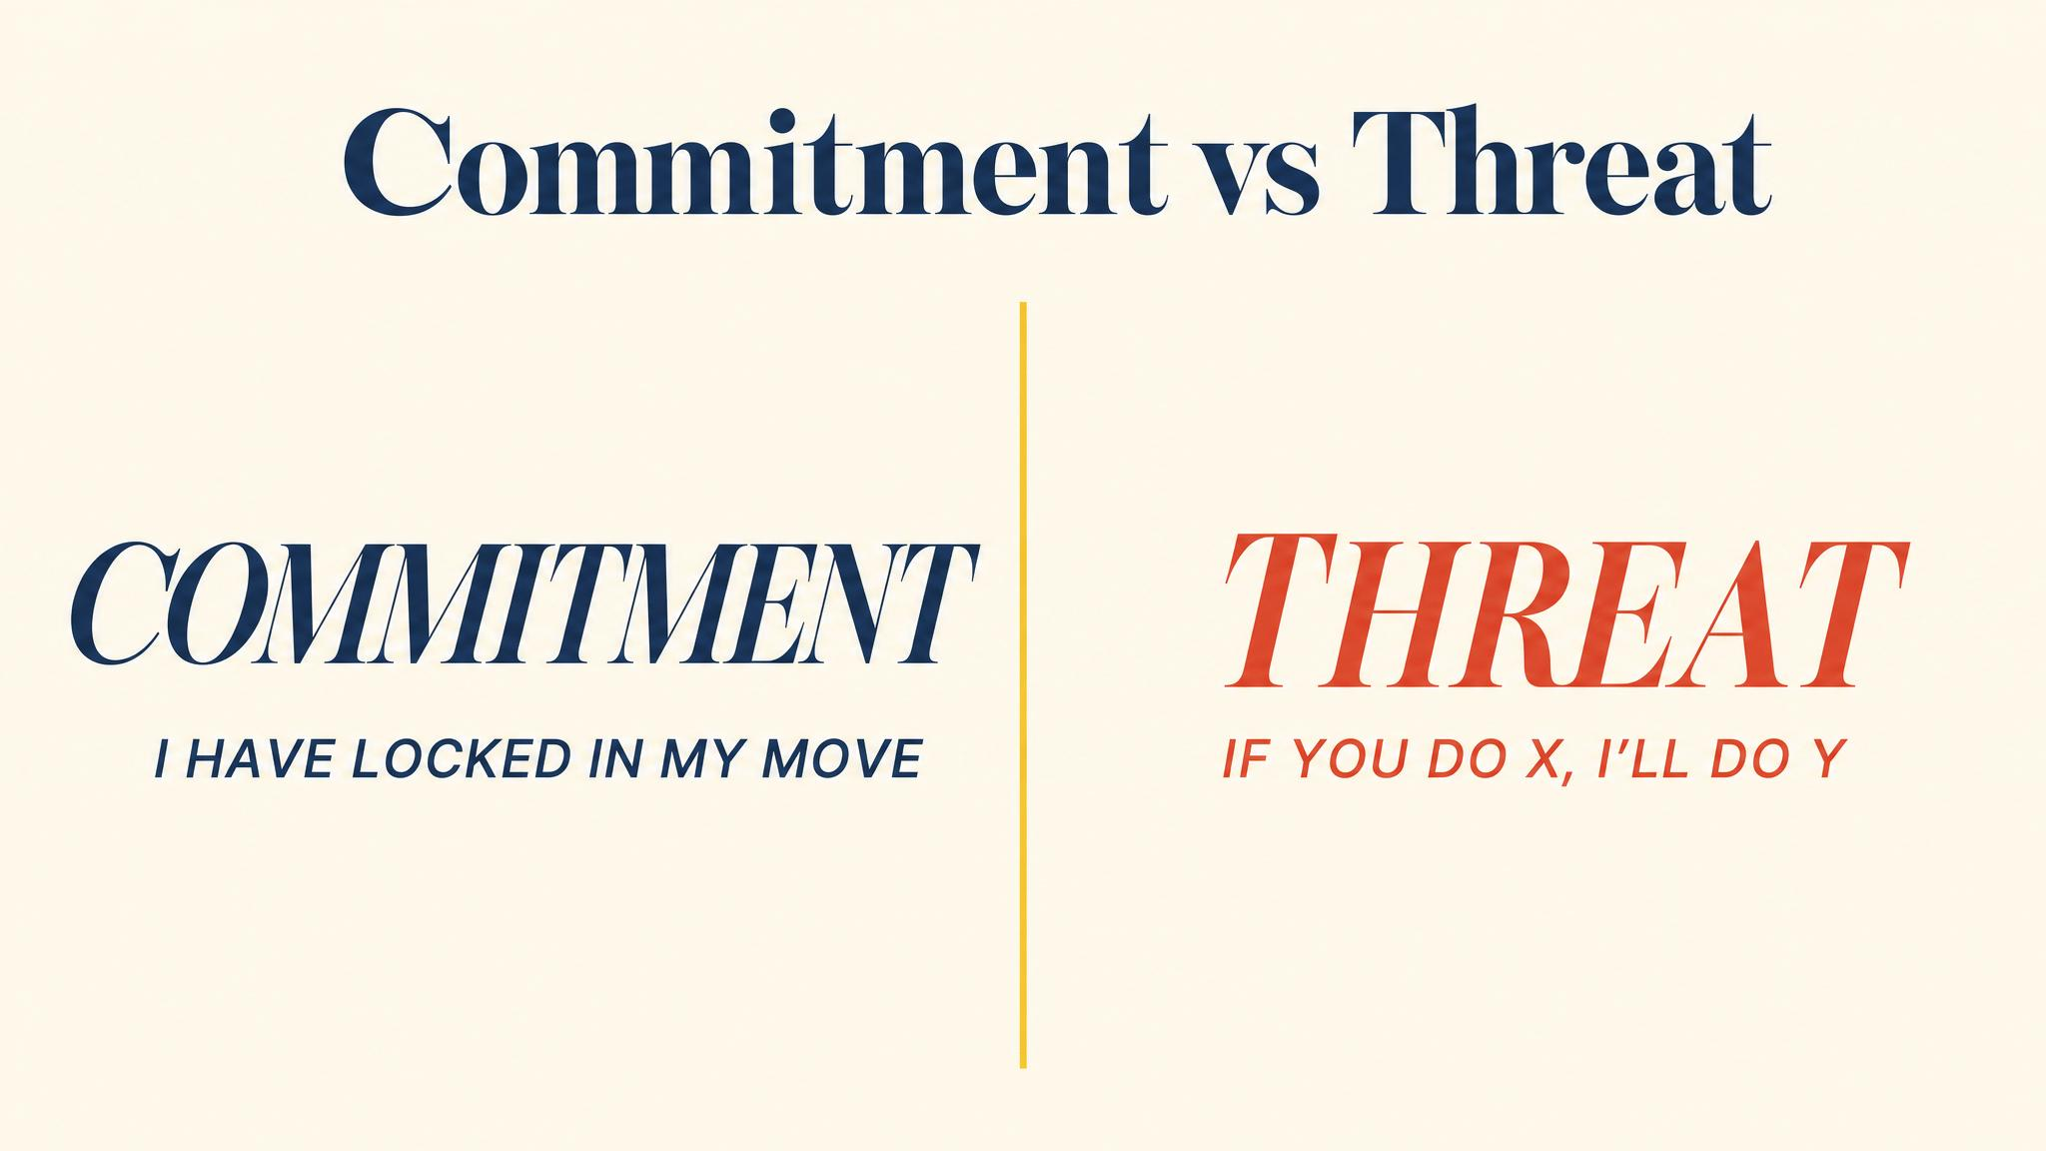
Notes:
The Stackelberg paradox. Commitment is a sunk action — it cannot be taken back. A threat is a promise about future behaviour. The first changes the game; the second only changes the words.

Slide 13
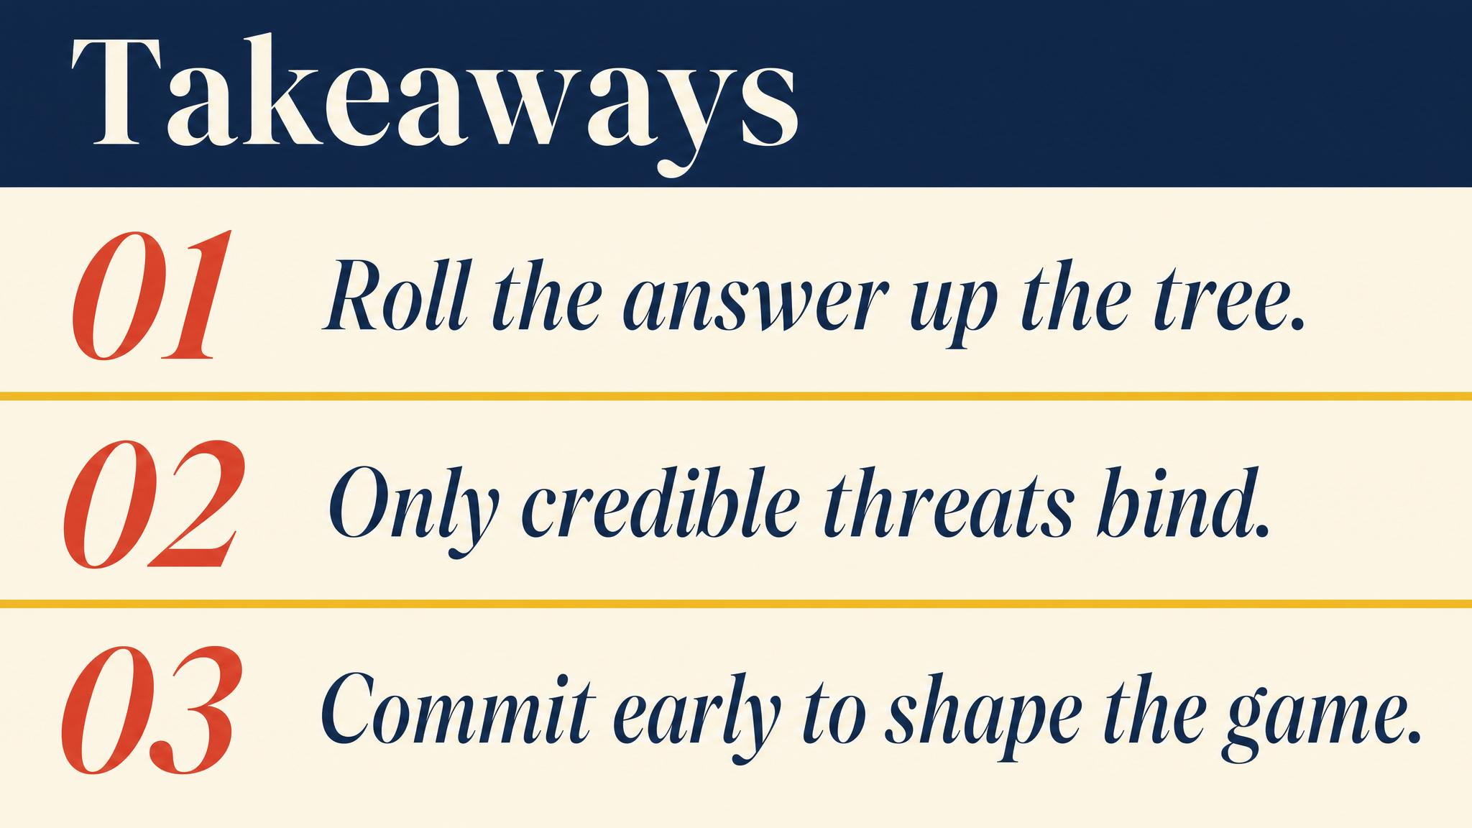
Notes:
Three things to carry forward. Reason backward — start at terminal nodes. Threats must be credible to bind. Commitment beats bluffing, because commitment changes the game.

Slide 14
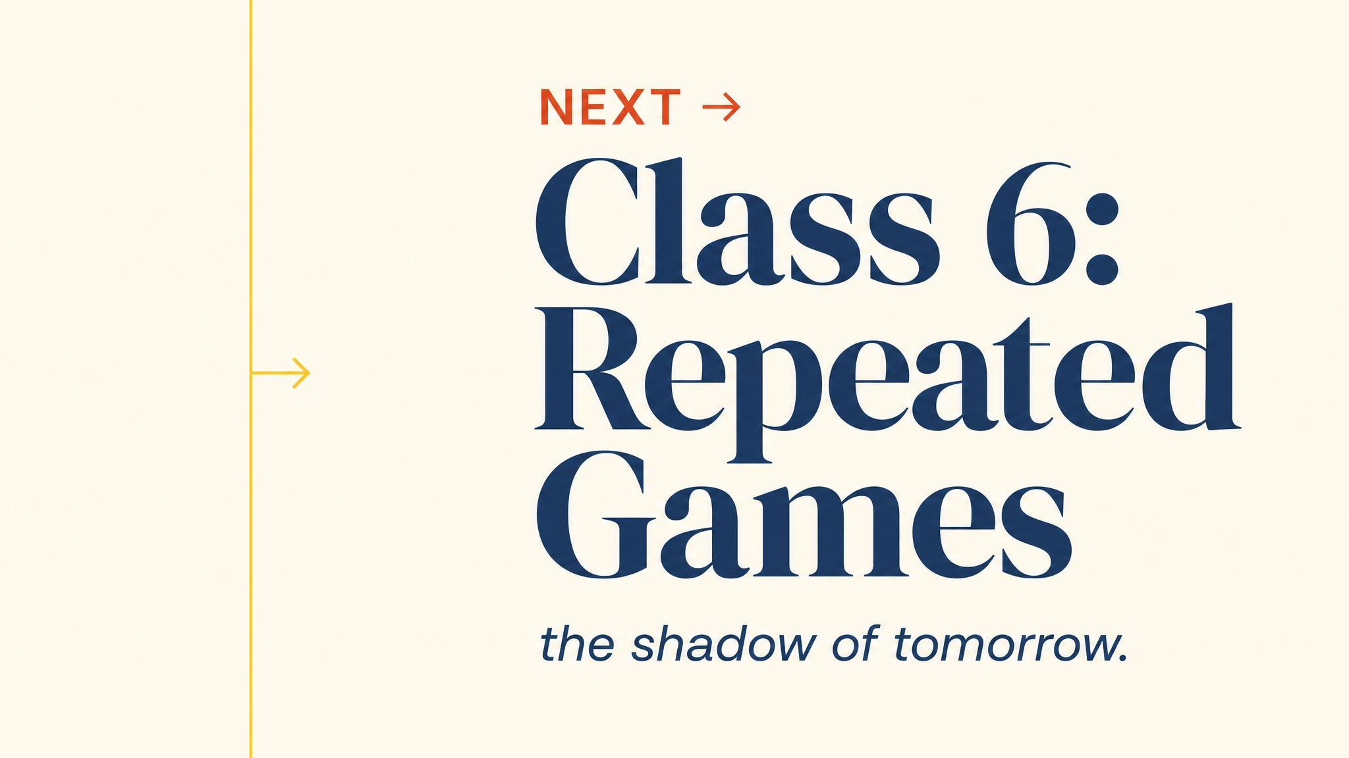
Notes:
Close with the bridge. Finite games end; backward induction works cleanly. Next class: games that never end. The shadow of the future will transform what cooperation is possible.

