Slide 1

Notes:
Open with the puzzle: in a one-shot Prisoner's Dilemma defection wins, yet in real life rivals cooperate. The bridge is repetition. When today's choice shapes tomorrow's relationship, niceness can flourish.

Slide 2
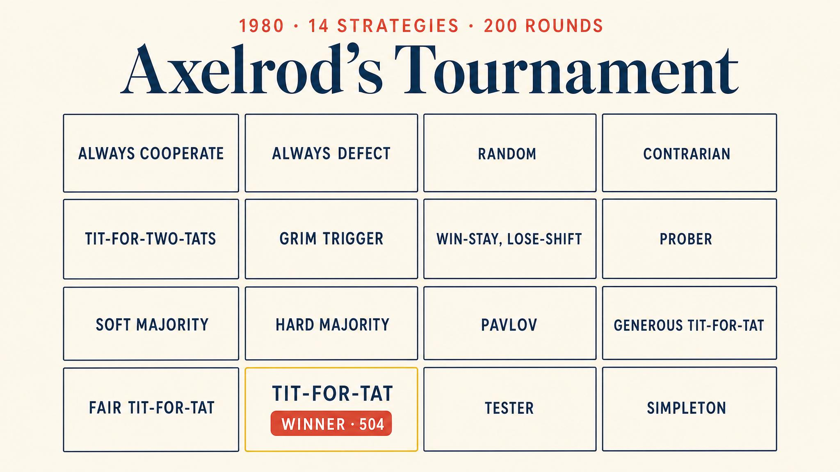
Notes:
Robert Axelrod invited scholars worldwide to submit strategies. Fourteen entries, every strategy versus every other in 200-round matches. A four-line program — Rapoport's Tit-for-Tat — won.

Slide 3
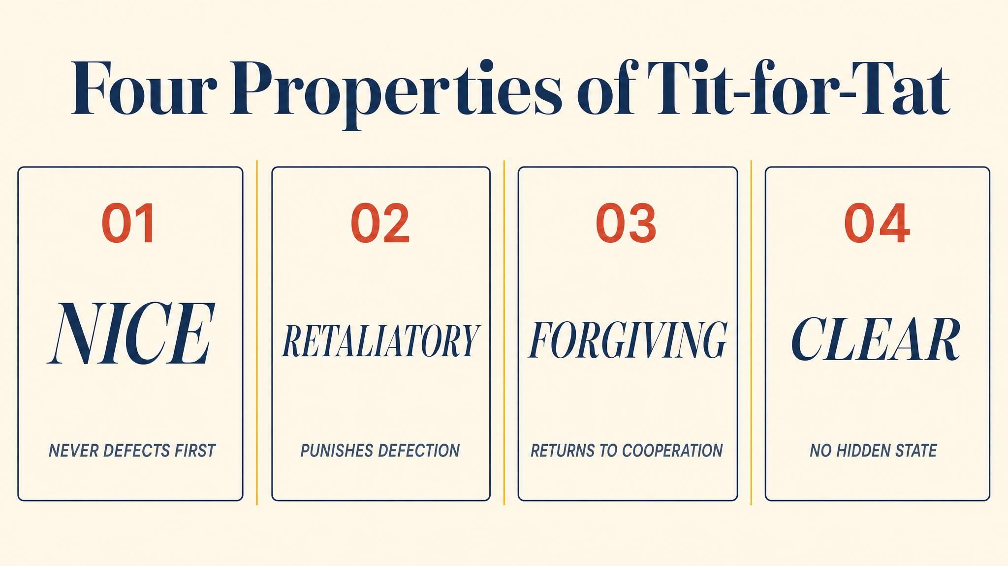
Notes:
Axelrod 1984 named the four properties that made Tit-for-Tat work. Nice, retaliatory, forgiving, and clear. Not exploitation — coordination.

Slide 4
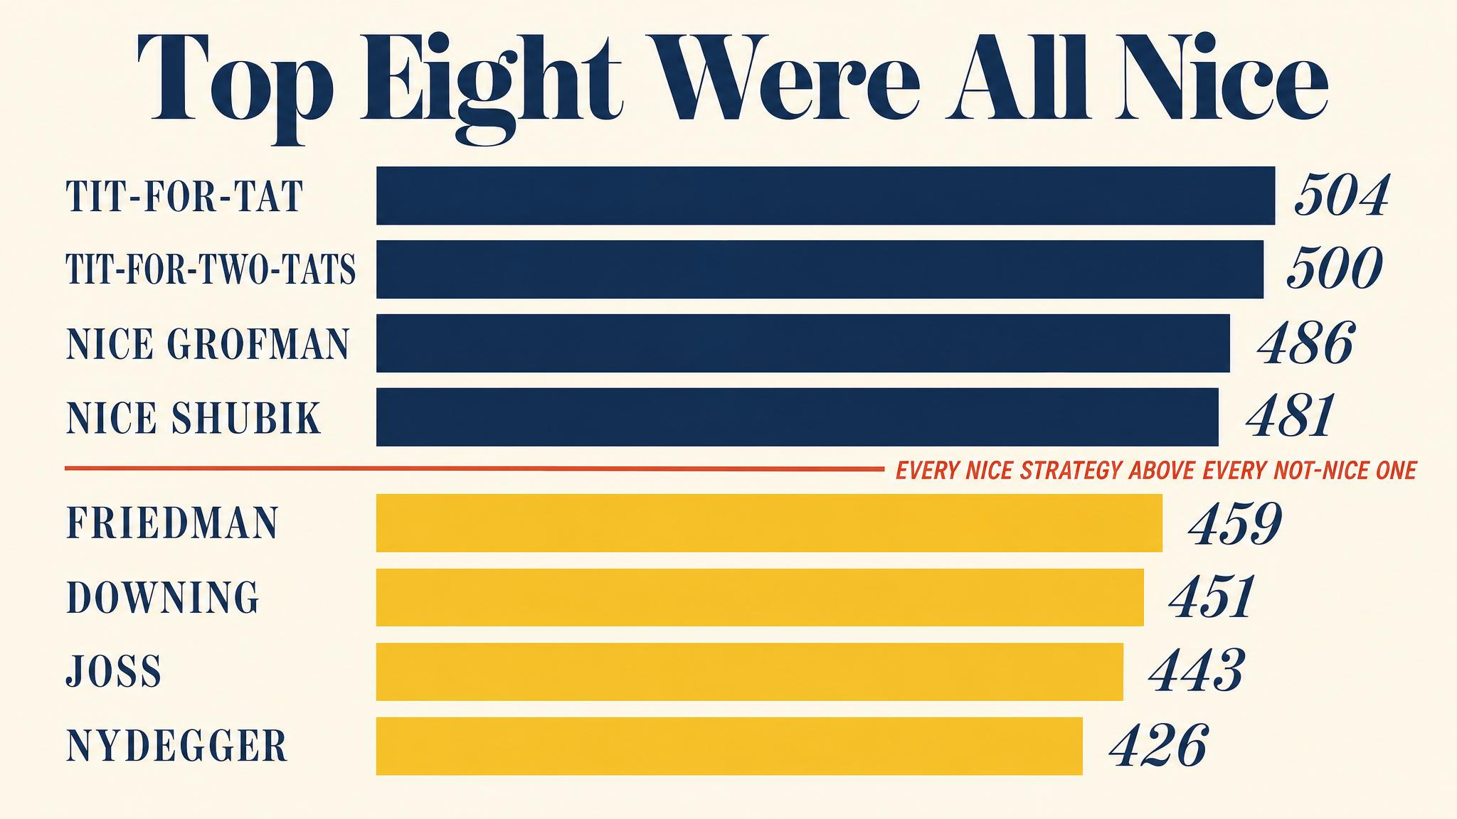
Notes:
Top eight strategies — all nice. Bottom six — all not nice. The pattern was not a fluke. Nice strategies steadily harvested mutual cooperation; nasty strategies cannibalised each other.

Slide 5
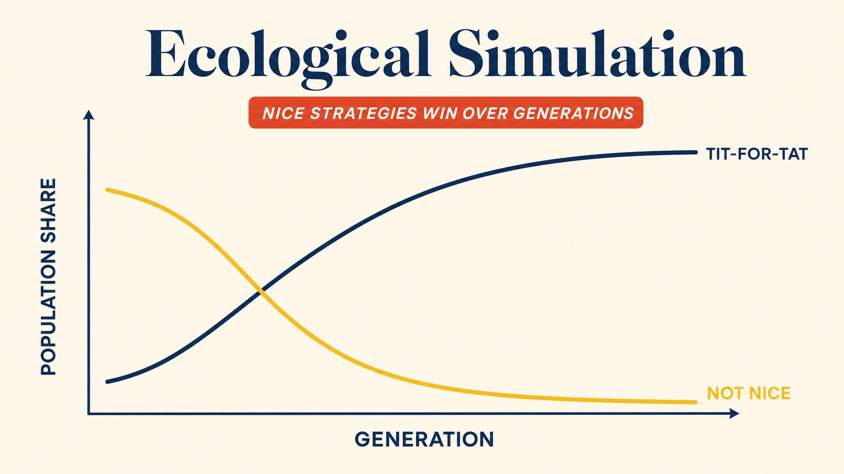
Notes:
Axelrod simulated a population whose strategy mix changed with success. Exploiters thrived on cooperators early, then ran out of prey and ate each other. By generation 200, Tit-for-Tat dominated.

Slide 6
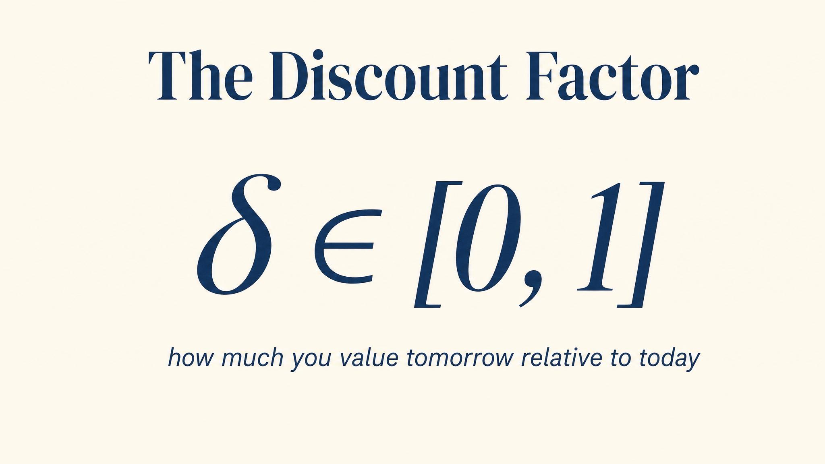
Notes:
Delta lives between zero and one. It measures patience, or the probability the game continues. A payoff tomorrow is worth delta times the same payoff today.

Slide 7
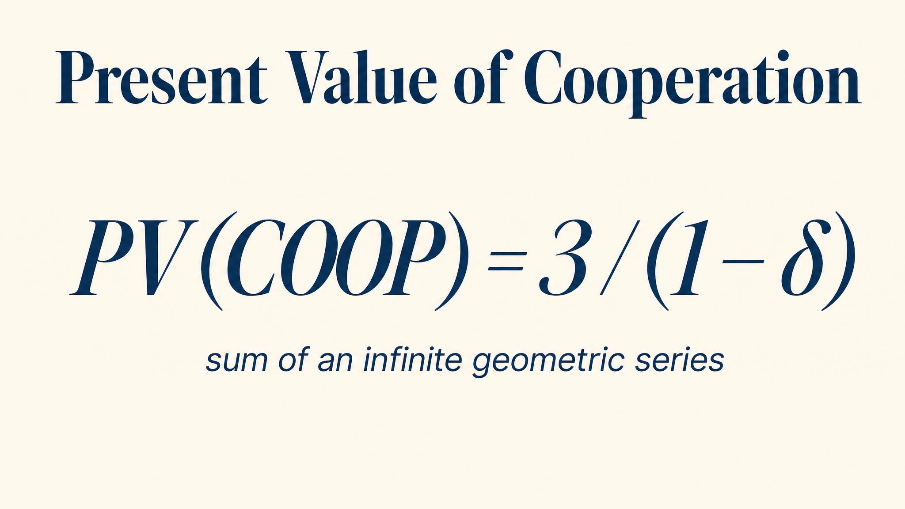
Notes:
Cooperating forever gives R divided by one minus delta. Defecting once then being punished forever gives T plus delta times P divided by one minus delta. Compare the two streams.

Slide 8
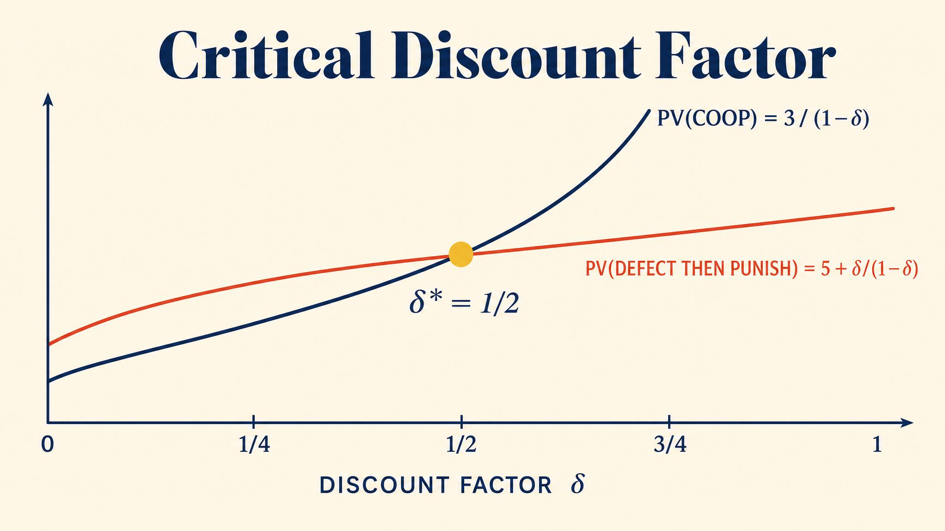
Notes:
Solve the inequality and delta-star equals one-half. When delta is at least one-half, cooperation under grim trigger is a subgame perfect equilibrium. Below that, only mutual defection survives.

Slide 9
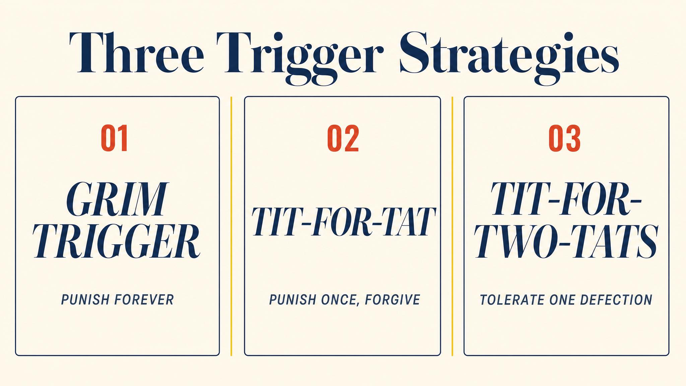
Notes:
Grim trigger punishes forever. Tit-for-Tat mirrors. Pavlov — win-stay, lose-shift — repeats good outcomes and switches after bad ones. Nowak and Sigmund 2008 found Pavlov robust in noisy environments.

Slide 10
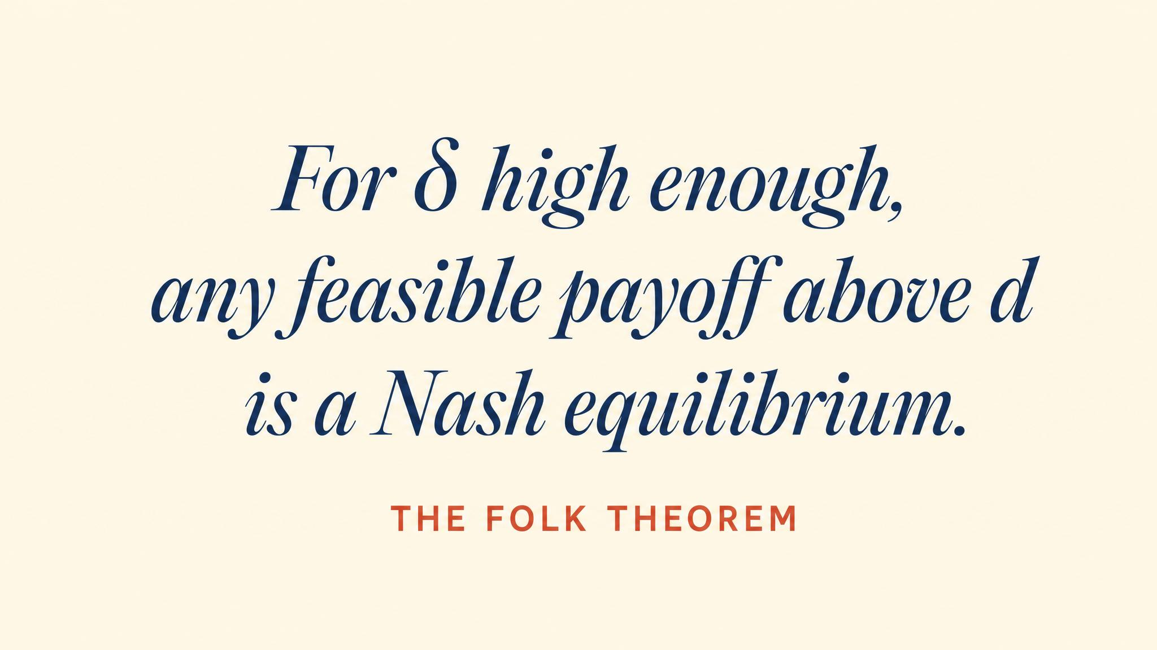
Notes:
Fudenberg and Maskin 1986 proved the folk theorem. With sufficiently patient players, virtually any feasible, individually rational payoff vector can be sustained as a subgame perfect equilibrium. Powerful — and permissive.

Slide 11

Notes:
Ashworth 1980 documented the live-and-let-live system in World War One trenches. Same units faced each other for weeks. High command broke the pattern with unpredictable raids — shortened the shadow — and cooperation collapsed.

Slide 12
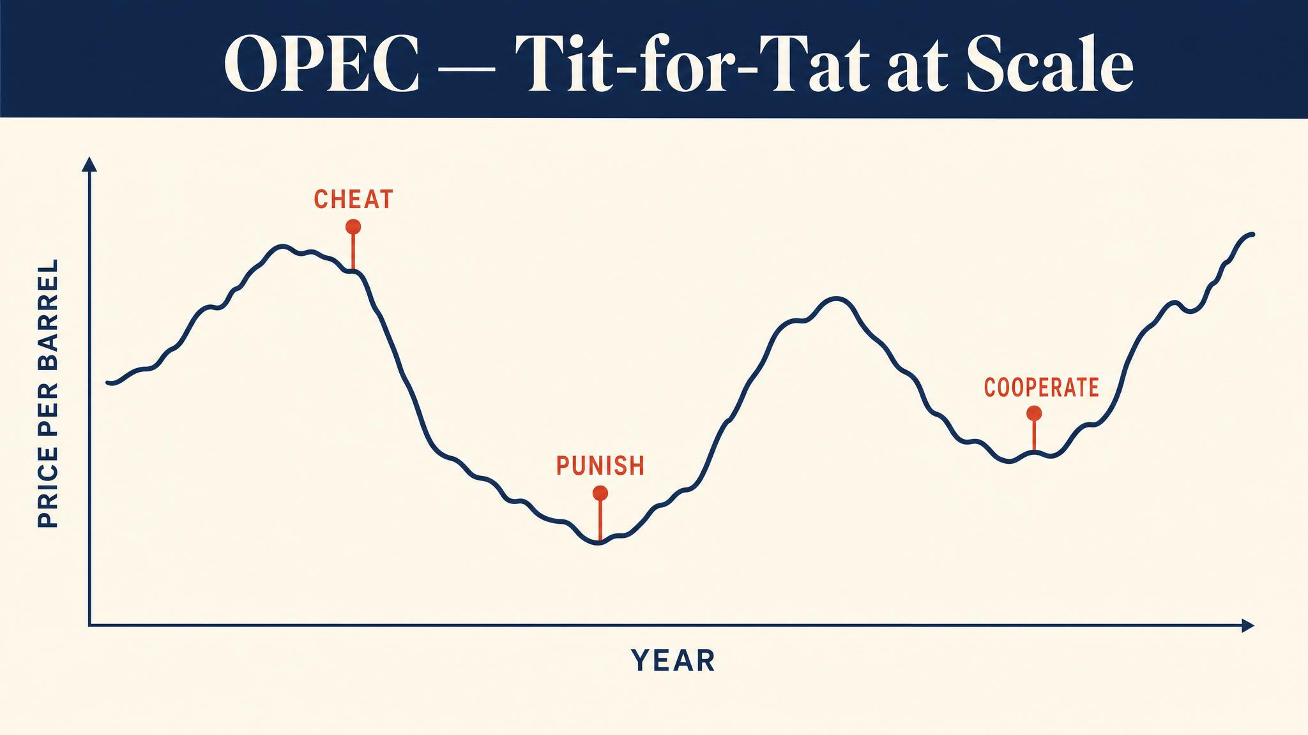
Notes:
Griffin 1994 reads OPEC's 1985–86 production surge as Tit-for-Tat. Saudi Arabia punished cheating, prices crashed, and discipline returned. Punishment phases can be essential to long-run cooperation.

Slide 13
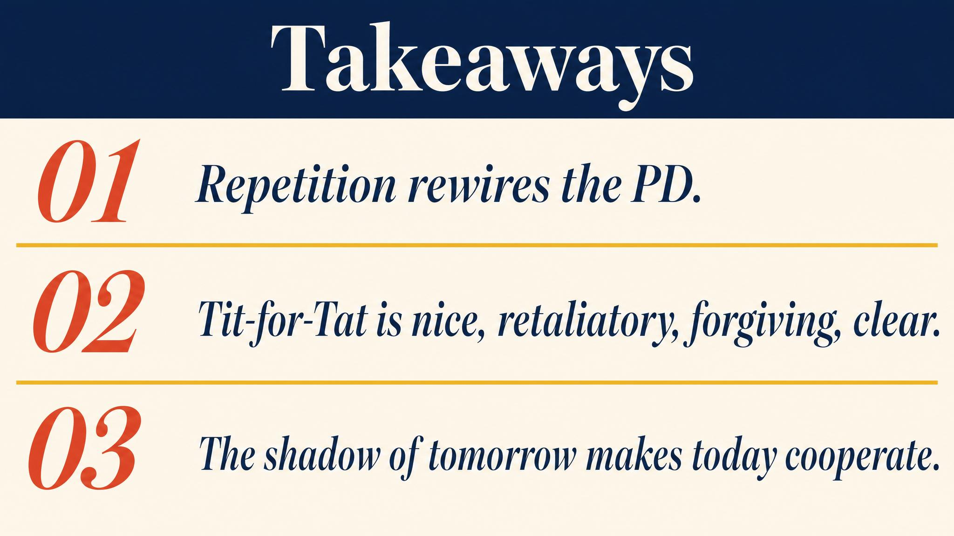
Notes:
Three lessons. Repetition transforms the Prisoner's Dilemma. The critical discount factor under grim trigger is one-half. The folk theorem expands the equilibrium set — possibility, not prediction.

Slide 14
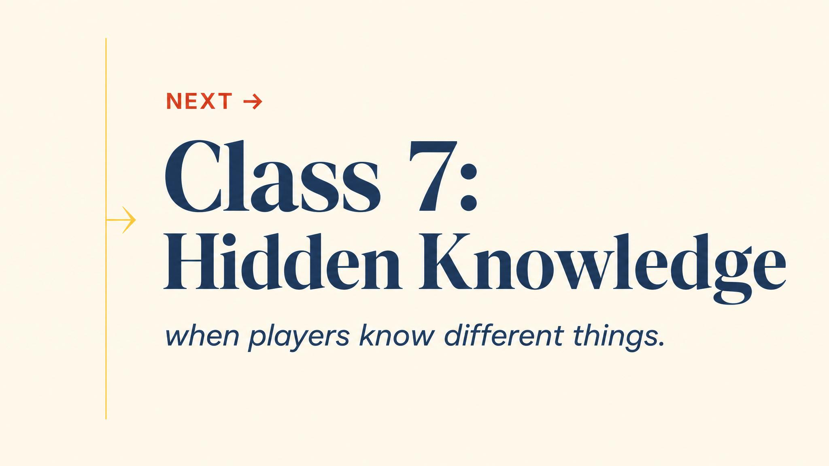
Notes:
Close with the bridge. Repetition assumed players knew each other's payoffs. Next chapter drops that assumption and enters the world of incomplete information.

