Slide 1

Notes:
Open with Matt's open-source code as a credible signal of talent. The chapter pivots on hidden types — when you don't know what the other player truly wants, every action becomes a clue.

Slide 2
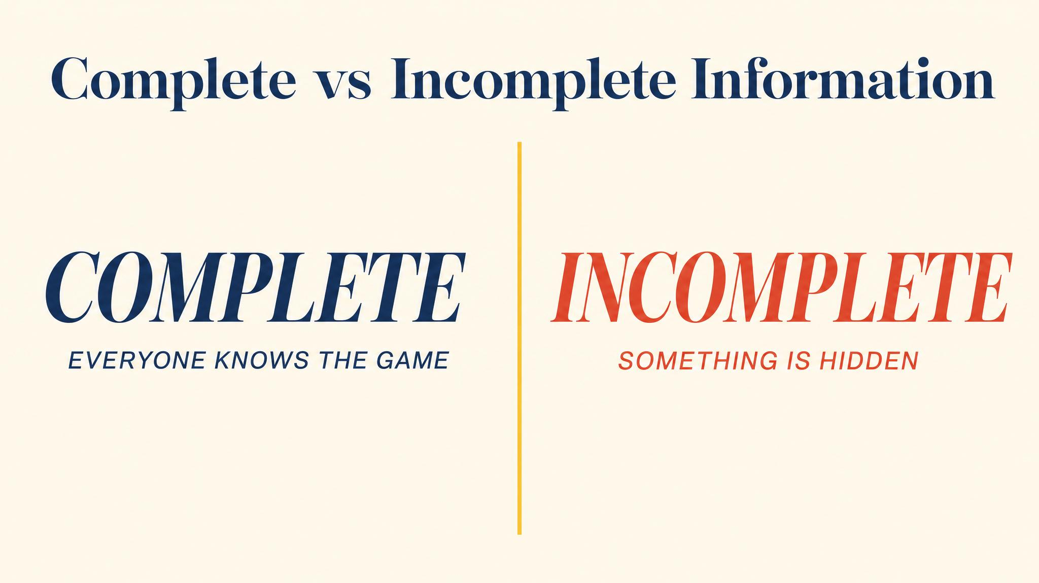
Notes:
Complete information means you know what every player wants. Incomplete means some payoffs are hidden. Note: this is distinct from perfect versus imperfect information, which concerned observability of moves.

Slide 3
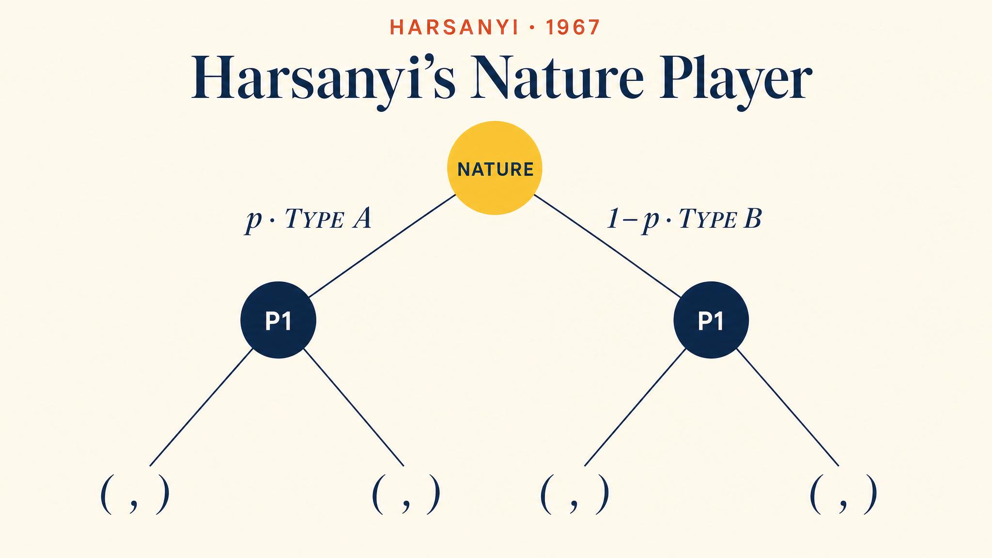
Notes:
Harsanyi's 1967–68 trilogy introduced a fictitious player called Nature. Nature draws each player's type from a known prior distribution. Each player observes their own type only. Incomplete information becomes imperfect information.

Slide 4
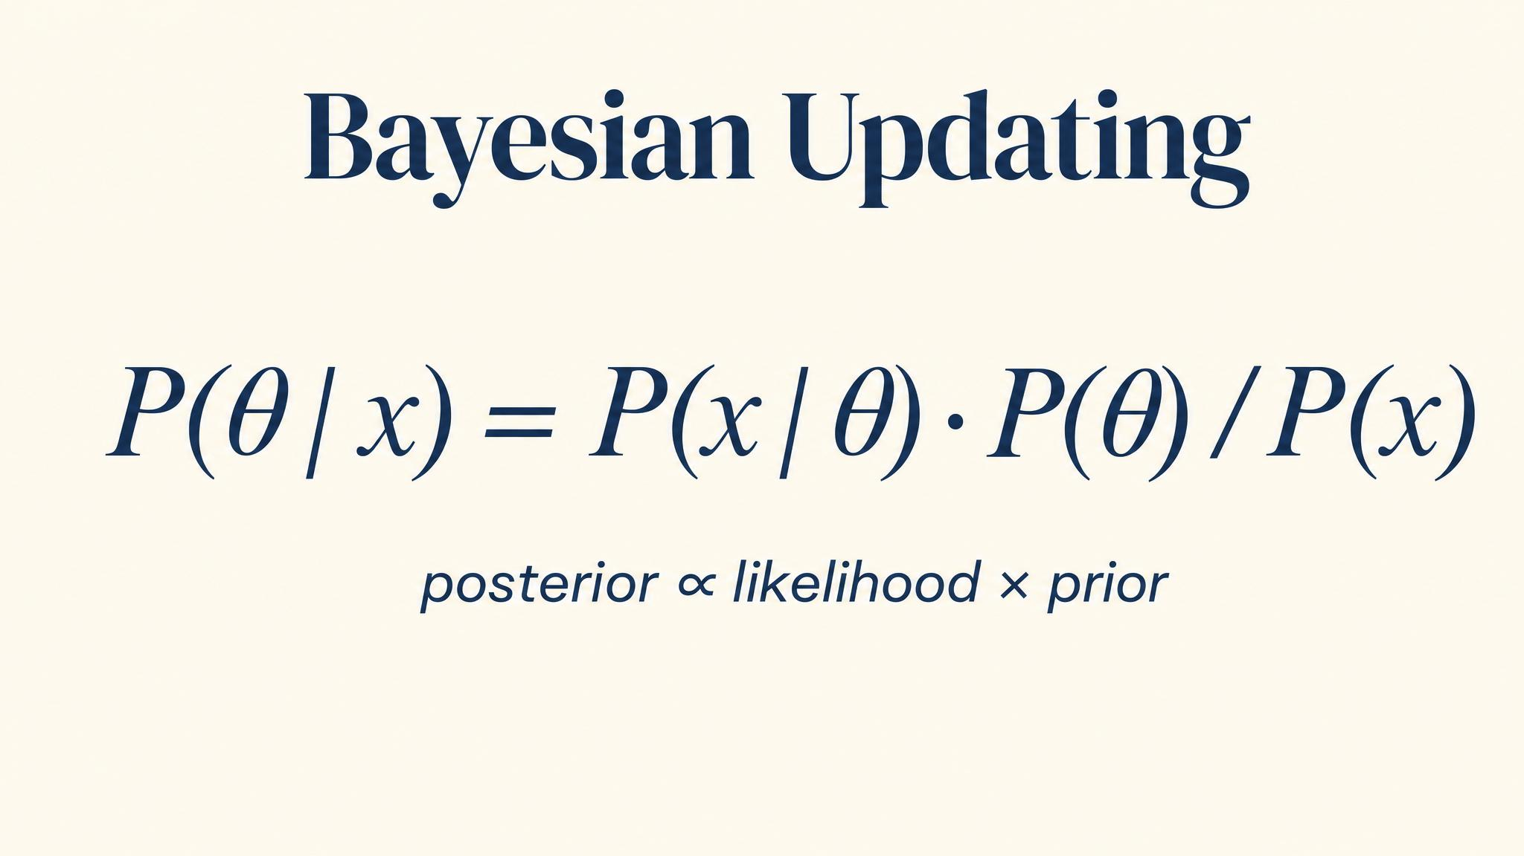
Notes:
Bayes' rule revises your belief about the opponent's type after observing an action. The more differently the types behave, the more informative the signal.

Slide 5
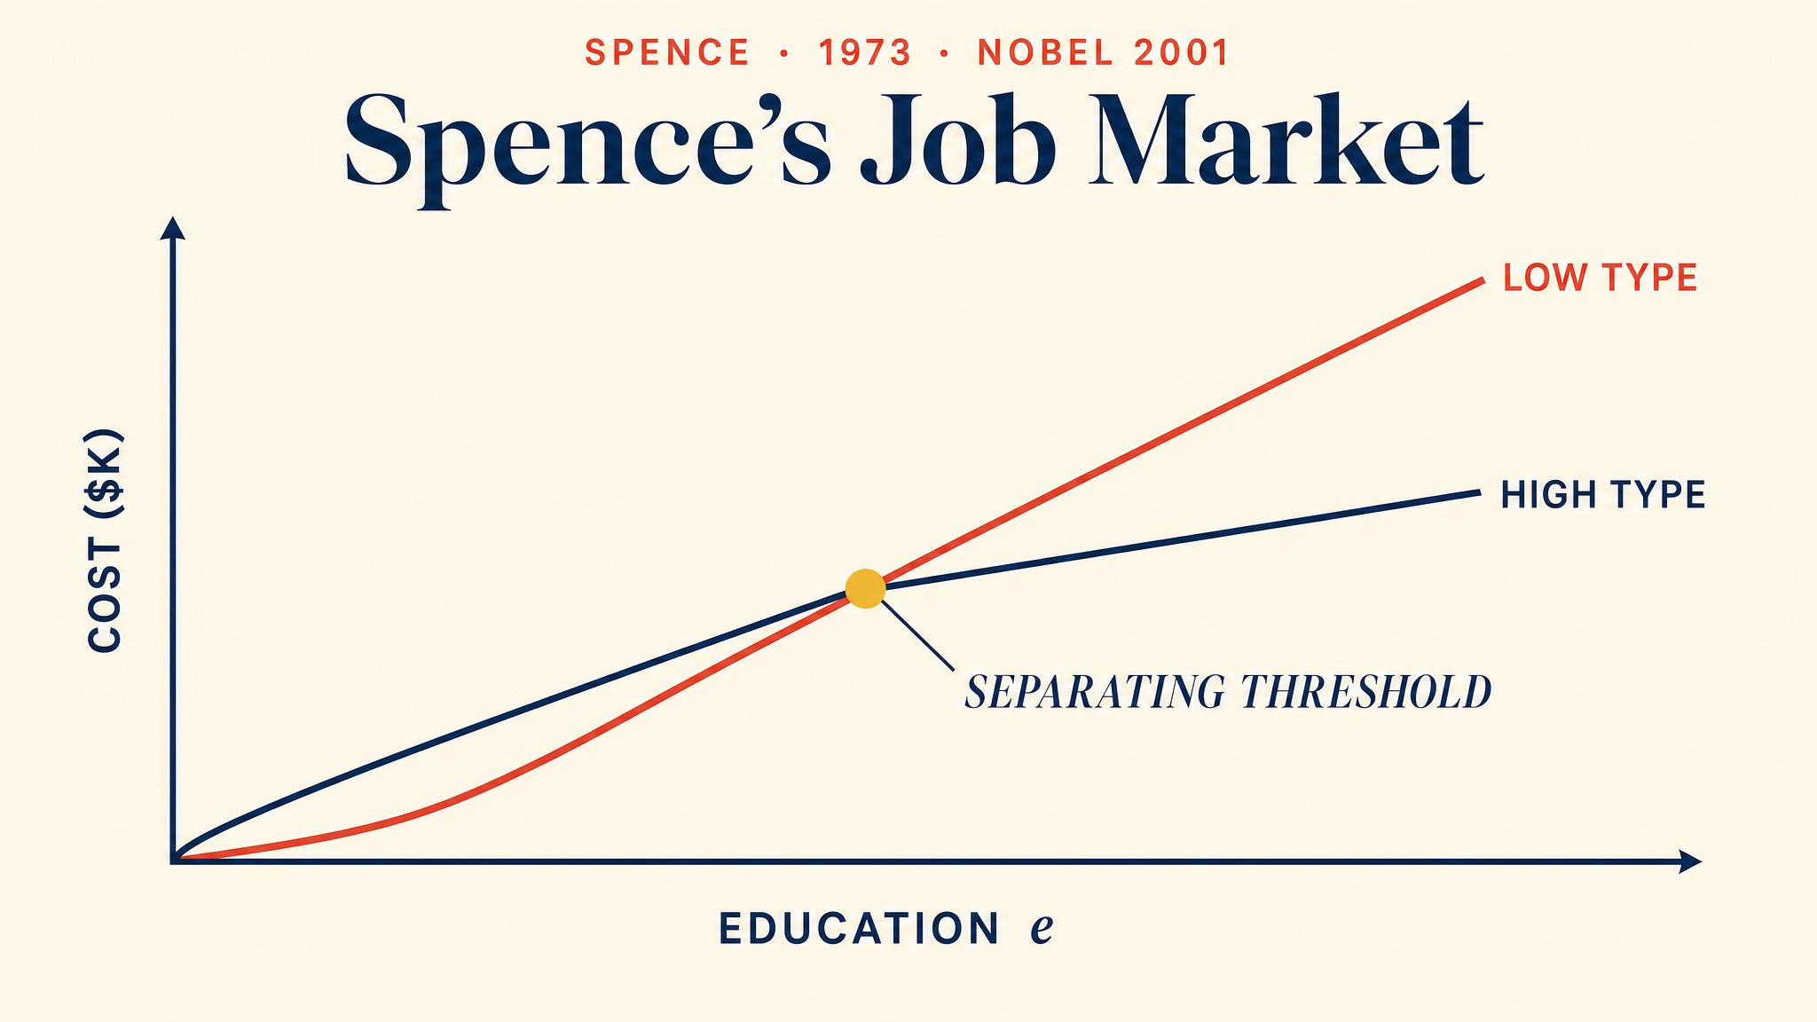
Notes:
Spence 1973: education costs Type H $30k, Type L $60k. Education need not teach anything productive — it just has to be differentially costly. This is the single-crossing property.

Slide 6
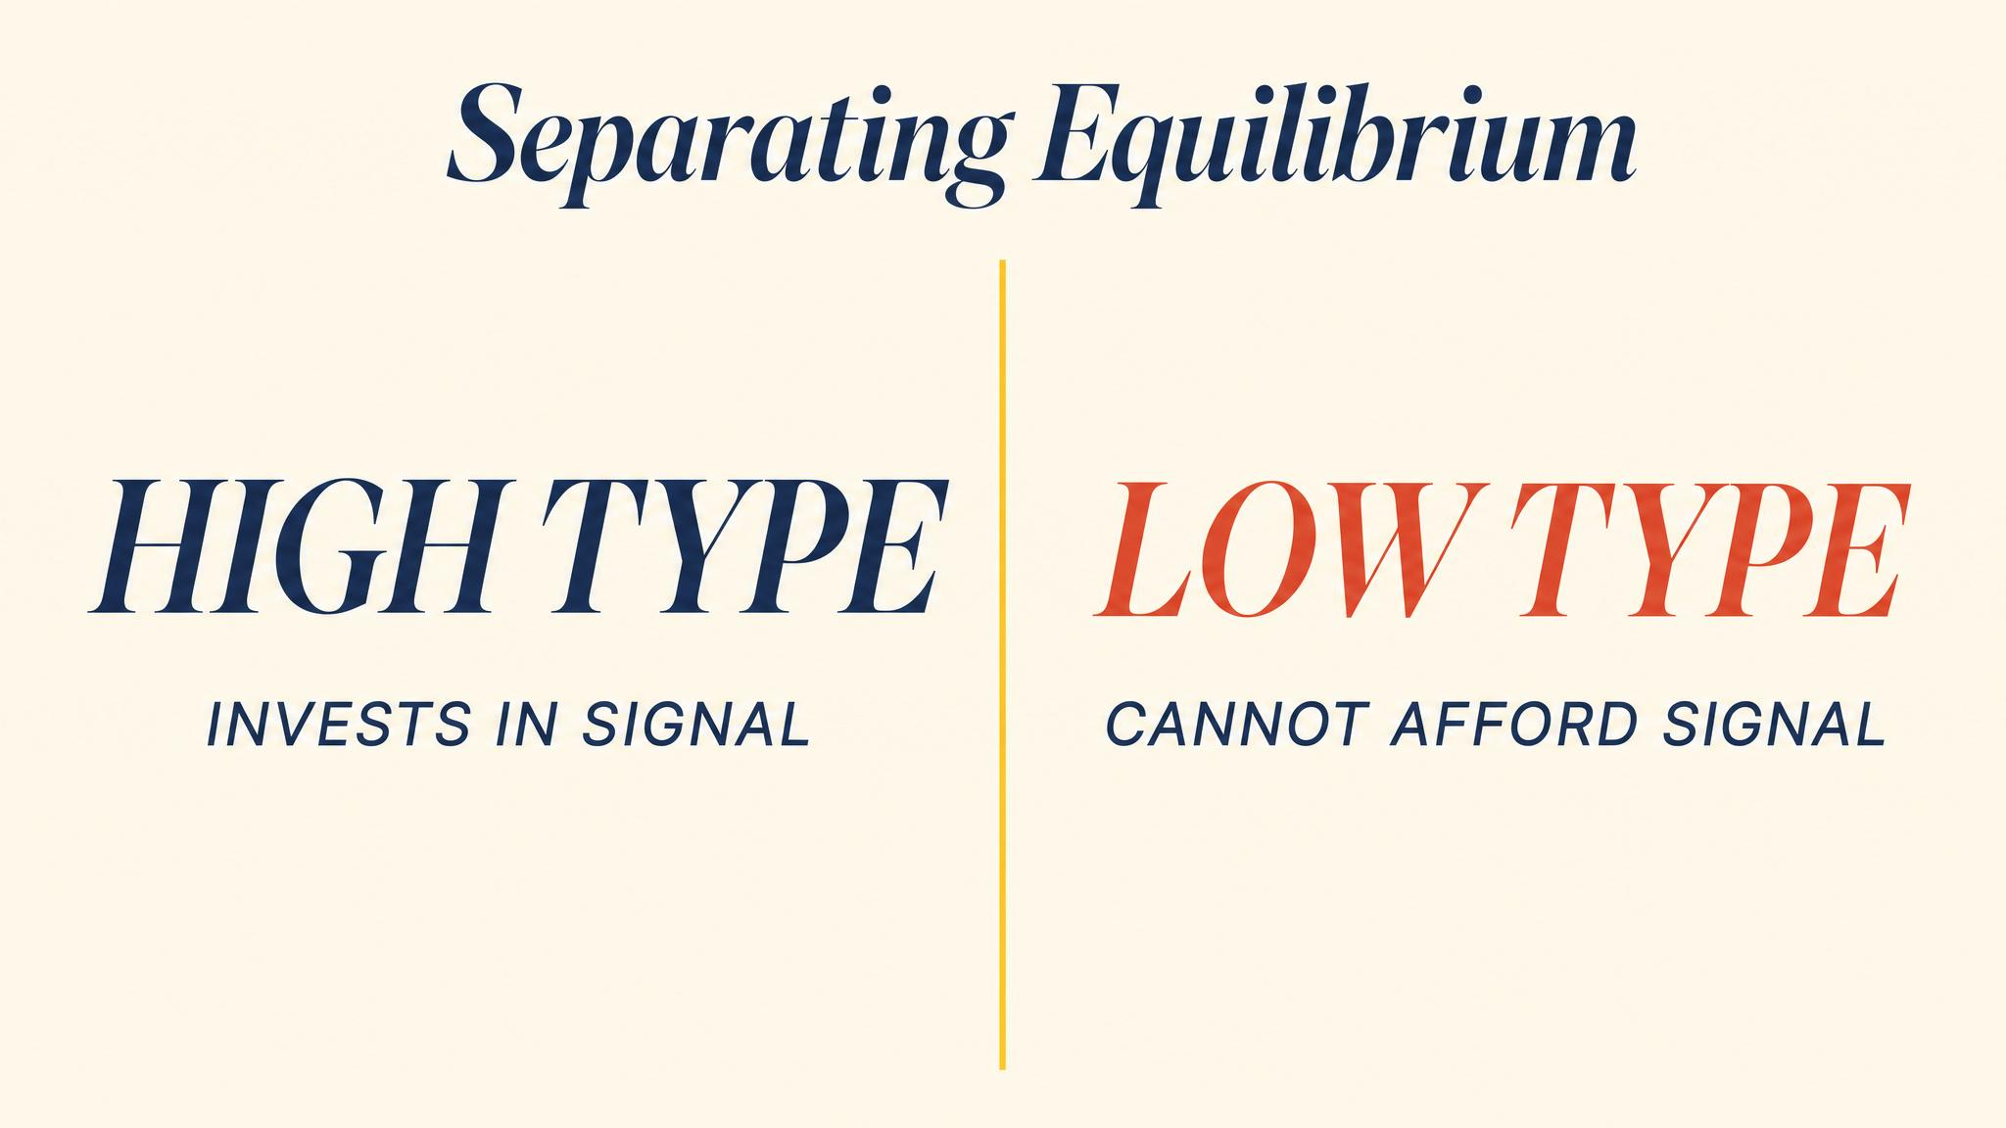
Notes:
Type H gets the degree, earns $70k net. Type L would only earn $40k net by getting the degree but $50k without — so Type L stays. The signal separates the types not because of skills, but because of cost asymmetry.

Slide 7
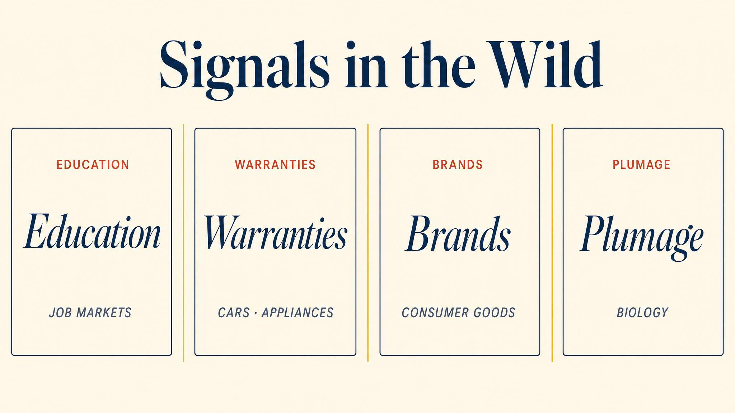
Notes:
Education, peacock tails, product warranties, VC funding rounds — all share the same structure. A privately-informed party takes a costly action that is differentially costly by type. Credibility comes from the cost.

Slide 8

Notes:
Rothschild and Stiglitz 1976 formalised screening. The uninformed party — the insurer — designs a menu so each type self-selects. Reckless drivers pick full coverage; safe drivers pick the high deductible. No one is forced to disclose anything.

Slide 9
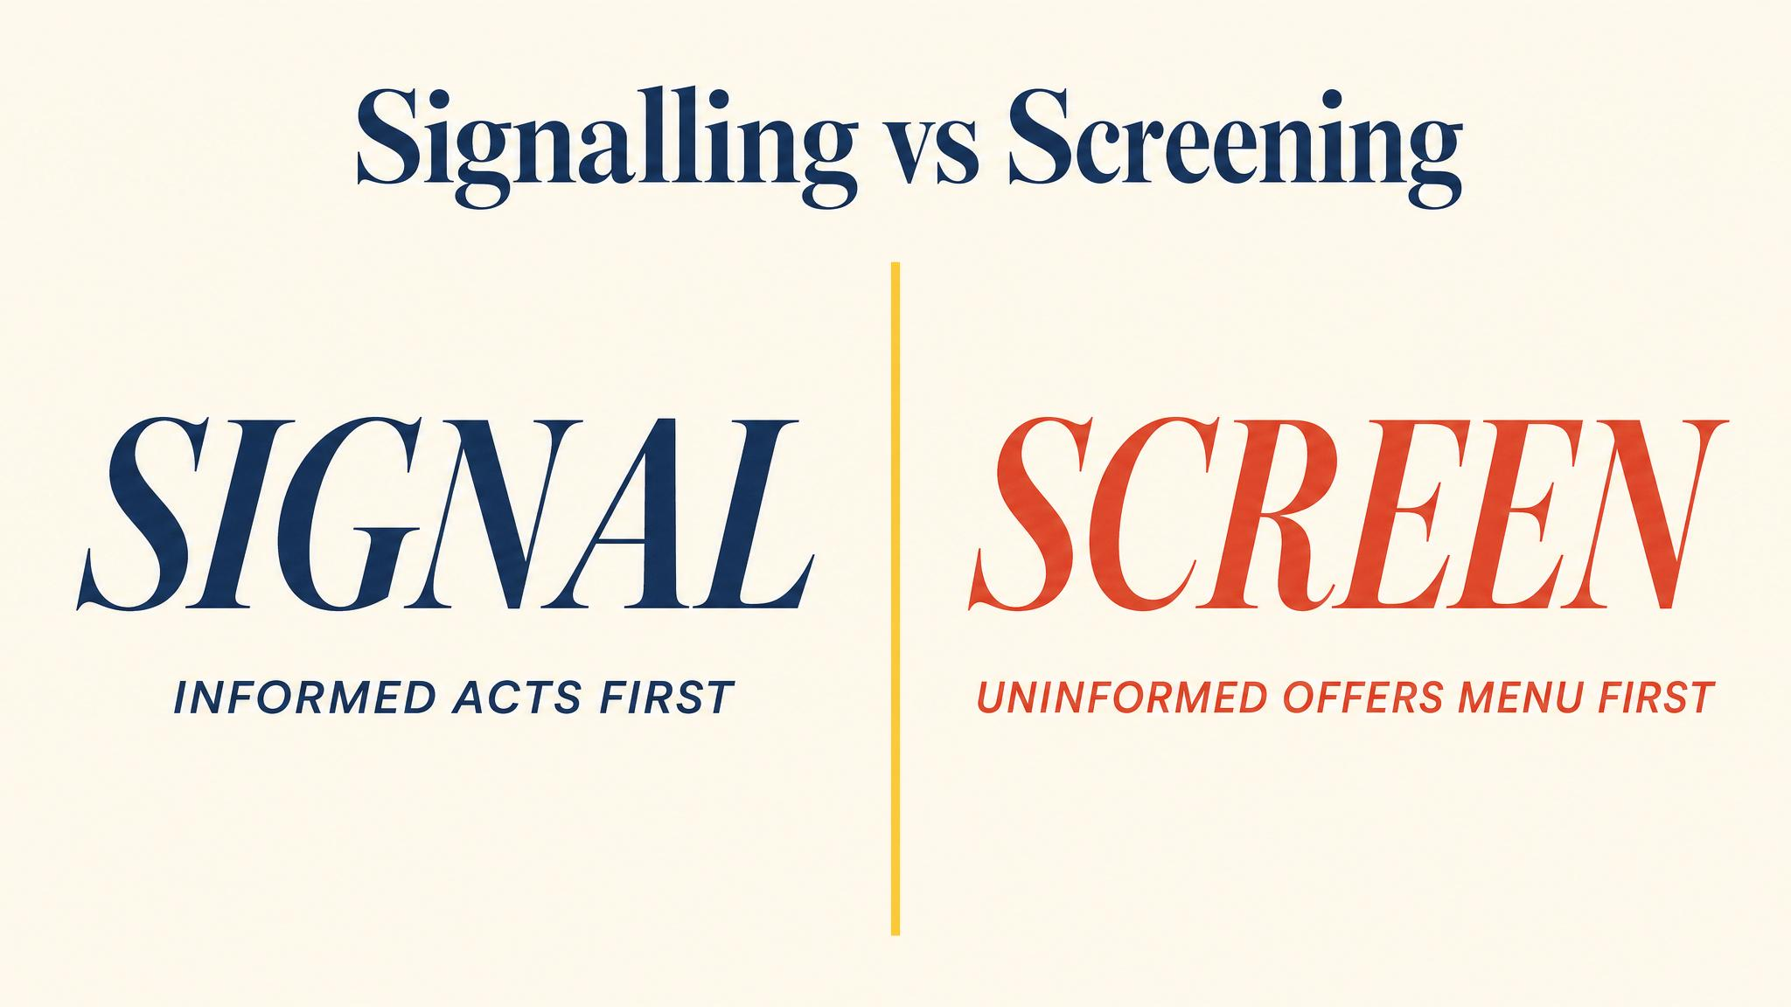
Notes:
Two timing structures. In signalling, the informed party moves first and pays the cost of revelation. In screening, the uninformed party moves first and pays through contract distortion.

Slide 10
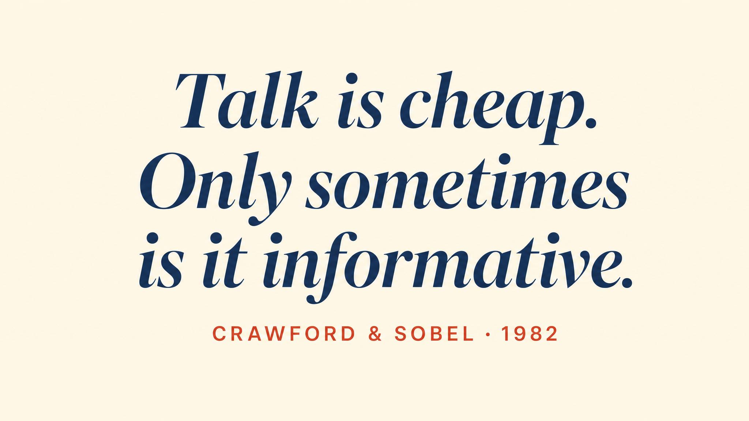
Notes:
Crawford and Sobel 1982. Costless messages convey information only when sender and receiver have aligned interests. When interests diverge, babbling equilibria always exist.

Slide 11
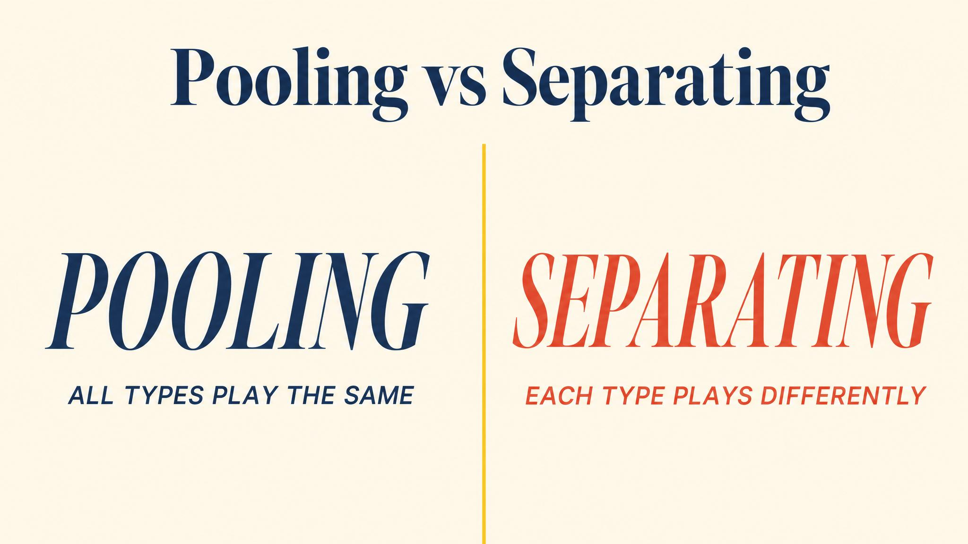
Notes:
Pooling: all types choose the same action — no information is conveyed. Separating: different types choose differently — actions reveal type. Cho and Kreps' 1987 intuitive criterion helps select among multiple equilibria.

Slide 12
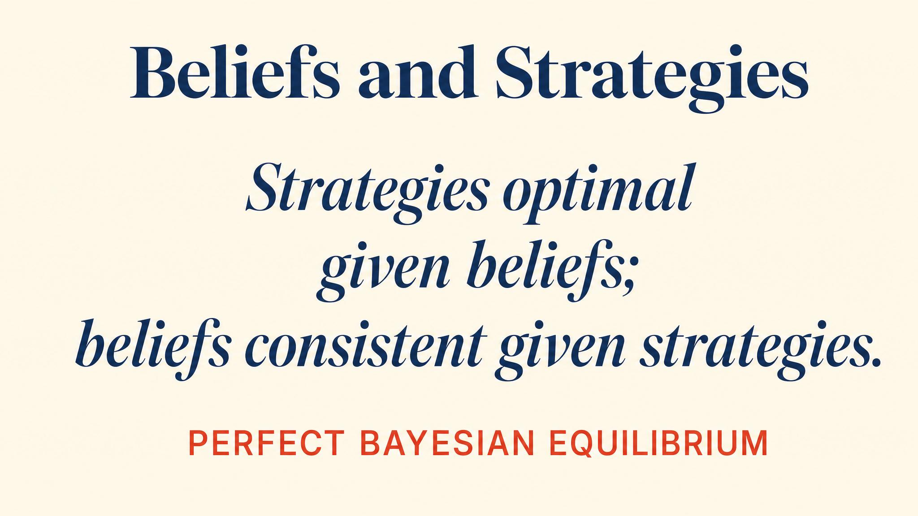
Notes:
Perfect Bayesian Equilibrium. Strategies must be sequentially rational at every information set, and beliefs must come from Bayes' rule wherever possible. Off-path beliefs need refinements like the intuitive criterion.

Slide 13
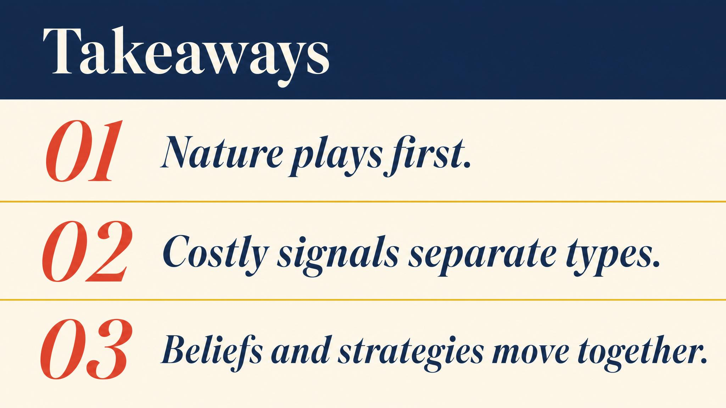
Notes:
Three lessons. Types are hidden; actions become clues. Credibility comes from differential cost — the same logic as commitment. Cheap talk informs only when preferences align.

Slide 14

Notes:
Close with the bridge. The signalling framework returns with a vengeance in auctions. Every bid is a signal — and the winner's curse is a direct failure of Bayesian updating.

