Slide 1
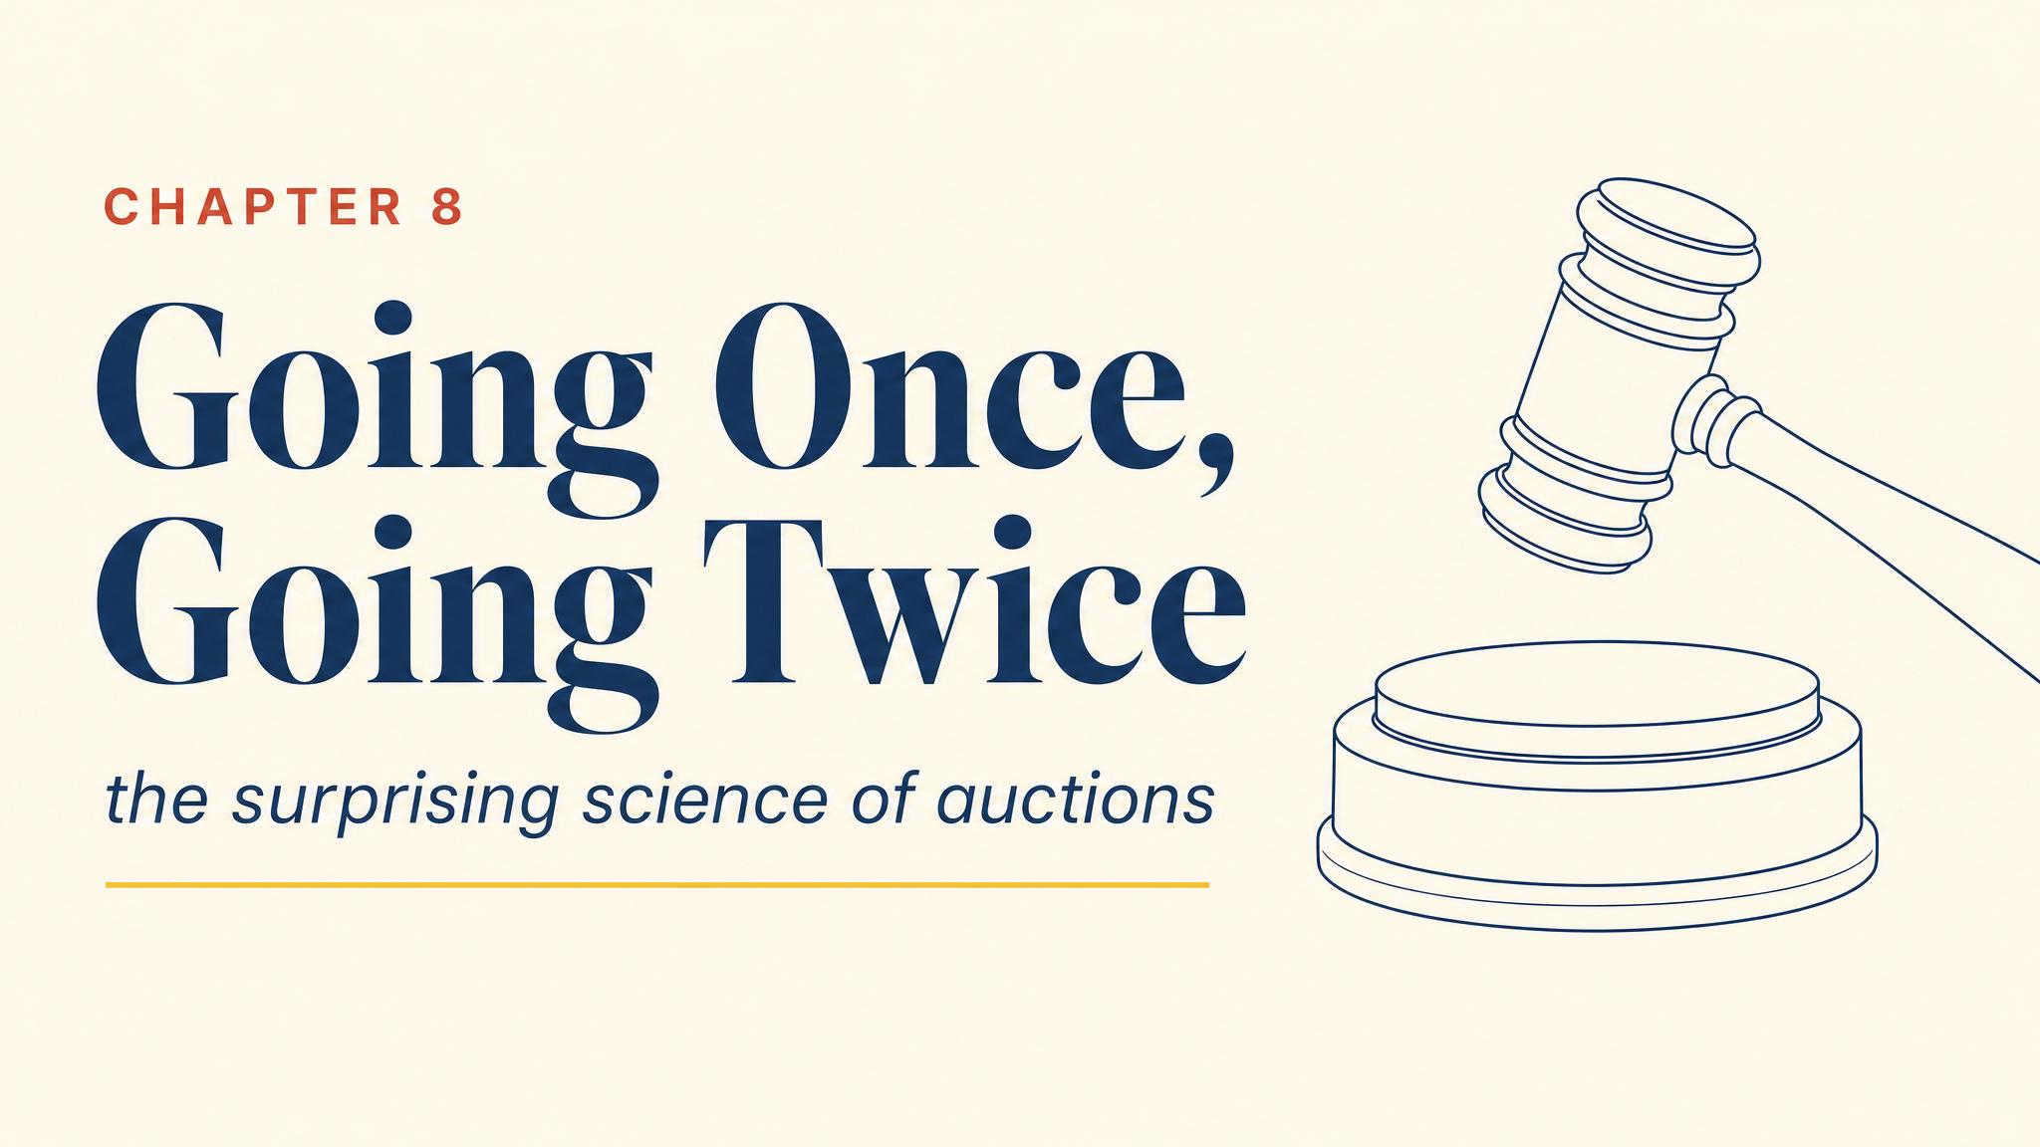
Notes:
Open with the FCC narrowband auction of July 1994 — game theorists in the room, executives at terminals, $617 million raised from a single auction. Auction theory met policy.

Slide 2
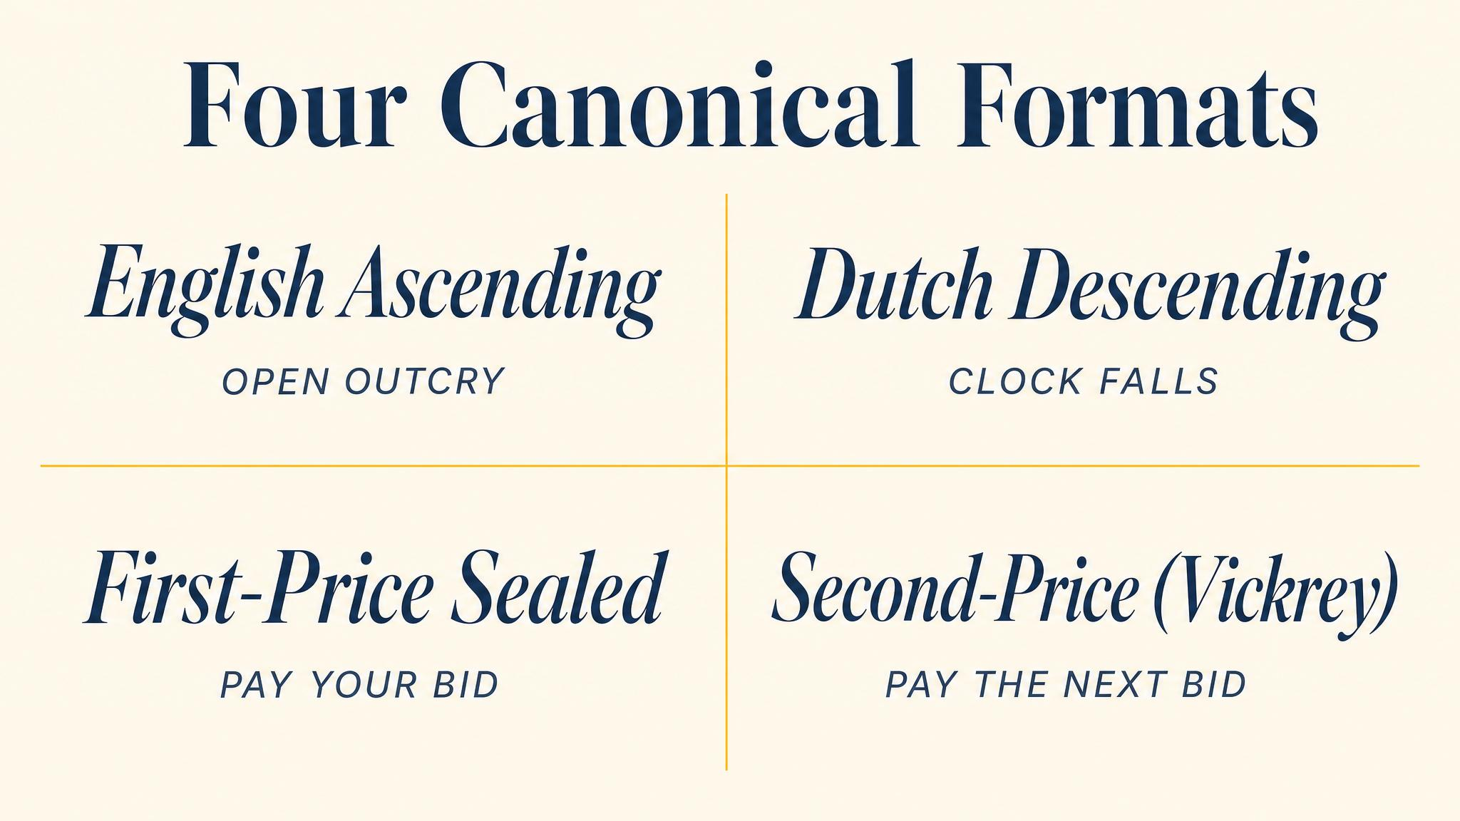
Notes:
Four canonical formats. English ascending, Dutch descending, first-price sealed-bid, and the Vickrey second-price sealed-bid. Each plays a different strategic game.

Slide 3
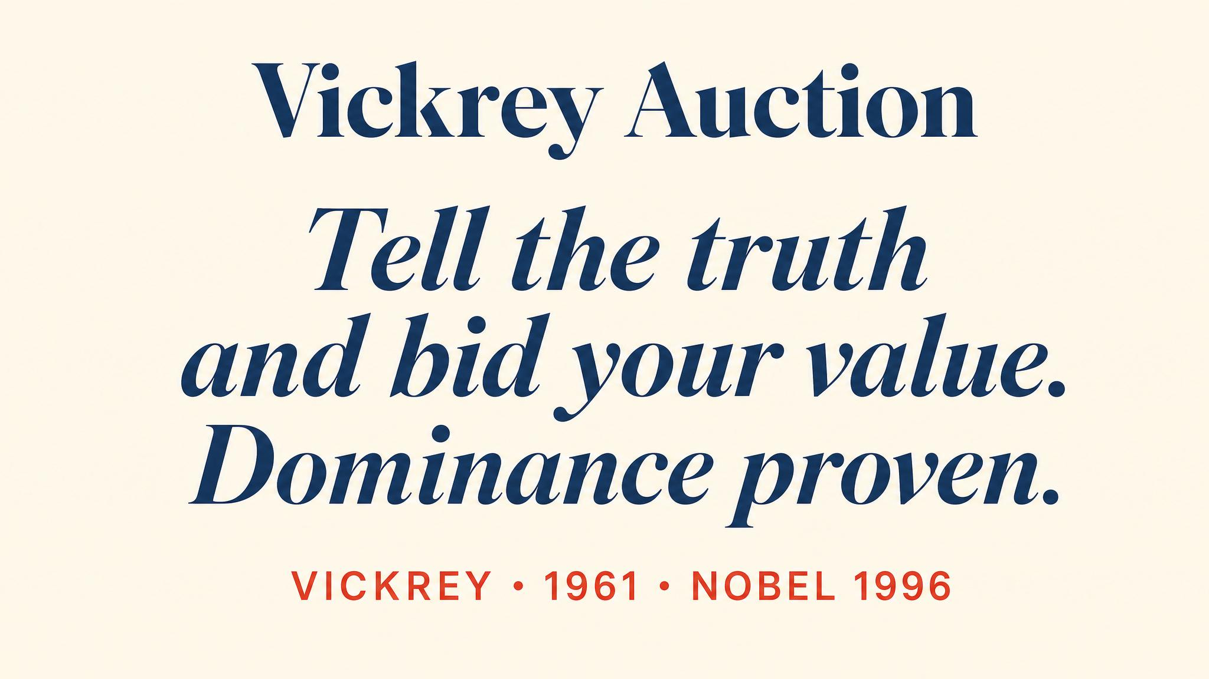
Notes:
Vickrey 1961: in the second-price sealed-bid auction, bidding your true valuation is weakly dominant. No matter what others do, you cannot do better than honesty.

Slide 4
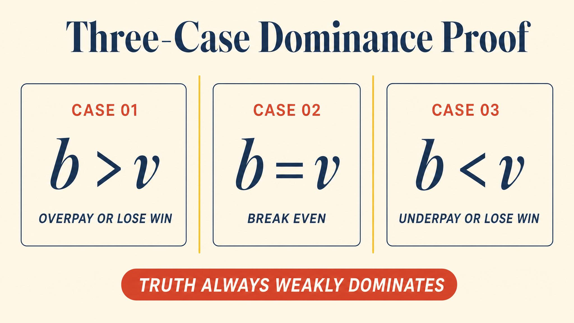
Notes:
Three cases prove the result. Bidding truthfully is at least as good as any deviation. Overbidding risks paying more than the item is worth; underbidding risks missing profitable wins.

Slide 5
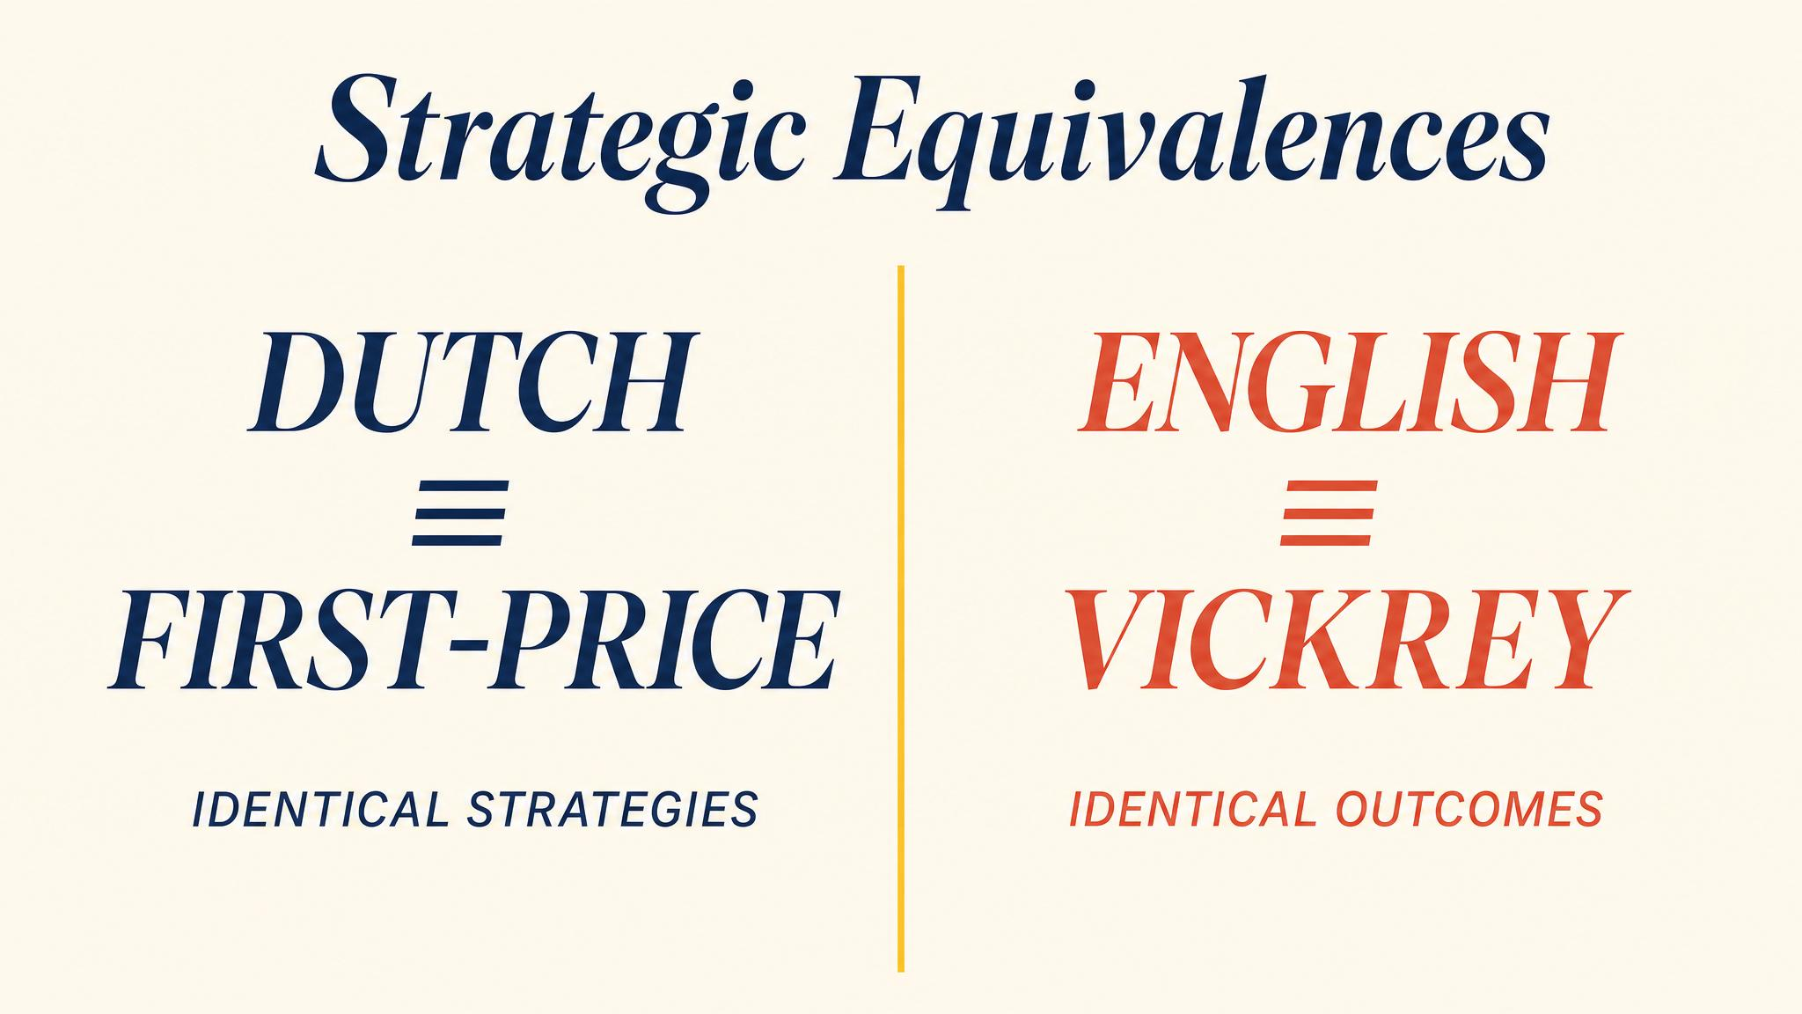
Notes:
Two strategic equivalences. English and Vickrey both yield the highest valuer paying the second-highest valuation. Dutch and first-price both demand commitment before observing rivals.

Slide 6
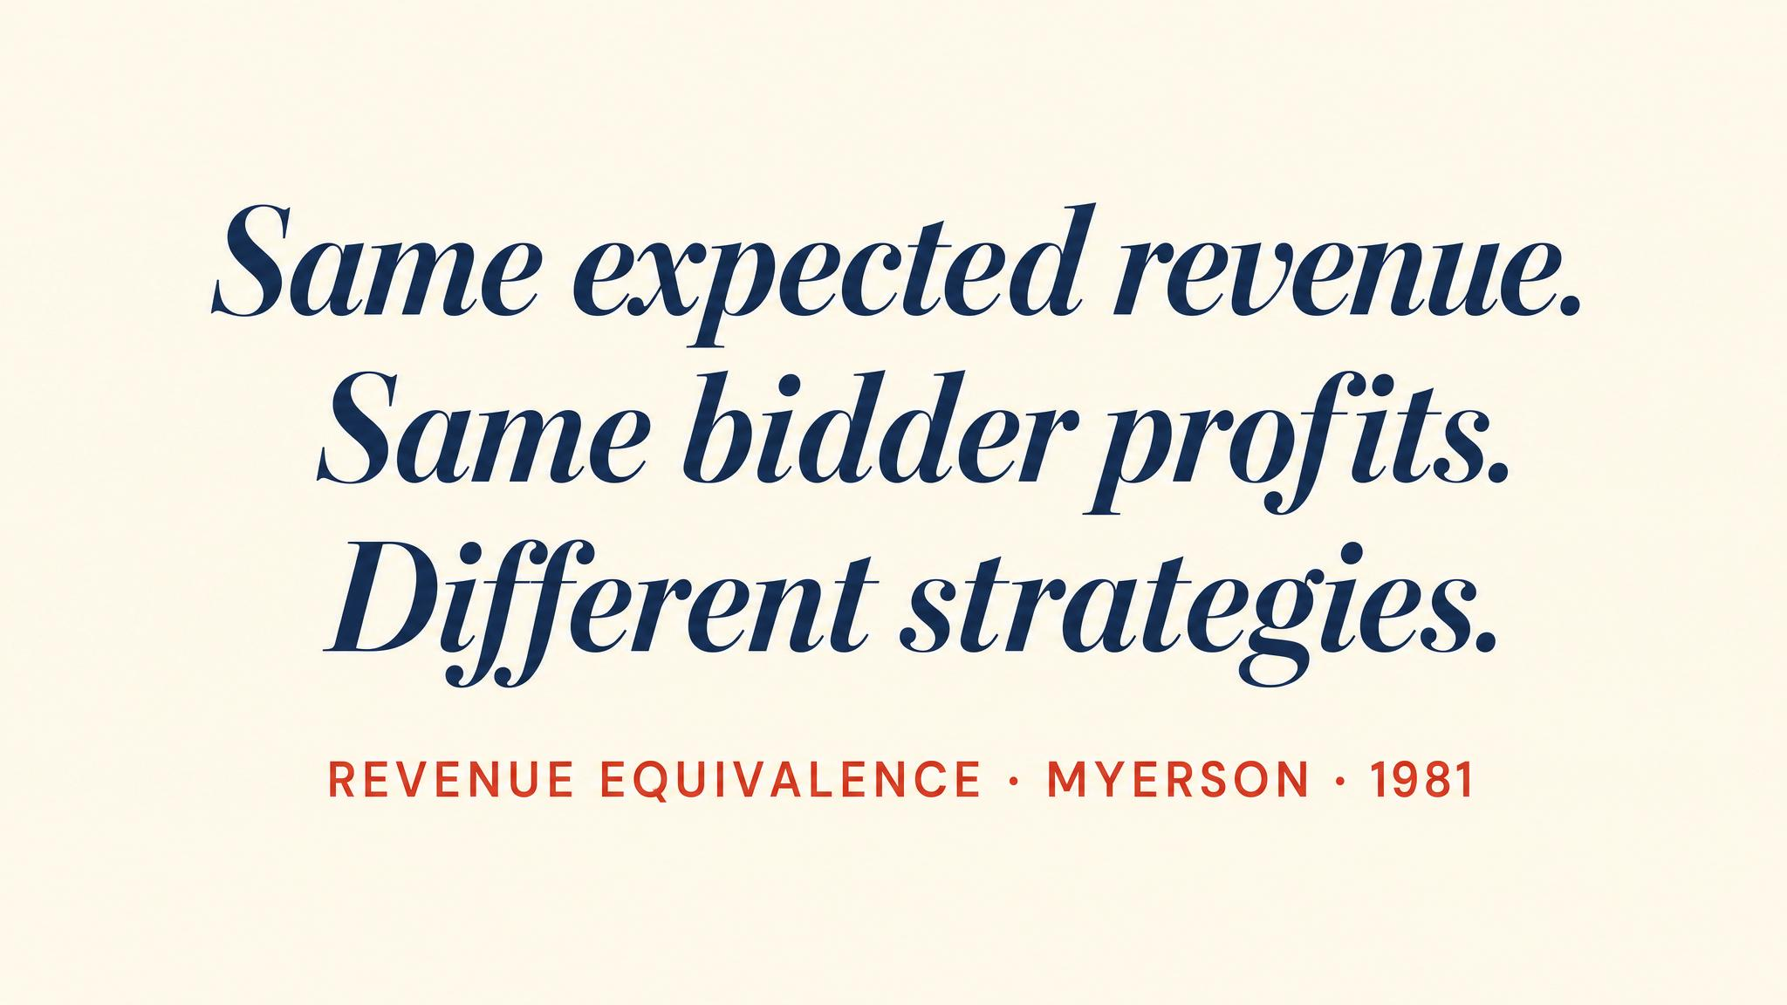
Notes:
Myerson 1981. Under independent private values, risk-neutral bidders, symmetric distributions, and efficient allocation, all four standard formats yield the same expected revenue. The crown jewel of auction theory.

Slide 7
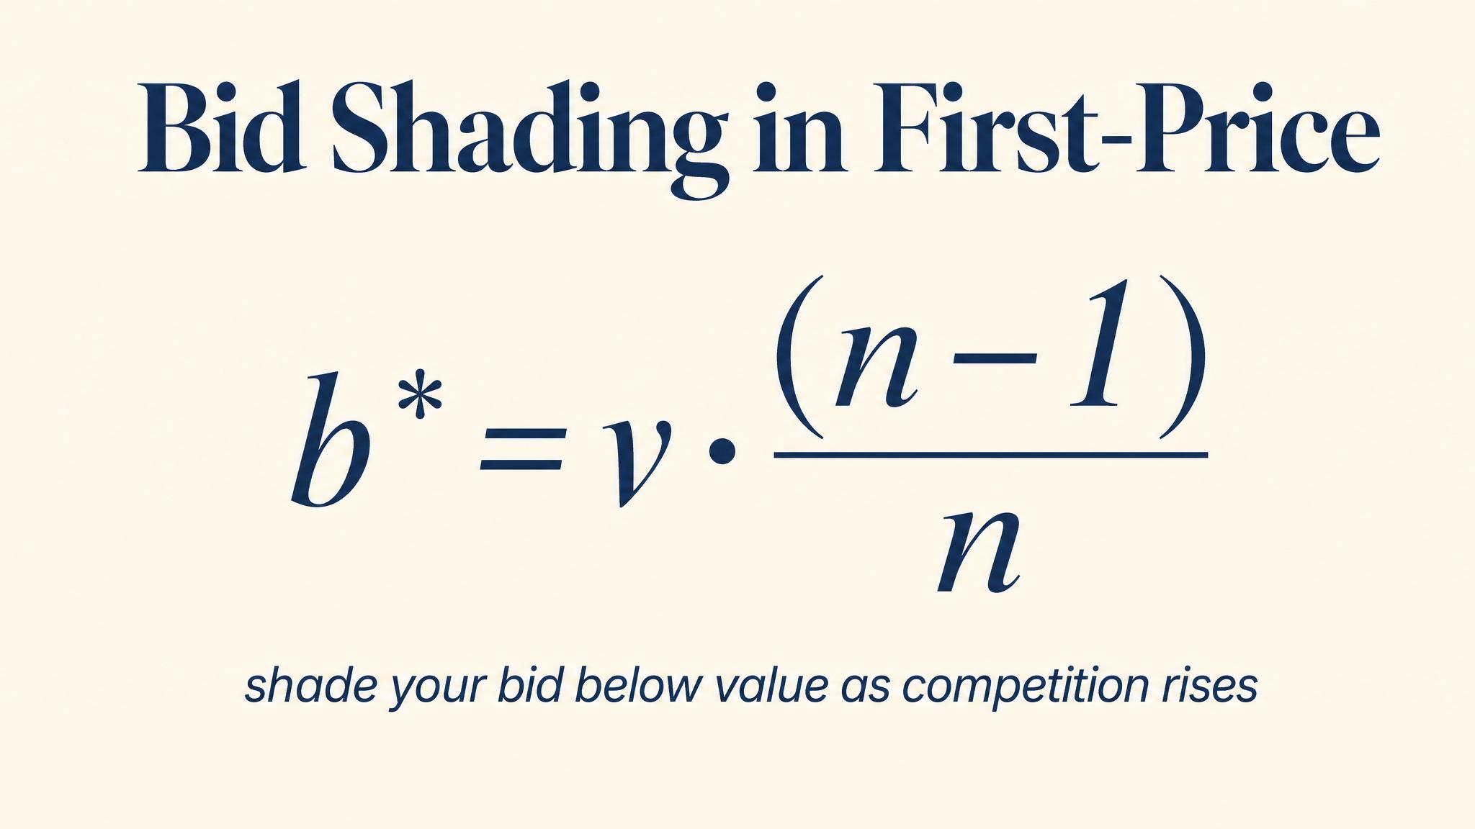
Notes:
In a first-price auction with n symmetric bidders drawing uniformly, the equilibrium bid is v times (n−1)/n. With six bidders, shade to five-sixths of value. Calibrated so expected revenue equals Vickrey's.

Slide 8
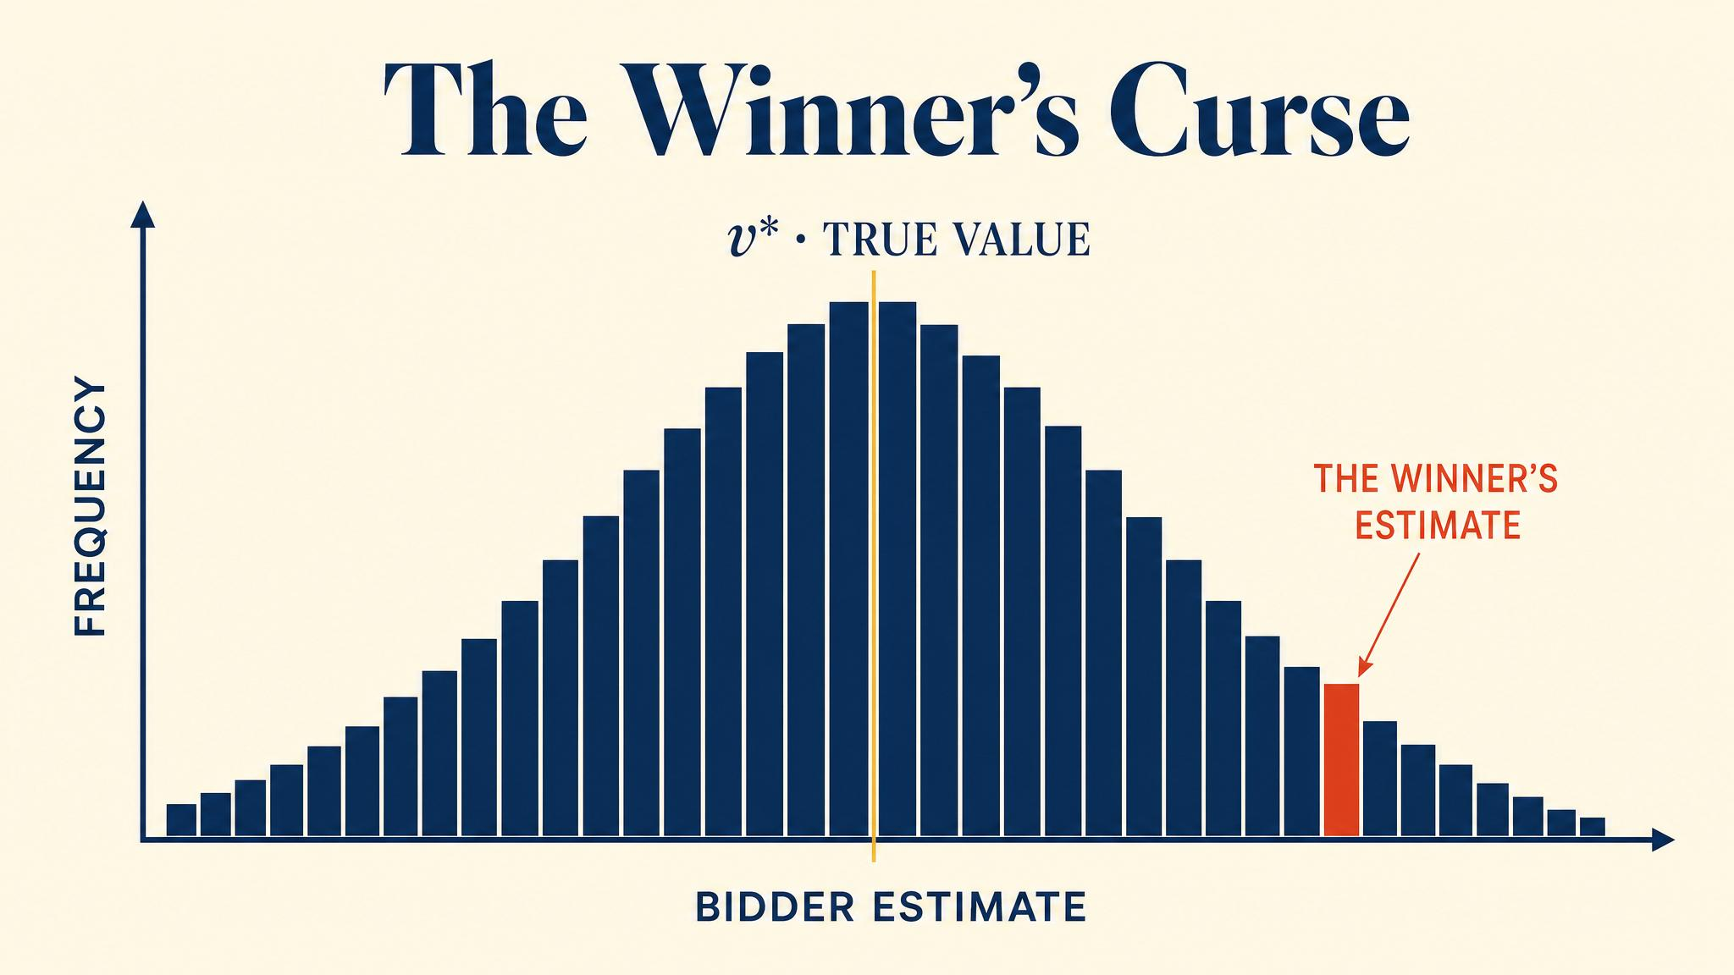
Notes:
Capen, Clapp, and Campbell 1971. Atlantic Richfield engineers showed winning bidders for offshore oil leases were systematically overpaying. Winning is itself information — about your own optimism.

Slide 9
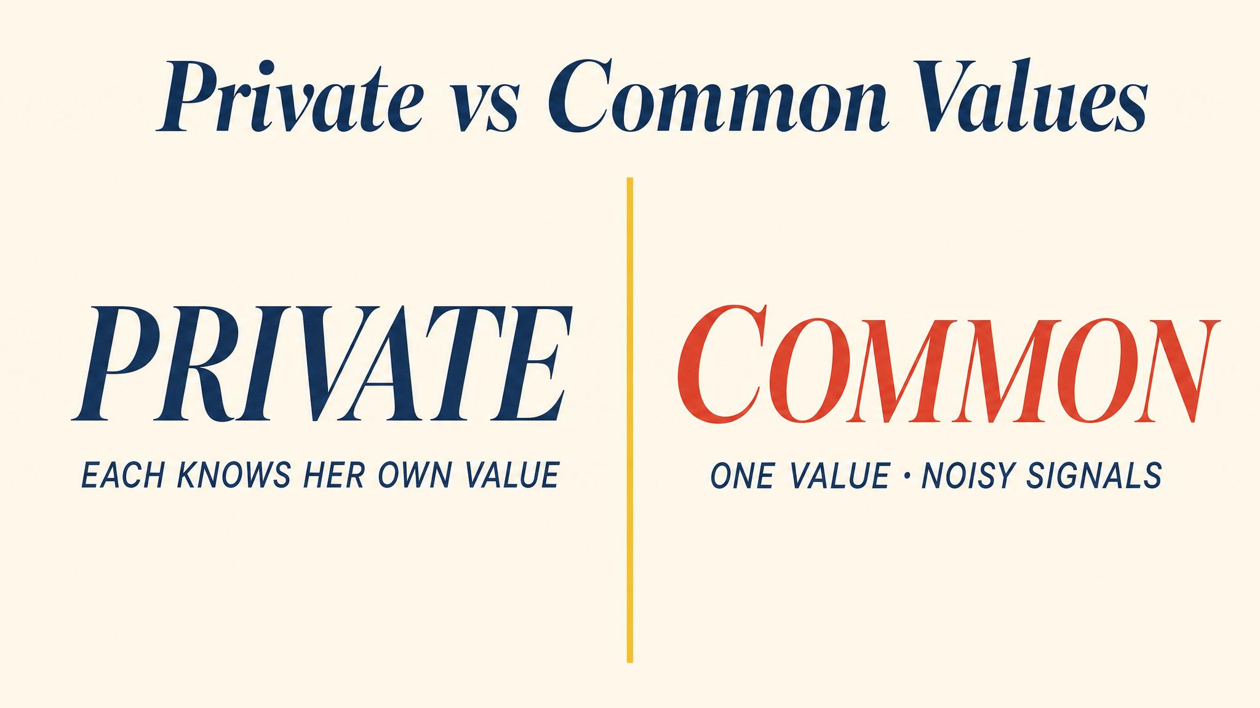
Notes:
Private values: each bidder knows what the item is worth to them. Common values: one true value, noisy estimates. Oil leases, Treasury bills, and mineral rights are common-value. Kagel and Levin 2002 showed even professionals fall for the curse.

Slide 10
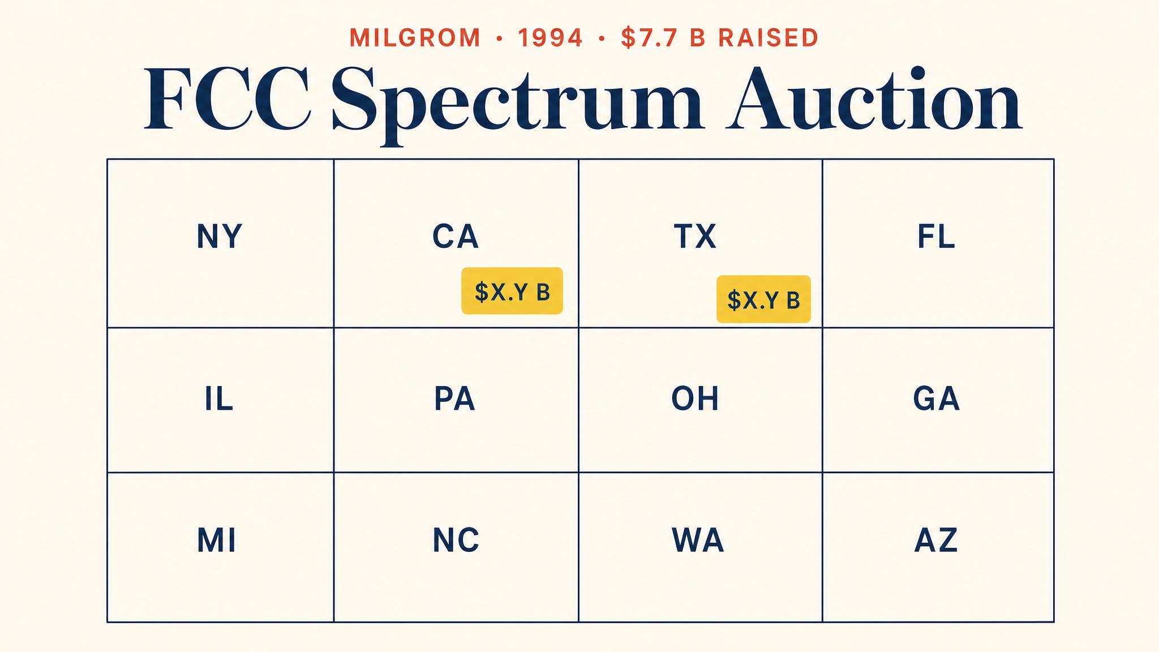
Notes:
Milgrom and Wilson designed the Simultaneous Multiple Round auction. All licences open at once, price discovery over many rounds, activity rules to prevent strategic holdouts. The narrowband auction raised $617 million.

Slide 11
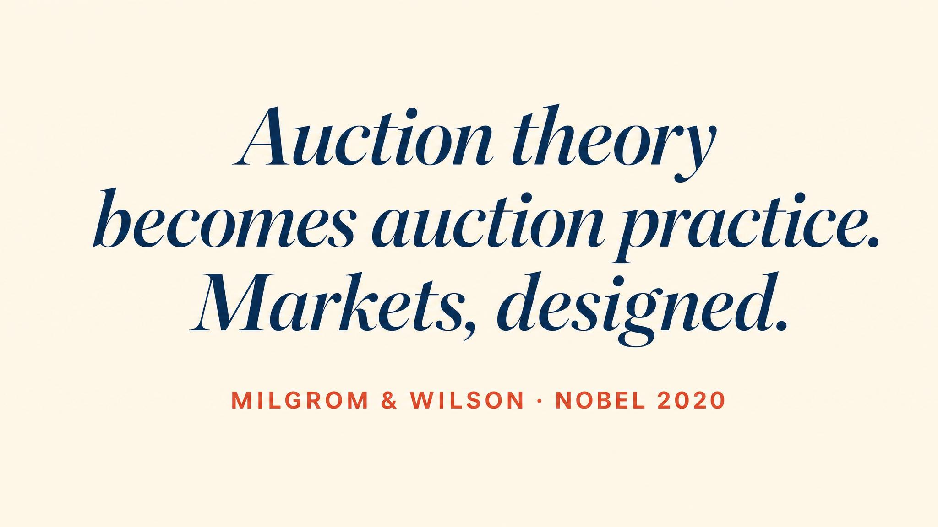
Notes:
October 2020. The Royal Swedish Academy awarded the Nobel to Milgrom and Wilson for improvements to auction theory and inventions of new auction formats. Theory meets practice.

Slide 12
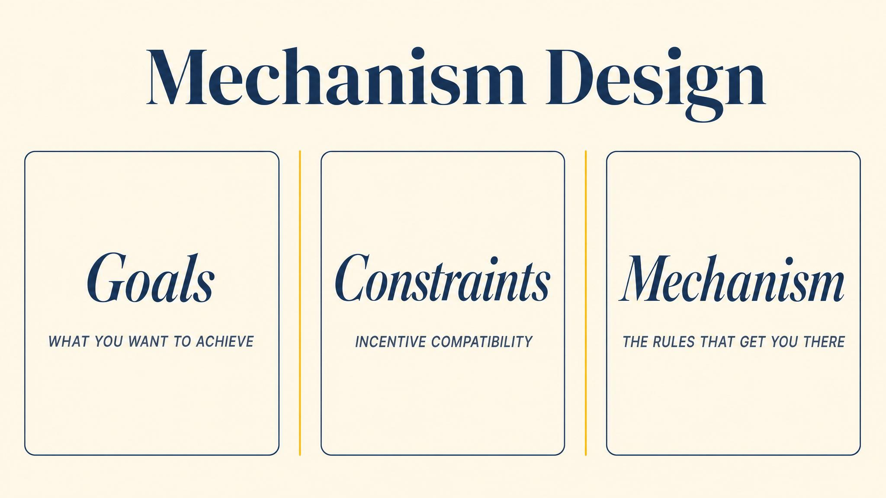
Notes:
Mechanism design — pioneered by Myerson in 1981 among others — flips the question. Not how players behave in a given game, but how to design the game to achieve a desired outcome.

Slide 13
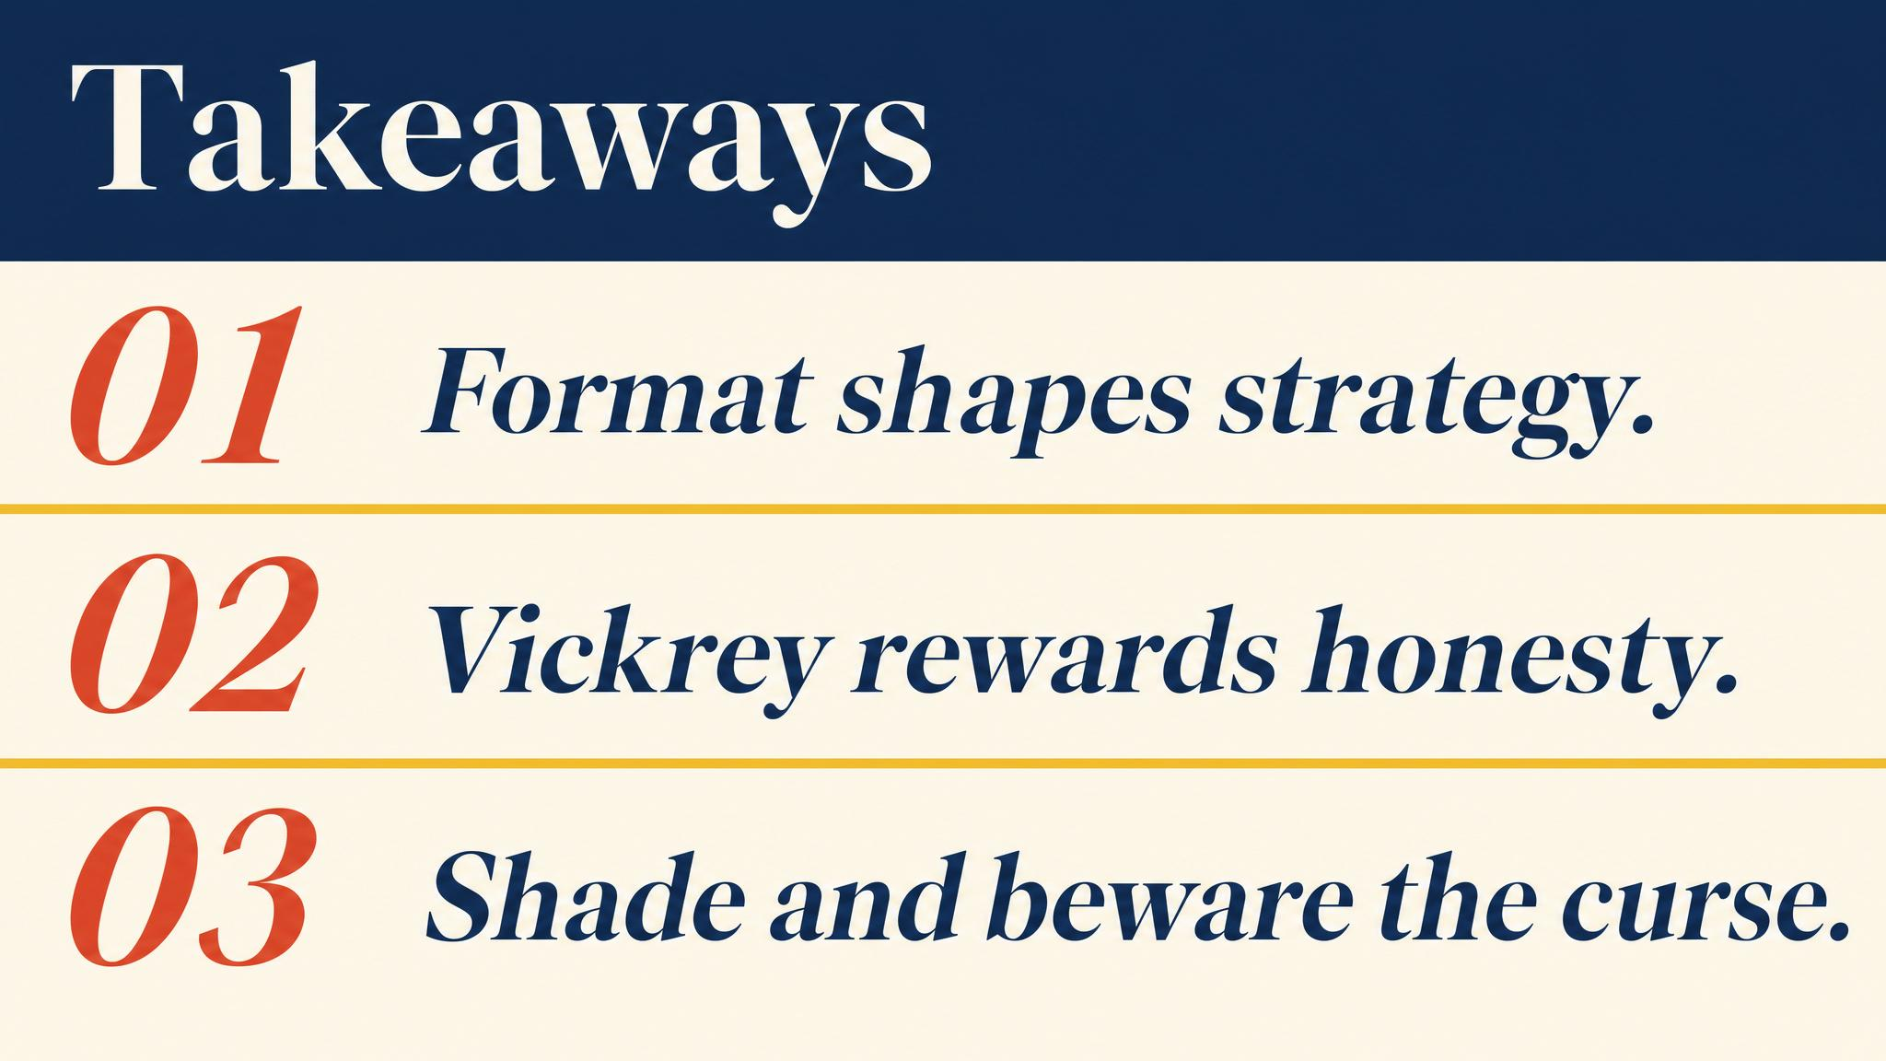
Notes:
Three lessons. Vickrey's second-price rule makes honesty weakly dominant. Under standard assumptions, all four formats raise the same expected revenue. The winner's curse demands Bayesian updating conditional on having won.

Slide 14
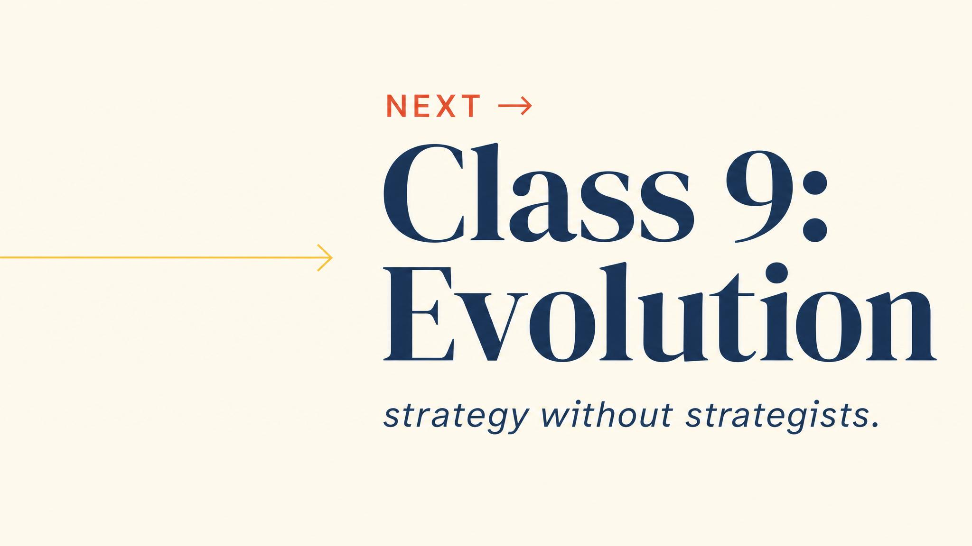
Notes:
Close with the bridge. Auctions are mechanism design with rational human players. Next chapter swaps rational deliberation for natural selection and finds the same equilibrium concepts in biology.

