Slide 1
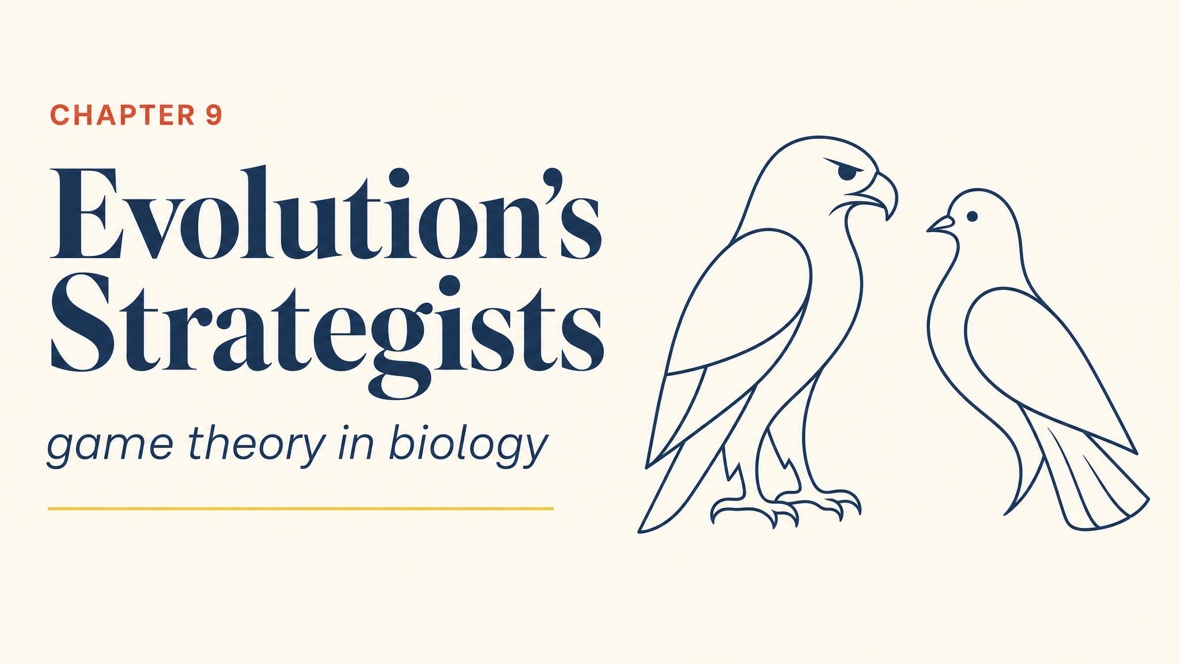
Notes:
Open with two red deer disengaging from an antler-locked fight. Why restraint? Maynard Smith and Price 1973 asked the game-theoretic question: what if natural selection is the force that picks strategies?

Slide 2
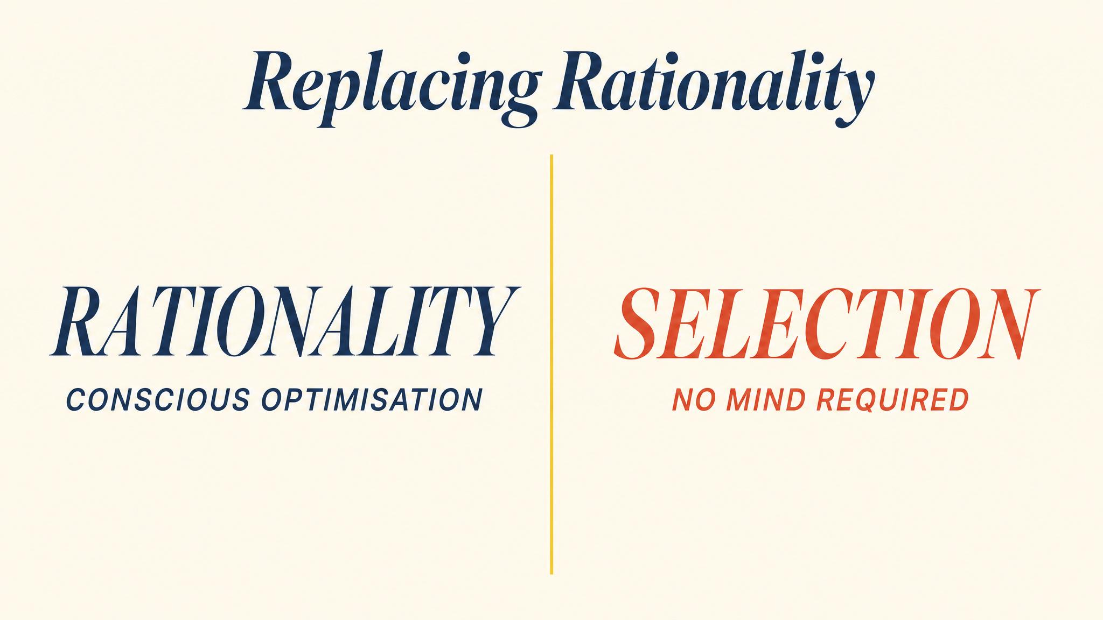
Notes:
Replace rational choice with natural selection. Replace payoff with reproductive fitness. The mathematics of game theory then applies to any population of interacting organisms.

Slide 3
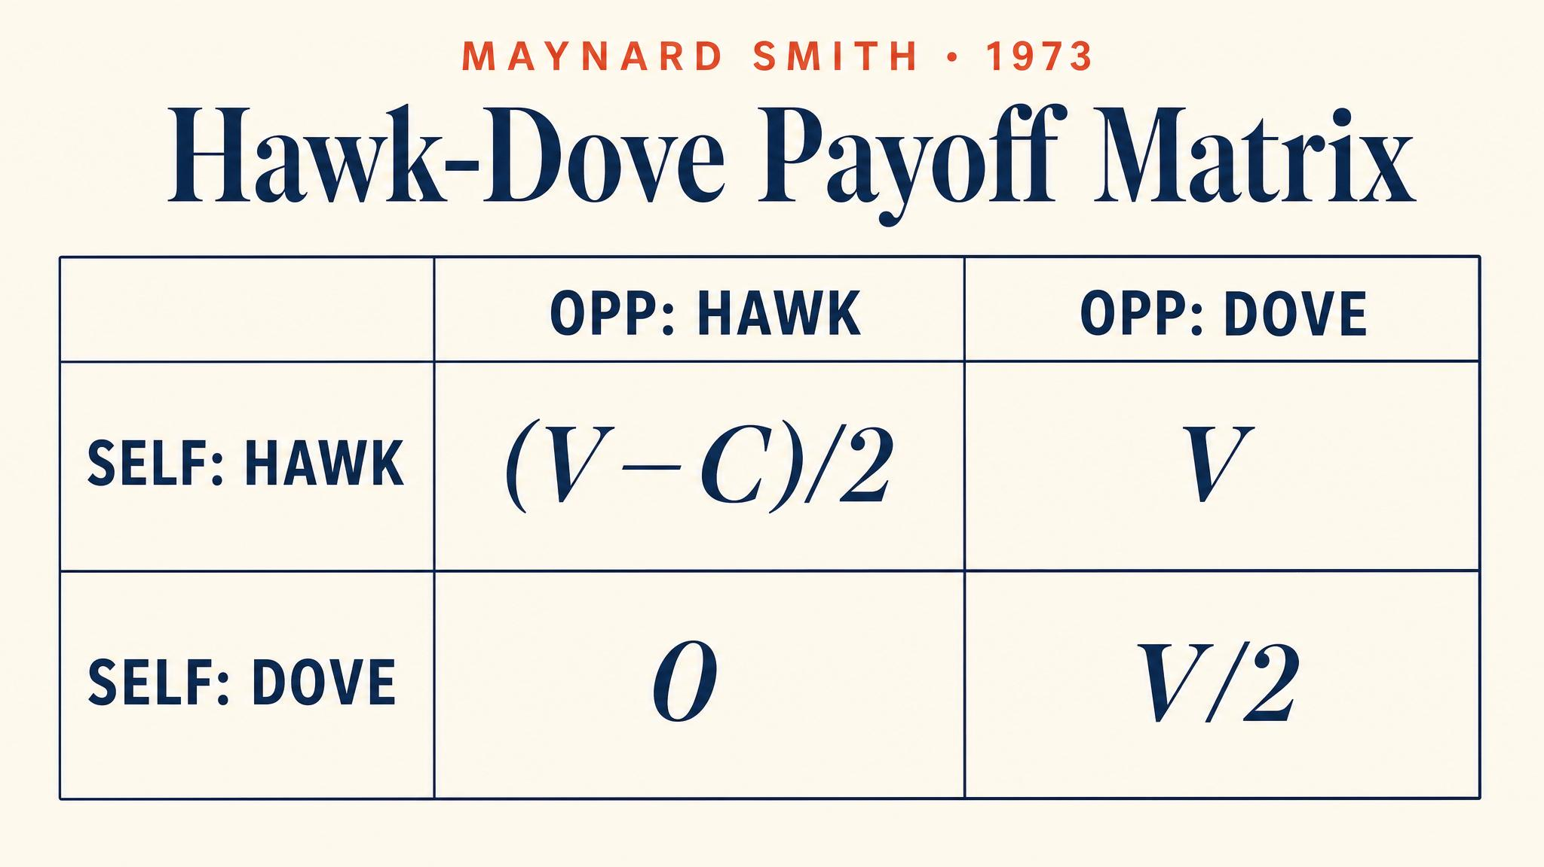
Notes:
Hawk-Dove. V is resource value, C is injury cost. Hawk versus Hawk yields (V−C)/2. Hawk beats Dove (V to 0). Dove sharing Dove yields V/2 each. When C exceeds V, Hawk-Hawk is negative.

Slide 4
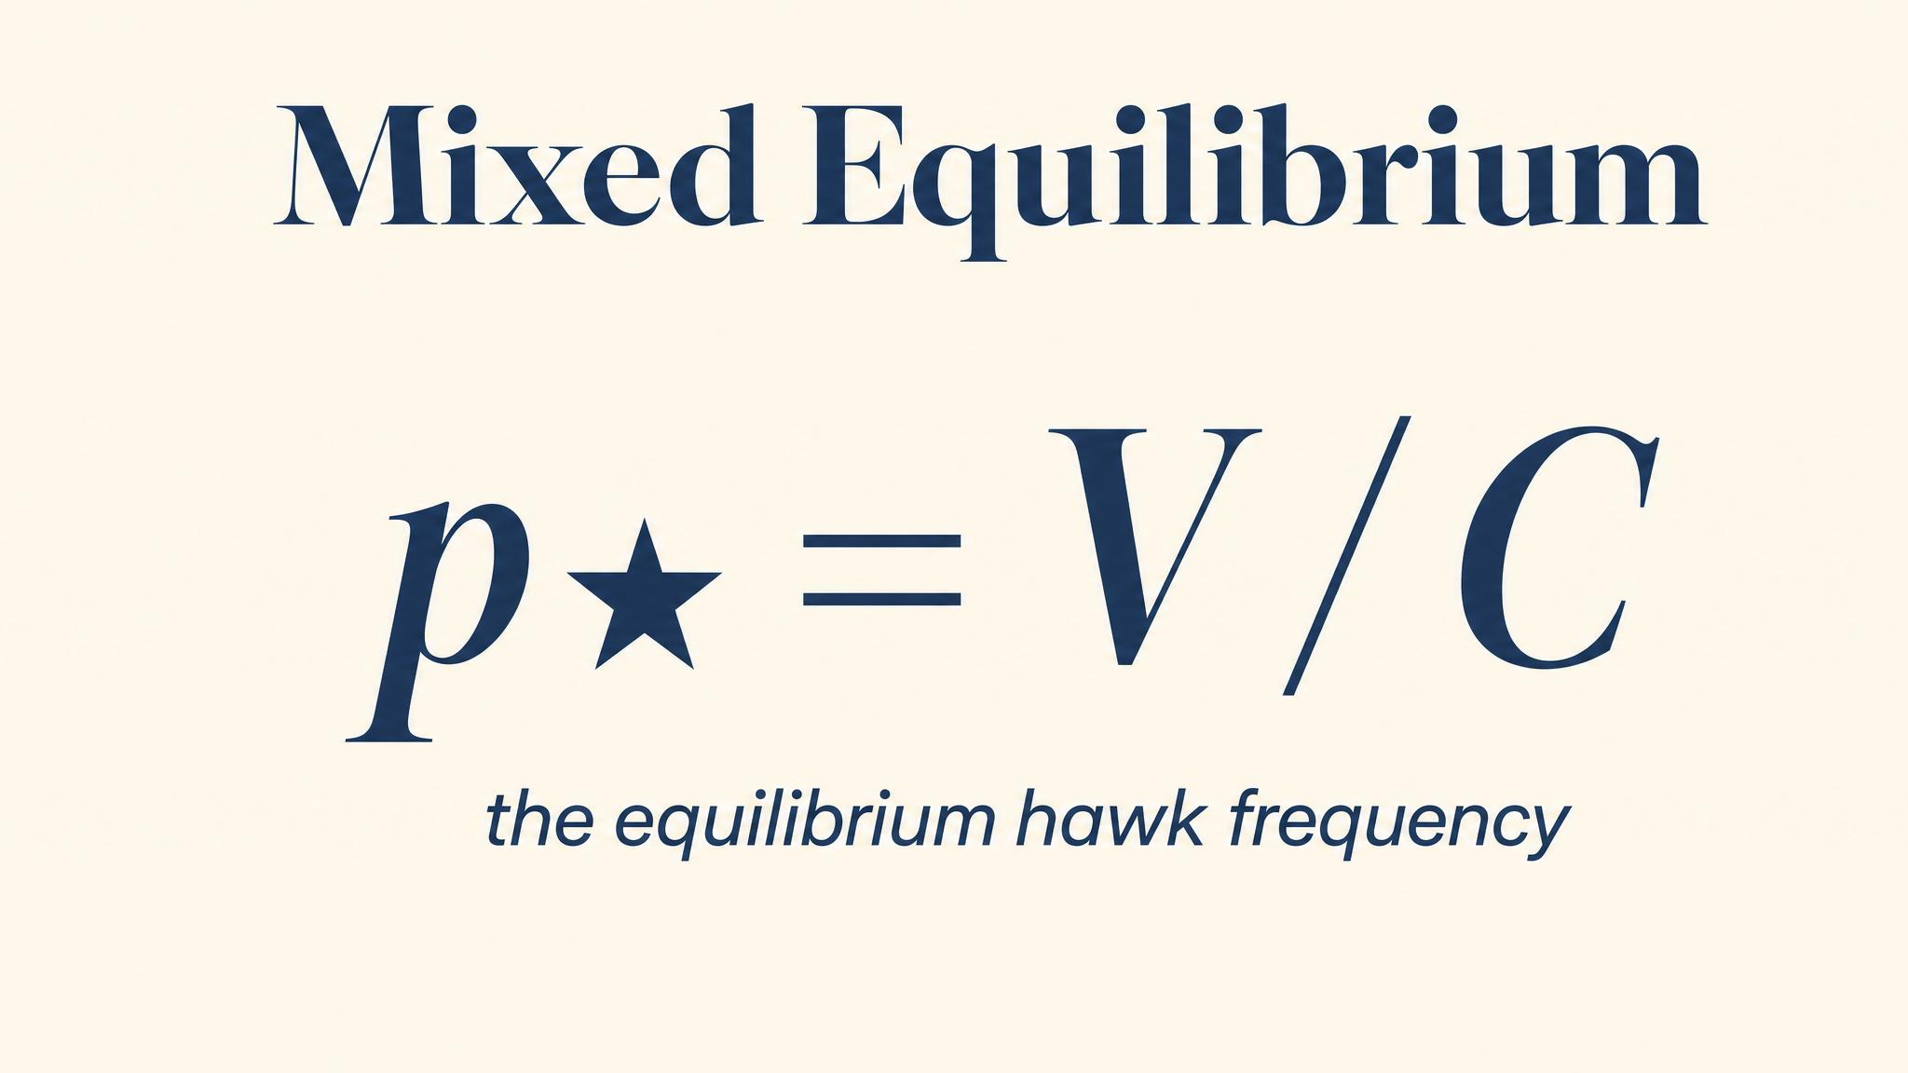
Notes:
Solve and the equilibrium proportion of Hawks is V/C. With V = 4 and C = 10, the population settles at 40% Hawks. Either each individual mixes — or the population is genetically polymorphic. Evolution doesn't care which.

Slide 5
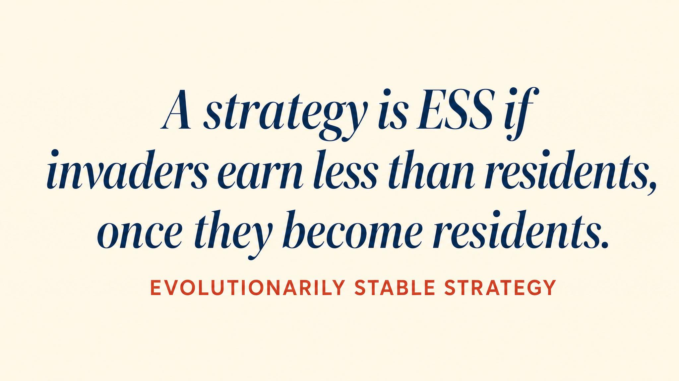
Notes:
An ESS is a strategy that cannot be invaded by any rare mutant. Formally: best-response to itself, plus a stability condition that handles ties against equally-fit mutants.

Slide 6
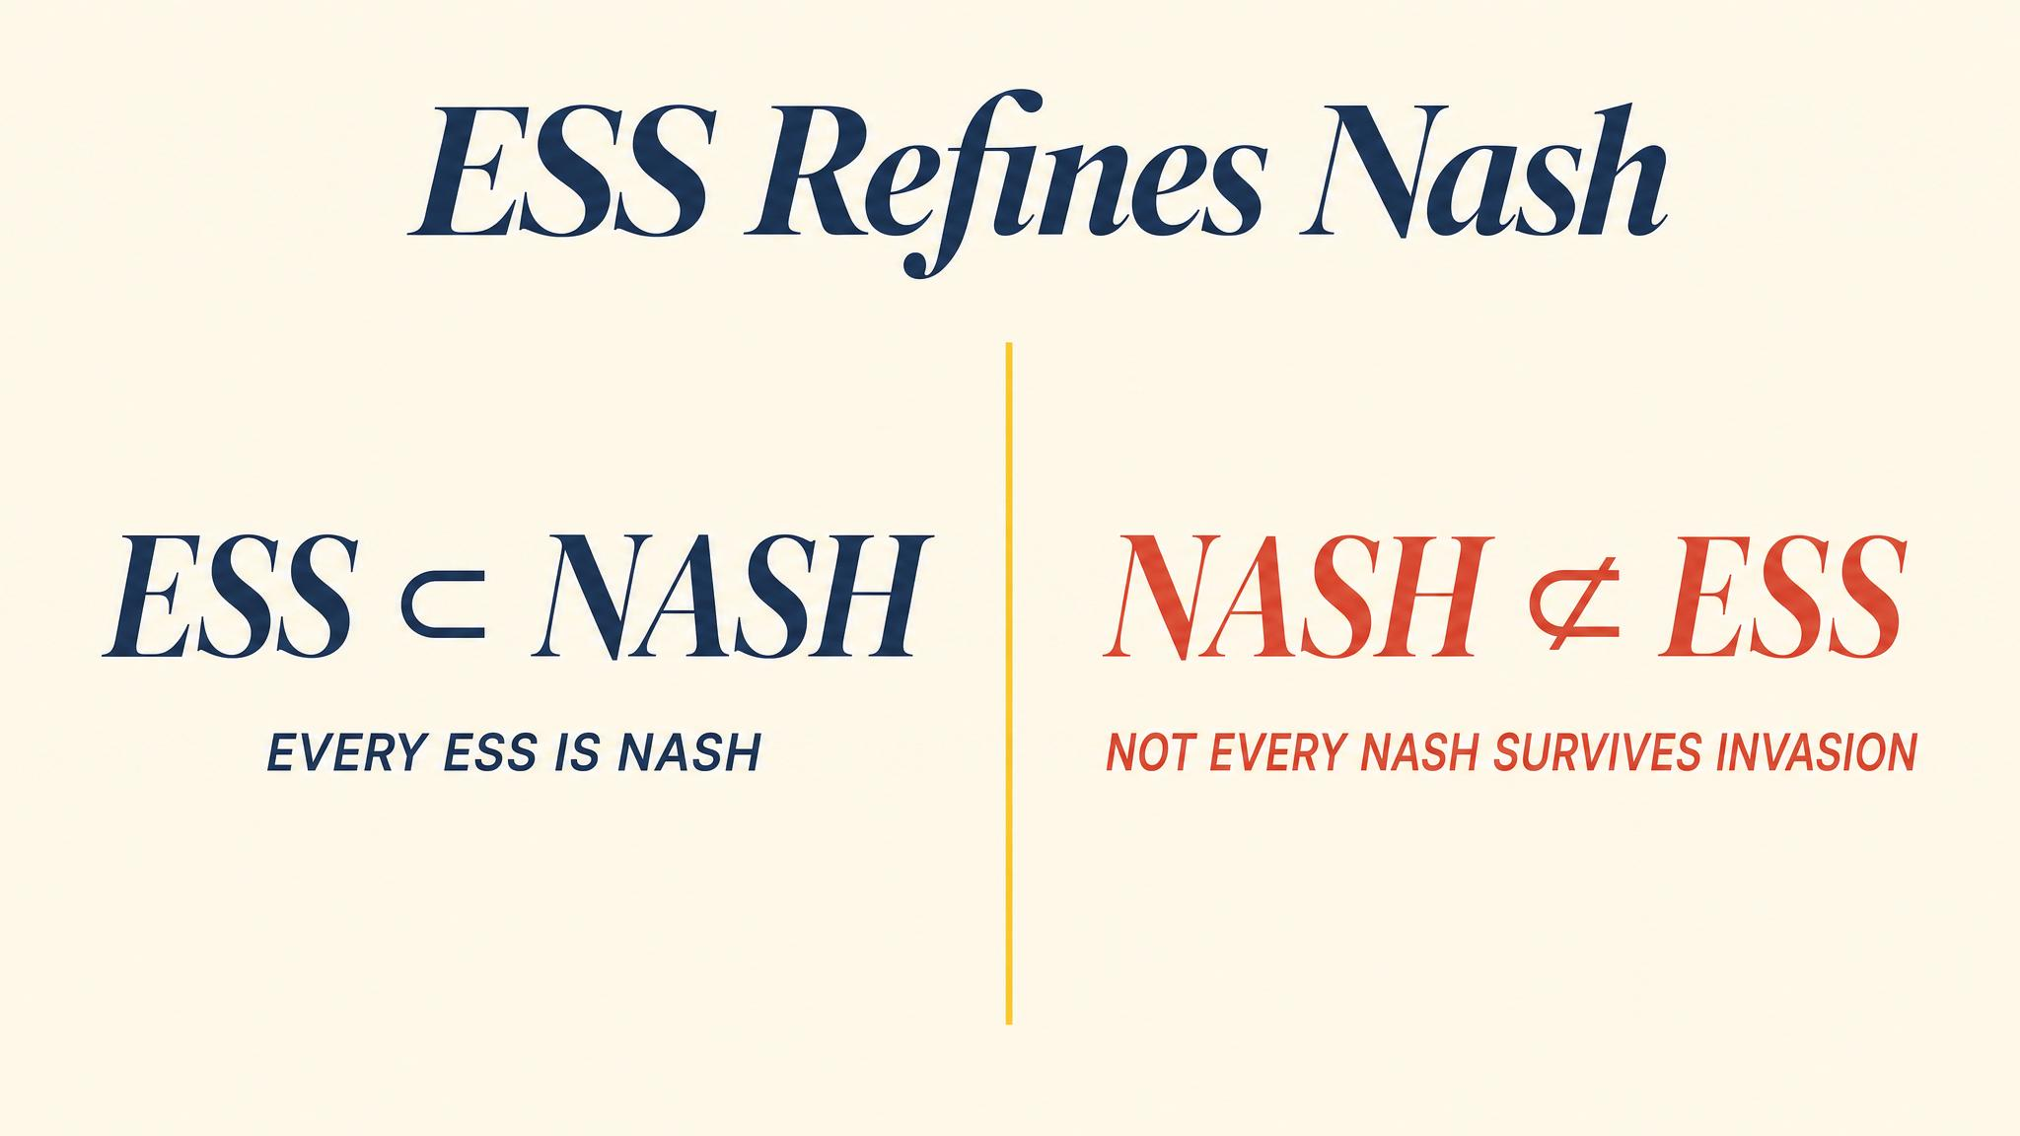
Notes:
ESS sits inside Nash. Every ESS is a Nash equilibrium, but not every Nash equilibrium is an ESS. The added stability requirement filters out equilibria that collapse under small perturbations.

Slide 7
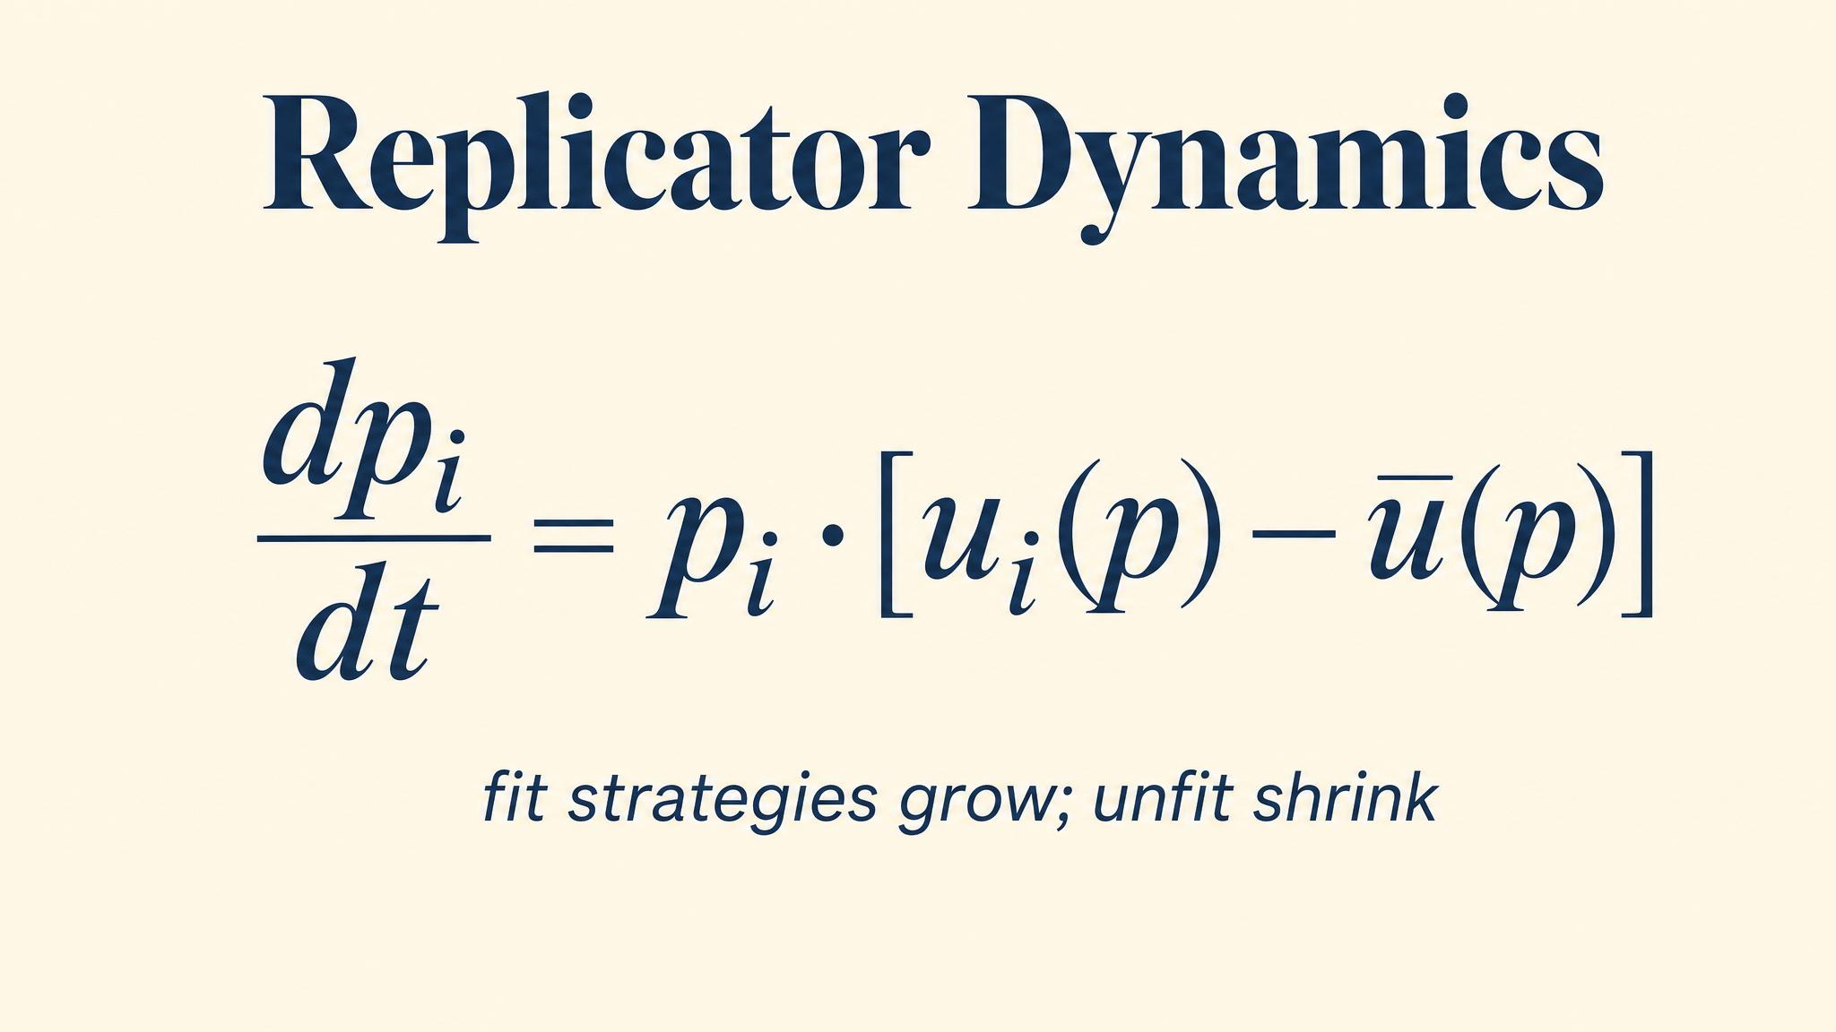
Notes:
Taylor and Jonker 1978. Strategies earning above-average payoffs grow; those below shrink. The rest points of the dynamics correspond to Nash equilibria, and stable rest points include the ESS.

Slide 8
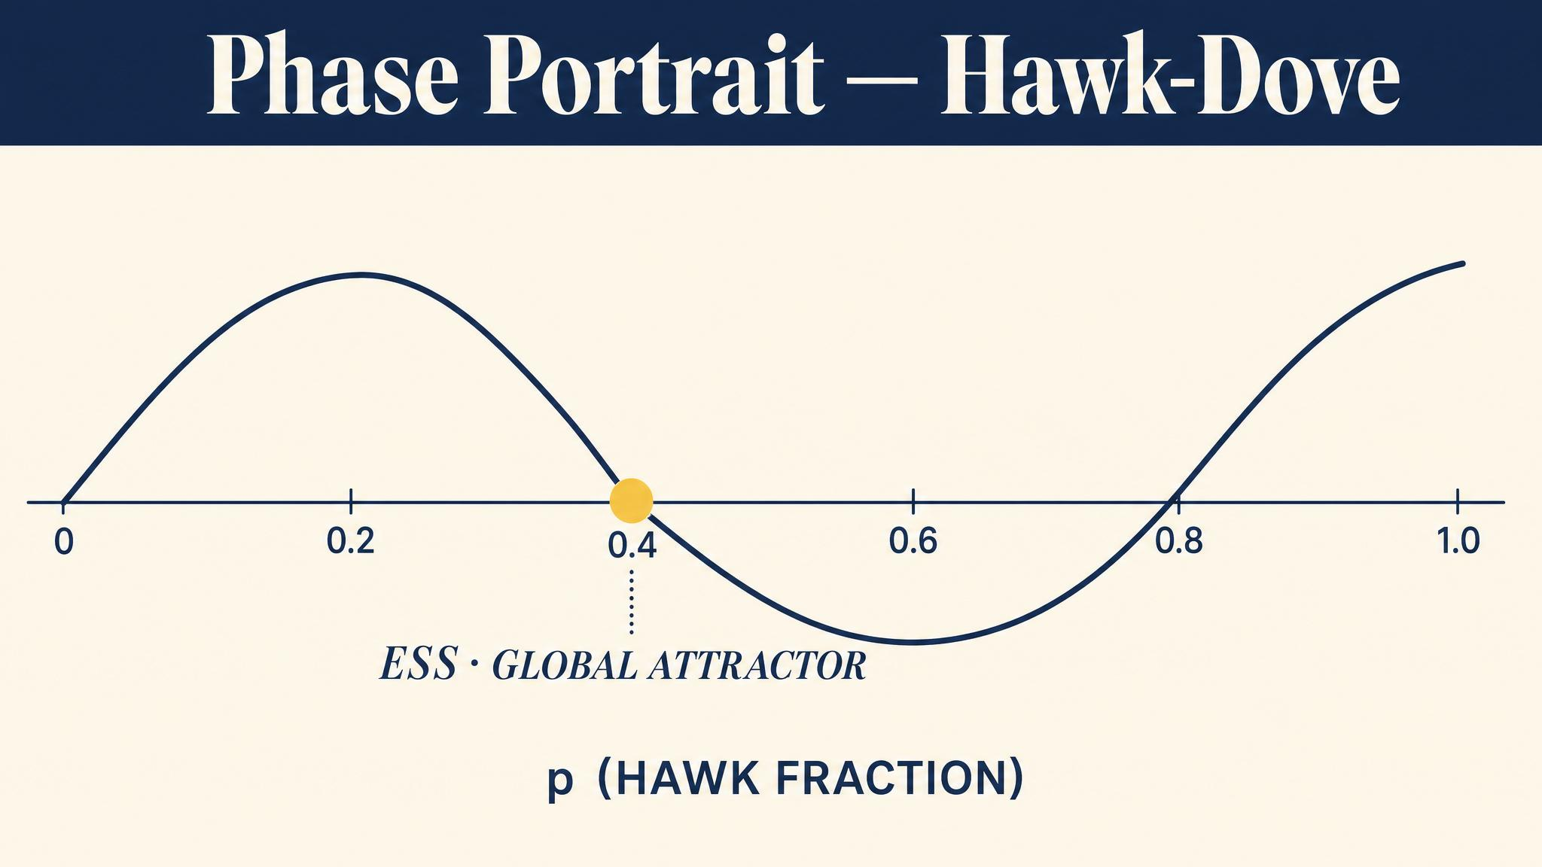
Notes:
If Hawks outnumber V/C, they destroy each other and Doves grow. If Doves outnumber 1 − V/C, Hawks feast and grow. Only at p* = V/C do fitnesses equalise. The ESS is a global attractor.

Slide 9
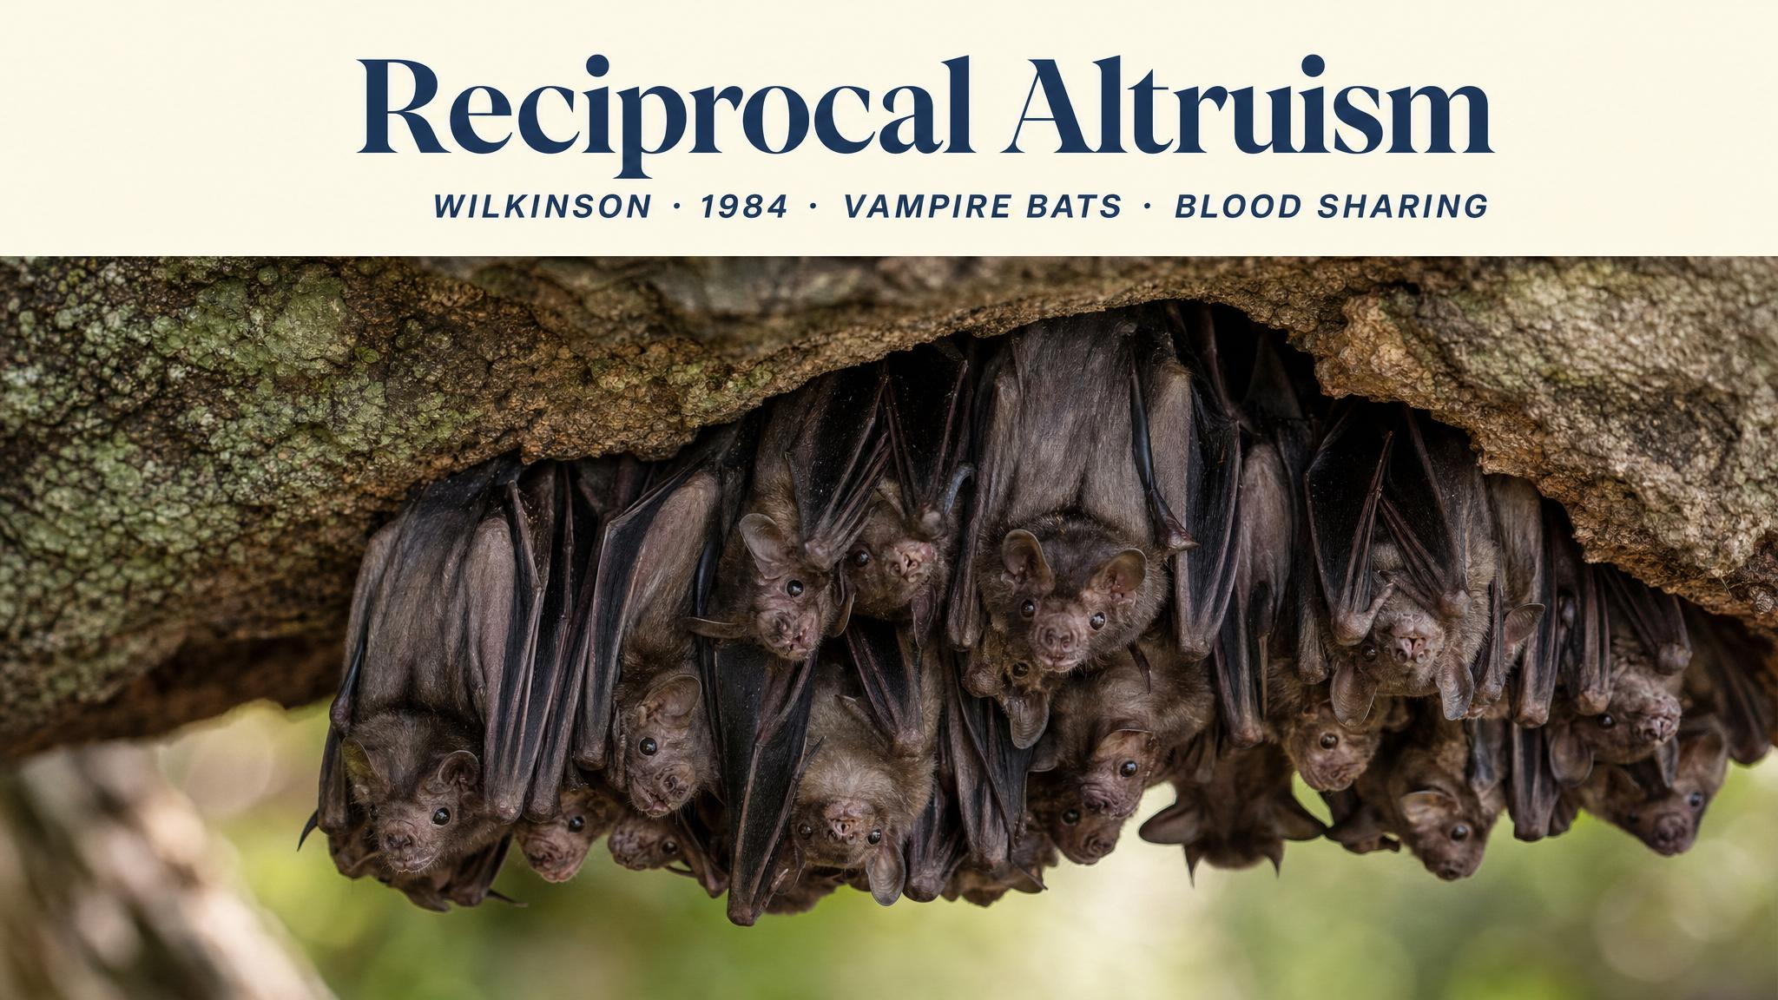
Notes:
Wilkinson 1984. Vampire bats in Costa Rica regurgitate blood to roost-mates who failed to feed. Sharing was preferential — past sharers received future shares. Tit-for-Tat in fur.

Slide 10
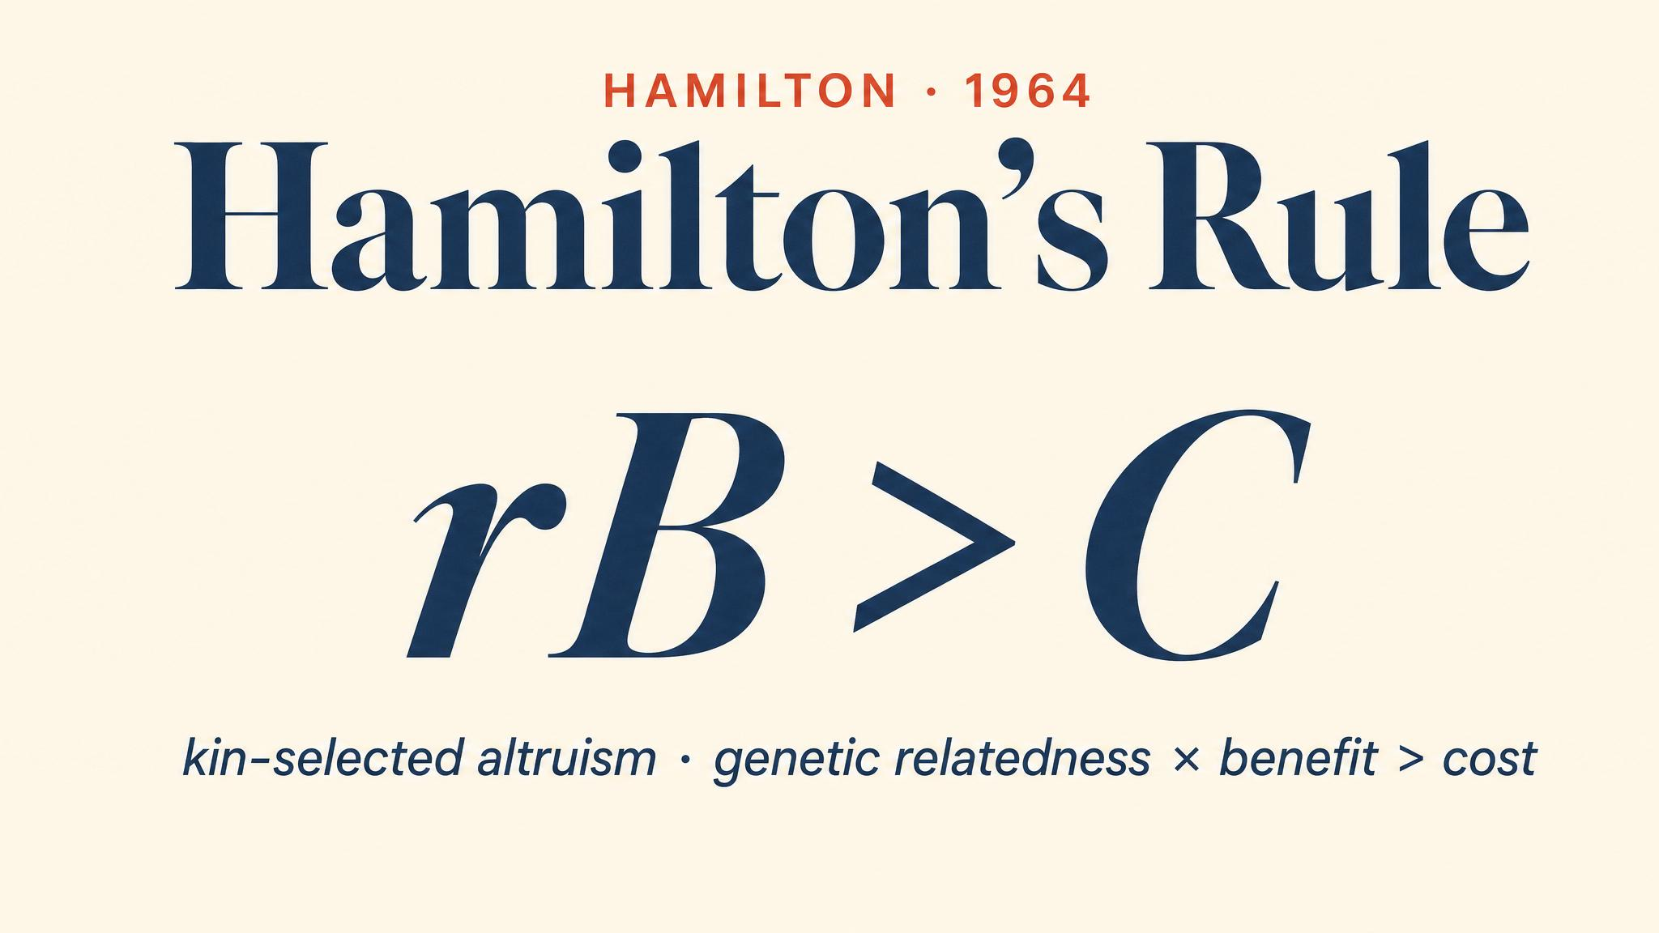
Notes:
Hamilton 1964. An altruistic gene spreads when r times b exceeds c. Siblings share r = 1/2; cousins r = 1/8. Haldane reportedly quipped he would die for two brothers or eight cousins.

Slide 11
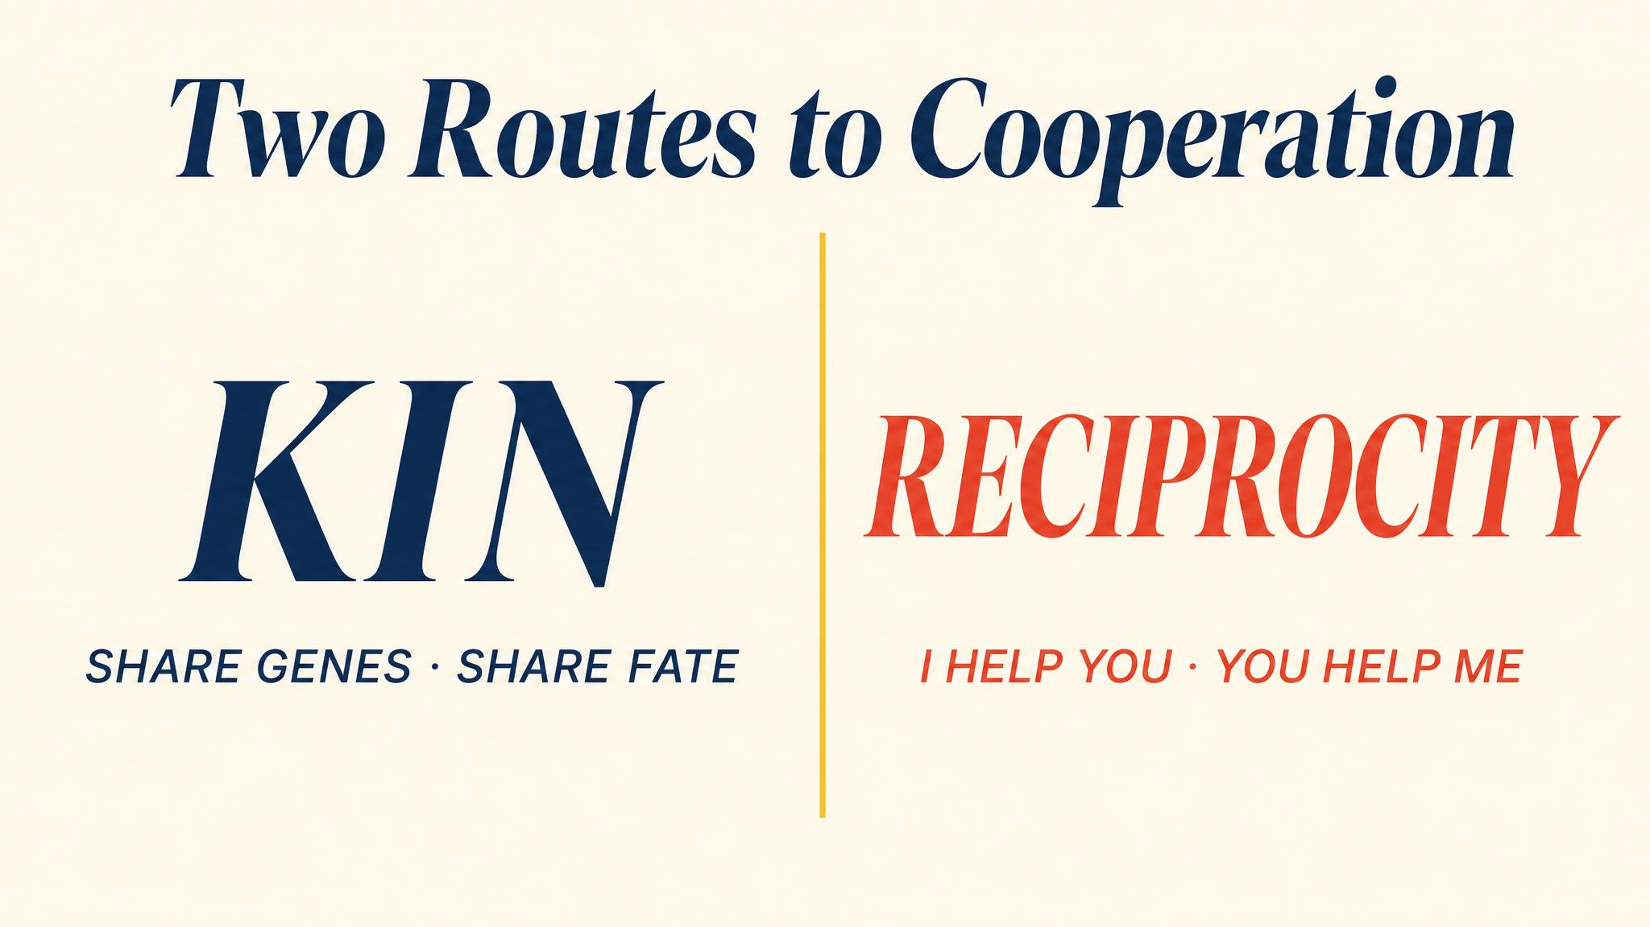
Notes:
Two mechanisms enable biological cooperation. Reciprocal altruism requires repeated interaction. Kin selection requires genetic relatedness. Both achieve cooperation without rational calculation.

Slide 12
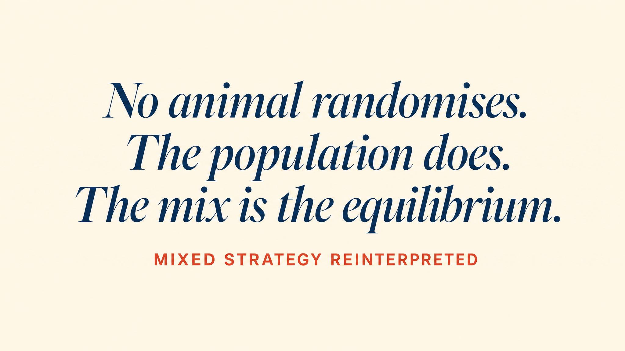
Notes:
Why would a rational player randomise? In biology, no individual randomises. The population-level mix emerges from differential survival of pure types. The interpretation that strained classical theory is natural in the evolutionary frame.

Slide 13
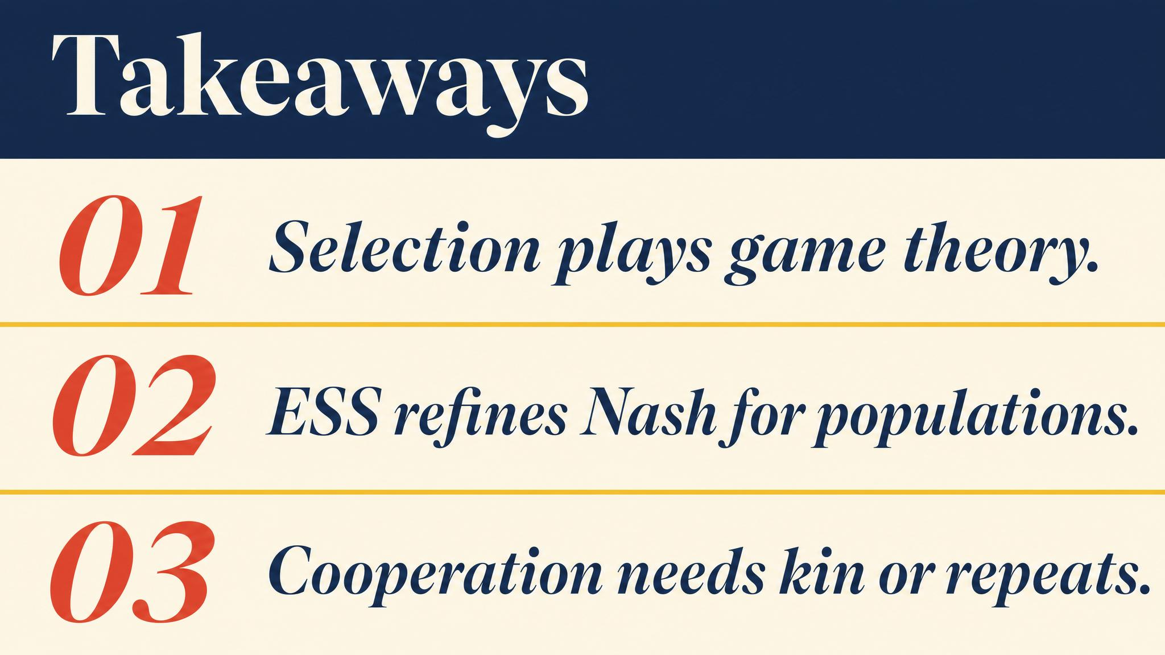
Notes:
Three lessons. ESS adds stability to Nash. Hawk-Dove equilibrium is V/C. Cooperation can evolve without any organism understanding why.

Slide 14
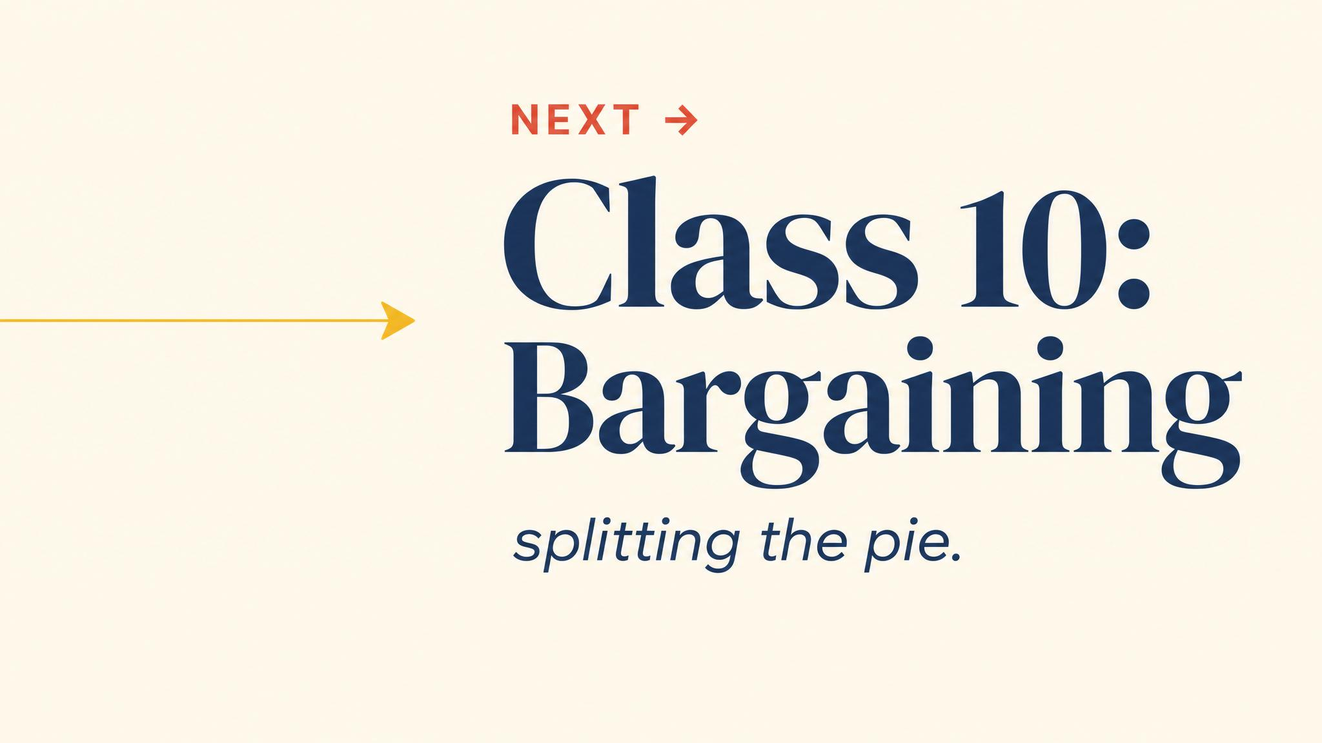
Notes:
Close with the bridge. Evolution showed strategic behaviour without rationality. Next chapter swings back to real humans — boundedly rational, shaped by psychology, emotion, and social context.

