Slide 1
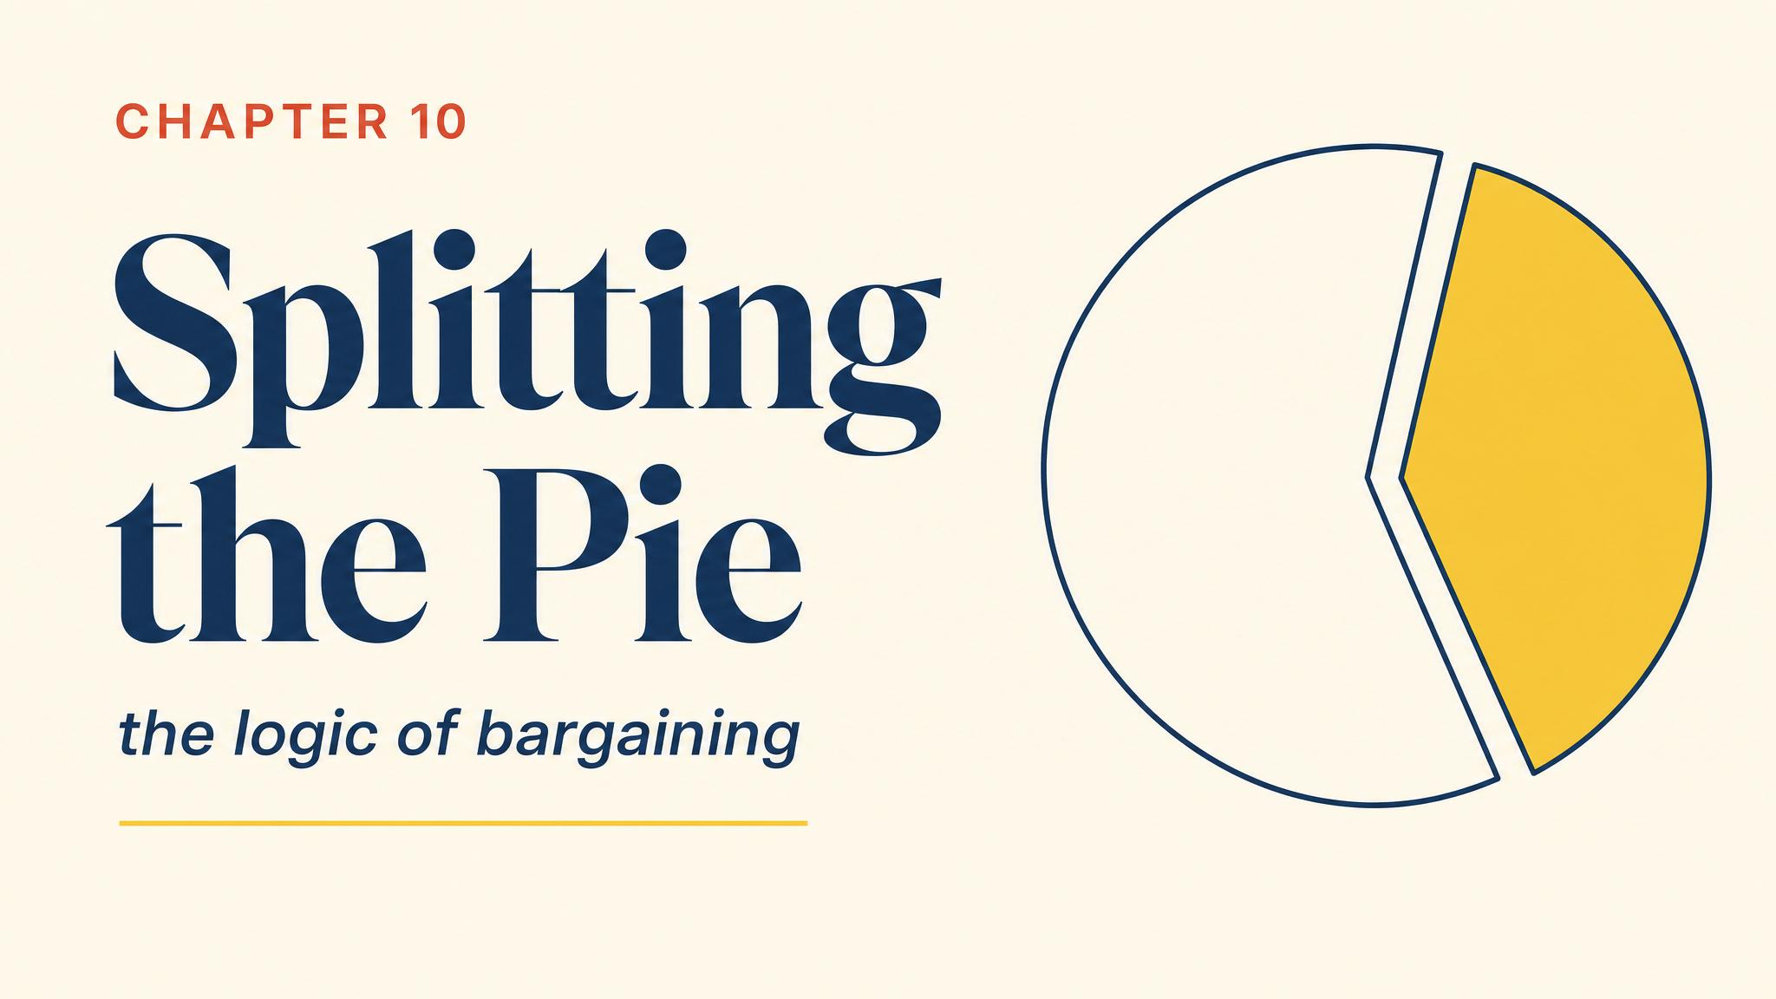
Notes:
Open with Toyota and the Australian automotive workers' union in October 2013. Gains from agreement existed, yet the bargain failed. Structure — not goodwill — determines who gets what.

Slide 2
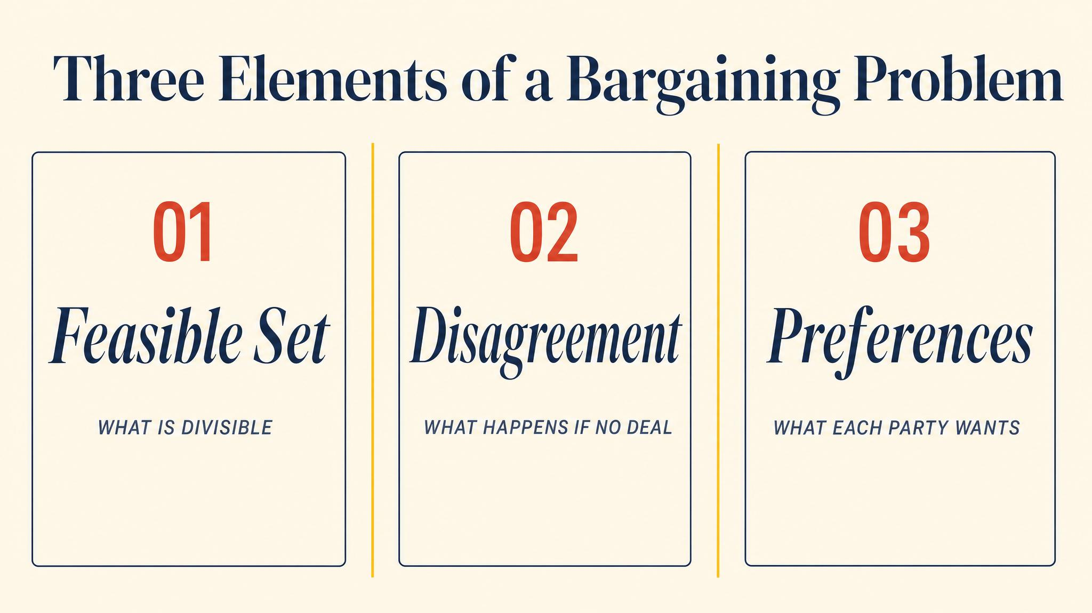
Notes:
A bargaining problem has three formal elements. The set of feasible agreements. The disagreement point d — what each party gets if talks fail. And utility functions over outcomes.

Slide 3
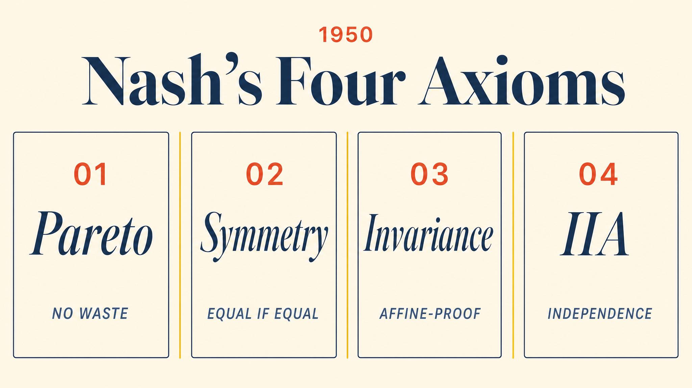
Notes:
John Nash 1950 proposed four axioms. Pareto efficiency, symmetry, scale invariance, and independence of irrelevant alternatives. From these, a unique solution follows.

Slide 4
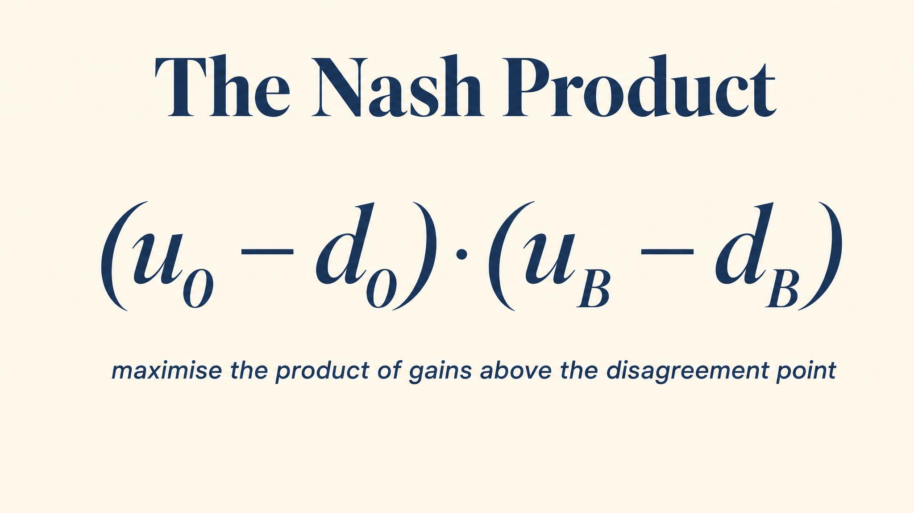
Notes:
The unique solution maximises the Nash product — the product of each player's gain above their disagreement payoff. In the symmetric case, this gives an equal split of the surplus.

Slide 5
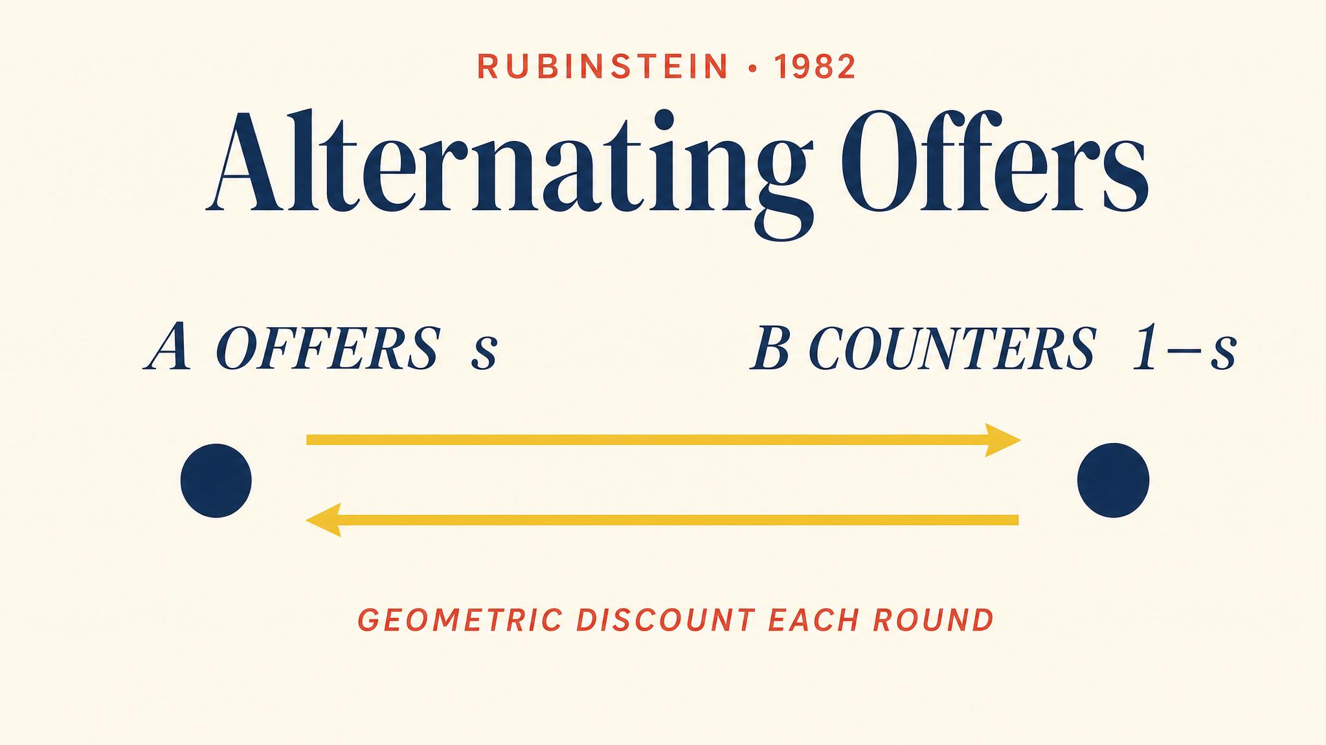
Notes:
Ariel Rubinstein 1982. Two players take turns proposing divisions of a pie. The other accepts and ends the game, or rejects and proposes next period. Time is the strategic ingredient.

Slide 6
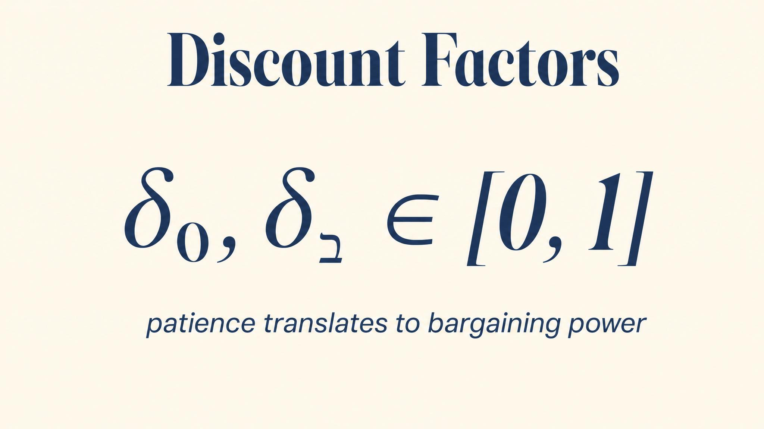
Notes:
Each player has a discount factor between zero and one. Higher delta means more patience. If your delta is 0.9, a dollar tomorrow is worth 90 cents today. Patience translates directly into bargaining leverage.

Slide 7
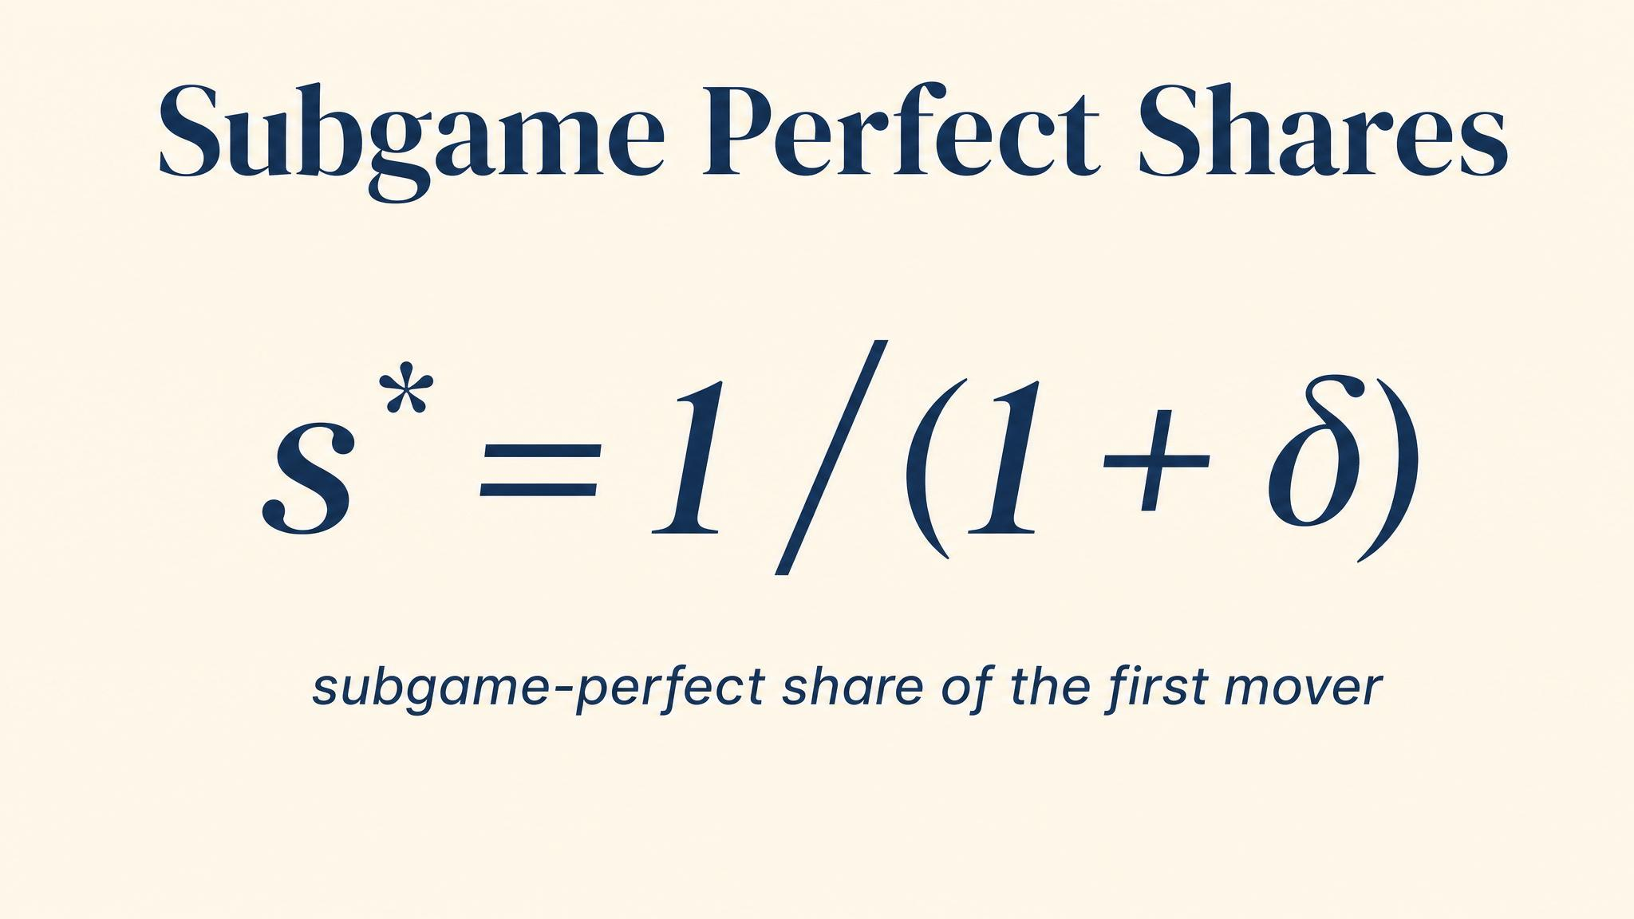
Notes:
Solving the two indifference conditions gives the unique subgame perfect equilibrium. Agreement is immediate. The proposer gets a slight first-mover advantage, and the more patient player captures a larger share.

Slide 8
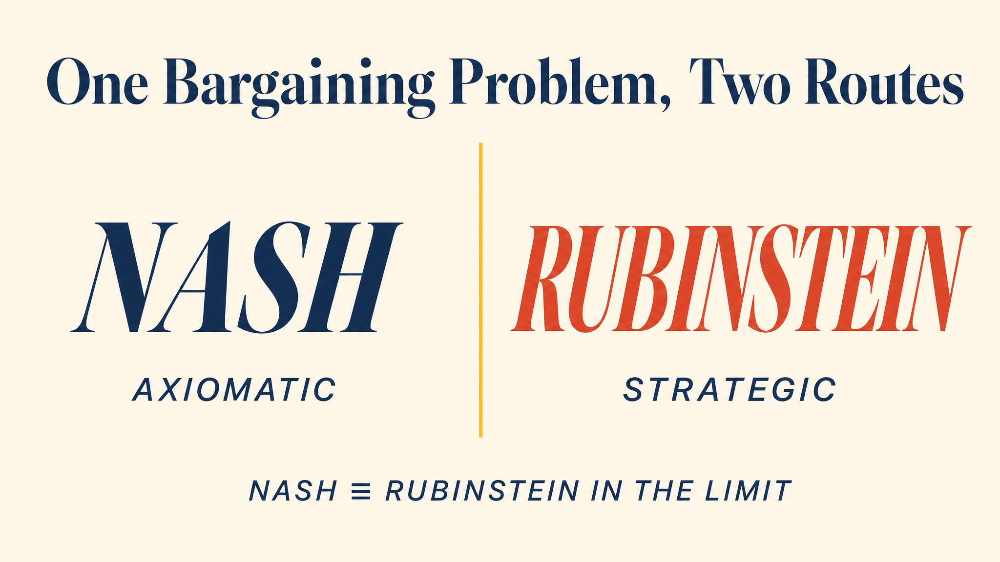
Notes:
Binmore, Rubinstein, and Wolinsky 1986 proved the bridge. As the time between offers shrinks to zero, the Rubinstein equilibrium converges exactly to the Nash bargaining solution. Axioms and strategy meet.

Slide 9
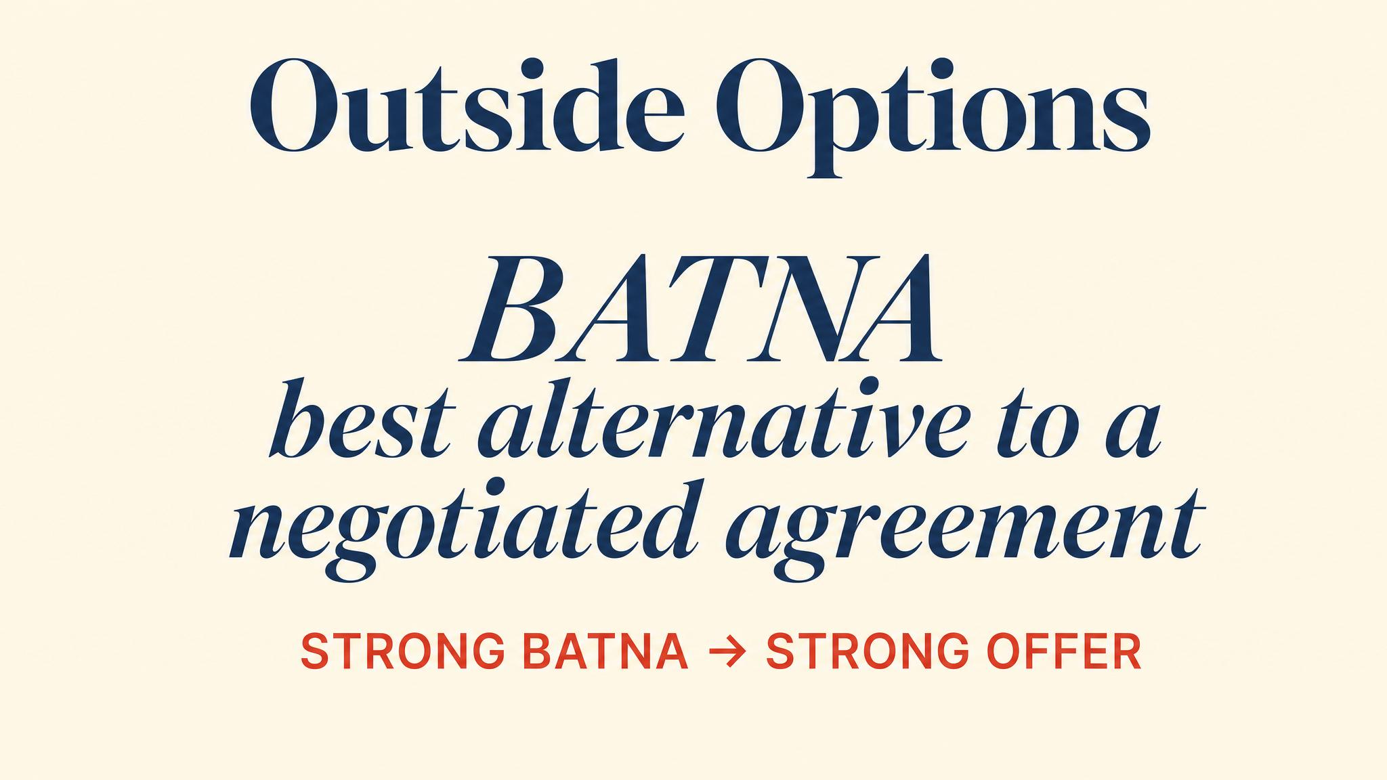
Notes:
Fisher, Ury, and Patton coined BATNA — the Best Alternative to a Negotiated Agreement. In the Nash framework BATNA fixes the disagreement payoff. In the Rubinstein model it fixes the outside option.

Slide 10
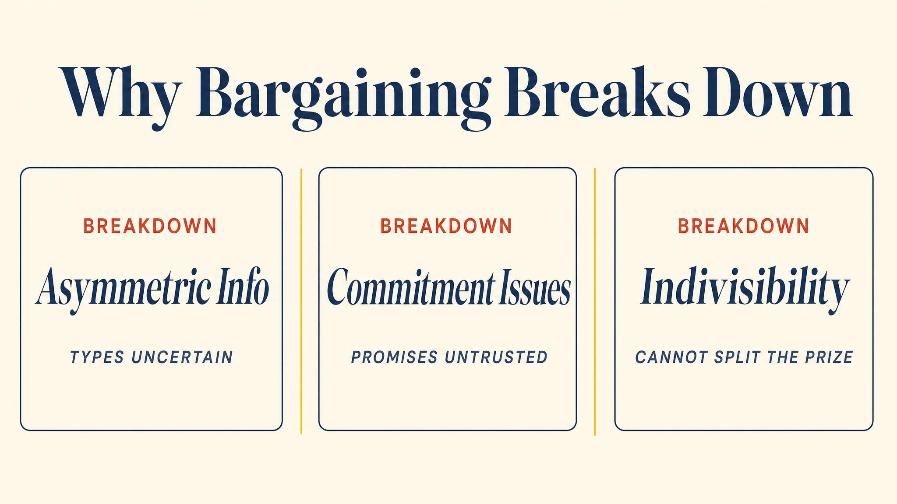
Notes:
Barbara Walter 2009 identifies three mechanisms of bargaining failure in civil wars. Asymmetric information, commitment problems, and issue indivisibility. The same logic explains strikes, lawsuits, and war.

Slide 11
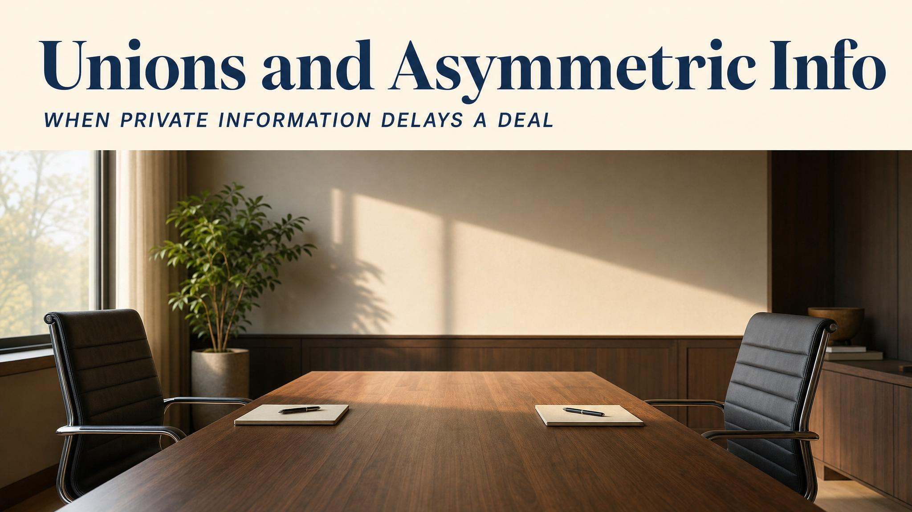
Notes:
Acemoglu and Shimer 1995. Firms know their own profitability; unions do not. The information gap produces costly strikes — a structural source of unemployment beyond complete-information predictions.

Slide 12
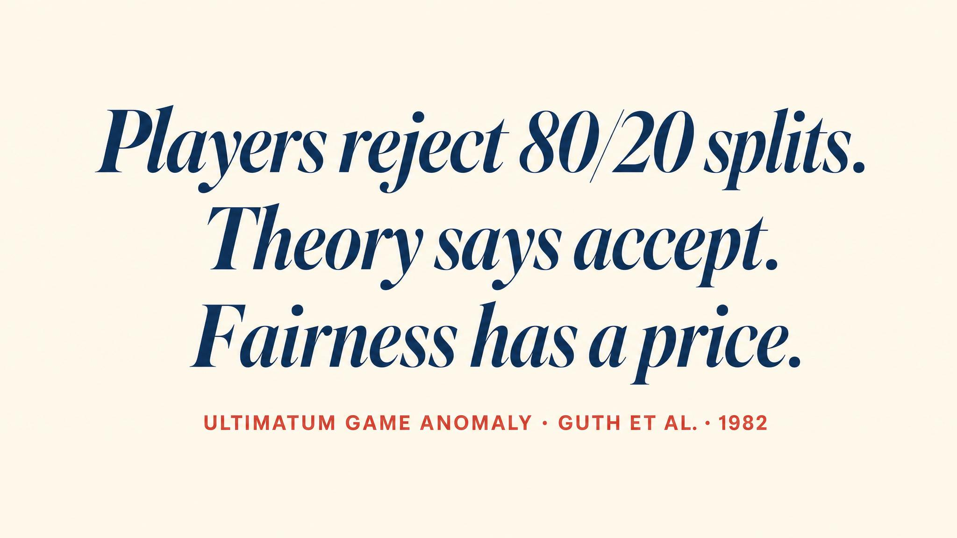
Notes:
Güth, Schmittberger, and Schwarze 1982 introduced the ultimatum game. Proposers offer 40–50%; responders reject offers below about 20%. Self-interest alone cannot explain the data.

Slide 13
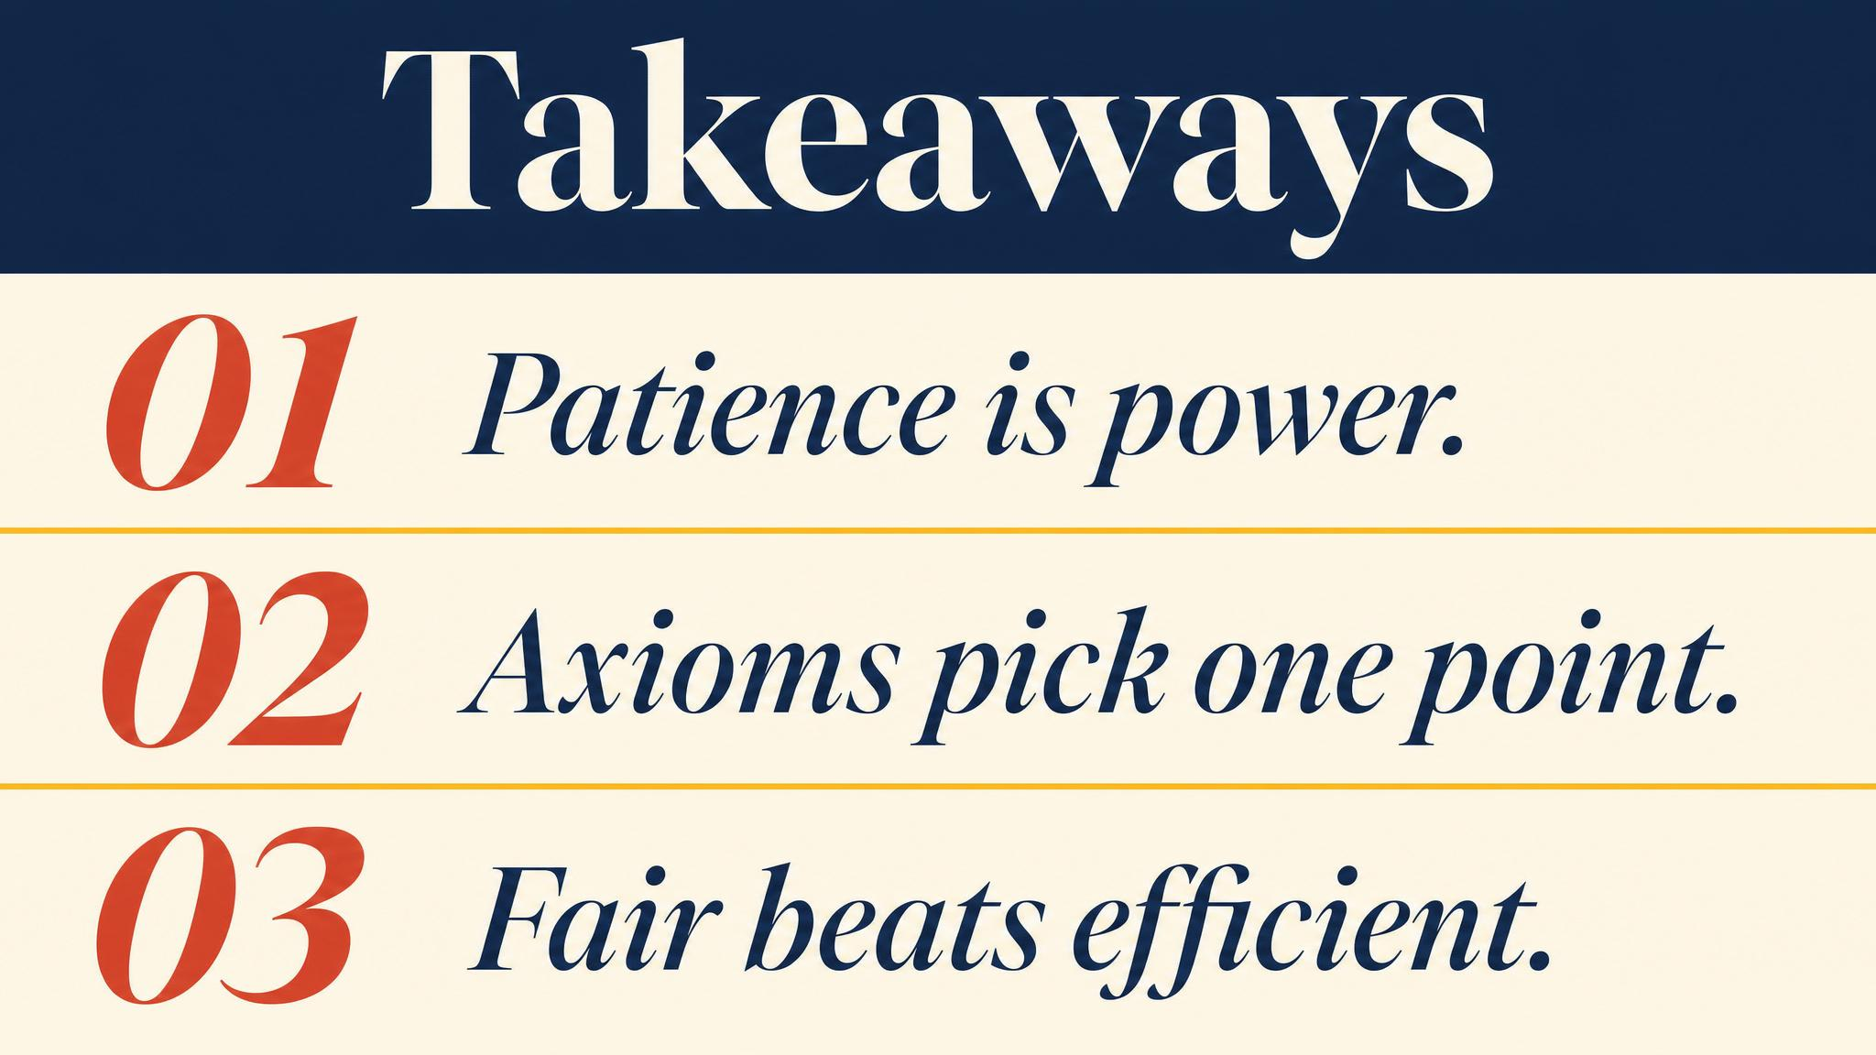
Notes:
Three lessons. The more patient player captures a larger share. Nash's axiomatic and Rubinstein's strategic solutions converge in the limit. BATNA is the primary determinant of bargaining power.

Slide 14
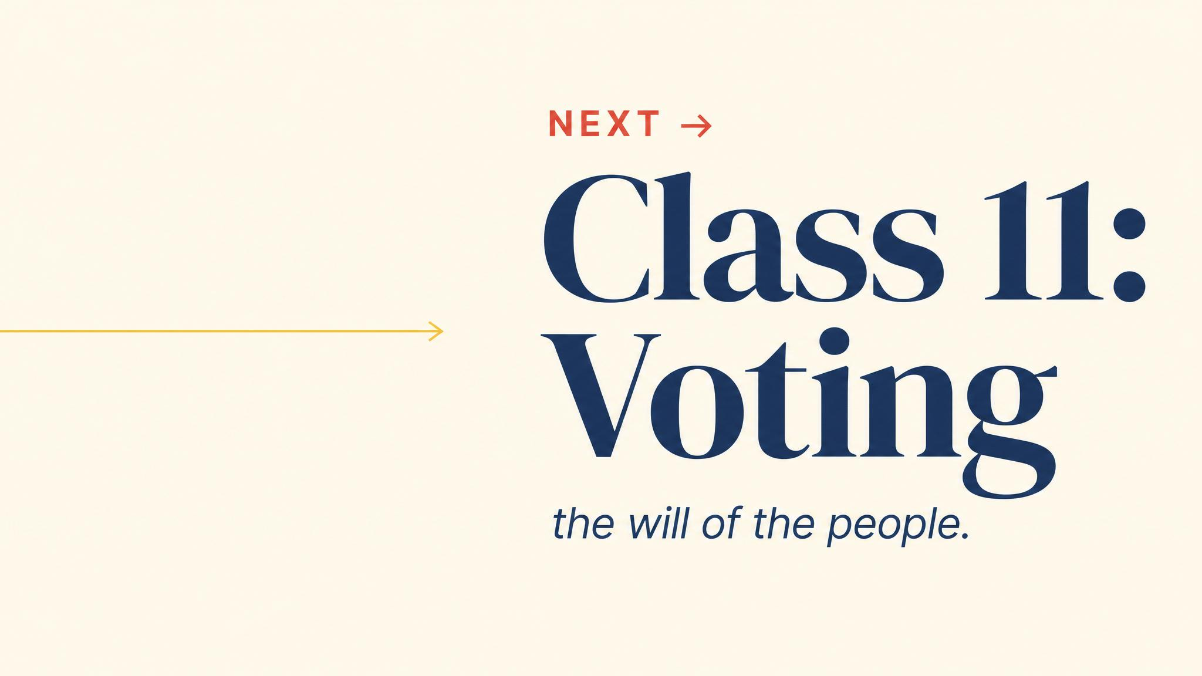
Notes:
Close with the bridge. Two-party bargaining yields a unique split. Group decision-making is far harder — Arrow's impossibility theorem shows aggregating preferences cannot satisfy all reasonable axioms at once.

