Slide 1

Notes:
Open with Florida 2000. Bush led Gore by 537 votes; Nader took 97,488. Whether Bush or Gore was 'the will of the people' depends entirely on which voting rule we use to ask.

Slide 2
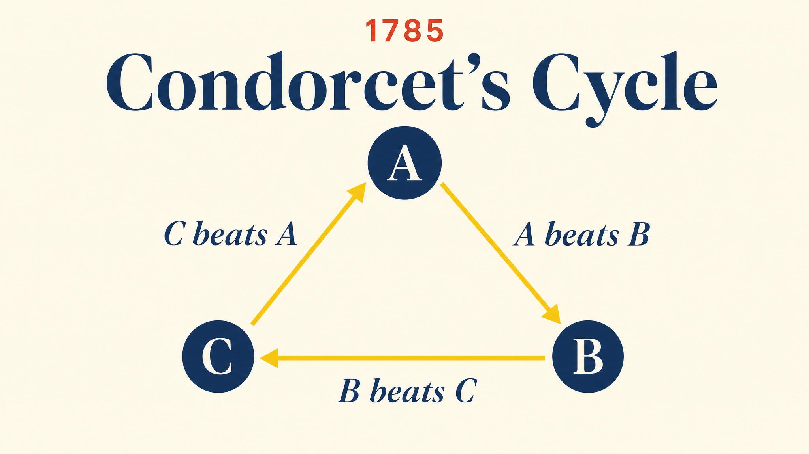
Notes:
Three voters, three options. A beats B by majority, B beats C, but C beats A. The group's majority preferences cycle like rock-paper-scissors. There is no Condorcet winner.

Slide 3
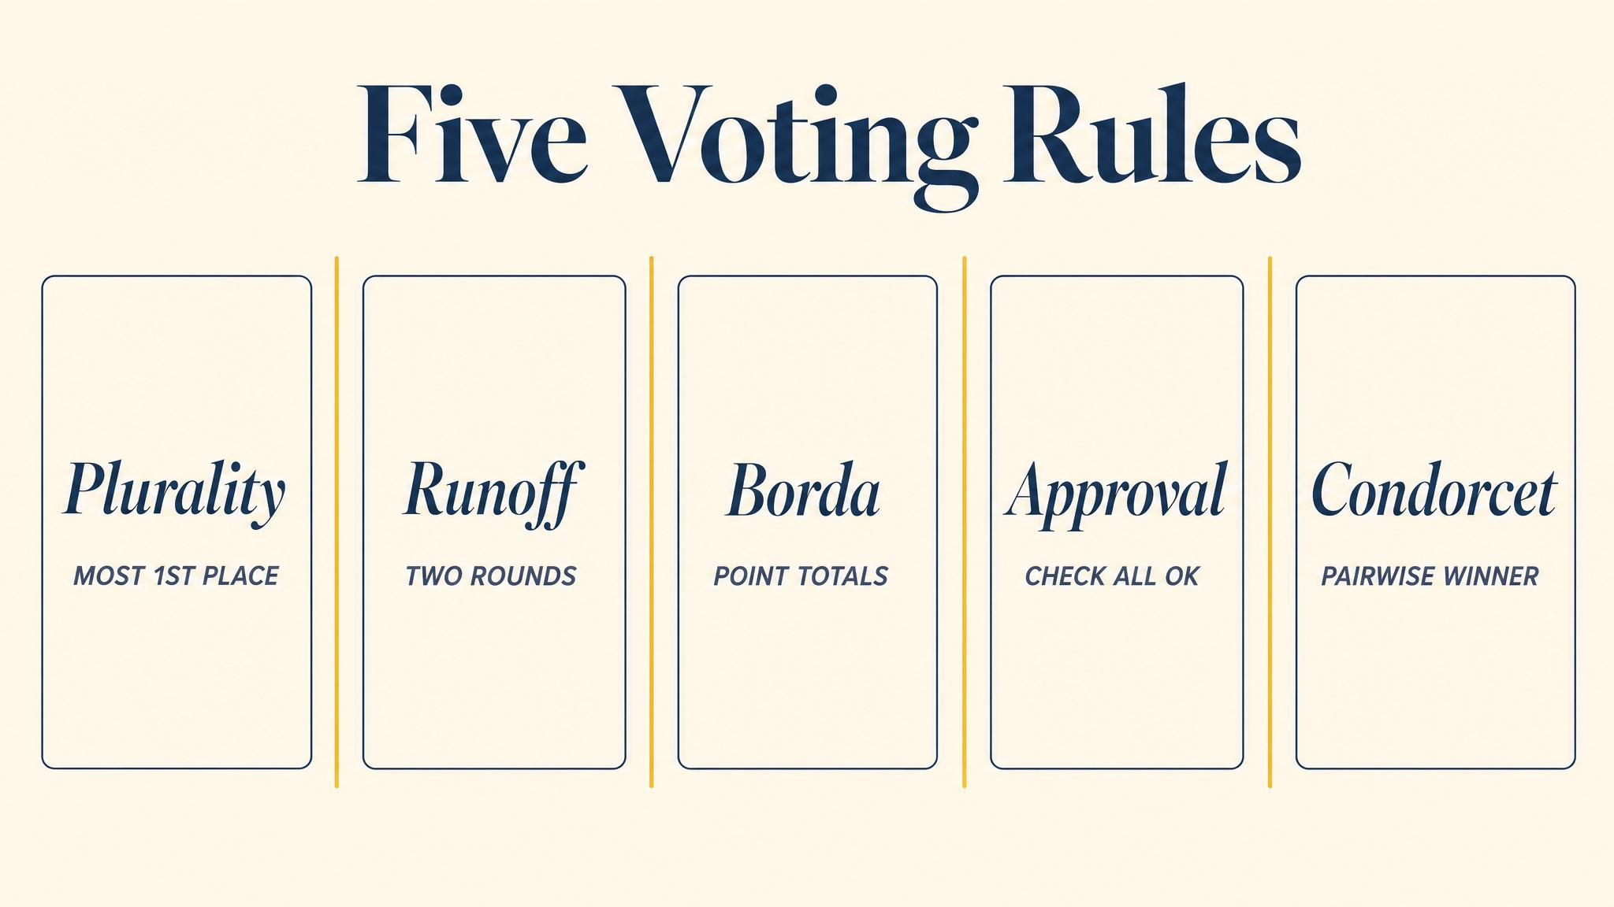
Notes:
Five common voting rules. Plurality, Borda count, instant runoff, Copeland, and approval. Each embodies a different fairness philosophy — and they can disagree on the same preference profile.

Slide 4
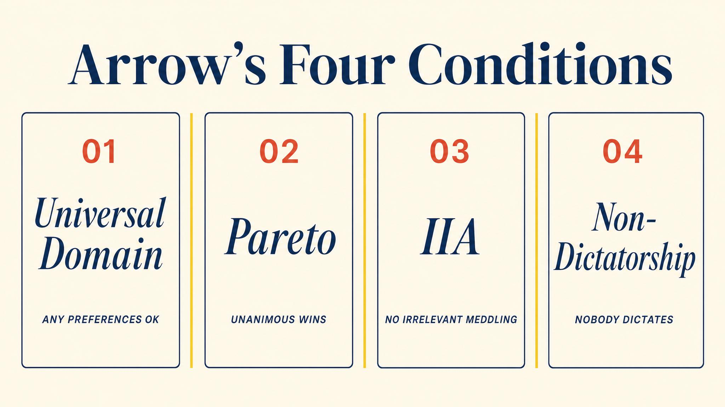
Notes:
Arrow 1951 named four conditions any reasonable voting rule should satisfy. Unrestricted domain, Pareto efficiency, independence of irrelevant alternatives, and non-dictatorship. Each seems indispensable.

Slide 5
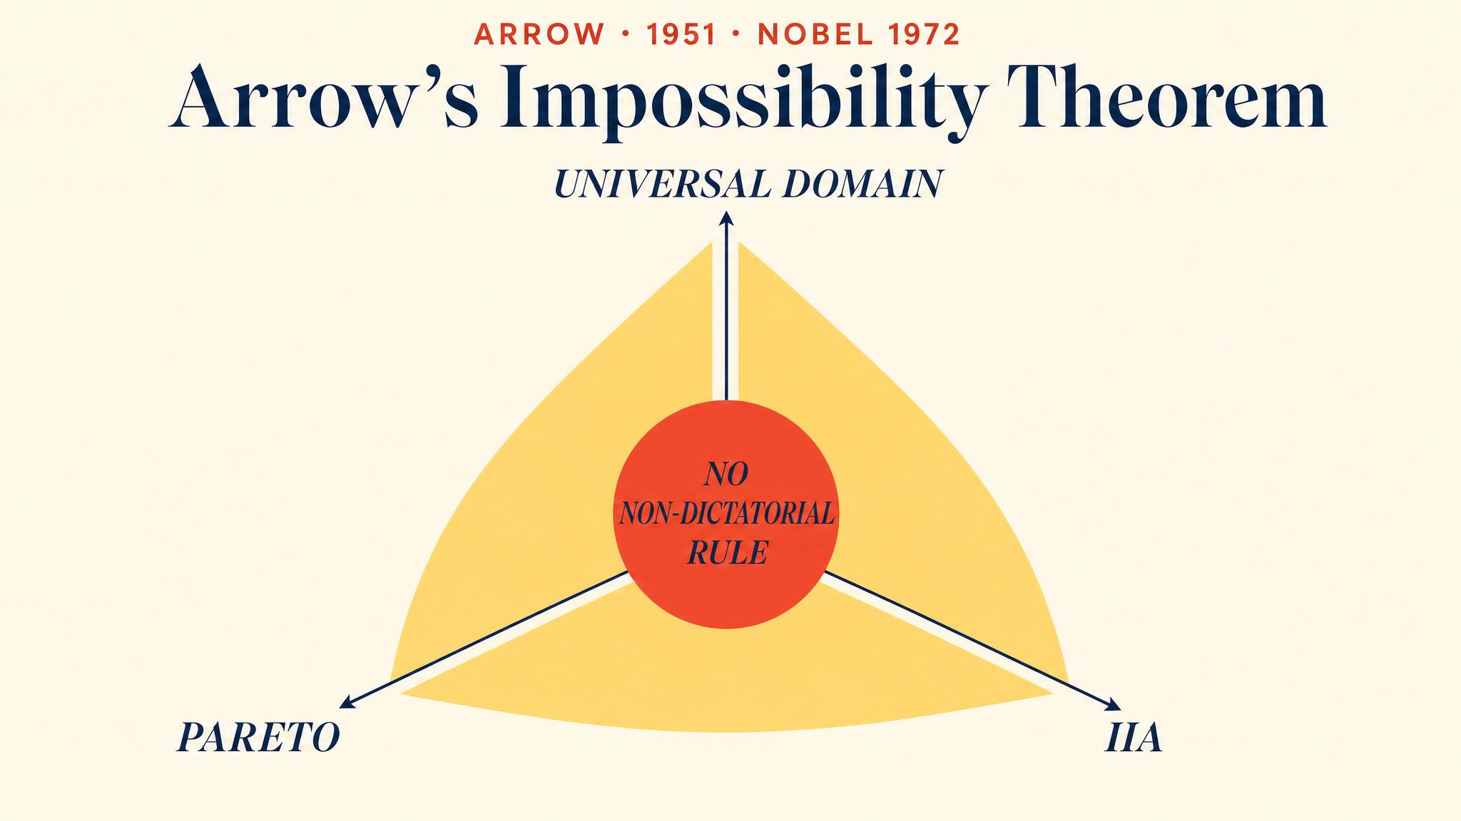
Notes:
Arrow 1951 proved that with three or more alternatives, no ranked-choice voting rule can satisfy all four conditions simultaneously. The right rule cannot exist. Trade-offs are unavoidable.

Slide 6
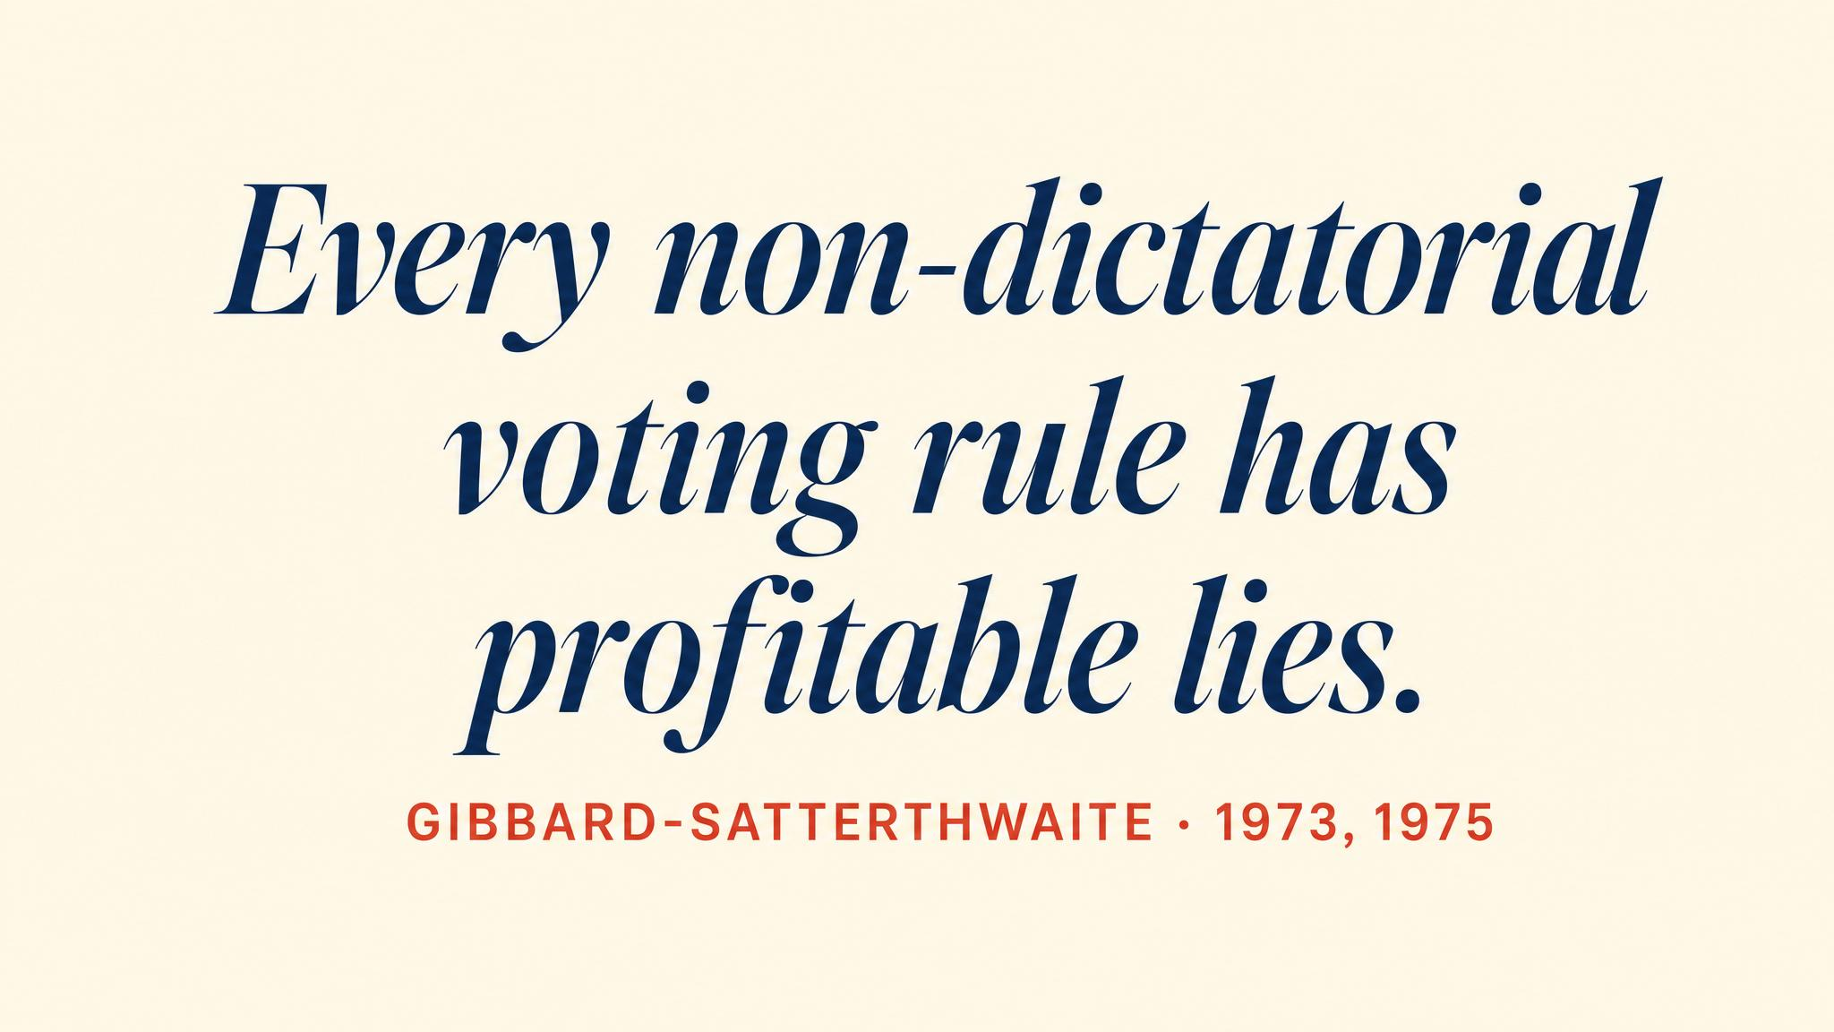
Notes:
Gibbard 1973 and Satterthwaite 1975 independently proved that every non-dictatorial voting rule with three or more outcomes is susceptible to strategic manipulation. No rule can make honesty always safe.

Slide 7
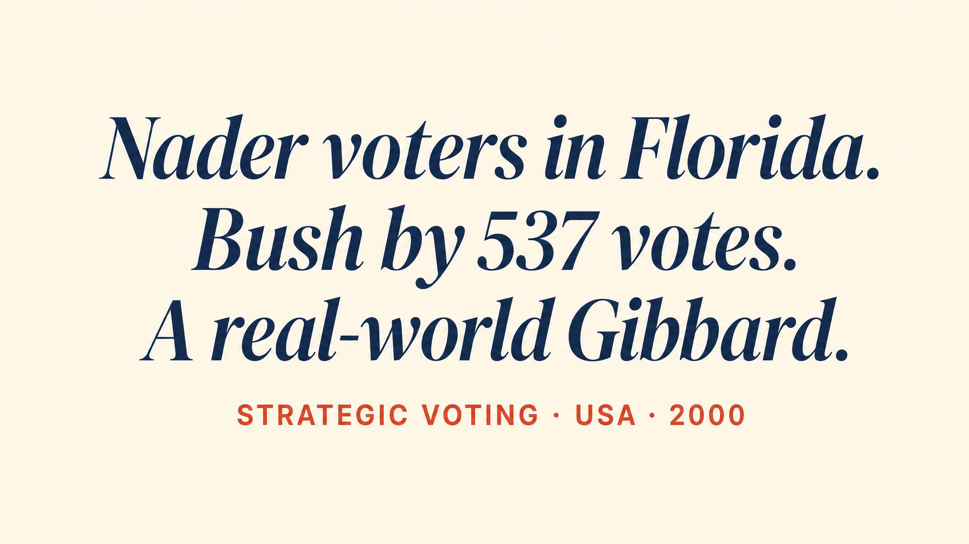
Notes:
A Florida Nader supporter with true ranking Nader > Gore > Bush faces the dilemma. Sincere voting helps elect Bush. Strategic voting for Gore prevents the worst outcome. Plurality begs for tactical voting.

Slide 8
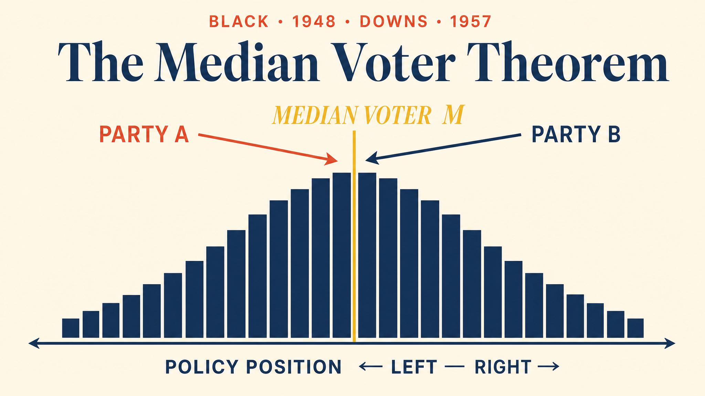
Notes:
Black 1948 and Downs 1957. With single-peaked preferences on a single dimension, two competing parties converge to the median voter in Nash equilibrium. Hotelling's beach problem in political clothing.

Slide 9
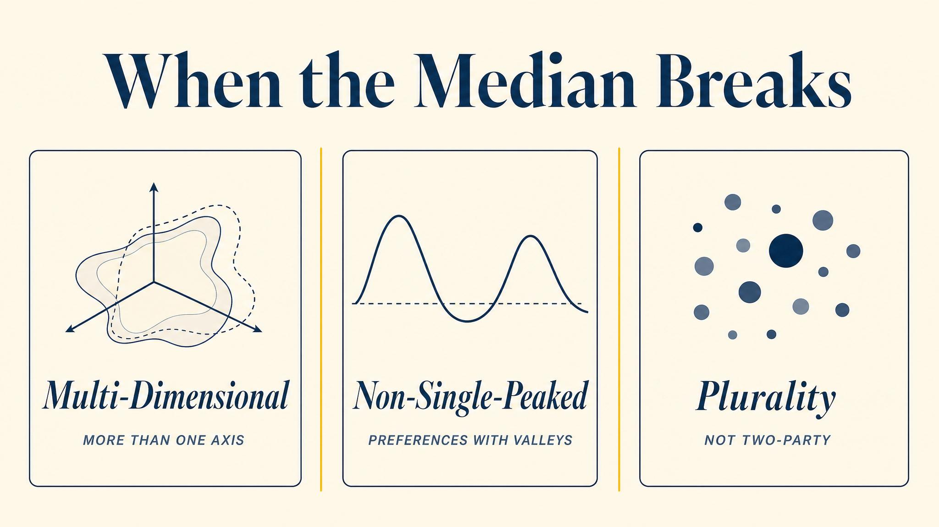
Notes:
Four failure modes. Multidimensional issues, bimodal distributions, ideologically committed parties, and asymmetric turnout. When the assumptions fail, convergence to the median fails too — and polarization becomes easier to explain.

Slide 10
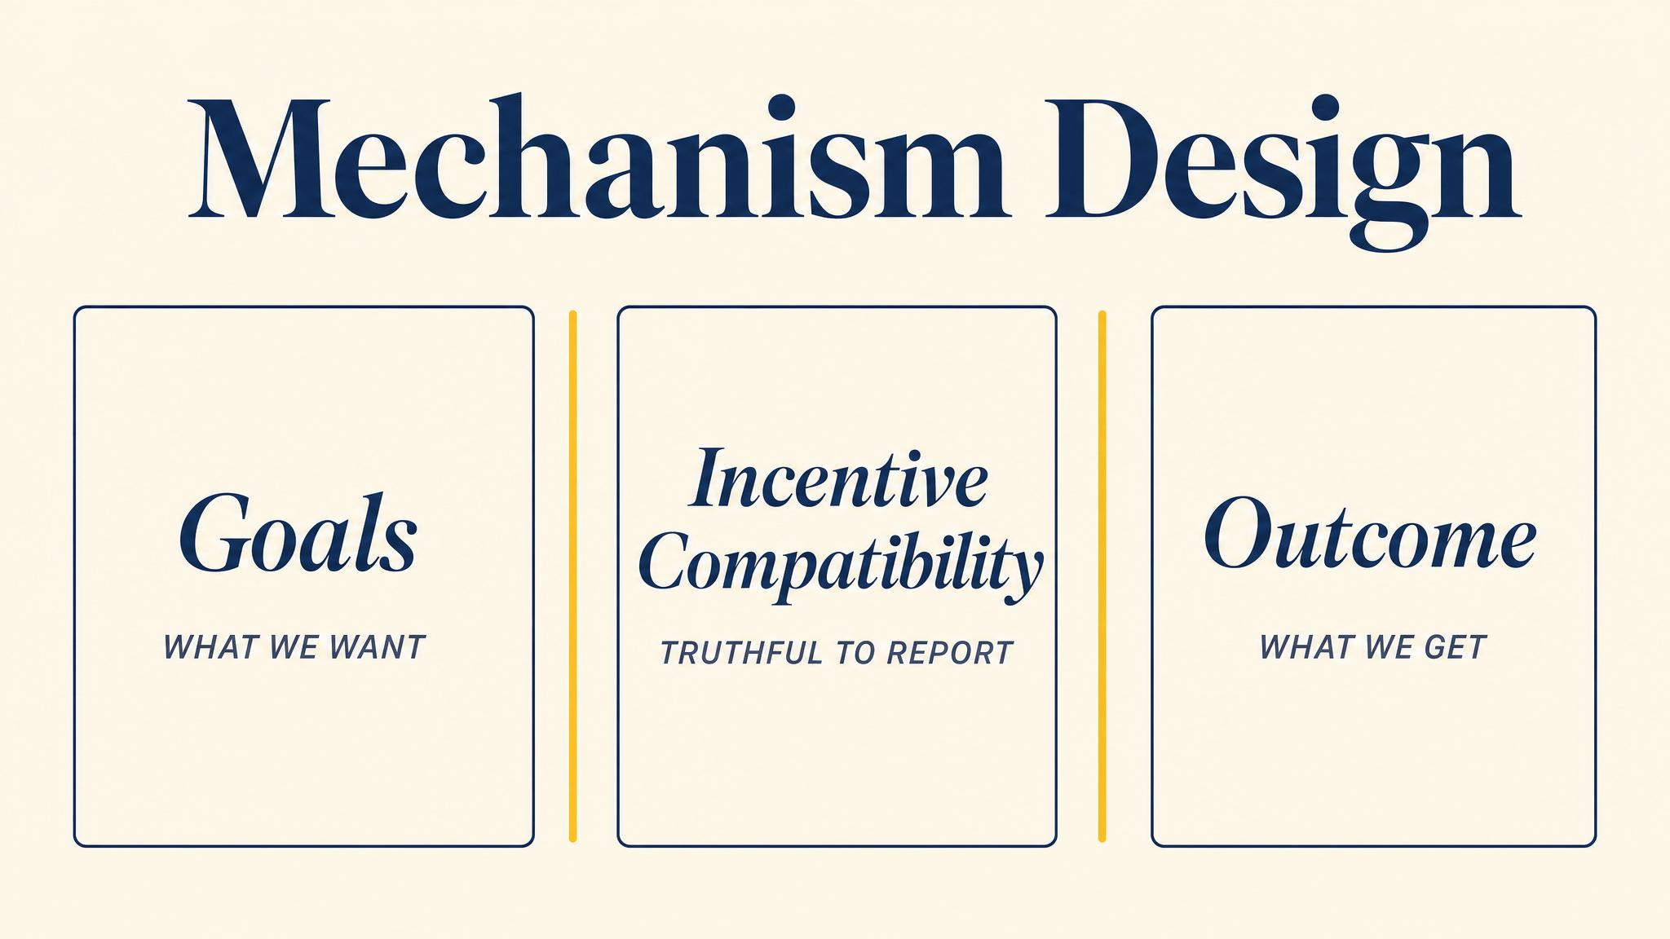
Notes:
Mechanism design is reverse game theory. Take strategic behaviour as given, then choose rules to produce desired outcomes. Hurwicz, Maskin, and Myerson shared the 2007 Nobel for this programme.

Slide 11
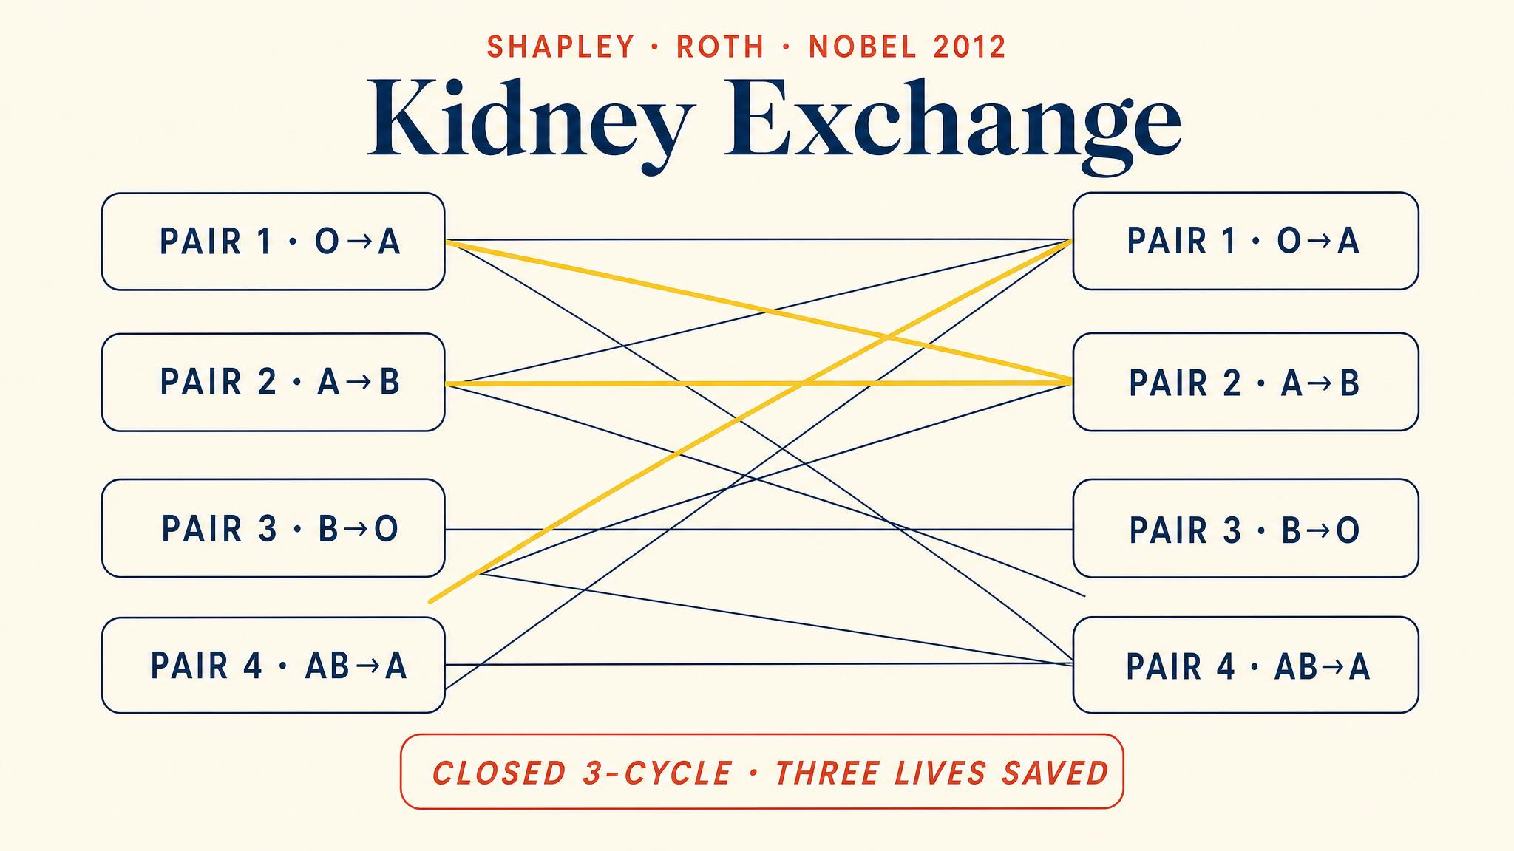
Notes:
Roth, Sönmez, and Ünver 2004 applied mechanism design to kidney exchange. The top trading cycles algorithm is strategy-proof, producing thousands of transplants that would otherwise never have occurred.

Slide 12
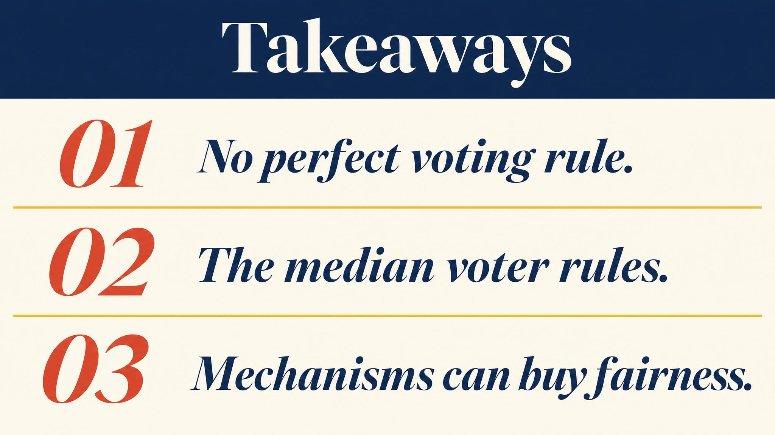
Notes:
Three lessons. Condorcet cycles show majority preferences can be incoherent. Arrow and Gibbard-Satterthwaite show no rule is perfect or fully strategy-proof. Mechanism design accepts strategy and designs around it.

Slide 13

Notes:
Close with the bridge. Voting institutions shape collective choice. Next chapter — the course finale — applies the full toolkit to climate summits, algorithmic markets, and the limits of game theory itself.

