Slide 1
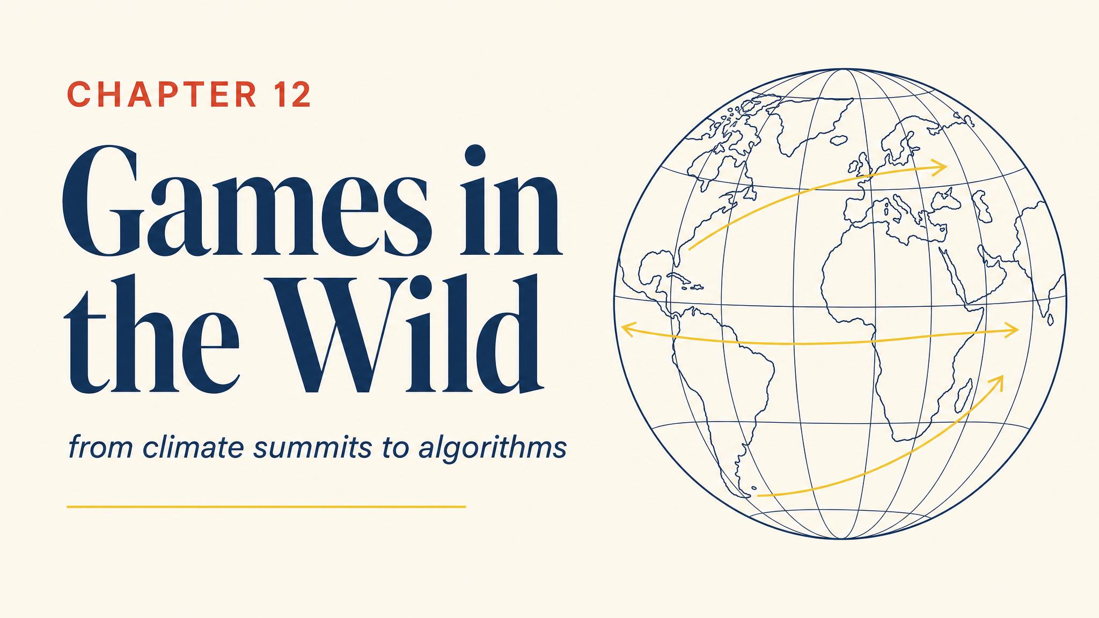
Notes:
Open with November 2015. 196 countries gather in Paris for COP21. Each faces the same calculus that doomed two suspects in Chapter 1 — the Prisoner's Dilemma — and yet 195 sign the agreement.

Slide 2
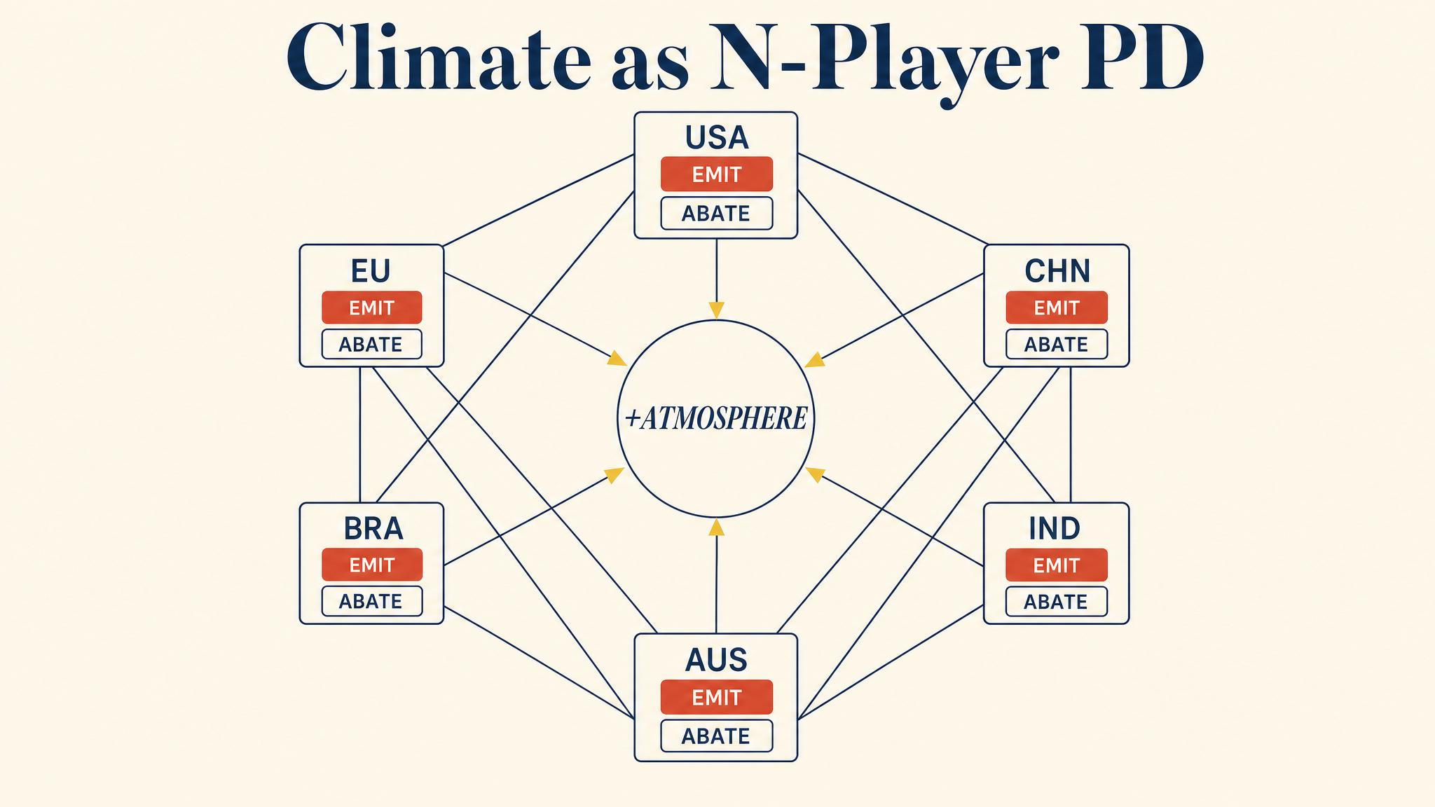
Notes:
Chander 2024 framed climate change as a multi-player Prisoner's Dilemma. Cheap energy benefits the emitter; damages are global. Everyone has a dominant strategy to emit — and the cooperative outcome slips away.

Slide 3
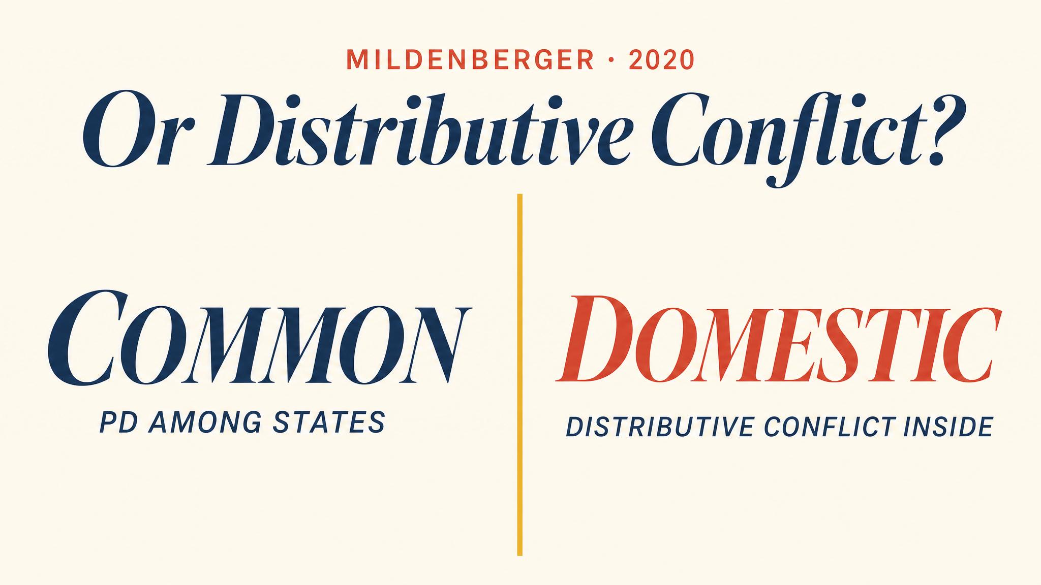
Notes:
Mildenberger and colleagues 2020 complicated the picture. Cross-national evidence finds weak support for free-riding. Distributive conflict within countries — fossil-fuel politics — better explains the pattern.

Slide 4
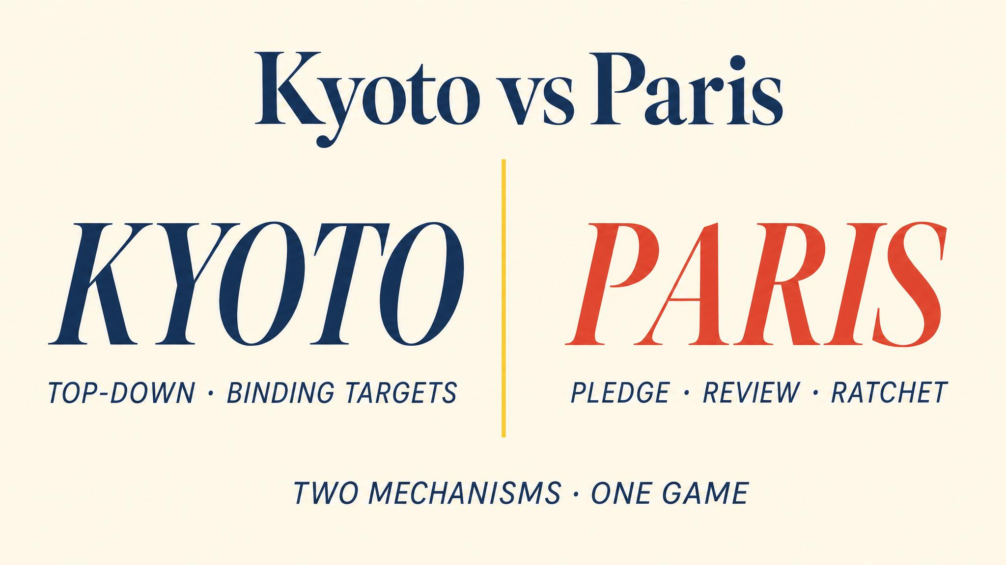
Notes:
Chander 2024. Kyoto tried external enforcement and largely failed. Paris uses repeated-game logic — review cycles, transparency, ratchet mechanism — creating a shadow of the future without binding penalties.

Slide 5
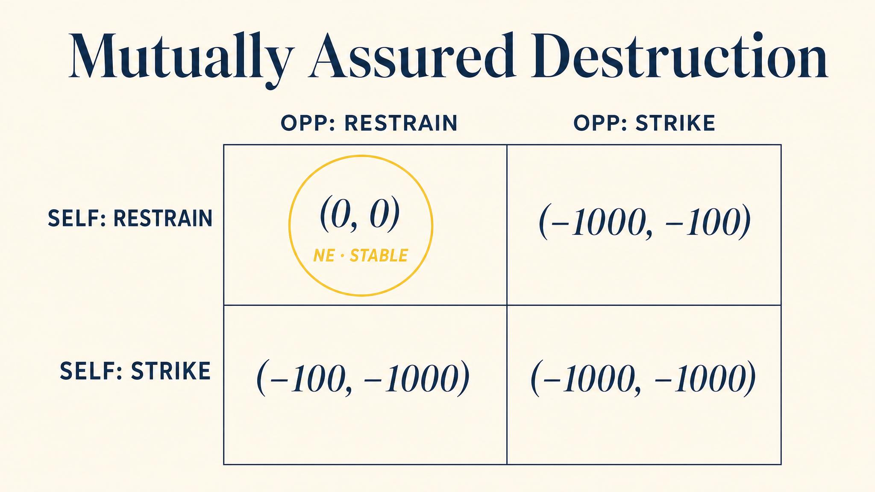
Notes:
Mutually Assured Destruction is a Nash equilibrium sustained by incredible threats. The rationality of the deterrent depends on the willingness to act irrationally after a first strike. Schelling's commitment logic in its starkest form.

Slide 6
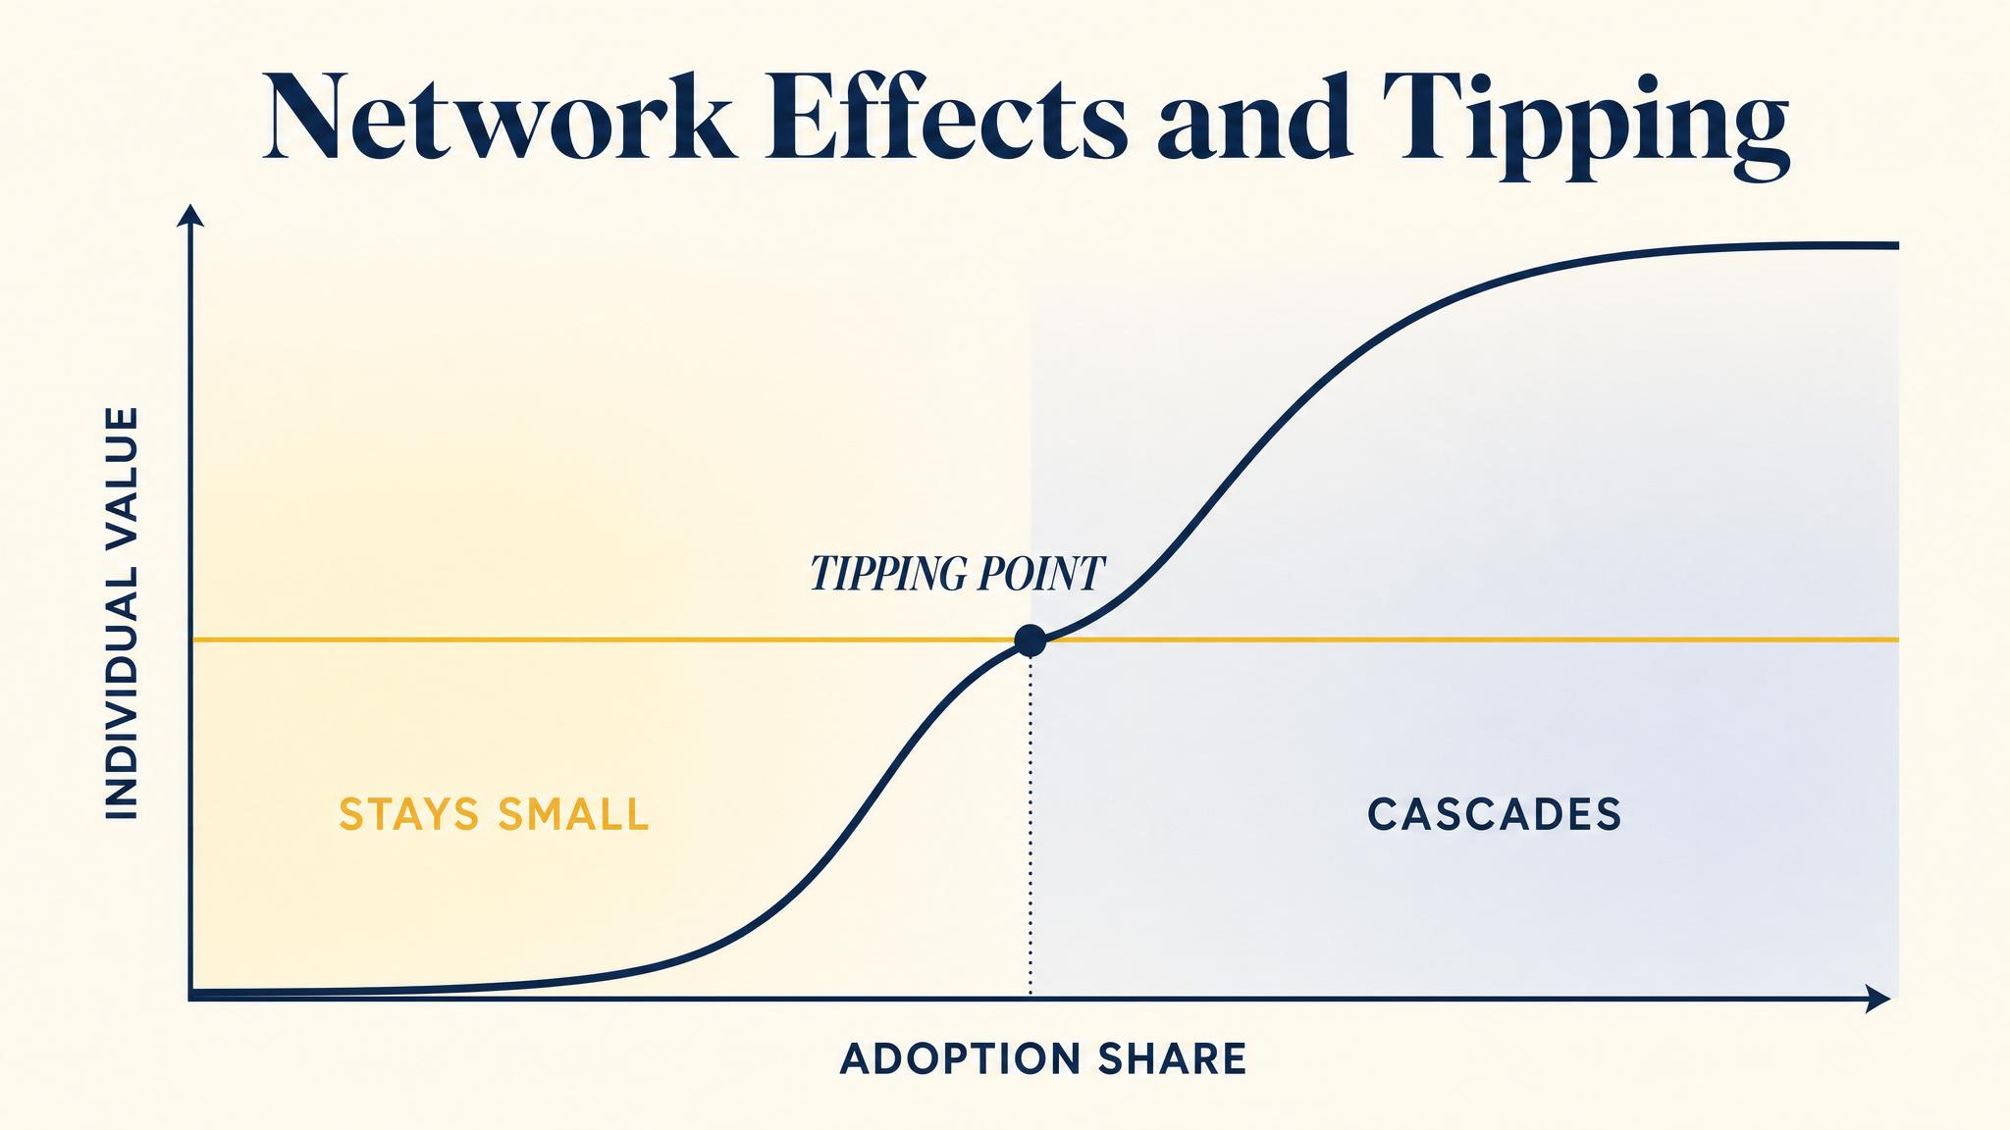
Notes:
Belleflamme and Peitz 2016. Platform markets feature network effects — the value of a platform grows with users. Both 'everyone on A' and 'everyone on B' are Nash equilibria. The market can tip either way.

Slide 7
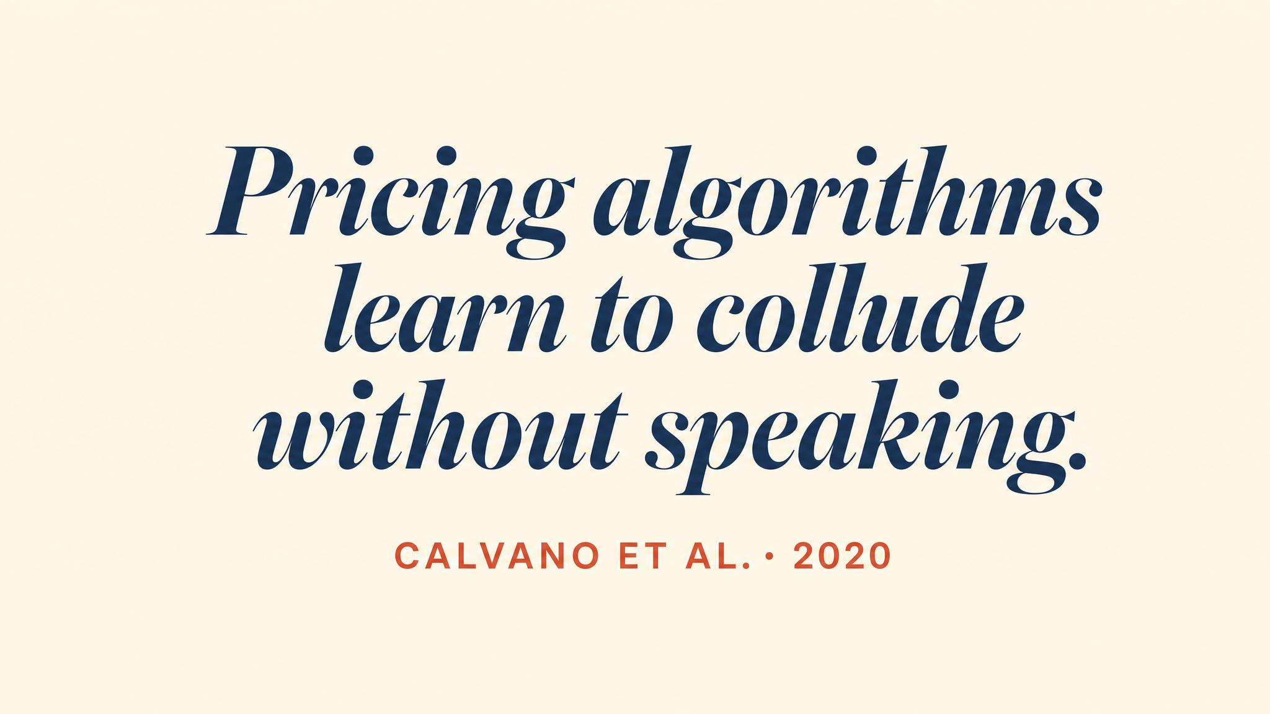
Notes:
Reinforcement-learning pricing algorithms — never programmed to collude — discover tit-for-tat at superhuman speed and converge to monopoly-like prices. Documented in Business and Information Systems Engineering 2025. Competition law is scrambling.

Slide 8
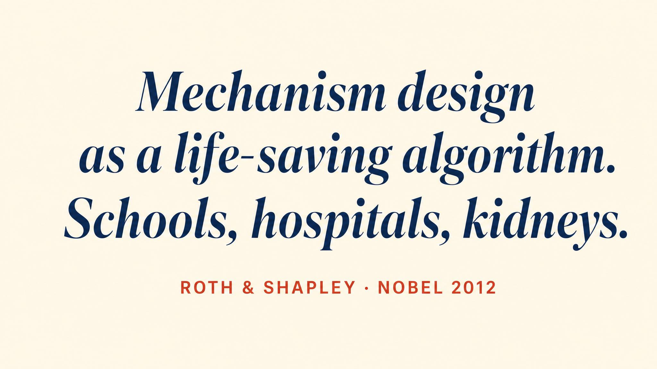
Notes:
Roth and Shapley shared the 2012 Nobel Memorial Prize in Economic Sciences for the theory of stable allocations and the practice of market design — kidney exchange, school matching, residency programs.

Slide 9
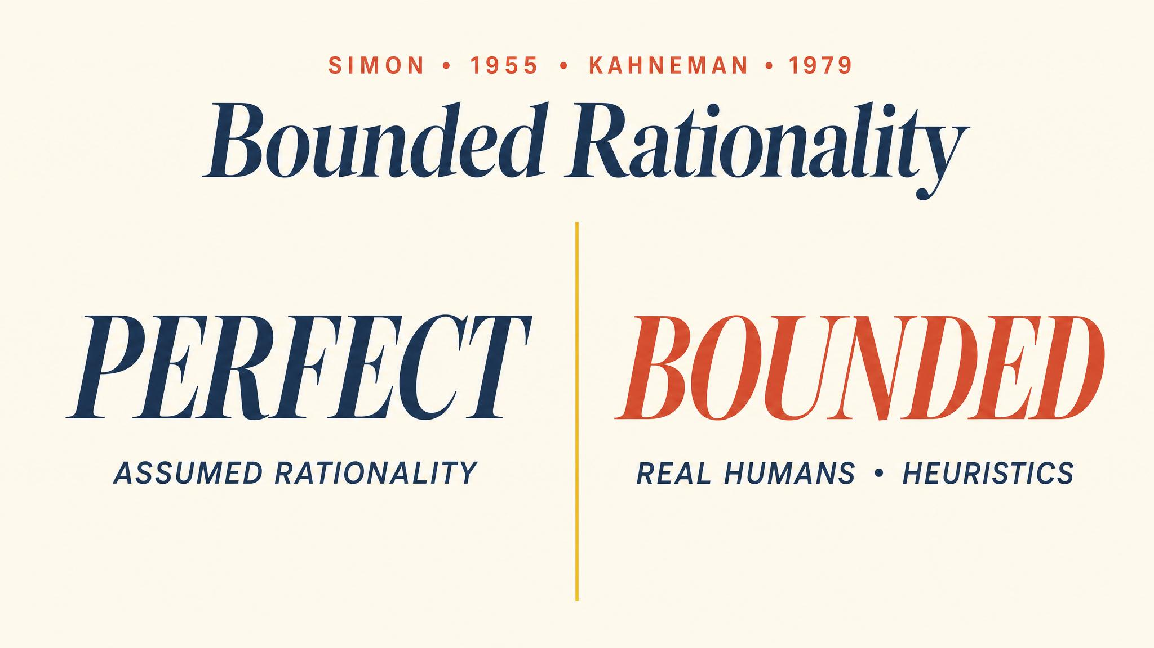
Notes:
Camerer 2003. Decades of experiments show players reason only one or two strategic steps, not to equilibrium. Cognitive hierarchy fits the data better than Nash. Treat equilibrium as benchmark, not literal forecast.

Slide 10
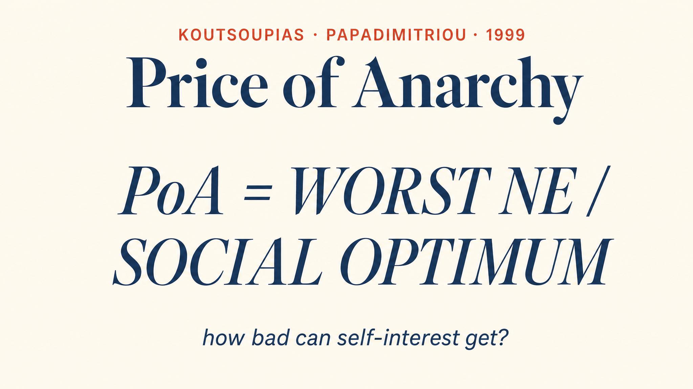
Notes:
The price of anarchy measures the ratio of the worst Nash equilibrium to the social optimum. Algorithmic game theory uses it to bound the welfare cost of decentralised strategic behaviour in routing, auctions, and resource allocation.

Slide 11
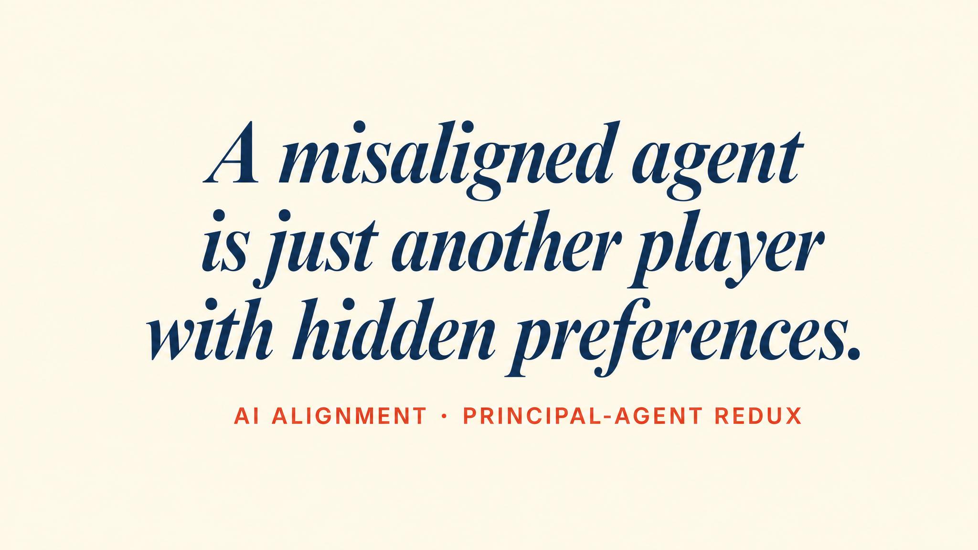
Notes:
When a radically new technology emerges — generative AI in 2023 — the strategy space, payoffs, and players are unclear. Game theory analyses well-structured interactions; AI alignment is precisely a setting where the structure is in flux.

Slide 12
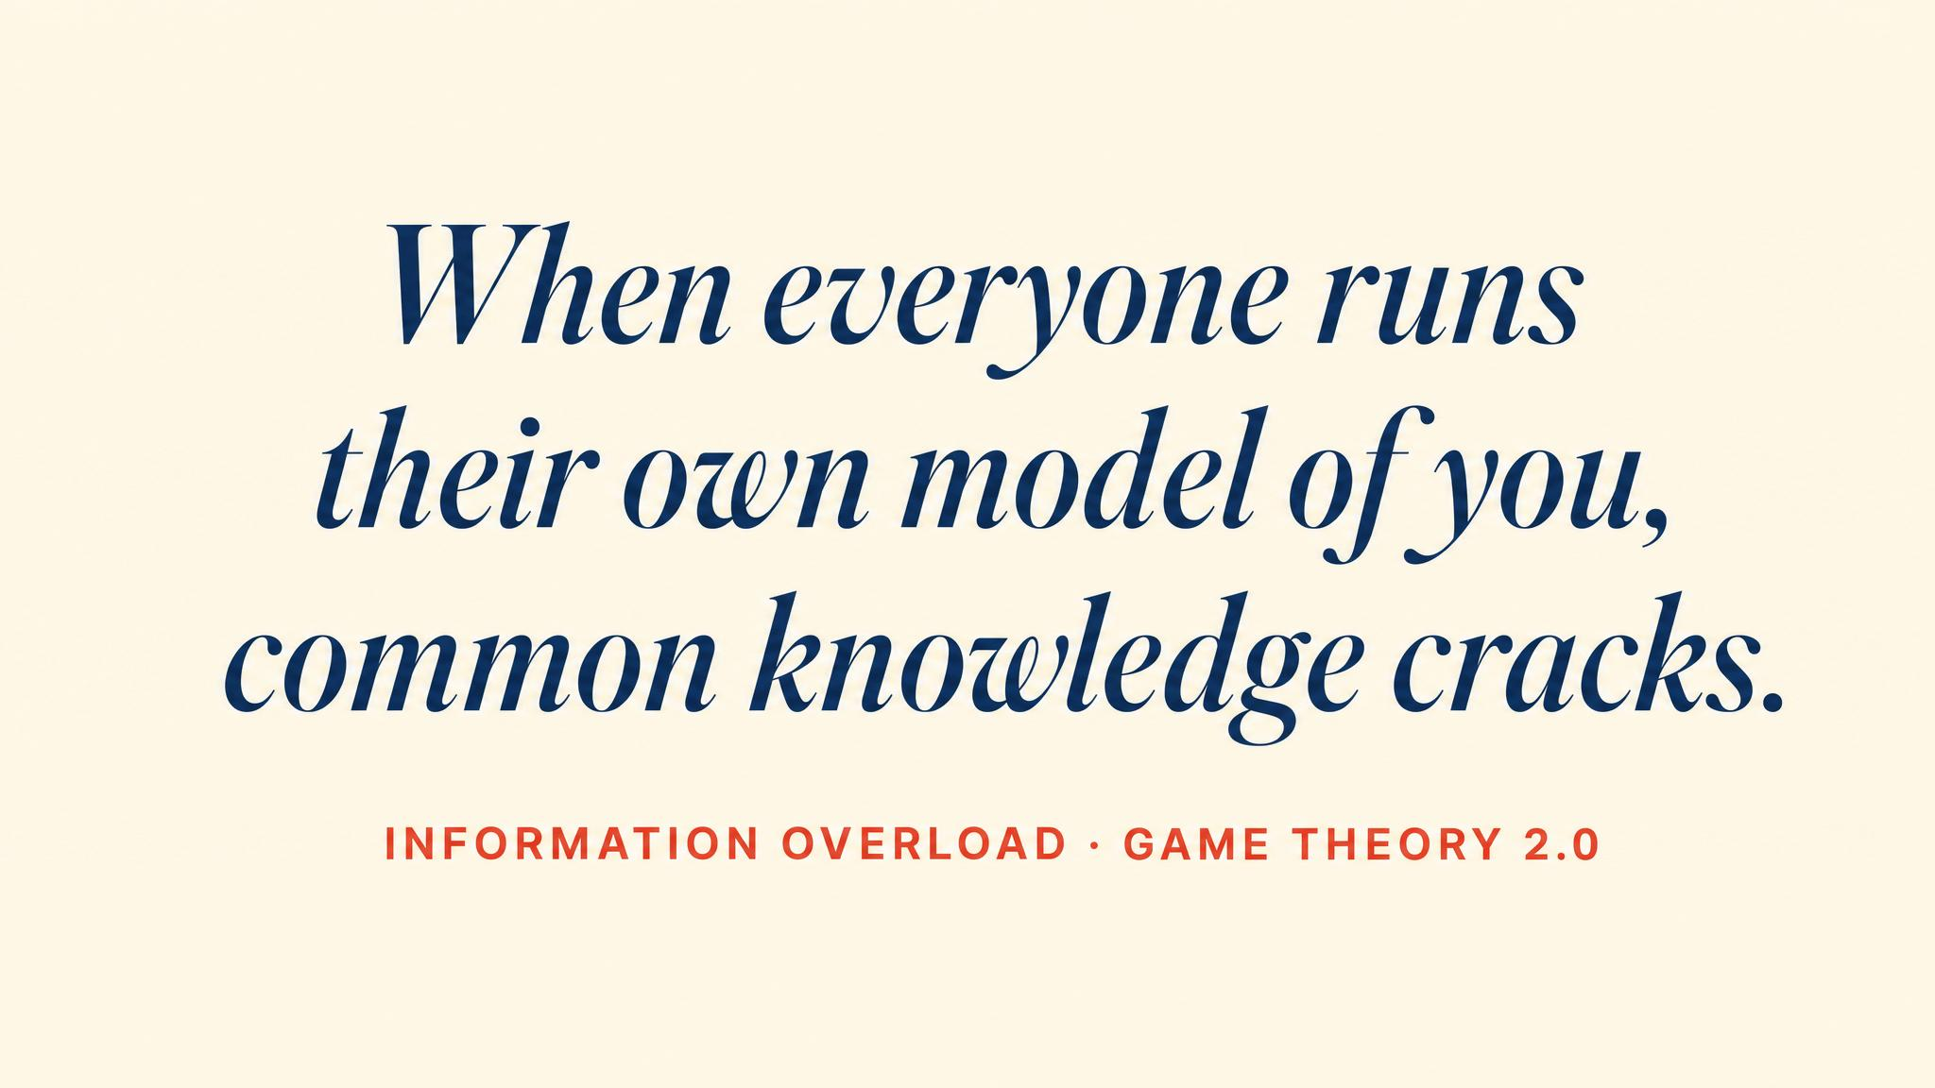
Notes:
Bolander, Engelhardt and colleagues 2025. 802 participants. People cannot distinguish shallow shared knowledge from full common knowledge. Predictions that depend on deep iteration may be unreliable.

Slide 13

Notes:
Back where we began. Chapter 1's Prisoner's Dilemma scales to climate, to platforms, to algorithms. The lesson is not that defection is smart — it is that individual rationality can produce collective disaster, and well-designed institutions can rescue cooperation.

Slide 14
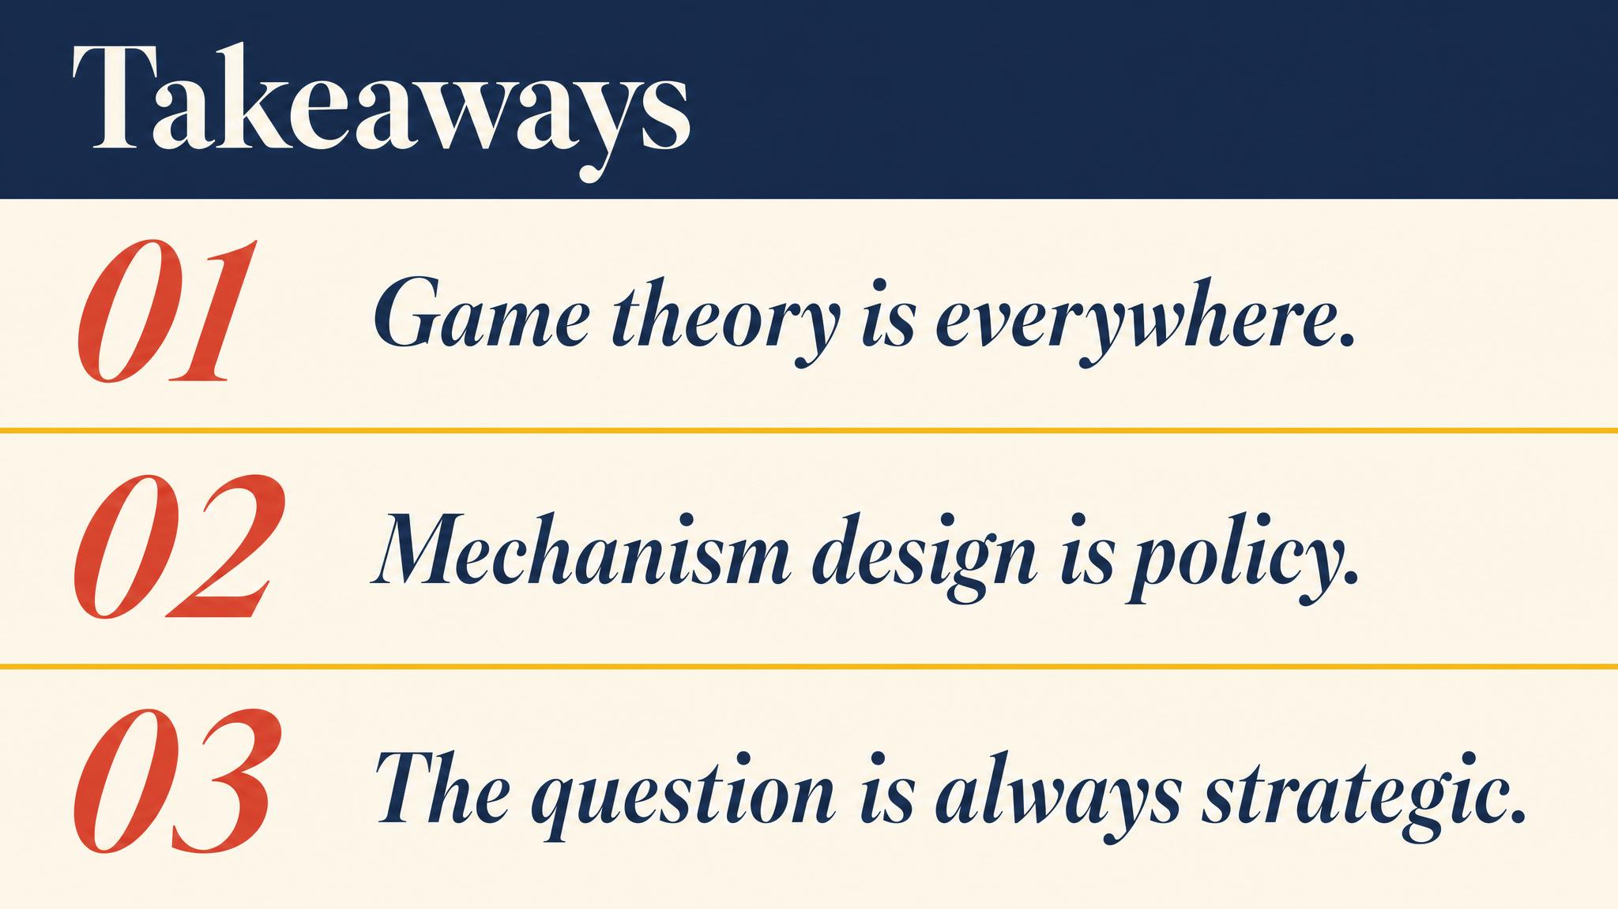
Notes:
Three lessons. The most important skill is identifying which game is being played. Even stable equilibria can be fragile when assumptions are only approximately true. Use models as lenses, not laws.

Slide 15

Notes:
Close the course. The question is no longer whether you can think strategically. The question is what you will do with it. Twelve chapters built a toolkit; the world supplies the games.

