Slide 1
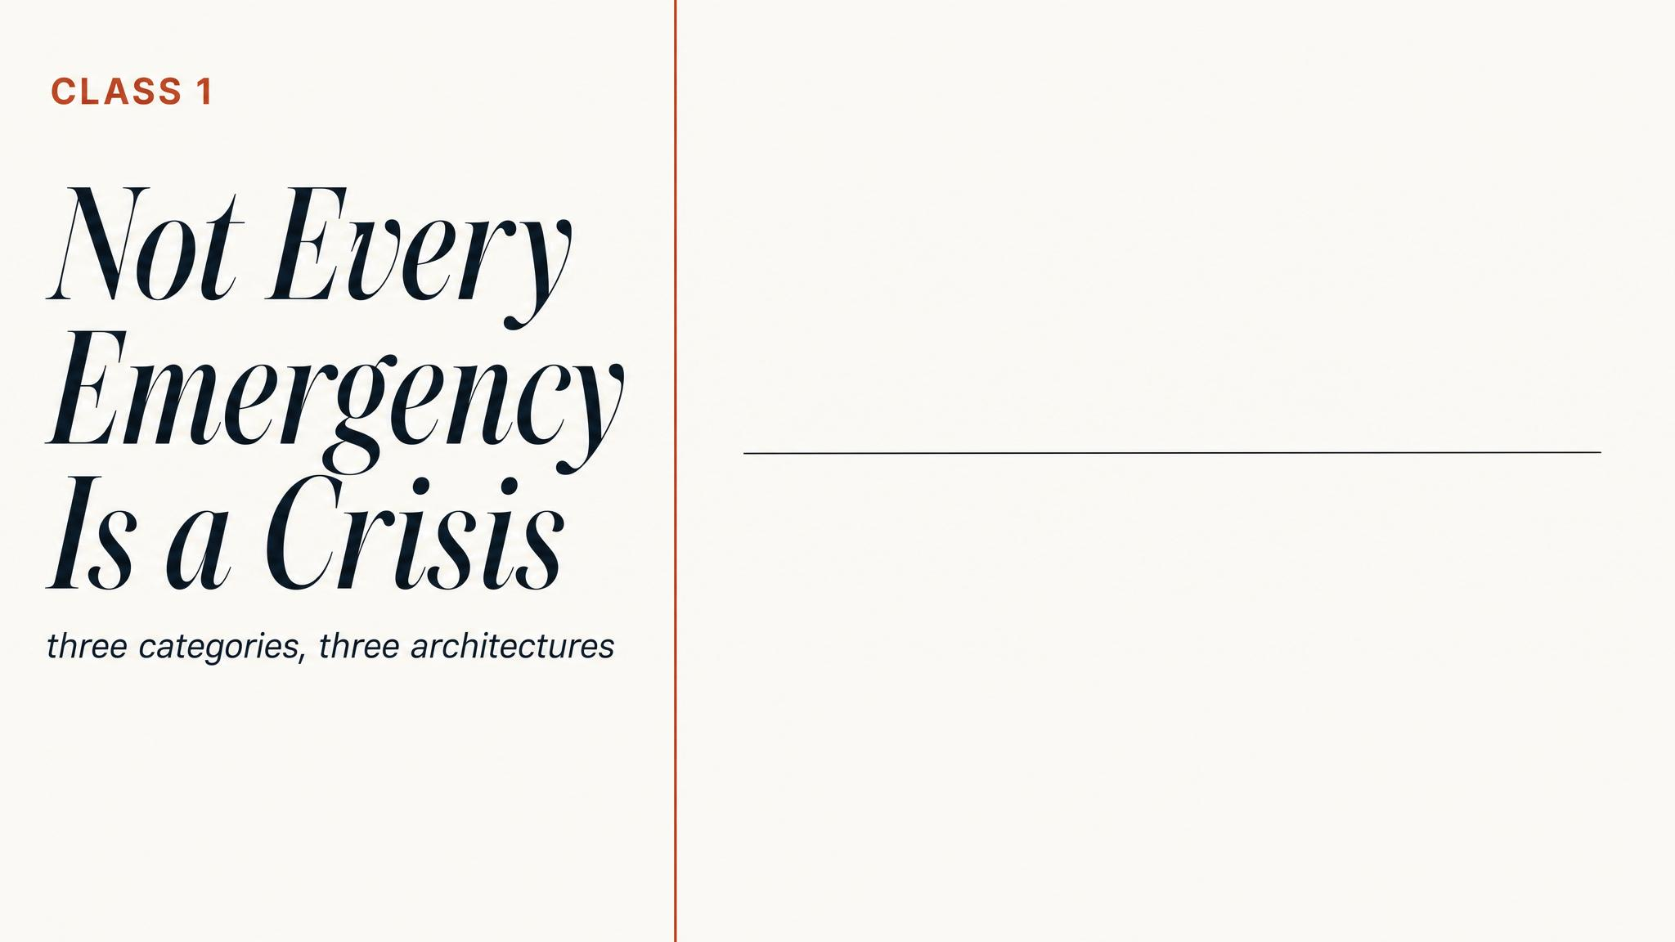
Notes:
Open with the title and the puzzle it sets up. Hold the room: classification sounds like a small problem, but at Grenfell it killed seventy-two people. Promise that the chapter will give them three precise words — incident, emergency, crisis — and explain why the difference is leadership itself.

Slide 2
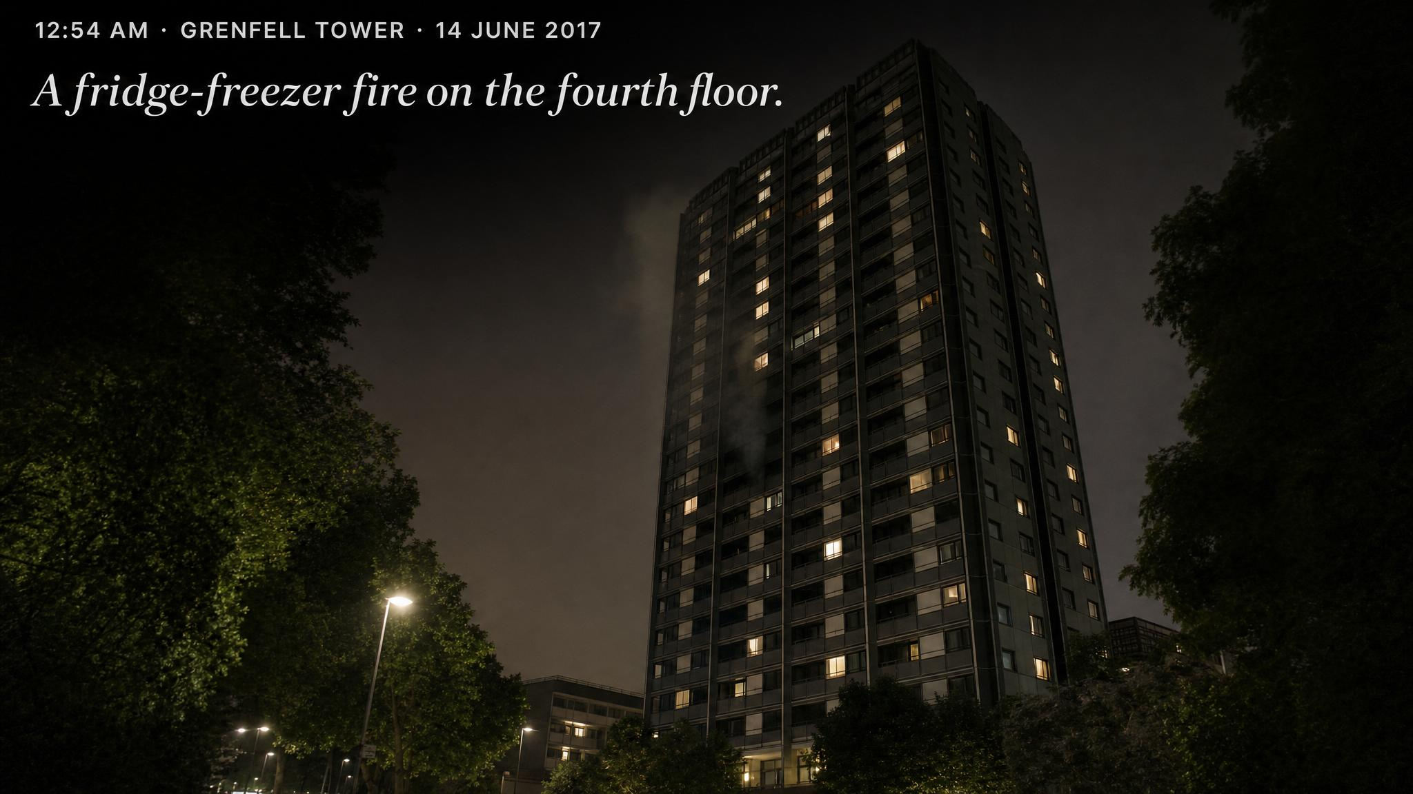
Notes:
Walk them through the opening minute. A resident in Flat 16, fourth floor, calls about a kitchen fire. Firefighters arrive in six minutes. Standard stay-put advice is given. To every outward appearance, this is the most routine call the London Fire Brigade handles thousands of times a year.

Slide 3
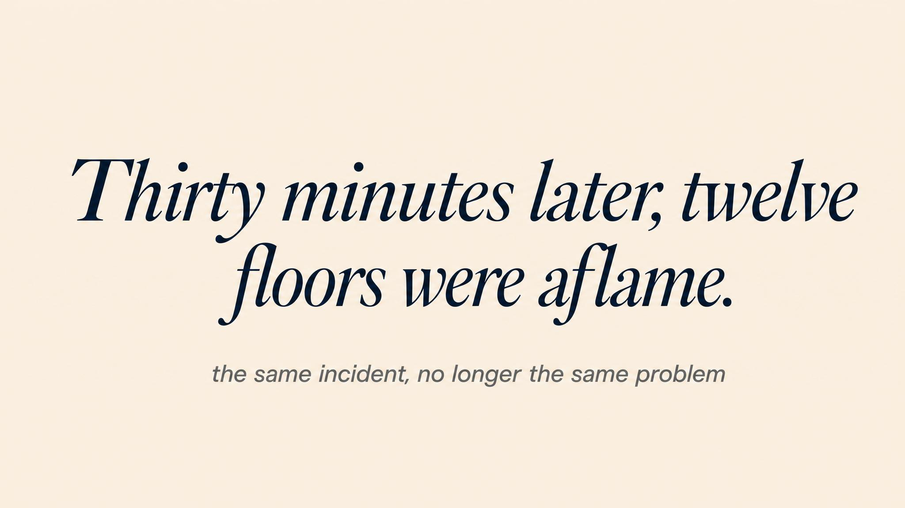
Notes:
Now the turn. Within thirty minutes, the cladding had turned the building into a vertical chimney of flame. The stay-put advice that was correct for a flat fire became catastrophically wrong. The system was agonizingly slow to recognize that the situation had crossed a threshold.

Slide 4
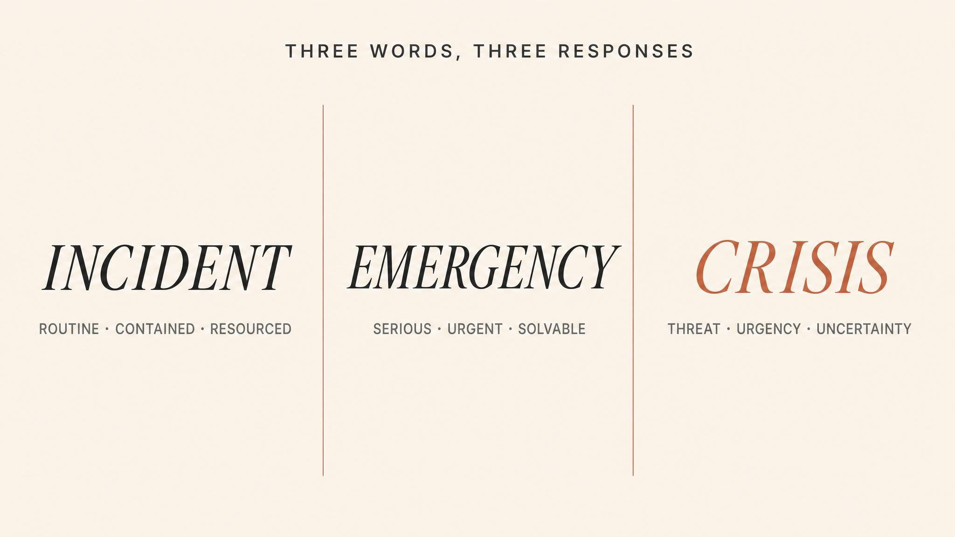
Notes:
Lay the three categories down clearly. An incident: routine, within capacity. An emergency: serious, time-pressured, but the problem is understood. A crisis: a problem you do not yet fully understand, with threat and urgency stacked on top. Each demands a different leadership response.

Slide 5
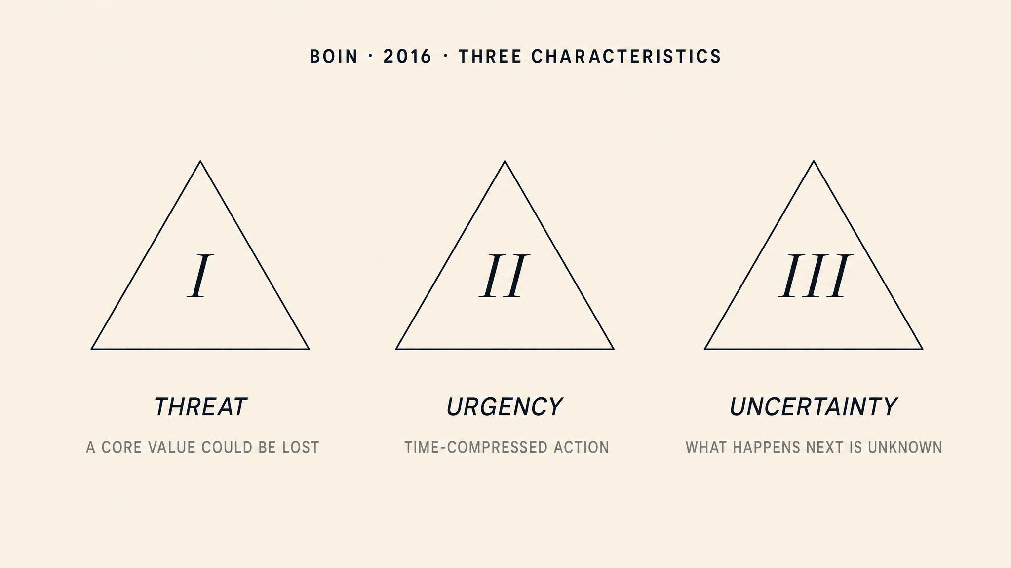
Notes:
Boin and colleagues' 2005 work, revised in 2016. Three characteristics: threat to core values, urgency that compresses the decision window, and deep uncertainty about the nature of the problem. The crucial point is that all three must be present simultaneously. Remove any one and the leadership challenge changes.

Slide 6
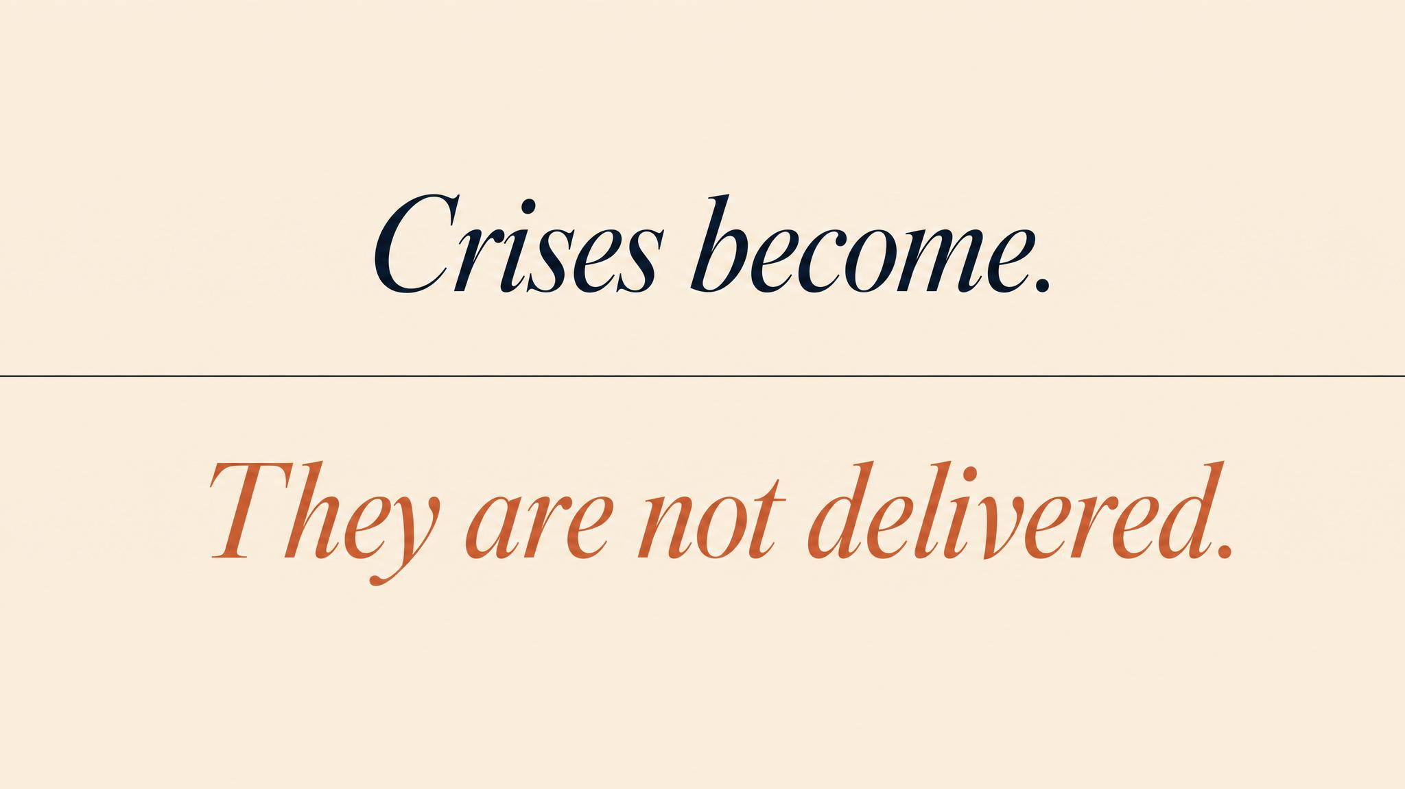
Notes:
Boin's other key idea: situations travel a continuum from 'no problem' to 'deep crisis'. The transition can be gradual or shockingly abrupt. Grenfell began as an incident, passed through emergency, and crossed into crisis — but the command structure kept operating in emergency mode long after the threshold had been crossed.

Slide 7
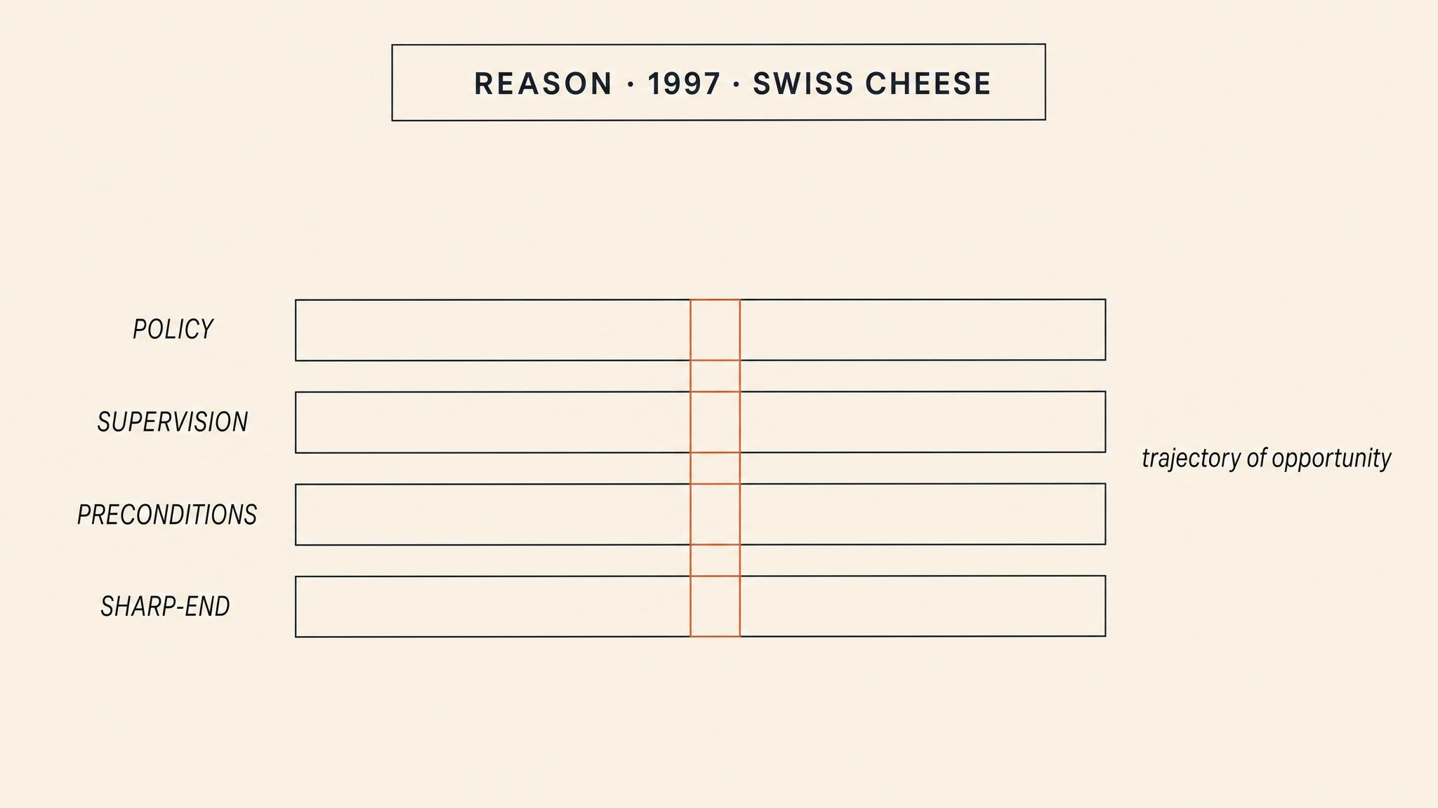
Notes:
James Reason's Swiss Cheese model, 1997. Defences are slices — policies, training, supervision, procedures. Every slice has holes. No single hole causes a catastrophe. When holes in multiple layers line up, a hazard becomes a disaster. Larouzée and Le Coze called it the dominant paradigm in their 2020 review.

Slide 8
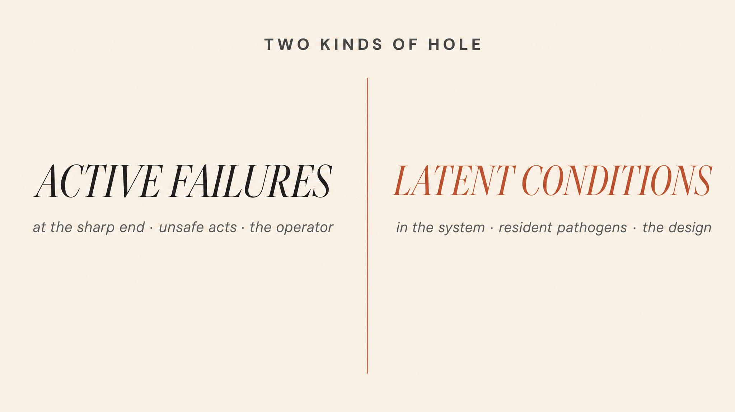
Notes:
Reason distinguishes two kinds of holes. Active failures are the unsafe acts at the sharp end — the pilot, the nurse, the firefighter. Latent conditions are the organisational decisions — budget cuts, deferred maintenance, abbreviated training — that quietly create the preconditions. Latent conditions are more dangerous because they persist unseen.

Slide 9
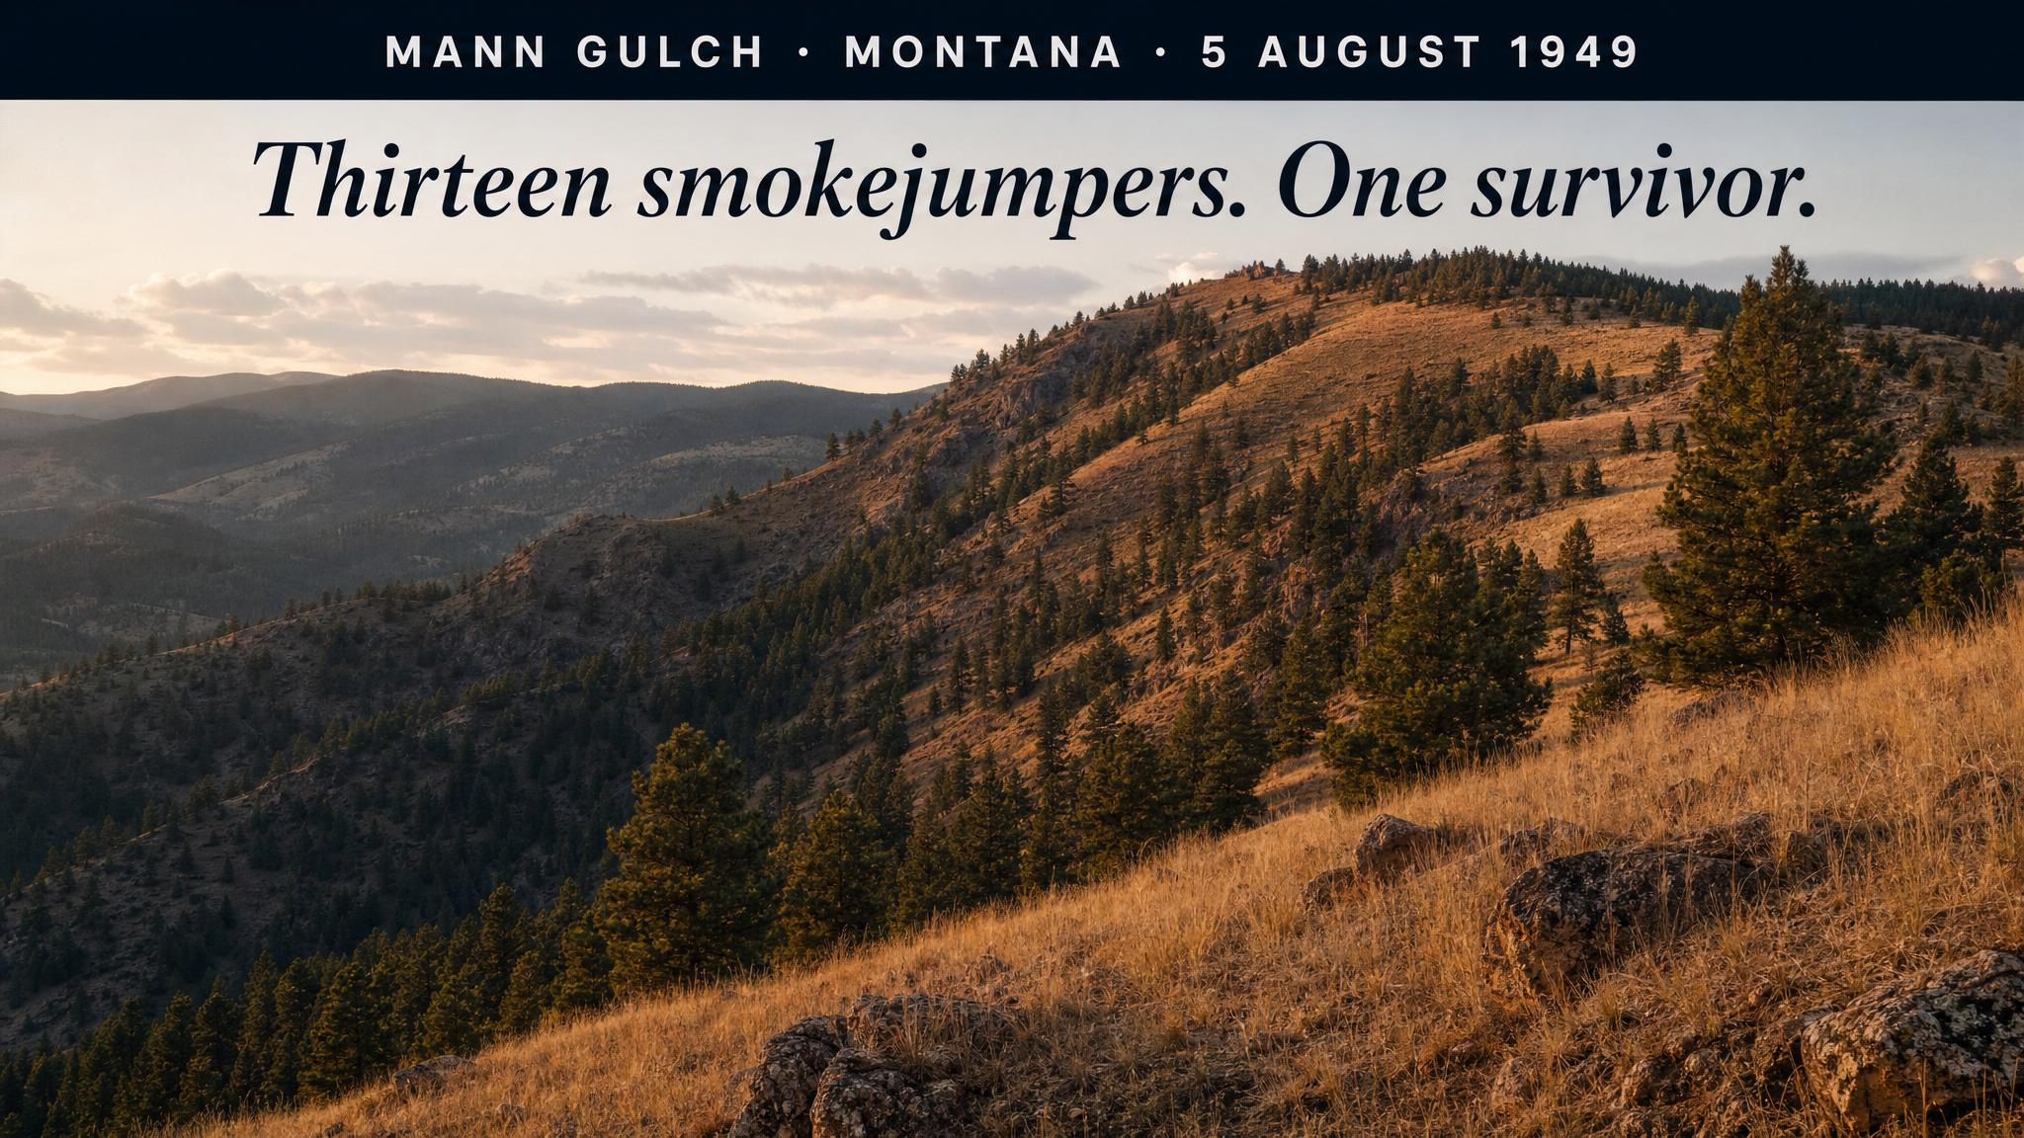
Notes:
Weick's 1993 analysis. Fifteen smokejumpers parachuted into Mann Gulch, Montana. Within two hours, thirteen were dead. Foreman Wagner Dodge invented the escape fire — burned a patch around himself so the main fire would pass over. He shouted to his crew to join him in the ashes. No one did. The act made no sense within their existing framework.

Slide 10
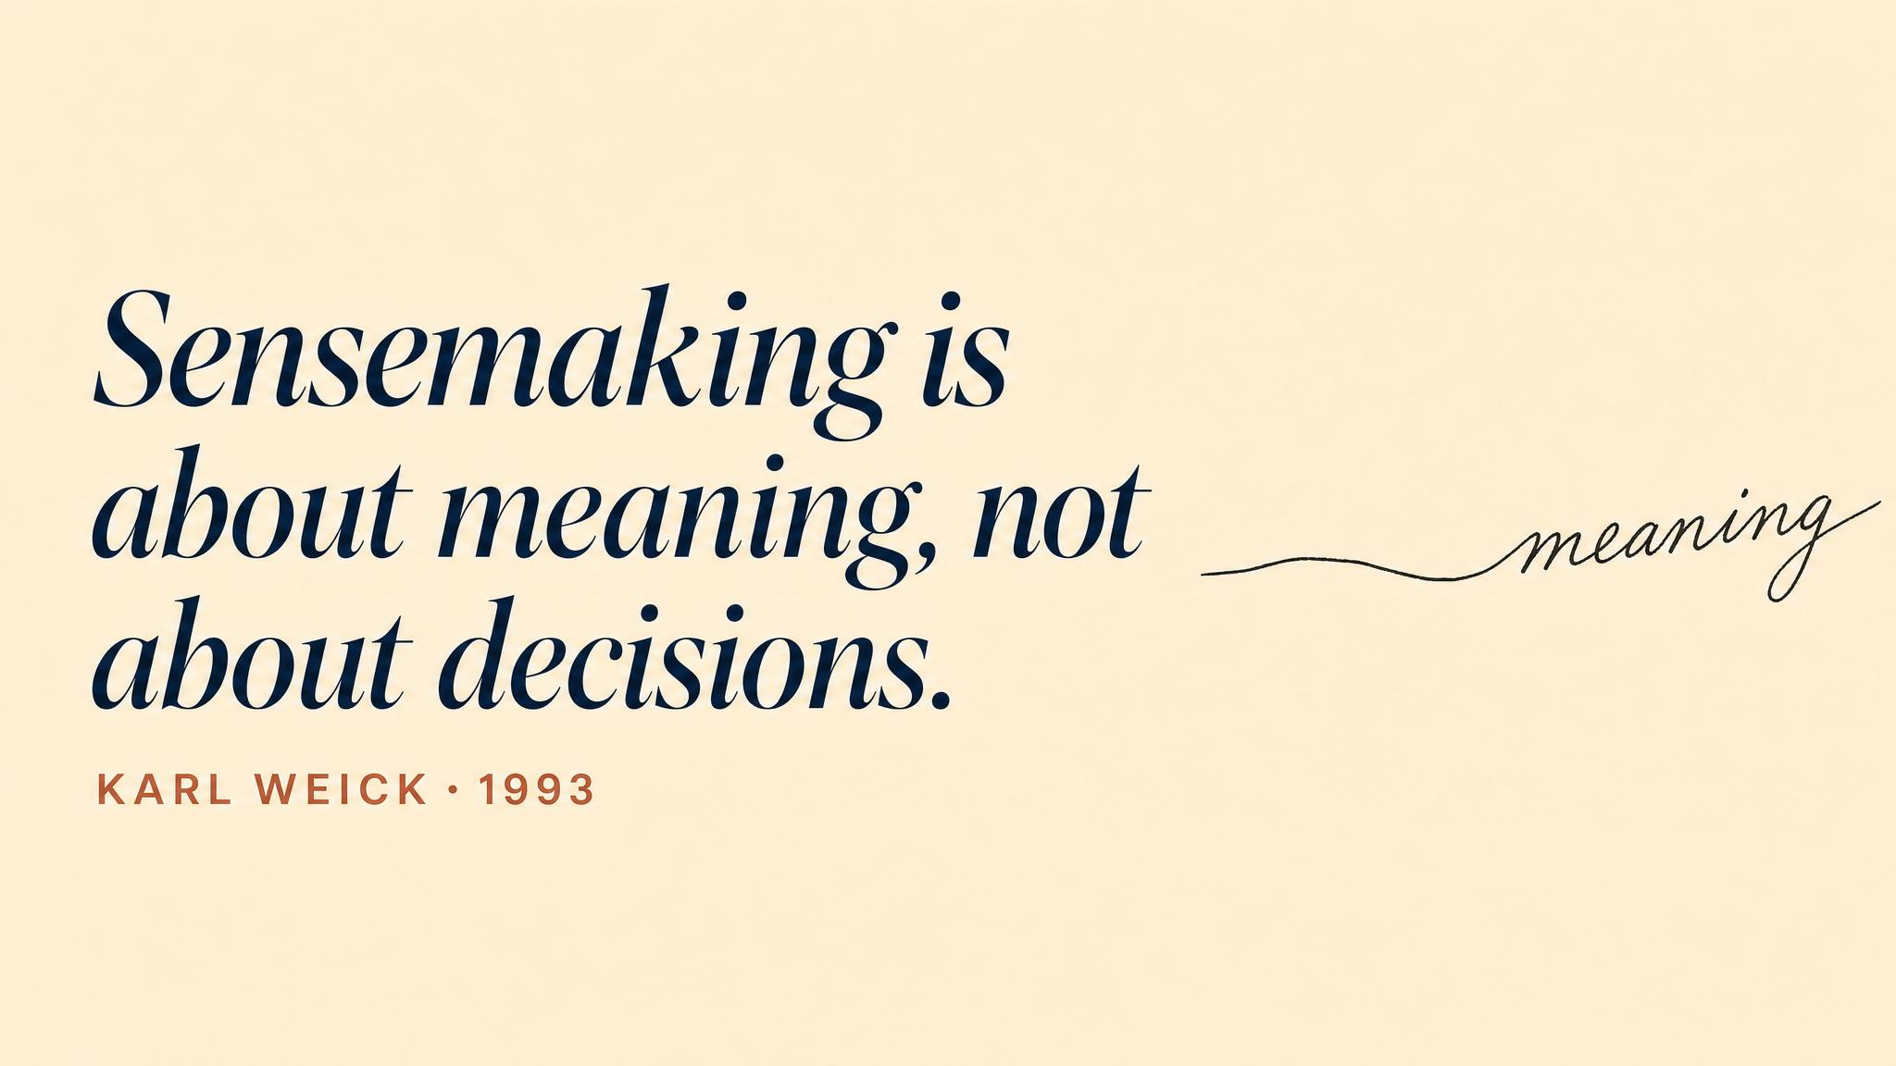
Notes:
Pause here. Read it slowly. Sensemaking, as Weick defined it in 1988, is not just understanding — it is the active, social process of creating a shared narrative that allows coordinated action. Maitlis and Christianson, in their 2014 review, emphasised that this process can collapse faster than the physical threat advances.

Slide 11
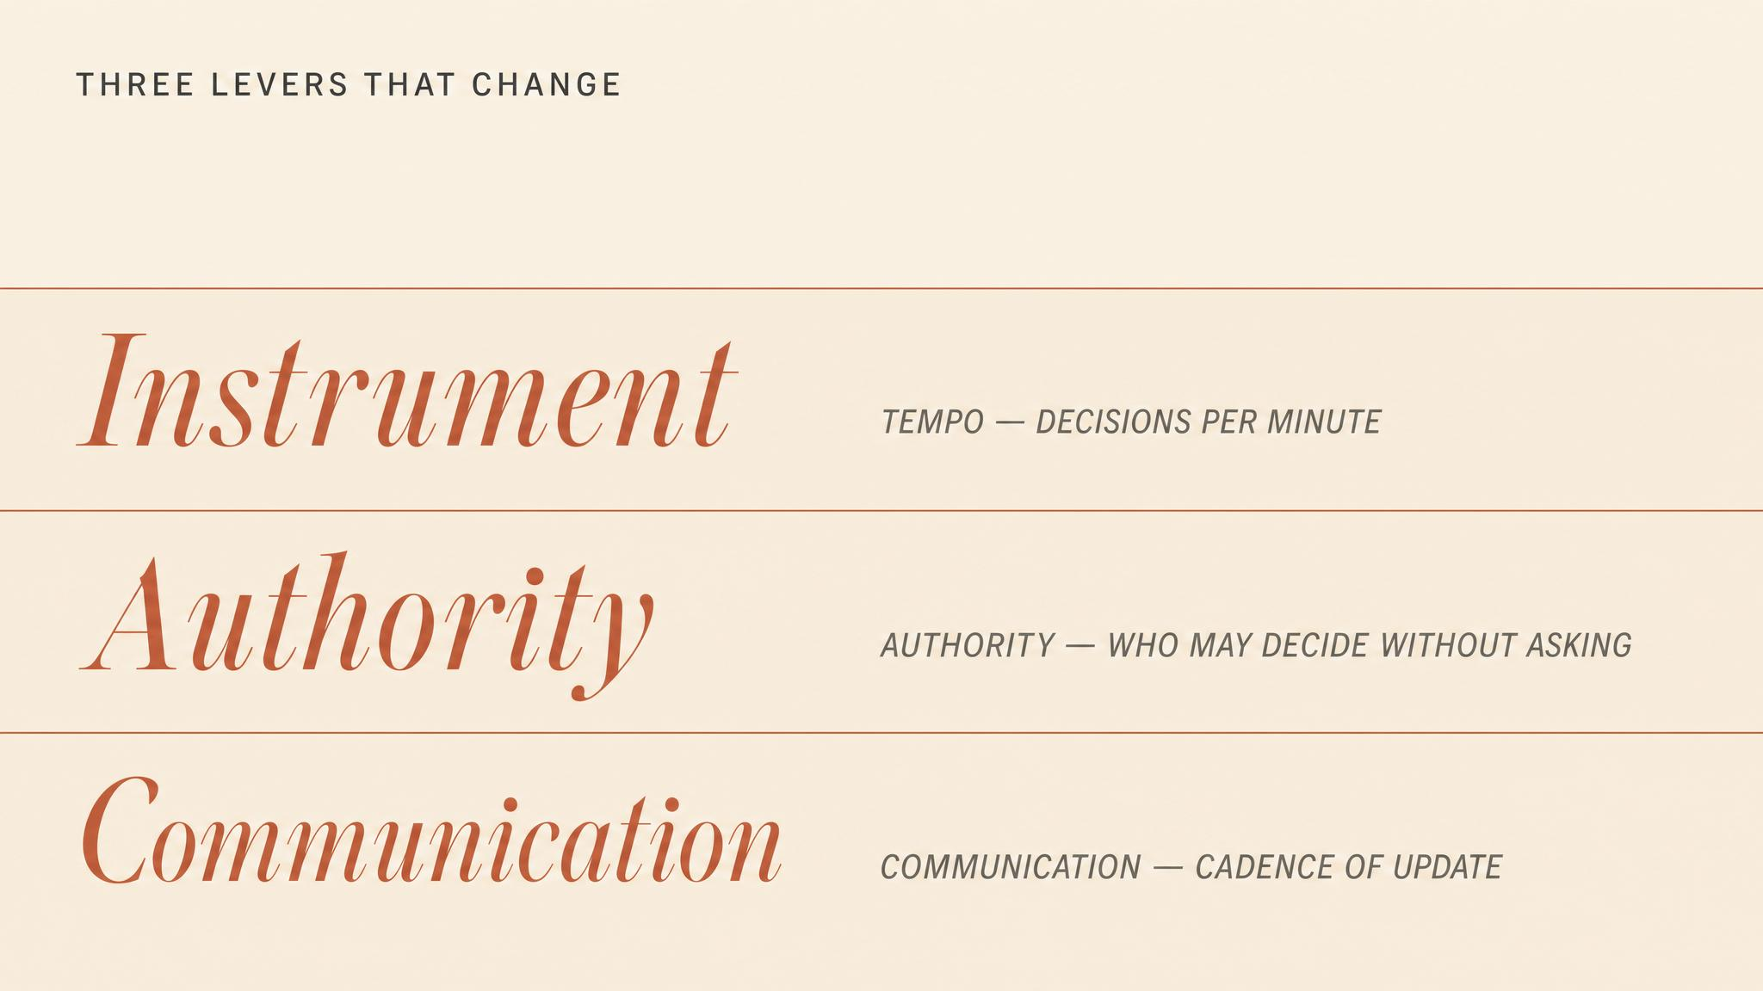
Notes:
Three dimensions where the responses differ. Tempo: crisis demands rapid cycling between action and reassessment, because the situation itself keeps changing. Authority: crises often require abandoning normal command structures — Dodge's escape fire was an act of improvised authority that fell outside any existing chain. Communication: crisis communication must openly acknowledge uncertainty rather than project confidence.

Slide 12
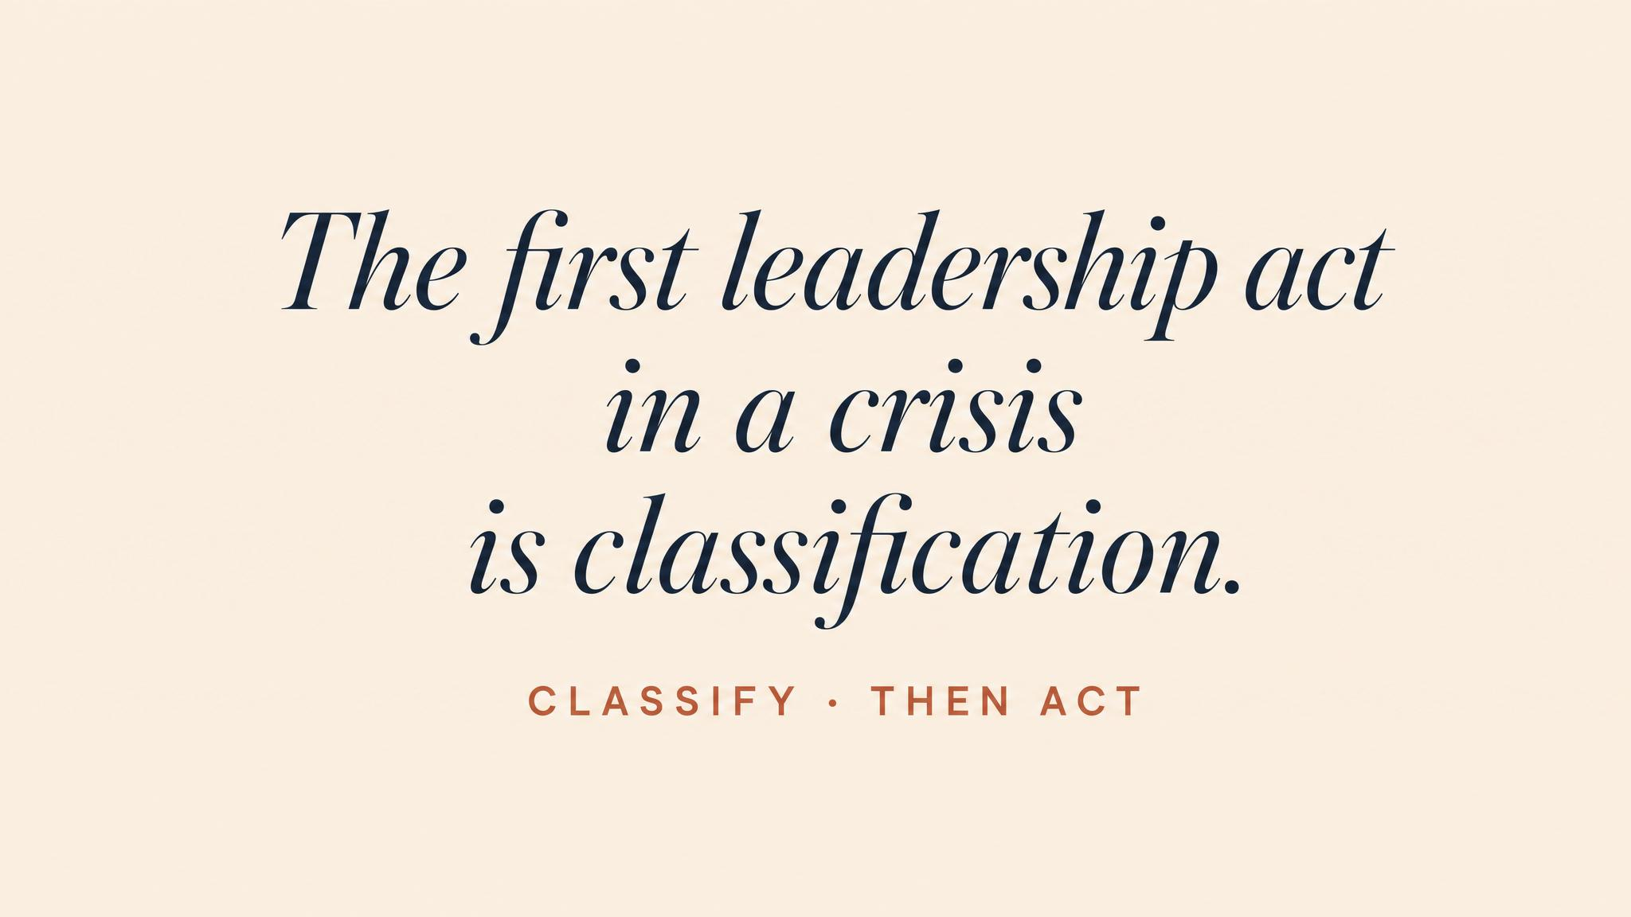
Notes:
The core claim of the chapter, stated as plainly as it can be stated. Classification is not a preliminary to leadership. It is leadership, in its most fundamental form. At Grenfell, the stay-put advice was the correct emergency procedure applied to a crisis situation. The wrong word produced the wrong action — at the worst possible time.

Slide 13
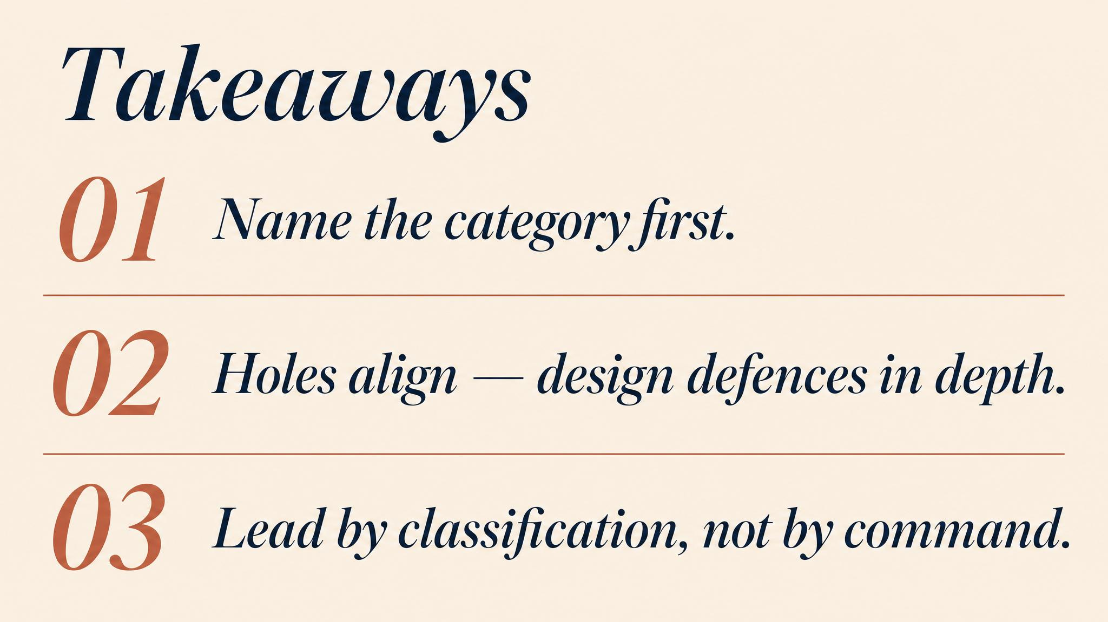
Notes:
Three things to carry forward. One: Boin's three criteria must all be present at once. Two: Reason's holes have to align across the whole system. Three: Weick's sensemaking is fragile and social — it can collapse faster than the threat itself. Pause briefly on each.

Slide 14

Notes:
Bridge into Chapter 2. We've learned to recognise a crisis once it has begun. Next we move to detection — the early ambiguous indicators, the weak signals, and why organisations systematically ignore the information that could prevent catastrophe. The activation gap is where the most consequential decisions are made.

