Slide 1

Notes:
Open the chapter with the claim that titles it: the first thirty minutes don't just shape the response. They are the response. Hold the room: we'll move from Fukushima to Tham Luang, and watch one trajectory bend toward catastrophe while another bends toward rescue, both decided in the opening minutes.

Slide 2

Notes:
Set the scene. At 3:27 p.m. on 11 March 2011, the largest earthquake in Japan's recorded history had just triggered a tsunami toward Fukushima Daiichi. External power was lost. Emergency diesel generators kicked in — the system was performing as designed. Fourteen minutes later, a fourteen-metre wall of water overwhelmed the seawall. The generators drowned. Batteries began to fail.

Slide 3
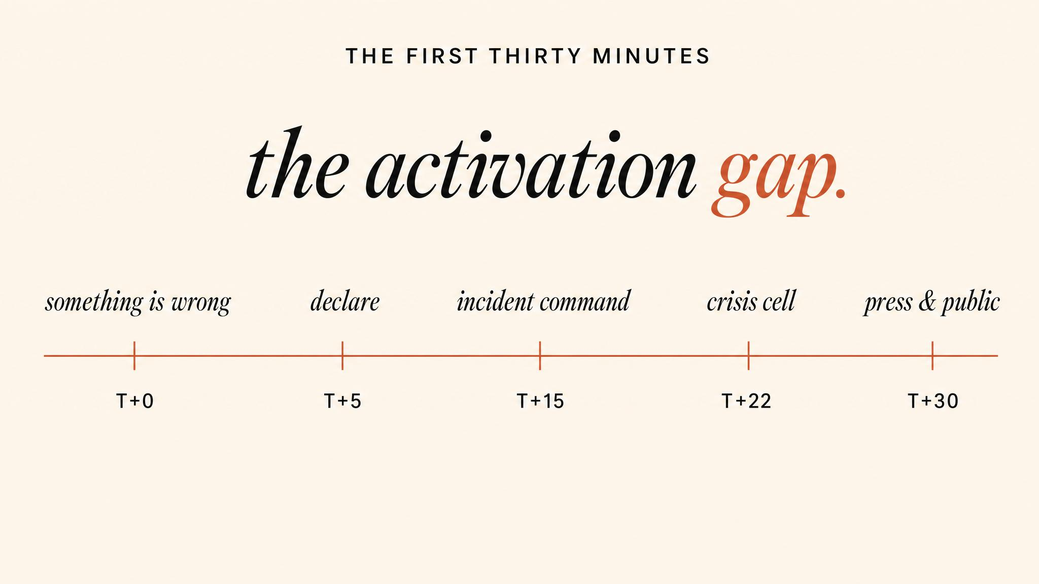
Notes:
Define the activation gap: the distance between 'something is wrong' and 'we are now in crisis response mode'. Boin and colleagues (2016) found that the most consequential decisions are made inside this gap — with the least available information. It is not primarily a problem of speed. It is a problem of recognition.

Slide 4
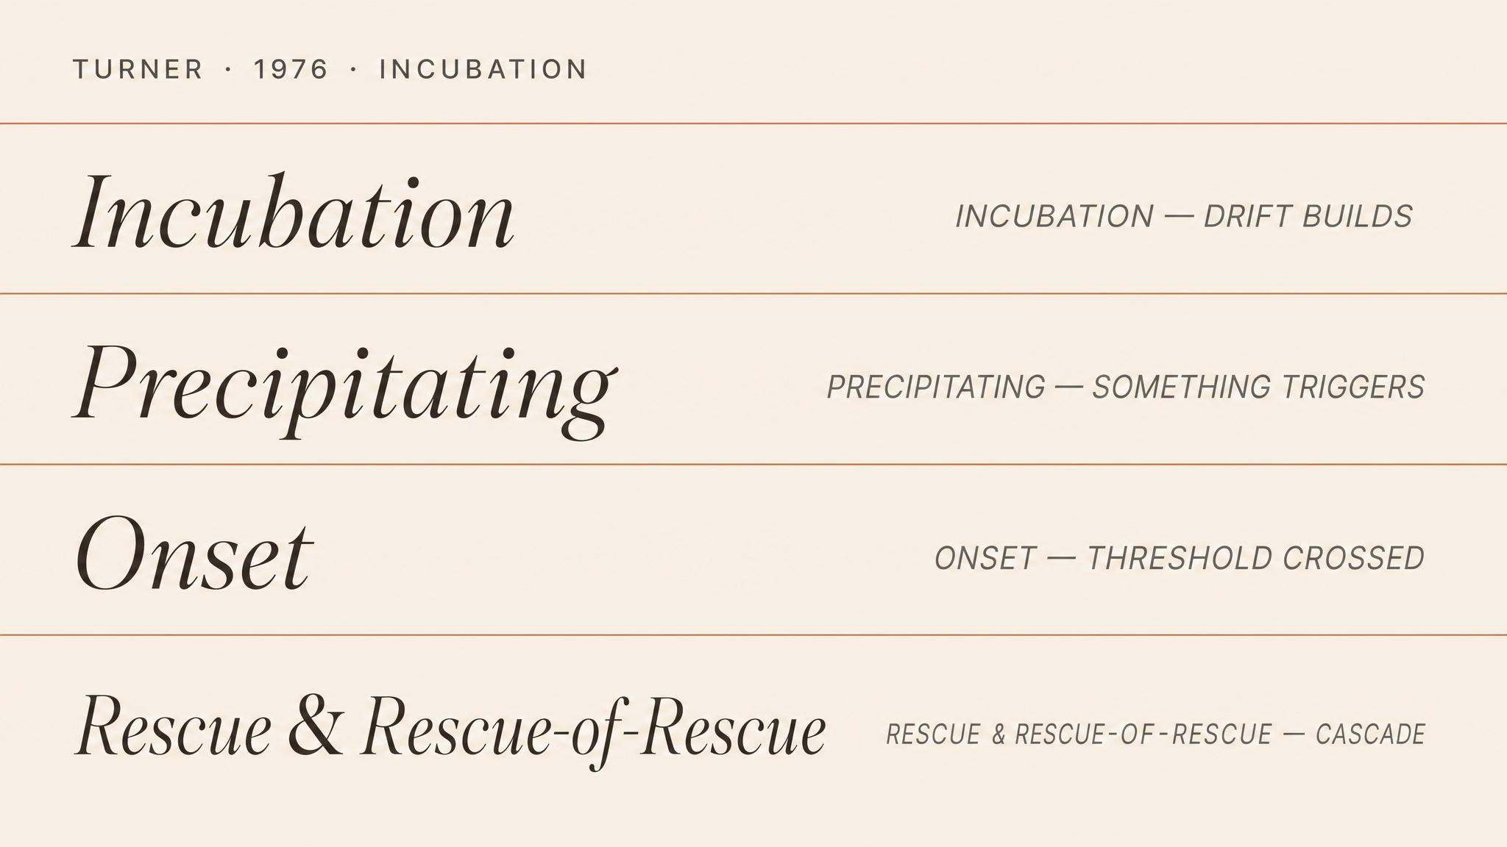
Notes:
Barry Turner's incubation period — described by Turner and Pidgeon in 1997 — identifies four ways information fails before a crisis. Unknown: information that simply doesn't exist in the system. Unappreciated: information that exists but isn't valued. Unassembled: information that exists in pieces but isn't combined. Unfitting: information that contradicts existing mental models and is therefore filtered out.

Slide 5
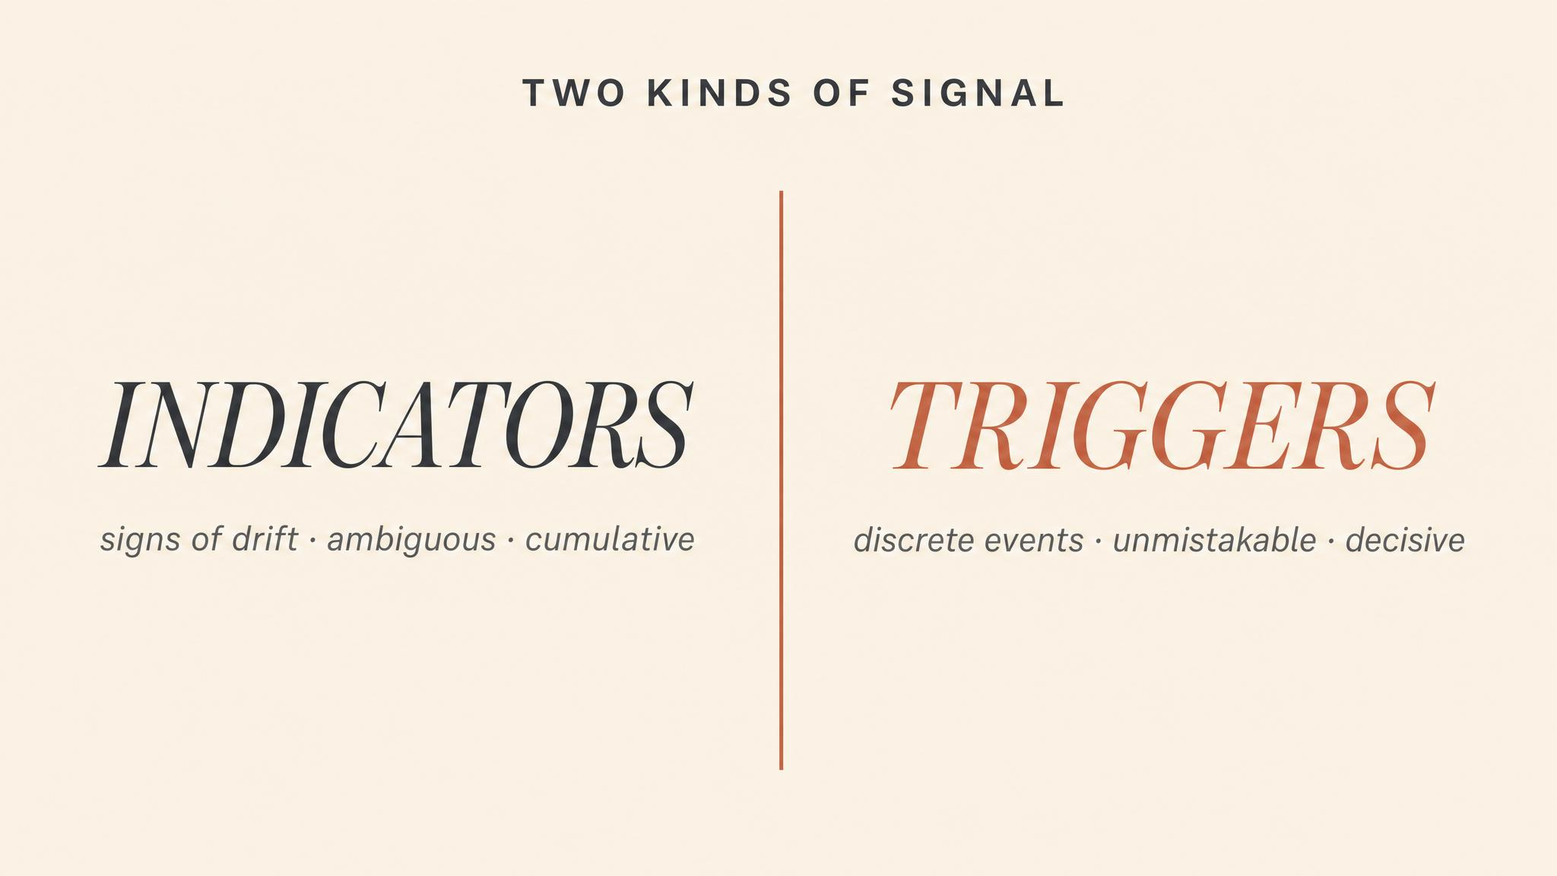
Notes:
The Institute of Medicine's 2013 toolkit on crisis standards draws a careful distinction. Indicators are data points that suggest a situation is developing. Triggers are specific thresholds that demand action. The gap between the two is where most organisations struggle — because activation carries costs, and there is a systematic bias toward under-activation.

Slide 6
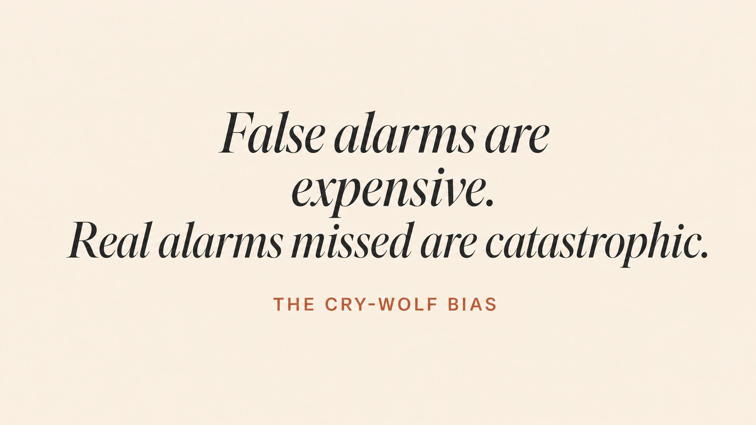
Notes:
Pause and read it slowly. Boin and colleagues, in their 2016 book The Politics of Crisis Management, name the structural problem: organisations are designed for efficiency, for routine, for the smooth processing of predictable inputs. Crisis detection requires the opposite orientation — vigilance toward the anomalous. The cry-wolf cost biases the whole system toward under-activation.

Slide 7

Notes:
Tham Luang, June 2018. When the Wild Boars football team failed to return, Chiang Rai's provincial governor Narongsak Osatanakorn assumed incident command within hours. What distinguished Tham Luang was not that the situation was simpler — a flooded cave with no proven rescue method is enormously complex — but that the activation architecture was clear: one decision-maker with unambiguous authority.

Slide 8
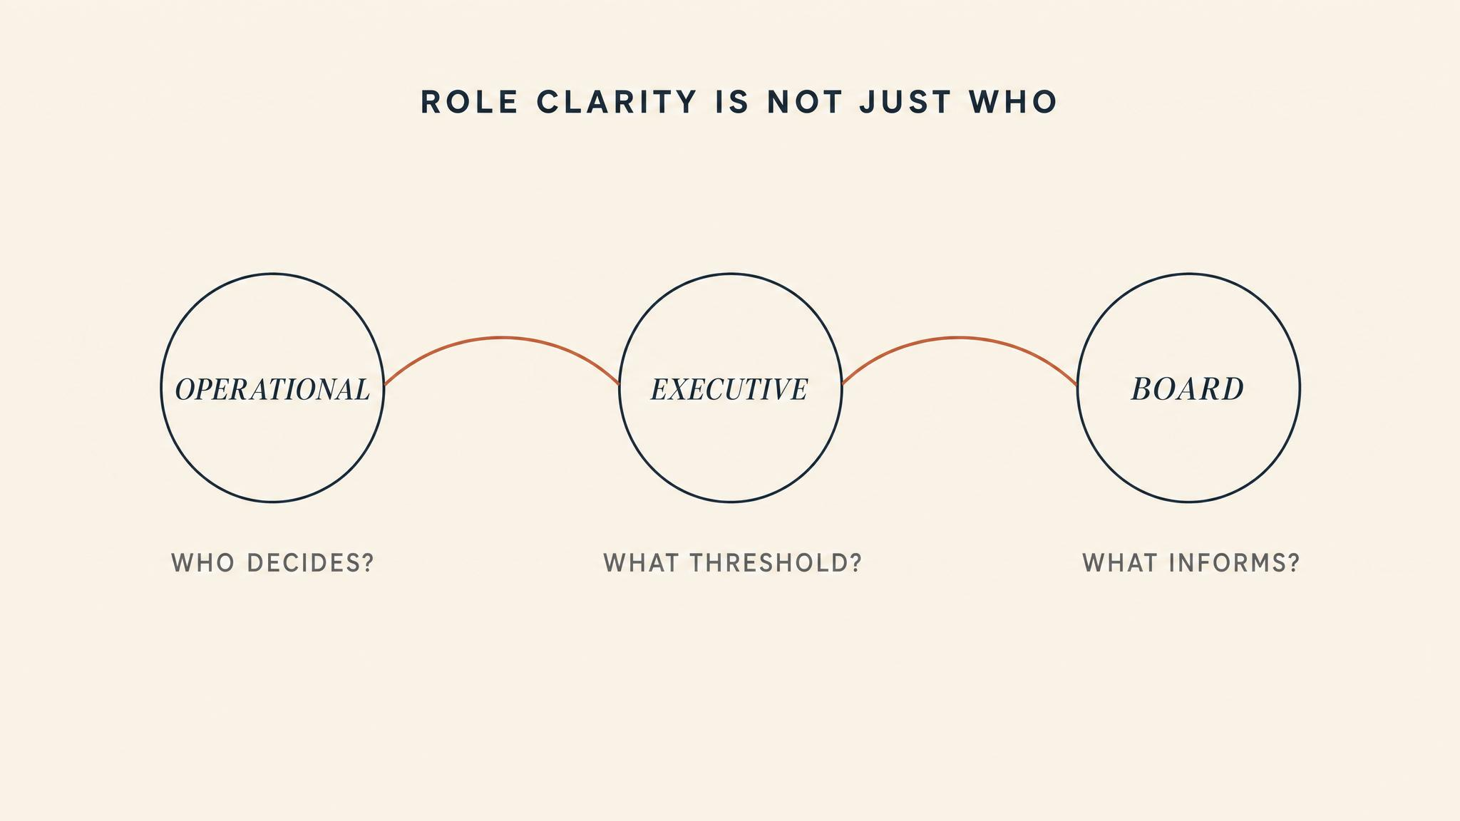
Notes:
Role clarity is more than 'who is in charge'. It is the mobilisation sequence — the order in which roles are activated and the dependencies between them. A common failure: activating resources before the assessment that determines what is needed. Another: failing to stand up communications capacity early enough. Crisis response is cascading, not parallel.

Slide 9

Notes:
Weick's 1988 paradox: in crisis, sensemaking is not passive. It is enacted. The actions you take to understand the situation change the situation itself, and focus what counts as a relevant cue. This is why information triage is not simply filtering — it is active, consequential, and partially self-fulfilling.

Slide 10
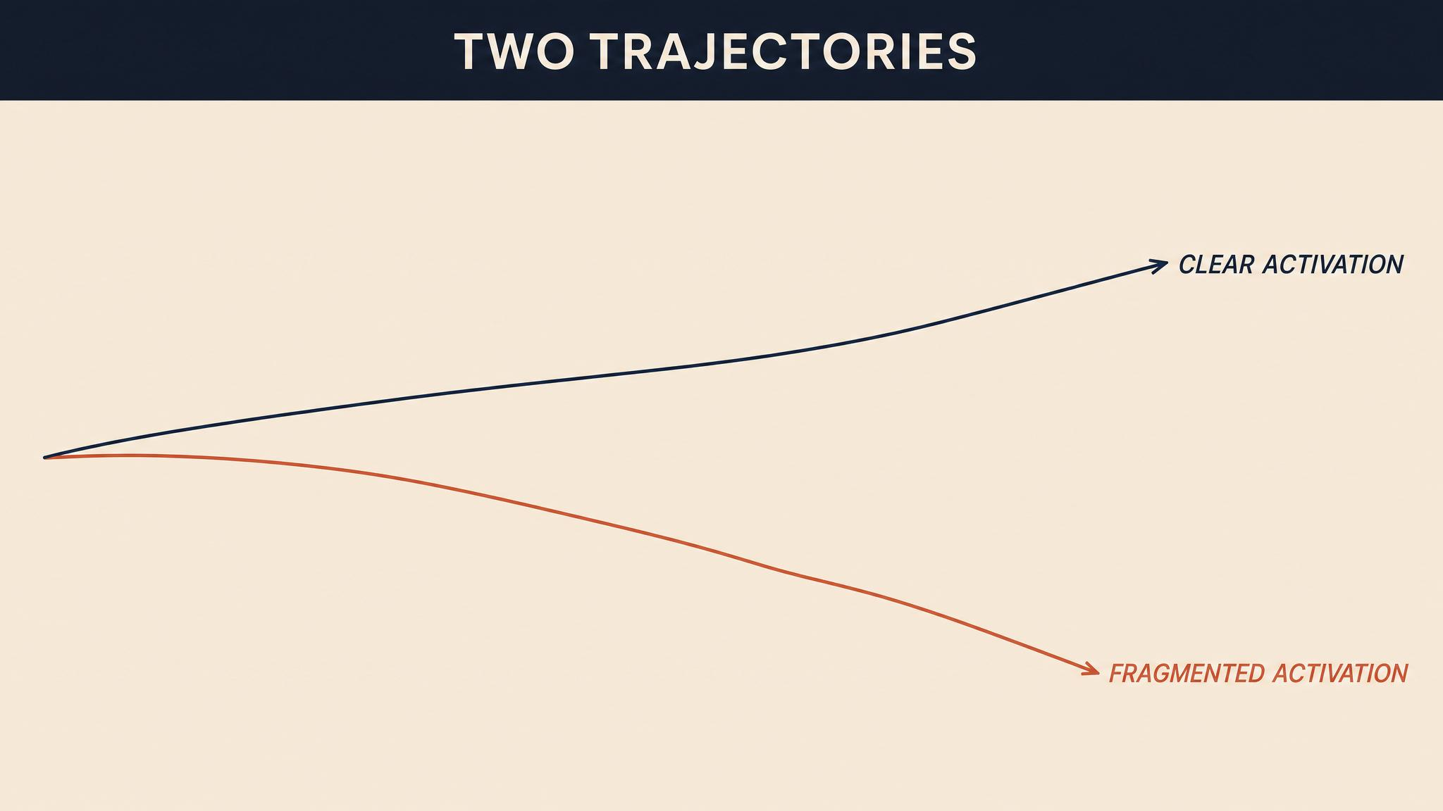
Notes:
The contrast between Fukushima and Tham Luang is a story about trajectory. At Fukushima — delayed activation, fragmented authority, overwhelmed information systems — set a path toward cascading failure that brave individual actions could slow but not reverse. At Tham Luang — swift activation, clear authority, effective coordination — set a path toward eventual rescue, despite enormous technical challenges. The boys were trapped for eighteen days, but the response architecture was established in the first hours.

Slide 11
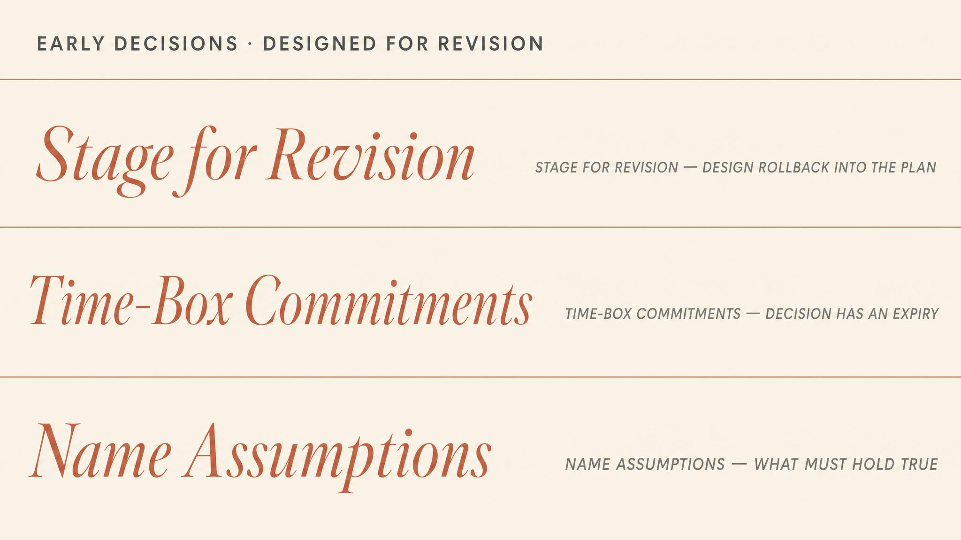
Notes:
Early decisions cannot be perfect; the information is fragmentary. But they can be designed for revision. Activate broadly rather than narrowly. Establish communication channels before you need them. Explicitly flag the assumptions that need to be tested as more information arrives. Treat the first thirty minutes not as the period when the right answer must be found, but as the period when the capacity to find the right answer is built.

Slide 12
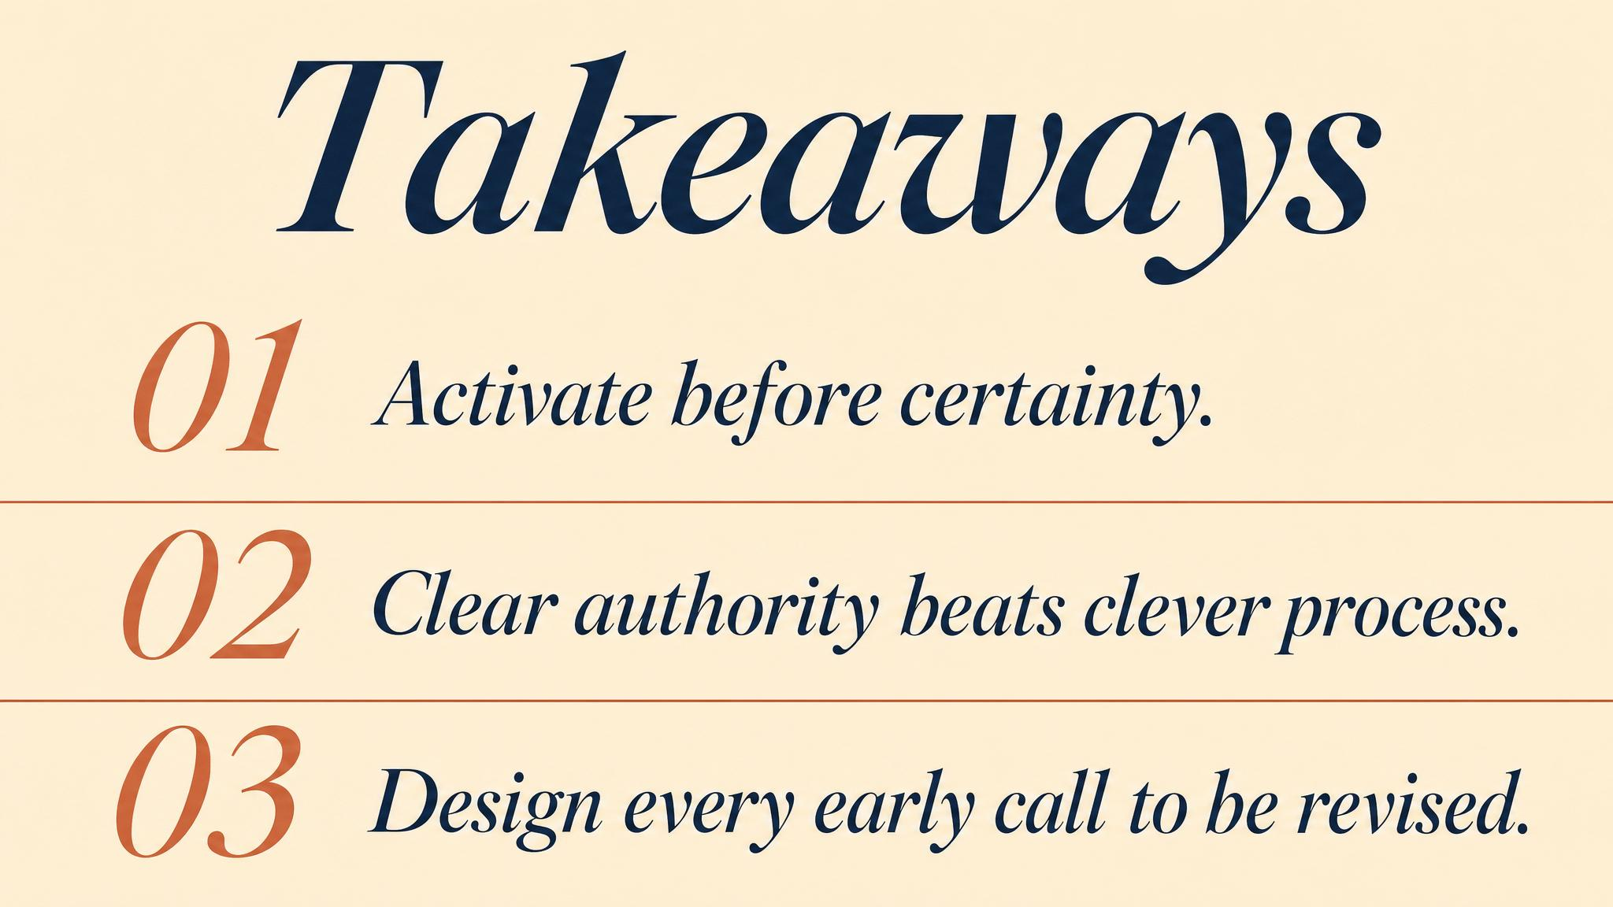
Notes:
Three things to carry forward. One: the gap between data points (indicators) and decision thresholds (triggers) is where activation lives. Two: role clarity is about sequence and dependencies, not just hierarchy. Three: Weick's insight that action focuses cognition — the first decisions shape what counts as information in the next.

Slide 13

Notes:
Bridge into Chapter 3. The opening mobilisation gives us a footprint, but the situation keeps evolving. Next we look at decision-making itself: how experienced people choose under time pressure, what happens to cognition under cognitive load, and why mode mismatch — using the wrong decision-making mode for the situation — can be lethal.

