Slide 1
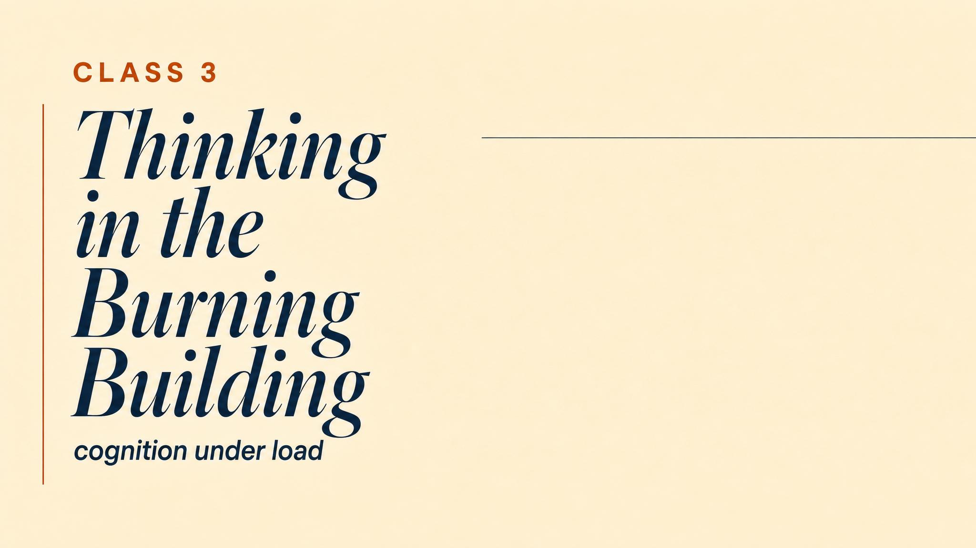
Notes:
Open with the central puzzle: Sullenberger over the Hudson, 208 seconds, two engines out. The rational-choice model says to evaluate weighted criteria. He does none of that. What was happening inside his mind that made that seeing possible — and what could have made it catastrophically wrong?

Slide 2

Notes:
Read it slowly. Flat. Certain. Not the voice of a man running probability calculations. Two thousand eight hundred eighteen feet. One hundred fifty-five souls aboard. Roughly 208 seconds before the aircraft hits something. The NTSB (2010) found that pilots given a 35-second delay to assess and decide before returning to LaGuardia crashed every time.

Slide 3
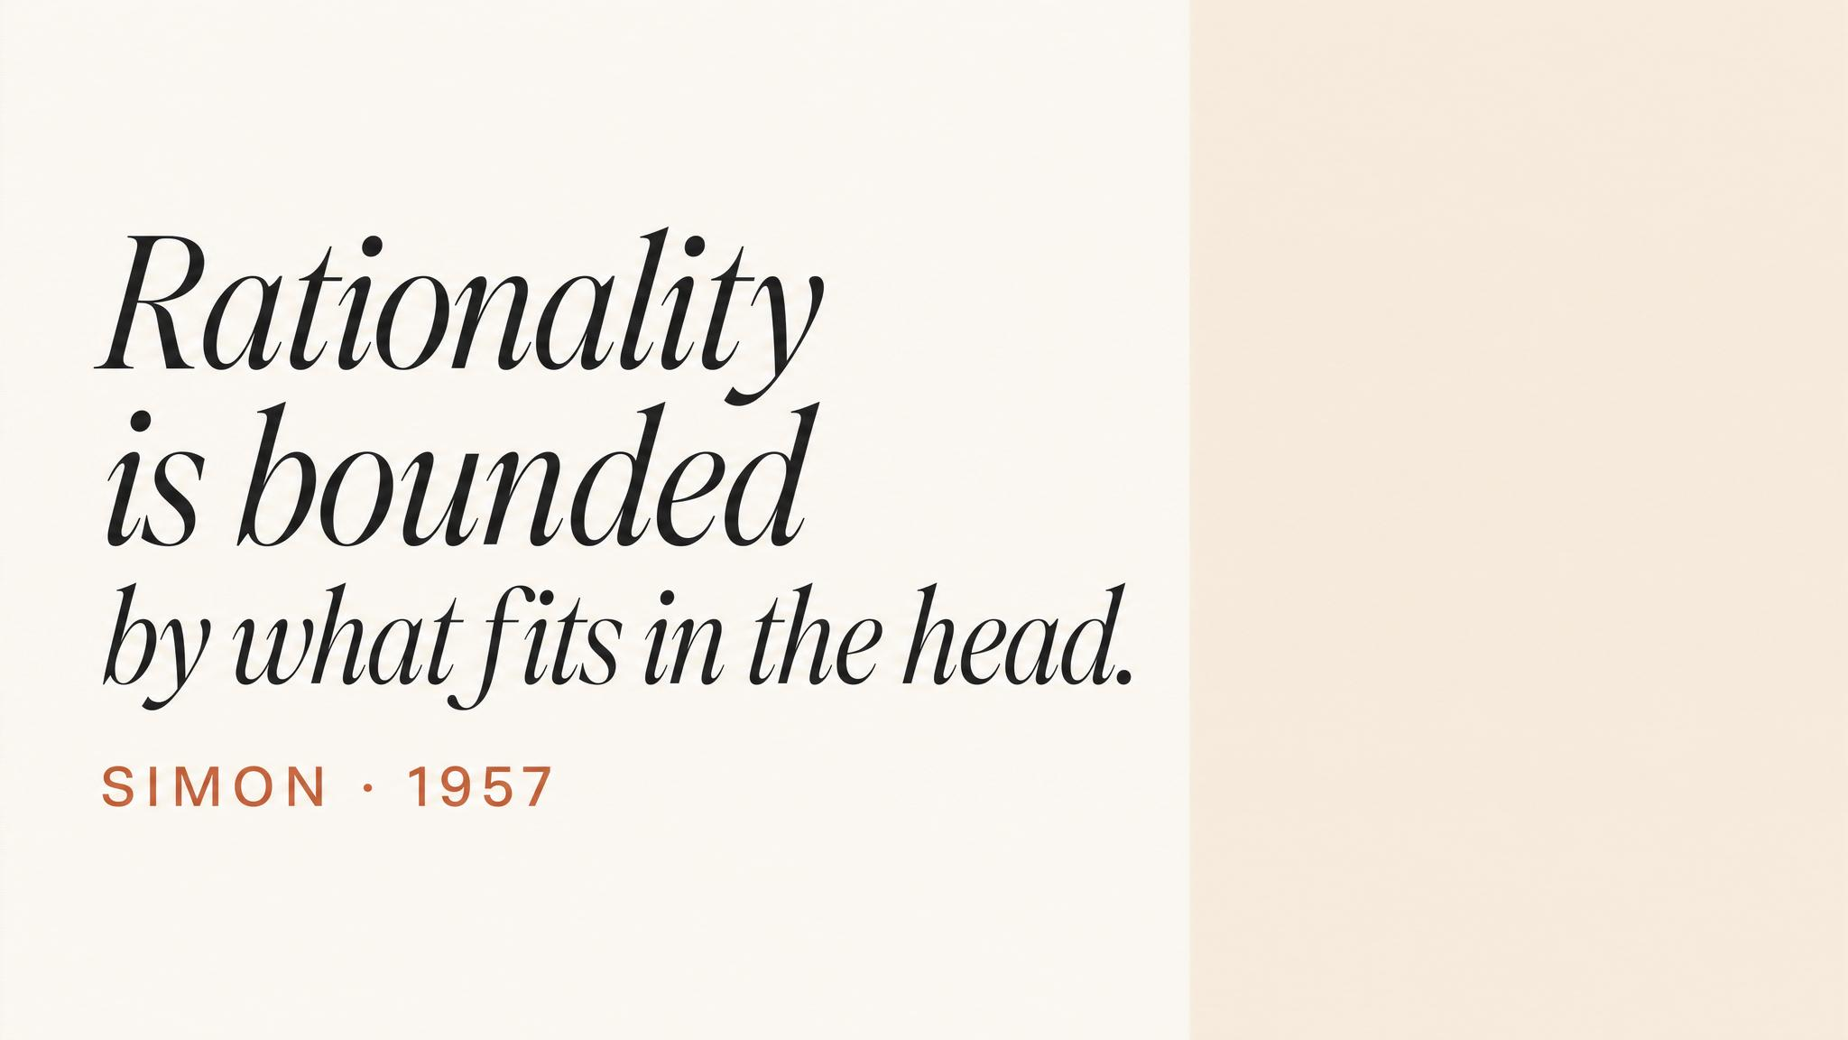
Notes:
Herbert Simon, 1947, Administrative Behavior. Bounded rationality: humans cannot evaluate all alternatives. They set an aspiration level and choose the first option that meets it. They satisfice. This was heresy when optimisation was the orthodoxy, and Simon won a Nobel for it. In crisis, satisficing becomes not just practical but essential.

Slide 4
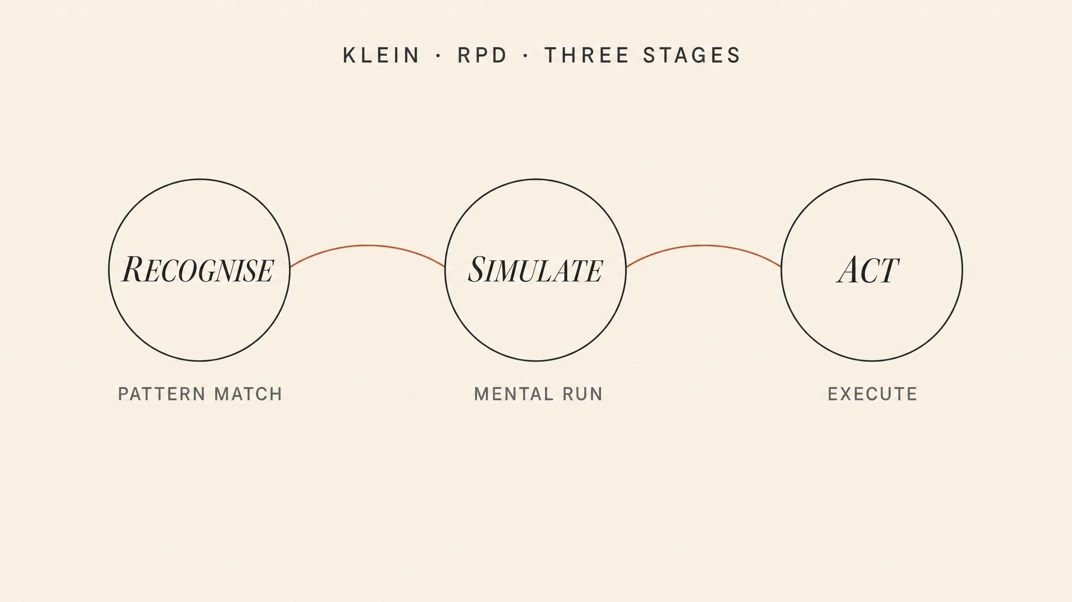
Notes:
Klein's RPD model — three stages. Recognise: rapidly categorise the situation by matching against stored patterns. Simulate: mentally run a single course of action and look for failure points. Act: commit. Klein and colleagues (2010) found that in 80–90 percent of fireground decisions, commanders considered only one option. They did not compare. They recognised.

Slide 5
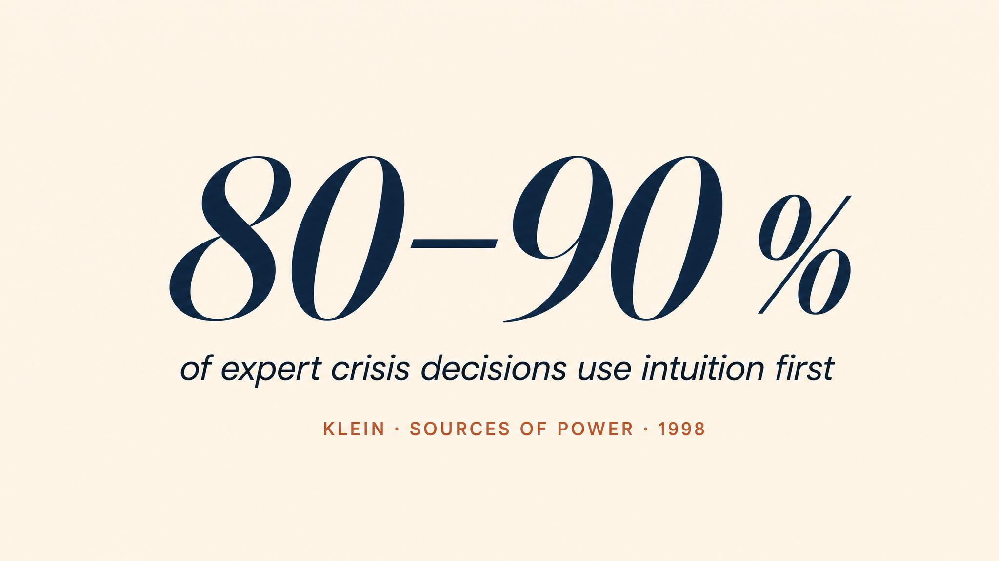
Notes:
Let the figure land. Klein's elegantly simple study: 26 experienced fireground commanders, average 23 years of service, 156 critical decisions. Classical theory predicted multiple options compared. In 80 to 90 percent, commanders considered only one option. They recognised. That's not guessing — that's compressed experience.

Slide 6
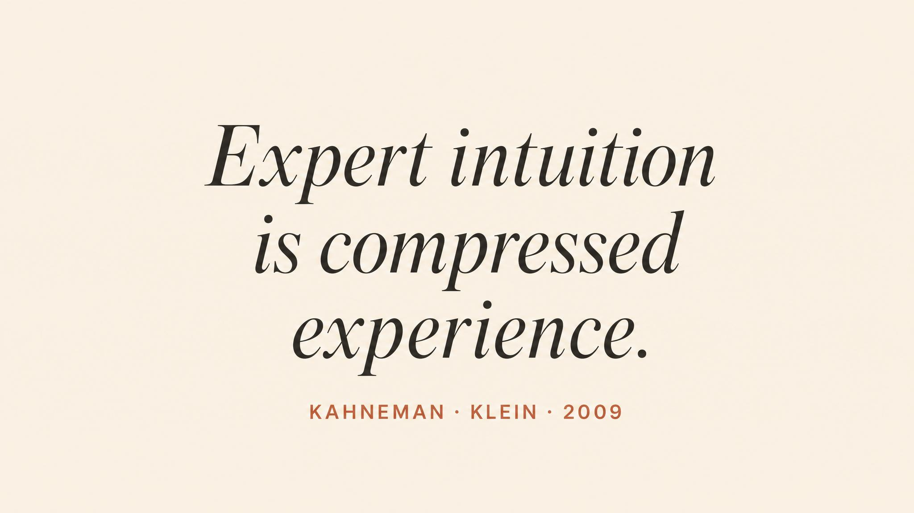
Notes:
The whole RPD framework reduces to this. Patterns are stored not as explicit rules but as perceptual configurations — bundles of cues, expectations, and actions. Klein calls it 'seeing the invisible'. The novice cannot see what the expert sees because the expert's perceptual system has been trained by thousands of exposures.

Slide 7
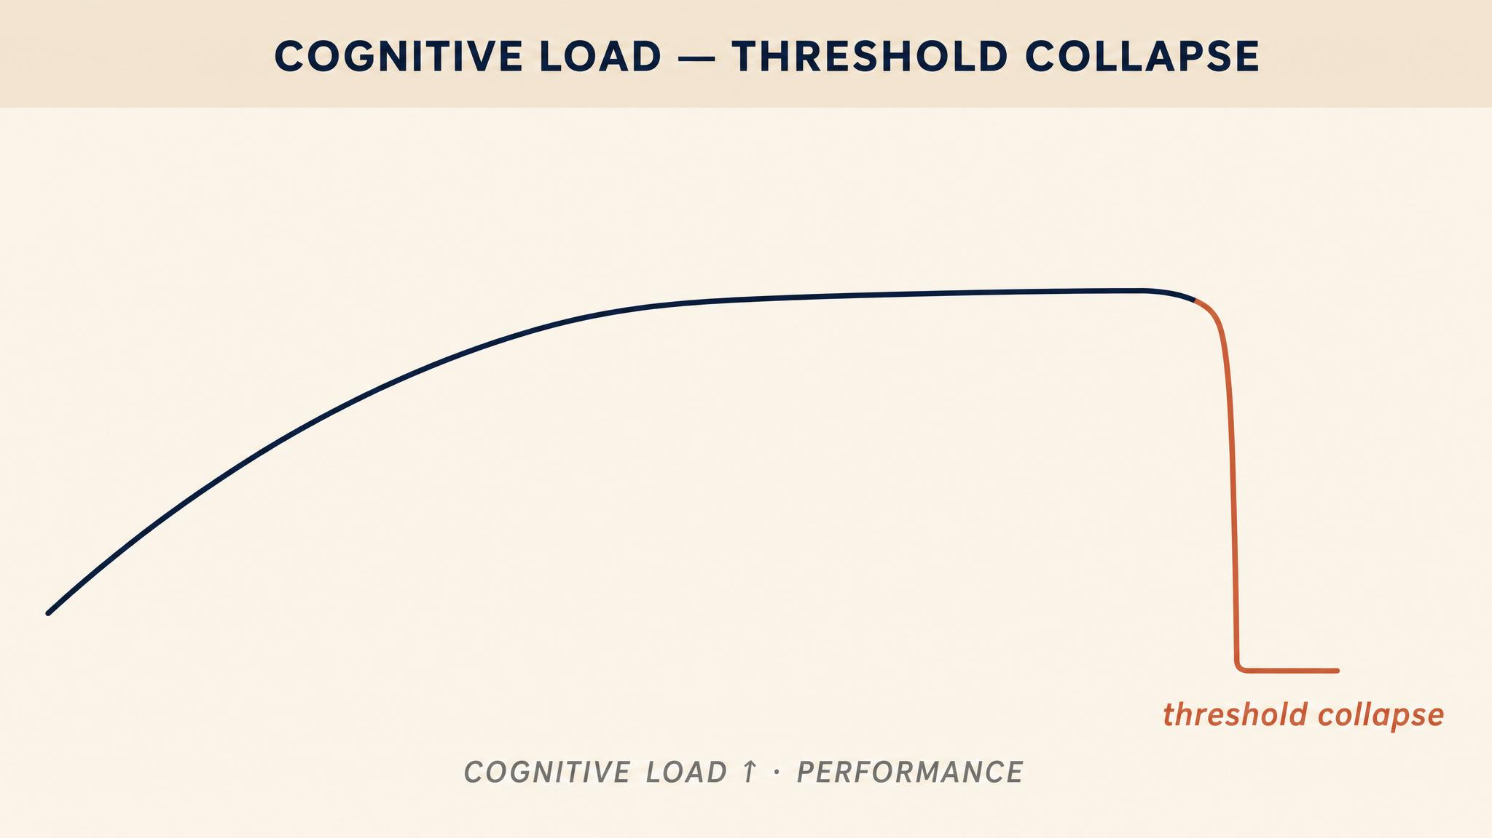
Notes:
Allen and colleagues (2014). Decision quality does not decline smoothly under load — it holds, then drops sharply. Under load, you can still read the gauges; you can no longer figure out what they mean together. The analytical system that catches errors goes offline first, leaving the automatic system without supervision.

Slide 8
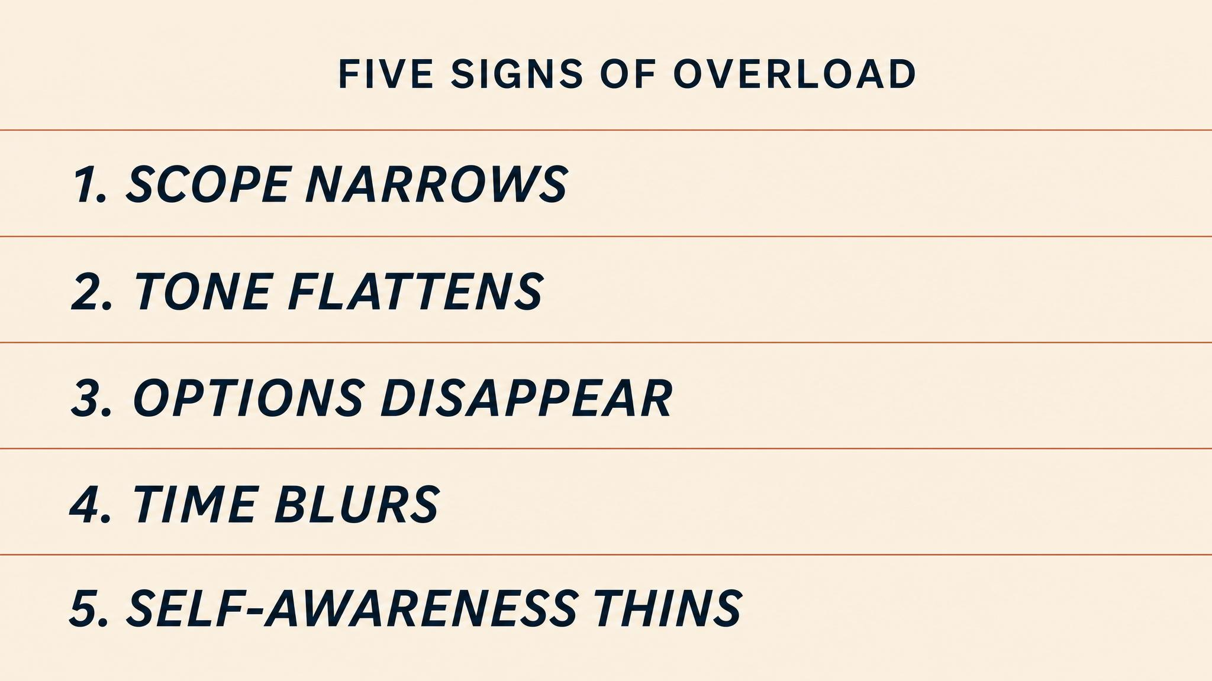
Notes:
Five signs that the cognitive system is going offline. Tunnel vision: fixation on one source. Tasks shed silently: dropping duties without noticing. Familiar reflexes: well-practised routines fired at the wrong situation. Communication thins: the overloaded person literally lacks bandwidth to talk and think. Affect flattens, or sharpens into irritability.

Slide 9
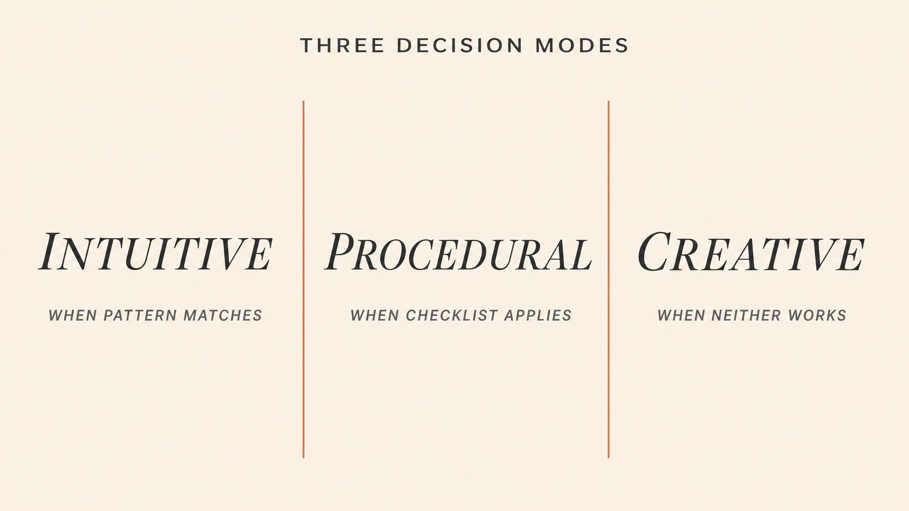
Notes:
Three modes. Recognition-primed: when time is measured in seconds and patterns exist. Analytical: when time allows for option comparison. Creative: when the situation is genuinely novel and no pattern will match. The dangerous moments are at the boundaries — mode mismatch. Sullenberger was in mode one; Dodge invented mode three; Fukushima was trapped in mode two when it needed mode three.

Slide 10
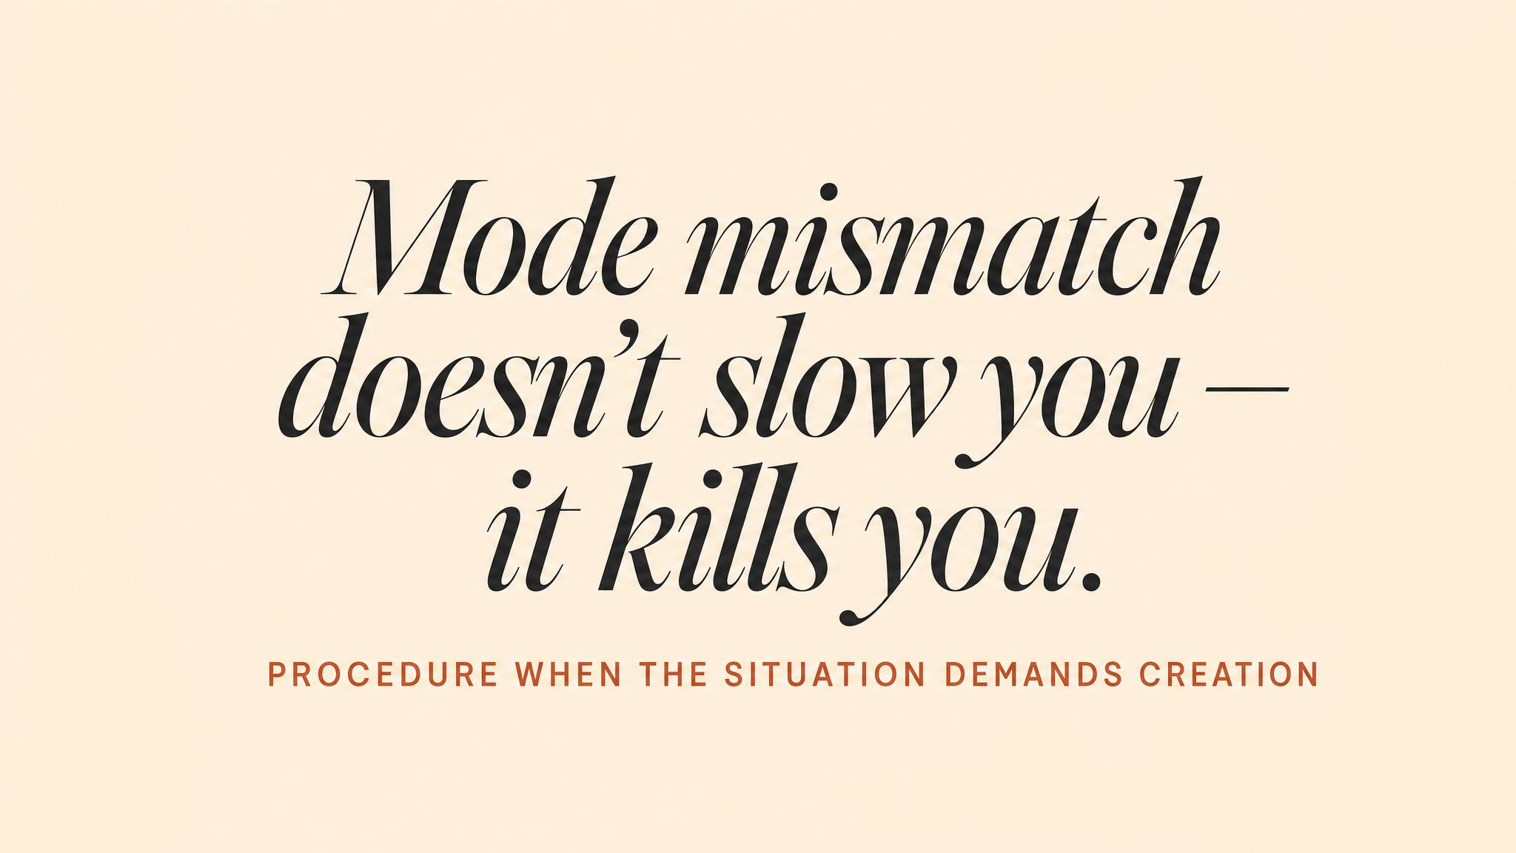
Notes:
Fukushima: with no reliable instruments, operators could not match the situation to trained procedures, which meant they could not act. The procedural framework that was designed to ensure careful decisions became a paralysis mechanism. Hours were lost to information that did not exist, while conditions deteriorated beyond recovery.

Slide 11
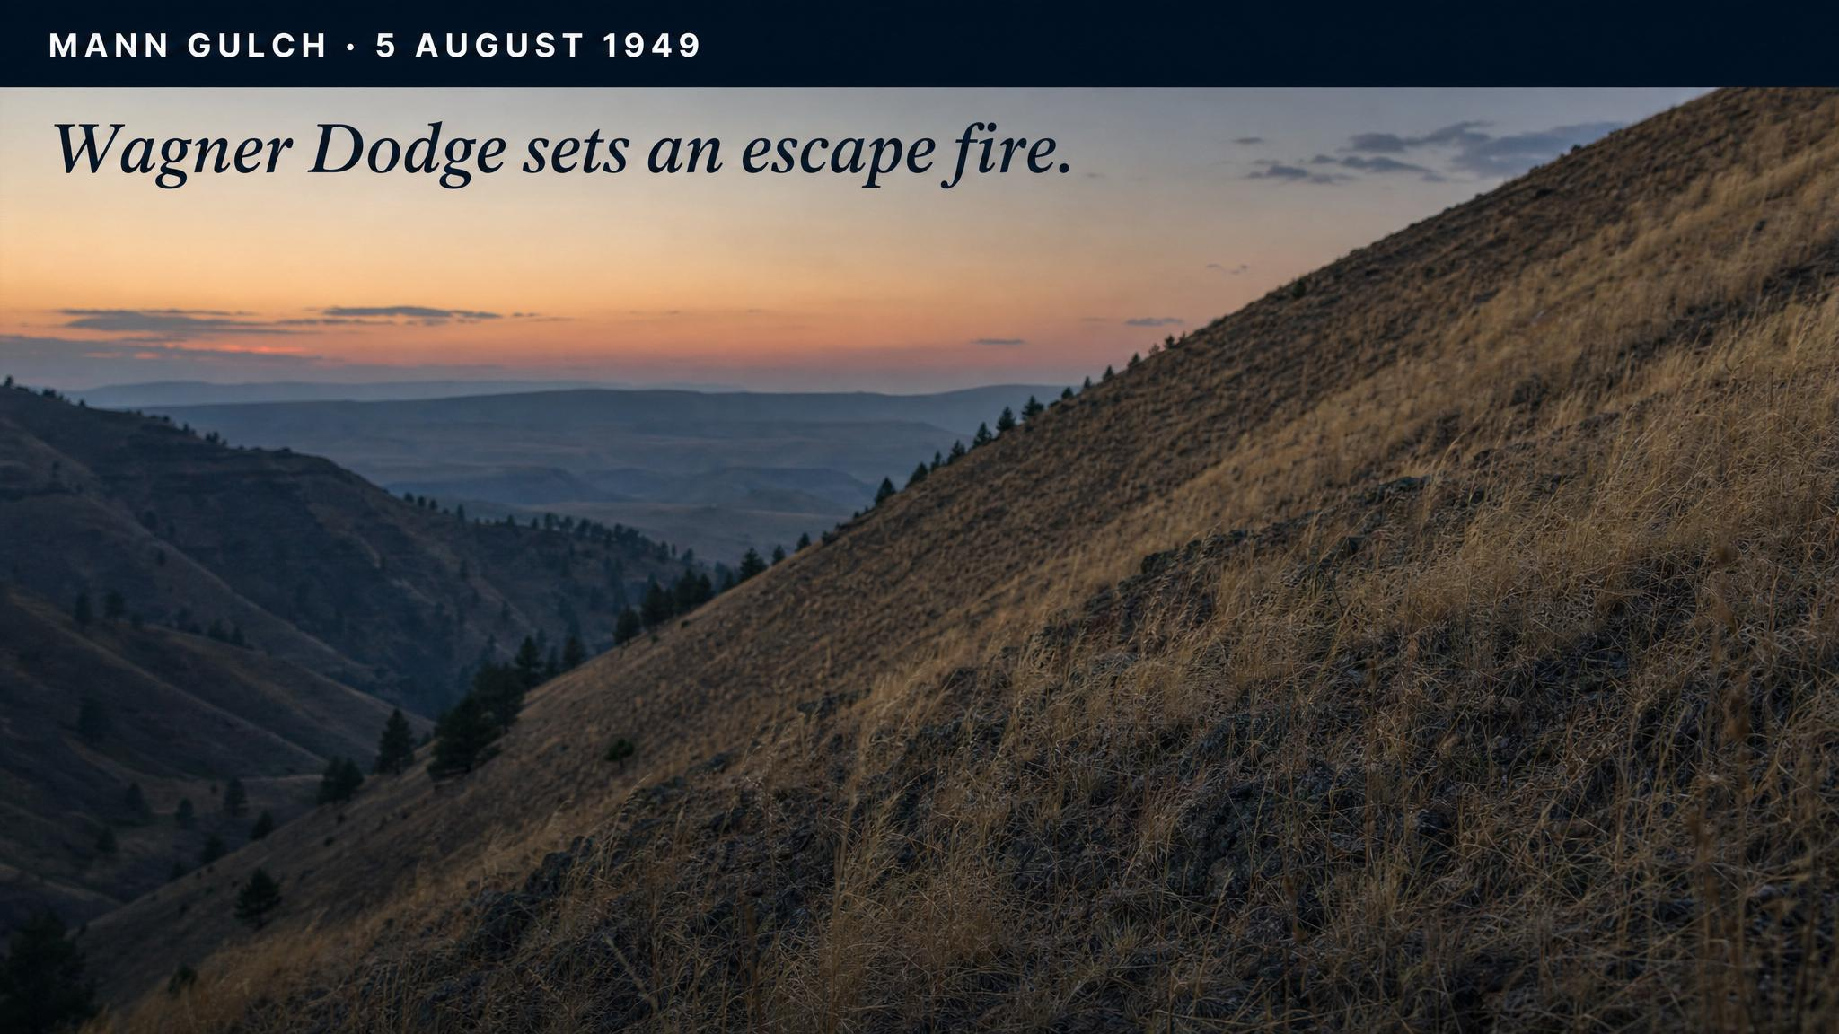
Notes:
Mann Gulch, viewed through Klein's lens this time. Dodge had ninety seconds. No pattern existed for what he did. Klein analyses the escape fire as a case where pattern matching was unavailable — the situation was genuinely novel — and the decision-maker's deep understanding of the domain enabled a creative leap. Domain depth, not procedure, was what made invention possible.

Slide 12
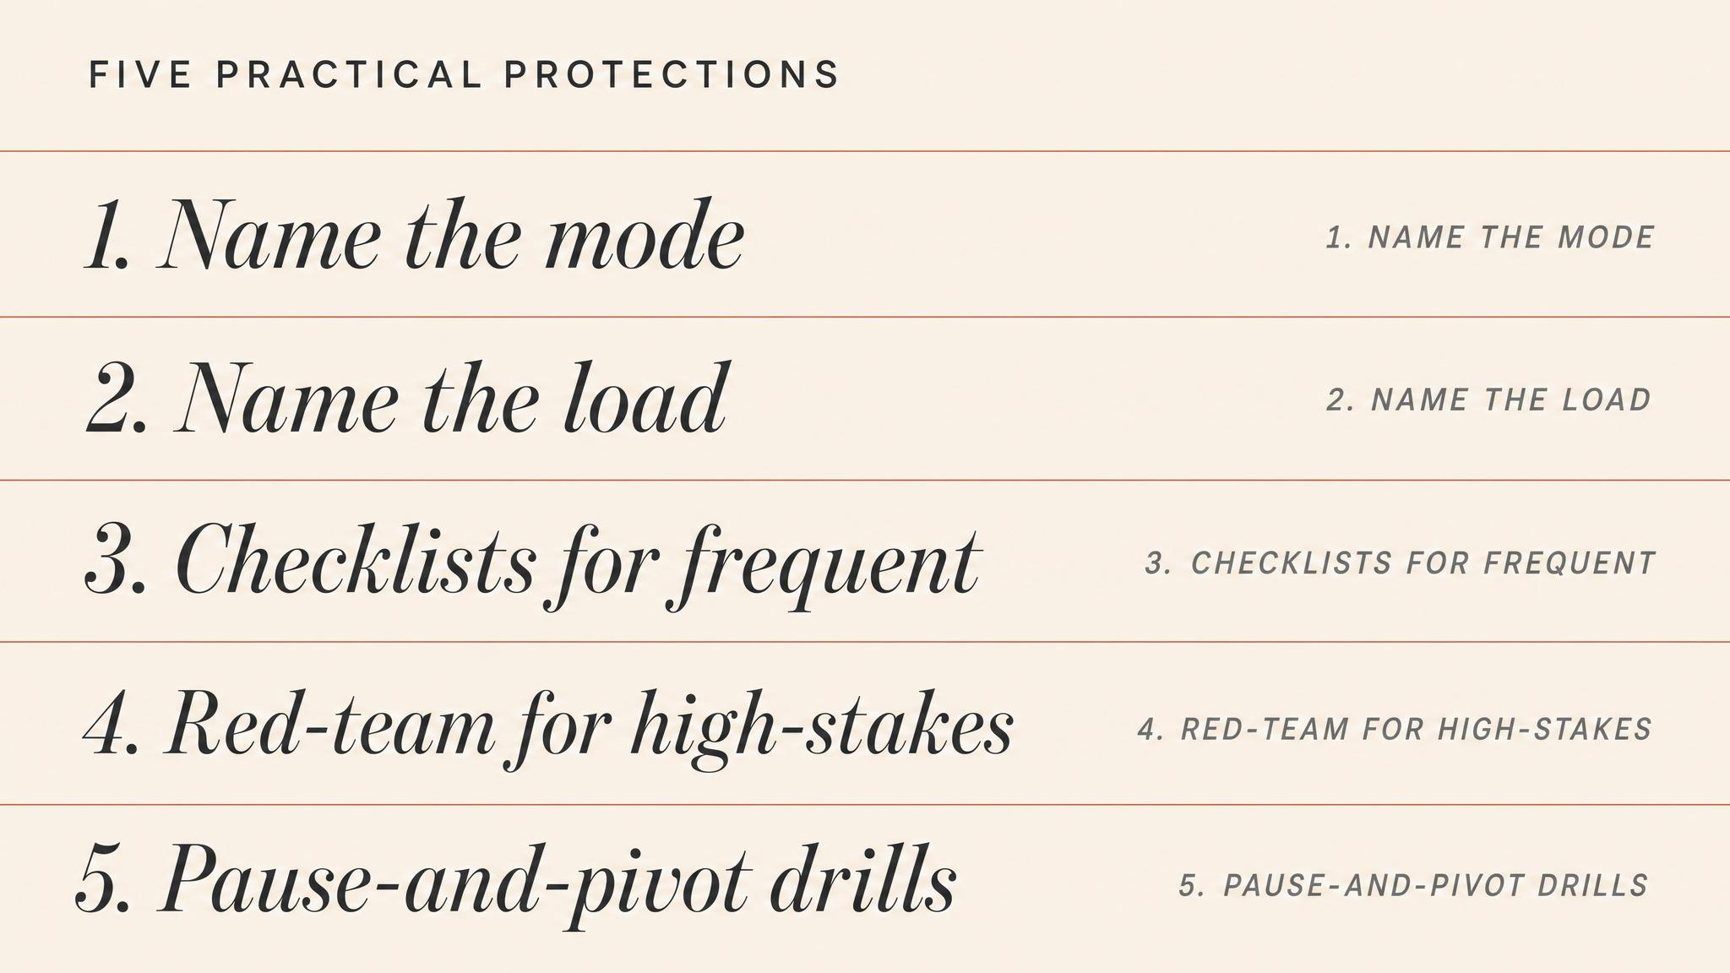
Notes:
Five practical protections. Strip every avoidable load — interruption, ambiguity, unresolved question. Build the pattern library before you need it: scenario training, after-action reviews. Designate a mode monitor — someone whose job is to watch the decision process itself. Create structured pauses. Make satisficing thresholds explicit: 'we are looking for an action that prevents X for the next two hours, not a permanent fix.'

Slide 13
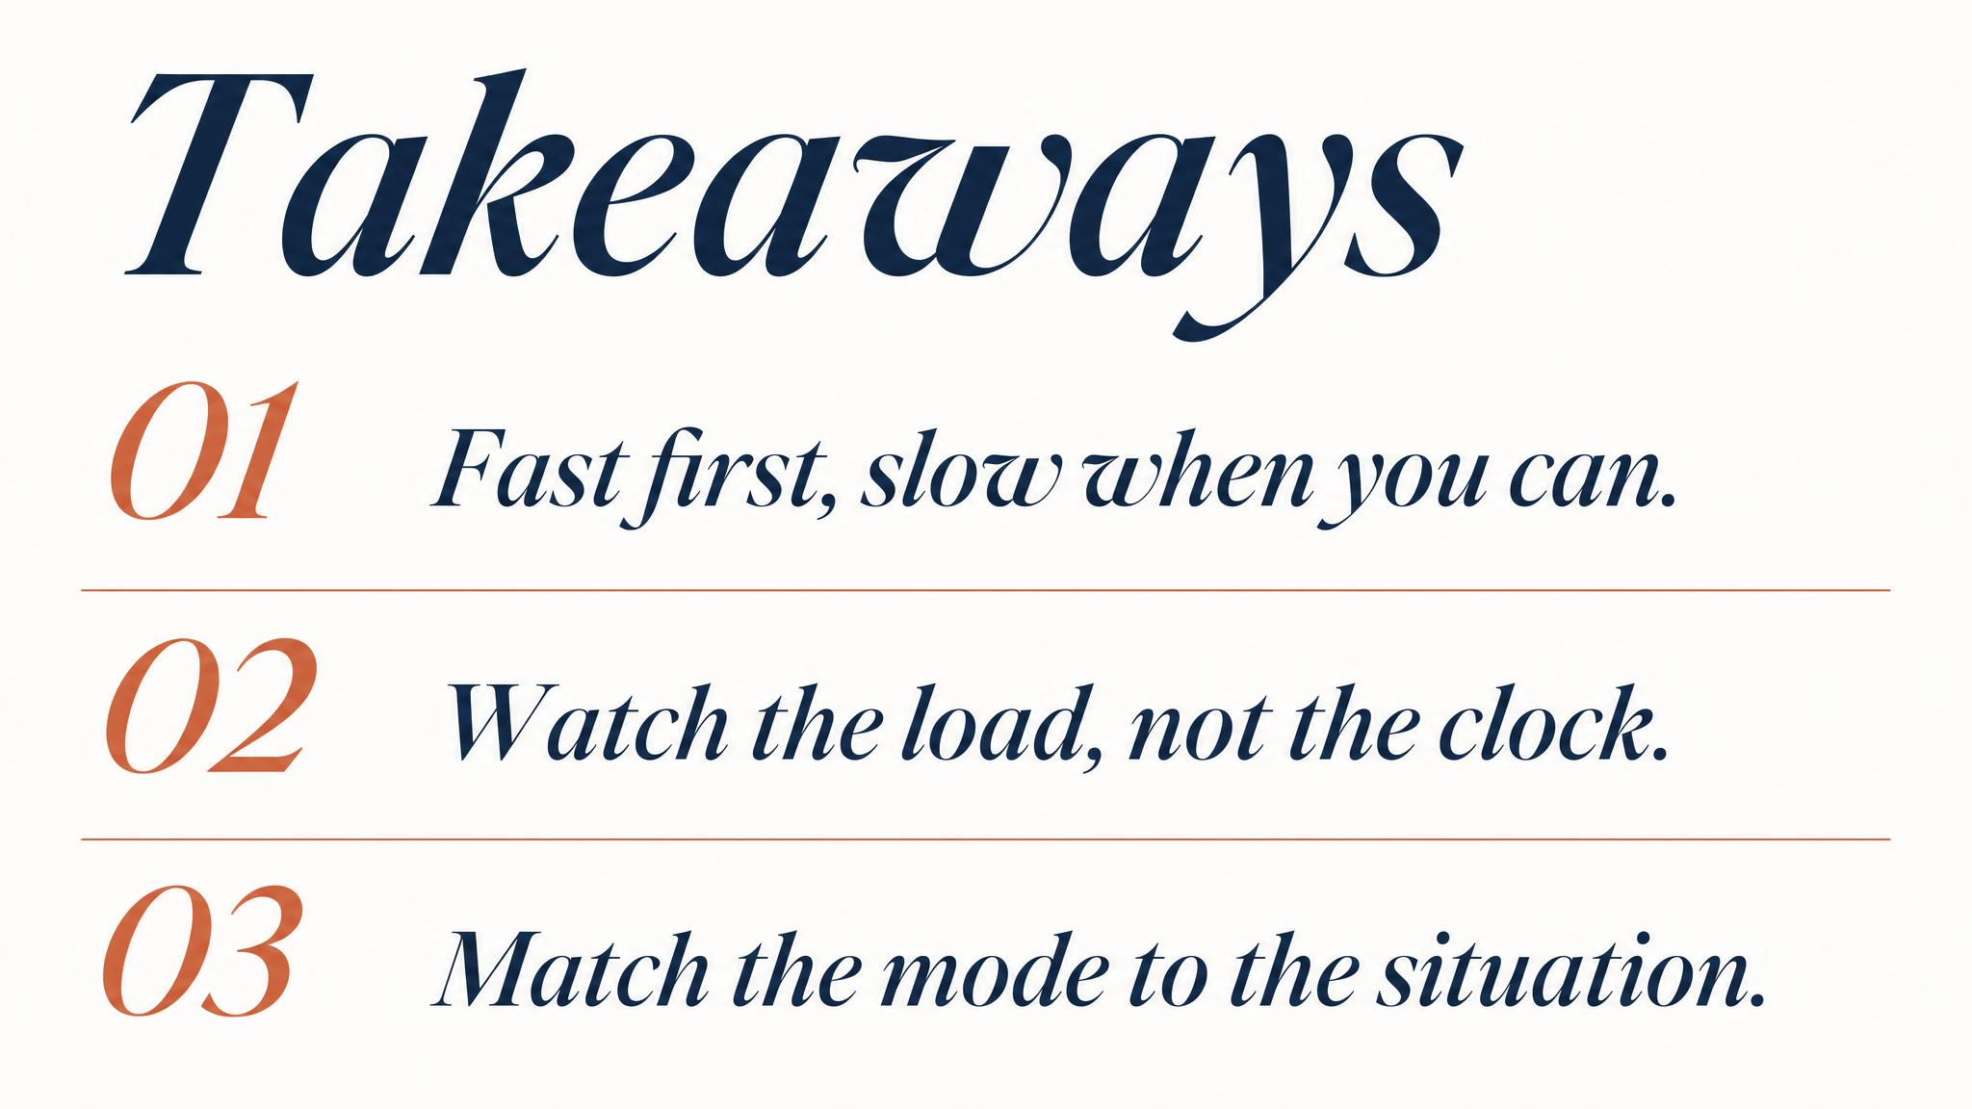
Notes:
Three things to carry. One: under time pressure, expertise recognises and simulates a single option — not a tournament. Two: cognitive load doesn't degrade quality smoothly; it holds, then collapses. Three: the test of a leader is mode awareness — picking the mode the moment demands, not the one their training rewards.

Slide 14

Notes:
Bridge to Chapter 4. The best decision is worthless if it cannot move — clearly, quickly, credibly. Next, the communication architecture: who needs to know what, in what order, with what fidelity. The same constraints we faced here — time, degradation, overload — shape the message received versus the message sent.

