Slide 1

Notes:
Open with the central premise: every crisis hides a deceptively simple question — who needs to know what, and when? The systems we build to answer it determine whether information reaches the people who can act on it. This chapter is about information architecture, not communication tactics.

Slide 2
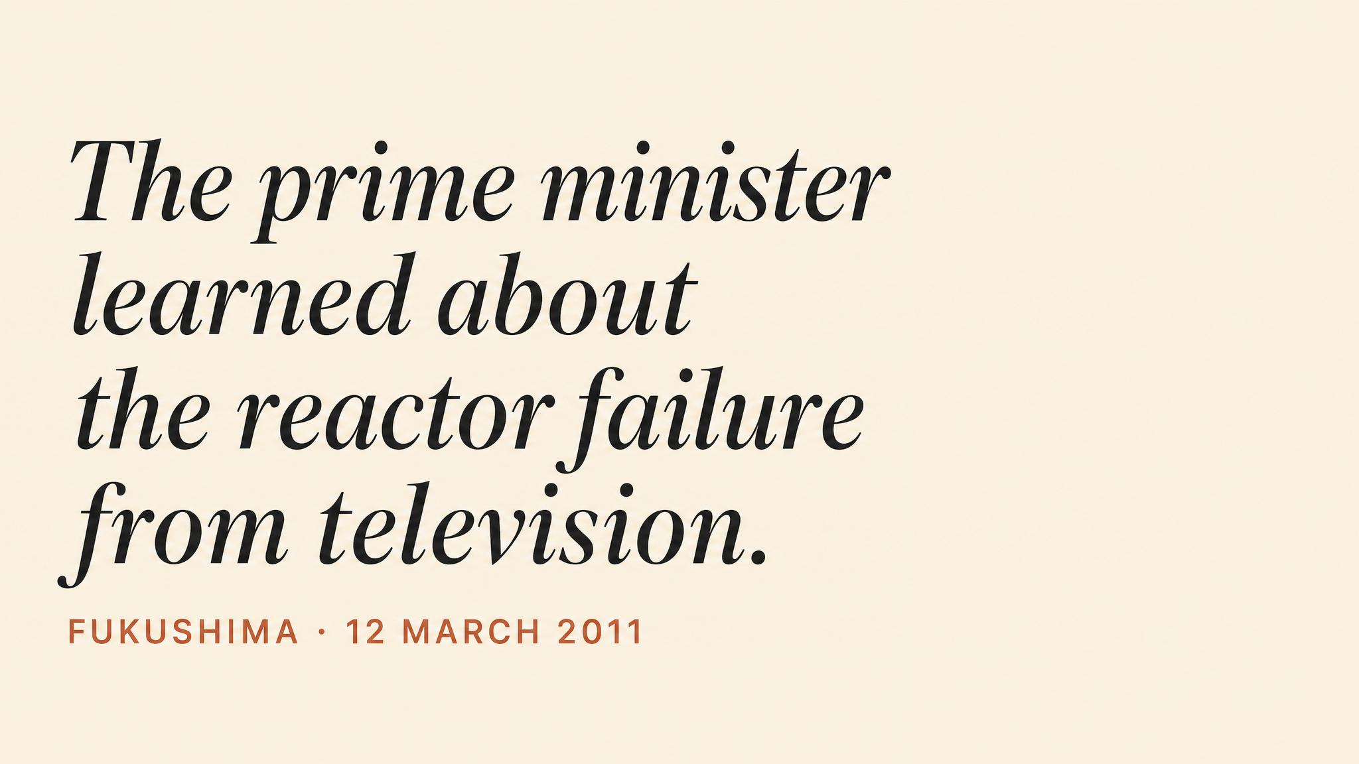
Notes:
Prime Minister Naoto Kan watched the Unit 1 hydrogen explosion on Japanese television — the first he had learned of it. TEPCO had not informed the government. The regulator had no independent information. National-level decision-makers debated evacuation zones based on assumptions that bore no relationship to actual reactor conditions. This was not a failure of technology. It was a failure of information architecture.

Slide 3
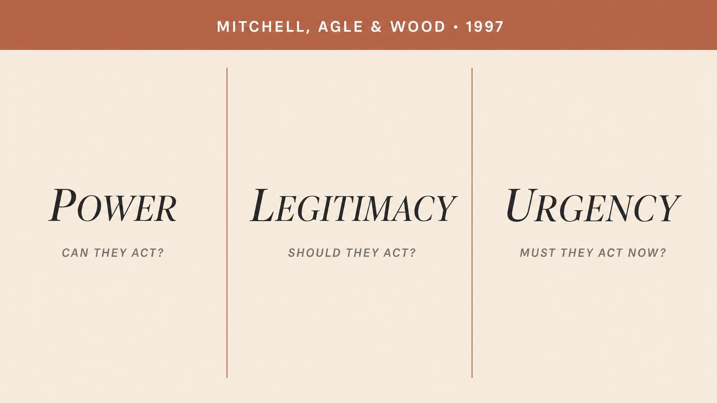
Notes:
Mitchell, Agle and Wood (1997) argued that managerial priority depends on three attributes: power, legitimacy, urgency. Stakeholders possessing all three are definitive and demand immediate attention. Those possessing only one are latent — they exist in the background, often unnoticed. The framework is foundational but designed for steady-state conditions.

Slide 4

Notes:
Alpaslan, Green and Mitroff (2009): dormant stakeholders — those possessing power but lacking legitimacy or urgency in normal operations — become dangerous and definitive overnight. Families of victims are not stakeholders at all in routine operations; the moment a crisis produces casualties, they become the most legitimate, most urgent, and through media amplification, most powerful actors in the system.

Slide 5
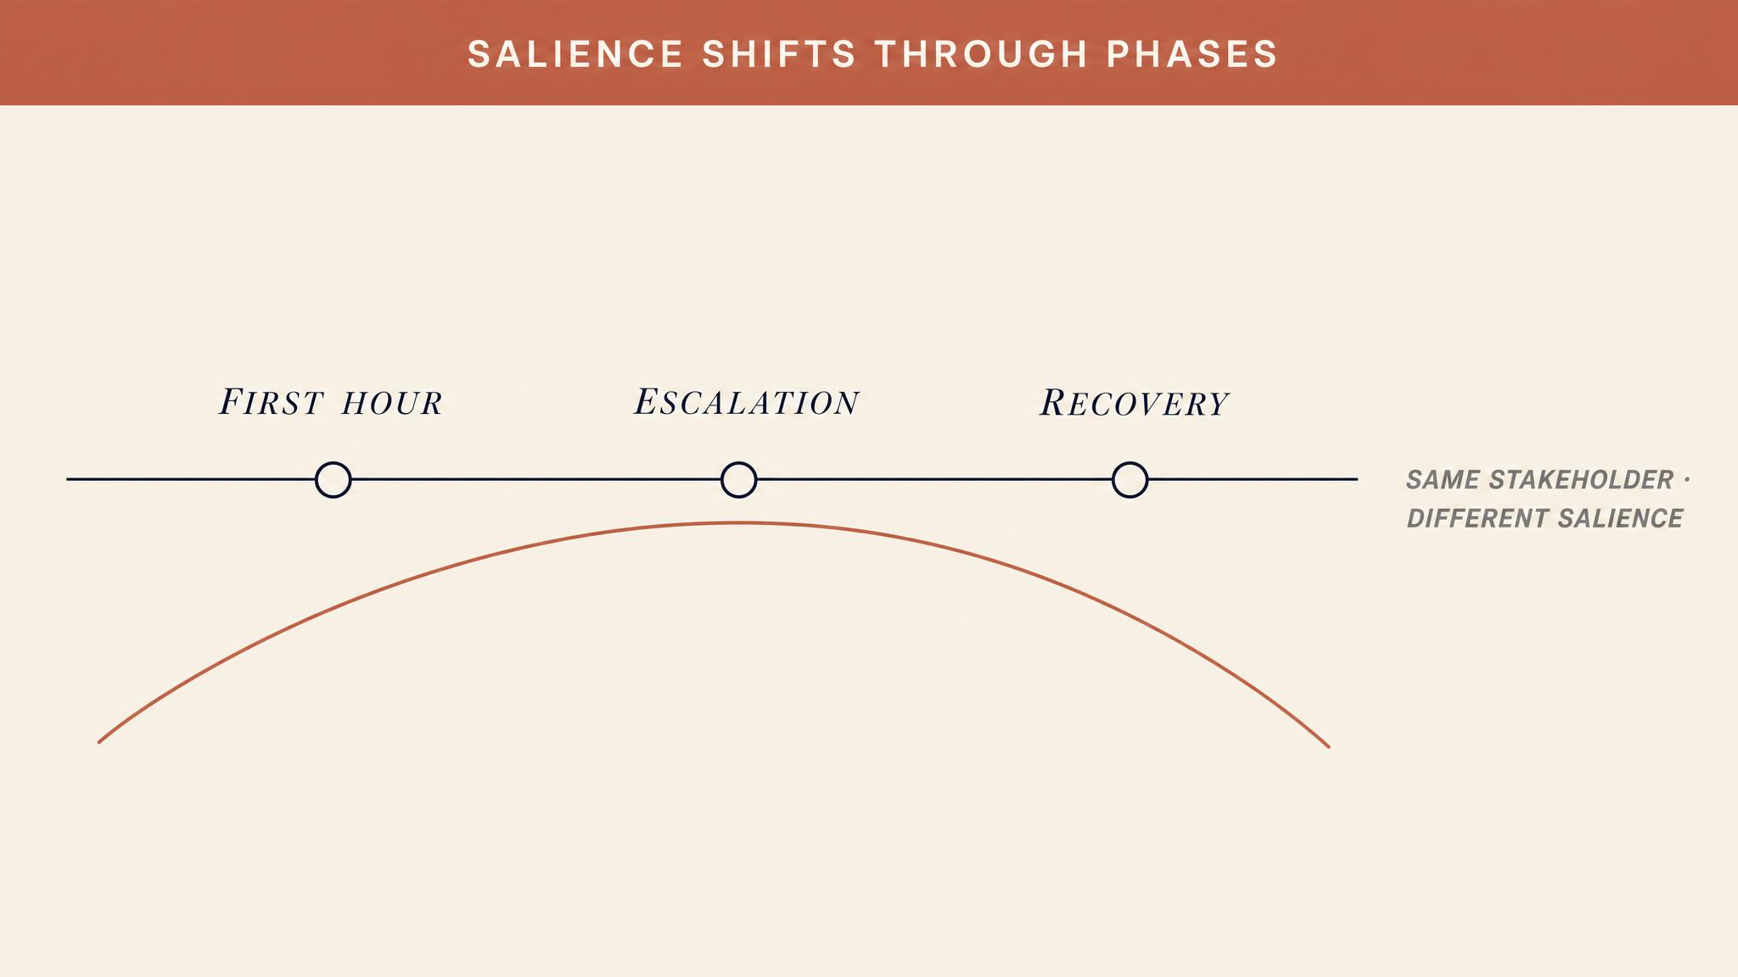
Notes:
Salience does not shift once and stabilise. It shifts continuously. Initial hours: operational responders — fire crews, medical teams, on-site engineers. Escalation: external agencies, political actors, media. Public peak: families, community advocates, opposition politicians who were entirely absent from the initial response now drive the narrative. Boin et al. (2017) document how formal hierarchies are routinely bypassed during these shifts.

Slide 6

Notes:
The instinct that everyone should get all the information is catastrophically wrong. Every piece routed to a decision-maker either supports or degrades capacity to decide. A minister receiving raw technical telemetry from a nuclear plant is not better informed — they are overwhelmed and less capable. The principle: fidelity matched to authority. Operational leaders need granular data. Strategic leaders need synthesised assessments. Political leaders need implication summaries.

Slide 7
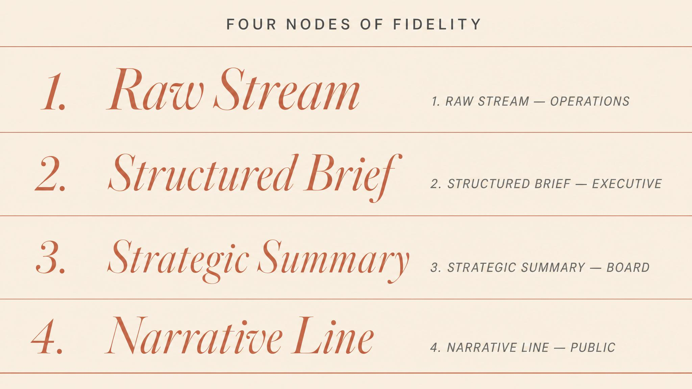
Notes:
Each node in the response structure needs different fidelity. The incident commander needs granular real-time data to make operational decisions. The executive team needs synthesised situation reports to make strategic resource decisions. The minister needs headline-level summaries with political implications highlighted. Affected families need accurate, compassionate, timely updates because their decisions are about whether to trust the organisation managing the crisis.

Slide 8
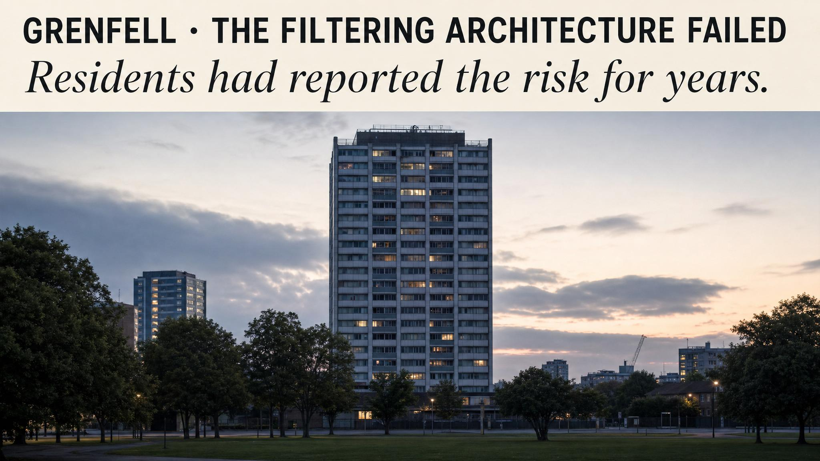
Notes:
The Phase 1 report of the Grenfell Tower Inquiry (Moore-Bick, 2019) documented that the London Fire Brigade, Metropolitan Police, and London Ambulance Service each operated with different situational pictures. Fire control room operators received calls from residents trapped on upper floors — intelligence that directly contradicted the stay-put assumption — but this was not systematically routed to the incident commander on scene. The information existed within the system. The filtering architecture failed to move it.

Slide 9
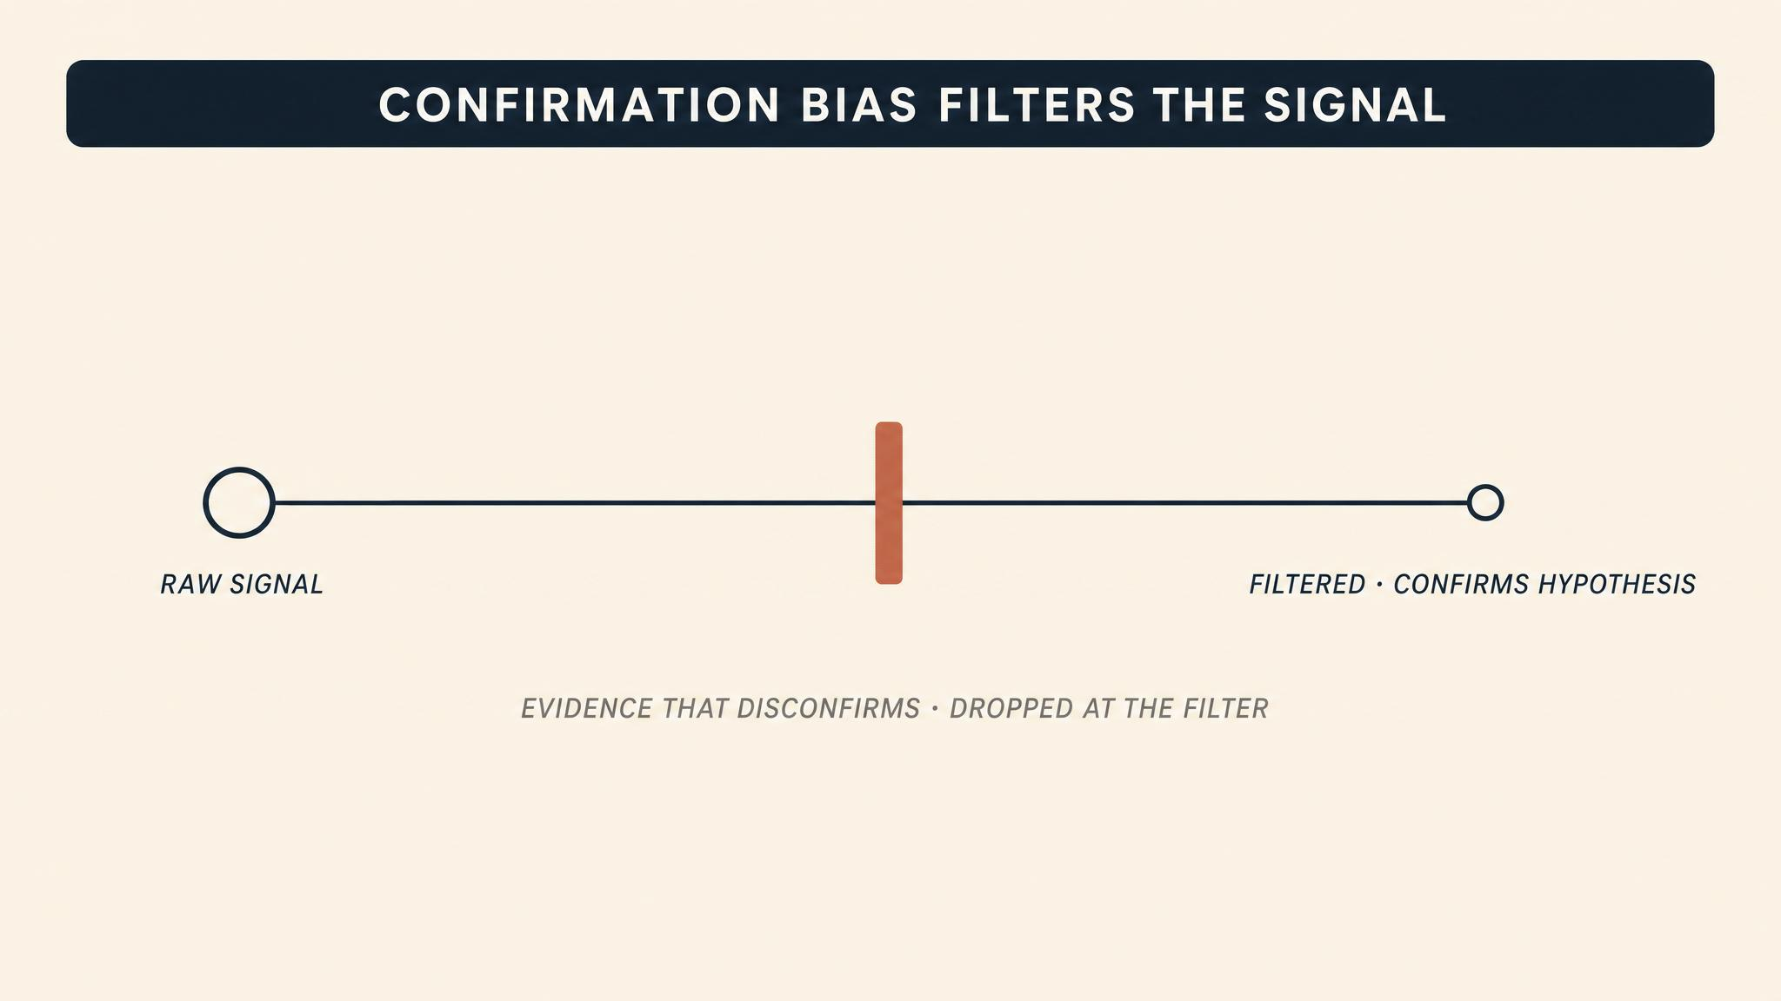
Notes:
Comes, Hiete, Wijngaards and Schultmann (2022) demonstrated experimentally that crisis managers preferentially route information confirming the existing operational picture and deprioritise information that contradicts it. Under high cognitive load, the bias intensifies. Precisely the information most likely to change a leader's decision — the disconfirming signal, the unexpected data point — is the information most likely to be filtered out.

Slide 10

Notes:
Ackerman, Wulf, Pipek and Randall (2014) documented that even organisations in the same country and sector carry distinct vocabularies that create dangerous miscommunication under pressure. During Australia's Black Summer (2019–2020), 'controlled' could mean the fire was contained or merely that resources were being applied — a potentially lethal ambiguity for a community deciding whether to evacuate. Bharosa, Lee and Janssen (2010) identified information sharing as the single greatest bottleneck in inter-agency coordination.

Slide 11
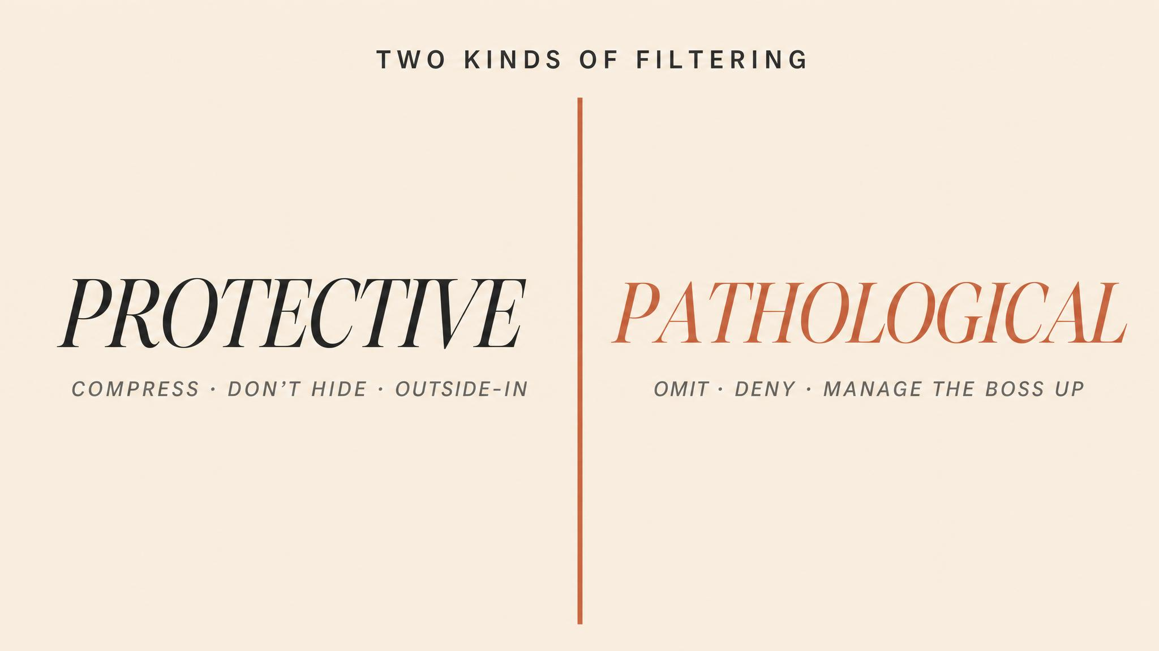
Notes:
Information filtering sits on a spectrum. Protective filtering shields decision-makers from noise so they can focus on signal — the intelligence cell that synthesises forty field reports, the public affairs officer who shields the incident commander from media. Pathological filtering creates blind spots. At Fukushima, TEPCO's information silo systematically excluded the most alarming data — filtering that served the filter, not the decision-maker.

Slide 12
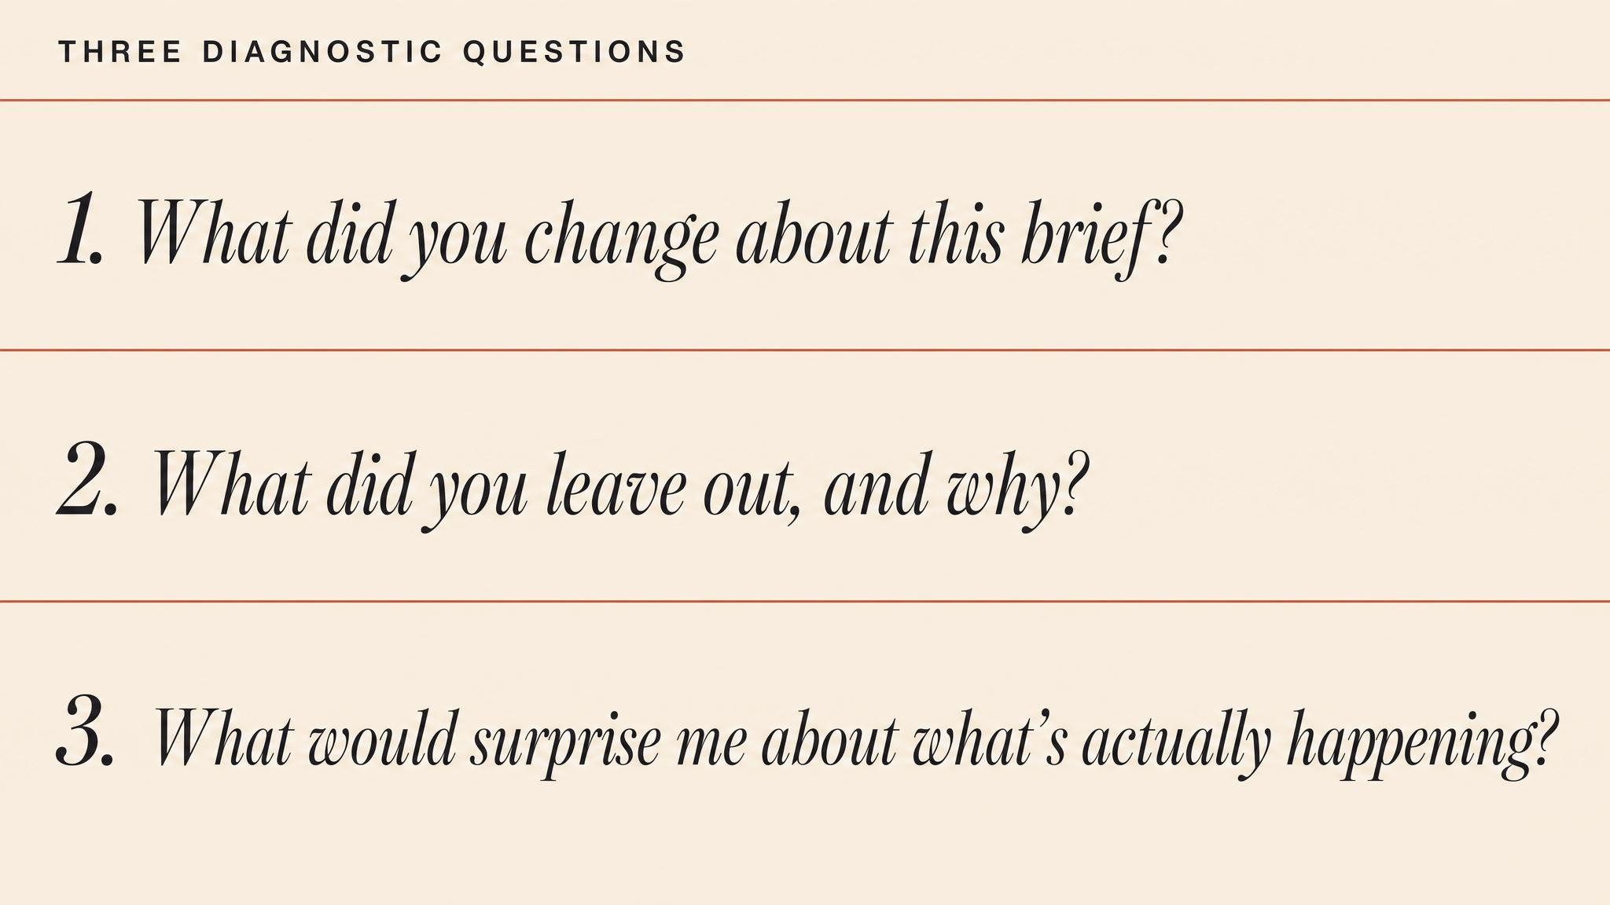
Notes:
Three diagnostic questions to tell protective from pathological. First: who benefits? Serving the decision-maker is protective; serving the filter is pathological. Second: is disconfirming information getting through? If everything confirms the operational picture, treat the system as suspect. Third: can the decision-maker pull deeper detail when needed? Pathological systems resist upward sharing even when asked.

Slide 13
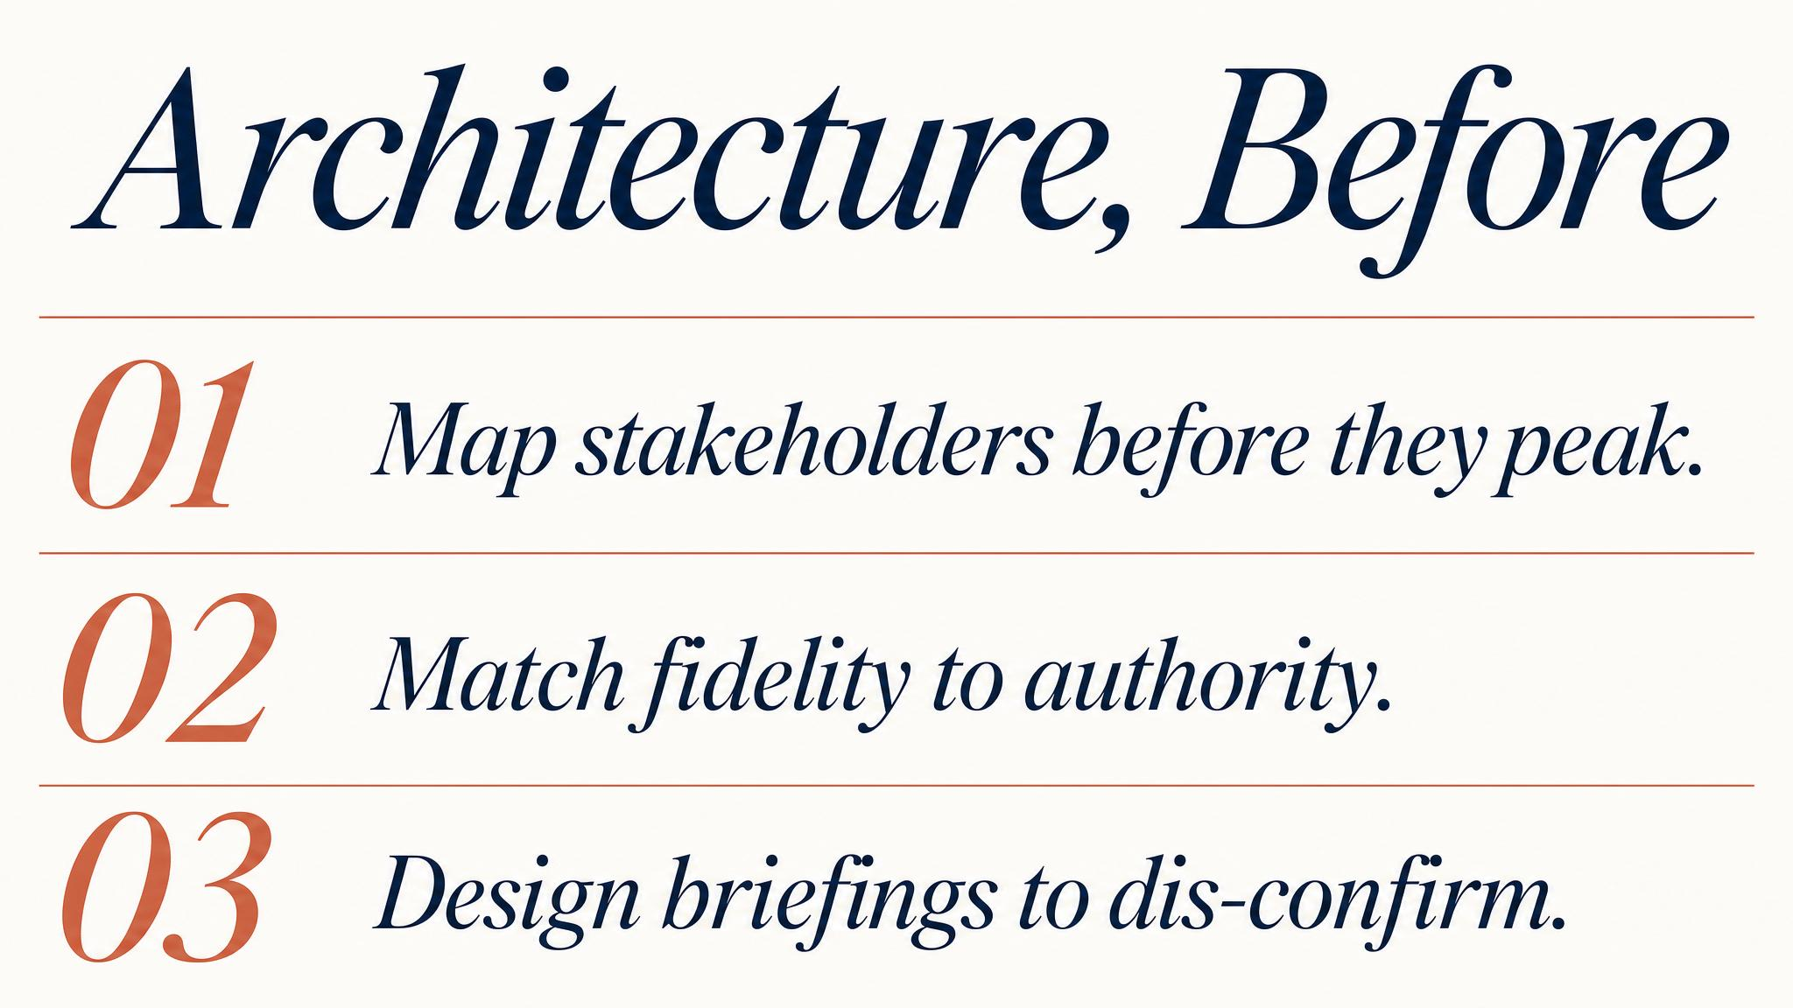
Notes:
Bharosa and colleagues (2010) found the organisations that performed best in multi-agency exercises had established protocols, common terminology glossaries, and pre-agreed escalation pathways before the crisis. Three things to build in advance: a stakeholder map stress-tested against scenarios; an information hierarchy specifying detail and authority at each node; coordination agreements that resolve terminology, authority and protocol conflicts before they matter.

Slide 14

Notes:
Bridge to Chapter 5. With the information architecture established, Chapter 5 turns to the public-facing dimension of crisis communication. How do you communicate with stakeholders, media and the public when information is incomplete and every word will be scrutinised? Stakeholder mapping and information hierarchy are the invisible scaffolding on which effective crisis communication is built.

