Slide 1
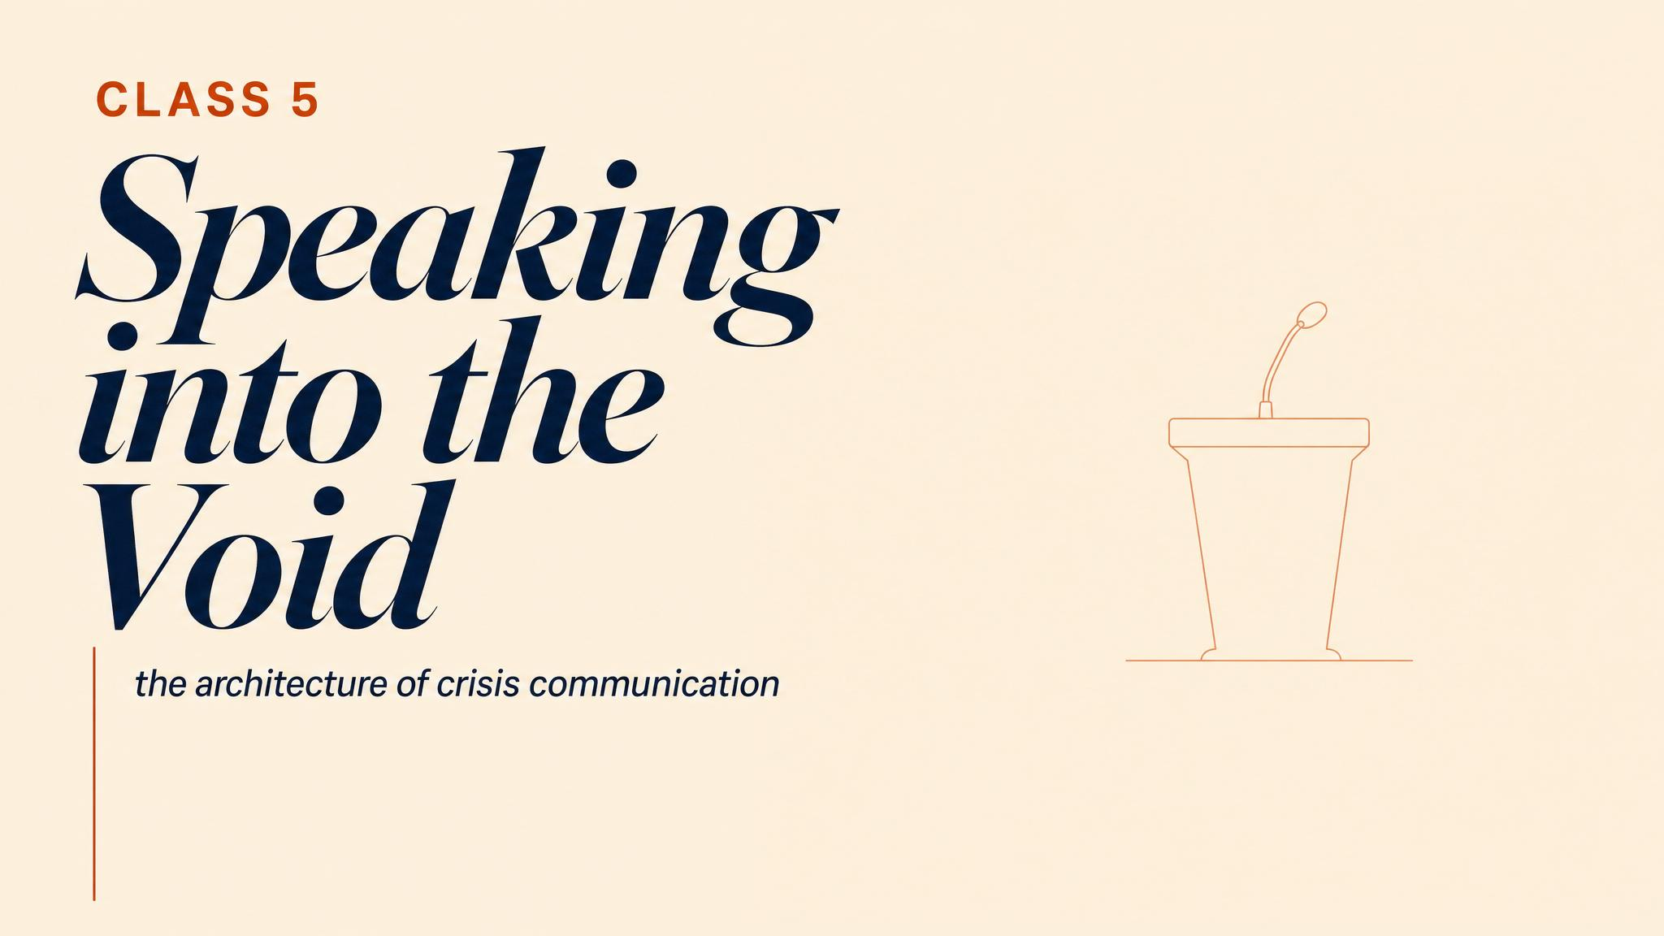
Notes:
Open with the 3:47 a.m. scenario: an explosion, two confirmed dead, a news crew at the perimeter, and forty-three minutes until the camera rolls. The certainty in this chapter is uncomfortable. If you say nothing, someone else will fill the silence — and they will fill it with speculation, fear, and blame.

Slide 2
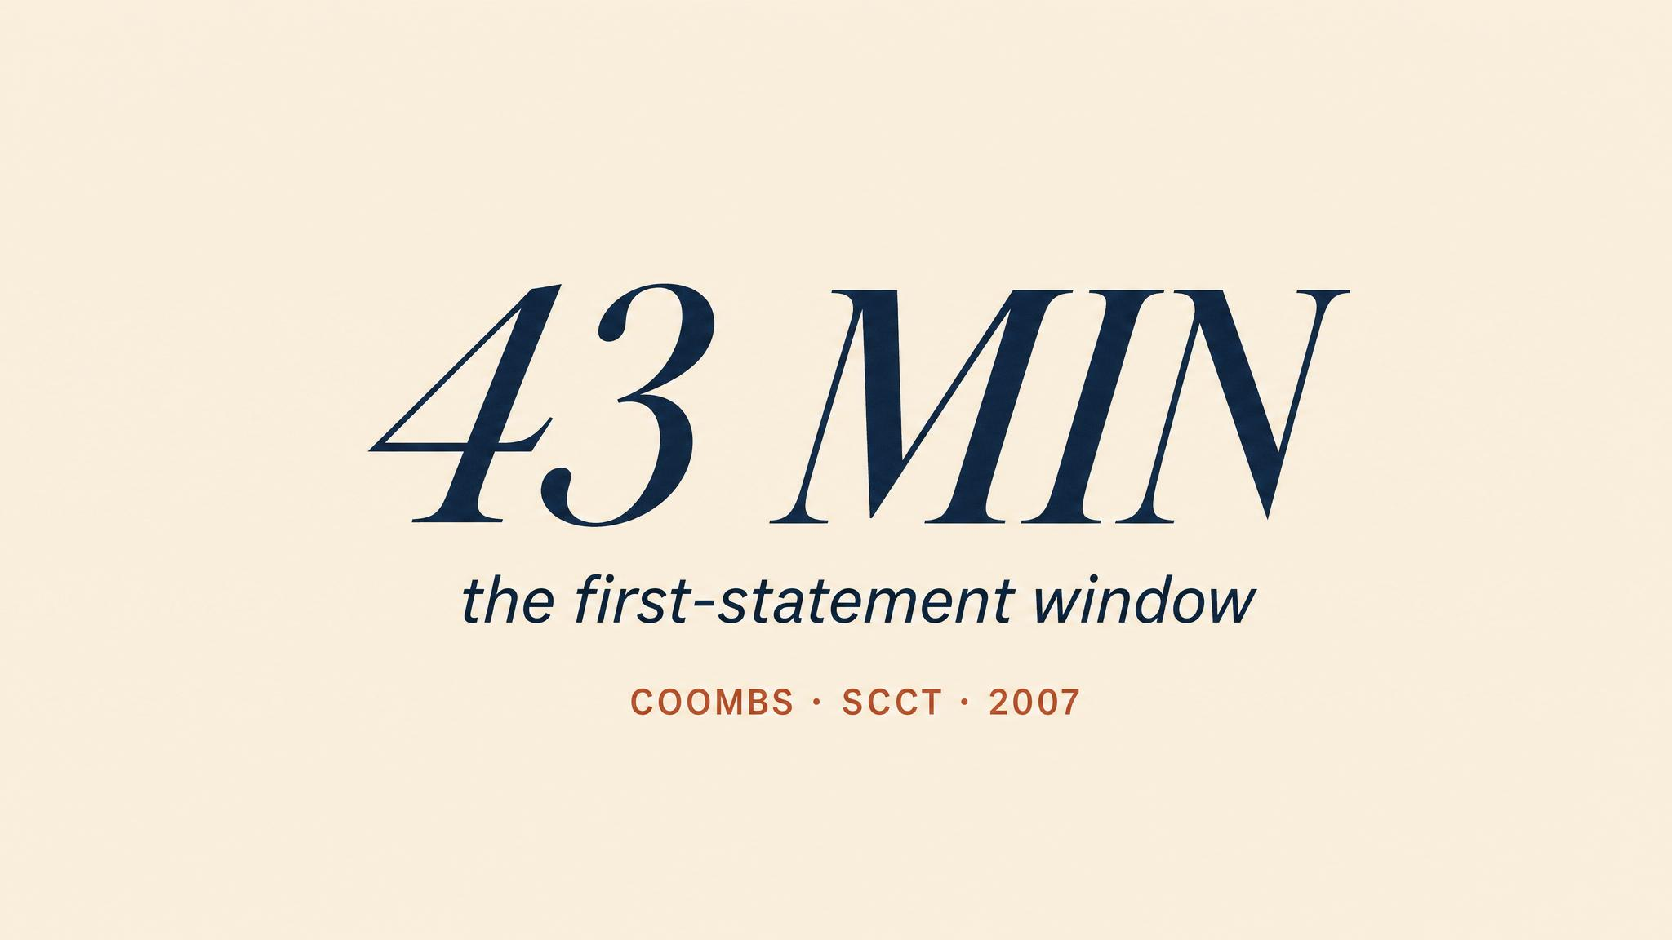
Notes:
Let the figure land. Three forty-seven a.m. Two confirmed dead, possibly more. Cause unknown. Site safety unknown. Forty-three minutes until the camera. Every careful, legally trained instinct screams: wait. That impulse is understandable. It is also catastrophic.

Slide 3
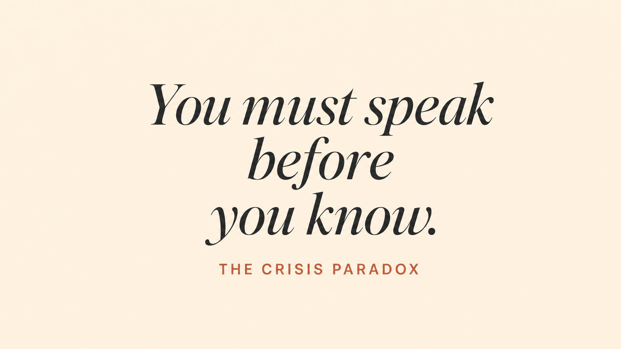
Notes:
Sellnow and colleagues' 2016 systematic review names the structural paradox. The moments when organisations have the least information are precisely the moments when the demand for communication is at its peak. Stakeholders do not wait for you to be ready. The public, the media, and your own employees require communication immediately — not when it is convenient.

Slide 4
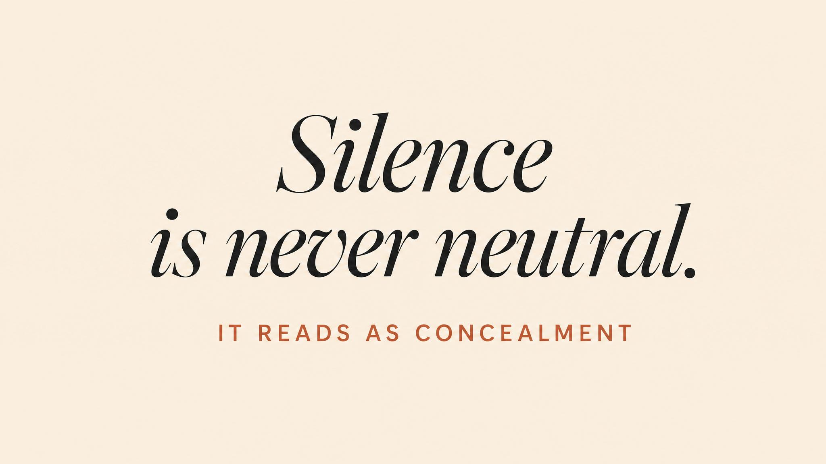
Notes:
Coombs' Situational Crisis Communication Theory, established in 2007, gives this its architecture. Post-crisis communication is not merely informational — it is reputational and relational. How you communicate in the first hours signals what kind of organisation you are. Every hour of silence answers that question for you, and never in your favour.

Slide 5
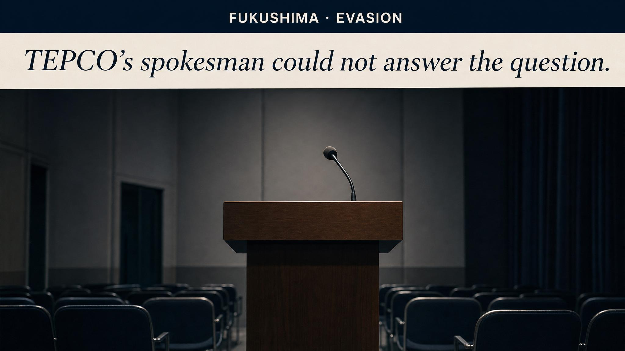
Notes:
Funabashi and Kitazawa, 2012. The Reactor 1 meltdown began on day one. TEPCO did not publicly acknowledge it for over two months. Technical jargon obscured rather than clarified. The mechanism of trust destruction here was incremental credibility erosion — once you have been caught understating, your audience assumes you are still understating.

Slide 6
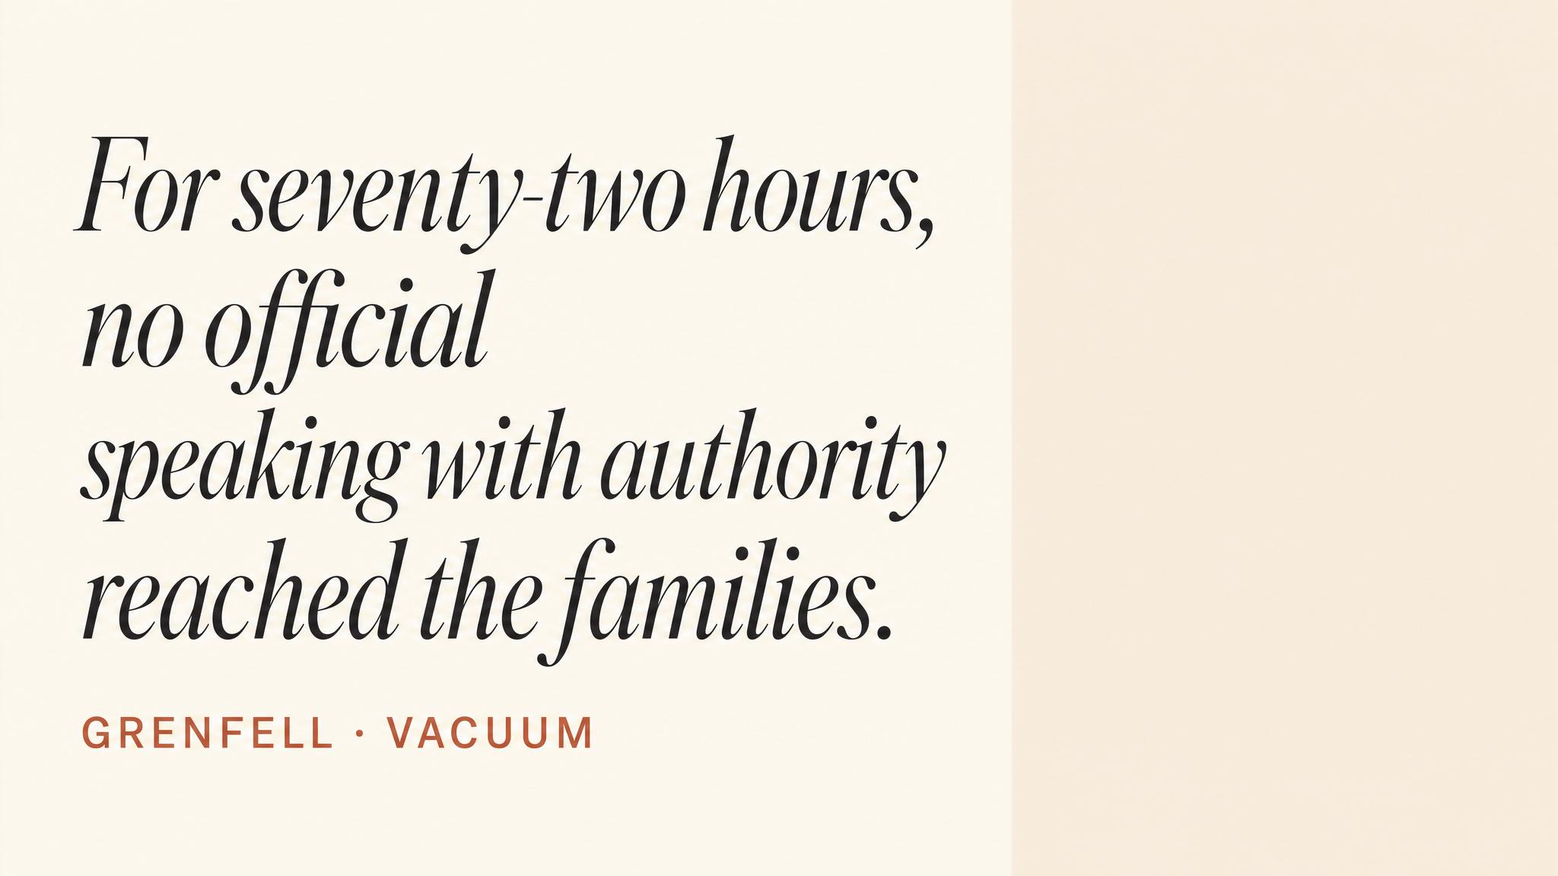
Notes:
Fourteenth of June, 2017. Seventy-two people killed. The Moore-Bick Phase 1 Report (2019) documented failures at every level — but the most damaging was structural. No single entity owned the public communication. Bereaved families received contradictory information. Institutional silence was interpreted as institutional indifference — and in many cases that interpretation was correct.

Slide 7
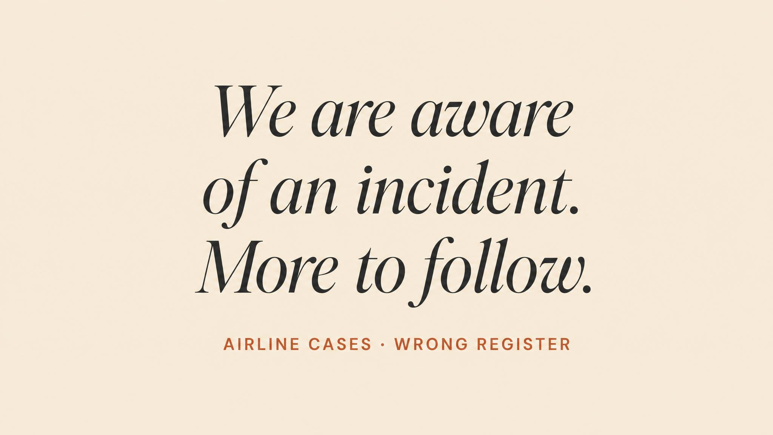
Notes:
Ray, 1999. Technically precise statements — factually accurate, legally vetted, operationally sound — landed as cold and mechanical. The failure mode is register: the emotional key in which a message is delivered. Schoofs and colleagues, 2019, showed across three studies that empathy is not a soft, optional dimension — it is a critical mechanism through which reputational outcomes are determined.

Slide 8
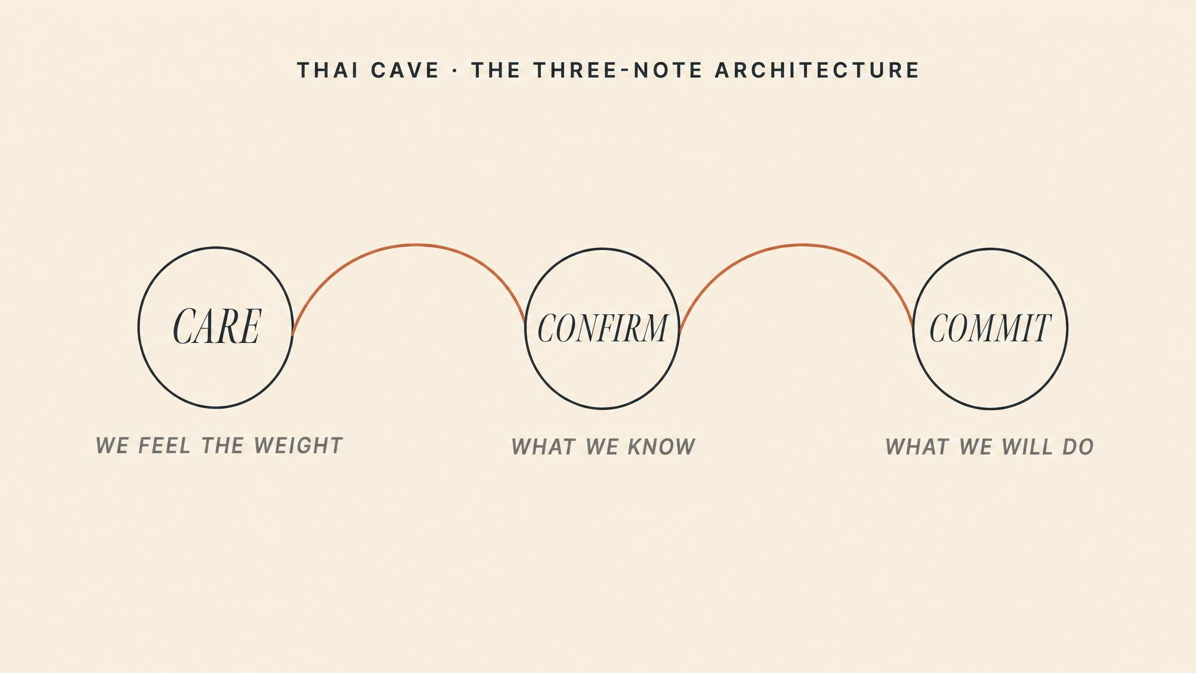
Notes:
Twenty-third of June, 2018. Twelve boys and their football coach trapped seventeen days under a global media siege. Regular press briefings even with no new information. Consistent messaging across dozens of agencies. Handwritten notes between trapped boys and families. Setbacks confirmed promptly. What worked was not more information — it was architecture.

Slide 9
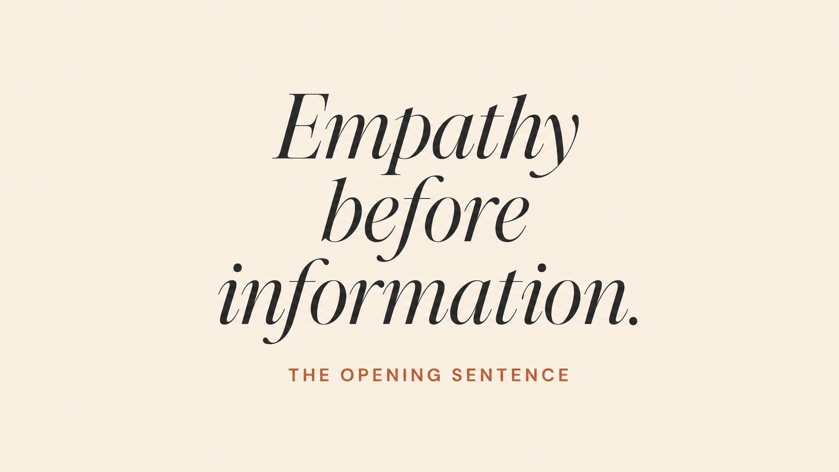
Notes:
Principle one. Before your audience processes a single fact, they have answered one question: does this person care about what we're going through? Schoofs et al. (2019) supply the experimental evidence. Empathy determines whether subsequent information is processed as trustworthy or defensive. The opening of any crisis statement must acknowledge the human reality before addressing the operational situation.

Slide 10
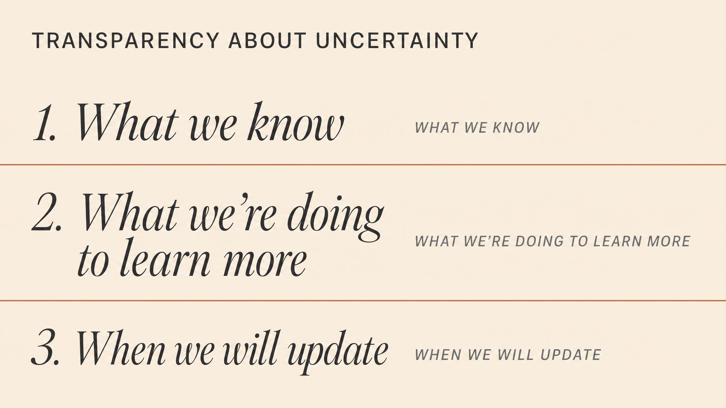
Notes:
Principle two. Sellnow et al. (2016): acknowledging uncertainty does not erode credibility — concealing it does. The formula is deceptively simple. Say what you know, say what you don't know, say when you expect to know more. That gives the audience a framework for understanding and a reason to wait for the next update rather than seek answers elsewhere.

Slide 11
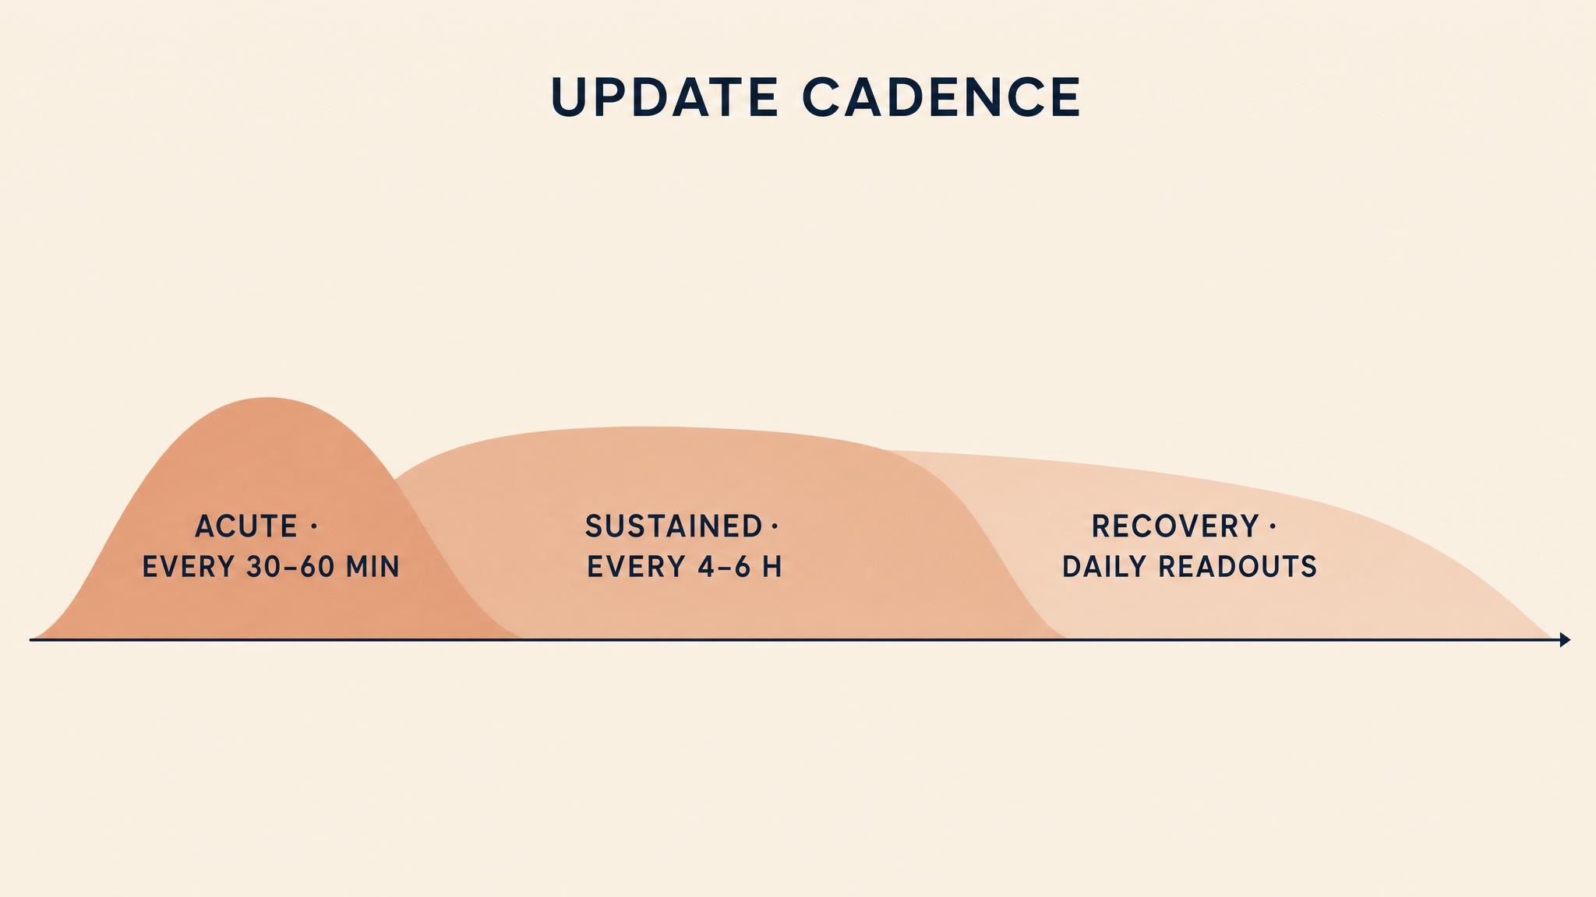
Notes:
Principle three. The Thai cave's most underappreciated innovation. Cadence pre-empts the 'why aren't they saying anything?' narrative, creates a Pavlovian expectation, and reduces the cognitive load of deciding when to communicate. Acute phase: every thirty to sixty minutes. Sustained: every four to six hours. Recovery: daily. A missed update is worse than a content-free update.

Slide 12
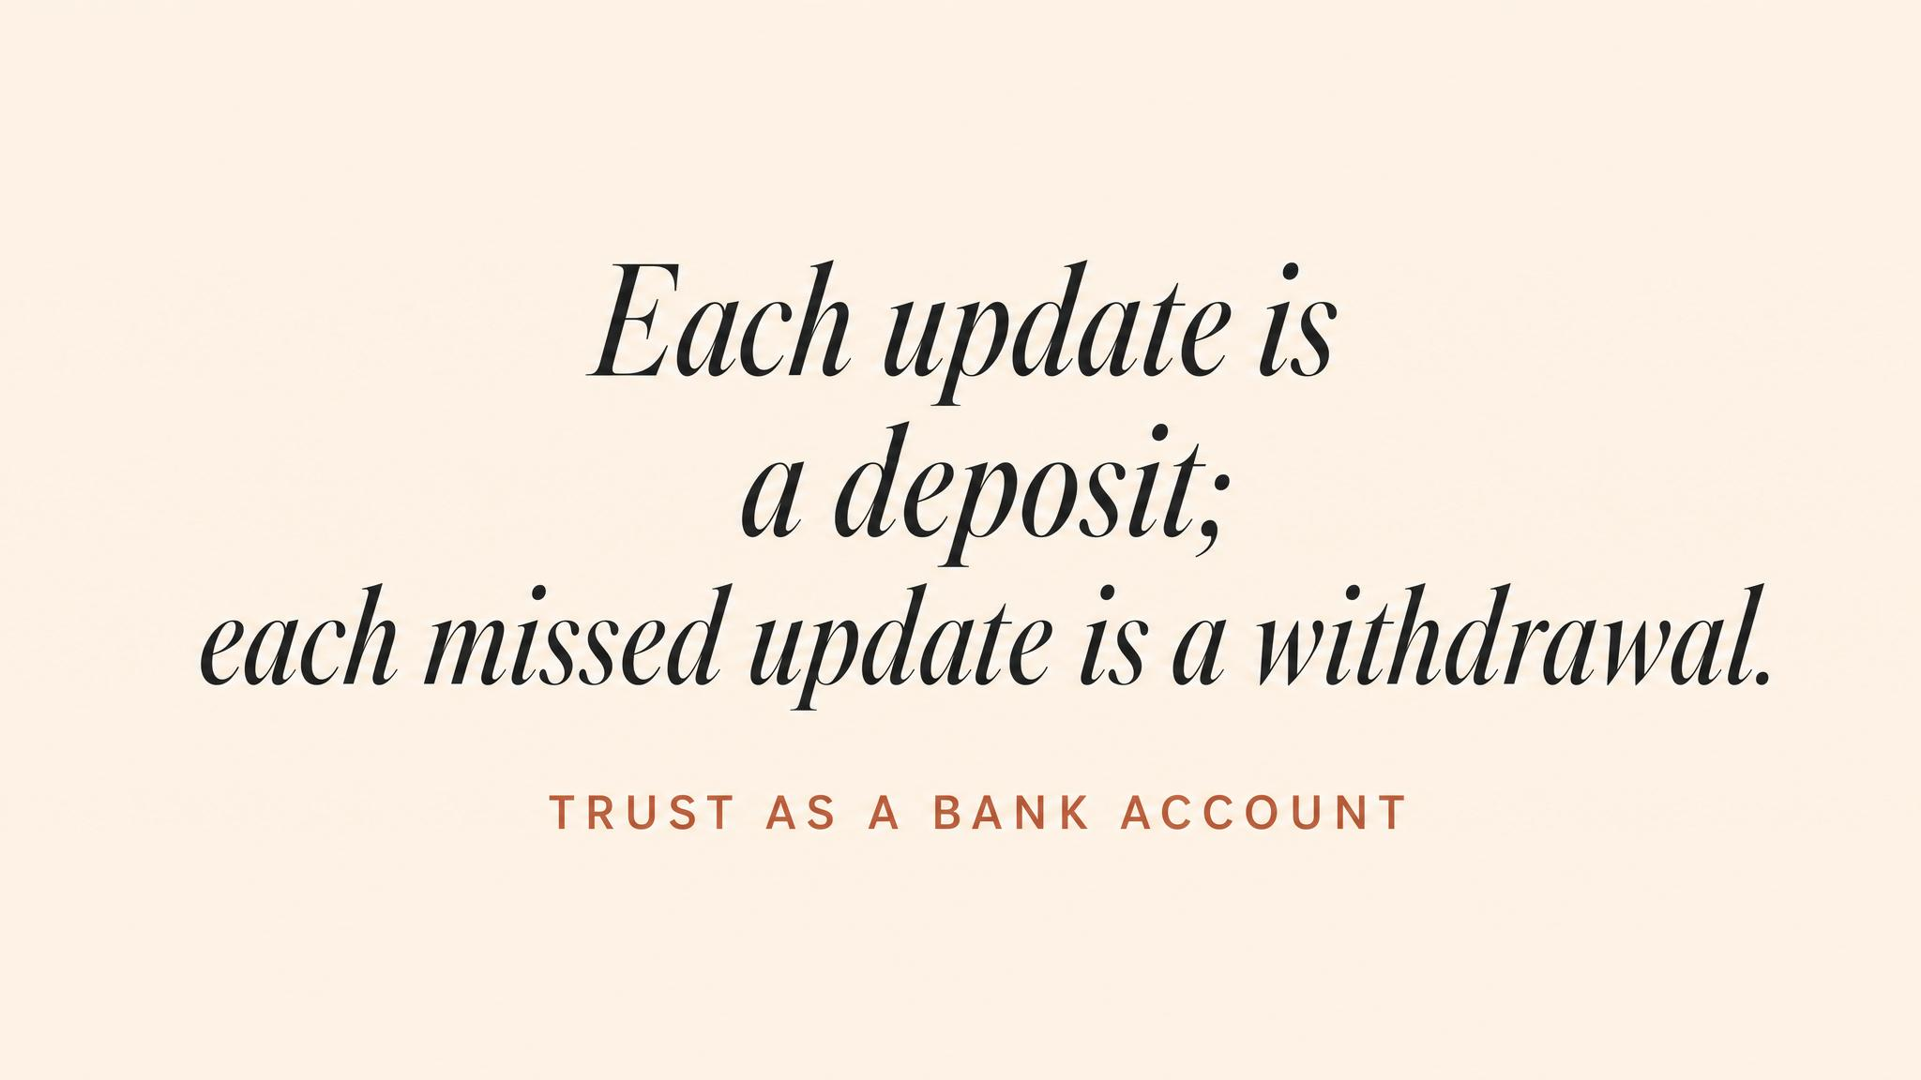
Notes:
Trust is a bank account you did not know you had until the crisis began. Every honest update is a small deposit. Every evasion, delay, or contradiction is a large withdrawal. The exchange rate is deeply unfair — it takes roughly ten deposits to recover from one significant withdrawal. Coombs (2007) adds the structural insight: different stakeholder groups maintain separate trust accounts.

Slide 13

Notes:
You always speak to at least two audiences at once. External: empathetic, measured, accessible. Internal: operationally specific, emotionally honest, free of corporate hedging. The trap is inconsistency. In a hyper-connected world the distinction is porous — staff share emails, screenshots leak. Different register and detail, consistent substance. Both must survive being read side by side.

Slide 14

Notes:
Bridge to Chapter 6. You now know how to communicate during a crisis. But what happens to the teams who must sustain crisis operations not for hours but for days, weeks, or months? Next: team resilience during prolonged operations — fatigue, morale, and why the communication practices you've learned here are essential to keeping people functional when the crisis refuses to end.

