Slide 1

Notes:
Open with the central problem of this chapter: crisis demands that outrun human endurance. The Thai cave rescue, Fukushima, Black Summer, COVID — all share one feature. Adrenaline runs out, but the situation does not. What sustains decision quality across the long night is not willpower. It is structure.

Slide 2
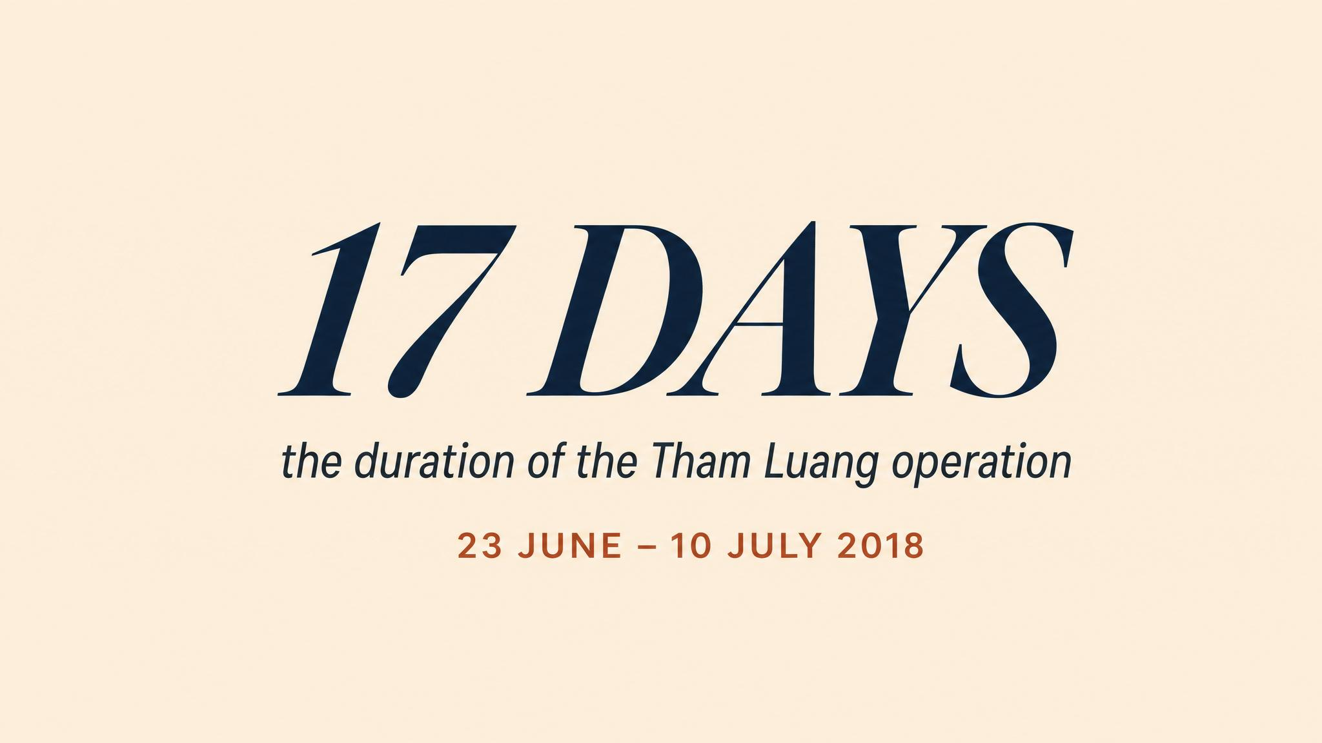
Notes:
Twelve boys and their coach entered the cave on 23 June 2018. Within hours, monsoon rains sealed the entrance. By the eighth day, divers had located them four kilometres in. But the relief was brief — the hardest decisions still lay ahead, and the people who would make them had been working a week without meaningful rest.

Slide 3
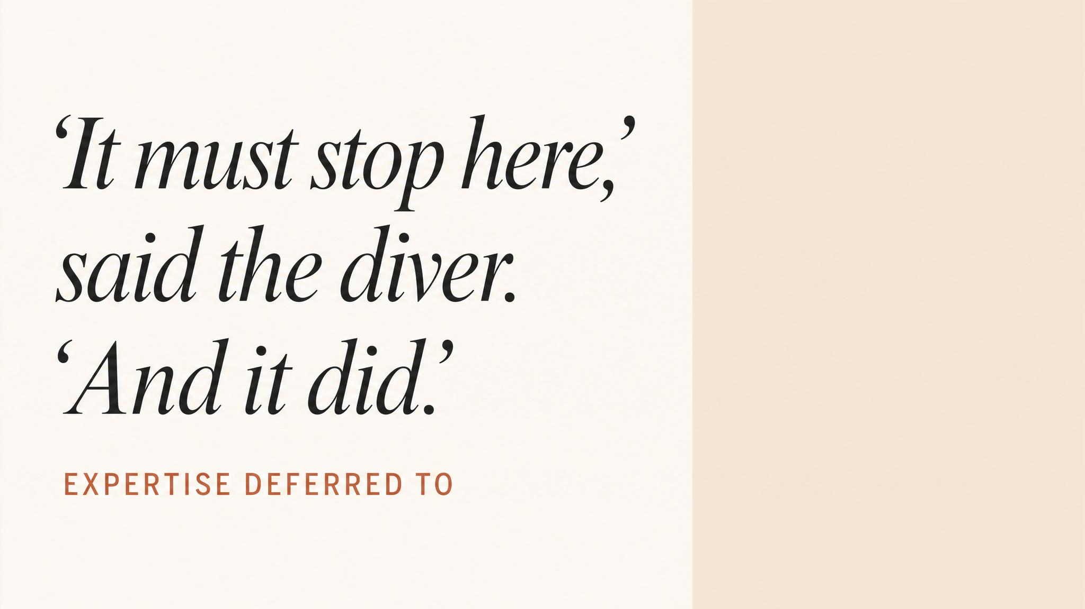
Notes:
Richard Harris sedated each boy after roughly forty-eight hours awake. He later acknowledged the decision relied on the team around him — the checks, the redundancy, the people willing to say stop — as much as on his own clinical judgment. The crisis did not care that everyone was tired.

Slide 4
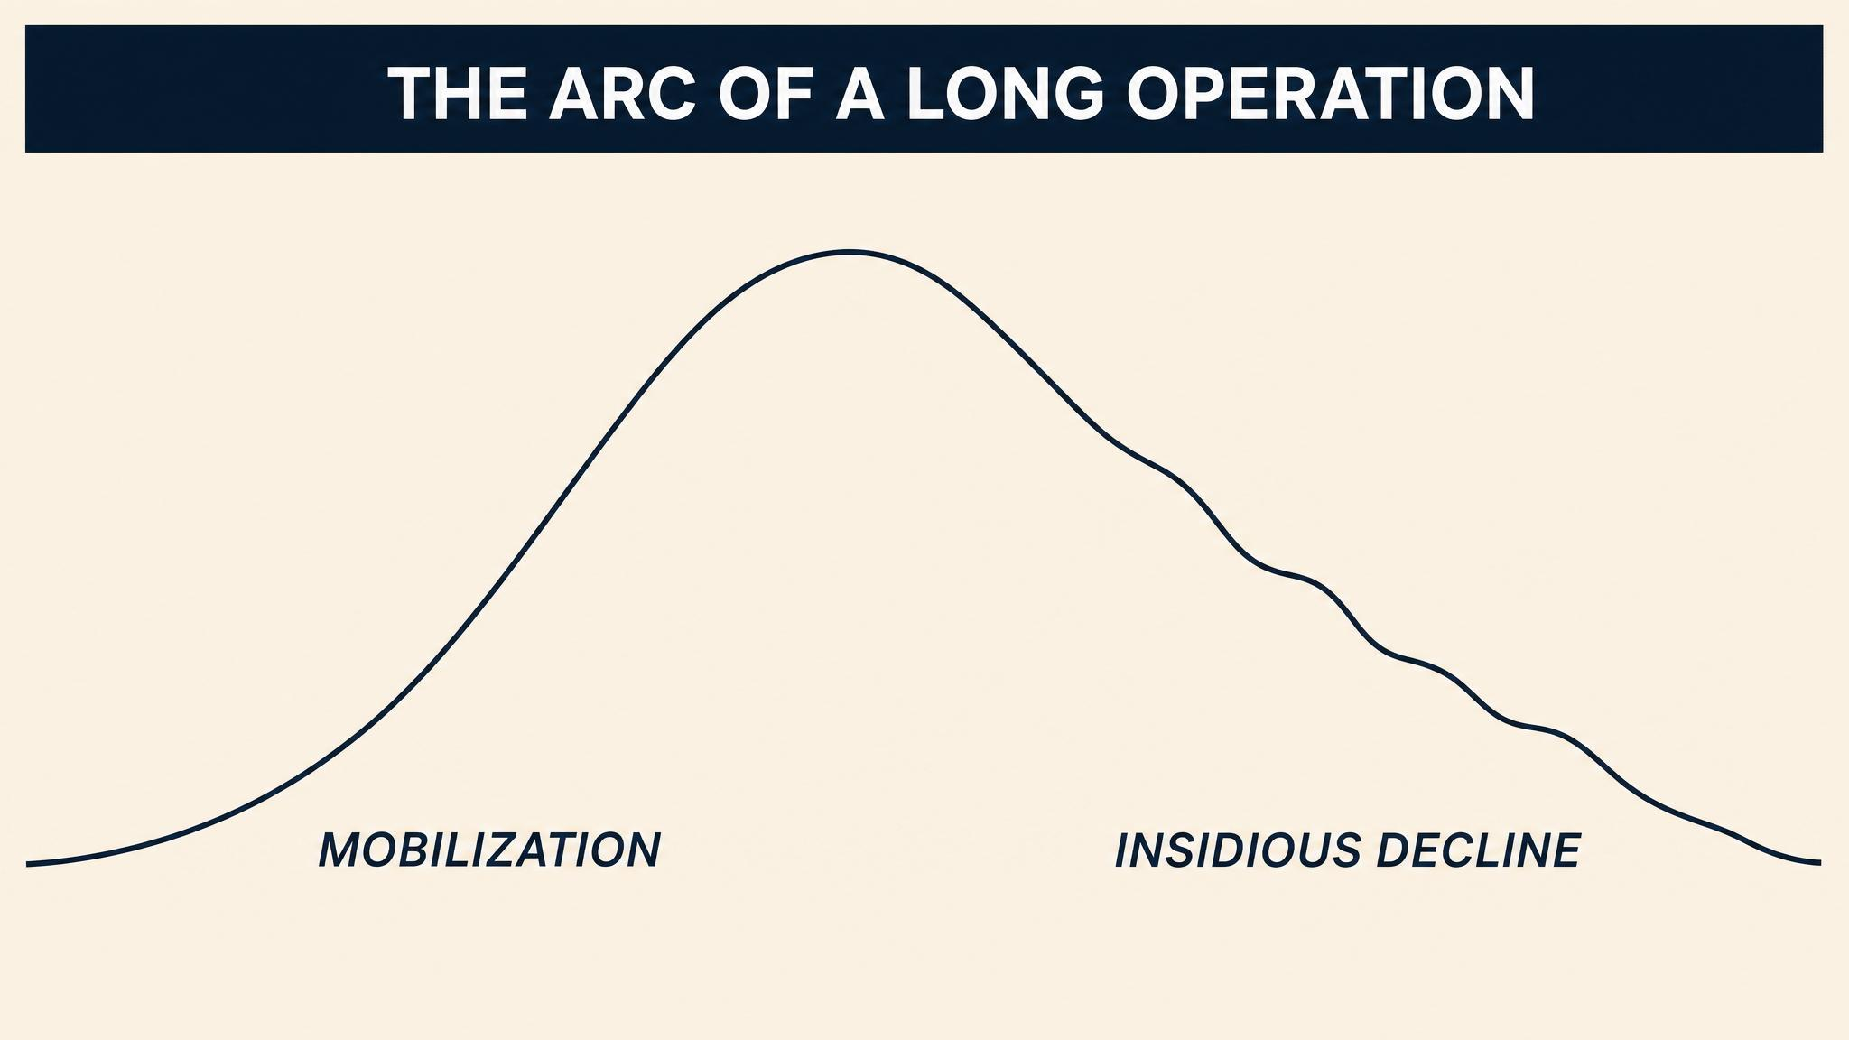
Notes:
Every crisis opens with a surge — cortisol, adrenaline, norepinephrine. Decision-makers report heightened clarity. But research on decision fatigue, as 2025 work shows, finds the quality of decisions degrades after prolonged effort. The decline is not dramatic. It is insidious. People default to heuristics, become risk-averse, and lose the metacognition to notice.

Slide 5
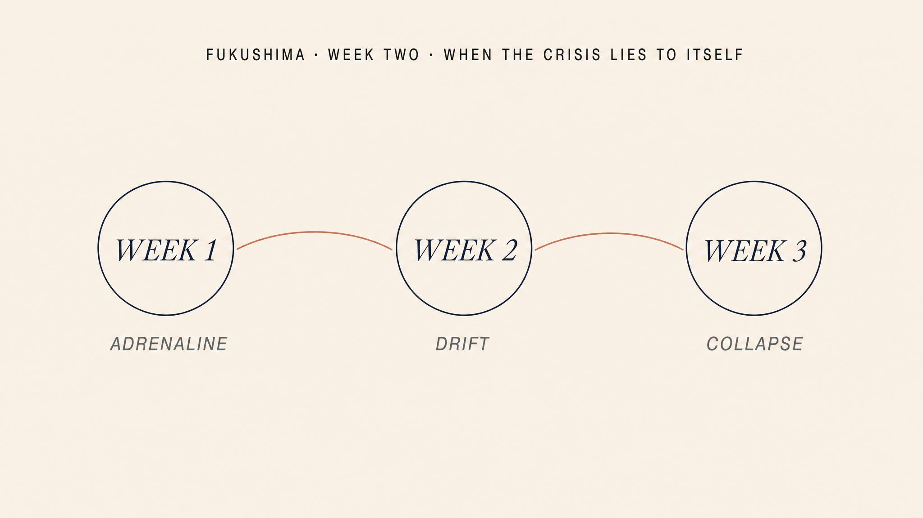
Notes:
Plant Superintendent Masao Yoshida made bold, technically sound decisions in the first twenty-four hours — including defying TEPCO orders to continue seawater injection. By the second week, coordination visibly deteriorated. Communications became confused. Decisions that should have taken minutes took hours. Not bureaucracy. Cognitive depletion.

Slide 6
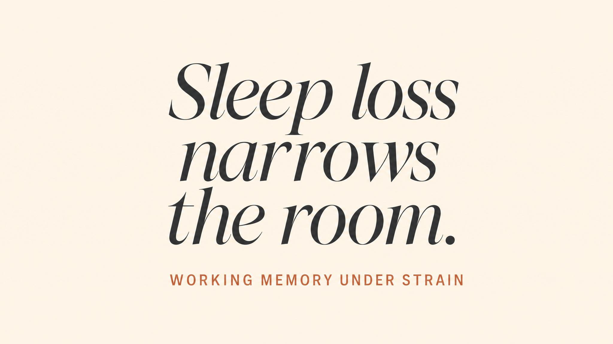
Notes:
Paas and van Merriënboer (2020) describe working memory as a finite mental workspace. Sustained stress disrupts it: intrusive worries — what if we're wrong, what are we missing — occupy the same space needed for analytical thought. Sleep deprivation degrades the prefrontal cortex. Cumulative fatigue erodes mental simulation.

Slide 7
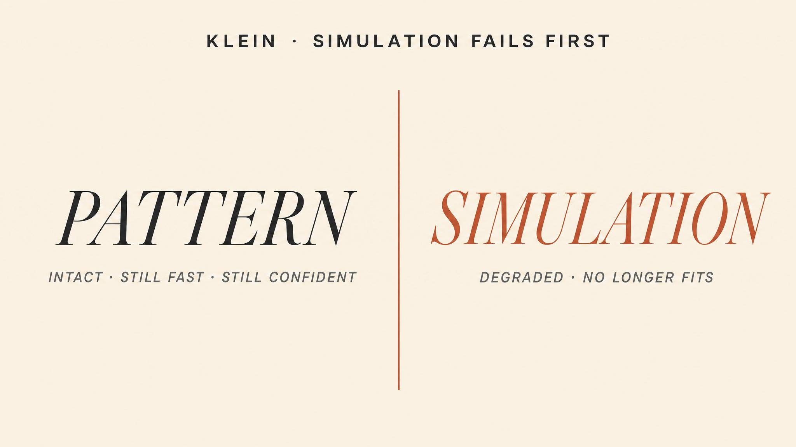
Notes:
Klein's research, spanning 1989 to 2004, shows mental simulation degrades first. Pattern matching is relatively automatic — it draws on long-term memory. Simulation demands sustained effortful processing. The result: experts still feel they know what is going on, but they lose the ability to evaluate whether their response fits the evolving situation.

Slide 8
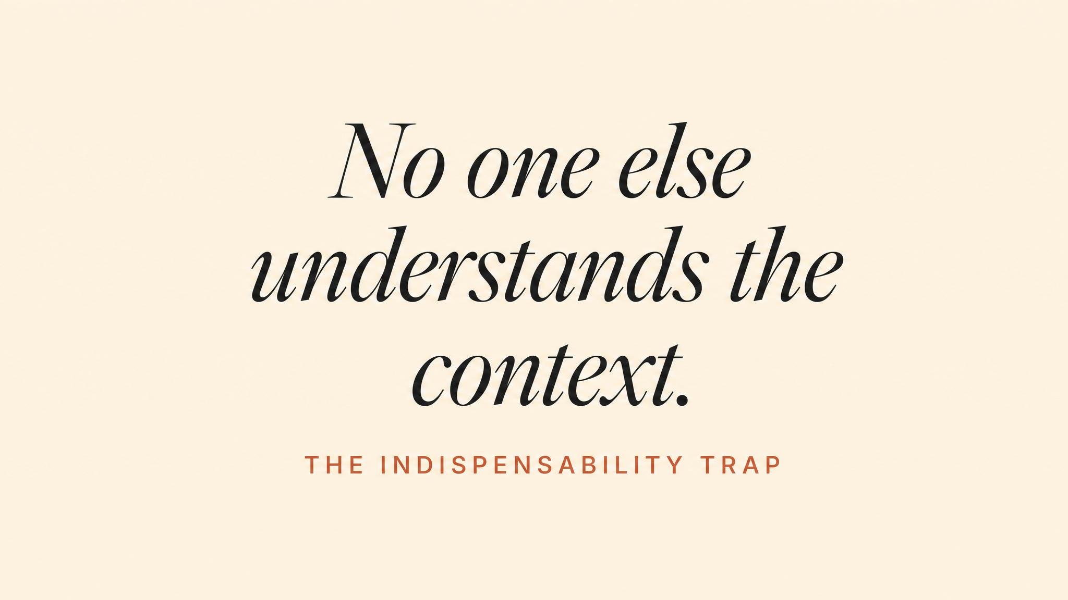
Notes:
Australian Black Summer, 2019 to 2020. Rural Fire Service captains worked sixteen to twenty hour days for weeks. Many felt that stepping away — even briefly — would constitute abandonment. Uccheddu and colleagues (2025) call this a predictable system failure. Commitment, ownership, accountability become liabilities when they prevent the leader from recognising their own impairment.

Slide 9
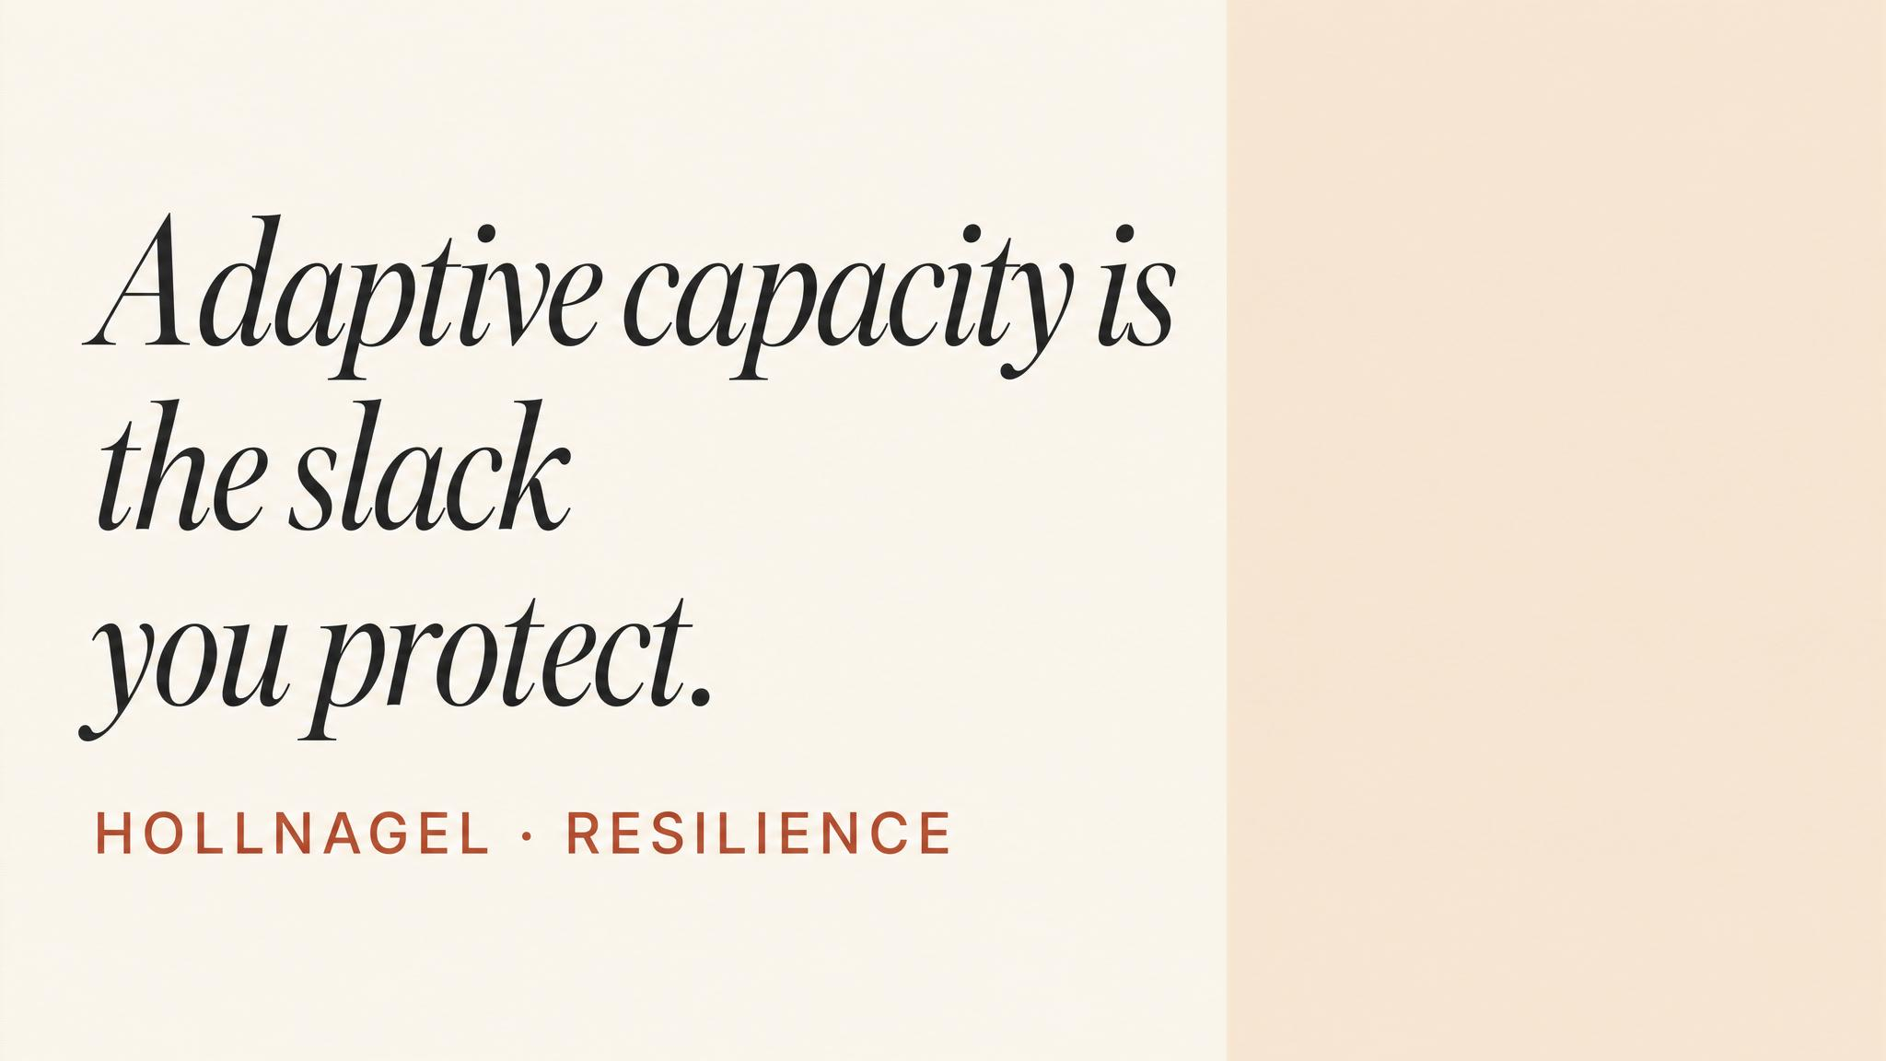
Notes:
VanSlyke, Brunell, and Simons (2020) observed leaders who thrived in temporary crises but struggled in prolonged ones. Their adaptive capacity — the ability to modulate effort across time — was poorly developed. Sustainable crisis leadership requires modelling self-care, appointing trusted deputies, and creating psychological safety for team members to step back.

Slide 10
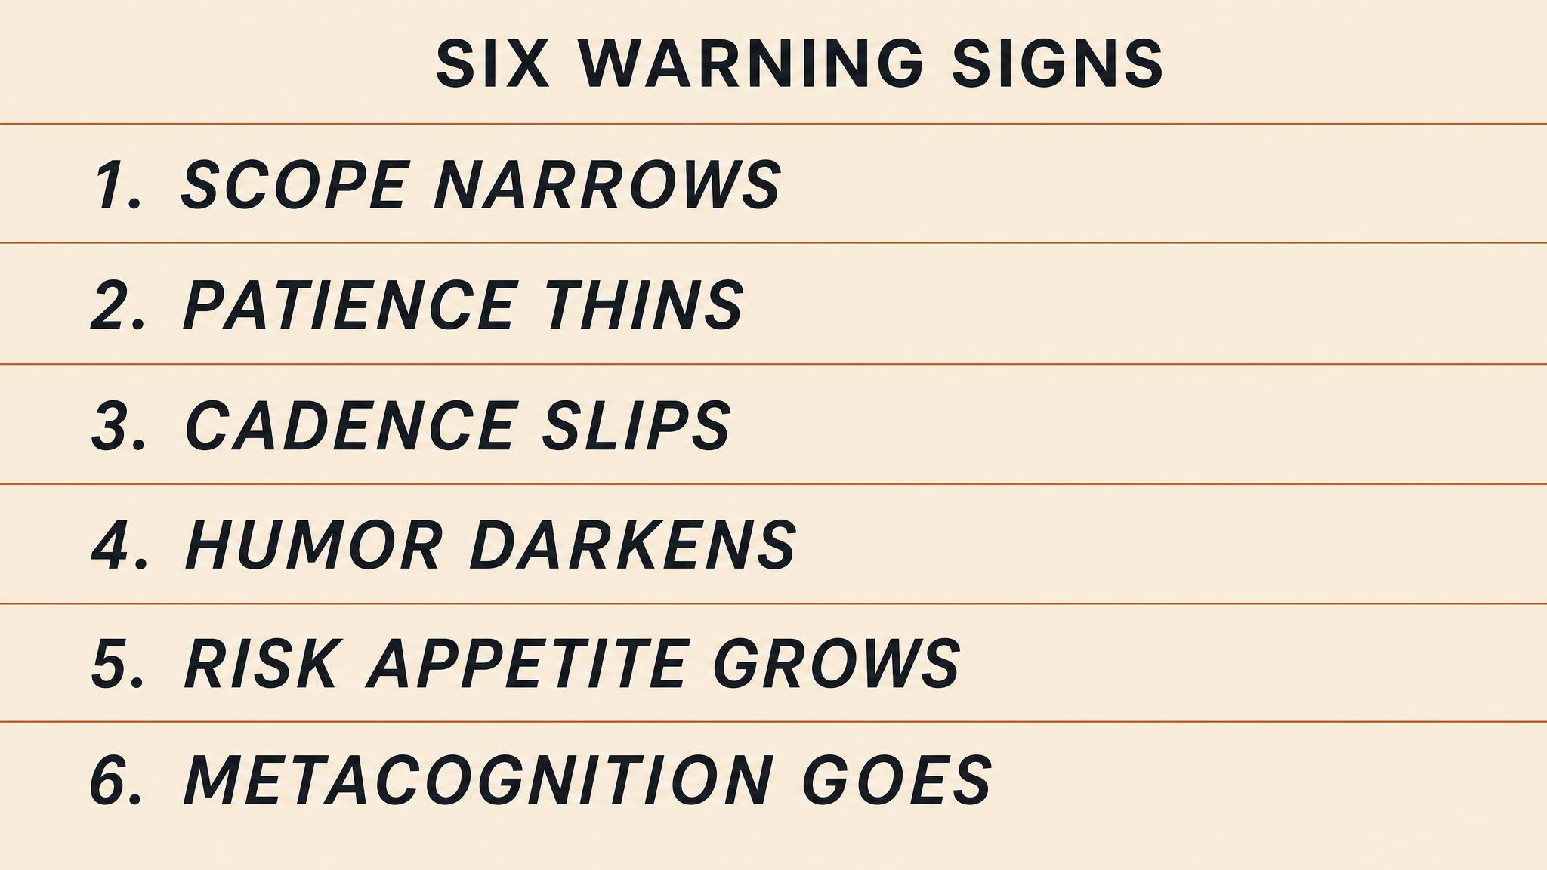
Notes:
Six observable warning signs. Irritability — snapping over minor issues. Inability to delegate — reclaiming tasks. Repetitive checking — reviewing the same information without retaining it. Neglect of basic needs — skipping meals, dismissing the body. Rigidity of thought — dismissing concerns. And loss of narrative coherence — difficulty summarising the situation clearly.

Slide 11

Notes:
Let the figure land. A 2020 emergency department study measured baseline handover adequacy at only fifty percent. Written communication of handover information was even worse — nineteen point two percent. Through structured intervention these rose to eighty-three percent and sixty-eight point seven percent. But the baseline reveals the default: human handover performance is poor.

Slide 12
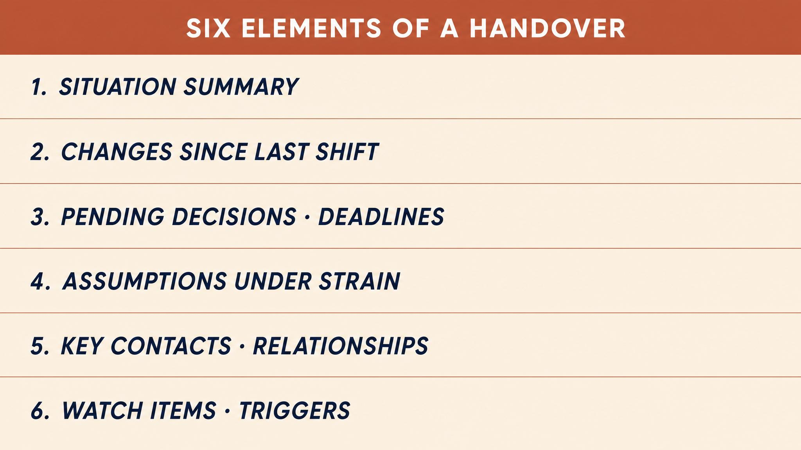
Notes:
Six structural features of effective handover, drawn from military and hospital research. Situation summary — current operational picture. Critical changes since last shift. Pending decisions with deadlines. Assumptions under strain. Key contacts and commitments. And watch items — triggers that would require reassessment. The goal: transfer judgment context, not just facts.

Slide 13
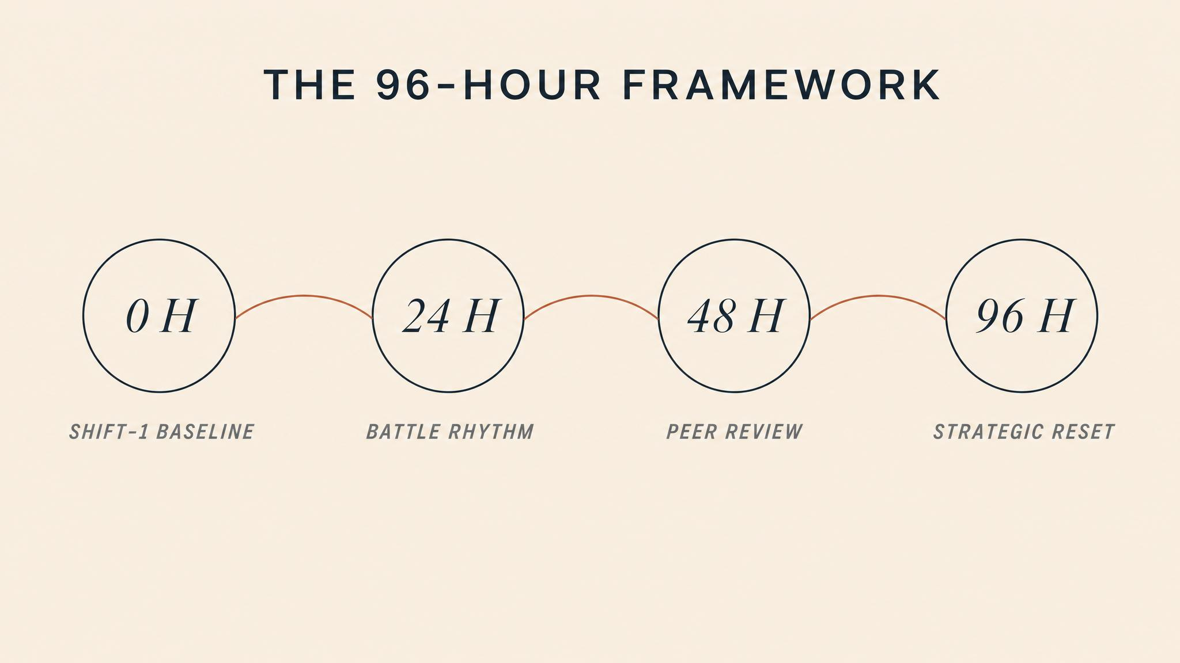
Notes:
A four-day framework. Hours zero to twelve: mobilization — the task is not making decisions but establishing the rhythm. Hours twelve to thirty-six: compensation — fatigue accumulates but experience compensates. Hours thirty-six to seventy-two: degradation — quality measurably declines. Hours seventy-two to ninety-six: endurance — only structured teams survive.

Slide 14

Notes:
Bridge to Chapter 7. We move from the internal dynamics of the crisis team to the external environment that surrounds it. When a crisis endures, it inevitably becomes public — communicating under uncertainty, managing stakeholders, maintaining legitimacy while the situation remains unresolved introduces a new set of demands.

