Slide 1
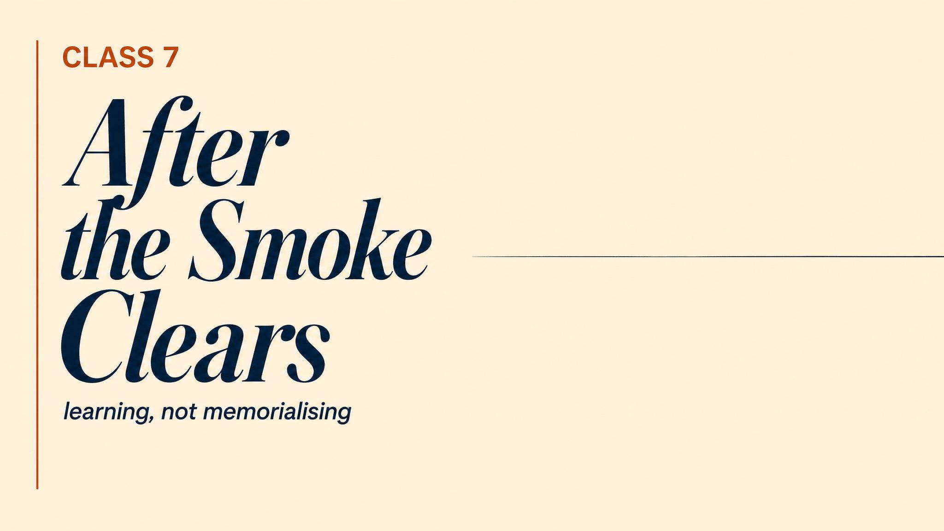
Notes:
Open on the morning of 14 June 2017. The Grenfell fire is extinguished. Seventy-two are dead. The pointing begins — residents to council, council to contractors, contractors to manufacturers, manufacturers to testing, testing to regulations. Everyone bore some responsibility. For a very long time, no one bore enough.

Slide 2
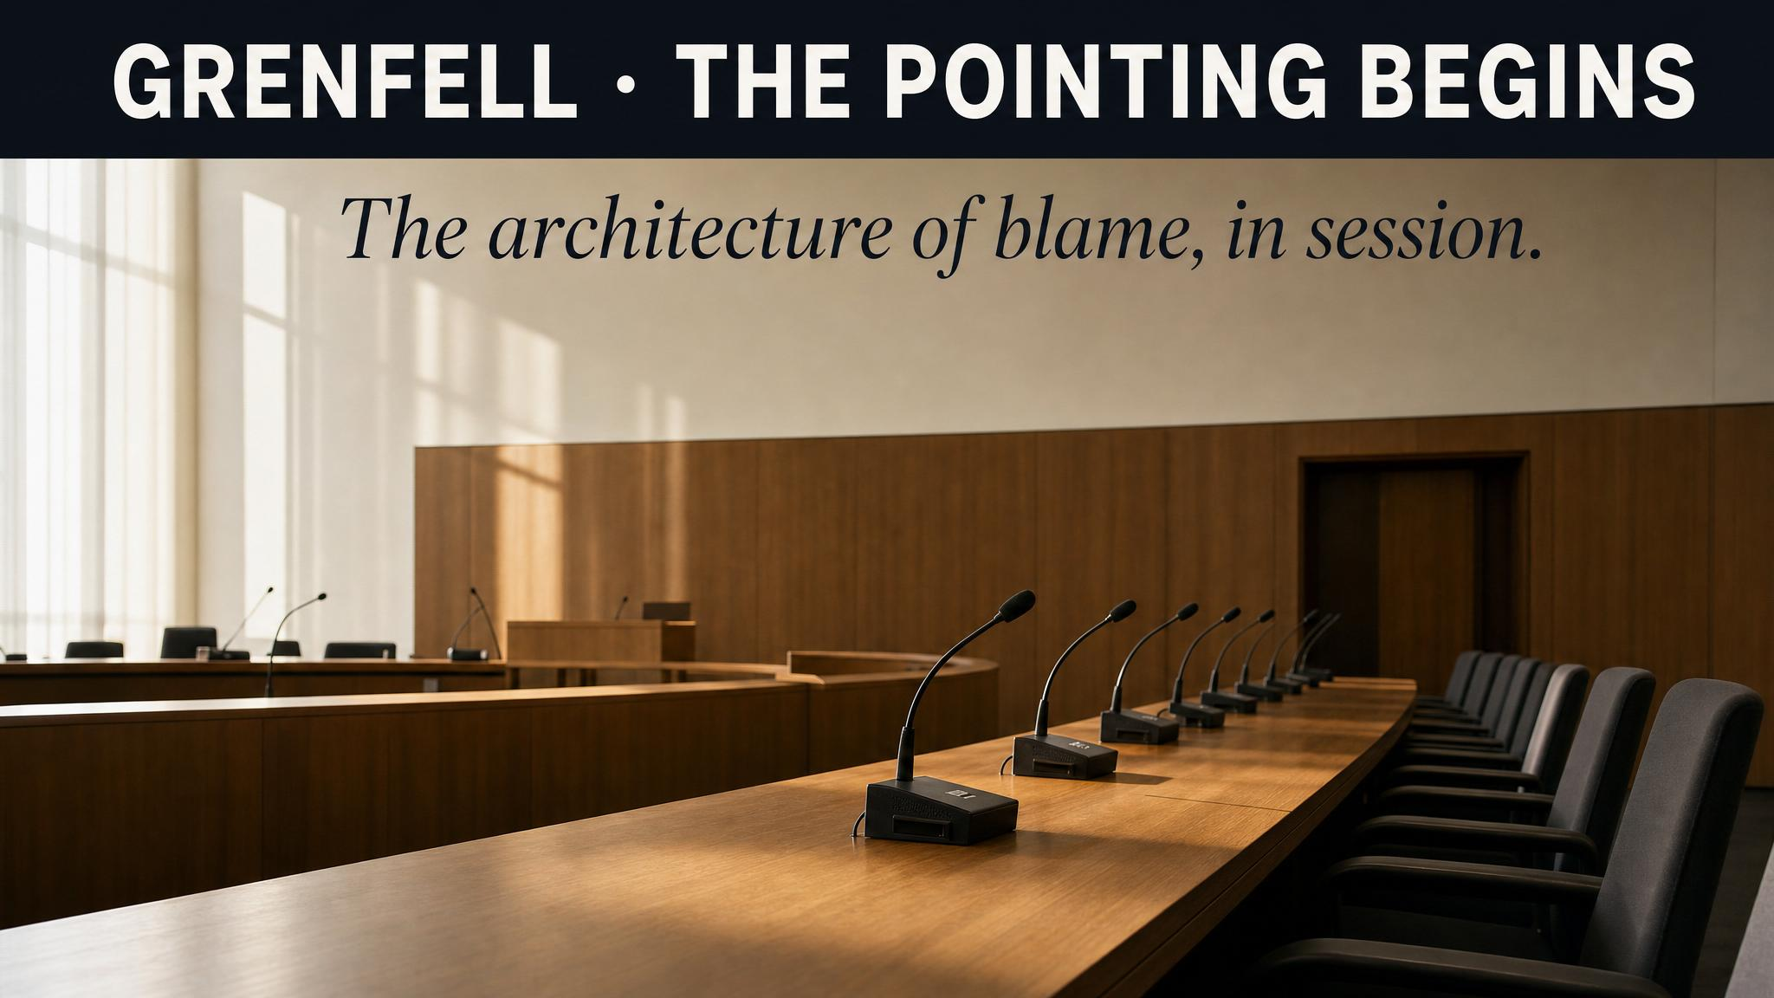
Notes:
Read it slowly. This chapter is about what happens after the acute phase of a crisis ends — when organisations decide, consciously or not, whether they will actually learn. The instinct to move on is powerful. It is also one of the most damaging things an organisation can do.

Slide 3
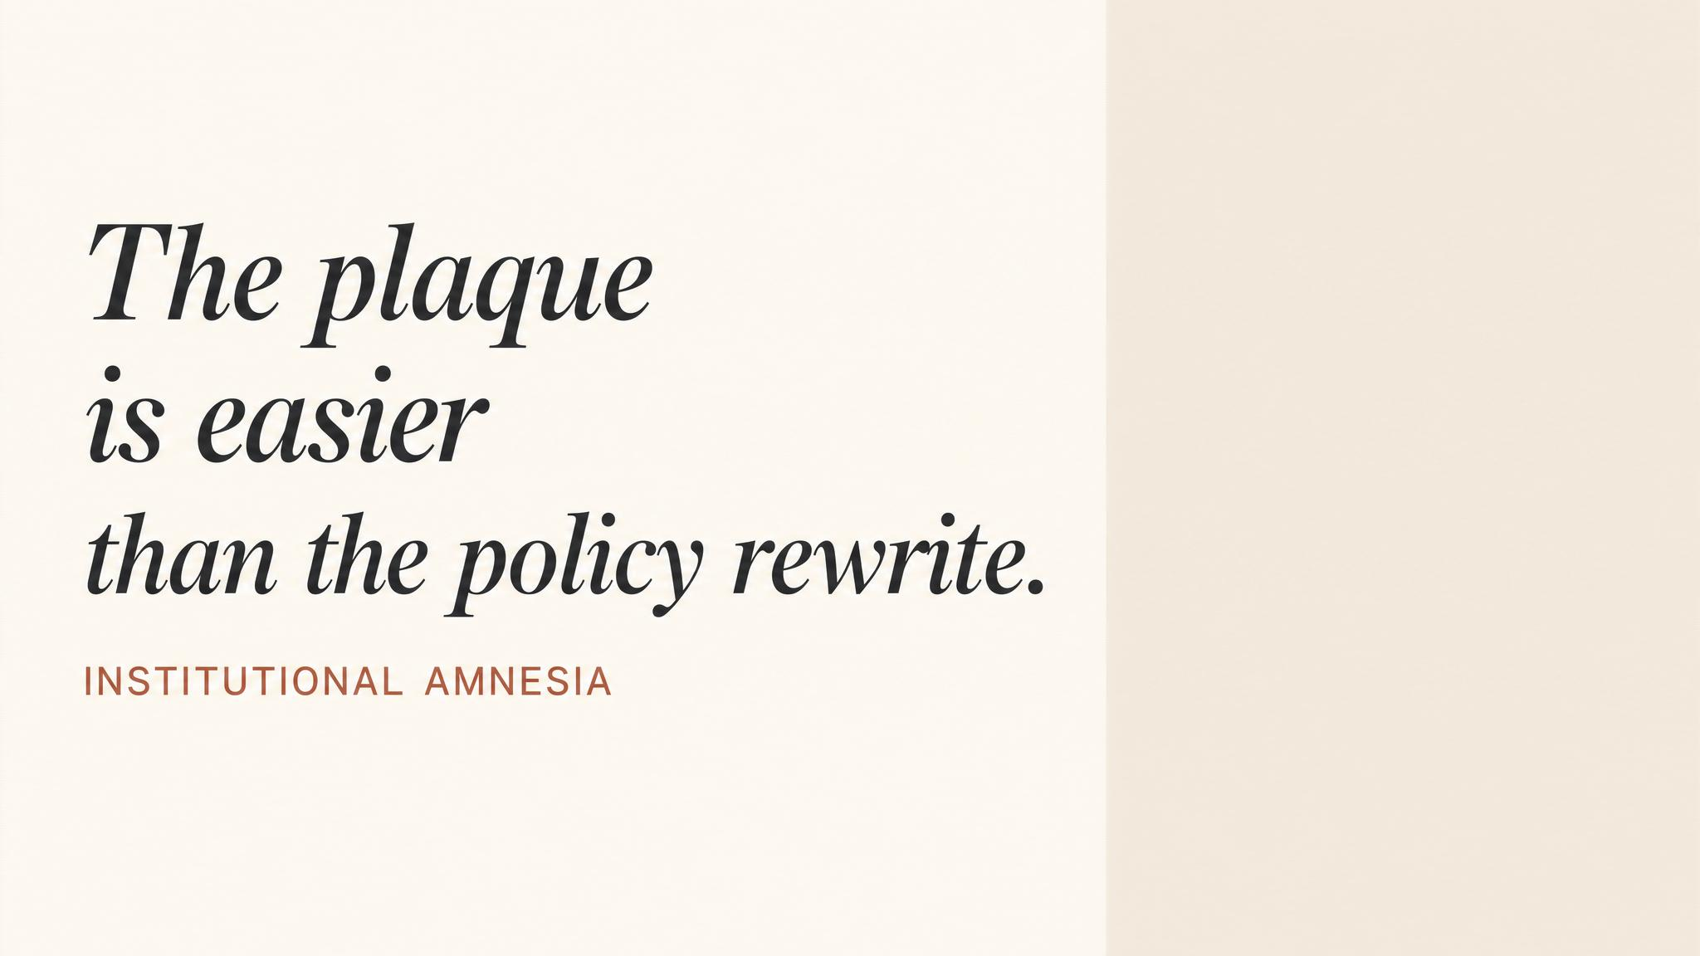
Notes:
Three reflexes follow the storm: relief, exhaustion, the wish to return to normal. Stakeholders want reassurance, markets want stability, lawyers counsel restraint. The result is institutional amnesia that masquerades as resilience. We got through it. Let's look forward. Helmreich (2000) showed the quality of post-incident analysis is the single strongest predictor of recurrence.

Slide 4
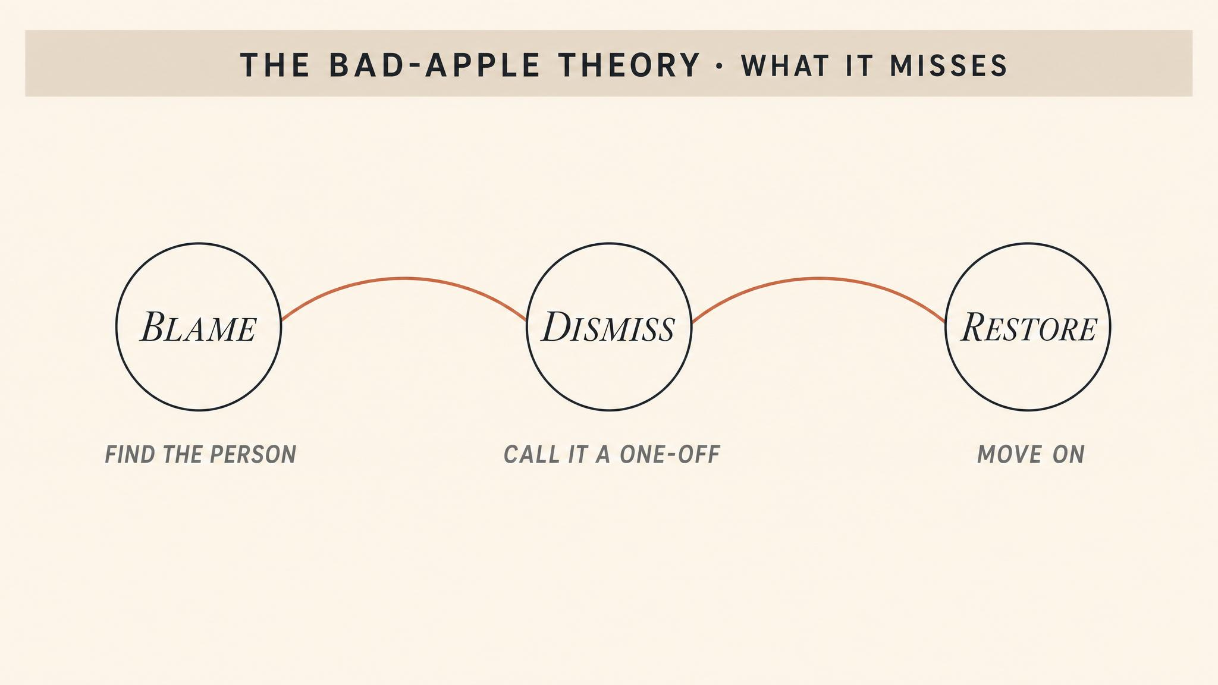
Notes:
Sidney Dekker calls this the bad apple theory — the comforting notion that complex systems are basically safe and accidents happen because unreliable people defeat the defences. It identifies a villain, implies a simple fix, satisfies the public's desire for accountability — and protects leadership from scrutiny. Almost always wrong. Punish individuals and reporting goes underground; near-misses disappear.

Slide 5
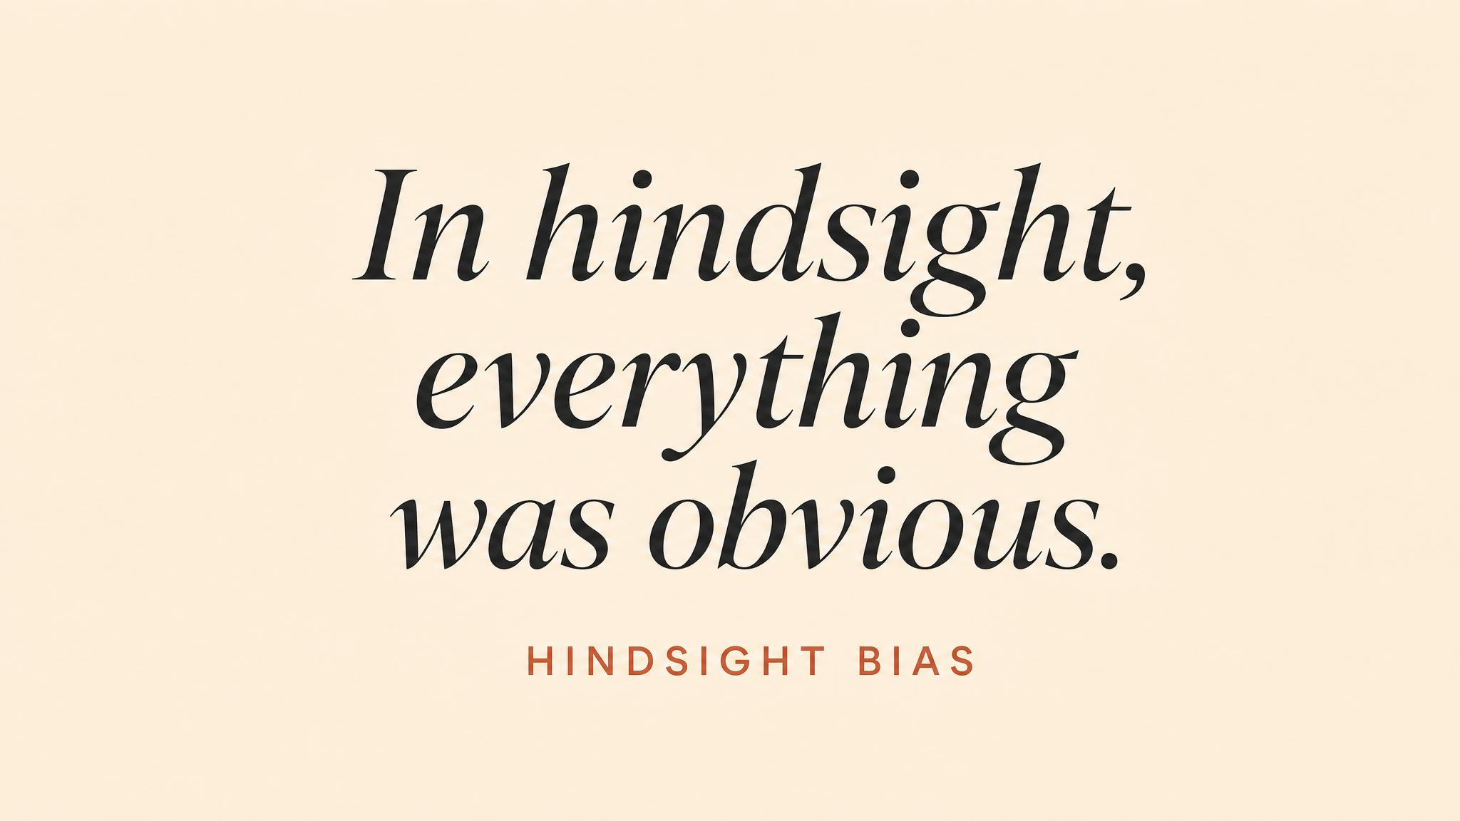
Notes:
Two biases compound. The fundamental attribution error blames character instead of context. Hindsight bias makes the warning signs look obvious only because we now know the outcome. Of course they should have noticed. But 'of course' is the language of hindsight, not the fog-filled, time-pressured, information-poor reality in which decisions were actually made.

Slide 6
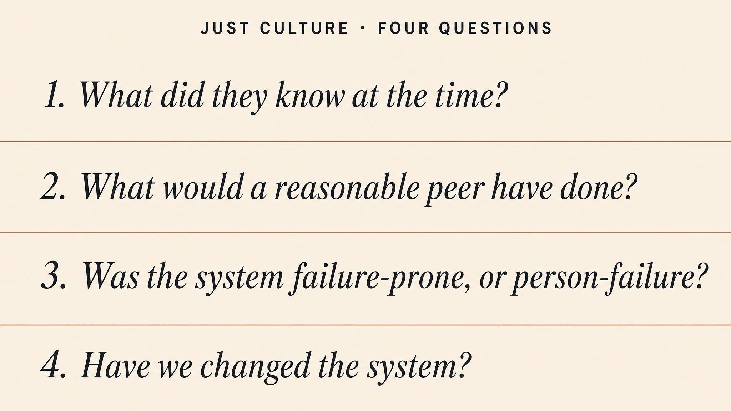
Notes:
Dekker's just culture (2008, 2012) balances accountability with learning. Four structured questions. Was it a genuine mistake? A slip or lapse — intended right, executed wrong? An at-risk behaviour — drift normalised within the team? Or genuinely reckless — a conscious choice to disregard a substantial, unjustifiable risk? Mistakes warrant consolation and redesign. Only reckless action warrants formal sanction.

Slide 7
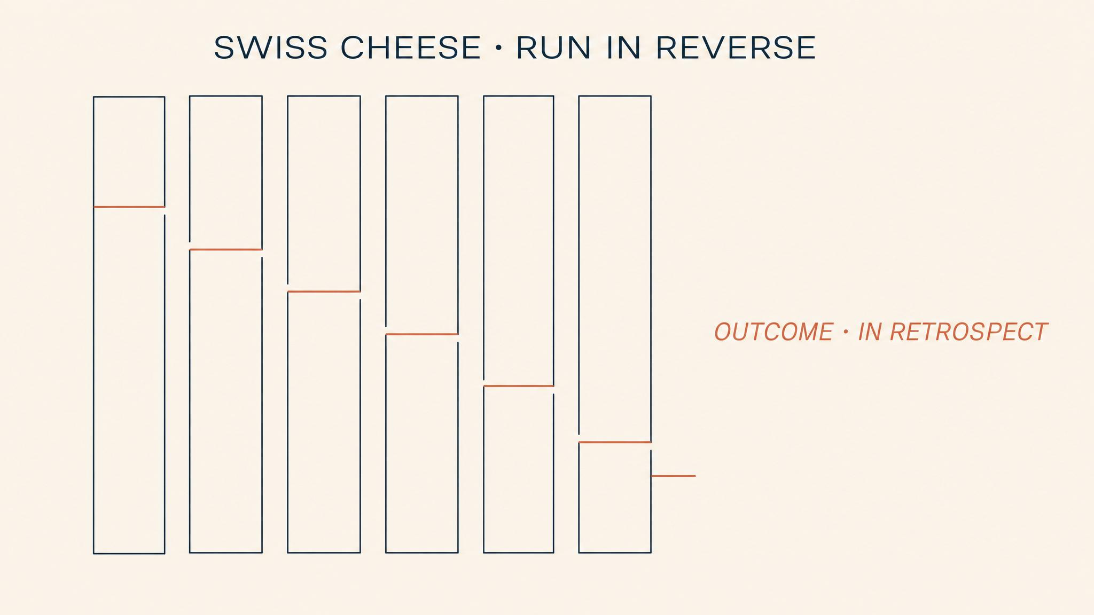
Notes:
Reason's Swiss Cheese model (1990) applied retrospectively resists single-cause explanations. The Grenfell inquiry identified failures across at least seven layers: original design, cladding selection, testing laboratories, refurbishment conduct, building control inspection, government oversight of regulations, and fire-service operational response (Moore-Bick, 2024). No single failure caused the disaster. The holes aligned. Wiegmann and Shappell (2019) warn against freezing the model into a static diagram.

Slide 8
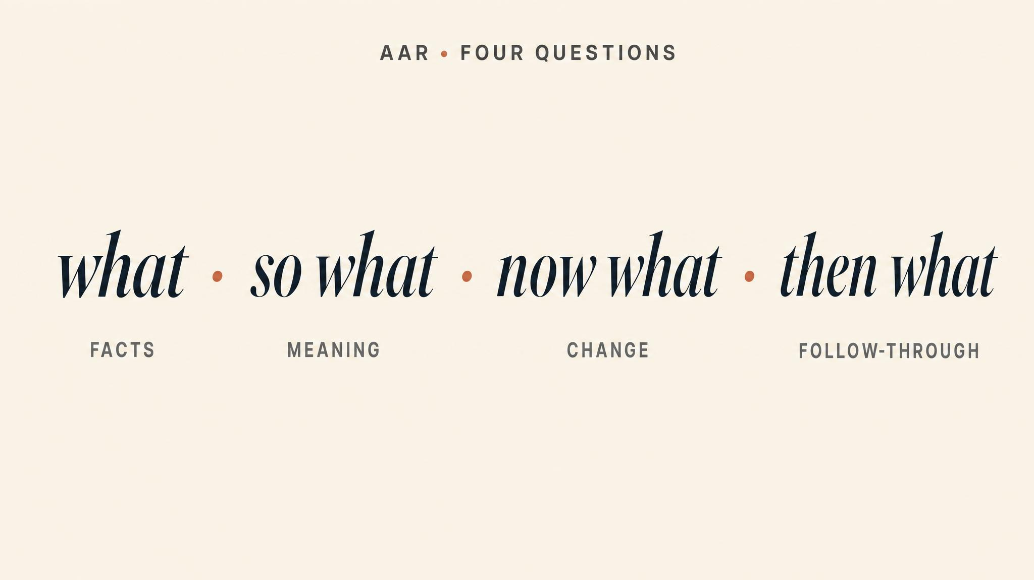
Notes:
After-action cadence in four moves. What happened — the validated timeline, triangulated across sources, contradictions flagged not resolved. So what — separate systemic from individual; for every active failure at the sharp end, ask what latent conditions at the blunt end made it likely (Reason, 1990). Now what — owners, resources, timelines, monitoring. Then what — close the feedback loop so reporters see change.

Slide 9
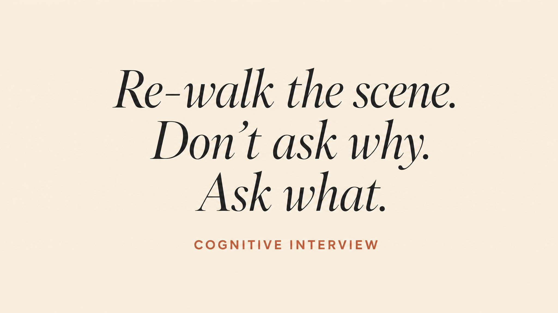
Notes:
How you interview determines the quality of everything that follows. Cognitive interview technique: ask participants to reconstruct forward in time, from what they knew and saw in the moment, without revealing what you already know. The instant an interviewer says 'and then the alarm went off', the recall is contaminated. Memory reorganises around outcome. You get hindsight, not account.

Slide 10
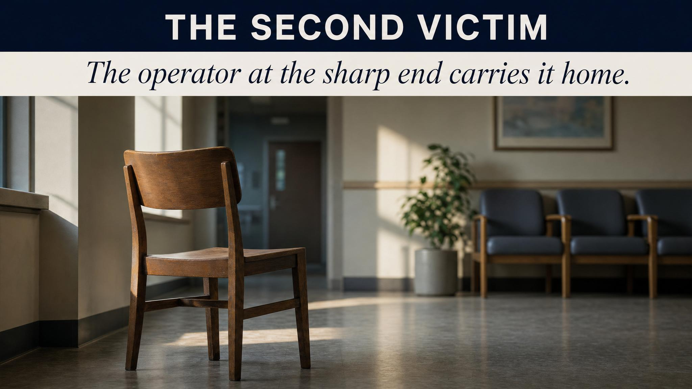
Notes:
Dekker writes powerfully (2012) about the second victim — the professional whose actions are under scrutiny after an adverse event, who experiences trauma, guilt, self-doubt, isolation, often without any institutional support. Colleagues avoid them. Lawyers advise silence. They relive the events but have no sanctioned space to process them. A just culture distinguishes accountability — which may still apply — from abandonment, which never should.

Slide 11
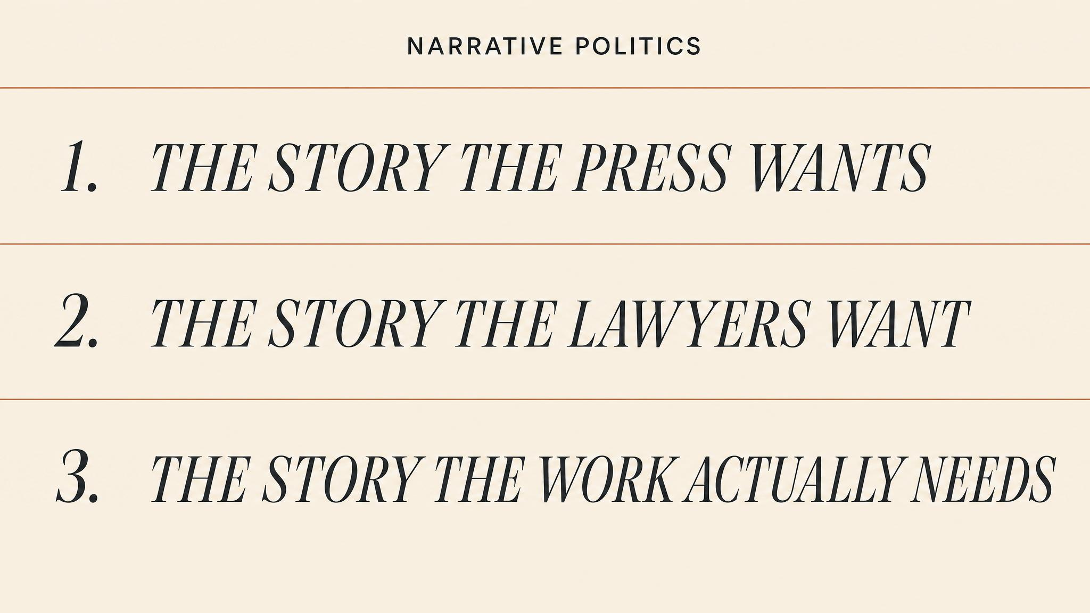
Notes:
Maitlis and Sonenshein (2010): post-crisis sensemaking is constructed through a retrospective narrative process that is deeply political. Individual-error narratives protect institutional legitimacy. Systemic-failure narratives drive structural change but threaten those who built the system. Perfect-storm narratives absolve everyone — at the cost of learning nothing. The leader's task is honesty enough to include uncomfortable truths and inclusion enough to hear those closest to the failure.

Slide 12
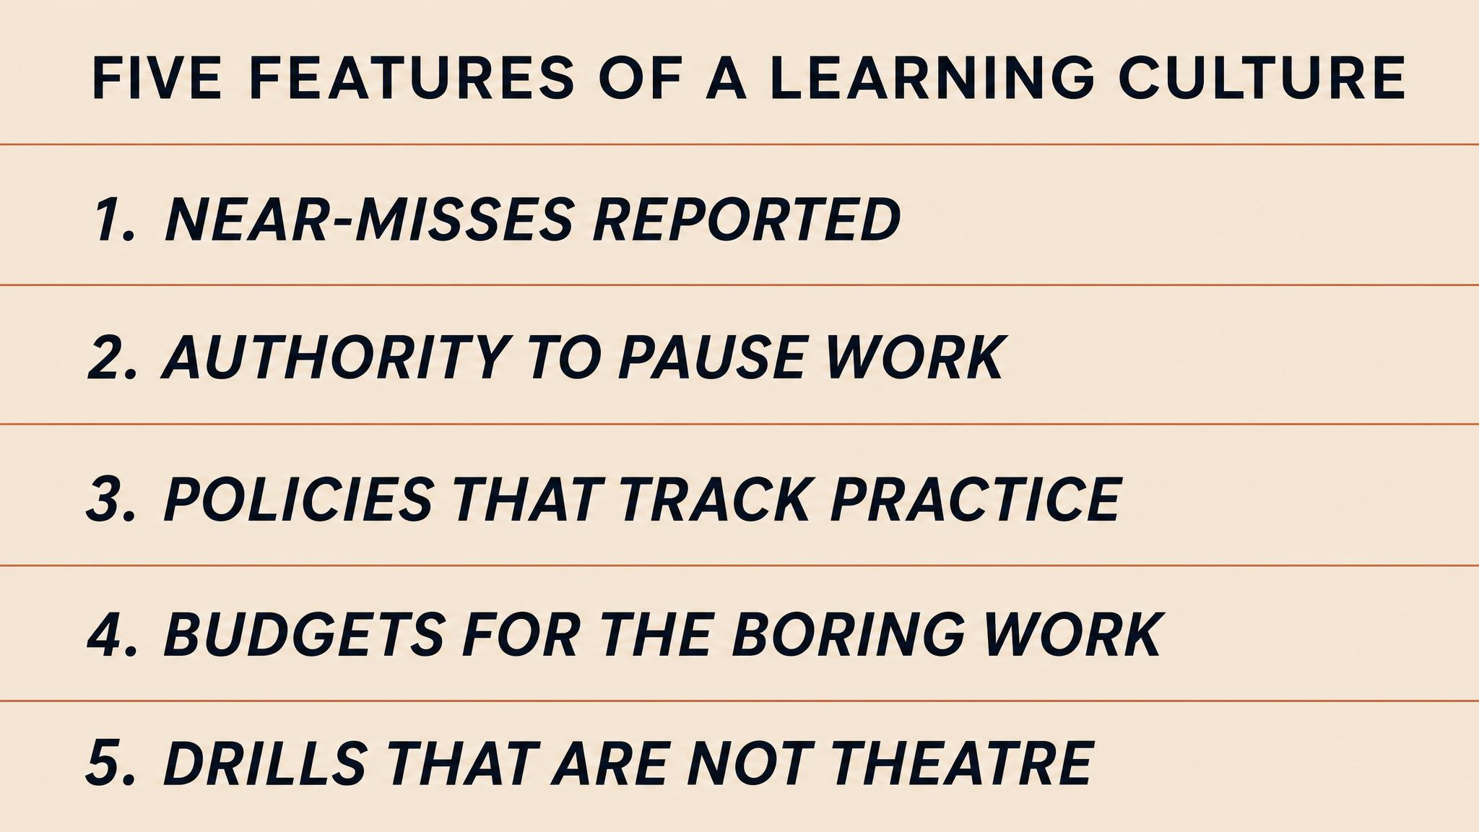
Notes:
Five features distinguish learning cultures. Psychological safety to report — built by consistent behaviour, not policy (Helmreich, 2000). Independent investigation — self-investigation is structurally compromised. Feedback loops that close — without them, reporting atrophies (Sieberichs and Kluge, 2021). Tolerance for ambiguity — comfortable with contributing factors, not root causes. Leadership modelling — senior leaders publicly acknowledging their own errors. Technically simple. Politically difficult.

Slide 13
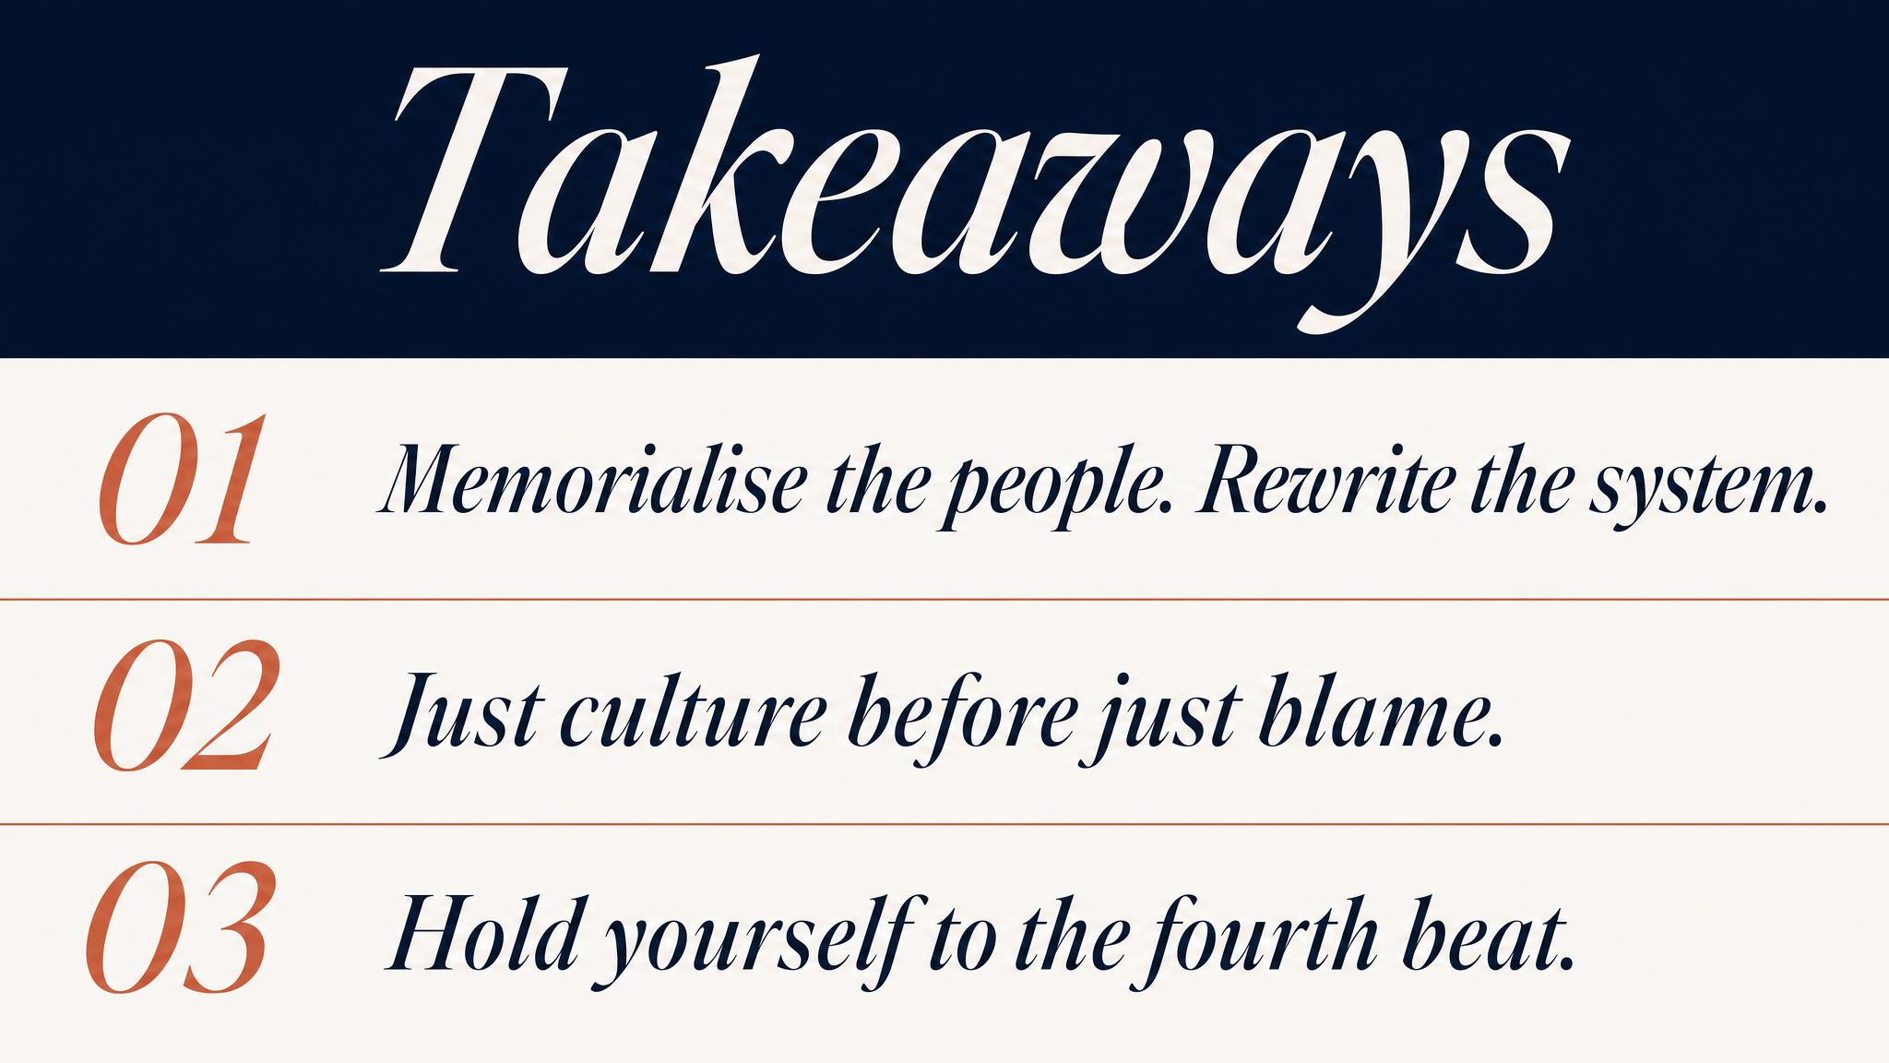
Notes:
Three to carry. One: the instinct to move on forecloses the learning that prevents recurrence — institutional amnesia is the default. Two: blame-first responses satisfy accountability but drive reporting underground and leave systemic conditions intact. Three: the second victim needs support, not abandonment — failing to provide it is unjust and organisationally self-defeating.

Slide 14

Notes:
Bridge to Chapter 8. This chapter was the architecture of retrospective learning. The next is the architecture of prospective readiness — crisis simulation, scenario planning, and the paradox of preparing for events that are, by definition, surprising. Organisations that rehearse failure most seriously are the ones that fail least catastrophically when the real thing arrives.

