Slide 1
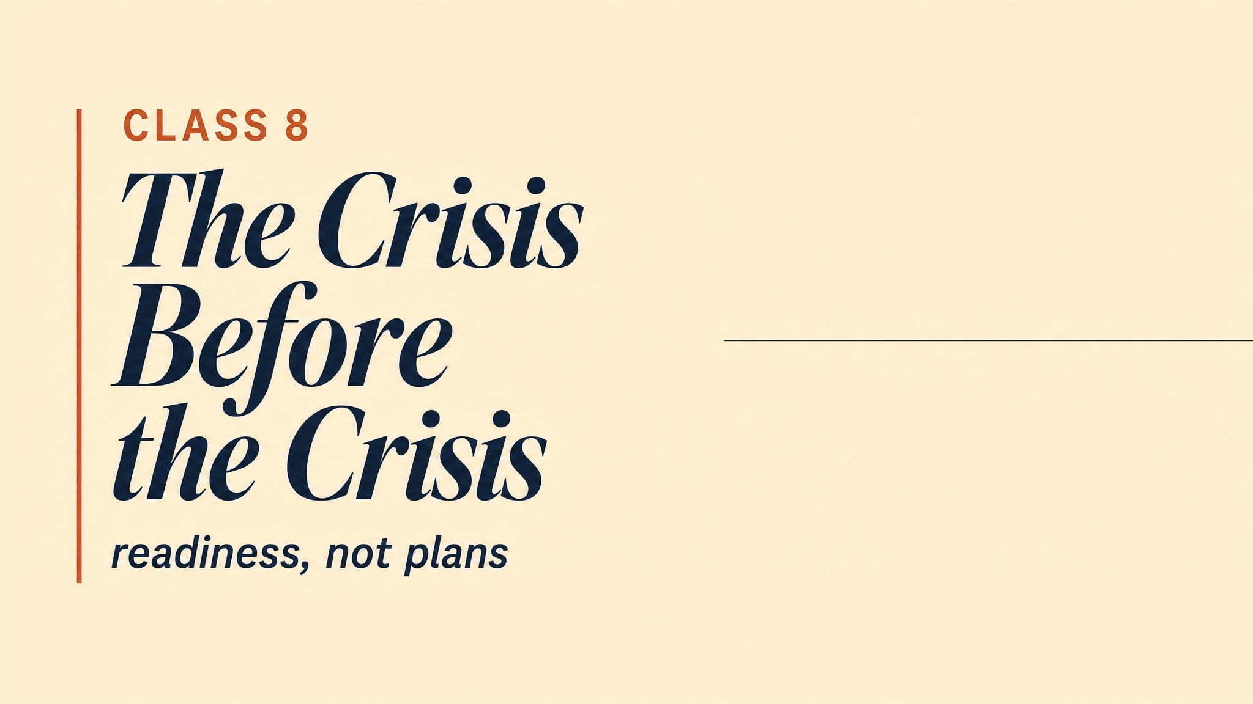
Notes:
Open with the central reframing of the entire course: the decisions that determine how a crisis unfolds are made long before it begins. The cladding is already on the building; the generators are already below the flood line. This final chapter asks the question you are now equipped to answer — what should have happened before any of it started?

Slide 2
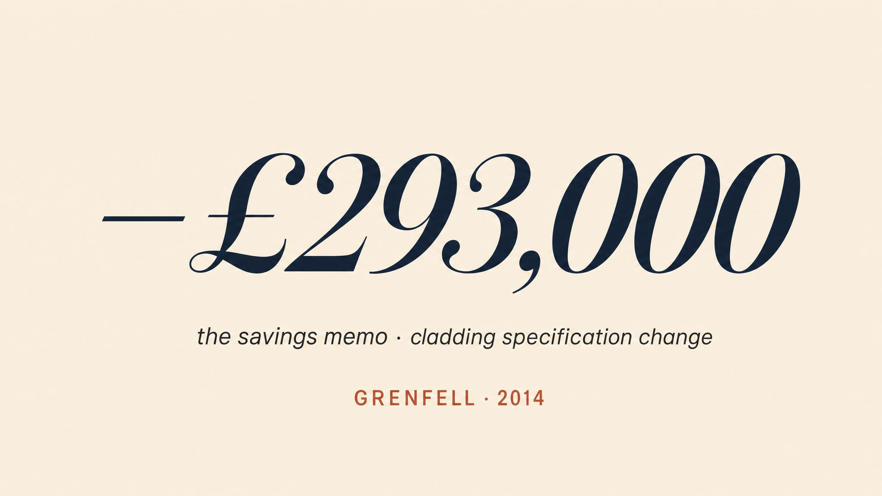
Notes:
Let the figure land. Grenfell's single most consequential decision was not made on the night of the fire. It was made years before, in a meeting room, by people who chose a cladding system that saved roughly £293,000 over a fire-resistant alternative. Seventy-two people died because of a procurement decision.

Slide 3
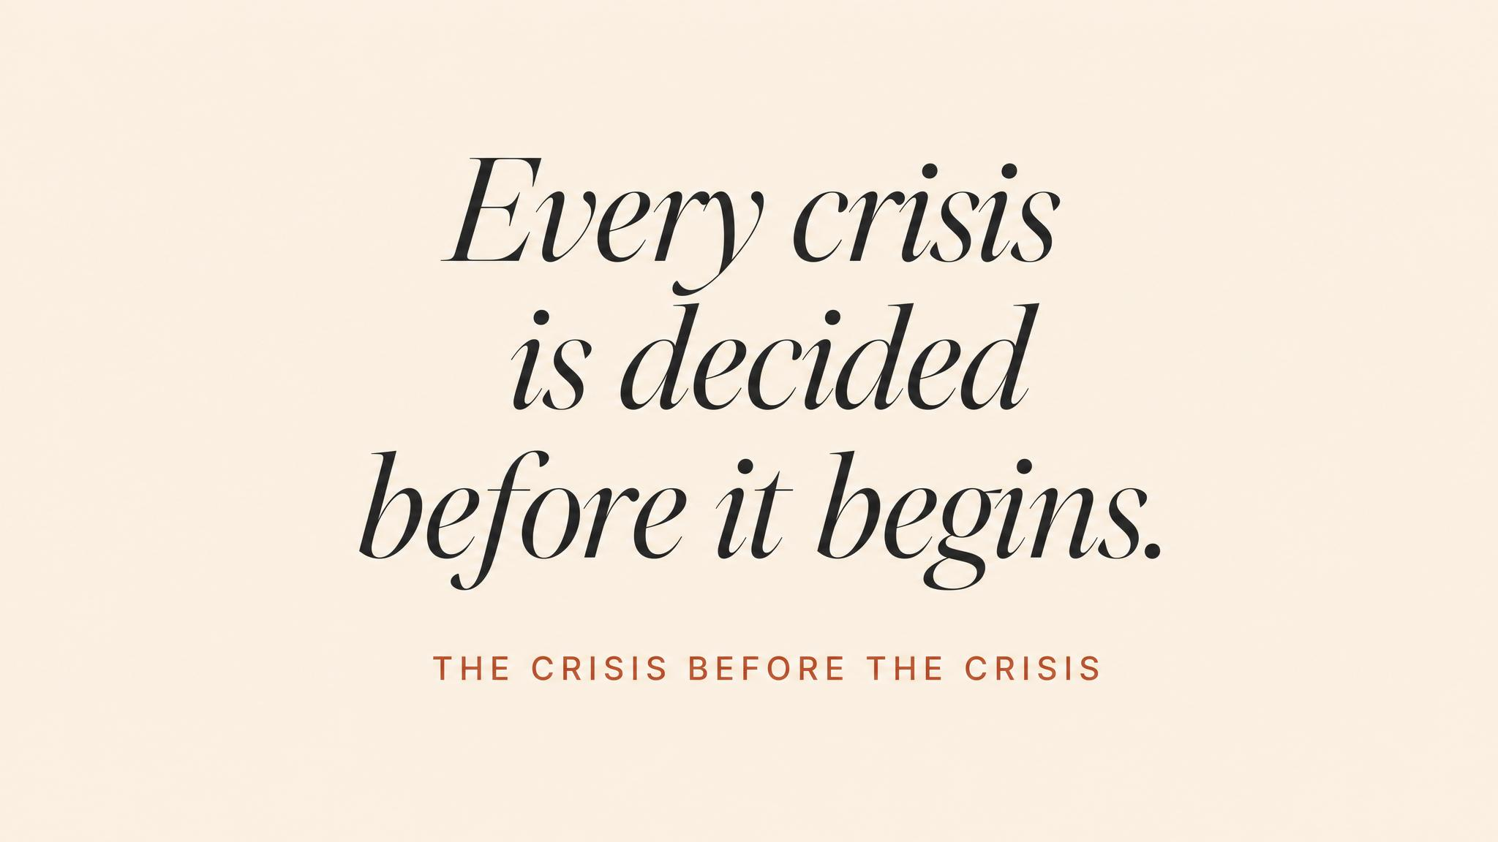
Notes:
The pattern repeats across every crisis this course has examined. Fukushima's backup generators were placed below the flood line in the 1960s. The institutional separation that delayed Thai cave coordination was built over years. The cladding, the generators, the reporting culture — all already there before the alarm sounded.

Slide 4
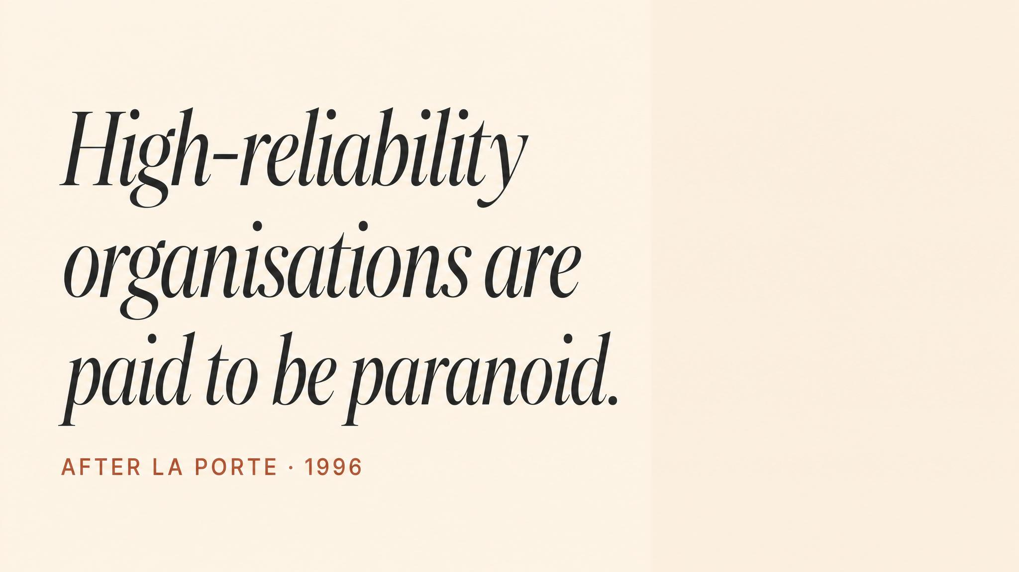
Notes:
Weick and Sutcliffe, 2015. Nuclear carriers, air traffic control, elite surgical teams — organisations that operate every day where a single error could be catastrophic, and yet sustain remarkably low rates of failure. What distinguishes them is not confidence. It is chronic wariness — a suspicion that the next failure is already incubating somewhere in the system.

Slide 5
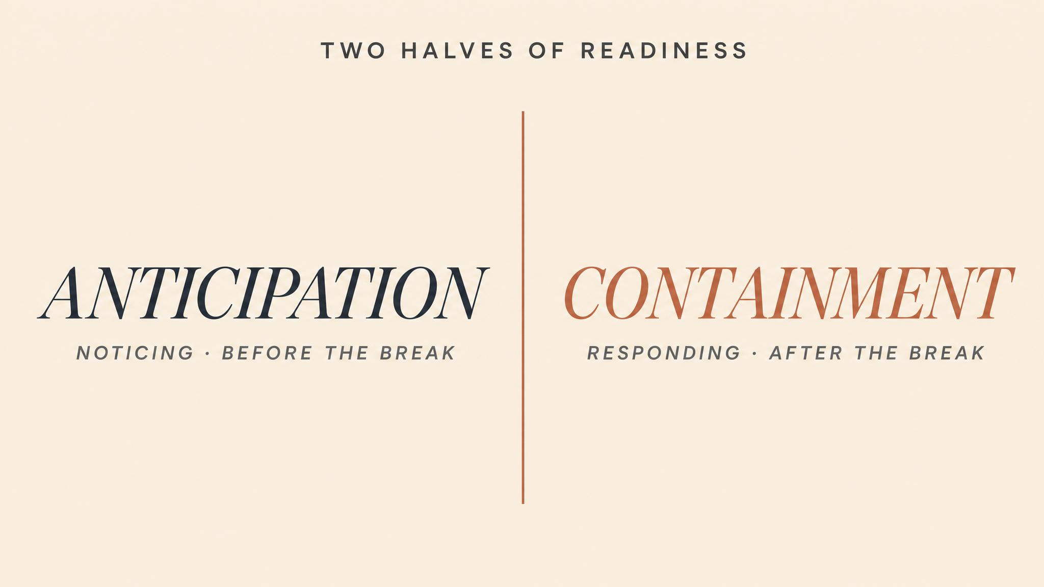
Notes:
Vogus and Sutcliffe, 2011. HROs hold a dual orientation. Anticipation: identifying and preventing potential problems before they materialise. Containment: developing the capacity to detect and limit problems that have already begun but are not yet catastrophic. Both, simultaneously, continuously.

Slide 6
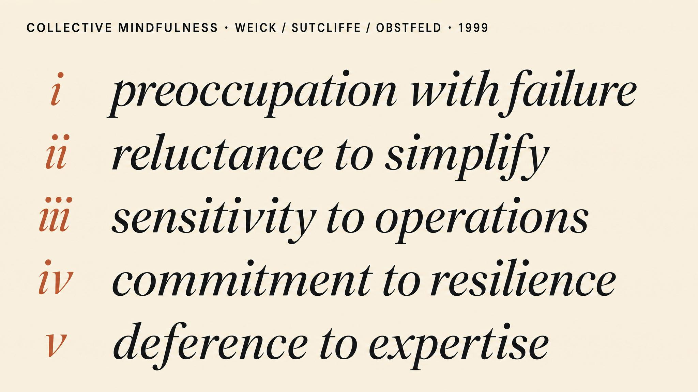
Notes:
Weick, Sutcliffe, and Obstfeld, 1999. Five processes. Preoccupation with failure — treat near-misses as evidence the system almost did not work. Reluctance to simplify — resist easy narratives. Sensitivity to operations — leaders in close contact with the front line. Commitment to resilience — assume some failures will penetrate. Deference to expertise — authority migrates to whoever has the most relevant knowledge.

Slide 7
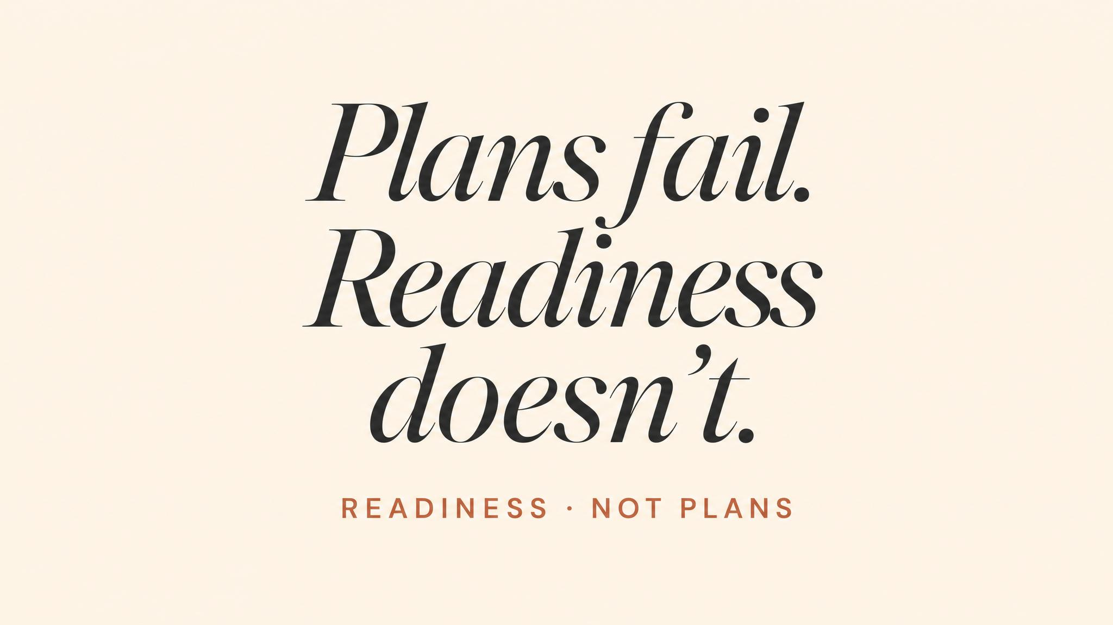
Notes:
Jin, Cameron, and Coombs, 2024. Traditional preparedness focuses on artefacts — plans, checklists, resource inventories. Crisis readiness is a more demanding concept: multilevel efficacy, mental adaptability, and what they call dynamic process-driven agility — the capacity to improvise coherently when the plan meets reality.

Slide 8
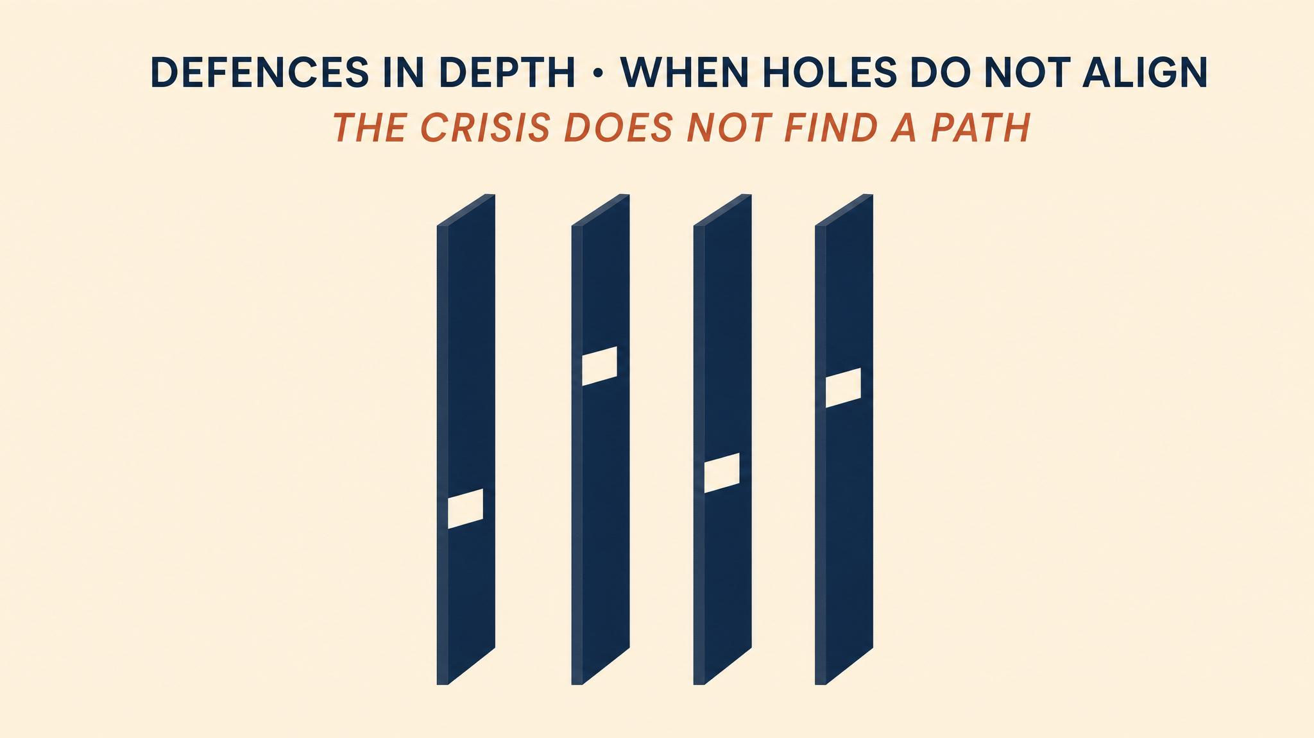
Notes:
The Swiss Cheese Model has been our retrospective lens all course. Its greatest practical value is proactive. Enumerate your layers — governance, plans, training, culture, resources. Examine each layer's integrity. Look for the dangerous alignments where a weakness in one layer is not compensated by strength in an adjacent one.

Slide 9
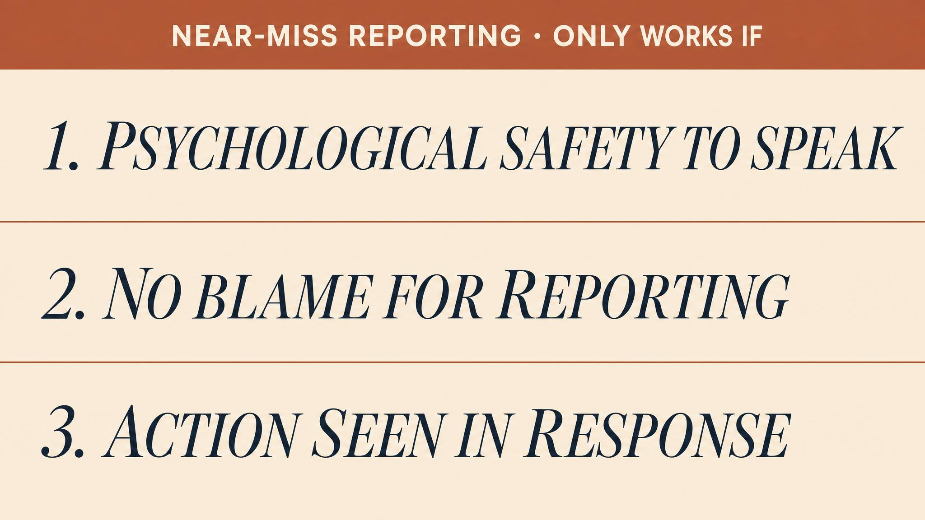
Notes:
Haas, Kulbacki, and McGuire, 2020. Near-miss reporting systems are one of the most powerful tools for surfacing latent weaknesses — but only when workers have genuine decision-making autonomy, when they are involved in analysing the events they report, and when the organisational response is visibly constructive. Reporting systems that merely collect data are a defence layer with a hole in it.

Slide 10
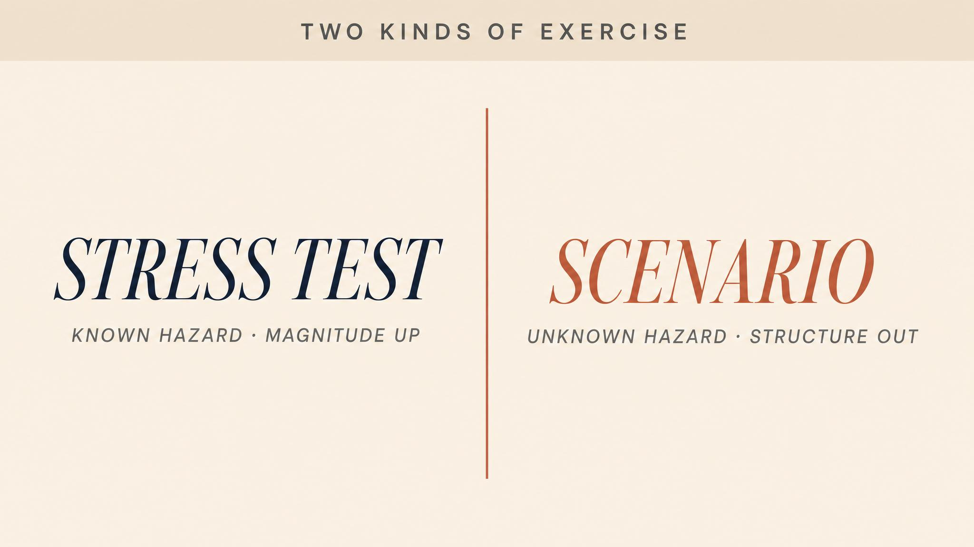
Notes:
Younis, 2024. Two complementary approaches. Stress testing applies extreme but plausible conditions to see where systems break. Scenario analysis envisions a range of possible futures to test the breadth of organisational response. Stress testing without scenario breadth prepares you for the last crisis. Scenario breadth without stress intensity surfaces problems that never get tested.

Slide 11
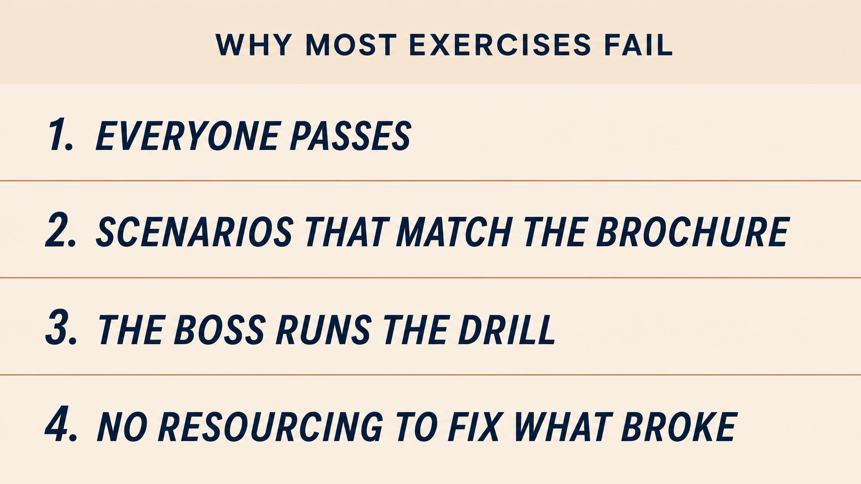
Notes:
Most exercises fail on one or both dimensions. They test only the obvious scenarios everyone has rehearsed. They allow leaders to perform well because the exercise is designed to confirm existing plans. They run hours, not the days or weeks a real crisis demands. And they skip the genuinely difficult parts — contradictory stakeholders, ambiguous information, sixteen hours of fatigue.

Slide 12
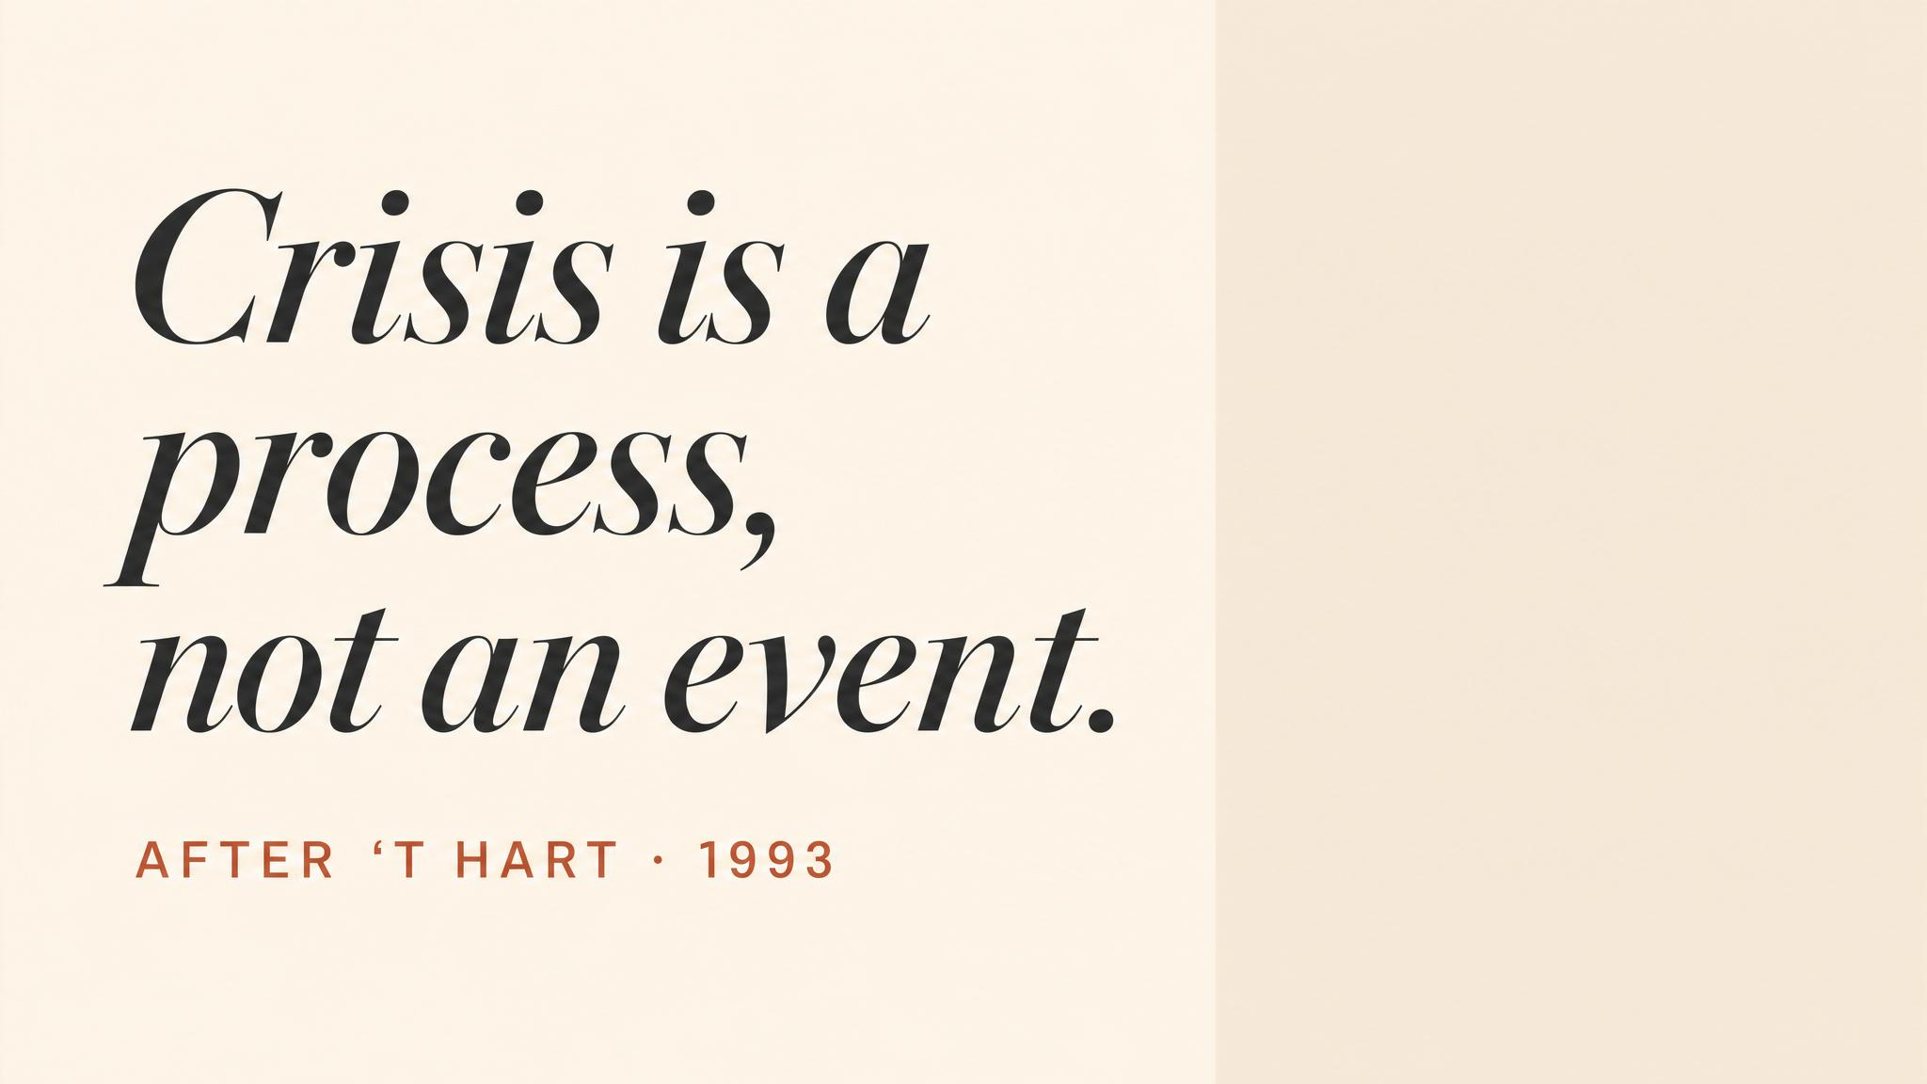
Notes:
Vogus and Sutcliffe, 2016. The critical distinction. Crisis-as-event thinking treats crises as discrete occurrences to be managed. Crisis-as-process thinking understands crises as emerging from ongoing organisational dynamics. Preparedness, in this view, is not something you do periodically. It is something you are, continuously.

Slide 13
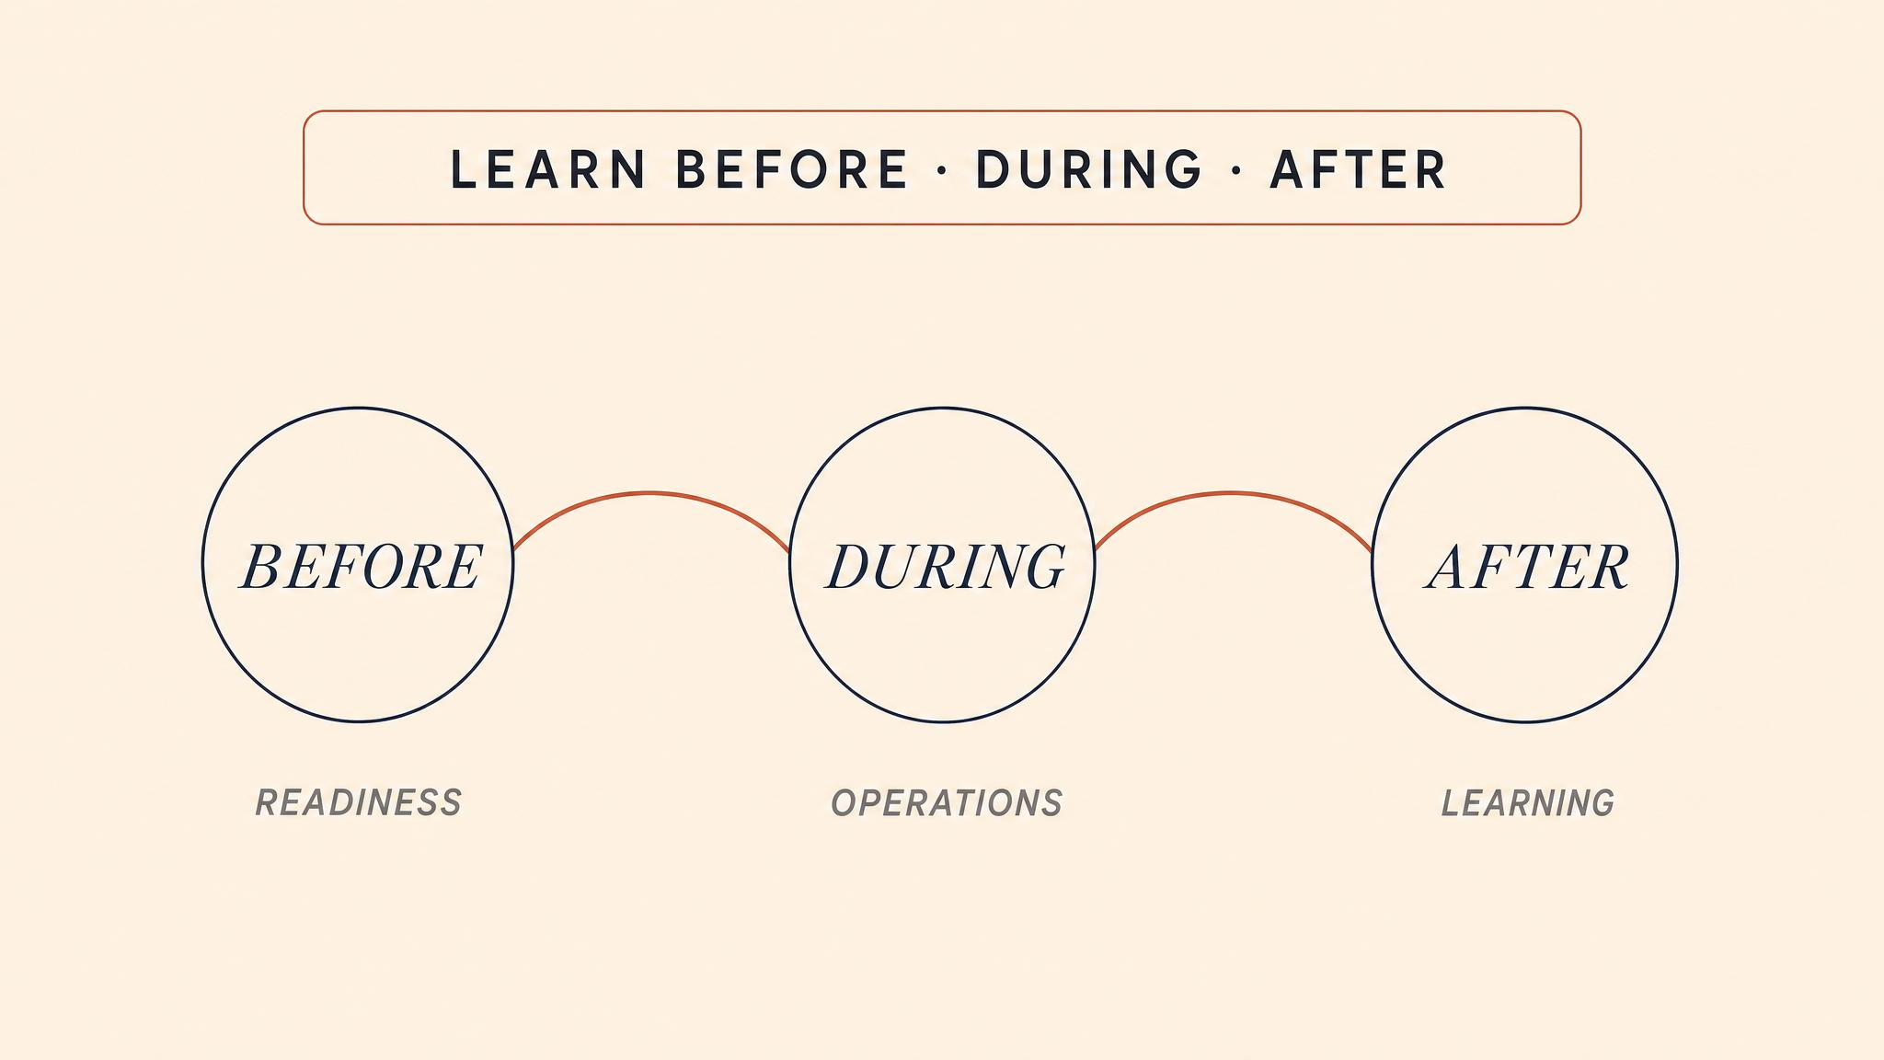
Notes:
Hanssen, Meidell, and Lindøe, 2022. Their systematic review finds that resilient organisations learn not only from crisis but in crisis and for crisis — before, during, and after disruptive events. Critically, they find that learning from normal functioning and minor everyday anomalies builds the deepest reserves of adaptive capacity.

Slide 14

Notes:
The course began with classification — learning to recognise a crisis. It closes here. All of this preparatory discipline only matters if the organisation will actually detect the precursors when they appear. The cladding, the generators, the reporting culture — they are already being decided right now. The question is not whether your organisation will face a crisis. The question is what kind of organisation it will be when the crisis arrives. The work begins now.

