Slide 1

Notes:
Open with the hook: it's nine pm on a Thursday, you're scrolling photos of eight-week-old puppies, and rational thought has taken a back seat. Set the frame for the chapter — this is not about perfection, it is about the week of preparation that prevents months of regret. Ask the room: who in here has acquired a dog in exactly this way? Hands often go up.

Slide 2
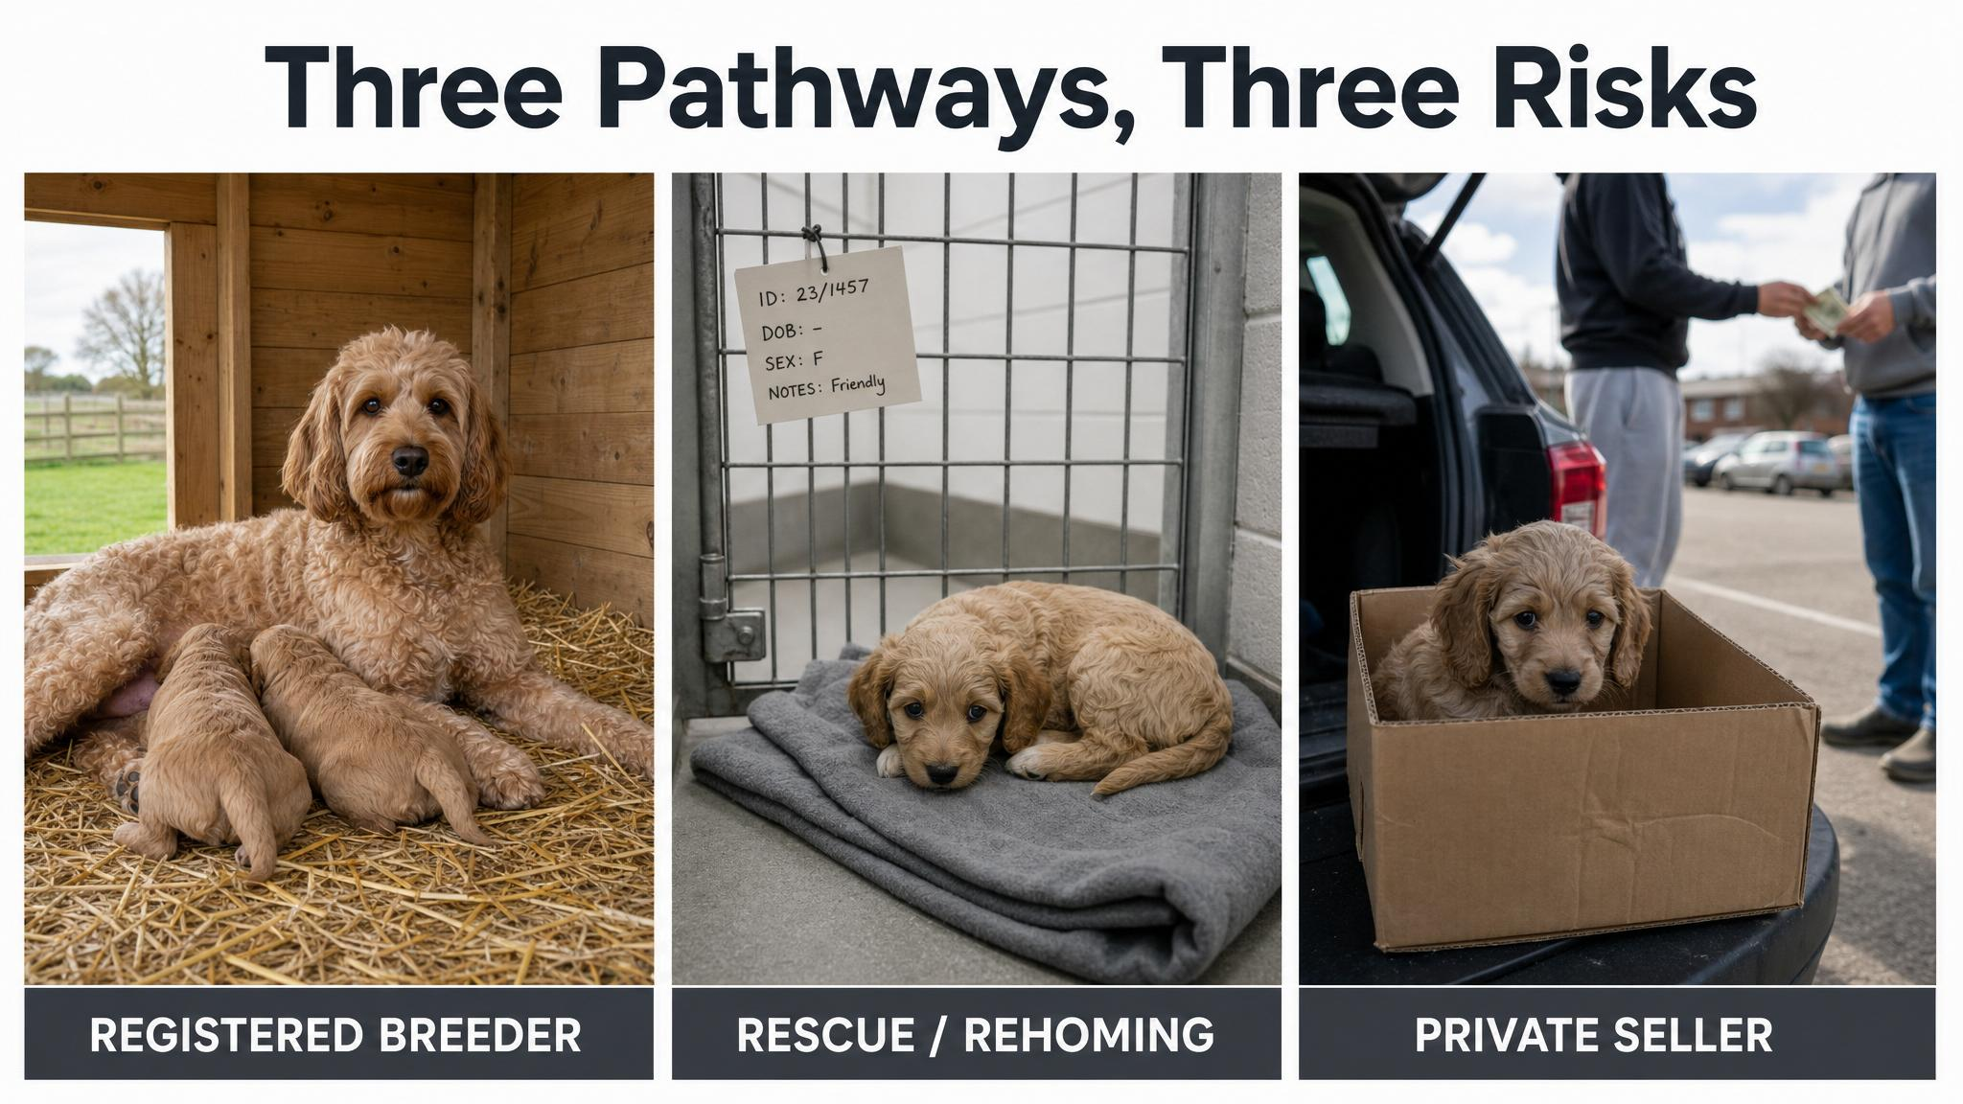
Notes:
Three pathways — registered breeder, rescue, private seller. Each comes with different transparency, different protections, and different risks. Packer and colleagues in 2021 found that friends, relatives, and private sellers collectively account for as many puppy acquisitions as breeders and shelters combined. The red flags to watch in private sales: seller wanting to meet off-site, multiple breeds from one seller, no chance to meet the mother, vague vet history, and high-pressure tactics.

Slide 3

Notes:
Both microchipping and council registration are mandatory across Australian states and territories. Microchipping is usually required by twelve weeks of age; council registration usually within three to six months. Remind the room that a microchip is not GPS — it's only useful if your contact details are current. Thousands of dogs each year cannot be returned because owners moved house and didn't update the database.

Slide 4

Notes:
Walk through it physically. Get on your hands and knees and look at each room from puppy height. The puppy experiences the world primarily through its mouth — everything gets tasted, chewed, and tested. The goal is not to create a sterile environment, only to remove the things that could genuinely harm your puppy. Ask the room: what's the most dangerous object on the floor in your house right now?

Slide 5
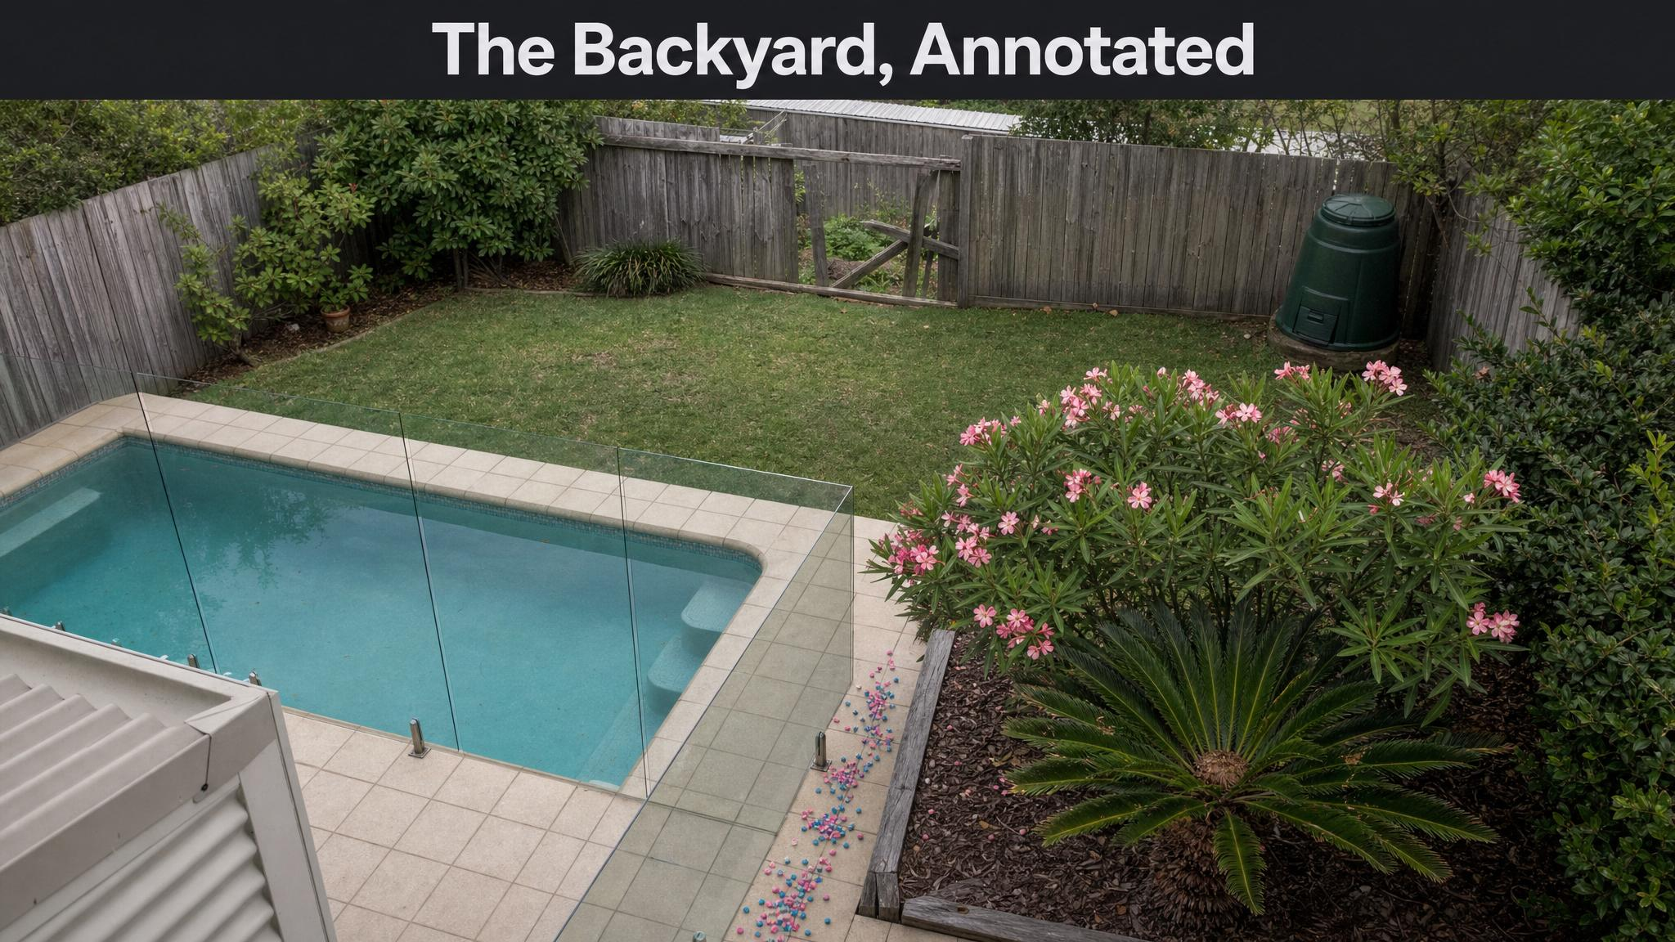
Notes:
The Australian backyard has its own hazards. Pool fencing is legally required, but check the gate is self-closing and the gaps are small enough for a puppy. Common toxic plants include Brunfelsia, oleander, cycads, and many mushrooms after rain. Metaldehyde-based snail bait is one of the most common causes of dog poisoning in Australia — switch to a pet-safe iron-based formula.

Slide 6
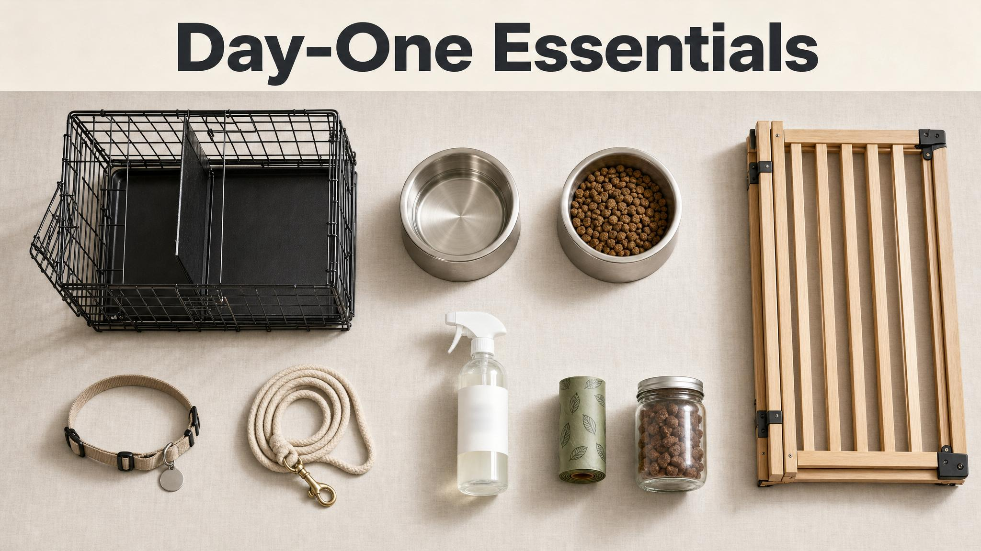
Notes:
Walk into any pet store and you'll walk out five hundred dollars lighter, having forgotten at least one thing you actually need. The pet industry is very good at selling anxiety. Cut through it — these nine items are your day-one essentials. Pause on the crate. A crate, properly introduced, becomes your puppy's den, not a cage. We'll cover crate training in detail later.

Slide 7
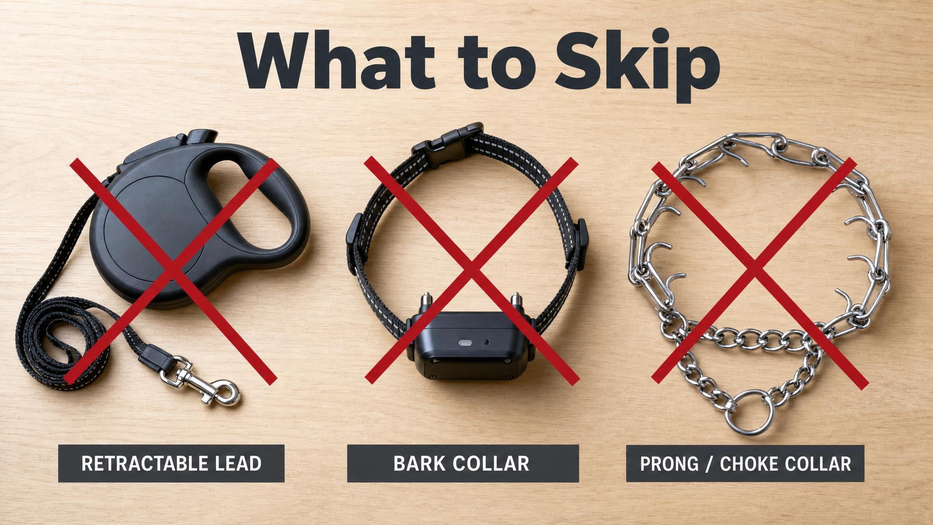
Notes:
Three items to skip. Retractable leads teach puppies to pull — the mechanism only releases line when the puppy applies pressure. Bark collars, prong collars, and choke chains have no place in evidence-based puppy raising. Blackwell and colleagues in 2008 and Herron and colleagues in 2009 found aversive training methods are associated with increased aggression and fear. There is no training problem with a puppy that requires pain to solve.

Slide 8

Notes:
Two roads to the same outcome. A baby gate across the kitchen doorway is management. Teaching a rock-solid stay is training. Both work — but one works with an eight-week-old today, and the other takes weeks of practice. When someone says their puppy is naughty for chewing shoes, the real question is: why did the puppy have access to shoes? That's not a training failure — it's a management gap.

Slide 9
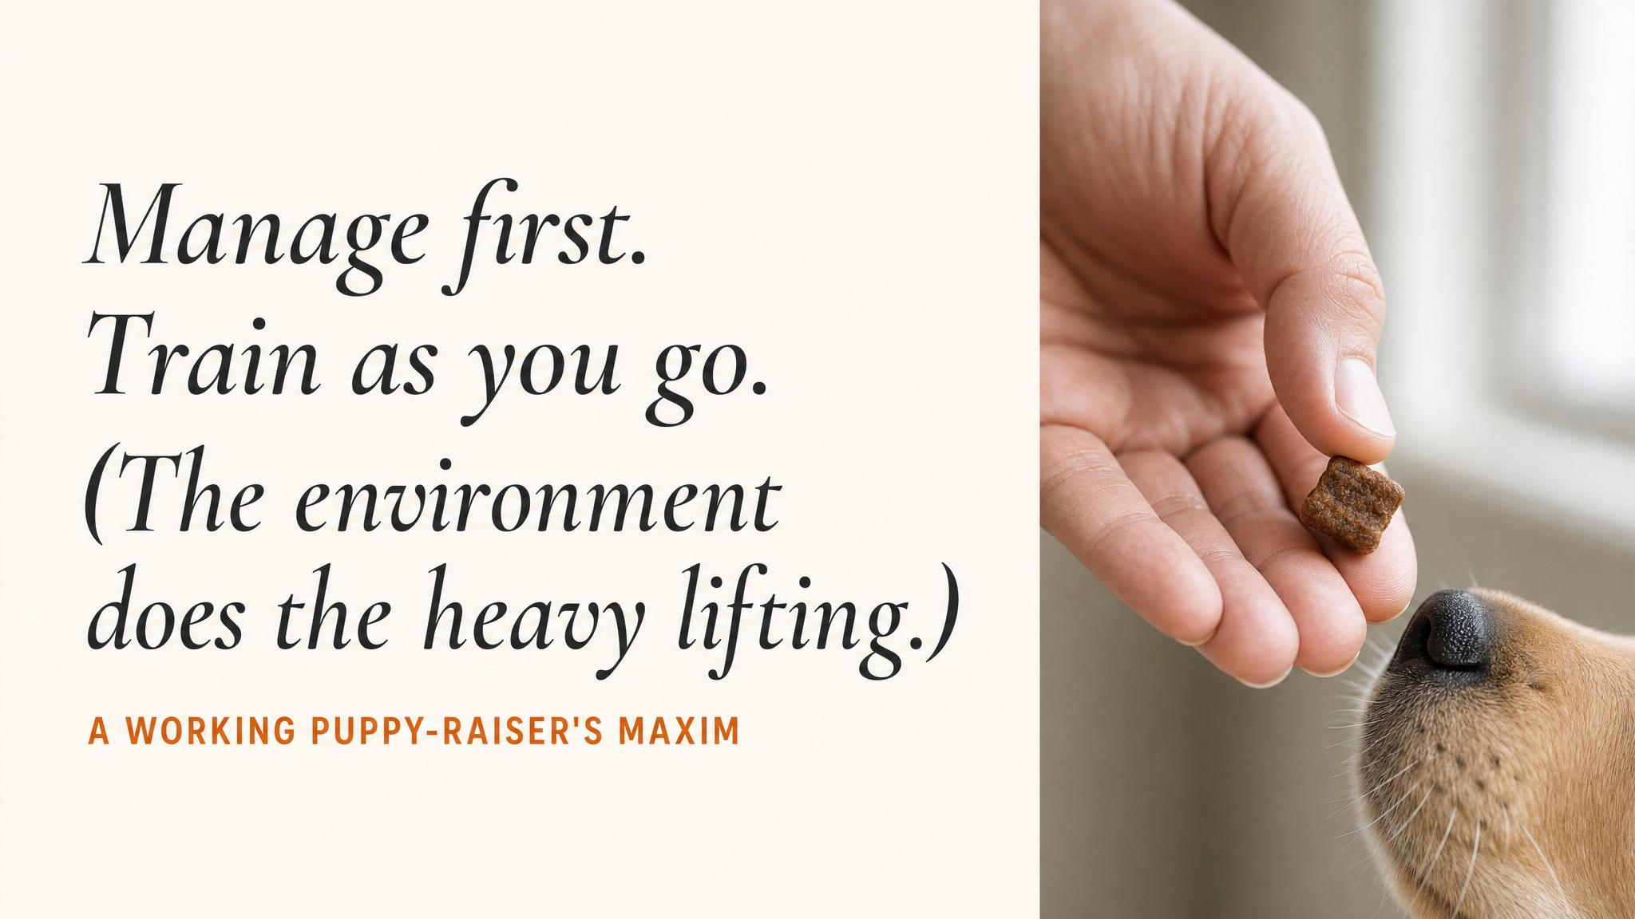
Notes:
Pause here. Read the maxim aloud slowly. Manage first; train as you go. The best puppy training plan in the world means nothing if the environment keeps setting your puppy up to fail. Sit with the room for a beat before moving on to the three foundations.

Slide 10
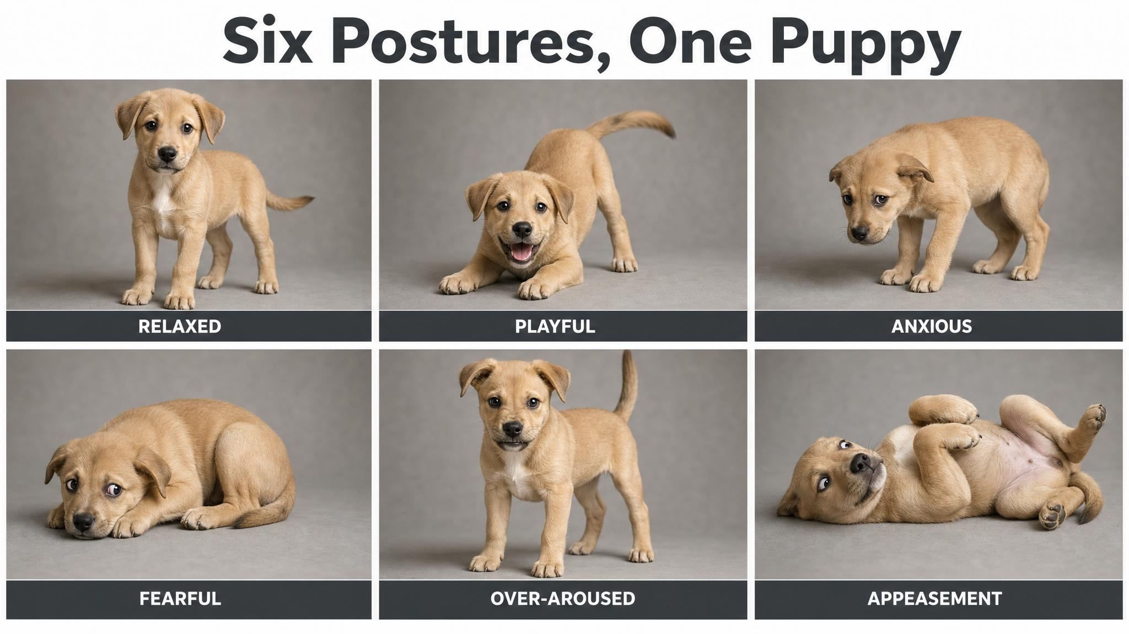
Notes:
Hasegawa and colleagues in 2015 showed that specific body language patterns — eye shape, ear position, tail carriage, weight distribution — reliably predict a dog's emotional state and learning readiness. Most people believe they're good at reading dogs. Most people are wrong. Linger on the appeasement panel: a dog rolling onto its back isn't always asking for a belly rub. It may be saying 'please stop.'

Slide 11
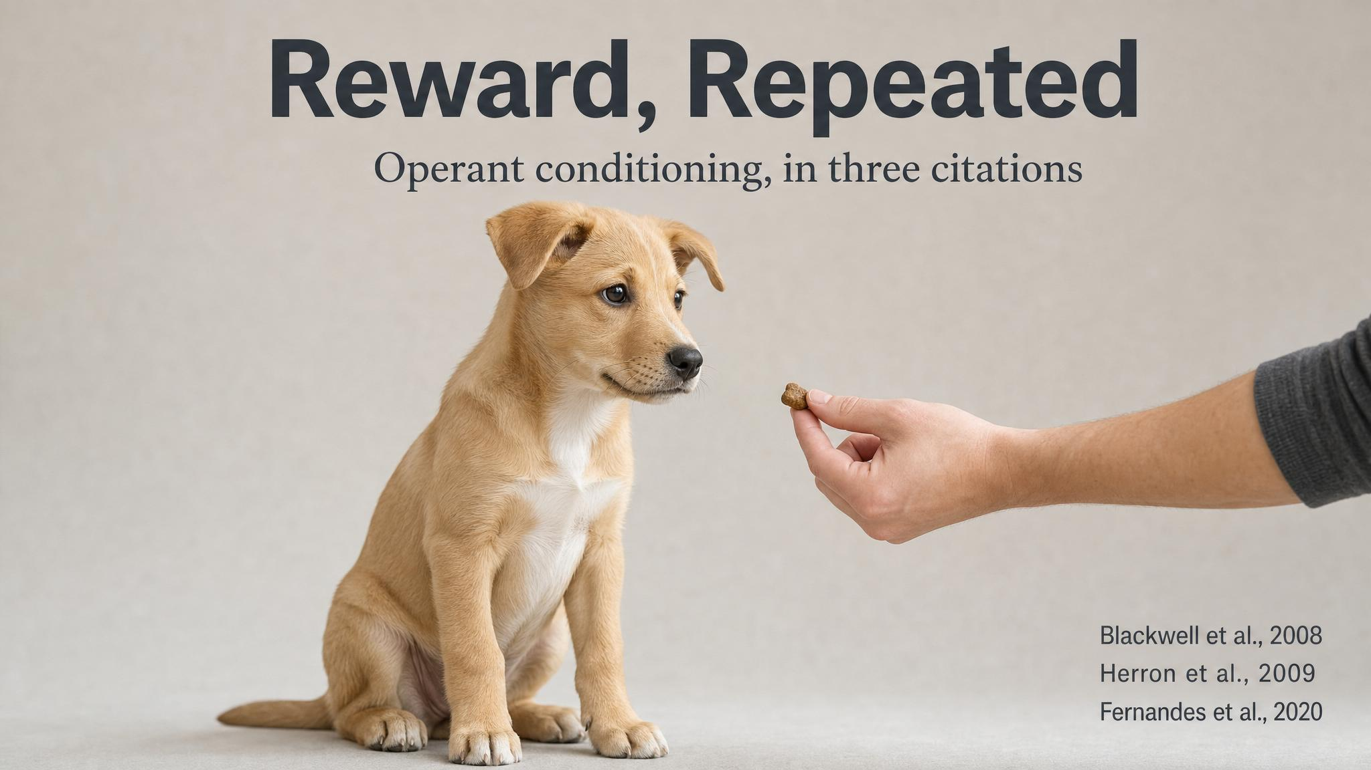
Notes:
Positive reinforcement is not a philosophy. It's a principle of learning theory — operant conditioning. Behaviours followed by pleasant consequences are more likely to be repeated. Blackwell and colleagues in 2008, Herron in 2009, and Fernandes in 2020 all show the same thing: reward-based methods are safer and at least as effective as aversive ones. Herron documented that confrontational techniques elicited aggressive responses in twenty-five to thirty-one percent of dogs tested. The science is clear.

Slide 12

Notes:
Plant the seed for next chapter. The socialisation period runs roughly three to twelve weeks, with some researchers extending it to fourteen — Howell and colleagues in 2015. Rooney and colleagues in 2022 showed that early, structured exposure produces bolder, less reactive, faster-problem-solving puppies. This window doesn't stay open forever. Class two is time-sensitive.

Slide 13
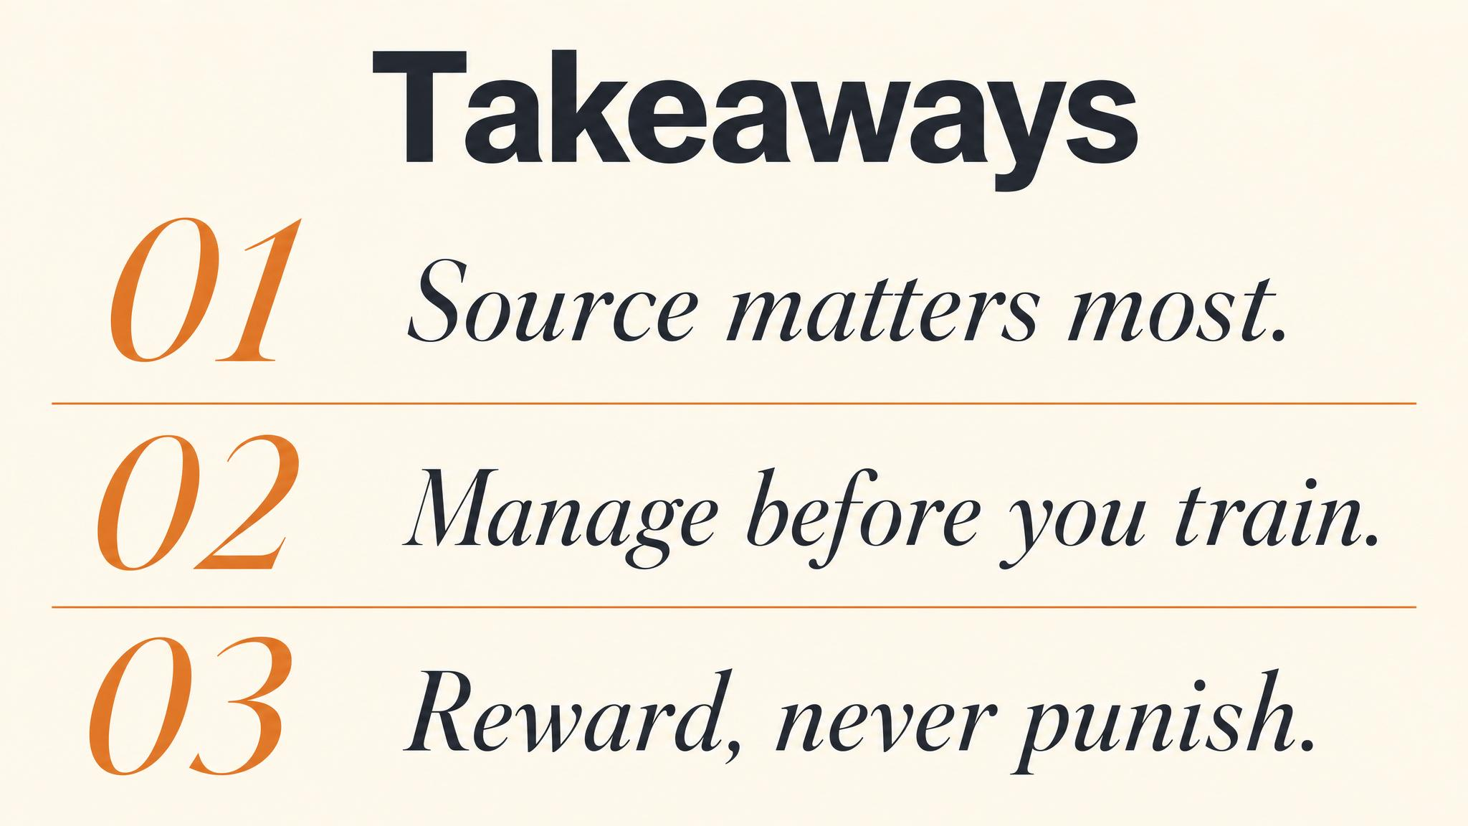
Notes:
Three things to carry forward. One: where you acquire your puppy sets the trajectory — research the source, ask hard questions. Two: management does the heavy lifting in the first weeks; training catches up. Three: positive reinforcement is the science, not the soft option. Pause briefly on each.

Slide 14
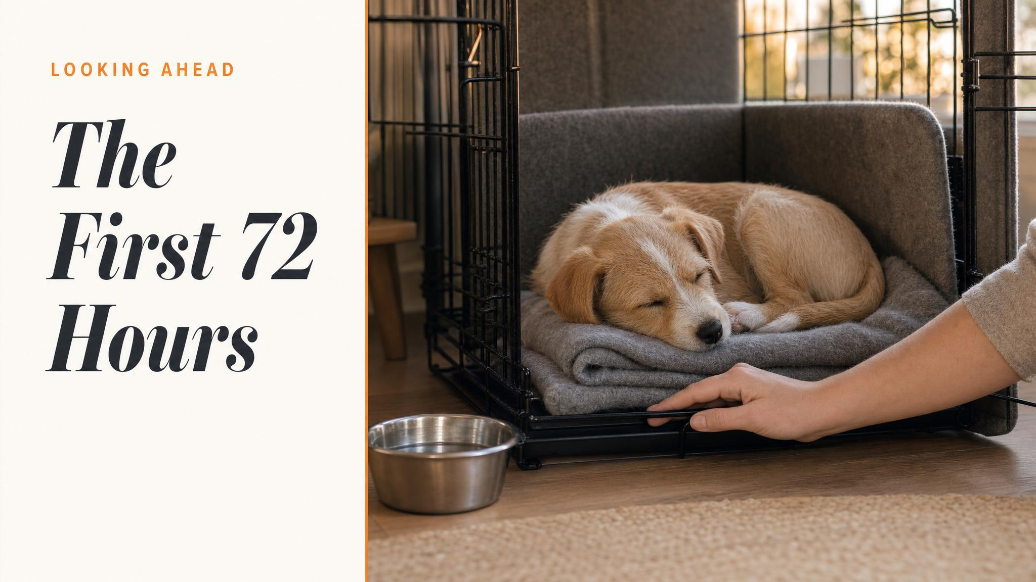
Notes:
Close with the bridge. You've thought about where your puppy is coming from, the legal obligations, how to make the home safe, what equipment actually matters, and how management can carry you through. That's a strong start. Next chapter: the socialisation window — the most important developmental period in your puppy's life, and the one with the tightest deadline.

