Slide 1

Notes:
Open with the 11:47 PM kitchen-floor scene. This chapter sits beside the listener through the first three days. Set the question early: is the 'tough love' advice on forums what the science actually says? Hold the tension before answering.

Slide 2

Notes:
Walk through the ride-home setup: secure carrier in the back seat, scent cloth from the litter, calm passenger hand. Two enormous stressors stack — first car ride, first separation. The job is not to make it fun. The job is to make it survivable.

Slide 3
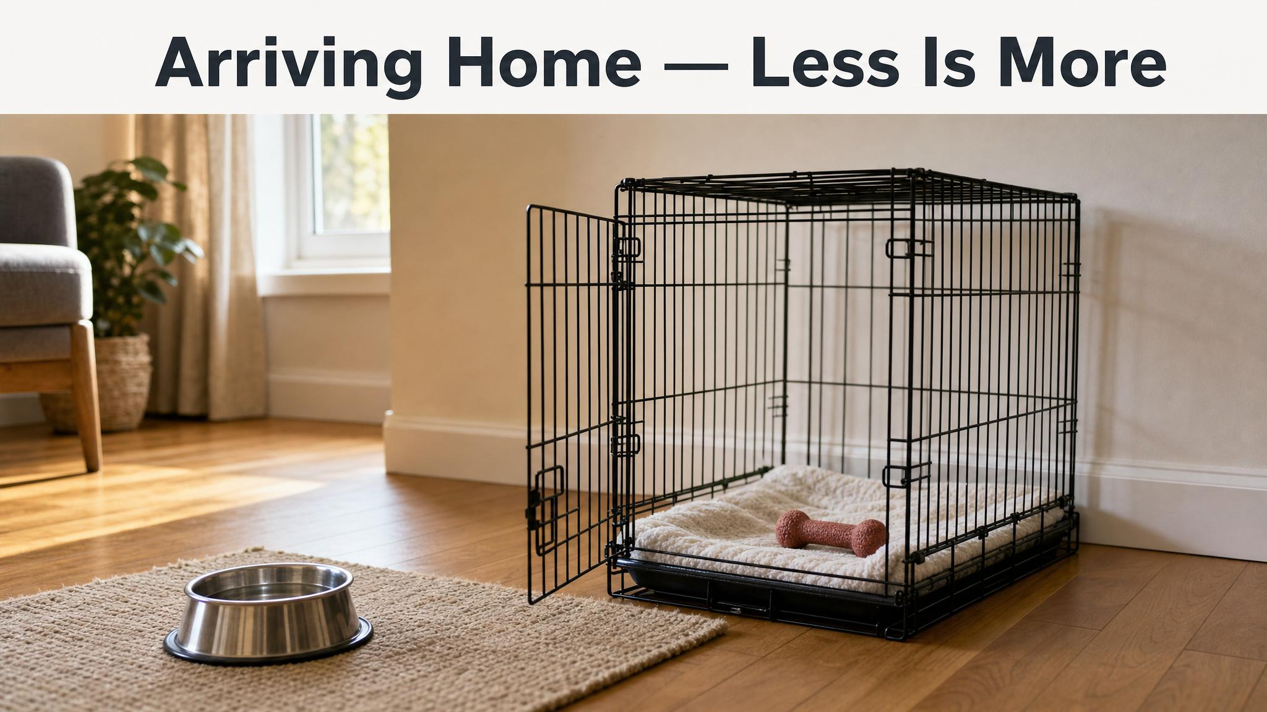
Notes:
Day One is not a tour of the house. One room, household members only, the puppy comes to you rather than the other way round. This is your first act of building secure attachment — being available without being overwhelming, as Topál and colleagues describe.

Slide 4
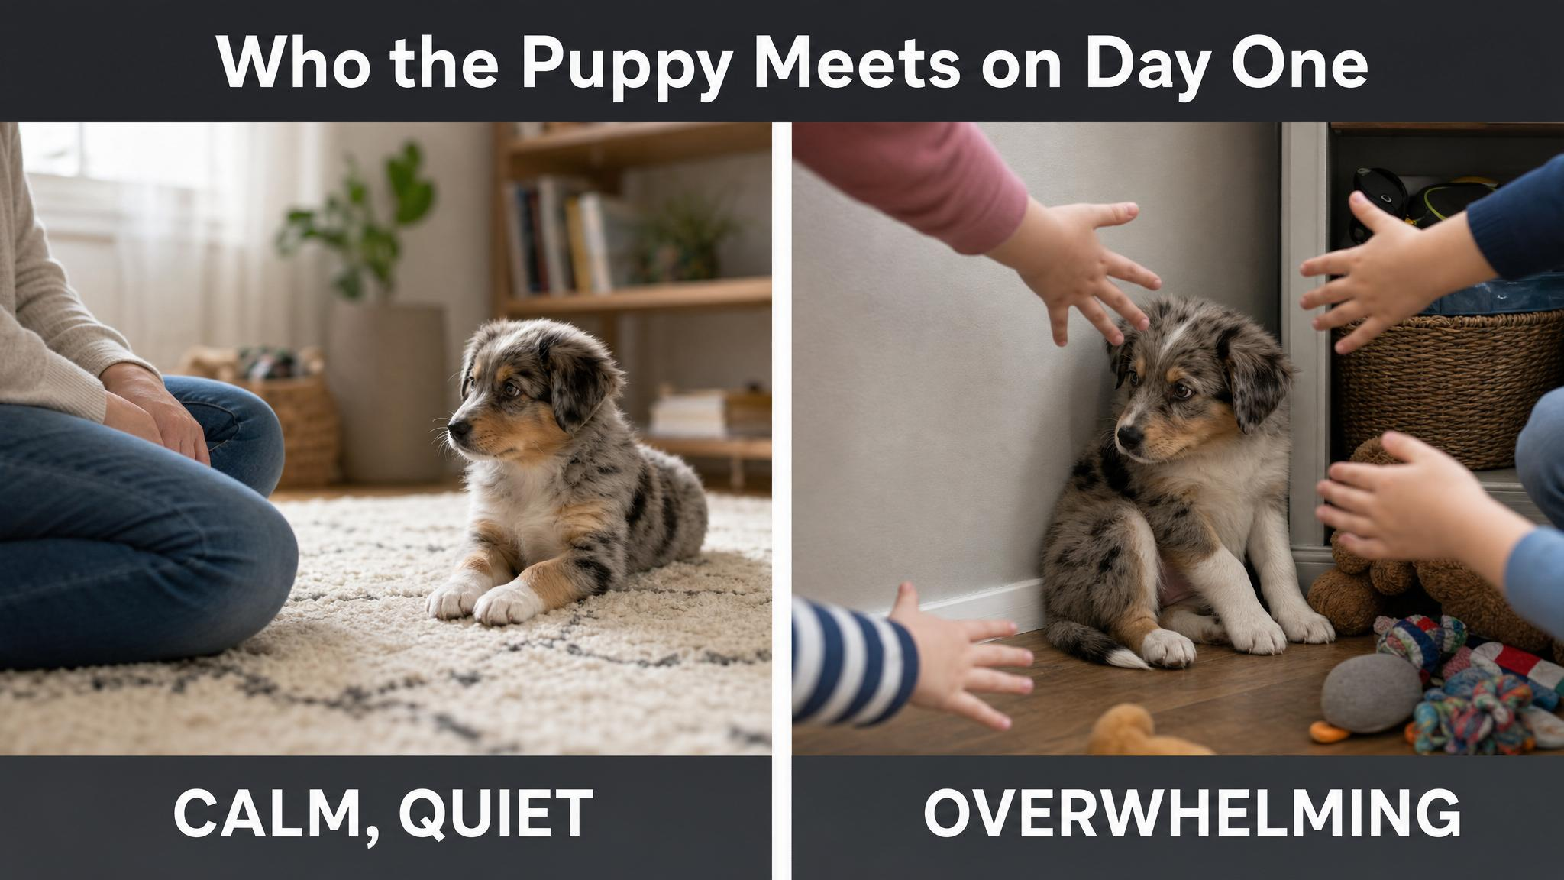
Notes:
Quality of exposure matters more than quantity. Vaterlaws-Whiteside and Hartmann's 2022 work backs this up. Visitors can come on Day Three or Four, one or two at a time. A child's natural enthusiasm is physiologically indistinguishable from a threat to an overwhelmed puppy.

Slide 5
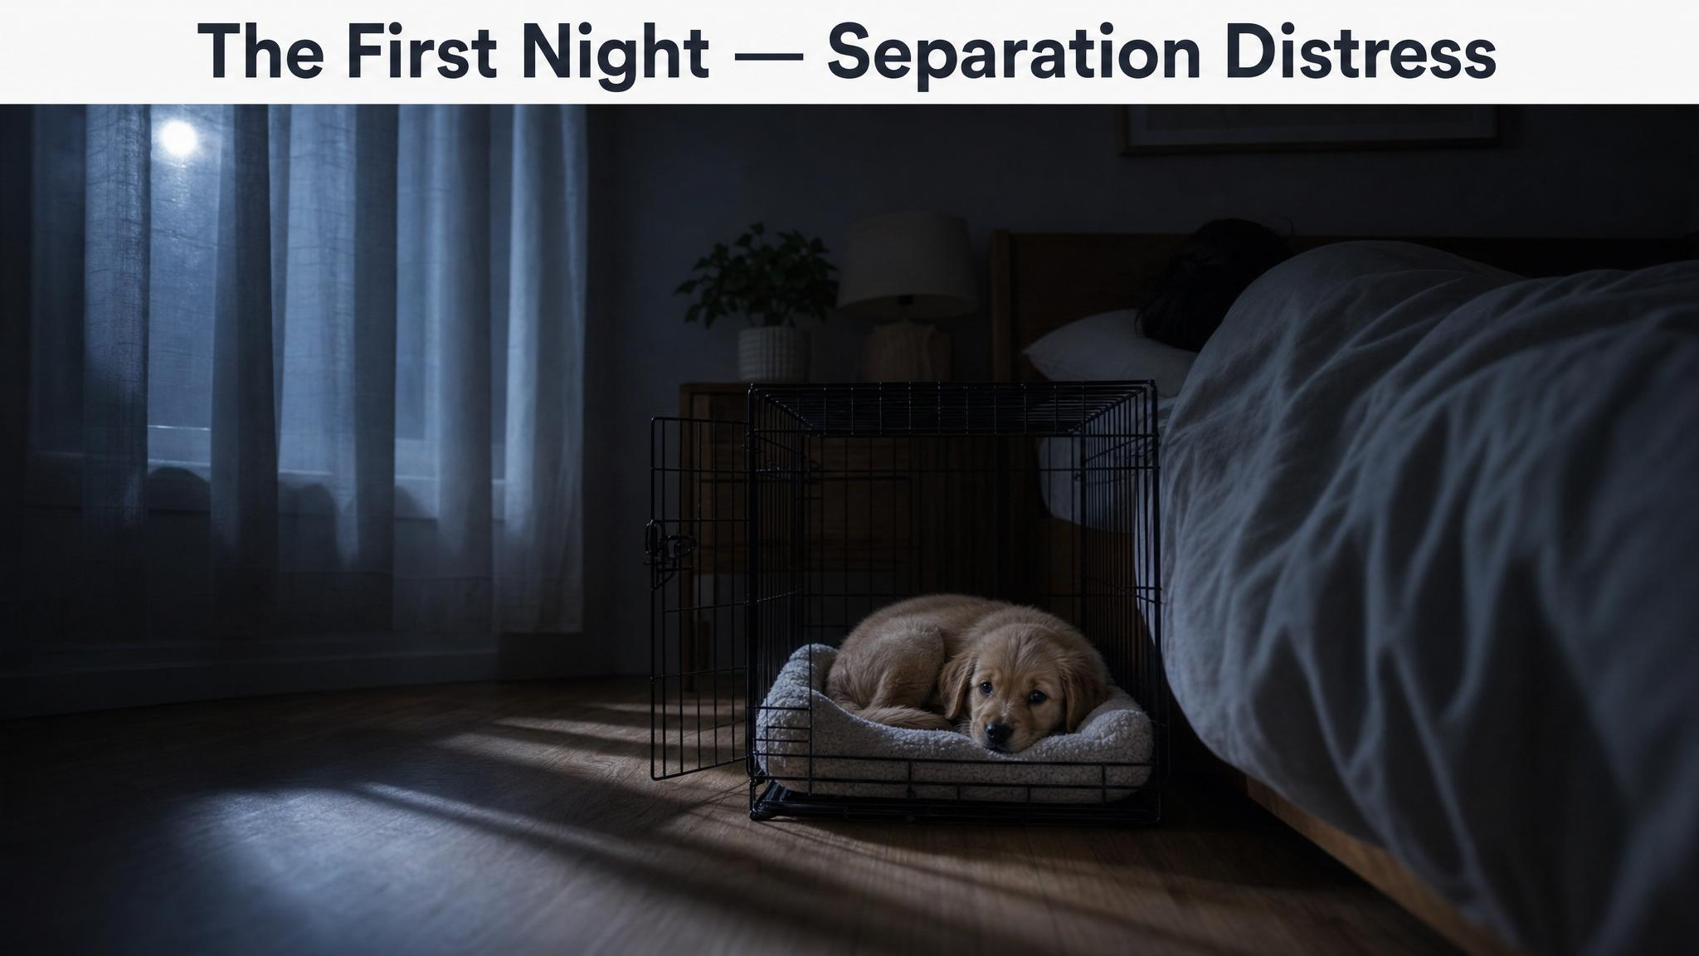
Notes:
Be direct: the first night will probably be hard. The crying is not manipulation — it is separation distress, a hardwired survival response in social mammals, as Sargisson described in 2014. The crate goes next to your bed, not downstairs.

Slide 6
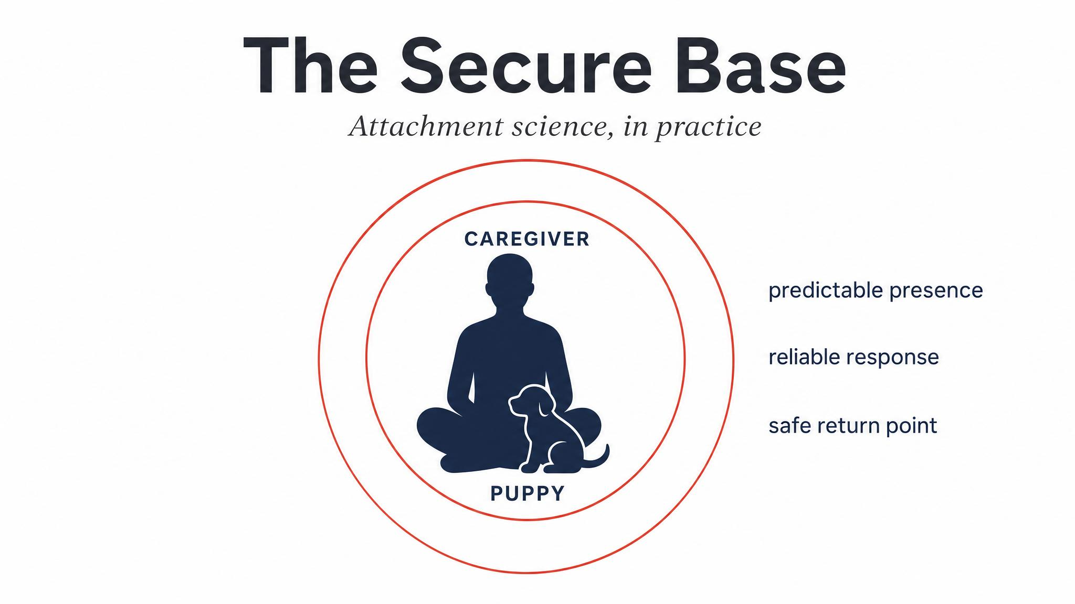
Notes:
Puppies, like human infants, use their caregiver as a secure base — a safe point from which to explore and to which they return when stressed (Topál et al., 2017–2025). On the first night, you are the only familiar social presence in this new world. Your proximity is a genuine physiological regulator.

Slide 7
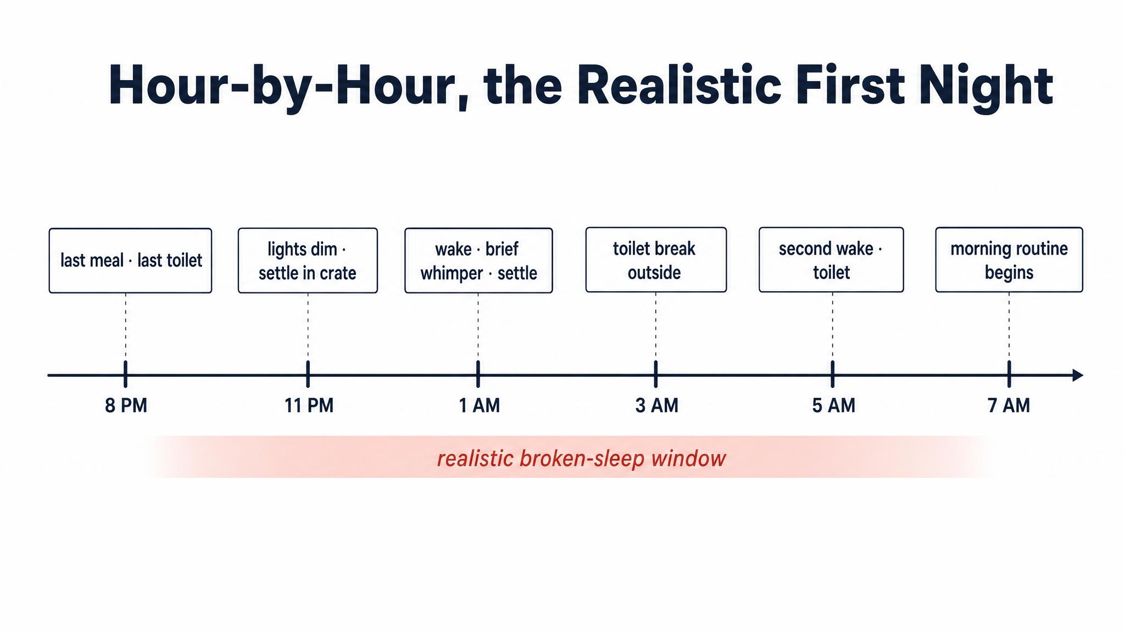
Notes:
Walk through the timetable: last feed by nine, final toilet by nine-thirty, into the crate by ten. Wake-ups around midnight and again around two or three are normal — an eight-week bladder holds two to three hours, longer overnight. Five or six AM, the day begins.

Slide 8
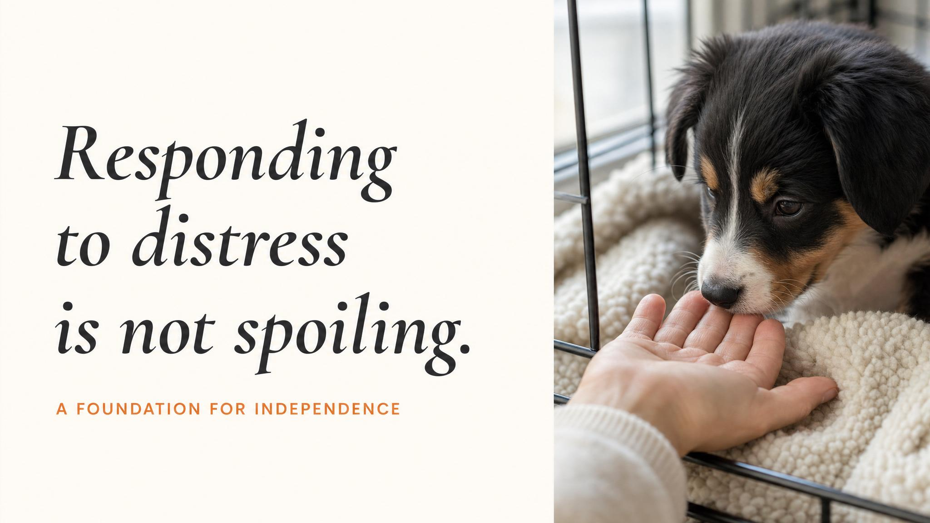
Notes:
Pause and read the quote slowly. The persistent myth is that responding teaches the puppy that crying works. The behavioural science says the opposite: consistent, attuned responsiveness produces secure attachment, more independence, better coping with being alone. Avoidant caregiving correlates with more separation-related disorders.

Slide 9
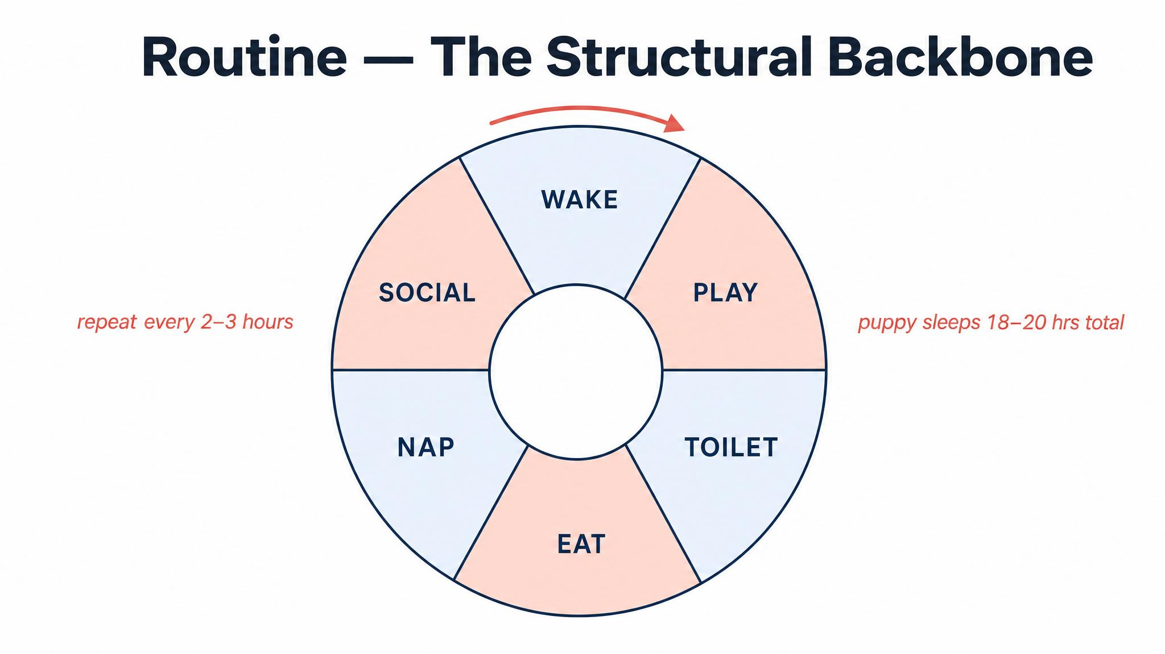
Notes:
Cornell veterinary and behavioural research between 2014 and 2025 consistently shows predictability reduces anxiety. One body of research suggests dogs raised with predictable routines show up to seventy percent more reliable behaviour. The cycle is simple — wake, toilet, breakfast, play, nap, repeat.

Slide 10

Notes:
An eight-to-ten-week-old puppy needs eighteen to twenty hours of sleep per day. That is not a typo. Most 'problem behaviours' in the first week — biting, hyperactivity, ankle-zooming — are an overtired puppy, not a bad one. Enforced naps are an act of care, not confinement.

Slide 11
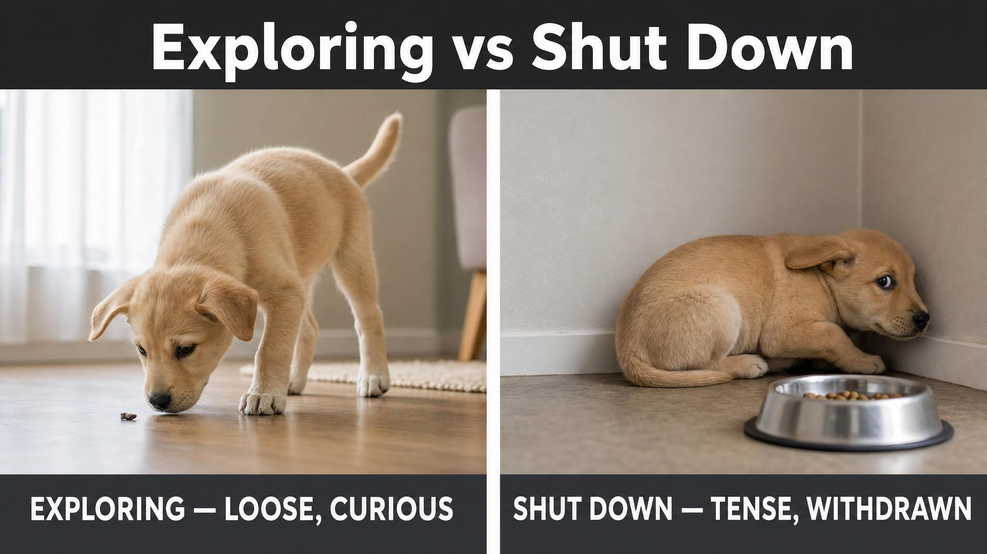
Notes:
Both puppies can look 'quiet.' Exploring shows loose body, curiosity, recovery from startles. Shut-down shows tense body, tucked tail, refused food, cut-off head turn. The answer to shut-down is less stimulation, not more — recovery comes from feeling safe (Vieira de Castro et al., 2020).

Slide 12
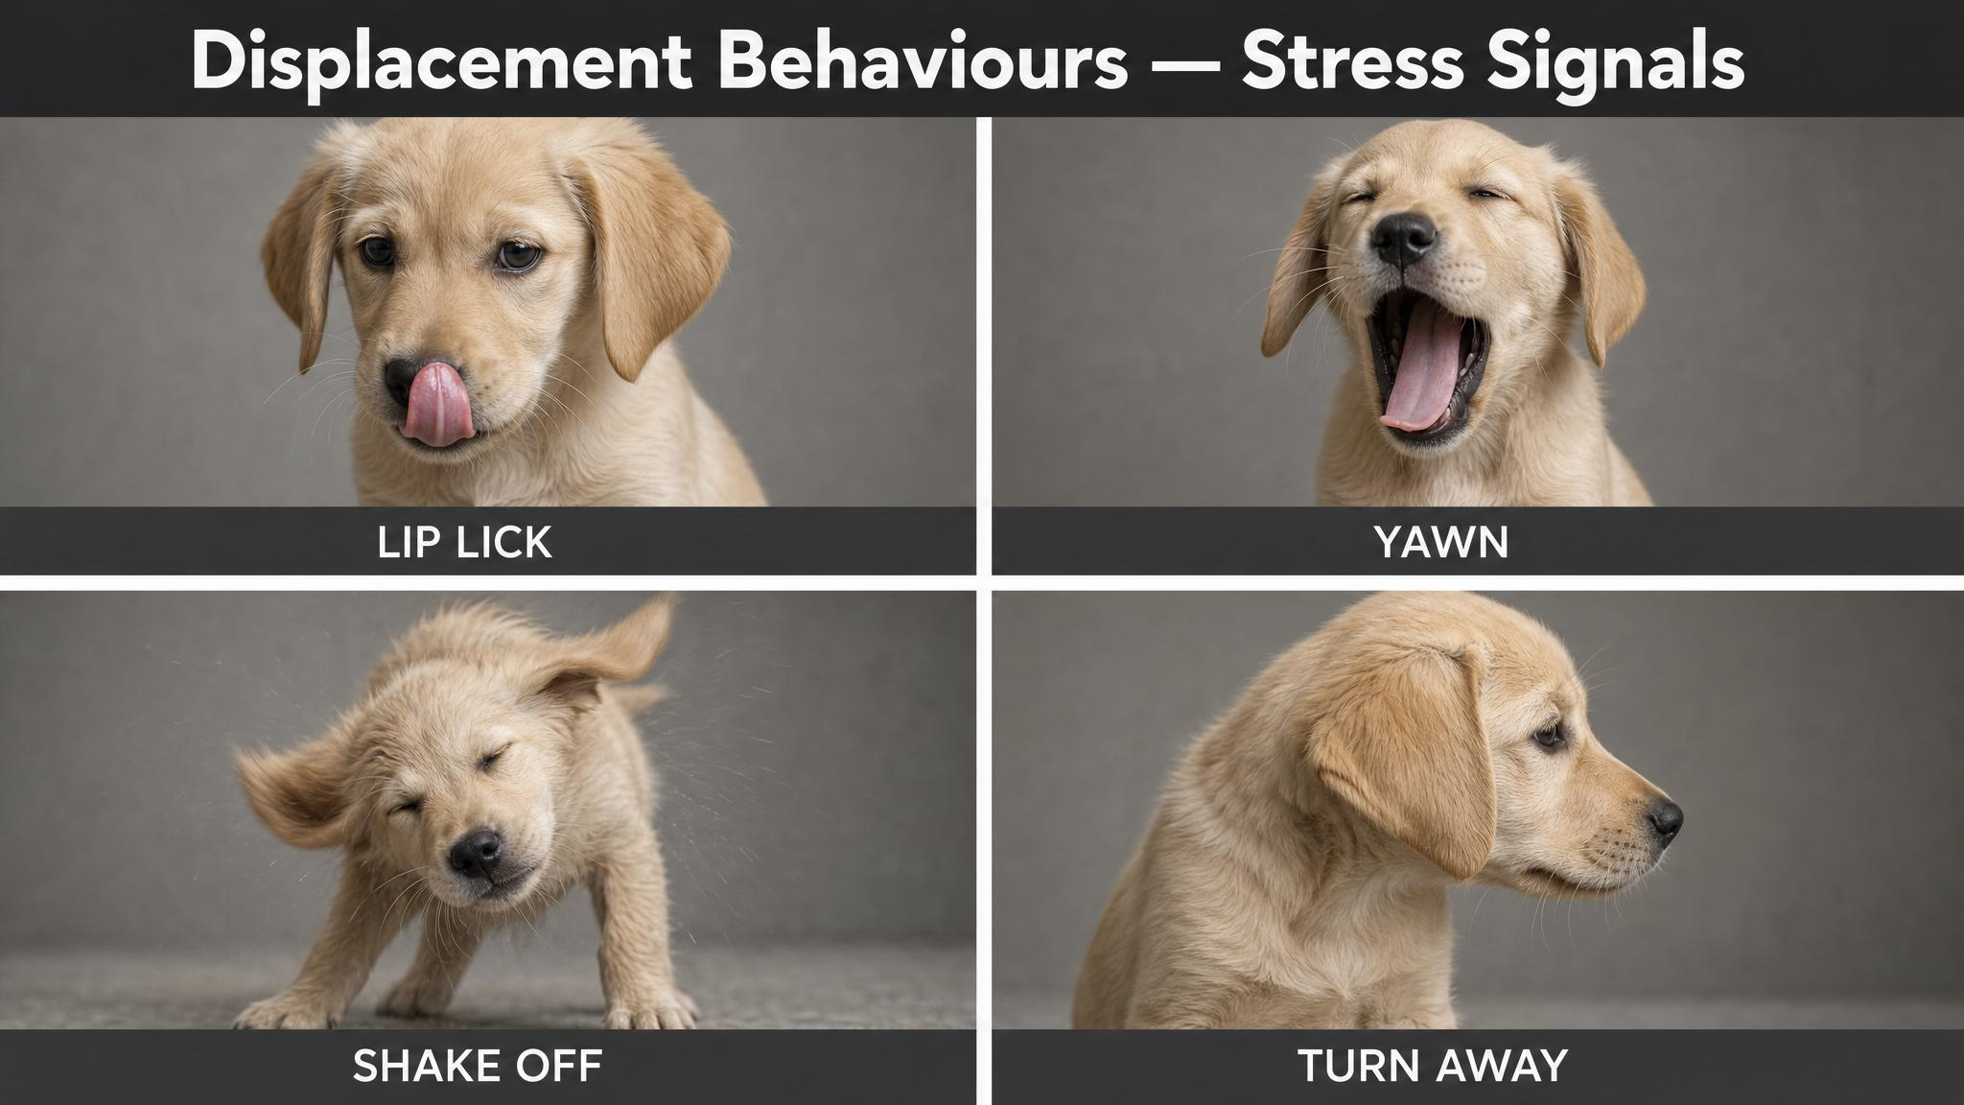
Notes:
These actions occur out of context and signal internal conflict — they are documented by VCA Animal Hospitals and Best Friends between 2019 and 2025. A puppy sniffing the floor intensely in a new room may not be tracking a scent. It may be self-soothing. Learn to read these in real time.

Slide 13
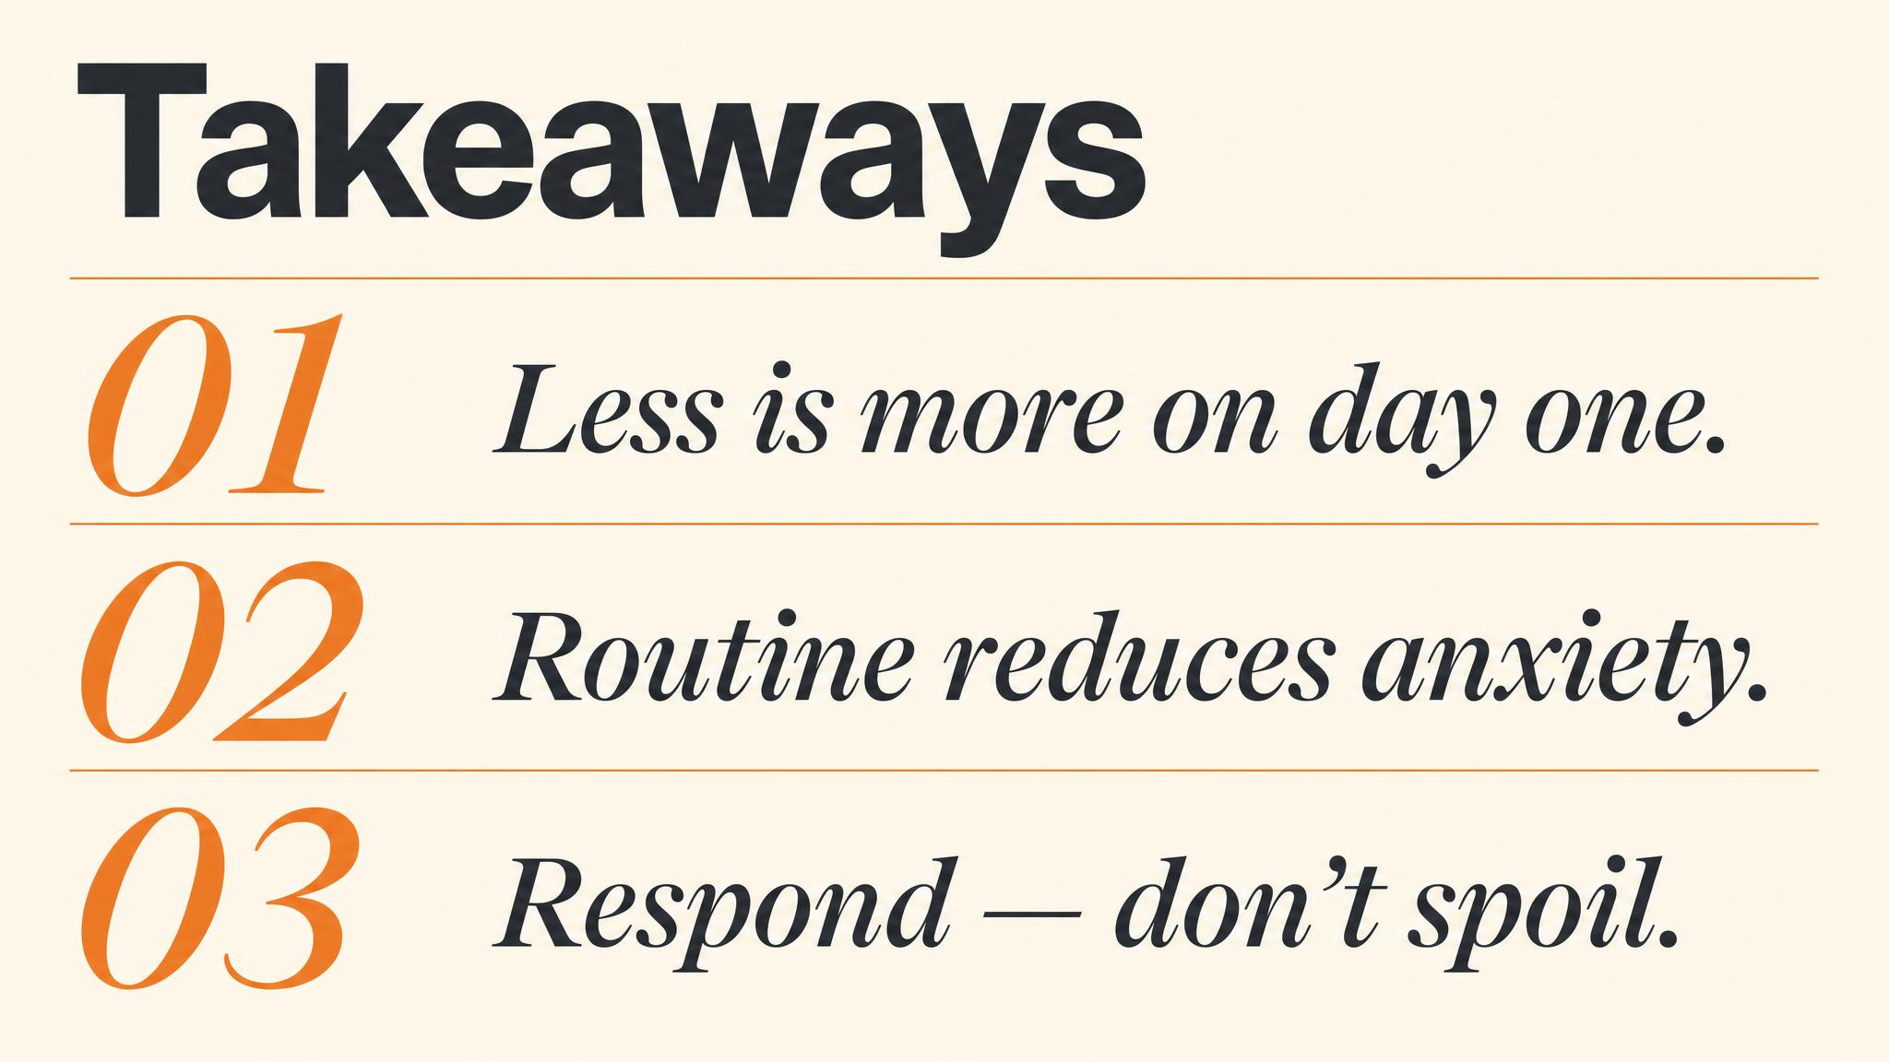
Notes:
Three things to carry forward. One: proximity on the first night is a physiological stress-regulator and builds secure attachment. Two: routine and predictability are the most powerful tools — pattern, not rigidity. Three: eighteen to twenty hours of sleep per day, and most 'problem behaviours' are overtiredness.

Slide 14

Notes:
Close with the bridge. Chapter Three explores socialisation in depth — what it really means, the critical windows, how to build a structured plan that grows confidence without overwhelming. We'll cover the difference between exposure and flooding.

