Slide 1
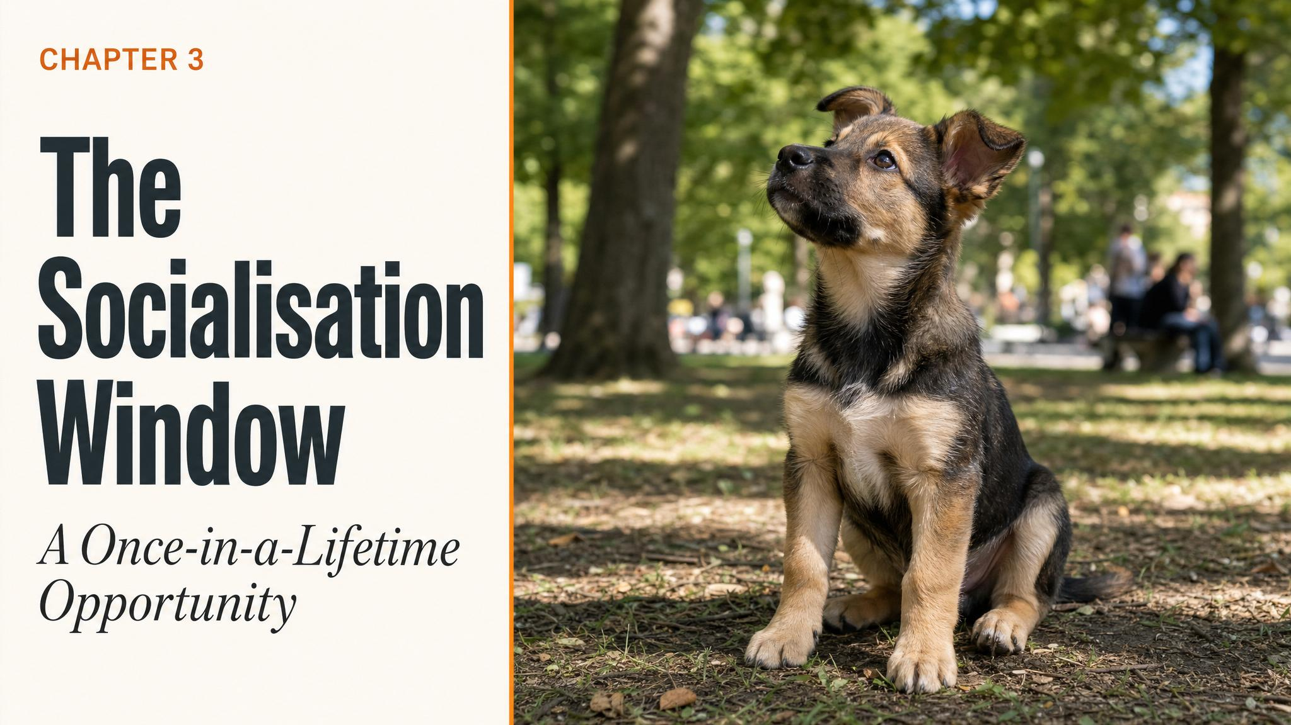
Notes:
Open with the title and the stakes. This is the most consequential developmental period your puppy will ever experience — roughly three to sixteen weeks. Tell the class the chapter has one job: convince them that what happens in this window matters more than anything they'll do later.

Slide 2
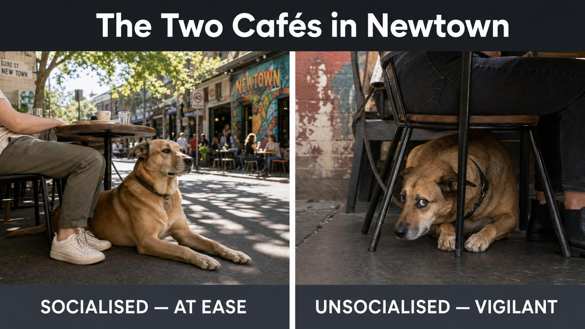
Notes:
Tell the Newtown café story. Two twelve-week-old Golden Retrievers, same litter genetics, three suburbs apart. One lies calmly under a chair as a toddler walks past; the other panics behind a couch when someone knocks on the door. Pause. Ask: what's the difference? Then answer — it's what happened between three and sixteen weeks.

Slide 3
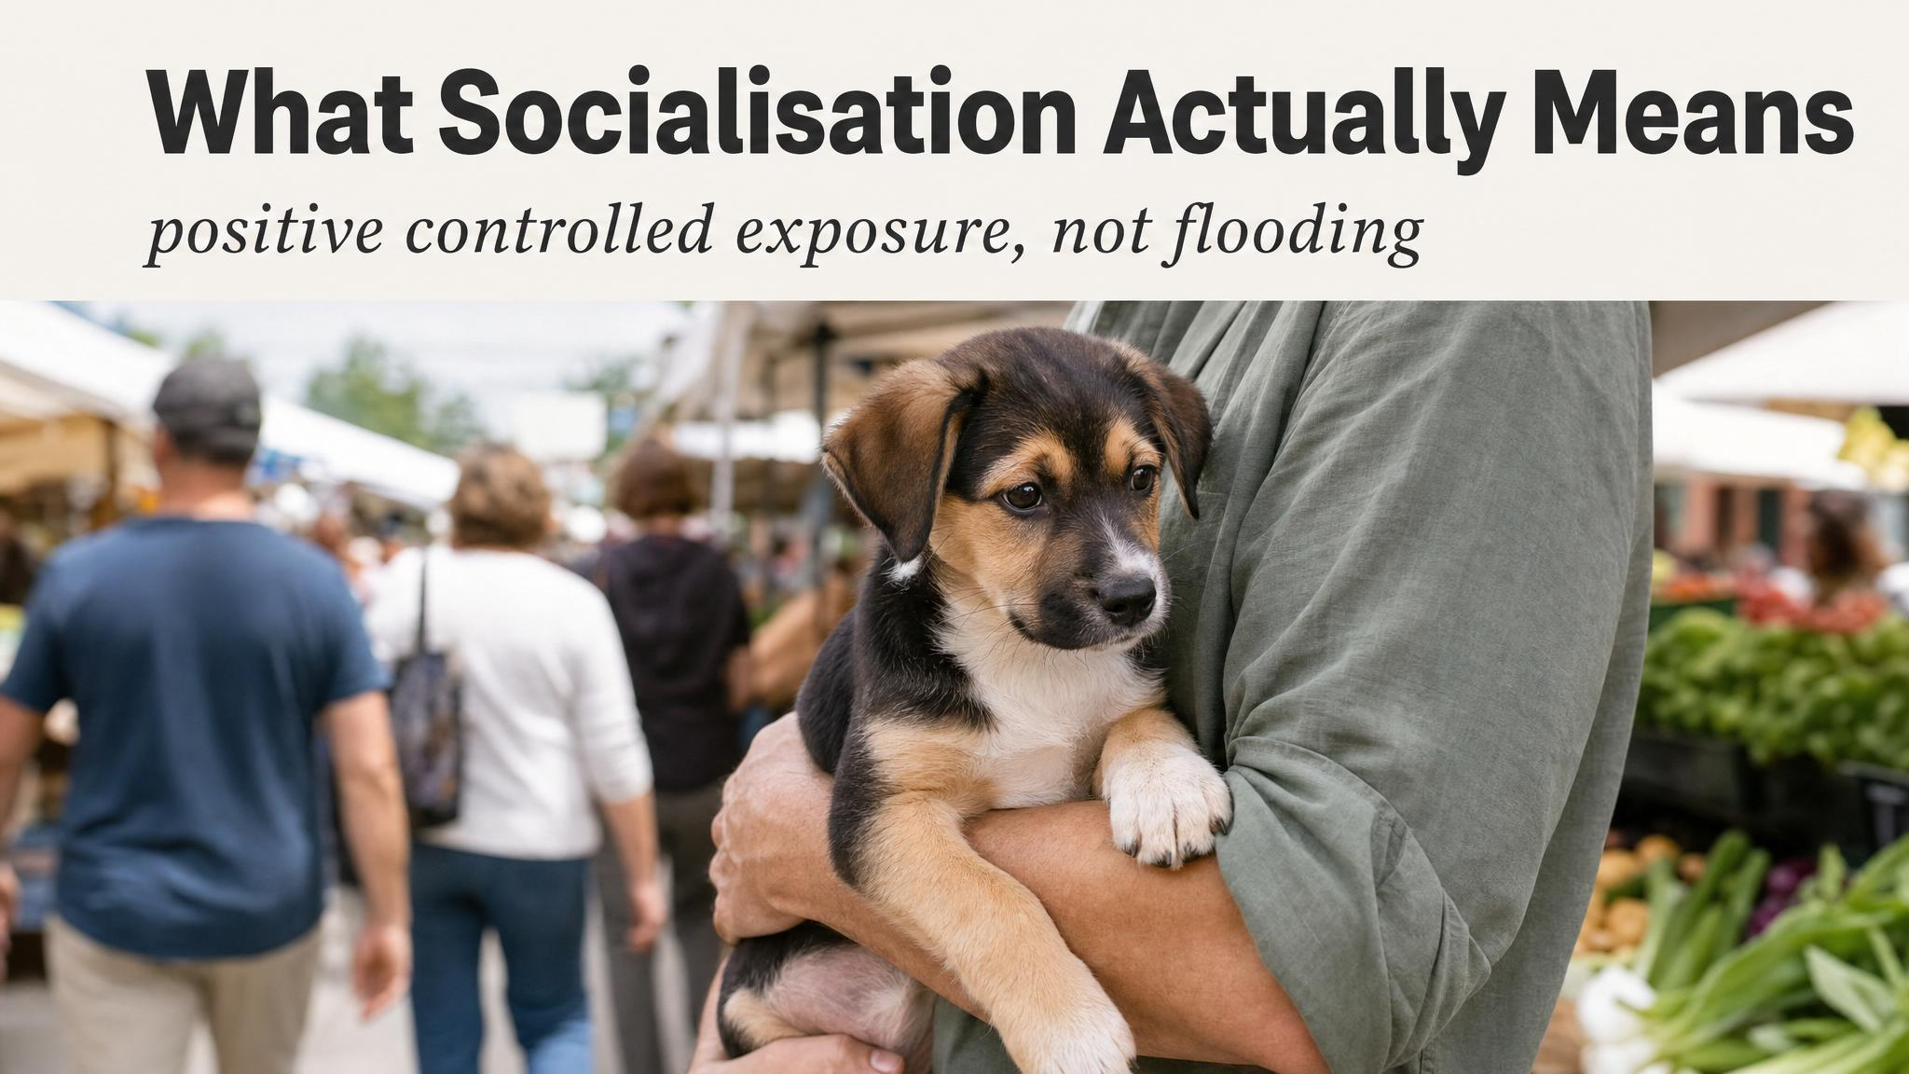
Notes:
Reset the definition. Most people picture puppies playing with puppies — that's about five percent of the territory. Socialisation is the systematic, positive introduction of a young animal to the full range of stimuli it will encounter throughout its life. Quality matters infinitely more than quantity.

Slide 4
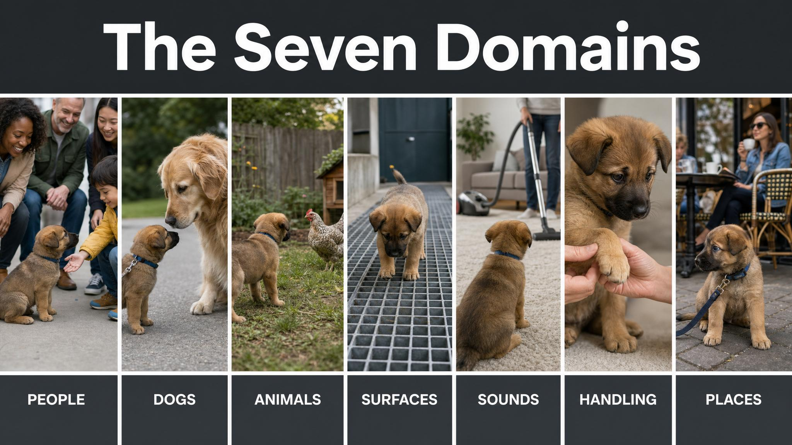
Notes:
Walk the seven domains: people, animals, surfaces, sounds, environments, handling, transport. Then say the line out loud — if your socialisation plan consists only of puppy play dates, you're covering roughly five percent of the territory. Pause on that.

Slide 5
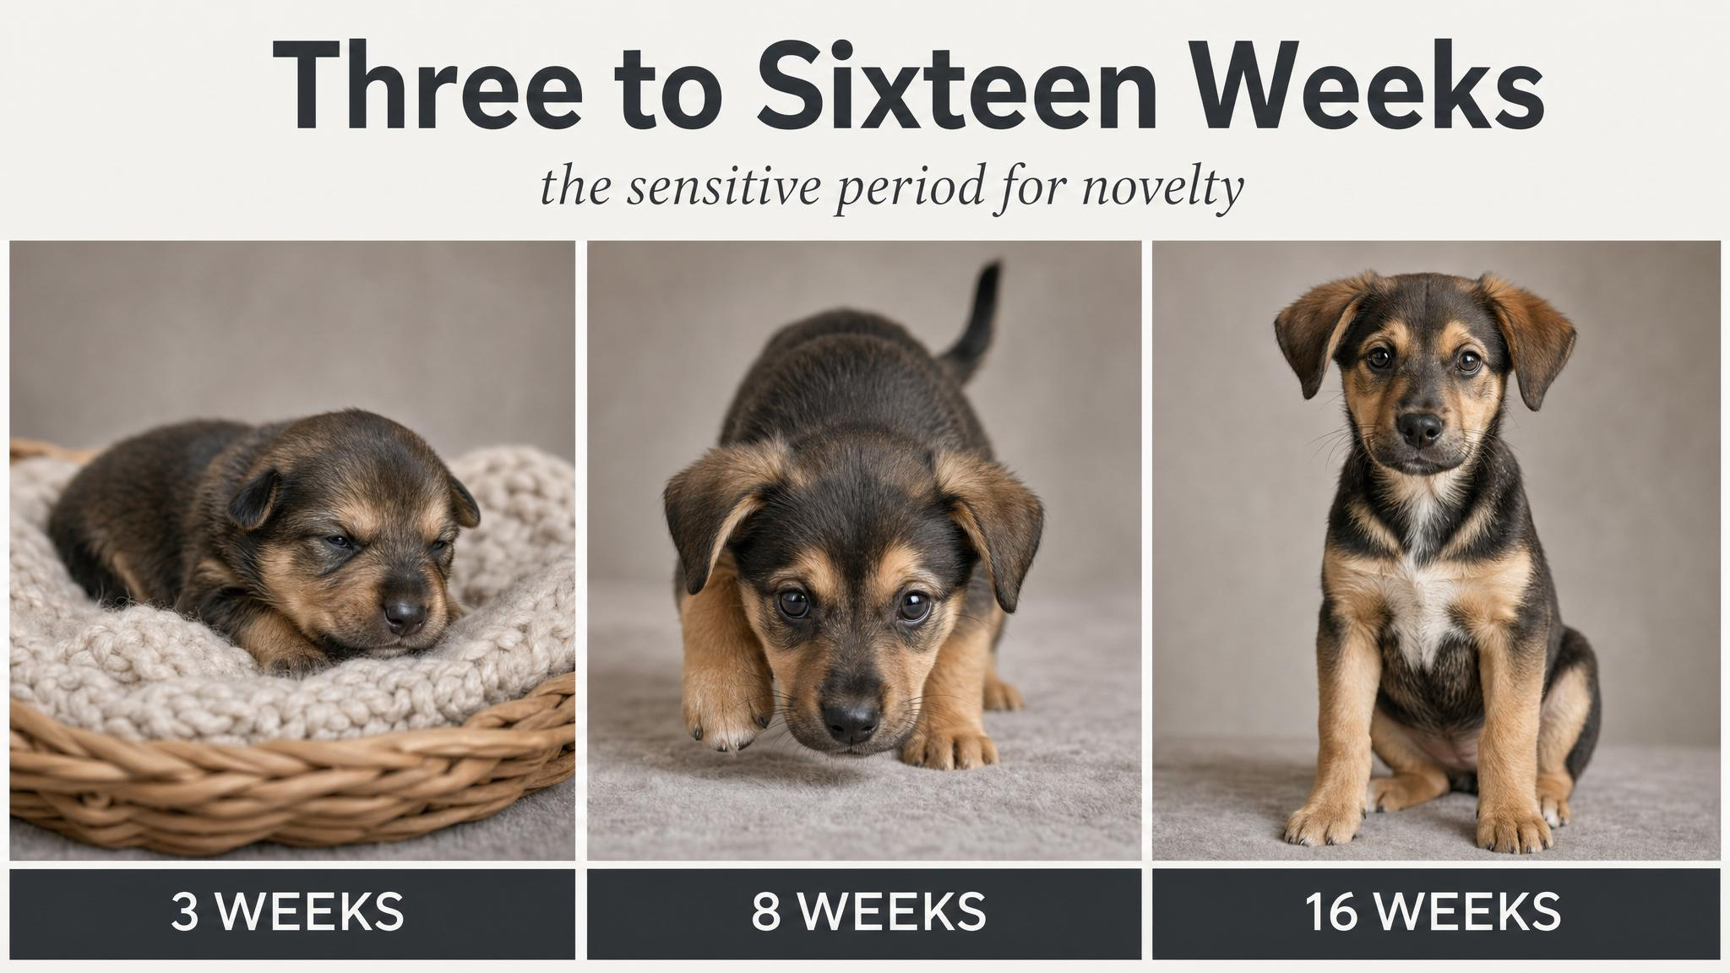
Notes:
This is the heart of the chapter. The sensitive period runs roughly three to sixteen weeks. Receptiveness to novelty starts high and gradually fades. The default caution response climbs in the opposite direction. By sixteen weeks the cement is largely set. Anchor this curve in their minds.

Slide 6
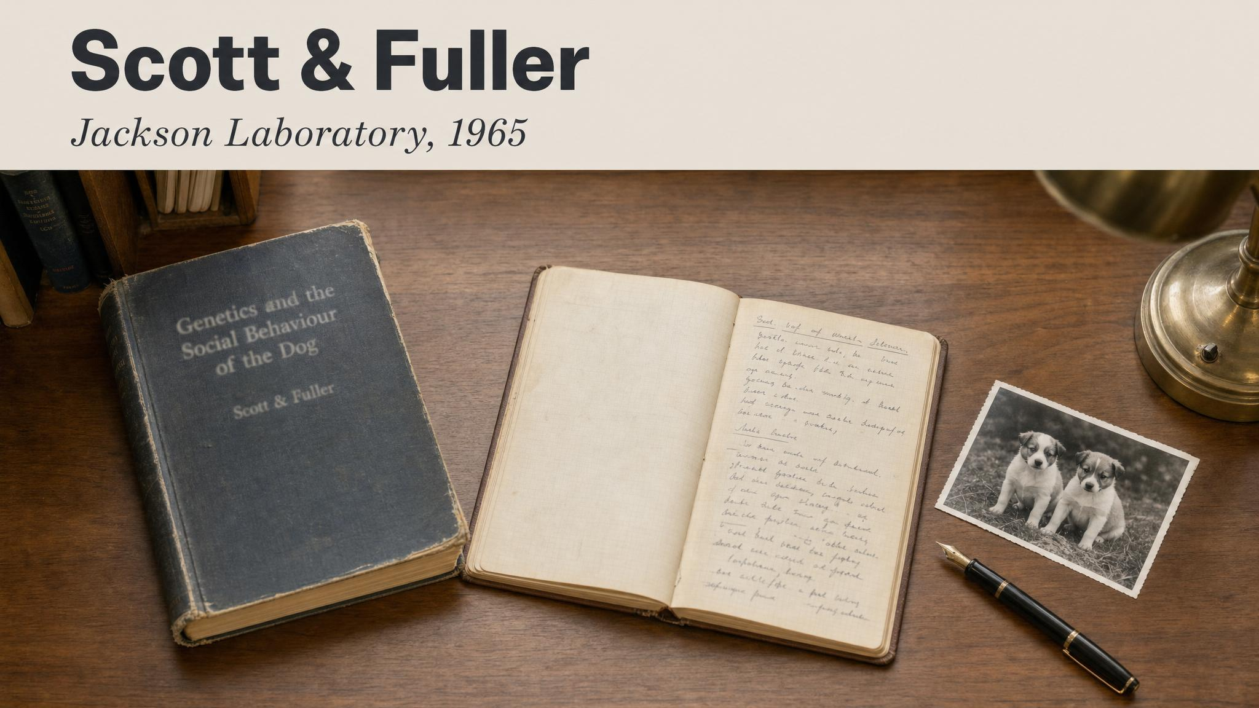
Notes:
Anchor the science. The concept of the critical period in canine development comes from Scott and Fuller's landmark twenty-year study at the Jackson Laboratory, published in 1965. Their work showed puppies between roughly three and twelve weeks were uniquely receptive to forming social bonds and accepting novel stimuli.

Slide 7
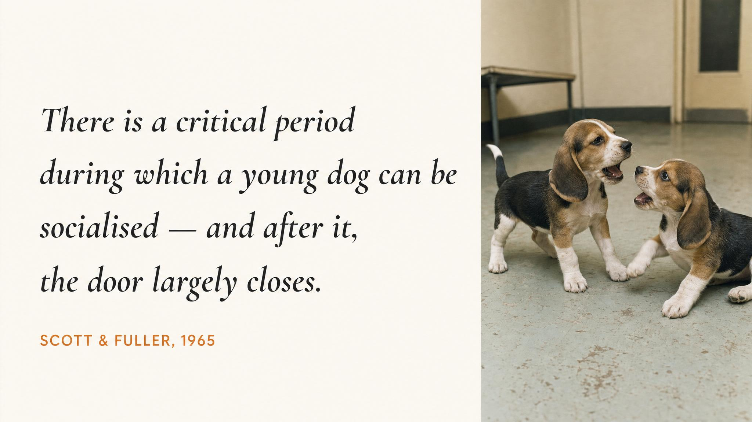
Notes:
Read the line slowly: a small amount of experience during a critical period will produce a great effect on later behaviour. Five minutes of calm, treat-paired exposure to a person in a wheelchair at eight weeks does more than five hours of remedial counter-conditioning at eight months. You're literally shaping neural architecture.

Slide 8
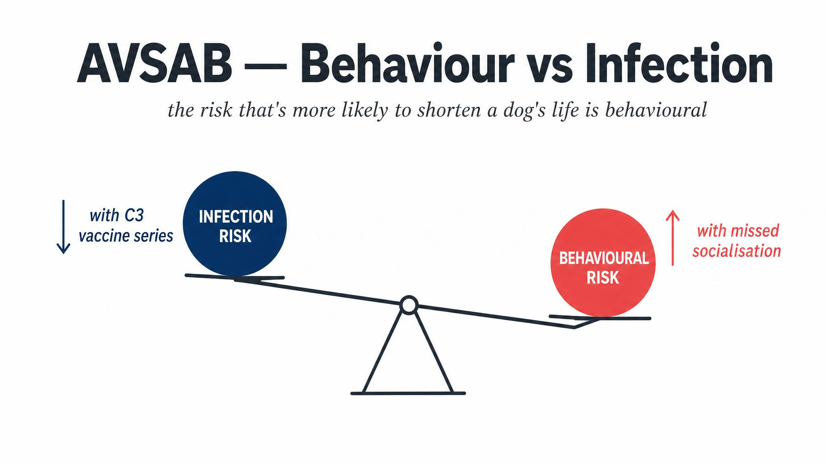
Notes:
Name the conflict and resolve it. Some vets, from an infectious-disease lens, advise isolating puppies until two weeks after the final vaccination — around sixteen weeks. That effectively locks the door on socialisation. The AVSAB position is the opposite: behavioural problems are the number one cause of death for dogs under three years of age, far exceeding infectious disease.

Slide 9
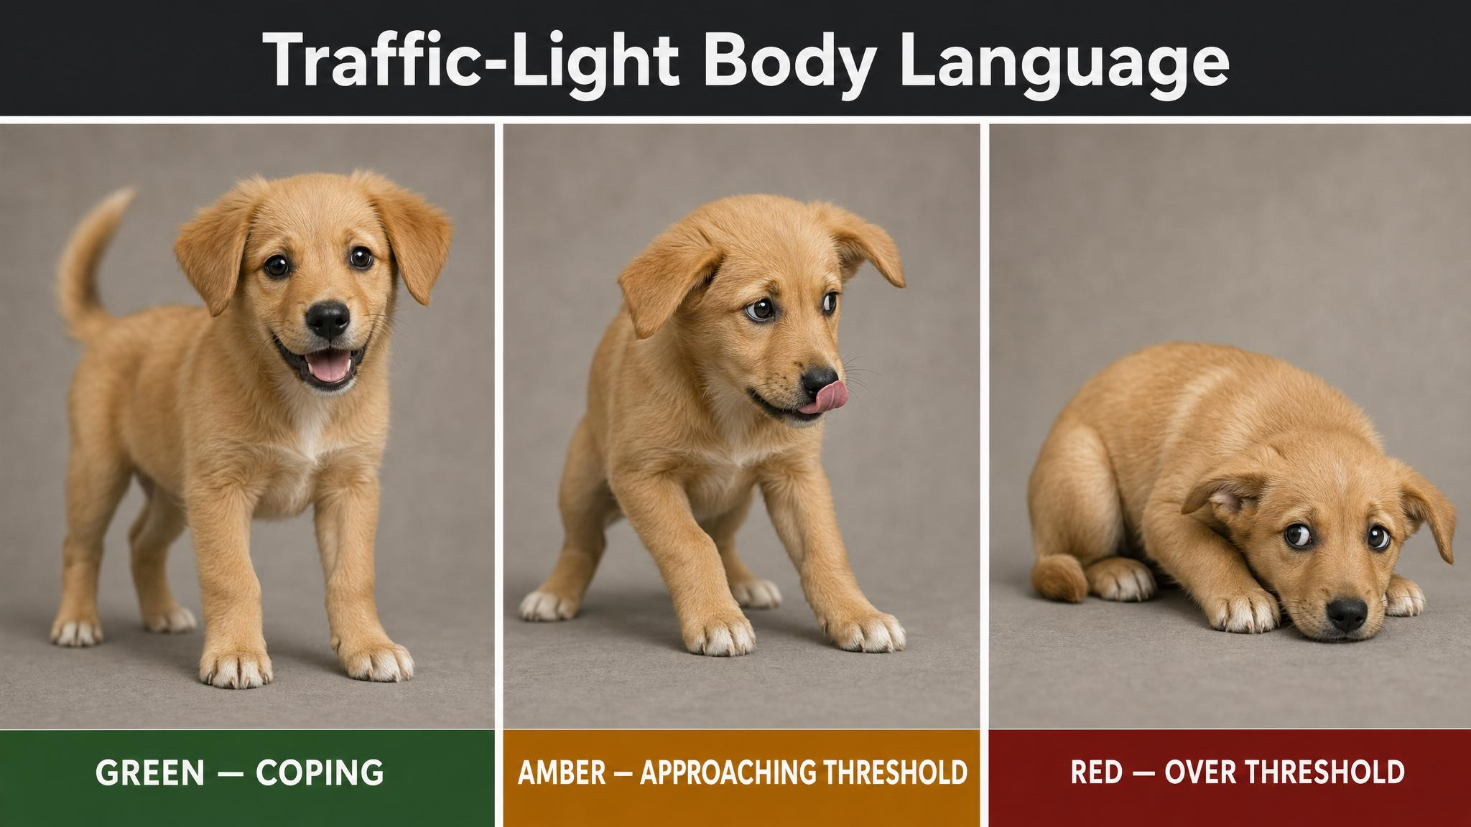
Notes:
Teach the traffic-light system. Green is loose, wiggly, taking treats easily — continue. Amber is lip-licking, yawning, head turning away, refusing treats — pause and assess. Red is whale eye, tucked tail, trembling, trying to flee — remove immediately. Most learning happens in amber. Most mistakes too.

Slide 10
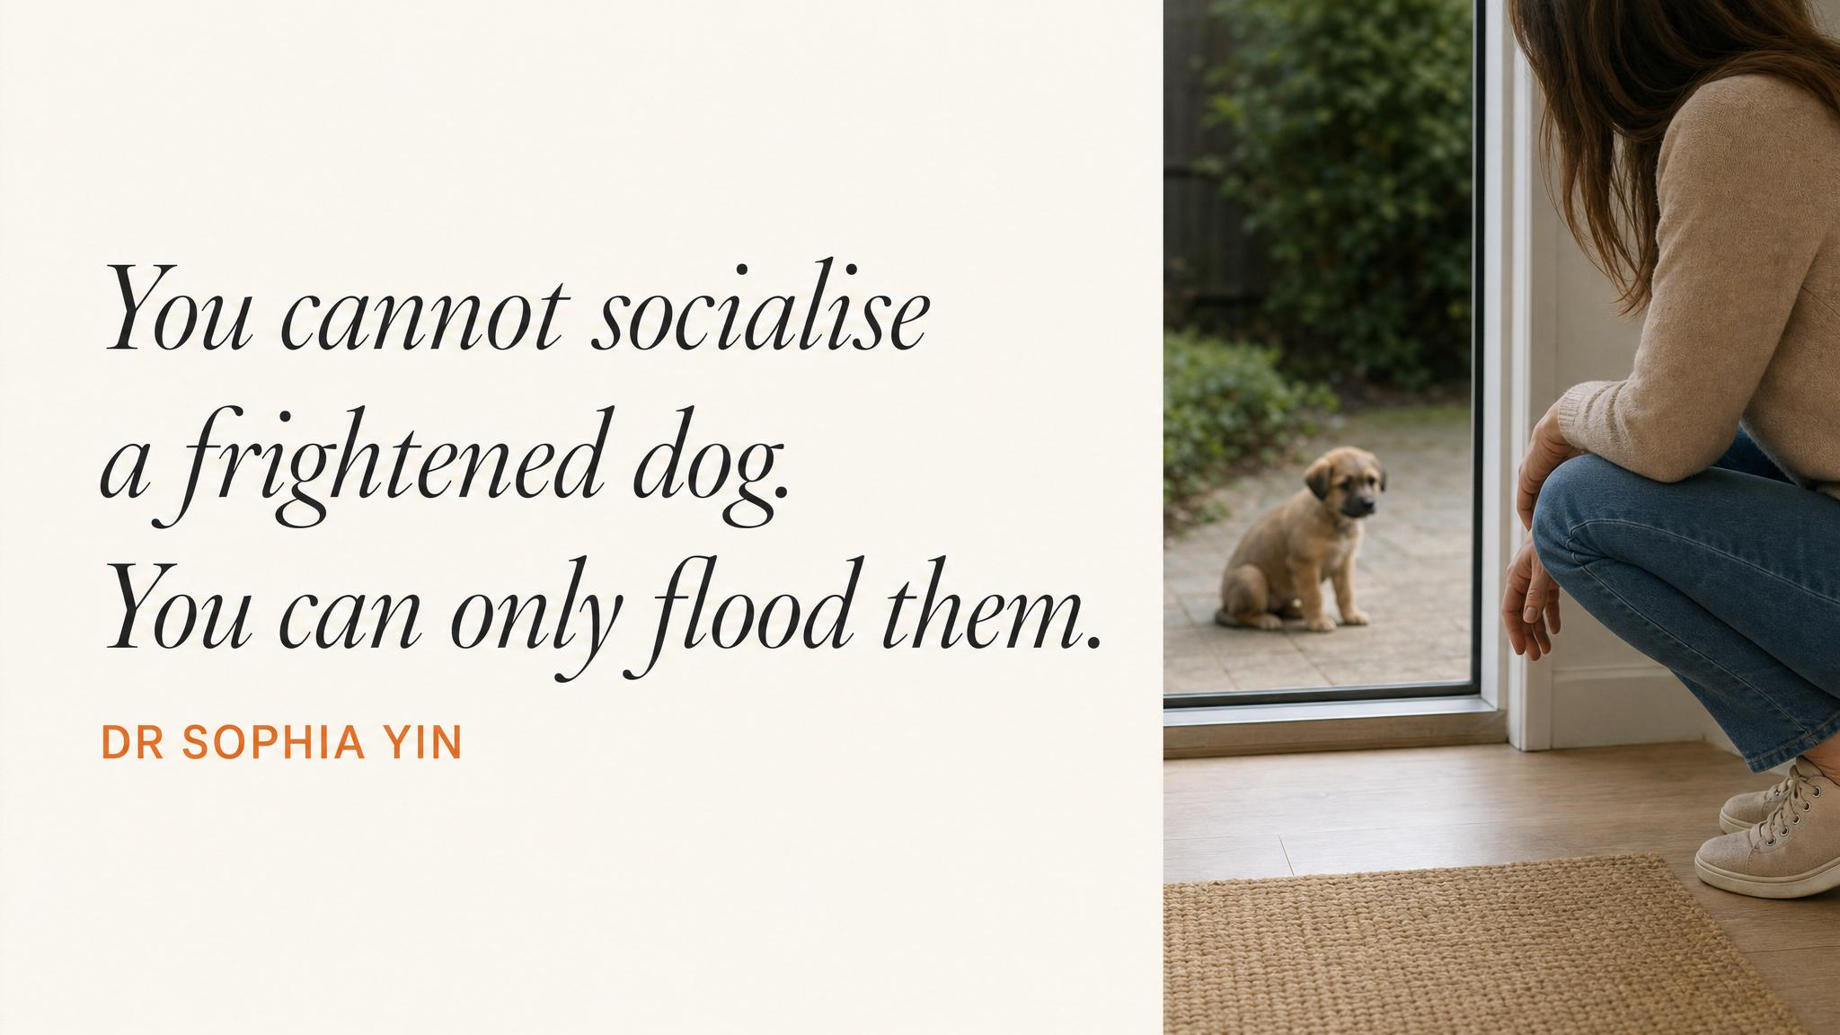
Notes:
Read Yin's line aloud. The goal is not exposure but positive exposure. A puppy who meets thirty people but is frightened by twenty-five of them has not been socialised — they've been traumatised. This is the single most common mistake new puppy owners make.

Slide 11
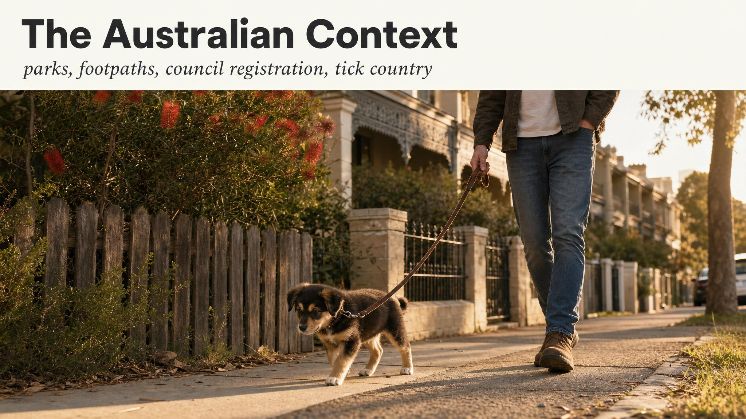
Notes:
Make it Australian. Bin night — wheel your own bin first, then the truck from a distance. Magpie season between August and November is real. Bunnings is socialisation gold for fifteen minutes, no longer. The beach after first vaccination — but never start with Bondi on a summer Saturday.

Slide 12
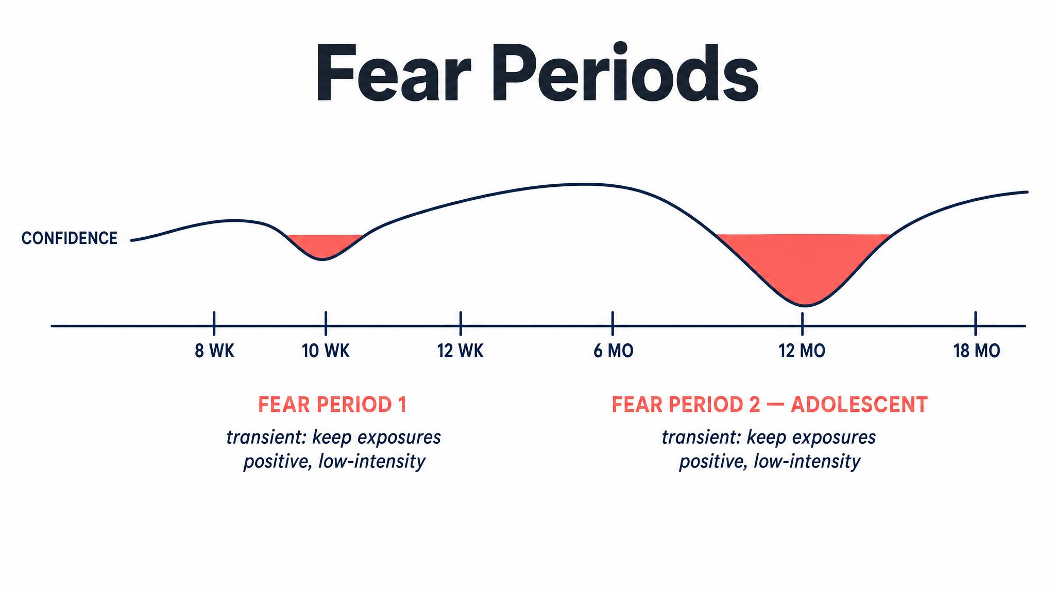
Notes:
Inside the sensitive period, two fear periods spike — the first around eight to ten weeks, the second around six to fourteen months, as Battaglia noted in 2009 and Seksel and colleagues confirmed in 2018. Reduce intensity, increase distance, raise treat value, watch body language with extra vigilance. Don't stop socialising — adjust.

Slide 13
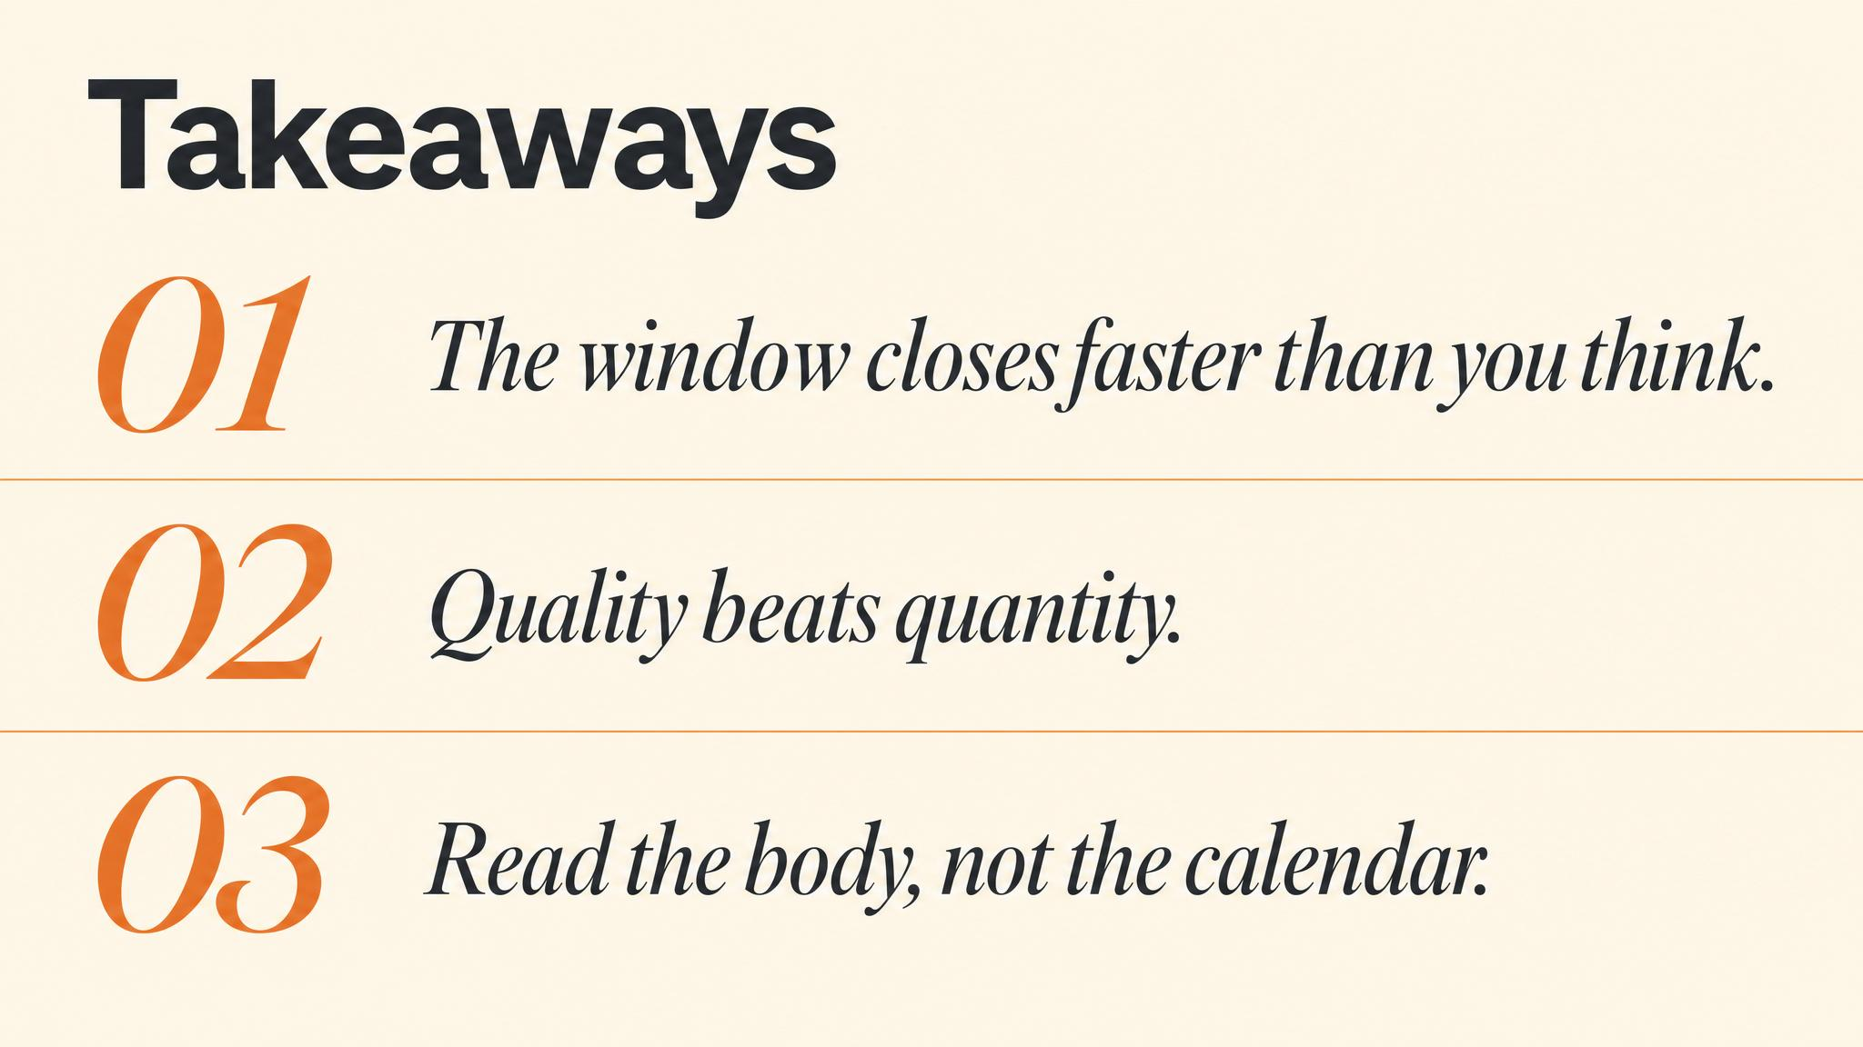
Notes:
Three things to carry forward. One: the sensitive period runs roughly three to sixteen weeks, and it gradually closes. Two: quality always trumps quantity — one positive experience is worth more than ten neutral or negative ones. Three: read the traffic light in real time — green continue, amber pause, red remove.

Slide 14
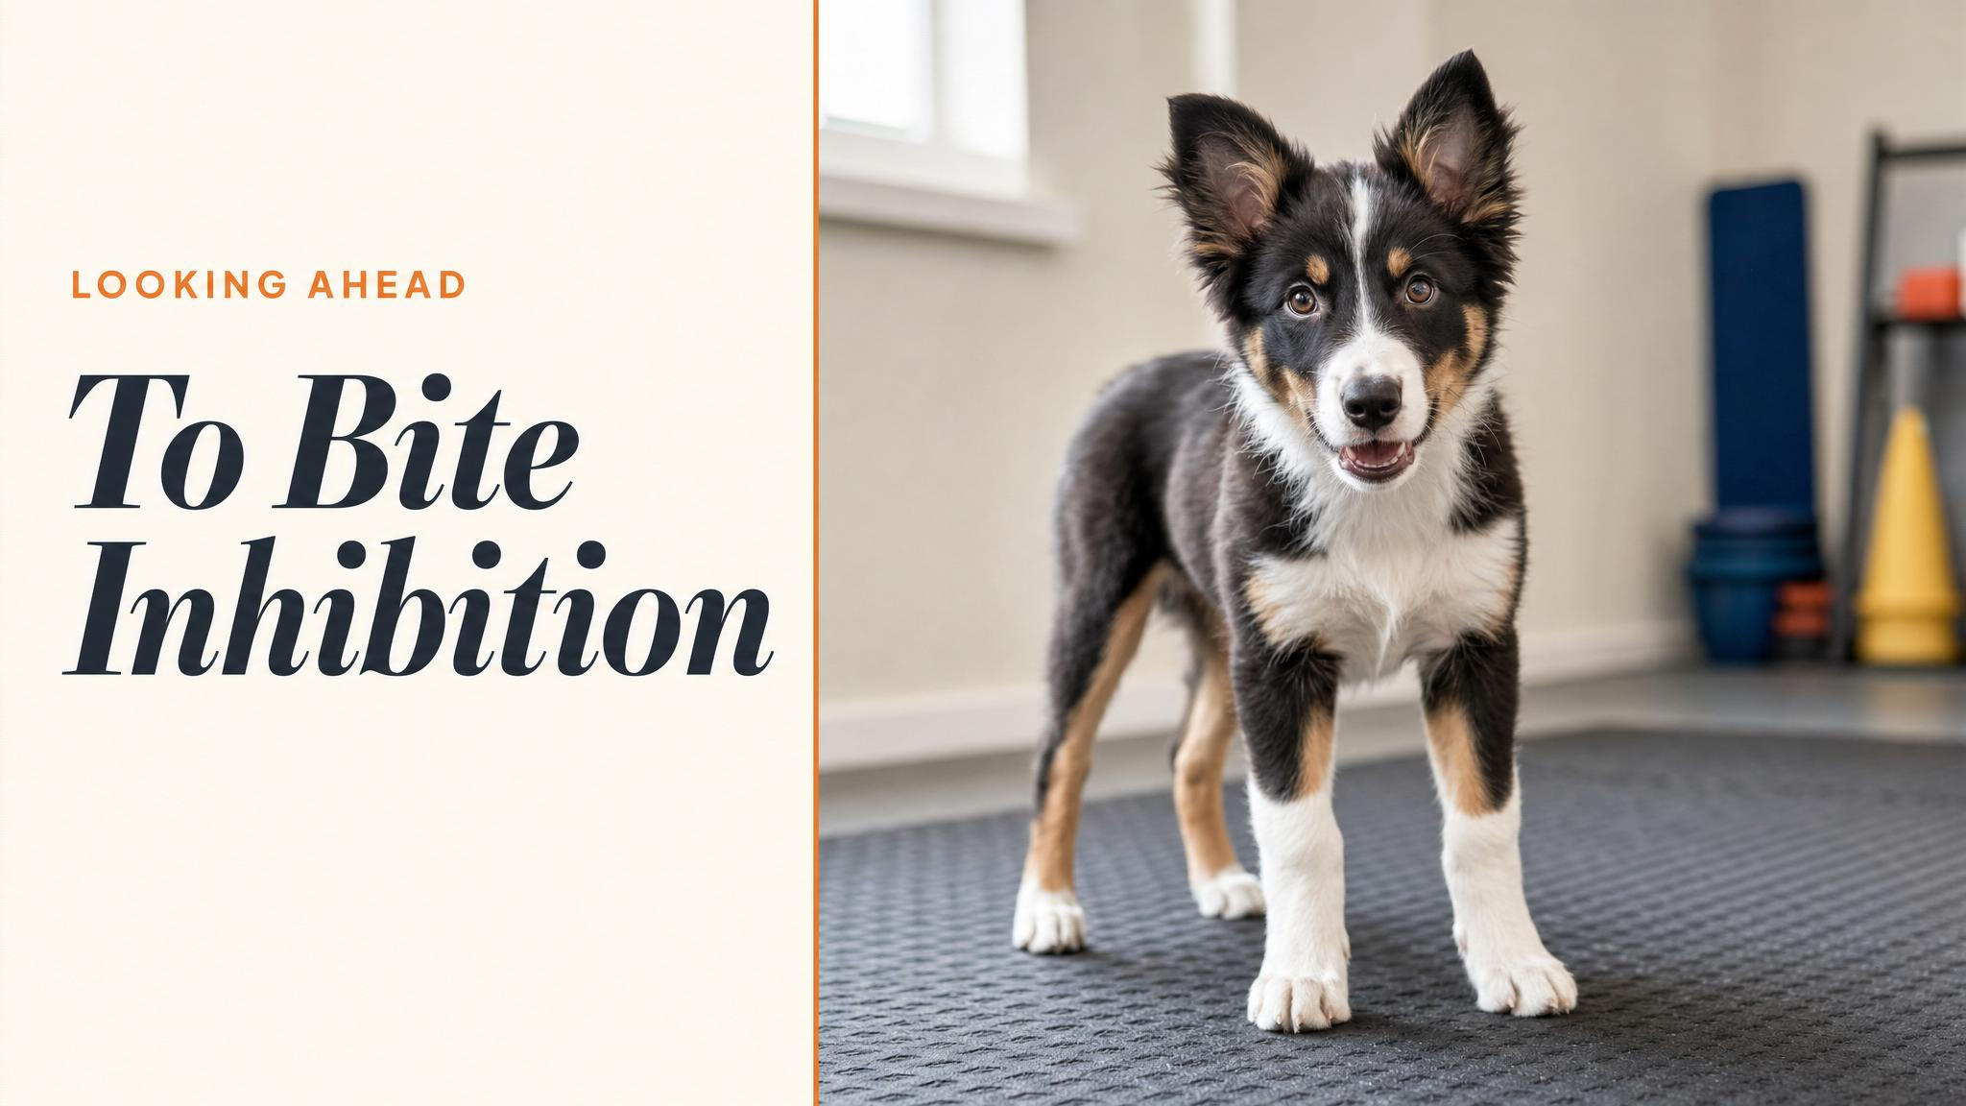
Notes:
Close with the bridge to the next chapter. Next we tackle mouthing and biting — the most common painful puppy challenge. Your puppy isn't being aggressive; they're learning bite inhibition. The counter-conditioning principles you've just met will redirect that mouthy enthusiasm into appropriate outlets.

