Slide 1
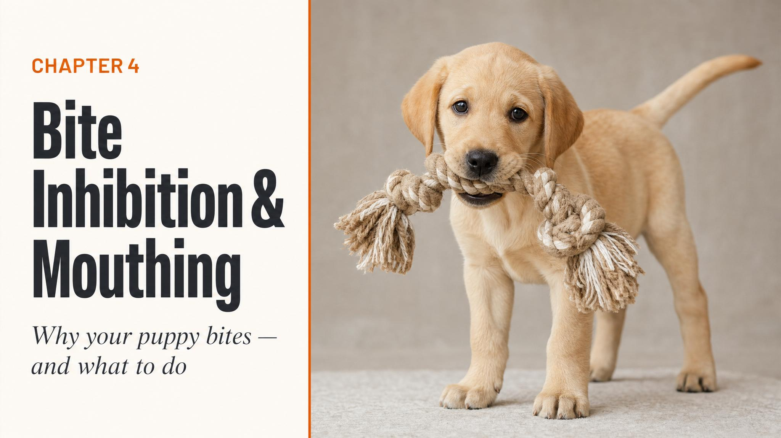
Notes:
Open with the title and the central reframe: those needle teeth are not a design flaw — they're a feature. Tell the room that everything in this chapter circles back to one of the most valuable skills a dog will ever learn. Then ask: how many of you have already searched 'is my puppy aggressive?'

Slide 2
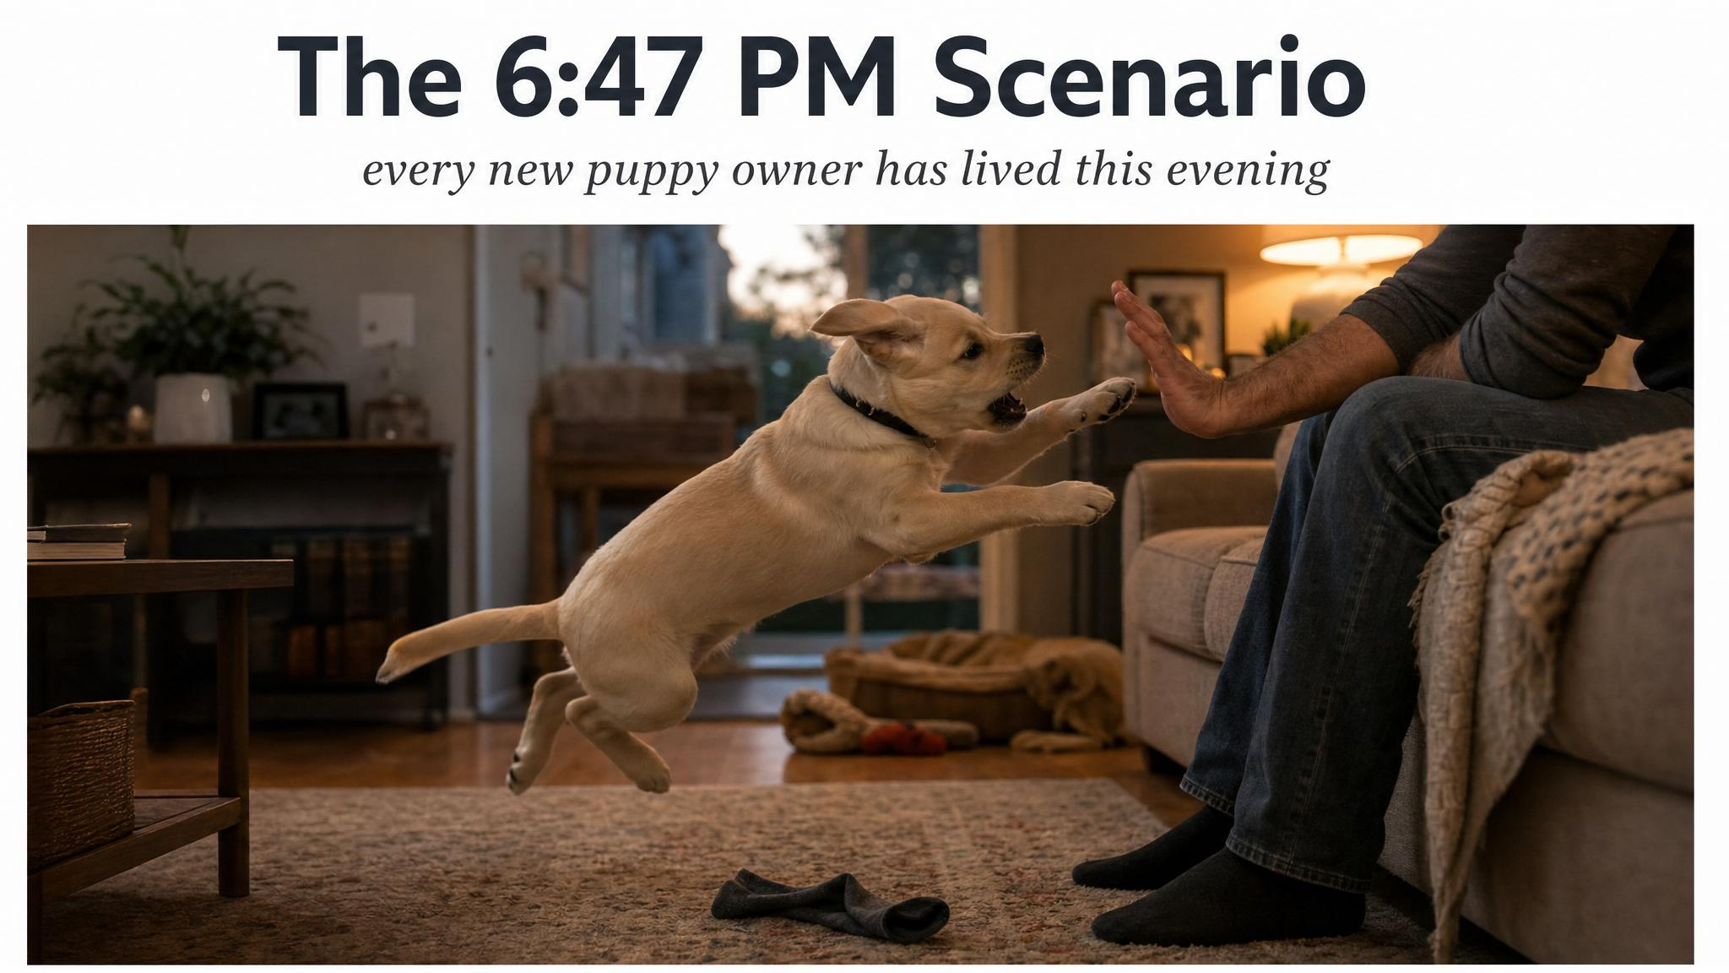
Notes:
Anchor the opening in the universal scene: end of a long day, four-kilogram puppy treating your ankle like a wildebeest. The class will recognise it. Then pause and ask: in that moment, what's the first thought that goes through your head? Surface the fear before debunking it.

Slide 3
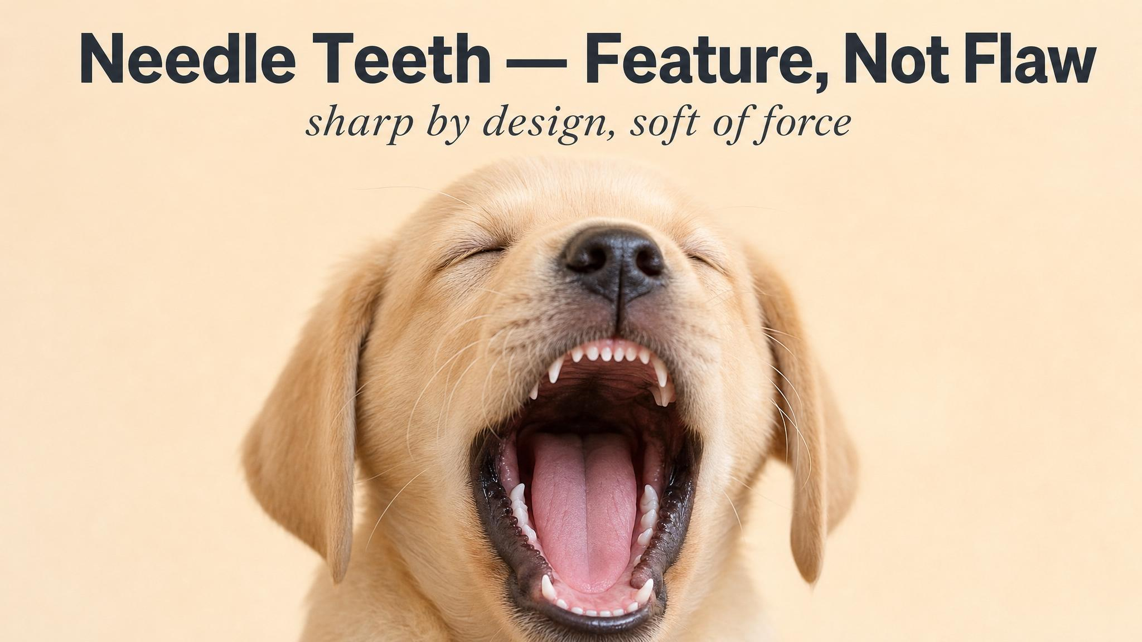
Notes:
Reframe the sharpness. Those teeth aren't a manufacturing defect — they're a high-precision feedback instrument. Even a gentle bite produces a loud reaction from a littermate, which is exactly how the puppy learns pressure calibration at low force levels. Without sharp teeth, the lesson would arrive too late.

Slide 4
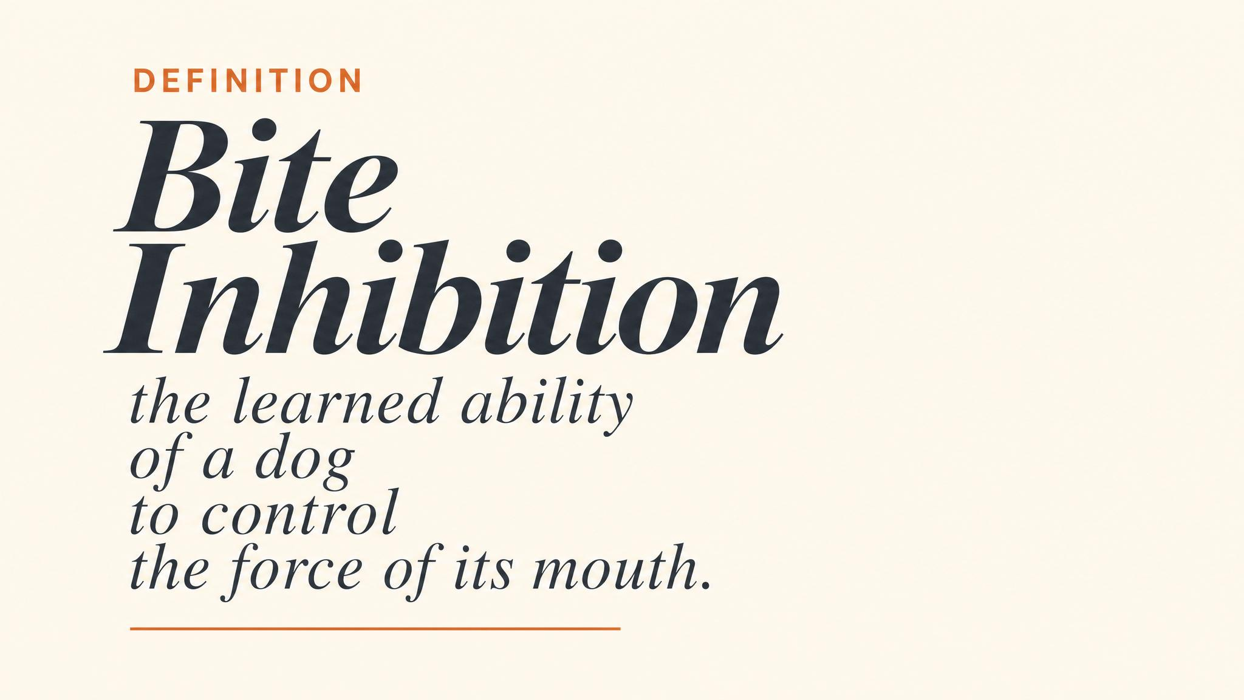
Notes:
Land the term carefully — bite inhibition is the learned ability to control the force of a bite, not the absence of biting. A dog with strong bite inhibition who is startled later in life is unlikely to cause serious injury. A dog without it is, in Dunbar's framing, a ticking time bomb regardless of how obedient they are.

Slide 5
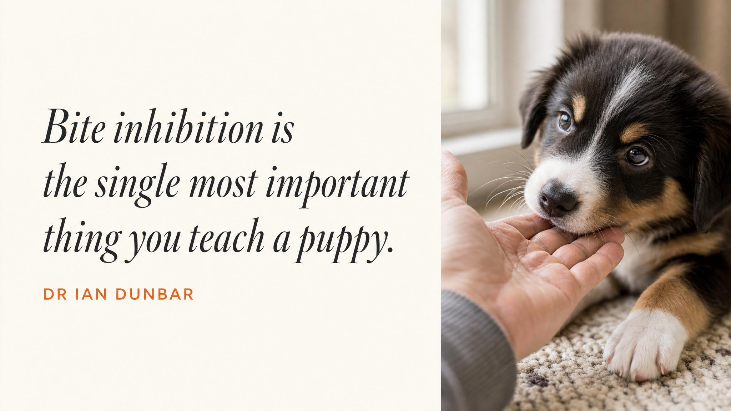
Notes:
Pause here and read the line slowly. Dr Ian Dunbar — vet, behaviourist, and the source most likely to be quoted on this topic — calls bite inhibition more important than sit, stay, or recall. Use the moment to mark the seriousness of what we're teaching: this is not a manners issue, it's a safety skill.

Slide 6

Notes:
Walk them through the social loop. Puppy bites too hard, the bitten puppy yelps and stops playing, the biting puppy learns that level of force ends the fun. Repeated dozens of times across the litter weeks, this is how puppies calibrate jaw pressure downward. Removed too early — before seven to eight weeks — and they miss those critical lessons.

Slide 7
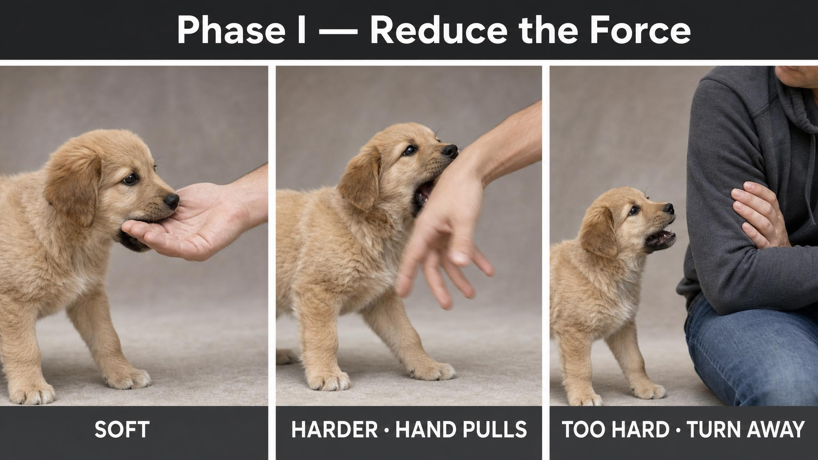
Notes:
Phase one is force reduction, not frequency reduction. Hard bite, brief high-pitched 'ouch', hand withdraws, attention turns away for five to ten seconds. Soft contact is permitted — that distinction is what gives the puppy the feedback loop they need. Over one to three weeks, most puppies noticeably soften their bite.

Slide 8
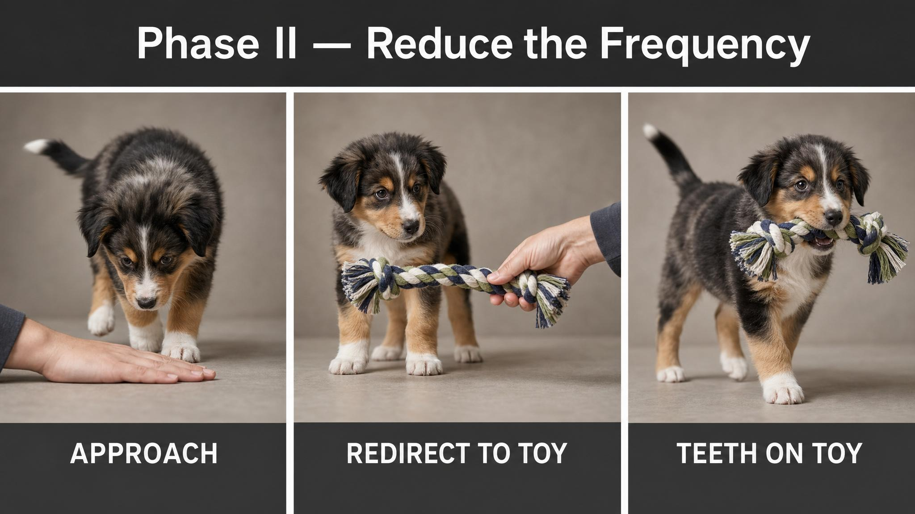
Notes:
Phase two only begins once bites are consistently gentle — typically after two to four weeks of phase one. Now even soft mouthing leads to a brief withdrawal of attention, and you redirect to a toy. Yin's 2010 suggestion of teaching a hand target — touching your open palm with the nose for a treat — gives the puppy an incompatible behaviour that earns reinforcement.

Slide 9
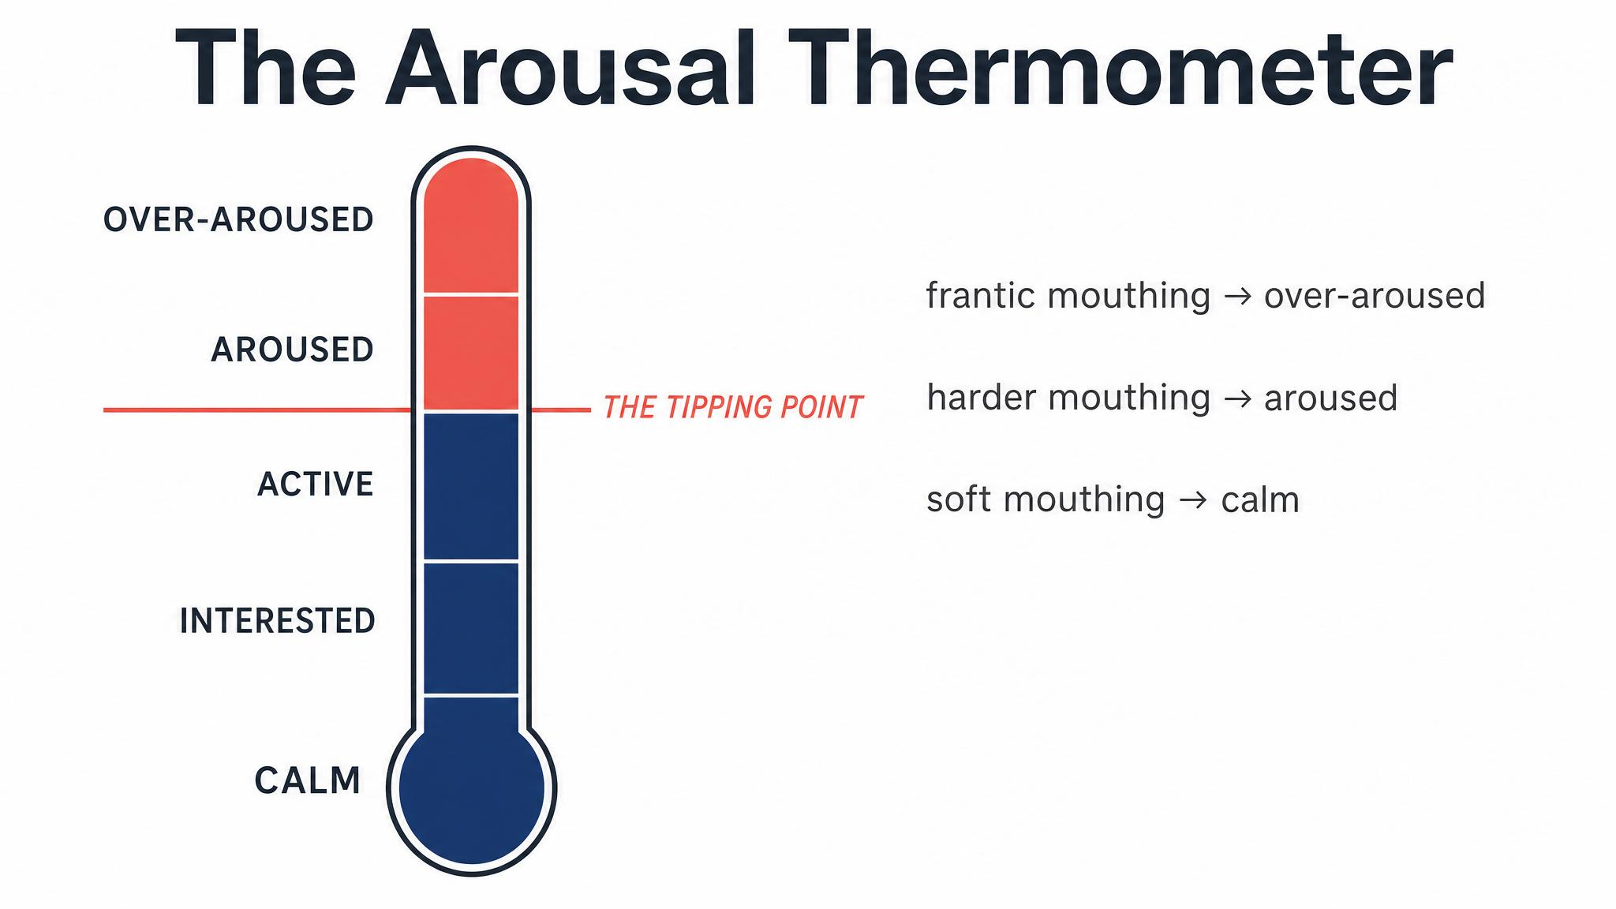
Notes:
Most 'biting problems' are arousal problems in disguise. In the learning zone the puppy can soften their bite, redirect, disengage. In the management zone you stop training and offer a chew. Over threshold, the prefrontal cortex is offline and no amount of 'ouch' or toy-waving will reach them. The intervention is rest, not correction.

Slide 10
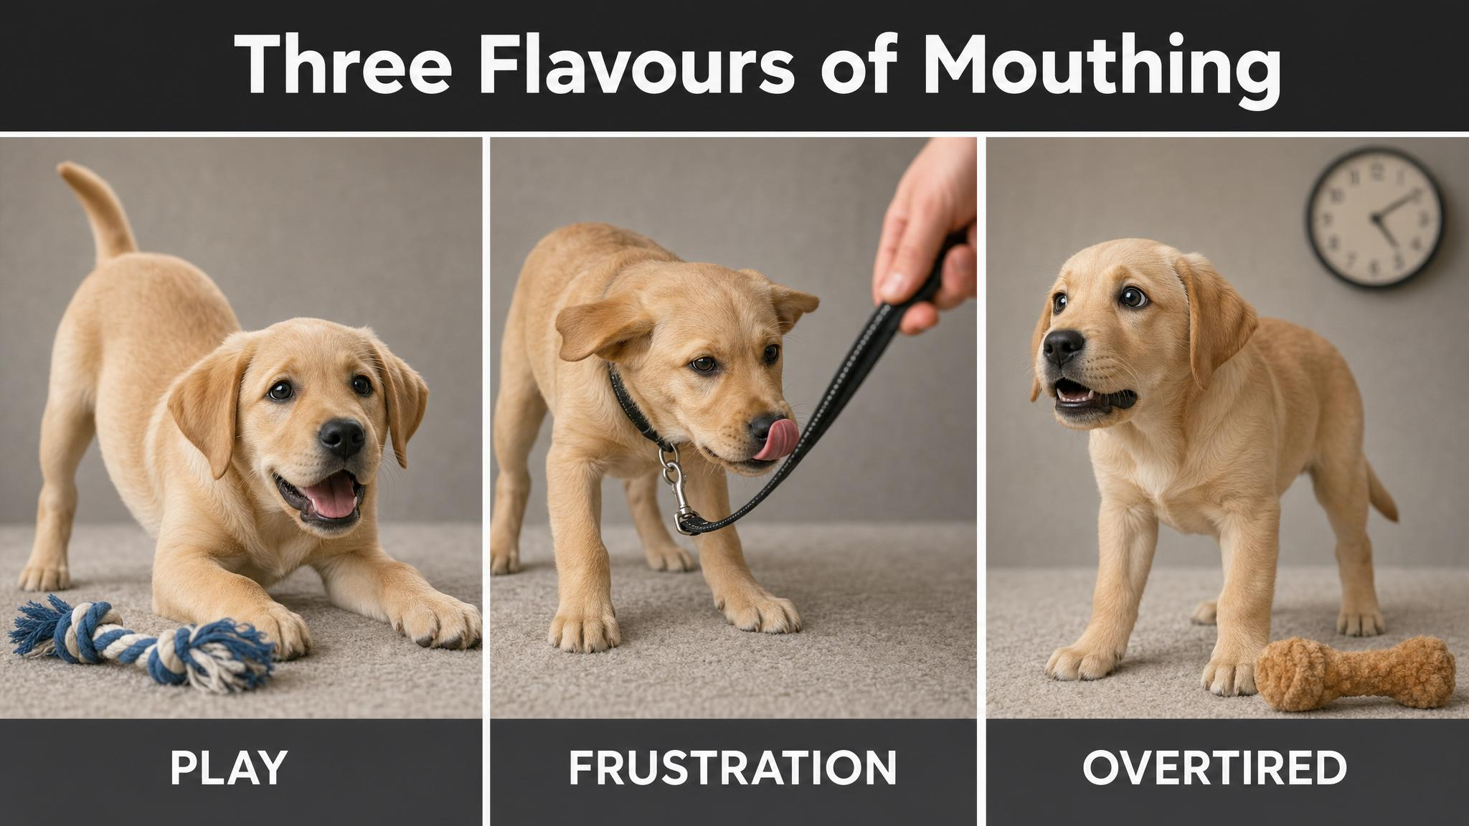
Notes:
Same teeth, three very different drivers. Play mouthing comes with a loose wiggly body and frequent pauses; frustration mouthing comes with stiffness and stress signals; overtired mouthing looks the most alarming but is the most predictable. The intervention that helps one will fail or backfire on the other two. Teach the room to read first, respond second.

Slide 11
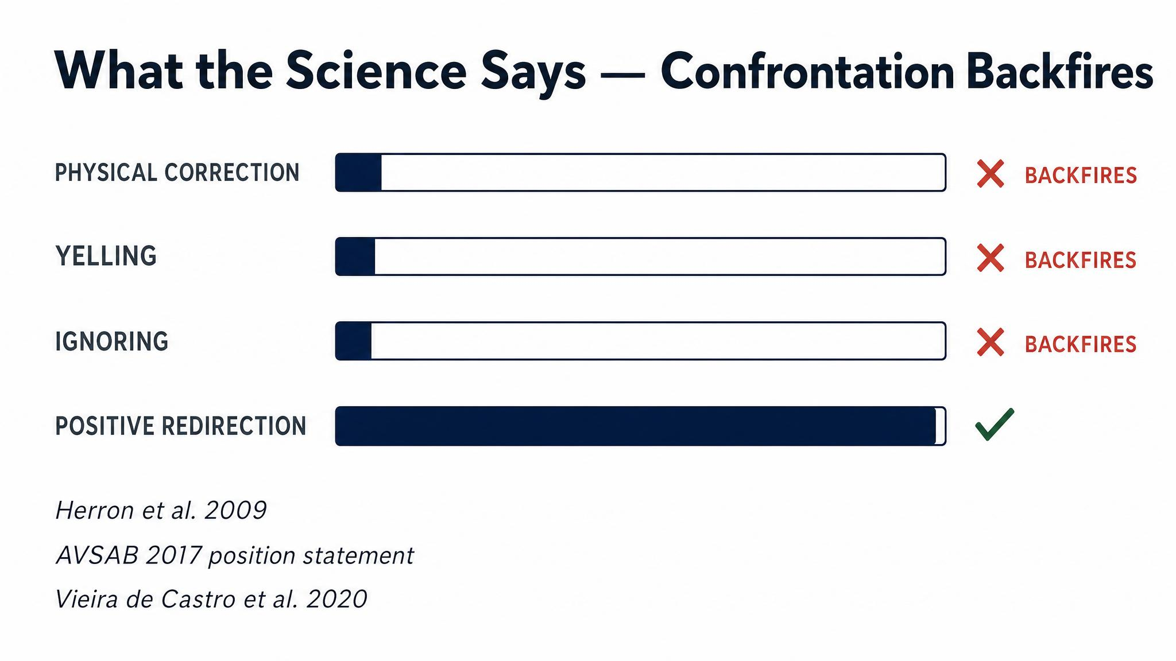
Notes:
Herron, Shofer, and Reisner surveyed 140 dog owners using various training methods in 2009. Their numbers are the simplest possible refutation of confrontational training. The aversive methods didn't just fail to teach bite inhibition — they actively created the aggression they claimed to fix. Reward-based methods sat at zero to six percent by comparison.

Slide 12
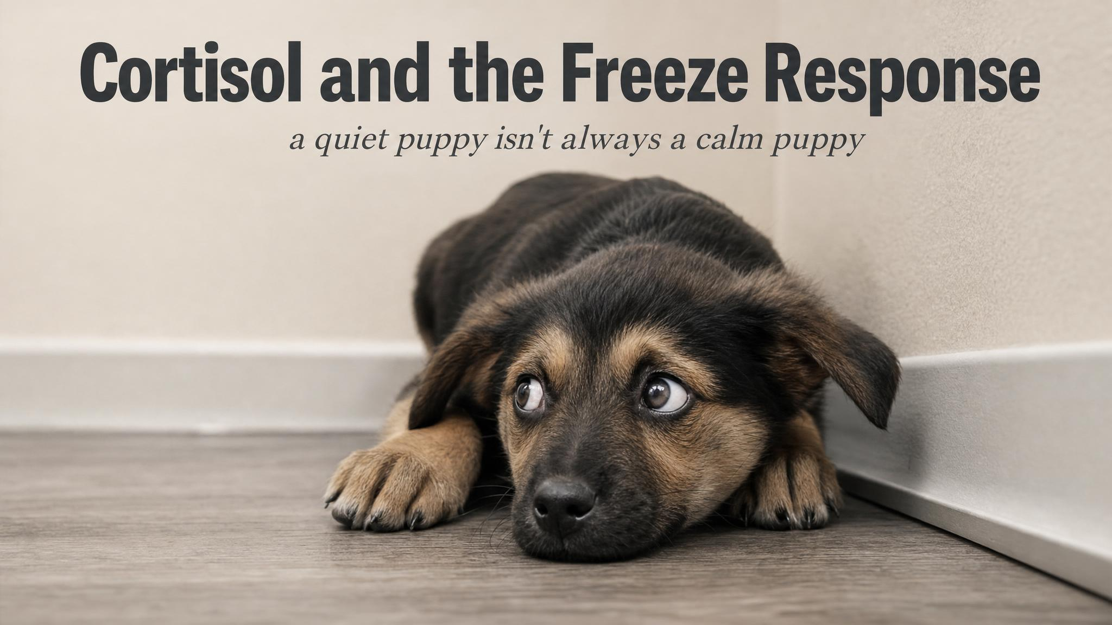
Notes:
Pause here. The freeze that follows a scruff-shake is often mistaken for calm submission — it's actually a fear response. The puppy has learned that their human is unpredictable. Vieira de Castro and colleagues in 2020 showed aversive methods elevate cortisol and produce more pessimistic responses on cognitive bias tasks. Ziv's 2017 review of seventeen studies reached the same conclusion.

Slide 13
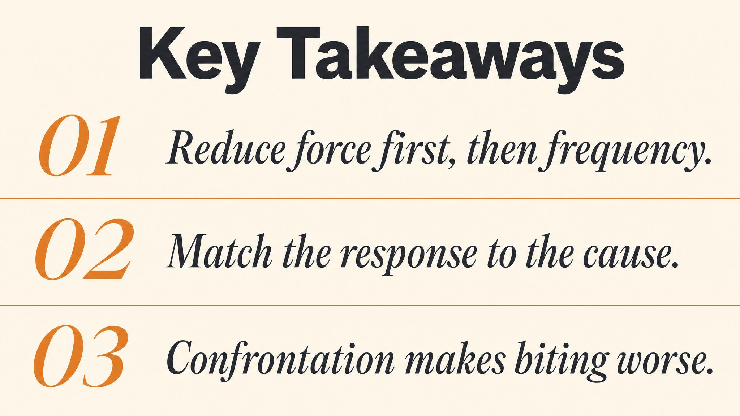
Notes:
Three things to carry forward. One: mouthing is normal developmental behaviour, not aggression. Two: you shape pressure first with graduated pressure reduction, then frequency. Three: most so-called biting problems are arousal problems, and the answer is often a nap, not a correction. Pause briefly on each before moving to the look-ahead.

Slide 14

Notes:
Close with the bridge: next class we move to crate and house training — why the crate is a management tool, not a punishment, and how counter-conditioning builds a positive association. The arousal management principles from this chapter apply directly when puppies resist the crate. If your puppy screams in there, the next class will explain why.

