Slide 1
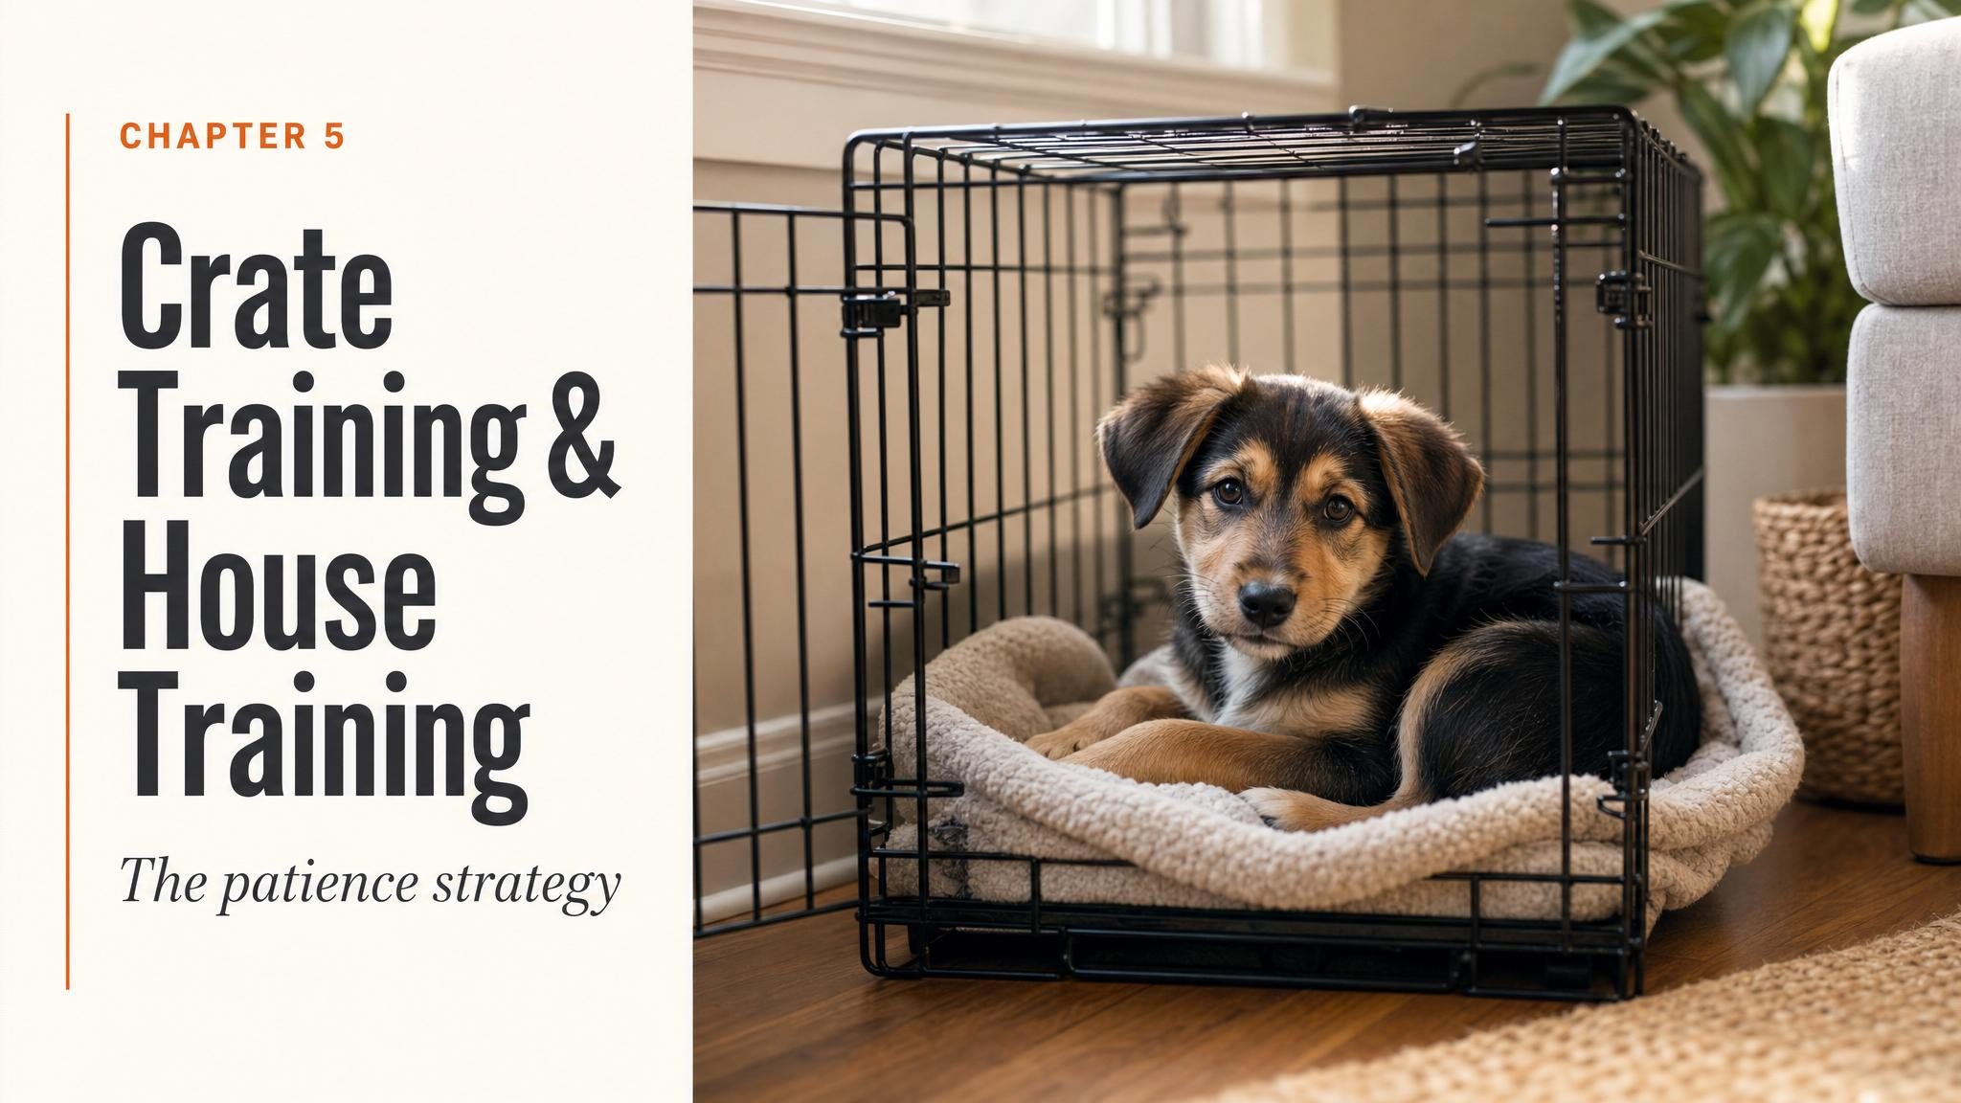
Notes:
Open with the title and the promise: this is the chapter where patience does the heavy lifting. Tell them up front that we're going to reframe patience as a strategy, not a sigh. Hold the puppy on screen for a beat before you start narrating.

Slide 2
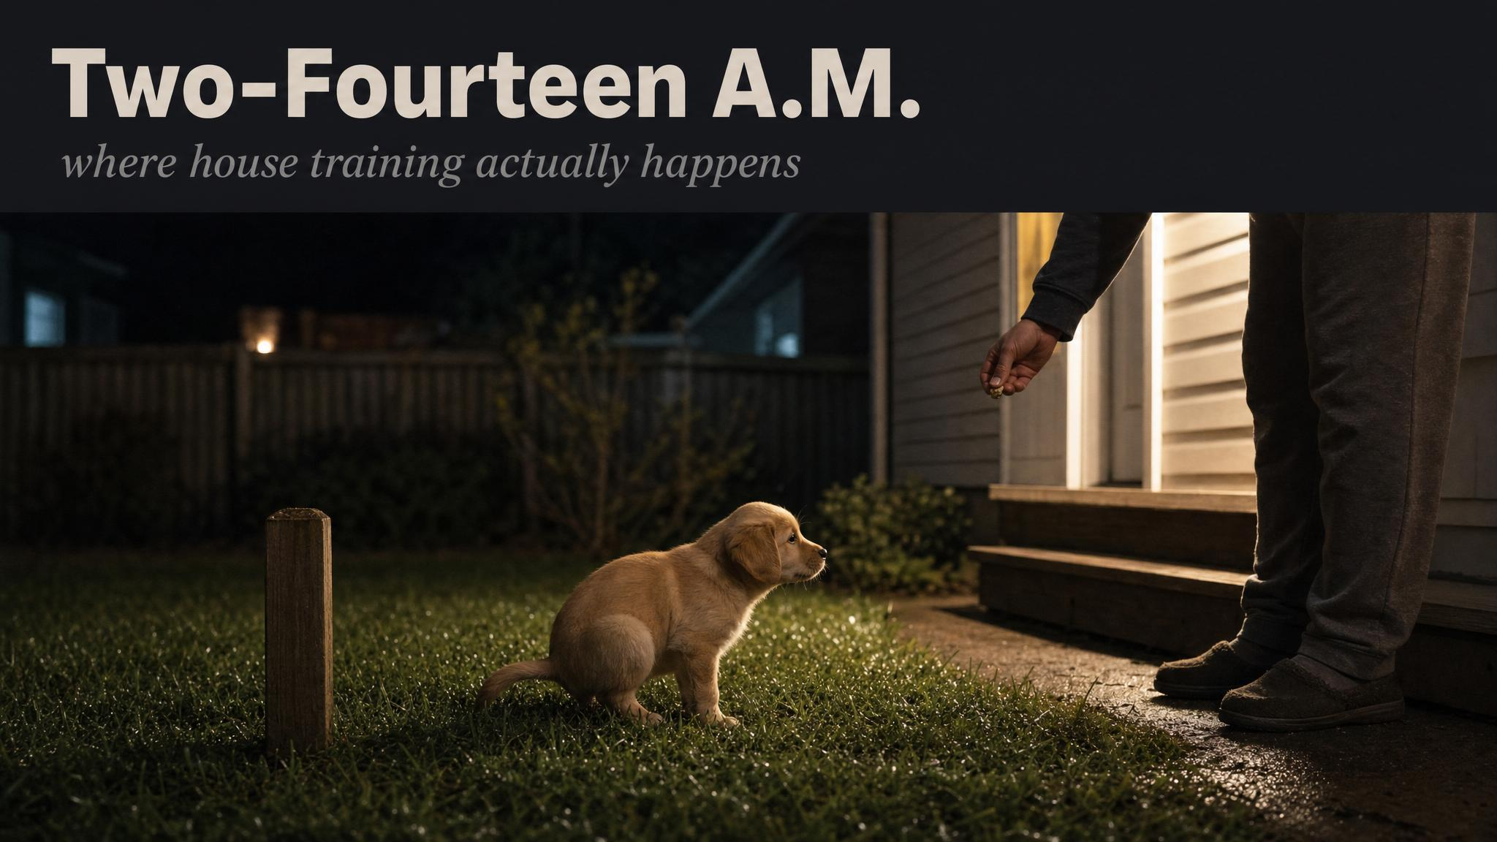
Notes:
Set the scene from the opening of the chapter: barefoot in wet grass, torch in one hand, treats in the other, a puppy more interested in moths than toileting. Ask the room: who has lived this moment? Use it to land the point that house training isn't glamorous — it just works.

Slide 3
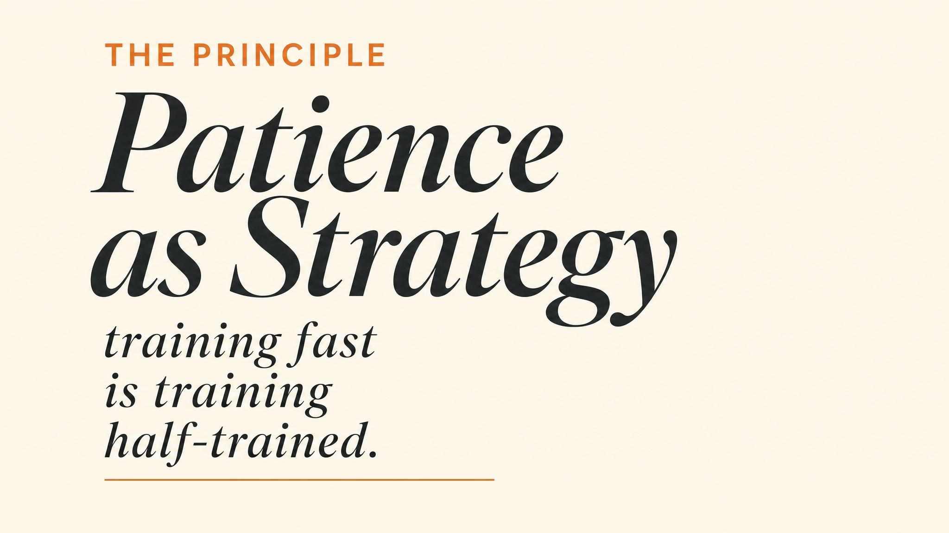
Notes:
Reframe the word patience. Tell them: in everyday language patience is passively enduring something unpleasant; here it means deliberately choosing to go slowly because the science says slow is faster. Cite Vieira de Castro 2020 and Casey 2021 aloud — punished dogs learn less and become more pessimistic.

Slide 4
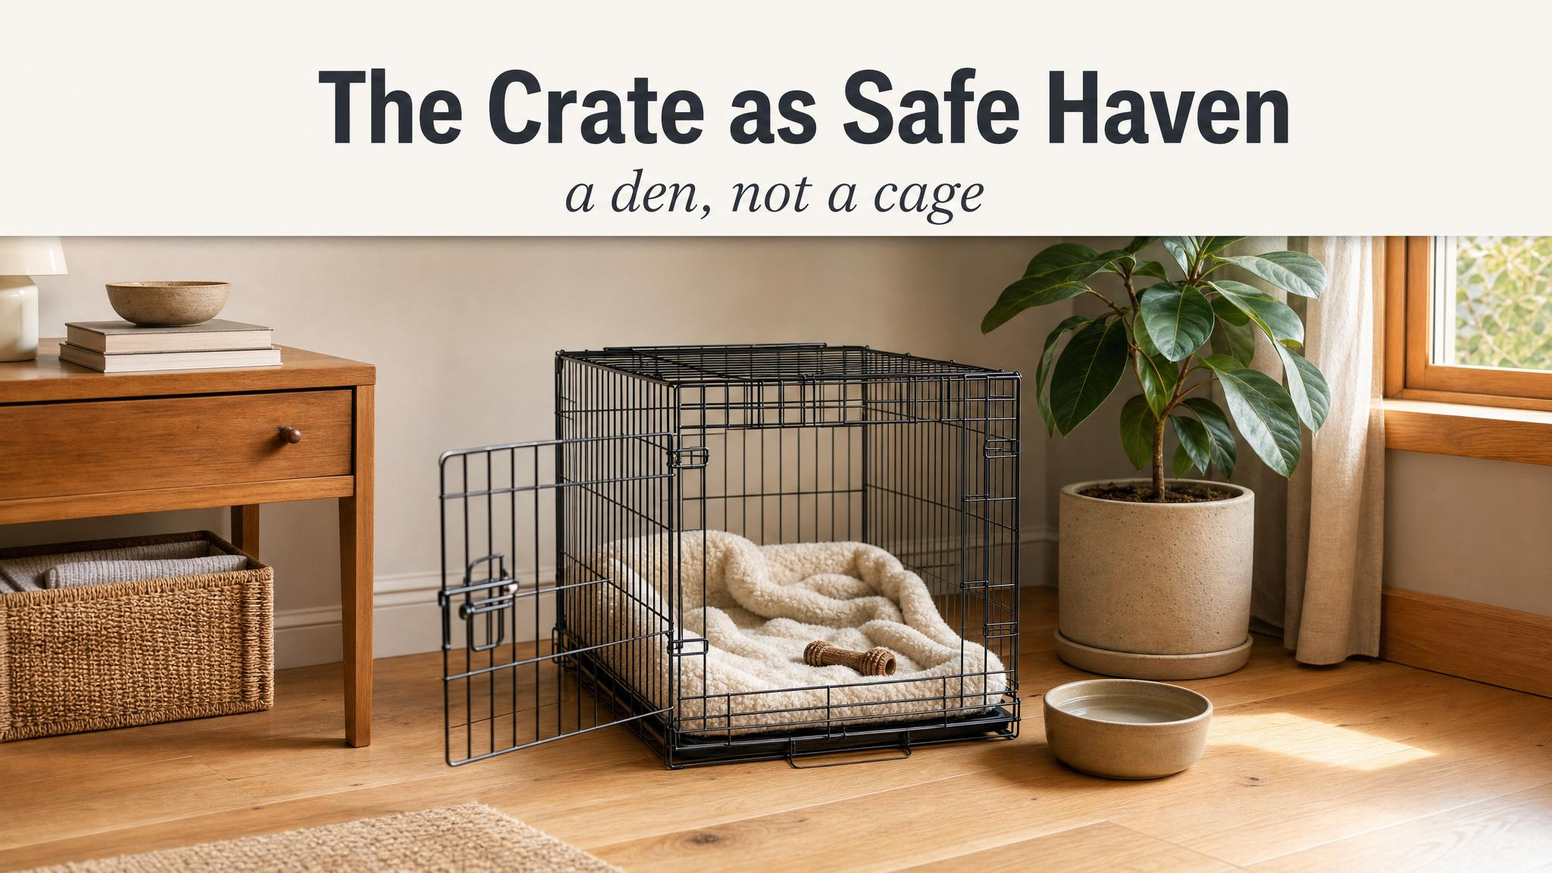
Notes:
Introduce Dr Sophia Yin's cardinal rule: the crate must never be used as punishment. Not once. The crate is a bedroom, not a prison cell. Connect this back to counter-conditioning from Chapter 3 and ask: if a puppy associates the crate with anger, what happens at the vet clinic later?

Slide 5
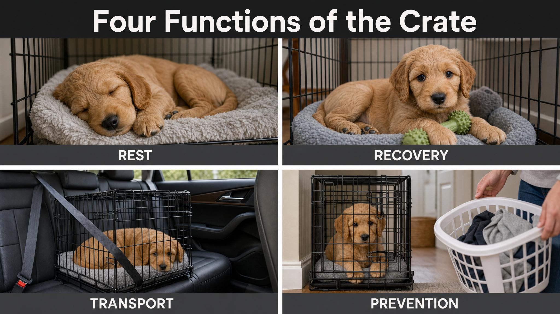
Notes:
Walk them through the four critical functions: house-training management, safe travel, enforced rest for the red-zone puppy from Chapter 4, and veterinary preparation — citing Stellato 2019 on positive prior crate experience reducing fear at the vet. Frame this as 'why every minute you invest is worth it'.

Slide 6
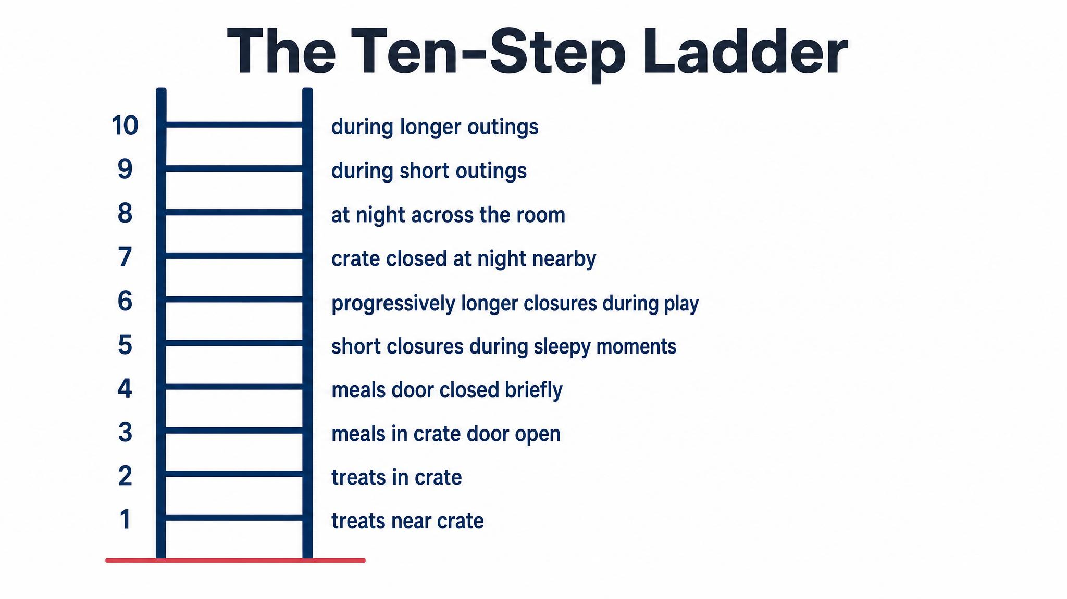
Notes:
Walk them up Yin's ten-step ladder: door removed, voluntary entry, meals at the door, meals inside, door briefly closed, door longer, you step away, you leave the room. Emphasise: read body language at every rung — relaxed posture, soft eyes, voluntary engagement. Only advance when the puppy is ready.

Slide 7
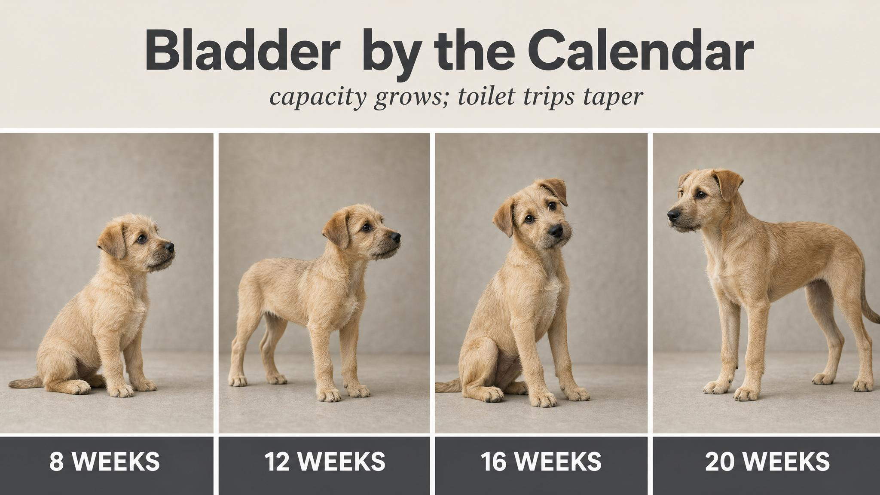
Notes:
Anchor the physiology: at 8 weeks a resting puppy can hold ~75 minutes; at 12 weeks ~90; at 16 weeks ~2 hours; at 20 weeks ~2.5 hours — these are Dunbar's 2025 numbers, and they are maximums. An active, eating, playing puppy has a much shorter practical window. The one-hour-per-month rule is your working approximation.

Slide 8
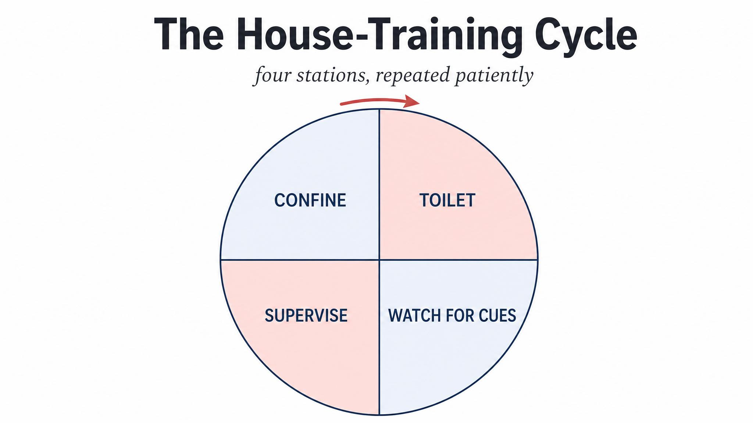
Notes:
This is the engine. Confine, toilet, supervise, repeat. The crate uses the puppy's natural avoidance of soiling their bed; the toilet break is when you mark and reward; supervised freedom means eyes on or tethered to you; then back into the cycle. It's not Instagram-worthy. It works.

Slide 9
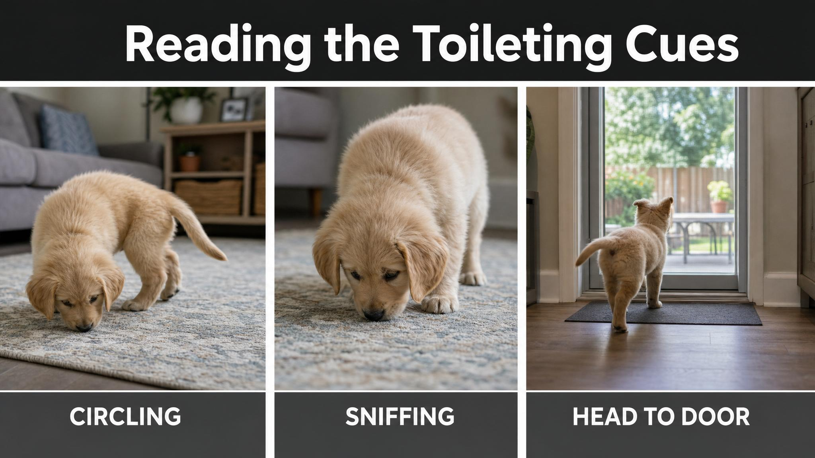
Notes:
Three cues to memorise: circling, intense sniffing, heading for the door. By the time you see squatting, you have about one second. Learning these cues builds directly on the body-language skills from Chapter 4. The earlier you catch them, the cleaner the carpet.

Slide 10
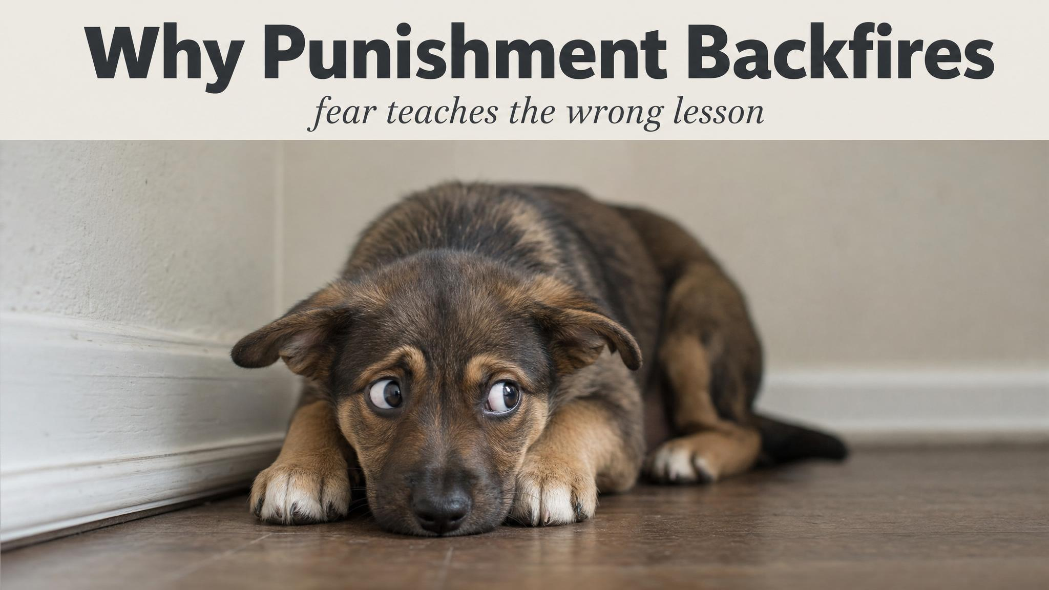
Notes:
The Australian Veterinary Association's 2019 position is unequivocal: punishment increases stress, causes learned helplessness, suppresses communication, and can lead to unpredictable aggression. The paradox: a punished puppy thinks 'toileting near this human is dangerous' and starts hiding to eliminate — which makes the problem worse. Add Vieira de Castro 2020's cortisol findings.

Slide 11
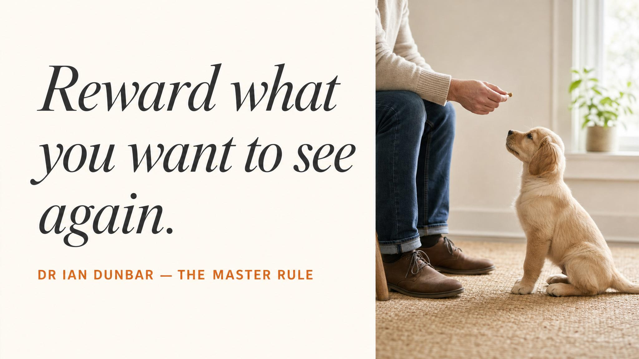
Notes:
Read it aloud, slowly. Dunbar 2004: the single most important skill in house training is not teaching — it's scheduling. Get the schedule right, and the puppy will teach itself. This is the master rule of the chapter. Pause here.

Slide 12
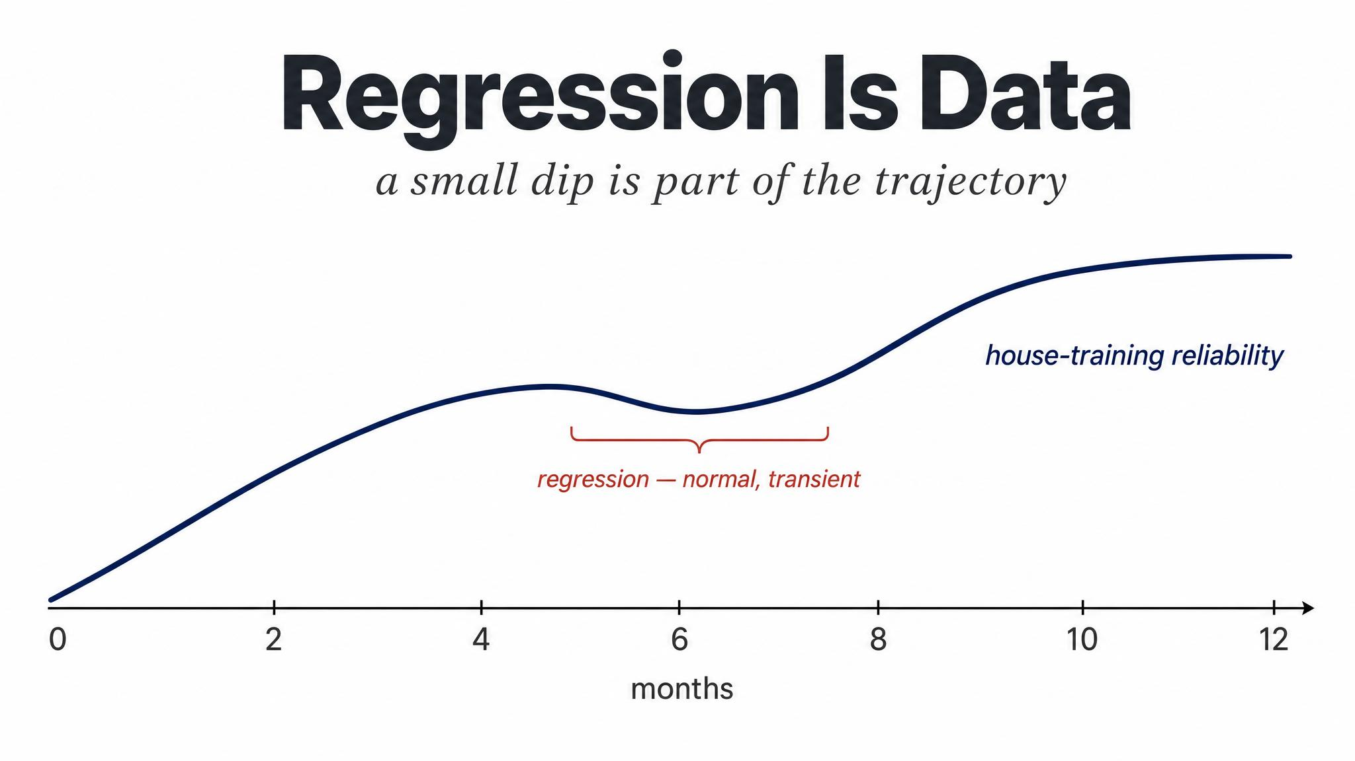
Notes:
Tell them: regression is normal. A reliable week followed by three accidents in a day doesn't mean you've failed. It means something has changed — developmental, dietary, routine. The correct response is to tighten management, not tighten the tone. Note we'll go deeper on regression in Chapter 8.

Slide 13
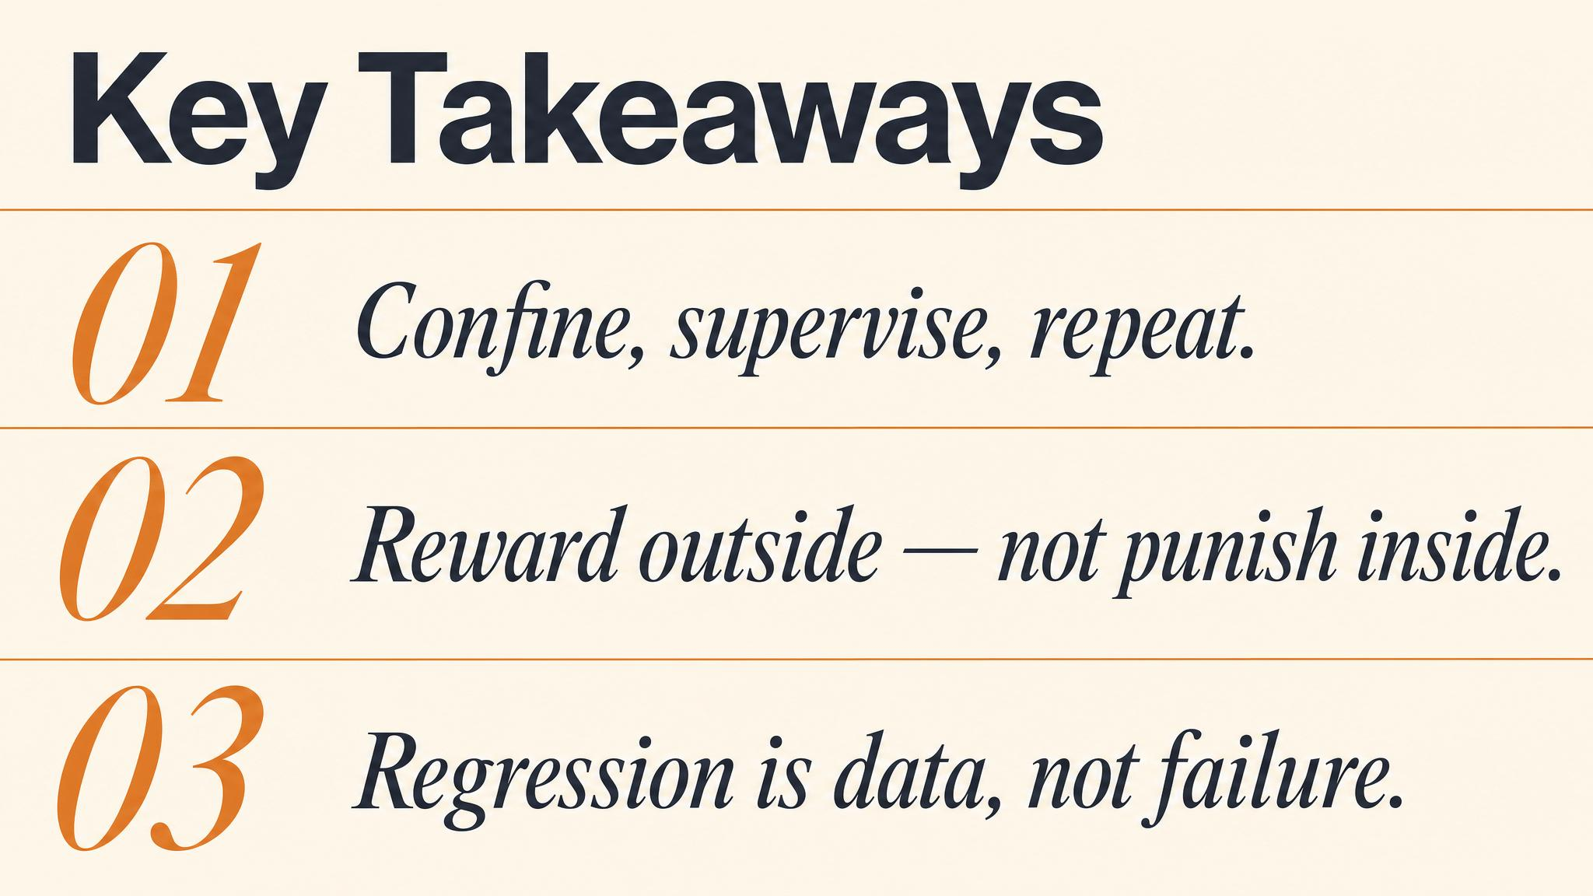
Notes:
Three things to carry forward. One: patience is an active, evidence-based strategy. Two: the crate is a bedroom, never a prison — built through systematic desensitisation. Three: house training is fundamentally a scheduling problem, and the cycle of confine-toilet-supervise-repeat does the actual work.

Slide 14
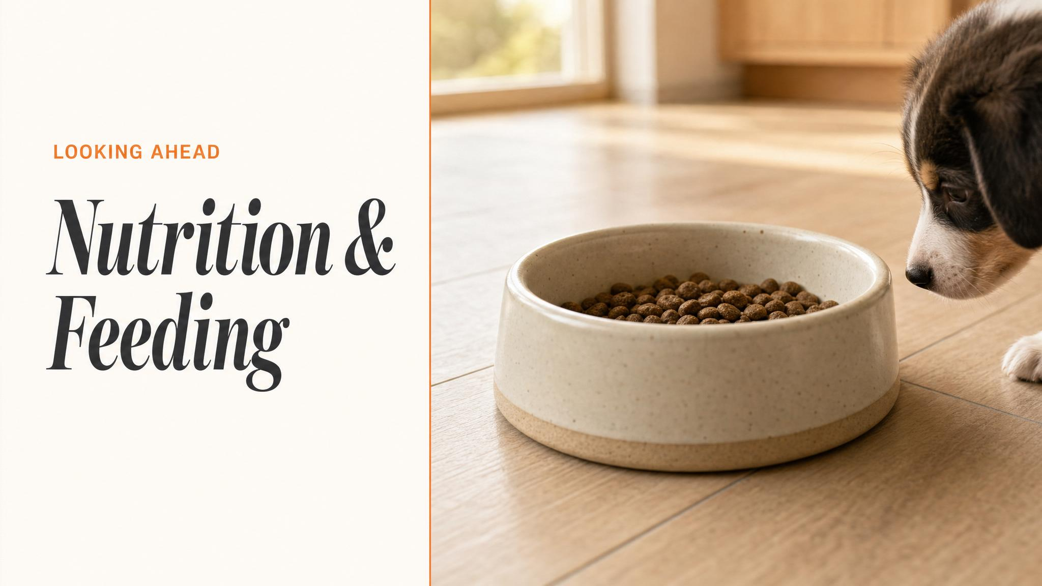
Notes:
Close with the bridge: next chapter is nutrition and feeding — schedules that interlock with the toileting rhythm you've just built, age-appropriate portions, the toxic-food map, and meals as enrichment. Tell them to bring everything they've learned about routine and reading their puppy.

