Slide 1
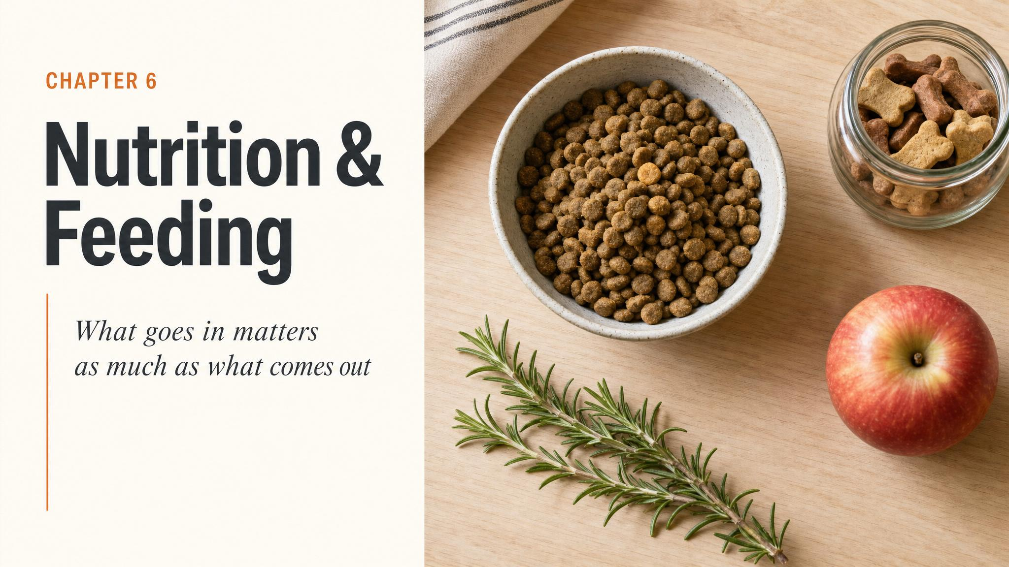
Notes:
Open by reading the chapter title aloud. Then frame the chapter as cutting through the noise: forty-seven bags on the shelf, three forum tabs open, and an eight-week-old puppy chewing a stick in the car park. Ask the room: who feels confident they're feeding the right thing? Hold the question.

Slide 2
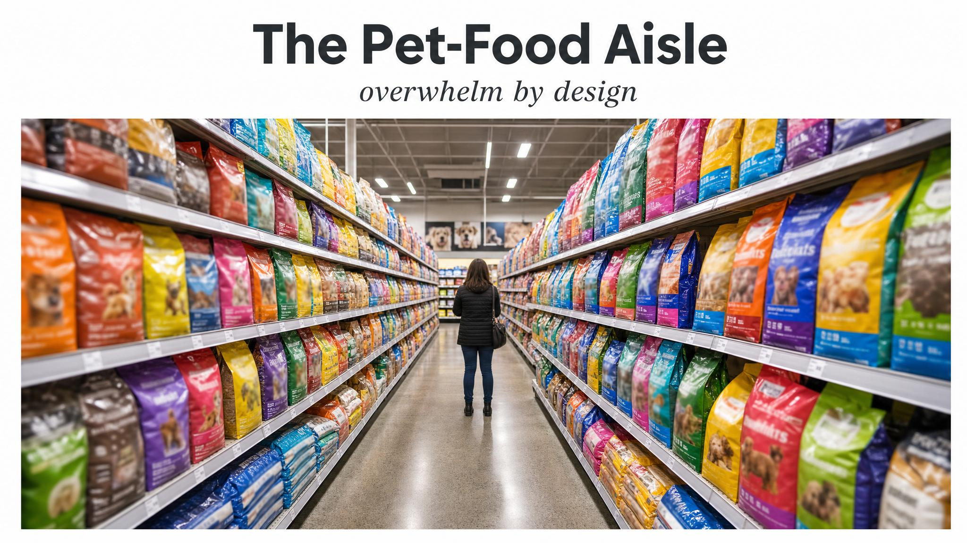
Notes:
Set the hook. A bag promising 'ancestral grain-free nutrition' with a wolf on the label, another 'holistically crafted', three open browser tabs of contradictory advice. Mealtime has become a source of guilt for many new owners — not because the science is hard, but because the marketing is loud. We're going to cut through it.

Slide 3
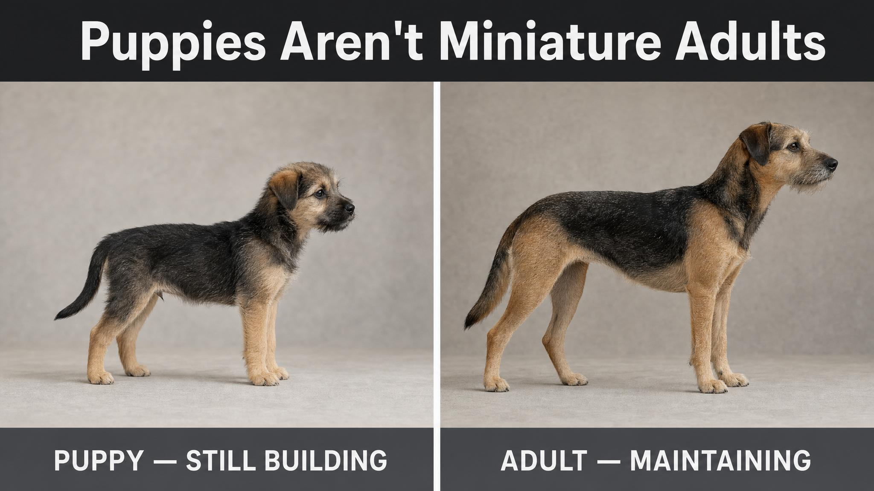
Notes:
Puppies aren't small dogs — they're biological construction projects. In their first twelve months most puppies multiply their birth weight by forty to fifty times. That rate of growth demands a different nutritional profile from an adult dog: more protein, more fat, carefully balanced skeletal minerals. Adult-maintenance food cannot do this job.

Slide 4
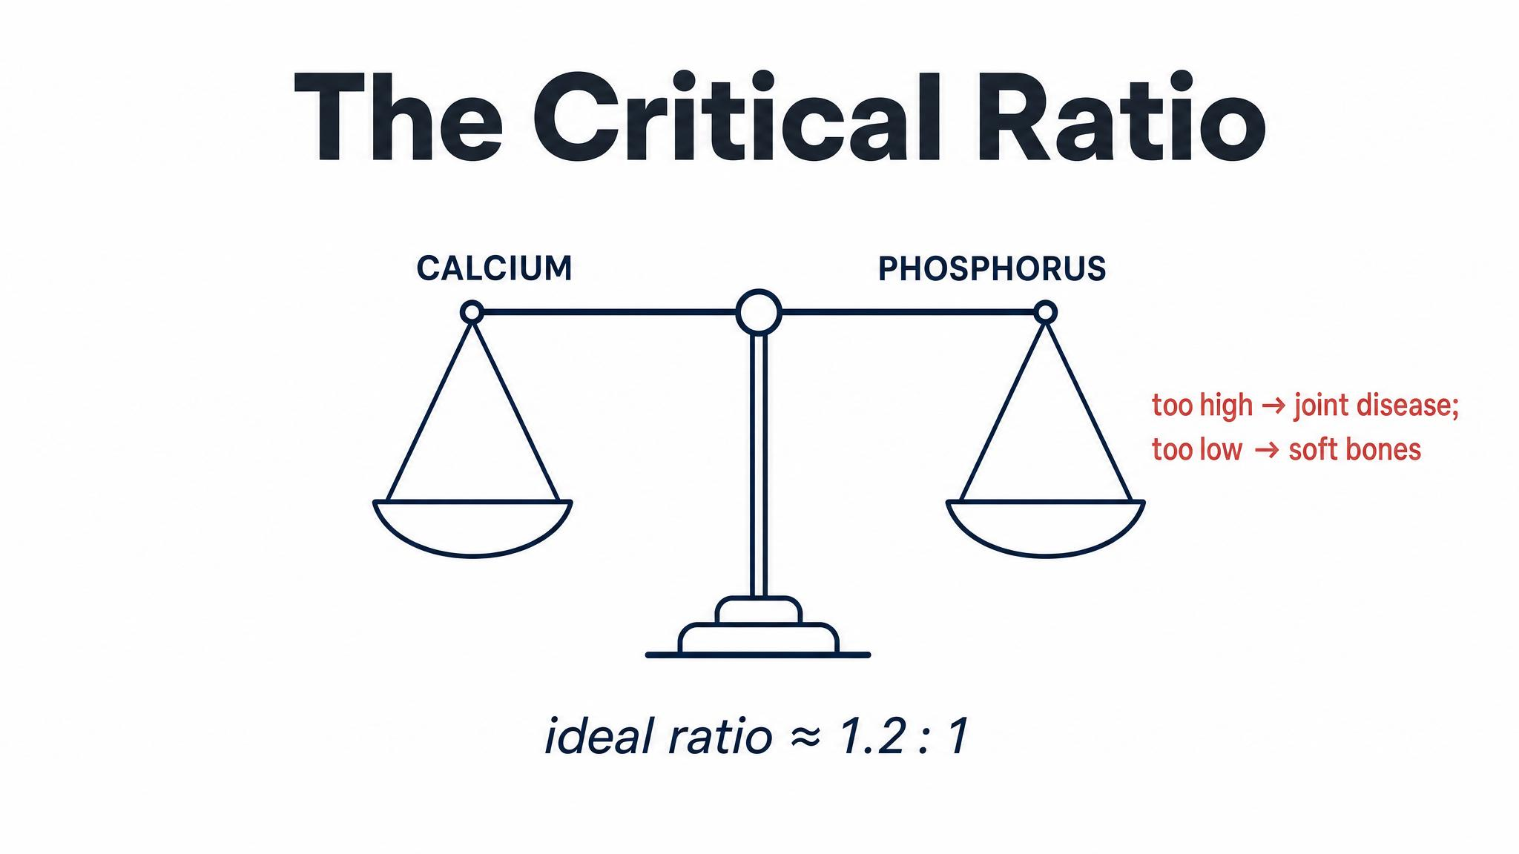
Notes:
The single most important nutritional consideration in puppyhood is not the amount of calcium, it's the ratio of calcium to phosphorus. Dobenecker and colleagues in 2019 found puppies need about two-to-one during peak growth, easing to roughly one-point-four-nine to one by seven to twelve months. Puppies cannot regulate calcium absorption the way adult dogs can — whatever you put in, they absorb. That's why DIY supplementation is dangerous.

Slide 5
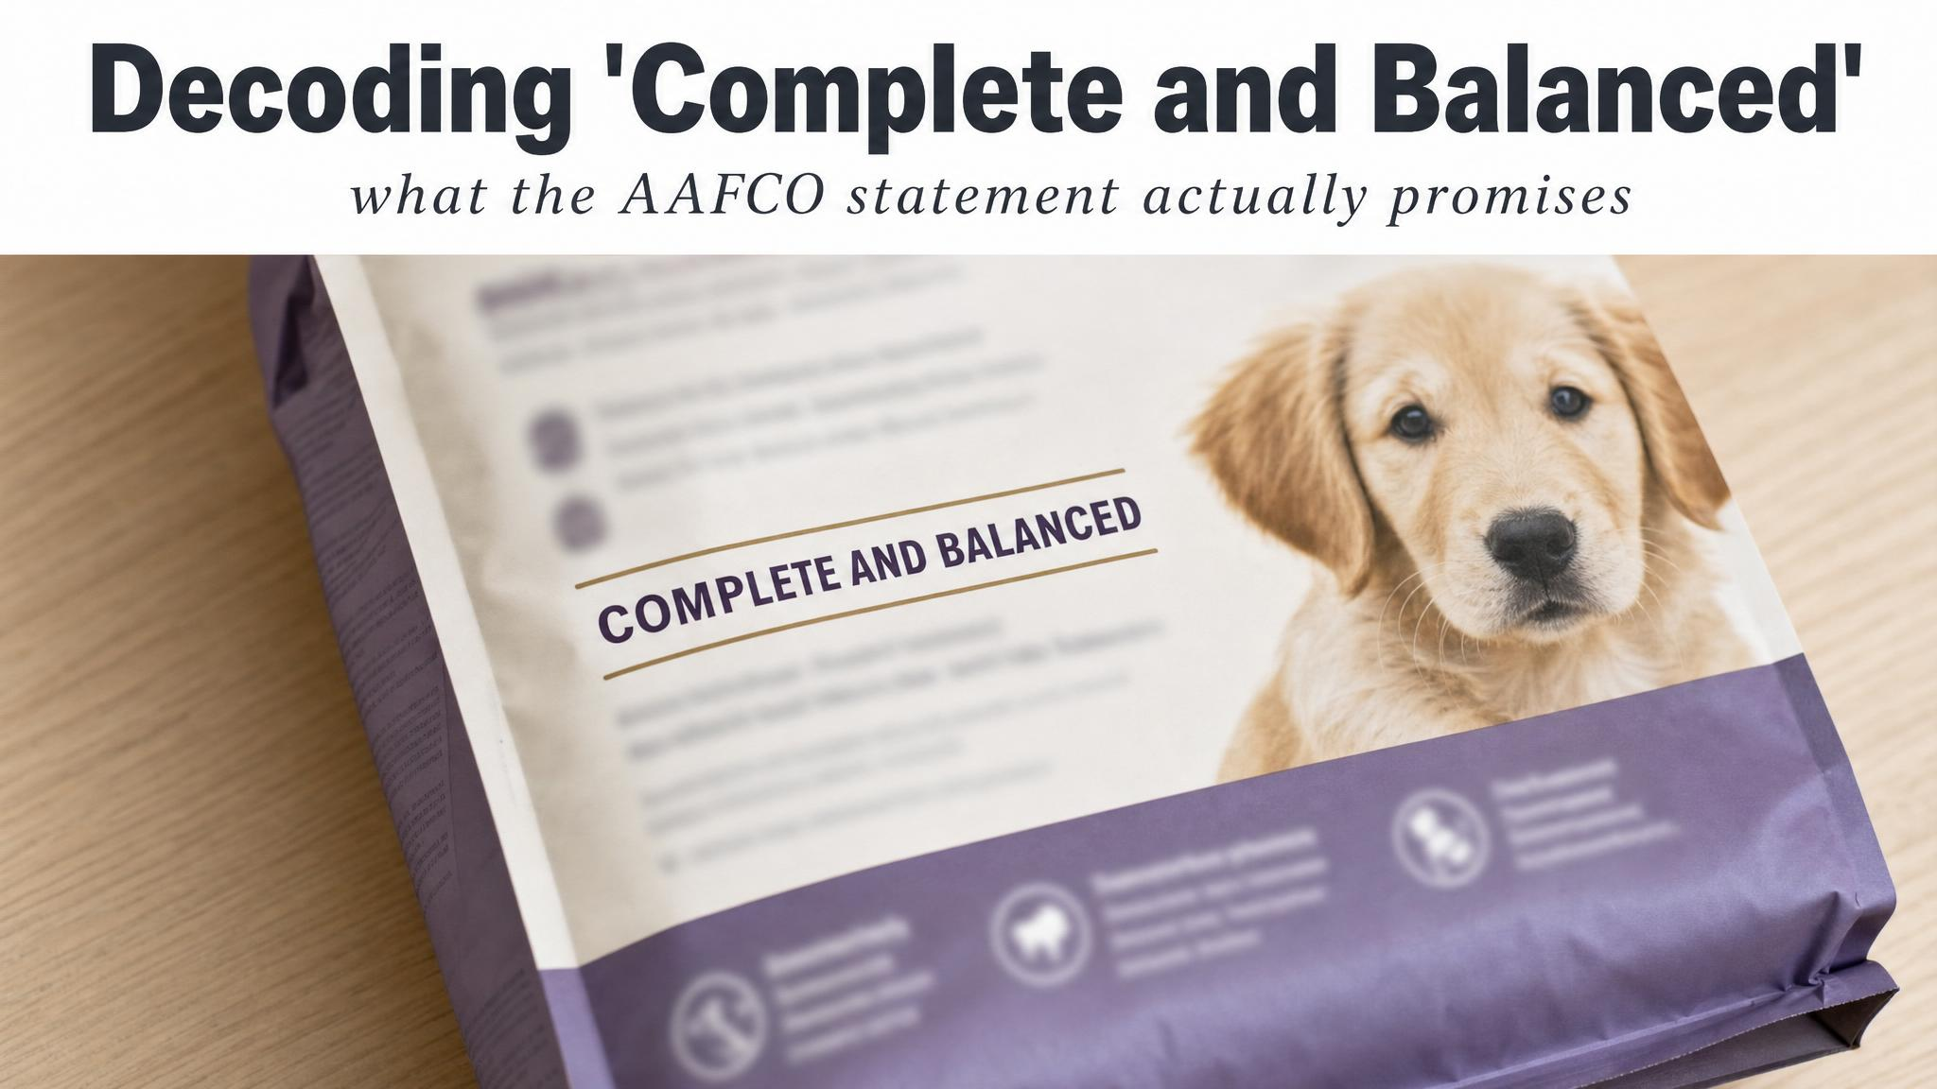
Notes:
'Complete and balanced' is not marketing — it's a regulatory phrase. In Australia, pet food follows guidelines aligned with AAFCO standards. When you pick up a bag look for the nutritional adequacy statement for growth or all life stages, and whether it was demonstrated by feeding trials or by formulation. Both are acceptable; feeding trials add real-world validation.

Slide 6
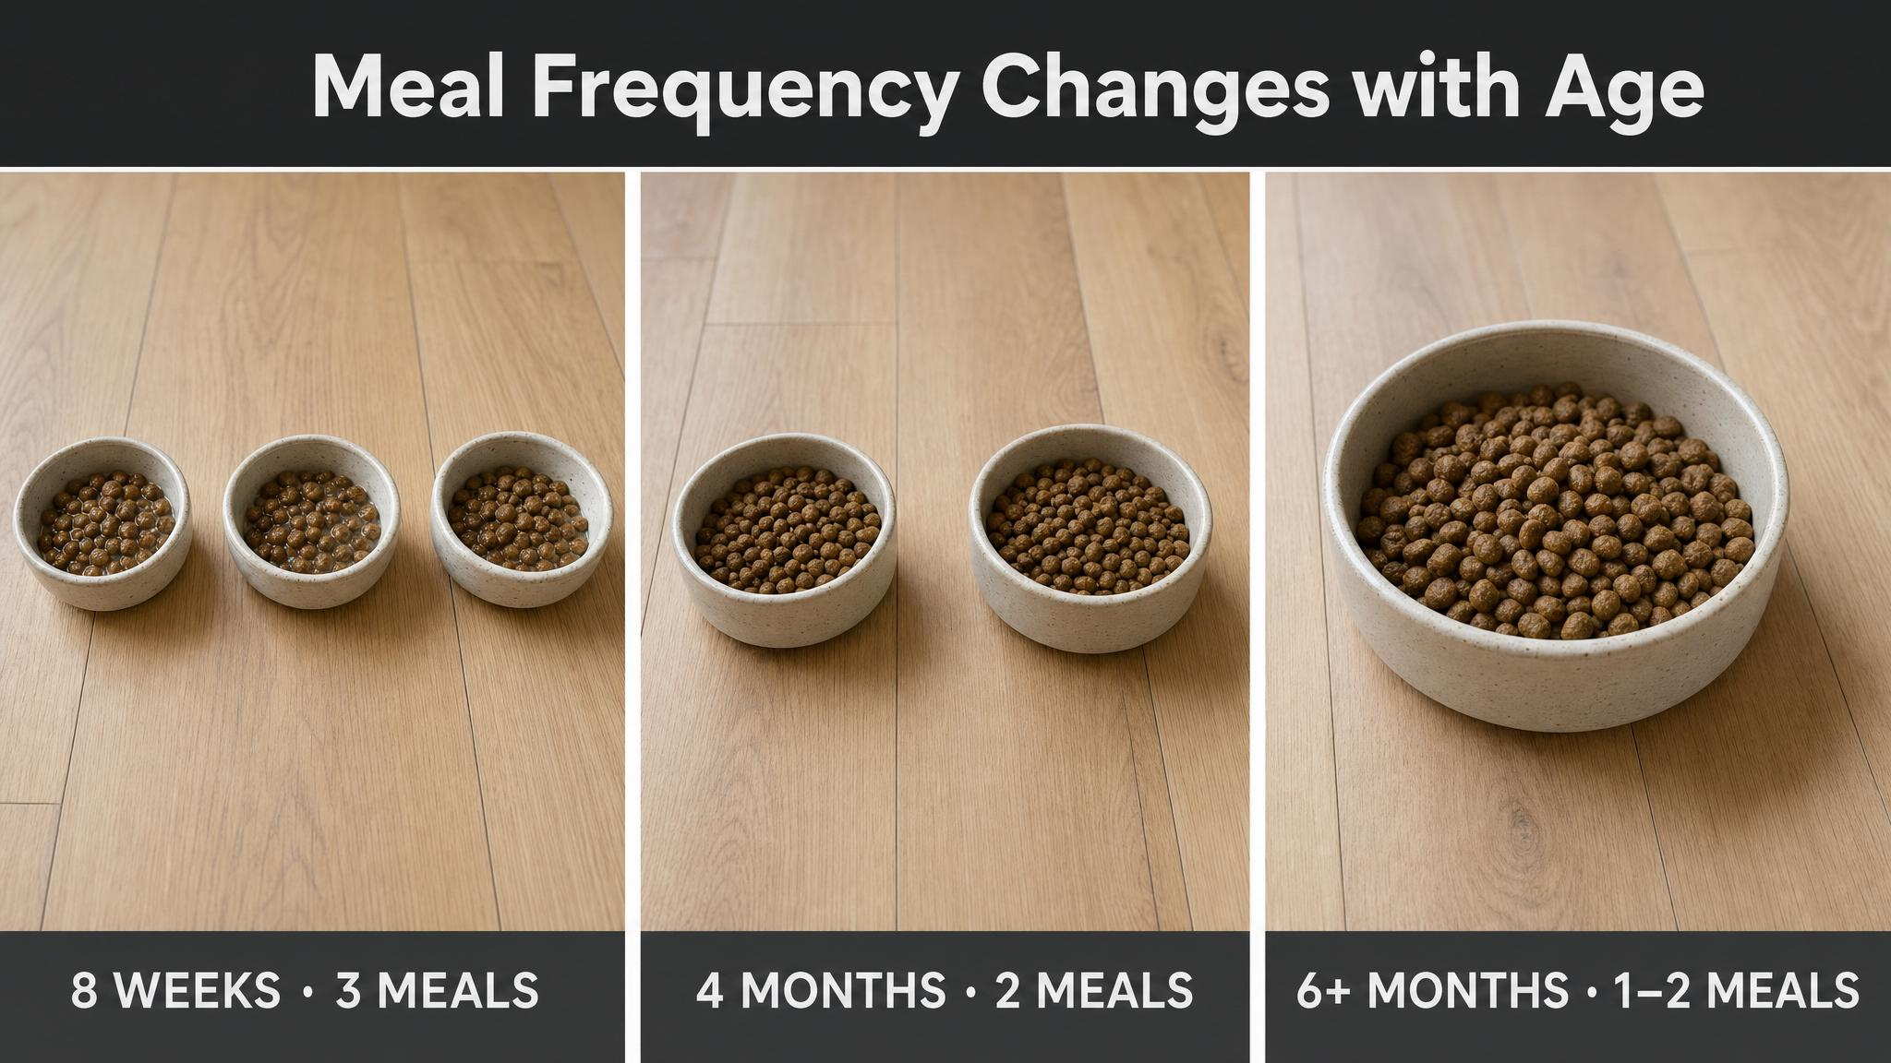
Notes:
Meal frequency is age-dependent and well-evidenced. Per the American Kennel Club: six to twelve weeks needs four meals a day; three to six months drops to three; six to twelve months moves to two — the schedule most adult dogs keep for life. Transition gradually over about a week, and watch stools and energy levels as you go.

Slide 7
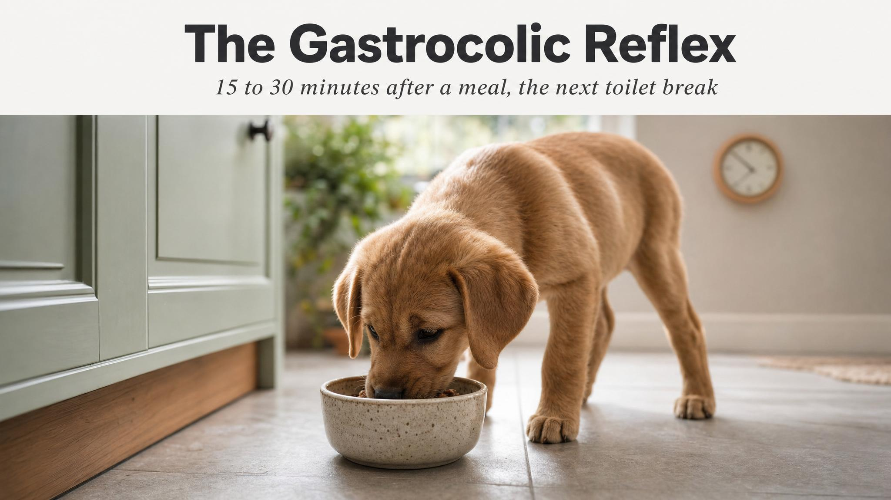
Notes:
Most puppies need to toilet within fifteen to thirty minutes after eating, driven by the gastrocolic reflex — food entering the stomach triggers movement in the colon. Planning for this single physiological fact is the most effective thing you can do to accelerate house-training. If the puppy eats at 7 a.m., have your shoes on and be ready by 7:15.

Slide 8
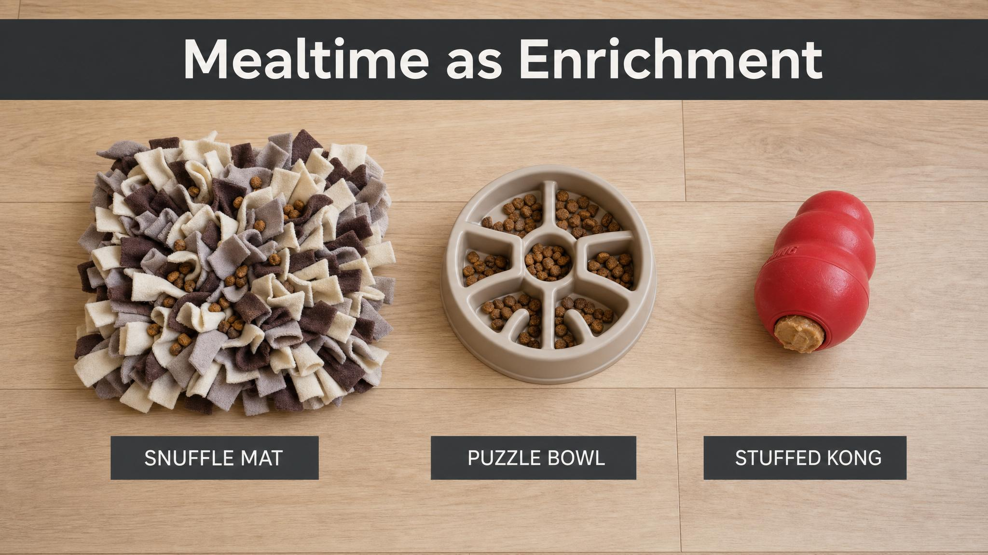
Notes:
A food bowl is the least interesting way to deliver a puppy's meals. Three meals from a bowl is roughly four-and-a-half minutes of eating a day. Hand-feed one meal, puzzle-feed one, and use the third as training reinforcers and you turn that four-and-a-half minutes into potentially forty-five minutes of enrichment, learning, and bonding. Same food. Different relationship.

Slide 9
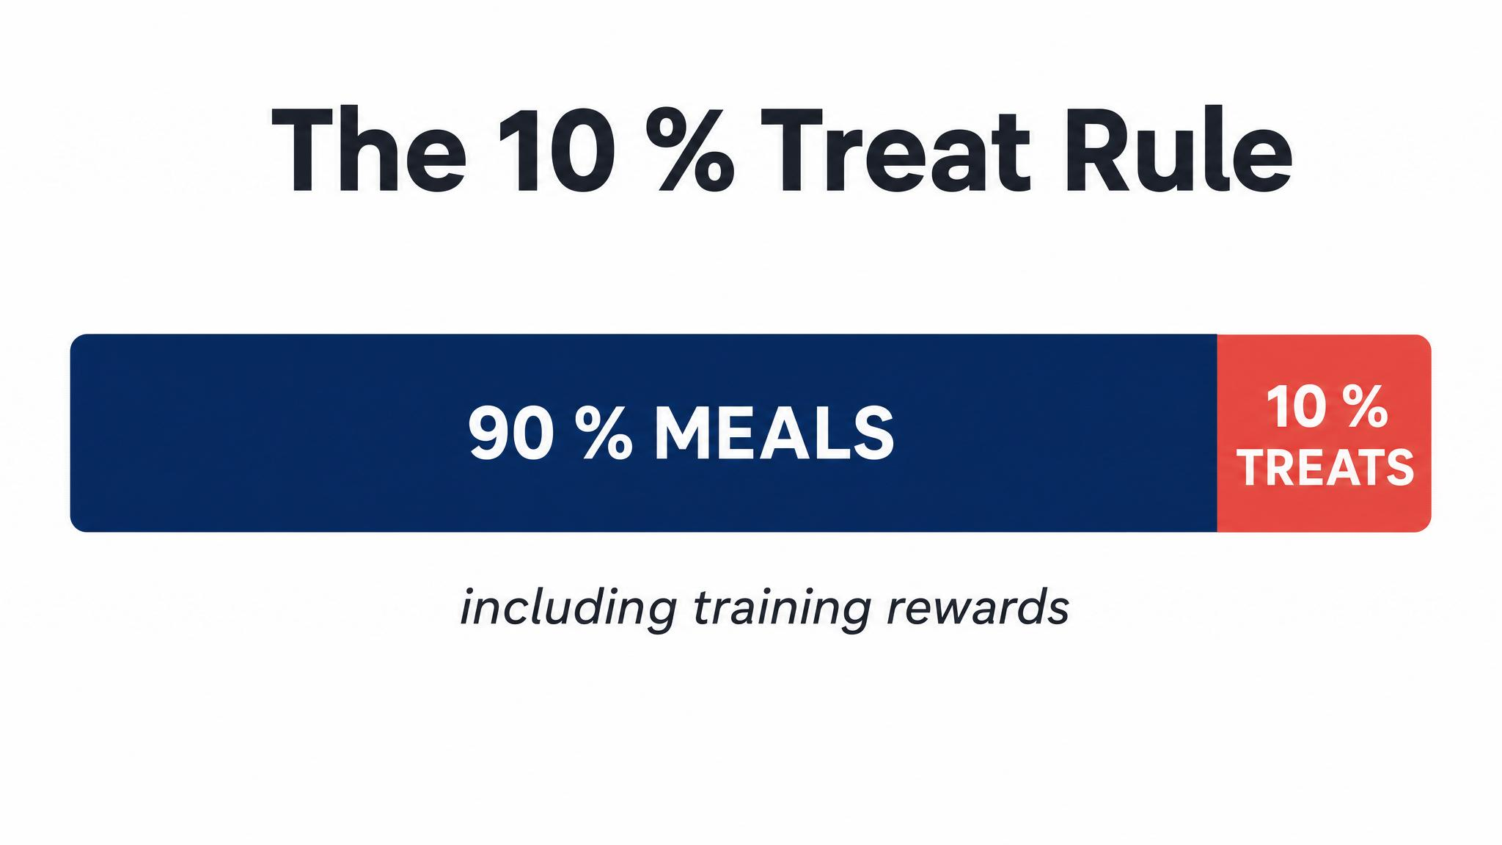
Notes:
A simple guideline from the American Kennel Club: treats and extras should be no more than ten percent of daily calories. Where most owners go wrong is not at meals but in the accumulation — a single dental chew can be twenty to thirty percent of a small puppy's day. Measure the daily allowance in the morning. Set aside a portion for training. Account for everything.

Slide 10
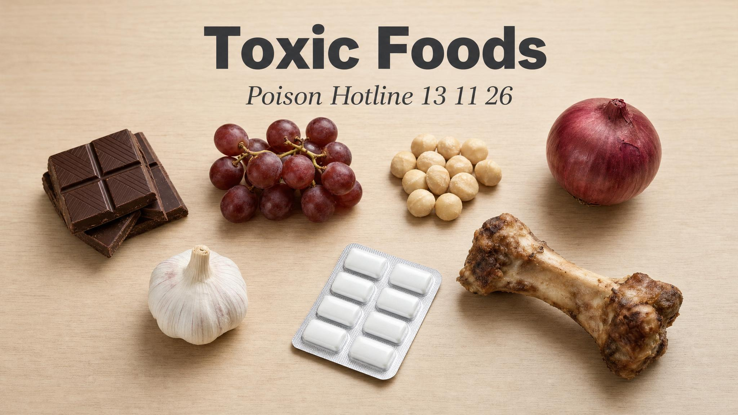
Notes:
Pause here. Read the number aloud: thirteen-eleven-twenty-six. Then again: thirteen-eleven-twenty-six. Twenty-four-hour service. Have students put it into their phones now — chocolate, grapes and raisins, xylitol, onion and garlic, macadamia nuts, cooked bones, corn cobs, bread dough. Cortinovis and Caloni found food-associated poisoning accounts for about 14.8% of hazardous exposures in companion animals.

Slide 11
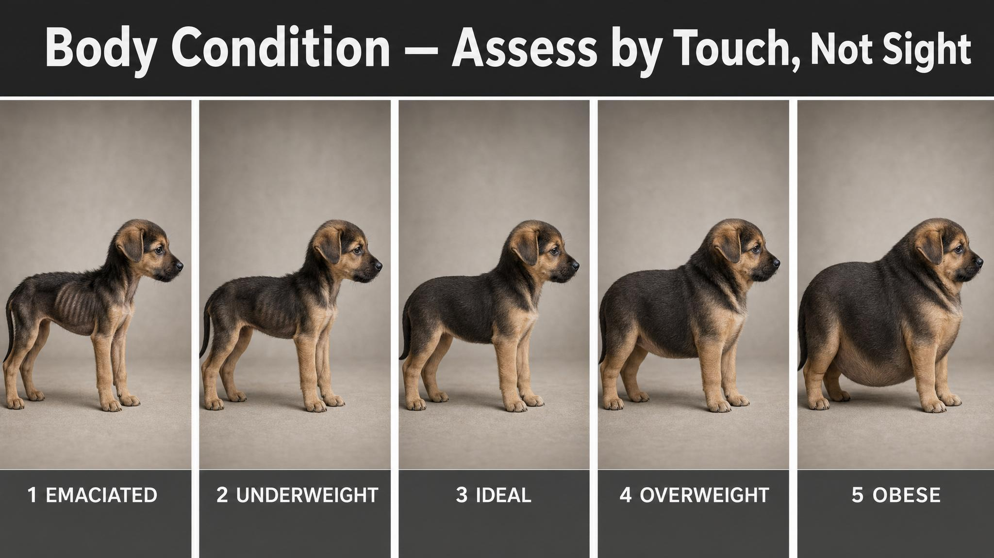
Notes:
Body condition scoring — developed by Laflamme in 1997 and adopted by the World Small Animal Veterinary Association — uses three landmarks: rib coverage, waist definition, and abdominal tuck. The crucial point: coat hides everything in the middle. You should be able to feel the ribs easily under a thin layer of fat, like feeling the back of your hand. If you have to press firmly to find them, the puppy is carrying excess weight. Lean puppies live up to fifteen percent longer — that's the Purina Lifespan Study.

Slide 12
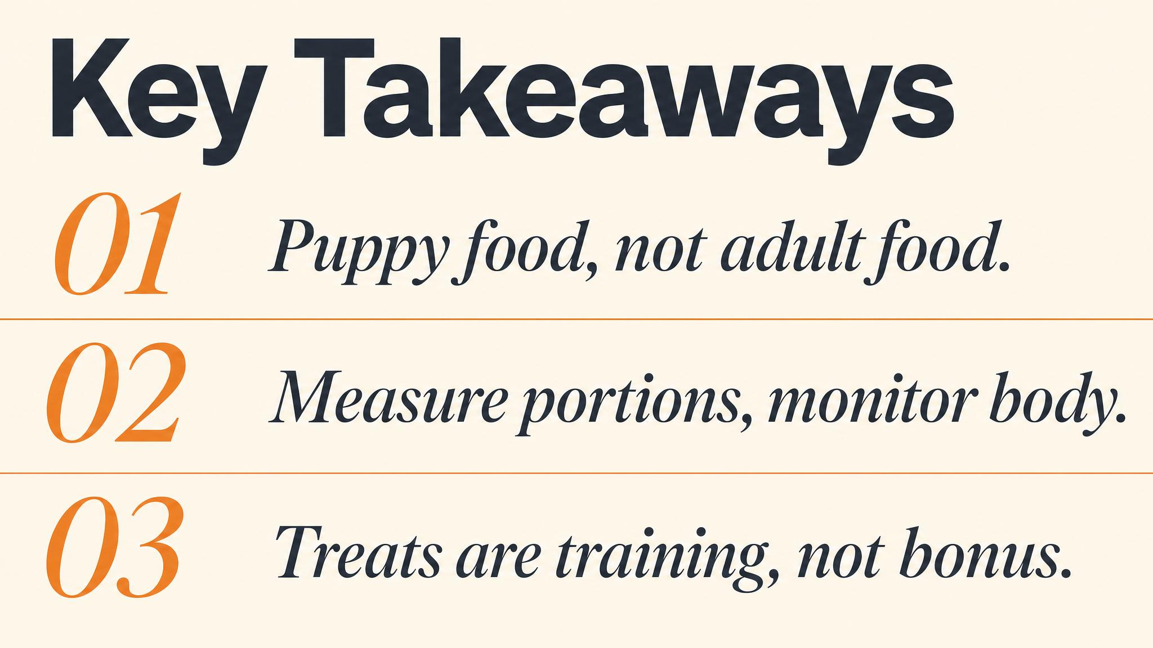
Notes:
Three things to carry forward. One: choose a food specifically formulated for growth — adult food cannot do this job. Two: every meal triggers the gastrocolic reflex within fifteen to thirty minutes, so plan toilet breaks around feeds. Three: score body condition with your hands every week, and adjust portions before weight becomes a problem, not after. Pause briefly on each.

Slide 13
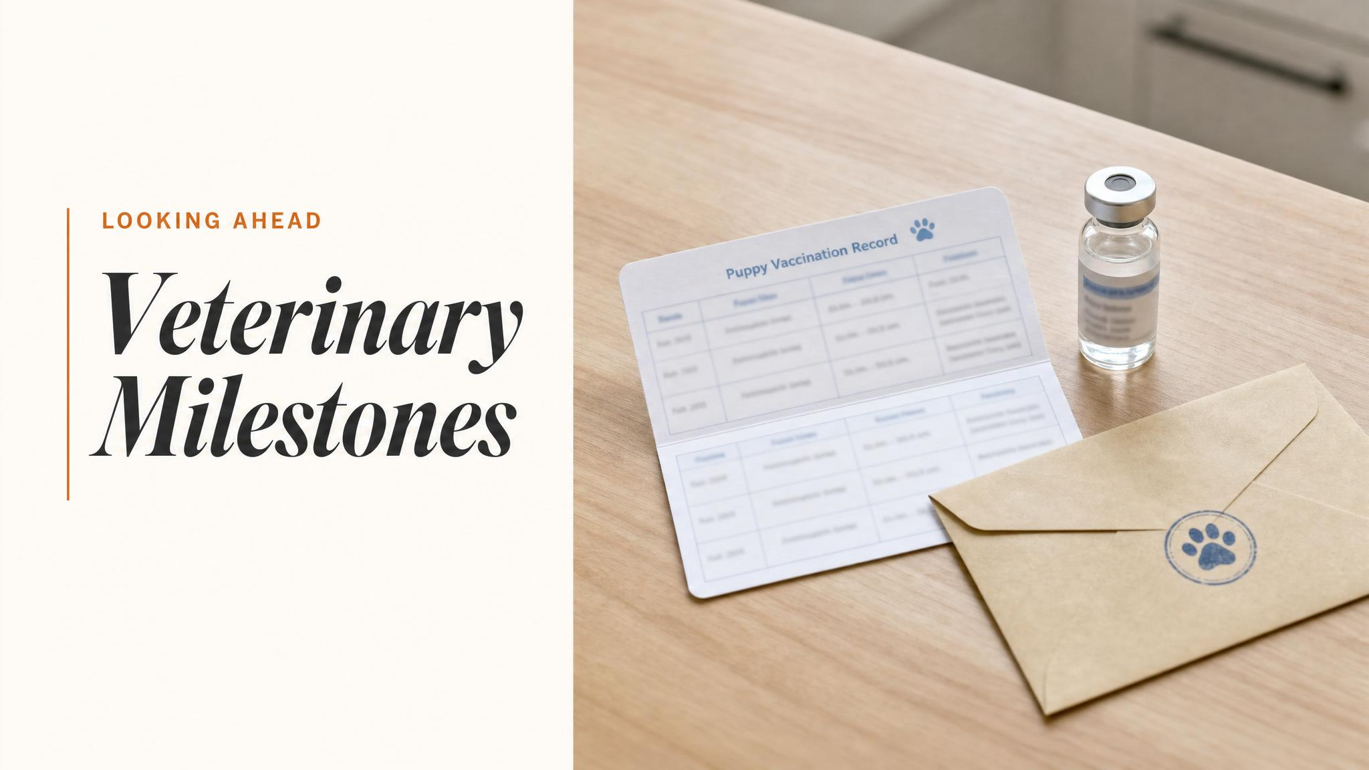
Notes:
Close with the bridge: next chapter, we move from the kitchen to the clinic. Vaccinations and the immunity gap, parasite prevention with an east-coast tick focus, the desexing decision, and how to make every vet visit a deposit in the cooperative-care bank rather than a withdrawal. The bond you're building through thoughtful feeding will pay off there too.

