Slide 1
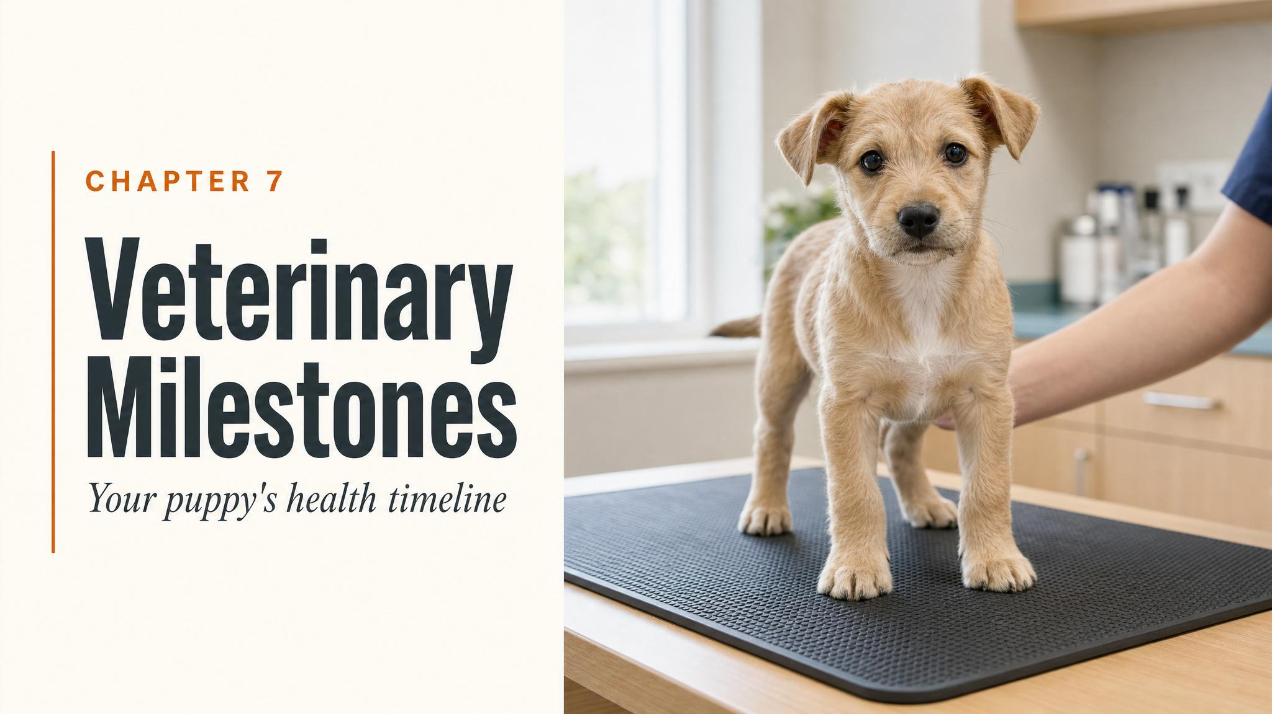
Notes:
Open with the chapter's frame: every vet visit is simultaneously a medical event and a training opportunity. This chapter gives the roadmap, not just for what medical milestones your puppy needs, but for making each one a positive experience that builds trust rather than fear.

Slide 2
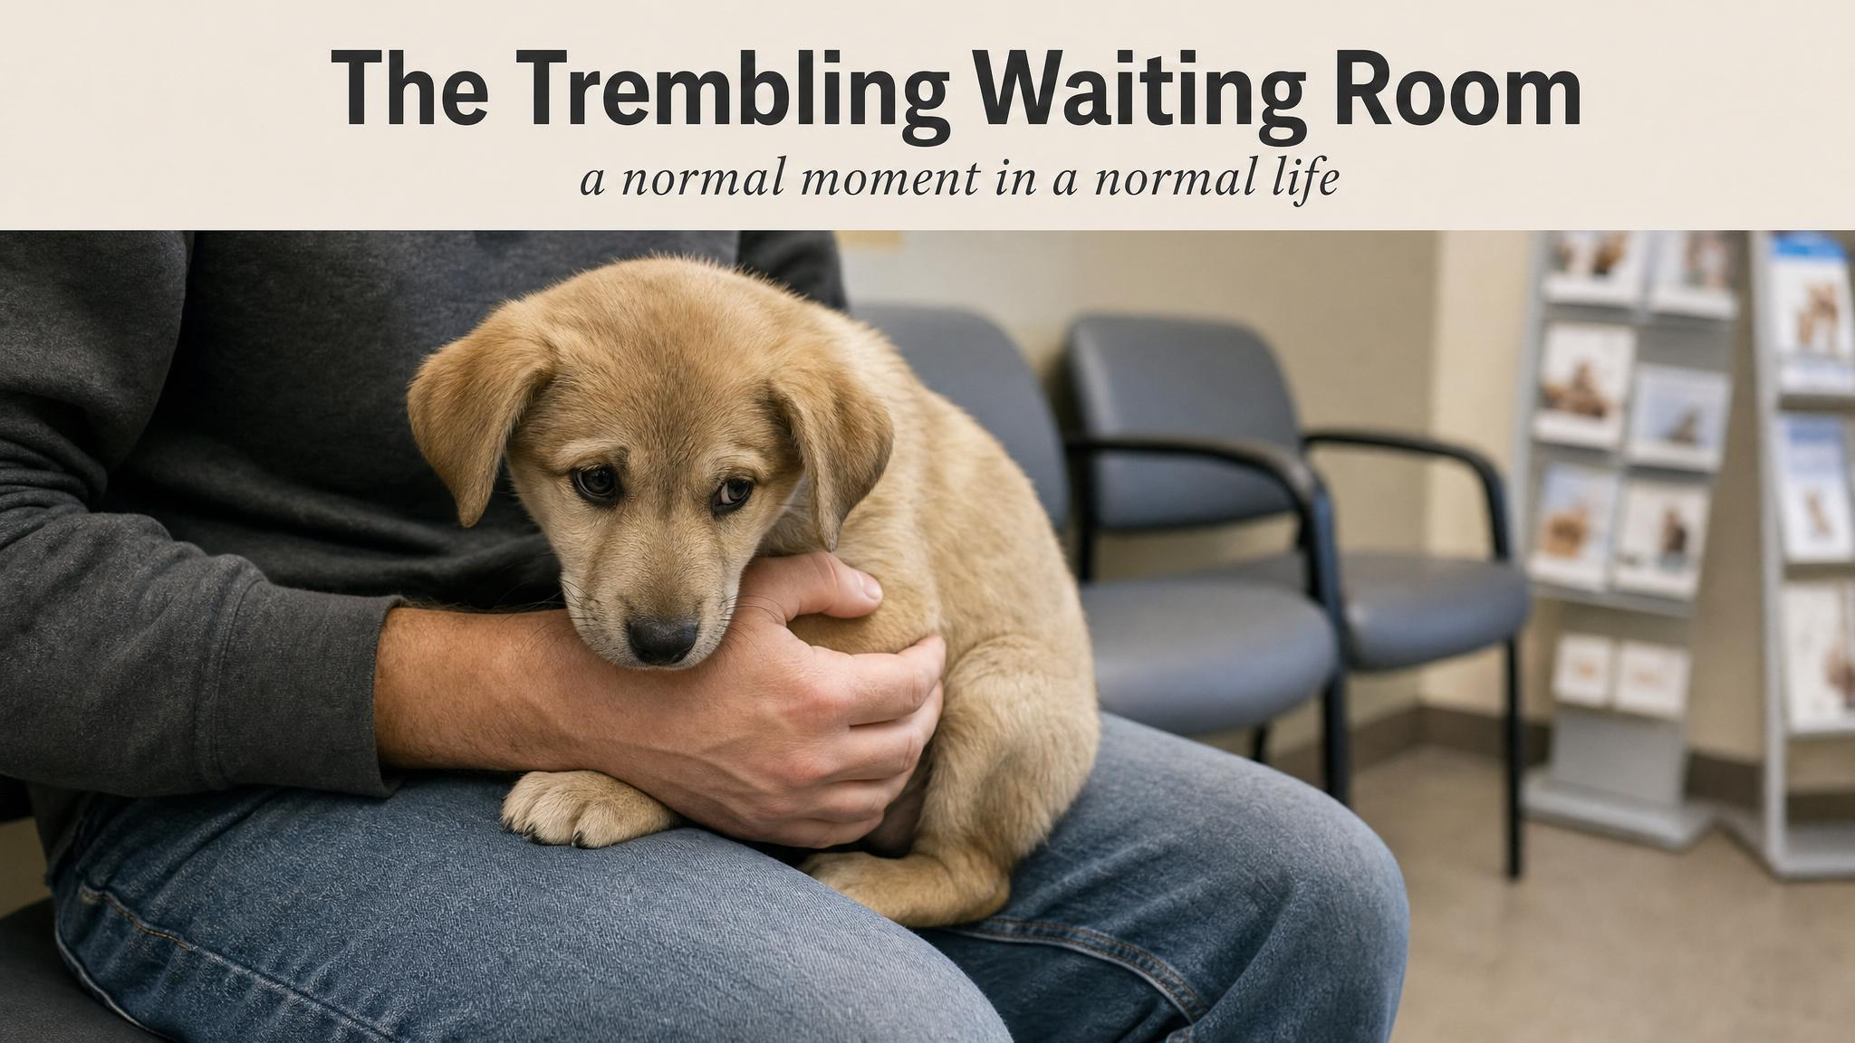
Notes:
Set the scene the chapter opens with — an eight-week-old Labrador trembling at the clinic door. The receptionist says 'they all hate it here.' Pause on the line. Then pivot: they don't have to. That is the chapter's whole project.

Slide 3
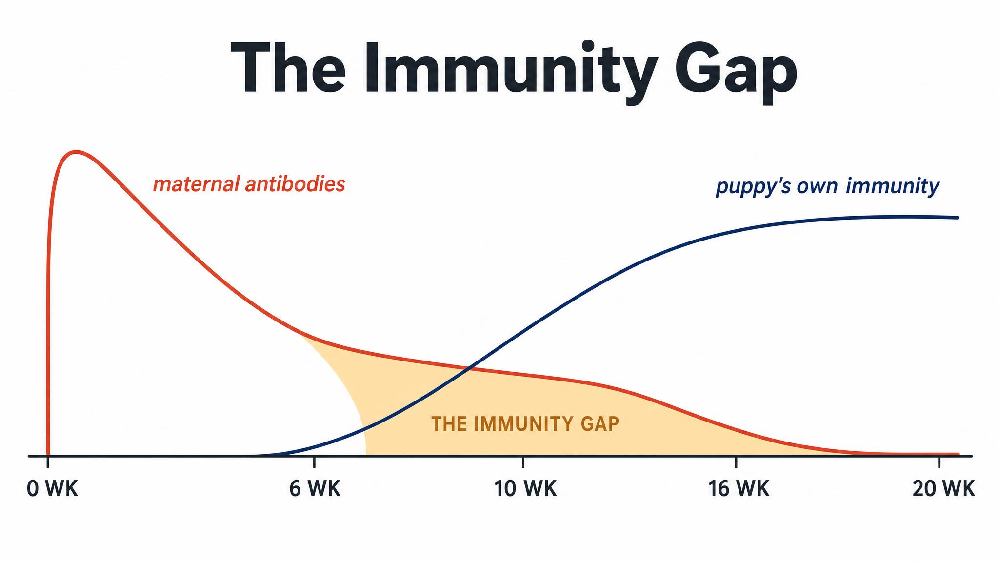
Notes:
Maternal antibodies — passed through colostrum in the first hours of life — protect the puppy until they don't. Between roughly six and sixteen weeks they have dropped too low to protect against disease but may still be high enough to neutralise a vaccine. That's the immunity gap, and it's why your vet gives a series rather than a single jab.

Slide 4
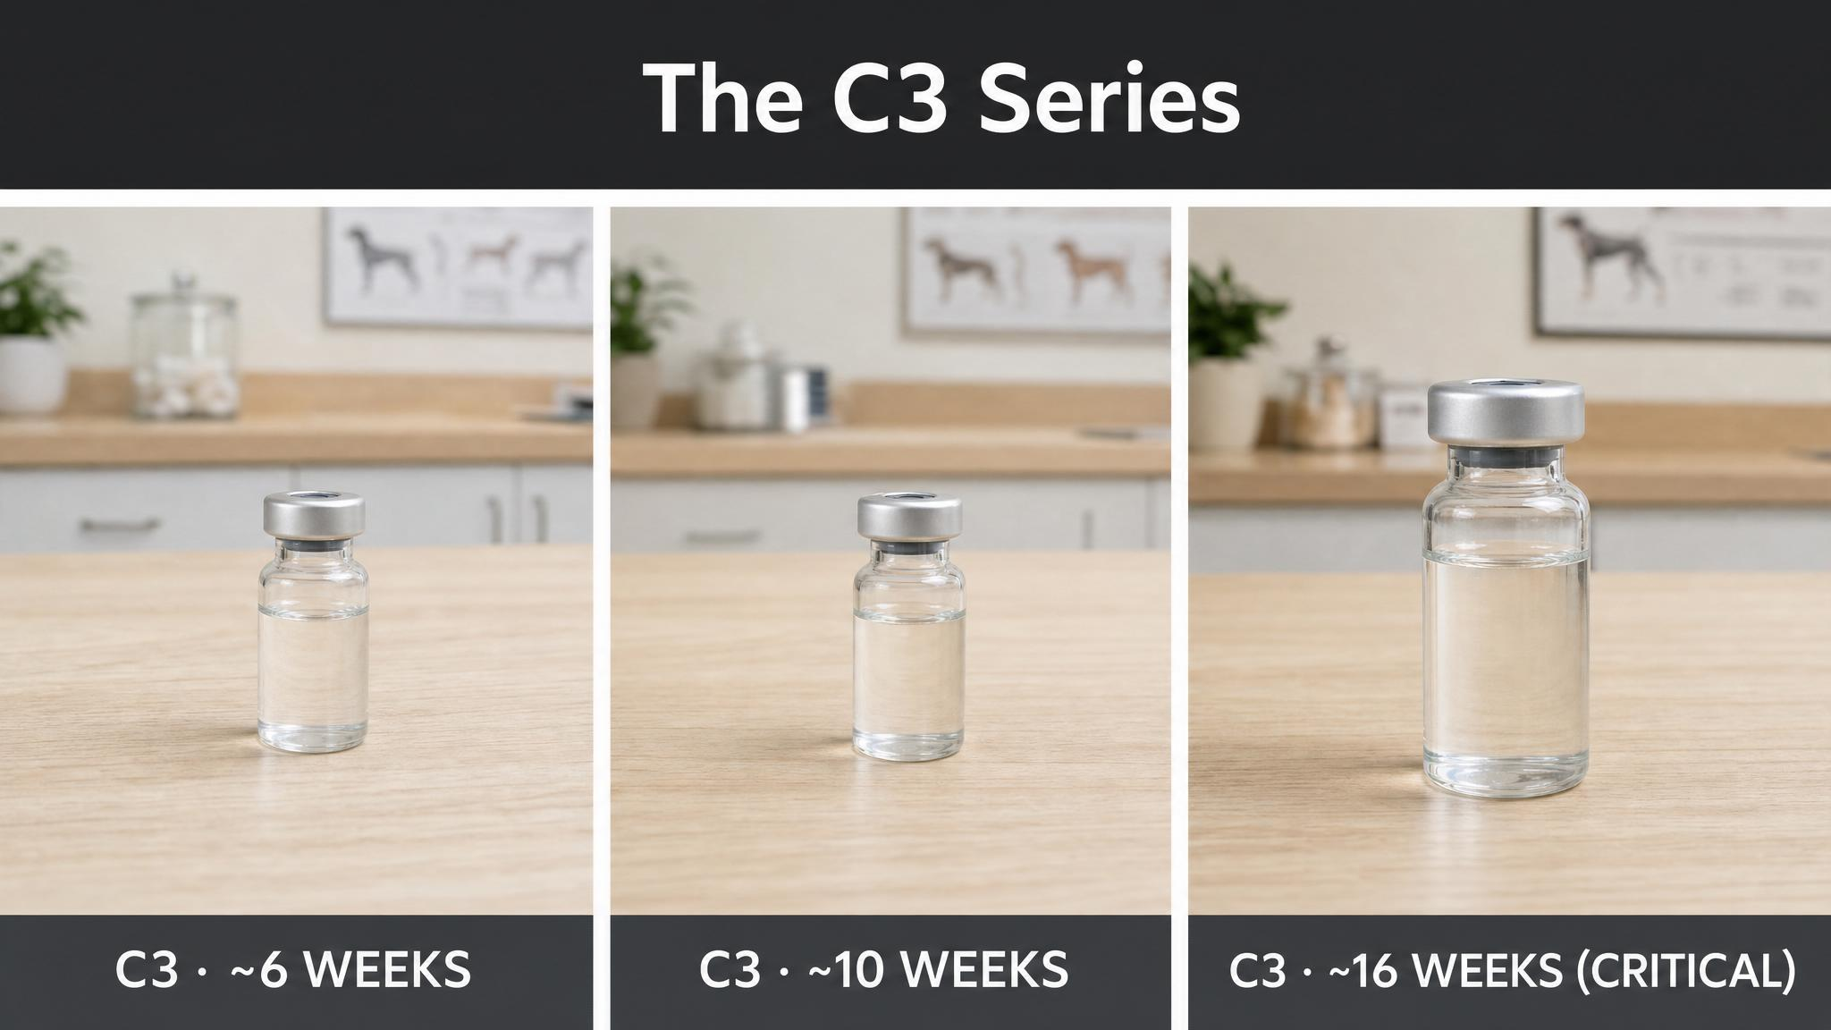
Notes:
Australia's core vaccination is the C3 — distemper, adenovirus (hepatitis), and parvovirus. The standard protocol is three doses at six to eight, ten to twelve, and sixteen weeks. The sixteen-week dose is the critical one, the dose most likely to produce a robust immune response after maternal antibodies have fully waned.

Slide 5
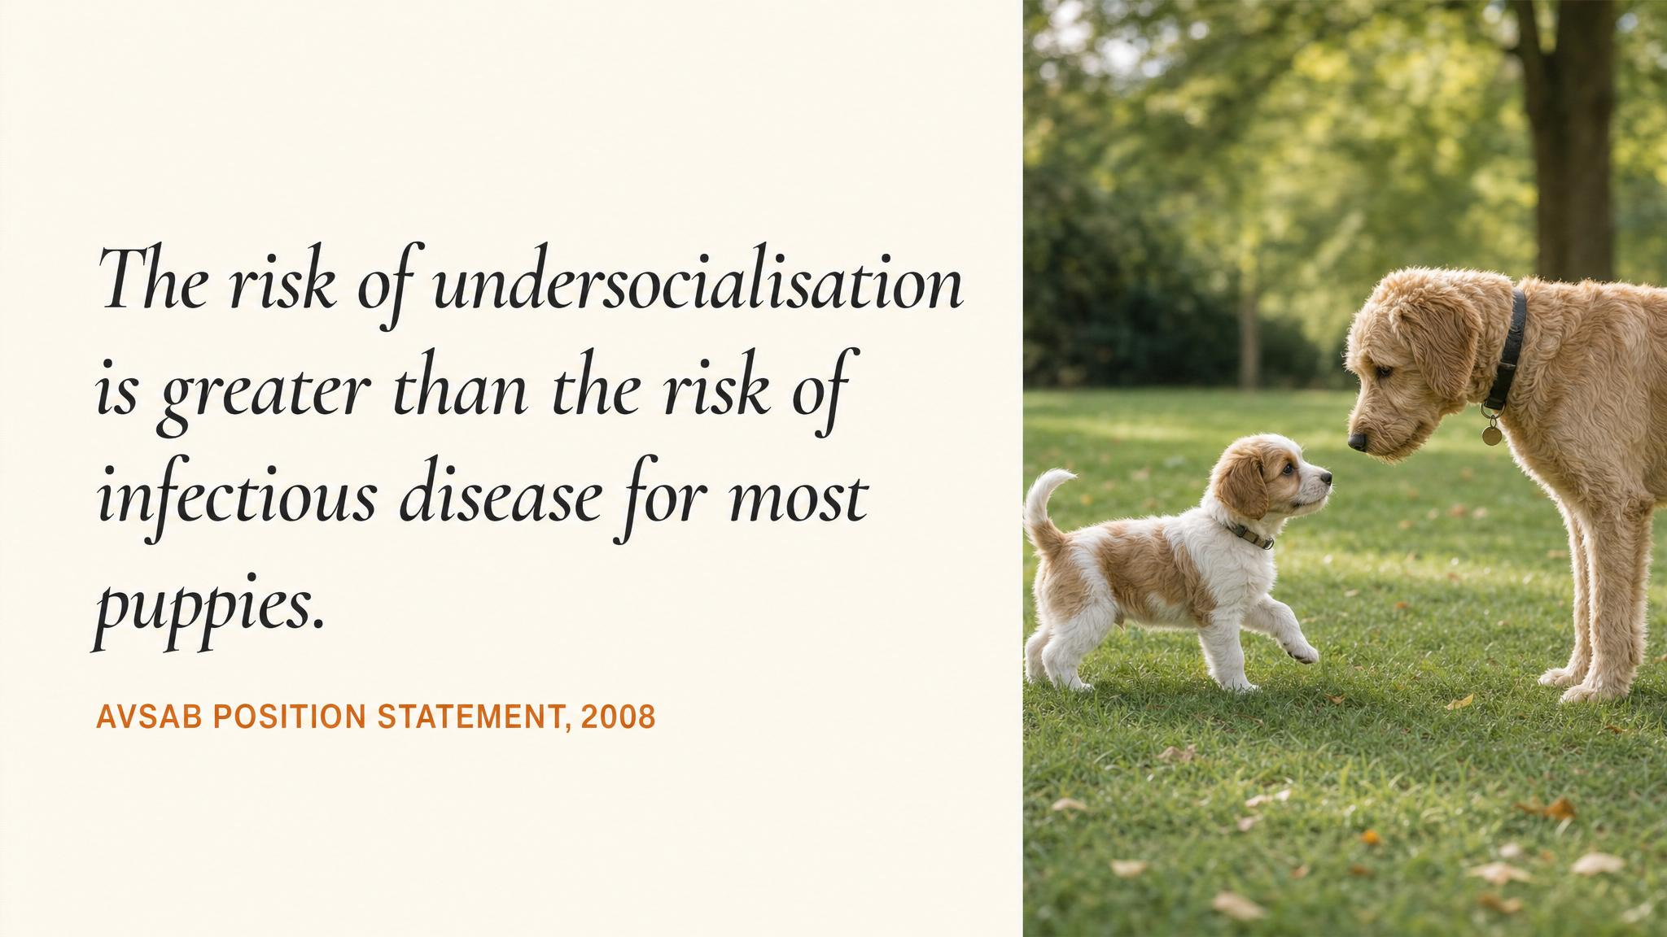
Notes:
The American Veterinary Society of Animal Behavior, in 2008 and updated in 2014, addressed the apparent tension between socialisation and disease risk head-on. The behavioural risk of doing nothing is greater than the infection risk of doing something, when appropriate precautions are taken — carrying the puppy, visiting vaccinated dogs in clean homes, attending well-run puppy classes on sanitised floors.

Slide 6
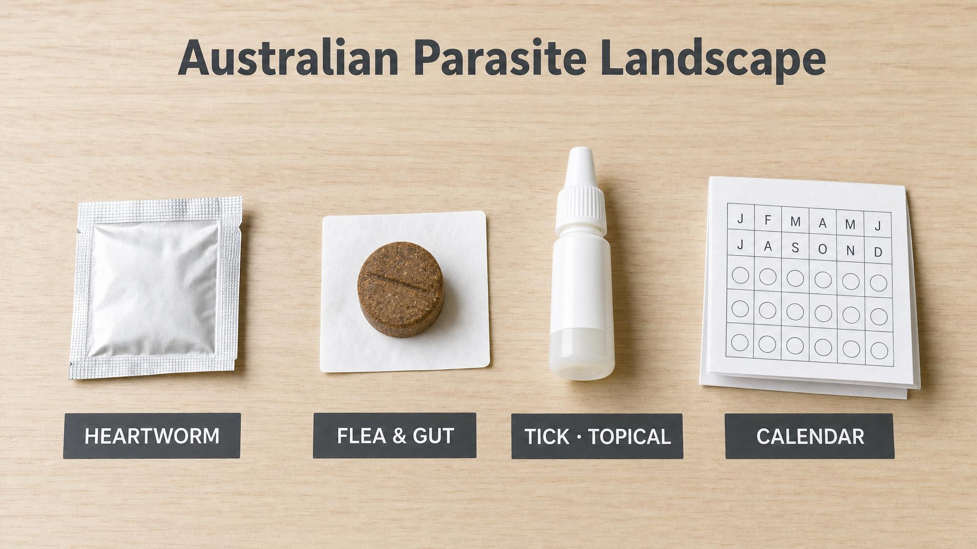
Notes:
Australia's warm climate and diverse ecosystems mean four parasite categories every plan must cover — intestinal worms, heartworm, fleas, ticks. Intestinal worming starts fortnightly from two weeks. Heartworm prevention starts at twelve weeks. Fleas at eight weeks. And then there's the tick we'll spend the next slide on.

Slide 7
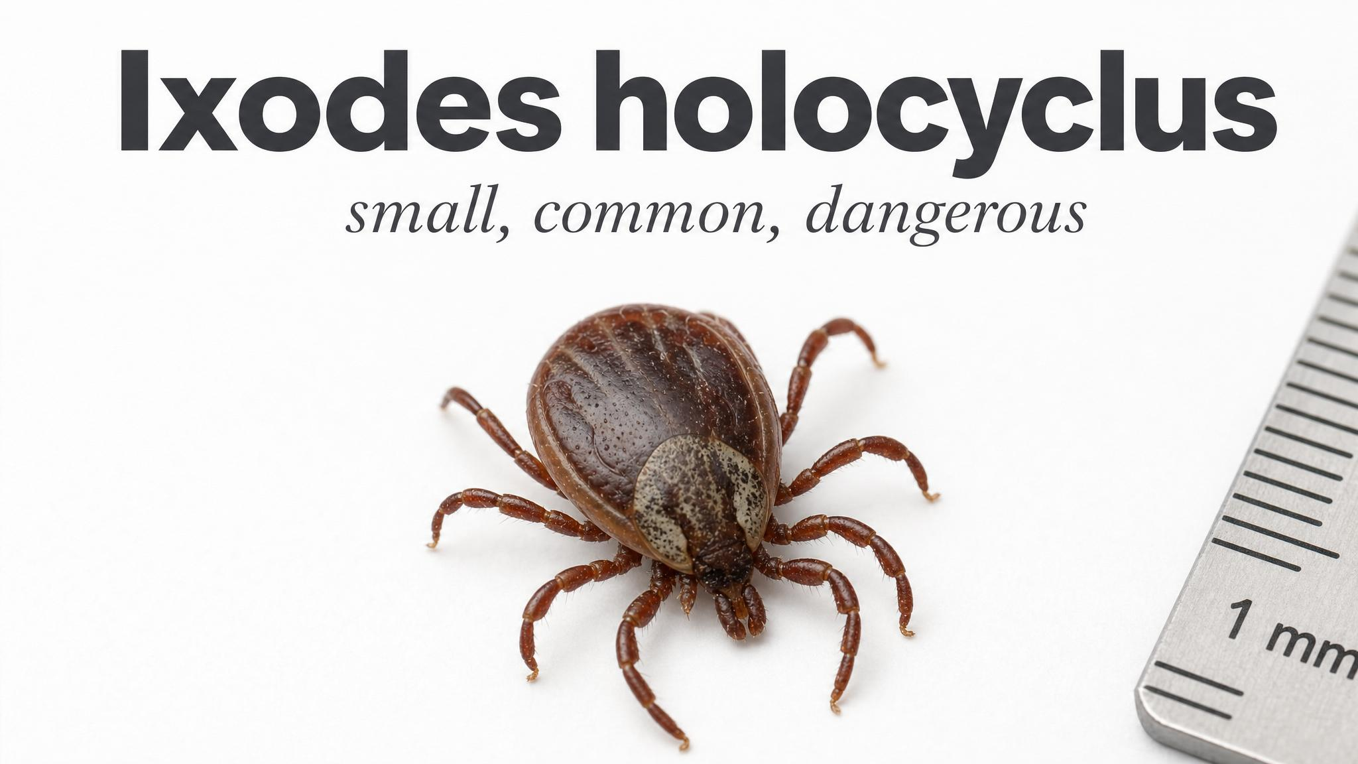
Notes:
Ixodes holocyclus, the Australian paralysis tick, is found from North Queensland to northern Victoria. Approximately ten thousand companion animals are affected by tick paralysis annually in Australia, according to a PMC review in 2014. And unlike paralysis ticks elsewhere in the world, removing the tick does not immediately reverse the paralysis. Animals can keep deteriorating after removal.

Slide 8
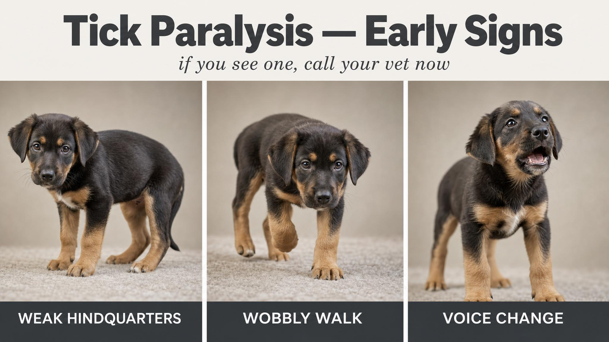
Notes:
The tick produces a neurotoxin called holocyclotoxin that causes rapidly ascending flaccid paralysis — symptoms move from the hind legs forward. The three signs to imprint on every owner in the east-coast zone: a changed bark or voice, wobbliness in the back legs, and retching. Especially during the warmer months from September to March. Treat any suspicion as an emergency.

Slide 9
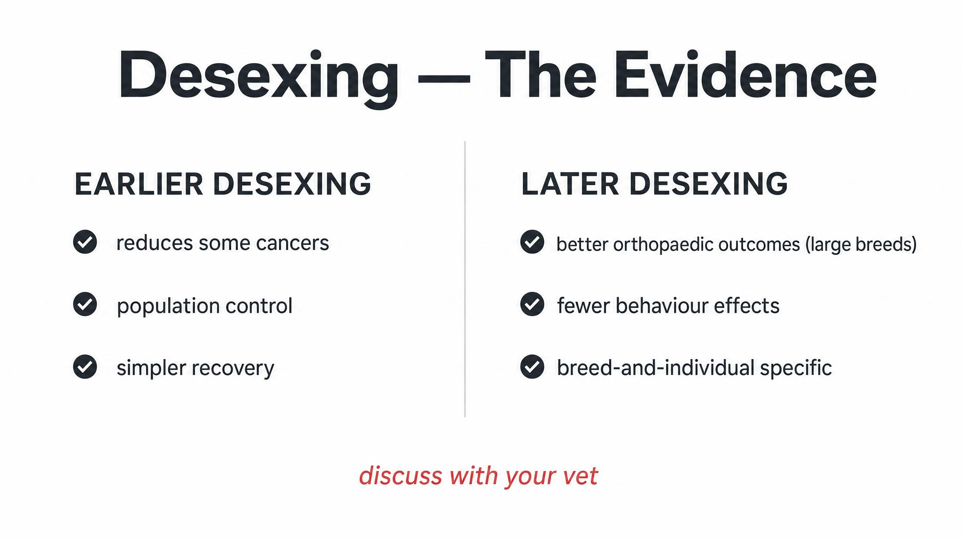
Notes:
Two landmark studies anchor this. Torres de la Riva and colleagues, 2013, found that male Goldens neutered before twelve months had double the rate of hip dysplasia, ten percent versus five percent, and three times the rate of lymphosarcoma. Hart and colleagues, 2020, expanded the question across thirty-five breeds and found the effects vary dramatically by size — large breeds vulnerable, small breeds not.

Slide 10
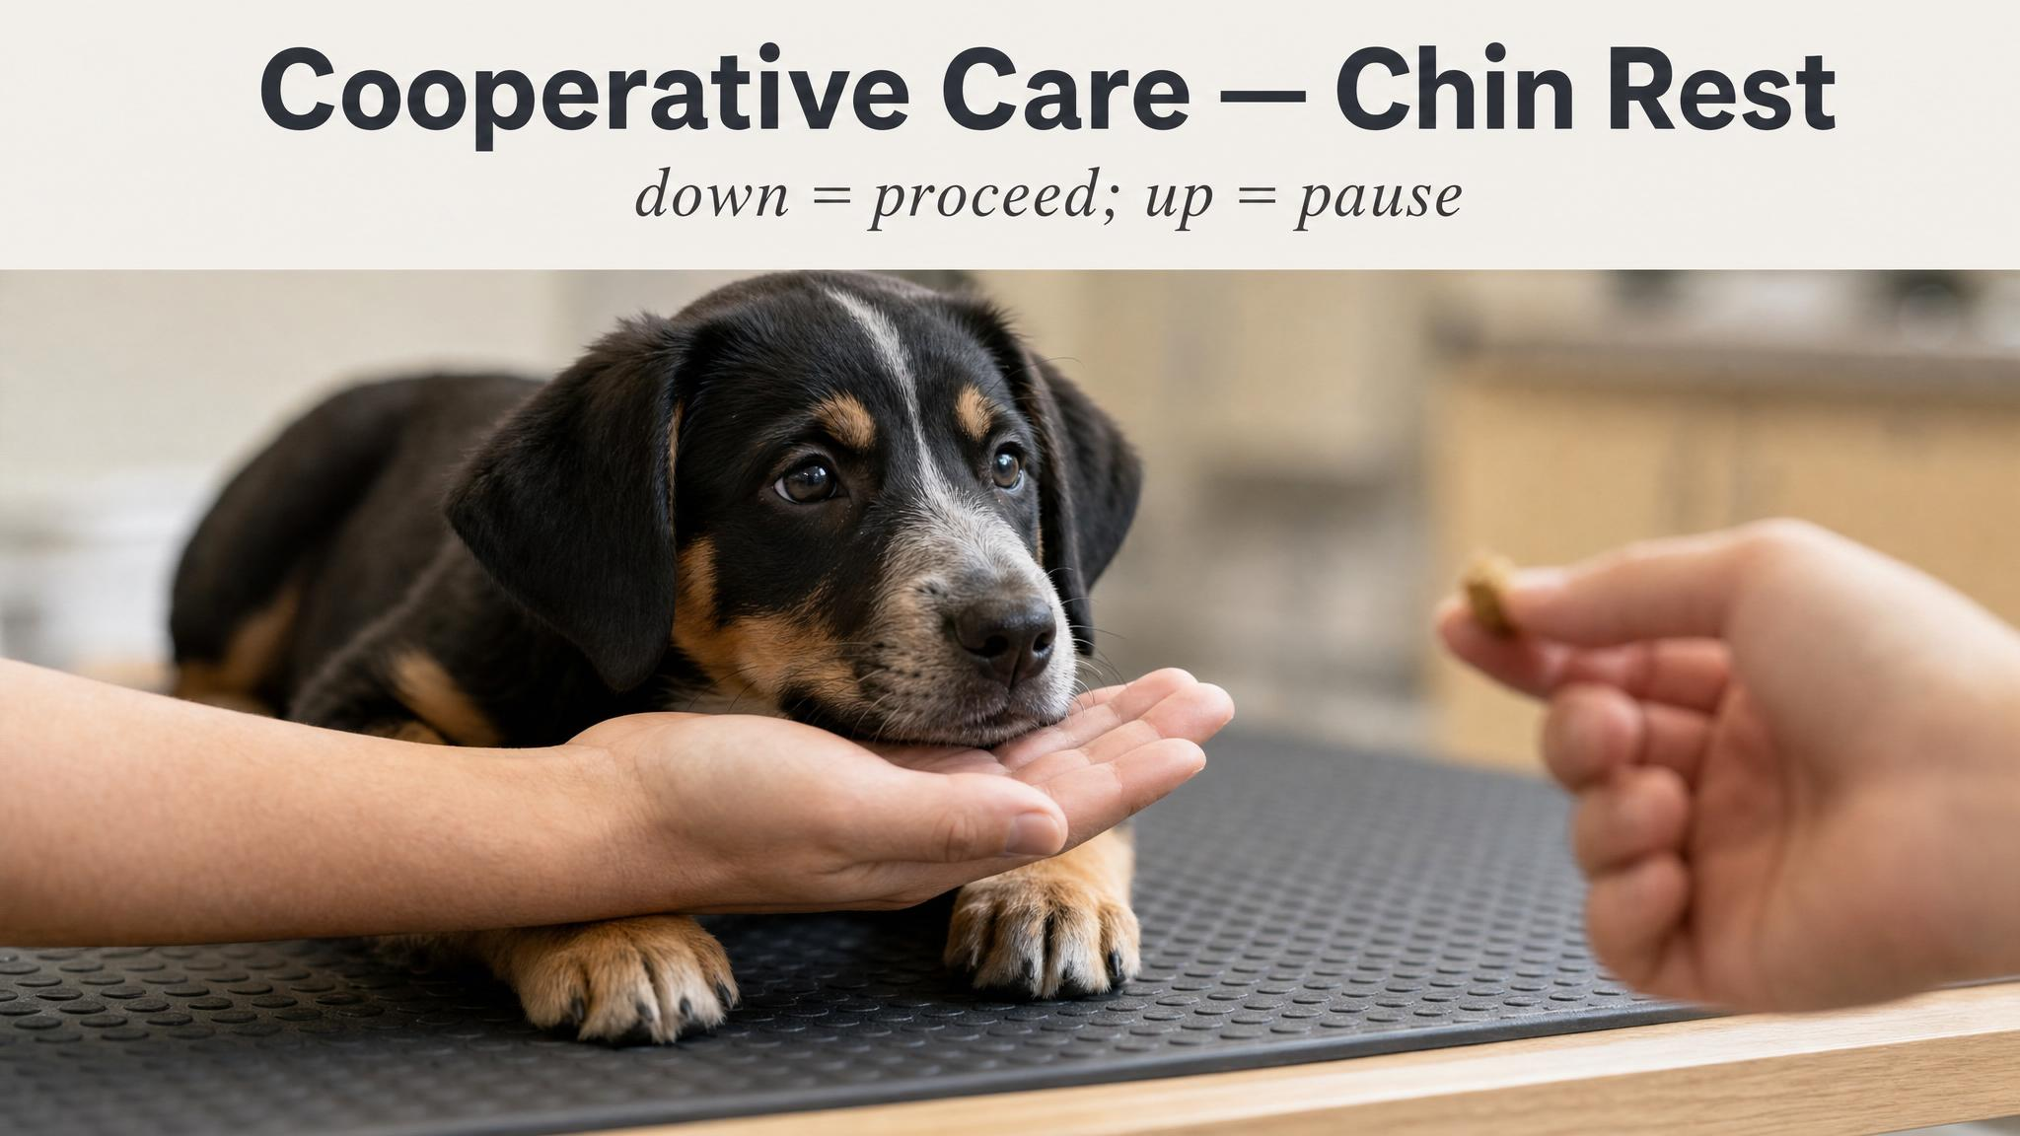
Notes:
Cooperative care, as Jones described in 2018, is the practice of training animals to be active willing participants in their own handling. The simplest example is the chin rest — the puppy voluntarily places its chin on your open hand. Chin down means 'I consent, proceed.' Chin up means 'I need a break.' This isn't permissiveness. It's a trained consent button that makes every future procedure faster, safer, and less stressful.

Slide 11
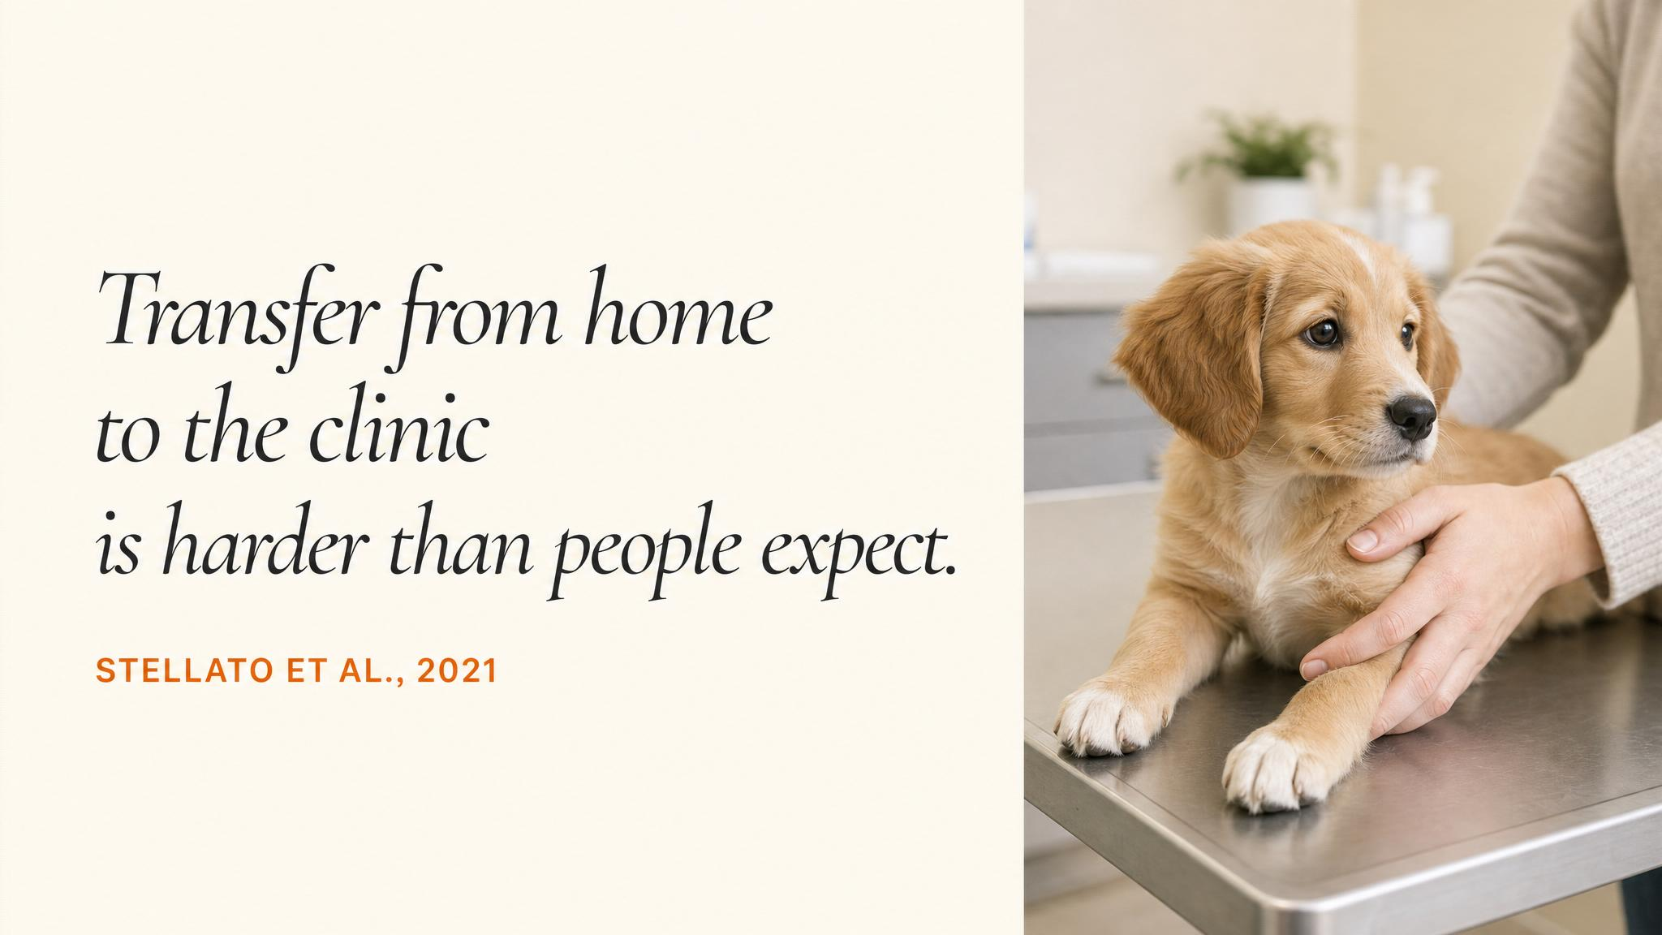
Notes:
Stellato and colleagues, 2022, ran a pilot of forty dogs and confirmed something every trainer eventually learns the hard way: cooperative-care skills don't automatically transfer from your living room to the vet's table. The clinic is a different environment — different surfaces, different smells, different stress baseline. You have to practice the chin rest at home and at the clinic, on a wobble board, on a rubber mat, on a real examination surface.

Slide 12
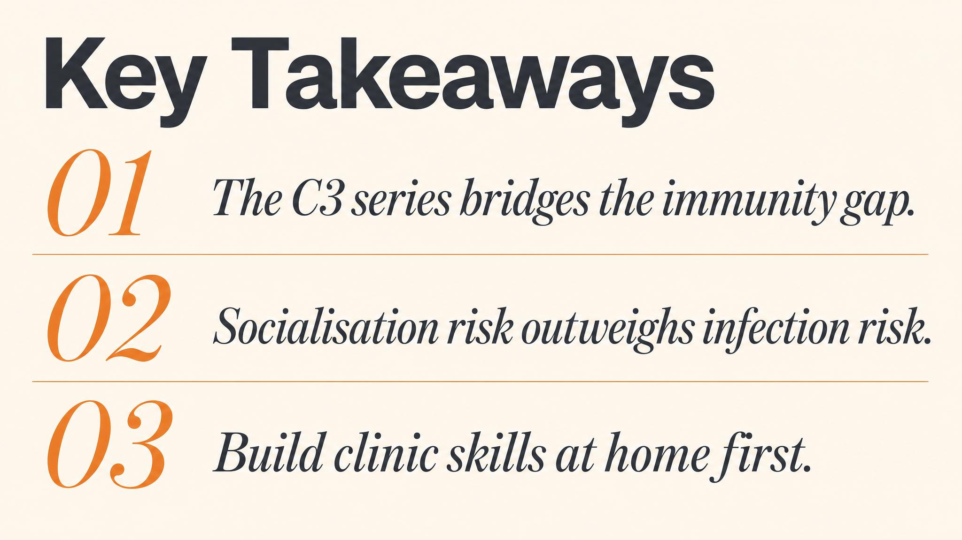
Notes:
Three things to carry forward. One: the C3 series exists to bridge the six-to-sixteen-week immunity gap, with the sixteen-week dose the most critical. Two: in the east-coast tick zone, a changed bark, wobbly hind legs, or retching is a veterinary emergency — do not wait. Three: cooperative care starts before the puppy ever needs a procedure. The consent button is built at home and used for life.

Slide 13
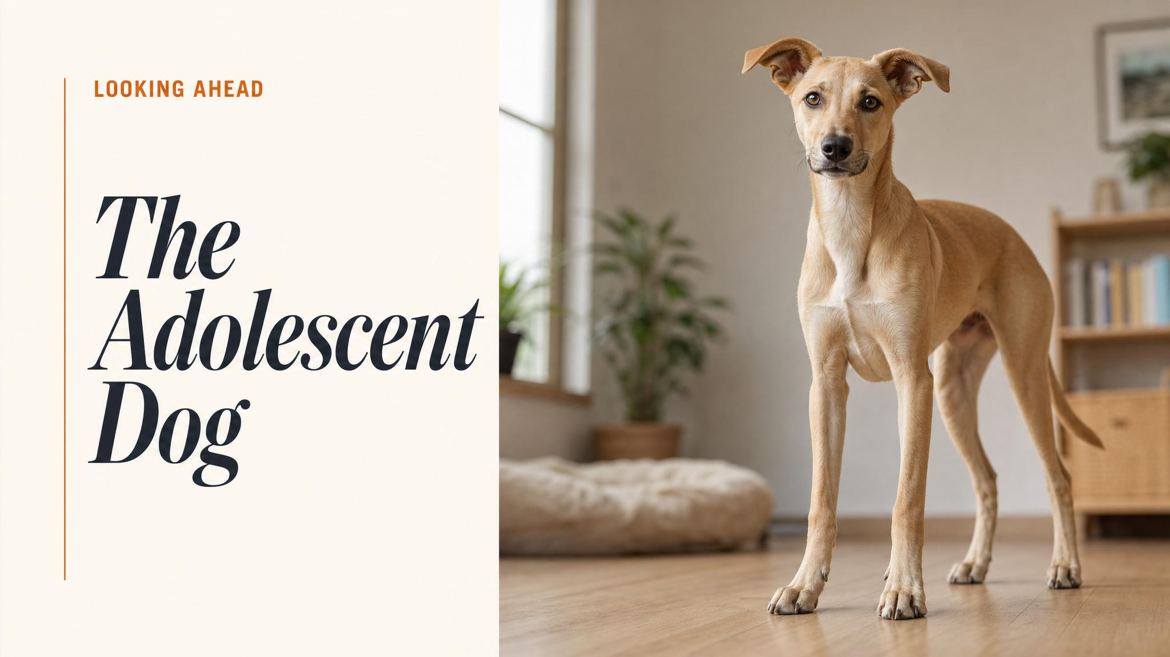
Notes:
Close with the bridge to Chapter 8. The neuroscience of canine puberty, the great regression that tests every foundation you've built, and how to know when to keep training, when to consult a veterinary behaviourist, and when to simply hold the line and wait it out.

