Slide 1
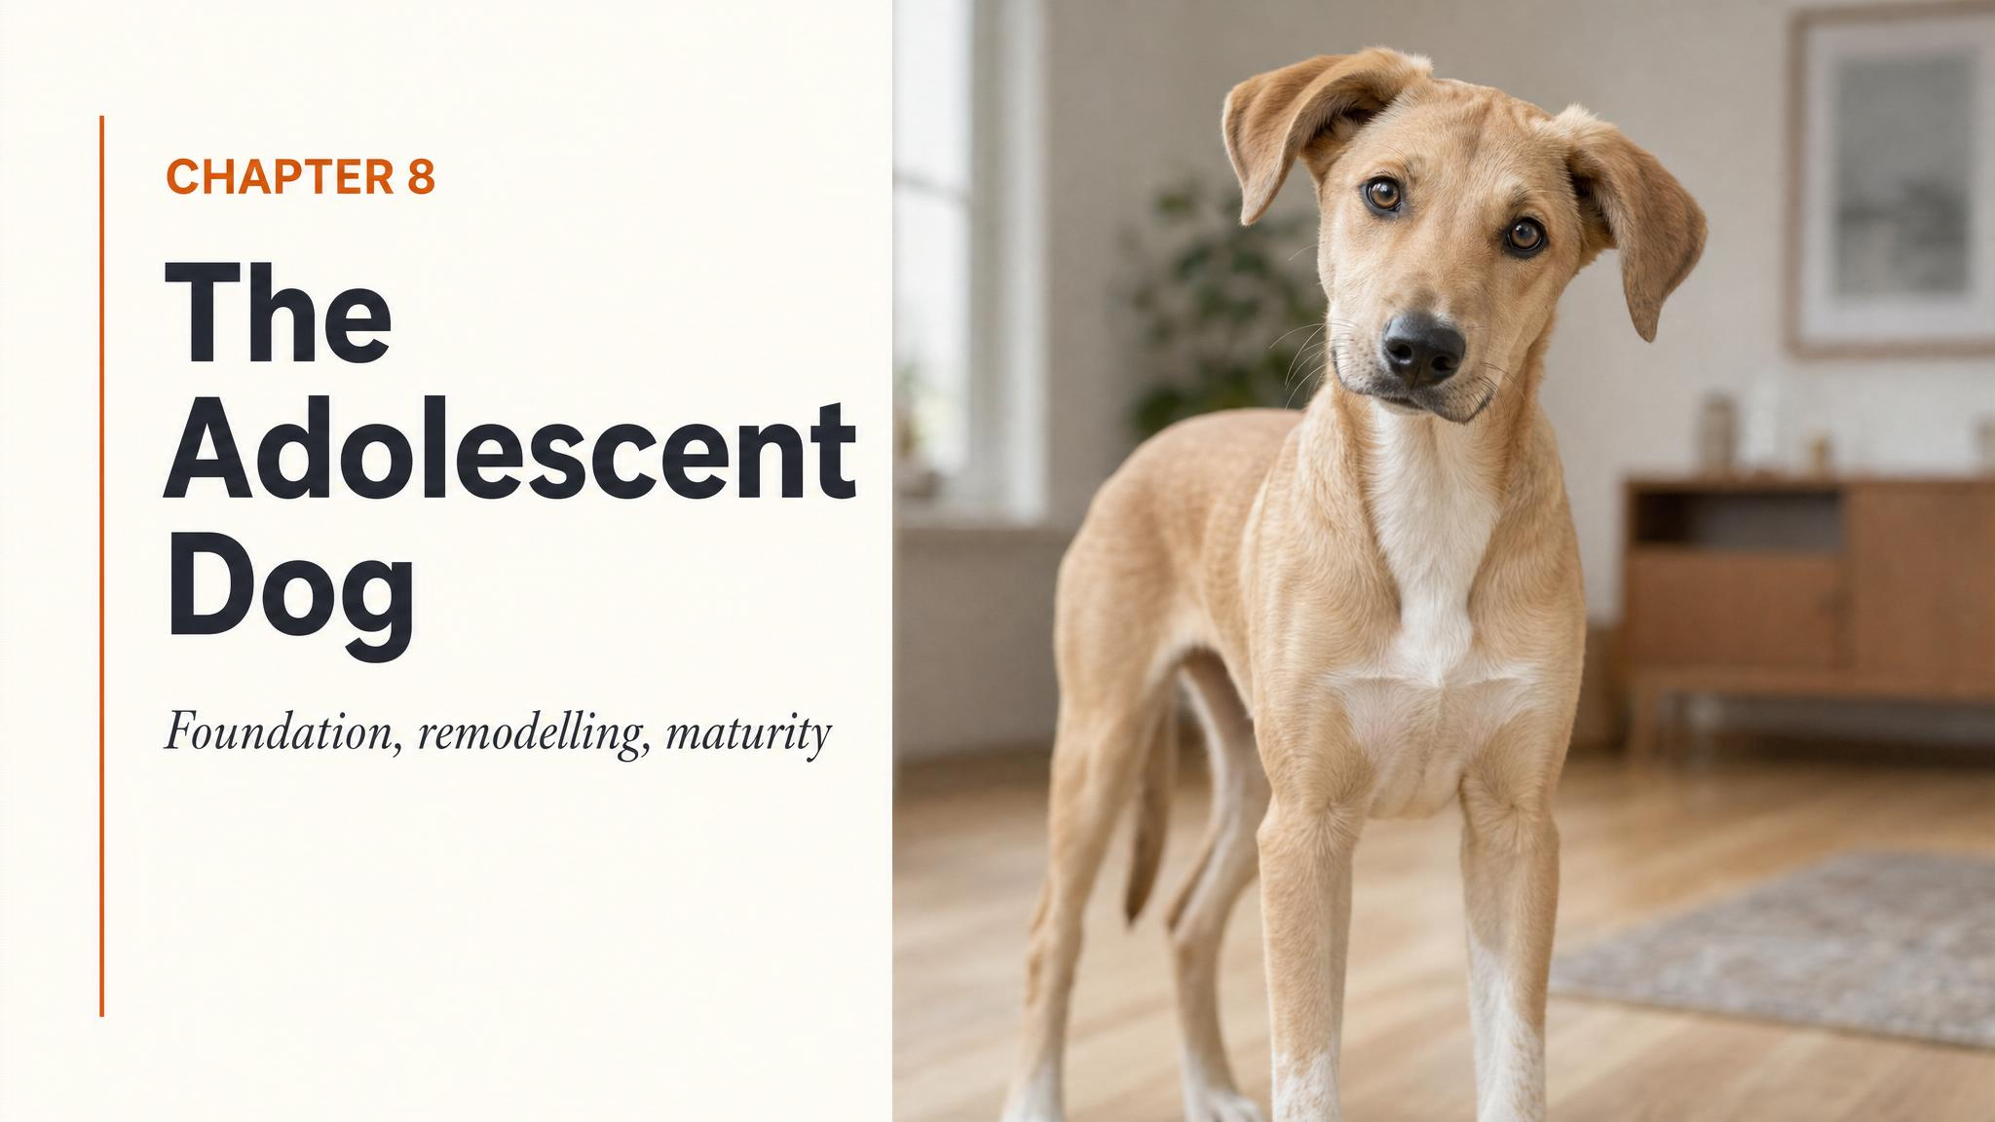
Notes:
Open by holding up the title image. Tell the room: this is the chapter every owner of a nine-month-old dog needs. Pause on the chewed couch cushion. Ask, gently — 'who in this room has lived through a Tuesday evening like that?' Use the laughter to begin.

Slide 2
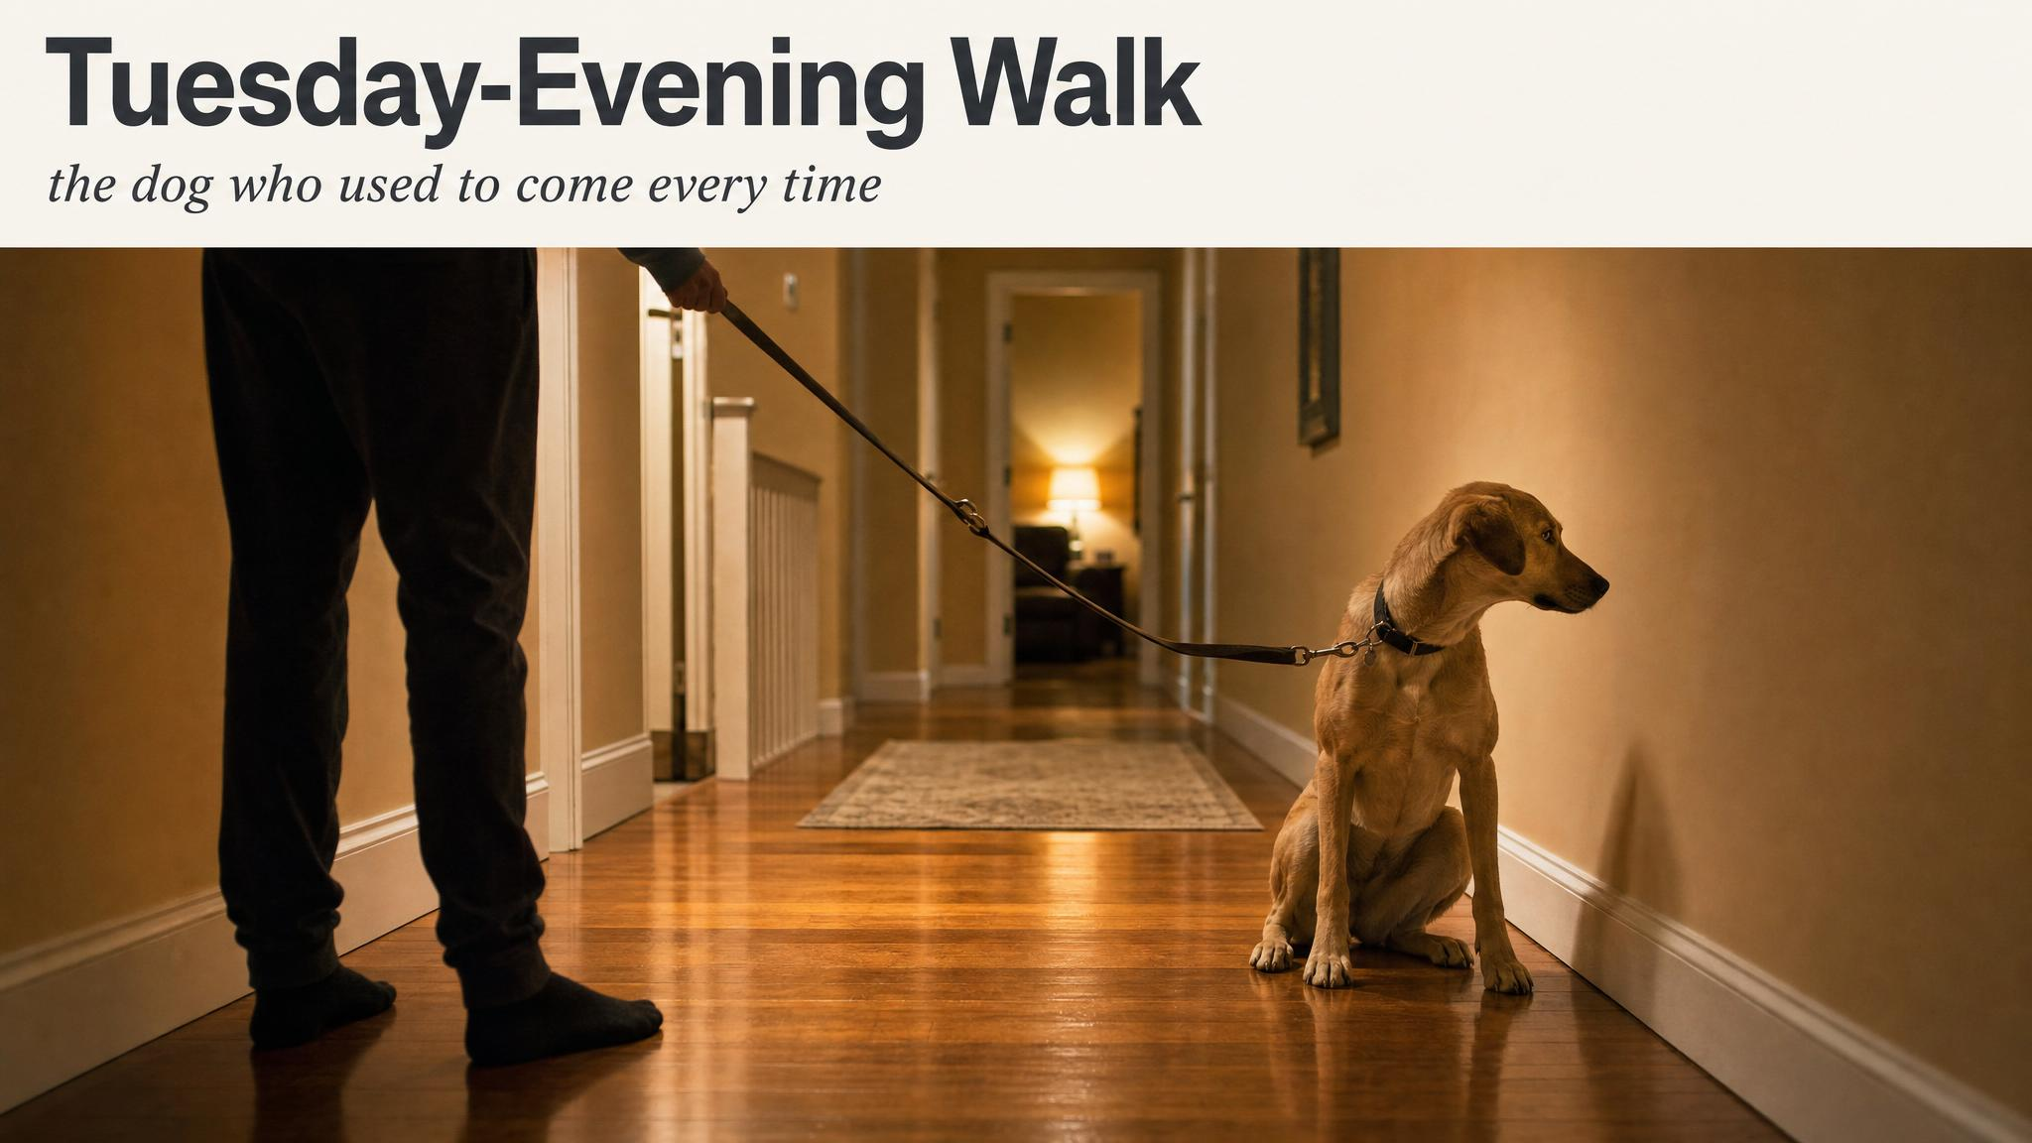
Notes:
Read the hook from the transcript almost verbatim — the cushion, the recall ignored at the park, the kitchen-floor accident with direct eye contact. Then deliver the answer: nothing happened to your dog. Something happened inside your dog. Hold the pause.

Slide 3
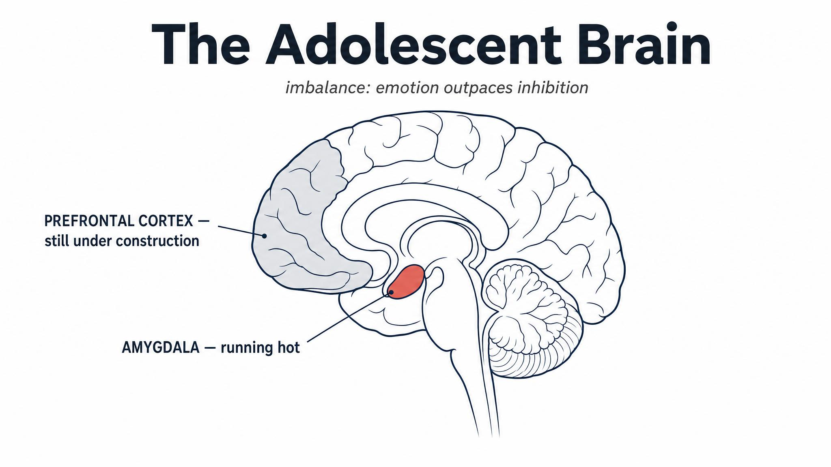
Notes:
Walk the room through the imbalance: amygdala running hot, prefrontal cortex still under construction. Cite Tottenham and Galván 2016 for the cross-species evidence. Tell them: this is why your dog 'chooses' the squirrel over your recall — the braking system is literally under construction.

Slide 4
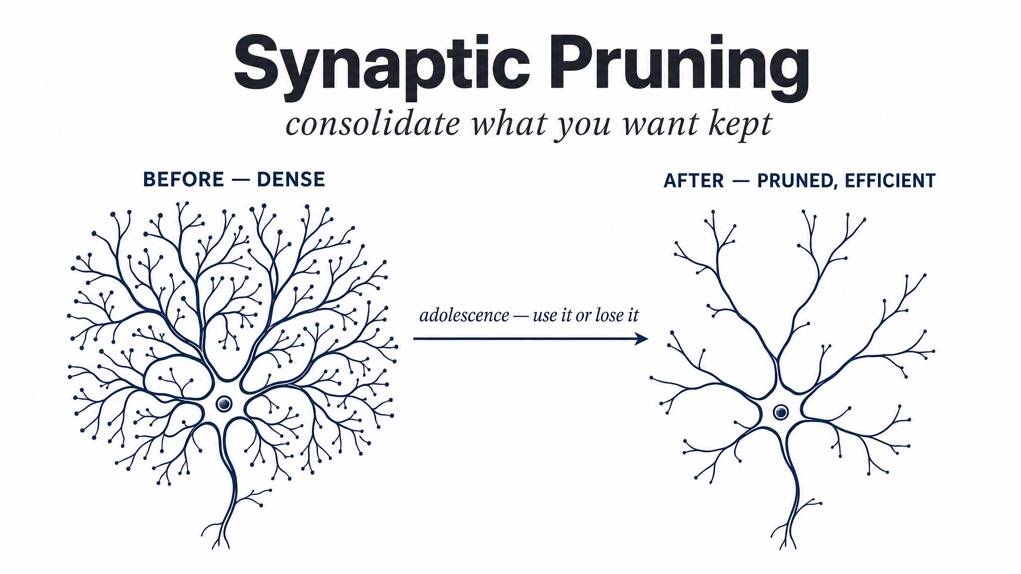
Notes:
Tell them the brain's editing rule: use it or lose it. Every reinforced pathway from puppyhood gets myelinated and kept. The unused ones get cut. This is why the socialisation and training from the early chapters matters profoundly — you were literally building the neural architecture your dog now needs.

Slide 5
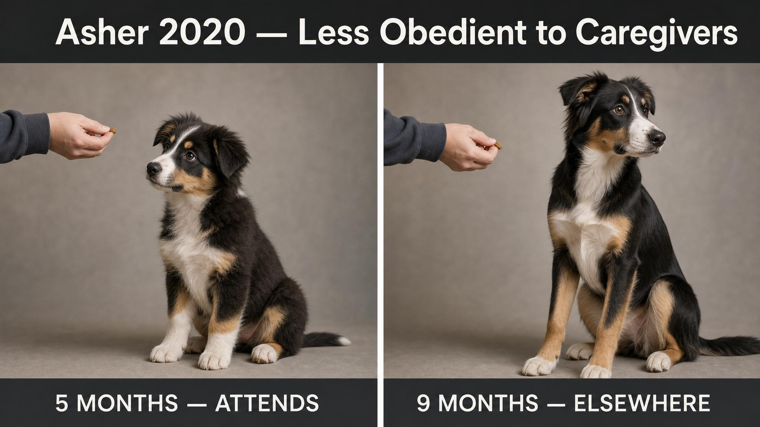
Notes:
Walk them through the landmark finding from Asher and colleagues in 2020. Dogs at eight months old showed significantly reduced obedience to their caregivers — but crucially, not to strangers. This mirrors human teenage behaviour: conflict is directed specifically at attachment figures. Their selective deafness is a sign of bond, not failure.

Slide 6
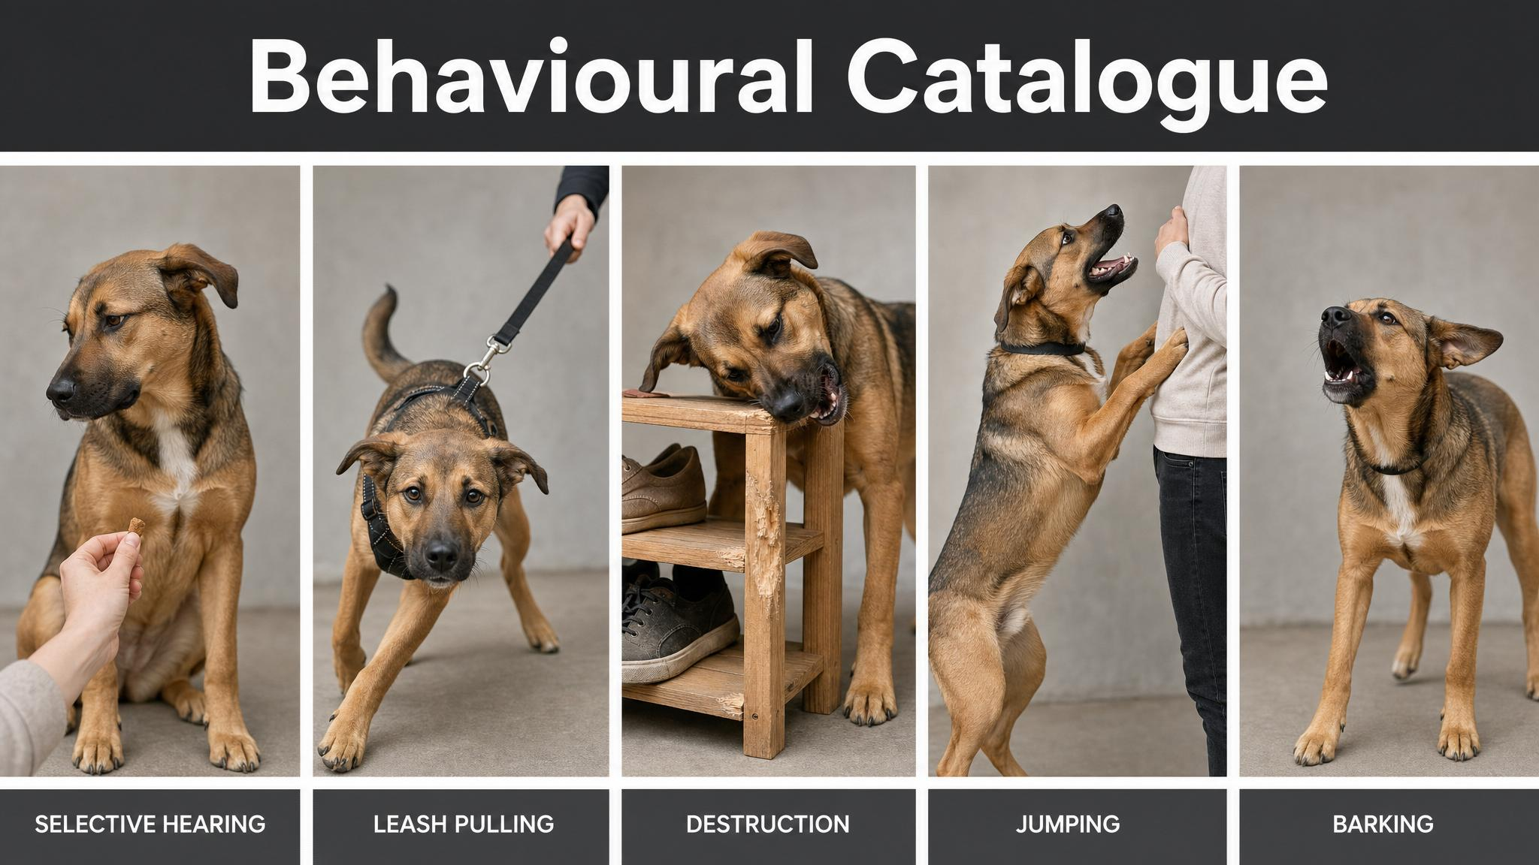
Notes:
Walk down the five panels. For each one, name the underlying mechanism — environmental motivation, second fear period, hormonal effects on bladder, adult teeth settling, barrier frustration. The reassurance: each one has a chapter you've already covered. The fix is patient retraining with better management.

Slide 7

Notes:
Name the second fear period — six to fourteen months. A dog who walked past rubbish bins at four months may now find them terrifying at ten months. Apply counter-conditioning from the earlier chapter: distance, high-value pairing, never force exposure. Cite Serpell and Duffy 2016 — these adolescent fears can become permanent if mishandled.

Slide 8
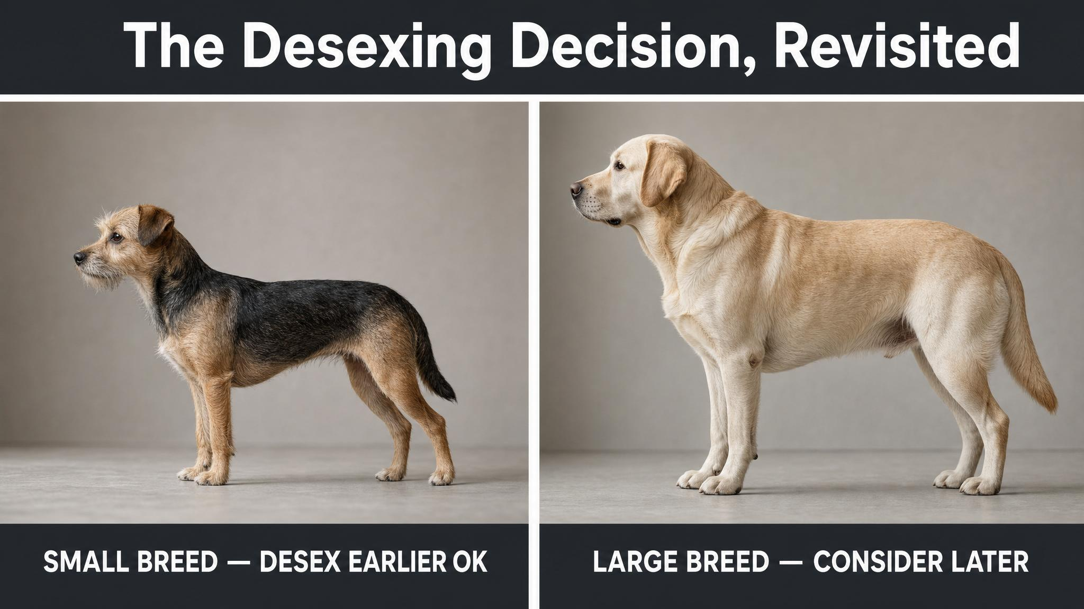
Notes:
The desex-at-six-months default is no longer best practice. Walk through Hart and colleagues 2020 — early neutering before twelve months doubles to quadruples joint disorders in many large breeds, while small dogs under twenty kilograms see no increased health risks. McGreevy 2018 adds the behavioural side: early-neutered males show more fear and anxiety. The conversation belongs with your vet, not the internet.

Slide 9
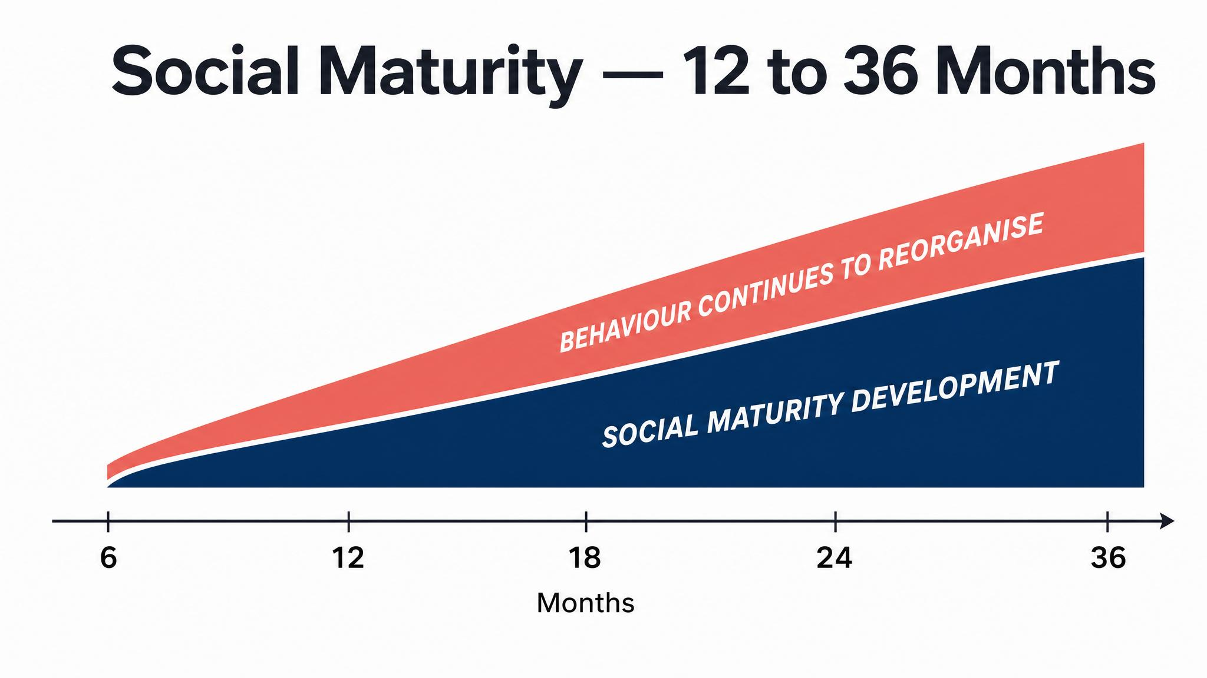
Notes:
Social maturity arrives between twelve and thirty-six months — larger breeds later, giant breeds not until age three. Bray and Harvey 2021 set the rational age groupings; Bray and colleagues 2021 show executive function continues improving through the second year. The dog your puppy is becoming is still under construction.

Slide 10
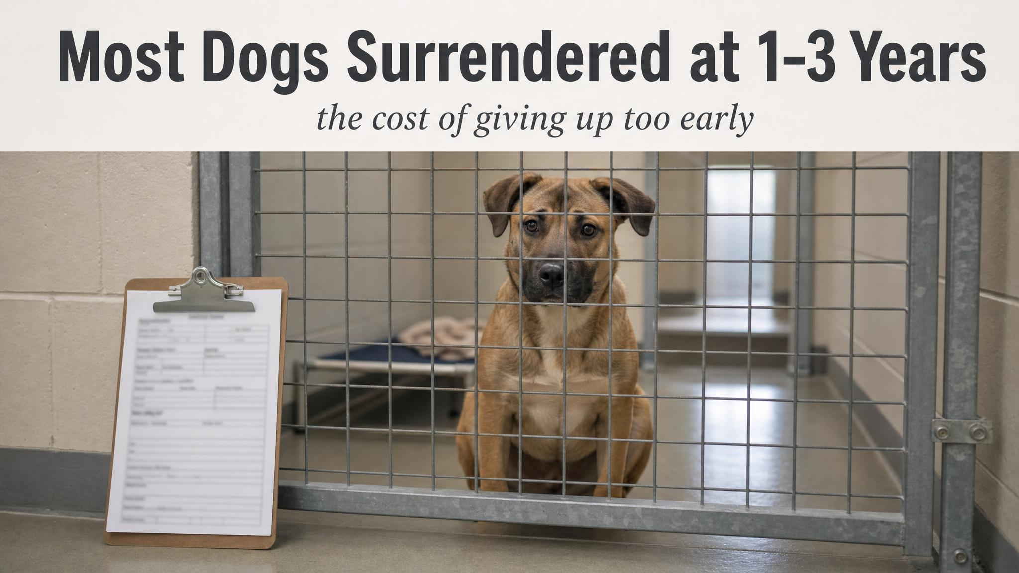
Notes:
Read this slowly. According to the American Animal Hospital Association 2015, most dogs surrendered to shelters are between one and three years old — precisely the social-maturity period. Many owners give up right before the corner is turned. Persistence is not a personality trait. It is the most important predictor of how this ends.

Slide 11
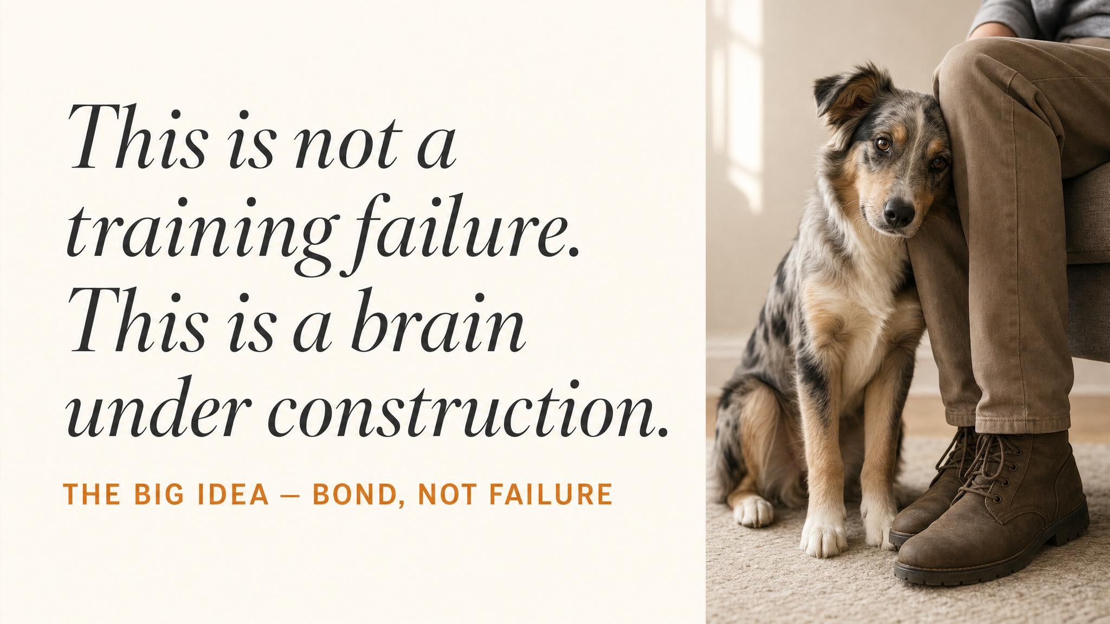
Notes:
Pause here. Read it aloud, slowly. Then explain the science behind it: dogs with secure attachments showed the most pronounced adolescent conflict behaviour, not the least. The person who feels the brunt of it is the person the dog is most attached to. Let that sit before moving on.

Slide 12
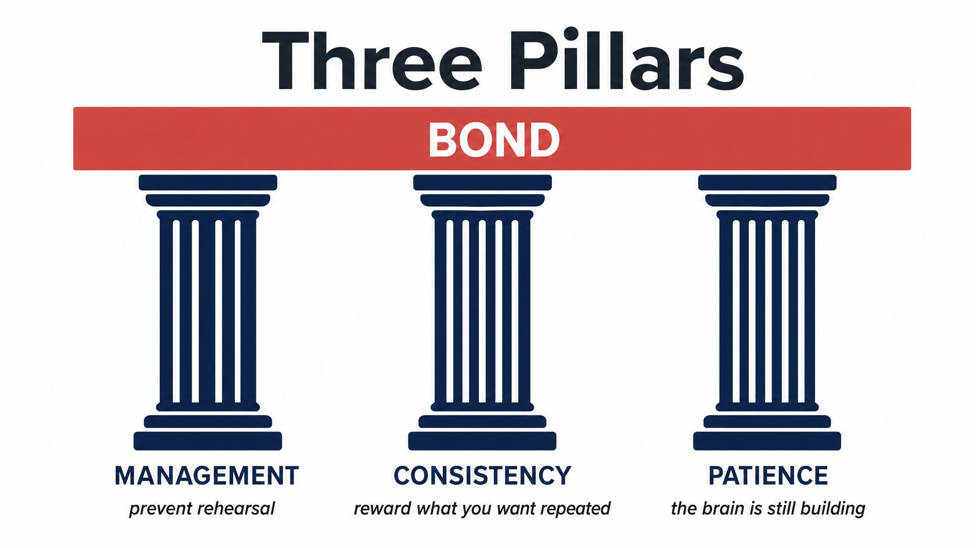
Notes:
These are the three things that carry you through. Management: long lines, baby gates, environmental control. Consistency: clear criteria, high-value rewards, predictable responses. Patience: every day is one closer to a mature brain. Hold up each word in turn. These three are the script when everything else feels chaotic.

Slide 13
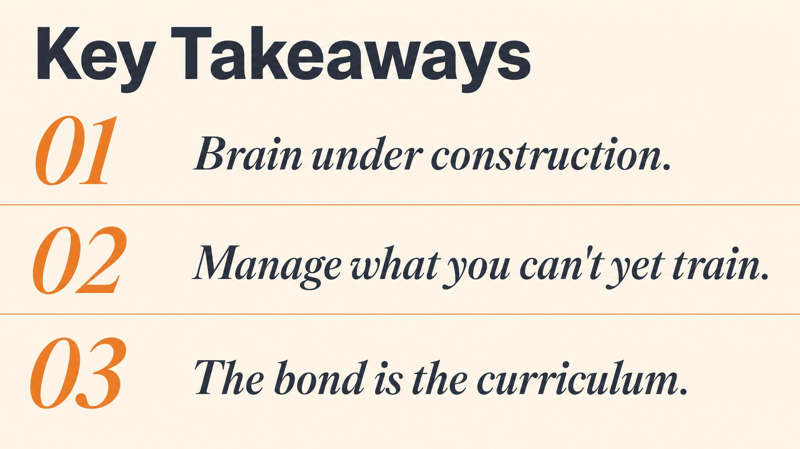
Notes:
Three things to carry forward. One — adolescence is a neurobiological phase, not a behaviour problem; synaptic pruning, hormonal surge, prefrontal weakening. Two — that 'selective deafness' to you is a sign of attachment, not failure (Asher 2020). Three — the foundation you built doesn't disappear; it's just buried under construction scaffolding. Pause briefly on each.

Slide 14

Notes:
Close the course. Tell them: this is the last field note. The skills you've gathered across the eight chapters — body-language reading, environmental management, positive reinforcement, routine, counter-conditioning, cooperative care, arousal regulation — don't expire when adolescence ends. They become the working grammar of your life with this dog. Keep observing. Keep enjoying. They're worth it.

