Slide 1
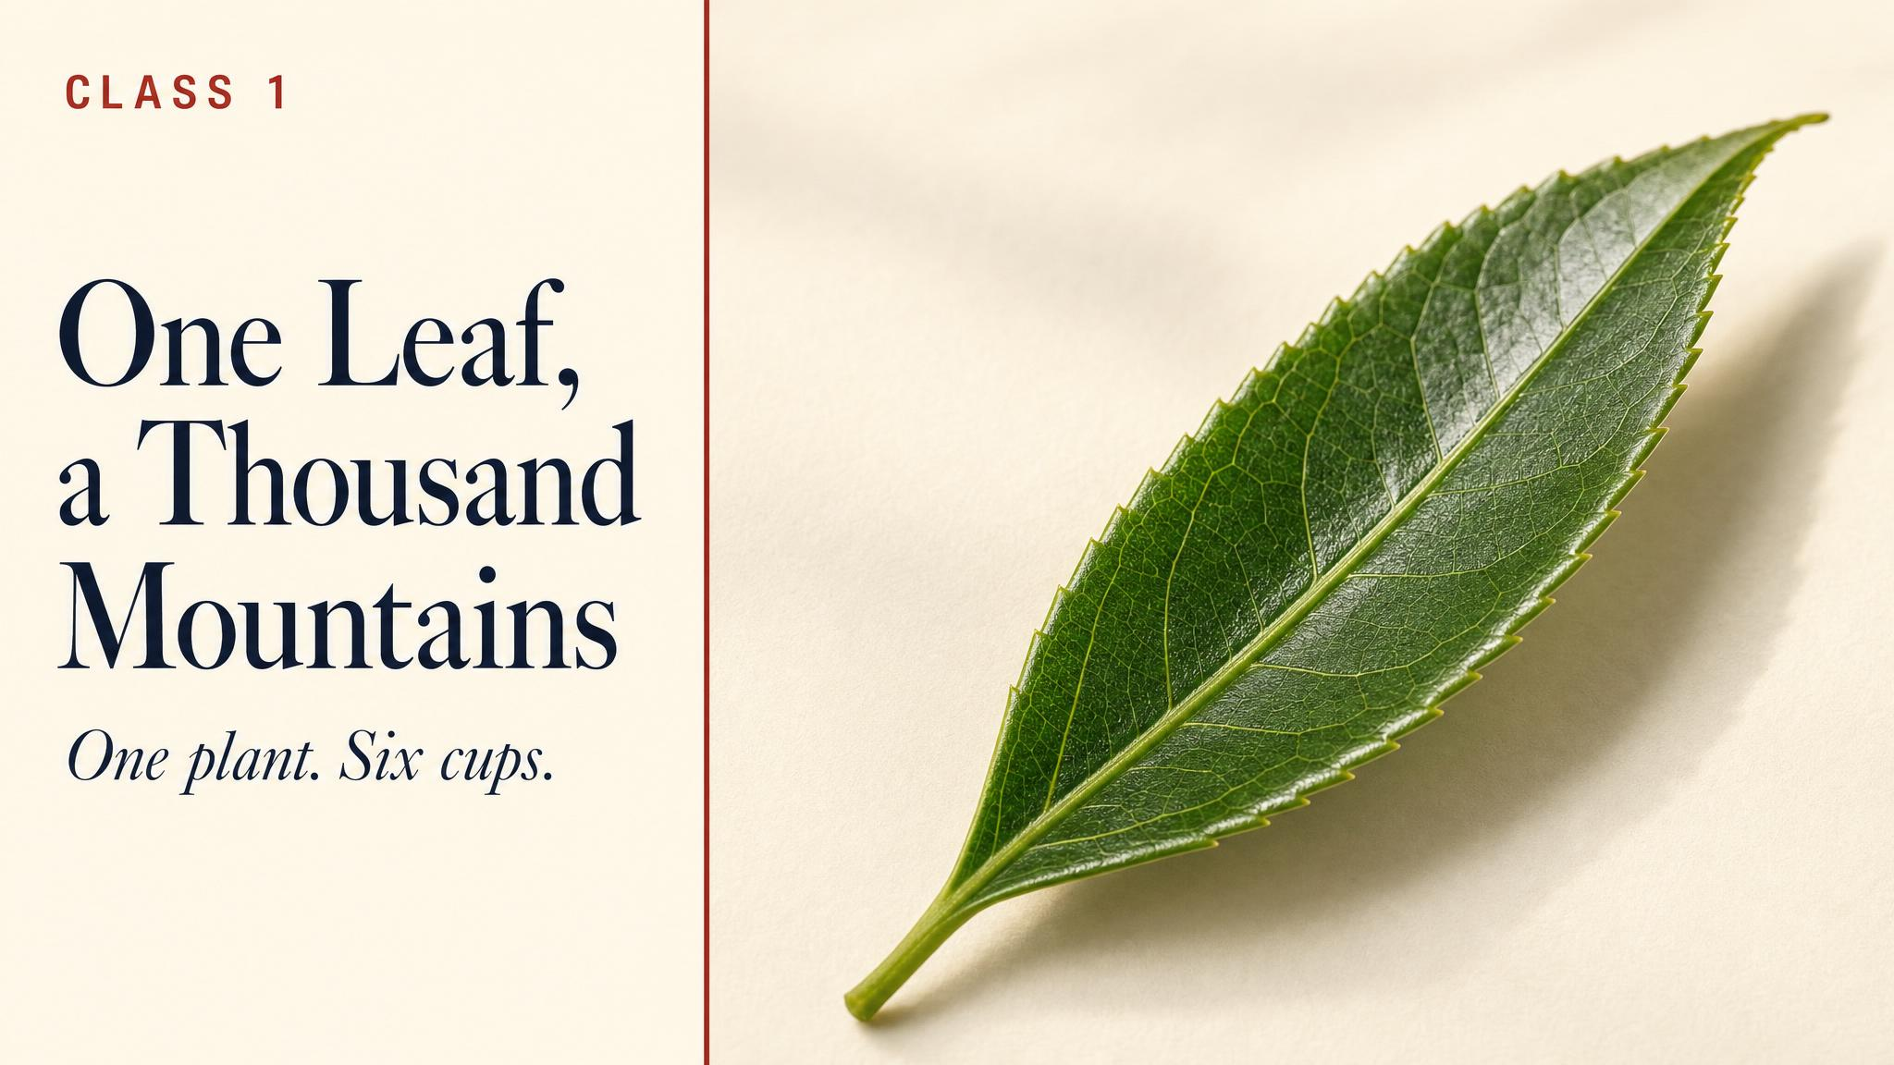
Notes:
Open by holding up the title and the puzzle: every cup of tea on Earth — green, white, oolong, black, pu'er — comes from a single species. Then ask the room: where do all the differences come from, if the plant is the same? Hold the question. Don't answer it yet.

Slide 2
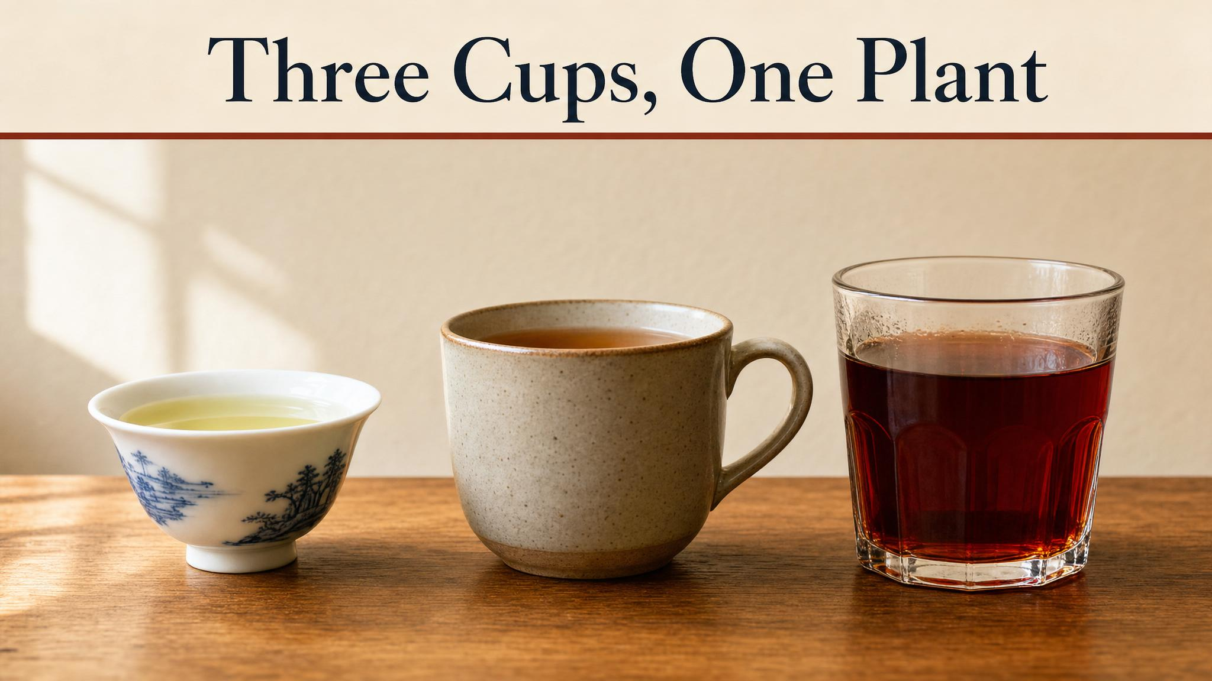
Notes:
The hook: three cups, three colours, three rooms in the world's mouth. Same plant. Same species. Ask: which would you choose right now, and why? Use this to draw out personal entry points before going into botany.

Slide 3
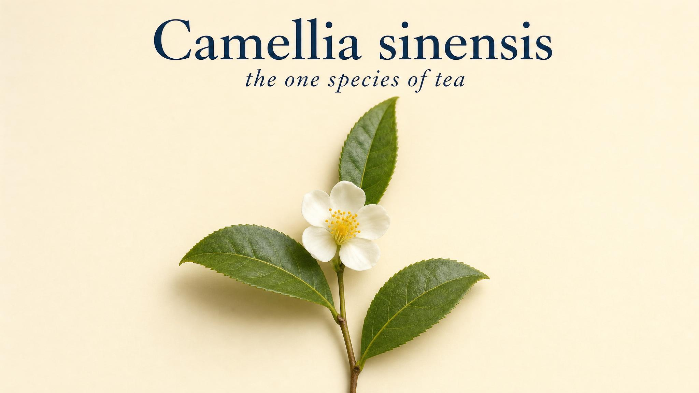
Notes:
Introduce the species — an evergreen shrub from the camellia family, kept hip-high in tea gardens but capable of growing into a tree. What the grower wants is the youngest tip: 'two leaves and a bud'. That's what gets picked, several times a year.

Slide 4
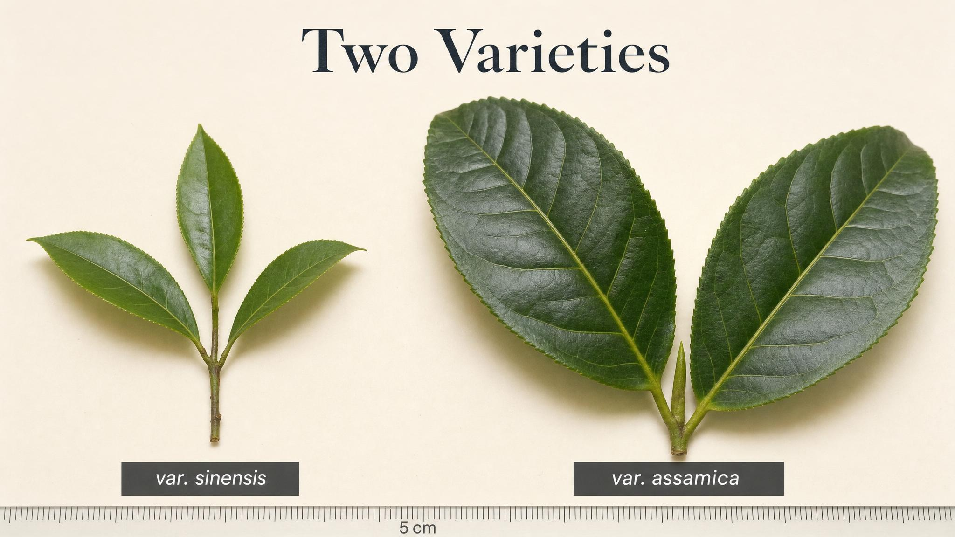
Notes:
Show the two varieties side by side: sinensis (small, cool, perfumed, mostly Chinese) and assamica (large, hot, malty, mostly Indian/SE Asian). The leaf size difference is the first visible sign of two very different chemical inventories.

Slide 5
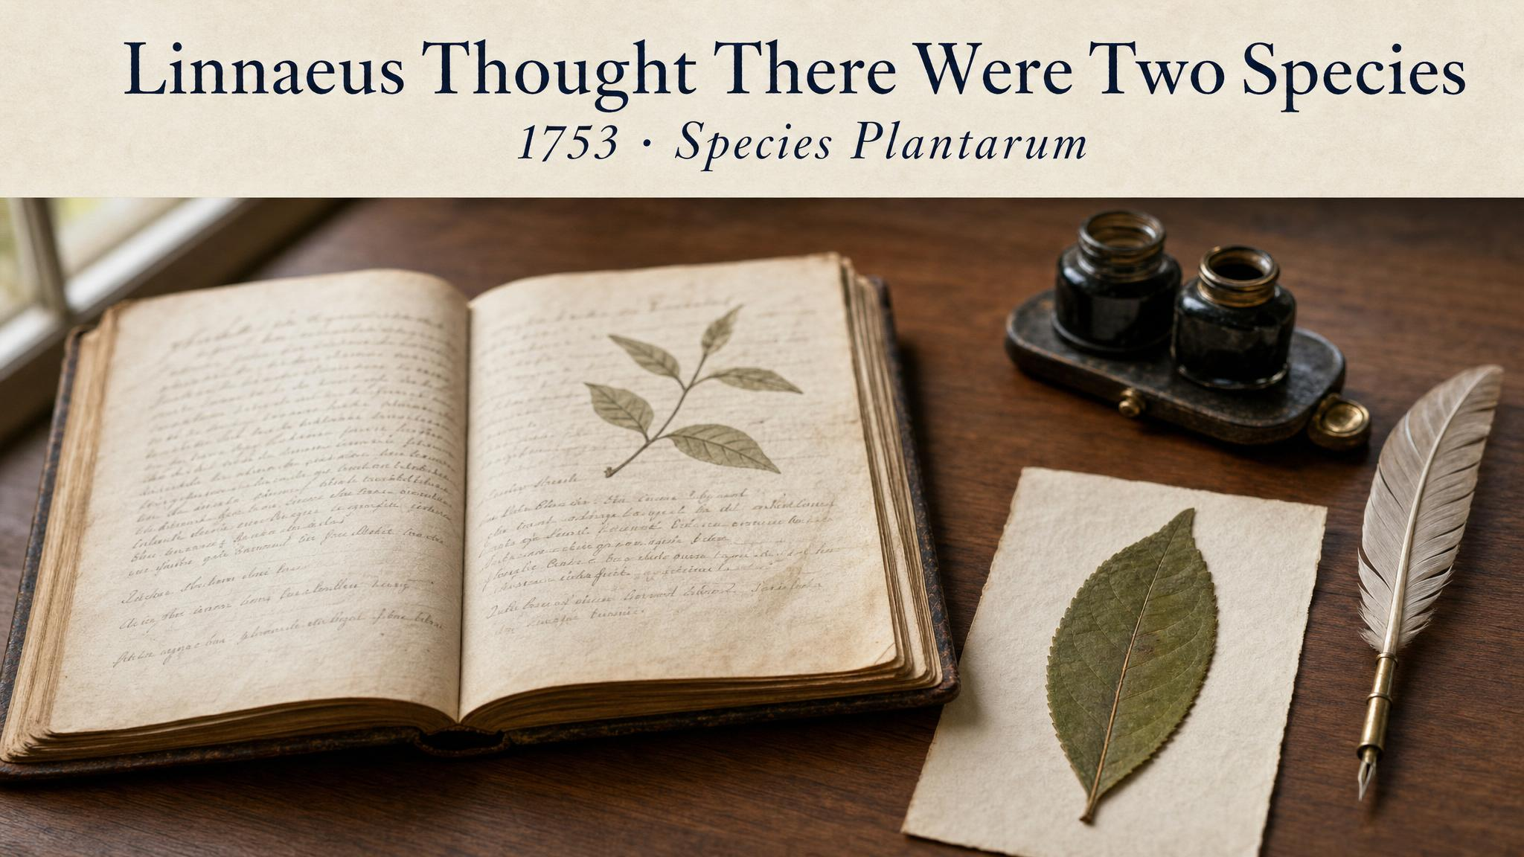
Notes:
In his 1753 Species Plantarum, Linnaeus listed green tea and black tea as two separate species — Thea viridis and Thea bohea. Later editions quietly merged them. The truth — that colour comes from processing, not from the plant — took the West a long time to absorb.

Slide 6
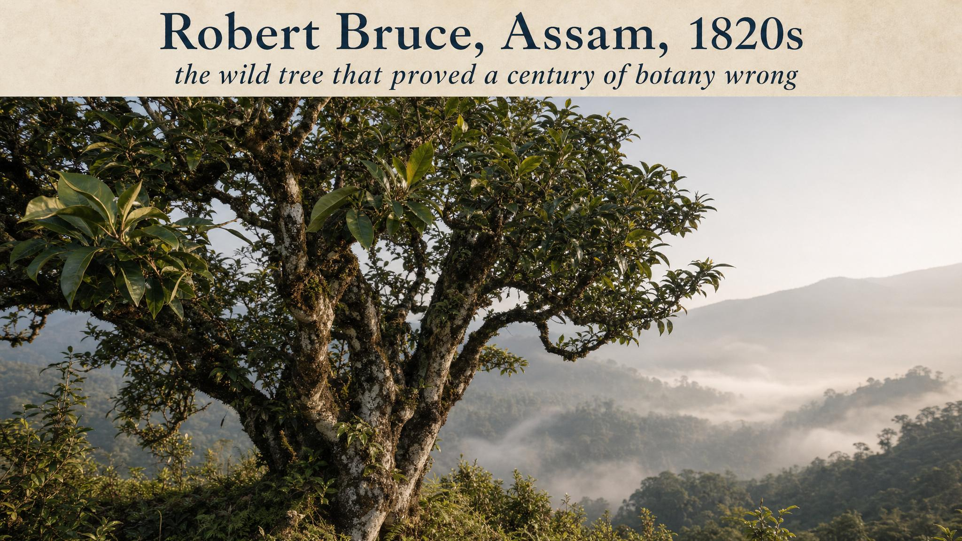
Notes:
Robert Bruce — a Scottish merchant in the East India Company — was shown wild tea trees by Singpho tribesmen in upper Assam in the 1820s. The colonial botanists in Calcutta dismissed the specimens at first. It took a decade and his brother Charles to convince them. The British tea empire was effectively built on that one revision.

Slide 7
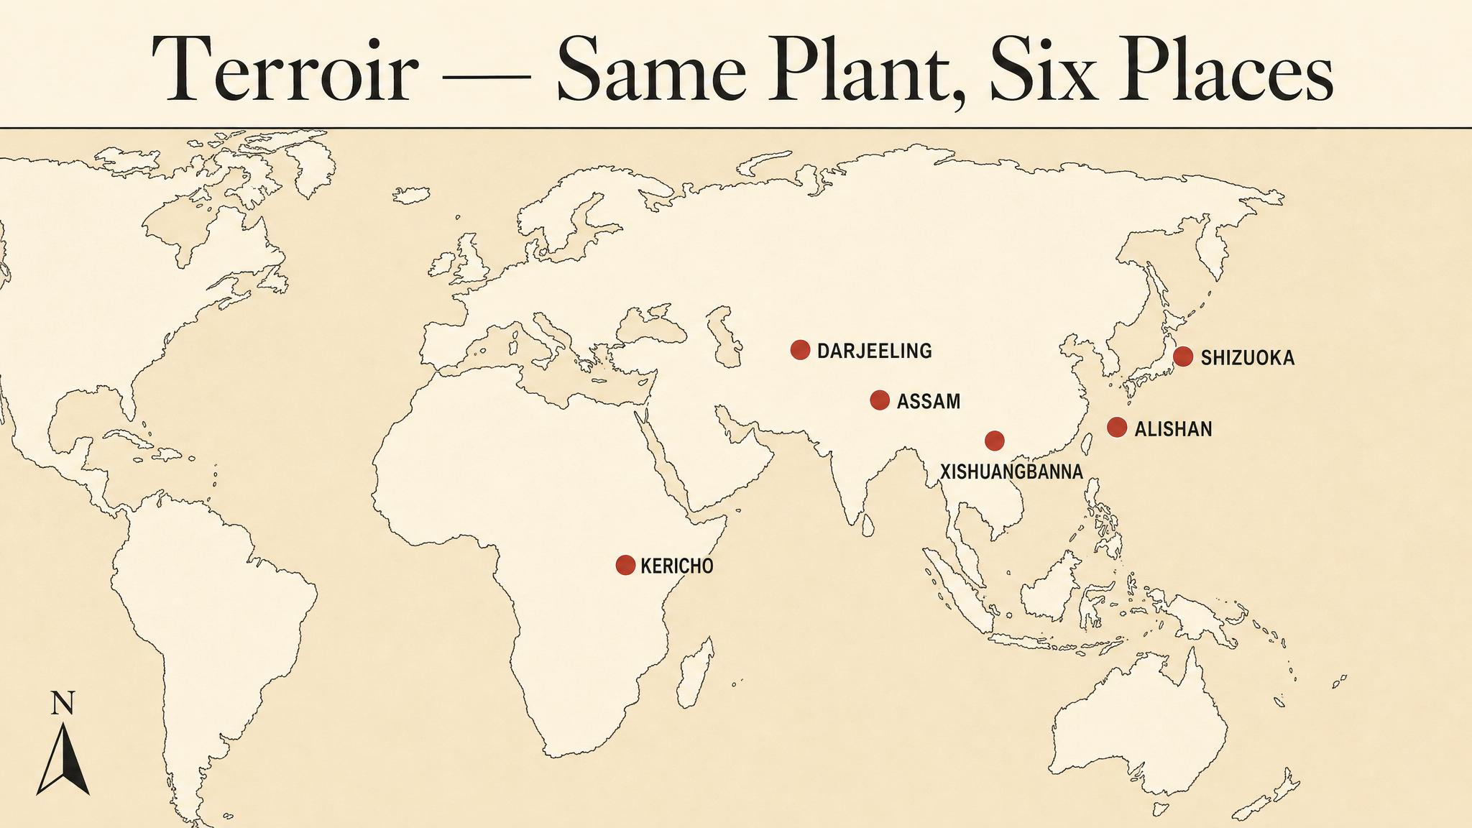
Notes:
Terroir borrows from wine: altitude, latitude, soil, climate, microclimate. The same species rearranges its chemistry to the place it grows. Walk the room through the six regions you'll see in the Terroir Explorer widget — point out the altitude difference between Assam (lowland) and Lishan (very high).

Slide 8
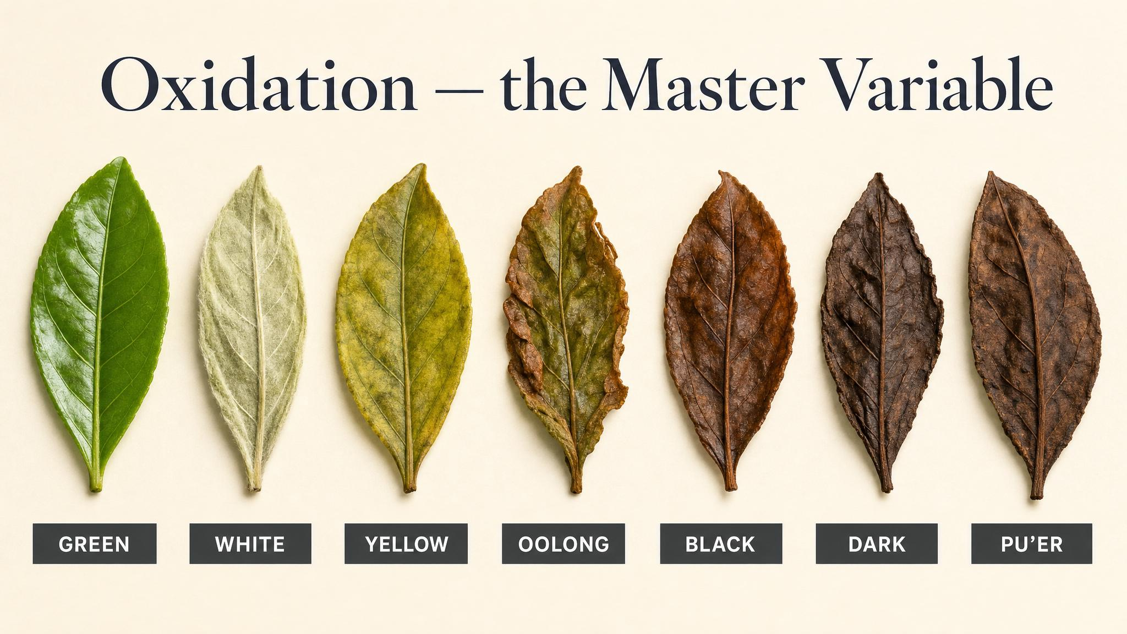
Notes:
The single most important decision in tea-making is how much oxidation to allow. Almost everything else — withering, rolling, firing — is in service of controlling that one variable. Push it to zero and you get white tea; push it all the way and you get black tea.

Slide 9
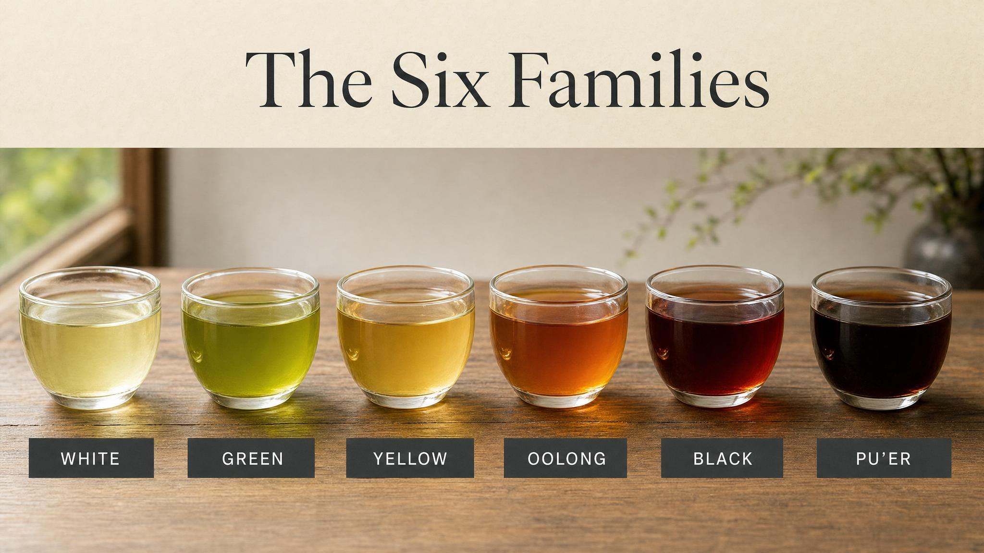
Notes:
From one leaf, six families. They are not six species — they are six positions on the oxidation spectrum, with a few extra wrinkles. White and green sit at the unoxidised end; black sits at the fully-oxidised end; oolong is the broad middle; yellow and dark are the small, fascinating exceptions.

Slide 10
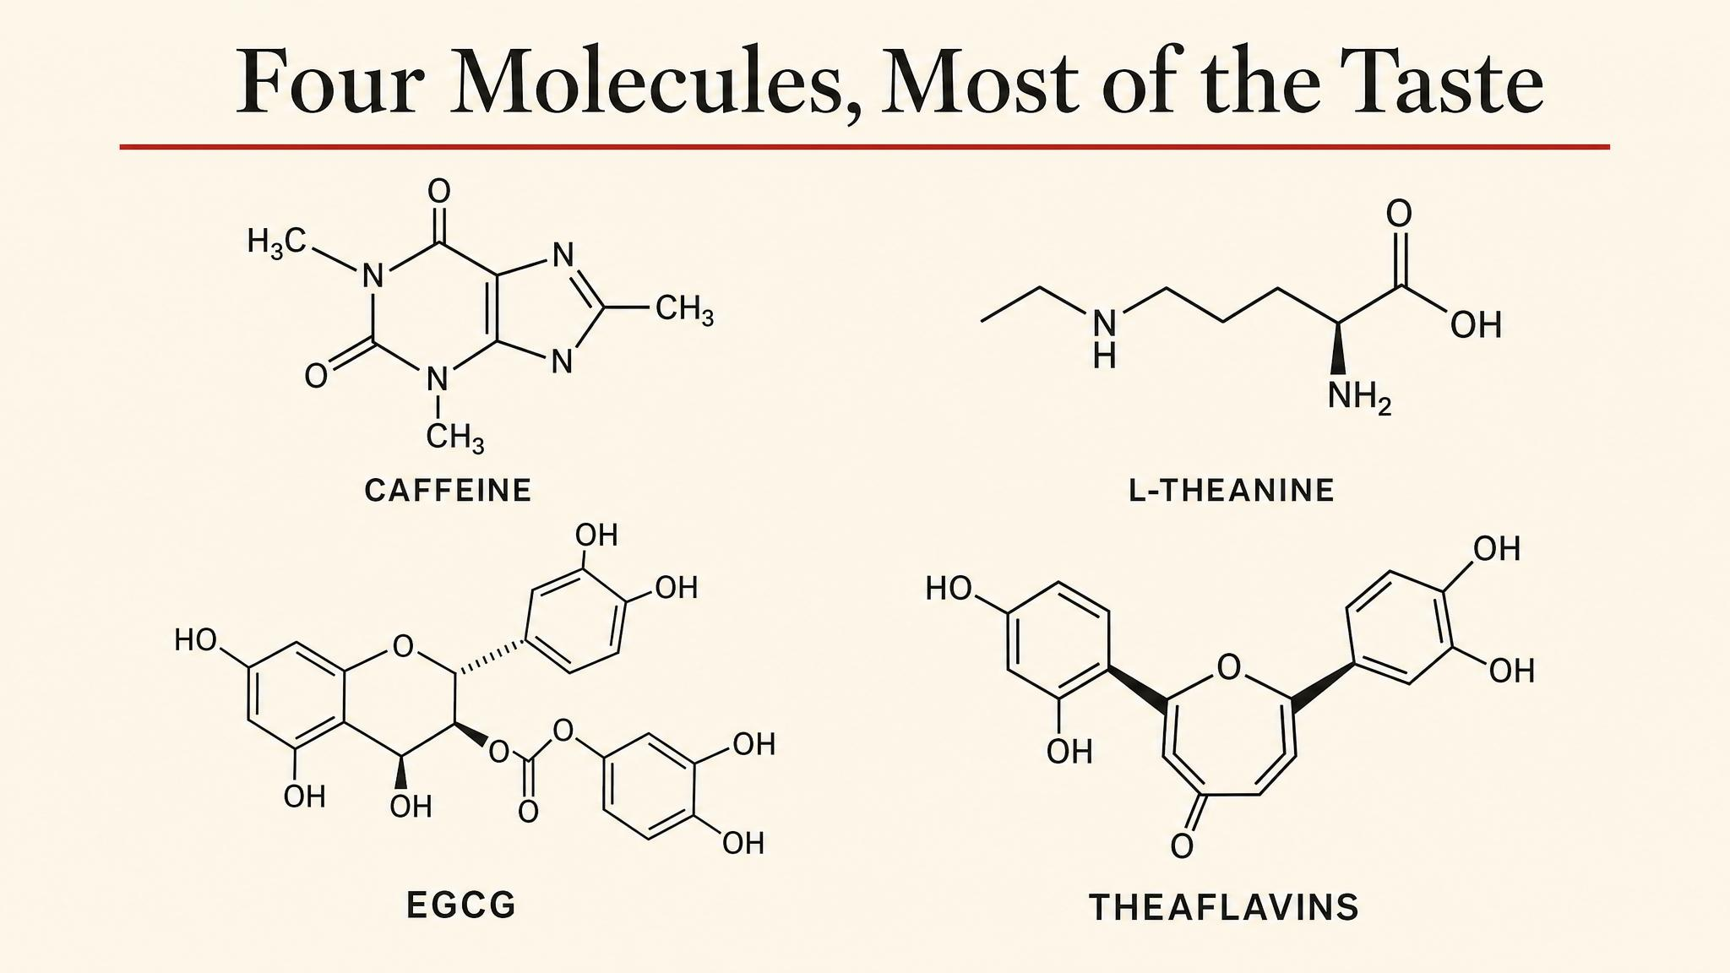
Notes:
Most of what tea tastes like, and most of what tea does to you, is the interaction of four molecules: catechins (the astringency, EGCG is the headline), caffeine (the alertness), L-theanine (the calm focus), and a cloud of volatiles like linalool (the aroma). The proportions change between the six families.

Slide 11
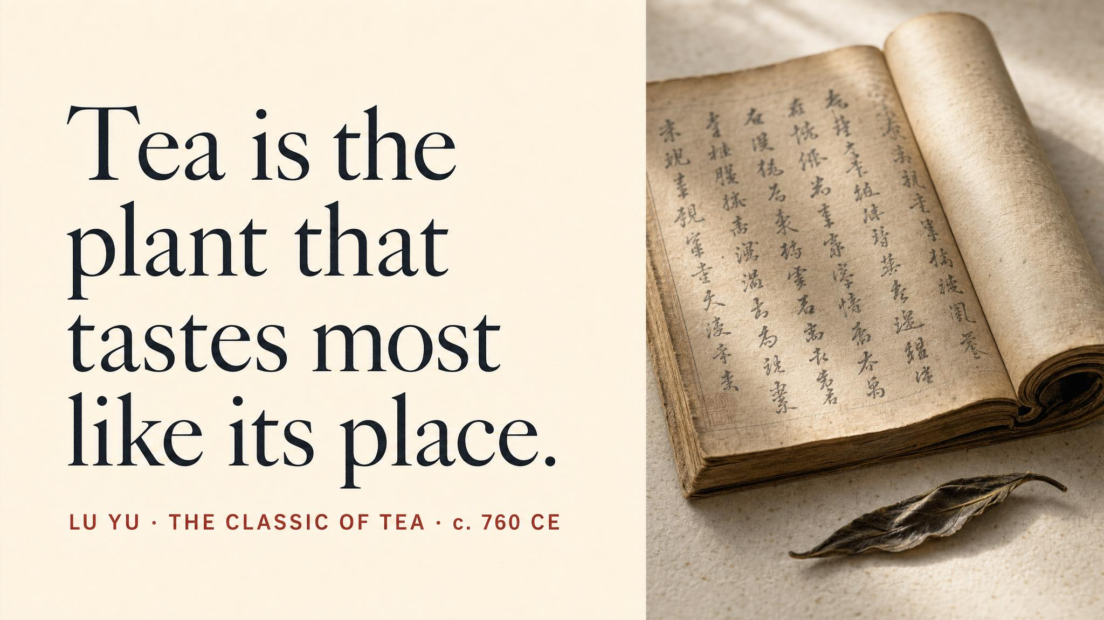
Notes:
Pause here. Read the Lu Yu quote aloud slowly. The Cha Jing — The Classic of Tea — was written in the mid-8th century, and remains the foundational text of tea culture. Use this moment to mark the cultural depth of what we've been treating as botany and chemistry.

Slide 12
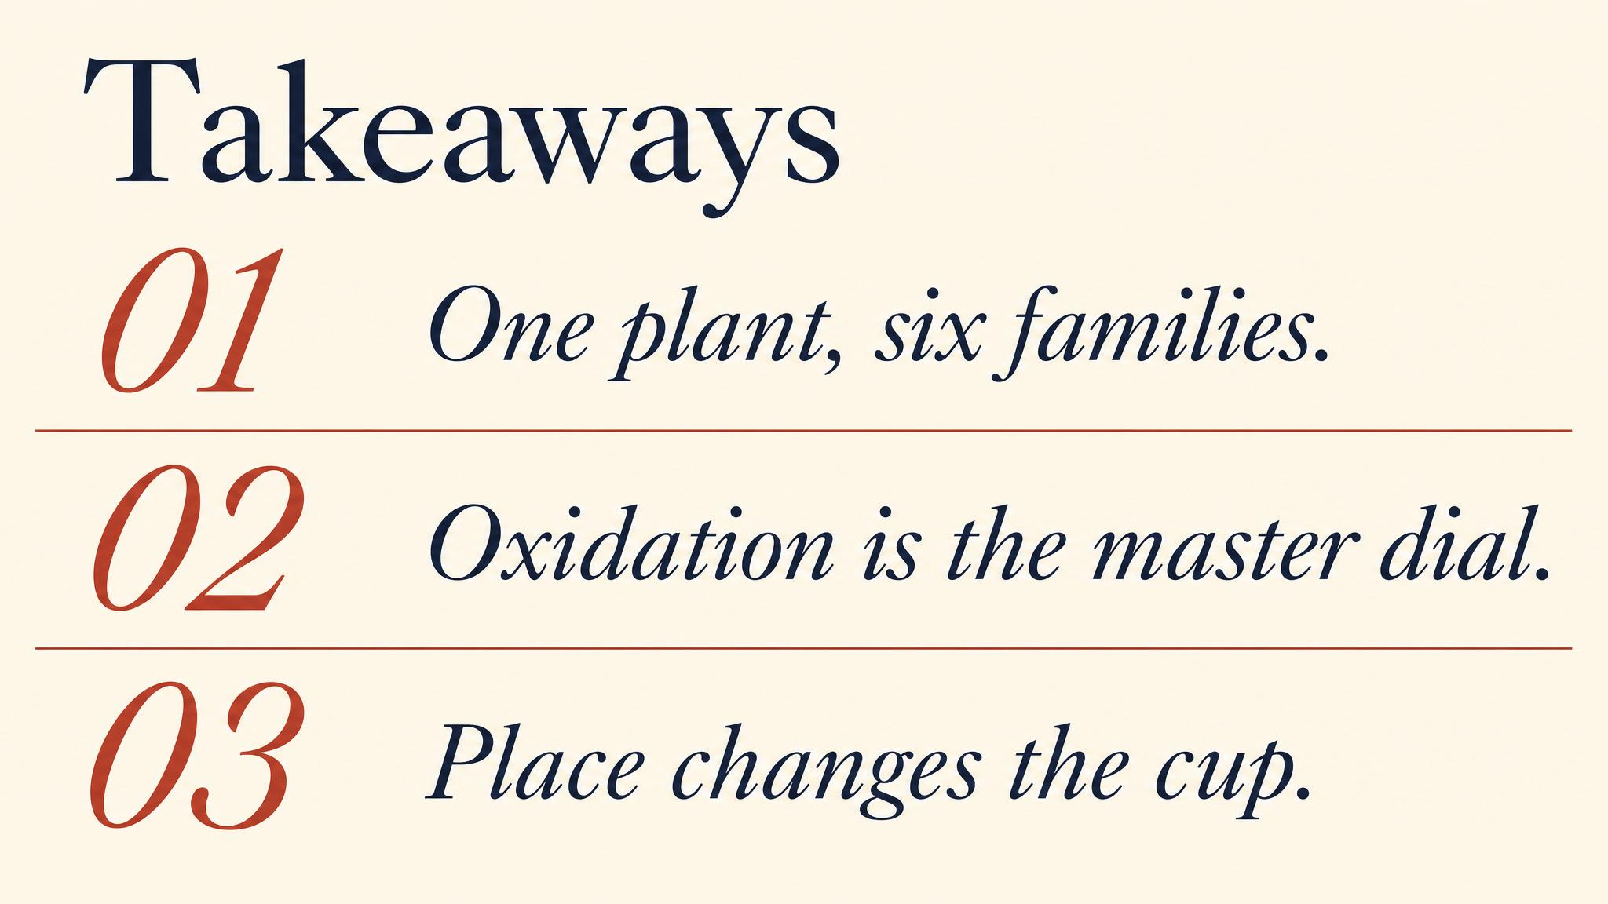
Notes:
Three things to carry forward. One: same species, six families, all driven by what humans do to the leaf. Two: variety pre-loads the leaf — sinensis is delicate, assamica is powerful. Three: oxidation is the master variable, the one knob that decides nearly everything. Pause briefly on each.

Slide 13
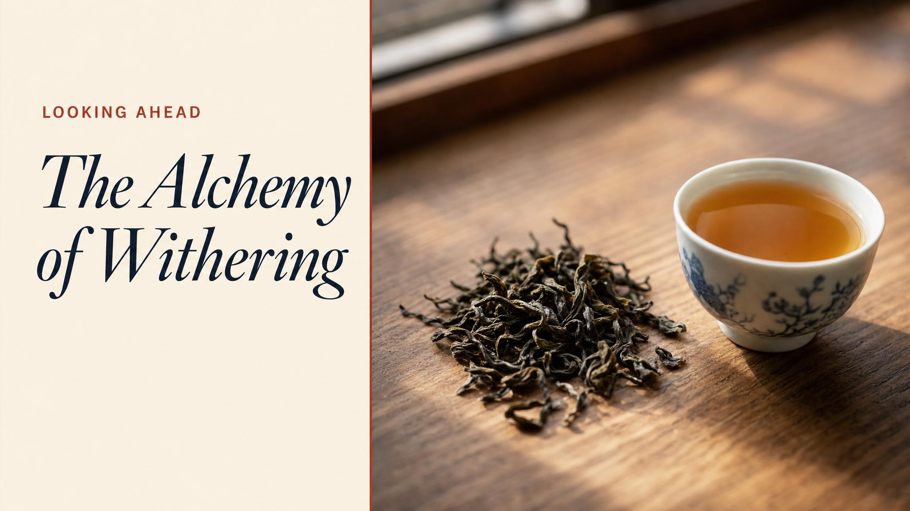
Notes:
Close with the bridge: next class, we follow these leaves into the factory. Withering, rolling, oxidation, firing — the actual choices that decide which of the six families a given batch becomes. The chemistry in detail.

