Slide 1
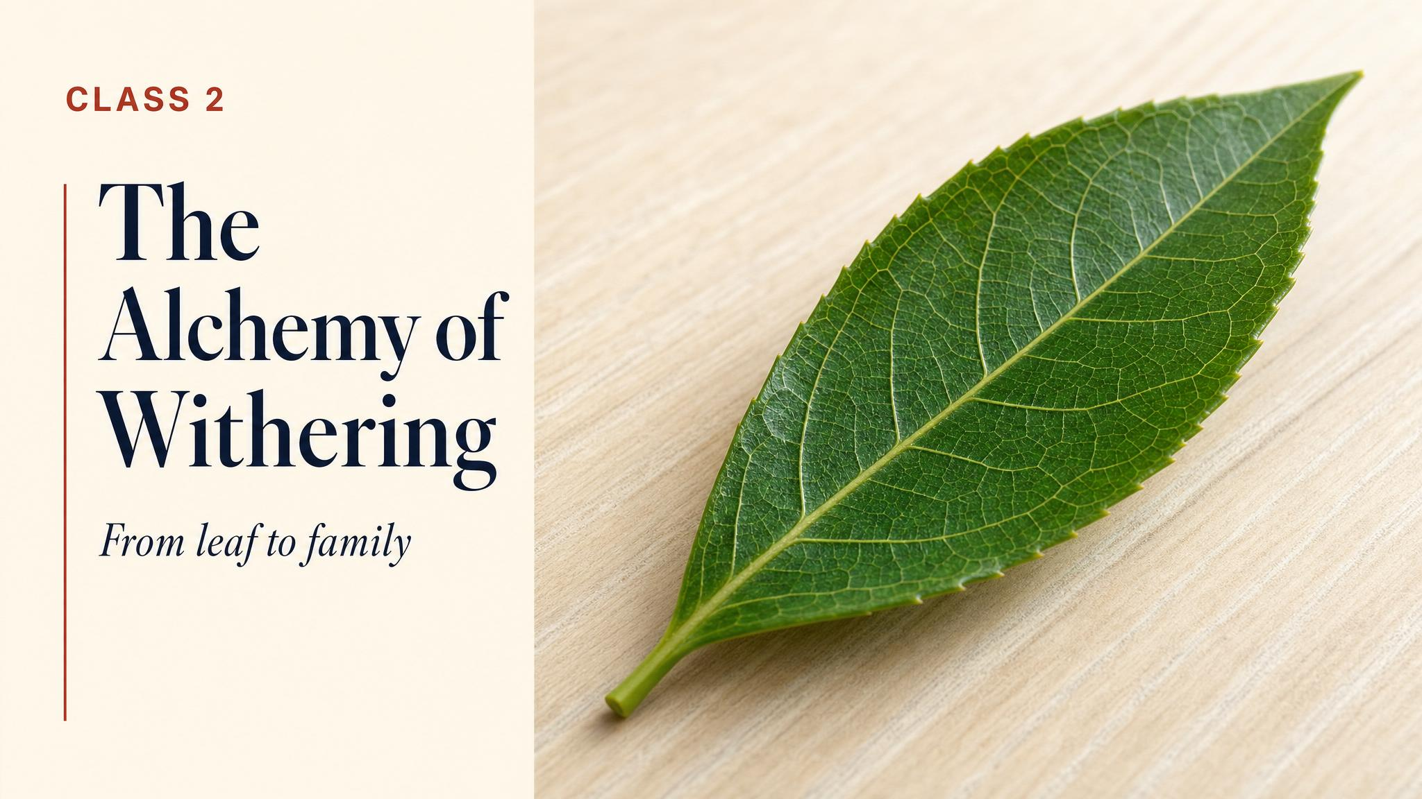
Notes:
Open with the puzzle from the chapter hook: bite a fresh tea leaf and it's disappointing — vegetal, slightly bitter, nothing like tea. Everything that gets us to a real cup happens in the next twelve to forty-eight hours. Today we trace that whole journey.

Slide 2
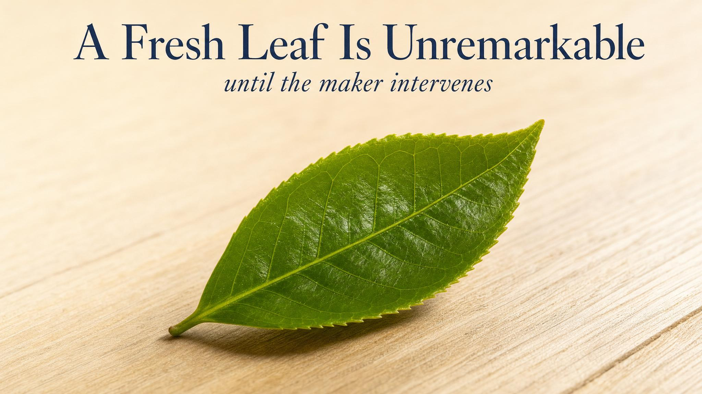
Notes:
Hold the room on the unremarkable. Most people have never tasted a fresh, unprocessed tea leaf. Doing so is genuinely a let-down — closer to a herb than to a beverage. Use this to set up: everything we love about tea is downstream of the maker's work.

Slide 3
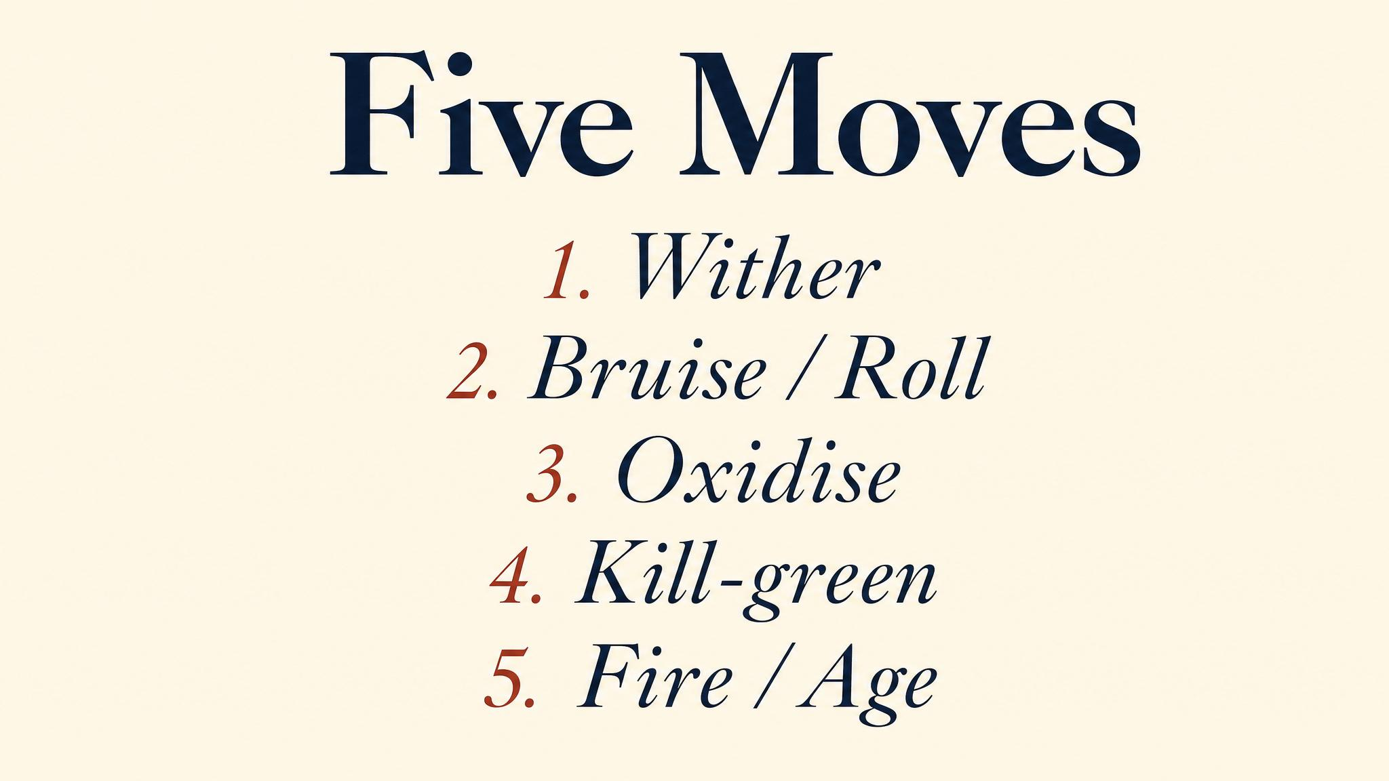
Notes:
These are the five moves. Some subset of these, in this order, produces every tea you have ever drunk. The maker's job is to decide how far to push each — and where, between steps, to stop the chemistry in its tracks.

Slide 4
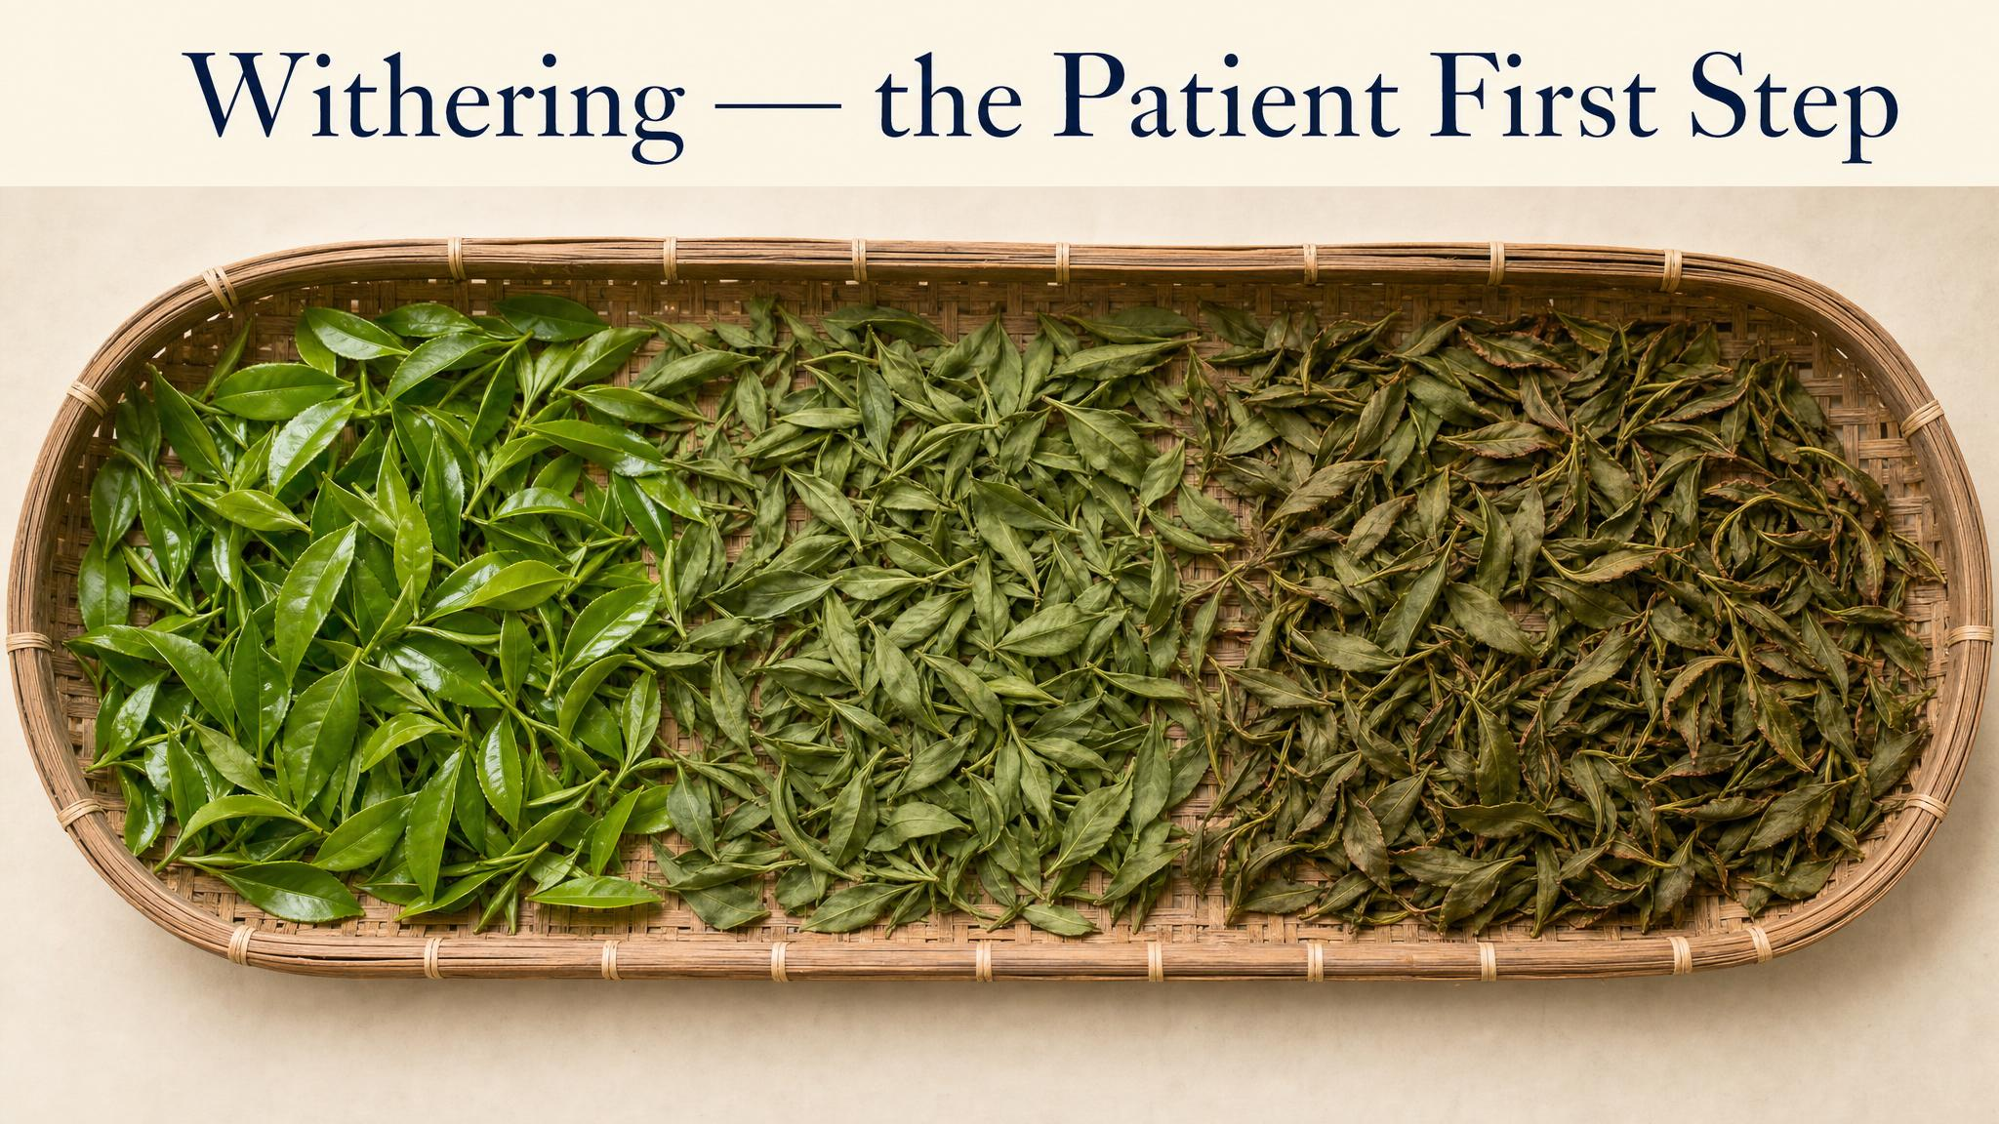
Notes:
Withering looks like nothing is happening. The leaves are just laid out on a tray. But moisture drops from 75% to about 55%, cell walls soften, the first volatile precursors begin to form. Without this, the next step — bruising — would just smash the leaf instead of releasing its chemistry.

Slide 5
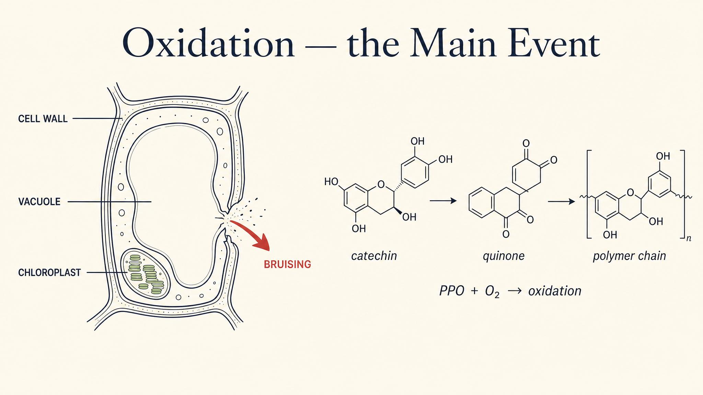
Notes:
Rolling broke the cell membranes. Now the catechins from the vacuole meet the polyphenol oxidase enzyme from the cytoplasm, in the presence of oxygen. This is the master reaction in tea-making. Everything between green and black sits on this dial.

Slide 6
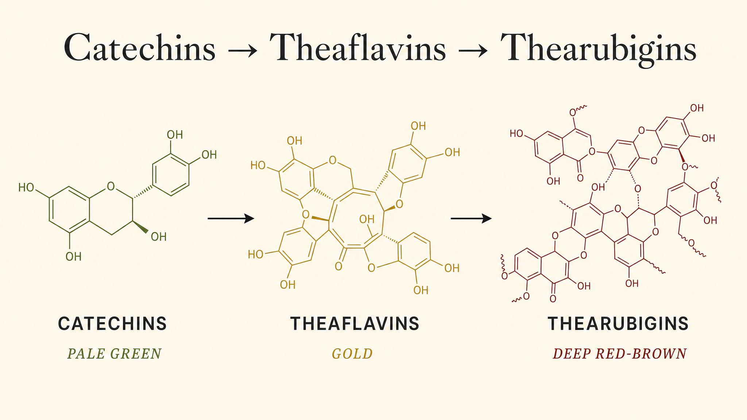
Notes:
This is the chemistry, in three words. The catechins of the fresh leaf get converted by the enzyme, in the presence of oxygen, first into theaflavins (which bring brightness and lift), and then into thearubigins (which bring body and depth). The ratio of these to each other and to the remaining catechins is much of what distinguishes one black tea from another.

Slide 7
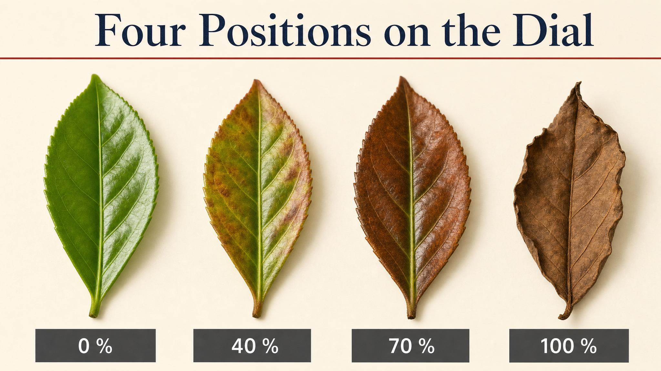
Notes:
The same leaf at four points on the oxidation dial. Note the gradient — there's no sharp boundary between green tea and oolong, between oolong and black. The maker decides where to stop, then kills the enzyme with heat to lock it in.

Slide 8
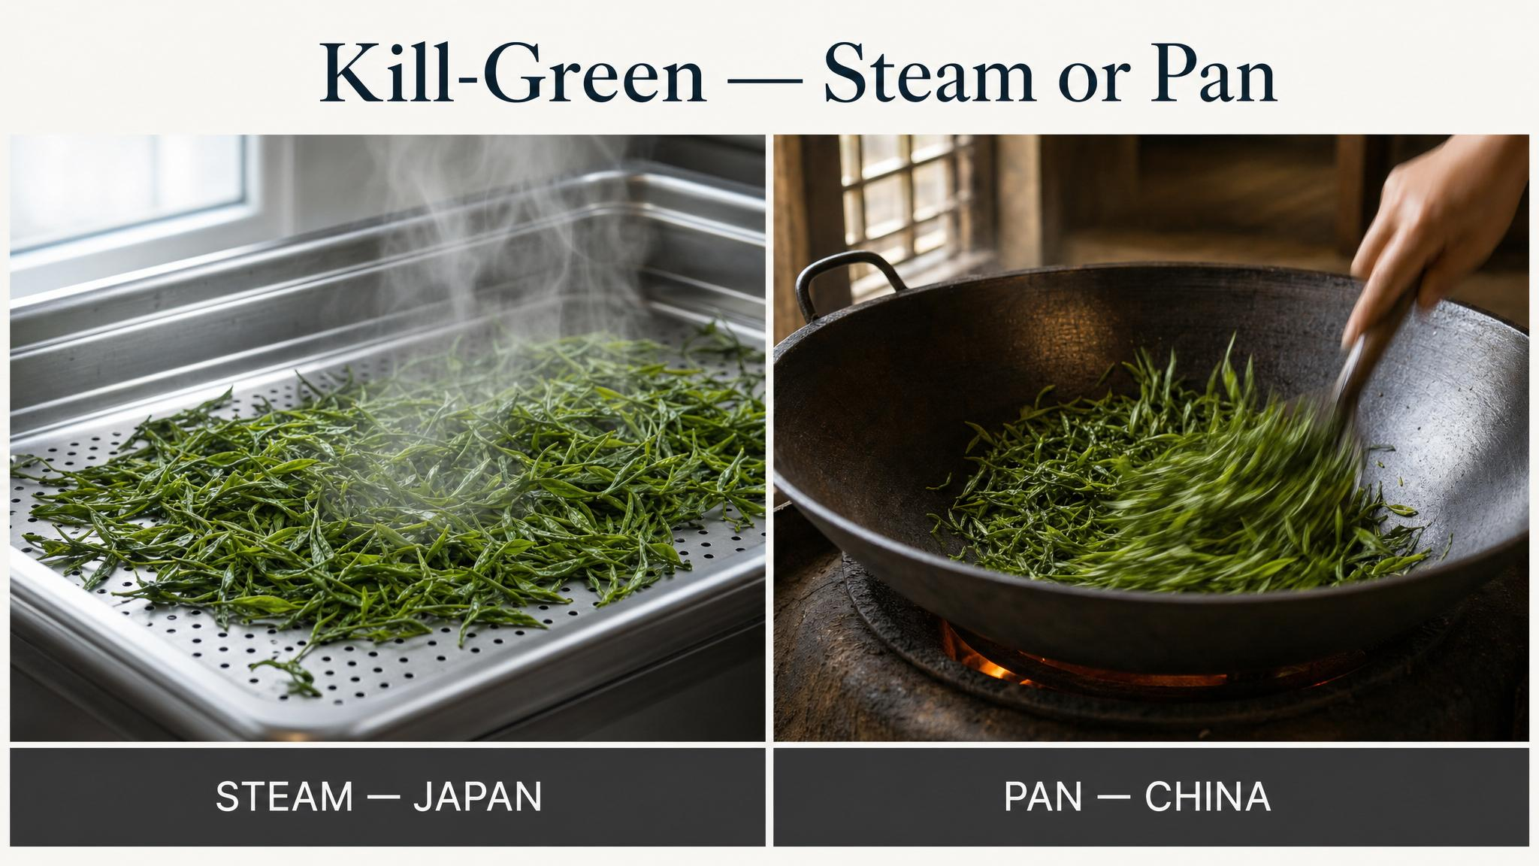
Notes:
Kill-green means denaturing the polyphenol oxidase enzyme with heat. Japanese tradition uses steam (≈100°C, 15–45 seconds) — the result is marine, grassy, umami. Chinese tradition uses pan-firing (≈200°C, a few minutes) — the result is nuttier, lightly roasted. Two cultures, same problem, different cups.

Slide 9
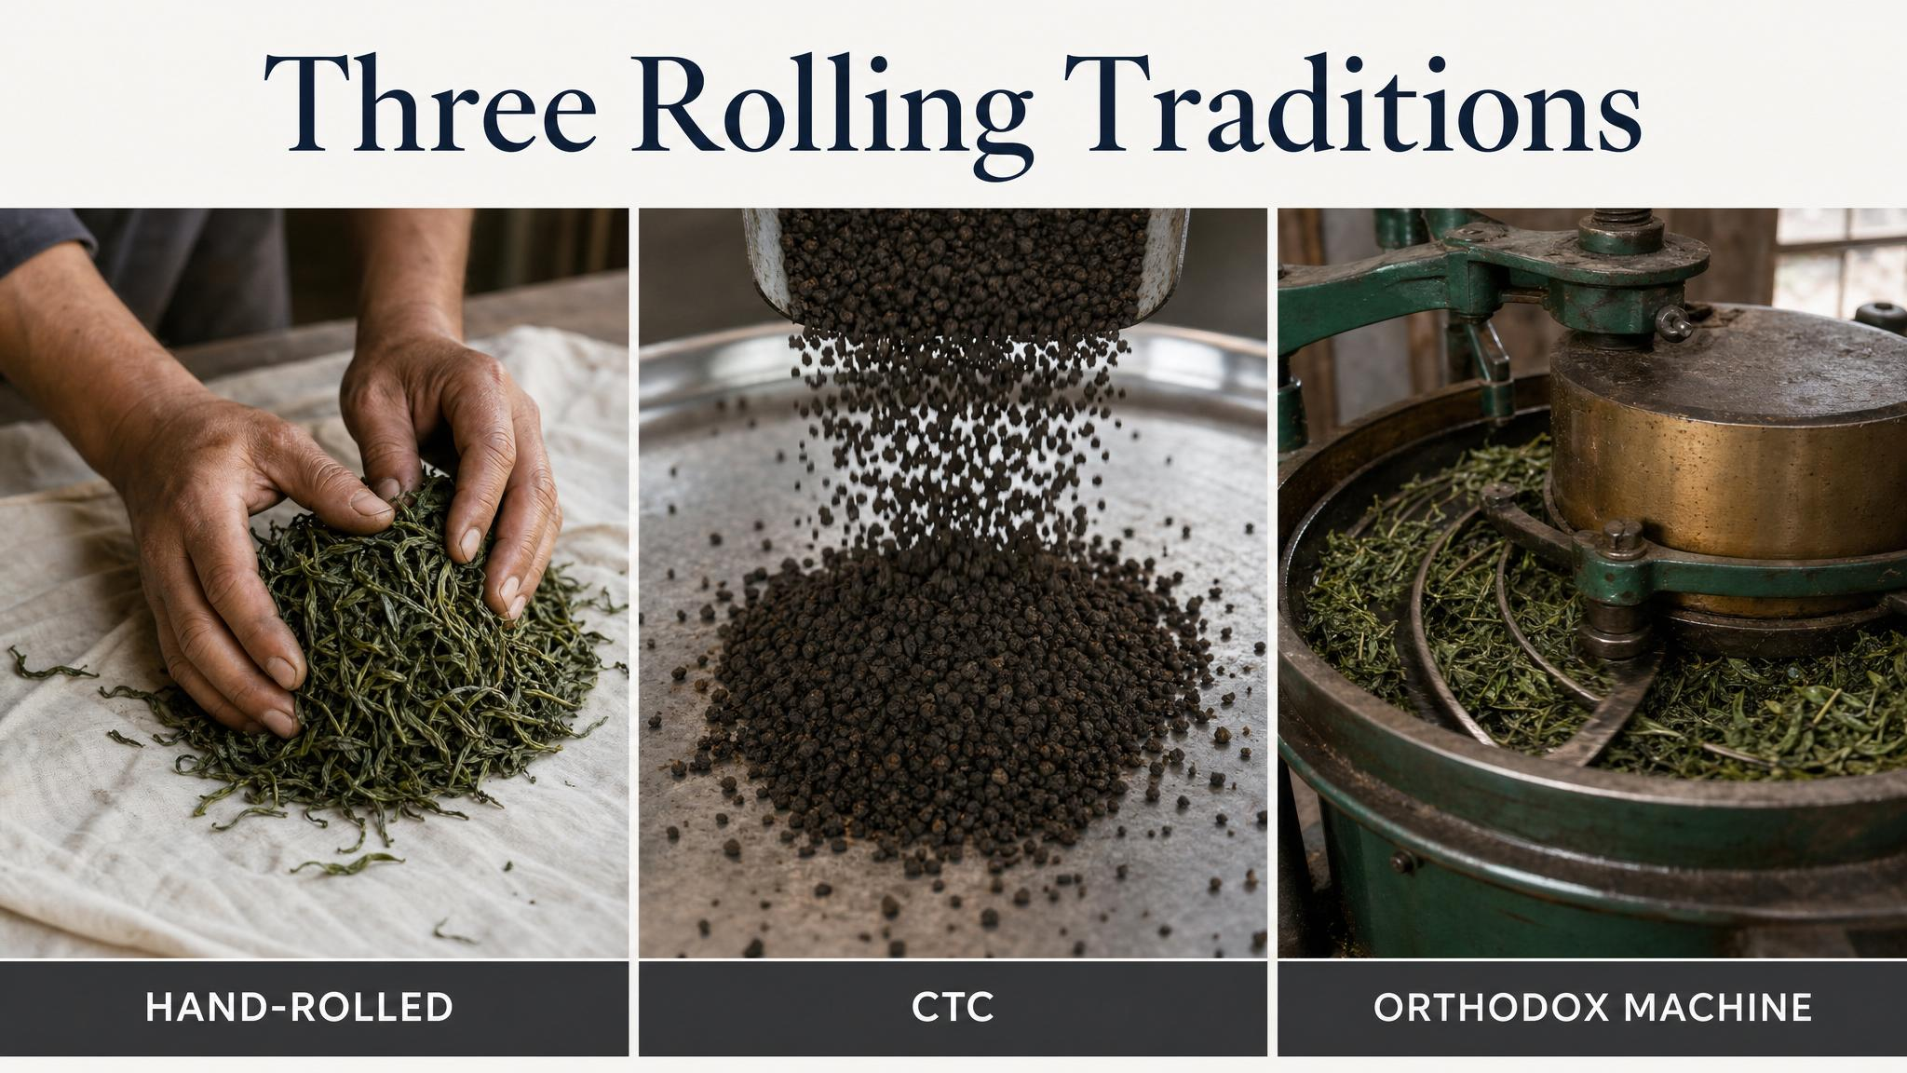
Notes:
How you break the leaf is as decisive as how long you oxidise it. Hand-rolling is the most labour-intensive and produces the most distinctive teas. Orthodox rolling is the standard for whole-leaf black teas. CTC is industrial, fast, and produces most of the tea you've ever drunk if you've ever drunk a teabag.

Slide 10
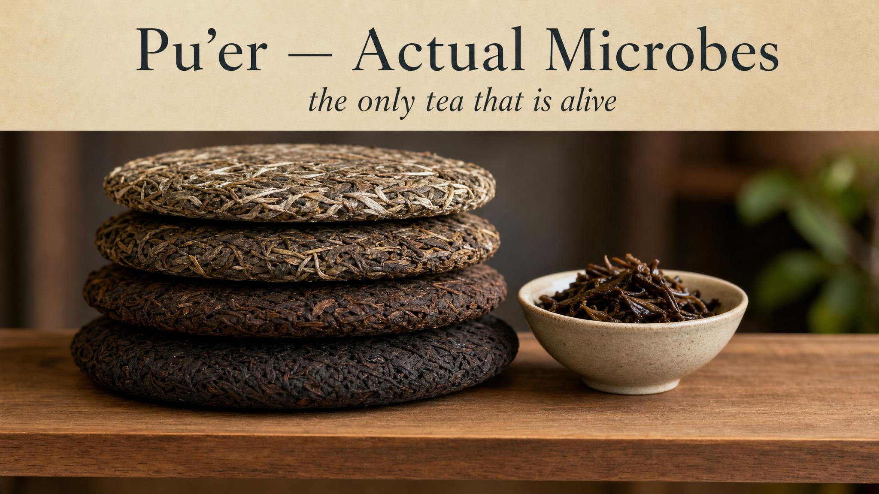
Notes:
The exception to the no-microbes rule. Pu'er and the other dark teas are genuinely fermented — filamentous fungi like Aspergillus niger, plus bacteria, work over weeks (shou, 'ripe') or decades (sheng, 'raw'). The cup that emerges is earthy, woody, sometimes mushroomy — flavours no amount of oxidation alone produces.

Slide 11
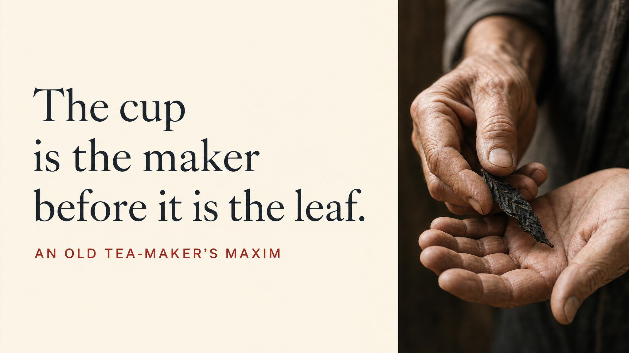
Notes:
Read the quote slowly. Pause. The cup arrives in the drinker's hands as the answer to a question the maker has spent decades learning to ask well. The chapter's emotional turn is here — chemistry alone doesn't make great tea; craft makes great tea, and the chemistry is what the craft is moving through.

Slide 12
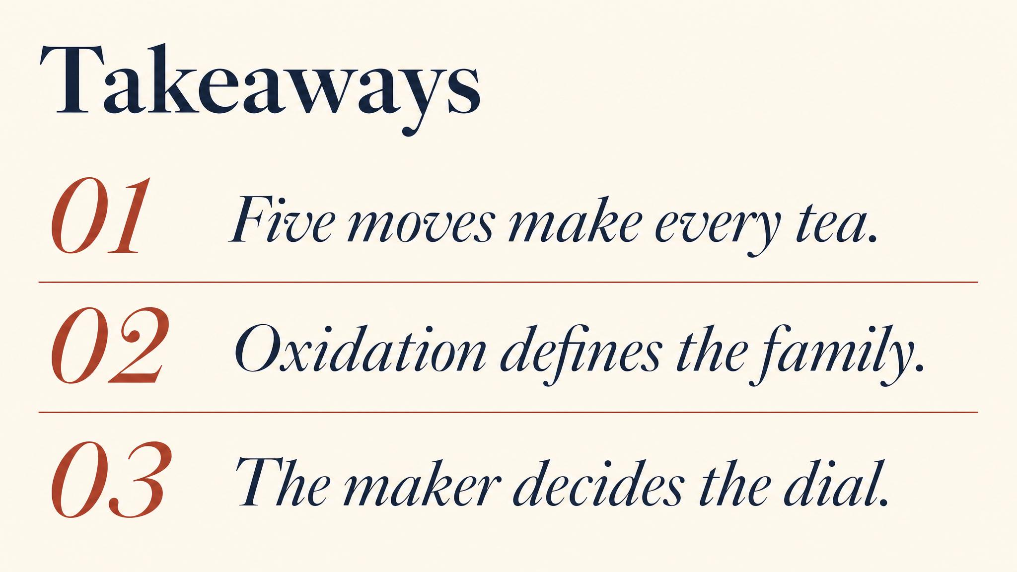
Notes:
Three things to carry. One: every tea you've ever drunk is some combination of five moves — wither, roll, oxidise, kill-green, dry. Two: the master reaction is enzymatic oxidation, not microbial fermentation, despite the trade calling it 'fermentation' for a century. Three: pu'er is genuinely the exception — real microbes, real fermentation.

Slide 13

Notes:
Close with the bridge: we have a finished, dry leaf. The other half of every cup — the half we have not touched yet — is water. Next class: temperature, time, ratio, mineral content, and what those four variables actually do to the chemistry we've spent two classes building.

