Slide 1
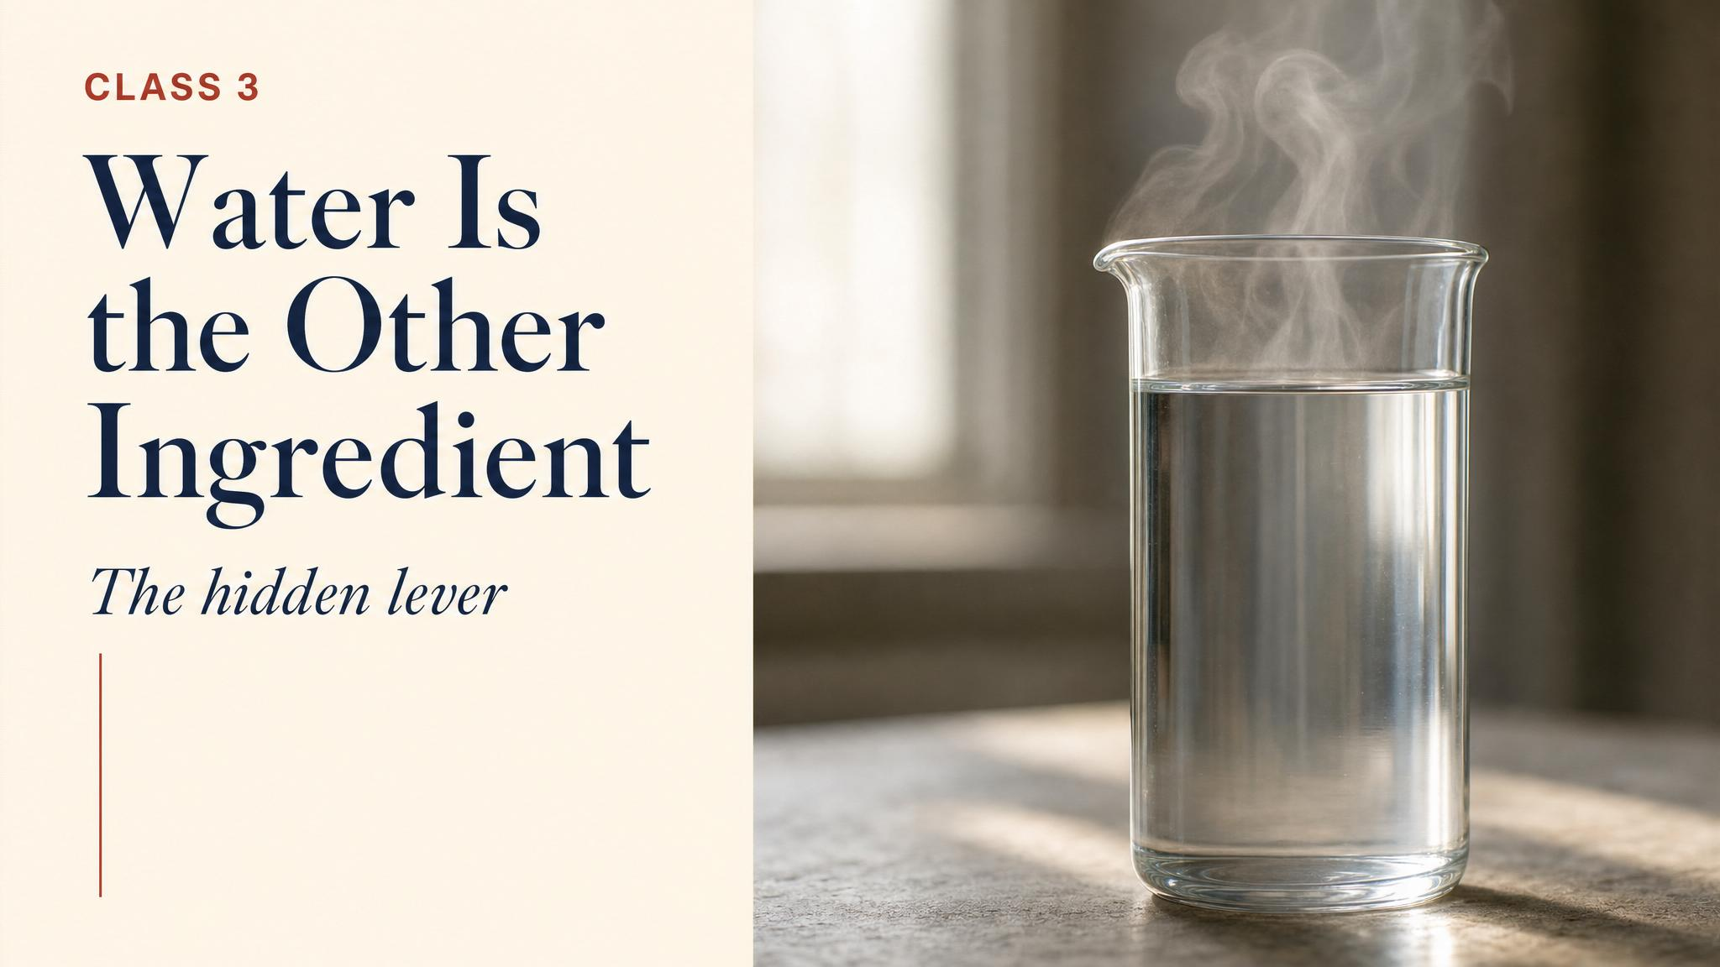
Notes:
Open with the chapter's apology: every tea drinker has ruined an expensive tea, blamed the tea, and not the kettle. This class is the chemistry behind that quiet failure — temperature, time, ratio, and the most overlooked variable of all, the water itself.

Slide 2
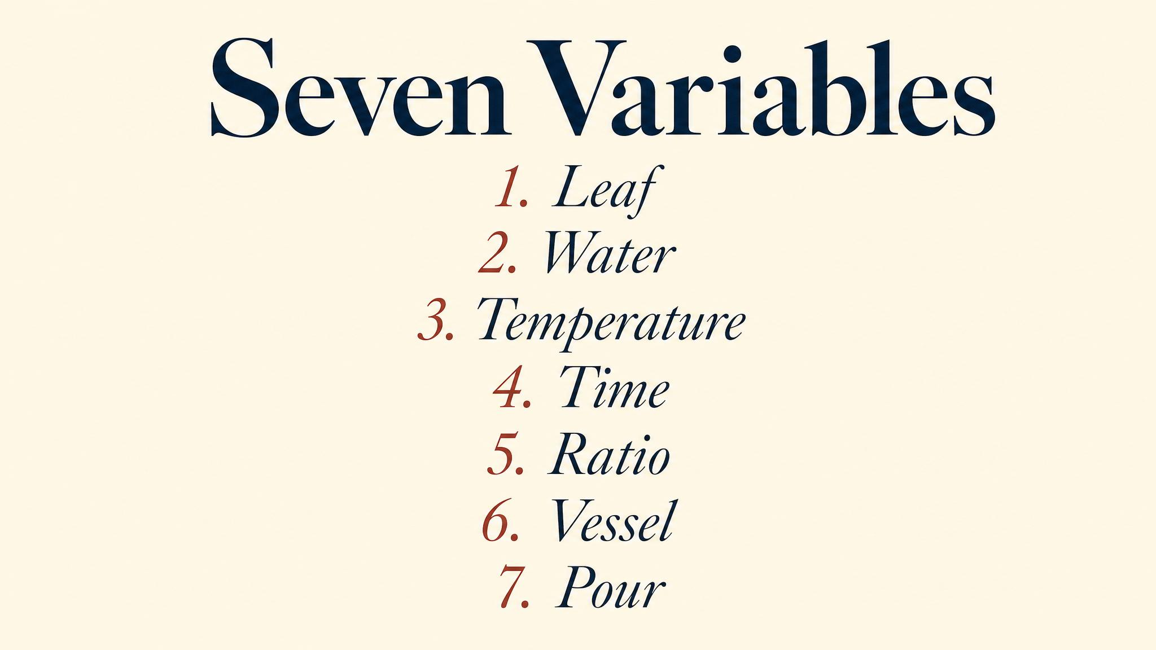
Notes:
Seven variables shape every cup. Temperature, time, and ratio do most of the work. Water is the great hidden lever. Vessel, agitation, and leaf shape are second-order dials. We'll spend most of class on the first four.

Slide 3
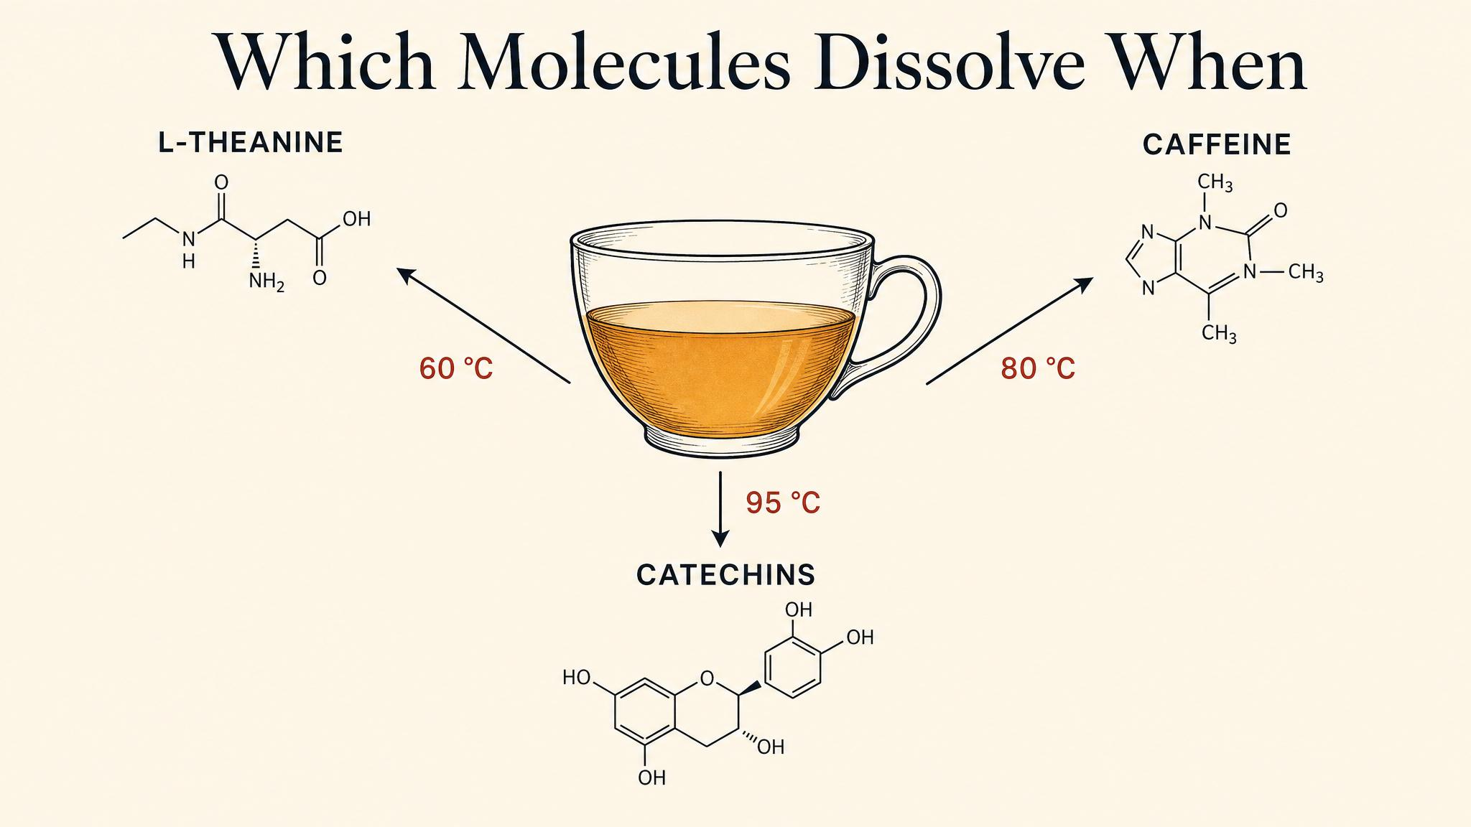
Notes:
Temperature is a chemical filter. Amino acids — sweet, umami — extract at lower temperatures. Caffeine sits in the middle. Catechins — bitter, astringent — need higher temperatures and longer time. Volatiles need heat to enter the steam where the nose can find them.

Slide 4
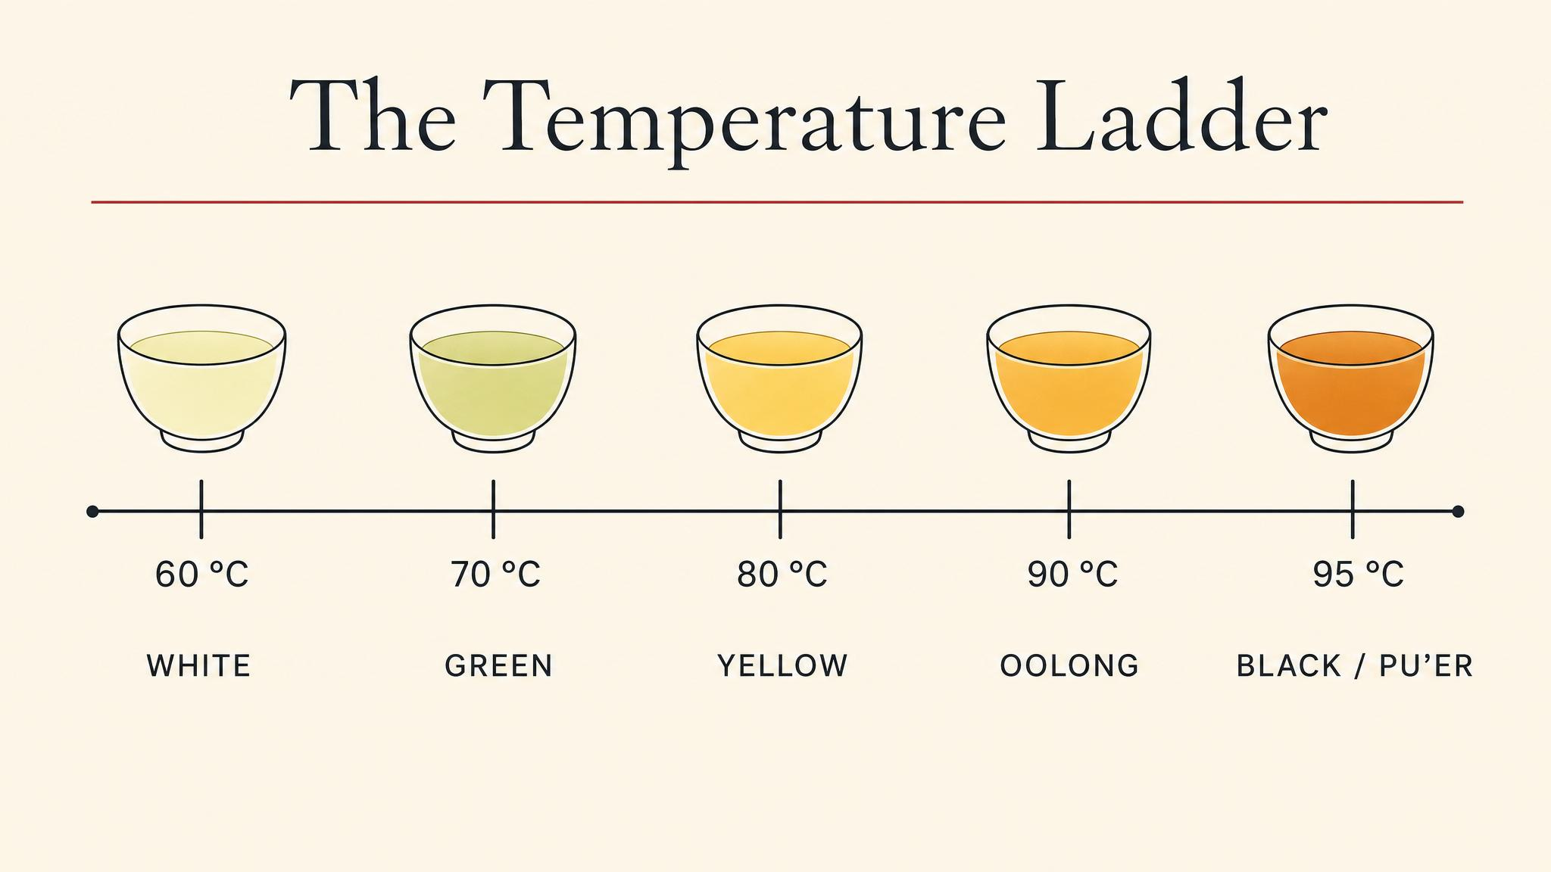
Notes:
A rough working ladder. Shaded greens (gyokuro) like ~60°C. Standard unshaded greens around 75°C. Oolongs in the high 80s and 90s. Black tea and dark tea want boiling. Boiling a gyokuro is the most common expensive-tea mistake in a Western kitchen.

Slide 5
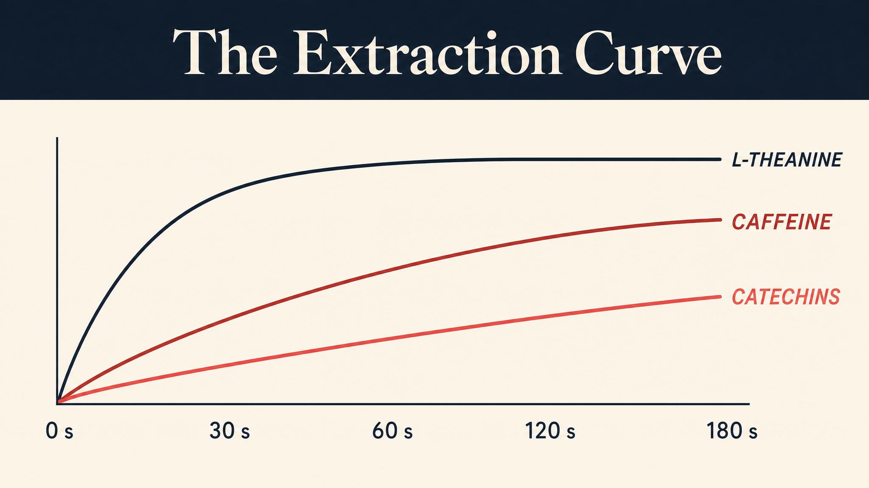
Notes:
Time doesn't scale linearly. Amino acids extract quickly and plateau. Caffeine comes out at a steady middle rate. Catechins are slow and keep building. Two minutes of steeping is a different cup from five — not 'stronger', but chemically different.

Slide 6
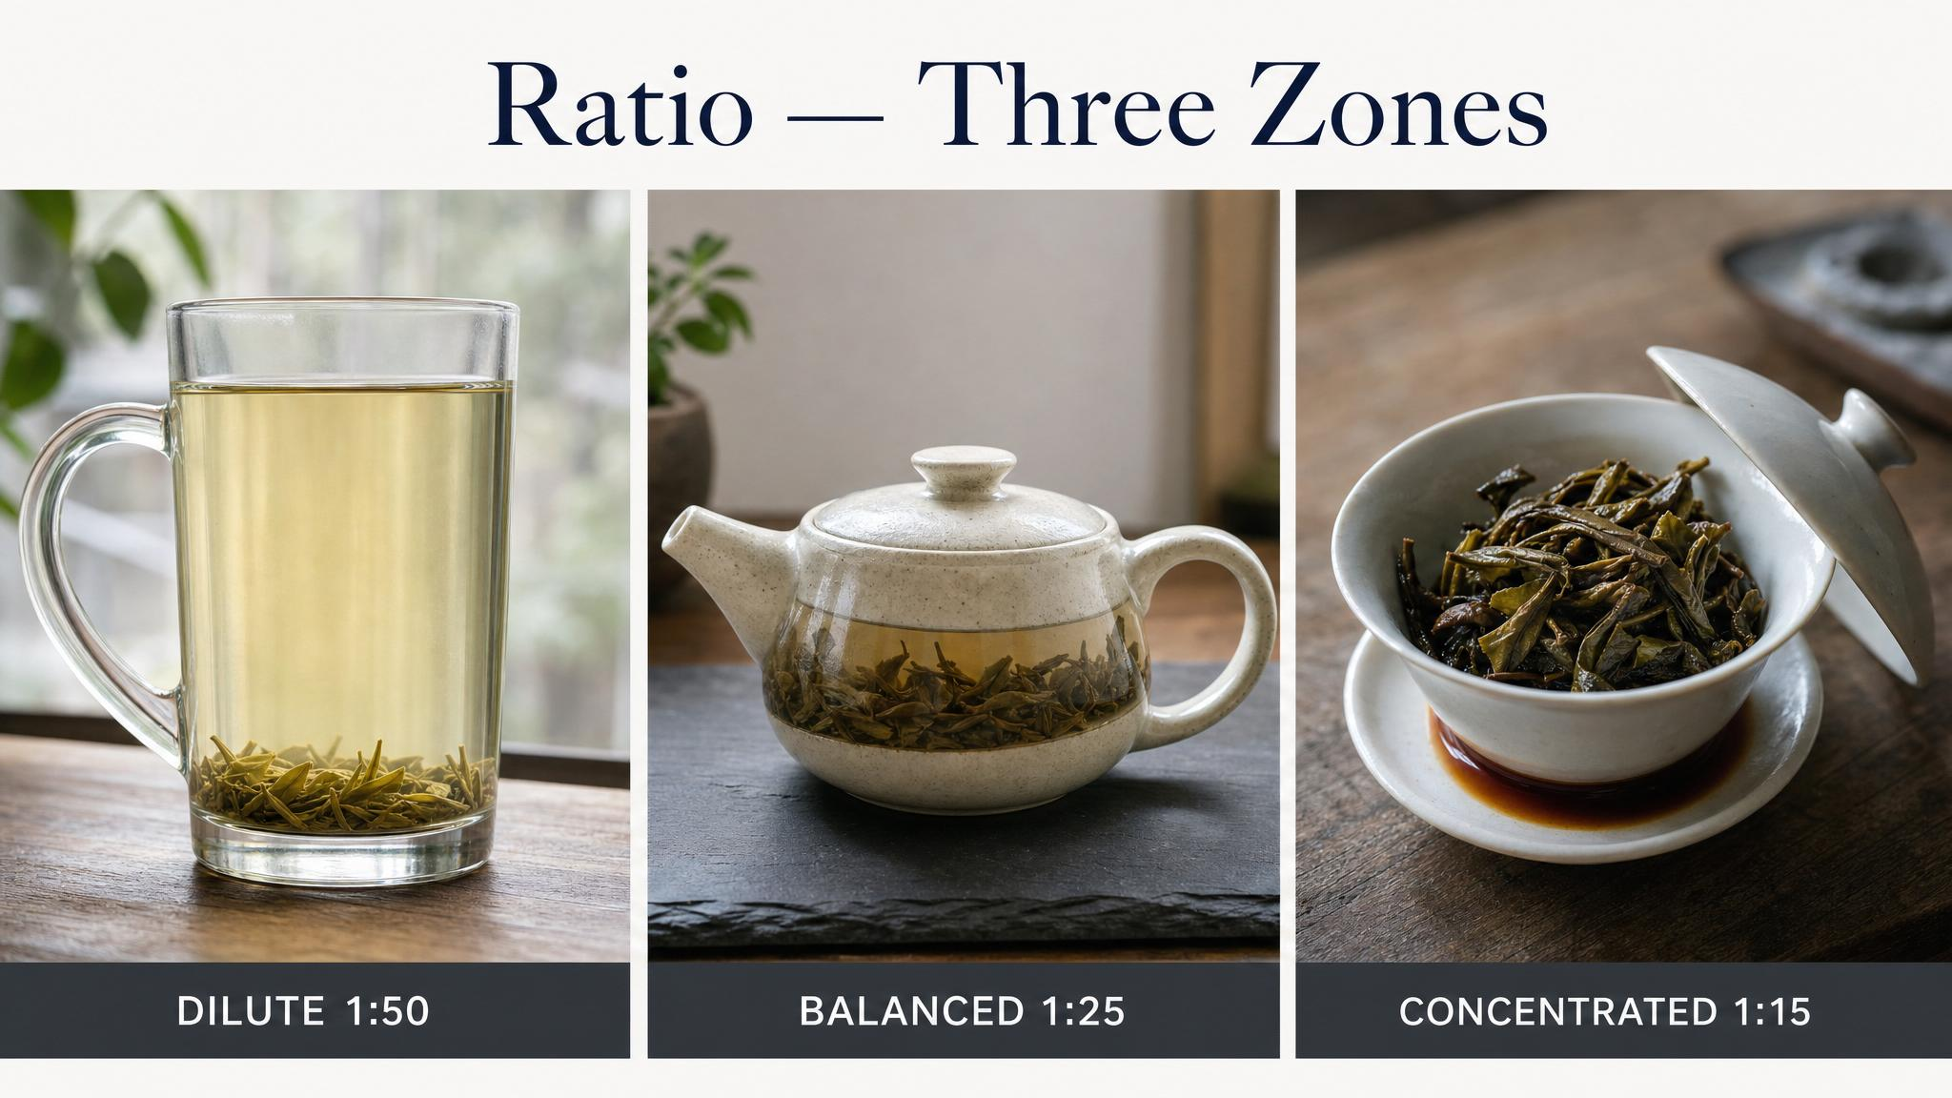
Notes:
Western style trades complexity for ease — modest leaf, one long steep. Gongfu maximises the leaf's variation — high ratio, very short steeps, multiple times. Cold brew uses time instead of heat. None of them is correct; each is a different recipe for the same chemistry.

Slide 7
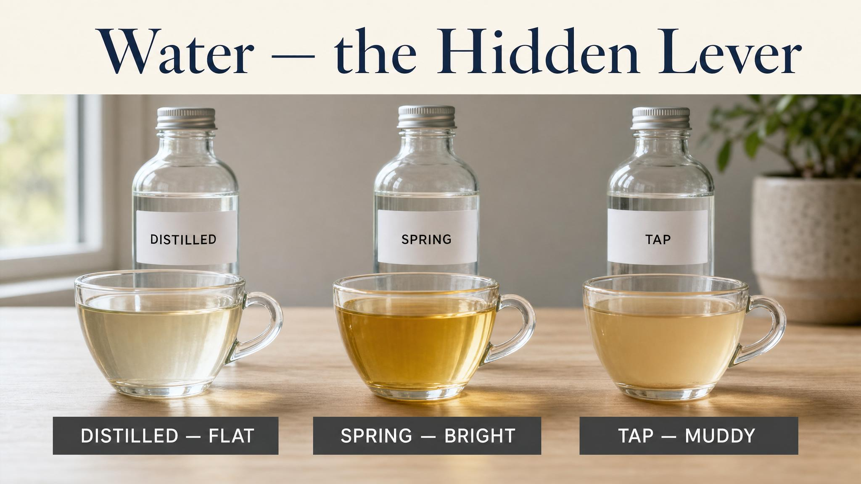
Notes:
Brew the same leaf with three waters and you'll get three meaningfully different cups. Distilled is hollow. Hard tap is muddied — bicarbonates react with the polyphenols. Moderate spring water with calcium around 30–80 ppm is the Goldilocks zone.

Slide 8
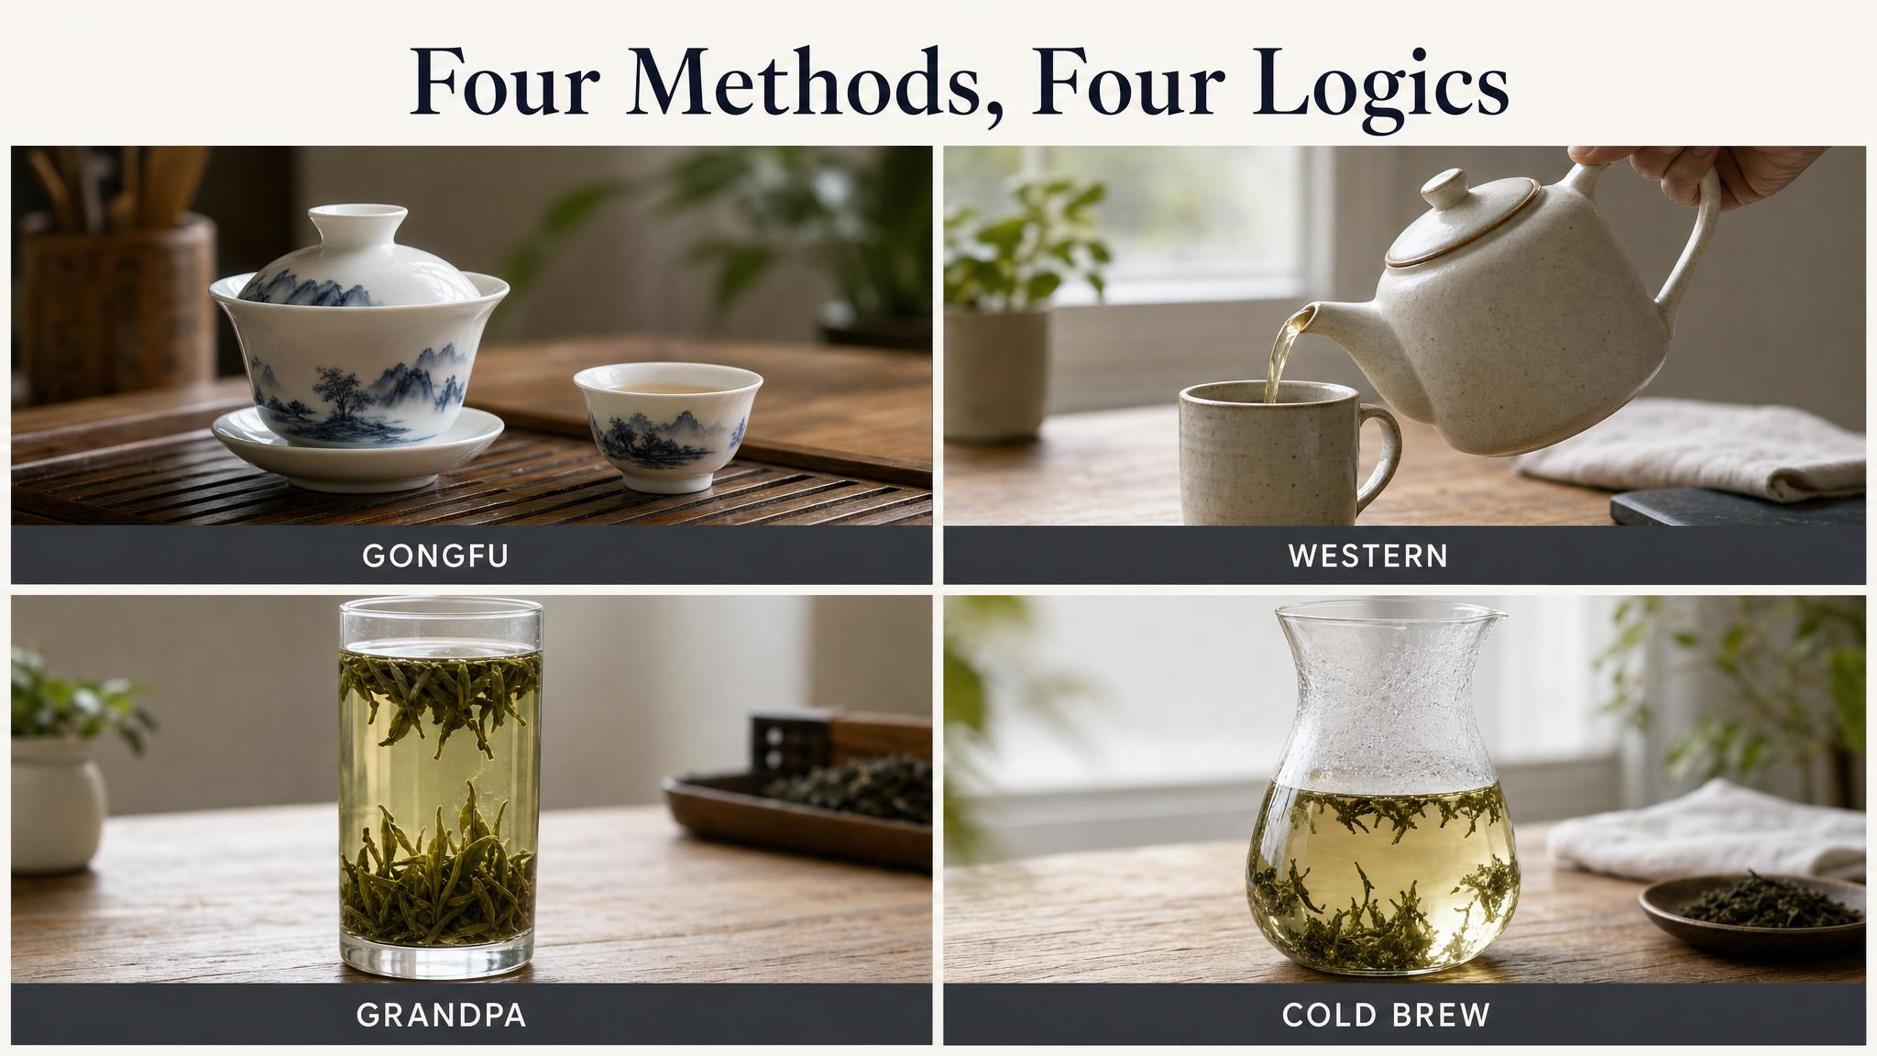
Notes:
Western style is for daily ease. Gongfu is for unfolding the leaf's complexity. Grandpa style is for slow all-day sipping. Cold brew is for the sweetest, smoothest cup you can extract without heat. Pair the method to the leaf you have.

Slide 9
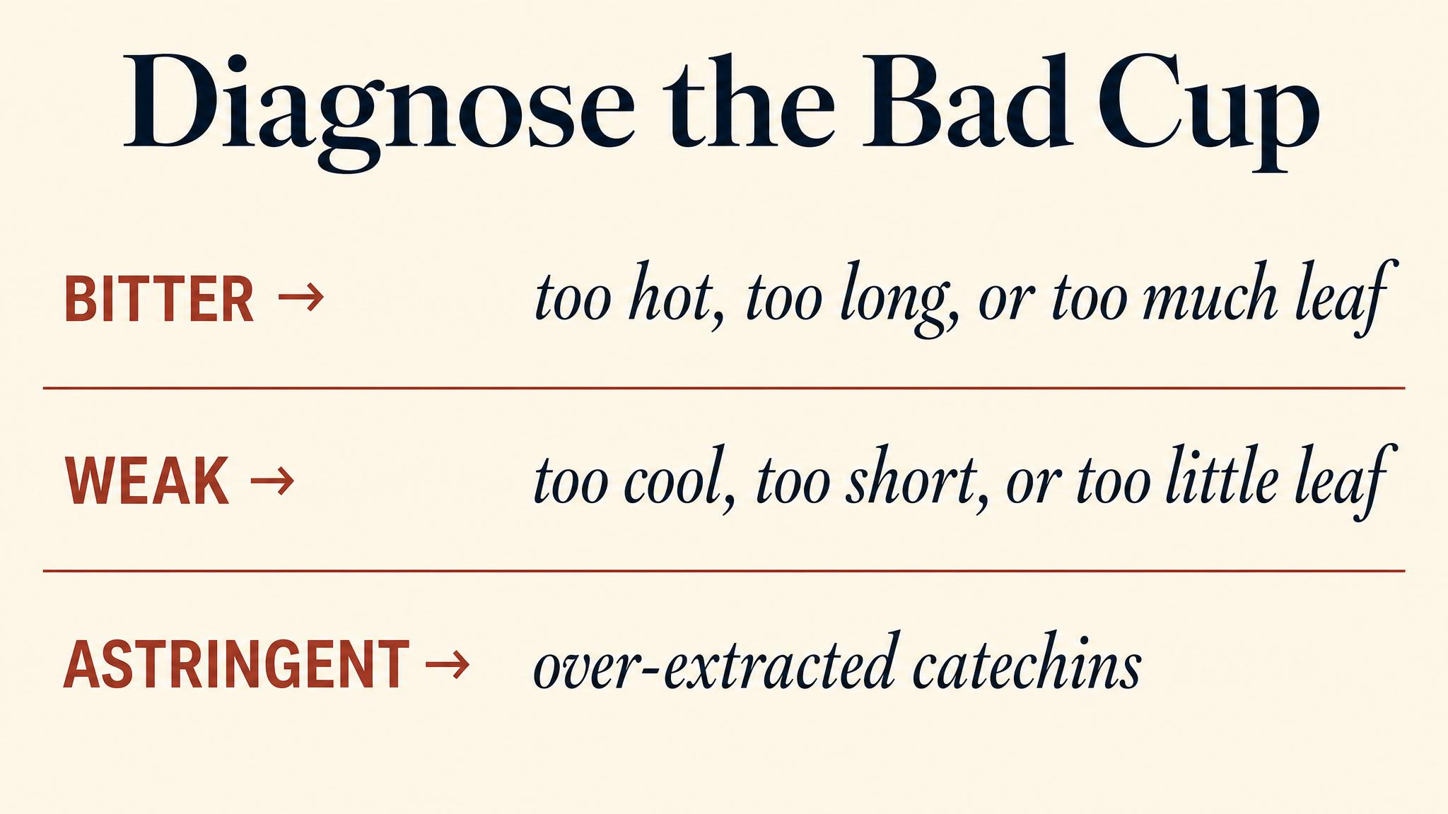
Notes:
Once you know the variables, every bad cup is diagnosable. Too bitter means over-extracted catechins — drop the heat or the time. No body means too little leaf or too soft water — fix one. Stewed and muddled means hard water plus too long a steep — fix the water first.

Slide 10
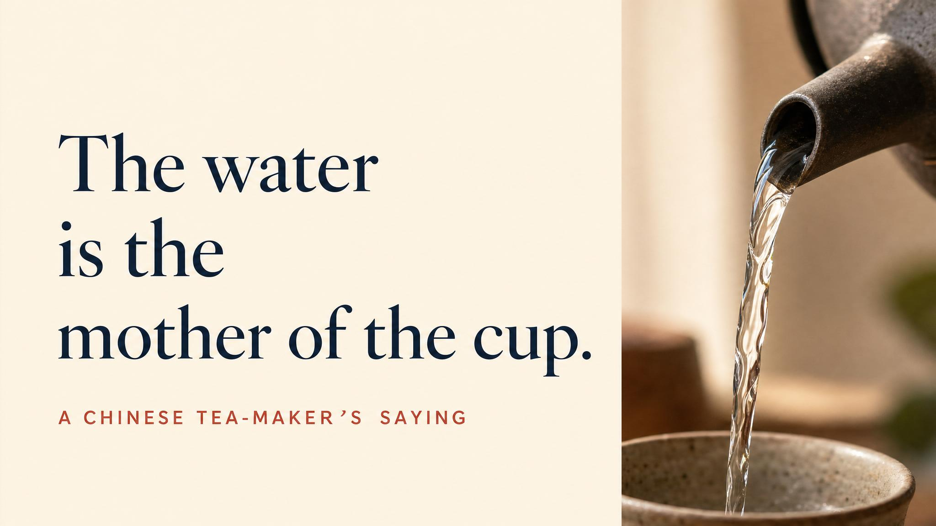
Notes:
Pause. Read it slowly. Zhang Yuan's Ming-dynasty manual already understood, four centuries ago, that water was half the cup. Modern chemistry agrees, with less elegance.

Slide 11
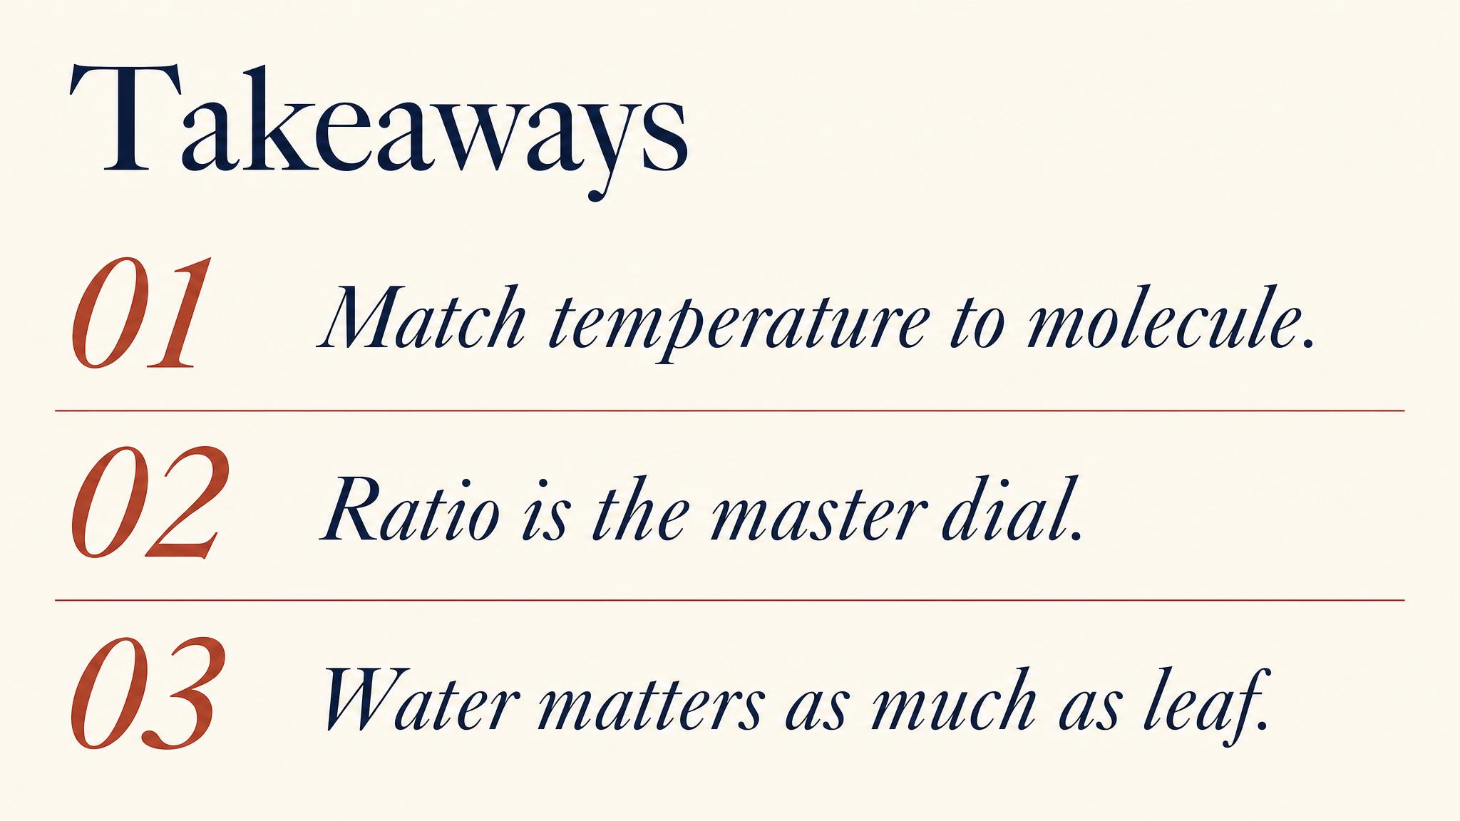
Notes:
Three things to carry. One: temperature is the chemical filter; pick it to match the leaf. Two: water itself is half the cup — don't waste premium leaf on bad water. Three: gongfu, Western, grandpa, cold brew — pair the method to the leaf and the moment.

Slide 12
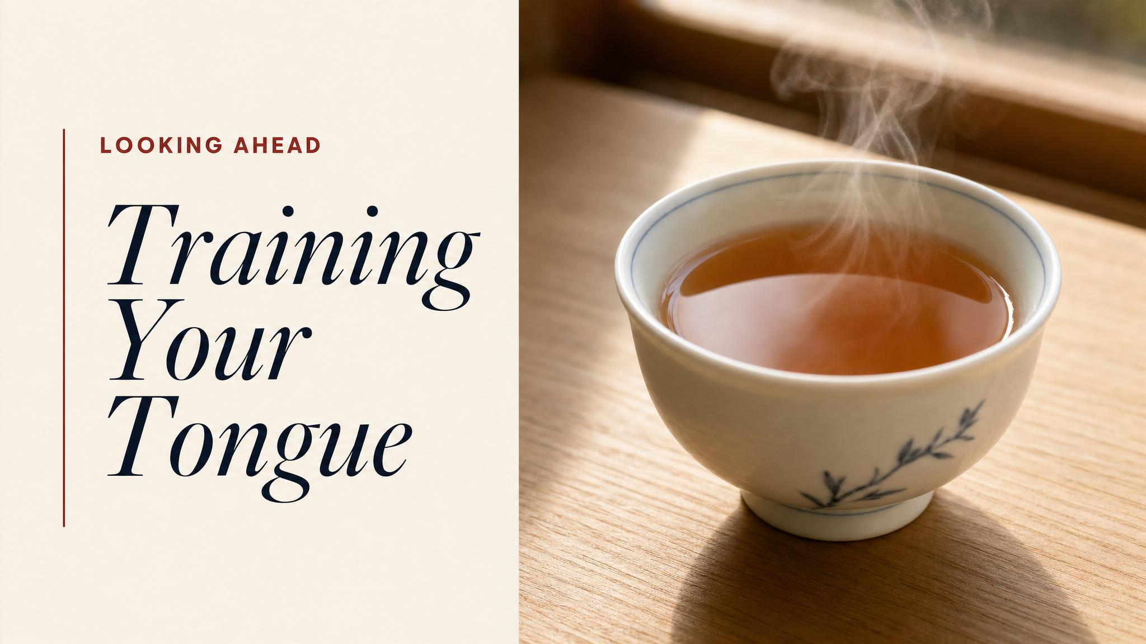
Notes:
Close with the bridge: you can put a beautifully brewed cup in front of yourself now. Next class, we look at the equipment you'll taste it with — the human tongue, the retronasal pathway, the trigeminal nerve. The science of why the cup tastes how it tastes.

