Slide 1
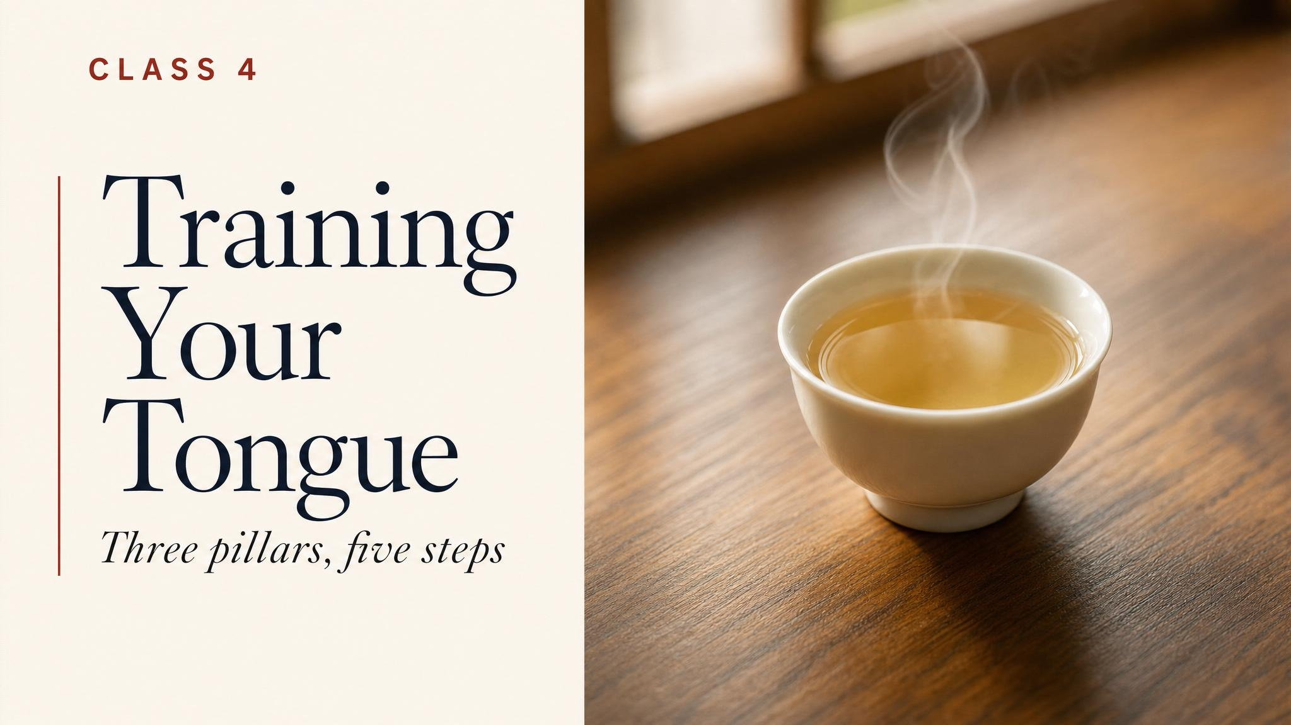
Notes:
Open with the nose-pinch demonstration. Have the room pinch their noses if they have any drink in front of them; instruct them to sip with the nose pinched and pay attention to what's actually there. Then release the nose. That second arrival is retronasal aroma — the channel most of us don't know is doing most of the work.

Slide 2
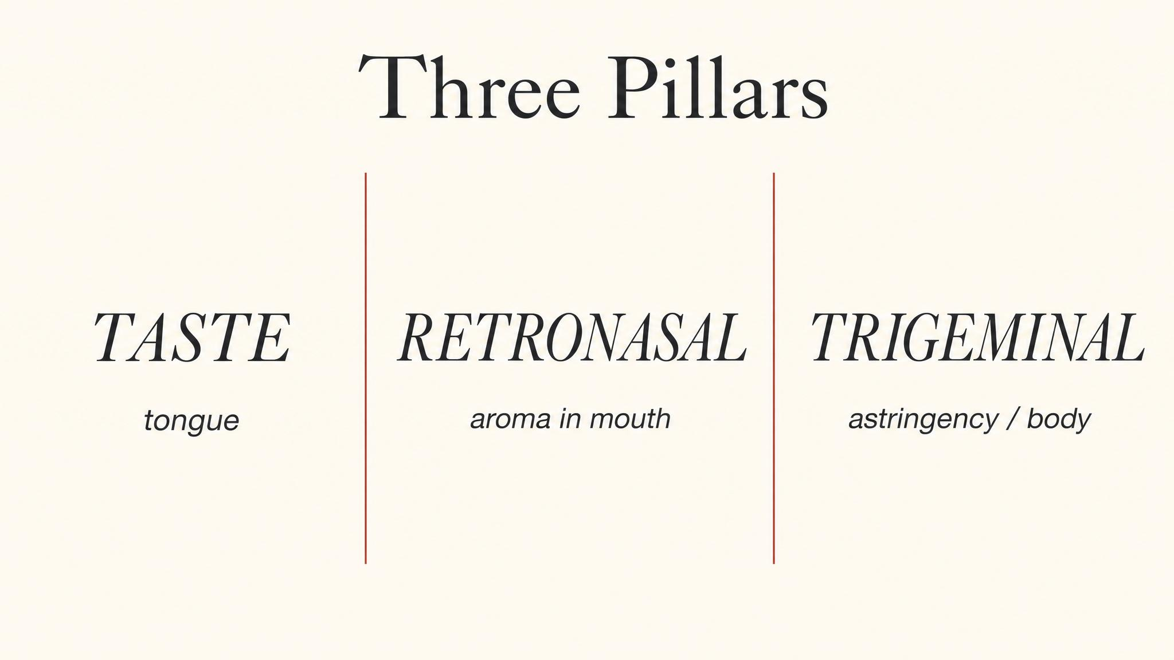
Notes:
Three pillars. Taste — five basic tastes on the tongue. Smell — especially retronasal smell, which is most of what we casually call flavour. Touch — the trigeminal nerve reporting astringency, body, temperature. Most people only know about the first one.

Slide 3
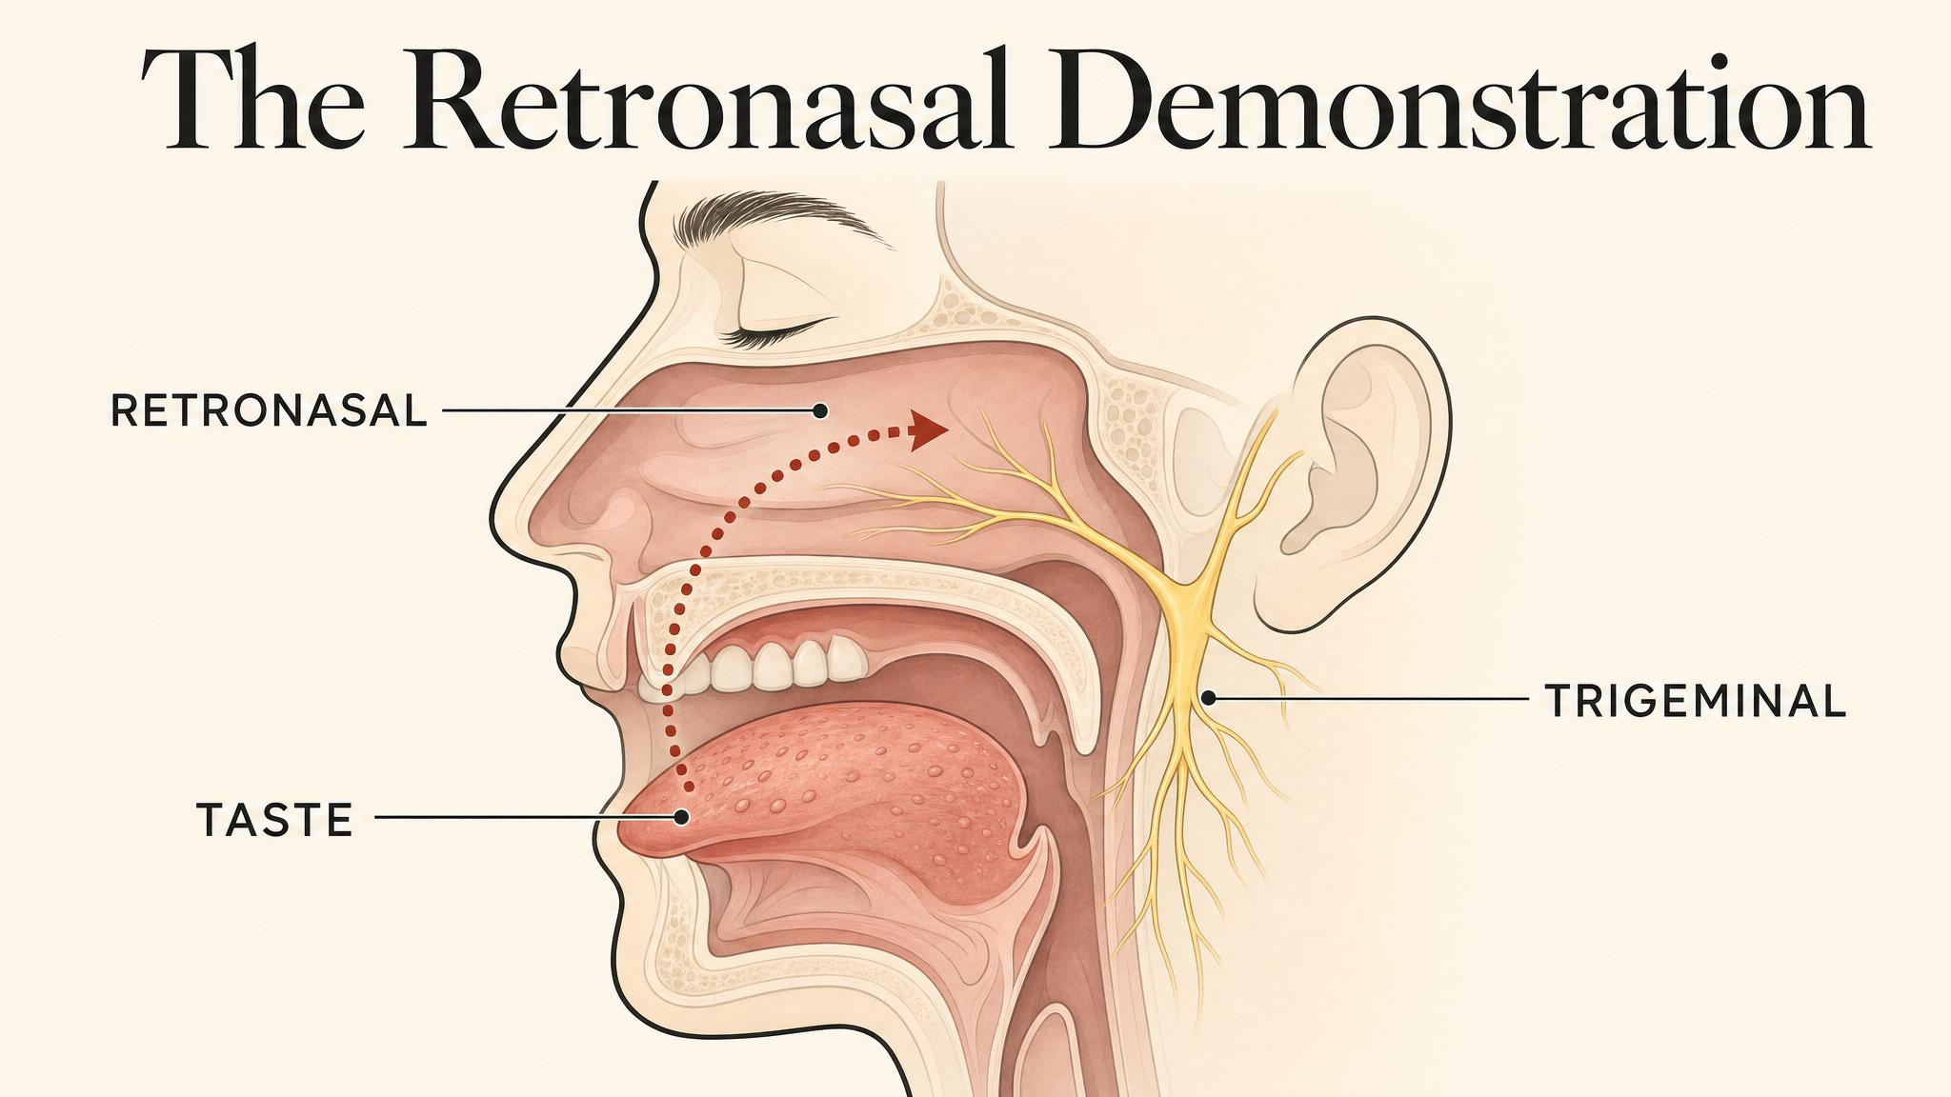
Notes:
When you swallow tea, warm aromatic molecules rise from the back of your mouth through the pharynx and reach the olfactory epithelium high inside the skull. This is retronasal smell — and it's responsible for nearly all of what we call 'flavour'. Front-of-the-nose smelling alone barely scratches it.

Slide 4
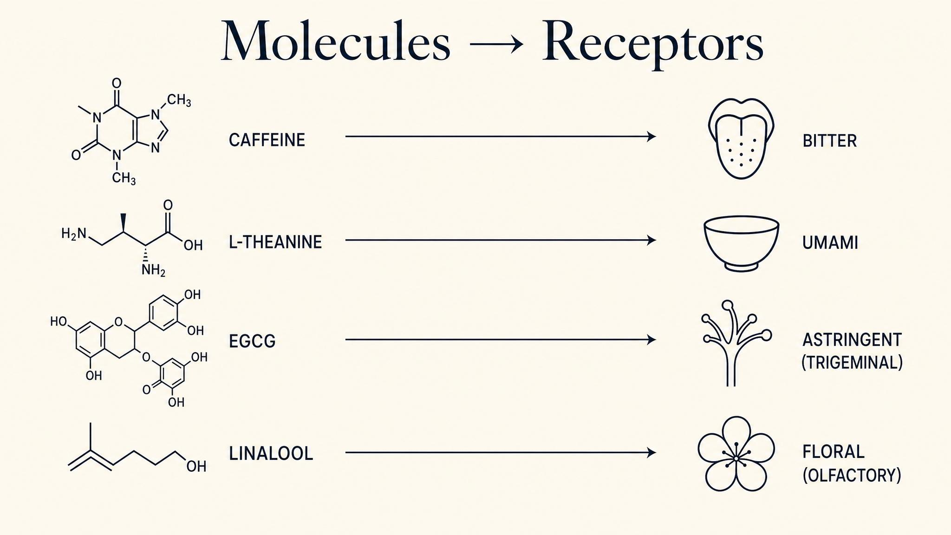
Notes:
Each major compound activates a specific sensory channel. L-theanine triggers the umami receptor — savoury taste. Catechins don't trigger taste at all; they bind to salivary proteins and the trigeminal nerve reports astringency. Caffeine activates bitter taste receptors. Volatiles travel the retronasal pathway to olfactory receptors and become 'aroma'.

Slide 5
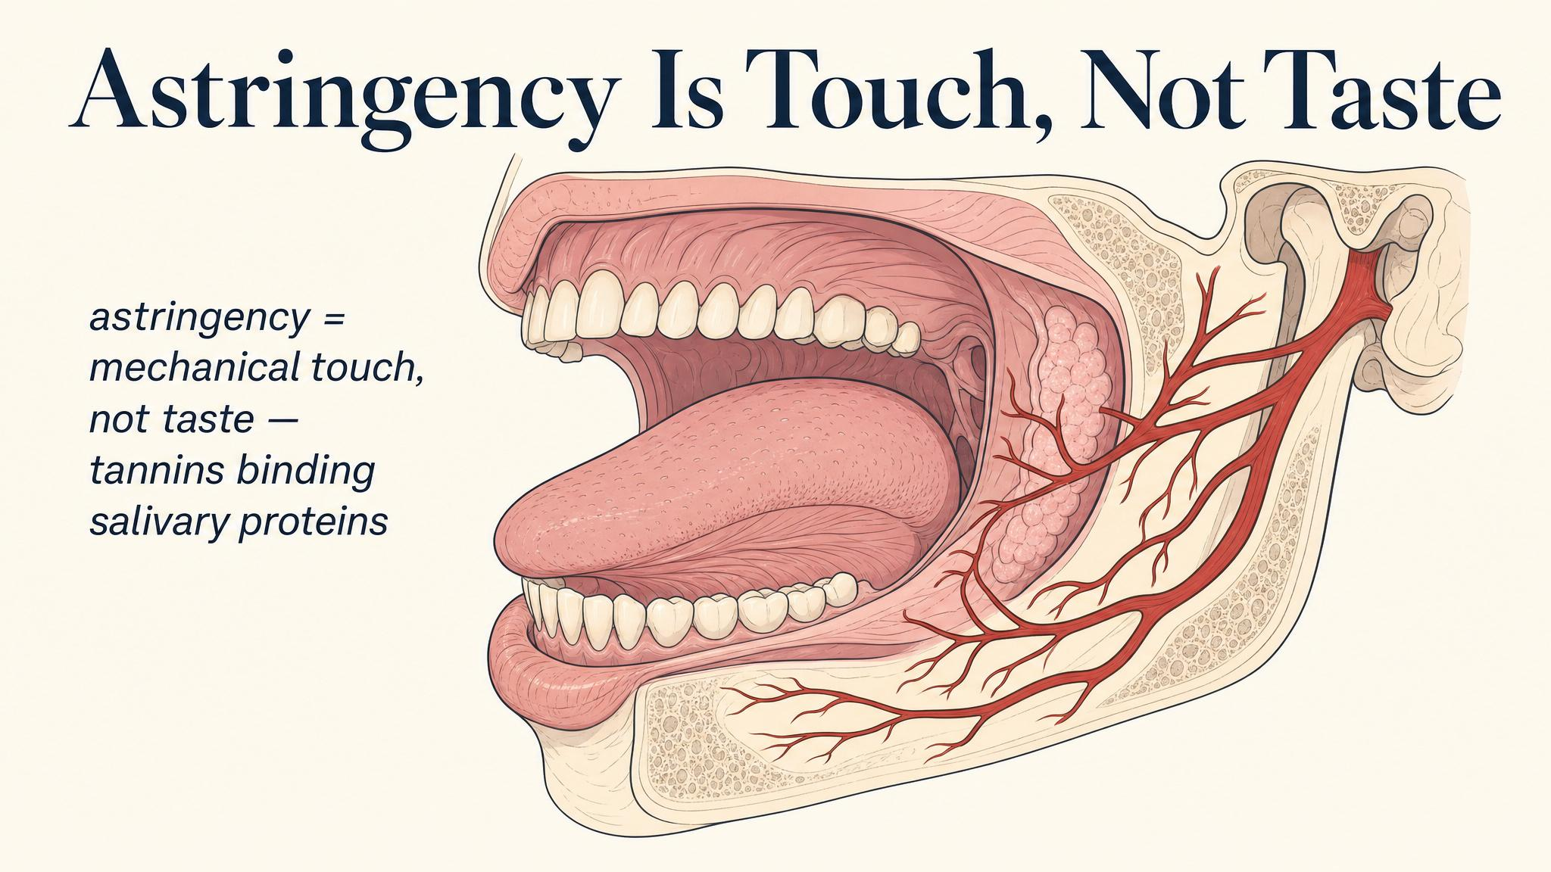
Notes:
Bitterness is taste — caffeine and some other compounds on the bitter receptors. Astringency is something completely different: catechins binding to the proteins in your saliva and changing how your mouth feels. The trigeminal nerve reports it as dryness or puckering. Casual speech mashes them together; the mechanisms are completely separate.

Slide 6
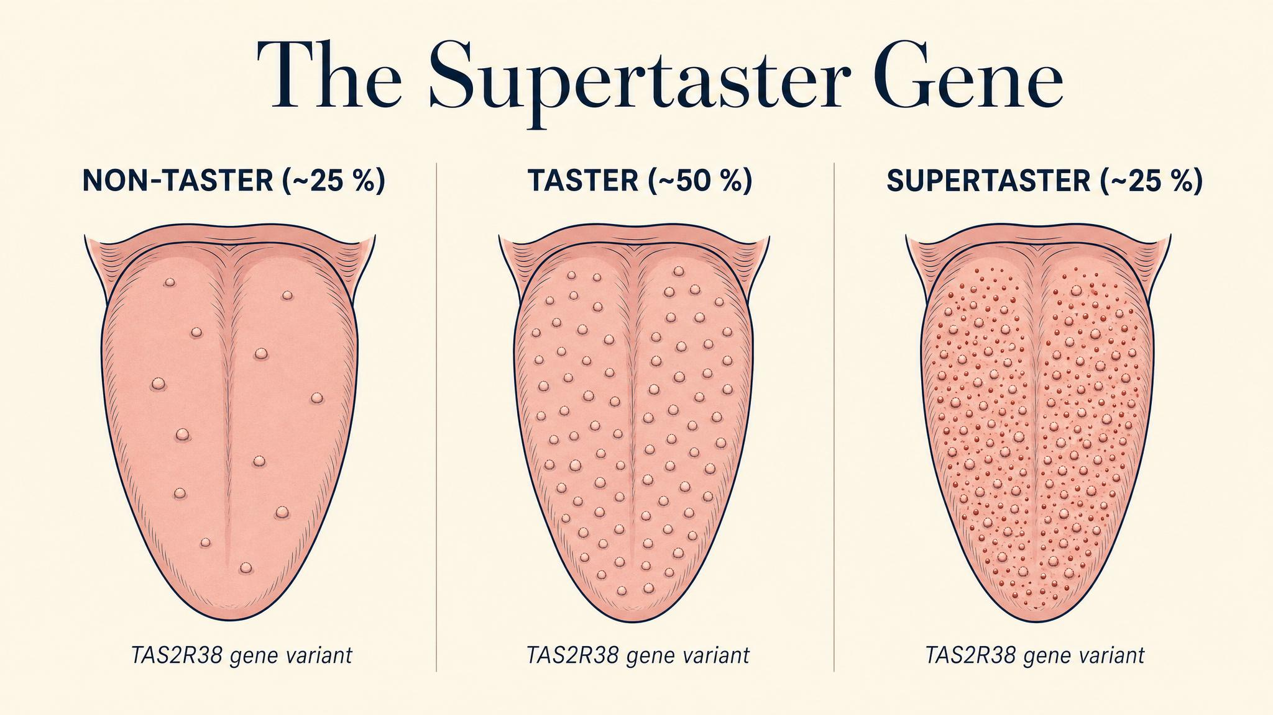
Notes:
Two people sharing a cup of tea are not always tasting the same cup. The TAS2R38 gene varies; a quarter of the population perceives bitter compounds dramatically more intensely (supertasters); another quarter barely registers them (nontasters). Disagreements about 'how bitter is this' are often receptor-level disagreements, not aesthetic ones.

Slide 7
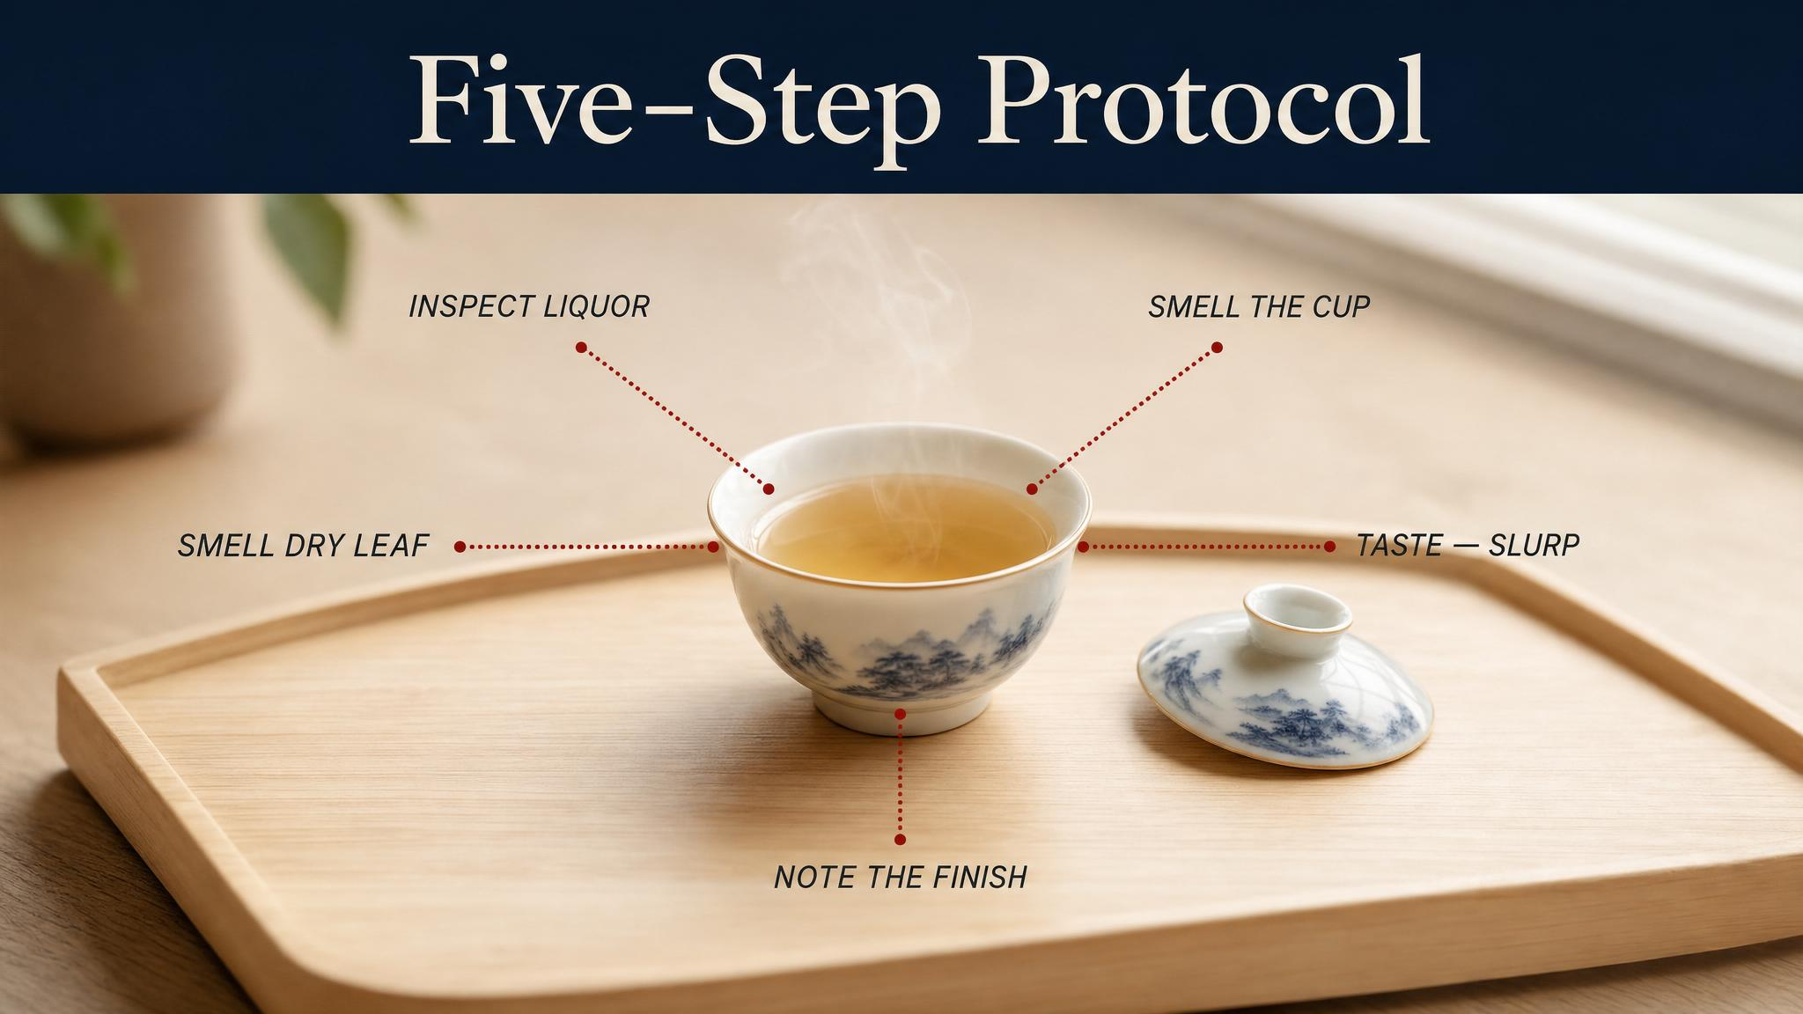
Notes:
Across Chinese, British, and Japanese traditions, the structure of professional tasting is similar: look, smell, sip, feel, follow. Each step engages one or two of the three pillars in turn. Together they slow the cup down enough that there is something to say about it.

Slide 8
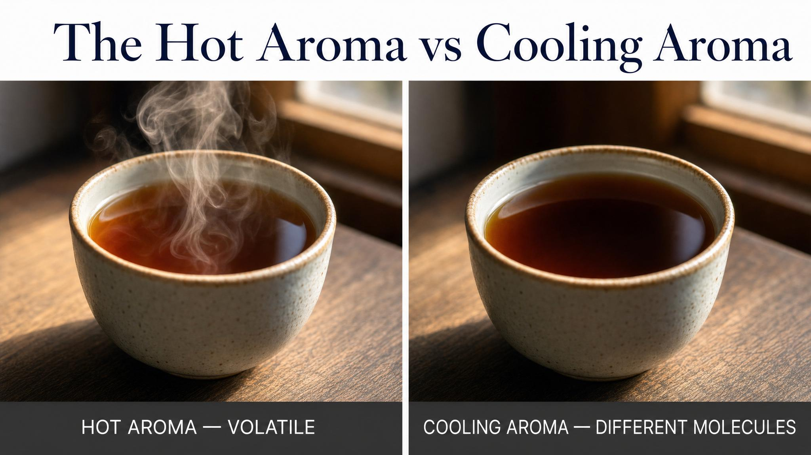
Notes:
Smelling the cup hot tells you about the light aromatics — they leave fastest. Smelling the cup cool tells you about the heavy aromatics that linger. Professional tasters check both, deliberately. The cup has more than one smell, and they tell different parts of the story.

Slide 9
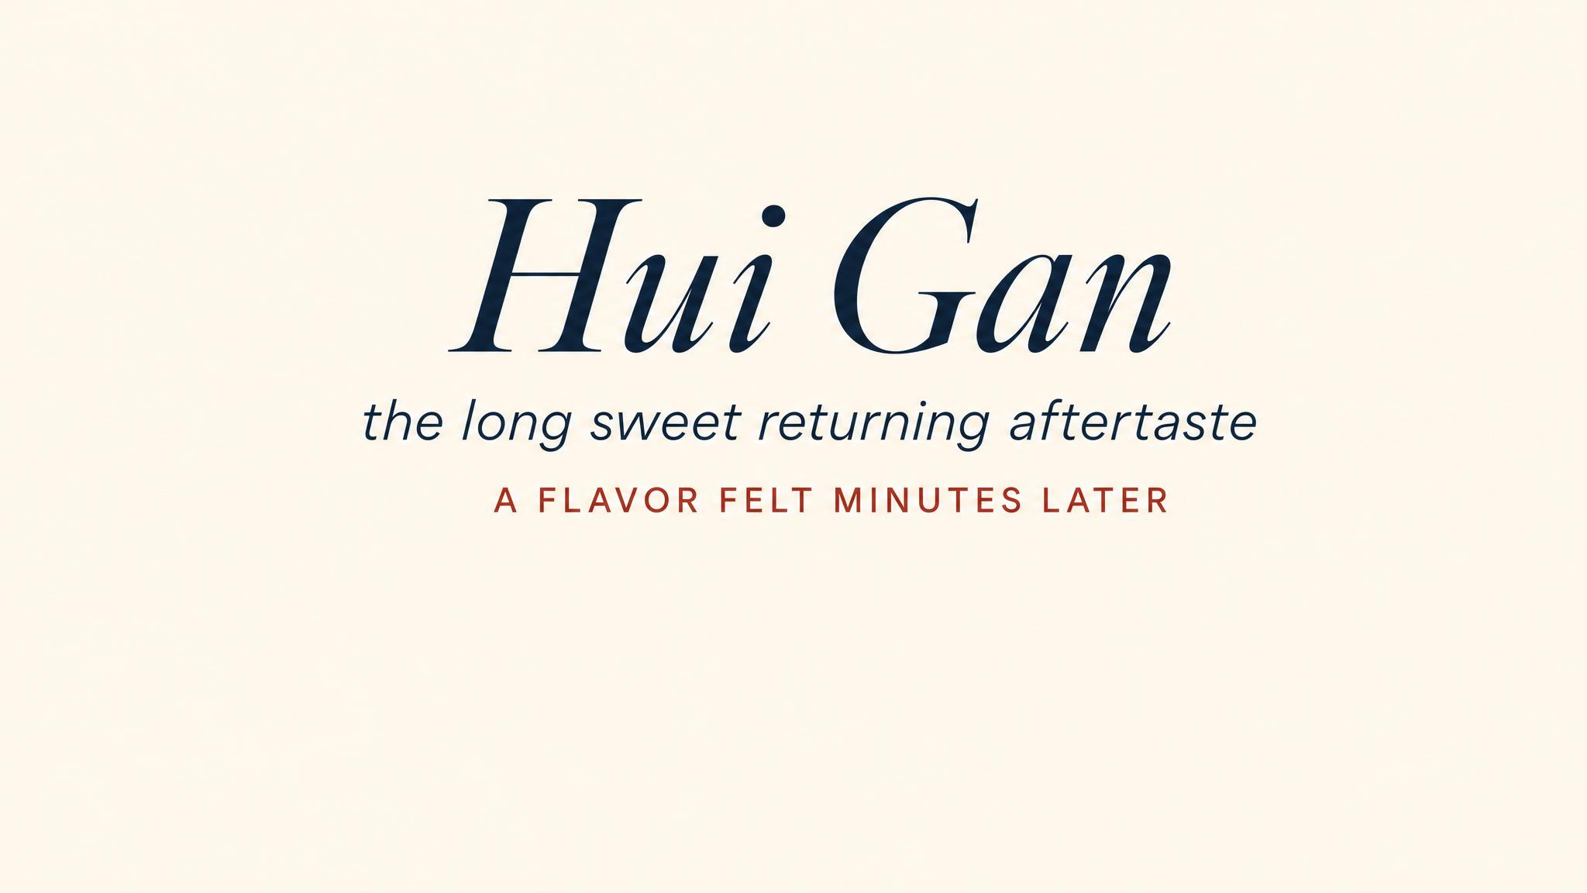
Notes:
The Chinese phrase huí gān — 'returning sweetness' — names the long tail of aftertaste a great tea leaves on the palate. Some cups are remembered chiefly in the finish, not in the sip. Always sit with the cup for a few seconds after swallowing; the leaf still has things to say.

Slide 10
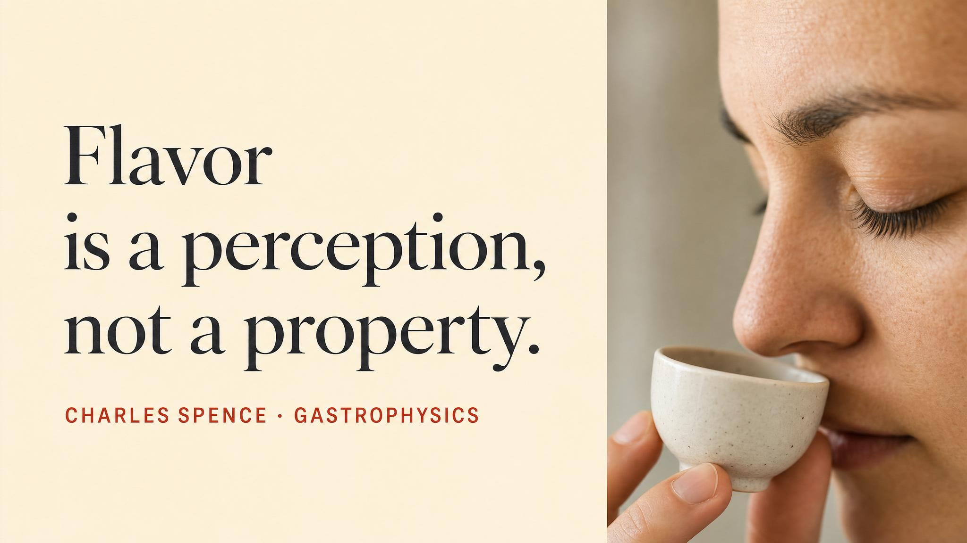
Notes:
Charles Spence, the Oxford gastrophysics professor, has spent a career documenting how 'taste' is really a confederacy of senses — and how attention itself is one of the loudest contributors. Pause on the line: 'mostly its members are smells'. Most students have never thought about this.

Slide 11
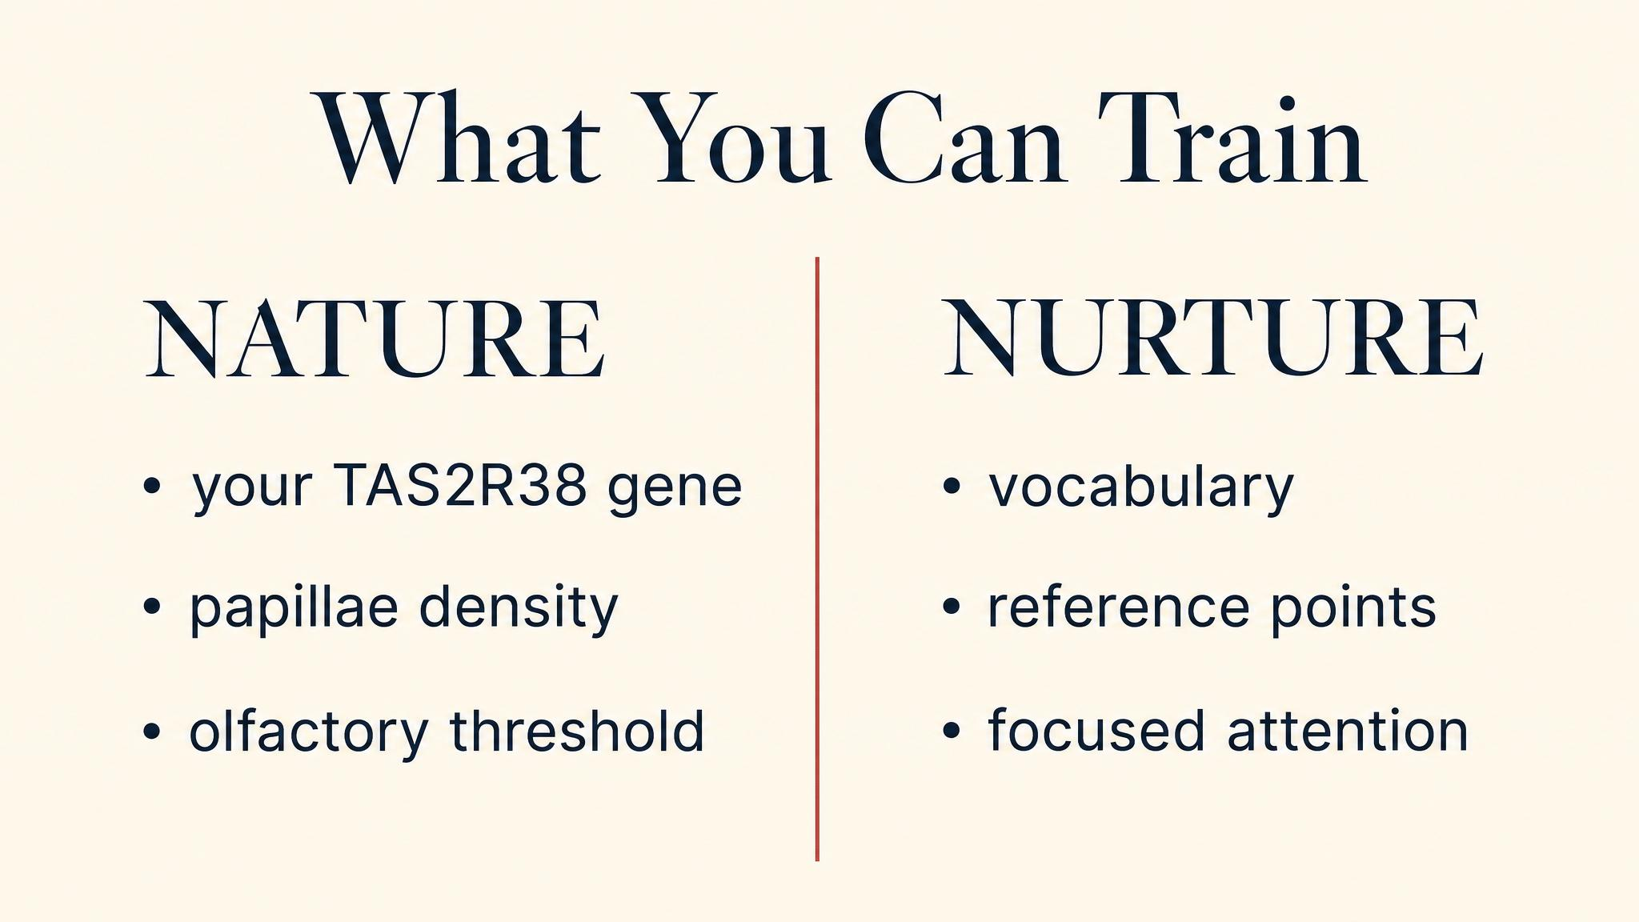
Notes:
The good news: the most useful parts of tasting are trainable. Attention, vocabulary, the ability to discriminate similar smells. The receptor map you were born with is the receptor map you keep — but it's not what limits most drinkers. Practice and the right vocabulary do most of the work.

Slide 12
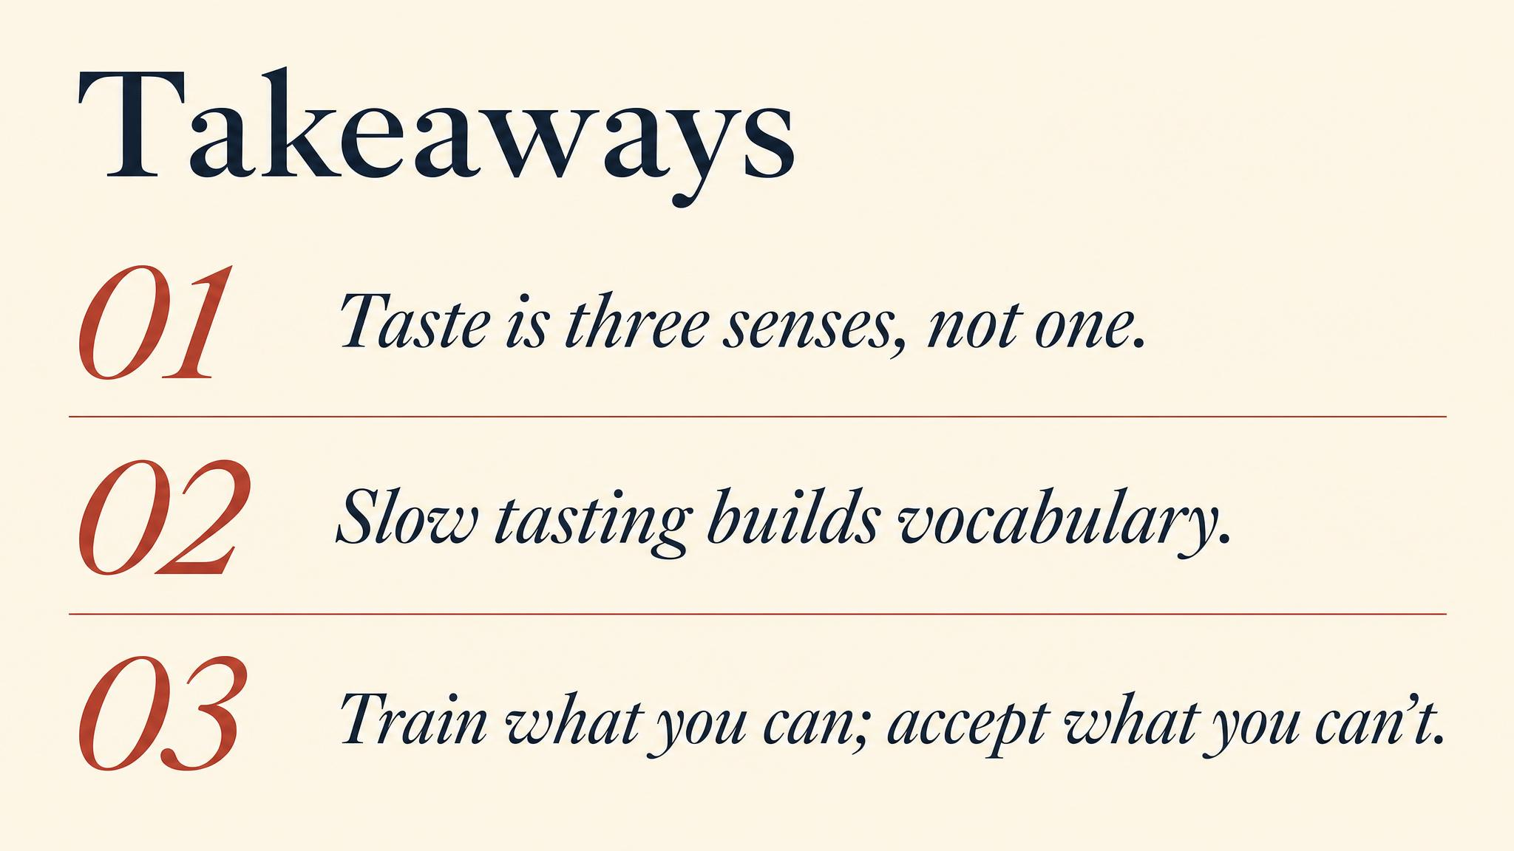
Notes:
Three things to carry to next class. One: most of what we call flavour is retronasal smell — pinch your nose to feel it. Two: astringency is the trigeminal nerve, not taste. Three: two people genuinely don't taste the same cup — TAS2R38 sees to that.

Slide 13

Notes:
Close with the bridge. We now know how to taste the cup. Next class, we step back and look at how whole societies have organised themselves around the leaf — from the Tea Horse Road to British colonial trade to the Japanese chanoyu and beyond. The cultural history of one species' very long career.

