Slide 1

Notes:
Open with the Boston Tea Party — three ships, 342 chests of tea, dumped in the harbour. The political quarrel that becomes a revolution. The tea itself began in a garden in Fujian and travelled across half the world to get to that harbour. The chapter follows the long journey.

Slide 2

Notes:
The species is from a specific place — Yunnan, plus the adjacent uplands of northern Myanmar and Laos. Indigenous peoples — Bulang, Dai, Wa, Jingpo — were using the leaf long before any written record. The plant became an article of trade by the early Han dynasty.

Slide 3
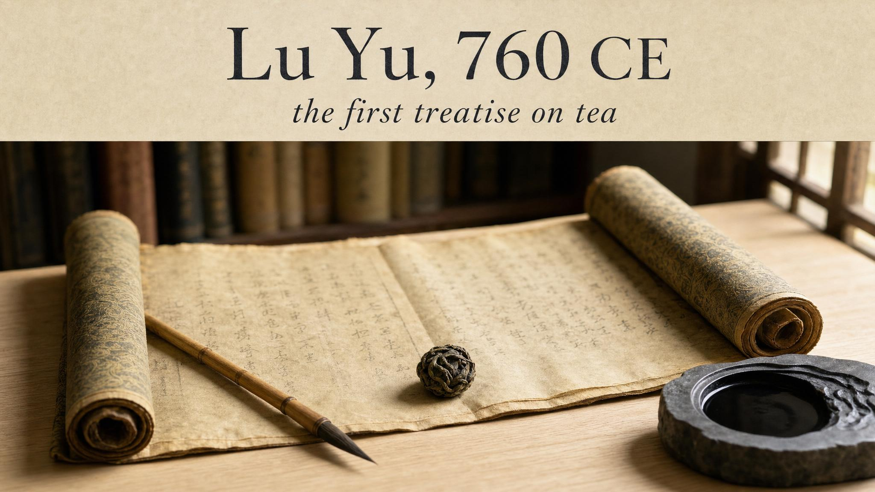
Notes:
Lu Yu wrote the Cha Jing around 760 CE — the foundational text of Chinese tea culture. The tea Lu Yu describes isn't loose-leaf brewing — it's compressed cakes, ground to powder, whisked with hot water. That method, exported a few centuries later, becomes the matcha of the Japanese ceremony.

Slide 4
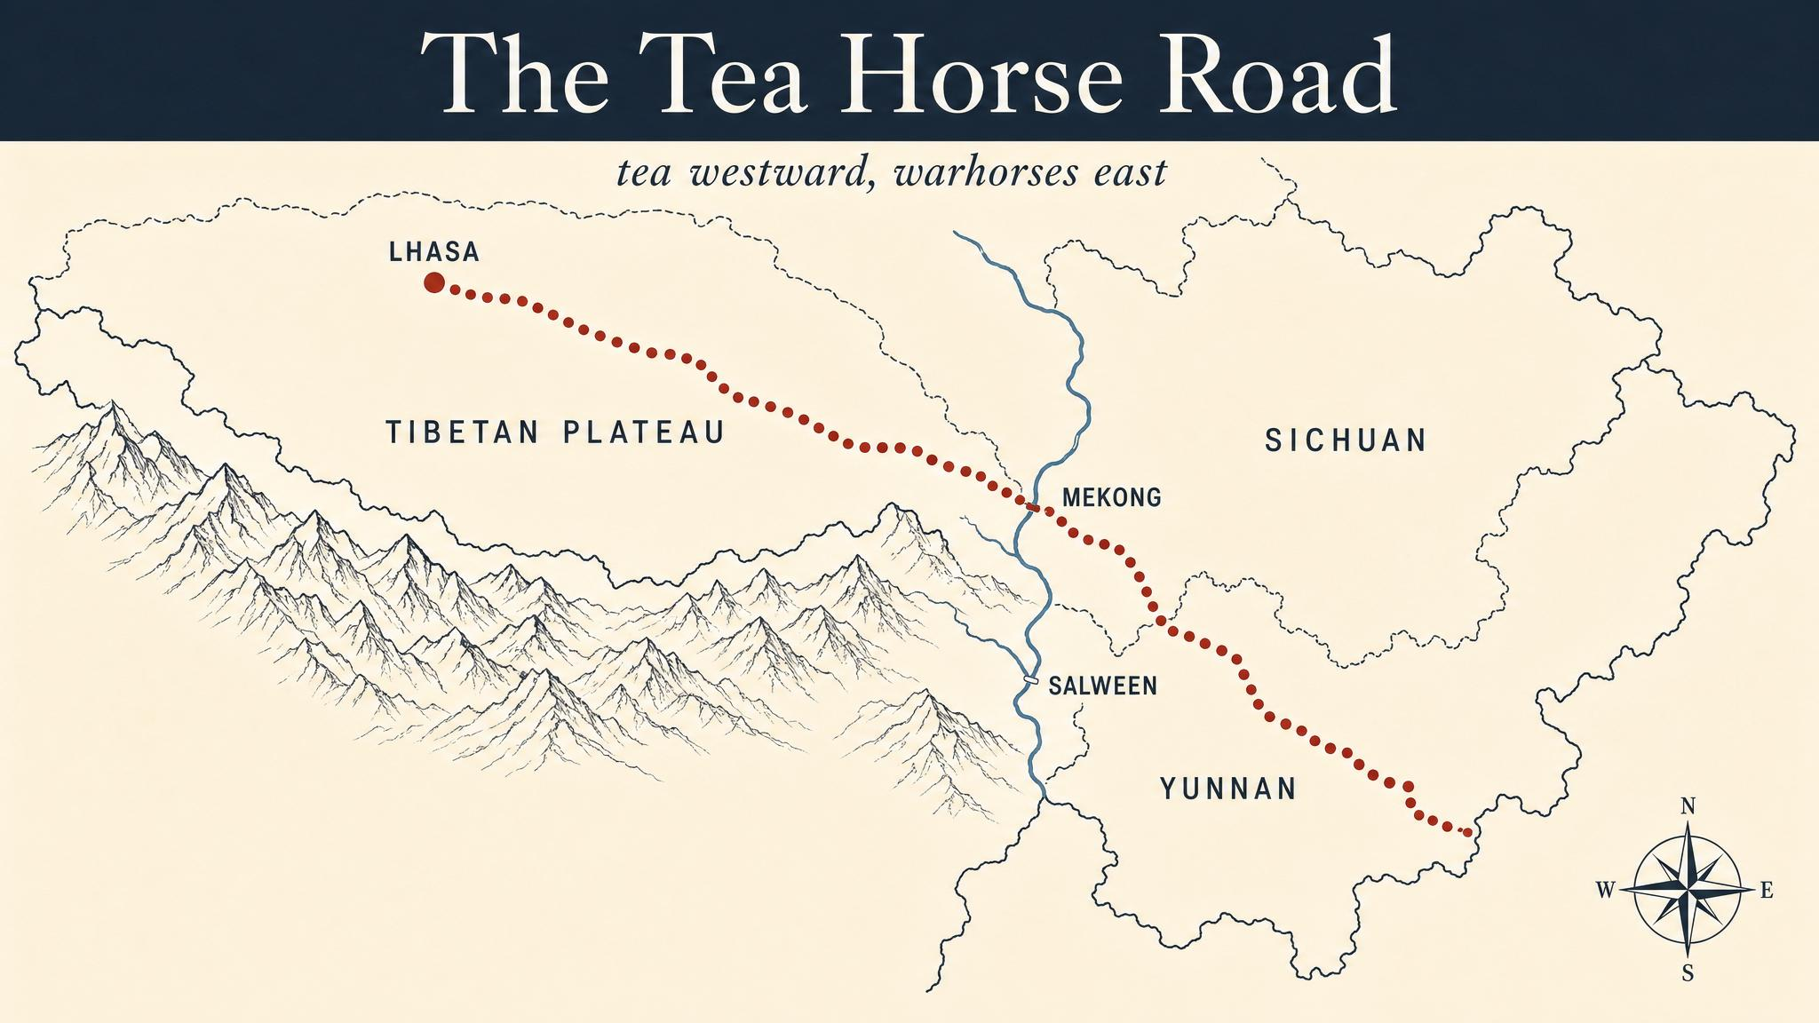
Notes:
For a thousand years, the Chinese state shipped tea bricks westward across the Tibetan plateau in exchange for warhorses. Whole towns grew up to service the mule caravans. Tea bricks were used as currency in border regions — you could pay your rent in compressed pu'er. This is also where deliberate ageing — the pu'er tradition — comes from.

Slide 5

Notes:
1191 — Eisai brings the Song-dynasty matcha method to Japan with the seeds. Over four centuries the Way of Tea takes shape, culminating in Sen no Rikyū's four principles: wa, kei, sei, jaku. The Japanese kept the chemistry but completely reinvented the ritual.

Slide 6
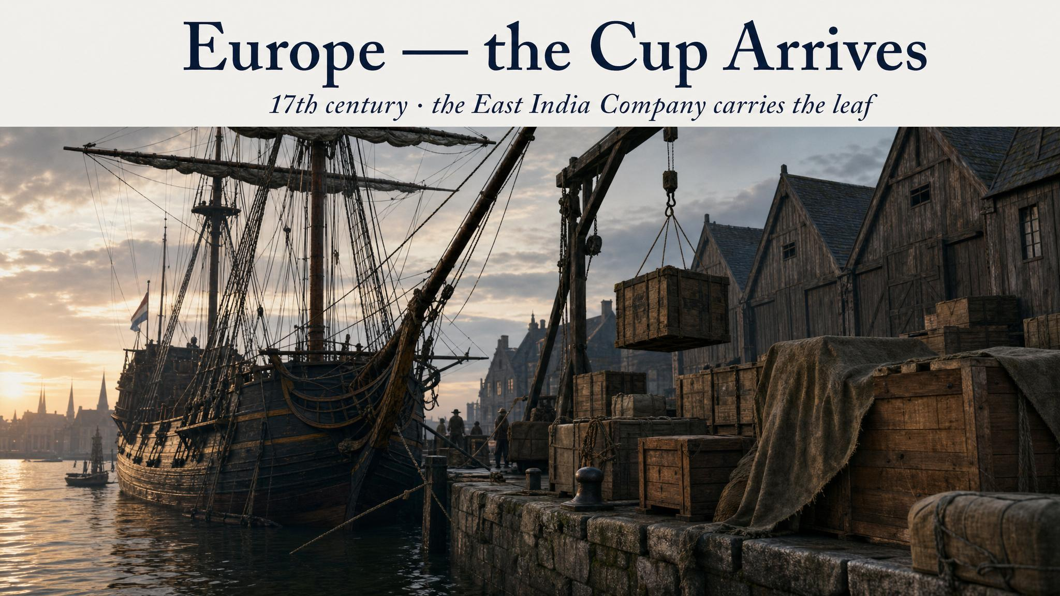
Notes:
1610 — the first ship-load of tea arrives in Amsterdam via the Dutch East India Company. From Holland the leaf moves into the British court via Catherine of Braganza's 1662 marriage to Charles II. Within a century, tea is the fashionable drink of London and tea duty is financing a significant fraction of British government revenue.

Slide 7
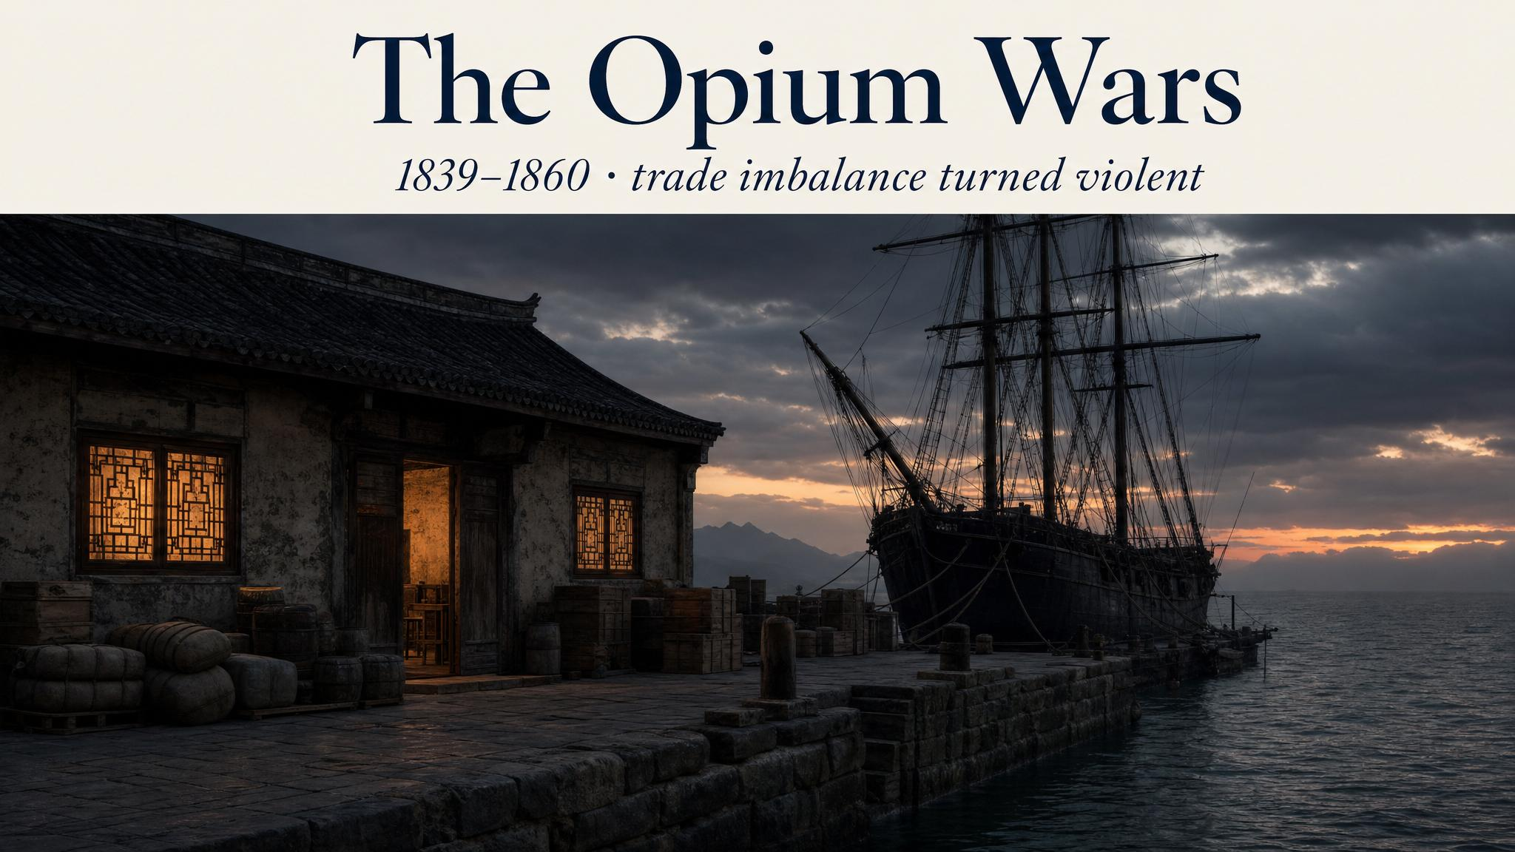
Notes:
It's impossible to tell the British tea story honestly without naming the Opium Wars. The British, running out of silver to pay the Chinese for tea, grew opium in India and sold it illegally into China — using the proceeds to finance the tea trade. When the Qing tried to stop the opium imports, Britain went to war and won twice. Hong Kong, the treaty ports, and the largest commercial humiliation in modern Chinese history.

Slide 8
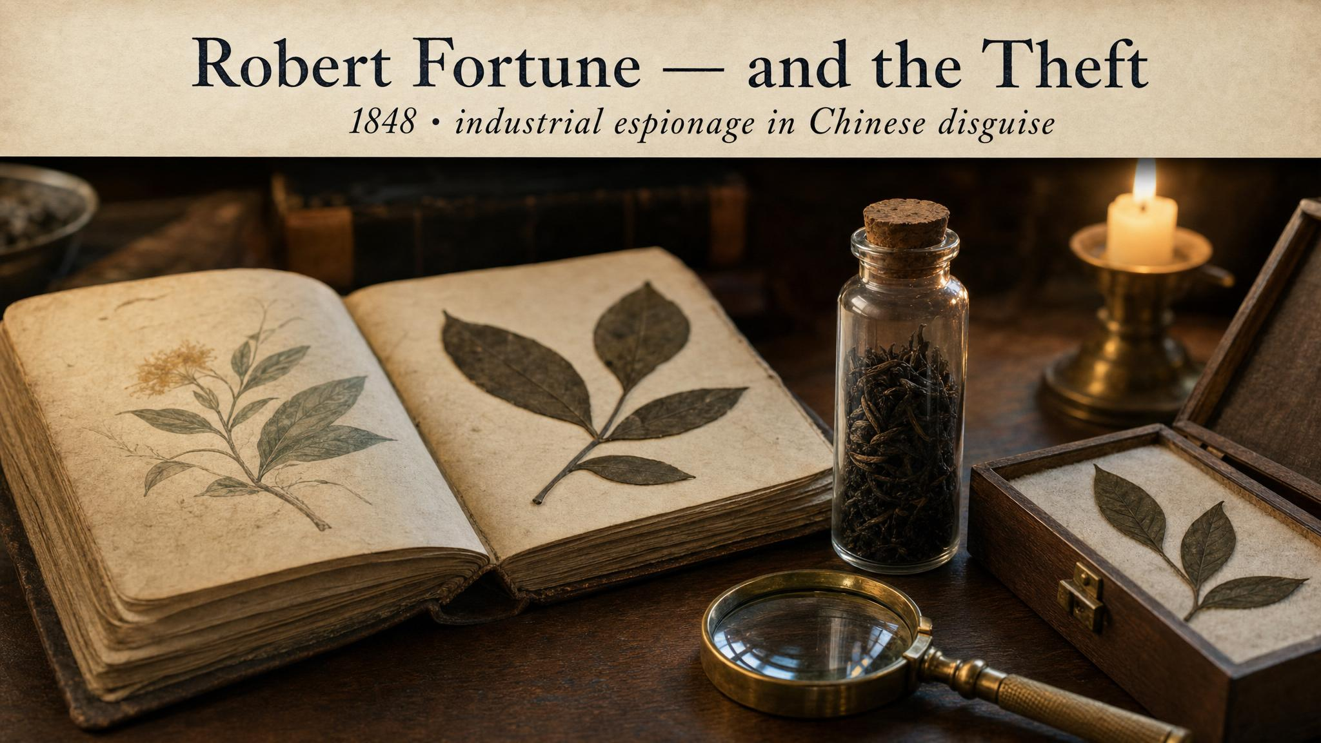
Notes:
1848 — Scottish botanist Robert Fortune, disguised as a Chinese merchant, spent two years in Fujian and Anhui smuggling out seeds, cuttings, and a handful of Chinese tea-makers willing to emigrate. Everything went to British India. Within twenty years, India was producing tea on an industrial scale. By 1900, India surpasses China as the world's largest tea exporter.

Slide 9
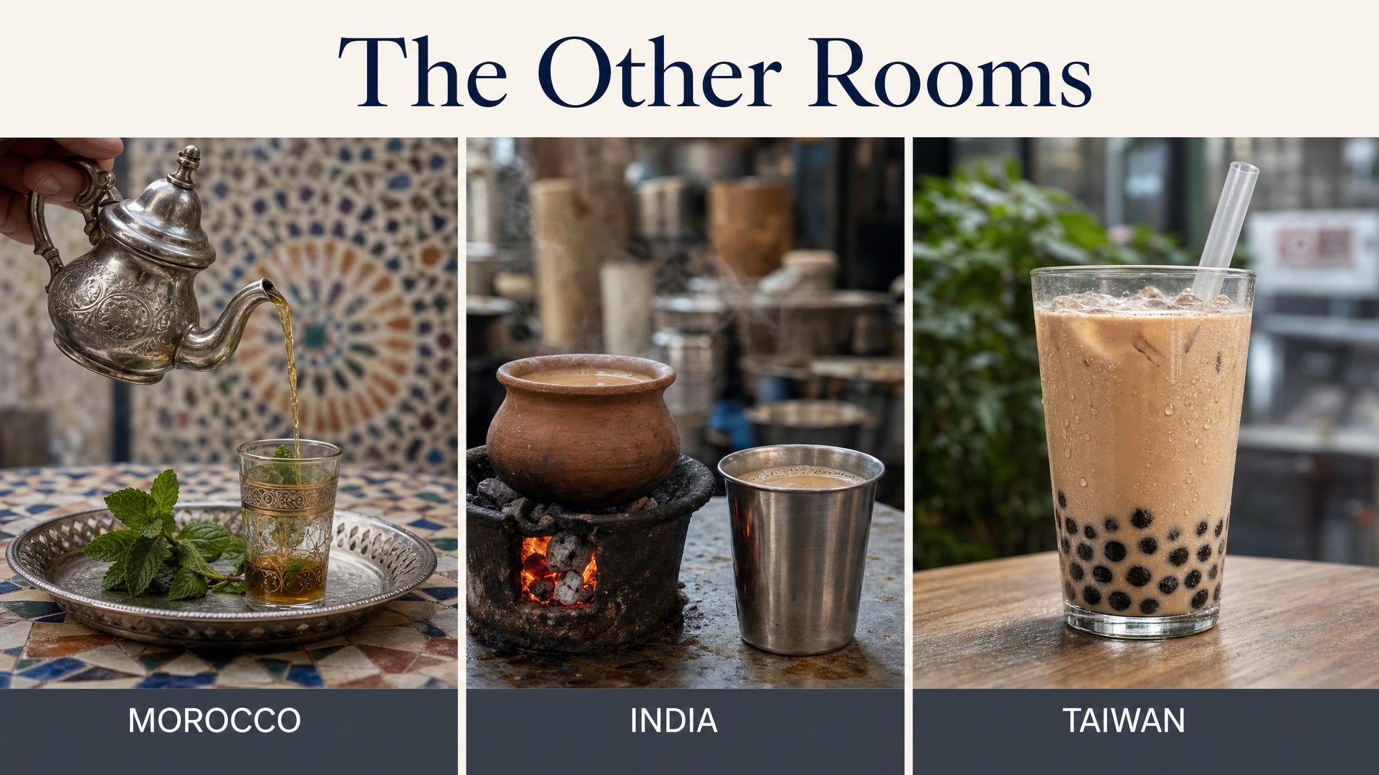
Notes:
Morocco took Chinese gunpowder green tea and built a culture of mint-and-sugar hospitality. India took British colonial CTC and let the chaiwallahs make it Indian. Taiwan added tapioca pearls and ice and a wide straw and invented bubble tea, in the 1980s, which has now spread worldwide. Three completely different reinventions — the leaf keeps becoming new things.

Slide 10
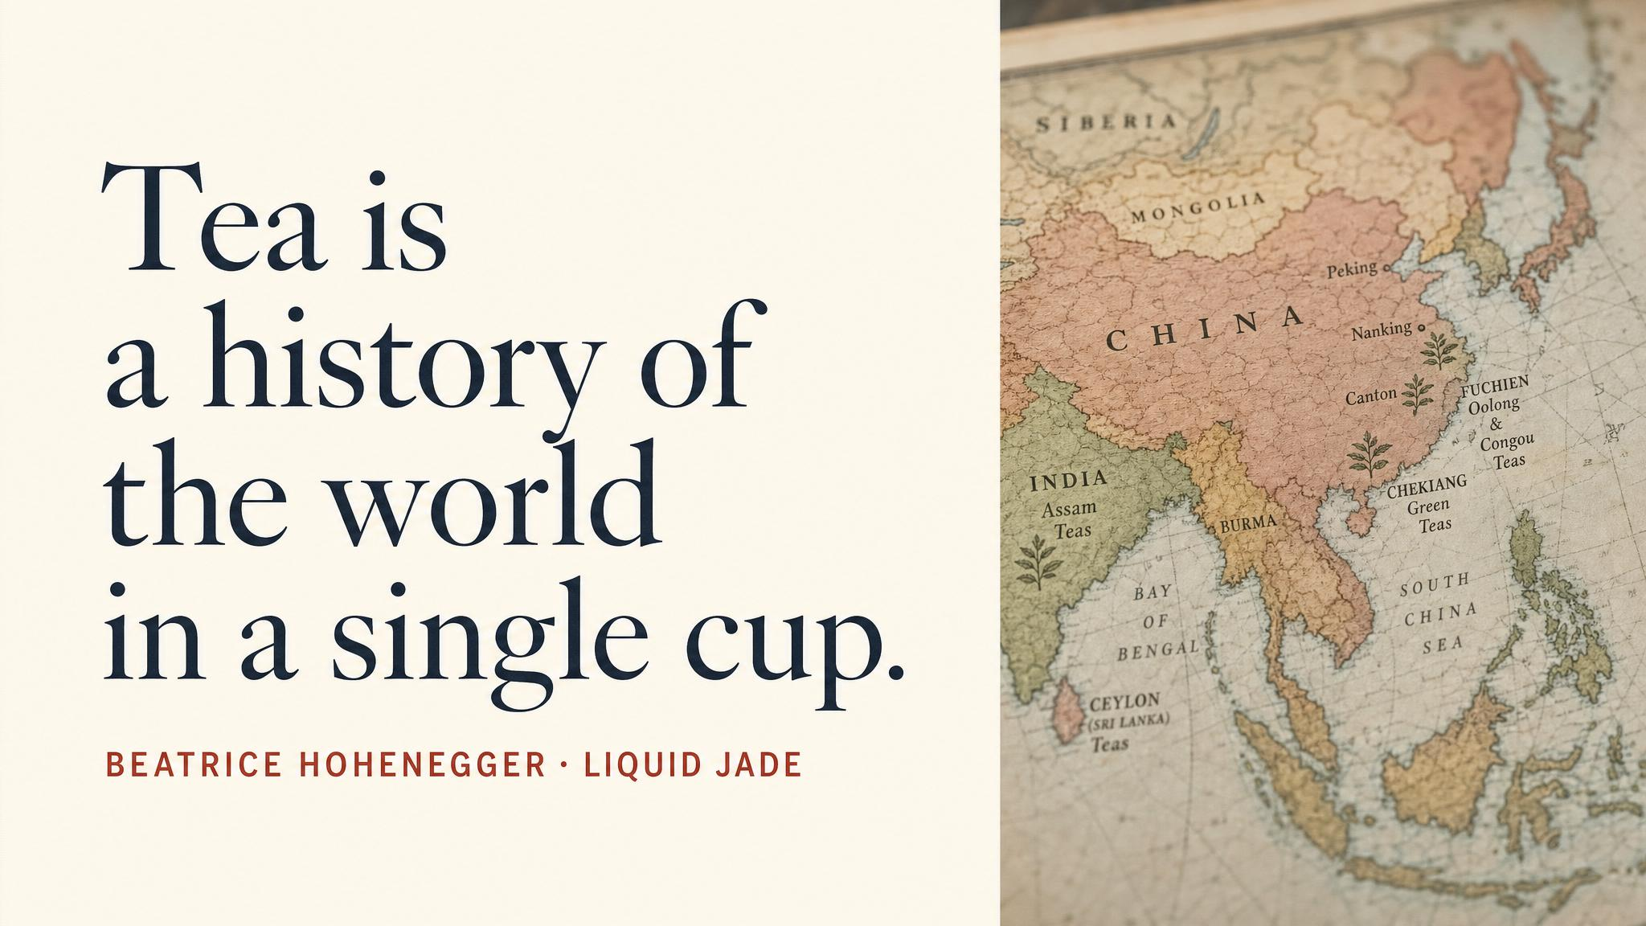
Notes:
Pause on the line: 'the silent architect of a thousand rooms'. The tea room, the tea house, the parlour, the chai stall, the boba shop. The same plant, building completely different spaces wherever it lands. The chapter's central image, slowed down for a beat.

Slide 11
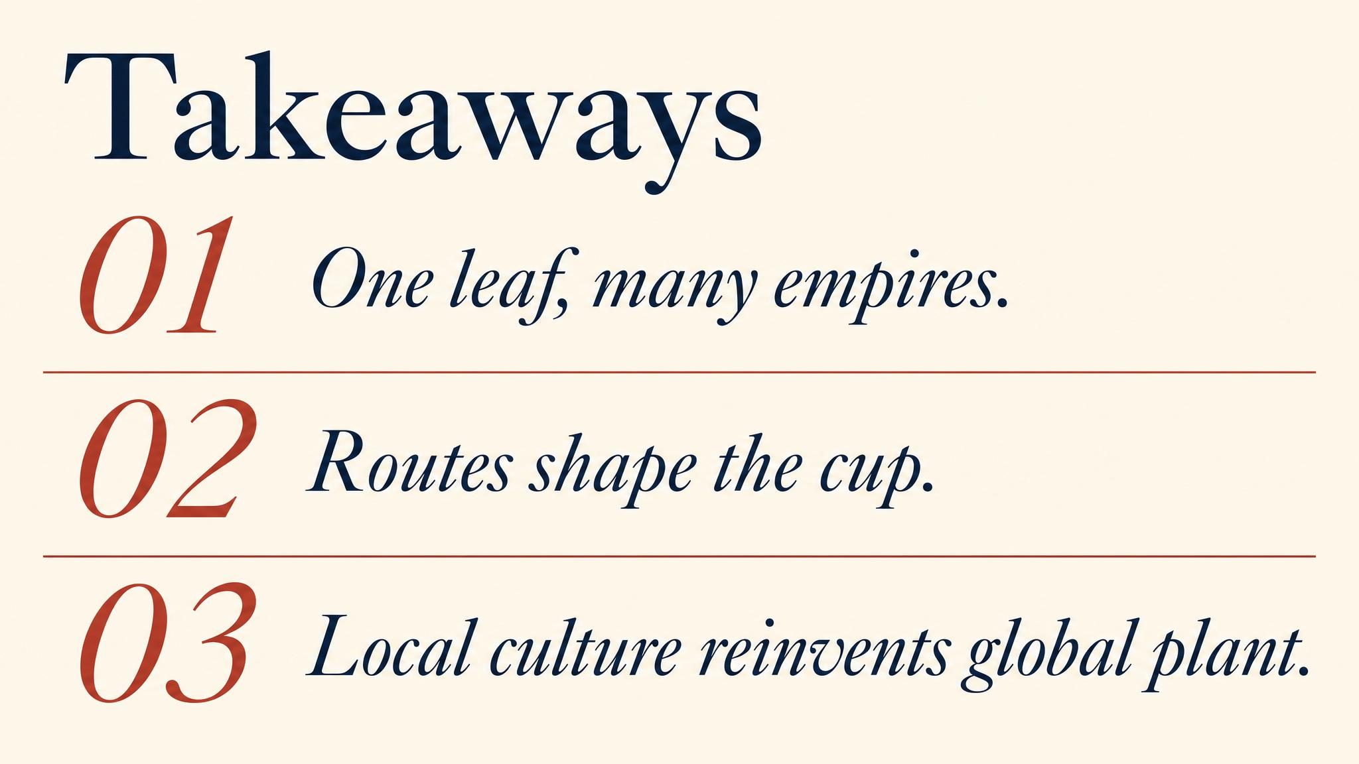
Notes:
Three things to carry. One: the species is from one place, but every culture that received it built something local — chanoyu, gongfu, atay, chai, boba. Two: tea was used as actual money for a thousand years along the Tea Horse Road. Three: the cup we casually drink carries the residue of trade routes, colonial violence, and centuries of cultural reinvention.

Slide 12
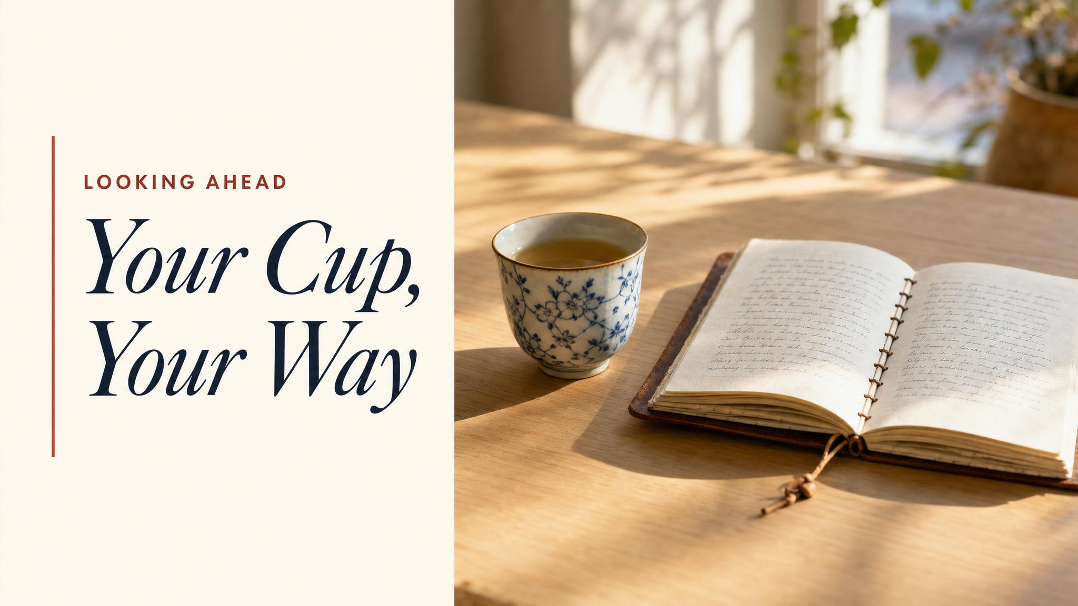
Notes:
Close with the bridge. The cup has travelled a long way to reach you. The final class is about what you do next: how to evaluate a tea, how to source intelligently, how to build a practice of your own that doesn't try to be Japanese or Chinese or British but is honestly yours.

