Slide 1
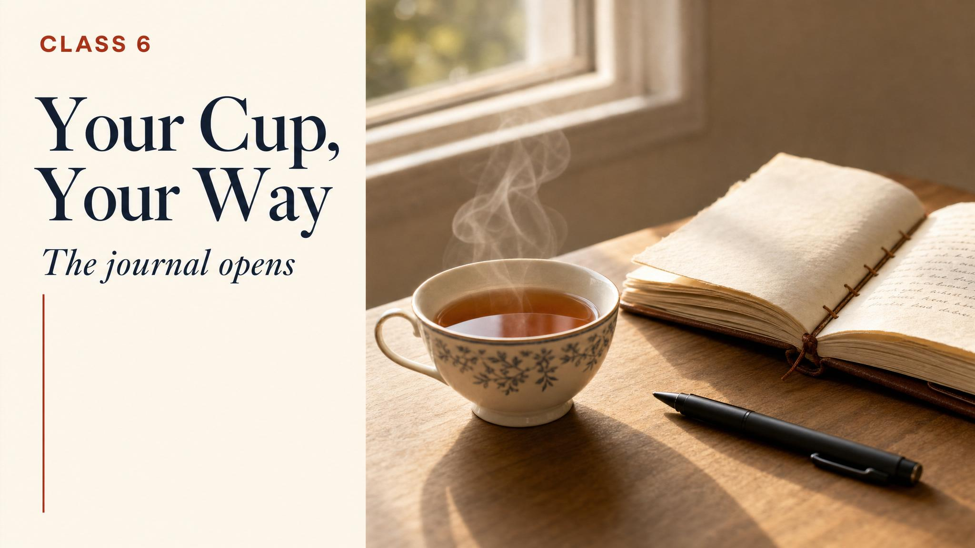
Notes:
Final class. We're not adding new chemistry — we're handing over the keys. Today is synthesis: how to evaluate a tea, how to source one, how to store it, and how to keep building your practice for the rest of your life.

Slide 2
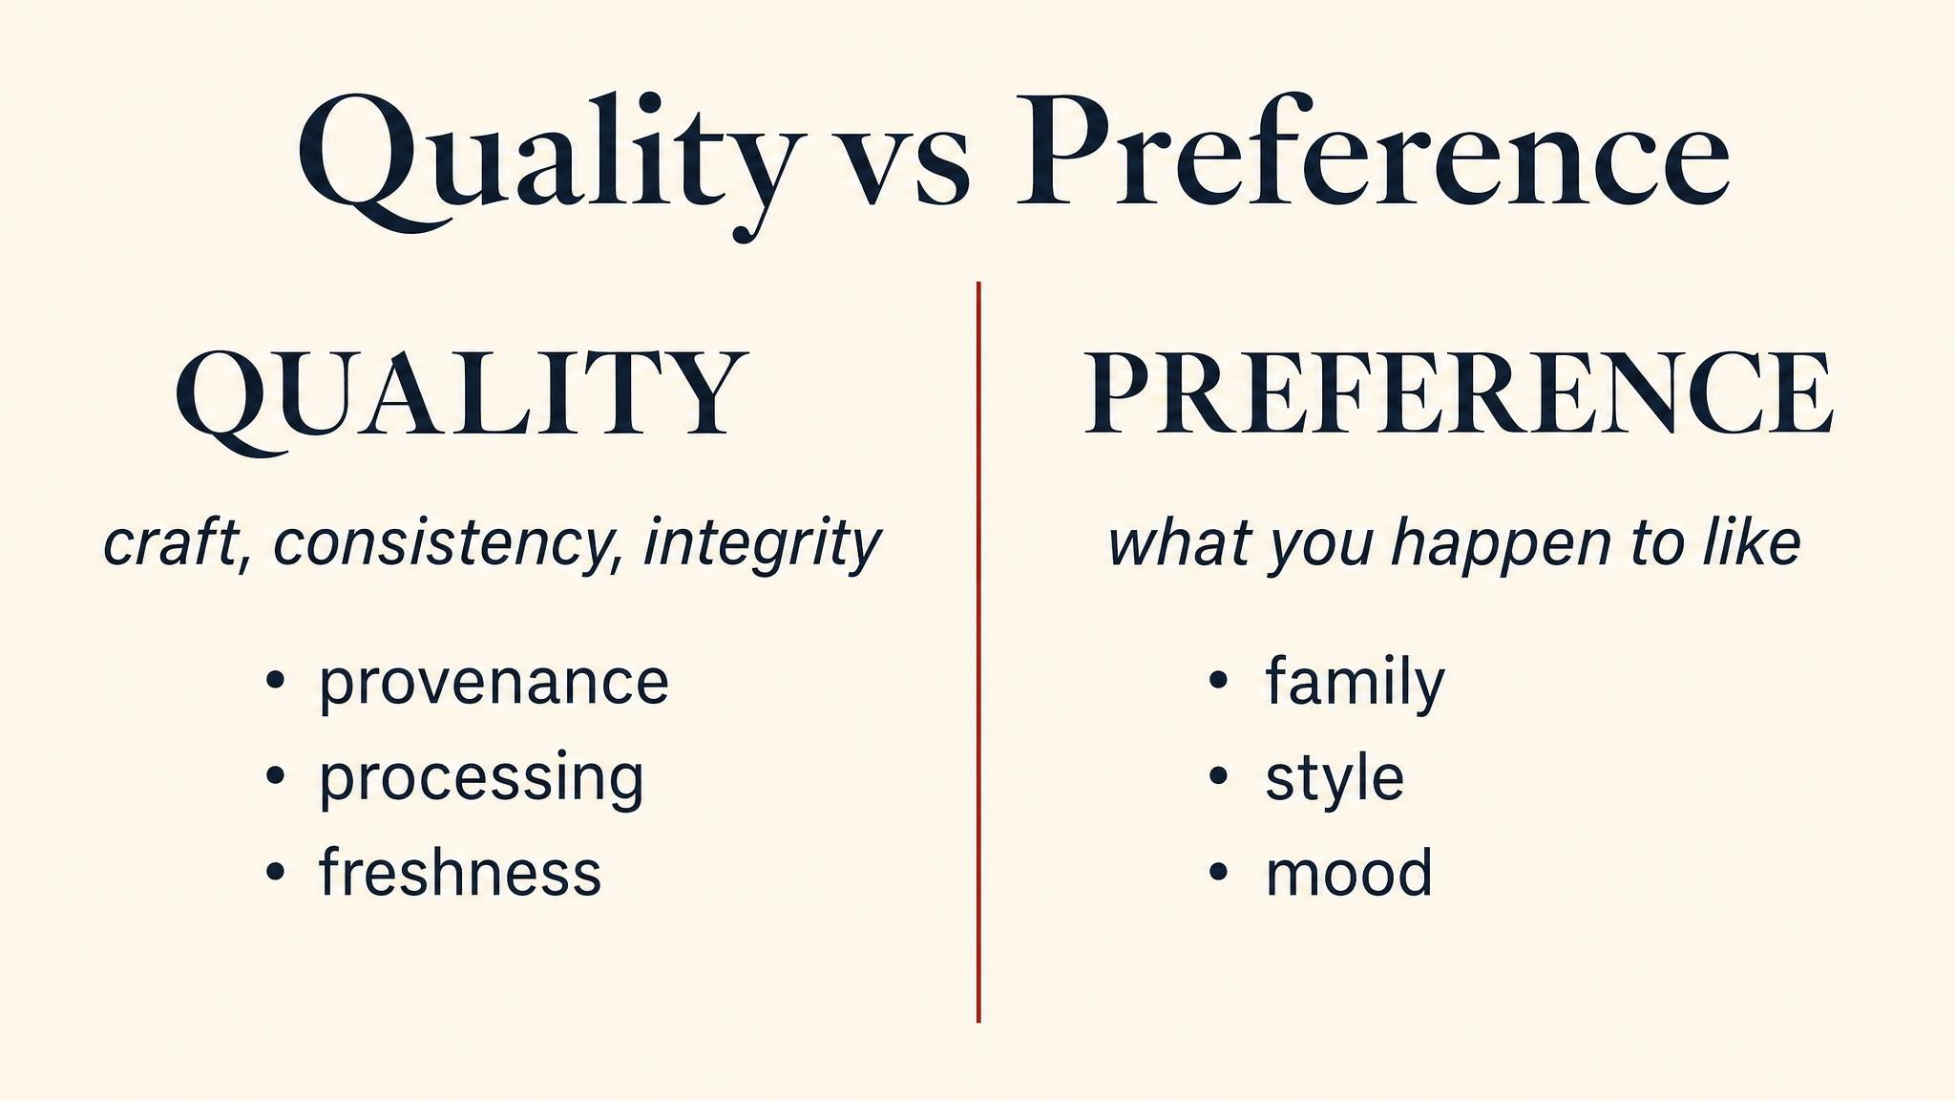
Notes:
Two questions, kept in separate compartments. Is the leaf well-made — that's the maker's question; you can answer it with the framework. Does it suit you — that's yours alone. Both matter. Both deserve respect. Confusing them is what produces snobs at one extreme and relativists at the other.

Slide 3
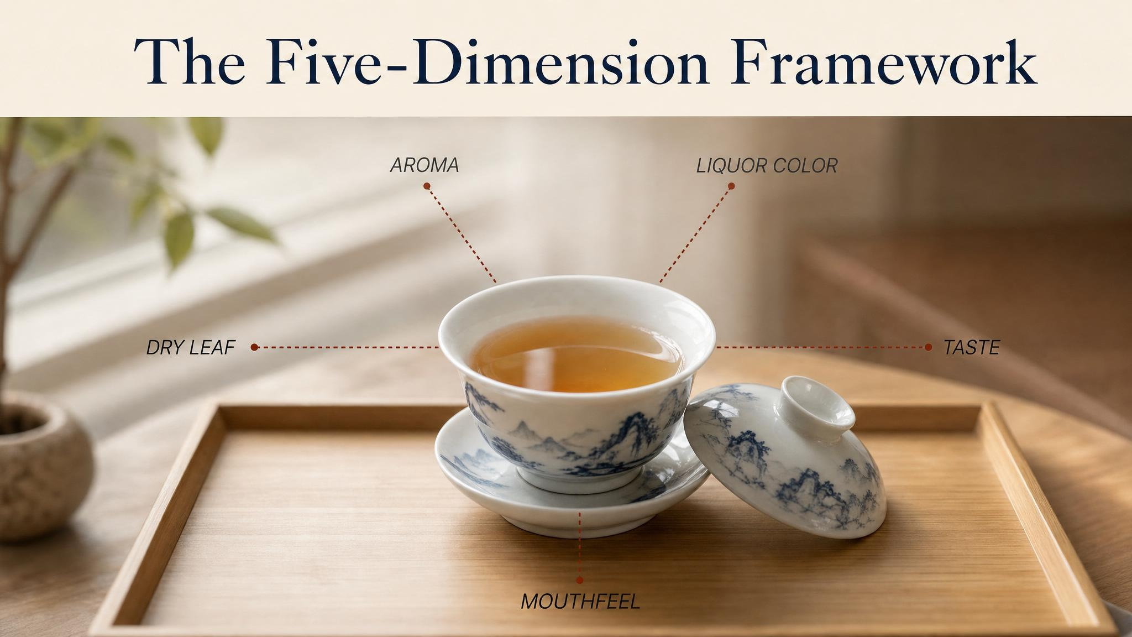
Notes:
The five-dimension framework from Class 4, now applied to evaluation. Dry leaf — what does the unbrewed leaf tell you. Aroma — hot and cooling. Taste — the five basic channels. Mouthfeel — the trigeminal pillar. Finish — the long sweet tail. Each dimension carries one piece of the verdict.

Slide 4
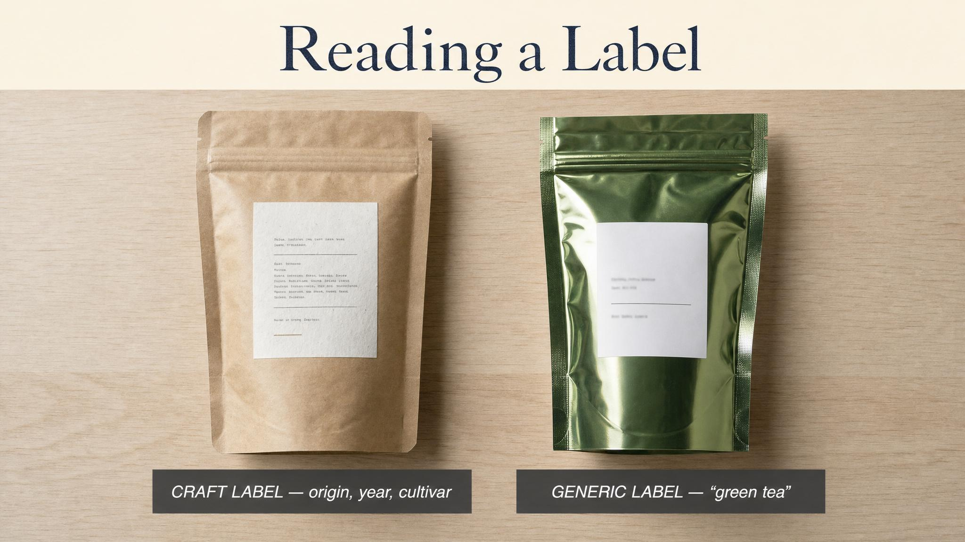
Notes:
A specific origin, harvest year, flush, and grade tells you what you need to evaluate. A label that says only 'Black Tea' is hiding everything. The asymmetry of information on tea packets is almost always intentional — the buyer who doesn't know what to look for pays more.

Slide 5
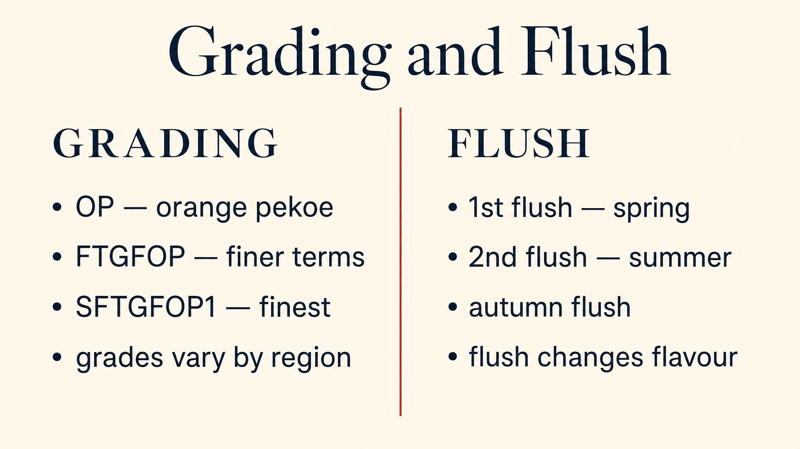
Notes:
Grade names leaf integrity — FTGFOP whole-leaf with tips, OP whole-leaf without, BOP broken. Flush names the seasonal picking. Both should appear on any tea worth buying. The absence of both is a red flag.

Slide 6
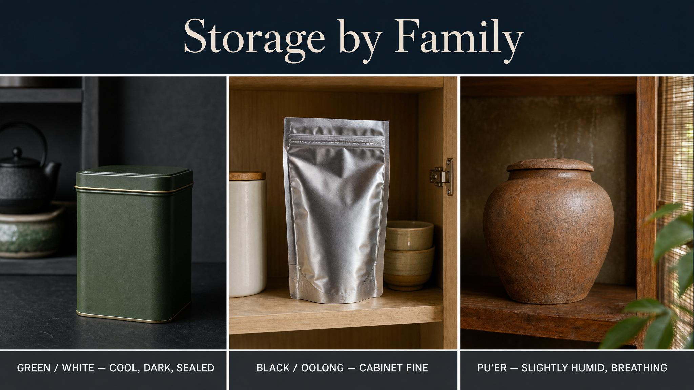
Notes:
Greens and whites want cold, dark, sealed — they decline fast. Oolongs and black teas are forgiving — cool, dark, dry is enough. Only pu'er actually wants to age; it specifically needs moderate humidity (60-75%) and moderate temperature (18-28°C) and ventilation to keep maturing. Spice cabinet, coffee shelf, and any place with strong smells are all places good tea goes to die.

Slide 7

Notes:
Keep a small journal. Doesn't need to be elaborate. Date, name, source, brewing parameters, three lines of impressions. Within a year, you'll have a personal map of what you've drunk. The journal is the discipline that turns occasional drinking into a practice.

Slide 8
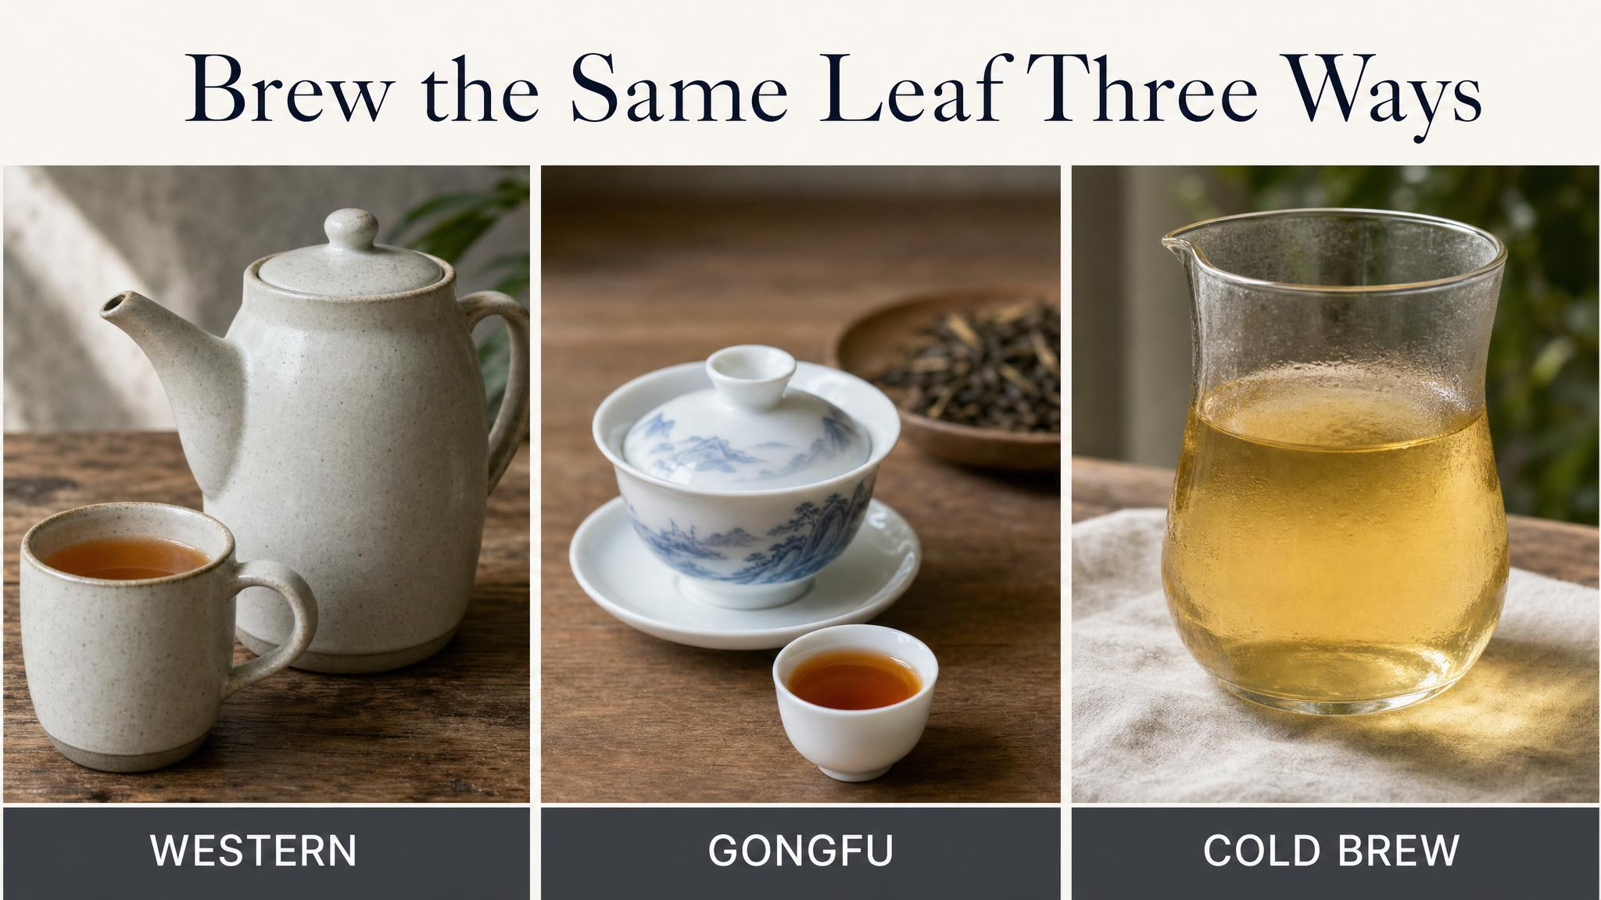
Notes:
One leaf, three brews. Pick a single tea — same packet, same morning. Brew it Western, gongfu, and cold. Take notes on each. You will learn more about brewing in this single afternoon than in a year of reading. The leaf will tell you what it can do.

Slide 9
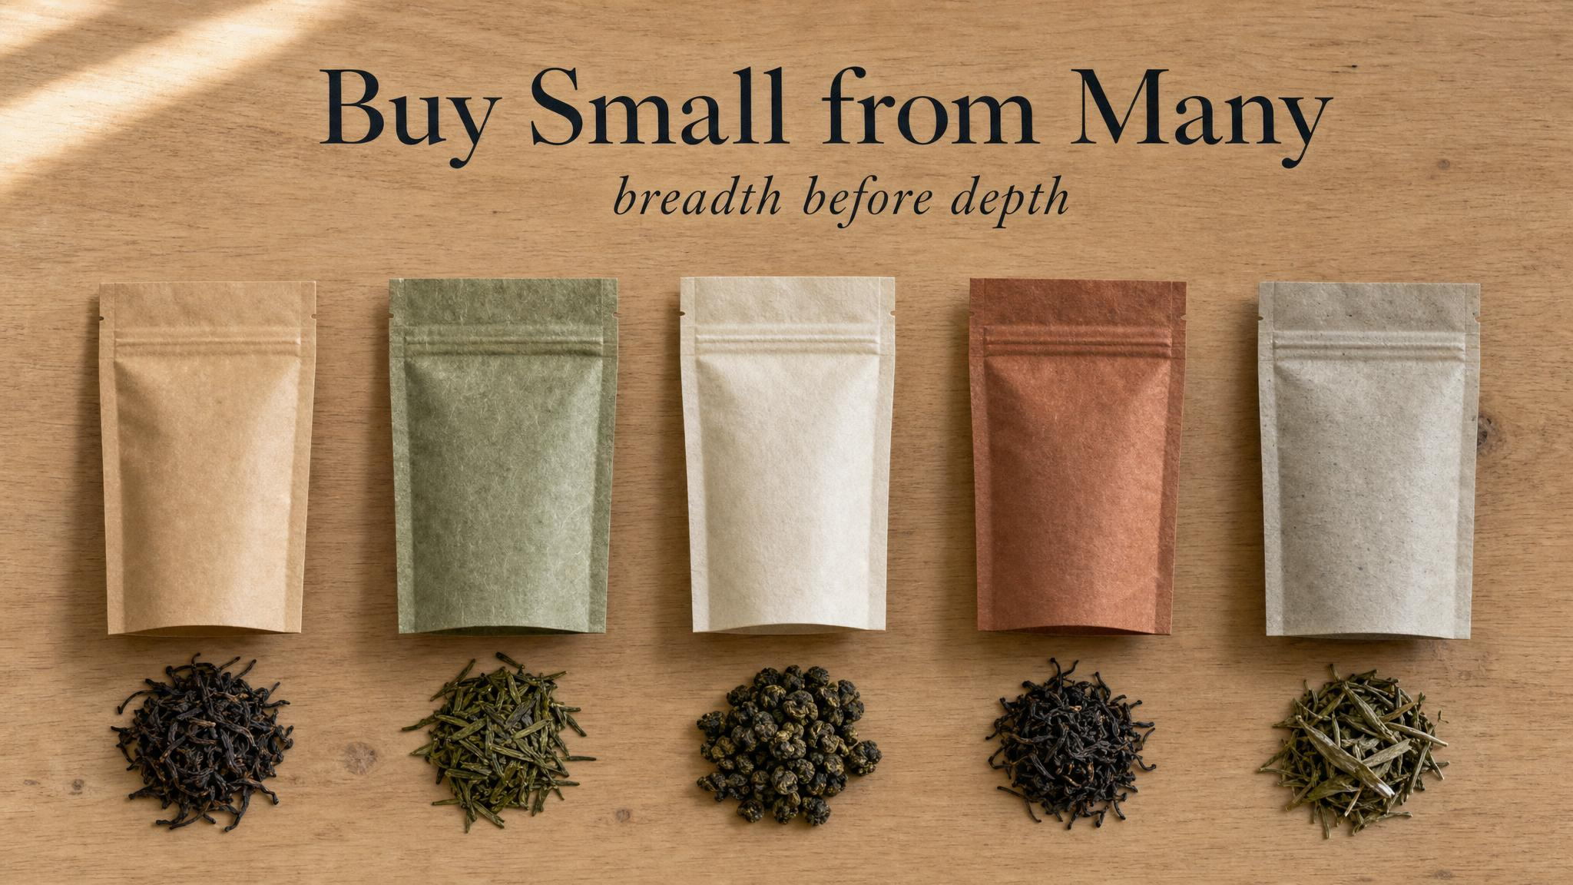
Notes:
Buy small from many. Twenty grams from five vendors teaches you more than a hundred grams from one. Tea is a relationship business — find two or three vendors you trust and the next year takes care of itself. The third-wave tea movement of the past decade has made this dramatically easier than it used to be.

Slide 10

Notes:
Drink with other people. Almost every tea tradition in the world is a hospitality form. Two people describing the same cup are richer, faster, and more honest than one alone. The supertaster gene from Class 4 means you and your friend are tasting different cups — and that's a feature, not a bug. Both descriptions add up.

Slide 11
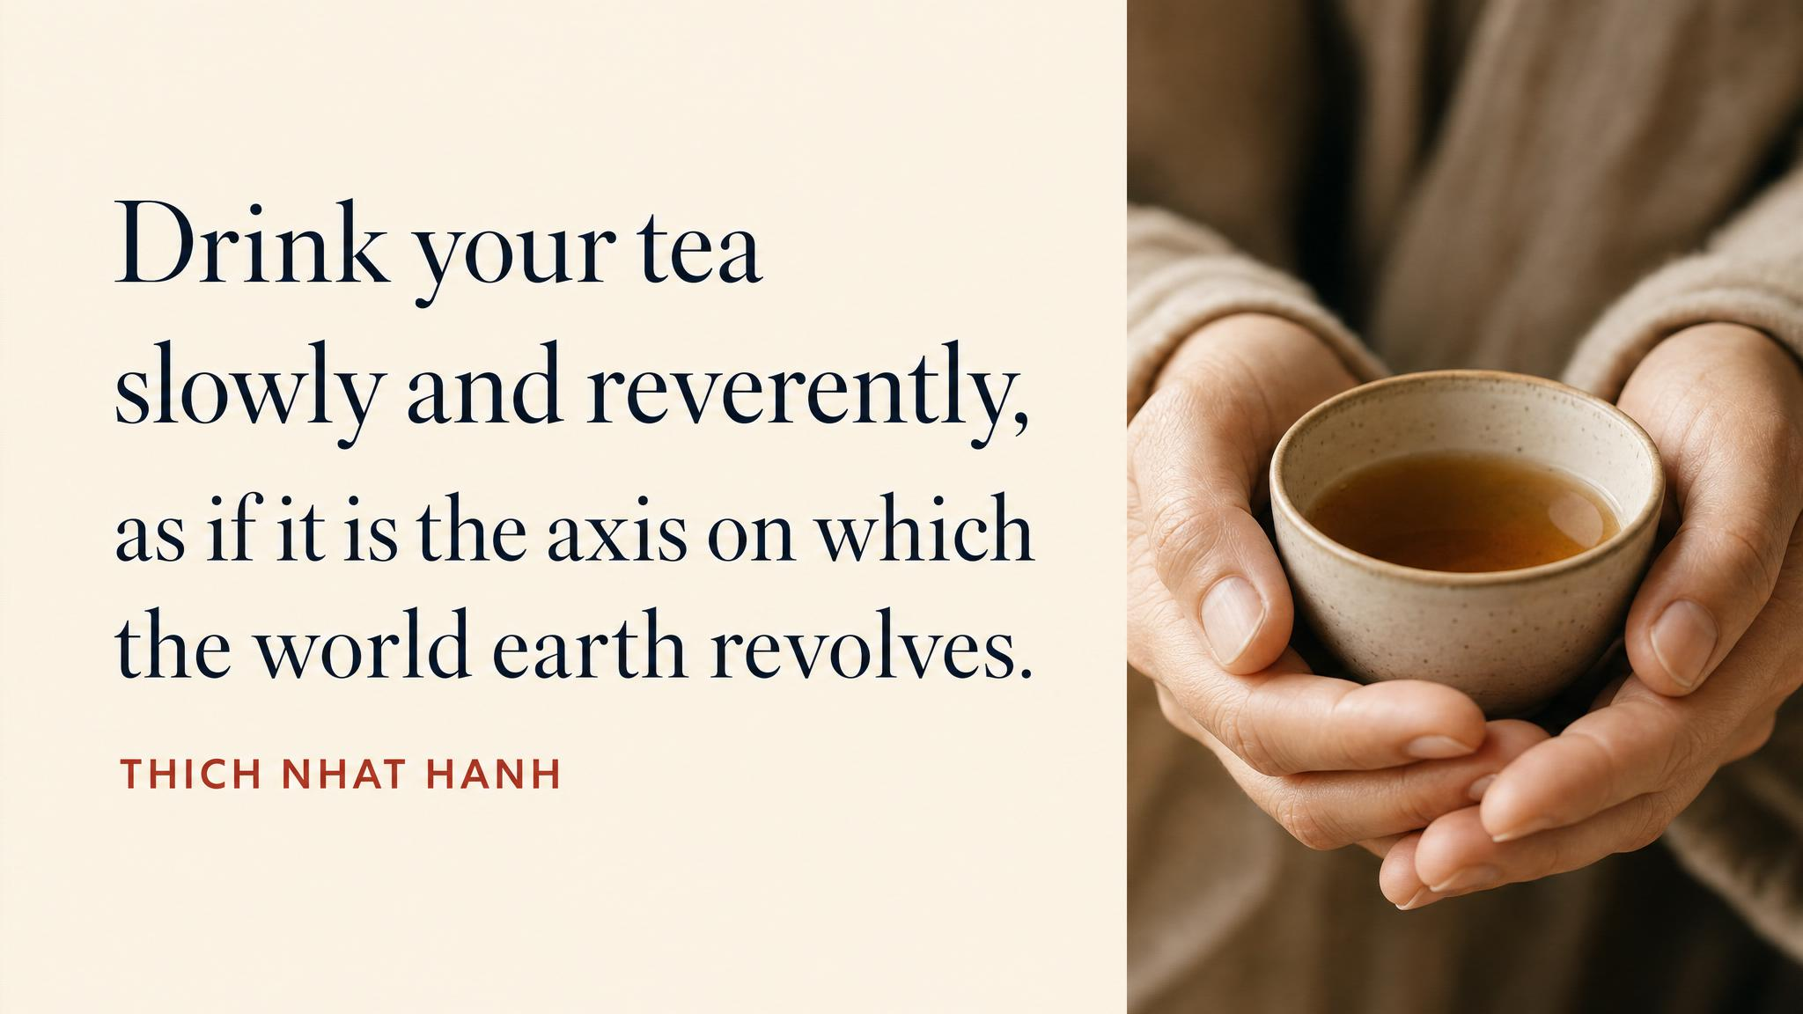
Notes:
Pause on the line. The cup is the axis of the earth — at least for the few minutes it's in your hand. The chapter's emotional close: there is no rush. Slow down. Pay attention. The cup will repay you.

Slide 12
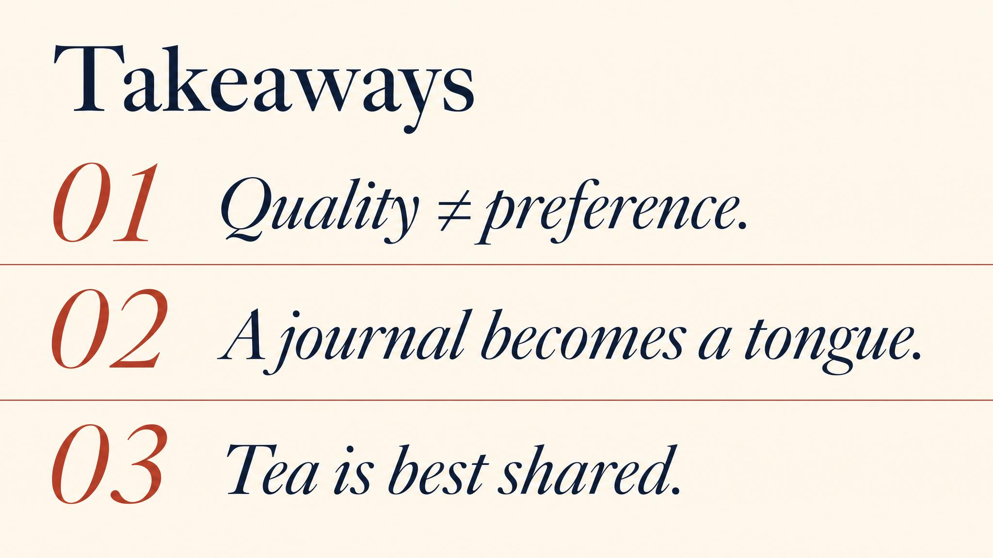
Notes:
Three things to carry. One: quality is one question; preference is another; keep them separate. Two: the five-dimension framework — appearance, aroma, taste, mouthfeel, finish — is enough to evaluate any tea you meet. Three: the practice is the curriculum. Keep a journal, brew the same leaf three ways, buy small from many vendors, drink with other people. None of that is in any textbook; all of it is the work.

Slide 13

Notes:
Close with the door open. There is no Class 7. There is the cup in front of you tonight, and the journal you have not yet opened, and a thousand makers you have not yet met. Drink slowly. Take notes. Share with someone. Buy small from many sources. Trust the leaf. Trust your tongue.

