Slide 1

Notes:
Open by holding the title and the image. Ask the room: when you picture a marathon starting line, who do you see? Then point to the storybook crowd: this is closer to the real picture. The first chapter is about dismantling the 'real runner' myth before we ever lace up.

Slide 2
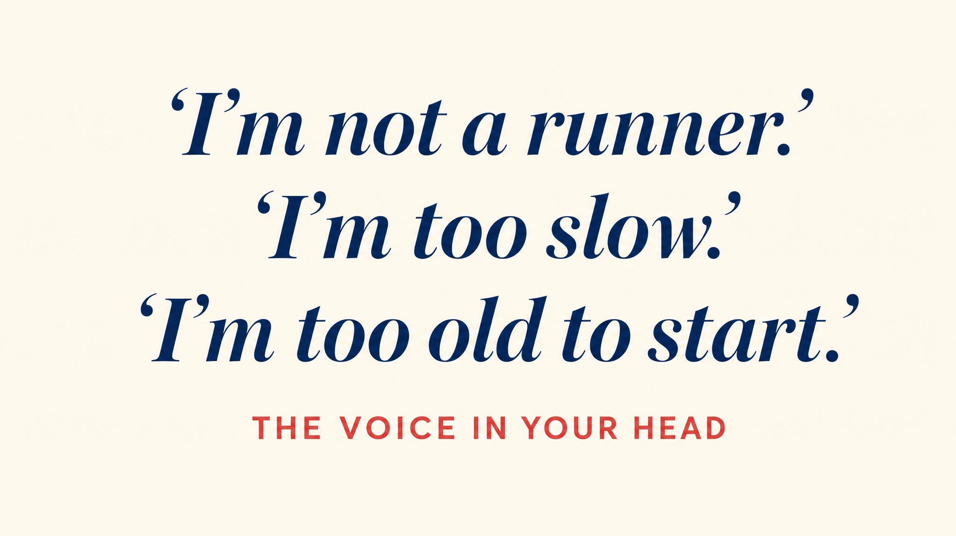
Notes:
Name the voice. Most beginners carry a quiet belief that real runners are someone else. Rhodes and colleagues in 2016 found that exercise identity — whether you see physical activity as part of who you are — is one of the strongest predictors of sticking with a program. The voice is the wall, not the lungs.

Slide 3
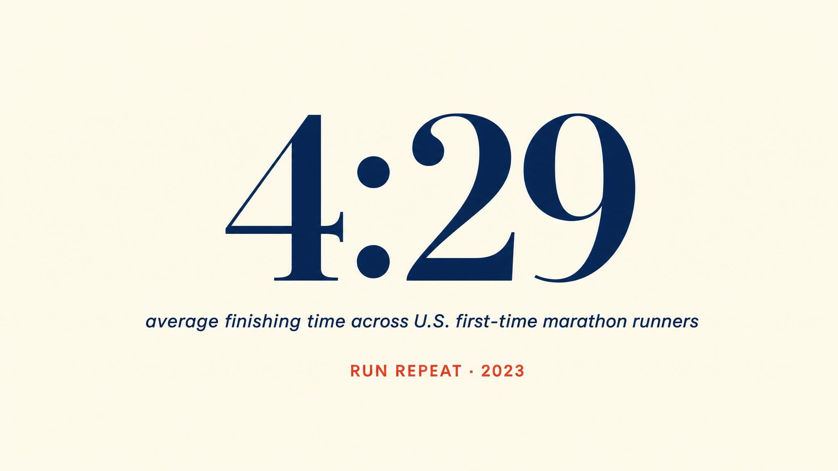
Notes:
Put the number on the board. RunRepeat's 2019 analysis of 19.6 million marathon results found the average finishing time was 4 hours and 29 minutes. That's roughly 10:17 per mile — a comfortable jog for many people. The 'real runner' archetype does not match the data.

Slide 4

Notes:
Bramble and Lieberman's 2004 endurance running hypothesis: humans didn't evolve to be fast — we evolved to never stop. Sweat glands, Achilles tendons, big glutes, a nuchal ligament — these adaptations only make sense for distance running. Persistence hunting was the original use case.

Slide 5
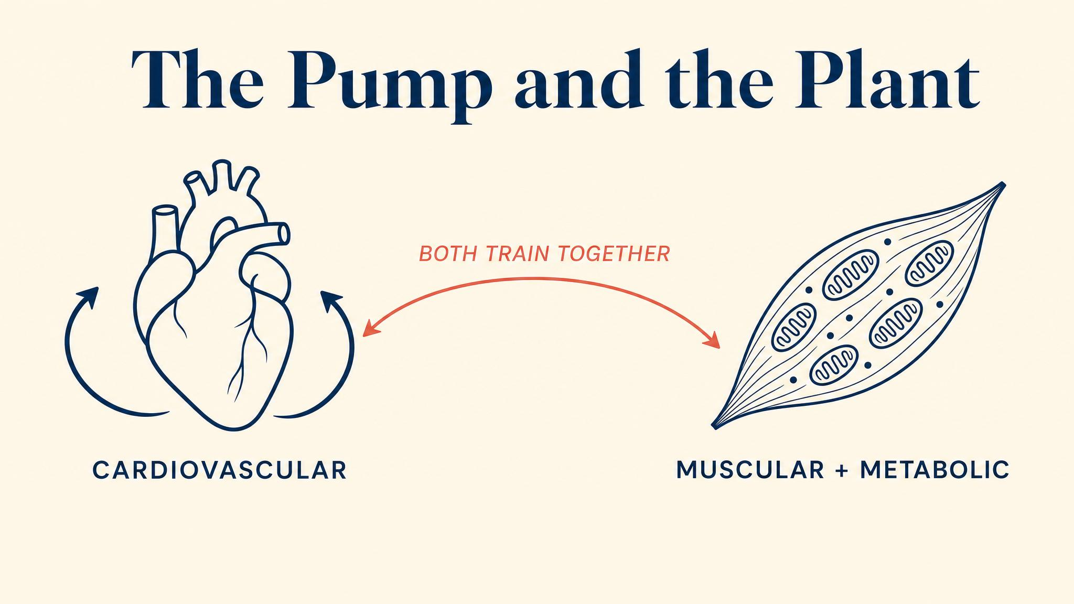
Notes:
Two engines. Your heart, which at rest pumps about 5 litres per minute, can climb to 20–25 L/min in trained athletes — that figure is from StatPearls 2024. Inside each muscle cell, mitochondria — the power plants — multiply with training. More mitochondria, more aerobic energy, more miles.

Slide 6
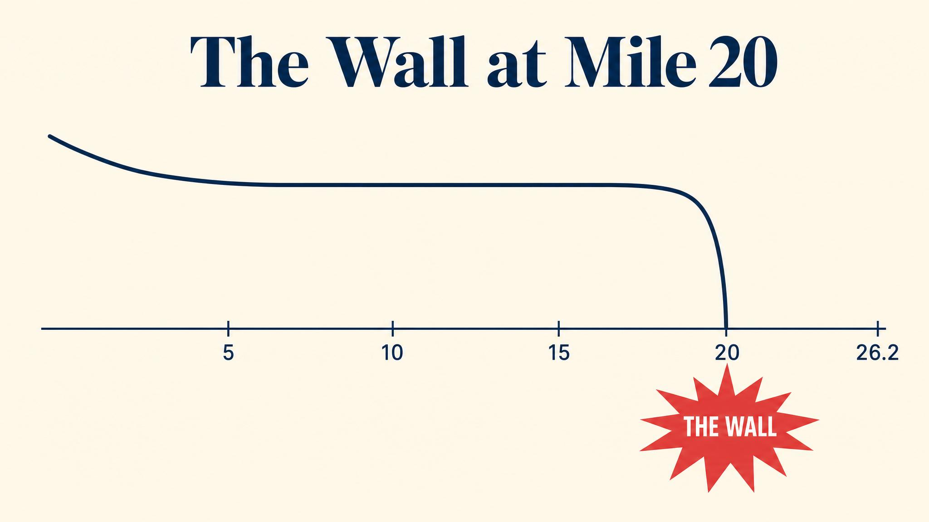
Notes:
The average runner stores about 2,000 calories of glycogen — enough for roughly 18 to 20 miles. The wall isn't willpower failure; it's a fuel-tank problem. We'll spend a whole chapter on the solution. For now, label the cause.

Slide 7
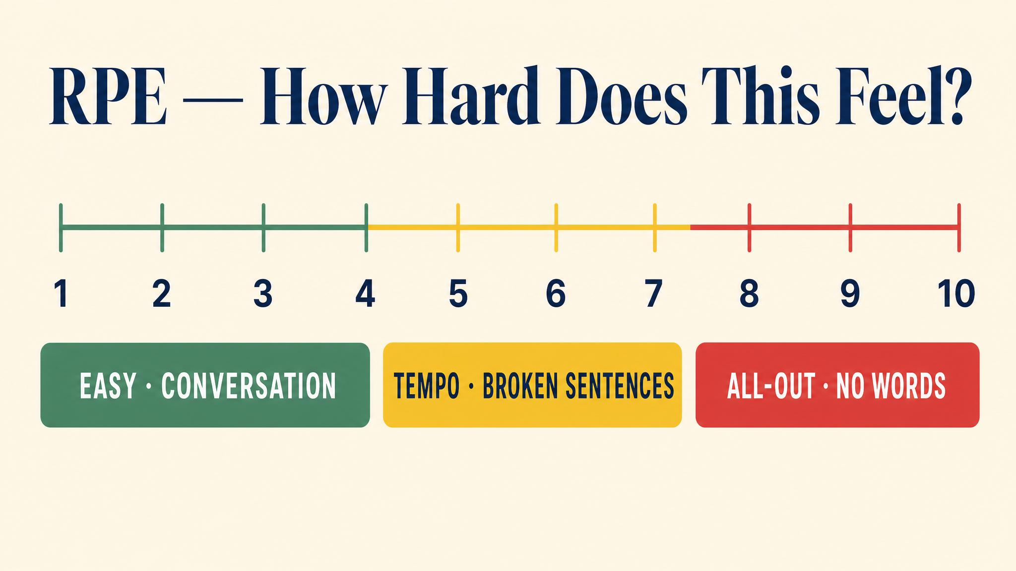
Notes:
Rate of Perceived Exertion — RPE — was developed by Gunnar Borg. A meta-analysis by Chen, Fan, and Moe in 2002 confirmed it correlates with heart rate, oxygen consumption, and breathing rate. We'll use a 1-to-10 scale, and most of your training should live at RPE 3 to 4 — easy, conversational. That part surprises everyone.

Slide 8
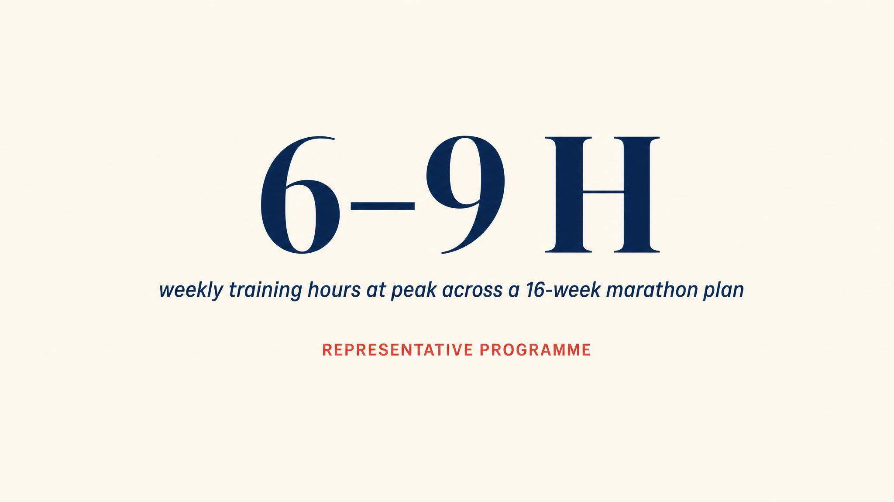
Notes:
A typical plan runs 16 to 20 weeks. Early weeks: 2 to 3 hours. Building phase: 4 to 6 hours. Peak: 6 to 9 hours per week — about the same as a season of a streaming show. Taper drops back. Most weekday runs are 30 to 60 minutes. Nobody's asking you to run three hours next Tuesday.

Slide 9
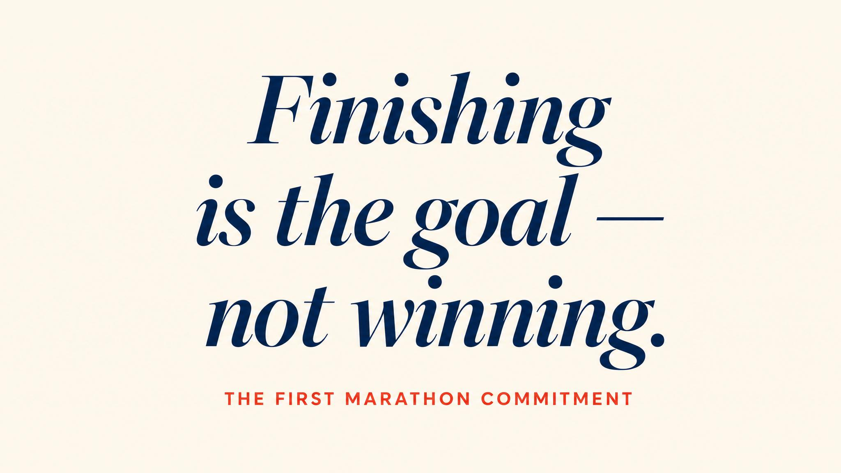
Notes:
Self-Determination Theory, from Ryan and Deci in 2000, names three psychological needs: autonomy, competence, relatedness. Process-oriented training — finishing is the goal, not finishing fast — supports all three. Outcome obsession undermines them. This isn't soft. It's the most supported framework in motivation research.

Slide 10
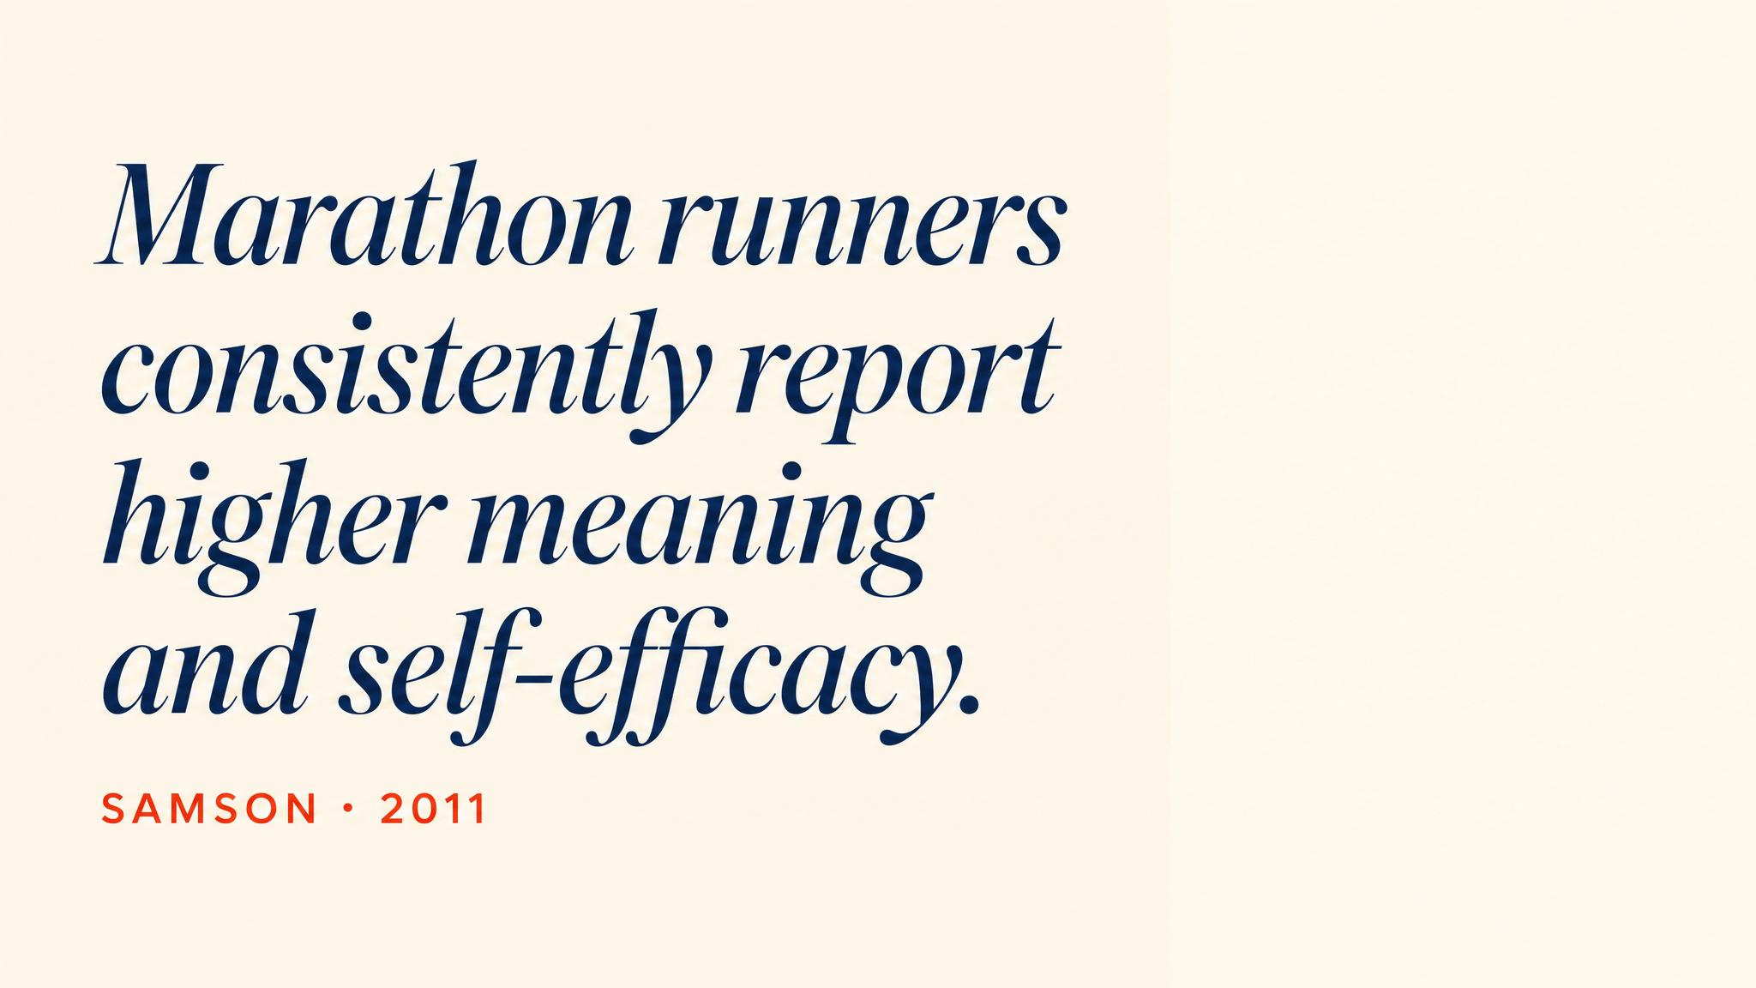
Notes:
Pause on this. Samson, in 2011, found that for distance runners self-efficacy is built primarily through two mechanisms: successful performance accomplishments — completing workouts — and physiological information — learning to interpret your body's signals. That's what every chapter from here is doing.

Slide 11

Notes:
Ryan and Deci in 2000 distinguished autonomous from controlled motivation. Autonomous reasons — yours — predict persistent behavior far more strongly. One sentence. Tape it to the bathroom mirror. You'll be glad you did around week 12.

Slide 12
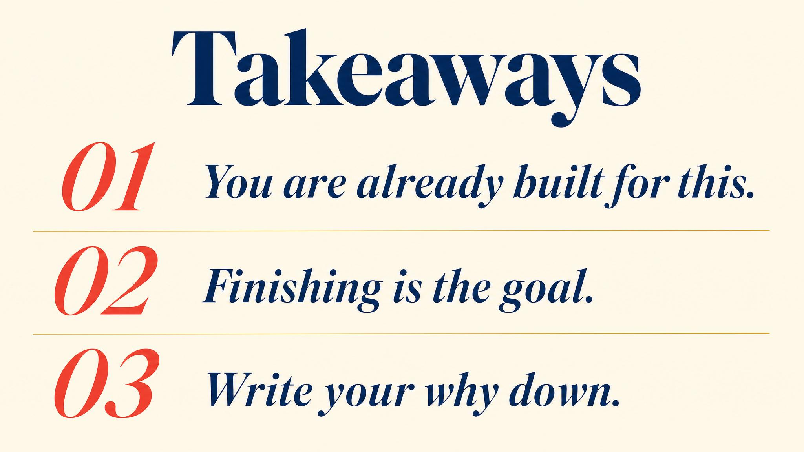
Notes:
Three to carry: the average marathoner runs about 4:29 — you belong; most training should feel easy at RPE 3 to 4; your personal why is the bridge between intention and the cold Tuesday alarm. Pause briefly on each.

Slide 13

Notes:
Close with the bridge: next chapter, we'll lace up. The magic of slow — why your easy days should feel almost suspiciously easy, why walking is a strategy not a crutch, and how the 80/20 principle shapes every elite endurance program.

