Slide 1

Notes:
Open with the parable. Runner A pushed hard from day one and dropped out in week six with shin splints. Runner B shuffled, chatted, kept walking when needed — and crossed the finish line. The most common story in beginner marathon training. The lesson: to run far, learn to run slow.

Slide 2

Notes:
Name the universal pattern: beginners run too fast on every day, not just race day. Slow jogging already feels hard, so the brain assumes it must be right. And running visibly slow in public feels embarrassing. That instinct is exactly what we have to override.

Slide 3
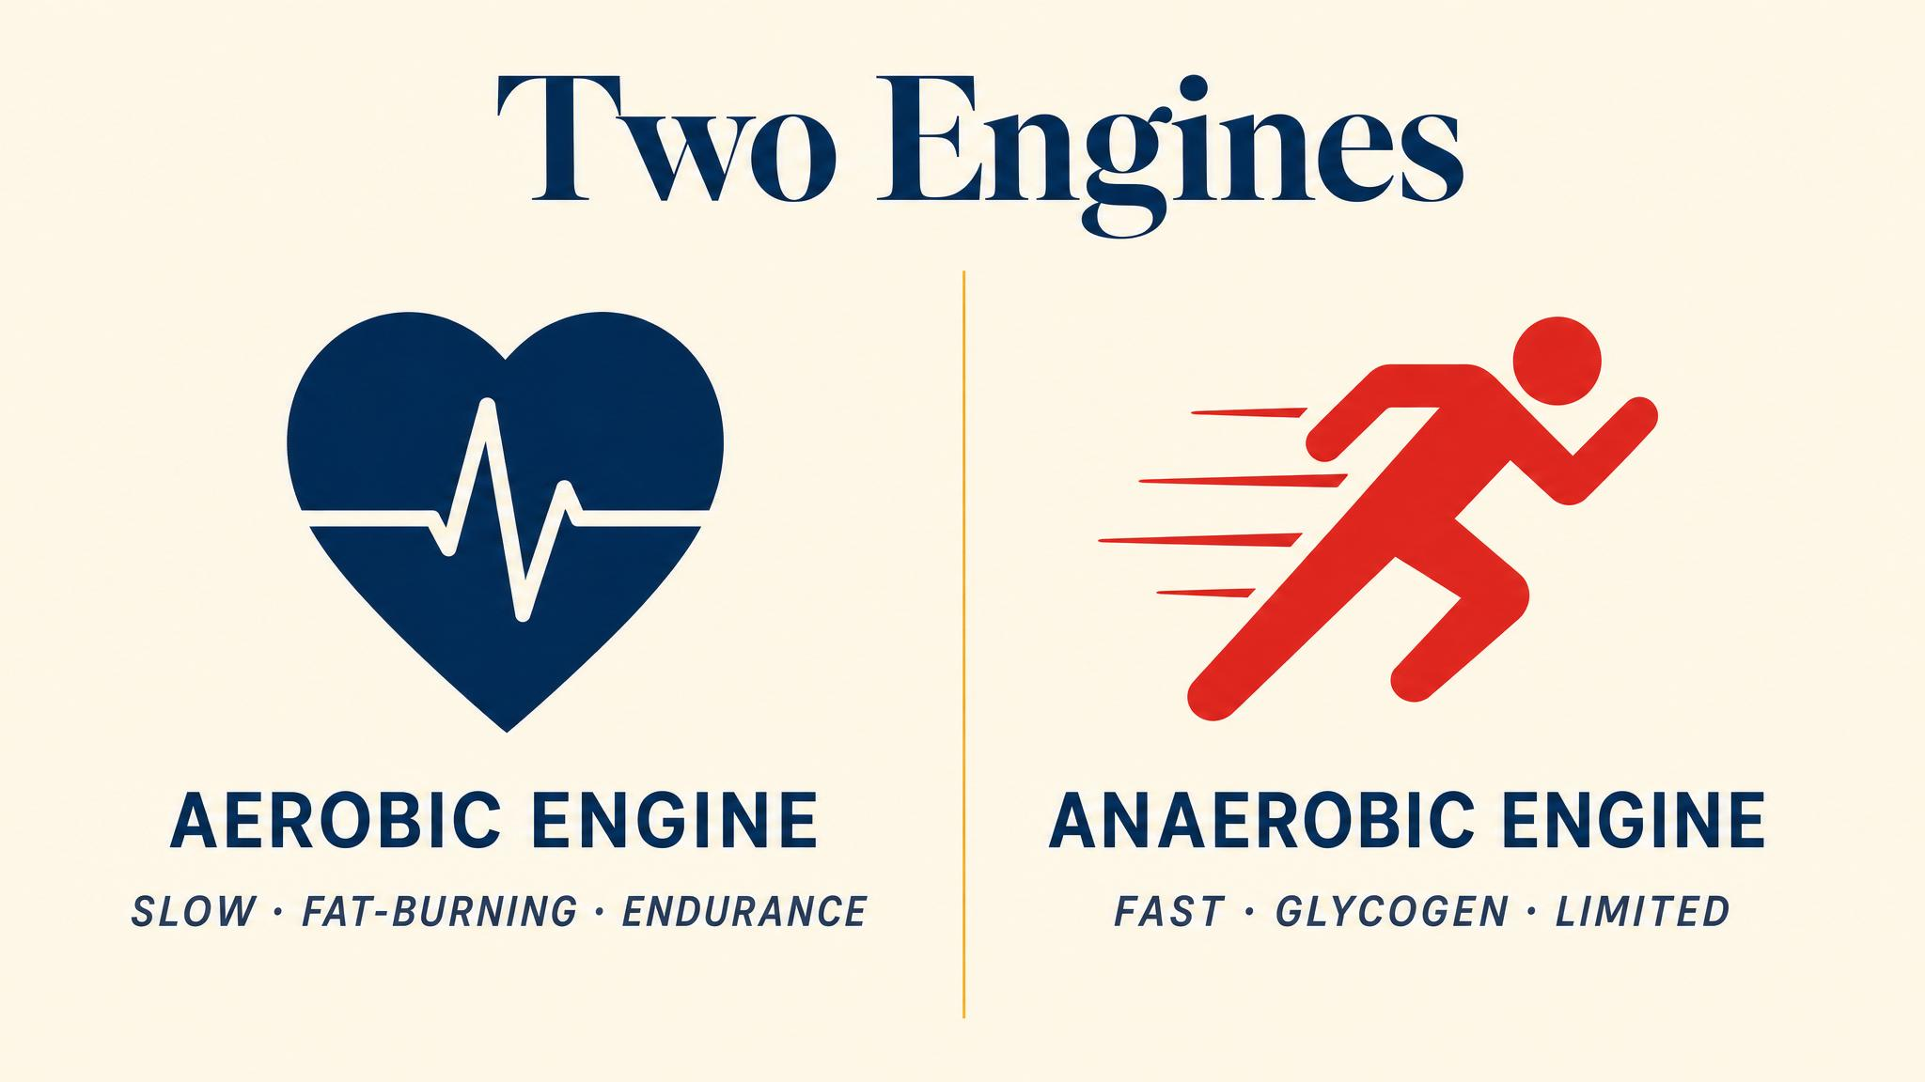
Notes:
Two engines inside your body. The aerobic system is your diesel — uses oxygen, burns carbs and fats, runs for hours. The anaerobic system is your turbo — sprints, hills, surges, but only minutes. The marathon, even for elites, is almost entirely aerobic, as Predel reported in 2014.

Slide 4
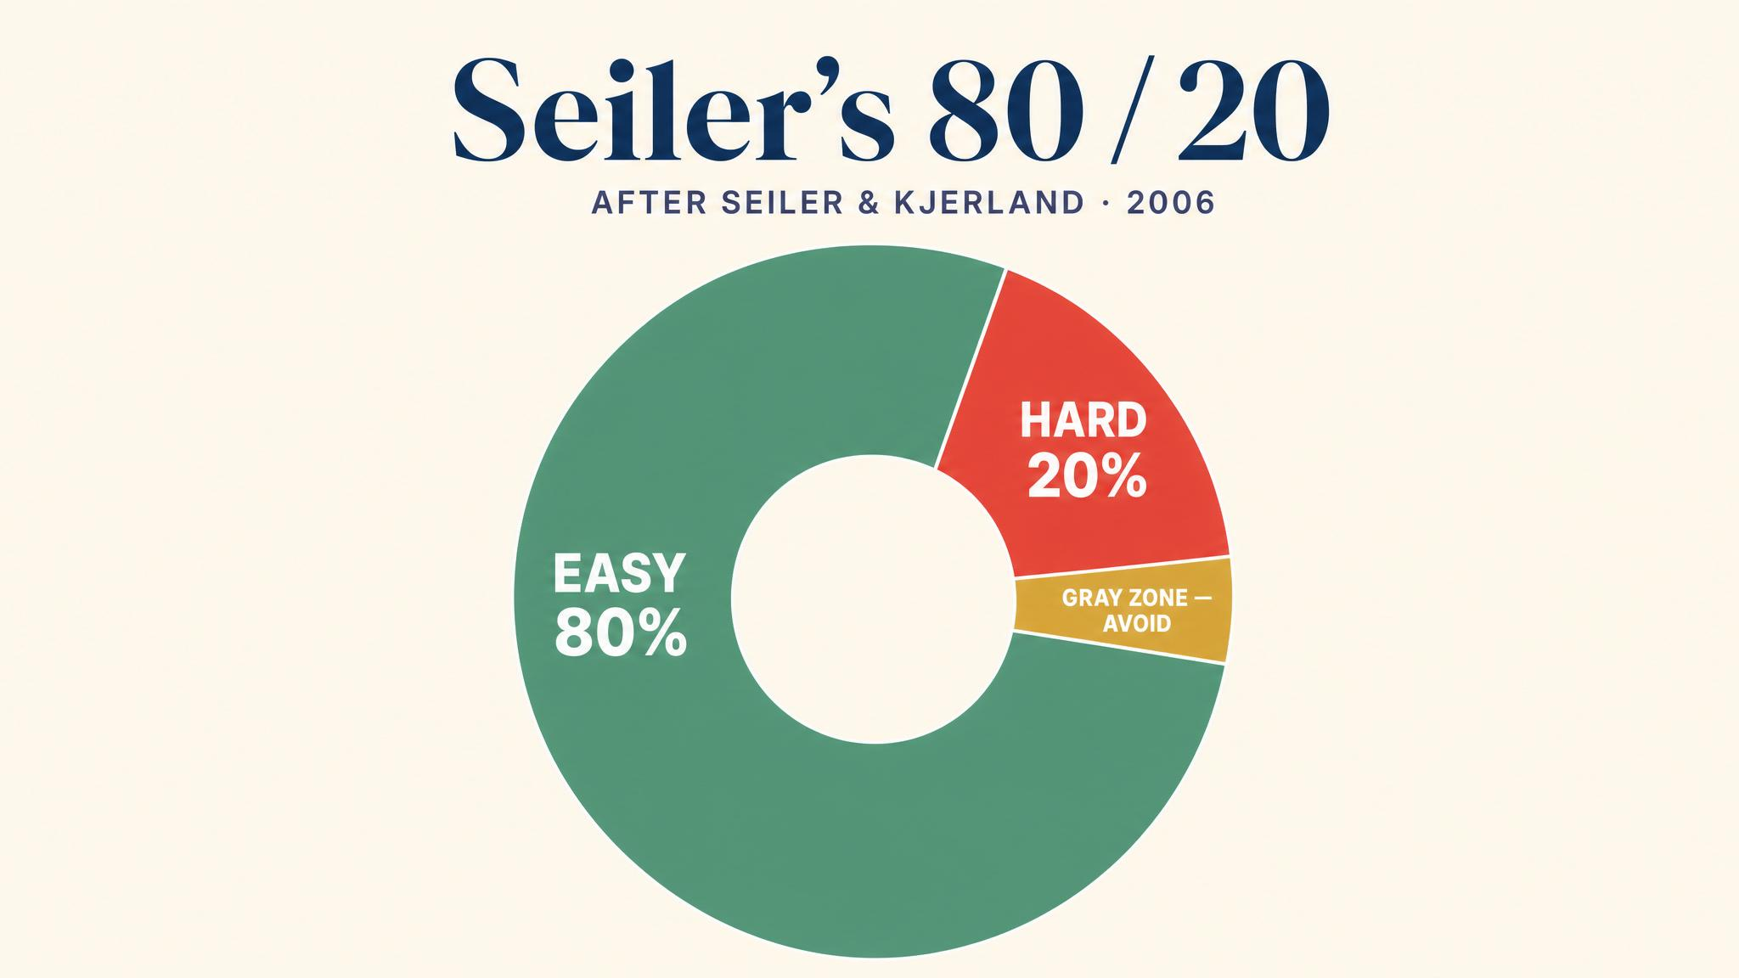
Notes:
Stephen Seiler's analysis of elite endurance athletes — Seiler and Kjerland 2006, expanded in 2010 — found a remarkably consistent pattern: roughly 80% easy, 20% hard. Muñoz and colleagues in 2013 confirmed the principle holds for recreational runners too. Slow most of the time is what makes you fast.

Slide 5
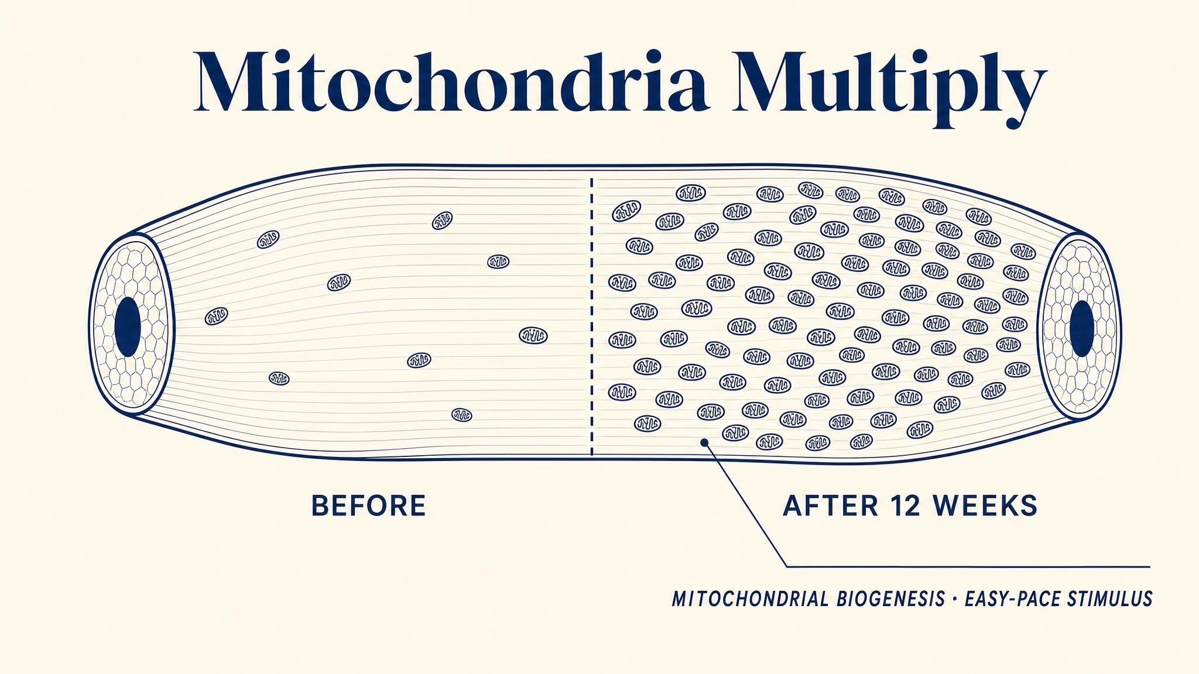
Notes:
Easy running triggers invisible adaptations. Mølmen and colleagues' 2024 meta-analysis of 345 studies found endurance training significantly increases mitochondrial content — and crucially, the biggest relative gains happen in people with the lowest starting fitness. If you're new to this, your body is primed for dramatic improvement.

Slide 6
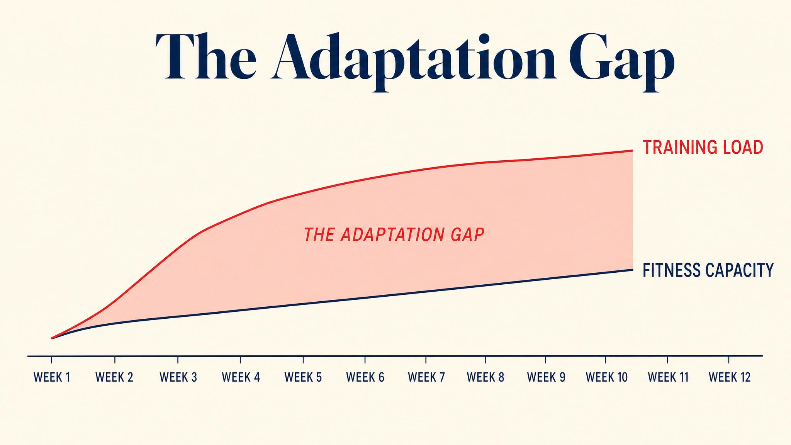
Notes:
Your cardiovascular system adapts in days to weeks. Your tendons, ligaments, and bones adapt in weeks to months. That gap is the primary driver of overuse injuries — a systematic review found a 40% injury incidence in runners. Running slow lets your bones catch up to your heart.

Slide 7

Notes:
The talk test. Woltmann and colleagues in 2015 validated it against lab measures: speaking in full sentences correlates with intensity below the ventilatory threshold — exactly where easy running should live. If you can't speak, slow down. If you can't speak even while walking briskly, that brisk walk IS your pace.

Slide 8
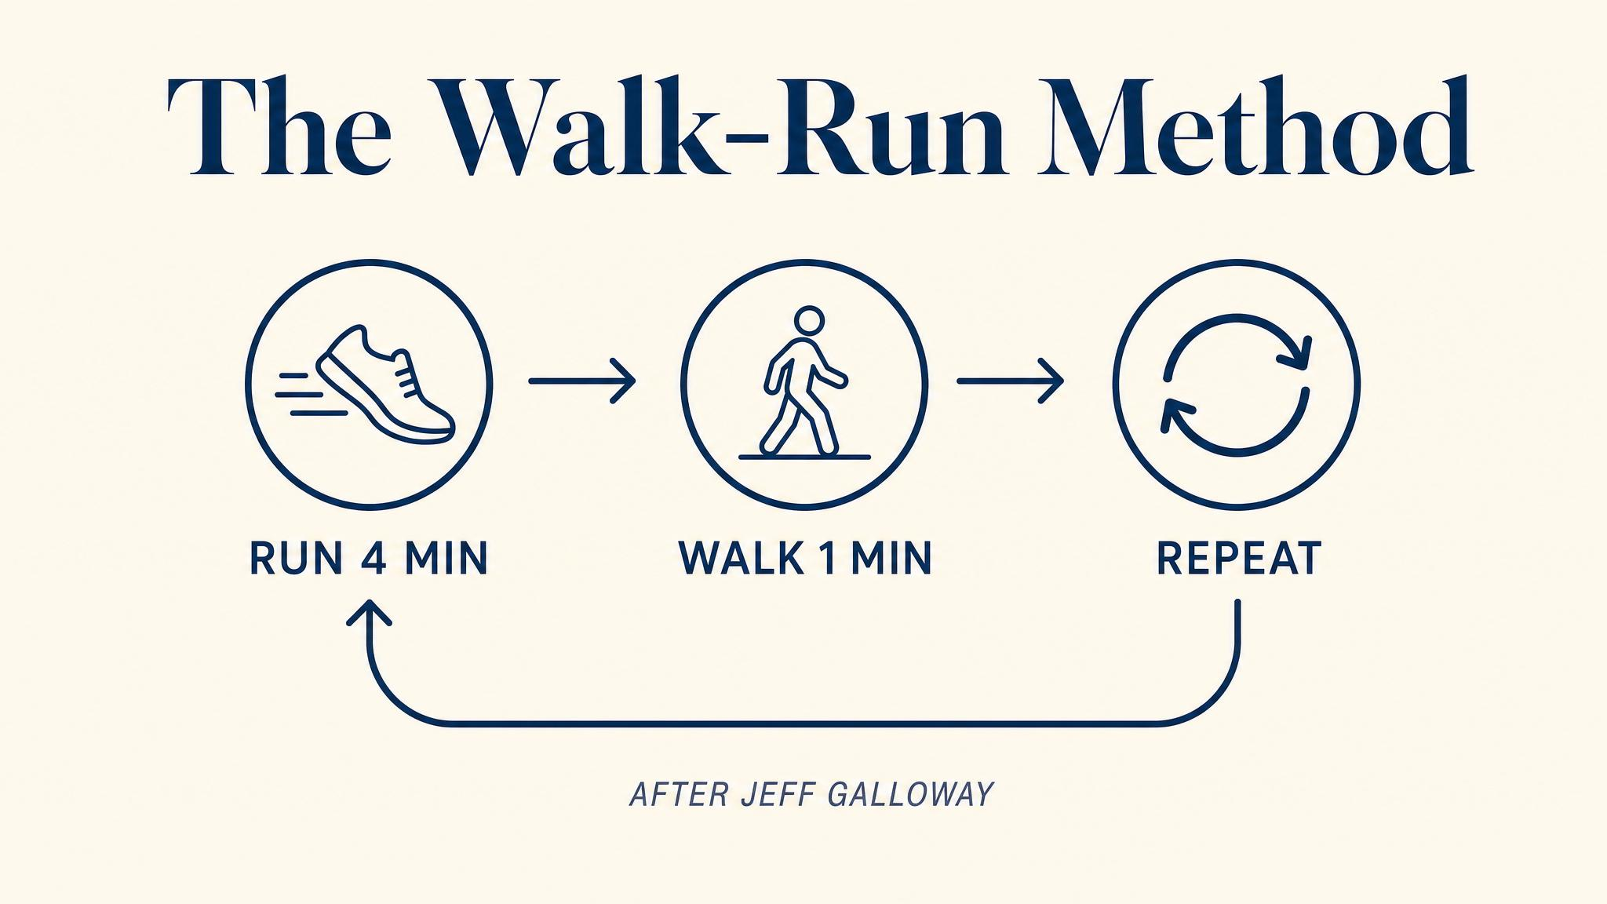
Notes:
Jeff Galloway's walk-run method. Hottenrott and colleagues in 2016 compared continuous runners with walk-run participants: similar finish times — 4:14 vs 4:08 — with significantly less muscle discomfort. Walk breaks are not failure. They're a research-supported strategy.

Slide 9
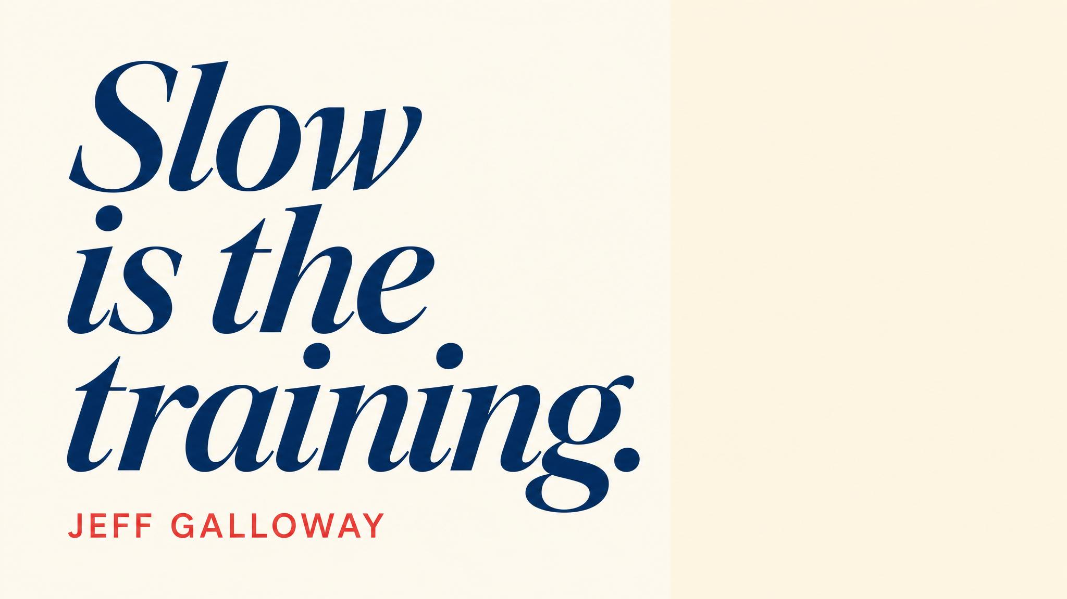
Notes:
Read the Galloway quote aloud and let it land. The walk-run method, as Galloway frames it, is wisdom — matching strategy to the actual demands of 26.2 miles. There is no shame in walking. There is only the science.

Slide 10

Notes:
Arthur Lydiard in 1960s New Zealand built his Olympic gold medalists on a foundation of long, easy aerobic running — radical at a time when interval training was the fashion. Seiler's research decades later confirmed what Lydiard discovered by coaching intuition: the 80/20 pattern is the distribution that works.

Slide 11
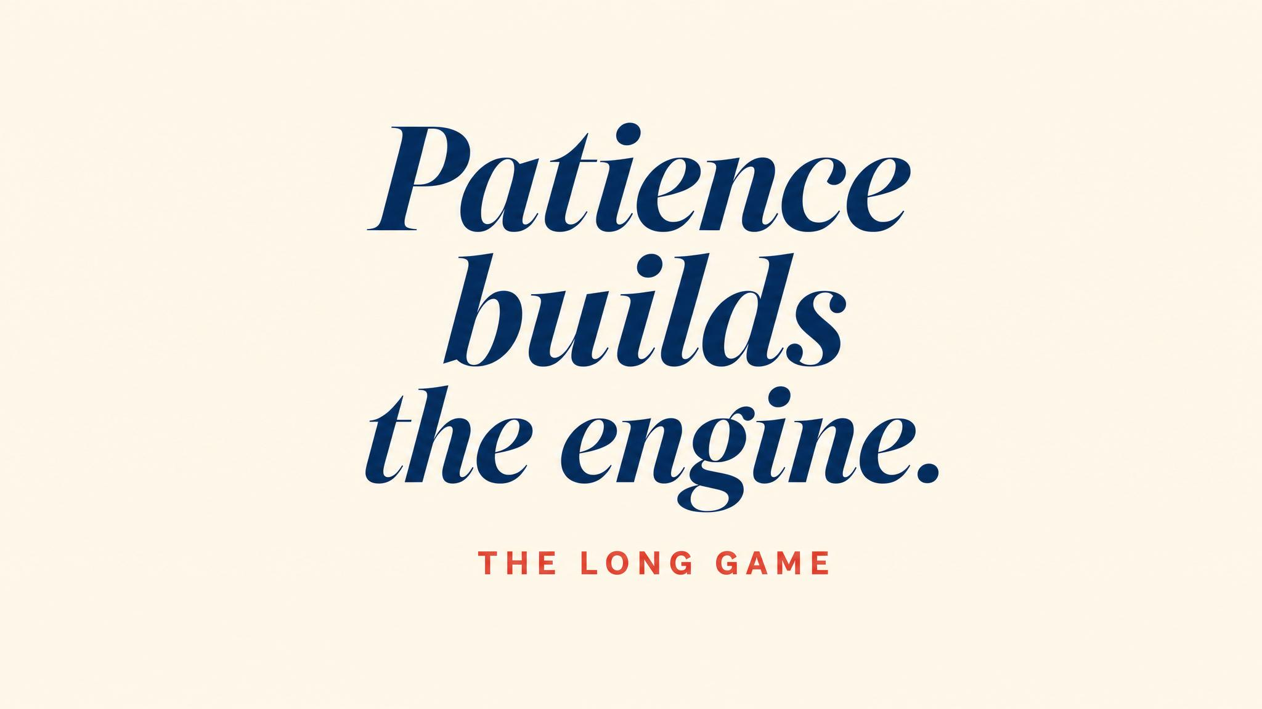
Notes:
The adaptations are invisible for weeks. Mitochondria multiplying, capillaries growing, heart strengthening — you won't feel faster right away. But by week six you will, and dramatically by week twelve. Protect the gap. Increase volume by no more than 10% per week, and take recovery weeks.

Slide 12
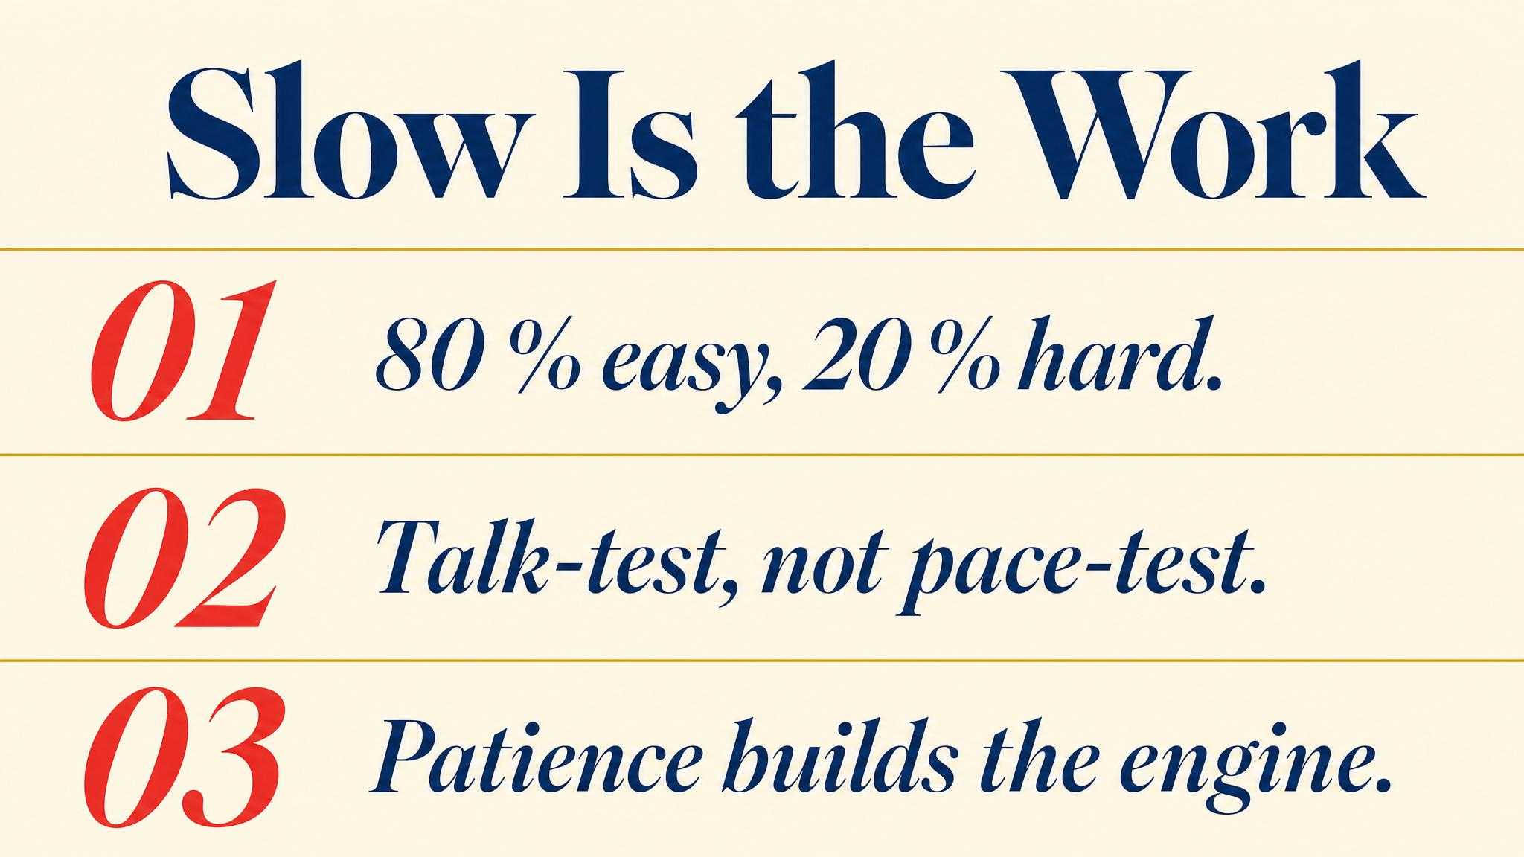
Notes:
Three to carry: roughly 80% of training is easy; the talk test is your honest pacing instrument; walk breaks are a strategy, not a crutch. Pause briefly on each.

Slide 13

Notes:
Closing bridge: next chapter, we'll build the actual week — the architecture of a training plan. Periodization, supercompensation, the long run, and the 10% rule. Bring your calendar.

