Slide 1
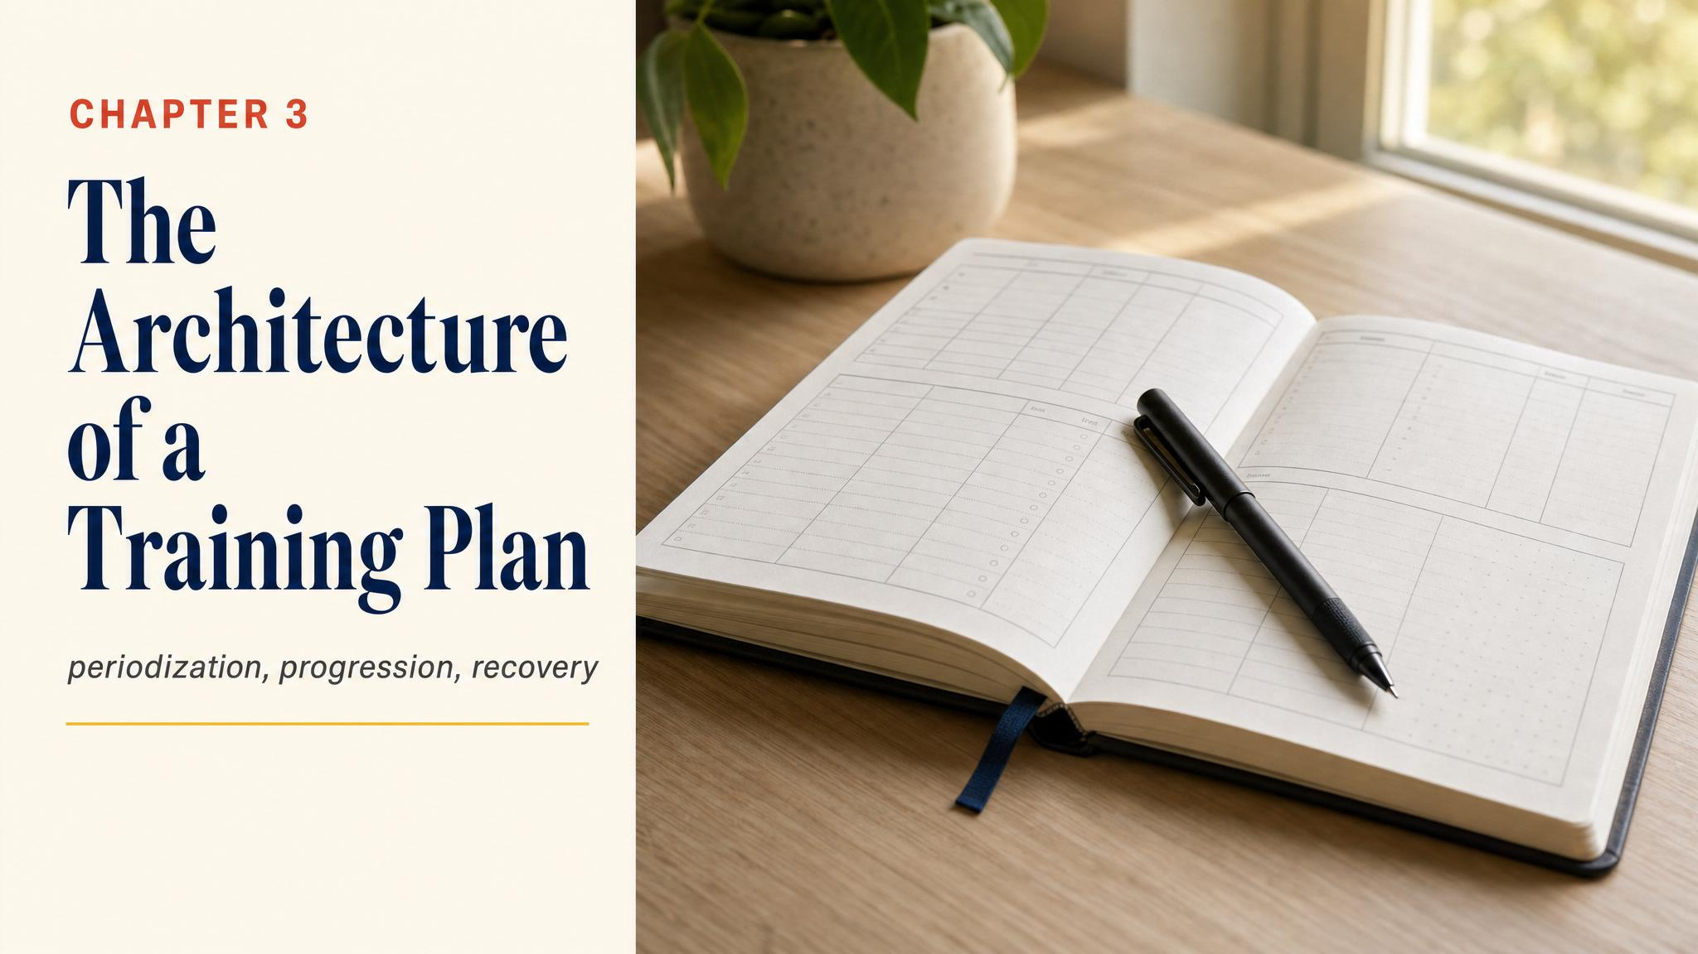
Notes:
Open with Sarah and Marcus. Sarah trained on enthusiasm and ended on the sidelines. Marcus trained on a blueprint and toed the start line healthy. This chapter is about that blueprint — why it looks the way it does.

Slide 2
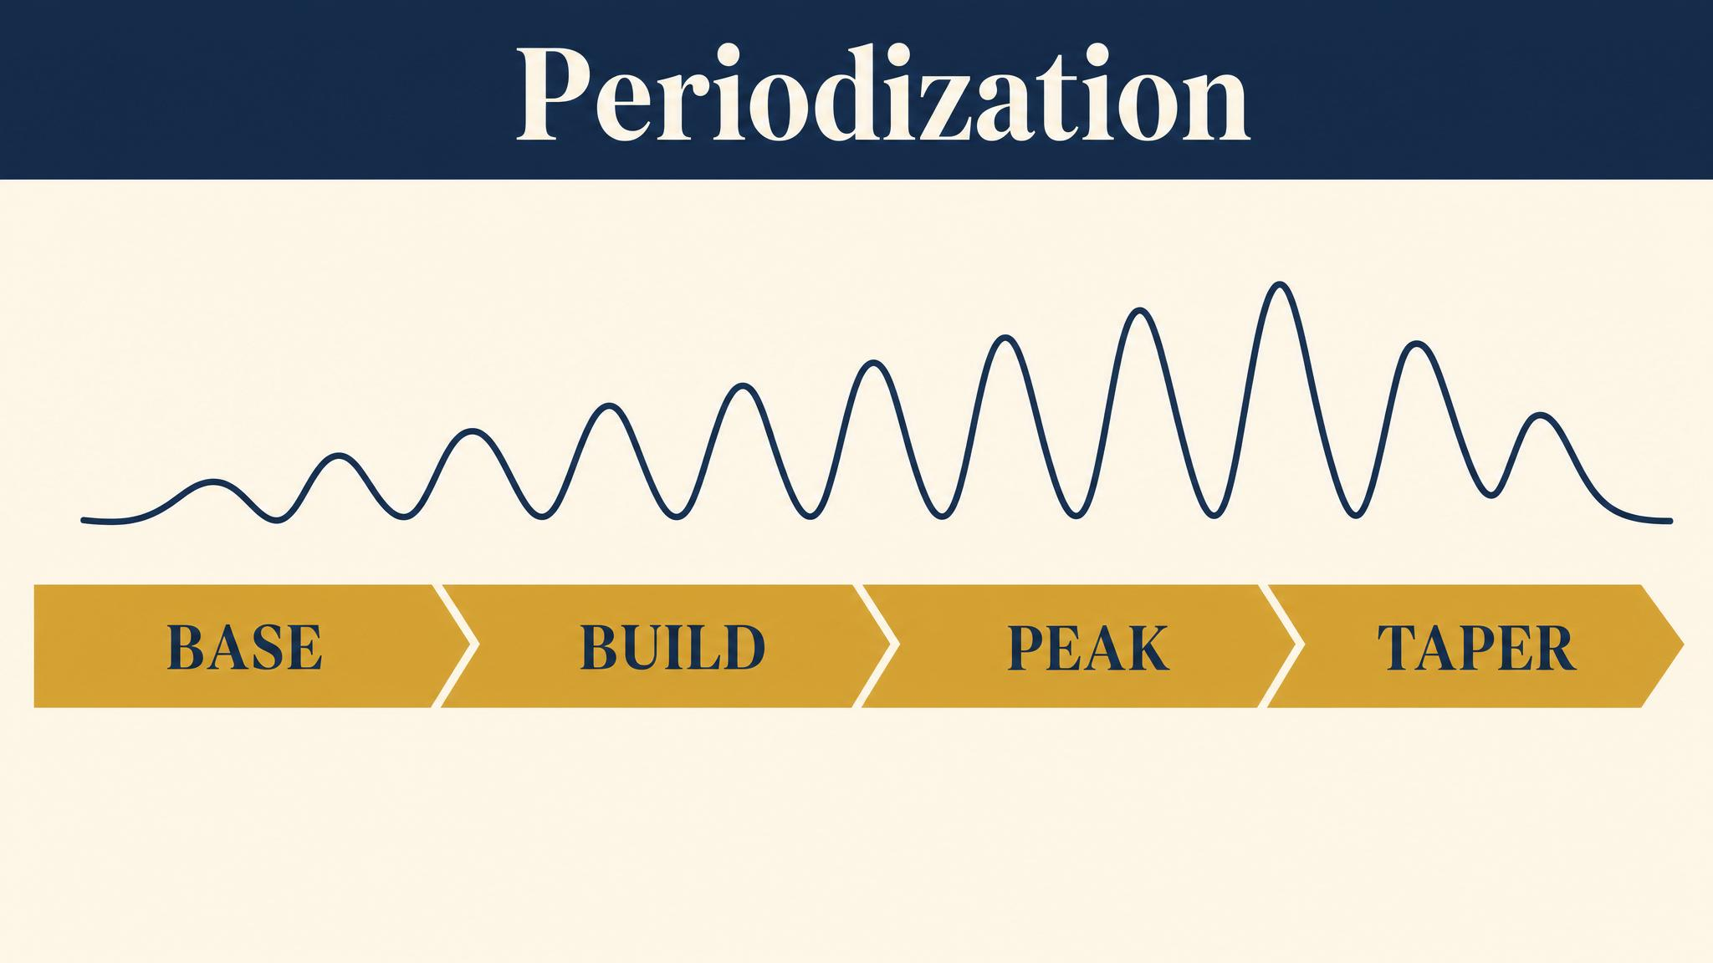
Notes:
Periodization. Soviet sports scientists in the mid-twentieth century formalised it; Bompa and Haff in 2009 wrote the modern textbook. The principle: build stress for two or three weeks, then deliberately pull back for one. That rhythm is the heartbeat of every good plan.

Slide 3

Notes:
Three scales. The whole 16–20 week marathon block is the macrocycle. Inside it, 3–4 week mesocycles are where build-recover happens. Inside each mesocycle, weeks are the microcycle. Each scale tells you how to plan stress.

Slide 4
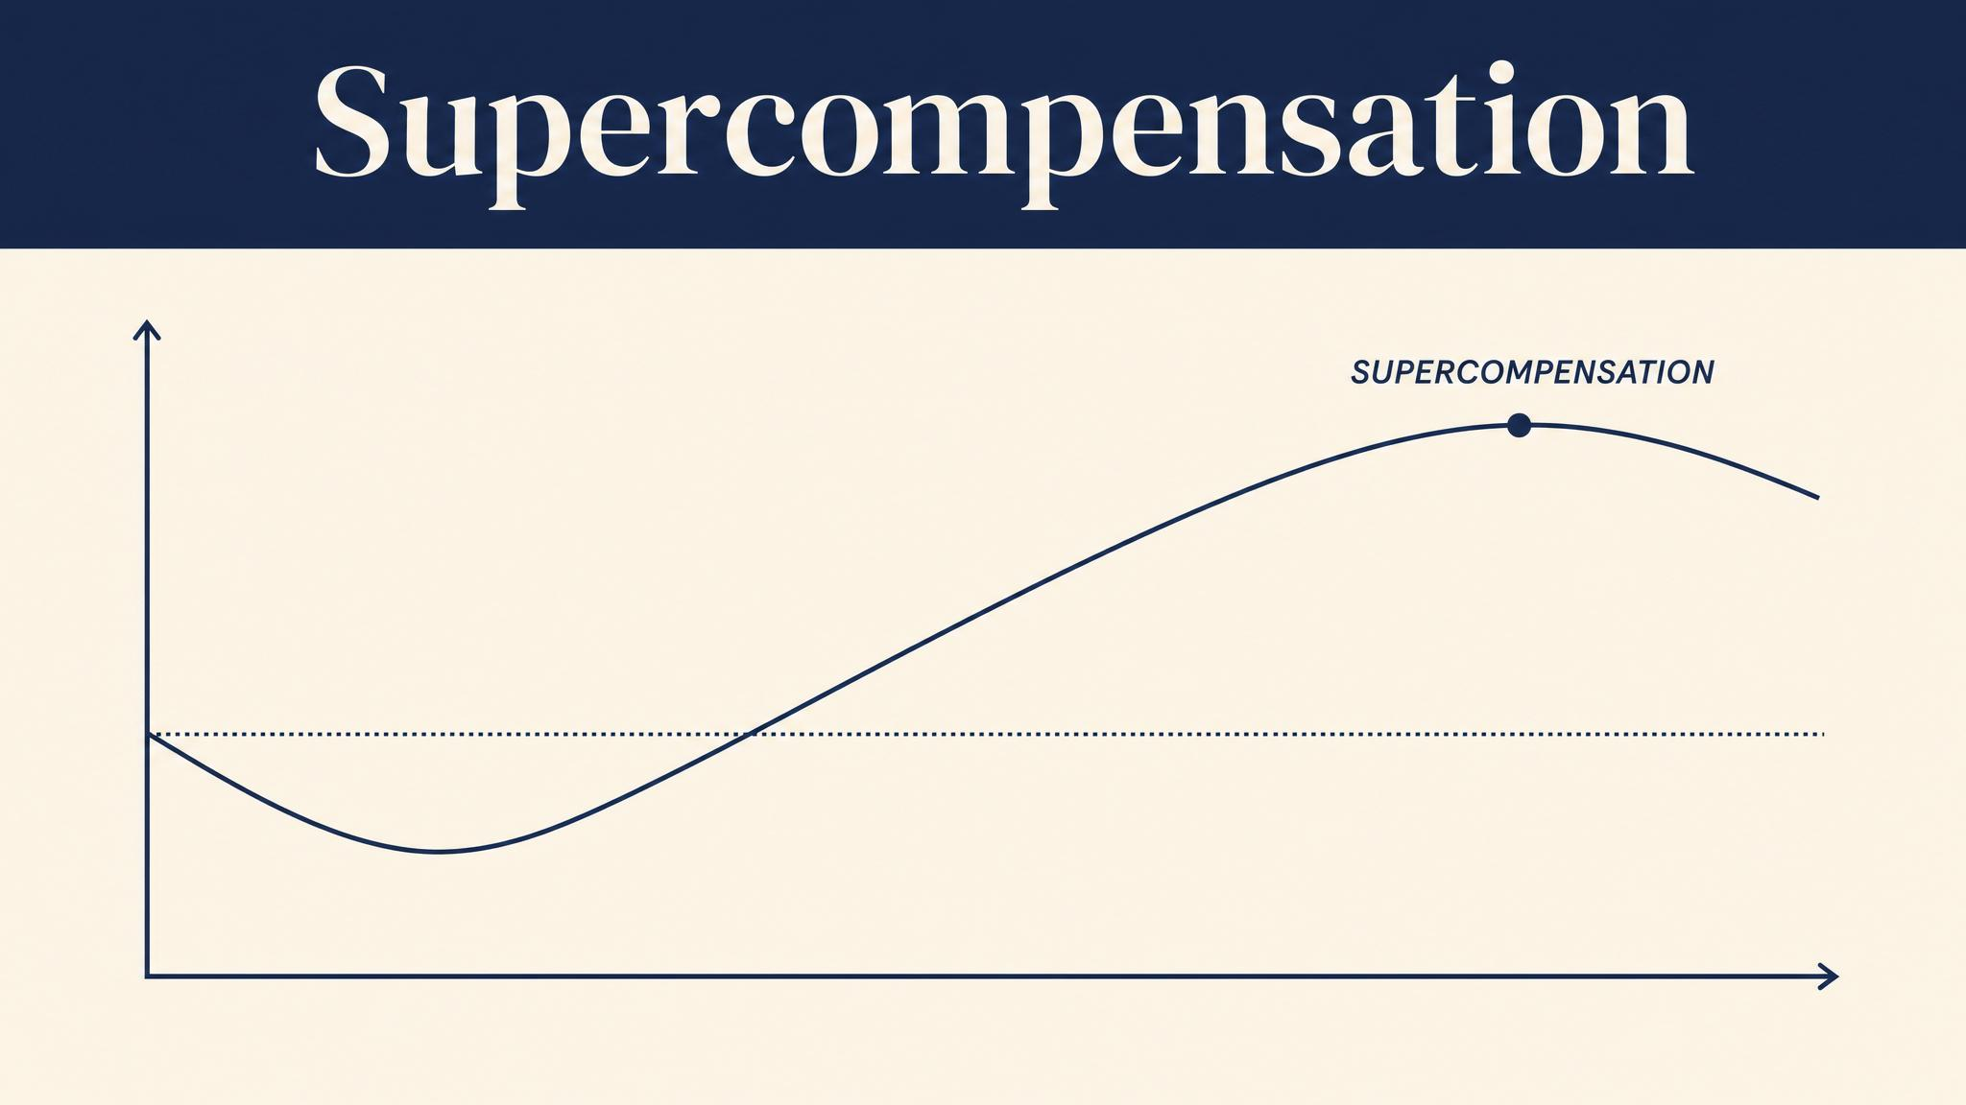
Notes:
You don't get fitter while running. You get fitter while recovering. Gambetta in 2007 describes the four-step supercompensation cycle: stress, recovery, adaptive overshoot, gradual return. Apply the next stimulus in the overshoot window and you build fitness on fitness.

Slide 5
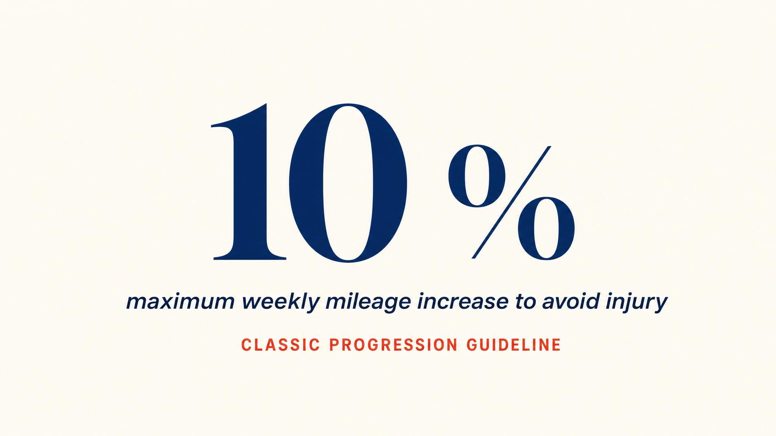
Notes:
Nielsen and colleagues in 2014 studied 874 novice runners: those who kept two-week mileage increases below 10% had the lowest rates of runner's knee and IT band syndrome. The 10% rule isn't a commandment — it's a guardrail. Use it as a ceiling, not a floor.

Slide 6
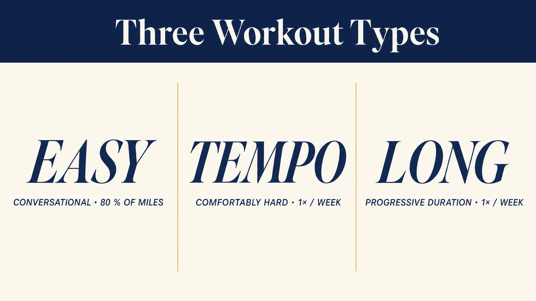
Notes:
For a beginner, almost every plan reduces to three workouts: the easy run (bread and butter), the long run (cornerstone), and the rest day (where adaptation happens). Understanding these three matters more than memorising any schedule.

Slide 7

Notes:
The long run is the single most important workout in marathon training. It teaches your muscles to burn fat, conditions joints and tendons, builds mental resilience. Most beginner plans peak at 18 to 22 miles, typically three weeks before race day. Conversational pace, always.

Slide 8
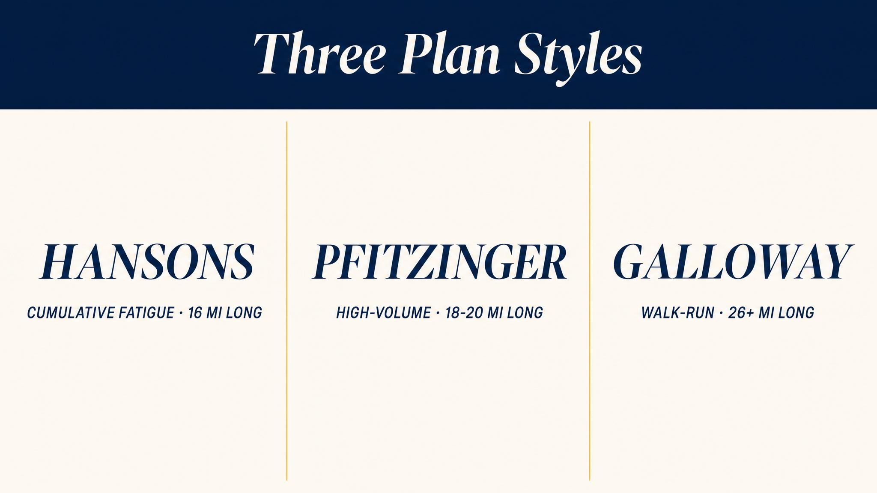
Notes:
Three legitimate styles: Galloway's walk-run, Higdon's four-day novice, Hanson's five-day moderate. No single plan is correct. The best plan is the one you can consistently follow, fits your schedule, respects your starting point.

Slide 9
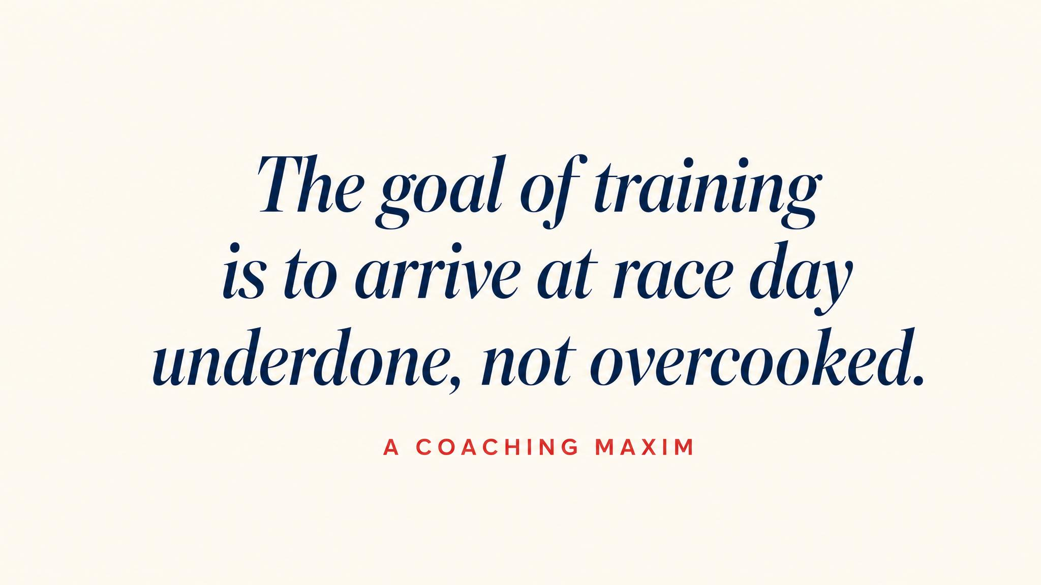
Notes:
Read aloud and let it land. Across Higdon, Galloway, and the Hanson brothers, the same line: the goal of training is to be on the start line healthy, rested, and eager to run. Every plan that accomplishes this is a good plan.

Slide 10

Notes:
Training age is not biological age. It's how long you've been consistently running. Kemler and colleagues in 2018 found novice runners — defined as those running less than 12 months — had double the injury rate of experienced runners. The plan isn't respecting your lungs; it's protecting your bones.

Slide 11
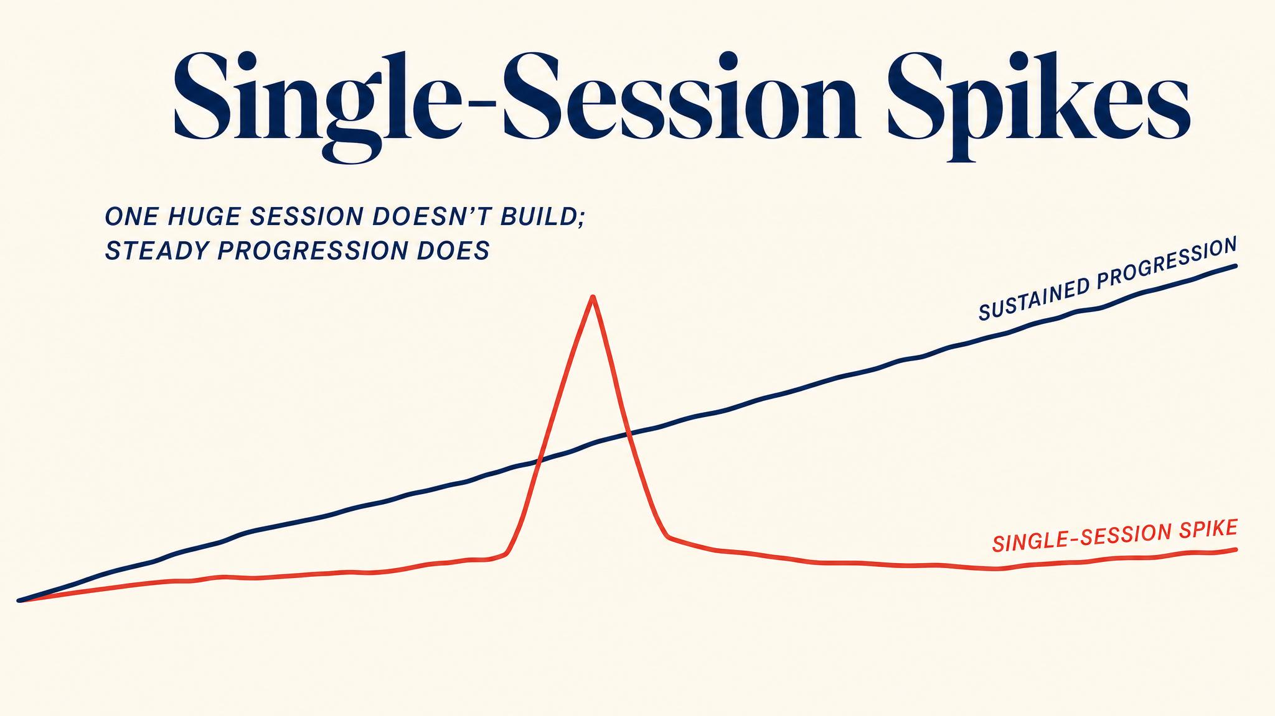
Notes:
Ramskov and colleagues in 2018 studied 5,205 runners and found that single-session distance spikes — running more than 10% beyond your longest run in the past 30 days — raise injury risk by 64%. Spikes are more dangerous than week-to-week mileage increases. The long run progresses gradually for a reason.

Slide 12

Notes:
Life happens. Missing a single run is never a crisis. What's dangerous is trying to cram missed miles into remaining days — that creates exactly the session-distance spikes Ramskov 2018 flags. The plan serves you. You don't serve the plan.

Slide 13
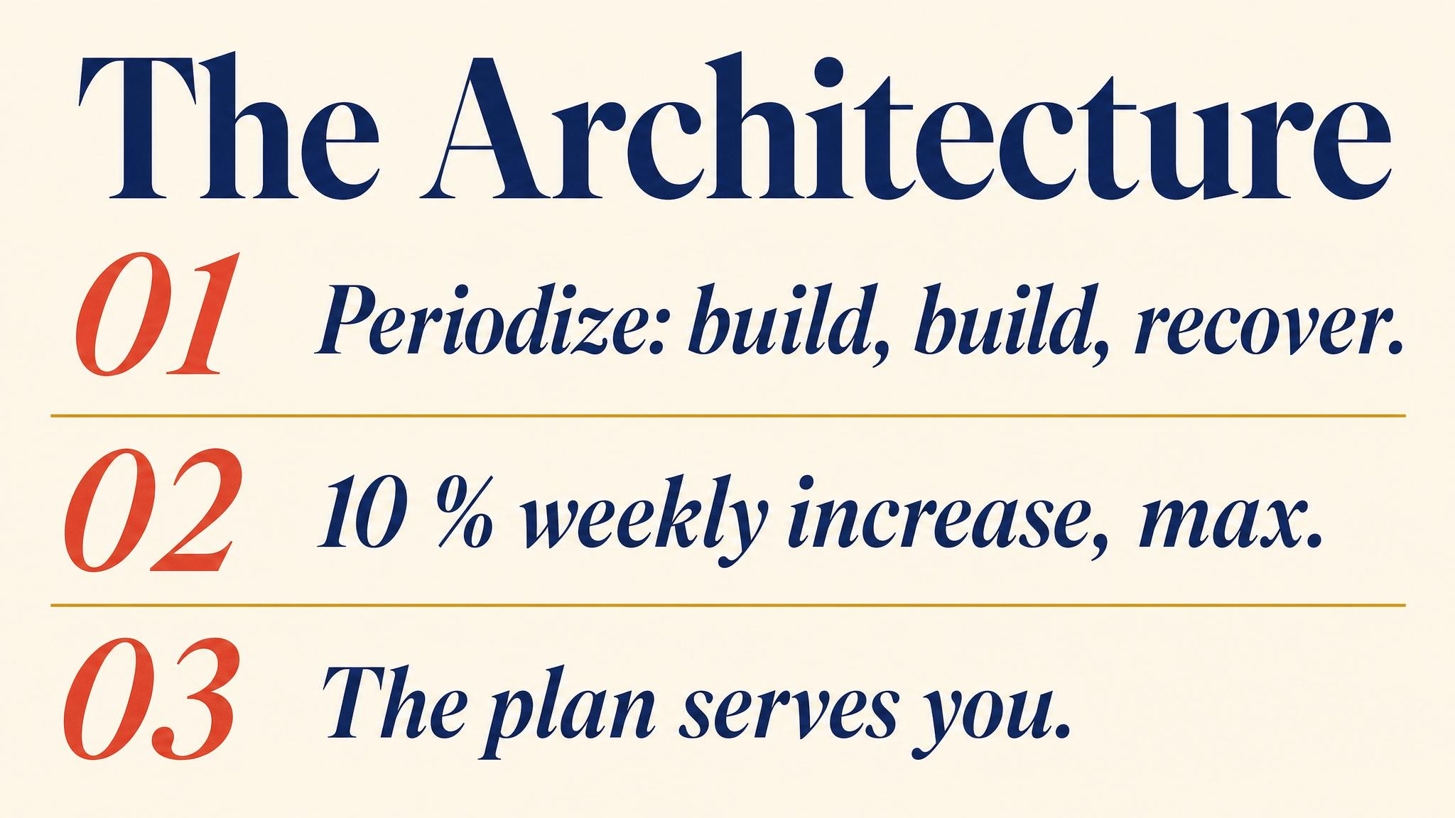
Notes:
Three to carry: periodization's build-build-recover rhythm is the heartbeat of every plan; the long run is the cornerstone; single-session distance spikes are the biggest injury predictor — bigger than weekly mileage changes.

Slide 14

Notes:
Closing bridge: next chapter, we zoom in on the body that's doing the training — how to tell discomfort from pain, the five most common beginner injuries, and the simple decision framework that protects you when something starts to whisper.

