Slide 1
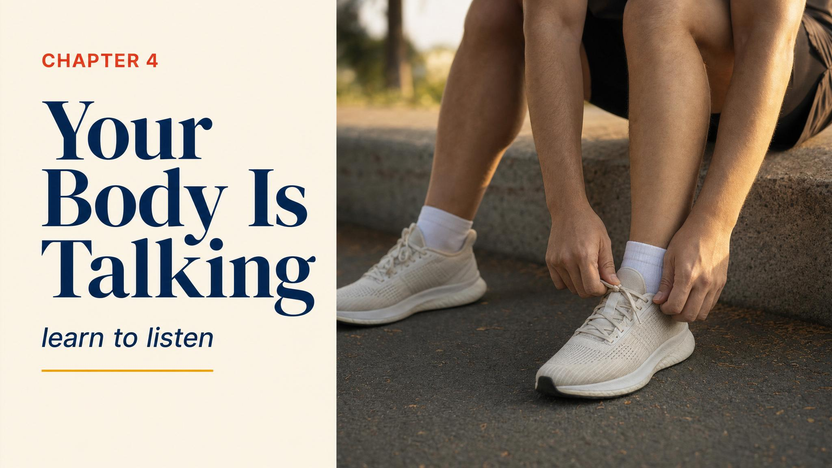
Notes:
Open with the scene: week five, Tuesday morning, a dull ache along the right shin. Schedule says four-mile easy. What do you do? Injuries are the number one reason people abandon marathon training, and almost all of them whispered first. This chapter is about learning to hear them.

Slide 2
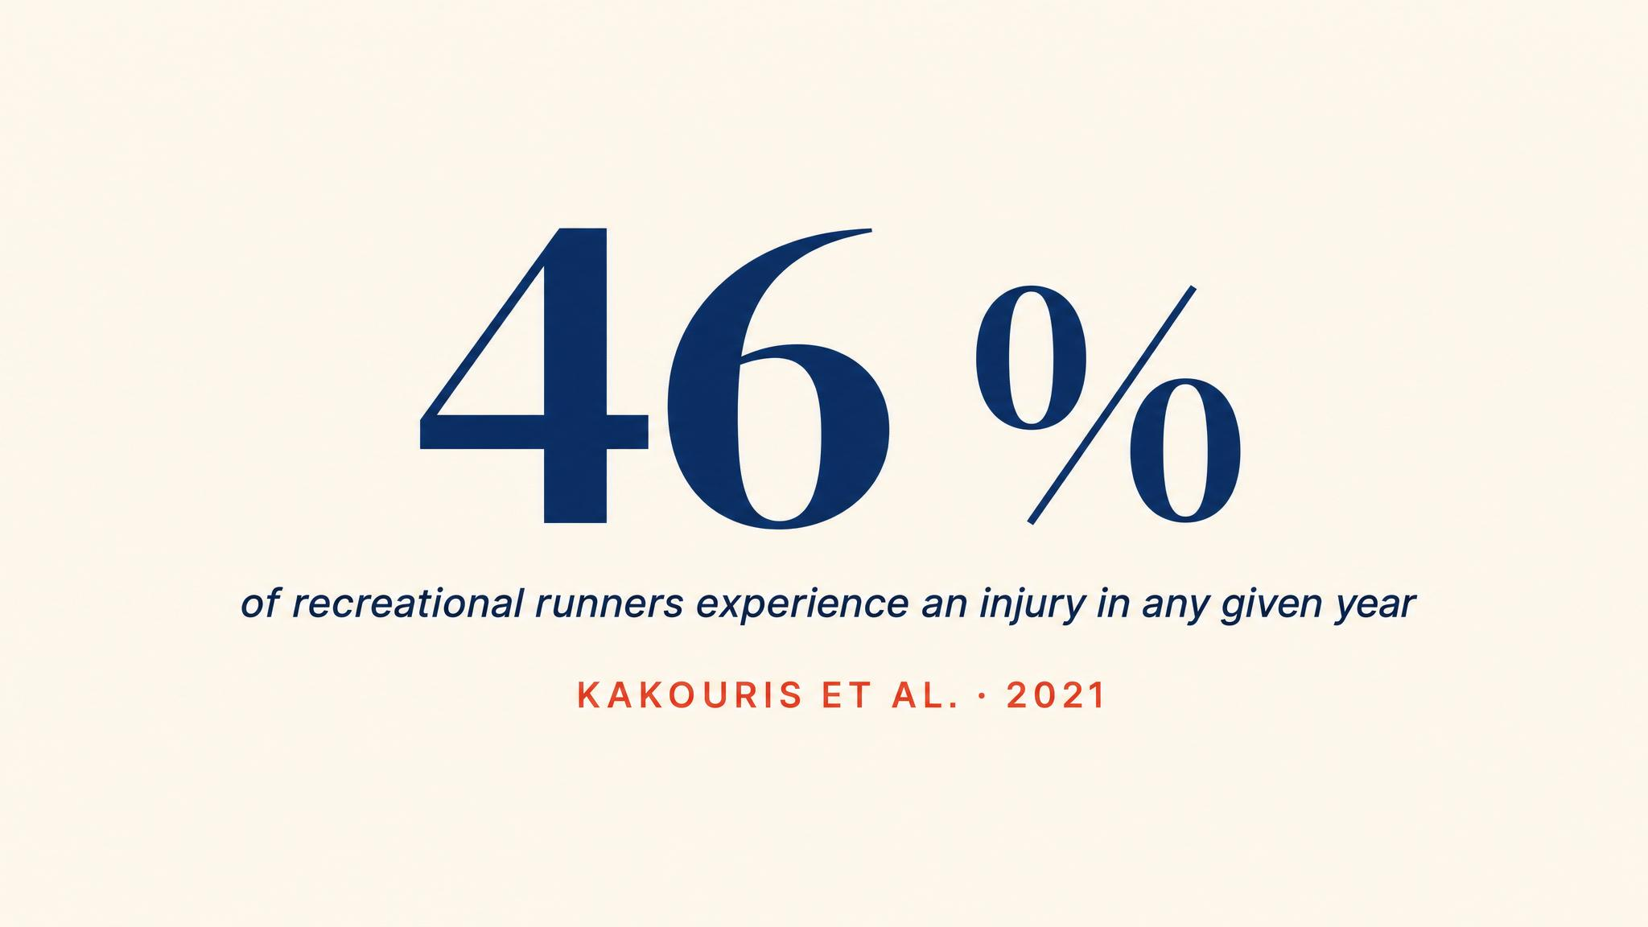
Notes:
Kakouris and colleagues' 2021 systematic review of 42 studies found a 40.2% overall injury incidence in runners, with prevalence reaching 44.6%. Taunton 2012 found up to 70% of runners sustain an overuse injury annually. These are big numbers. But almost all of them whispered first.

Slide 3
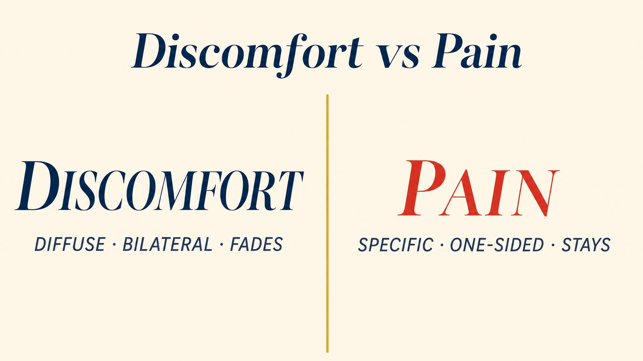
Notes:
Discomfort is diffuse, bilateral, fades during activity, resolves within hours. Pain is specific, often unilateral, worsens during or after, and persists. Confusing the two is the trap: stop at every twinge and you never build fitness; push through every signal and you end up injured.

Slide 4
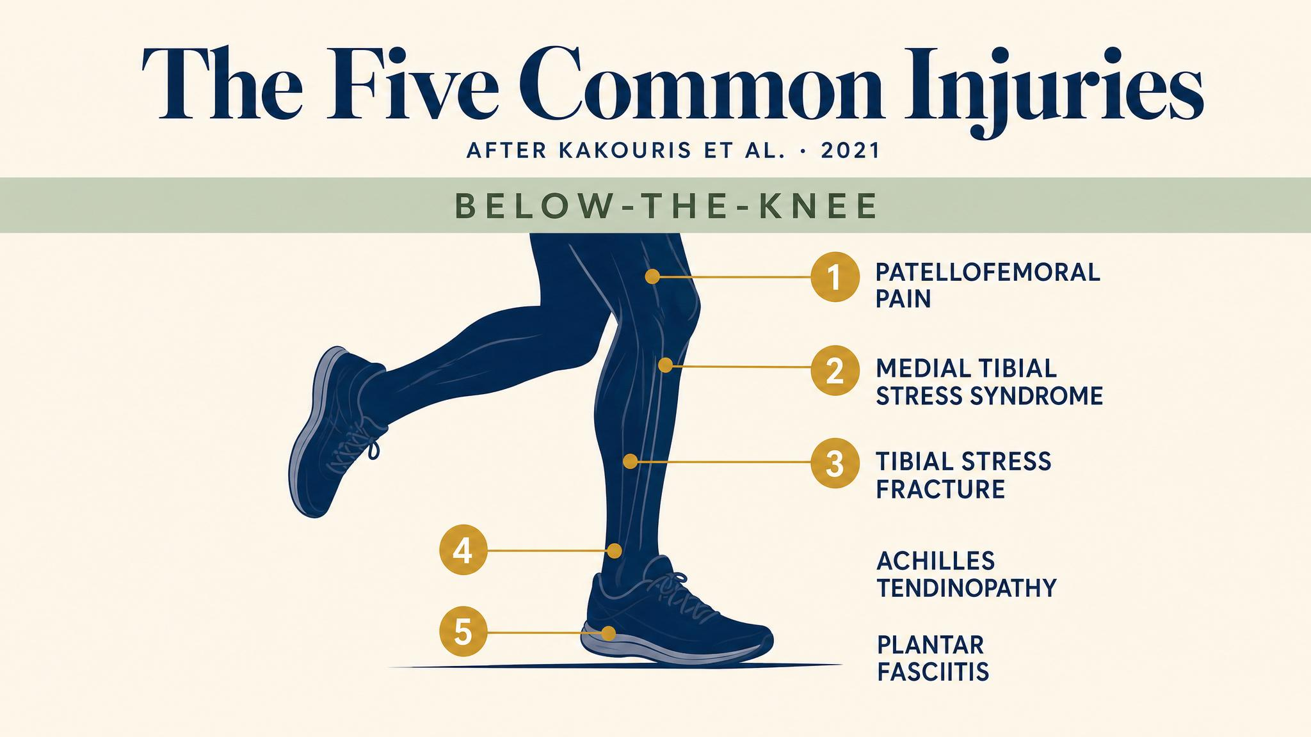
Notes:
Five injuries account for the majority of beginner cases: runner's knee, shin splints, Achilles tendinopathy, plantar fasciitis, and IT band syndrome. Kakouris 2021 reports prevalences from about 6% to 17%. Taunton 2012 notes more than 80% of running injuries occur at or below the knee.

Slide 5
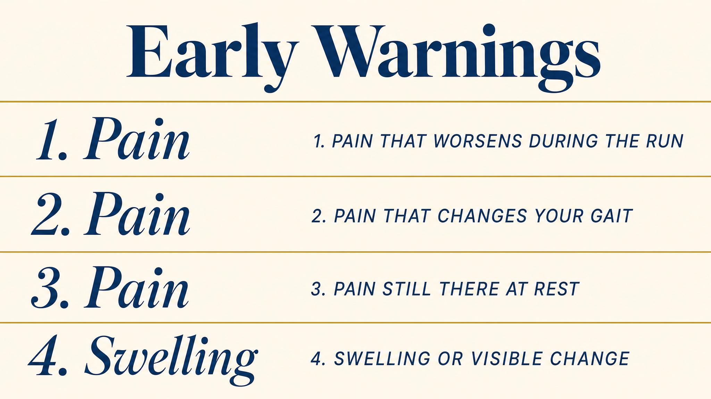
Notes:
The red flags: sharp or localised pain you can point to, one side only, pain that worsens during the run or changes your gait, pain at rest or first thing in the morning, swelling or visible change. These are the whispers that need to be heard.

Slide 6

Notes:
Blagrove and colleagues in 2022 reviewed lower-limb resistance training and found it improves running economy and may reduce injury risk. 15 to 20 minutes, two to three times a week, targeting glutes, hips, calves, and core. No gym required.

Slide 7
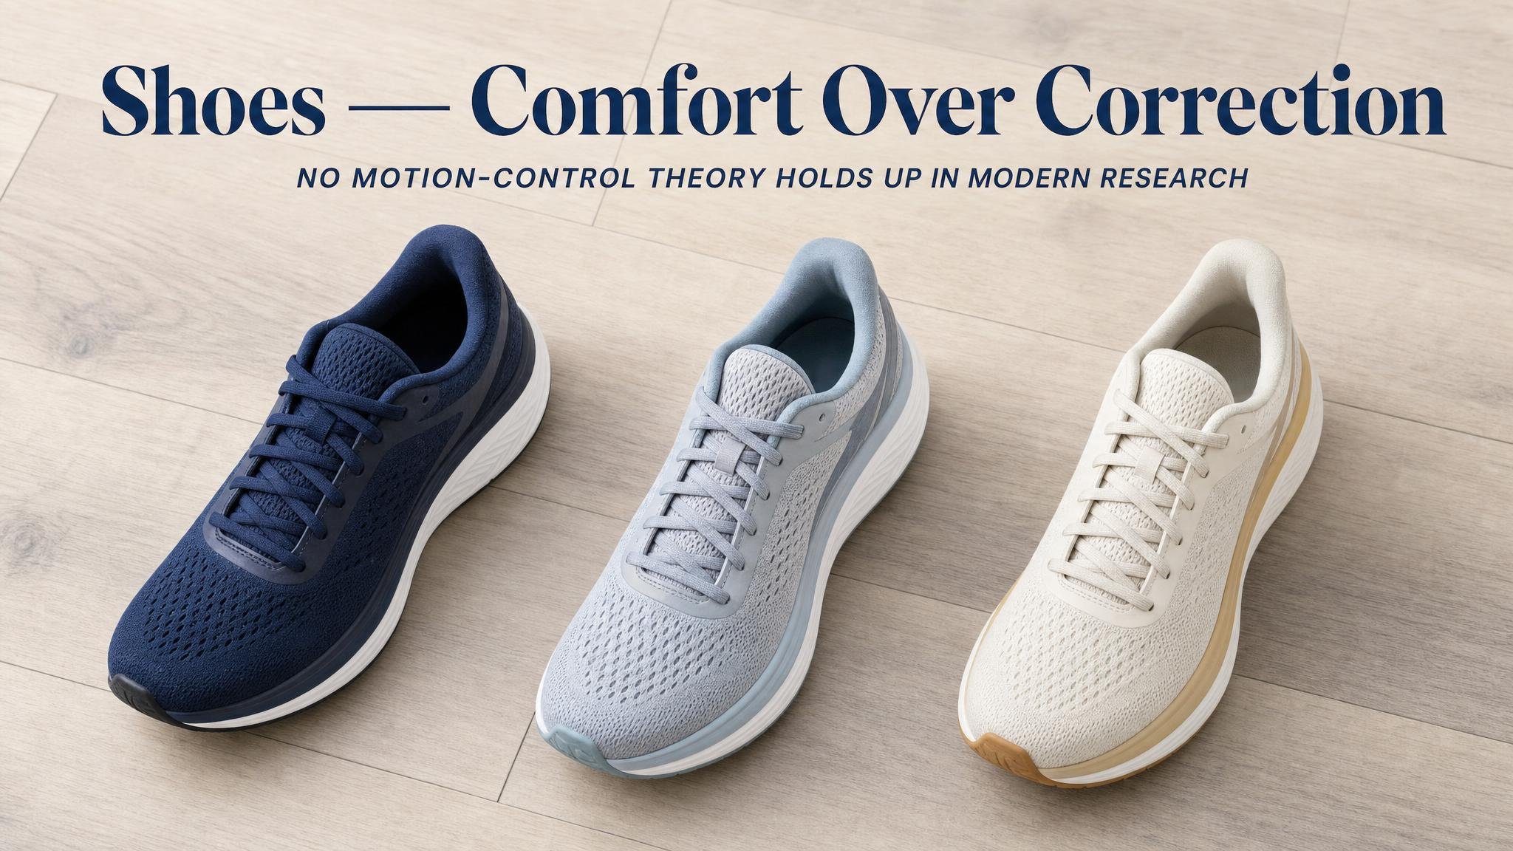
Notes:
Malisoux and Theisen 2020 found the role of shoe technology in injury prevention has been largely overrated. Pronation-correction is not strongly supported. What matters is the comfort filter: choose shoes that feel best. Replace at 400 to 500 miles. Don't change types mid-cycle.

Slide 8
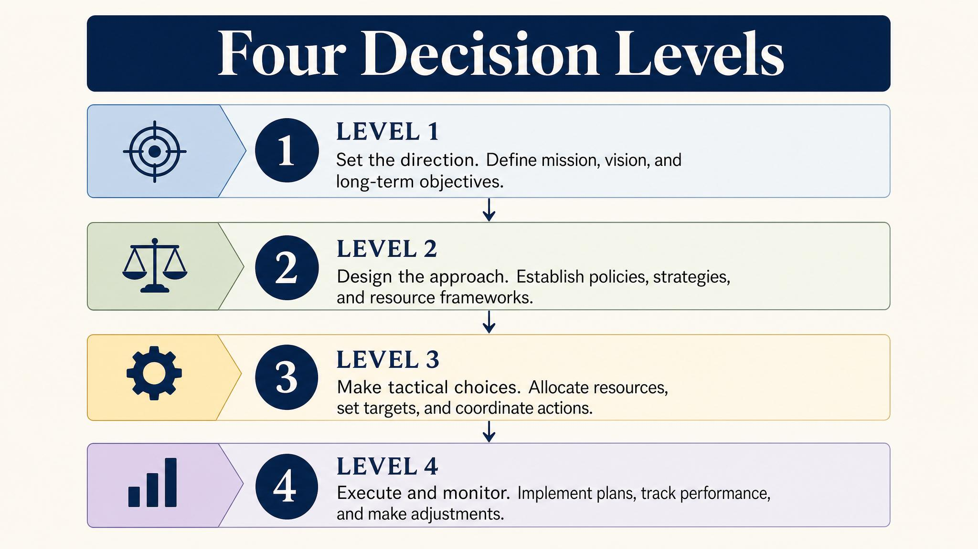
Notes:
The four-level framework. Level one: monitor and proceed — mild bilateral soreness that fades in ten minutes. Level two: modify — specific ache that doesn't fully clear, shorten or substitute. Level three: rest — pain that alters form or persists at rest, two to three days off. Level four: see a professional — pain at rest, lasting more than three to five days, swelling, or above 6/10.

Slide 9
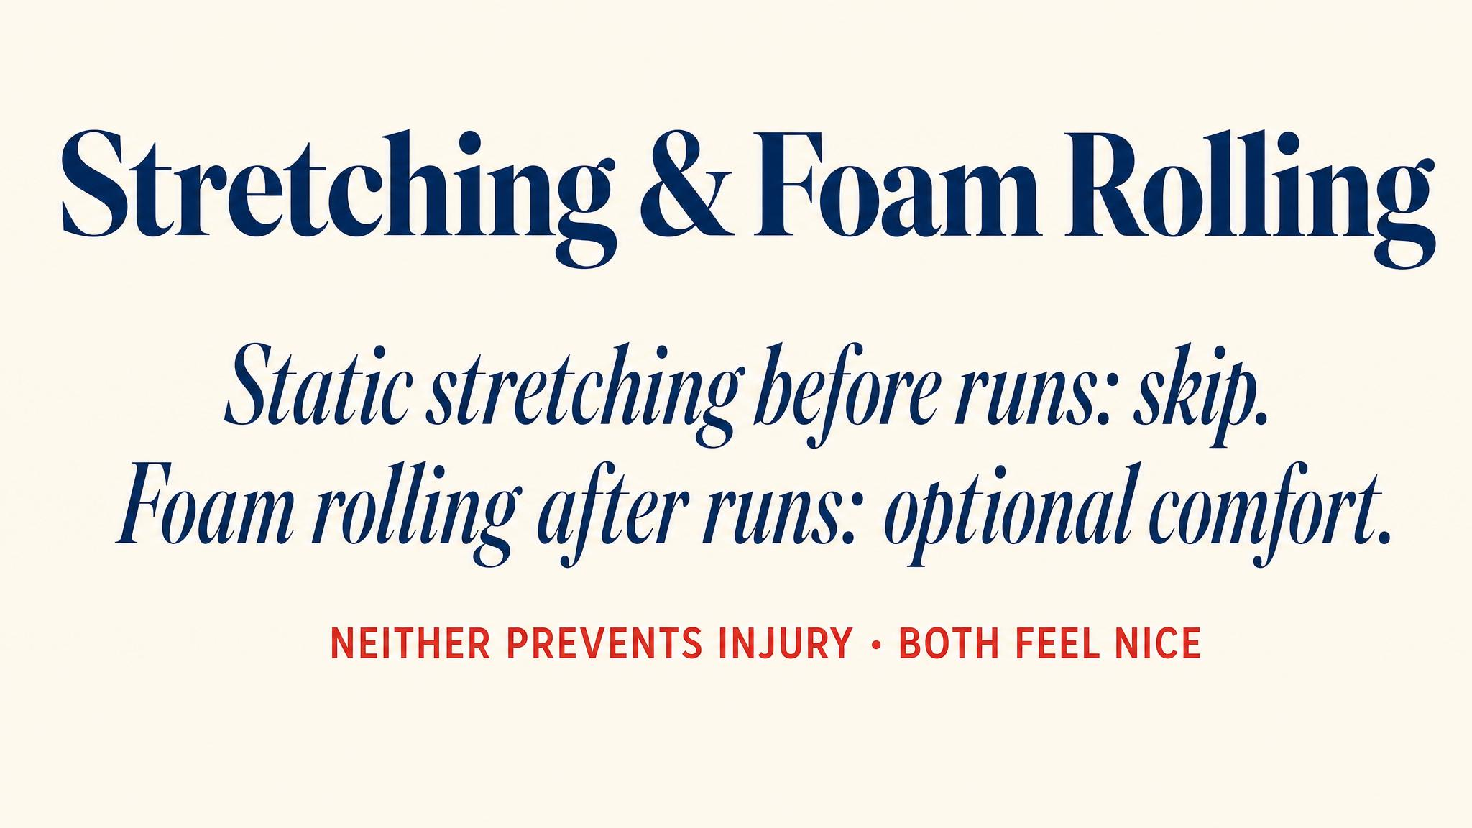
Notes:
Static stretching before runs doesn't prevent injury and may briefly reduce force. Dynamic warm-ups are better. Foam rolling, per Wiewelhove 2019 and Hendricks 2020, has modest effects — slightly reduces soreness, possibly via altered pain perception. Useful complement, not a substitute for strength training.

Slide 10
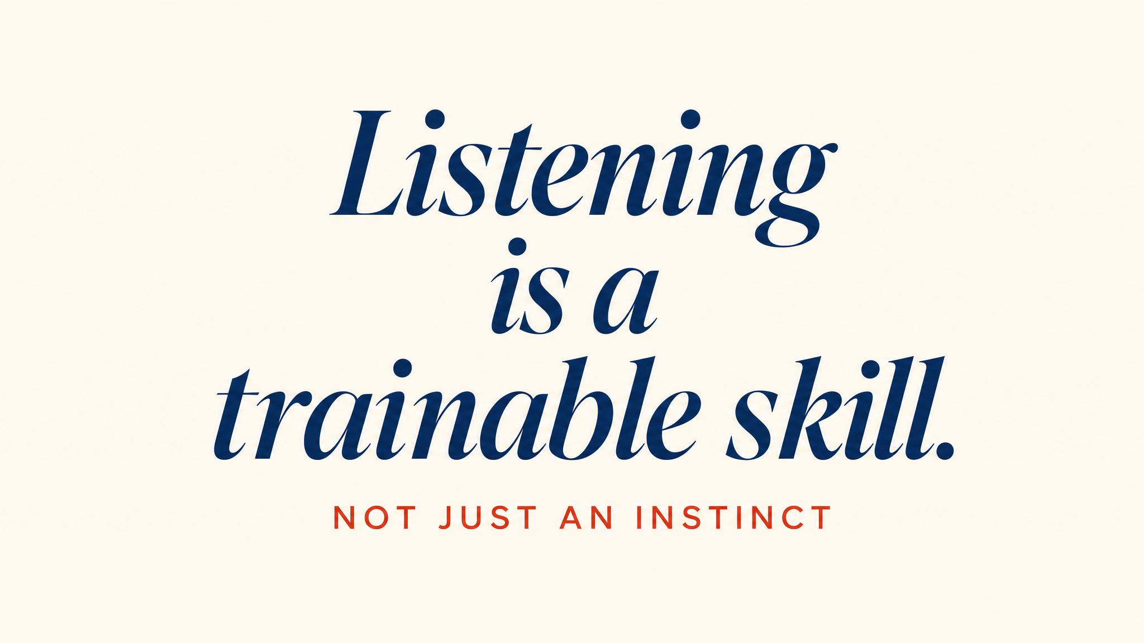
Notes:
Pause on this. The most important takeaway: listening to your body is not weakness. It's a skill — arguably the most important skill in your marathon journey. The runners who finish are the ones who learned to tell the voice that says this is hard from the voice that says something is wrong.

Slide 11
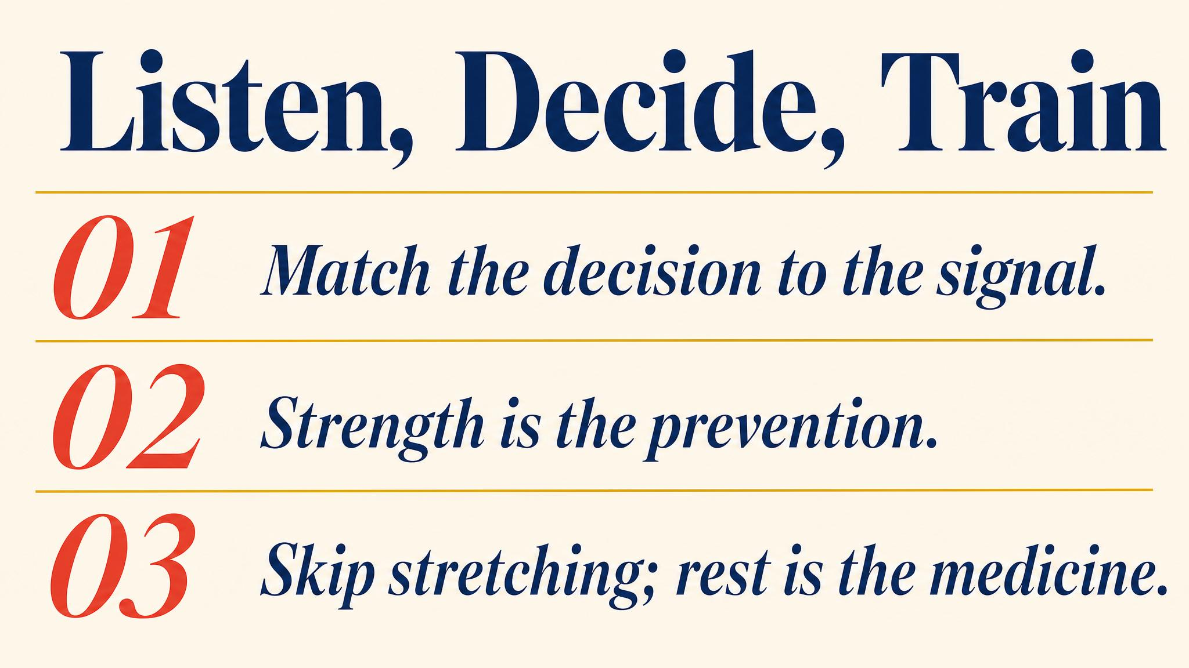
Notes:
Three to carry: most overuse injuries announce themselves before they get serious; strength training beats stretching for prevention (Blagrove 2022); use the four-level decision framework — monitor, modify, rest, or see a professional.

Slide 12

Notes:
Closing bridge: next chapter, we turn to the fuel that powers all of this. Why carb-loading advice is mostly wrong, what your body actually needs during long runs, and how to prevent the wall. Your muscles can't rebuild what they don't have the raw materials for.

