Slide 1
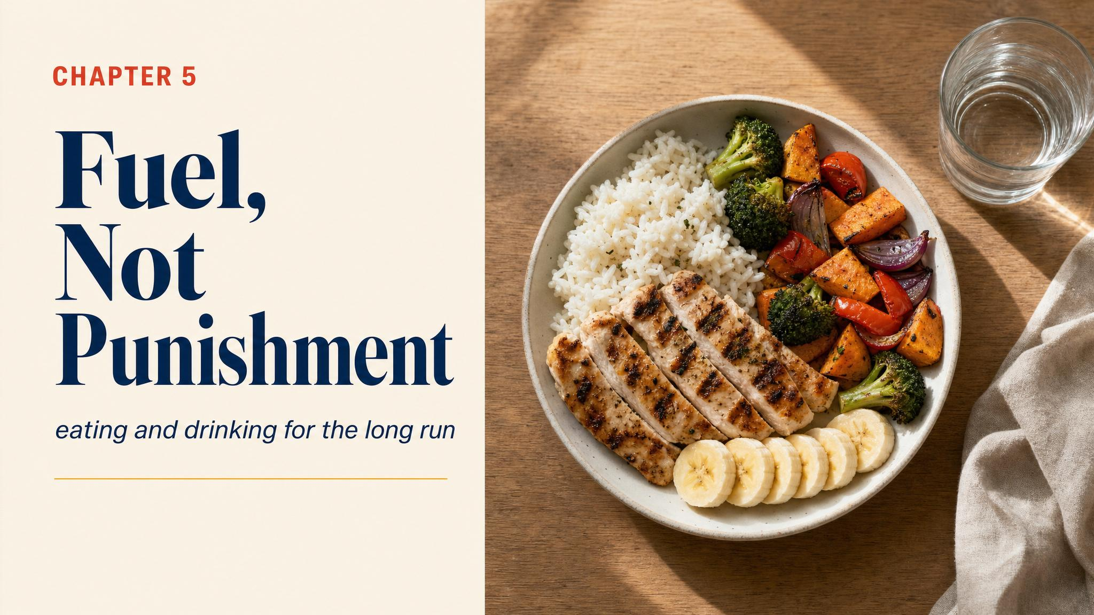
Notes:
Open with mile 21 of the Chicago Marathon — legs to concrete, brain to fog. Not injury. Not bad form. Glycogen depletion. The wall is a fuel-tank problem, not a willpower failure. This chapter is about owning the fuel.

Slide 2
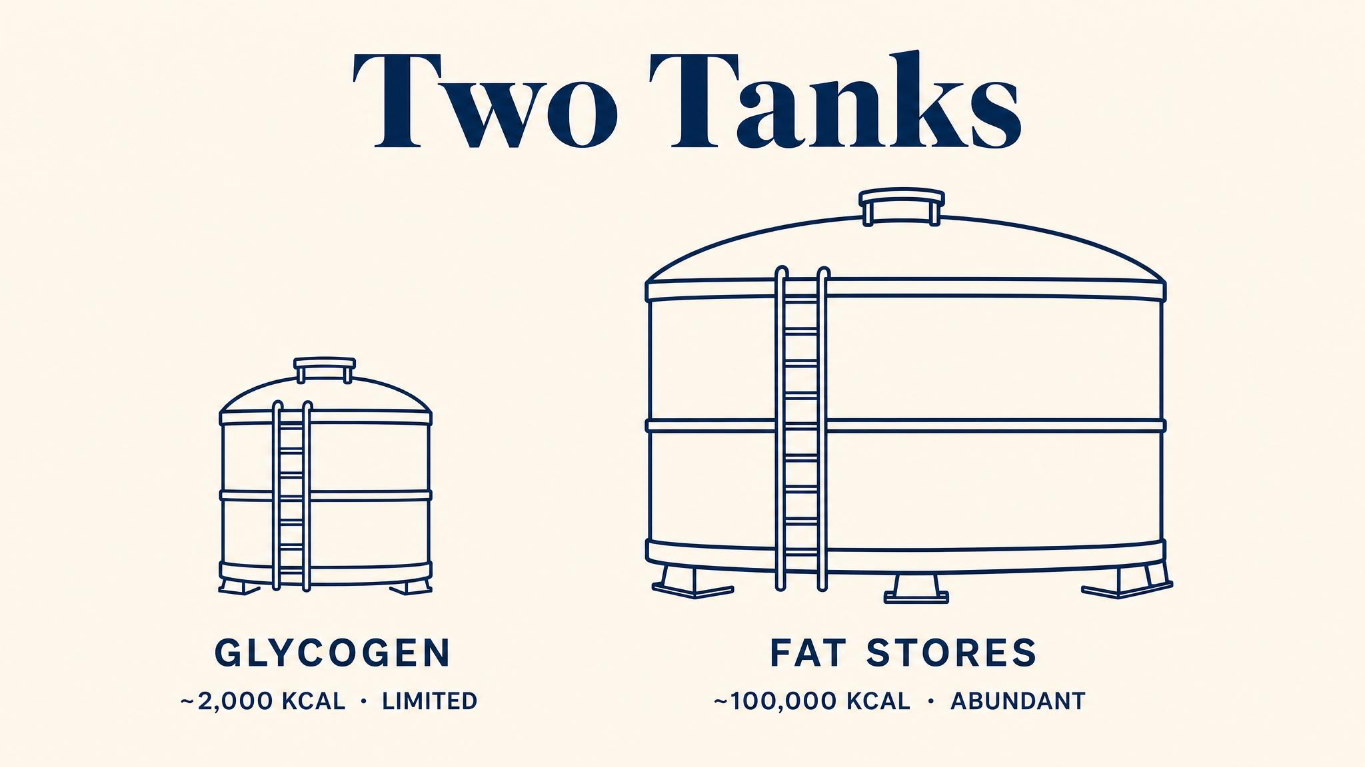
Notes:
Two tanks of very different sizes. Glycogen — 1,500 to 2,000 calories, small but powerful. Fat — 50,000+ calories, abundant but slow. The math seems simple: burn fat. But biology is more complicated.

Slide 3
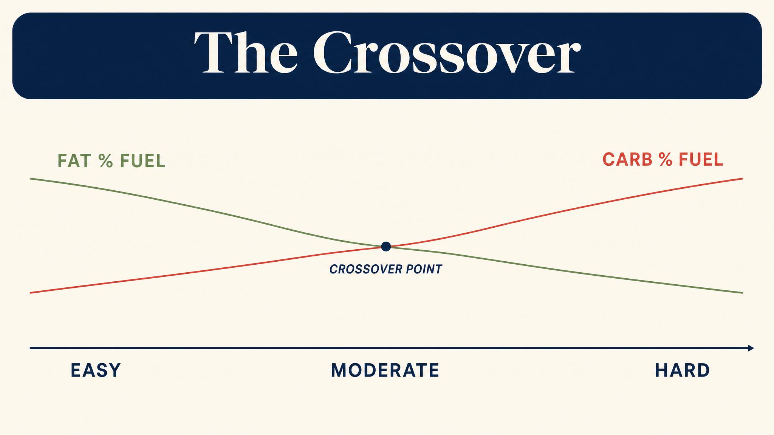
Notes:
At easy pace, you burn roughly 50–60% fat. At marathon race pace, the carb share rises to 70–80%. At a hard sprint, almost all carbs. Pace matters profoundly: faster pace doesn't just tire your legs, it drains your glycogen tank faster. Rapoport 2010 modelled this.

Slide 4
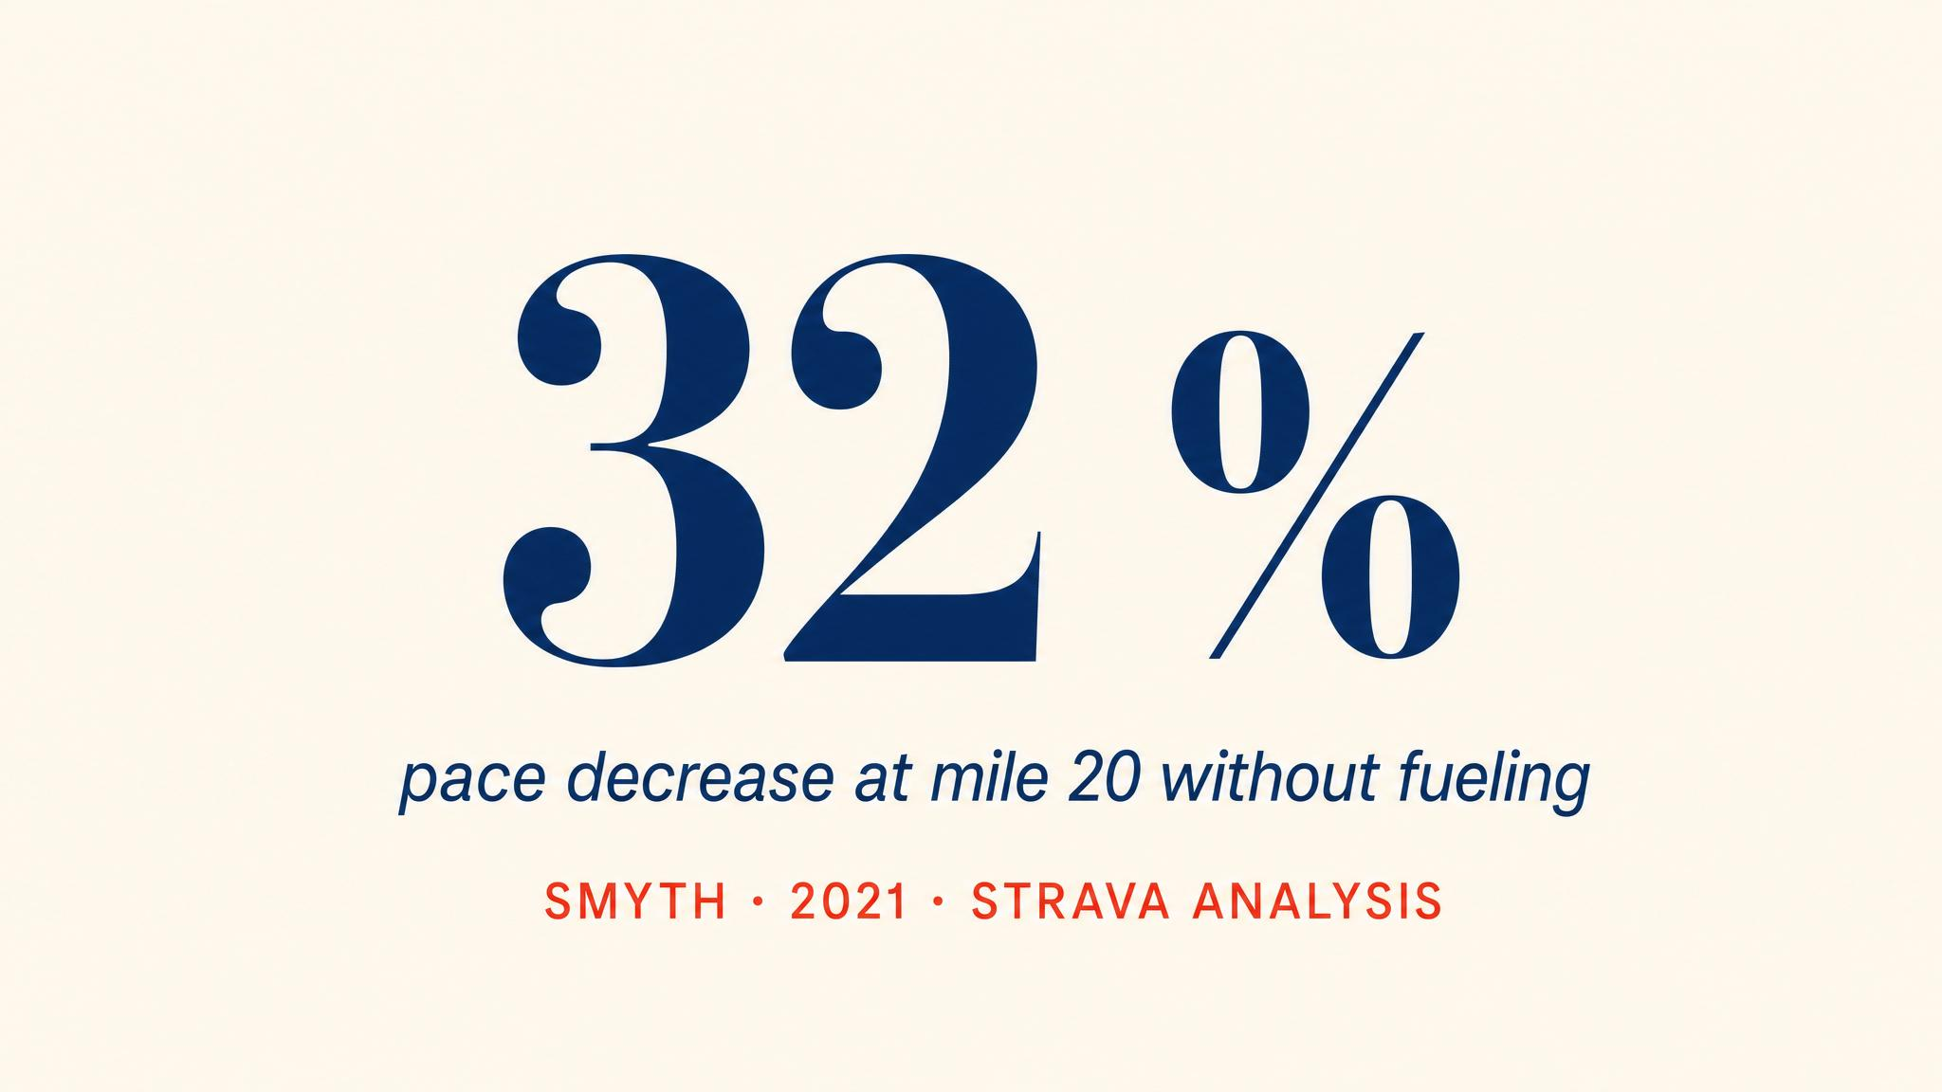
Notes:
Smyth and colleagues' 2021 analysis of over four million marathon records found a consistent pattern: sustained pace collapse after mile 20, concentrated between miles 20 and 22. The mathematics of glycogen depletion predict it. Rapoport 2010 confirmed: more than two-fifths of runners experience severe depletion.

Slide 5
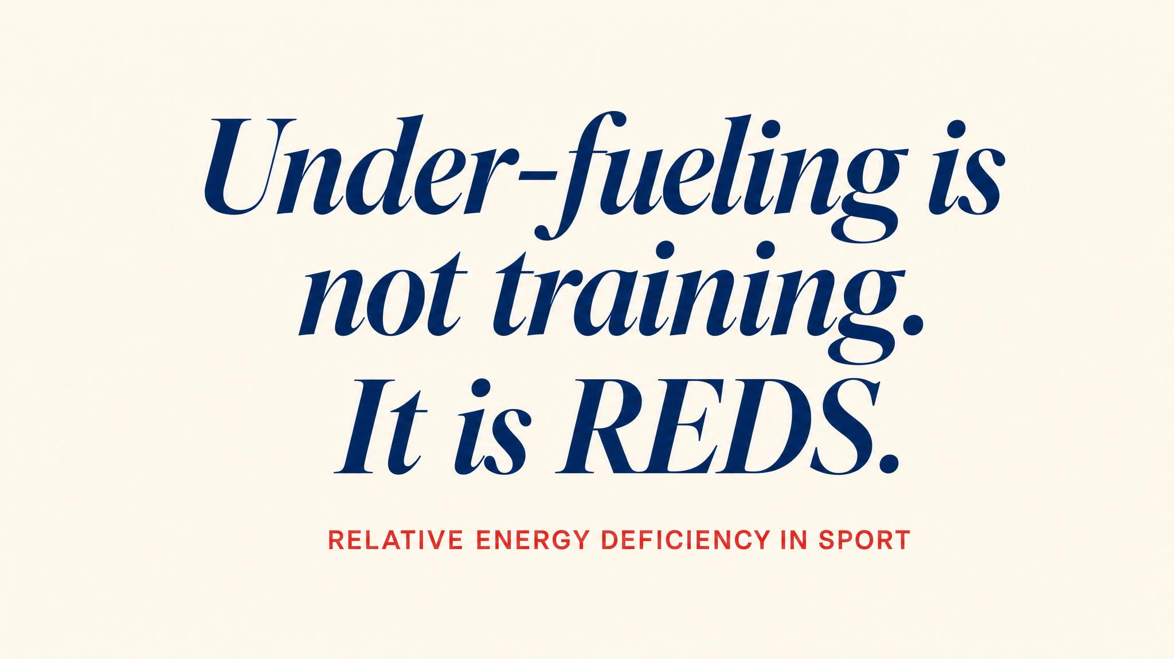
Notes:
Day-to-day under-fueling is the most common nutritional mistake. Marathon training adds 400 to 800 calories of expenditure per day. Mountjoy and colleagues 2022 documented Relative Energy Deficiency in Sport — REDS — what happens when chronic low energy compromises adaptation. Stress fractures, fatigue, hormonal disruption.

Slide 6
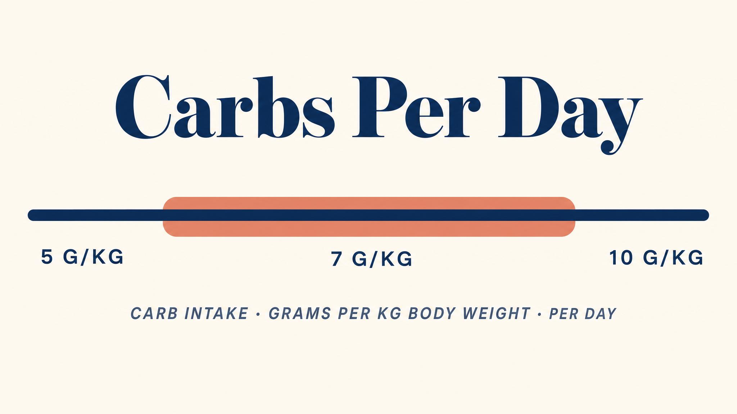
Notes:
Burke and colleagues 2011: moderate training days call for 5–7 g of carb per kg of body weight; heavy days, 7–10 g. For a 68 kg runner, that's 340 to 475 g per day. Substantial. Multiple servings of rice, pasta, bread, fruit. Practising eating carbs in training improves your race-day carb metabolism, as Cox and colleagues 2010 showed.

Slide 7

Notes:
Burke 2011 recommends 30 to 60 grams of carbohydrate per hour during prolonged endurance exercise. For most recreational marathoners, 30 to 45 g per hour is a practical start. Whichever source you choose — gel, chews, drink, banana, real food — practice with it extensively.

Slide 8
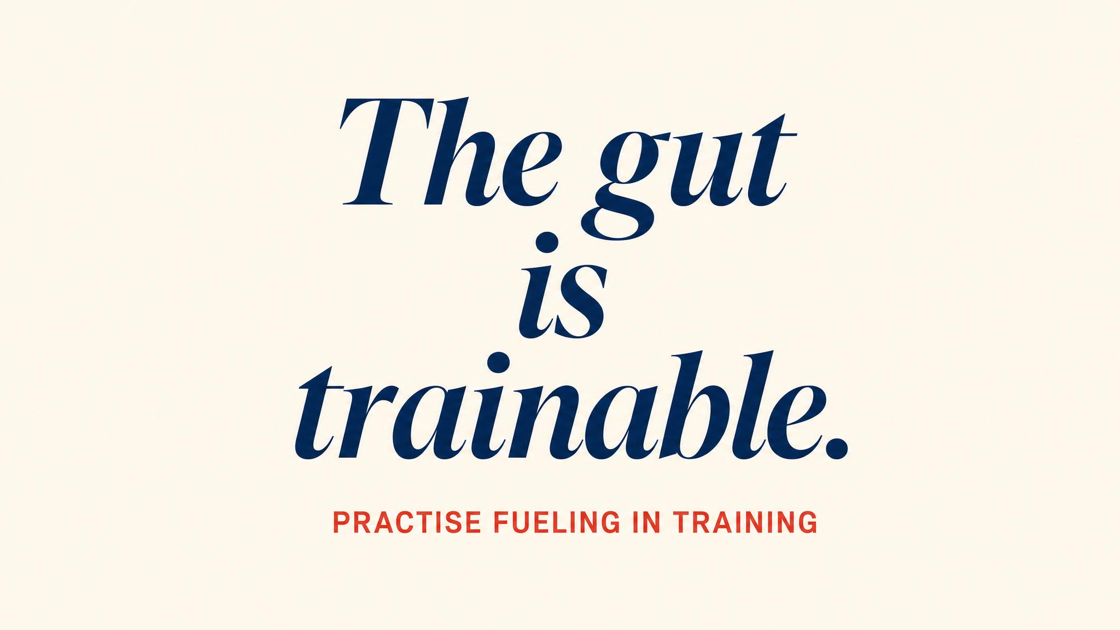
Notes:
Costa and colleagues 2017 showed it directly: a two-week gut-training protocol reduced gastrointestinal symptoms by 60 to 63%. Practising fueling during training adapts your gut. Start 8 to 10 weeks out, with small amounts, gradually increase. By race day, fueling should feel boring.

Slide 9
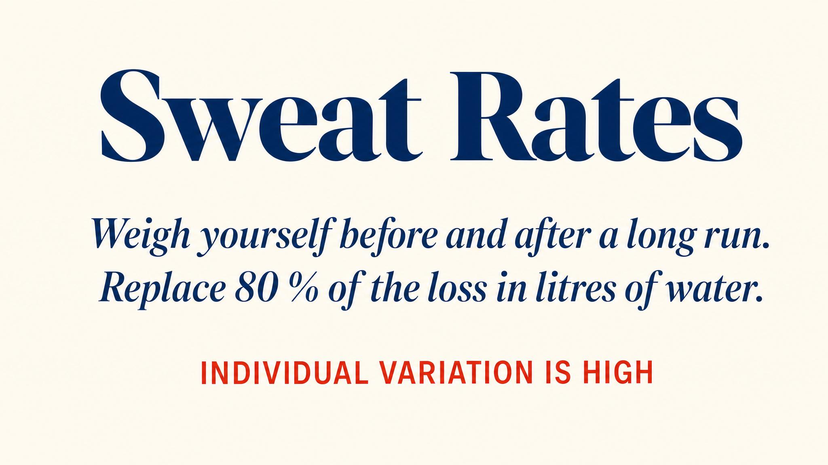
Notes:
Sawka and colleagues 2007 set the goal: prevent more than 2% body weight loss from dehydration. Casa and colleagues 2021 reported marathon sweat rates ranging from 0.81 to 1.52 L/hr — huge individual variability. Drink to a plan based on your actual rate, not on thirst alone or compulsion. Avoid exercise-associated hyponatremia.

Slide 10

Notes:
Pause here and read it aloud. Nothing new on race day. Not a gel flavour, not a sock, not a caffeine pill, not a sports drink. Every long run is a rehearsal. By race day, the fueling plan should feel routine and boring. That's exactly what you want.

Slide 11

Notes:
Reject the 'earn your food' narrative. You're not running to burn calories — you're eating to fuel running. The direction of the relationship matters enormously. Every adaptation in this course is built from food. Under-fueling undermines the very work training is meant to do.

Slide 12
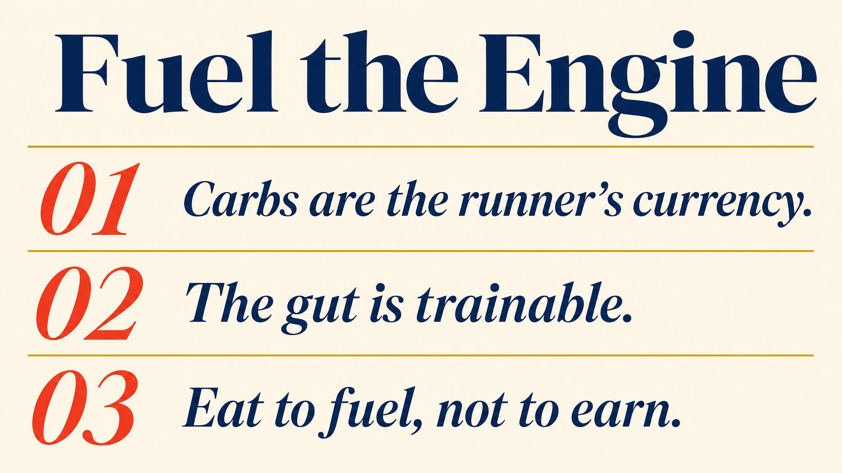
Notes:
Three to carry: eat enough daily — under-fueling is the most common mistake; in-run fueling at 30 to 60 g/hour after the first hour; nothing new on race day — practice every detail. Pause on each.

Slide 13

Notes:
Closing bridge: next chapter, the mind. Marcora's psychobiological model, motivation, self-talk, association vs dissociation, the mental race plan. Most first-time marathoners prepare their bodies and leave their minds to chance. We won't.

