Slide 1

Notes:
Open at mile 19. Body is fine — fueling dialed in, miles logged. But the voice in the head is now screaming. Most first-time marathoners prepare their bodies meticulously and leave their minds to chance. This chapter is about making sure that doesn't happen to you.

Slide 2

Notes:
Marcora 2015's psychobiological model. Exercise terminates not when the body truly fails, but when the perception of effort outpaces motivation to continue. The brain is the final gatekeeper. This doesn't mean the marathon is 'all in your head' — but how you experience the physical realities is profoundly shaped by psychology.

Slide 3
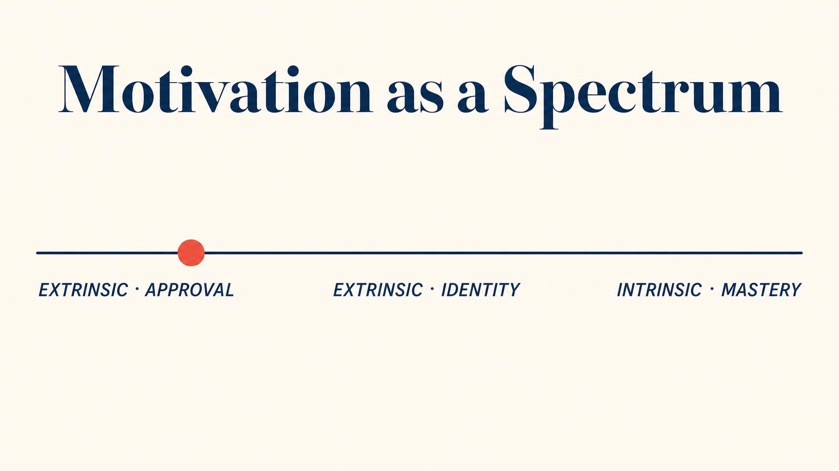
Notes:
Vallerand 2007's hierarchical model: motivation is a spectrum, not a switch. Intrinsic — running because the act itself is satisfying — on one end. Extrinsic — running for a medal, a photo, to prove a point — on the other. Internalised motives sit in between. Intrinsic predicts long-term persistence.

Slide 4
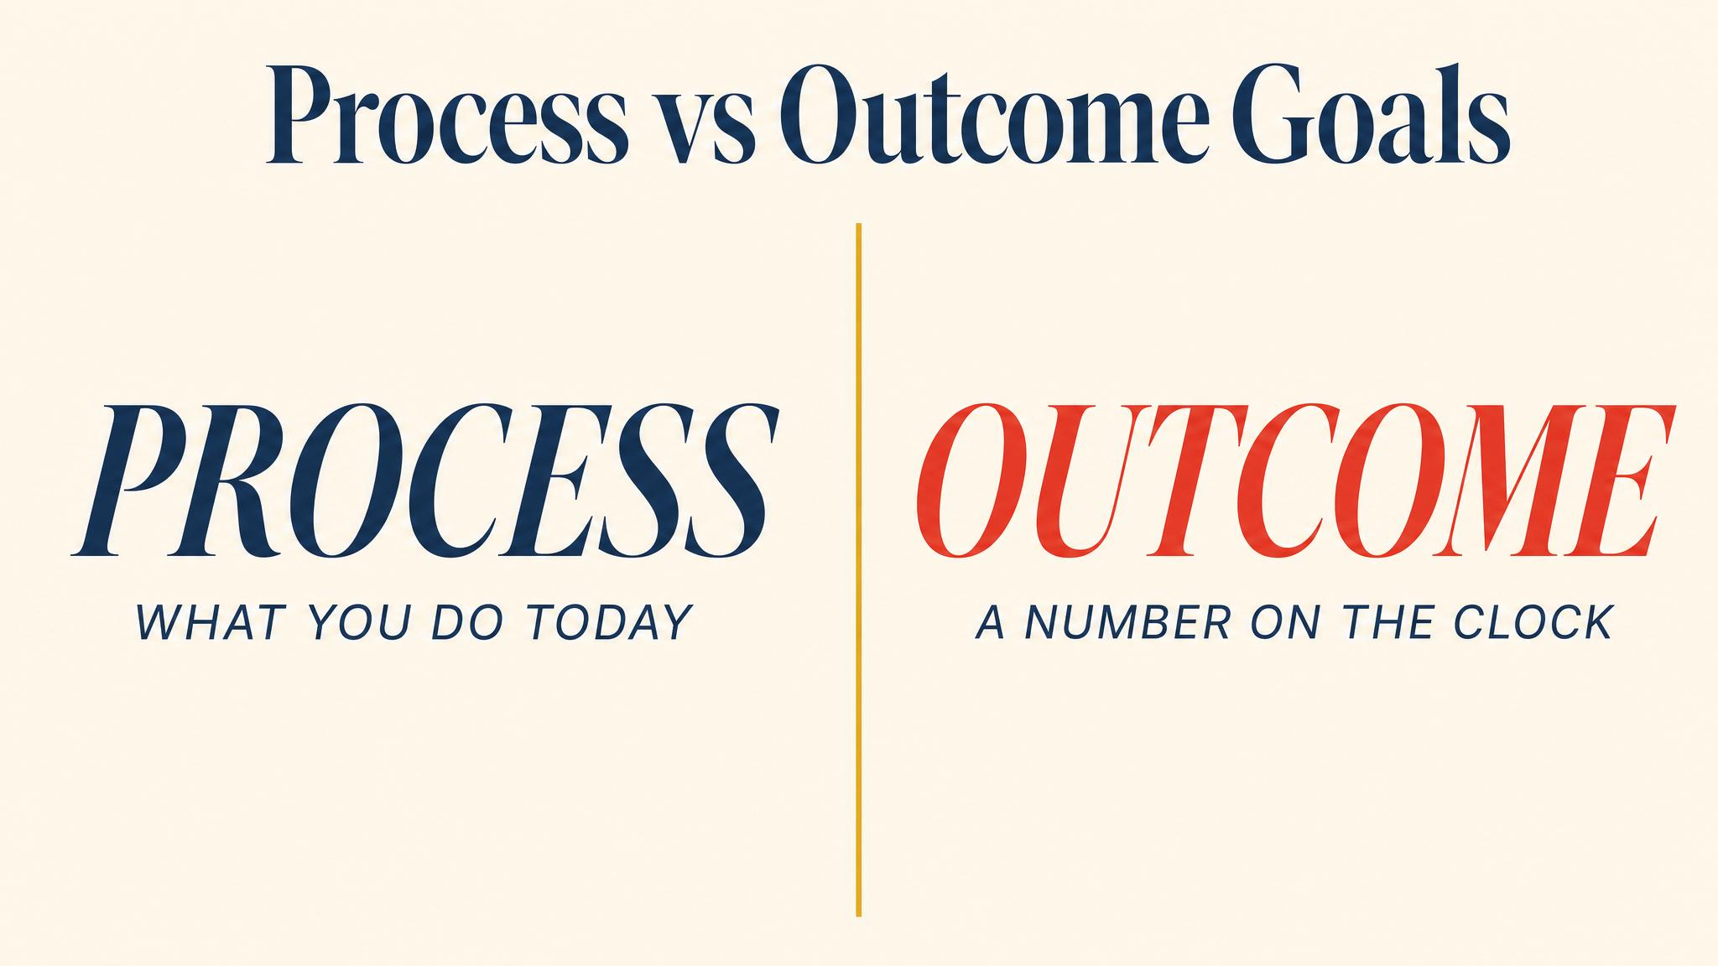
Notes:
Swann and colleagues' 2022 systematic review and meta-analysis: process goals — specific actions you can control — enhance self-efficacy more than outcome goals. Outcome goals based on interpersonal comparison reduce engagement and raise anxiety. The chapter's recommendation: run with intention, fuel consistently, rest when planned. Process.

Slide 5
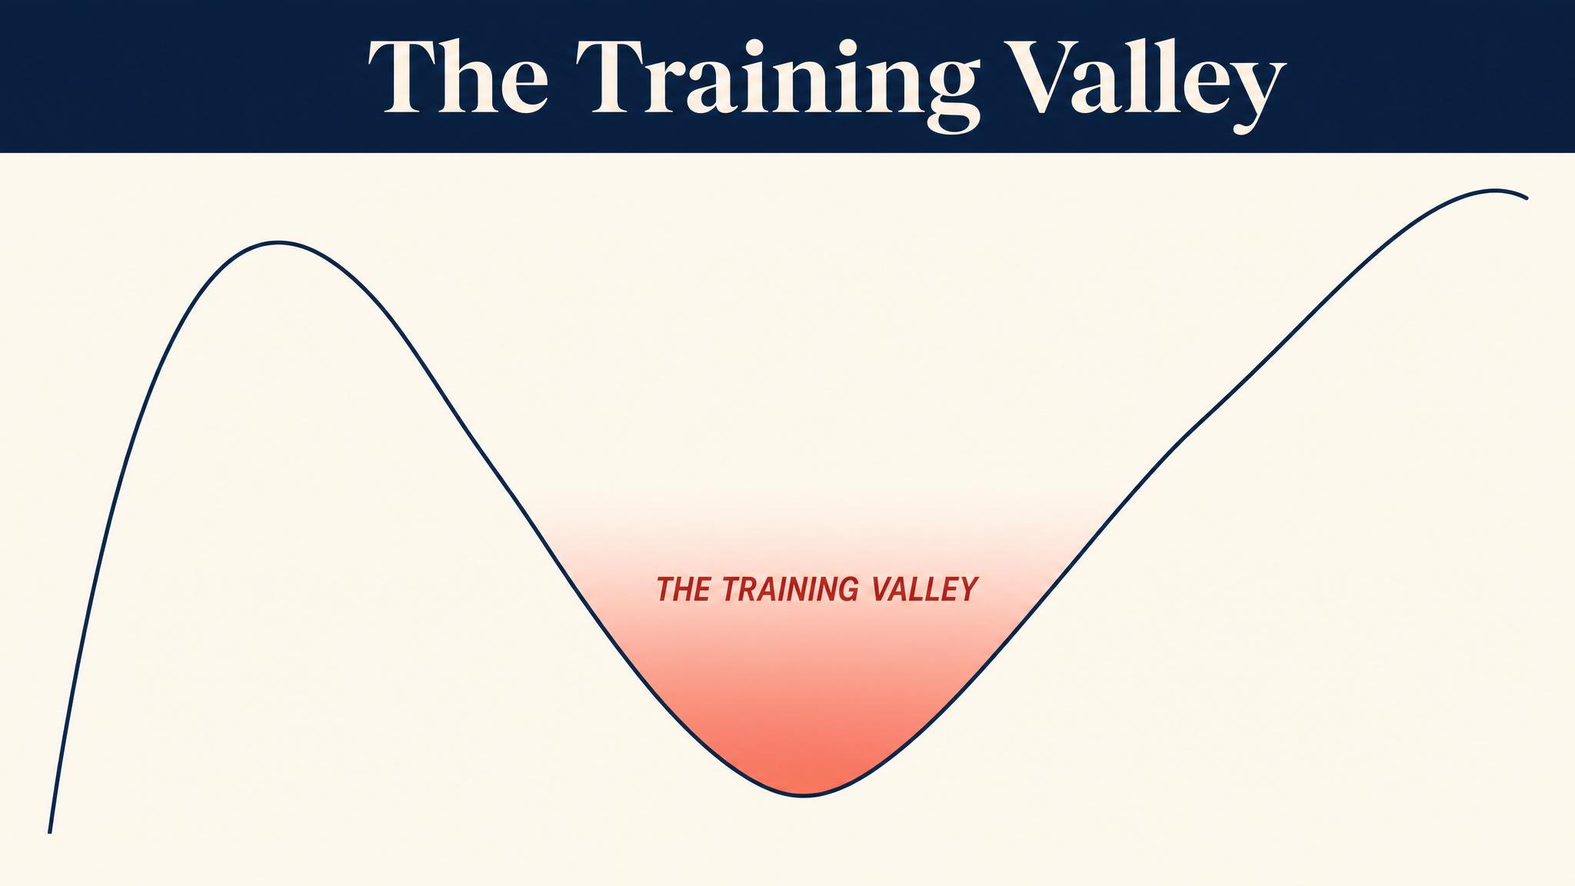
Notes:
The training valley sits between weeks 8 and 14: novelty has worn off, race is still abstract, body is chronically tired, the whole thing can feel pointless. Predictable. Knowing it's predictable is powerful. The valley is not a sign of wrong motivation — it's a natural cost of the process.

Slide 6
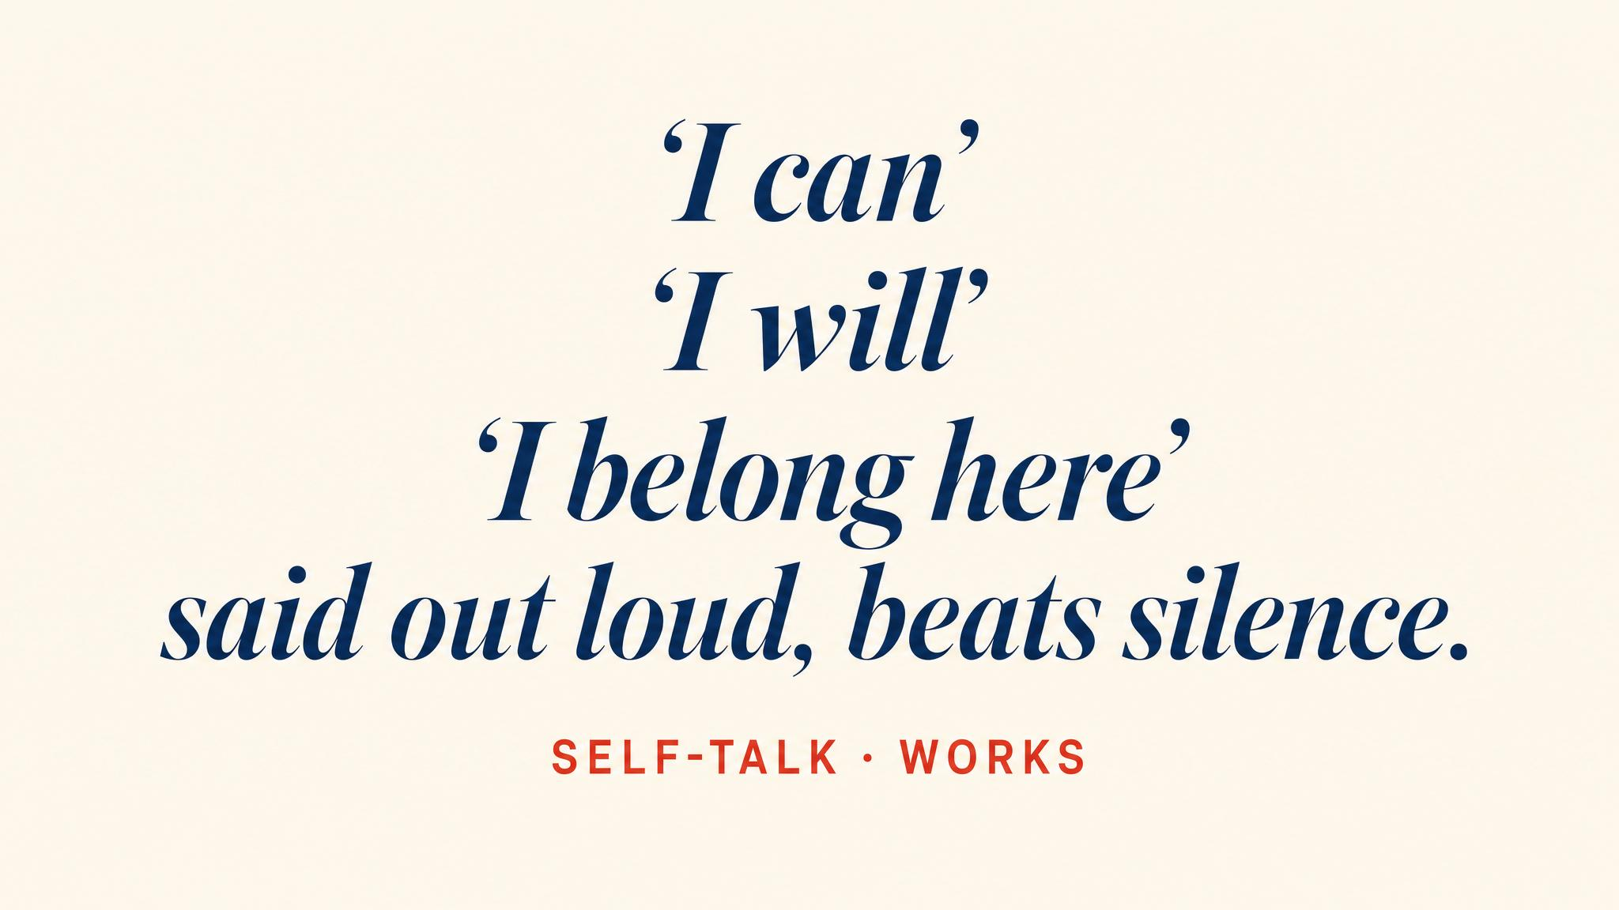
Notes:
Hatzigeorgiadis and colleagues' 2011 meta-analysis of 32 studies: deliberate self-talk improves performance with a moderate effect size. Two types: instructional ('relax your shoulders', 'short quick steps') for form, motivational ('you are strong') for sustained effort. Authenticity matters — develop yours in training.

Slide 7
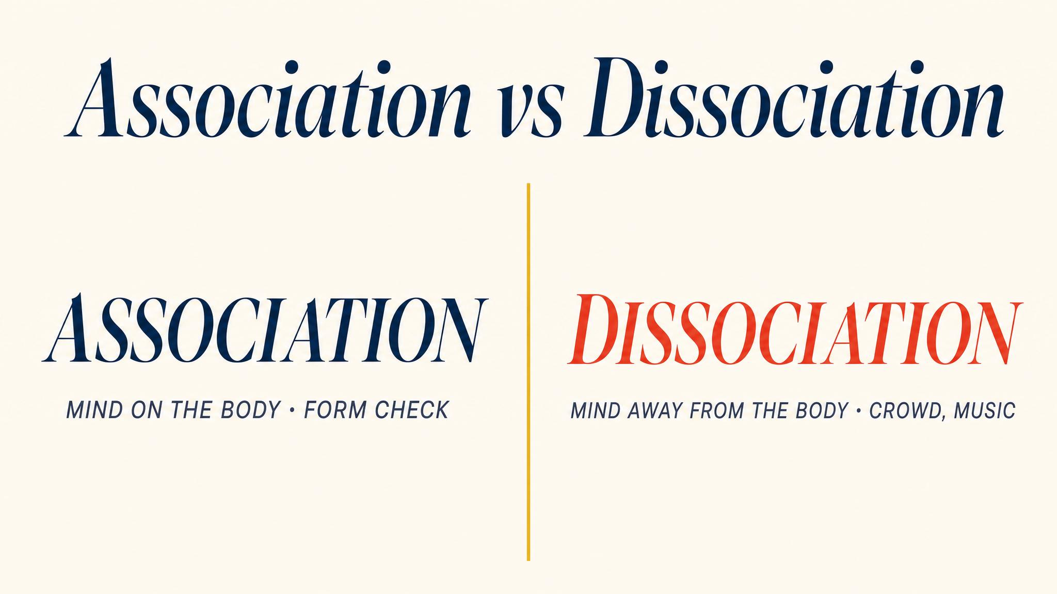
Notes:
Masters and Ogles 1998 reviewed 20 years of research. Association — inward focus on form, breathing, pace — links to faster performance. Dissociation — outward focus on scenery, music, crowd — links to lower perceived exertion. The skill isn't choosing one forever. It's knowing when to deploy each.

Slide 8
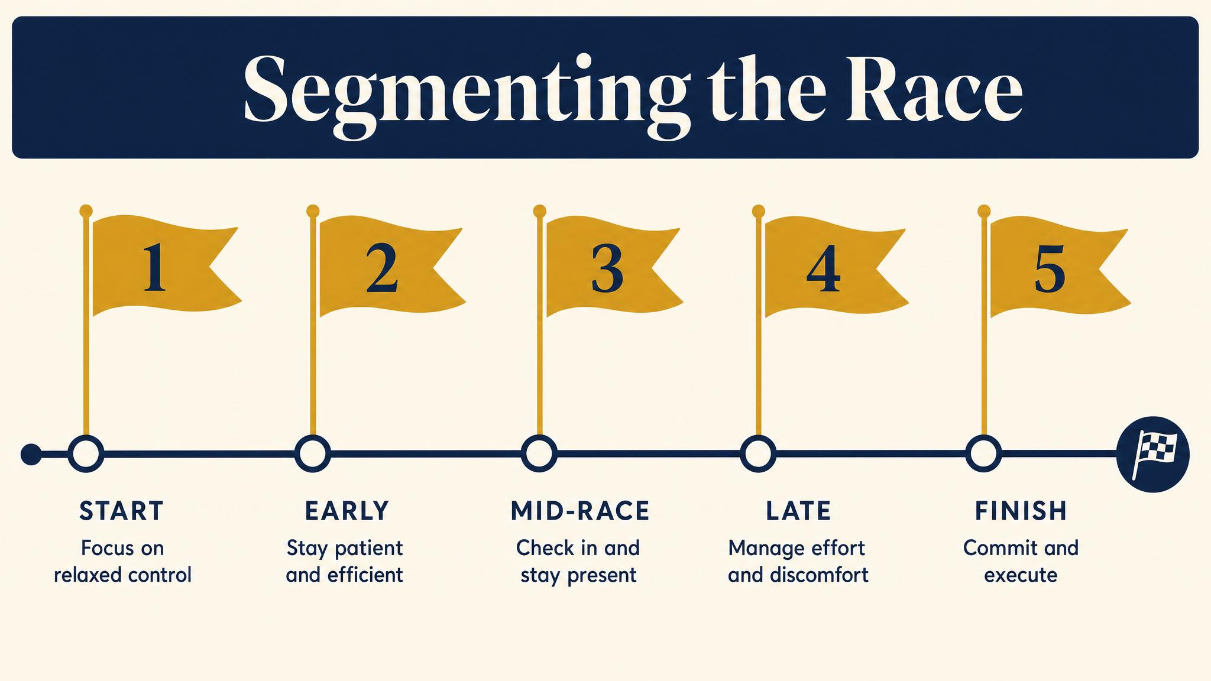
Notes:
Segmenting — breaking 26 miles into psychologically digestible chunks — is one of the most reported coping strategies (Buman 2008). Aid station to aid station. Mile to mile. Lamppost to lamppost. Each completed segment produces a small psychological victory and feeds the next.

Slide 9
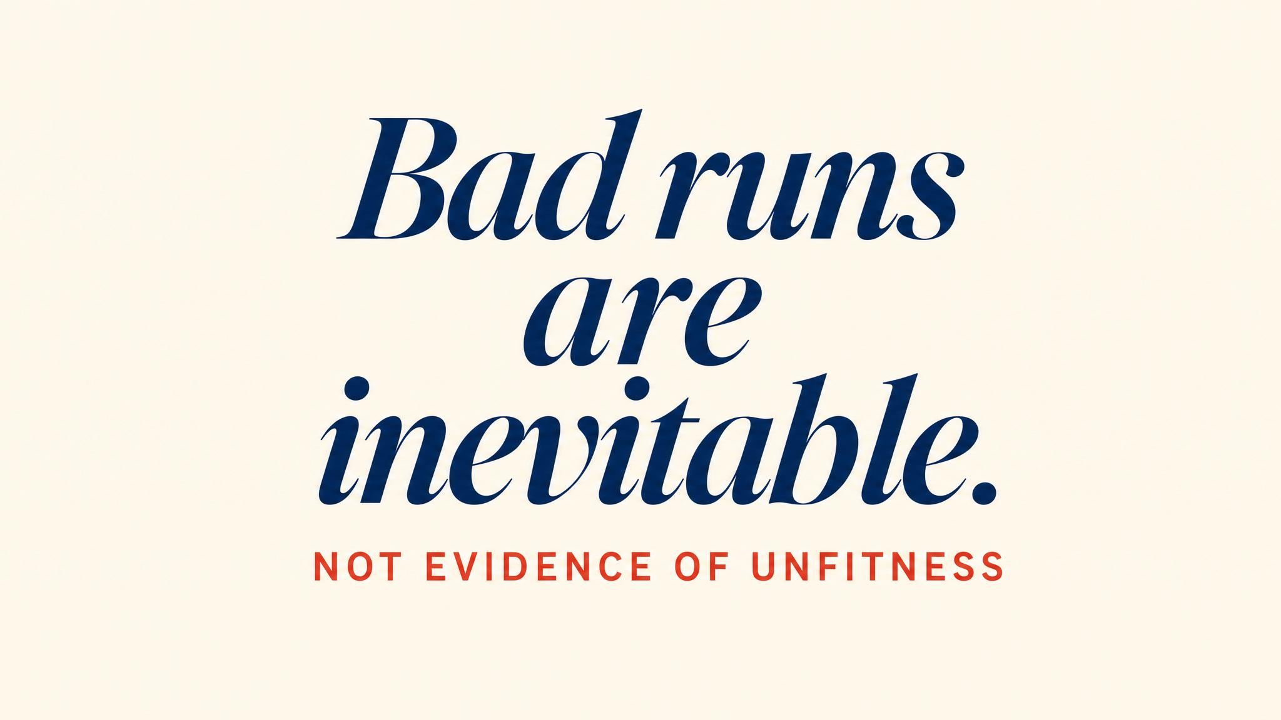
Notes:
Bad runs are built into the process. The danger isn't the bad run itself — it's the catastrophic narrative built around it. Cognitive defusion: observe the thought without believing it. 'I'm having the thought that I can't do this.' Surviving bad runs is evidence you bank for race day.

Slide 10

Notes:
Talia, Nirit, and Defrin 2019 found endurance athletes show higher pain tolerance and lower fear of pain — not from innate toughness, but from repeated calibration. The mental skill is engaged acceptance: acknowledge the discomfort, choose not to fight it, direct attention to what you can control. Different from ignoring the body. A middle path.

Slide 11
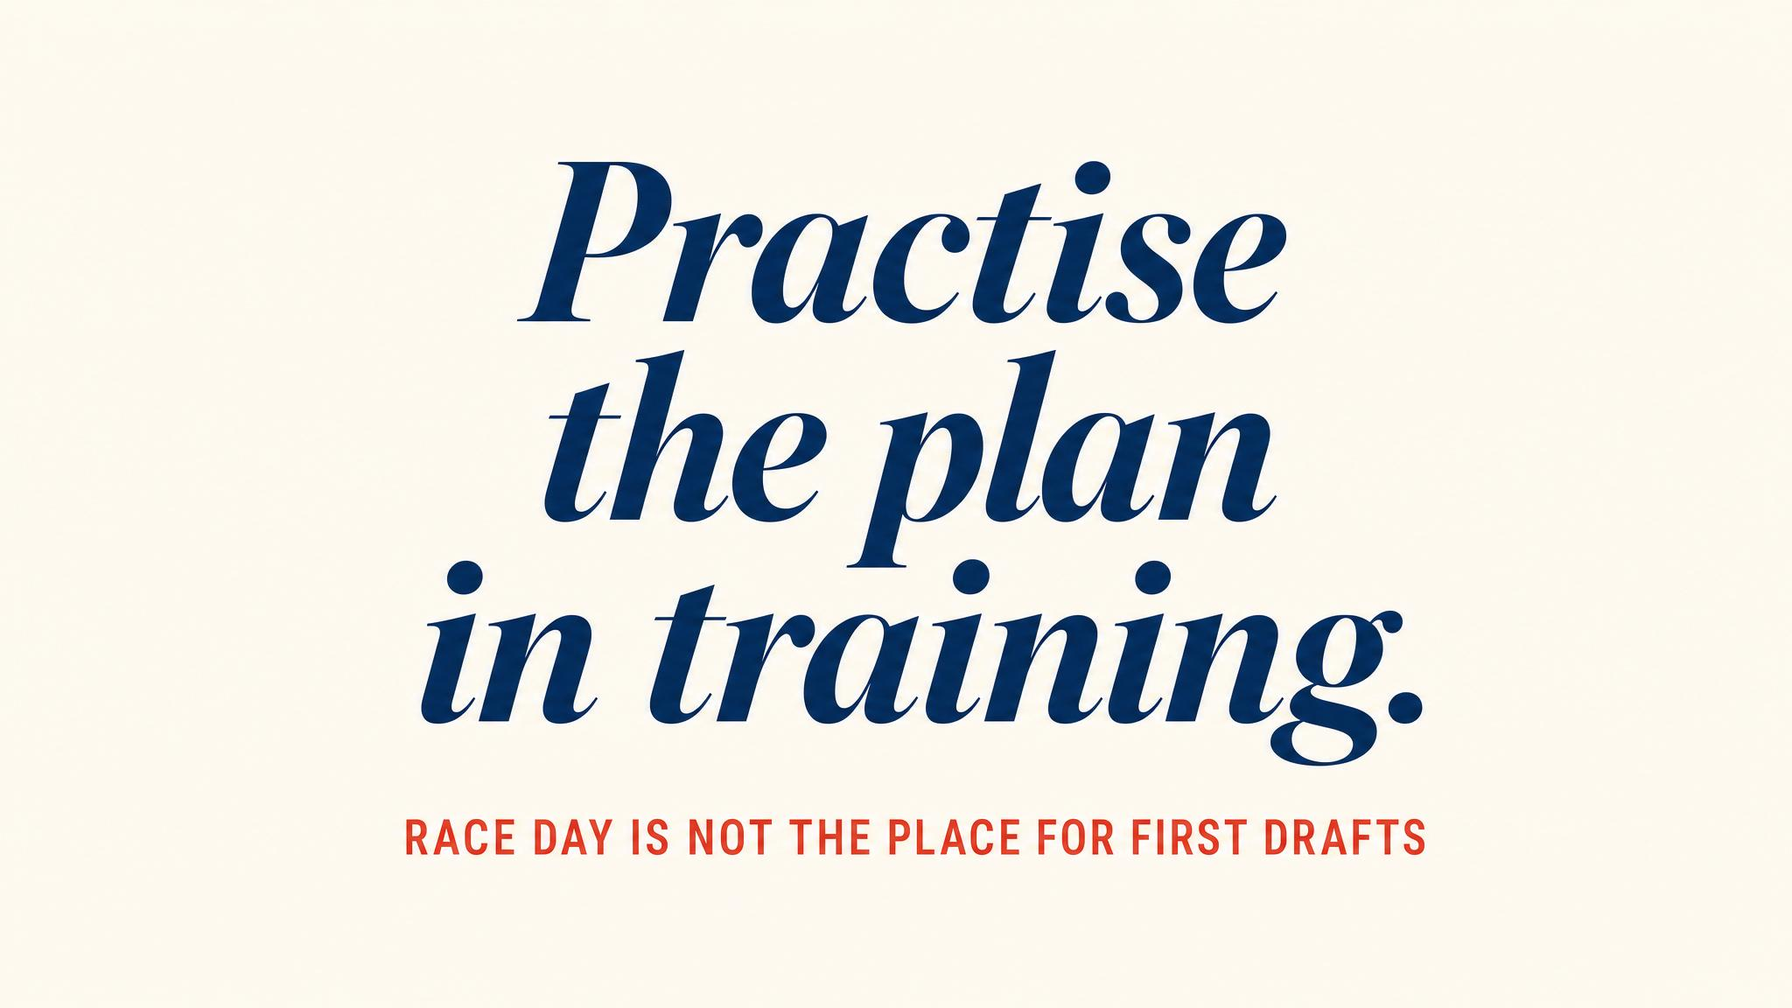
Notes:
Read aloud. Marcora 2015 underscores it: the psychological interventions that most reliably improved endurance performance were practised, not merely understood. Self-talk in the last three miles of long runs. Test segmenting on a sixteen-miler. Refine. Personalise. The mental race plan is built today.

Slide 12
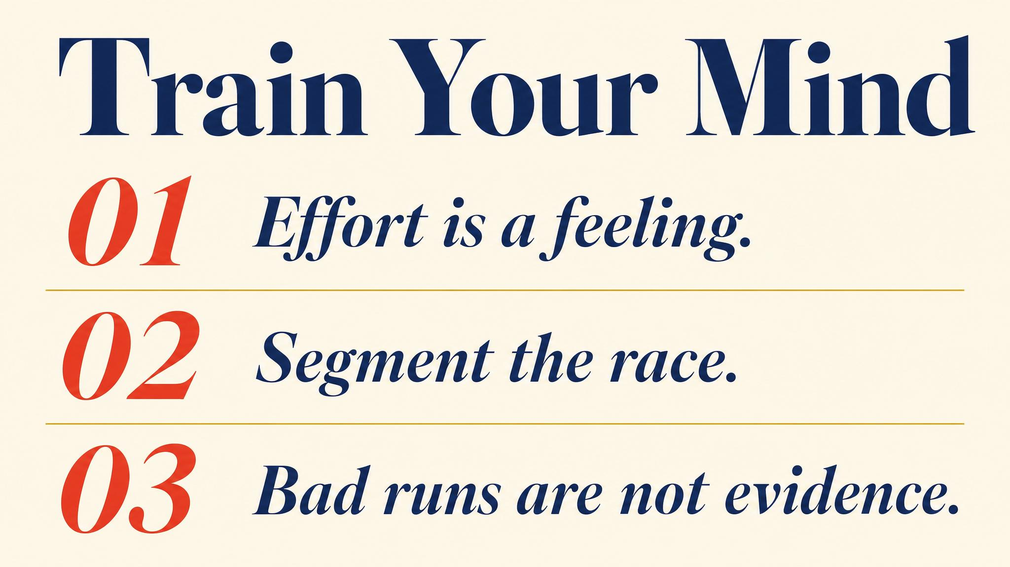
Notes:
Three to carry: the brain decides when to stop (Marcora 2015); process goals beat outcome goals especially during the training valley (Swann 2022); mental strategies must be practised to work under pressure.

Slide 13

Notes:
Closing bridge: next chapter, the taper. The most evidence-supported phase of training — and the hardest to trust. Race-week logistics, carb loading, the nothing-new principle, conservative pacing, the morning-of routine. Doing less is the final piece of doing your best.

