Slide 1

Notes:
Open two weeks out. The plan says run less, much less, and it feels like a cruel joke. The taper is the most evidence-supported phase of training and the hardest to trust. This chapter is about why doing less is the final piece of doing your best.

Slide 2

Notes:
Throughout training you've been making deposits in two accounts: fitness and fatigue. Fatigue masks fitness. Mujika and Padilla 2003: the taper lets fatigue dissipate while fitness remains essentially intact. You're not getting fitter in the taper — you're finally getting to use the fitness you already have.

Slide 3
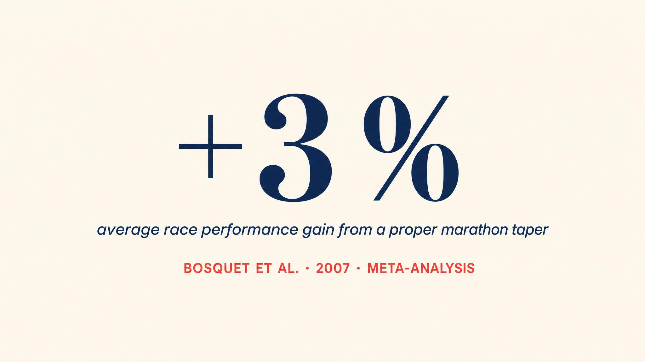
Notes:
Mujika and Padilla 2003: a well-executed taper improves performance by about 3%, range 0.5 to 6%. For a four-hour marathoner, 3% is roughly seven minutes. Smyth and Lawlor 2021 confirmed in 158,000 runners — strict three-week tapers saved a median 5:32, or 2.6%.

Slide 4
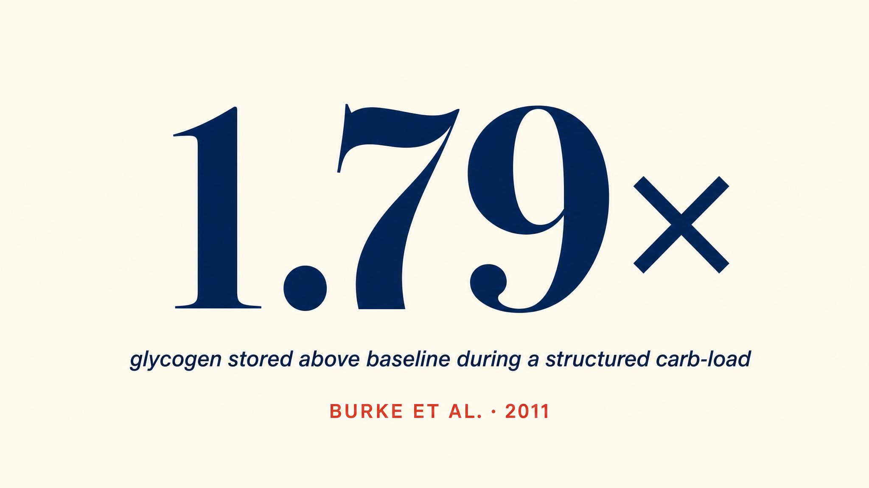
Notes:
Bussau and colleagues 1997: with reduced training and adequate carbohydrate intake, muscles can store up to 1.79 times baseline glycogen — and those supercompensated levels persist for at least three days. This is the physiological benefit the taper unlocks. Solem 2025 confirmed the underlying mechanics.

Slide 5
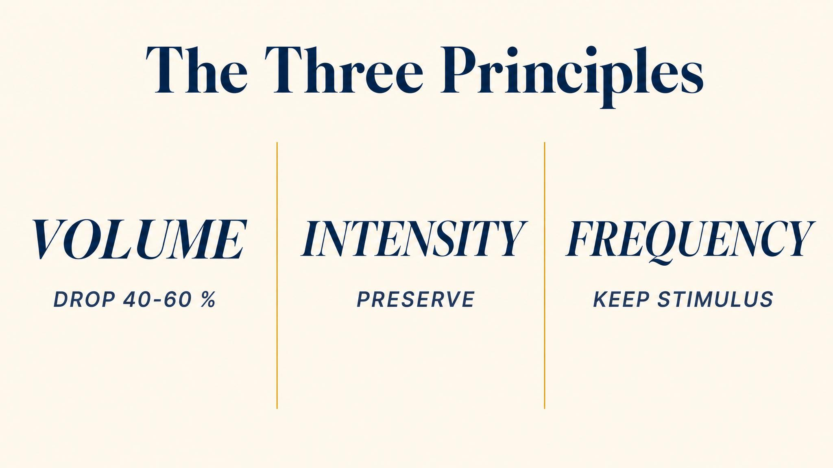
Notes:
Three principles from Mujika and Padilla 2003. One: cut weekly volume by 40 to 60% across two to three weeks, progressively. Two: maintain intensity — keep some tempo or marathon-pace work, just less of it. Three: drop frequency by no more than 20%. Easy jogging alone leads to slight detraining.

Slide 6

Notes:
Up to 78% of marathon runners experience significant taper anxiety. Restlessness, irritability, poor sleep, sudden conviction you've lost fitness, phantom pains. A 2019 study found 67% reported new aches that weren't injuries. Expecting it is half the cure. The science is unambiguous — the taper works.

Slide 7
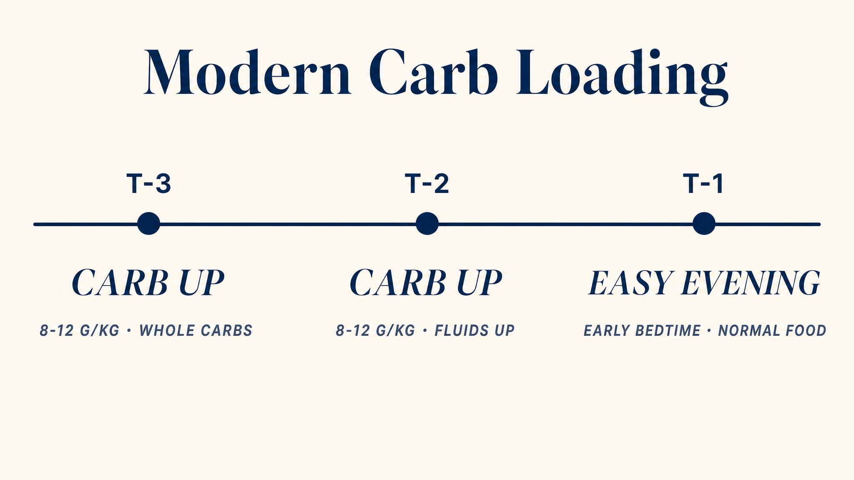
Notes:
Carb loading really works — but as a multi-day process, not one giant pasta dinner. Burke 2007: 10 to 12 g/kg of carbs daily over the 36 to 48 hours before the race. The old depletion phase is obsolete and counterproductive (Solem, Clauss, Jensen 2025 confirm). A familiar moderate dinner the night before — heavy on carbs but comfortable — is the modern approach.

Slide 8

Notes:
Read aloud. Every piece of clothing, every fuel source, every piece of technology should have been tested in training — ideally in a long run of 15+ miles. The marathon amplifies everything: a sock seam at mile 18 becomes a bleeding blister. The expo is designed to tempt you into exactly these mistakes.

Slide 9
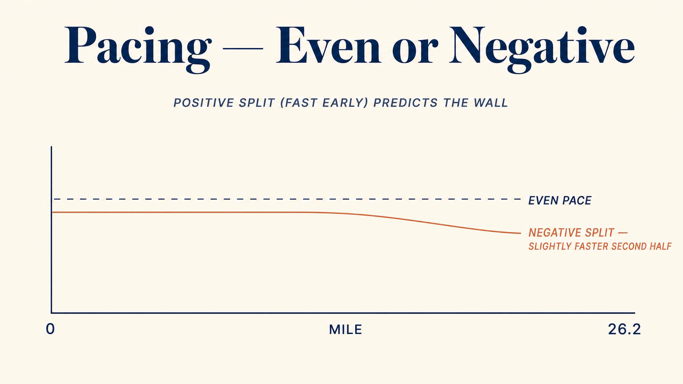
Notes:
Pacing research is unambiguous. Smyth and Lawlor 2021: world-class records almost universally follow even or slight negative splits. Conservative early pacing preserves glycogen, reduces early lactate, delays fatigue, minimises cardiovascular drift. Running 15 to 20 seconds slower per mile in the first three to five miles costs one to two minutes but can save ten to fifteen later.

Slide 10

Notes:
Most runners fixate on the night before. But research shows it's the sleep two and three nights before that matters most. Expect to sleep poorly the night before — pre-race excitement, early alarm. Bank eight or more hours Wednesday and Thursday for a Sunday race. Walk the expo briefly and leave.

Slide 11
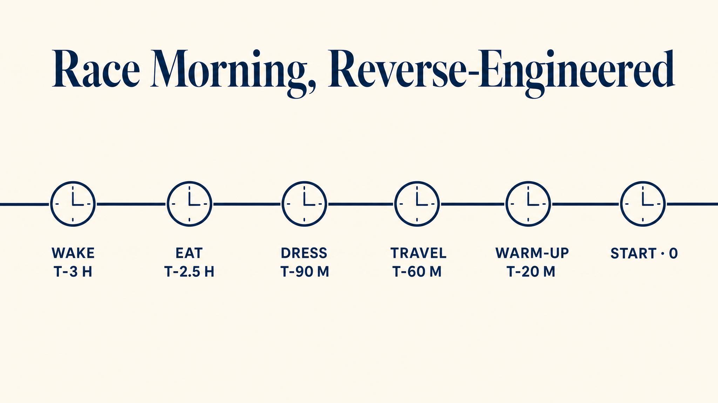
Notes:
Build morning backward from gun time. 7 a.m. start: wake 4:30, eat 5:00 (300 to 500 cal practiced meal), arrive 6:00, corral 6:40, gun 7:00. Use the time. Trust the taper. Conservative pacing. Every decision in race week passes through one filter: does this help me run well on Sunday, or does it satisfy my anxiety right now?

Slide 12
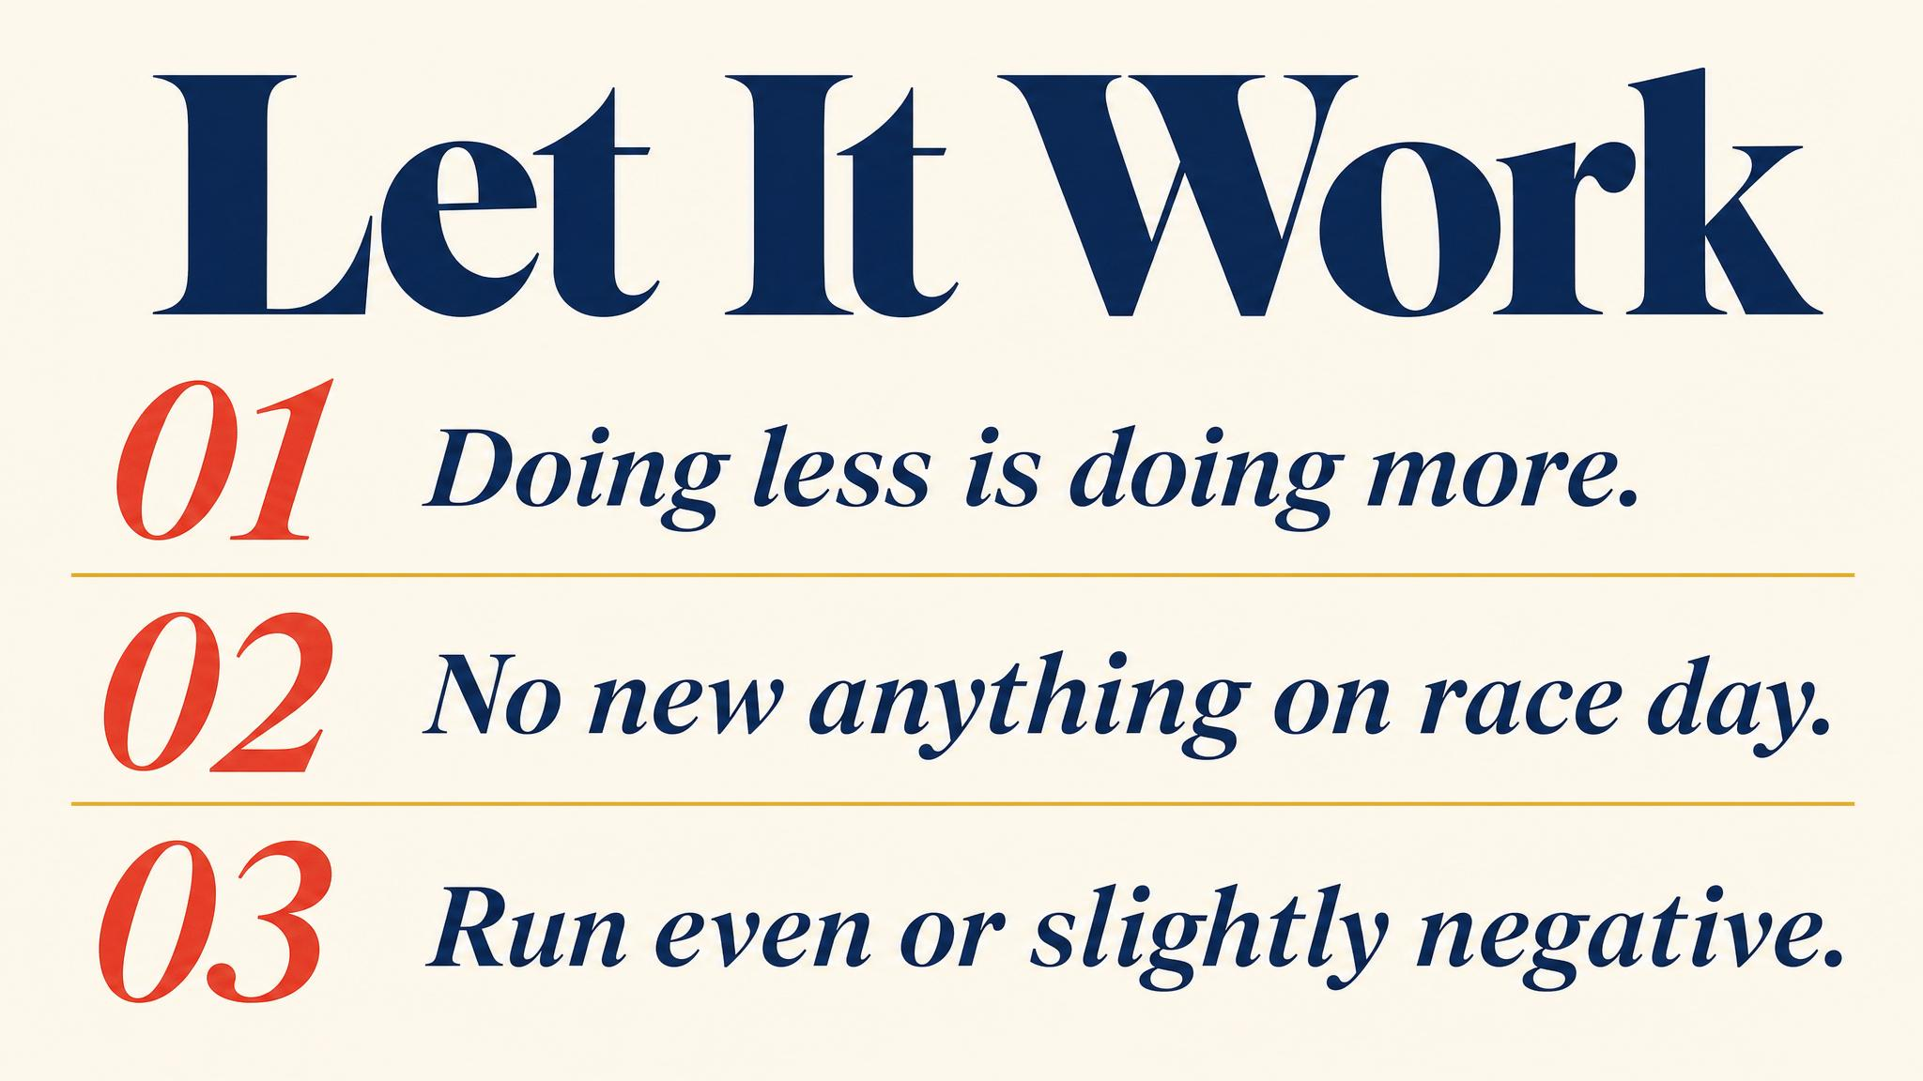
Notes:
Three to carry: the taper cuts fatigue while preserving fitness (Mujika and Padilla 2003); carb-load over 36 to 48 hours, not in one dinner (Burke 2007); nothing new on race day — practice every detail.

Slide 13

Notes:
Closing bridge: next chapter is race day. We walk through every mile — the start, the honest miles, the dark miles, the finish — and what happens after. You've done the work. Now let it work for you.

