Slide 1
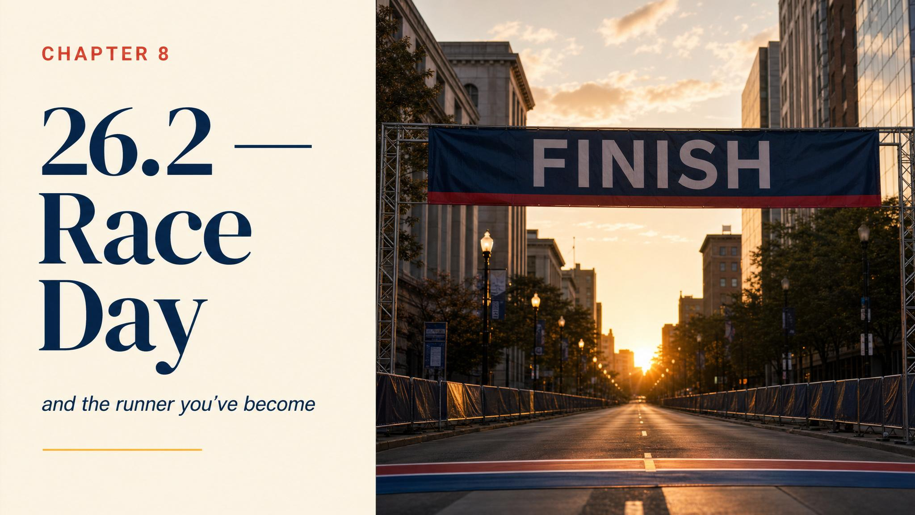
Notes:
Open at 4:15 a.m. Already awake. Weather checked four times. 52°F, partly cloudy. Good conditions. You know what 'good conditions' means now. You are more prepared than you feel. The anxiety is your nervous system acknowledging something extraordinary is about to happen.

Slide 2

Notes:
Eat 3 to 4 hours before the gun. Burke 2007: 1 to 4 g of carb per kg of body weight, topping off the glycogen you carefully loaded over the previous 36 to 48 hours. Familiar food only — the same one you tested in training. The hotel buffet exotic option is admired, not eaten.

Slide 3
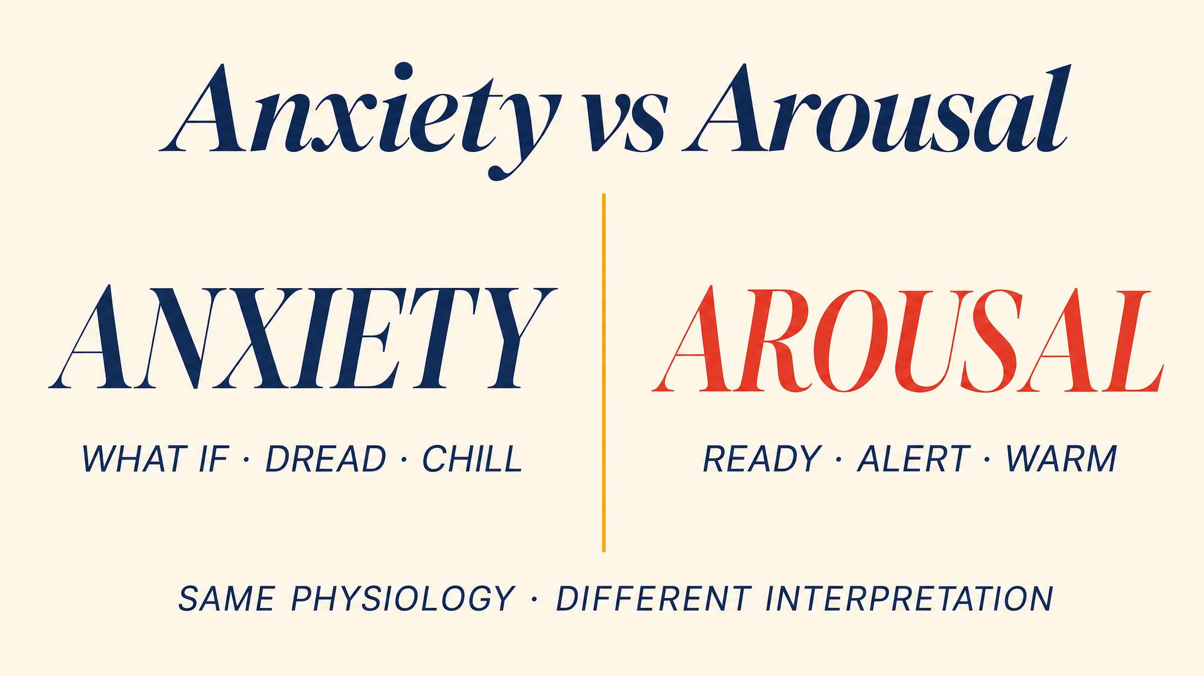
Notes:
Anxiety impairs performance. Arousal can enhance it. The physical sensations are nearly identical — what determines the effect is your interpretation. Use the breathing technique: four-count inhale, six-count exhale. You're not eliminating the butterflies — you're organising them into formation.

Slide 4

Notes:
A 2024 systematic review found 77% of studied marathon performances showed positive pacing — runners slowed in the second half, often dramatically. Almost everyone who held pace or ran negative started conservatively. Every minute above target in miles 1–6 is borrowed from miles 20–26. Rapoport 2010 modelled this exactly.

Slide 5

Notes:
By mile 7 the adrenaline burns off. Breathing rhythmic. Short sentences. You're now in steady-state aerobic metabolism. Burke 2007: 60 to 90 g of carb per hour. Take fuel on schedule — by the time you feel depleted you're already in trouble. A gel or chew every 30 to 45 minutes from around mile 5 or 6.

Slide 6
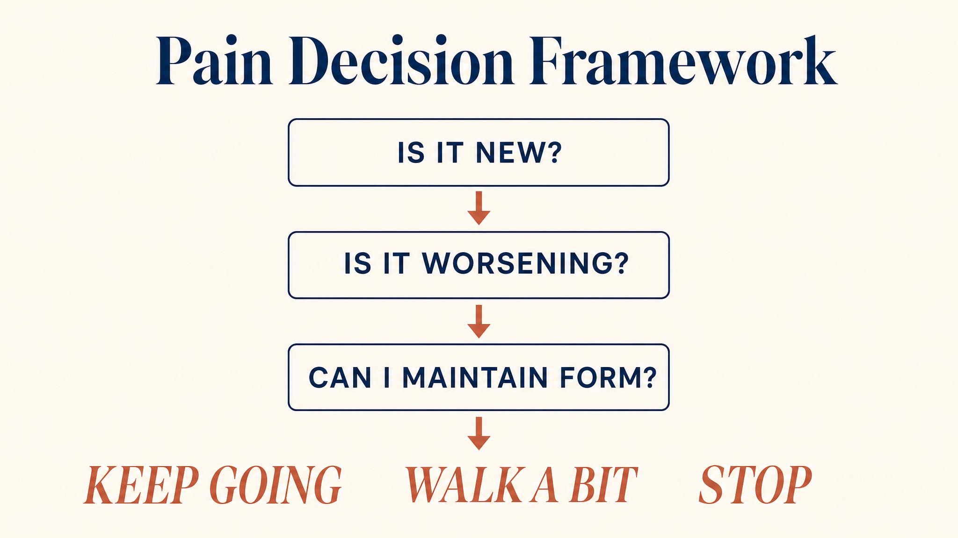
Notes:
The pain decision framework in real time. Three questions: is it sharp and localised? Is it worsening with each step? Does it change when you change pace or form? Most pain you feel in a marathon is dull, diffuse, stable — real, unpleasant, not dangerous. Pageaux 2014: perceived effort, not actual limits, decides whether you continue.

Slide 7
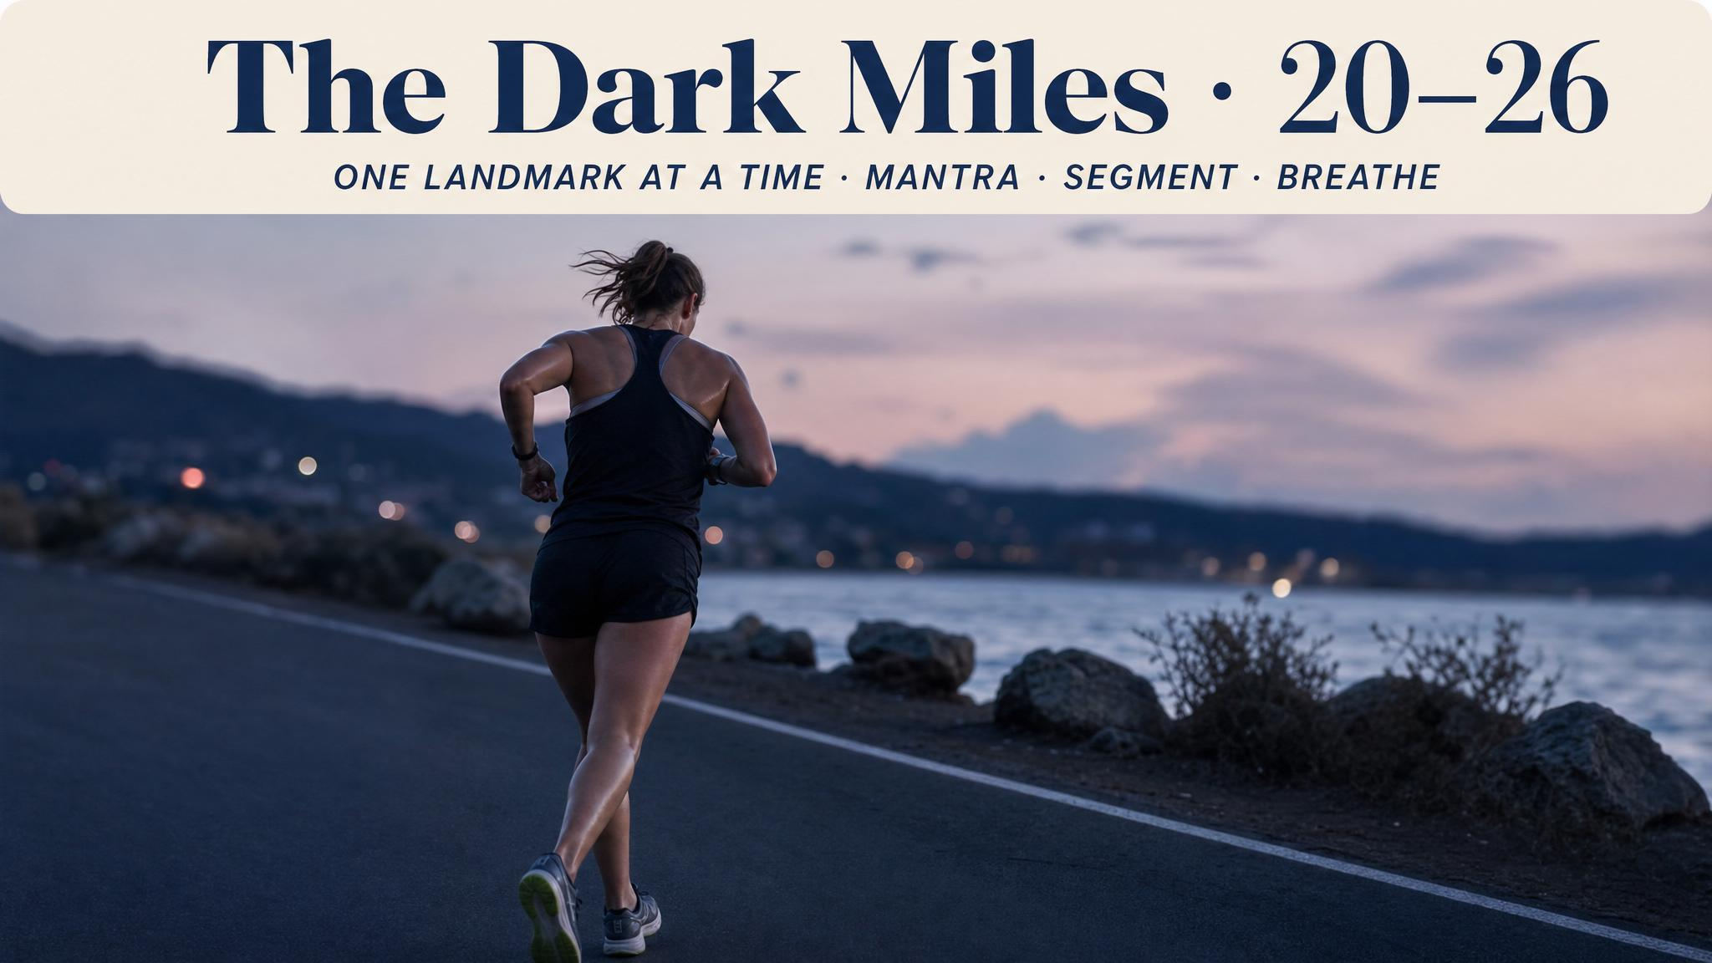
Notes:
Welcome to the part that makes a marathon a marathon. Pageaux 2014: you don't stop because muscles cannot contract. You stop because your brain decides effort exceeds motivation. Blanchfield and colleagues 2014: motivational self-talk reduced perceived exertion and improved endurance performance by 18%. Not 2%. 18%. The phrases you practiced are interventions.

Slide 8
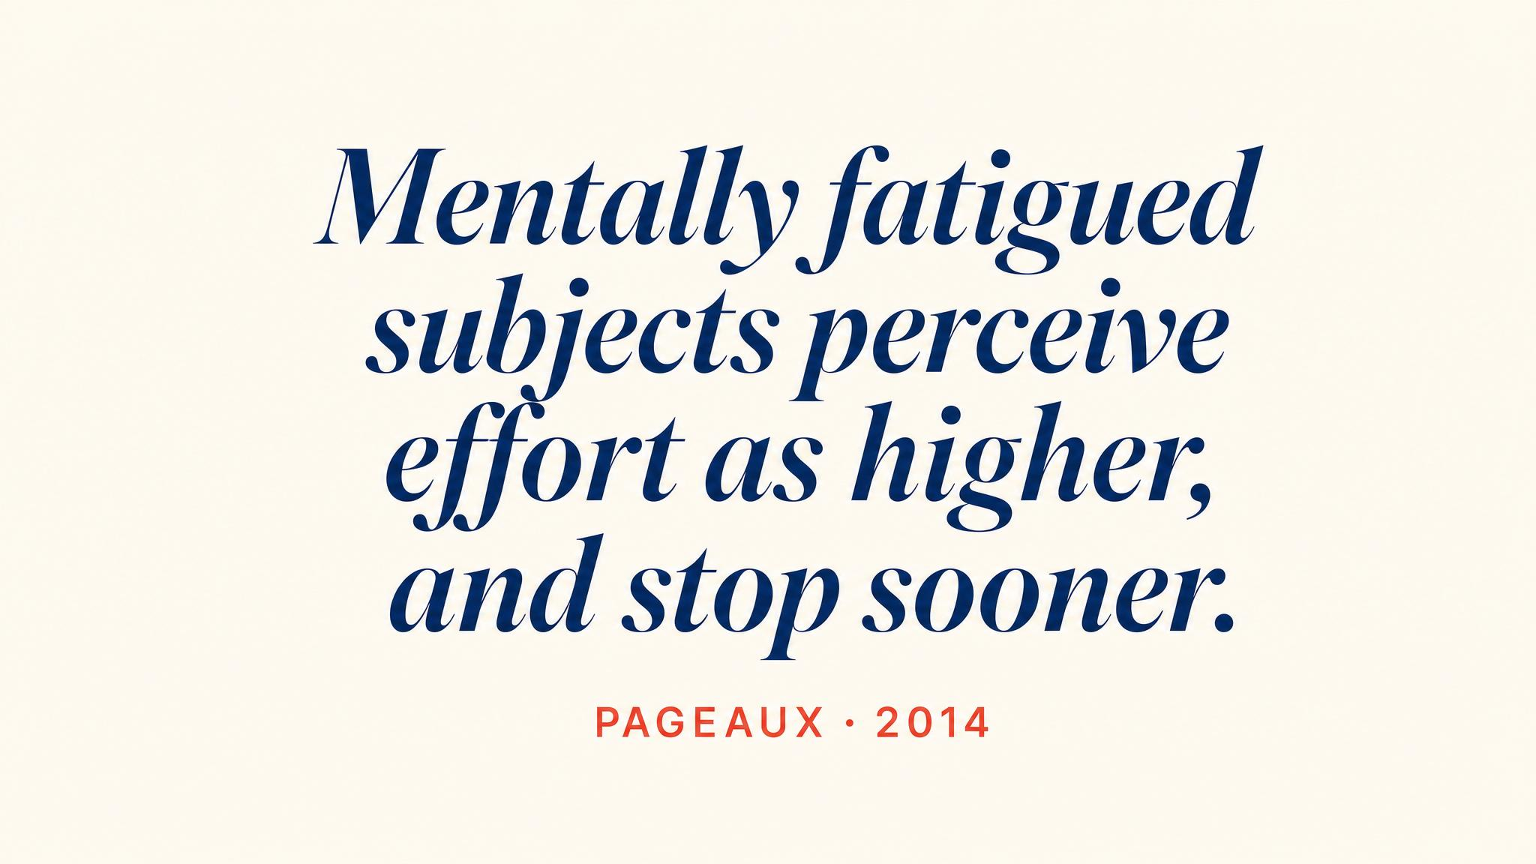
Notes:
Pause and read. Pageaux 2014 — the psychobiological model in plain language. You can keep going. The question is whether you choose to. The phrases you practiced — 'I am strong', 'keep pushing', 'this is what I trained for' — are performance interventions with experimental evidence behind them.

Slide 9
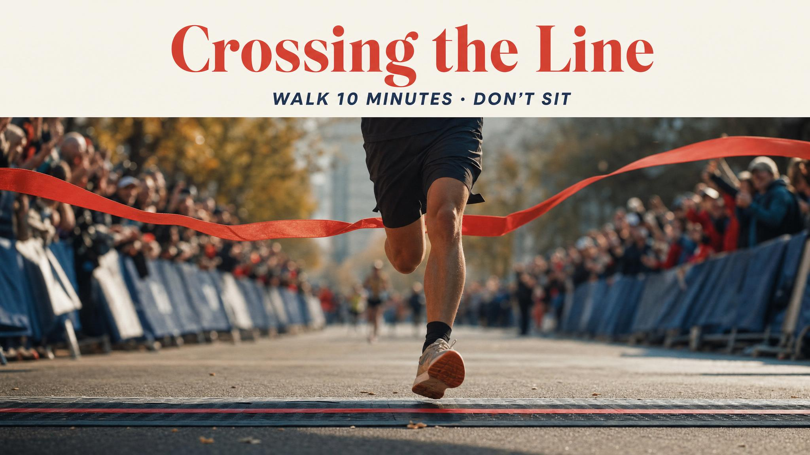
Notes:
Cross the line. Maybe running, maybe shuffling, maybe weeping. Within 90 seconds, the legs will inform you that standing is going to be a project. Keep walking 10 to 15 minutes — cardiovascular system needs time. Refuel within 30 minutes (Burke 2007). Drink to thirst. Feel what you feel.

Slide 10
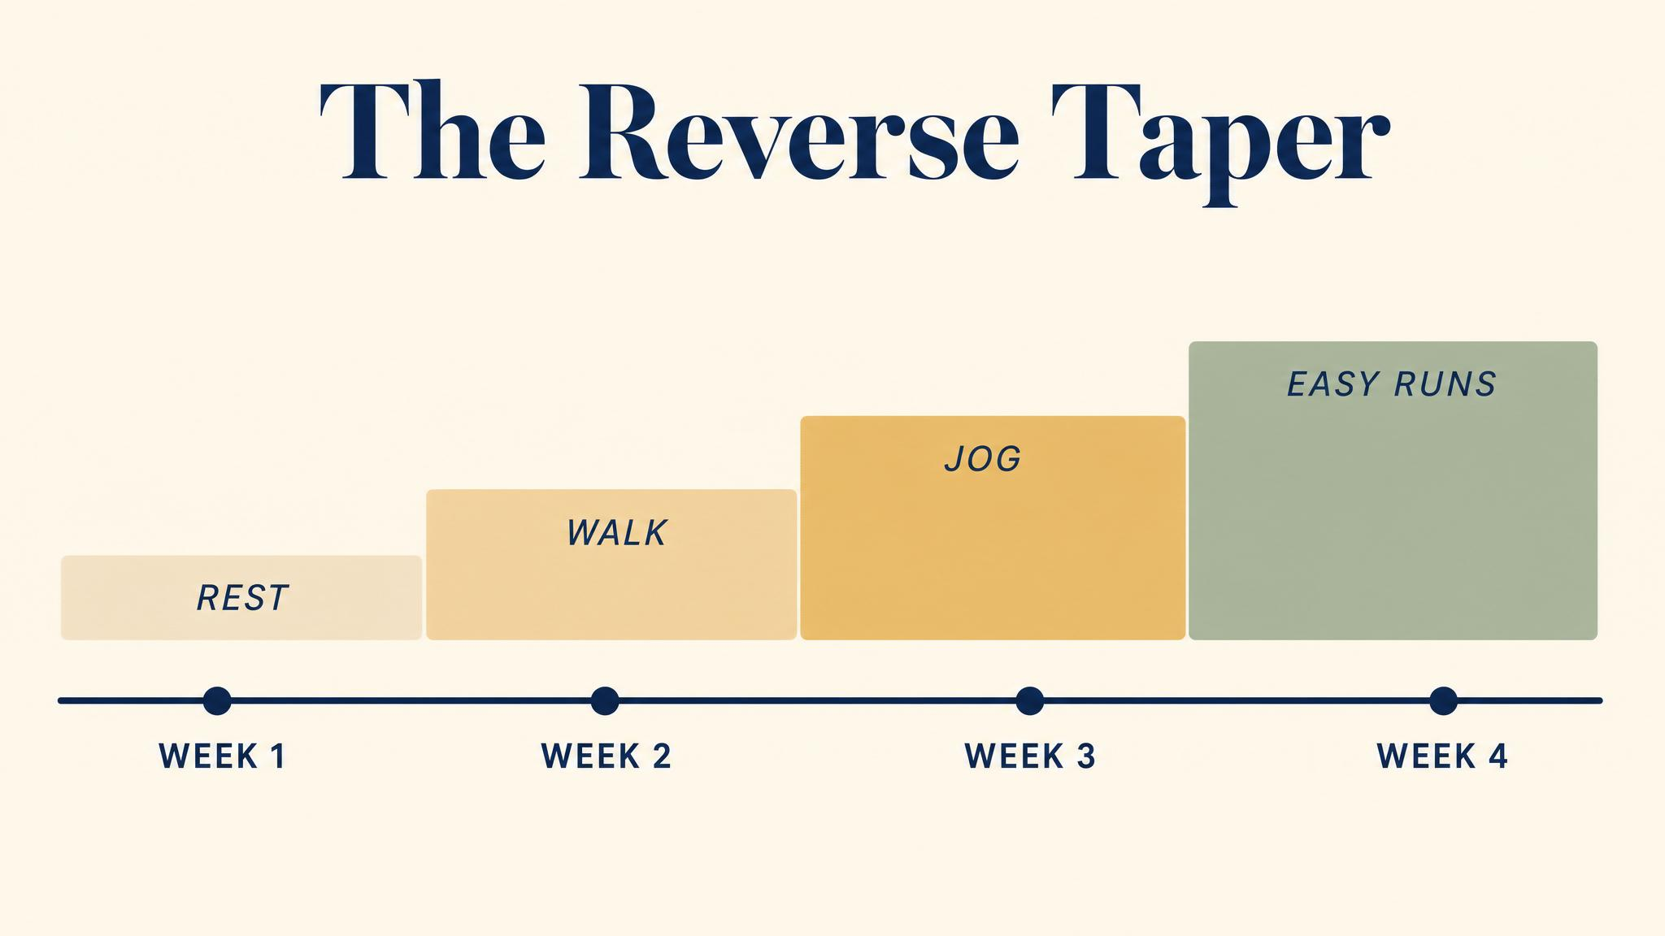
Notes:
The marathon causes substantial physiological disruption — muscle damage, inflammation, depleted glycogen, compromised immunity, persisting 3 to 7 days. Roughly one day of recovery per mile raced — about 26 days to full volume. Days 1–3: rest or walking. Days 4–7: light cross-training. Week 2: very easy short runs. Respect the recovery.

Slide 11
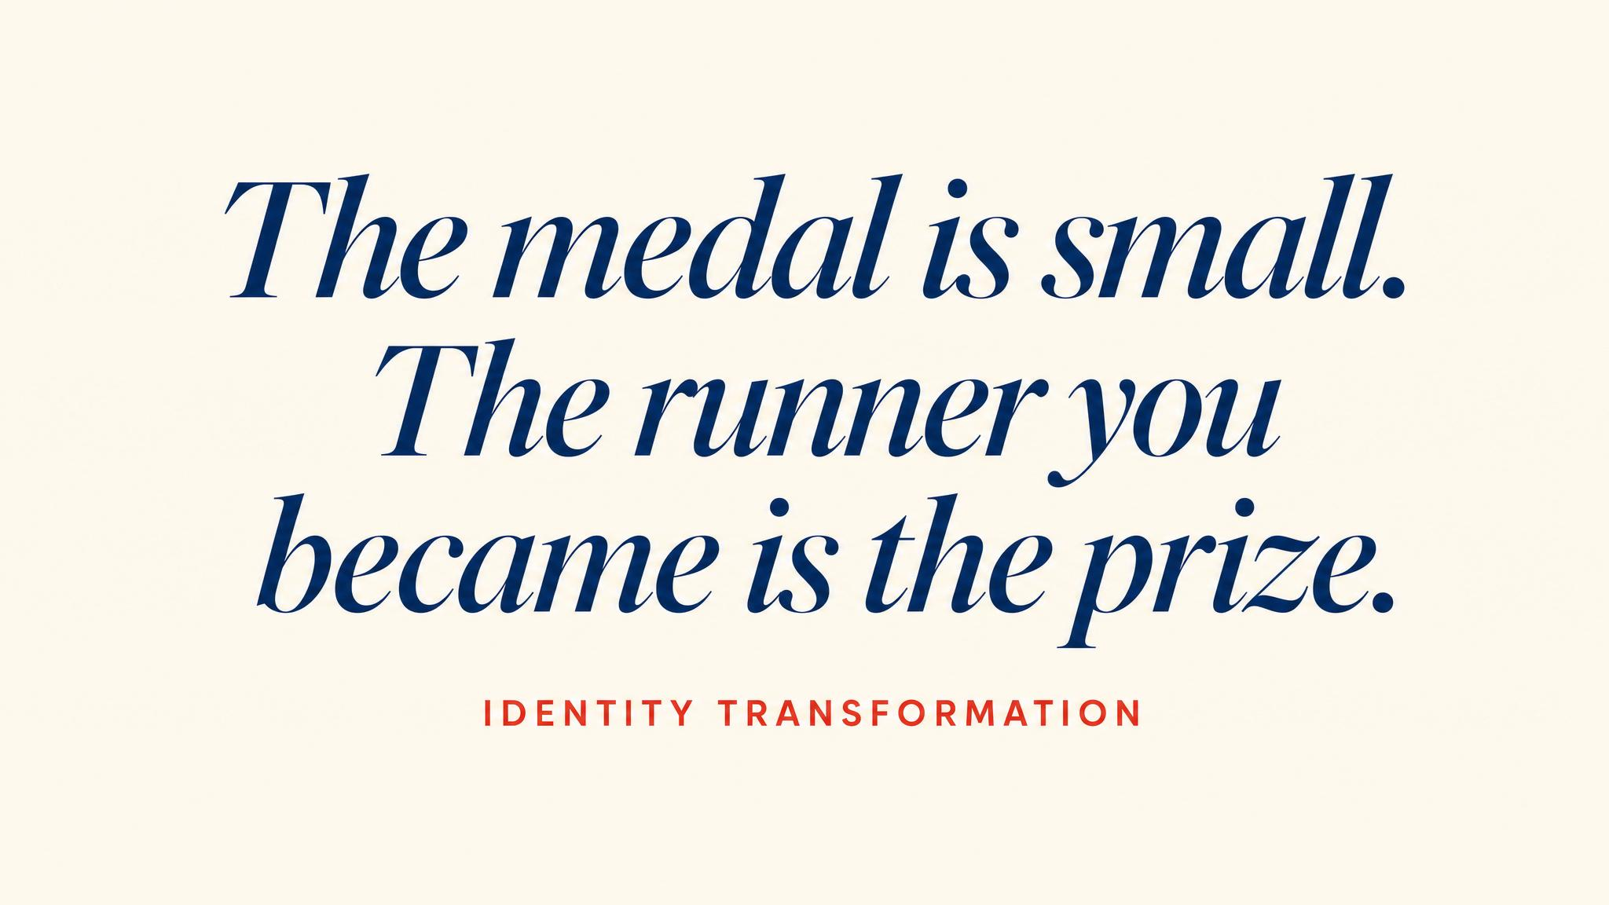
Notes:
Beauchamp and colleagues 2017 describe identity transformation through social identity theory: when people categorise themselves as members of an active group — as runners — that self-categorisation drives future behavior. You don't run because you're motivated on a Tuesday morning. You run because that's what runners do, and you are one. The marathon didn't make you a runner. The training did. The race made it official.

Slide 12
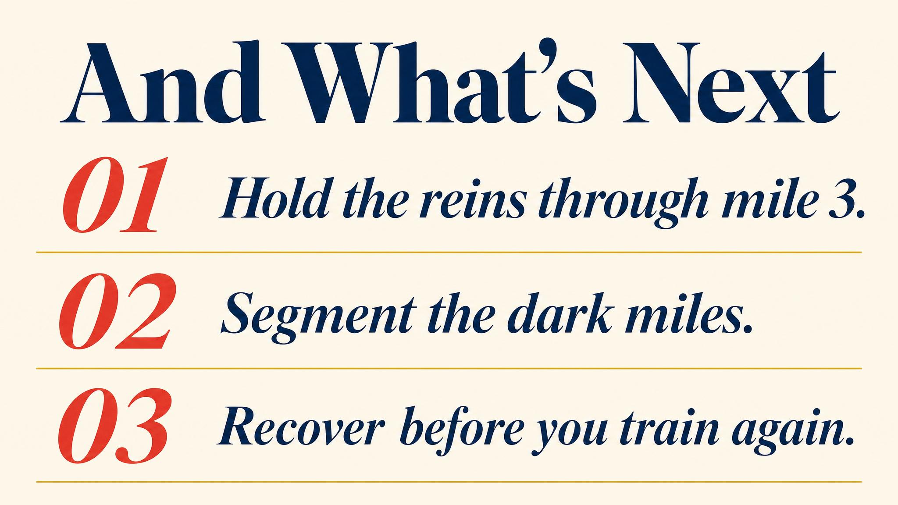
Notes:
Three to carry forward: pace conservatively early, finish strong; fuel on schedule before glycogen perception lags; you have become a runner — the identity, the framework, the capacity transfer to everything else you'll ever attempt.

Slide 13

Notes:
There's no next chapter. There's just the road and you on it. The course you've completed was never really about one race. It was about giving you the knowledge to own your running life. Every future training cycle, every new distance, every next starting line — you have the framework. Now go run.

