Slide 1
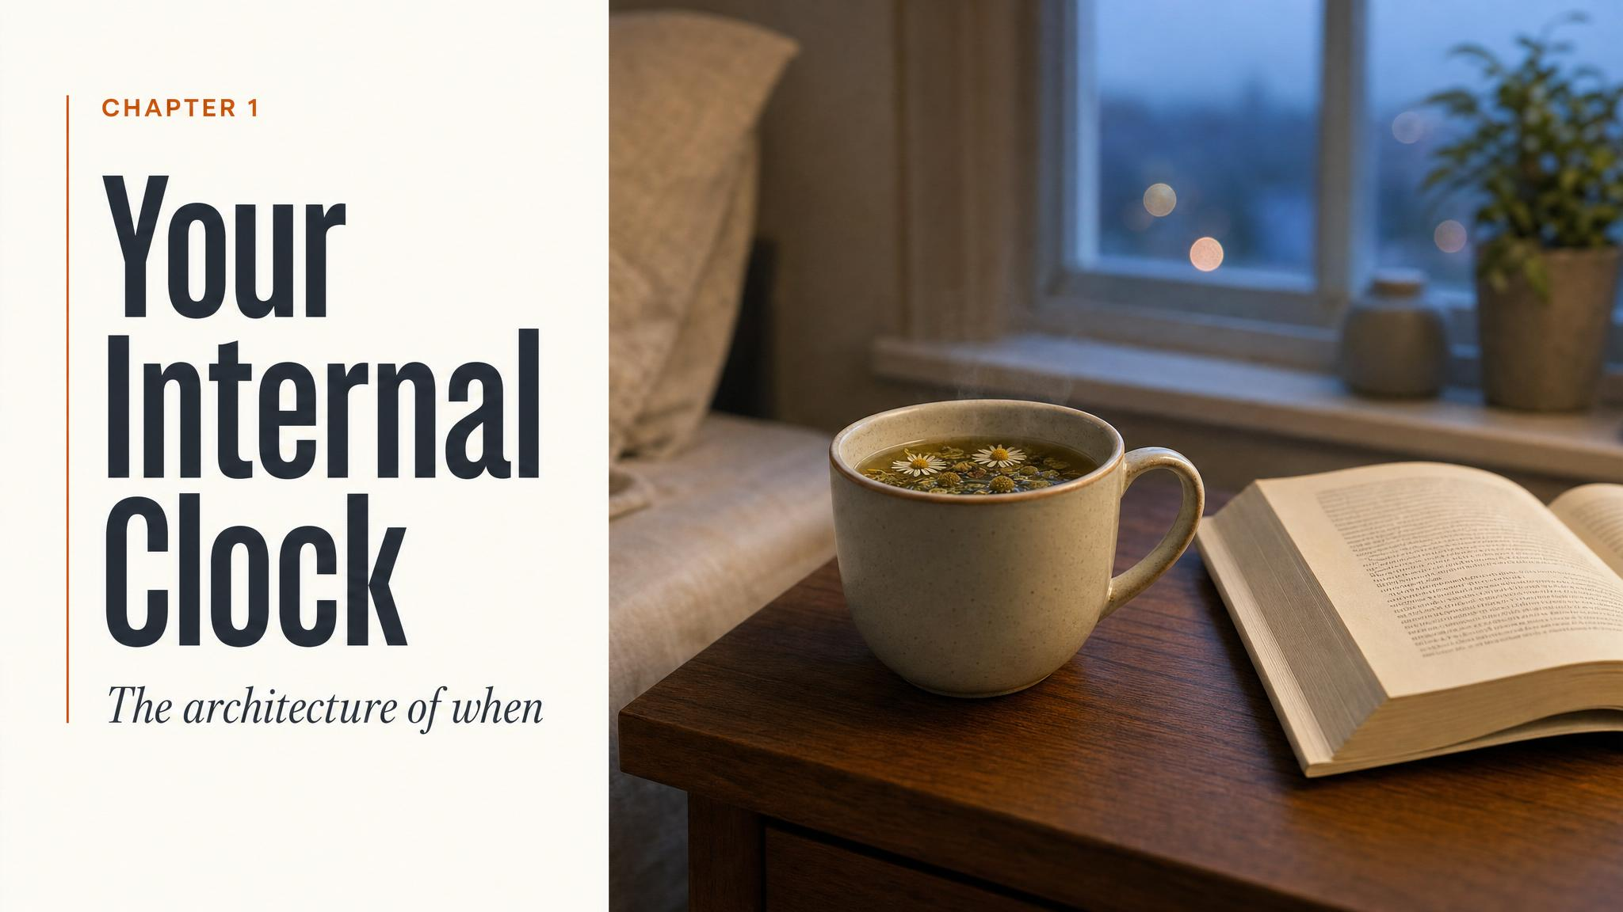
Notes:
Open with the puzzle: it's 2 a.m., you're wide awake, your roommate is asleep, and tomorrow you'll drag yourself to a 9 a.m. lecture. Ask the room: is something wrong with you? Hold the question. The chapter's whole argument is that this isn't willpower — you're running a biological clock you never chose.

Slide 2
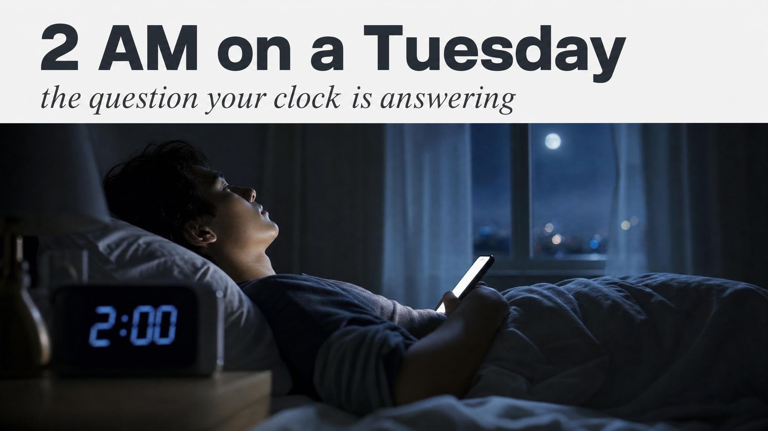
Notes:
Land the hook hard. Most students recognise themselves in this image. The point isn't to shame the late sleeper or praise the early one — it's to set up the chapter's central claim. The difference between these two students is biology, not character.

Slide 3
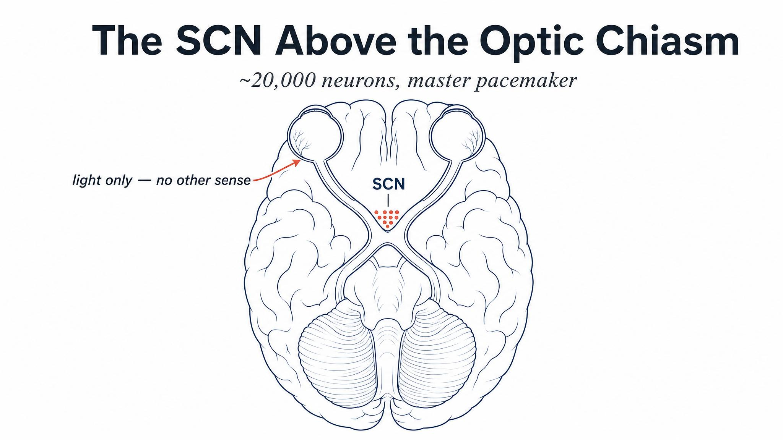
Notes:
Walk them to the anatomy. The SCN — suprachiasmatic nucleus — sits literally above the optic chiasm. That position is not accident. It's the architecture of a system designed around light. Twenty thousand neurons running a 24-hour orchestra.

Slide 4
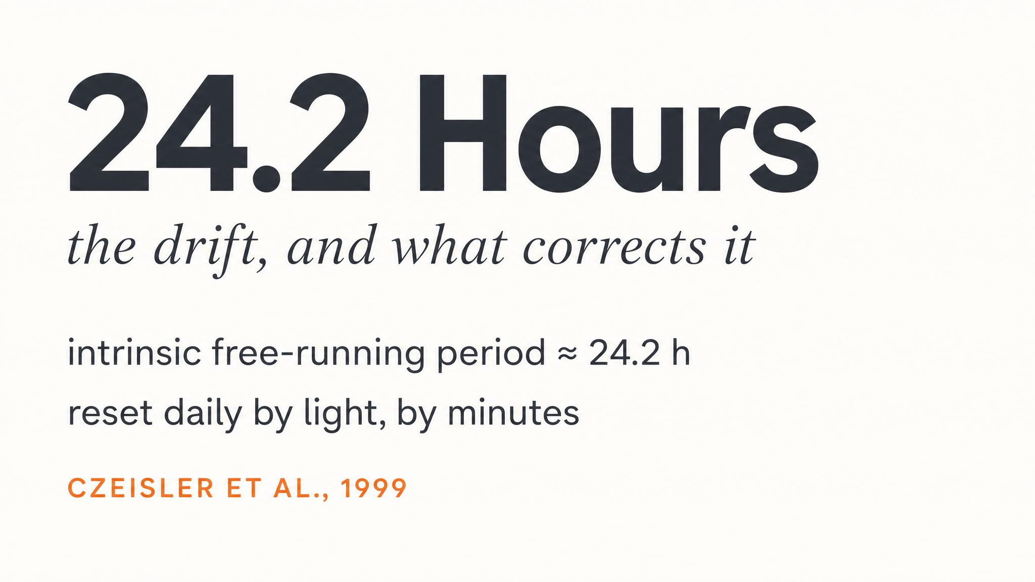
Notes:
In a windowless lab — no clocks, no daylight, no time cues — the human cycle averages about 24.2 hours, slightly longer than a day. Left alone, your clock drifts later and later. The image is the watch metaphor: a watch that runs a few minutes slow each day. Something must reset it.

Slide 5
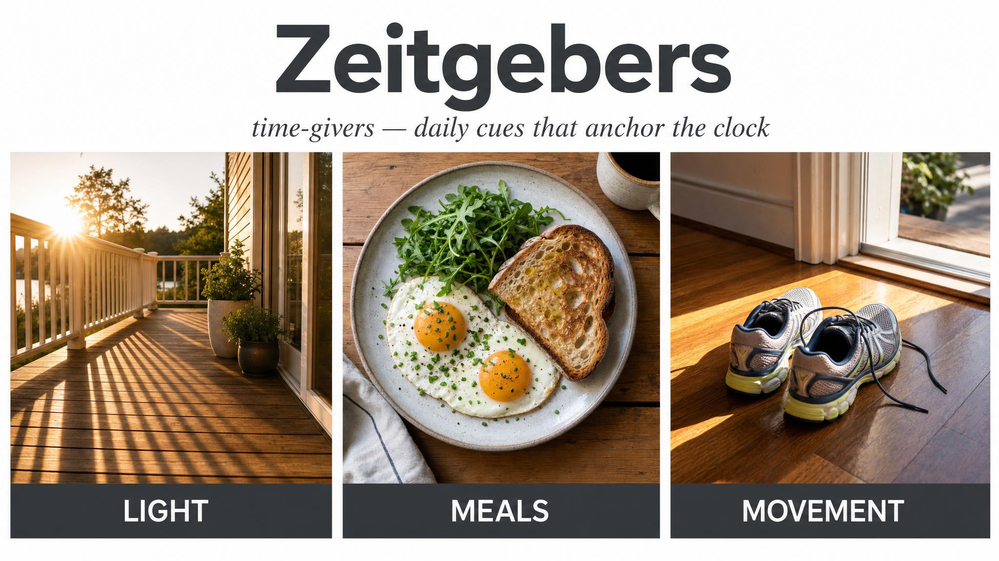
Notes:
Zeitgeber is German for 'time-giver'. Light is the dominant one — photons hitting your retina travel a dedicated highway to the SCN. But meal timing, exercise, and social contact all chip in. Quante and colleagues in 2019 confirmed that meal timing and physical activity measurably entrain rest-activity patterns. Ask the room which they think is strongest — most guess wrong.

Slide 6
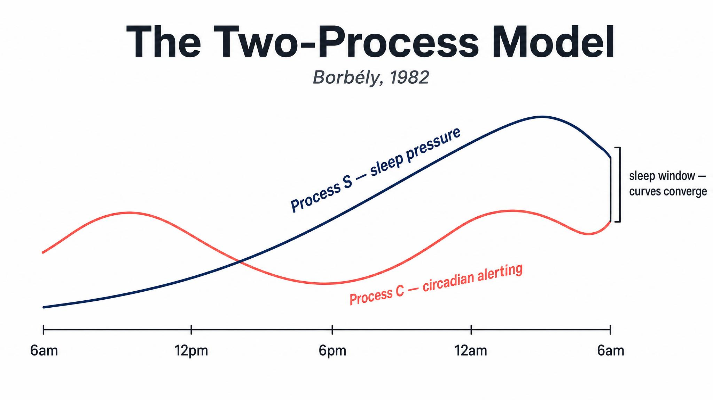
Notes:
In 1982 the Swiss researcher Alexander Borbély proposed the model that still dominates four decades later. Two processes, running simultaneously. Process S — sleep pressure — rises with wakefulness. Process C — circadian alerting — oscillates independently. Sleepiness is the gap between them. Walk them through the two curves on the slide.

Slide 7
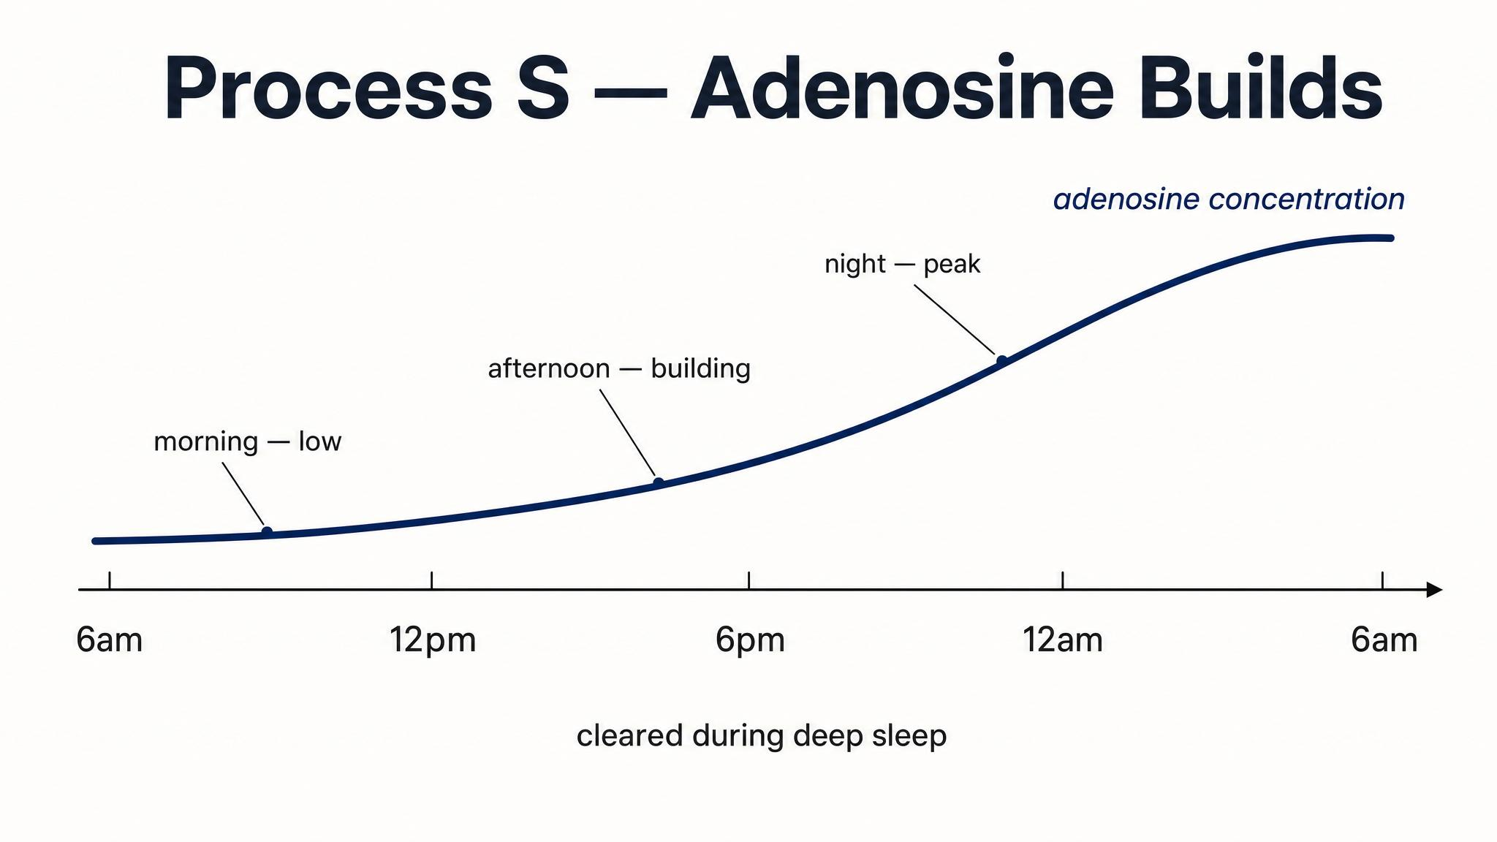
Notes:
Process S is homeostatic sleep pressure. From the moment you wake, adenosine — a neural metabolism byproduct — accumulates. Roughly sixteen hours later it peaks. Sleep clears it. If you pull an all-nighter, S doesn't plateau — it keeps climbing, which is why 4 a.m. after an all-nighter feels almost painful.

Slide 8
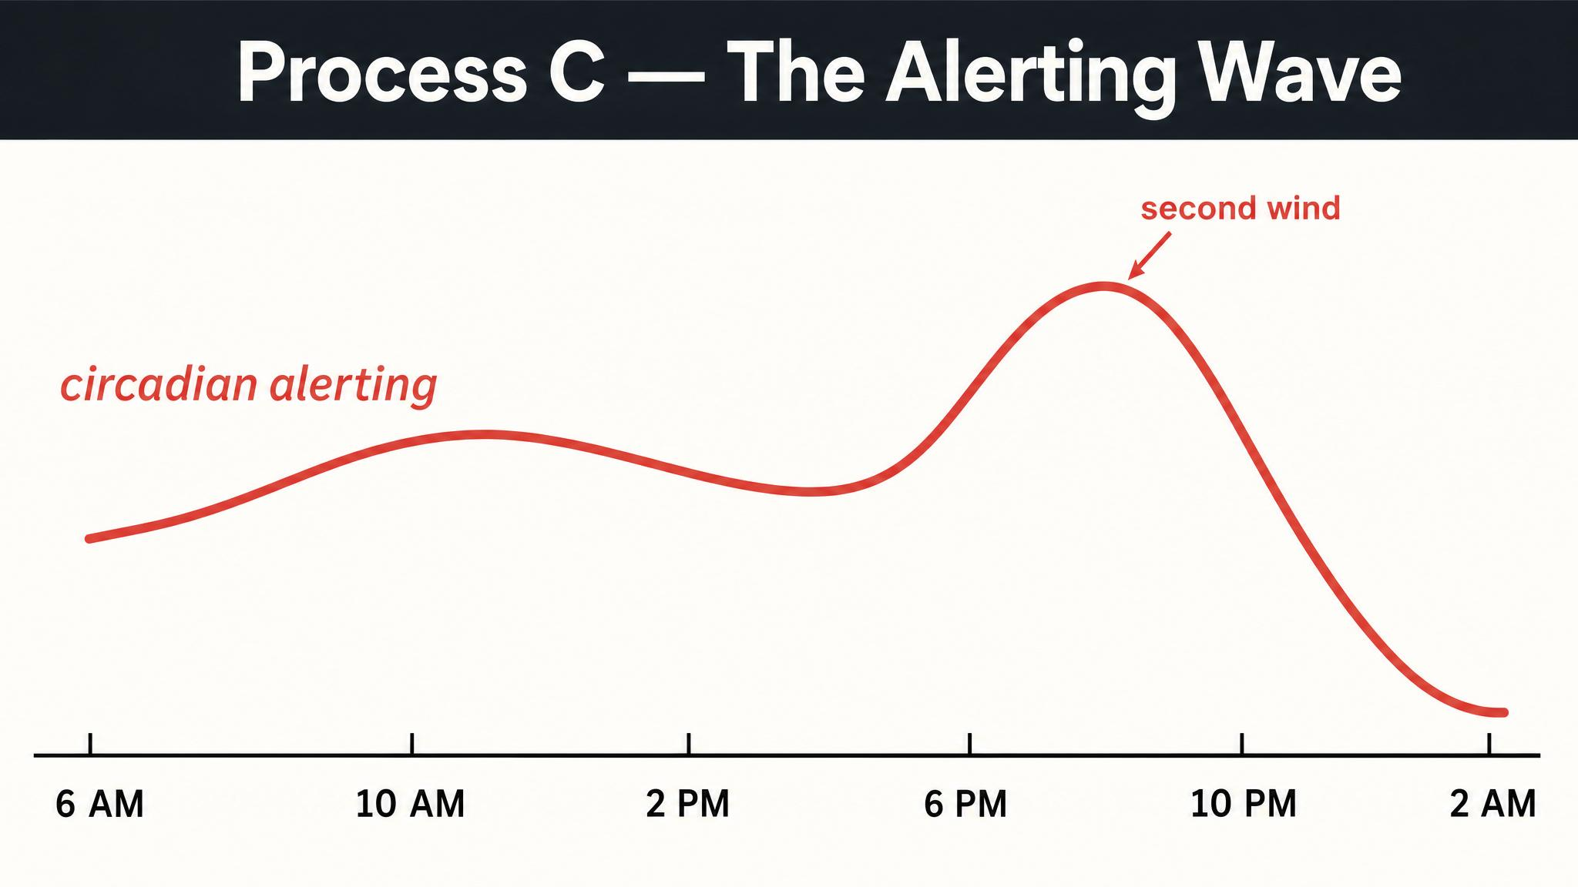
Notes:
Process C is independent of how long you've been awake. It follows its own 24-hour rhythm: low in early morning, dips slightly in the early afternoon — that's the post-lunch slump, and it isn't just about the sandwich — peaks in the early evening, then drops as night comes. The 'second wind' at 7 or 8 p.m. is C near its peak masking S.

Slide 9
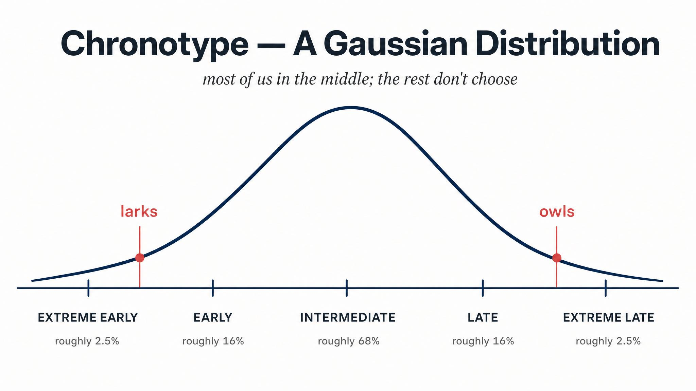
Notes:
Chronotype is your genetically influenced tendency toward morningness or eveningness. Roenneberg's team measured tens of thousands of people with the Munich Chrono-Type Questionnaire and found a near-Gaussian distribution — most in the middle, with progressively fewer at the lark and owl extremes. It shifts across the lifespan: kids are larks, teens delay sharply, latest point around age twenty, then slowly earlier.

Slide 10
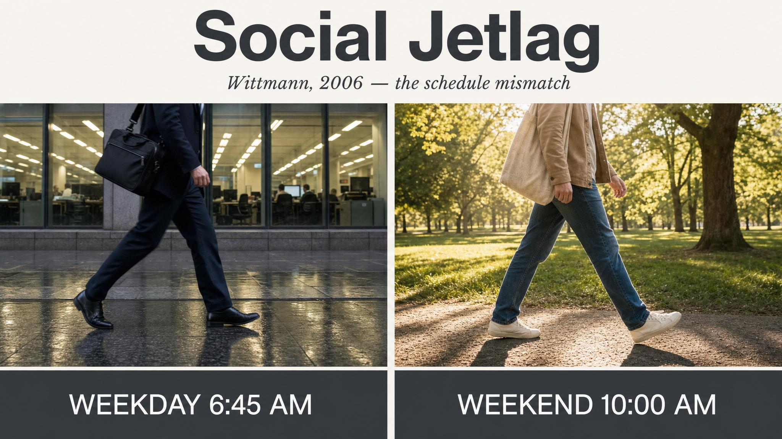
Notes:
Social jetlag is the chronic mismatch between your biological clock and your social schedule — the difference between your sleep midpoint on free days and on work days. Wittmann and colleagues in 2006 found it linked to more caffeine and nicotine use, lower well-being, and more depressive symptoms. The owls suffer worst, because modern schedules favour larks.

Slide 11
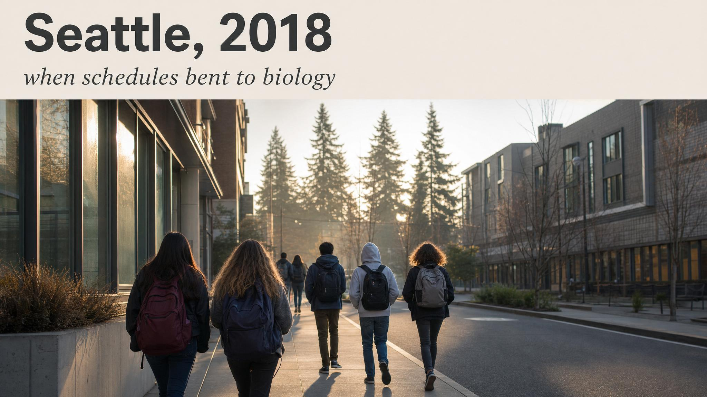
Notes:
Dunster and colleagues in 2018 studied Seattle high school students before and after the district pushed start times from 7:50 to 8:45 a.m. Using wrist actigraphy — objective movement sensors — they found students gained a median 34 minutes of daily sleep, with a 4.5% lift in median grades and better attendance. Bedtimes did not shift later. They slept into what their biology was already calling for.

Slide 12
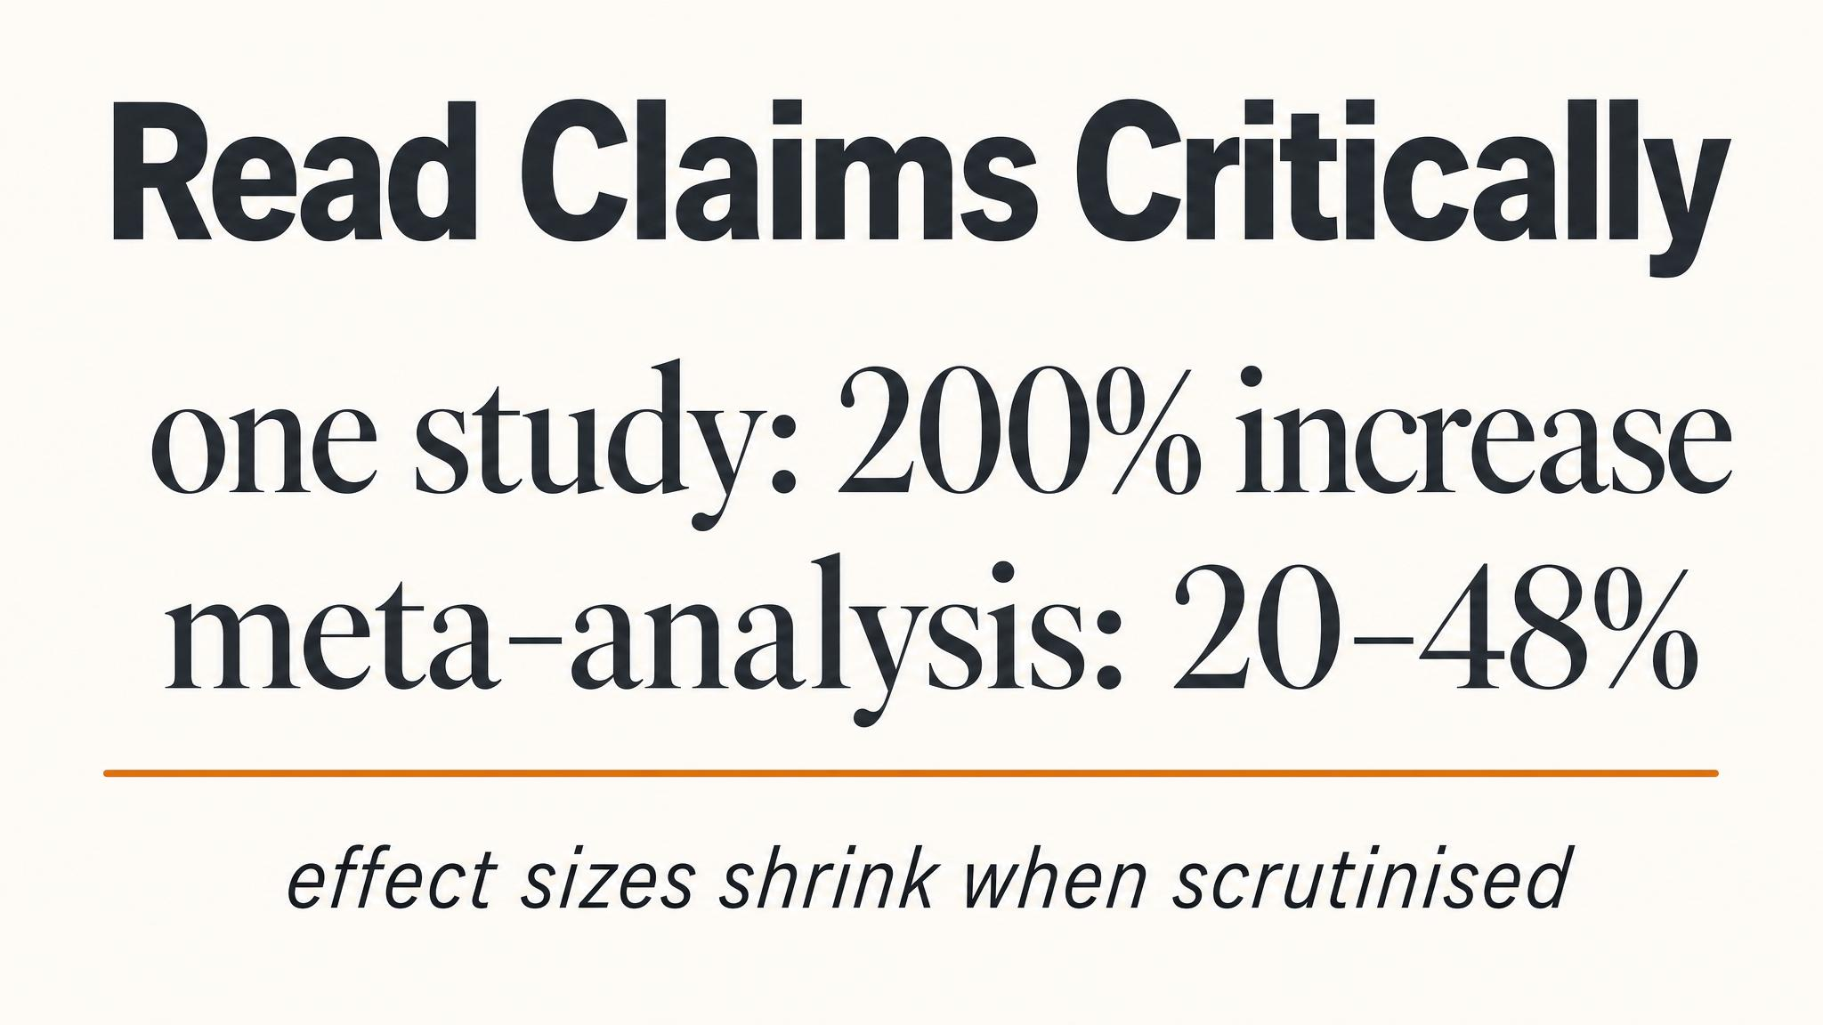
Notes:
Walker's 'Why We Sleep' popularised the claim that under six hours raises heart-attack risk by 200%. The actual meta-analytic range is more like 20–48% relative risk. Sleep matters for cardiovascular health — but scientific literacy means attending to effect sizes and the difference between relative and absolute risk. This is a skill the rest of the course leans on hard.

Slide 13
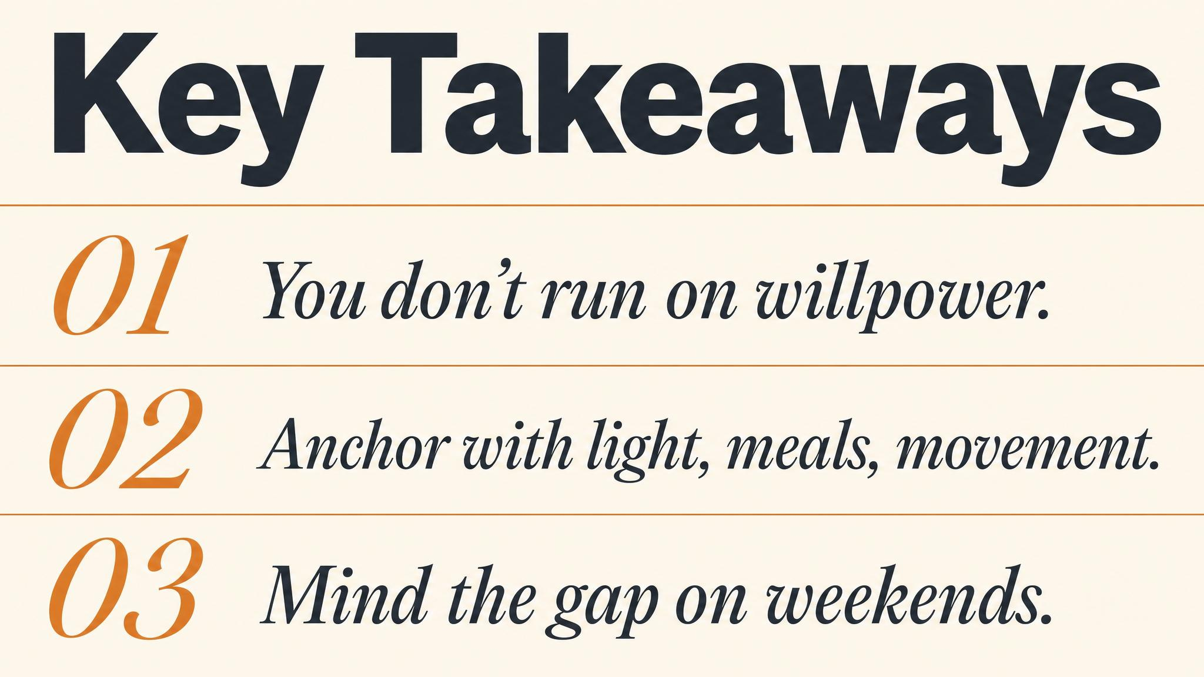
Notes:
Three things to carry forward. One: the SCN — twenty thousand neurons above the optic chiasm — runs a roughly 24.2-hour clock that zeitgebers entrain to the external day. Two: sleepiness is Process S meeting Process C, the homeostatic and circadian processes interacting. Three: schedules can bend to biology — the Seattle study is the proof of concept.

Slide 14
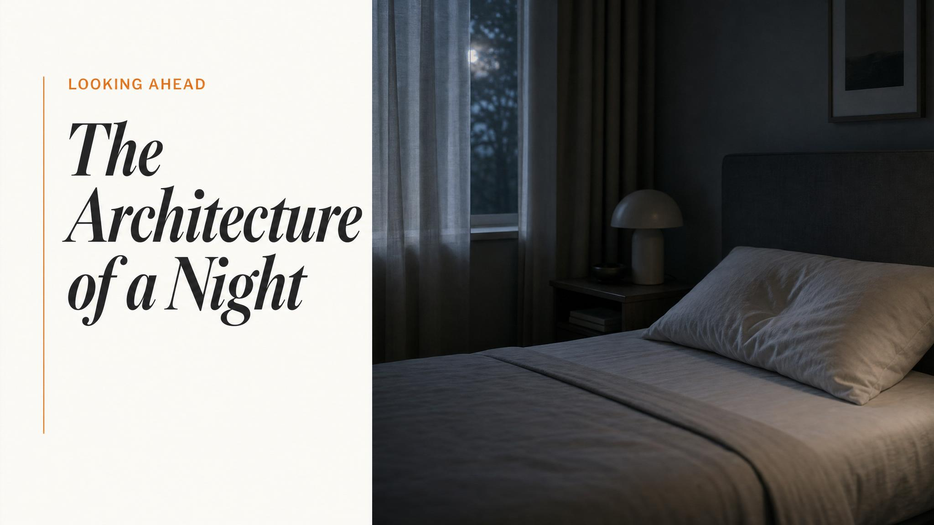
Notes:
Close with the bridge: now you have the scaffold — SCN, Process S, Process C, zeitgebers, chronotype. Next class we descend into the architecture of a single night. The repeating cycles of light sleep, deep slow-wave sleep, and REM, each with its own neural signature and its own job to do.

