Slide 1
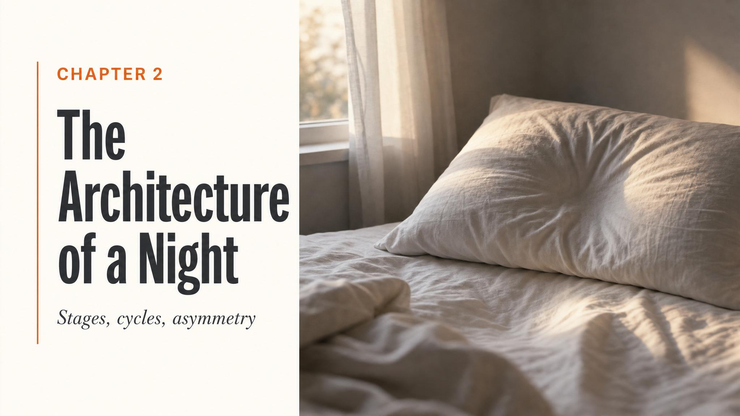
Notes:
Open with the hook: two students sleep the same six hours, but at different windows of the night — Maya midnight to 6 a.m., Jake 3 a.m. to 9 a.m. — and they wake up impaired in completely different ways. Same hours, radically different outcomes. Hold that puzzle. Tell them the answer is sitting in tonight's lecture: sleep is not one thing.

Slide 2

Notes:
Land the hook concretely. Maya front-loads her night and captures most of her deep N3 but loses her REM-rich final cycles. Jake back-loads and gets through the REM window but misses the deep-sleep surge. Same total — radically different bills. The architecture is the story.

Slide 3
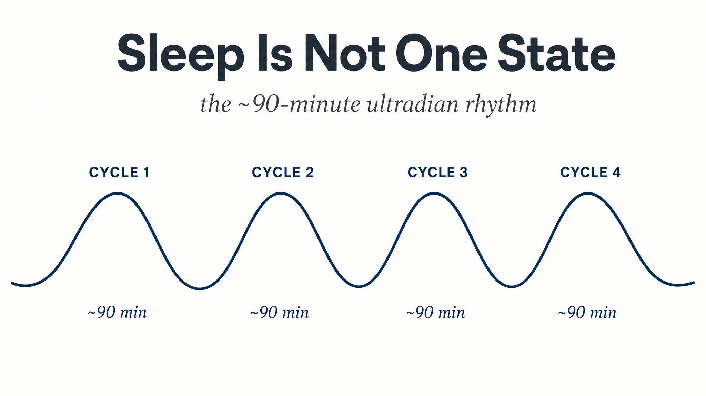
Notes:
Define the ultradian rhythm: a within-sleep rhythm nested inside the 24-hour circadian rhythm from last lesson. Roughly four to six full cycles across a typical eight-hour night, per Patel and colleagues 2024. Make the distinction crisp: circadian sets the calendar, ultradian sets the structure within the night.

Slide 4
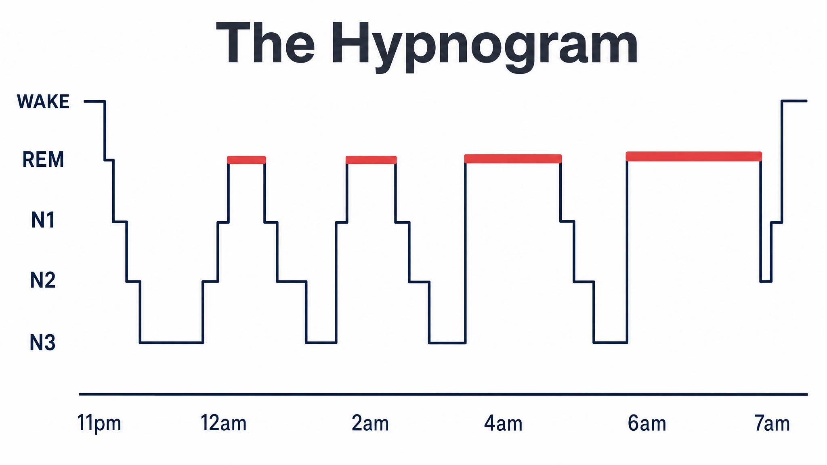
Notes:
Walk them across the hypnogram from left to right. Note the deepening descent into N3 early — driven by adenosine pressure — and the progressively longer REM bands later, gated by the circadian signal. By the final cycle, REM may last 40 to 60 minutes while N3 has nearly vanished, per Patel and colleagues 2024.

Slide 5
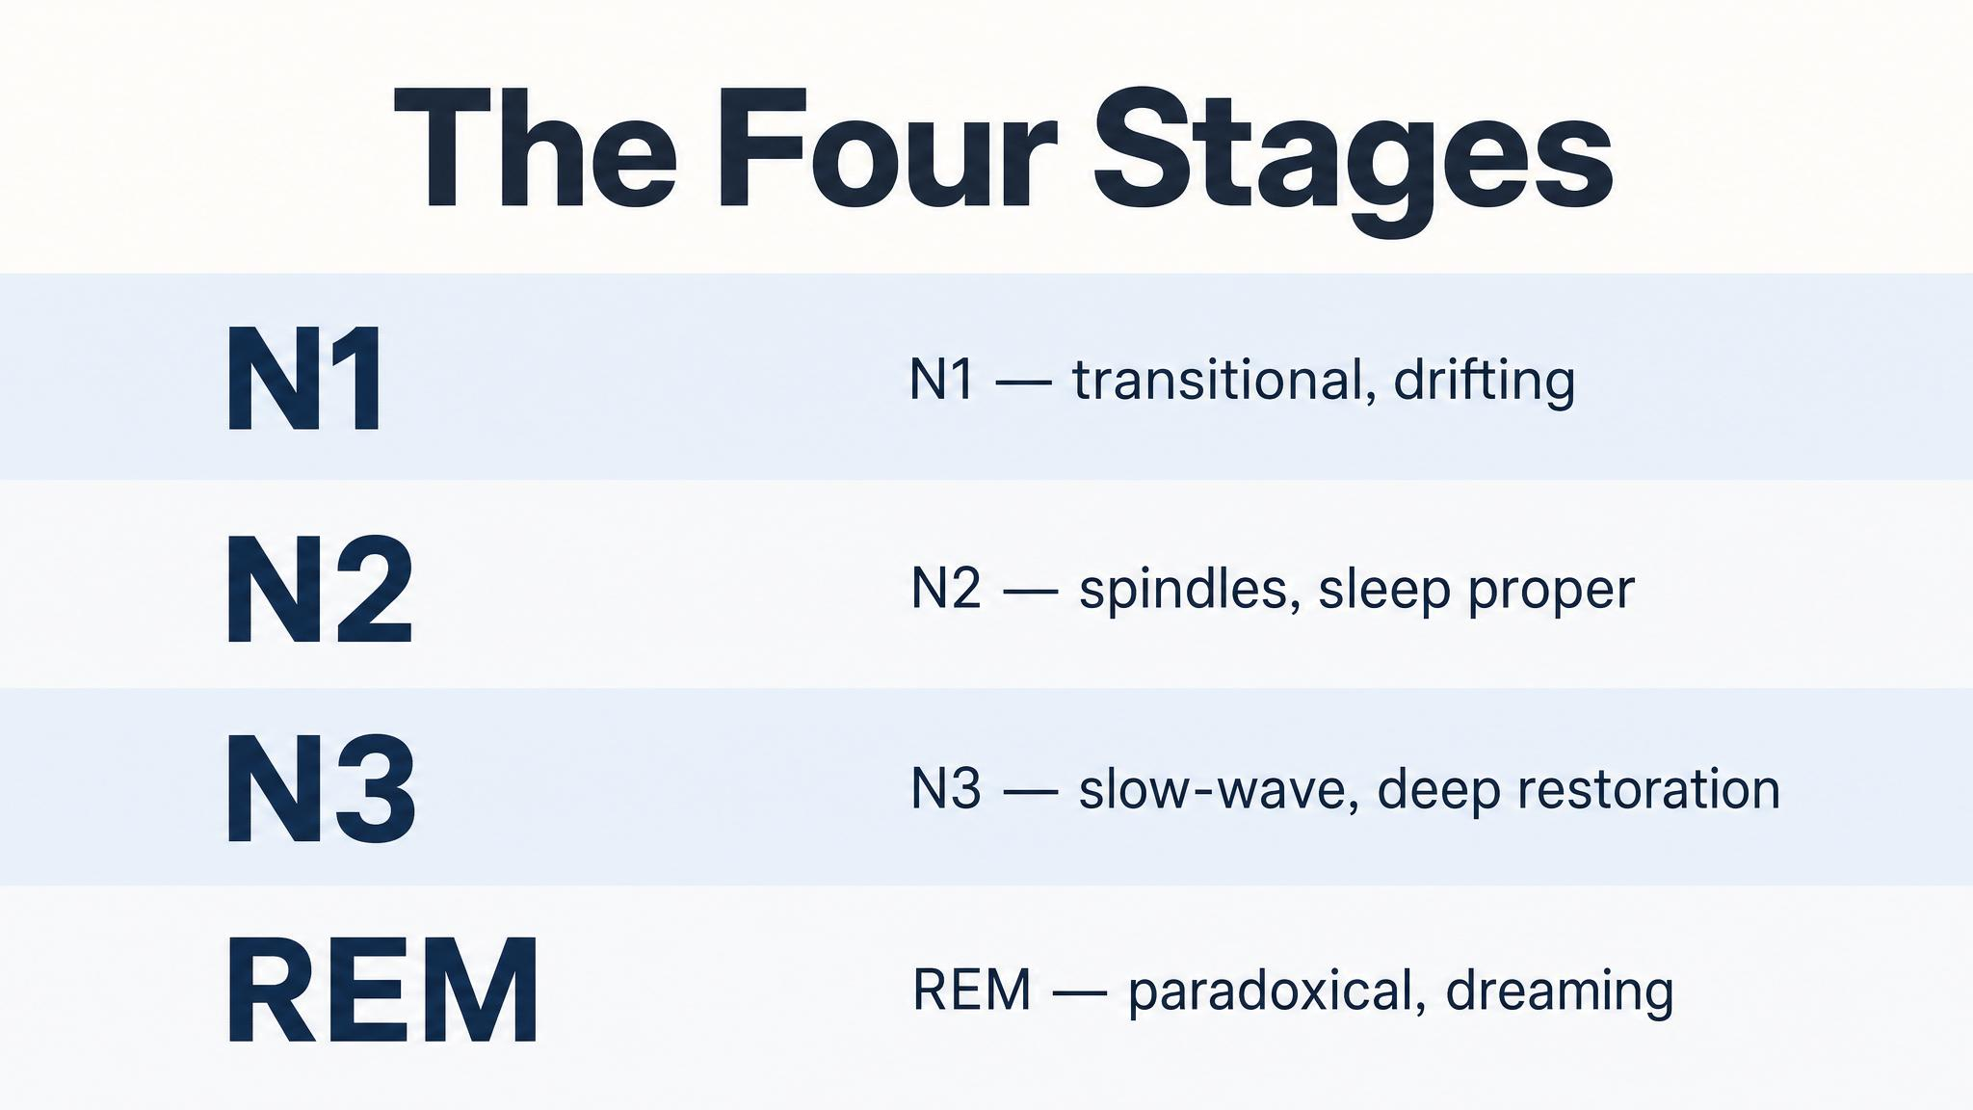
Notes:
Set up the inventory. N1 — the doorway, about five percent, hypnagogic phenomena, lasts one to five minutes. N2 — the workhorse, forty-five to fifty-five percent, home of spindles and K-complexes. N3 — deep slow-wave sleep, delta waves zero-point-five to two hertz. REM — paradoxical sleep, brain awake, body paralysed.

Slide 6
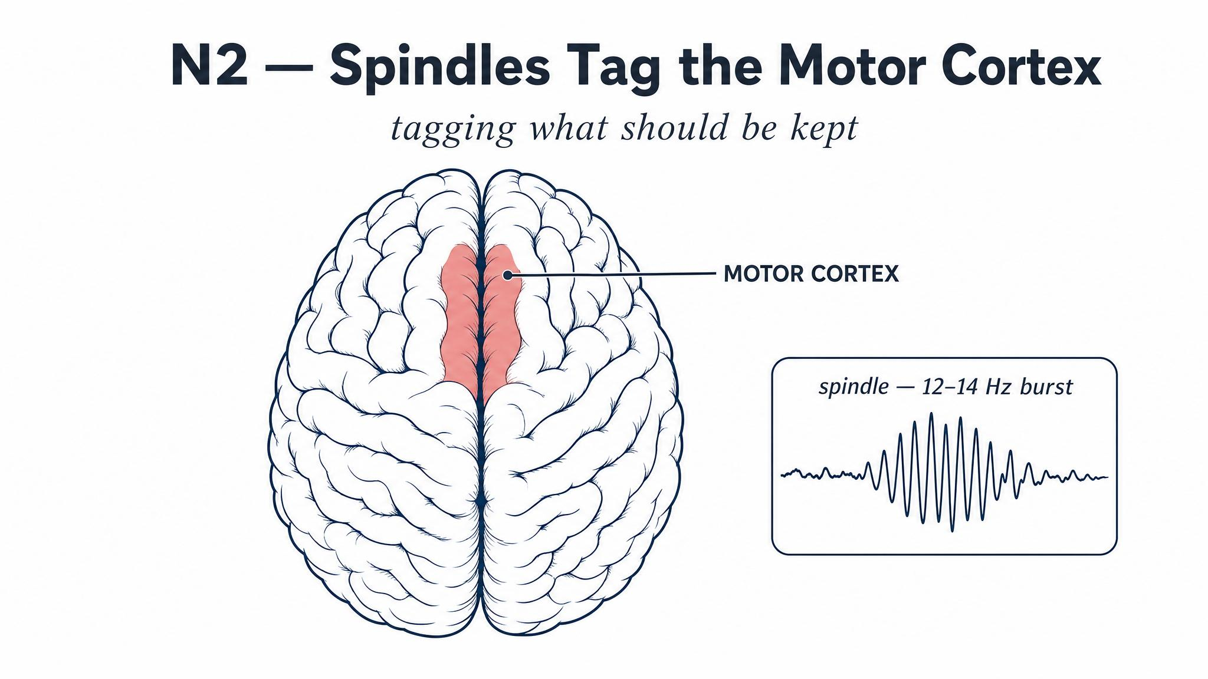
Notes:
This is the killer Nishida and Walker finding from 2007. Motor-skill gains tracked the density of N2 sleep spindles — and the spindles were regionally specific. Train the right hand, and the left motor cortex's spindles light up. The brain isn't passively resting in N2; it's rehearsing the day's motor learning at an anatomically precise location.

Slide 7
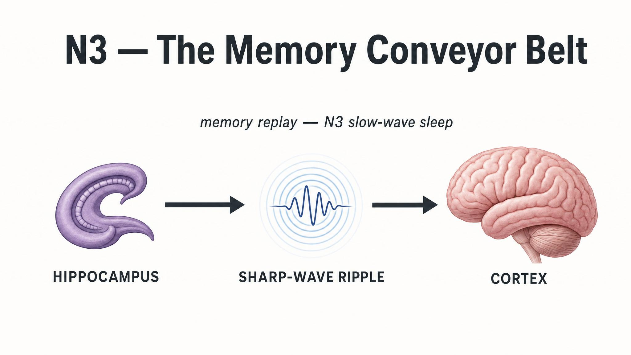
Notes:
The active system consolidation model: memories encoded by the hippocampus during the day are spontaneously reactivated during slow-wave sleep. Sharp-wave ripples nest inside thalamic spindles which nest inside cortical slow oscillations — a triple-nested coordination that gradually transfers memory representations into long-term neocortical storage. Diekelmann and Born 2010; Rasch and Born 2013.

Slide 8
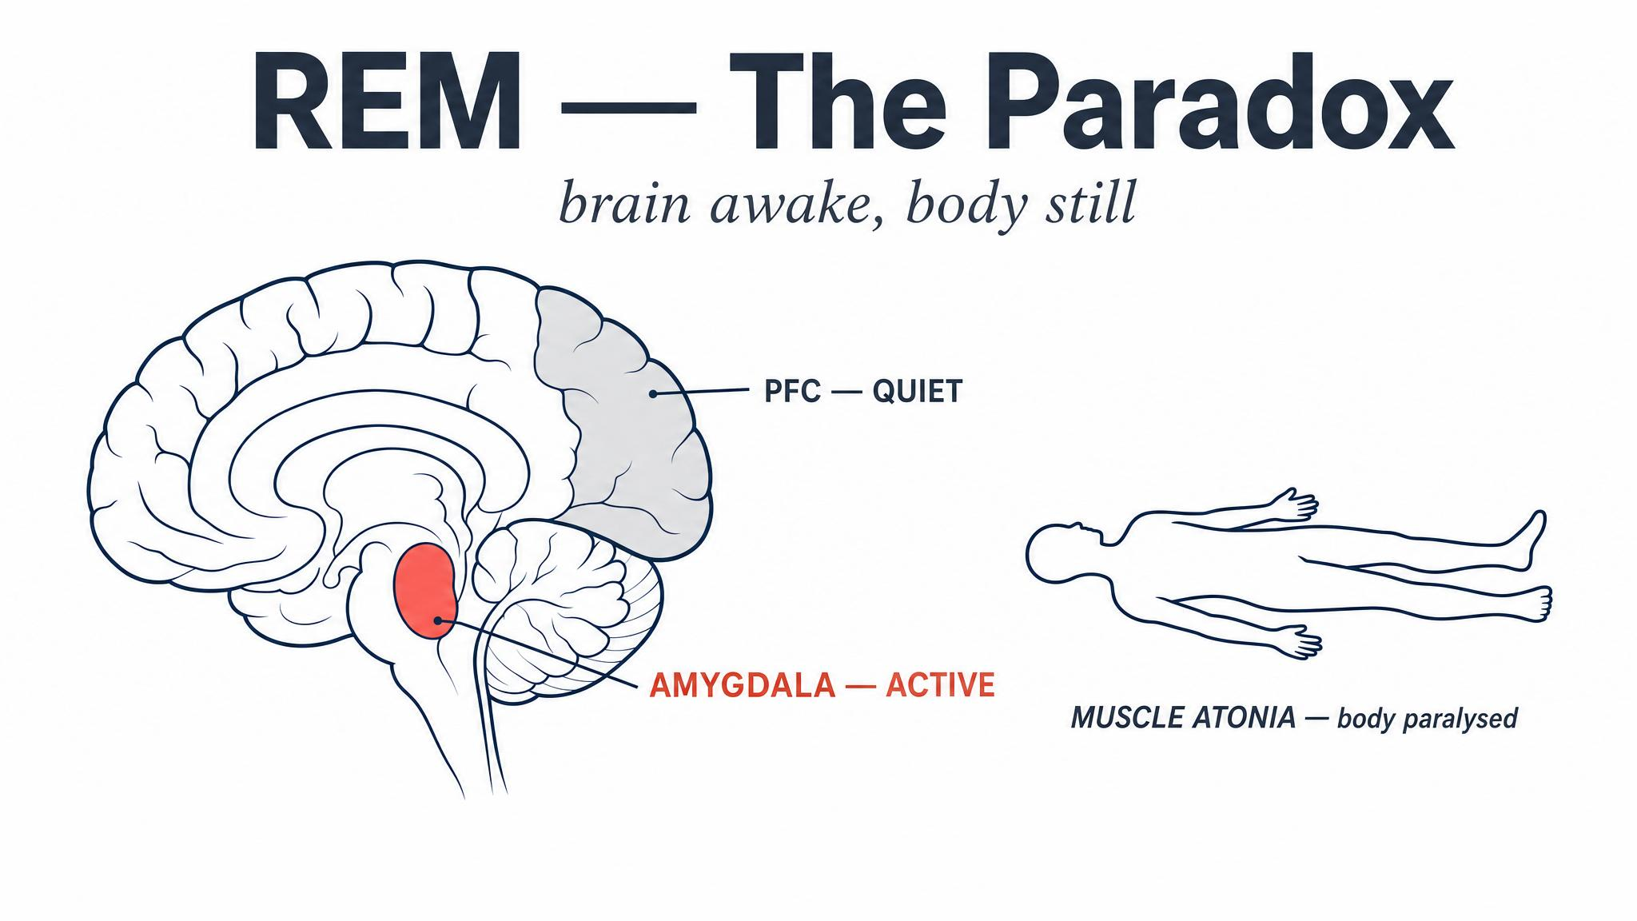
Notes:
REM was originally called paradoxical sleep for exactly this reason. Brain electrically almost as active as wake; voluntary muscles disconnected by brainstem inhibition. Amygdala and ACC light up. Prefrontal cortex falls quiet. The neurochemistry — high acetylcholine, low norepinephrine and serotonin — creates conditions for emotional memory processing.

Slide 9
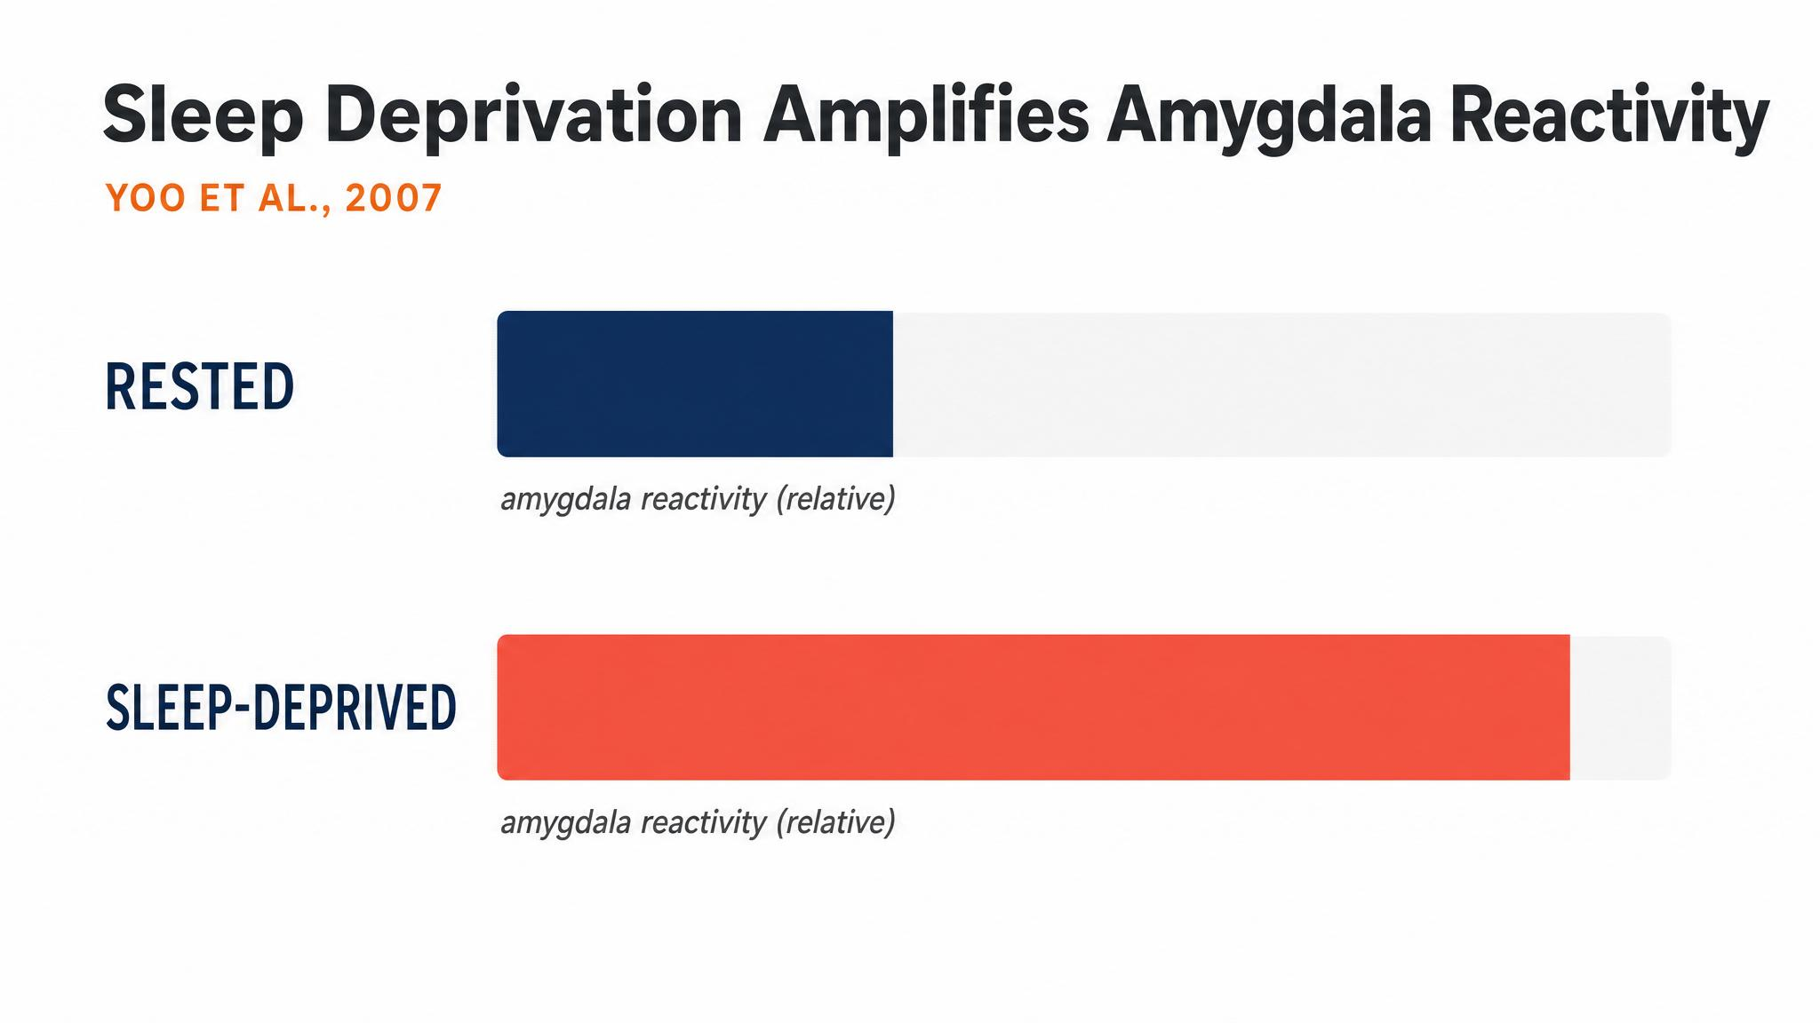
Notes:
Goldstein and Walker 2014: sleep deprivation amplified amygdala reactivity to negative emotional stimuli by roughly sixty percent. And the connection between the amygdala and the medial prefrontal cortex — the circuit that normally keeps emotional responses in check — was reduced. Caveat them with Tempesta 2018: contradictory findings exist; REM and NREM work as a coordinated system.

Slide 10
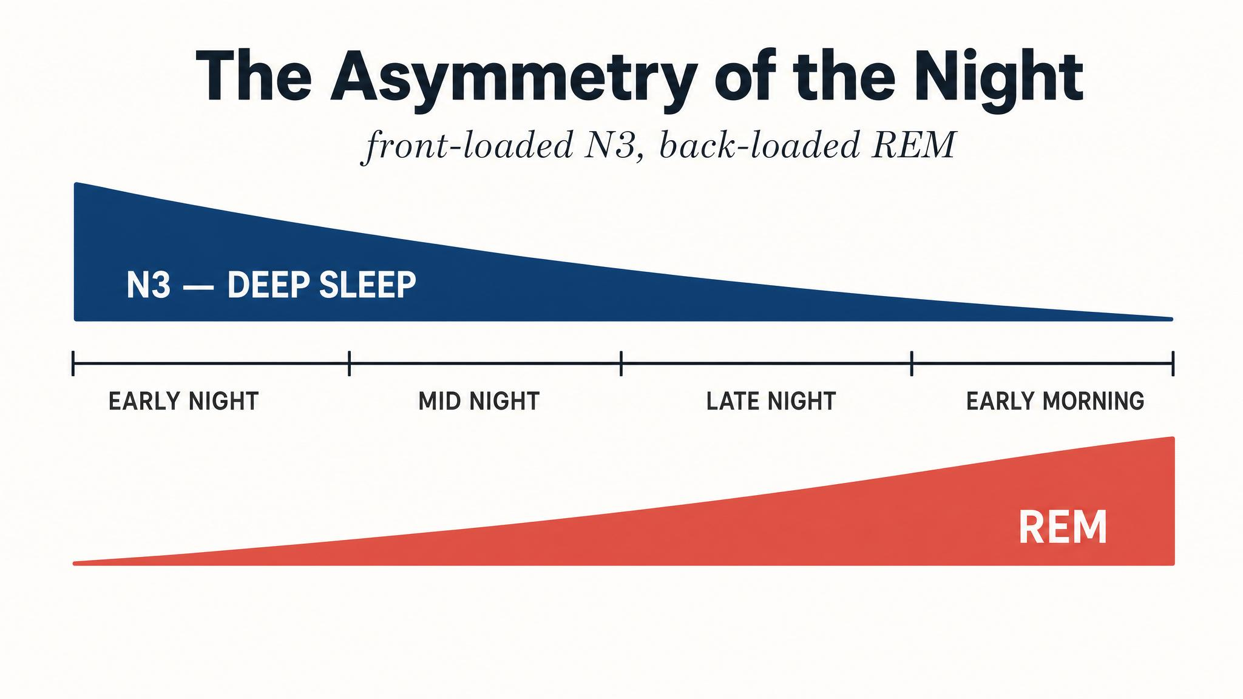
Notes:
This is the central asymmetry. The first half of the night is biased toward N3 because Process S — adenosine pressure — peaks at sleep onset. The second half tilts toward REM because Process C — the circadian gate — favours REM in the early morning hours. The two-process model from Chapter 1 doesn't just decide when you sleep; it programs the internal structure of each night.

Slide 11
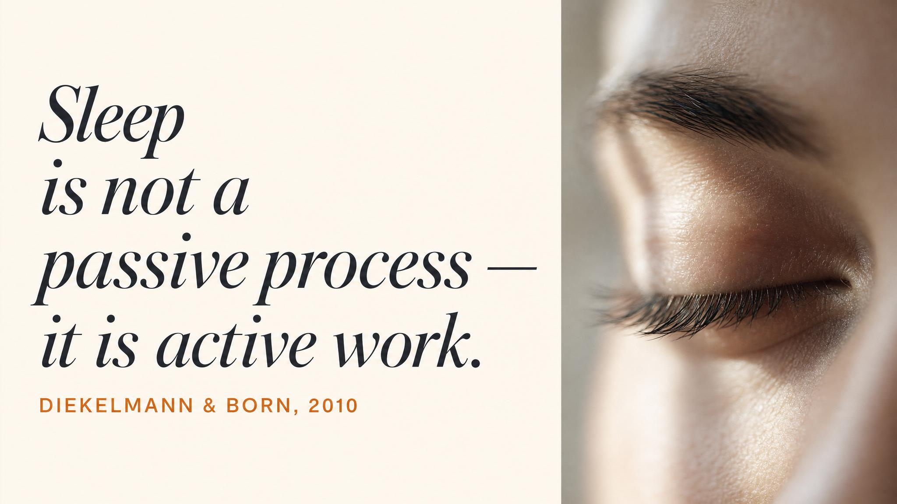
Notes:
Pause. Read this quote aloud slowly. The sleeping brain is not maintaining memories — it is actively reorganising them, extracting gist, integrating them into existing knowledge networks. This is the central reframe of the chapter: sleep is not a passive resting state. It is generative cognitive work.

Slide 12
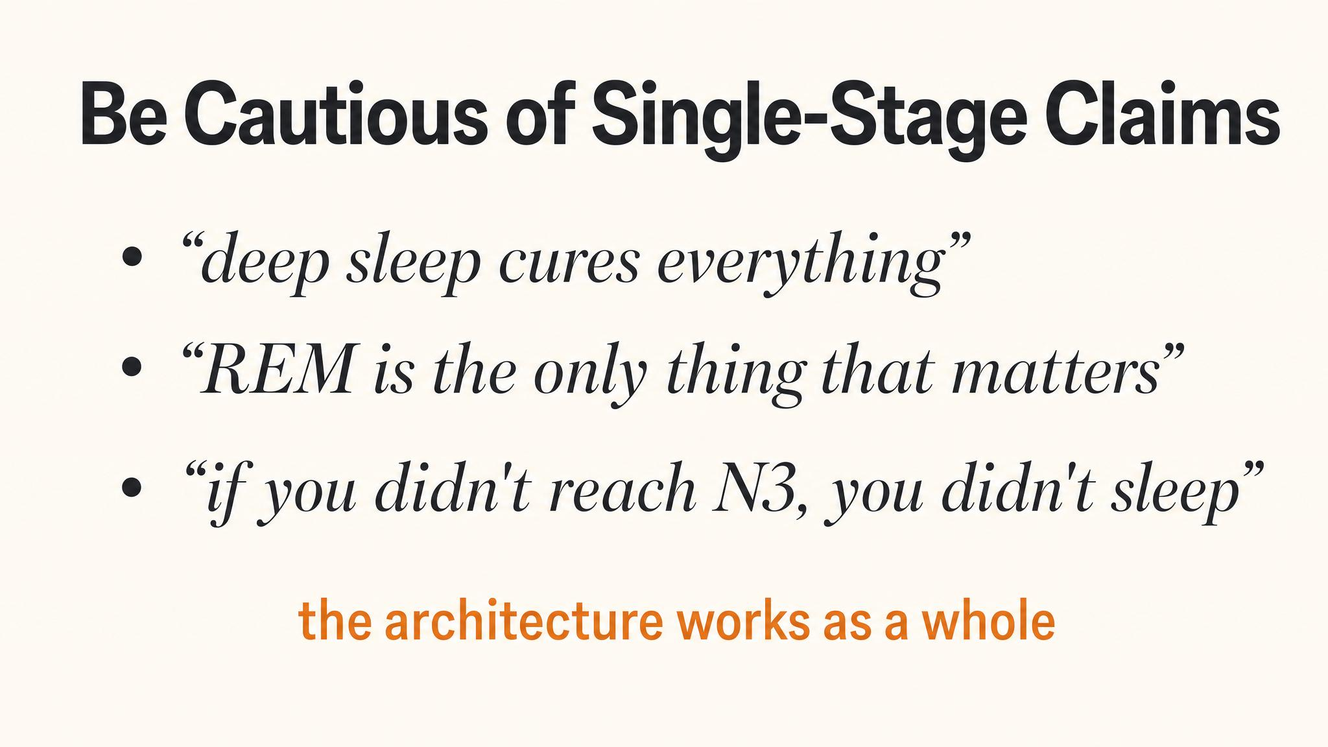
Notes:
Build students' critical immunity. Popular accounts love single-stage claims — 'REM does emotion.' Tempesta and colleagues 2018 caution that contradictory findings exist. Schönauer and Rasch 2015 propose NREM first consolidates content, then REM integrates and decontextualises. Lesson: be sceptical of any claim that assigns a complex psychological function to a single sleep stage.

Slide 13
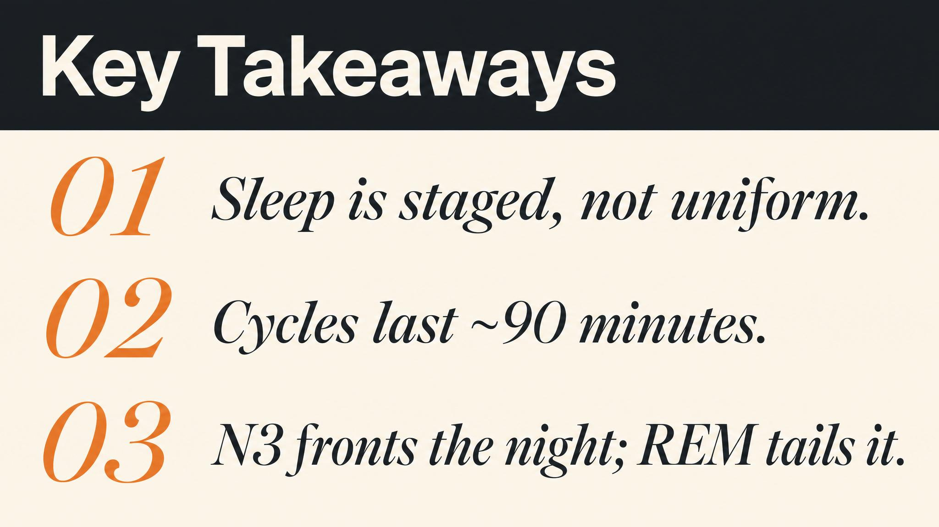
Notes:
Three things to carry forward. One: sleep is not a uniform state — it is a staged sequence, cycling roughly every ninety minutes. Two: that sequence is asymmetric — N3 dominates the first half, REM dominates the second. Three: no stage does its job alone — they are a coordinated system. Pause briefly on each.

Slide 14

Notes:
Close with the bridge to the next class. You now know the architecture of a single night. Next chapter: the single most powerful tool for controlling that clock — light. Melanopsin-containing retinal cells, the phase-response curve, morning sunlight, evening avoidance. Light, treated correctly, is the most powerful button on your clock.

