Slide 1
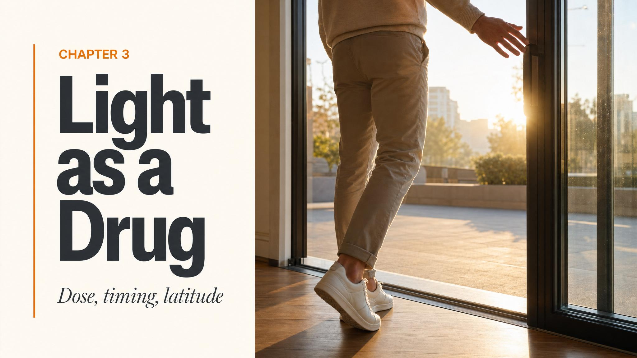
Notes:
Open with the Wright 2013 camping study. Eight volunteers, seven days under natural skies in the Colorado Rockies, no electric light — every internal clock shifted roughly two hours earlier and the gap between owls and larks shrank. Use this hook to ask: what was the active ingredient? Hold the question. The answer is light.

Slide 2
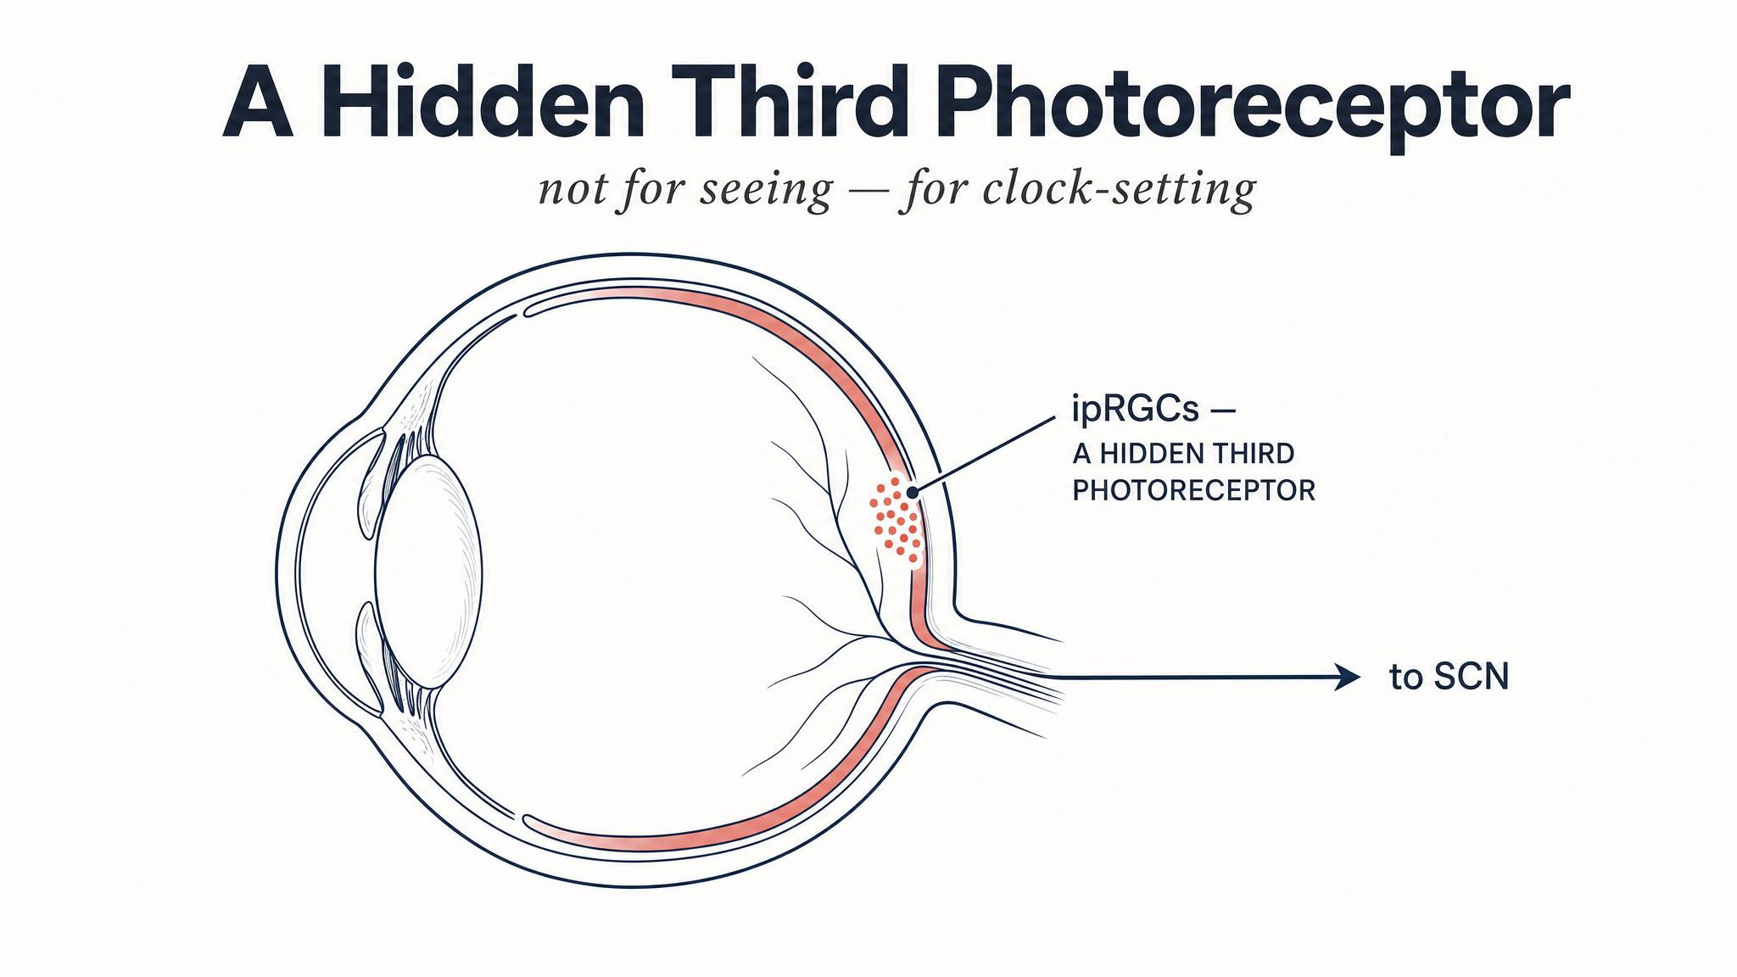
Notes:
Until the early two-thousands, textbooks listed two photoreceptors: rods and cones. Schmidt, Hattar, and Berson described a third class in 2019 — intrinsically photosensitive retinal ganglion cells, only 1-2% of RGCs, with long branching dendrites and their own photopigment. They look nothing like rods or cones.

Slide 3
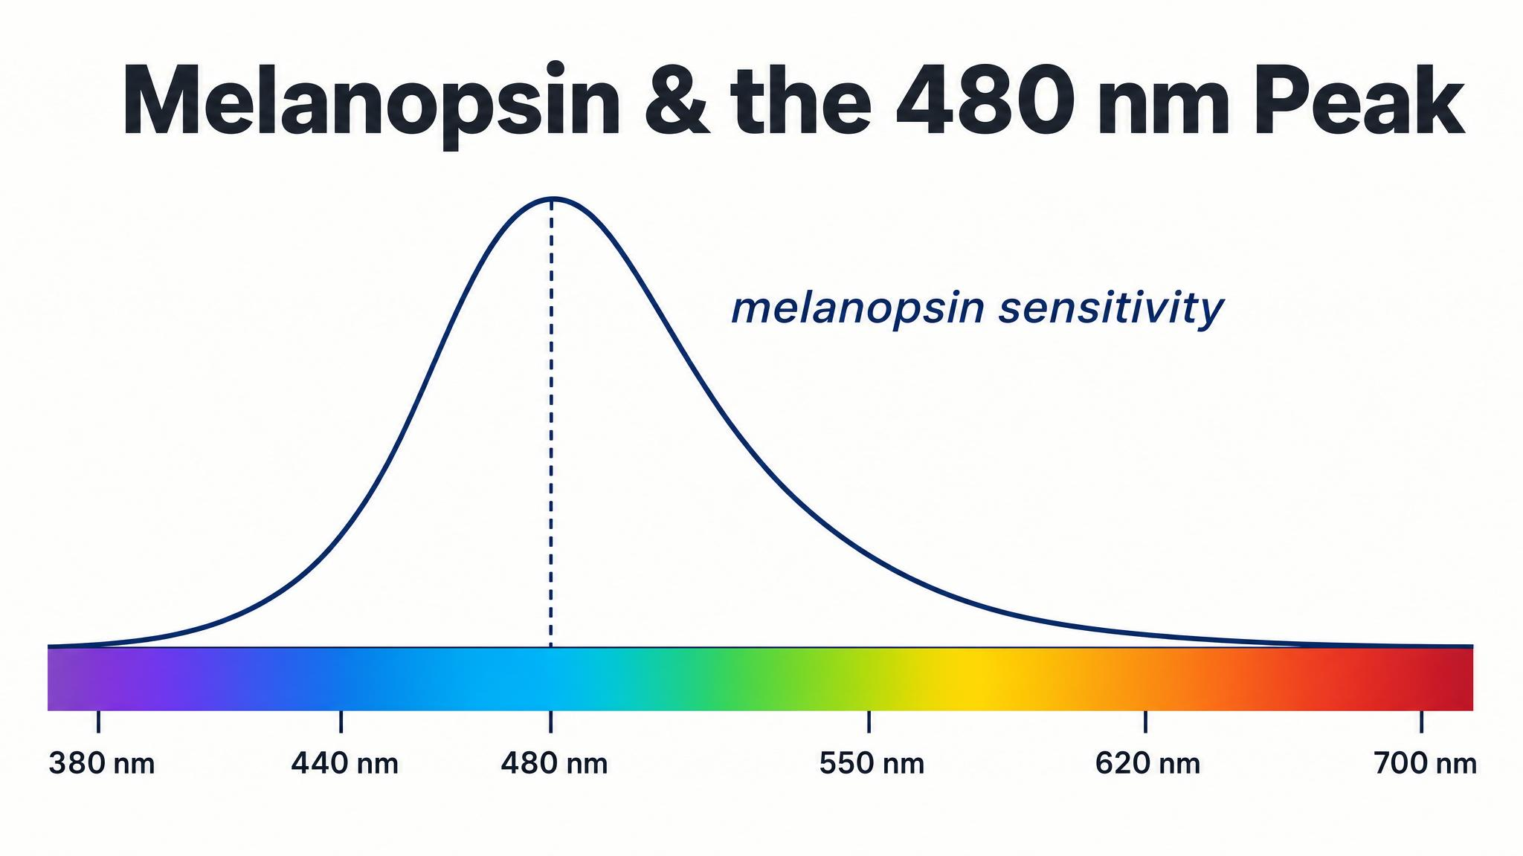
Notes:
Melanopsin is the photopigment inside the ipRGCs — an ancient molecule, closer to invertebrate photopigments than to the rhodopsin in your rods. Its peak sensitivity is around 480 nanometres — blue light. The ipRGC depolarises slowly and keeps firing for minutes; it's asking one question, all day long: how bright is the world right now?

Slide 4
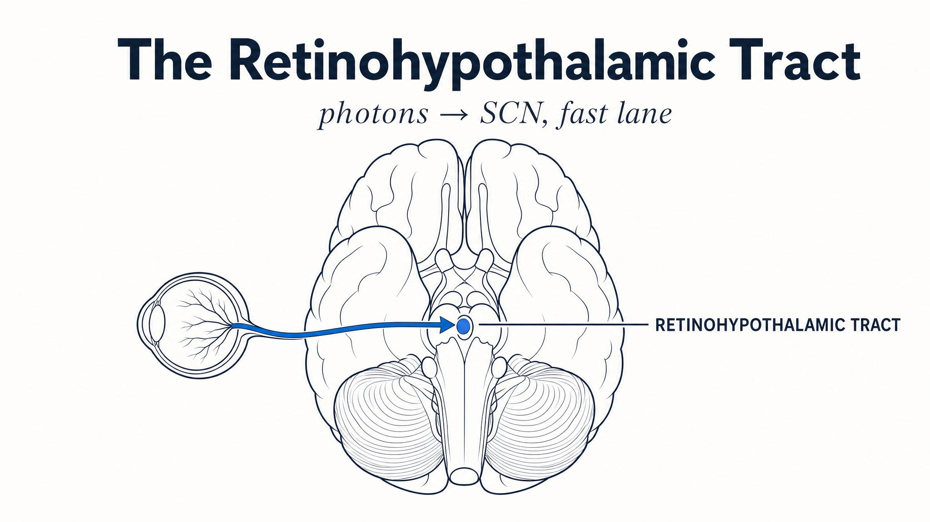
Notes:
The ipRGCs project directly to the SCN via the retinohypothalamic tract — among the most direct sensory pathways in the entire brain. Monosynaptic: one cell, one synapse, one destination. Its sole purpose is to keep your internal clock locked to the light-dark cycle outside.

Slide 5
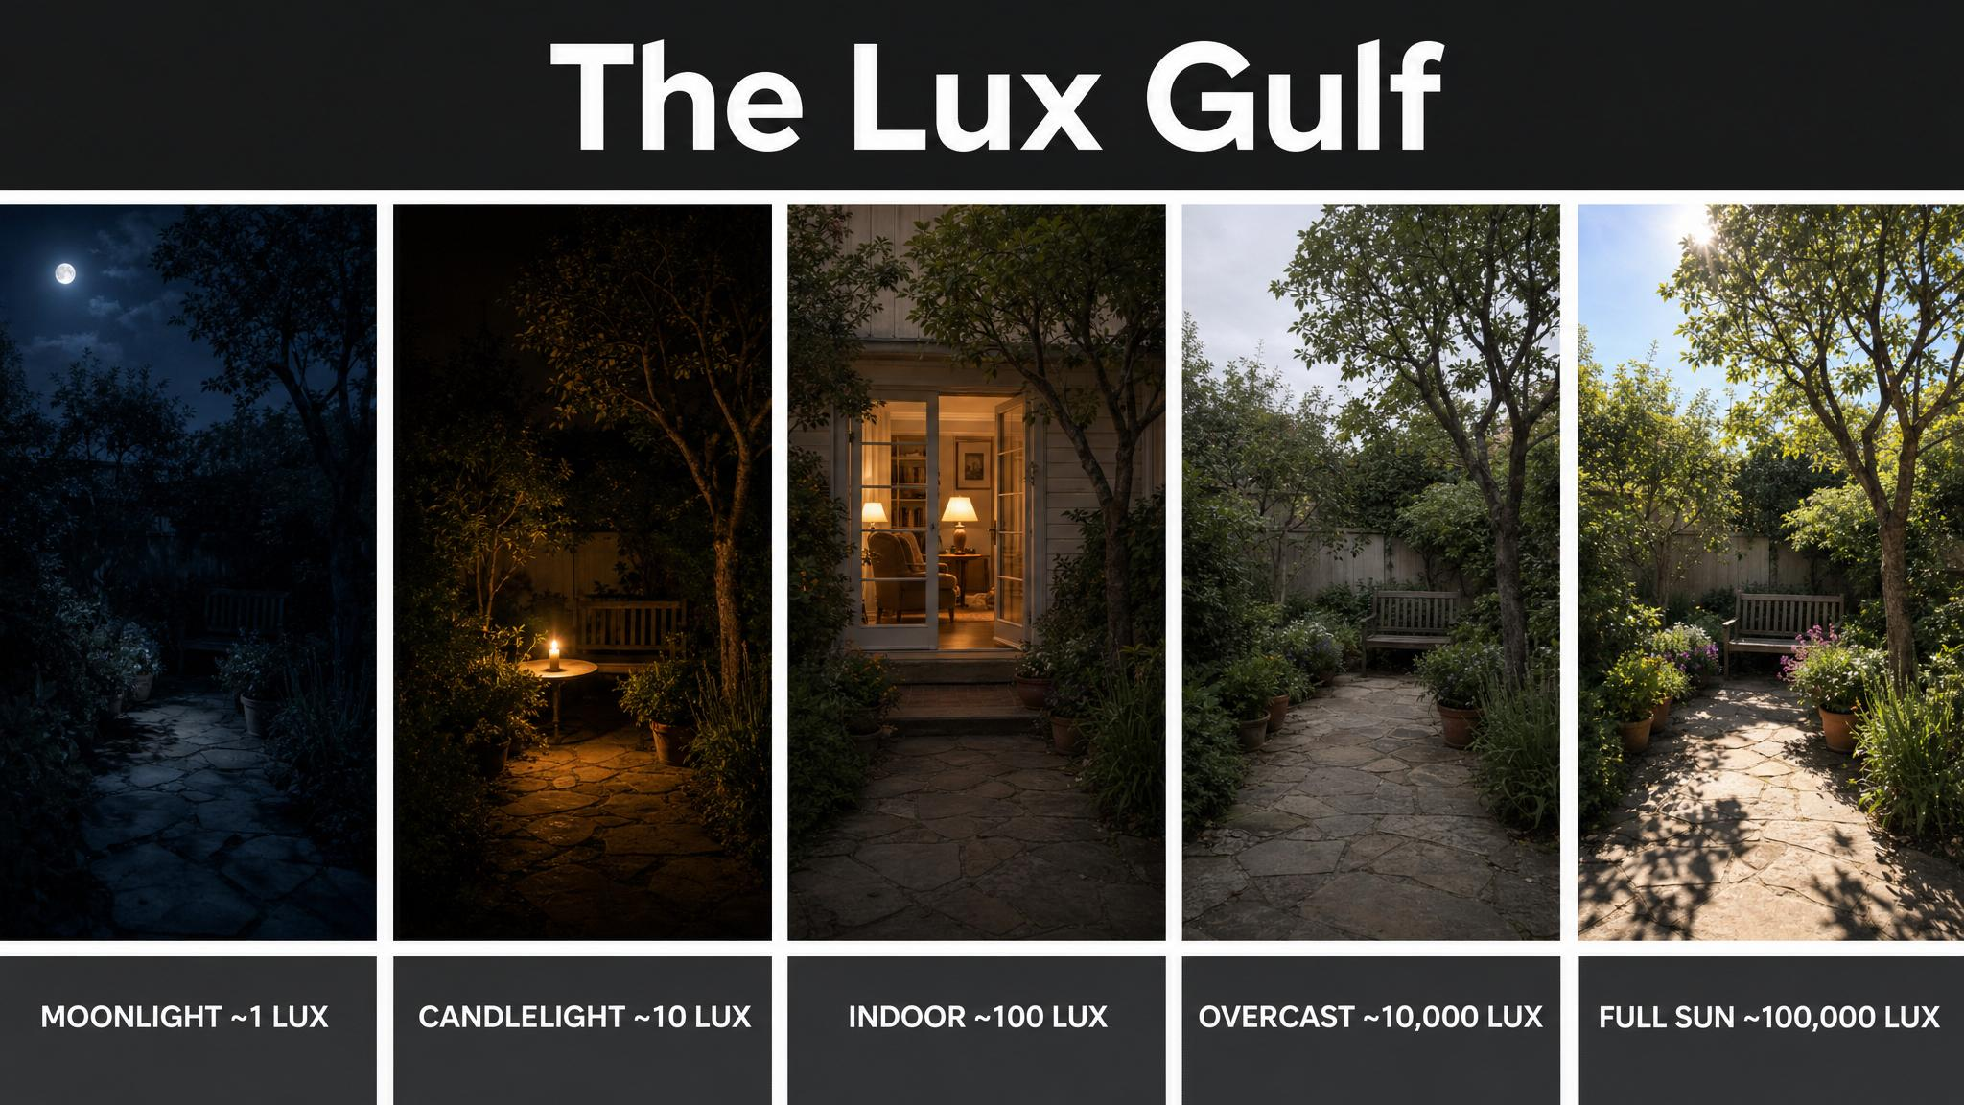
Notes:
Walk the room across the scale. Candlelight ~10 lux. A bright office or classroom, 200-500 lux. An overcast outdoor day, 2,000-10,000 lux. Direct sun, 30,000-100,000 lux. Even overcast cloud cover delivers ten to fifty times more light than a well-lit office. Wright's campers received roughly thirteen times more daytime light than under normal indoor conditions.

Slide 6
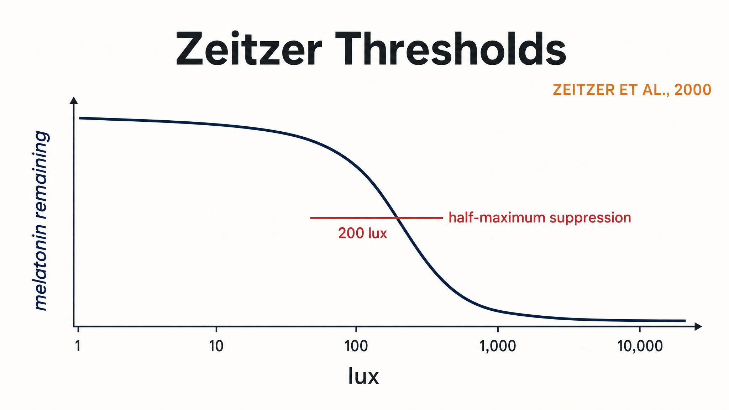
Notes:
Zeitzer and colleagues 2000 mapped the curve. Half-maximum melatonin suppression at roughly 100-120 lux — ordinary room light already engages the system. Suppression saturates around 200 lux; phase-shifting saturates near 550 lux. To get a strong, reliable entrainment signal, researchers typically use 2,500 lux or more — natural daylight delivers this effortlessly.

Slide 7
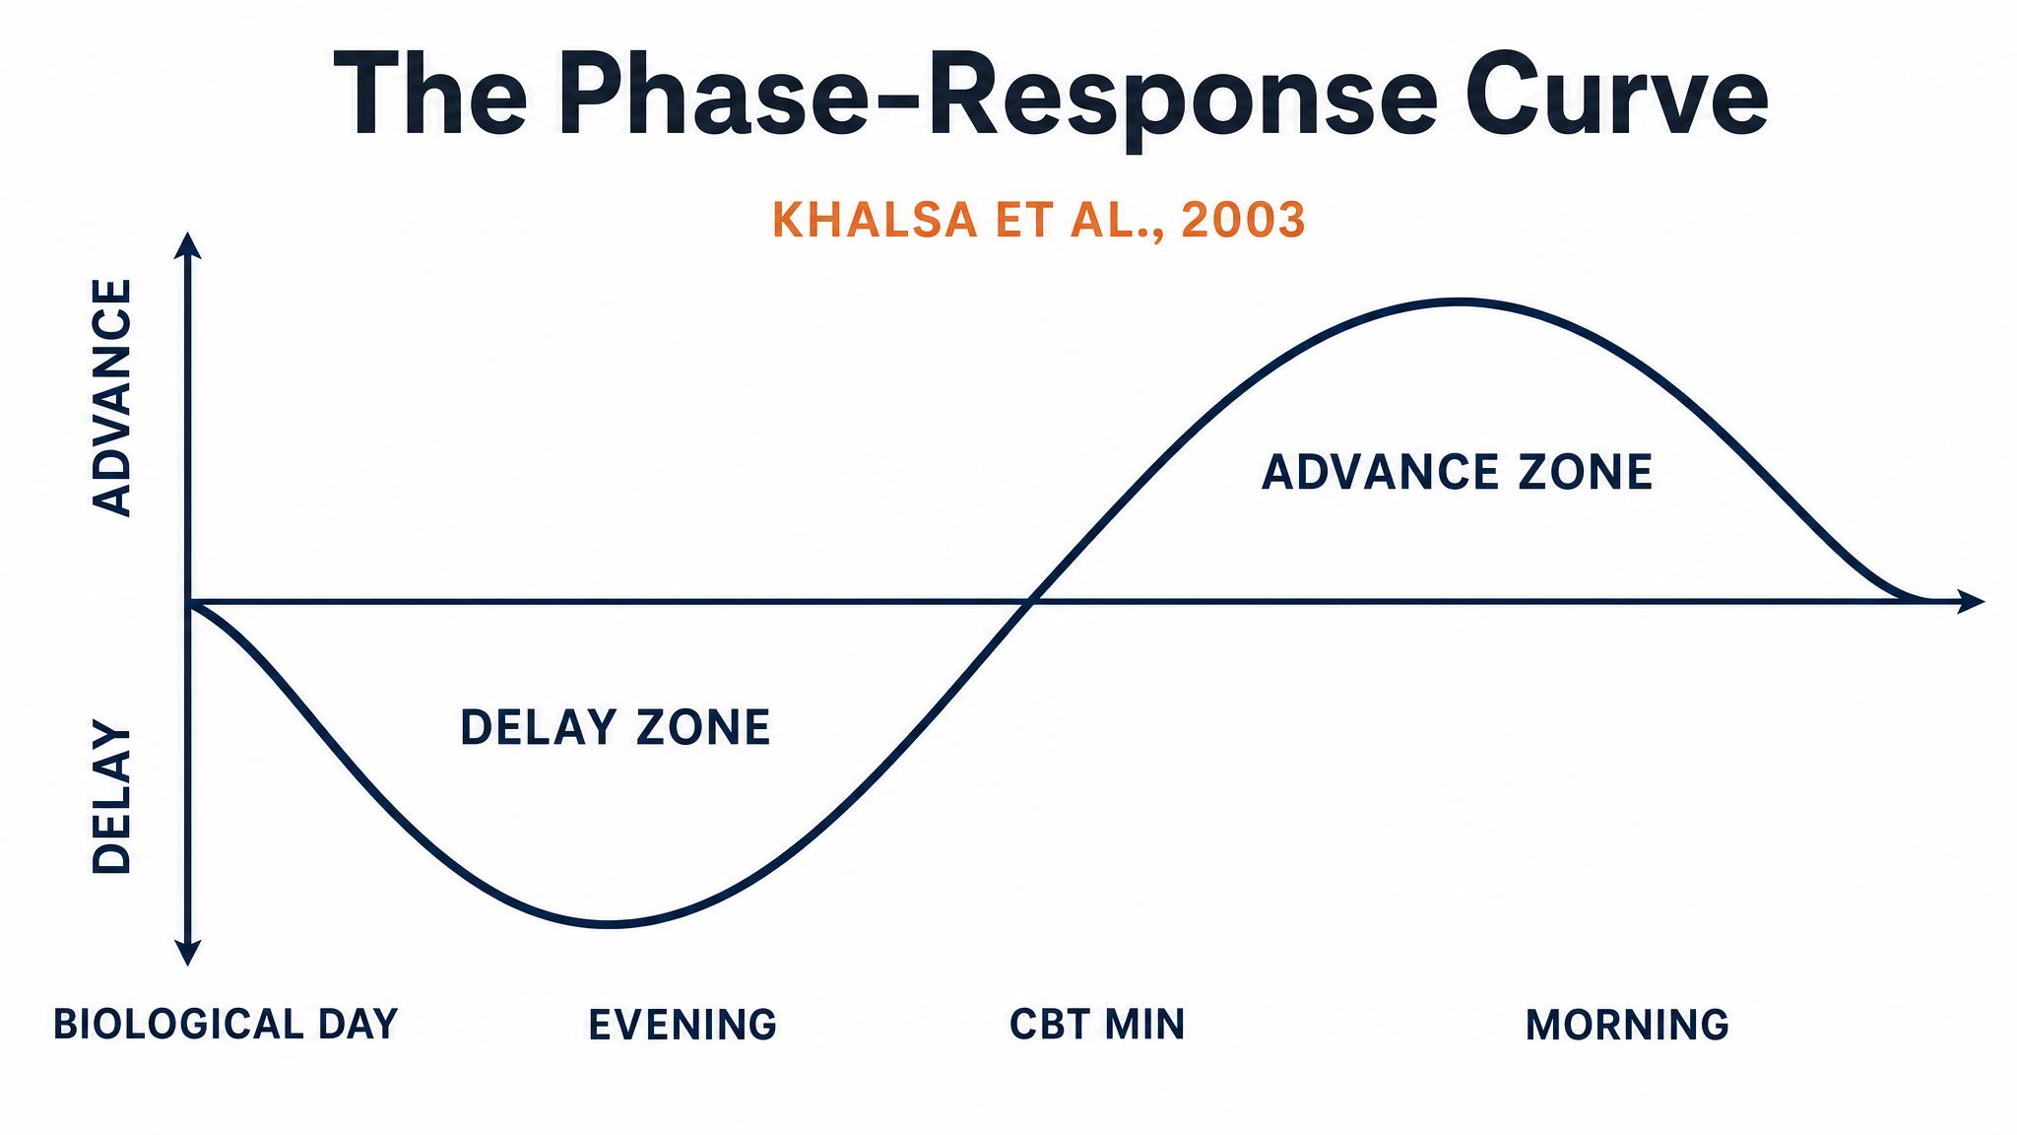
Notes:
Khalsa, Jewett, Cajochen, and Czeisler 2003 — twenty-one participants, 6.7-hour pulses at ~10,000 lux, given at different circadian phases. Light before CBTmin delays the clock; light after CBTmin advances it. There is no extended dead zone — afternoon is the system's quietest hour, but never truly silent.

Slide 8
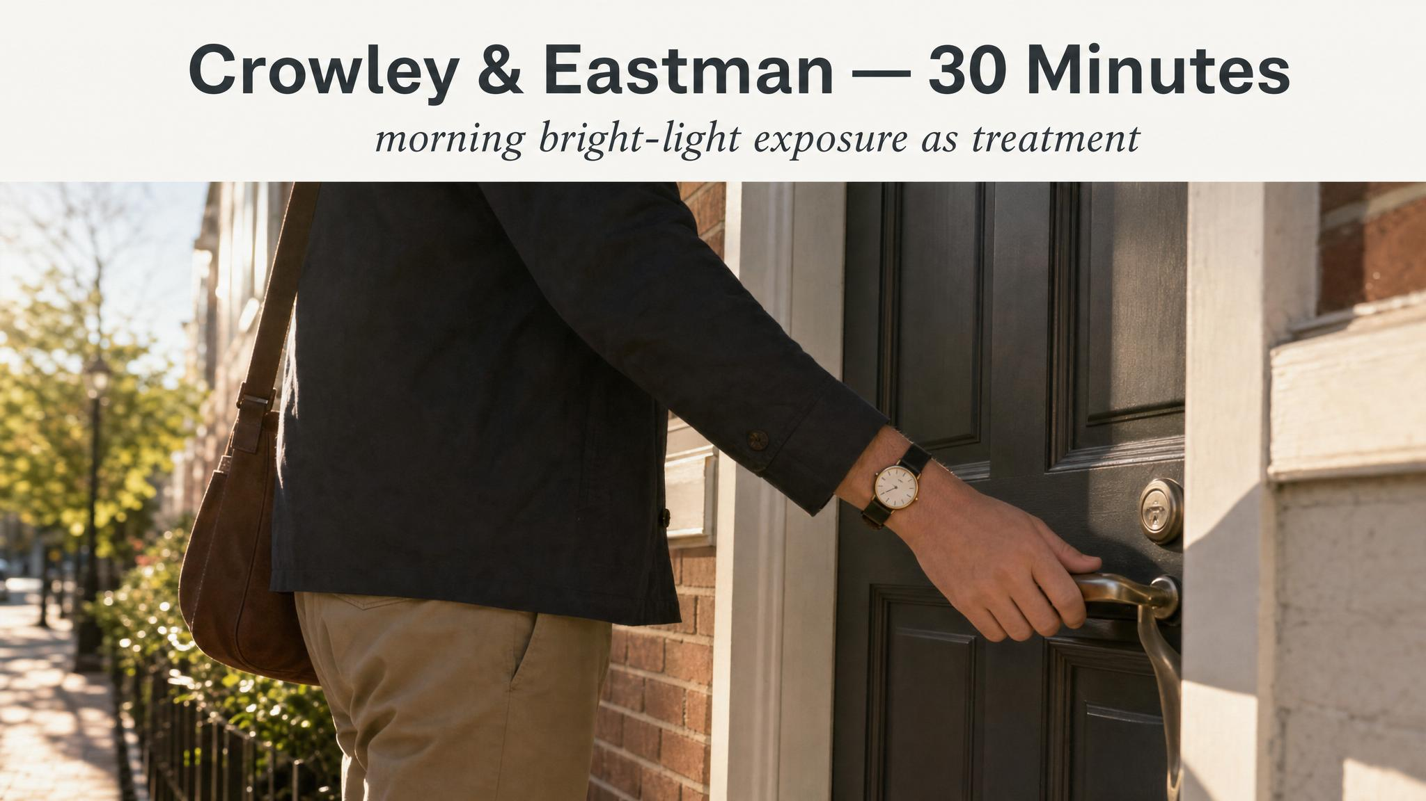
Notes:
Crowley and Eastman 2015 tested duration directly. Just 30 minutes of morning bright light at ~5,000 lux produced a 1.8-hour phase advance — roughly 75% of the maximum effect from a full two-hour exposure. You do not need to spend hours outdoors. A focused fifteen to thirty minutes shortly after waking is enough.

Slide 9
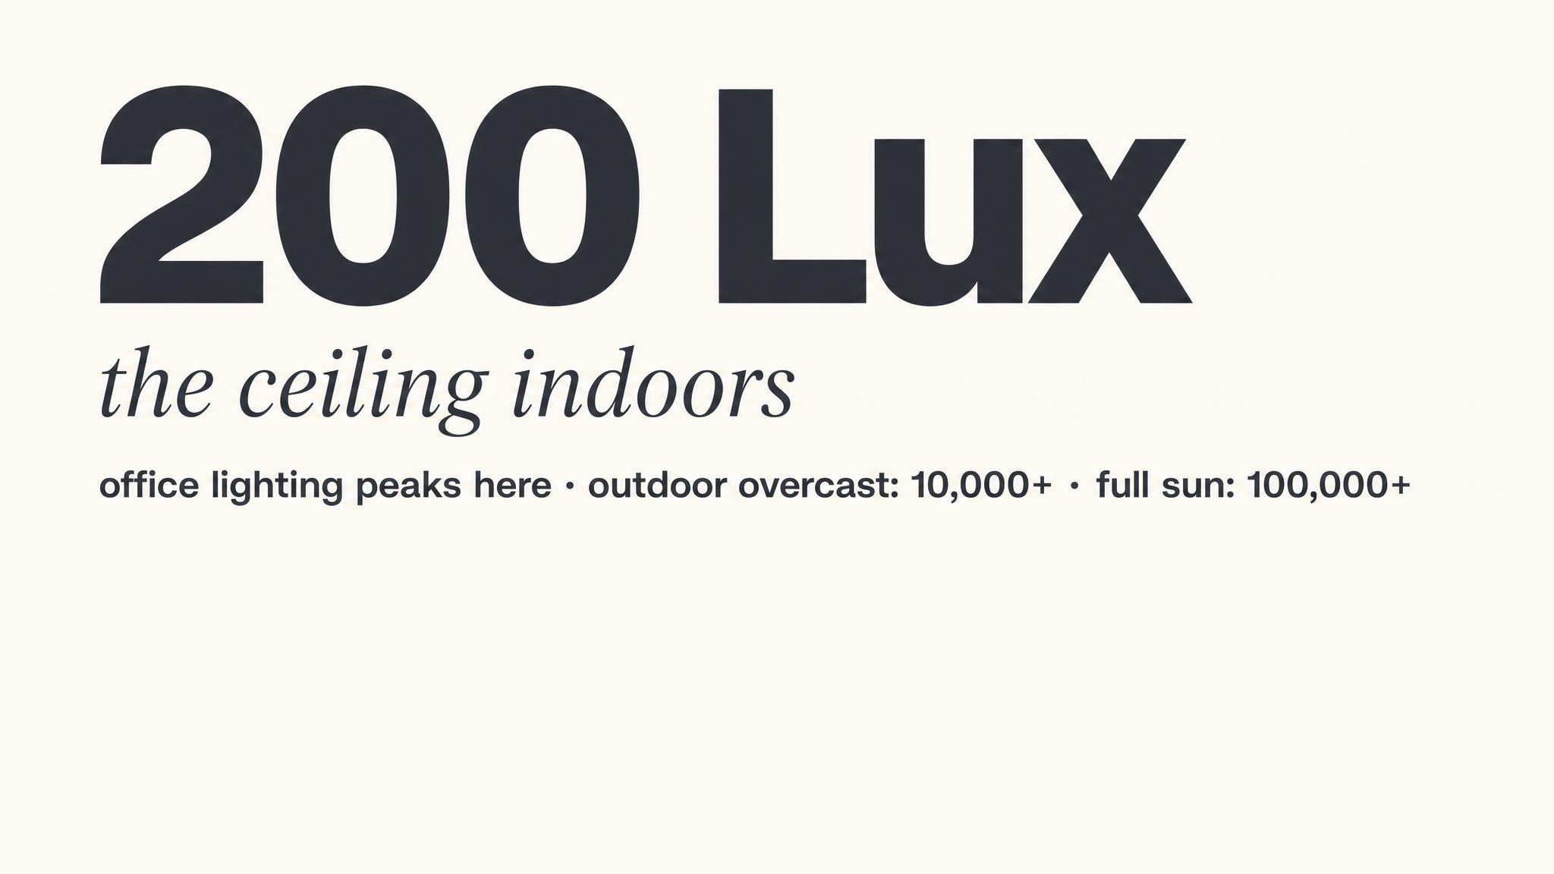
Notes:
Melatonin suppression saturates at only ~200 lux (Zeitzer 2000). A phone at arm's length delivers 30-80 lux — real, but modest. A dim-room target of 50 lux or below is reasonable. Bright overhead room lighting easily breaks the 200-lux ceiling, particularly the lower-retina overhead lights that reach dense ipRGC dendrites.

Slide 10
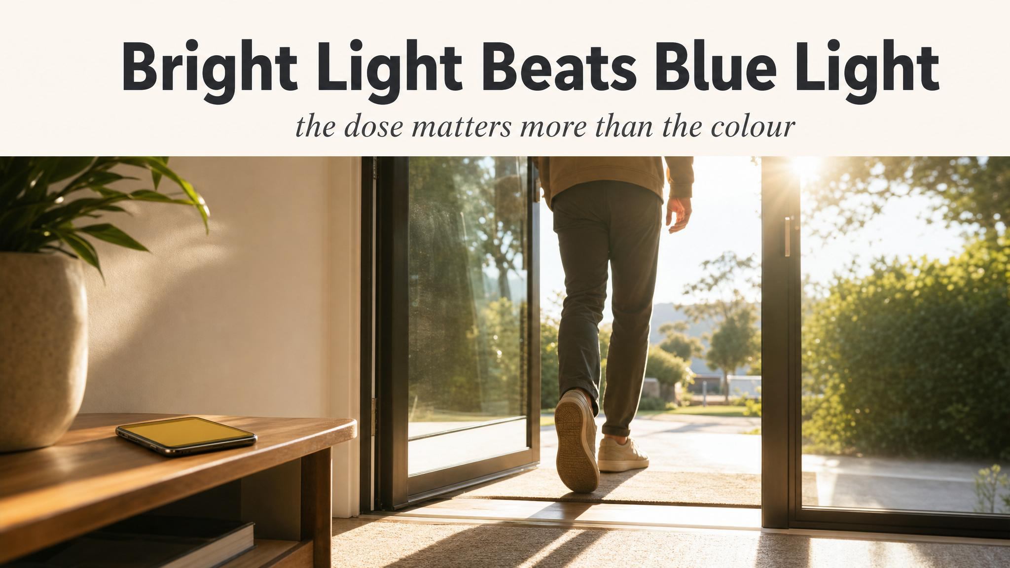
Notes:
Pause here. St. Hilaire and colleagues 2022 exposed one hundred participants to monochromatic light across wavelengths. Early minutes — the short-wavelength S-cones contribute. As exposure continues over hours, melanopsin dominates. The system is broadly responsive. Total intensity matters far more than colour.

Slide 11
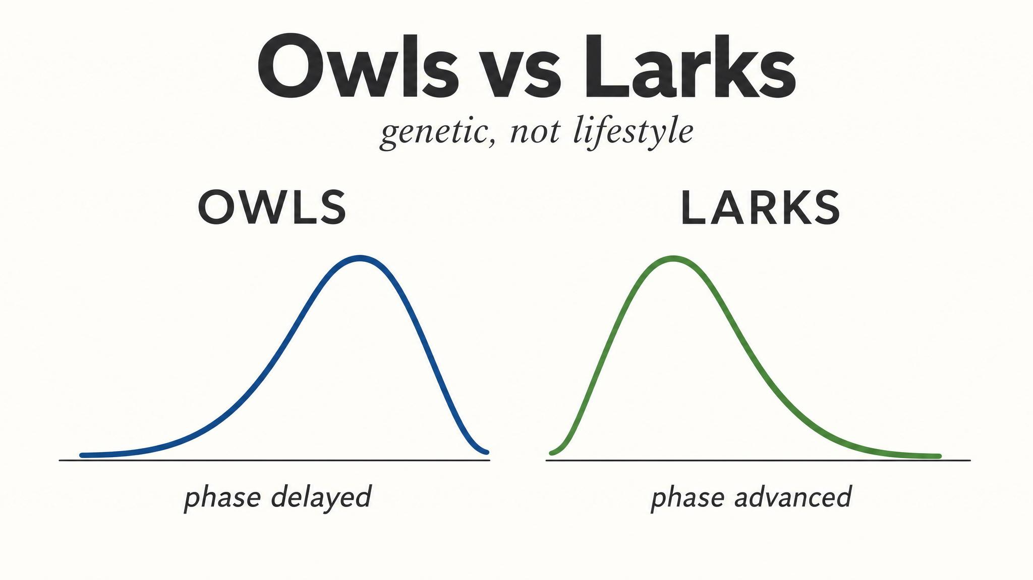
Notes:
Chronotype sets the baseline; light shapes where it lands. A lark with MSFsc 2:30 a.m. and an owl with MSFsc 5:30 a.m. — the PRC operates identically in both, but CBTmin sits at different clock times. 7 a.m. light hits the lark in the advance zone and the owl in the delay zone. The Dunster 2018 Seattle study — when school start shifted from 7:50 to 8:45 a.m., students gained 34 minutes of sleep, and morning light moved from delay zone into advance zone.

Slide 12

Notes:
Read slowly. The most effective sleep intervention available to most people costs nothing, requires no prescription, and takes less than thirty minutes — step outside in the morning. Dunster 2023 found daytime light is twice as predictive of sleep timing as evening light. Wright 2013 shifted clocks two hours earlier in a week, with nothing but sunlight.

Slide 13
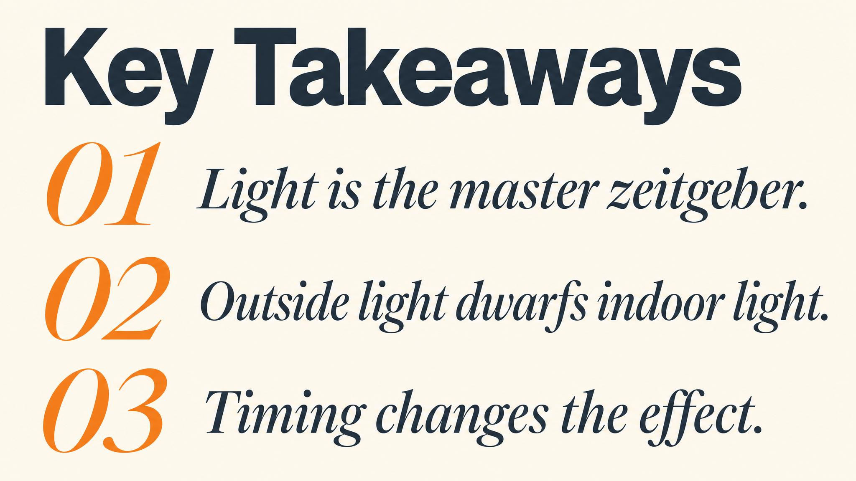
Notes:
Three takeaways. One: bright morning light after CBTmin pulls your clock earlier — the single most effective circadian intervention. Two: bright light beats blue light. The system is broadly responsive across wavelengths at higher intensities. Three: daytime light has roughly twice the predictive power for sleep timing as evening light. Pause on each.

Slide 14

Notes:
Close with the bridge. Light sets the timing of sleep; adenosine sets its urgency. Next chapter turns to sleep pressure and the homeostatic drive — and the molecule that blocks adenosine's signal. We'll see why caffeine's timing matters more than its dose.

