Slide 1
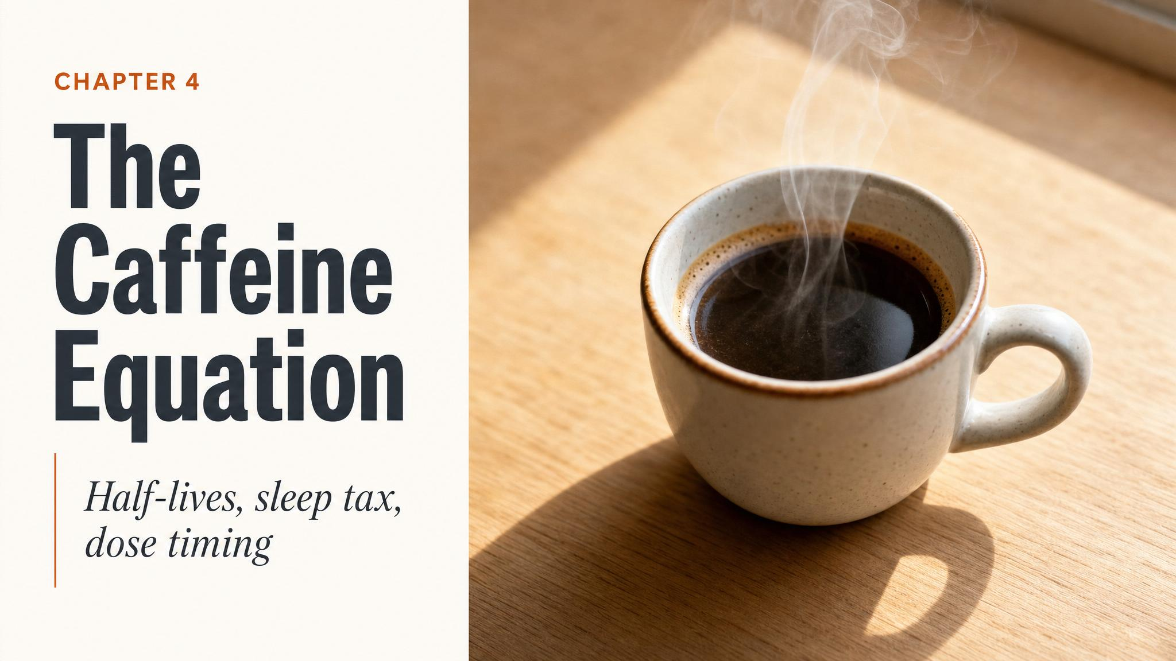
Notes:
Open with the central paradox of the chapter: caffeine doesn't give you energy — it hides your tiredness, and then quietly taxes the deepest stage of your sleep. Ask the room to keep an honest tally of when they had their last caffeinated drink today; you'll come back to it.

Slide 2
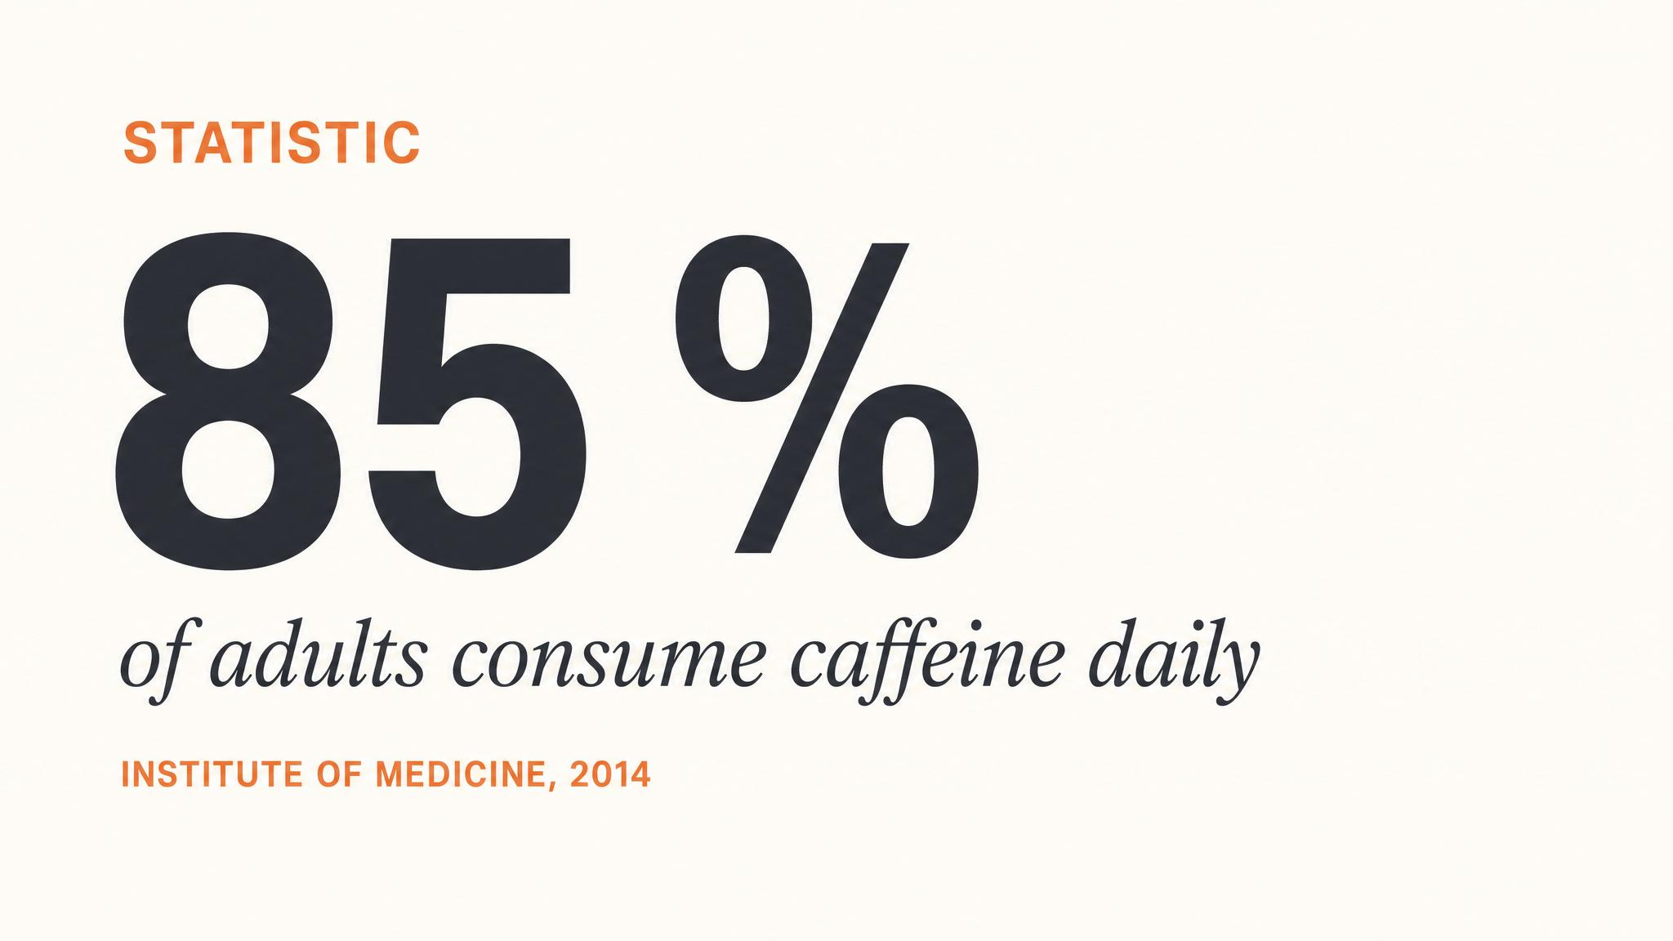
Notes:
Anchor the scale. Roughly 85% of adults worldwide consume caffeine daily. That's the background against which every claim in this chapter sits — we're not talking about a fringe drug, we're talking about the default chemistry of the global workforce.

Slide 3
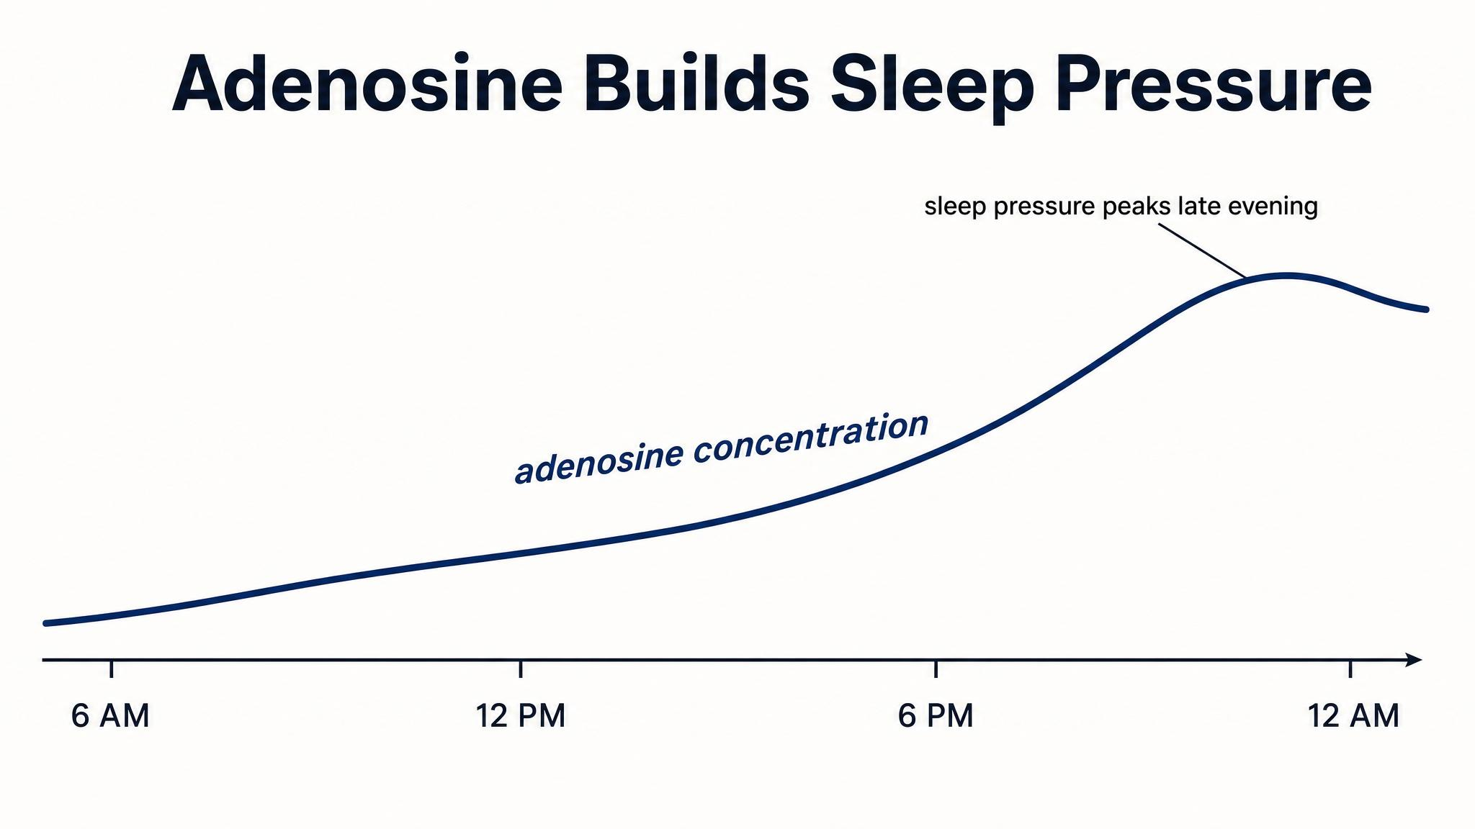
Notes:
Recall from Chapter 1: every neuron that fires burns ATP, and adenosine is the byproduct. It binds to A1 receptors (which inhibit wake-promoting neurons) and A2A receptors (which activate sleep-promoting pathways). That's how your brain knows it's tired (Reichert et al., 2022).

Slide 4
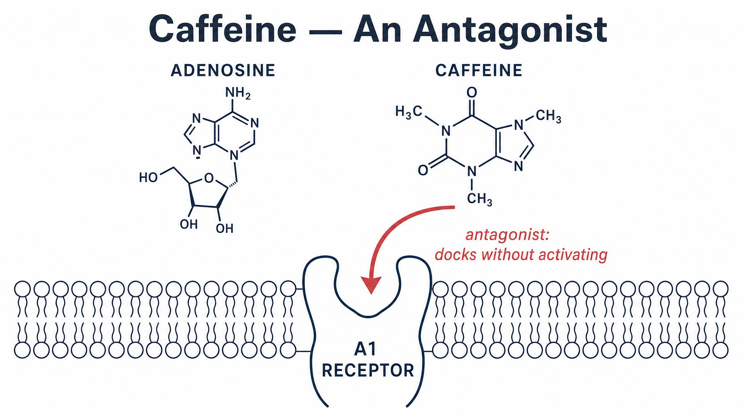
Notes:
Caffeine's three-dimensional structure is similar enough to adenosine that it can slide into the same receptors — but it occupies them without activating them. That's antagonism. The sleepiness signal stays quiet, yet adenosine itself keeps accumulating in the background (Reichert et al., 2022).

Slide 5
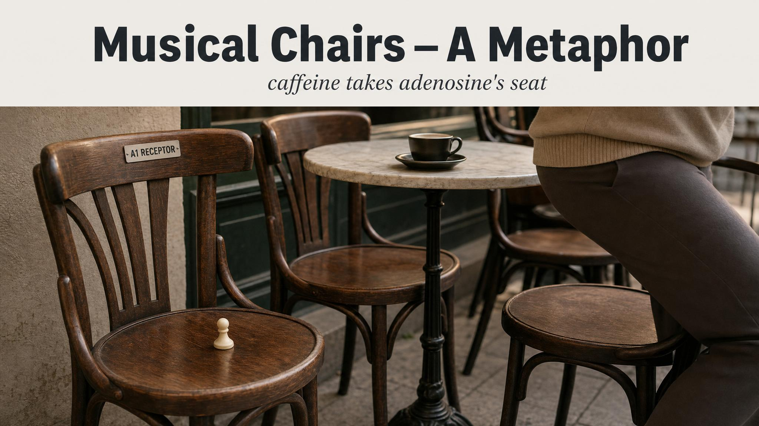
Notes:
The metaphor: adenosine players want to sit. Caffeine imposters get there first, occupy the chairs, and the sleepiness signal stays quiet. But adenosine production doesn't stop. The players are still arriving — they just can't sit down. When the caffeine finally clears, every chair fills at once.

Slide 6
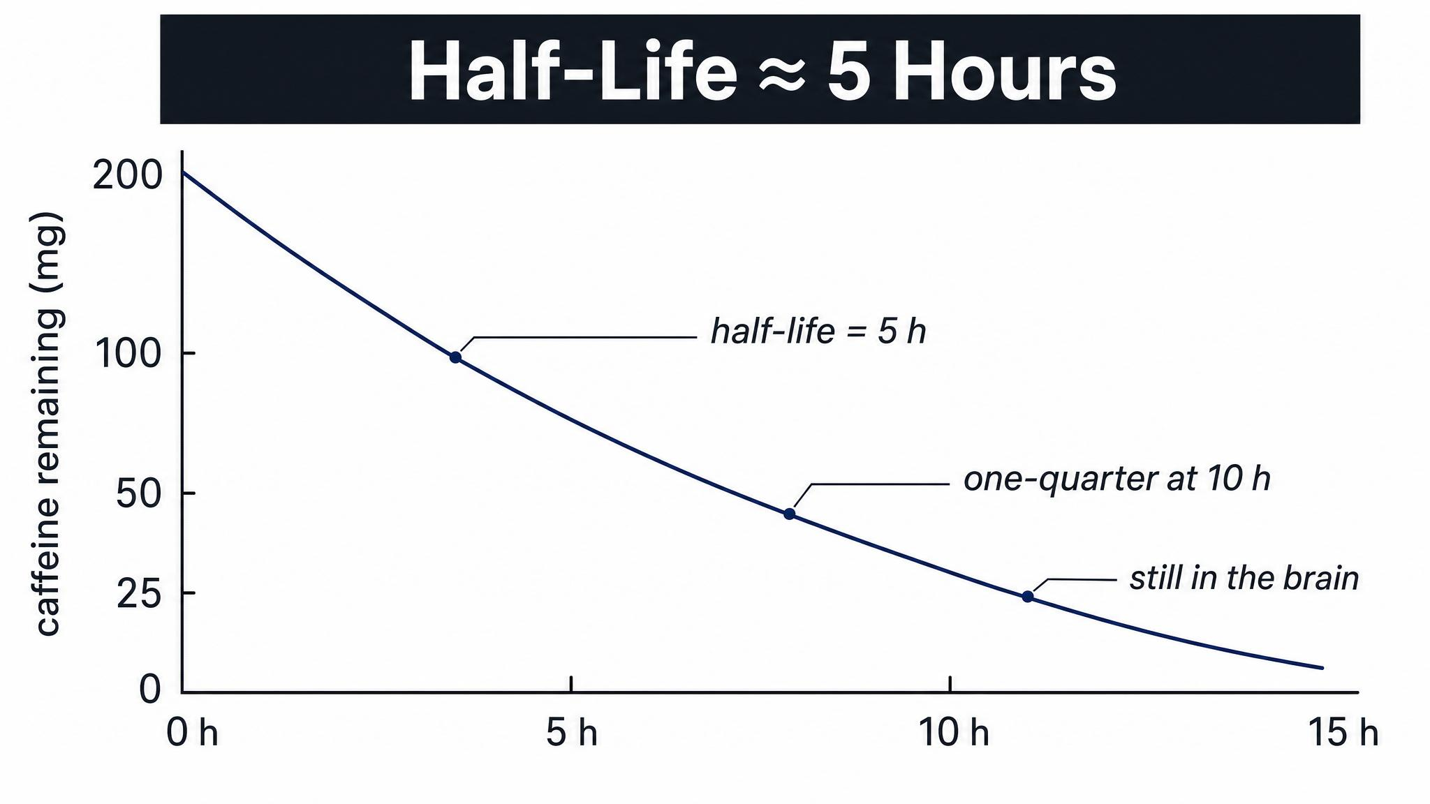
Notes:
The average half-life is about 5 hours in healthy adults (range 1.5 to 9.5 hours, Institute of Medicine 2001). A 200 mg coffee at 2 p.m. is still 100 mg at 7 p.m., 50 mg at midnight, 25 mg at 5 a.m. Single doses linger longer than people realise.

Slide 7
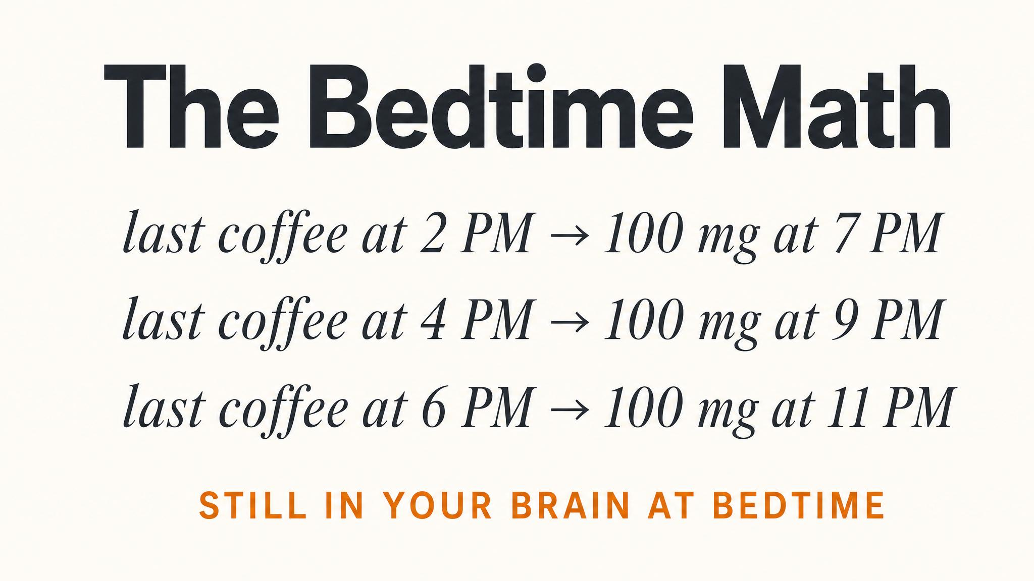
Notes:
Walk the class through the arithmetic out loud. The 200 mg latte at 2 p.m. is still half-dose at 7 p.m., still a quarter-dose at midnight, still measurable at 5 a.m. That's why 'I had it hours ago' is rarely the defence it sounds like.

Slide 8
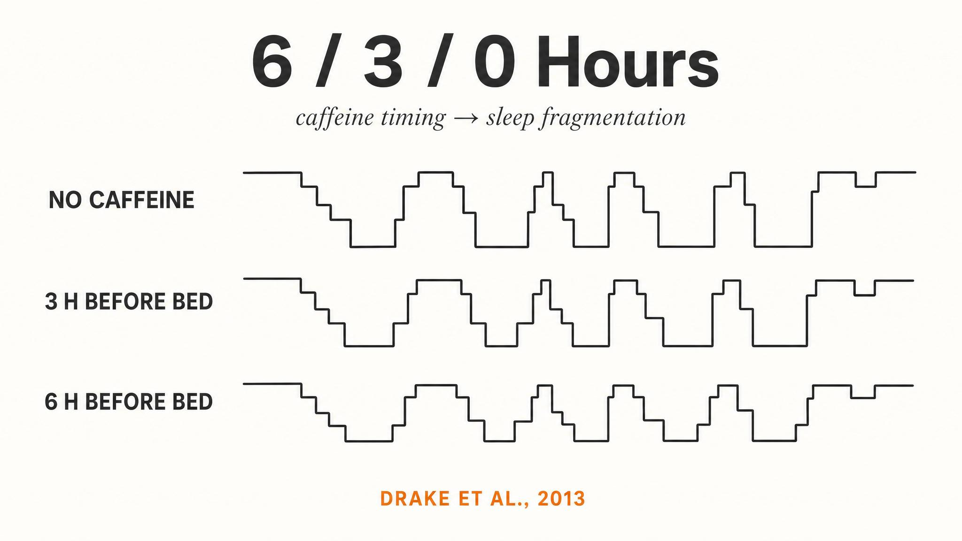
Notes:
The landmark study. Drake and colleagues (2013) gave 400 mg of caffeine 0, 3, or 6 hours before bed. Even the 6-hour condition lost more than an hour of total sleep — and the participants didn't notice. Subjective ratings were unchanged; polysomnography told the truth.

Slide 9
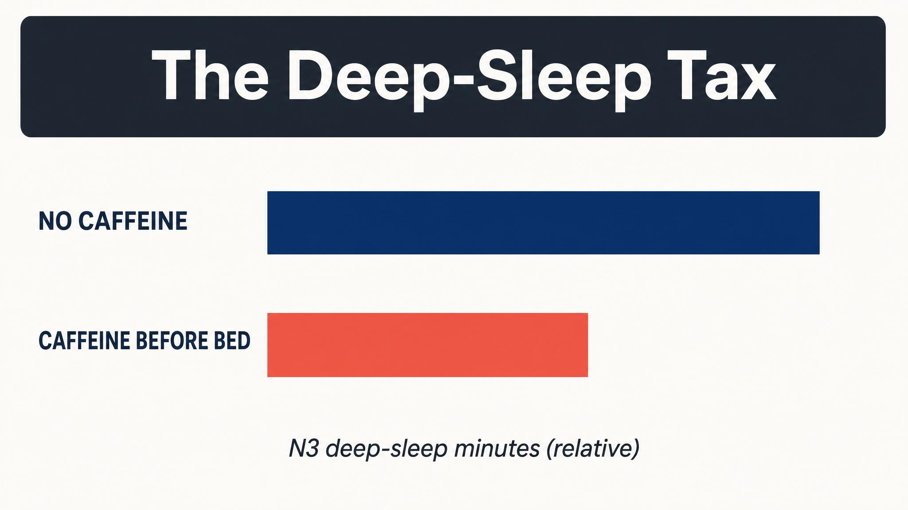
Notes:
Gardiner and colleagues (2023) — a meta-analysis across multiple studies — found a significant dose-dependent reduction in N3 slow-wave sleep, averaging about 11.4 minutes. Four of the studies also showed reduced delta-frequency EEG power. It's not just less N3 time — it's shallower N3 too.

Slide 10
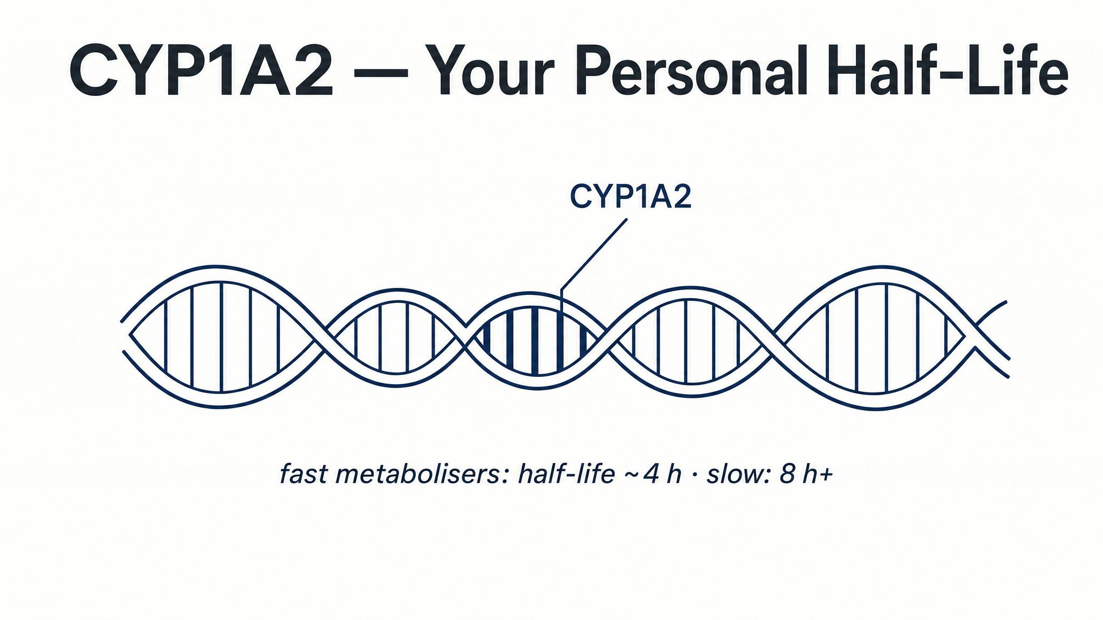
Notes:
About 95% of caffeine is metabolised by the CYP1A2 enzyme in the liver (Nehlig, 2018). Fast metabolisers may clear it in 2–3 hours; slow metabolisers in 7–9. Genetic knockout mice without CYP1A2 had half-lives seven times longer (Berthou et al., 1996). Oral contraceptives roughly double half-life; pregnancy extends it up to 15 hours.

Slide 11
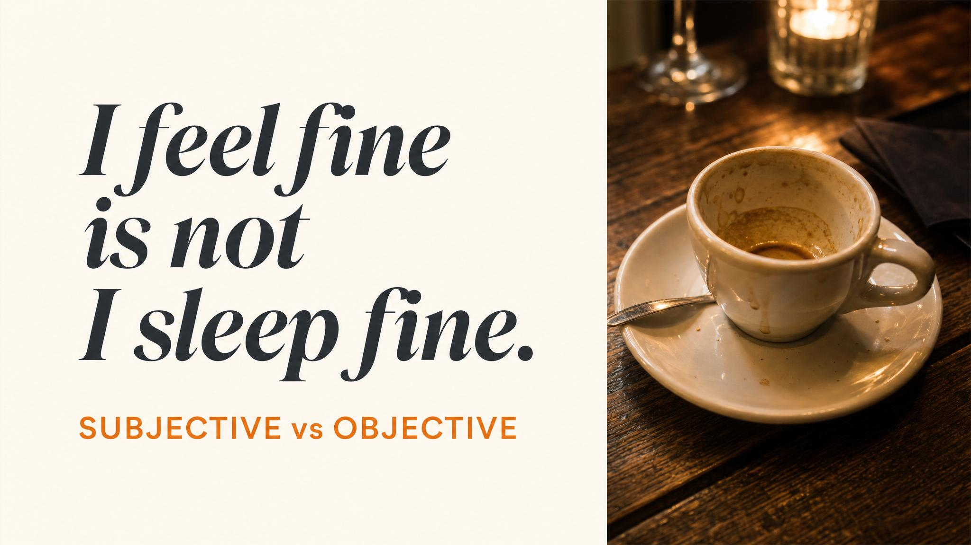
Notes:
Read the Drake et al. quote aloud and let it sit. This is the central humility of the chapter — your gut feel about how a coffee affected your sleep is a poor proxy for what polysomnography would actually show. The damage is silent.

Slide 12
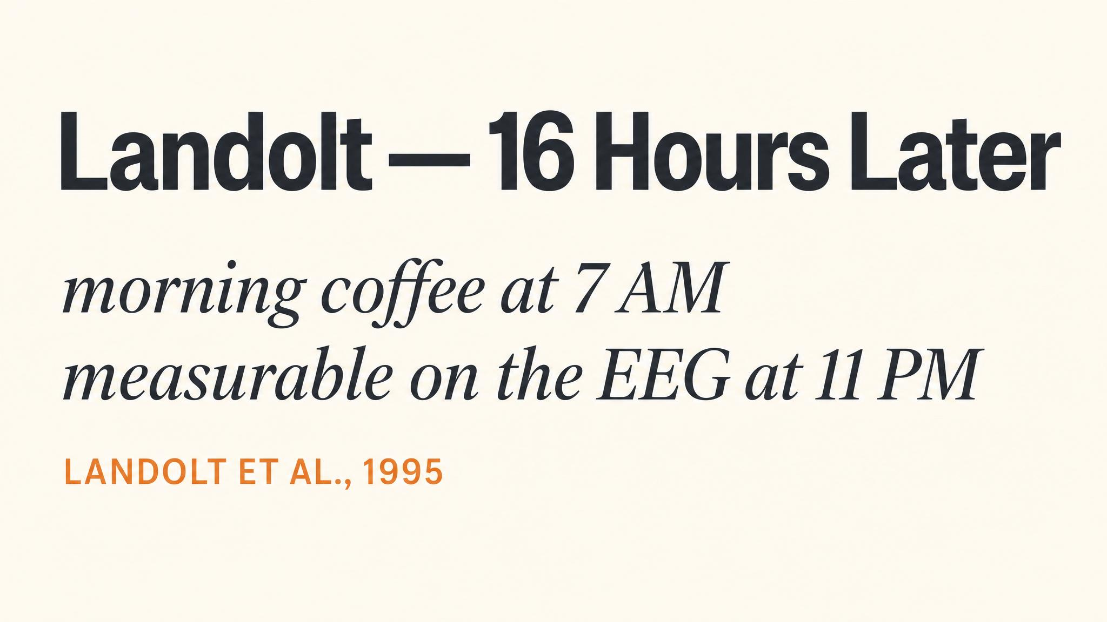
Notes:
Landolt and colleagues (1995) administered 200 mg of caffeine at 7:10 in the morning — roughly 16 hours before sleep onset — and still observed reduced sleep efficiency and reduced delta-frequency power that night. Even when salivary caffeine had cleared, the residual impact on slow-wave architecture was measurable.

Slide 13
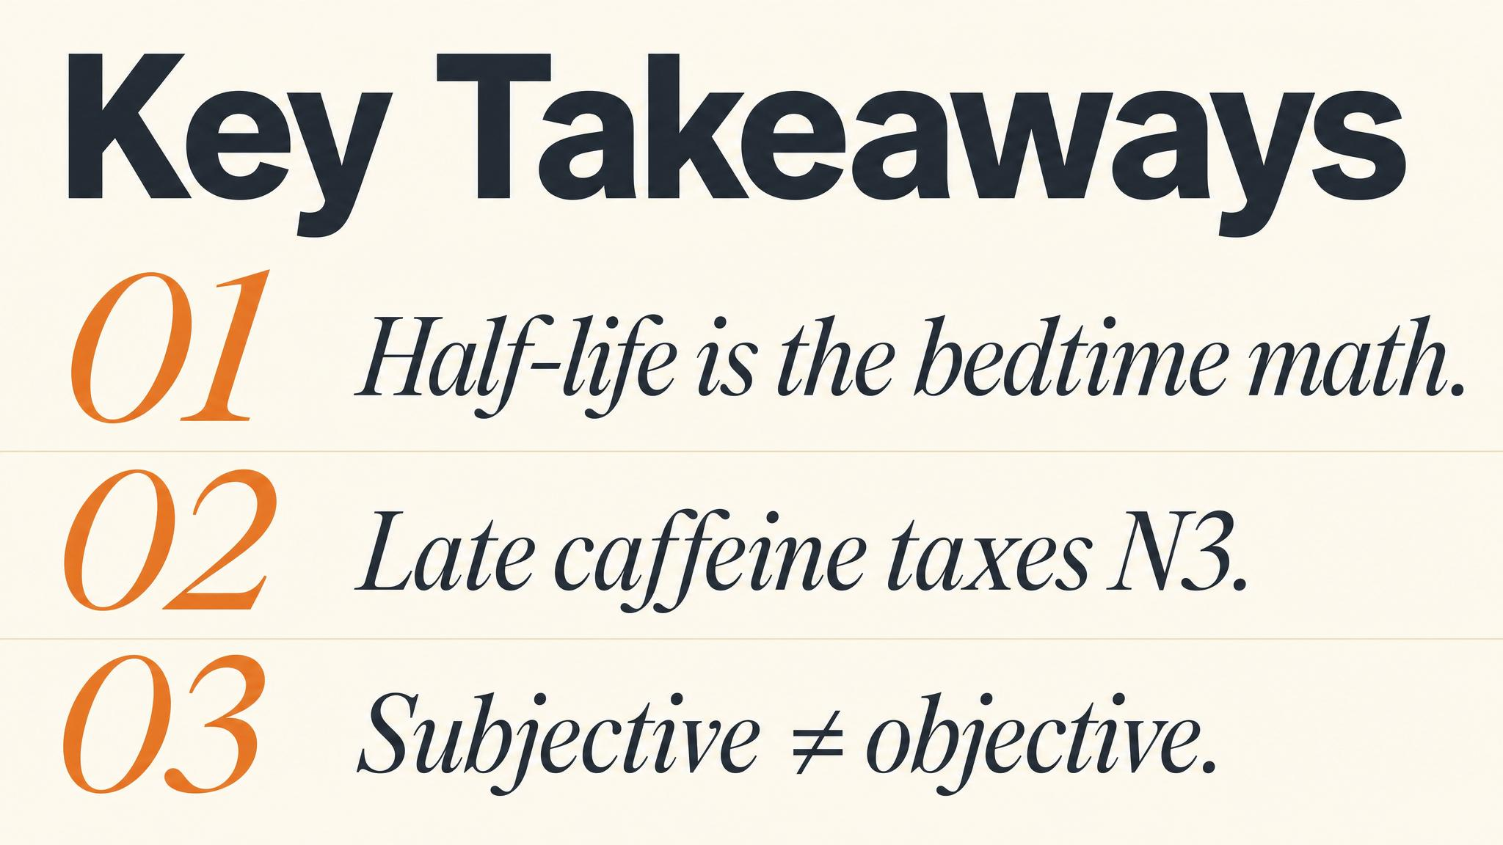
Notes:
Three things to carry forward. One: caffeine doesn't eliminate tiredness, it masks the adenosine signal. Two: average half-life is about 5 hours — so afternoon coffee is bedtime coffee for many people. Three: the price is paid in N3 slow-wave sleep, the stage most associated with physical restoration.

Slide 14
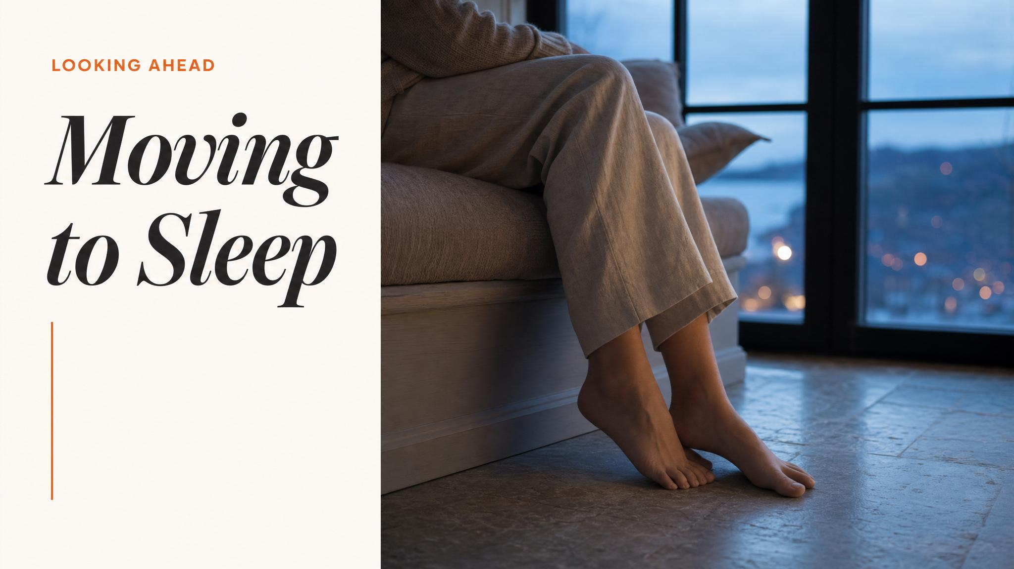
Notes:
Close with the bridge. Now that we've seen how caffeine masks the homeostatic sleep signal, Chapter 5 — Moving to Sleep — turns to how exercise and core body temperature open or jam the gate to deep sleep. Different lever, same architecture.

