Slide 1
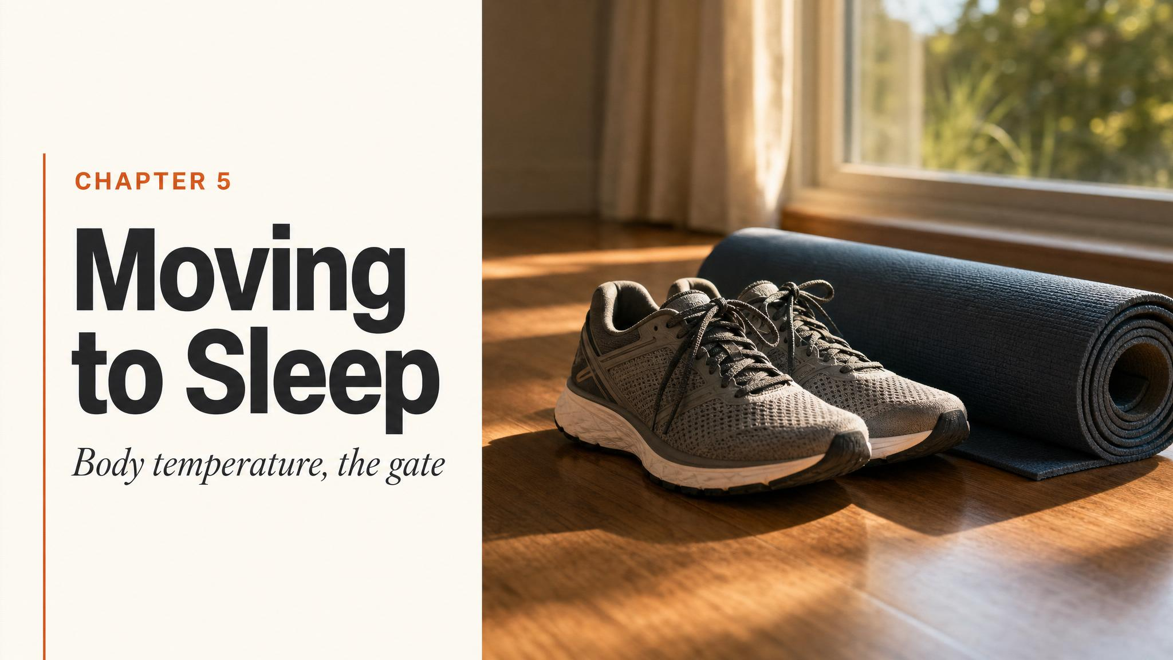
Notes:
Open with the paradox: a hot bath at night puts you to sleep, but it is not the warmth doing the work — it is the rapid cooling that follows. This chapter teases apart the temperature gate to sleep, and answers the evening-exercise question students always ask. Hold up the title and let the puzzle land before turning the page.

Slide 2
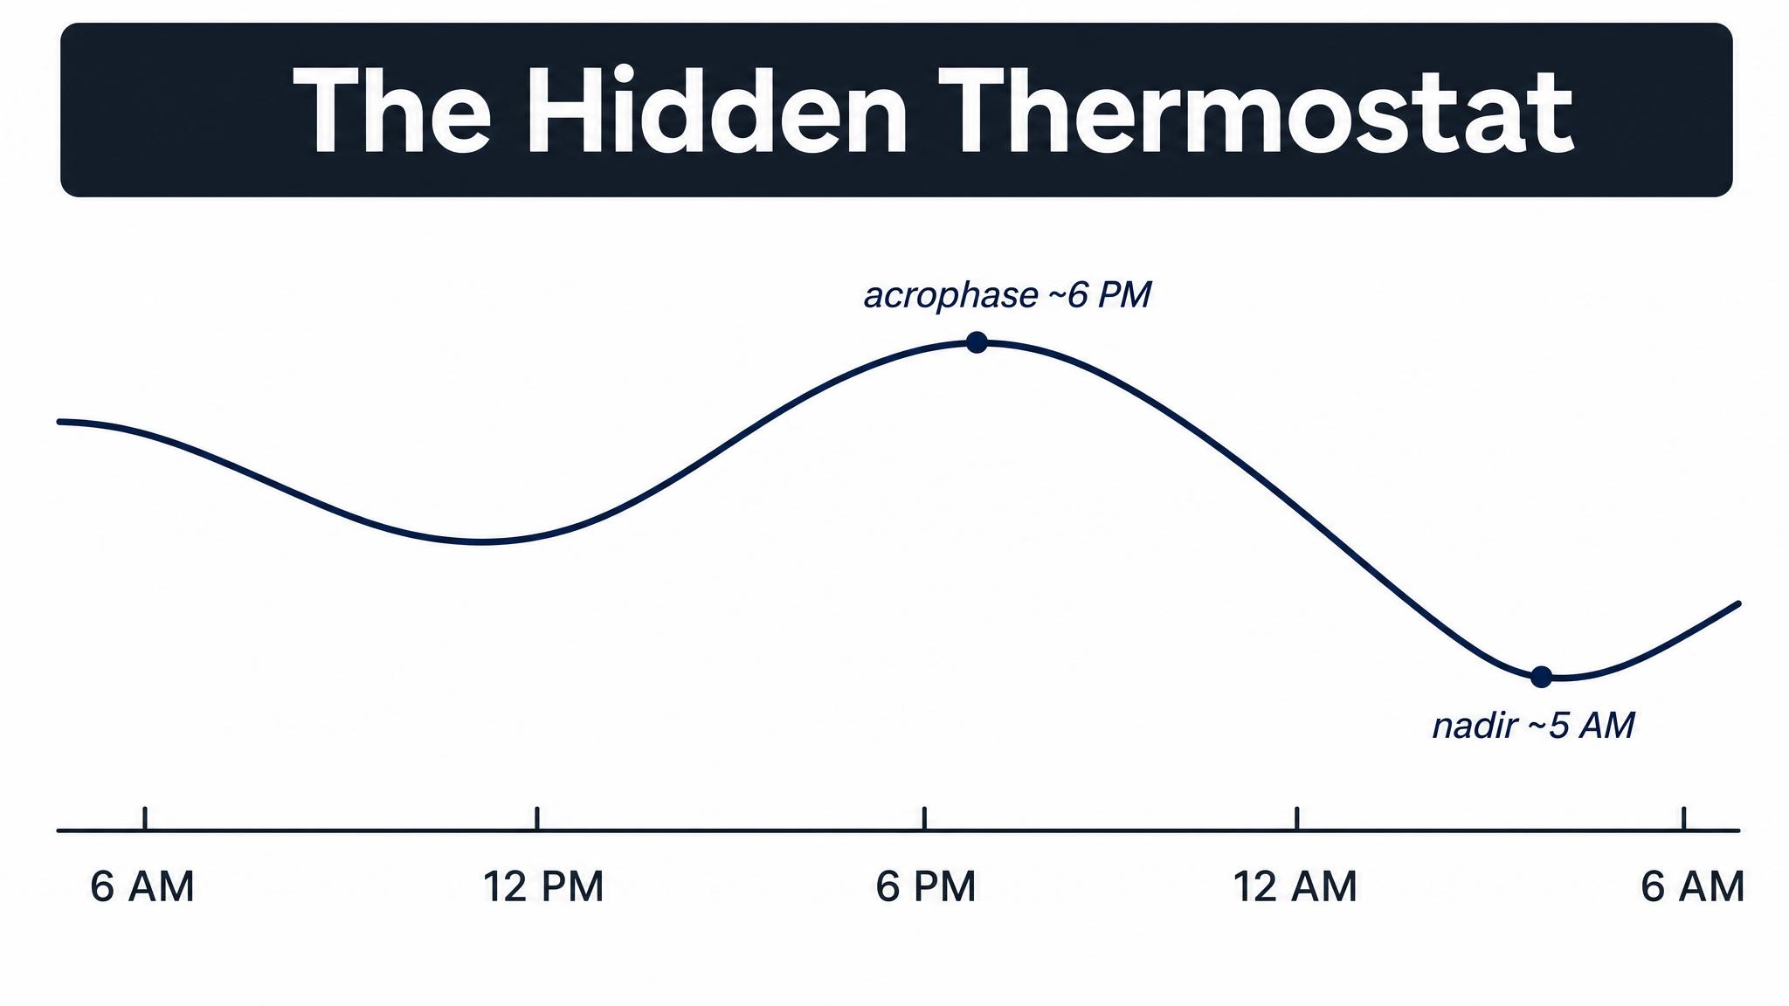
Notes:
The SCN doesn't only time melatonin — it also drives a daily oscillation in core body temperature. The curve isn't a side-effect of sleeping; it persists even under constant-routine protocols where participants stay awake. The shape itself is the point: a rise, a peak, then a long descent.

Slide 3
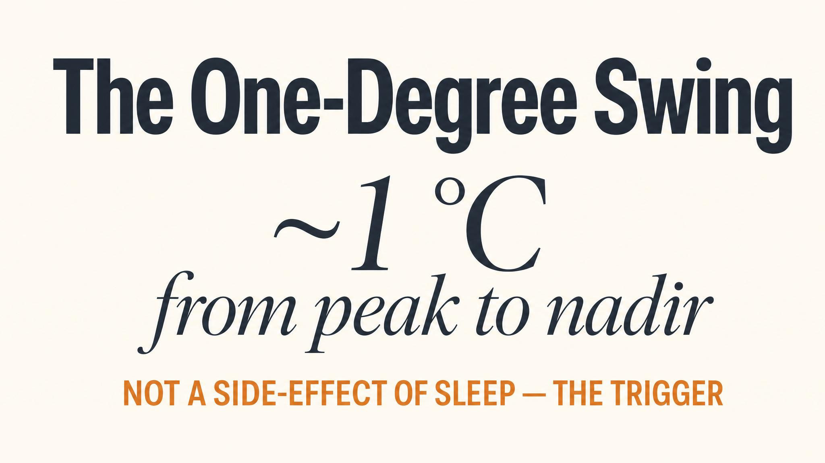
Notes:
The whole circadian swing in core body temperature is about one degree Celsius — roughly 1.8 Fahrenheit. Small in absolute terms, but biologically enormous. The peak sits between 5 and 7 p.m. for most adults; the nadir between 3 and 5 a.m.

Slide 4
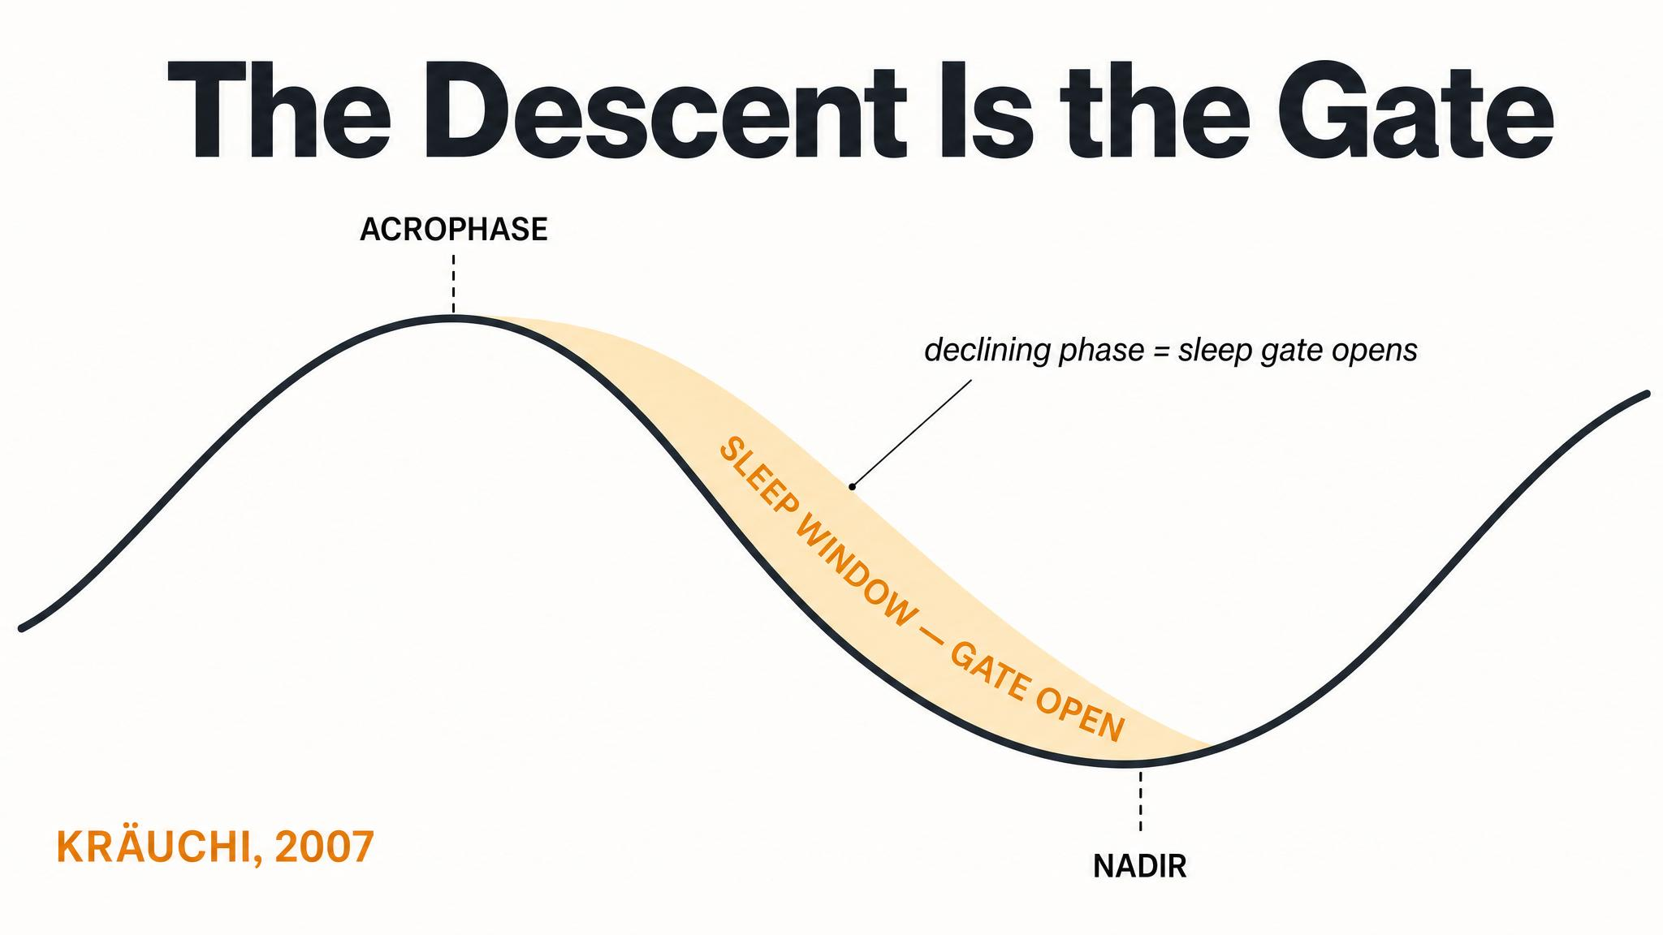
Notes:
The crucial move is from correlation to causation. As Kräuchi showed in 2007, the descending phase of the curve isn't just when sleep happens — the heat loss itself helps trigger sleep onset. That's why the model calls it the temperature gate.

Slide 5
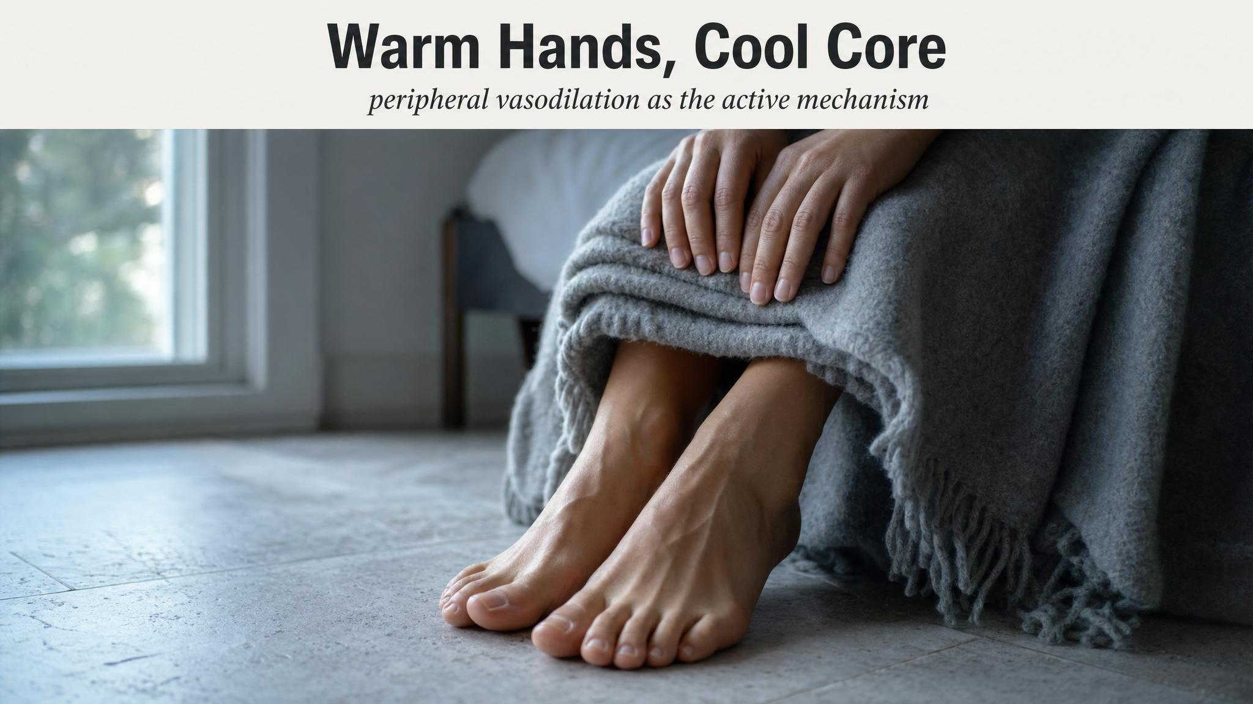
Notes:
Kräuchi and colleagues in 2000 ran a brutal head-to-head: which physiological signal best predicts how quickly you fall asleep? Not heart rate, not melatonin, not subjective sleepiness — but the distal-proximal skin temperature gradient. Warm hands and feet, relative to the trunk, is the strongest predictor of sleep onset latency.

Slide 6
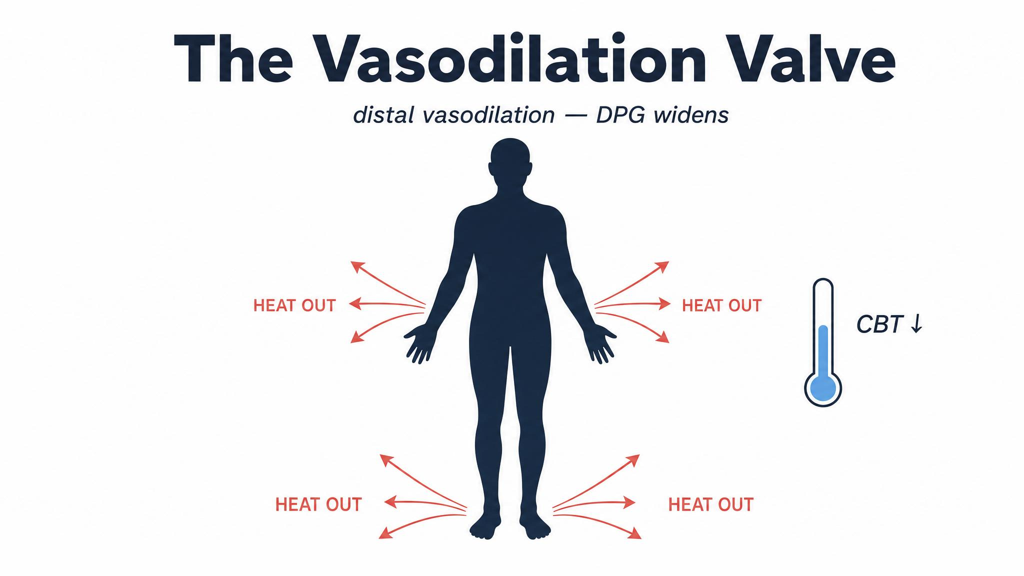
Notes:
Mechanistically — the SCN, an hour or two before habitual bedtime, signals peripheral vasodilation. Blood vessels in hands, feet, and face open up; warm blood floods to the surface; heat radiates out; the core temperature drops. Your body is preparing for sleep before you feel sleepy.

Slide 7

Notes:
Haghayegh and colleagues in 2019 meta-analysed seventeen studies of pre-bedtime passive body heating. The result: a warm bath at forty to forty-two-and-a-half degrees Celsius, scheduled one to two hours before bed, shortens sleep-onset latency by about ten minutes on average. The bath doesn't warm you to sleep — it primes vasodilation so the cooling-off afterward is sharper than it would have been.

Slide 8
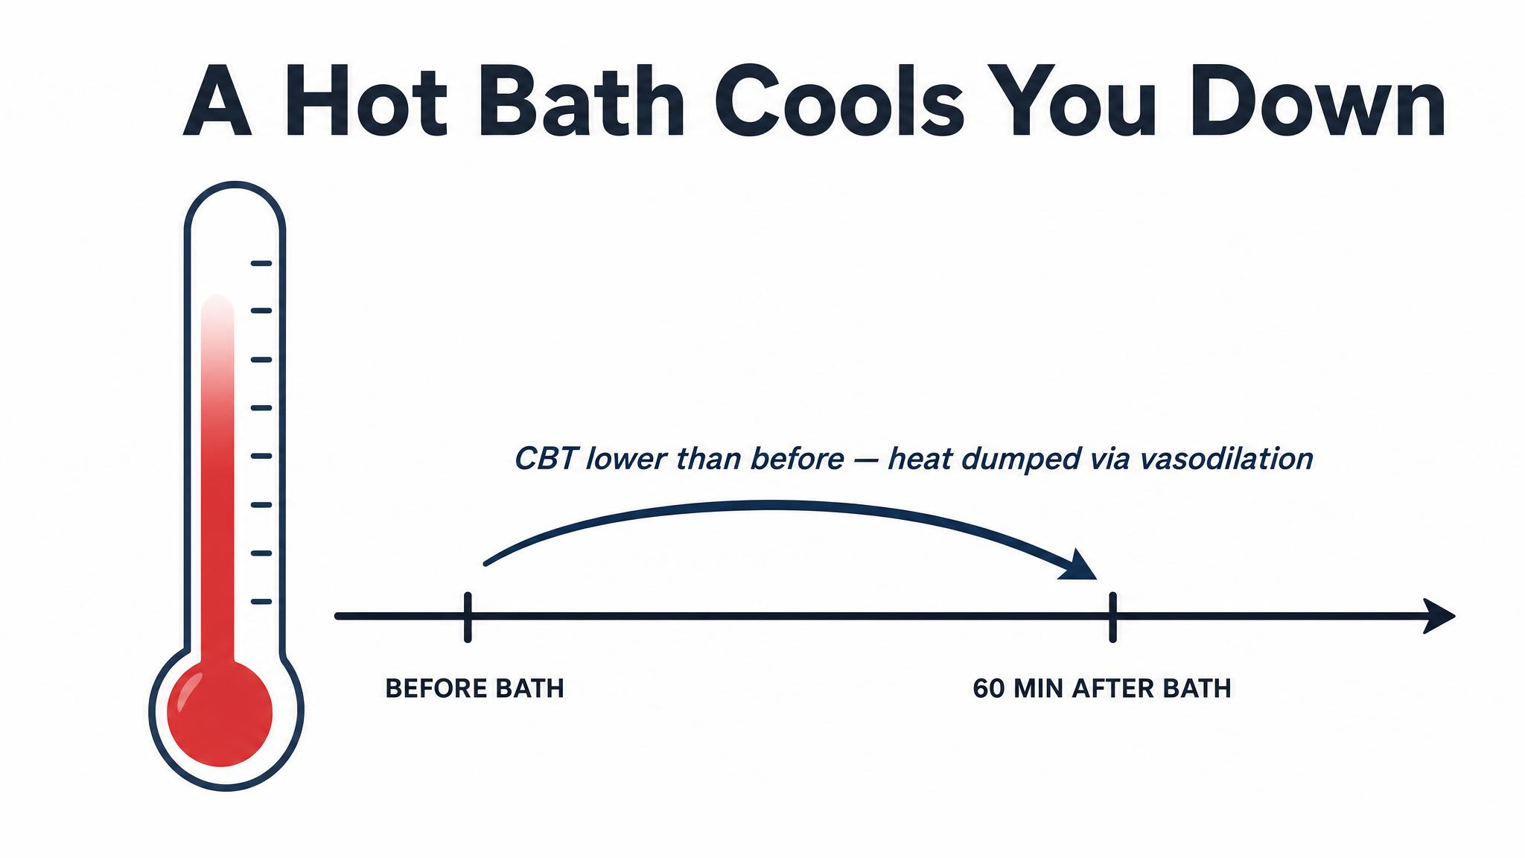
Notes:
Pause on this sentence and read it aloud. It is the rate of heat loss, not warmth itself, that the sleeping brain responds to. The warm bath is a delivery mechanism for rapid cooling — a physiological trick that hijacks the thermoregulatory system you carry around all day.

Slide 9
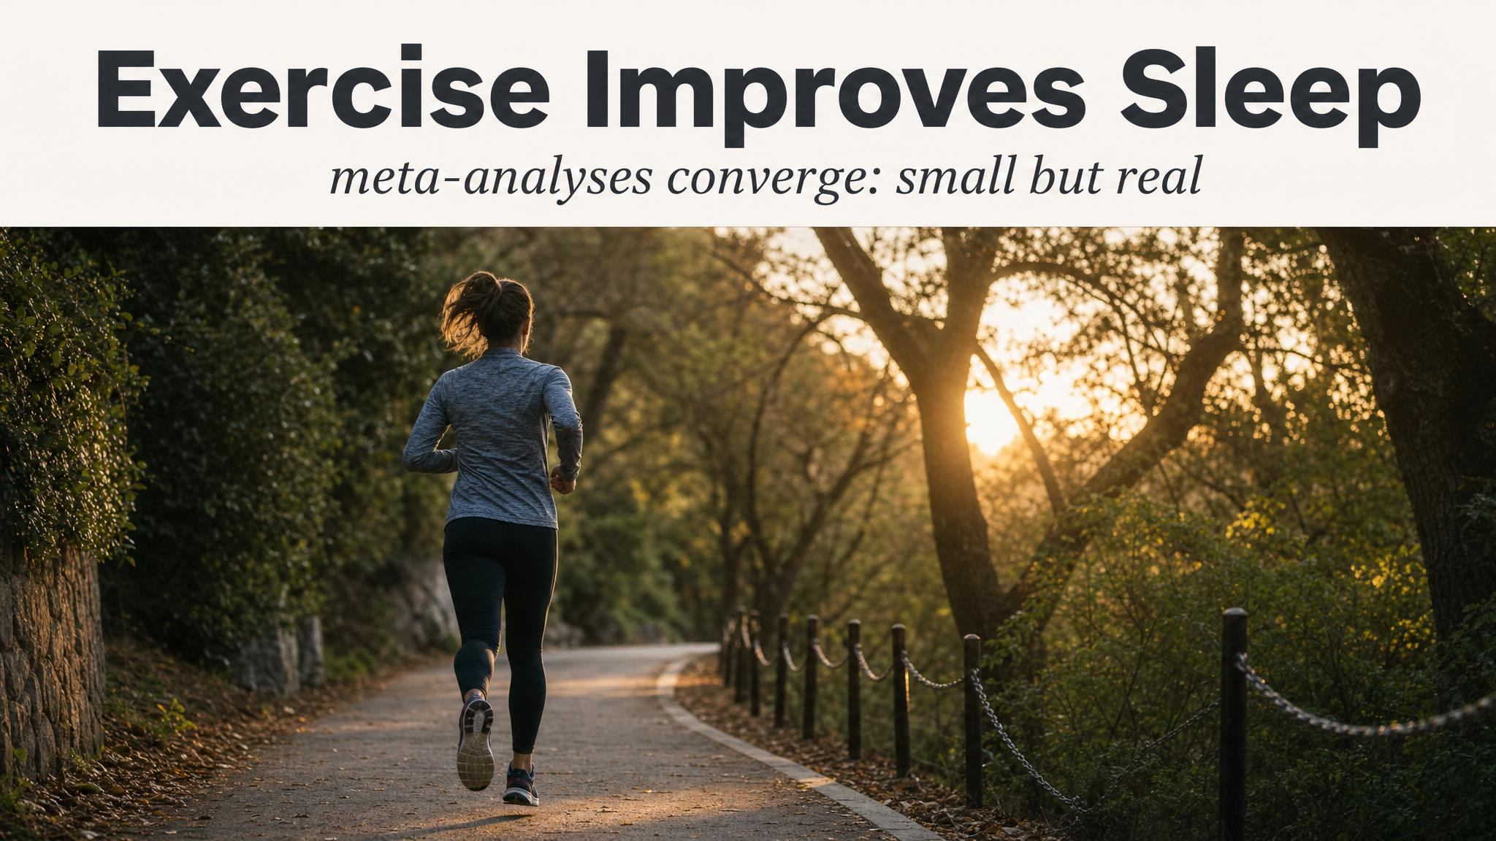
Notes:
Kredlow's 2015 meta-analysis of sixty-six studies found that regular exercisers showed improvements across the board — sleep-onset latency, total sleep time, sleep efficiency, and N3 deep sleep. Yamanaka in 2021 added the mechanism: sixty minutes at sixty percent VO2-max significantly increased delta power during N3, with larger and more stable slow waves.

Slide 10
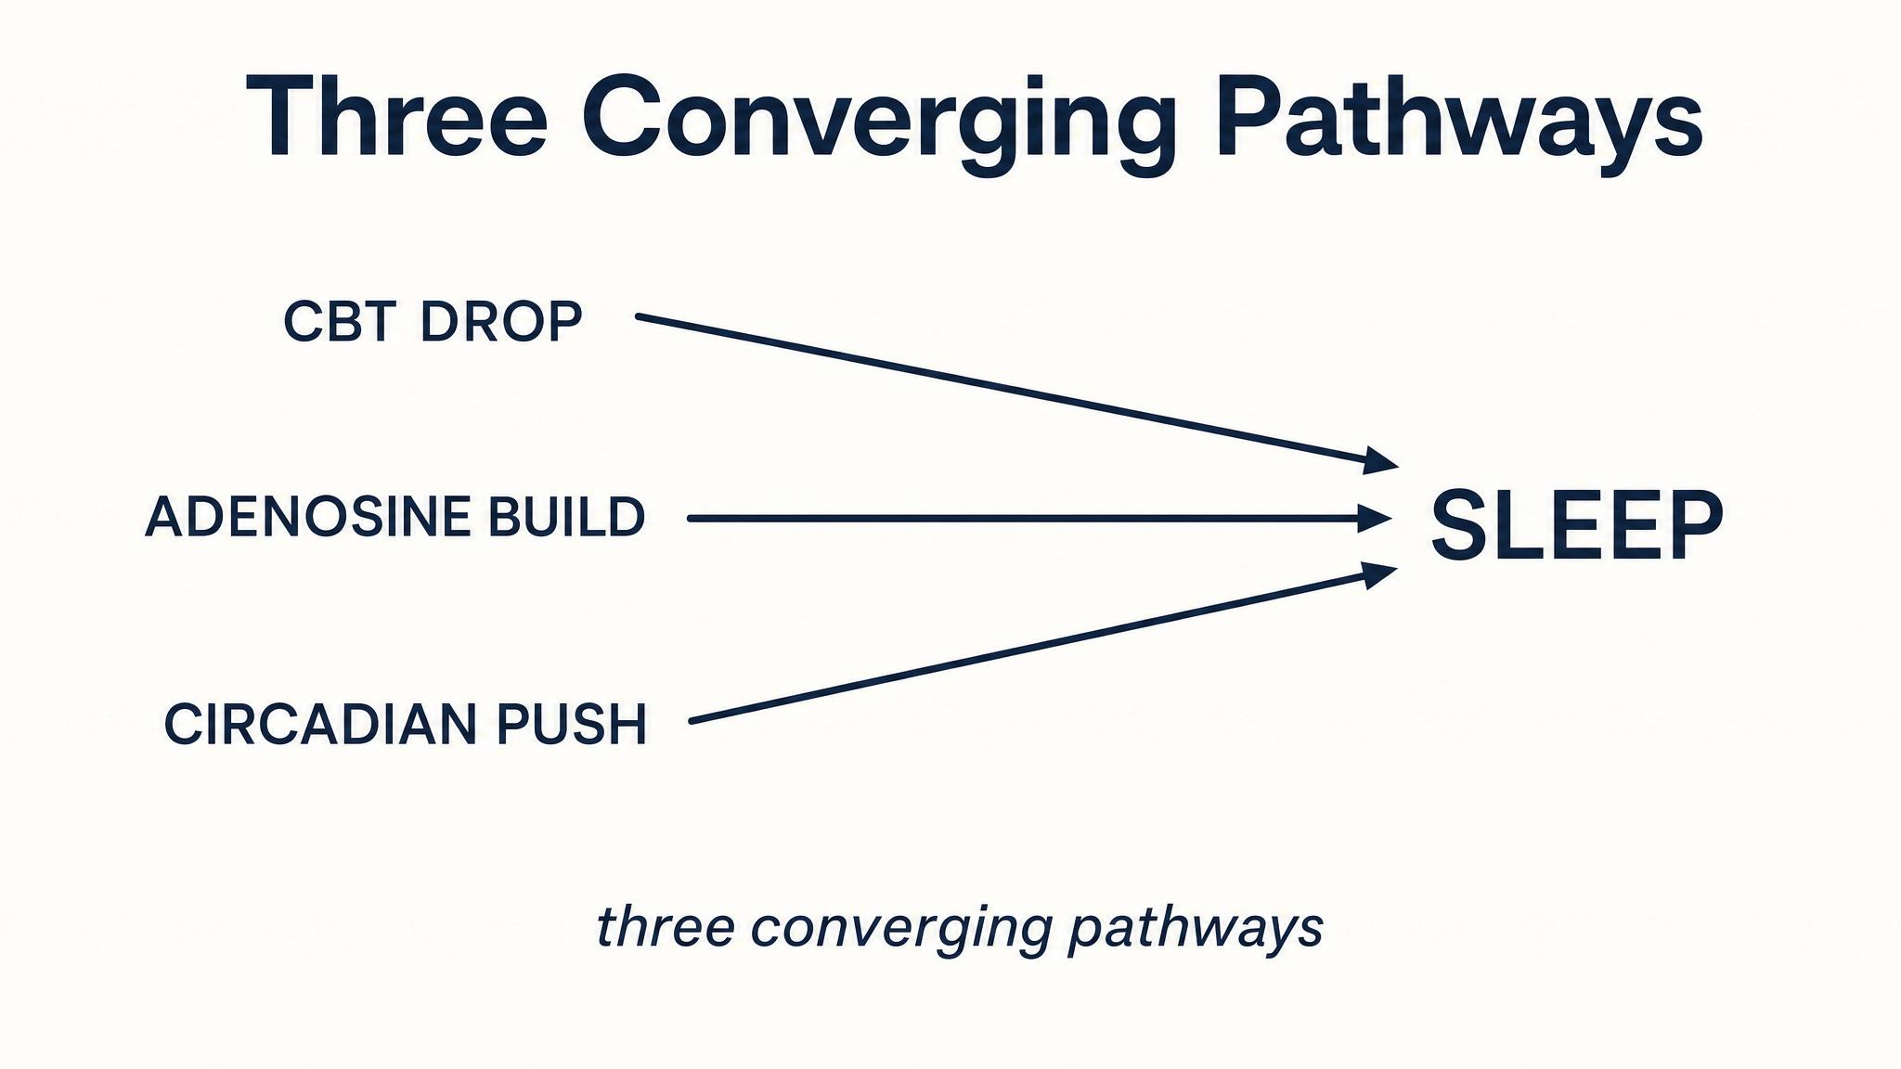
Notes:
Exercise improves sleep through three converging mechanisms. The temperature pathway: exercise elevates core temperature by one to two degrees, then it overshoots downward, mimicking and amplifying the circadian descent. The adenosine pathway: Dworak in 2007 showed intense exercise can push brain adenosine to two hundred twenty-nine percent of resting levels. And the circadian pathway: outdoor exercise delivers the bright-light zeitgeber from Chapter 3.

Slide 11
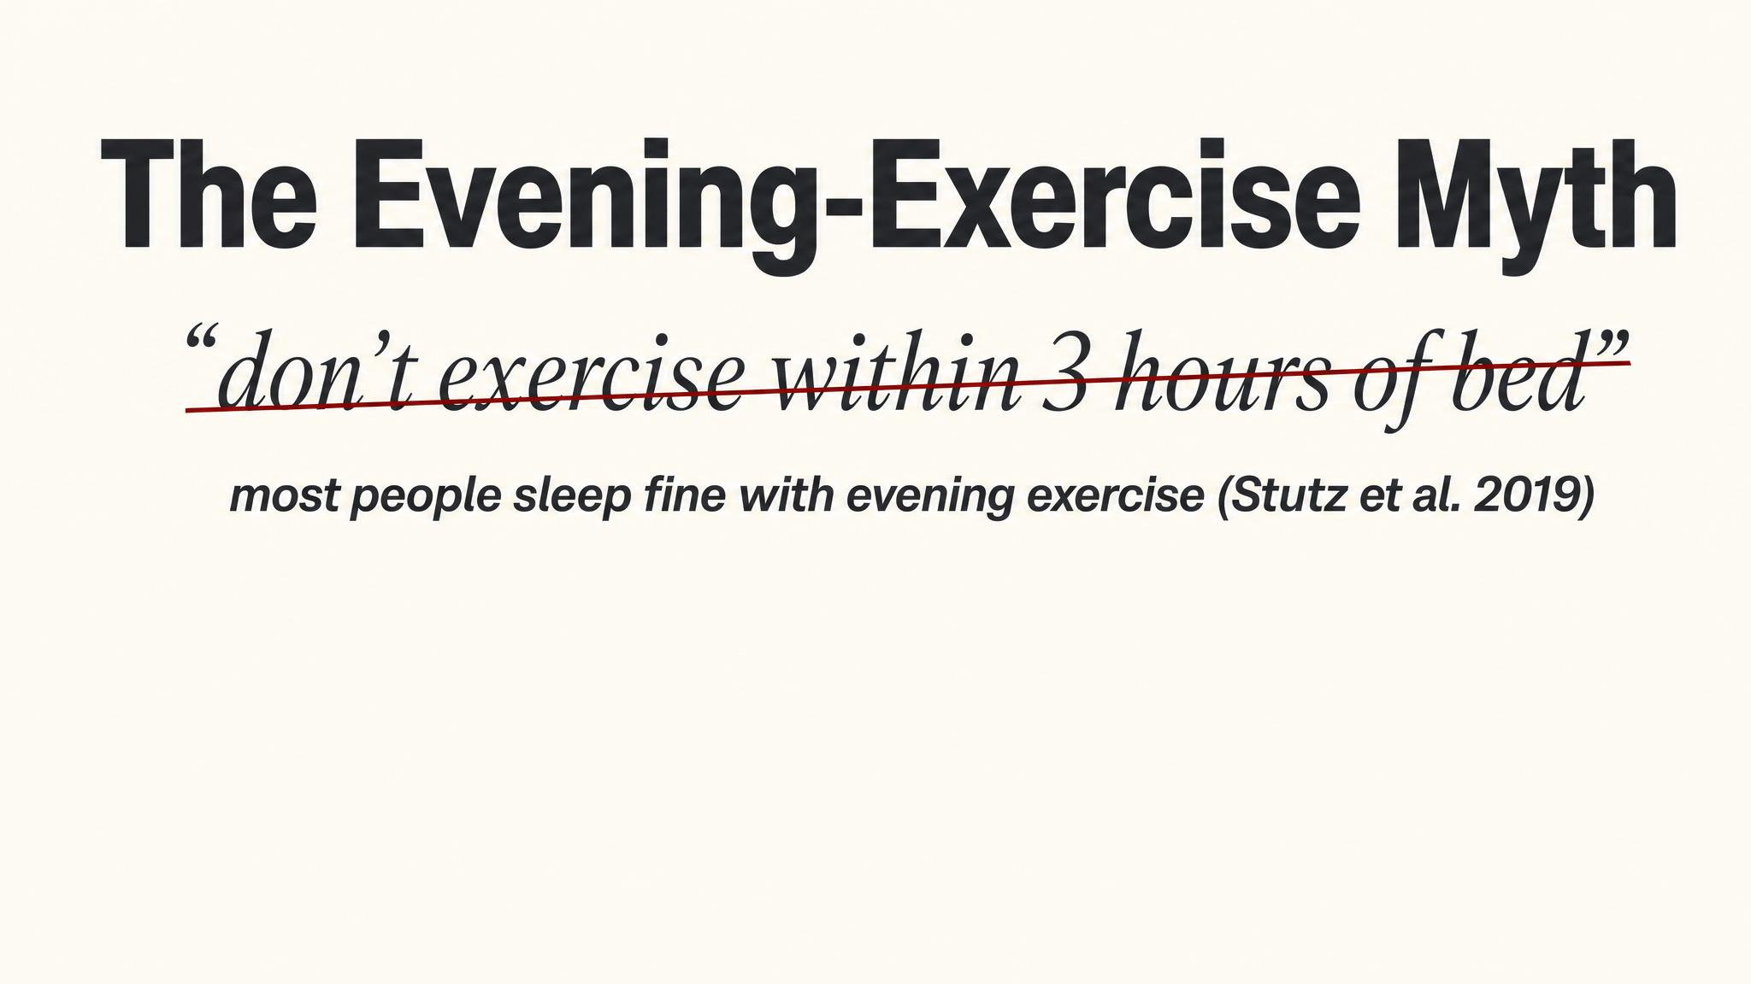
Notes:
The blanket warning to avoid all evening exercise is overstated. Stutz, Eiholzer, and Spengler's 2019 meta-analysis of twenty-three studies found evening exercise actually increased slow-wave sleep and decreased light stage 1. The only narrow exception: vigorous-intensity exercise finishing less than one hour before bedtime.

Slide 12
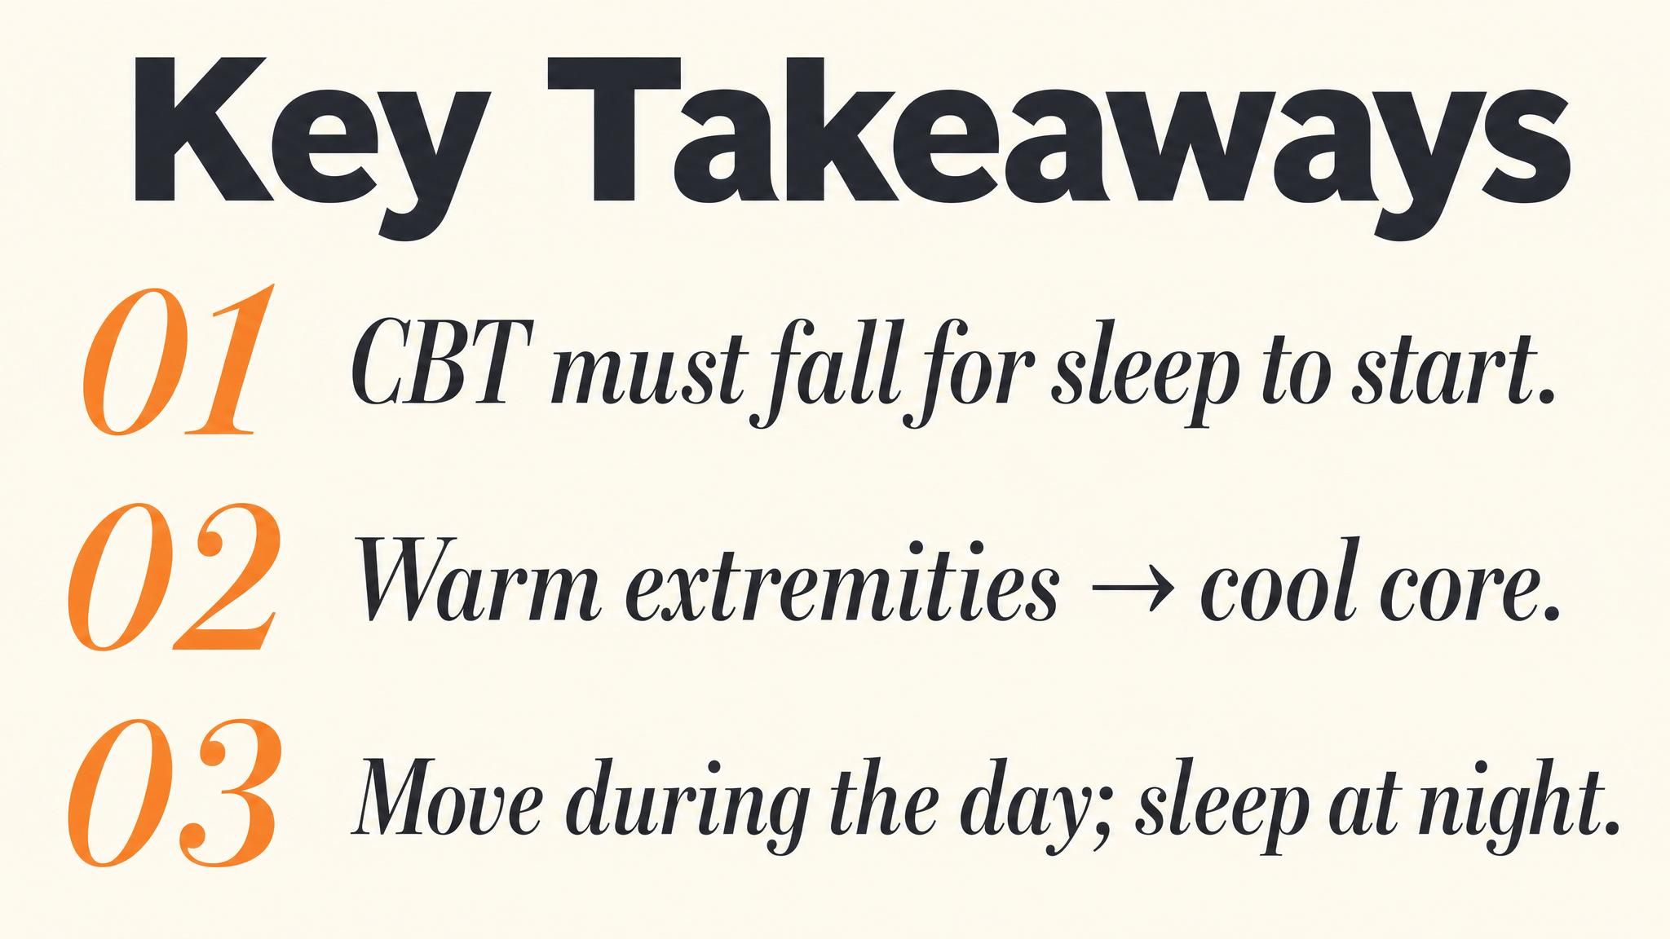
Notes:
Three things to carry forward. One: the declining phase of the core body temperature curve is the biological trigger that opens the gate to sleep. Two: a warm bath one to two hours before bed works by amplifying the subsequent cool-down, not the warming. Three: evening exercise is fine for almost everyone — only vigorous exercise inside the last hour before bed has a documented penalty.

Slide 13

Notes:
Next class we move from the body to the bedroom: screens, stimulation, and wind-down. We'll see how the bedroom temperature sweet spot — roughly eighteen to twenty Celsius, or sixty-five to sixty-eight Fahrenheit — connects directly to the vasodilation mechanism from today. Your bedroom is either working for your sleep or against it.

