Slide 1
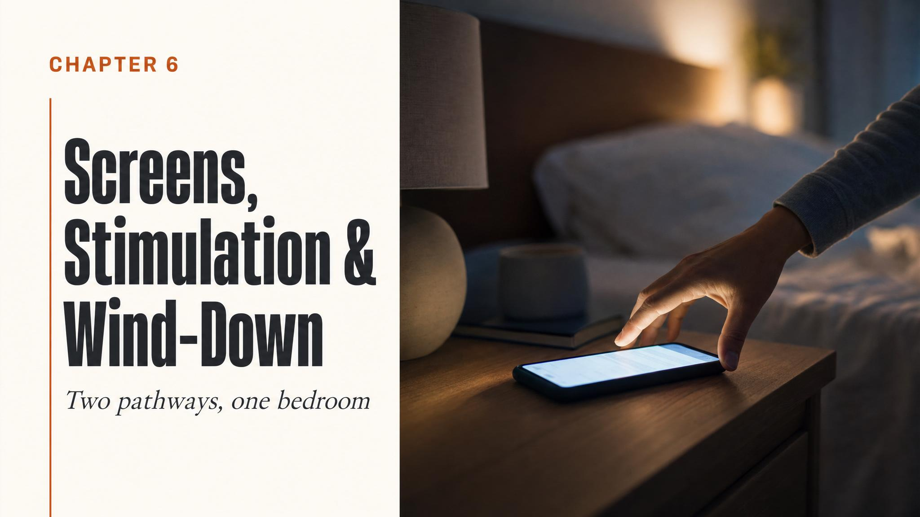
Notes:
Open with the chapter's core promise. Most students walked in knowing 'blue light is bad' — we are about to recalibrate that. The orange tint on your screen is addressing the smaller problem; the real reason your brain won't shut up has almost nothing to do with wavelengths of light. Pause briefly on the subtitle before moving on.

Slide 2
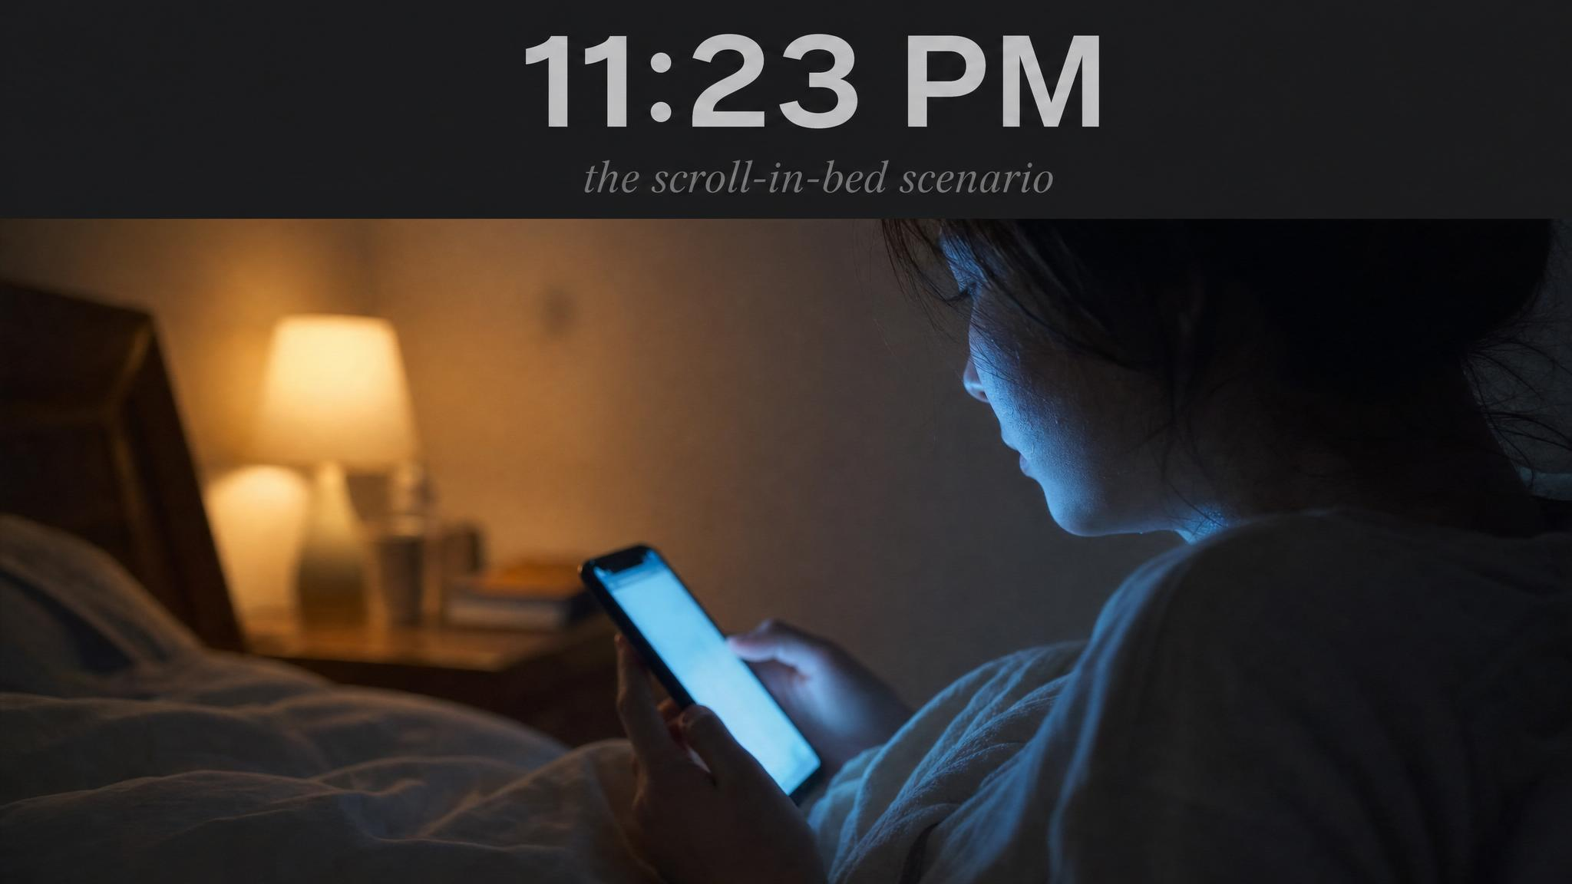
Notes:
Read the opening scene aloud — set the room in 11:23 PM. The blue-light filter is dutifully tinting the screen orange; the student is doing the 'right' thing about the light. Hold the puzzle: why do you feel more awake now than you did an hour ago? Let the silence do some work.

Slide 3
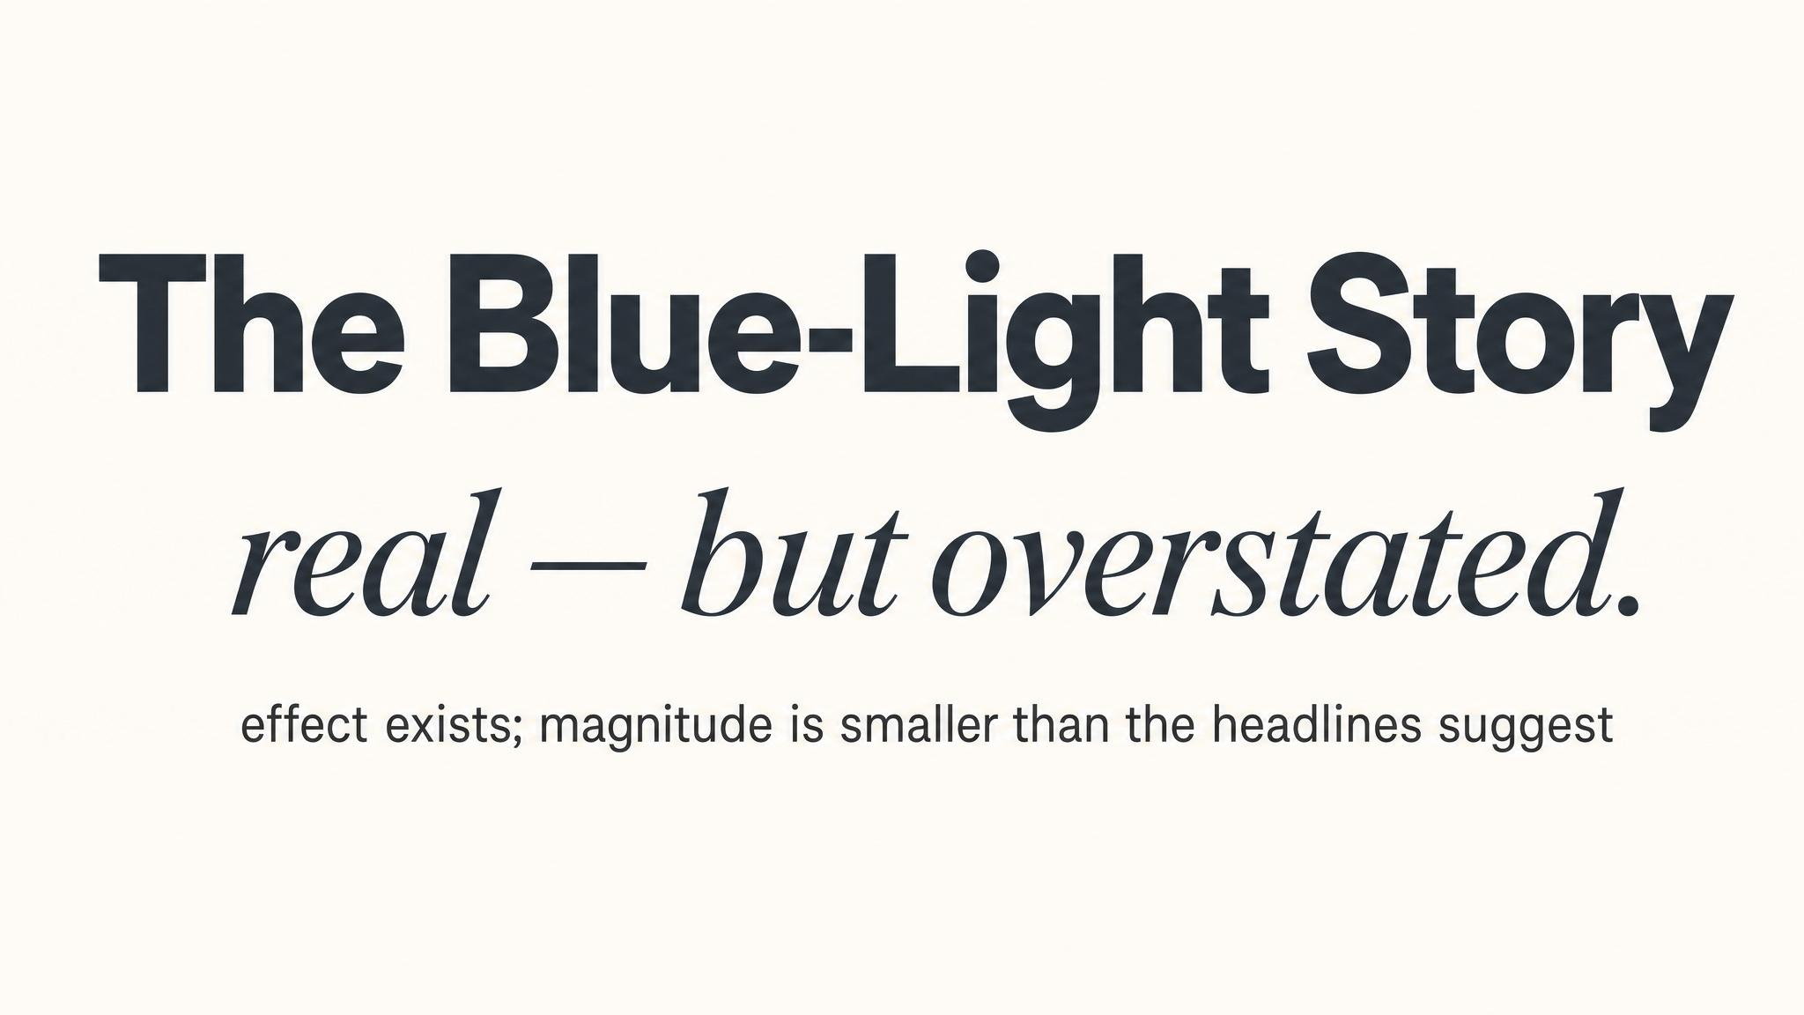
Notes:
Name the calibrated claim. Blue light does suppress melatonin — that part is real. But the cultural narrative dramatically overstates how strong the effect is at the doses you actually meet through a phone screen. The next two slides put numbers on it.

Slide 4
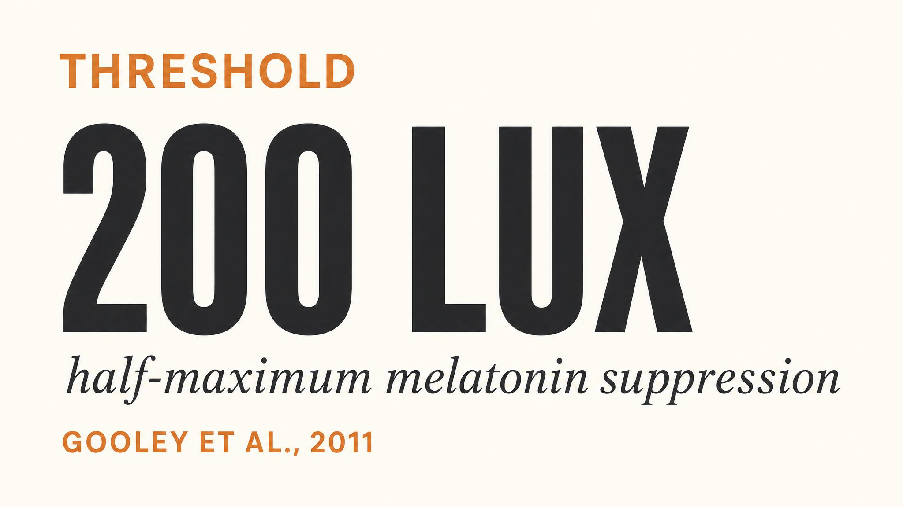
Notes:
Anchor the threshold. Gooley and colleagues, 2011: room light of approximately 200 lux before bedtime suppressed melatonin onset in 99% of participants and shortened melatonin duration by roughly 90 minutes. Underline the level: 200 lux is the illumination of a moderately well-lit living room, not a phone screen at arm's length.

Slide 5
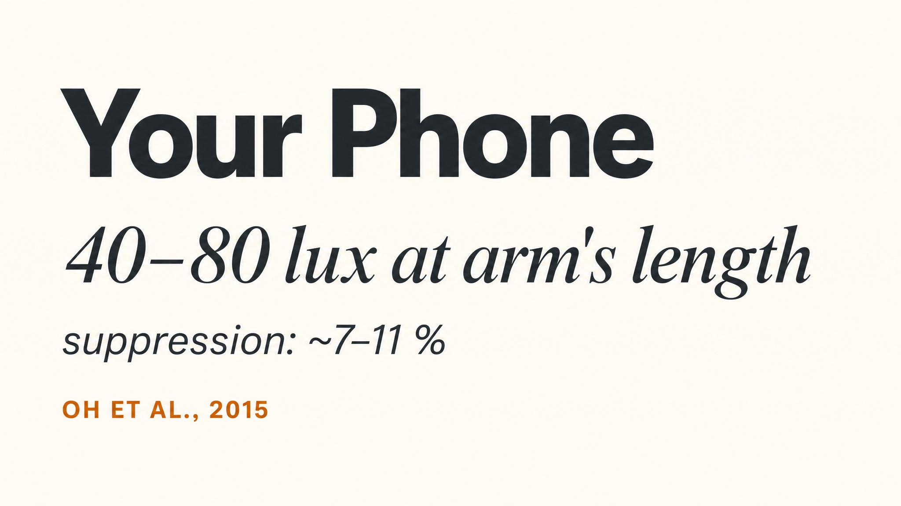
Notes:
Now the comparison lands. A phone at typical viewing distance delivers 20 to 80 lux — well under the 200-lux suppression threshold. Oh and colleagues, 2015, measured only 7 to 11 percent melatonin suppression for typical smartphone use in a dark room. Real, but modest — a far cry from the 99% the Gooley data showed at 200 lux.

Slide 6
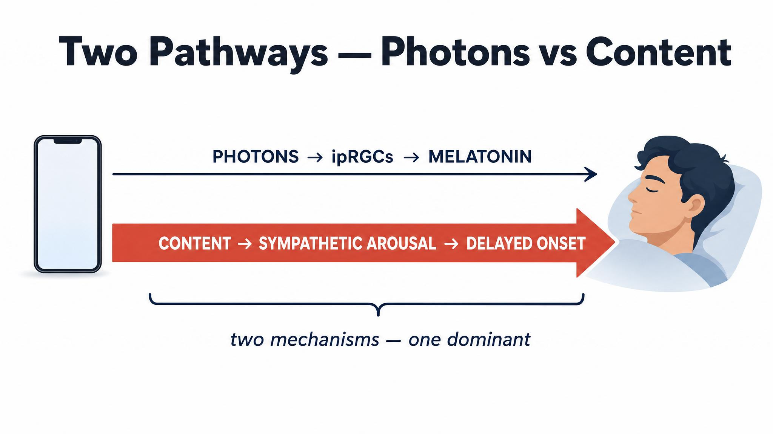
Notes:
This is the pivot of the chapter. Two pathways carry screens to sleep: photons via the SCN, and content via cognitive arousal. The arrow that matters is the thick red one underneath. Hold this image — every later slide is a refinement of it.

Slide 7
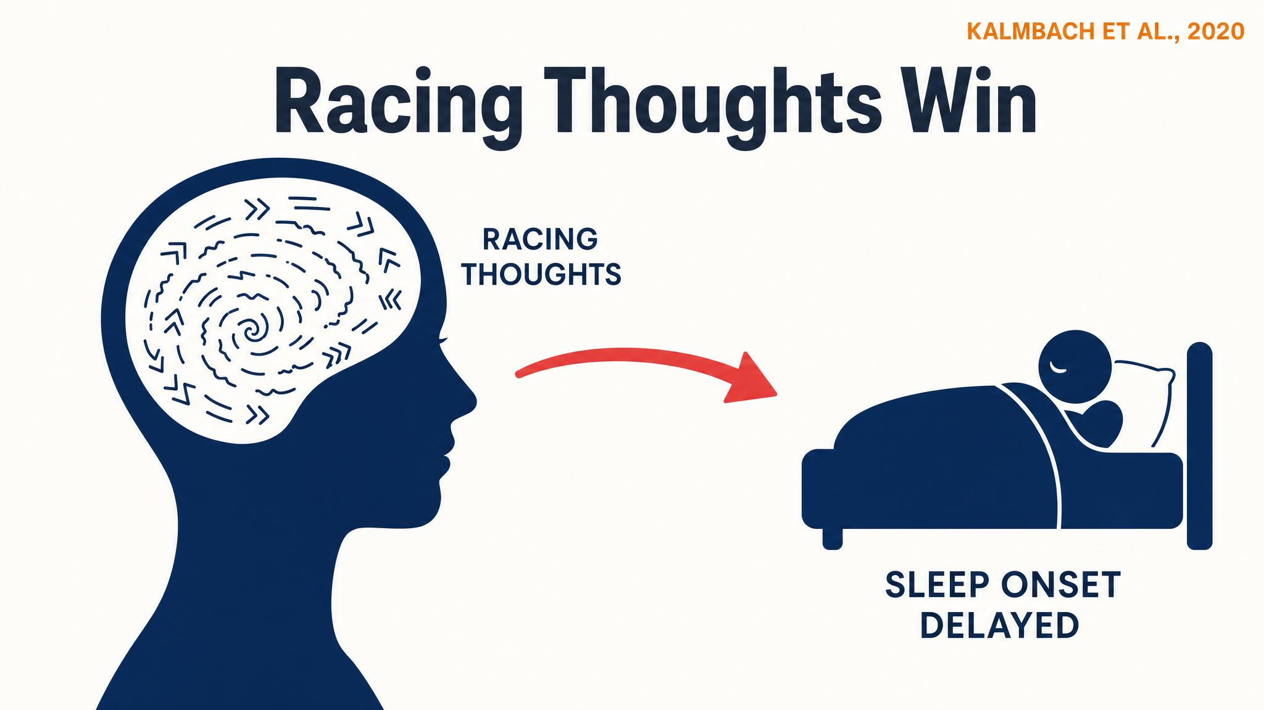
Notes:
Anchor the empirical claim. Kalmbach and colleagues, 2020, ran polysomnography on 52 adults and found that nocturnal cognitive arousal — the racing mind — was a stronger predictor of difficulty falling asleep than clinical insomnia diagnosis, depression, or even body-based arousal. Your mind racing is, in measurable terms, more disruptive than your body being tense.

Slide 8
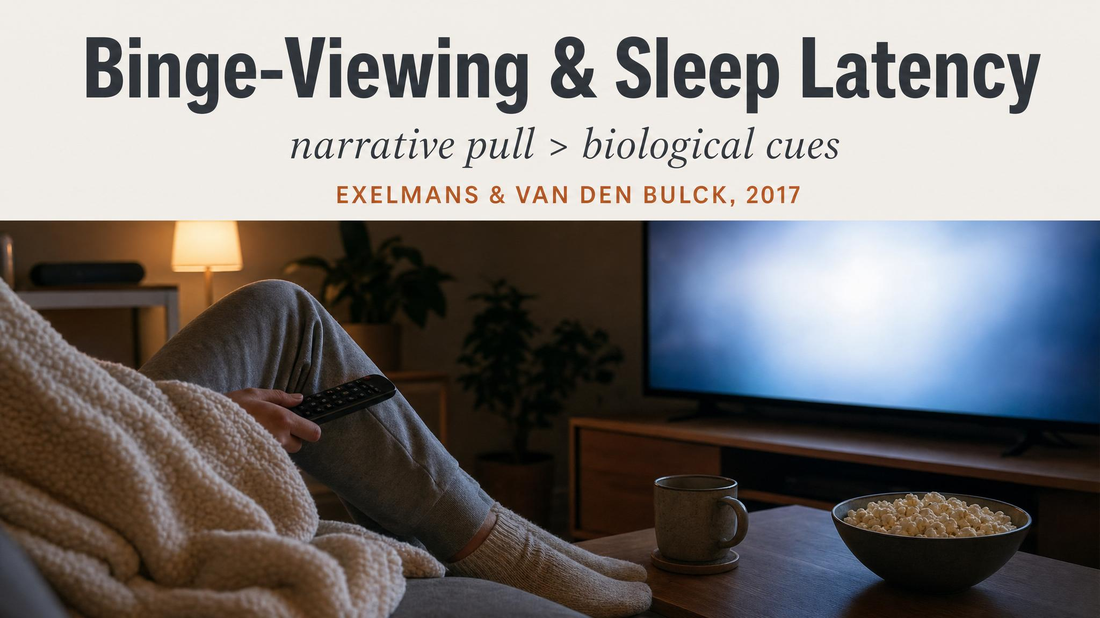
Notes:
Now zoom into the screen-use context. Exelmans and Van den Bulck in 2017 studied 423 young adults and their binge-viewing habits. The mechanism that explained the sleep cost was not light exposure — it was cognitive pre-sleep arousal. The 'just one more episode' pull is the active ingredient.

Slide 9
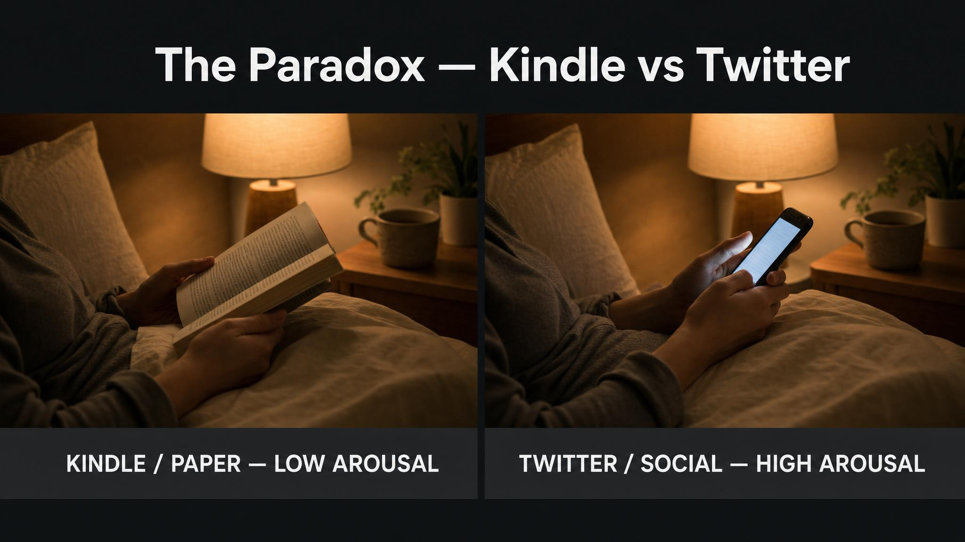
Notes:
Stage the paradox. Scenario A: a familiar novel on a low-brightness Kindle in a dim room, breathing slow, pleasantly drowsy. Scenario B: a political thread on a phone at medium brightness, jaw clenched, two replies composed and deleted. Both are 'screen time'. The physiological states are not the same. The question is not 'are you using a screen?' but 'is this moving your nervous system toward sleep or away from it?'

Slide 10
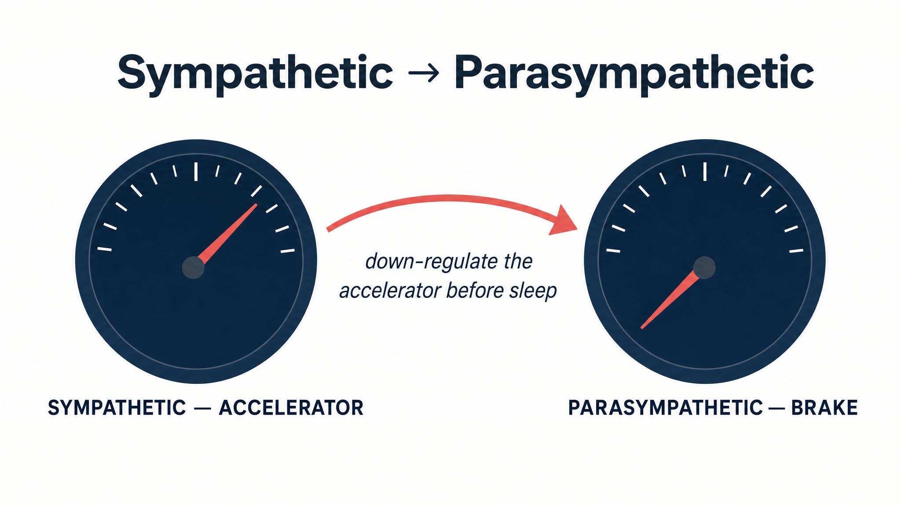
Notes:
Falling asleep is not a switch. It is easing a car from highway speed down to a stop — a progressive shift from sympathetic to parasympathetic dominance. Bonnet and Arand, 2010, showed that normal sleepers make this transition; insomniacs stay in sympathetic hyperactivation. Anything that revs the engine — outrage, work email, competitive gaming — fights that shift, regardless of what night mode the phone is in.

Slide 11
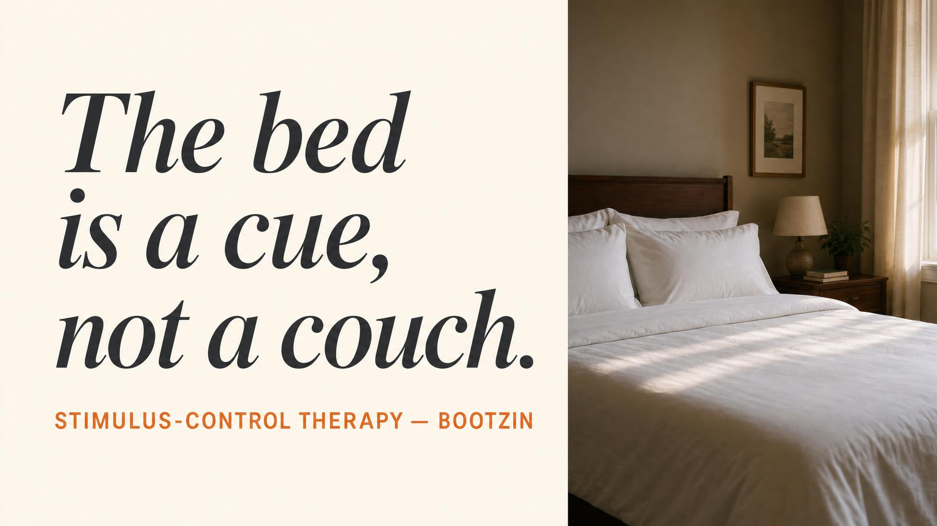
Notes:
Read the line aloud, slowly: don't fight adenosine, plan around it. Pre-commitment beats willpower. The prefrontal cortex you need to put the phone down at 11pm is the same prefrontal cortex that adenosine is impairing. Make the decision earlier in the day, when your judgement still works.

Slide 12
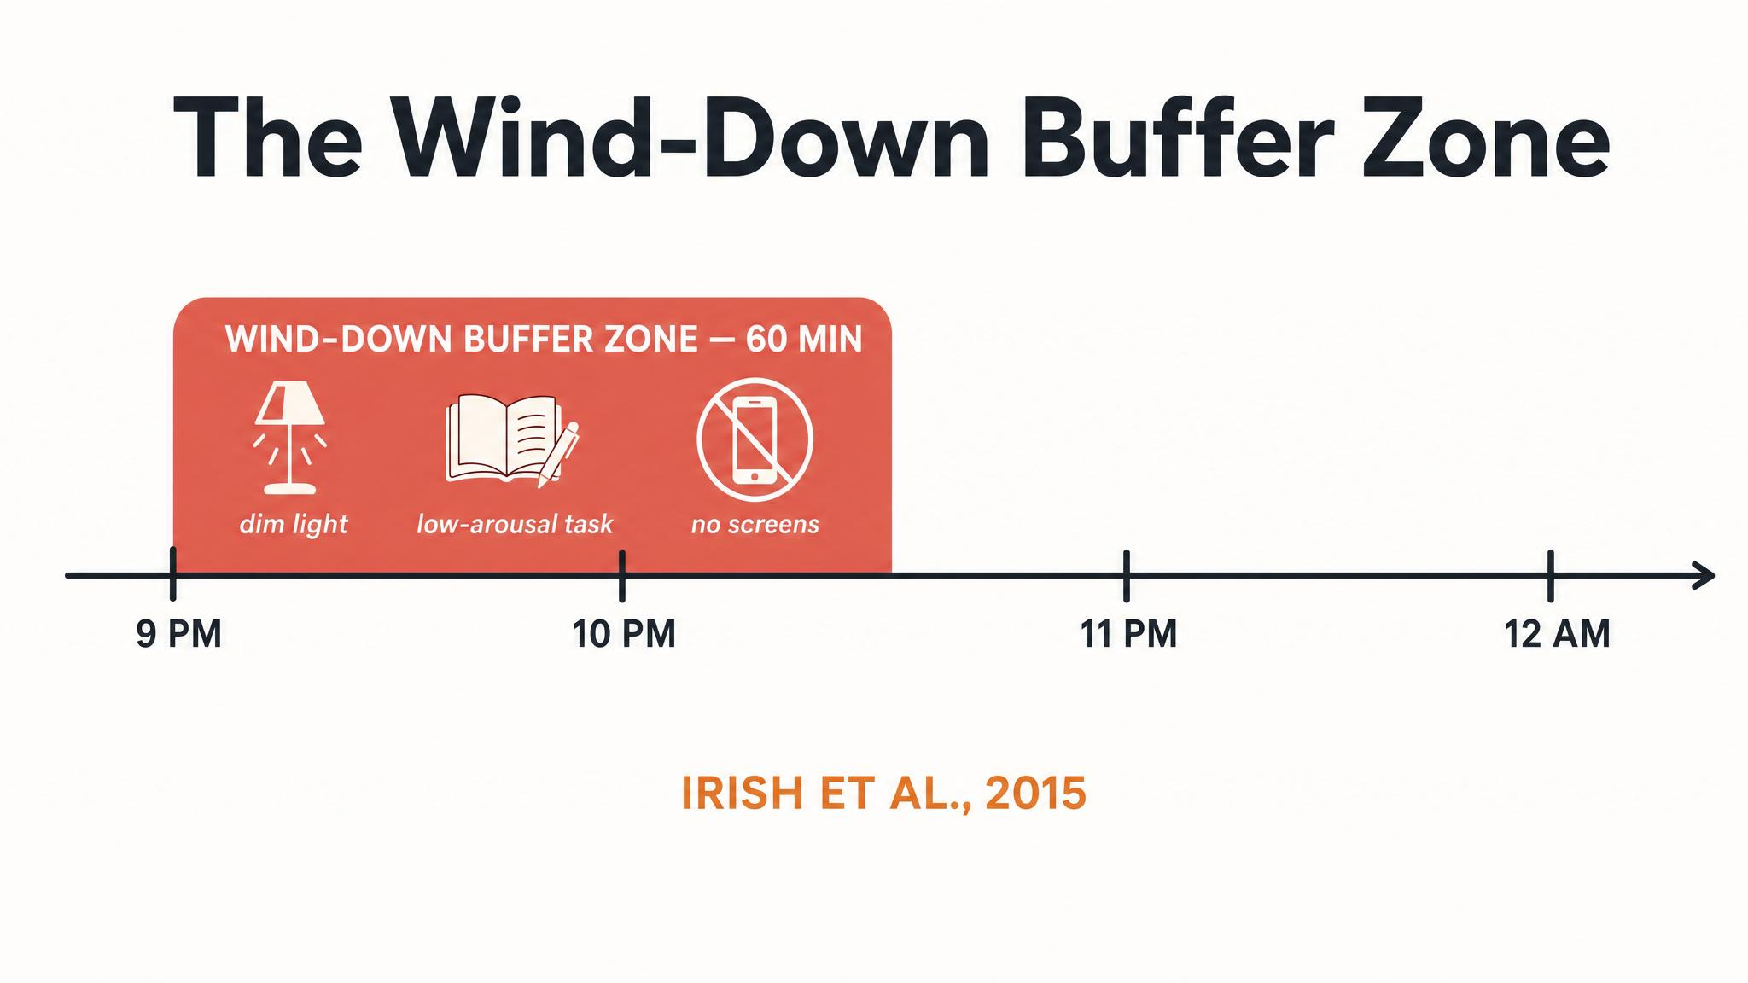
Notes:
Irish and colleagues, 2015, reviewed behavioural strategies and recommended establishing a bedtime routine 30 to 45 minutes before sleep to wind down and slow central nervous system activity. The chapter widens that to 60 to 90 minutes. The shape that matters is the descending staircase: arousal trending down, light trending down, demands trending down. Consistency turns the sequence itself into a conditioned cue.

Slide 13
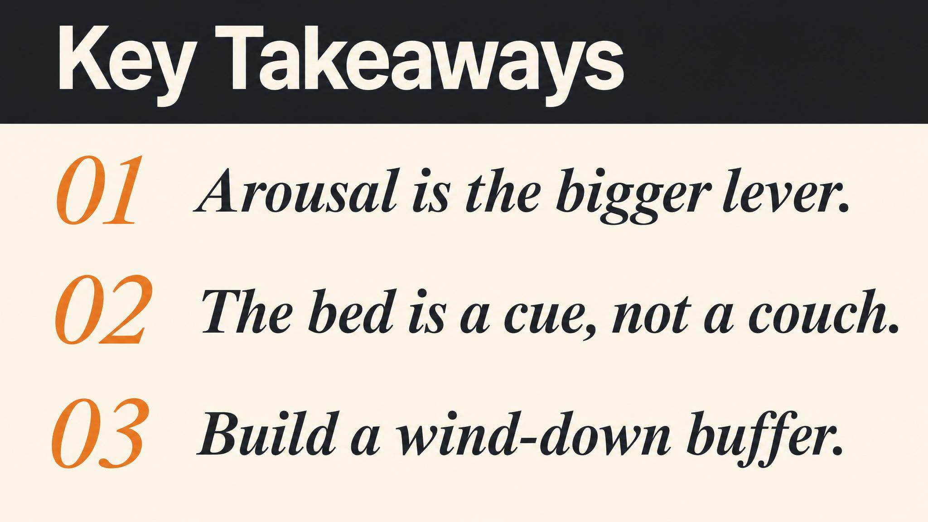
Notes:
Three things to carry forward. One: light is the small lever, arousal is the big one. Two: the bed is a conditioned cue, not just a piece of furniture — reserve it for sleep. Three: pre-commit to the wind-down earlier in the day, when your prefrontal cortex still works. Pause briefly on each line.

Slide 14
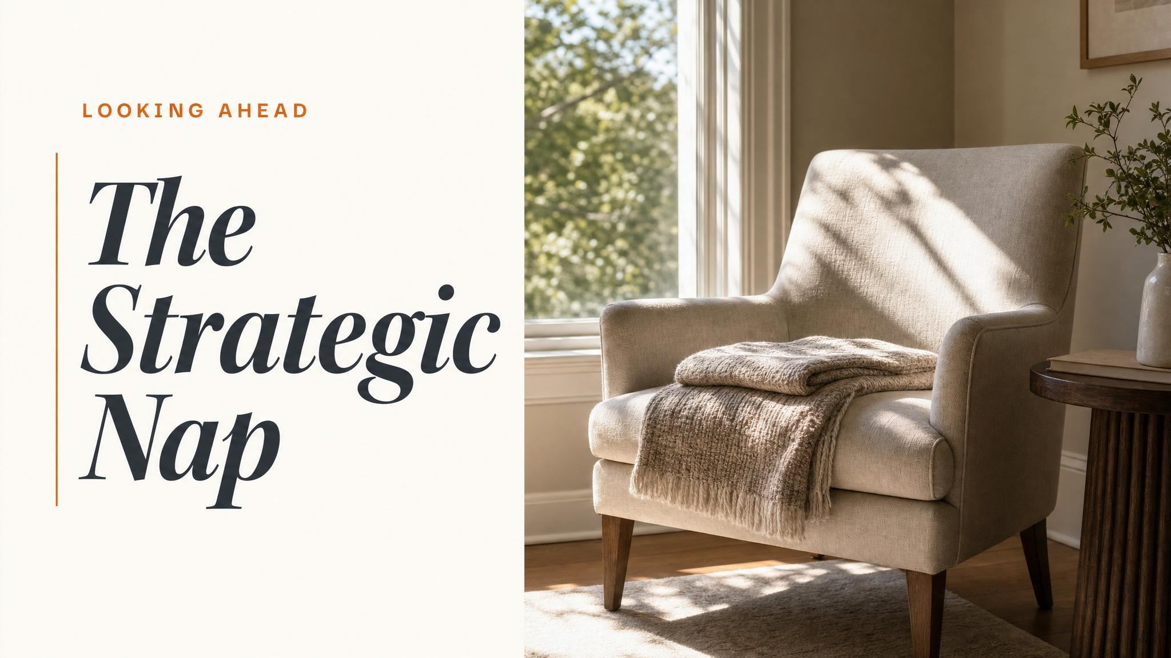
Notes:
Close with the bridge. Next chapter — The Strategic Nap — synthesises the whole course. We will fold circadian timing, sleep architecture, caffeine, temperature, and the arousal management you just learned into a single practical question: how do you nap well? Same nervous system, smaller dose.

