Slide 1
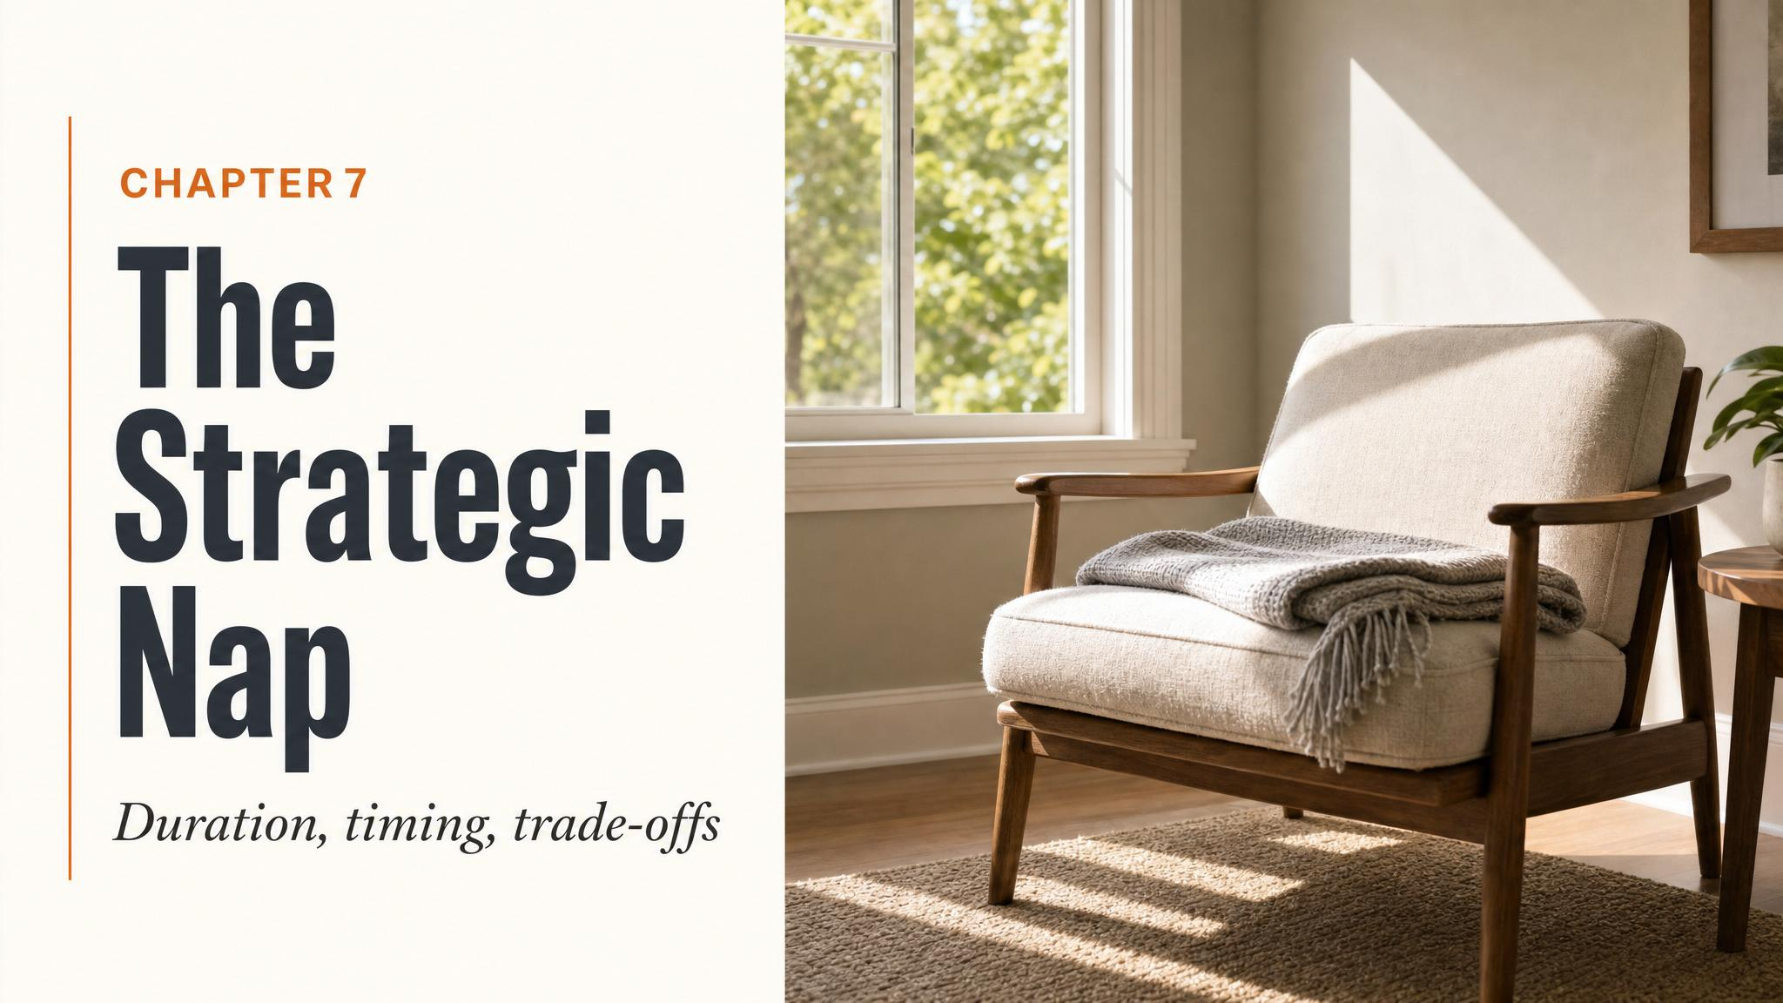
Notes:
Open with the moment: 1:47pm Tuesday, you've slept seven hours, and your eyelids are heavy. Should you nap, and for how long? Tell the room this final chapter pulls every dial we've studied — Process S, sleep stages, light, caffeine, temperature, arousal — into one decision.

Slide 2
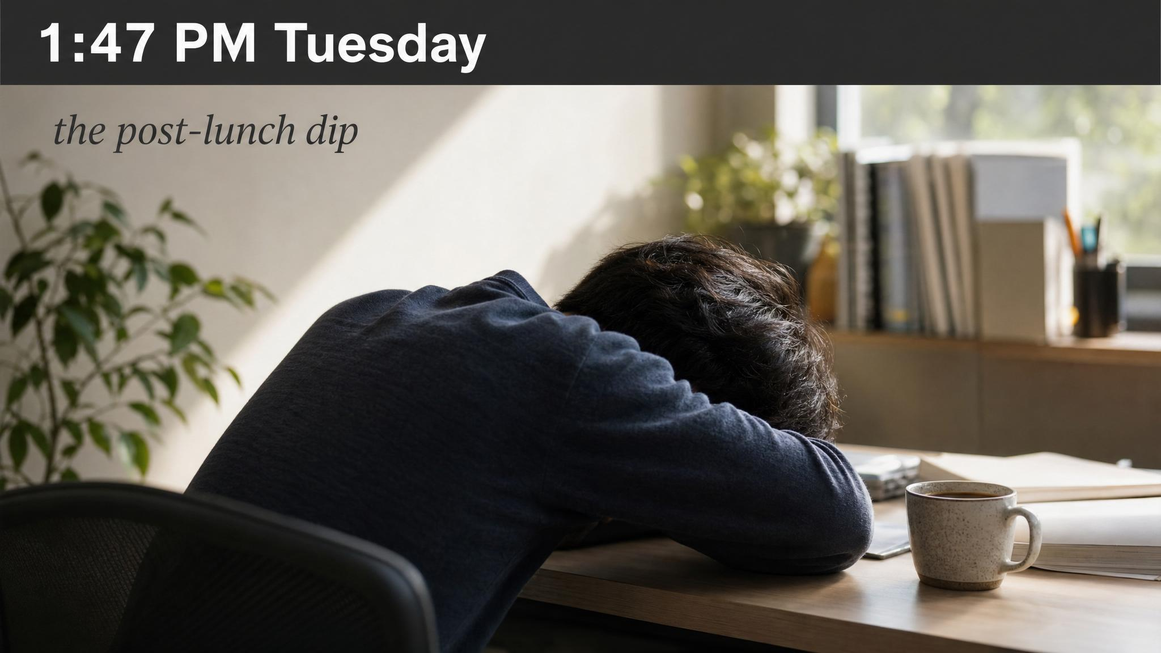
Notes:
Land the scene. Almost everyone in the room has been here this week. Tell them that the answer — nap or not, and for how long — isn't intuition. It draws on nearly every concept of the course. A well-designed nap is a tiny masterclass; a poor one is a case study in what happens when you ignore the science.

Slide 3
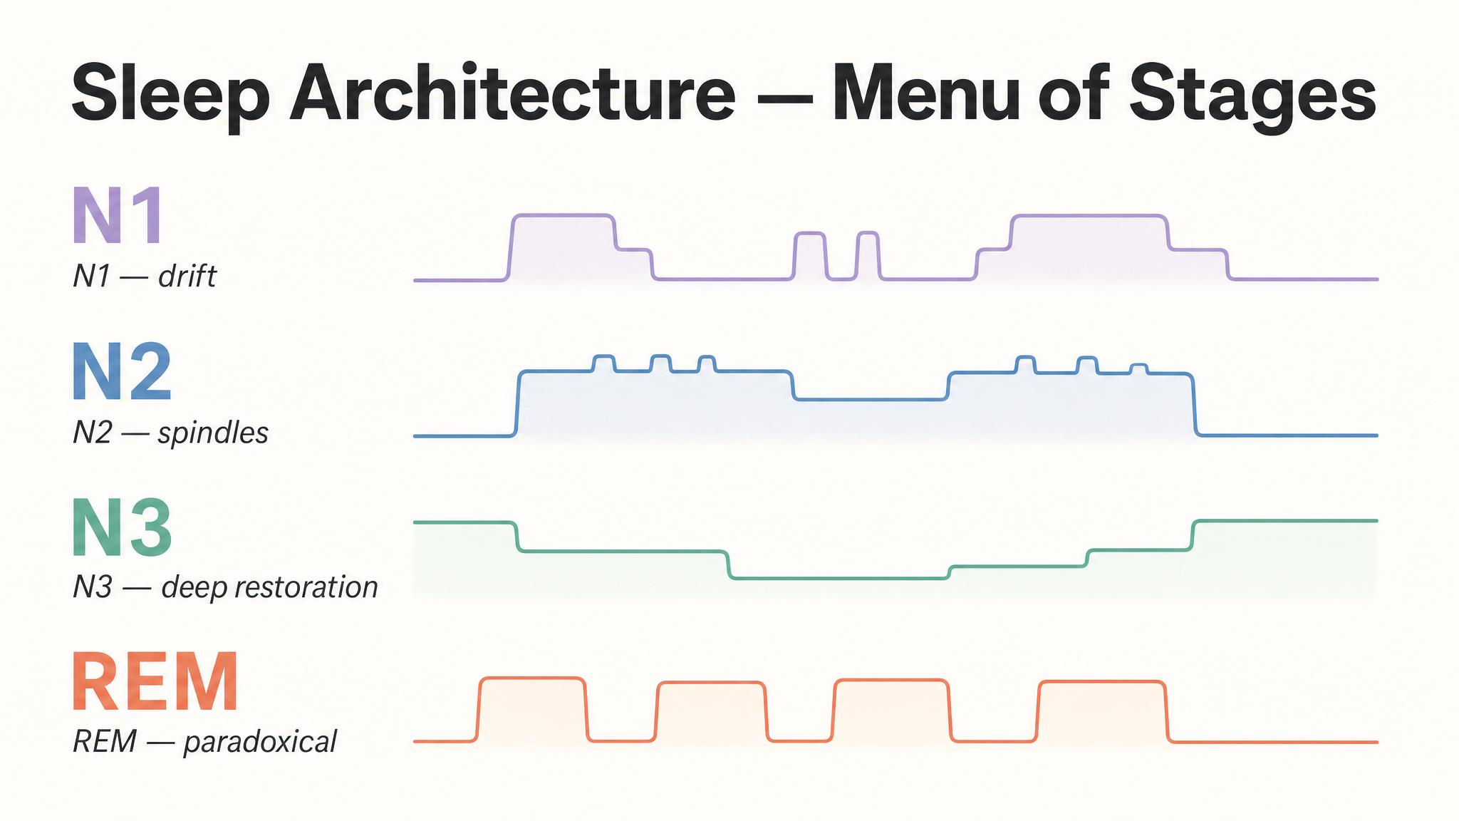
Notes:
Recall the chapter-two scaffold. You enter N1, descend into N2 where spindles consolidate motor and declarative memory, sink further into N3 slow-wave sleep, then rise through REM. Roughly ninety minutes for the full cycle. Tell them the value of a nap depends entirely on which stages you reach — and which stage you are in when the alarm sounds.

Slide 4
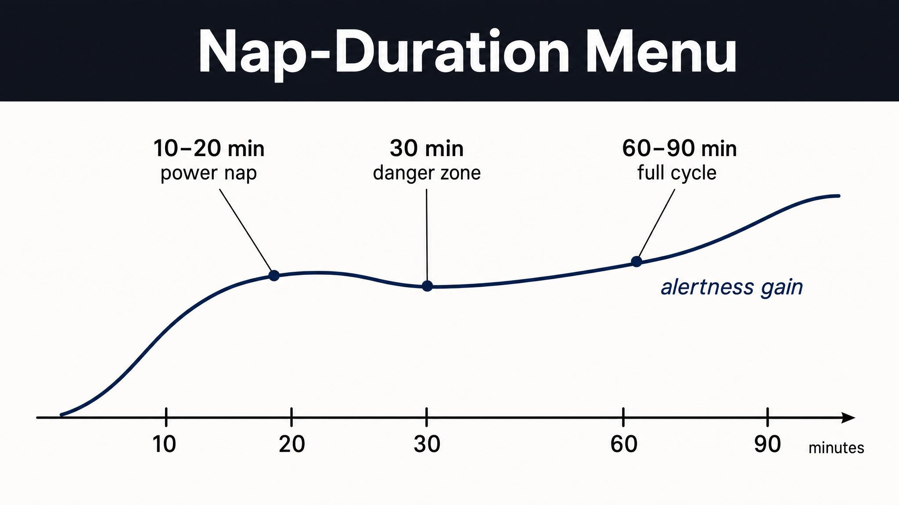
Notes:
Walk them down the menu. Ten and twenty stay in N1 and N2 — clean and crisp. Sixty drops you into deep N3. Thirty is unpredictable, sometimes N3, sometimes not. Ninety completes the cycle and lets you rise back through light stages before the alarm. The pattern comes from Hilditch, Dorrian and Banks' 2017 systematic review.

Slide 5
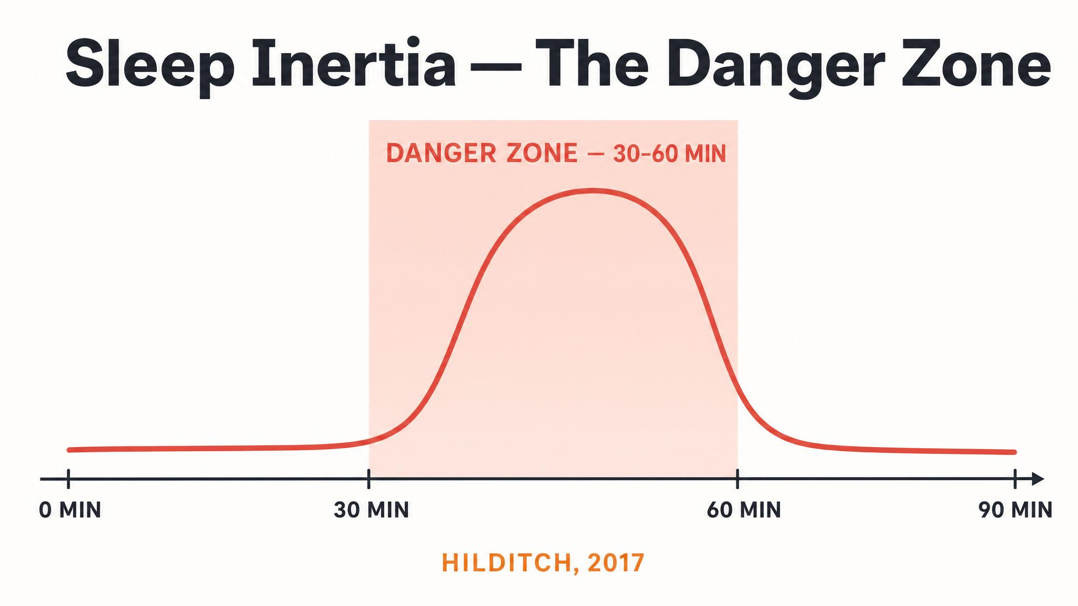
Notes:
Sleep inertia is the grogginess after waking, particularly from N3. Pulled out of slow-wave sleep, your prefrontal cortex is slow to reboot — measurable decrements for fifteen to thirty minutes, sometimes over an hour. The practical takeaway is stark: there is no such thing as a medium nap. Nap short, or commit to ninety. Avoid the middle.

Slide 6

Notes:
Rosekind and colleagues studied long-haul pilots given a forty-minute nap opportunity, during which they captured an average of twenty-six minutes of actual sleep. The result: a fifty-four percent improvement in physiological alertness, thirty-four percent in performance versus the no-rest control. N1 and N2 only — and the payoff was substantial.

Slide 7
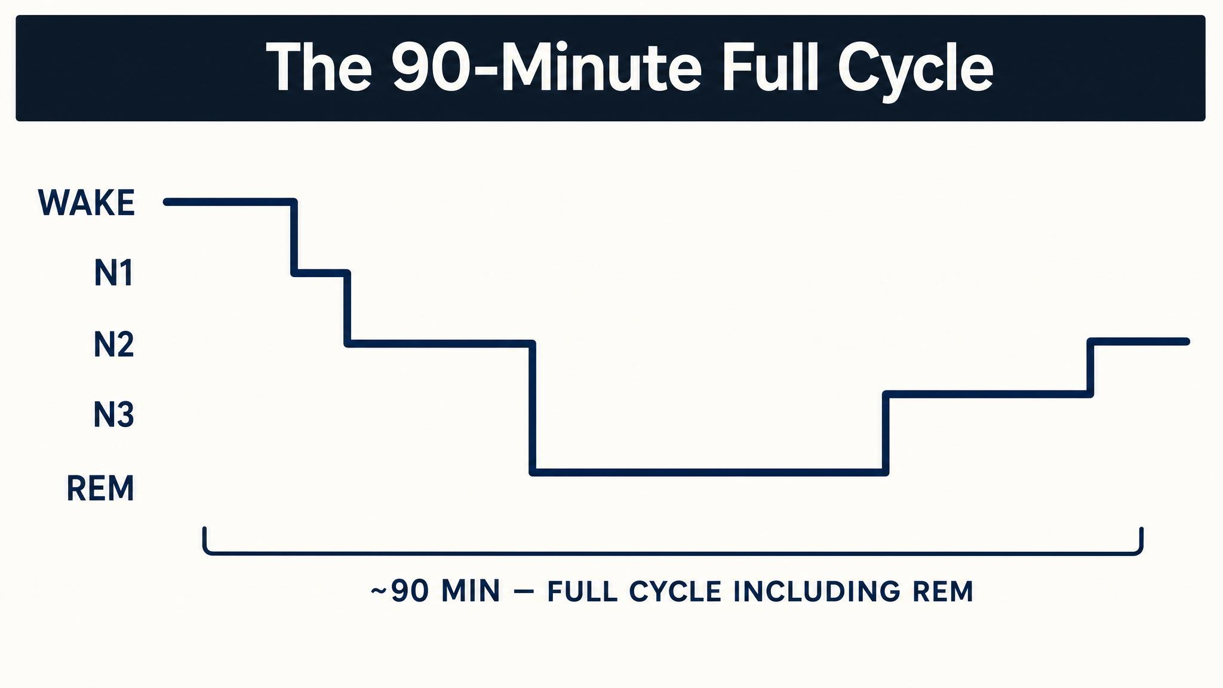
Notes:
Mednick, Nakayama and Stickgold in 2003 showed naps of sixty to ninety minutes containing slow-wave sleep AND REM produced perceptual-task gains statistically indistinguishable from a full night of sleep. A single afternoon nap rivaled eight hours. The slow-wave handled consolidation; the REM enabled creative integration.

Slide 8
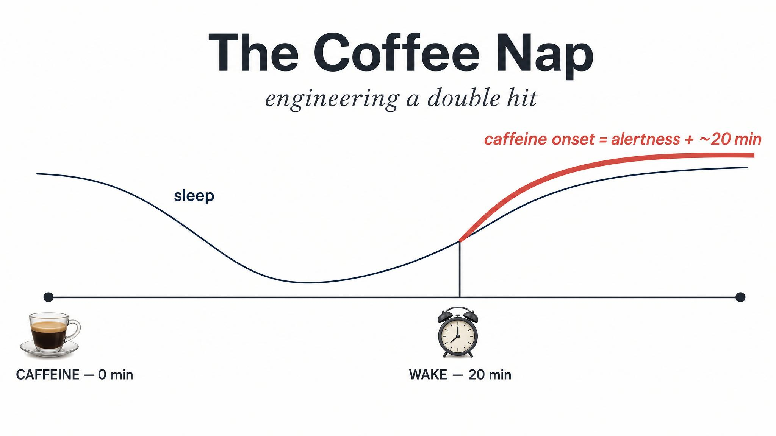
Notes:
The protocol: drink coffee quickly, lie down for twenty minutes, then wake. Caffeine takes about twenty to twenty-five minutes to be absorbed and cross the blood-brain barrier. Meanwhile the nap clears some adenosine. Hayashi and colleagues showed in 2003 this combination outperformed nap-alone, caffeine-alone, or bright-light alone. Synergistic, not additive.

Slide 9
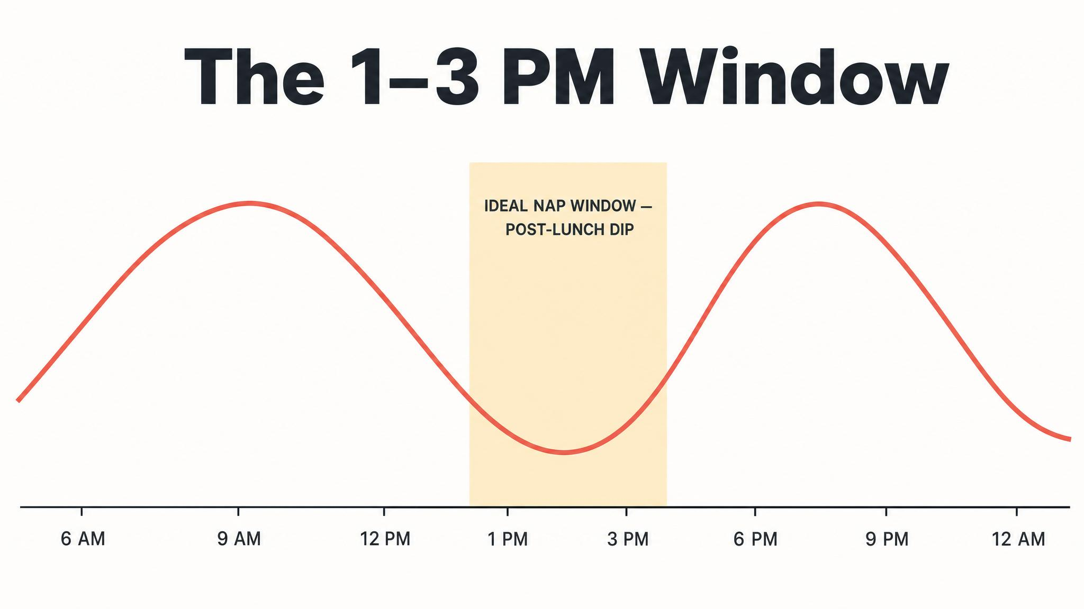
Notes:
Monk established in 2005 that the afternoon trough is circadian in origin — even people who skip lunch experience it. Strijkstra and colleagues in 2003 modeled it mathematically: the multiplicative interaction between S and C produces a secondary sleep-propensity peak squarely in the early afternoon. This is the window your biology actually offers you.

Slide 10
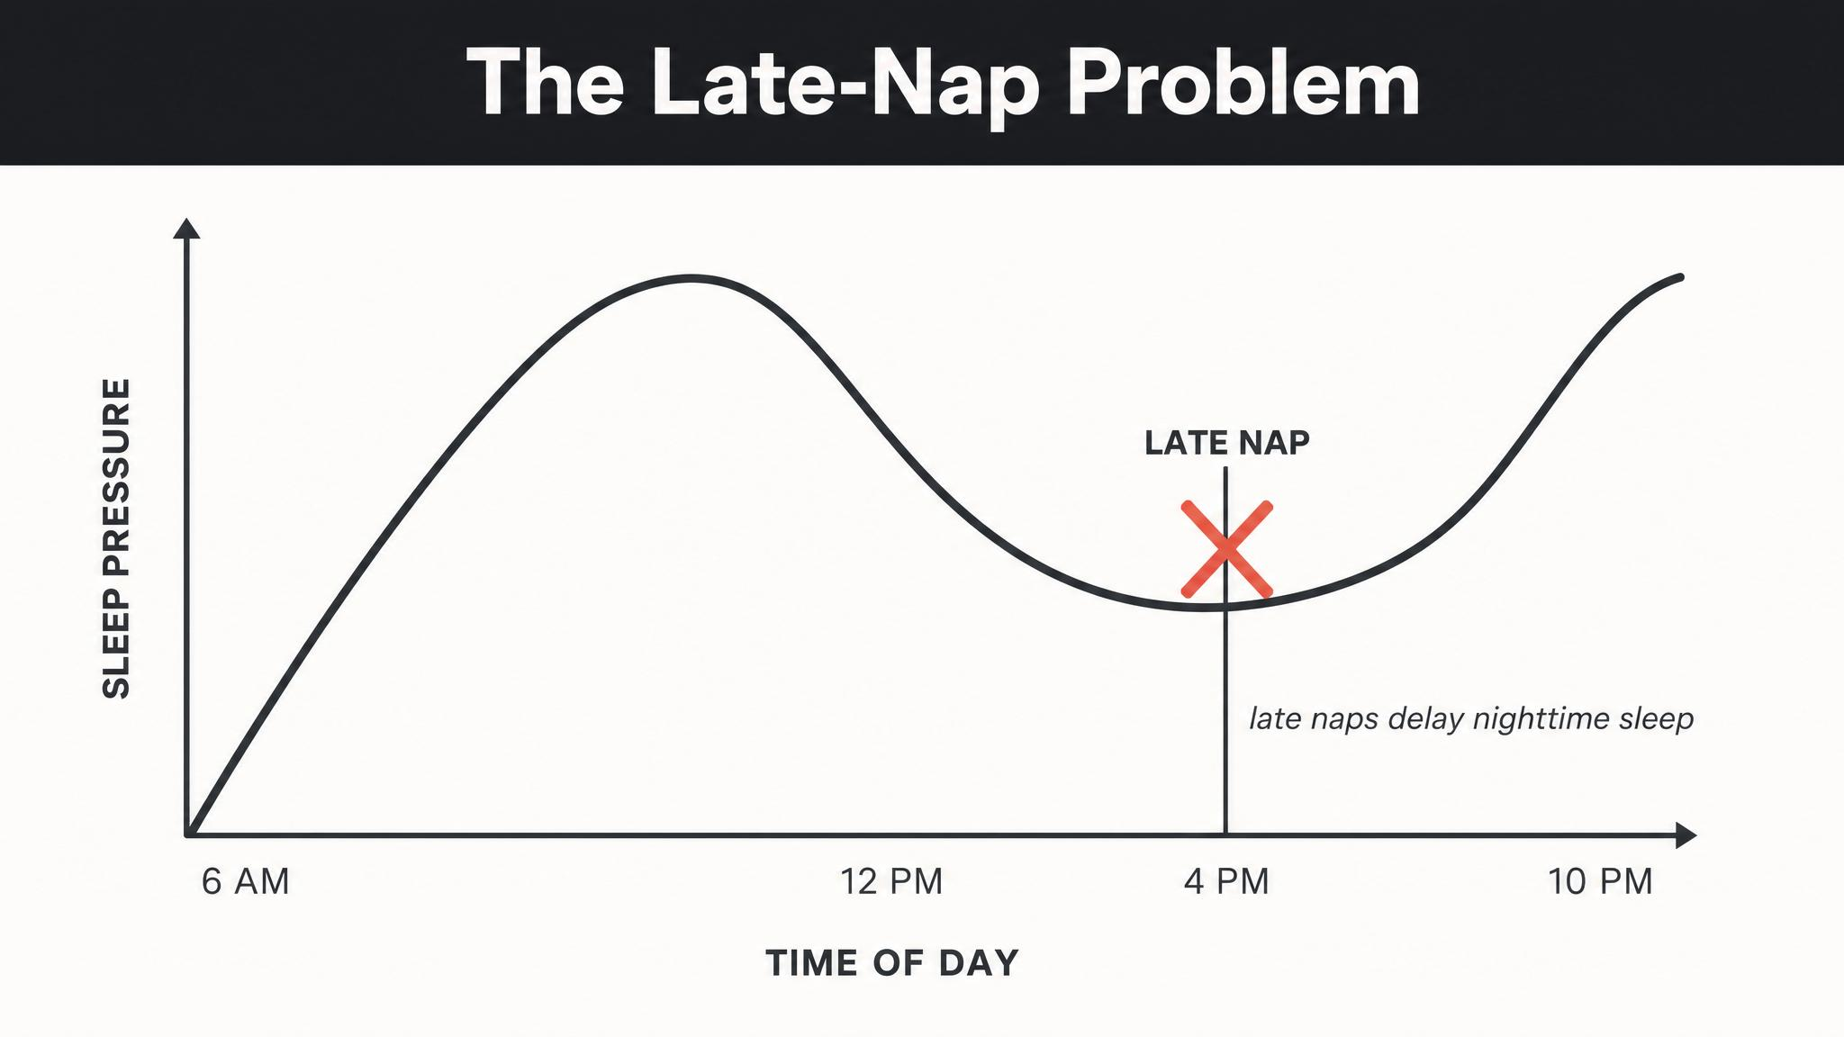
Notes:
Late naps clear Process S at precisely the wrong time — the homeostatic analogue of evening light. Boukhris and colleagues in 2025 found that twenty-five and ninety-minute afternoon naps, when completed by 3pm, did not adversely affect nighttime sleep in student athletes. The variable wasn't duration. It was timing. Naps ending in the post-lunch dip leave the night intact.

Slide 11
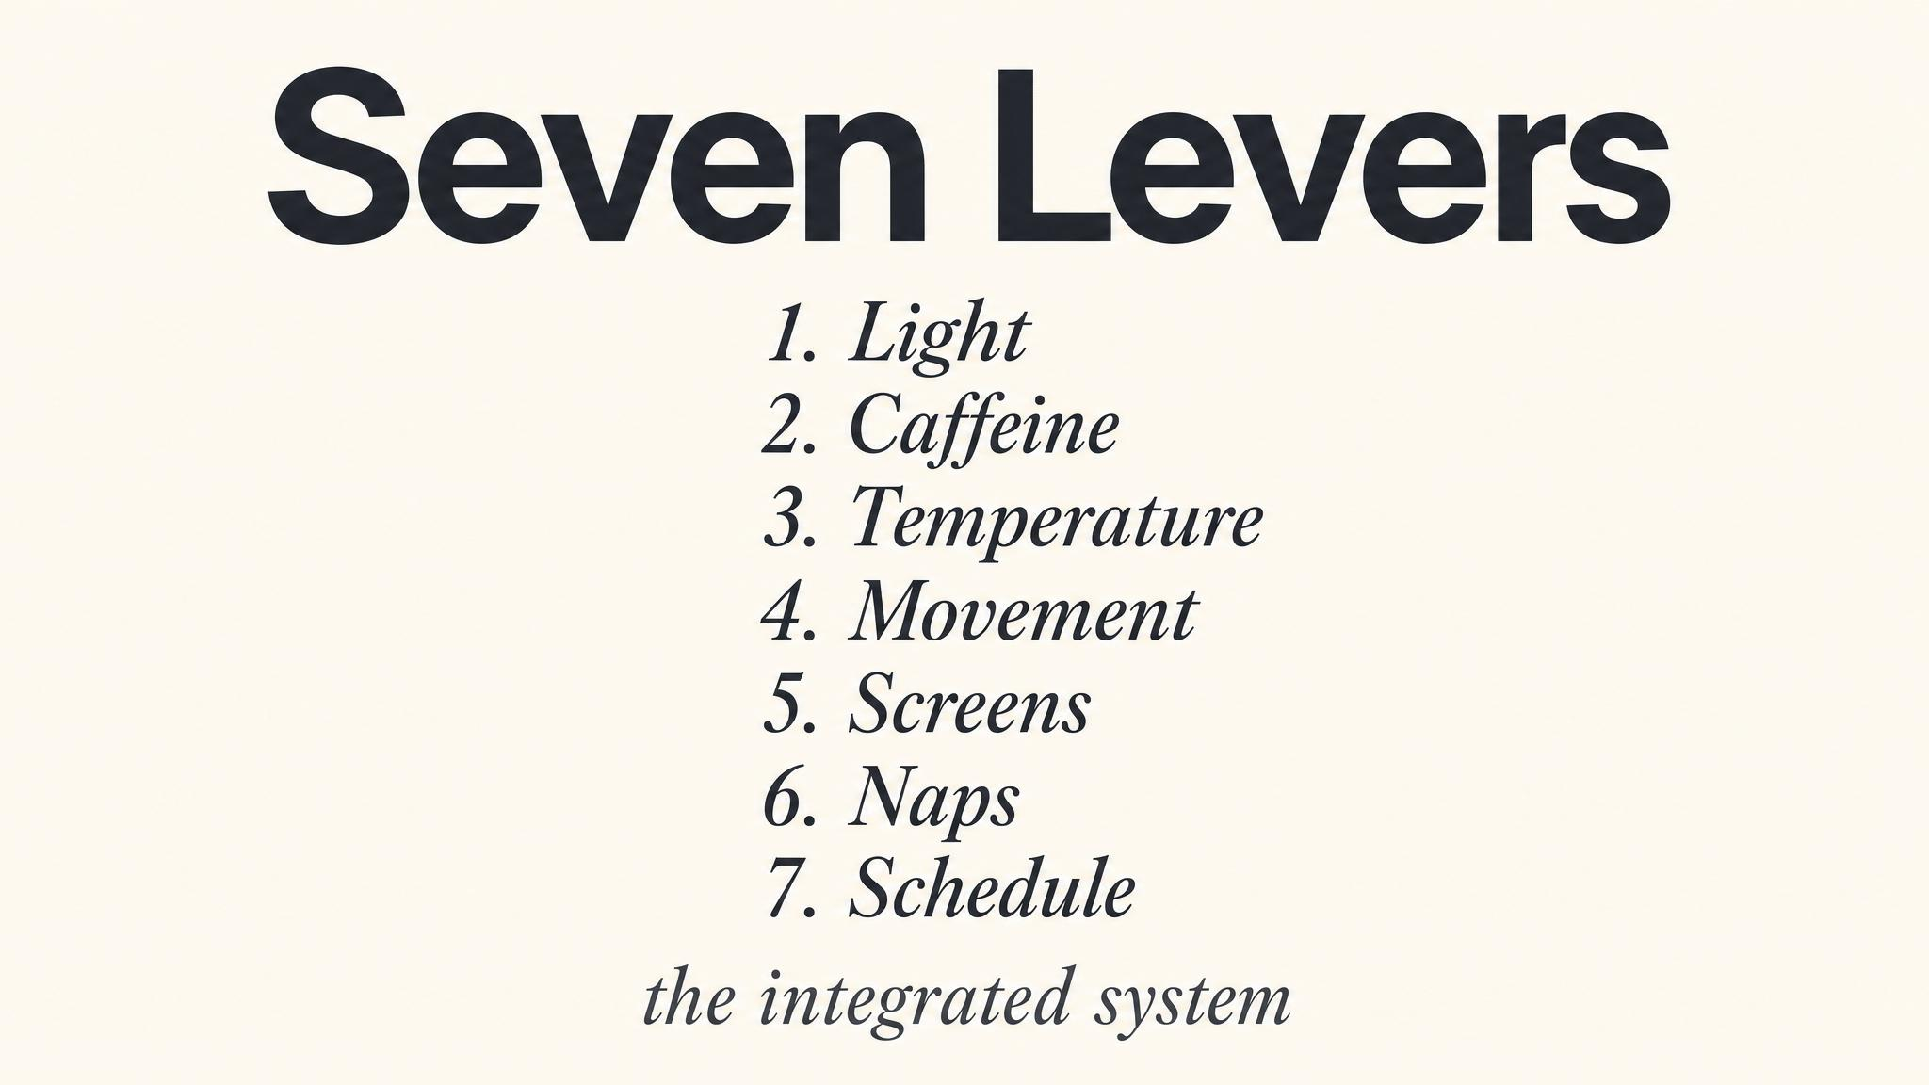
Notes:
Seven levers, one system. Circadian timing from Chapter One. Sleep architecture from Two. Light from Three. Caffeine from Four. Temperature from Five. Arousal management from Six. And strategic napping from Seven, which integrates all six. Miss one and the nap degrades into frustration. Get them all right and twenty minutes can transform an afternoon.

Slide 12
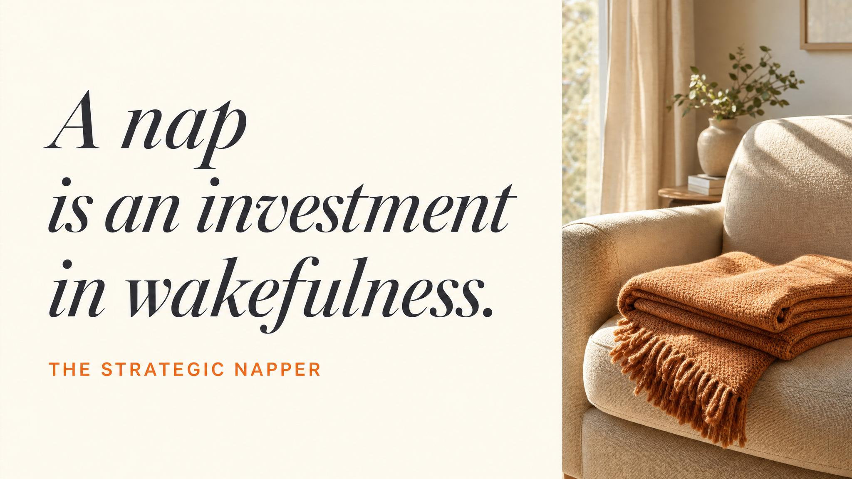
Notes:
Pause here. Read the line aloud slowly. A nap is not an escape from wakefulness — it is an investment in it, but only if you understand the terms of the investment. This is the line you want them carrying out of the course.

Slide 13
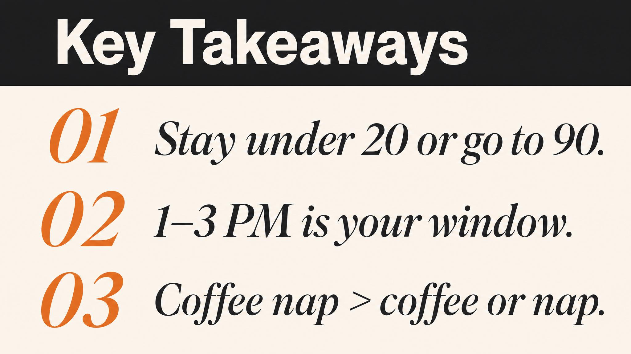
Notes:
Three things to carry forward. One: there is no medium nap — go short under twenty minutes for N1 and N2, or commit to ninety for the full cycle. Two: thirty to sixty is the danger zone, deep enough for N3 but not enough to escape it. Three: finish by 3pm — Boukhris 2025 showed nighttime sleep stays intact when the nap ends in the post-lunch dip.

Slide 14
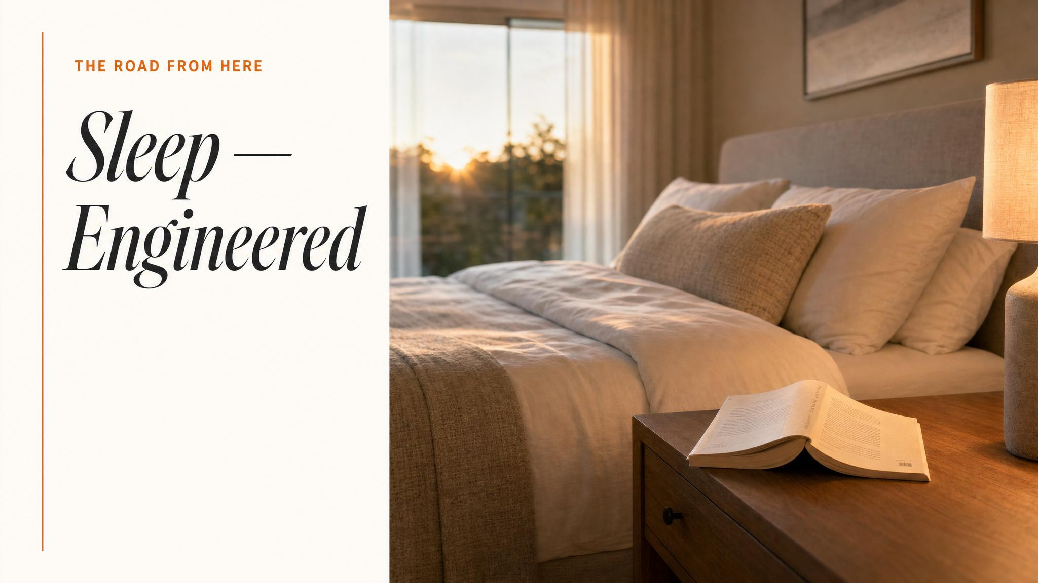
Notes:
Close the course. Tell them they now hold seven levers — circadian alignment, sleep stages, light, caffeine, body temperature, wind-down arousal, strategic napping. Combined, these aren't seven isolated facts; they're an integrated personal sleep system, built one chapter at a time. Sleep is the foundation on which every waking hour is built.

